Slide 1


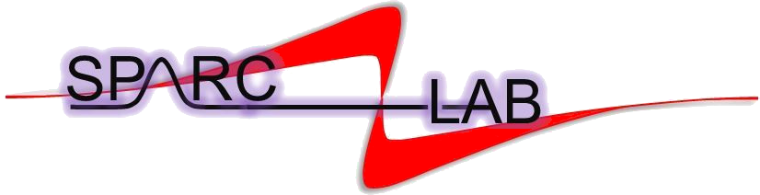

Beam dynamics studies for advanced-compact RF injector for PWFA
Gilles Jacopo Silvi*
Ph.D. School in ACCELERATOR PHYSICS – XXXVII cycle
Sapienza University of Rome
Supervisors: Prof. Enrica Chiadroni (Sapienza University of Rome)
Prof. Andrea Mostacci (Sapienza University of Rome)
Dott. Anna Giribono (INFN-LNF)
*gillesjacopo.silvi@uniroma1.it

Slide 2
OUTLINE
Motivation
PWFA principles
Optimization of injectors PWFA-based
EuPRAXIA@SPARC_LAB base-line injector optimization
EuPRAXIA@SPARC_LAB C-band injector upgrade
Photocathode studies and ML for optimization of RF photo gun
Conclusions and future prospectives

Slide 3
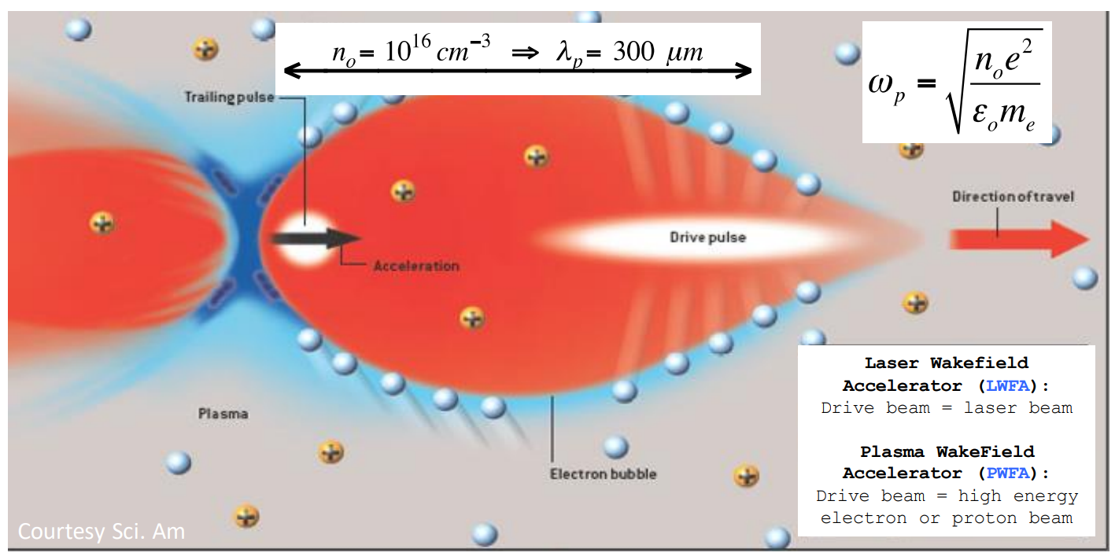
Particle-Driven Wakefield Acceleration
1 The driver beam passes through the plasma
2 The driver beam pushes away plasma electrons, forming a positive charge bubble and plasma oscillations
3 The charge separation generates an oscillating electric field.
4 The witness beam is positioned in the accelerating phase of the wave, gaining energy
Beam dynamics studies for advanced-compact RF injector for PWFA

Slide 4




Particle-Driven Wakefield Acceleration
Longitudinal matching
ultra-short electron bunches are required to maintain the energy spread below 1%.
Transverse matching
Beam dynamics studies for advanced-compact RF injector for PWFA

Slide 5
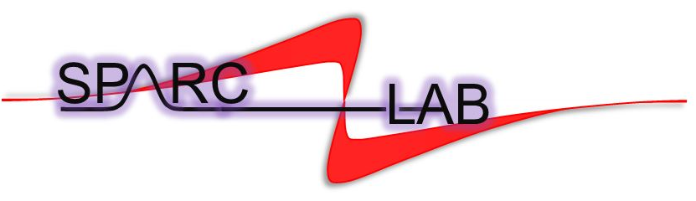
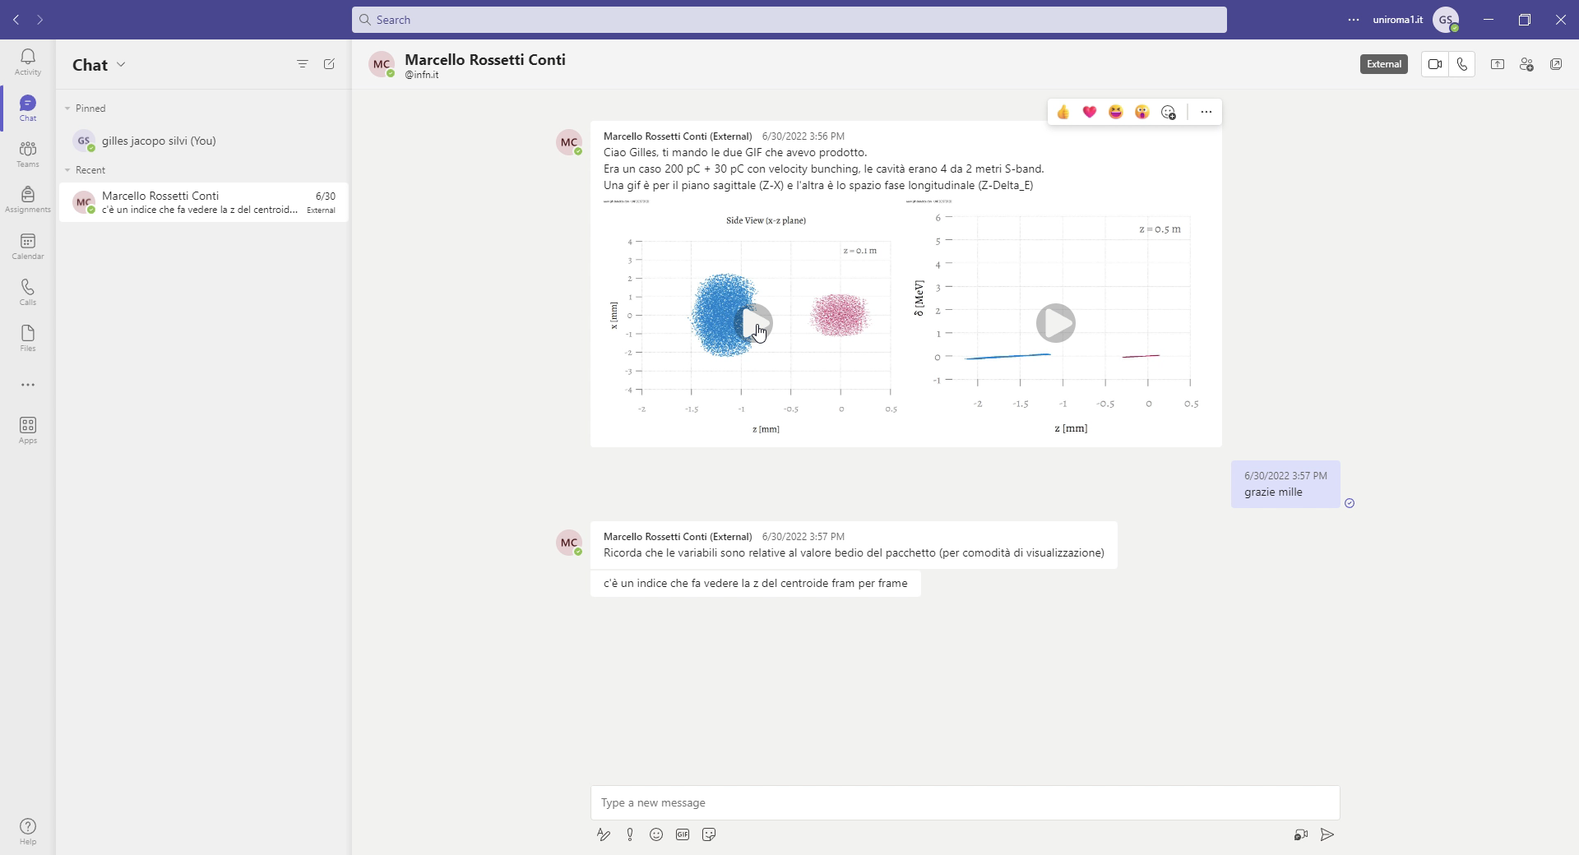
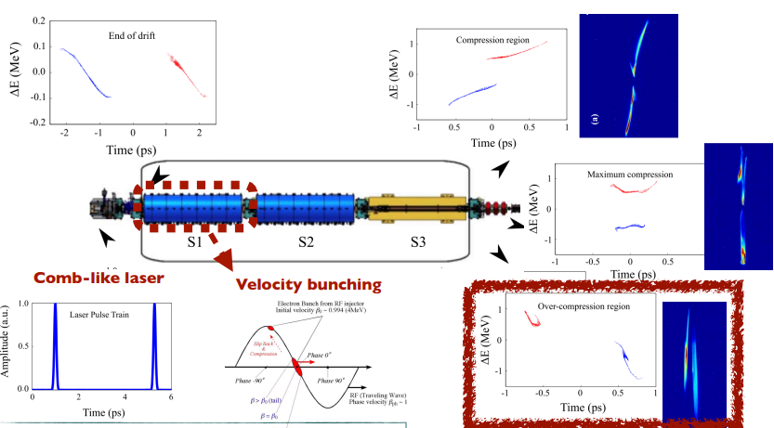
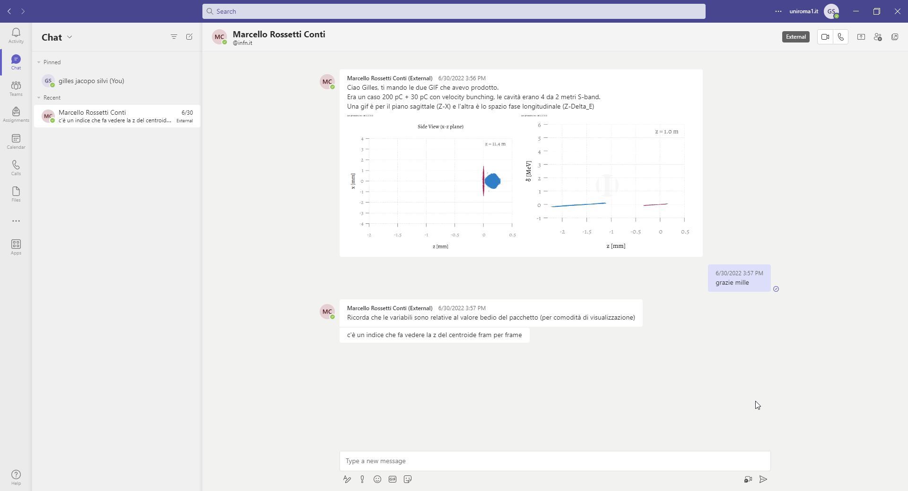
Driver and Witness beams generation
Witness
Driver
Courtesy of M. Rossetti Conti
Courtesy of E.Chiadroni
L. Serafini and M. Ferrario, AIP Conf. Proc. No. 581 (AIP, New York, 2001), p. 87.
M. Ferrario et al., Phys. Rev. Lett. 104, 054801 (2010) 3.
S. G. Anderson et al., Phys. Rev. ST Accel. Beams 8, 014401 (2005)
M. Ferrario et al. Laser comb with velocity bunching: Preliminary results at SPARC, Nuclear Instruments and Methods in Physics Research Section A: Accelerators, Spectrometers, Detectors and Associated Equipment, Volume 637, 2011.
Beam dynamics studies for advanced-compact RF injector for PWFA

Slide 6
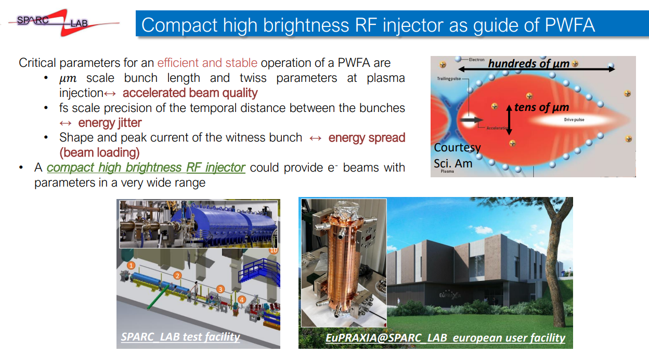
PWFA driven by compact-advance RF injector
Advanced photoinjector fulfil beam requirements to match plasma in term of High brightness :
-um scale bunch length and transverse dimension accelerated beam quality
-fs scale precision of the temporal distance between the bunches energy jitter
-Shape and peak current of the bunch energy spread (beam loading)
A compact high-brightness RF injector could provide electron beams with parameters in a very wide range
Courtesy of A. Giribono
R. Pompili et al., "Free-electron lasing with compact beam-driven plasma wakefield accelerator", Nature 605, 7911, doi.org/10.1038/s41586-022-04589-1 (2022)
Beam dynamics studies for advanced-compact RF injector for PWFA

Slide 7
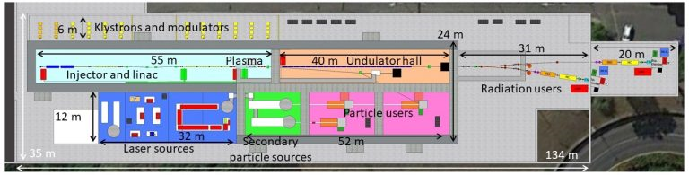
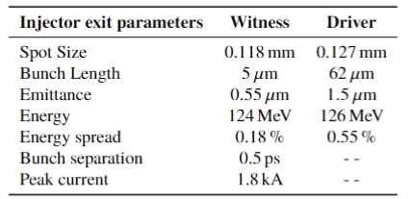
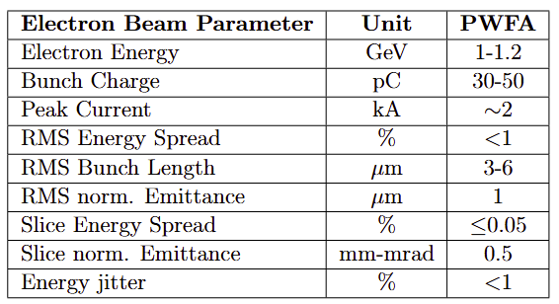
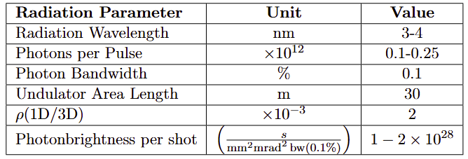
EuPRAXIA@SPARC_LAB
M. Ferrario et al., EuPRAXIA@SPARC_LAB Conceptual Design Report, LNF Technical Note 18-03, 07/05/2018.
Assmann, R.W., Weikum, M.K., Akhter, T. et al. EuPRAXIA Conceptual Design Report. Eur. Phys. J. Spec. Top. 229, 3675–4284 (2020).
EuPRAXIA@SPARC_LAB is the first European research infrastructure to demonstrate the usability of a plasma accelerator combining a high-brightness GeV–range electron beam generated in a state-of-the-art linac, and a 0.5 PW–class laser system.
EuPRAXIA@SPARC_LAB will be a user facility dedicated for instance to the production of a high-brightness plasma accelerated beam to induce Self Amplified Spontaneous Emission (SASE) in an FEL undulator.
ultra-short, high-quality electron beams
S-band RF photo-injector
X-band RF booster linac
Plasma Stage
Undulator
Beam dynamics studies for advanced-compact RF injector for PWFA

Slide 8
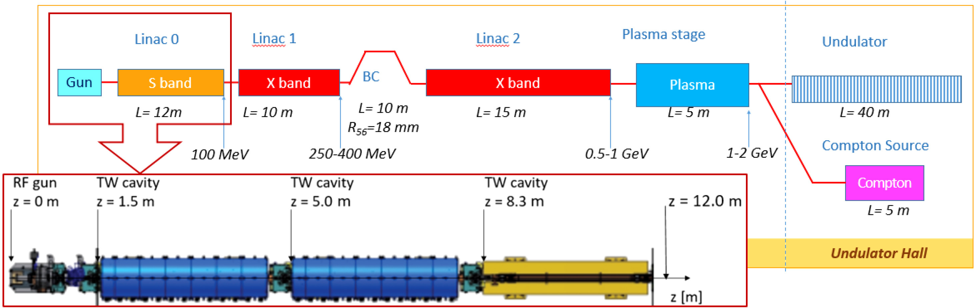
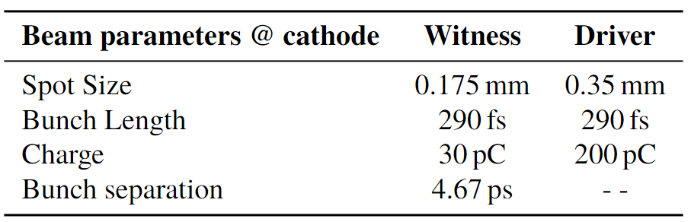
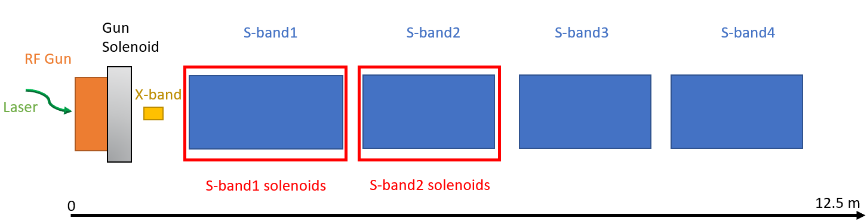
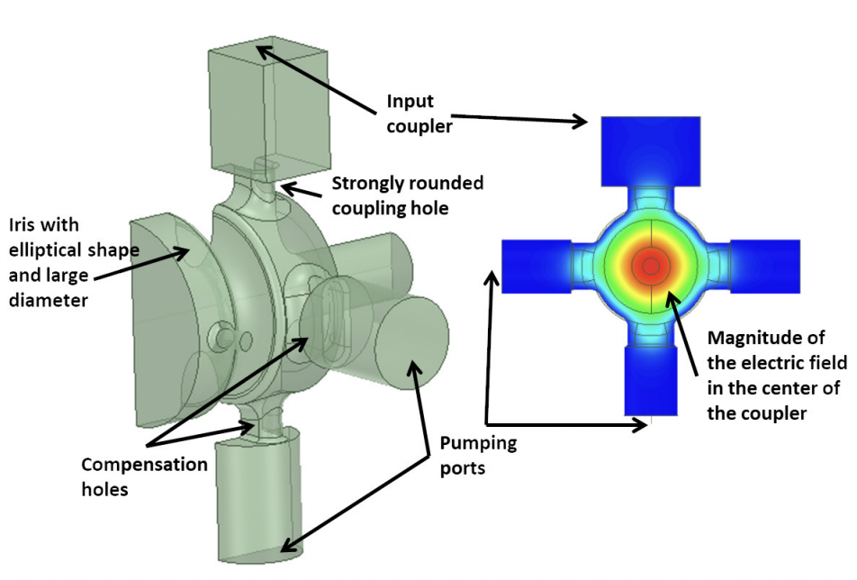
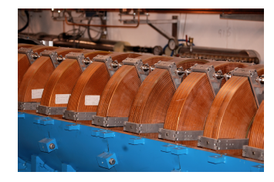
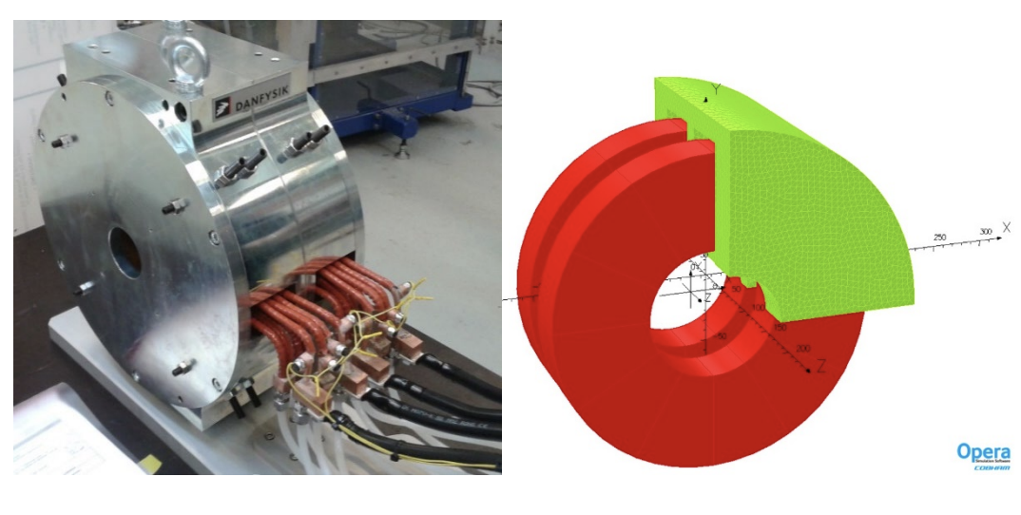
EuPRAXIA@SPARC_LAB base-line RF injector
0,175 mm
0,35 mm
220 fs
220 fs
30 pC
200 pC
4,67 ps
3m
2m
2m
2m
M. Ferrario et al., EuPRAXIA@SPARC_LAB Conceptual Design Report, LNF Technical Note 18-03, 07/05/2018.
A. Giribono et al. EuPRAXIA@SPARC_LAB, The high brightness RF photo injector layout proposal, NIMA (2018)
G.J Silvi et al. "Beam dynamics optimization of Eu-PRAXIA@SPARC_LAB RF injector" IPAC’23, Venezia, Italy, May. 2023, paper WEPA040
Beam dynamics studies for advanced-compact RF injector for PWFA

Slide 9
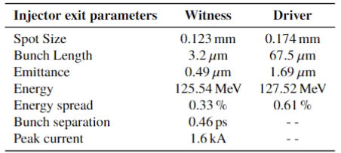
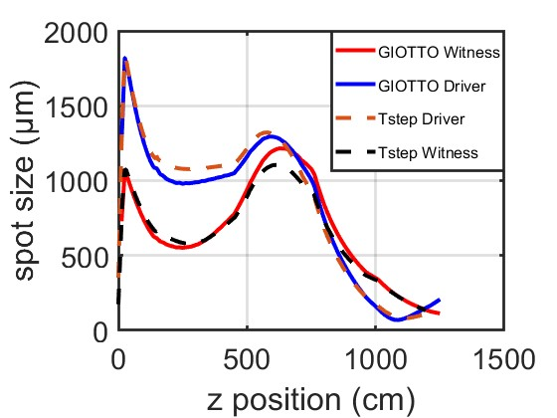
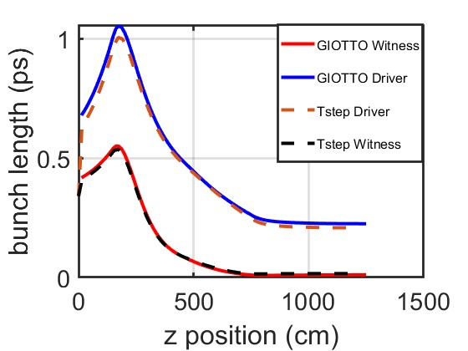
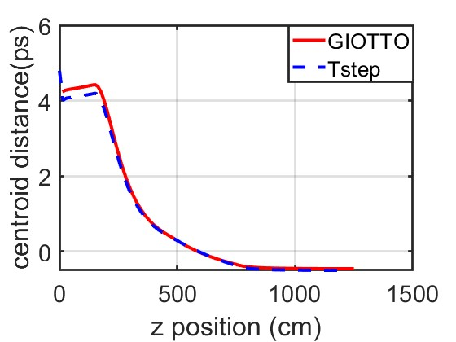
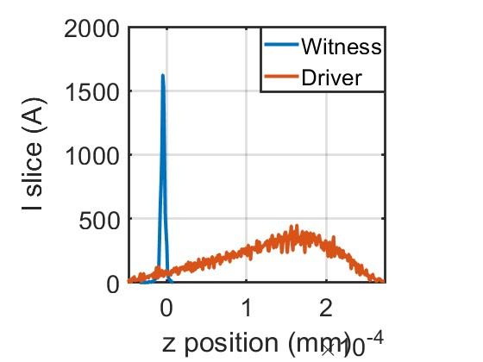


Working point Optimization with Genetic Algorithm
Young L M and J B 2003 The particle tracking code Parmela Proceedings of the 2003 Particle Accelerator Conference
Floettmann K A space charge tracking code https://www.desy.de/ mpyflo/
Bacci A, Rossetti Conti M and Petrillo V 2016 Giotto: A genetic code for demanding beam-dynamics optimizations
CDR Injector parameters
GIOTTO output
GIOTTO
Beam dynamics studies for advanced-compact RF injector for PWFA

Slide 10
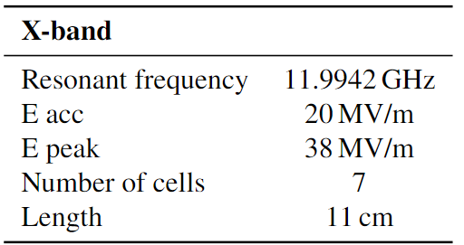
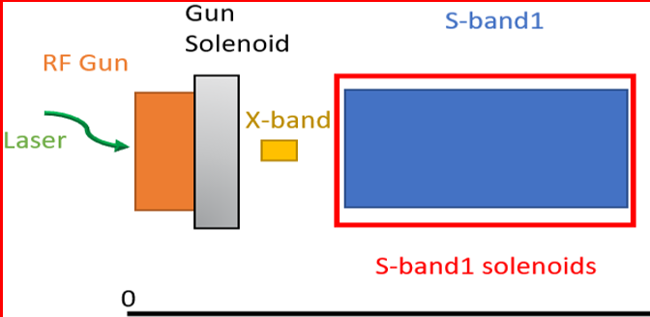
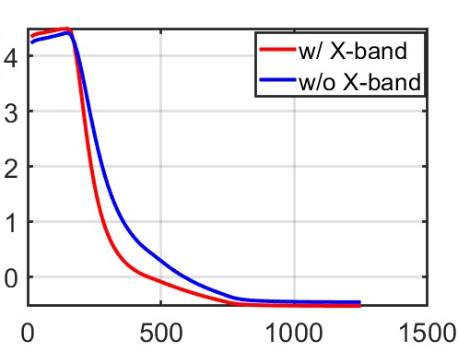
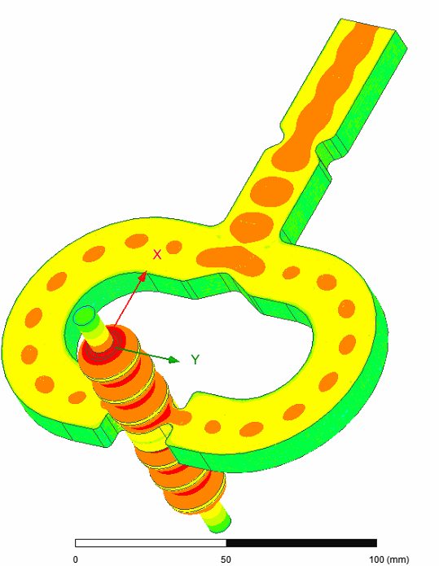
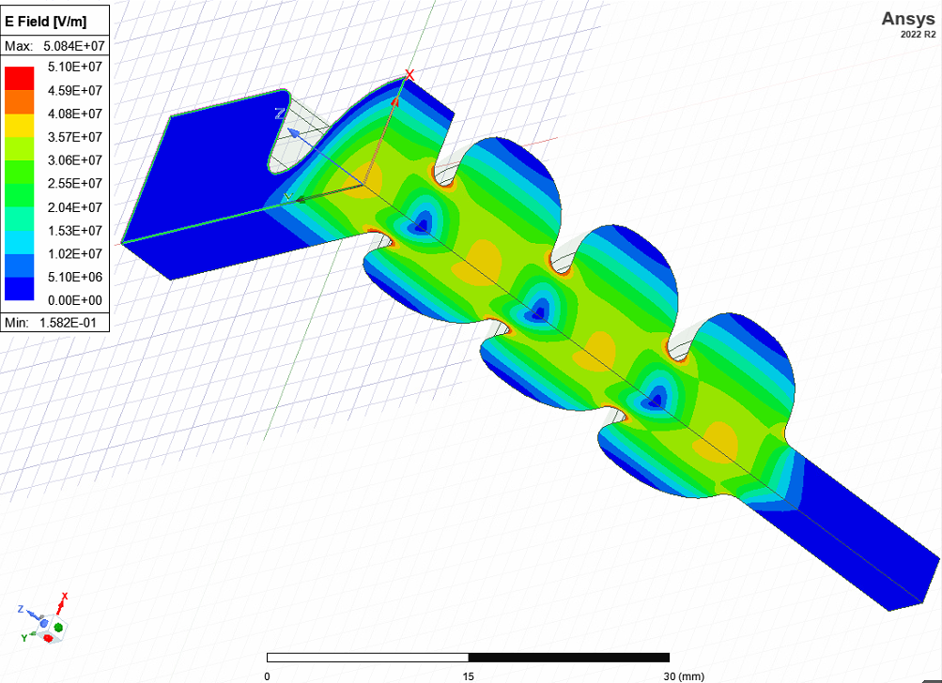
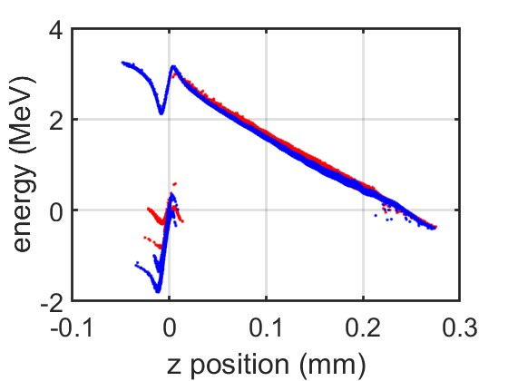



High Harmonic Cavity for longitudinal phase space manipulation
13 m
centroid distance (ps)
ΔE (MeV)
$$σ_{T_{Dw}}=0,54 ps$$
$$σ_{T_{Dw}}=0,46 ps$$
Courtesy of L. Faillace
Z (cm)
z (mm)
Bacci A, Faillace L and Rossetti Conti M 2018 Extreme high brightness electron beam generation in a space charge regime.
Alesini D et al., 2015 Study of a C-band harmonic RF system to optimize the RF bunch compression process of the SPARC beam 6th International Particle Accelerator Conference p TUPWA058
Emma P., 2001 X-Band RF harmonic compensation for linear bunch compression in the LCLS SLAC Nation Accelerator Laboratory Technical Note SLAC-TN-05-004, LCLS-TN-01-1
G.J Silvi et al., Optimizing beam dynamics in the EuPRAXIA@SPARC_LAB RF injector, SIF Congress 2023, 10.1393/ncc/i2024-24323-5
Beam dynamics studies for advanced-compact RF injector for PWFA

Slide 11
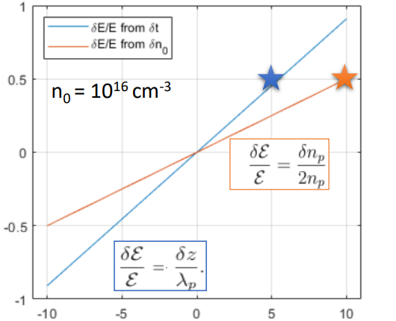
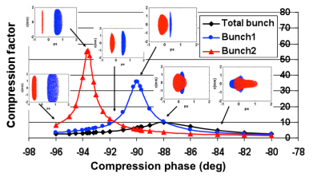
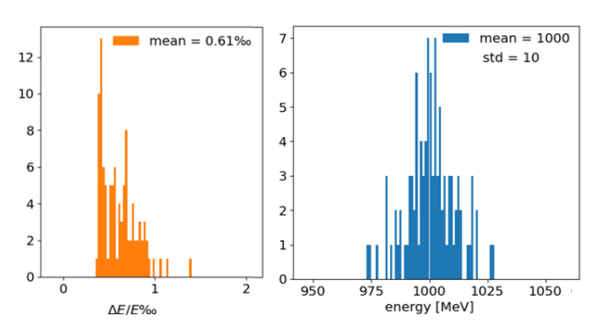



Stability requirements
$$δn_{0}(‰)$$
-10 -5 0 5 10
A Mostacci et al. Proceedings of IPAC2011, San Sebastián, Spain
ΔE/E
-10 -5 0 5 10
$$δt_{DW}\left(fs\right)$$
For the EuPRAXIA working point, a temporal jitter between the driver and witness beams of δt ≈ few fs corresponds to an energy jitter of <1 %.
Courtesy of A. Del Dotto and S. Romeo
Slice ΔE/E ‰
Energy (MeV)
Beam dynamics studies for advanced-compact RF injector for PWFA
S. Romeo, G.J Silvi et al. Numerical studies for EuPRAXIA@SPARC_LAB plasma beam-driven working point. In Proc. IPAC’23, Geneva, Switzerland, 05 2023.

Slide 12

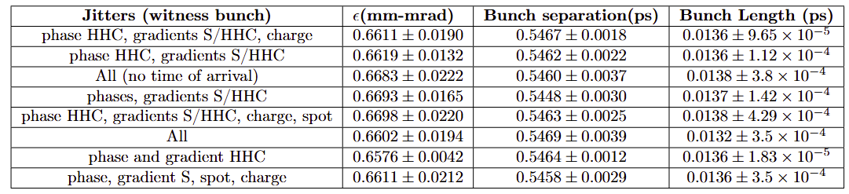
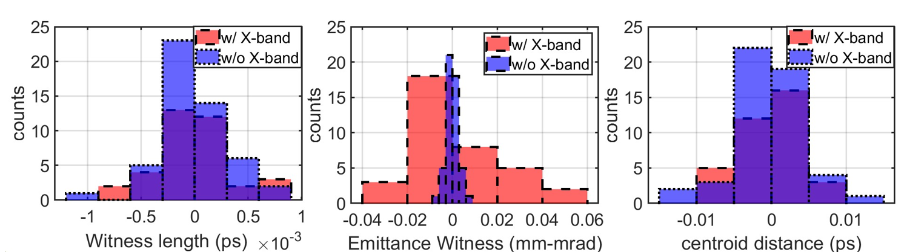
Stability studies of the injector w/ and w/o the HHC
State-of-the-art jitter and beam dynamics requirements
Injector w/o HHC
Injector w/ HHC
Jitter of the parameters
Beam dynamics studies for advanced-compact RF injector for PWFA

Slide 13
Motivation for a C-band RF injector upgrade
The C-band technology allows for:
Higher efficiency suitable for applications requiring high repetition rates (400 Hz).
Reduce injector footprint by maintaining high-quality high-brightness beams.
Easier transition to the X-band booster.
Peak field Higher than S-band.
Gun 160-180 MV/m
TW structures 60 MV/m (35 MV/m S-band)
J. Rosenzweig and E. Colby, Charge and wavelength scaling of RF photoinjector designs, AIP Conf. Proc. 335, 724 (1995).
W. Fang et al., “Design, fabrication and first beam tests of the c-band rf acceleration unit at sinap,” Nuclear Instru-ments and Methods in Physics Research Section A: Acceler-ators, Spectrometers, Detectors and Associated Equipment,vol. 823, pp. 91–97, 2016, issn: 0168-9002. doi: https ://doi.org/10.1016/j.nima.2016.03.101. https://www.sciencedirect.com/science/article/pii/S0168900216301474
D.Alesini,A.Bacci,M.Bellaveglia.,BeamenergyupgradeofthefrascatiFEL LINACwithaC-bandRFsystem,in:ProceedingsoftheIPAC10,Kyoto,Japan, 2010,pp.3682–3684.
Beam dynamics studies for advanced-compact RF injector for PWFA

Slide 14
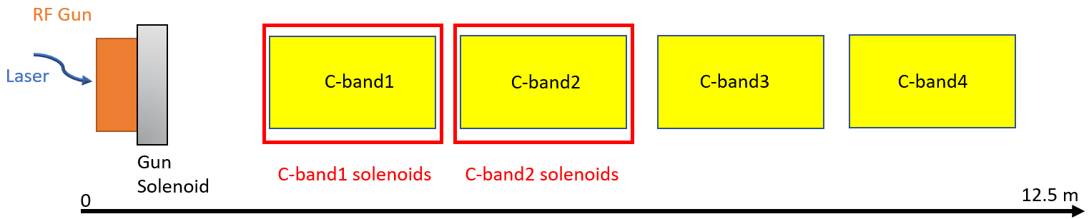
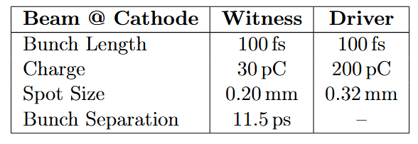
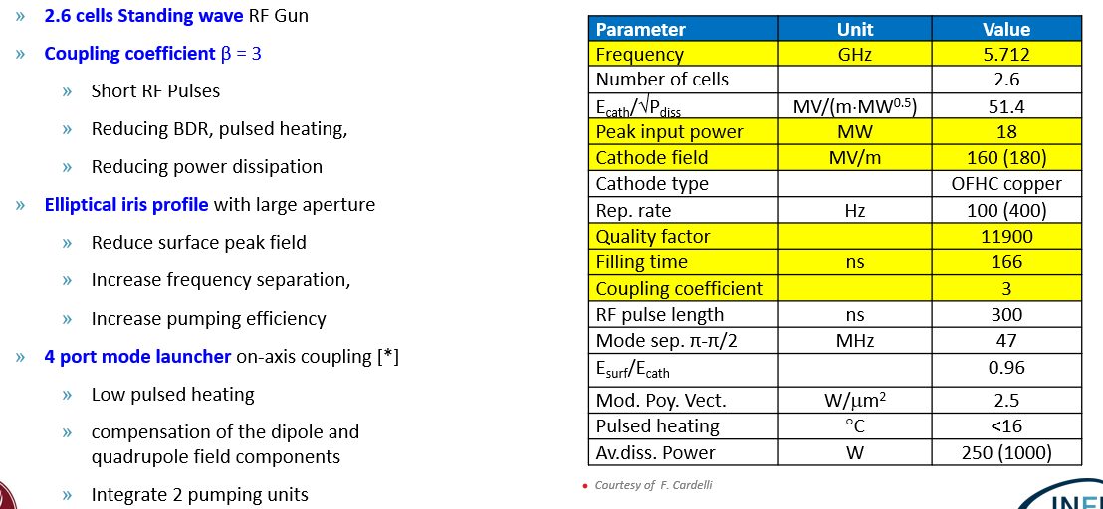

C-band injector layout proposal
Designed @LNF and tested @PSI
1,7 m
0,6 m
0,6 m
0,6 m
8 m
2,6 cells C-band RF Gun equipped with a solenoid
4 TW C-band accelerating structures, the first one 1,5 m long while the other 1 m
2 emittance compensation solenoids around the first two TW sections
Overall length of ≈ 8 m
Courtesy of F. Cardelli
G.J Silvi et al – Beam Dynamics Simulation of High Brightness, High Repetition Rate RF C-band injector for future EuPRAXIA@SPARC_LAB Upgrade. Submitted and accepted for 6th European Advanced Accelerator Concepts Workshop (EAAC23).
Giribono A, G.J Silvi et al. - Dynamics studies of high brightness electron beams in a normal conducting, high repetition rate C-band injector, PHYSICAL REVIEW ACCELERATORS AND BEAMS 26, 083402 (2023)
G. D’Auria et al, Compact-Light Design Study, doi:10.18429/JACoWIPAC2019-TUPRB032
M. Croia, D. Alesini, F. Cardelli, M. Diomede, M. Ferrario, A. Giribono, S. Romeo, C. Vaccarezza, and A. Vannozzi, High gradient ultra-high brightness C-band photoinjector optimization, J. Phys. Conf. Ser. 1596, 012031 (2020)
Design based on G Castorina et al 2018 J. Phys.: Conf. Ser. 1067 082025
D. Alesini et al., Design, realization and high-power RF test of the new brazed free C band photo-gun, Proc. IPAC'24, 2024
F. Cardelli et al., Design and realization of high-gradient C-band standing wave RF gun, SIF Congress 2023, 10.1393/ncc/i2024-24272-y
Beam dynamics studies for advanced-compact RF injector for PWFA

Slide 15
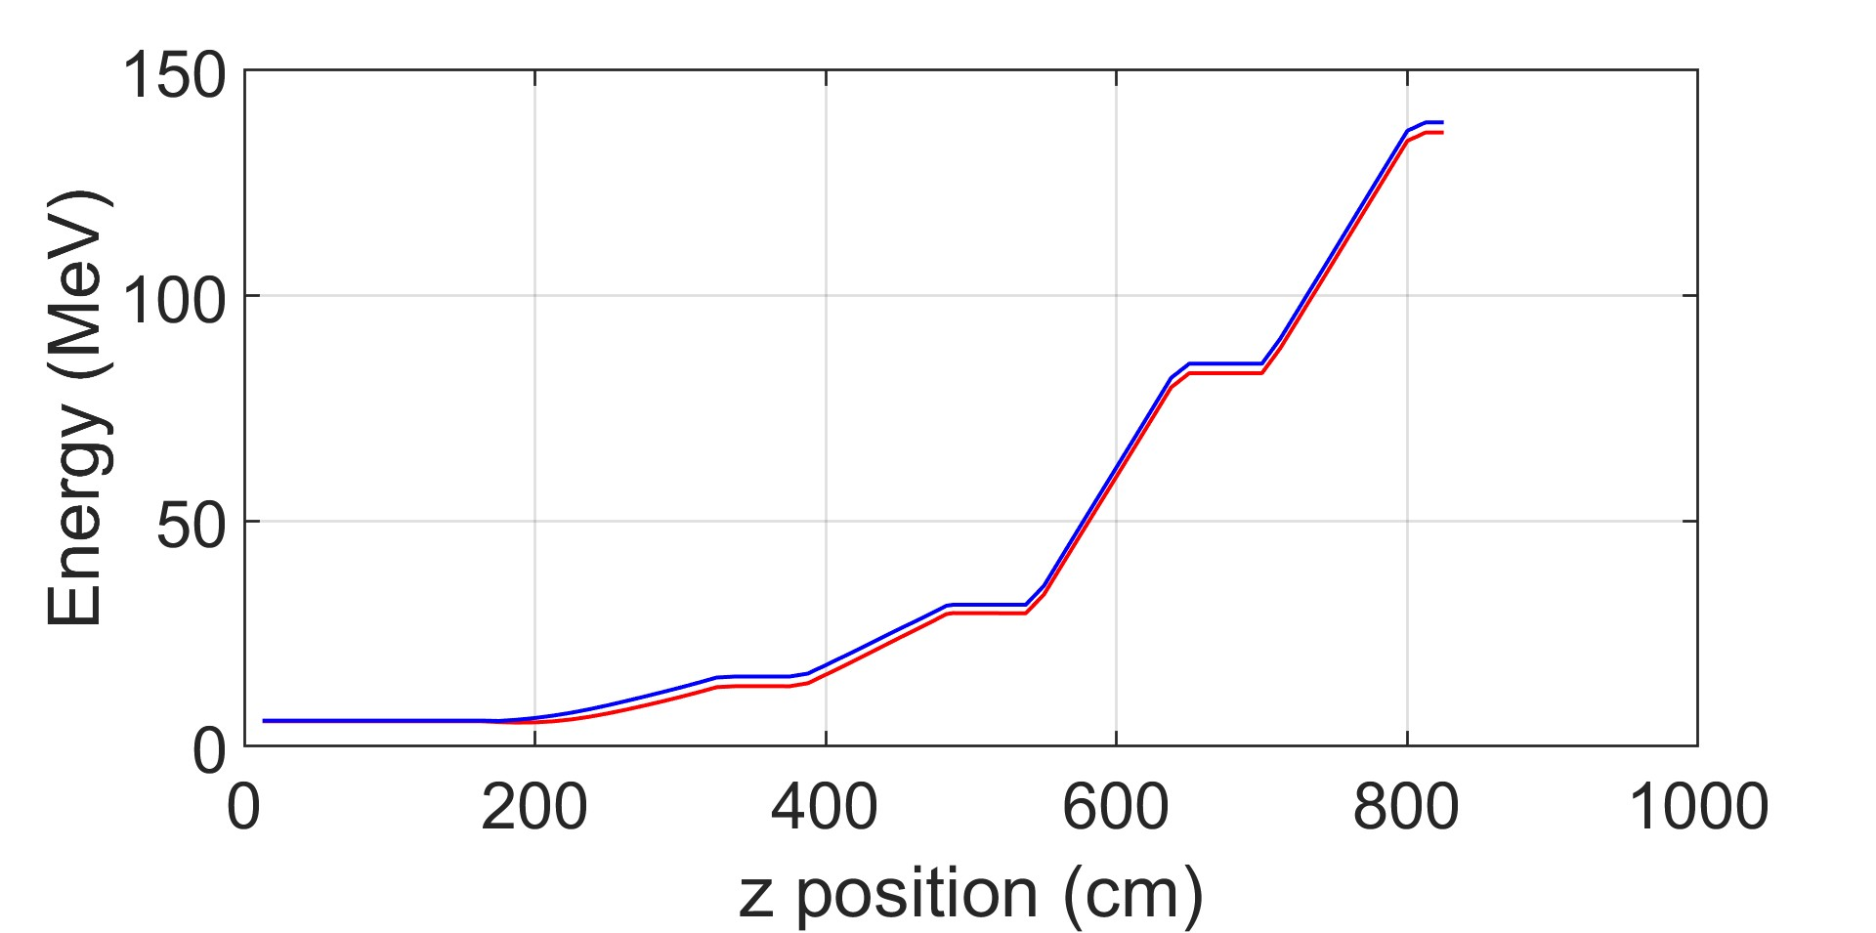
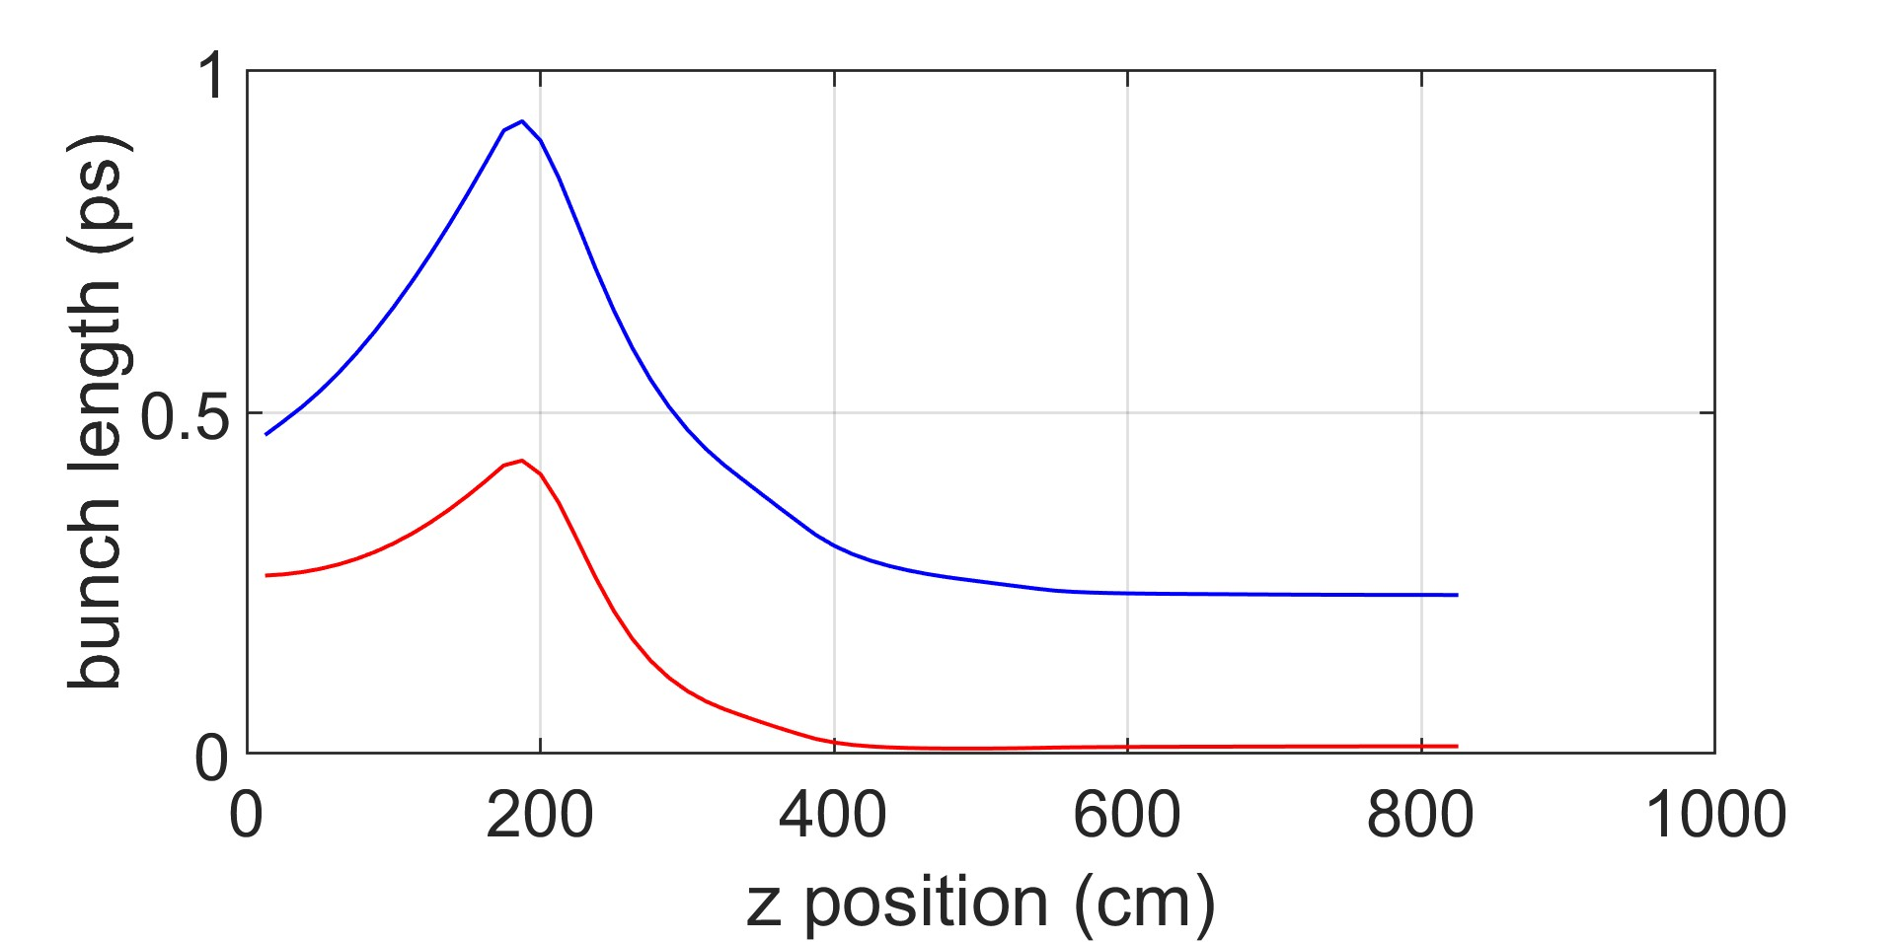
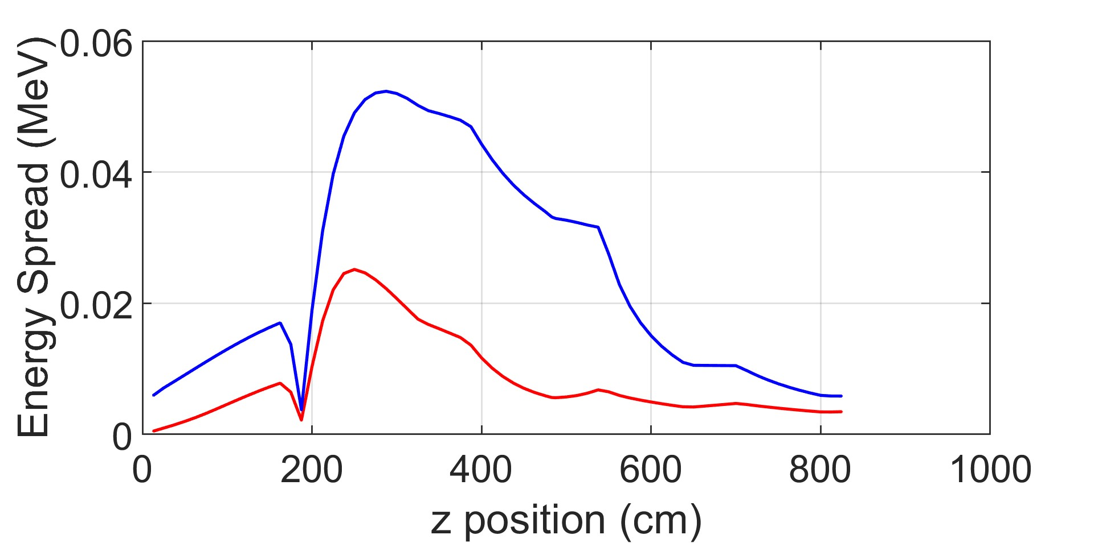
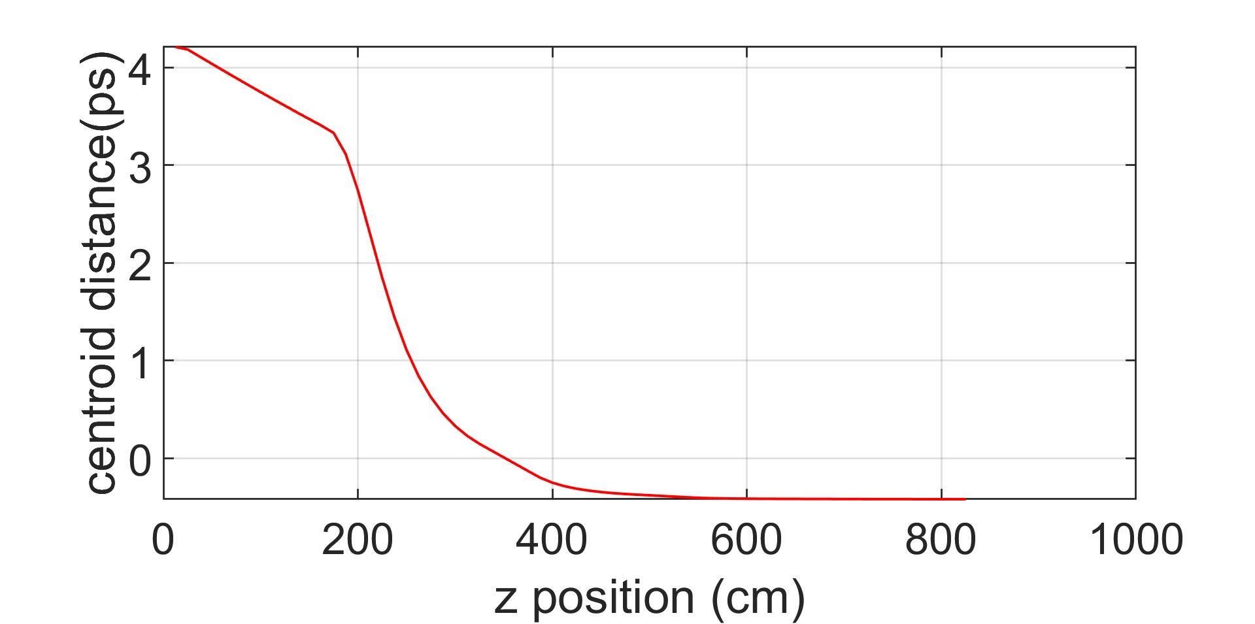
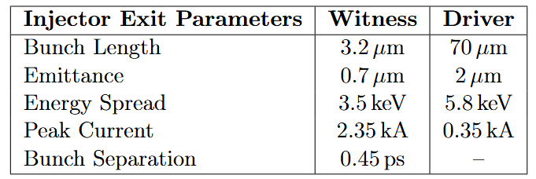
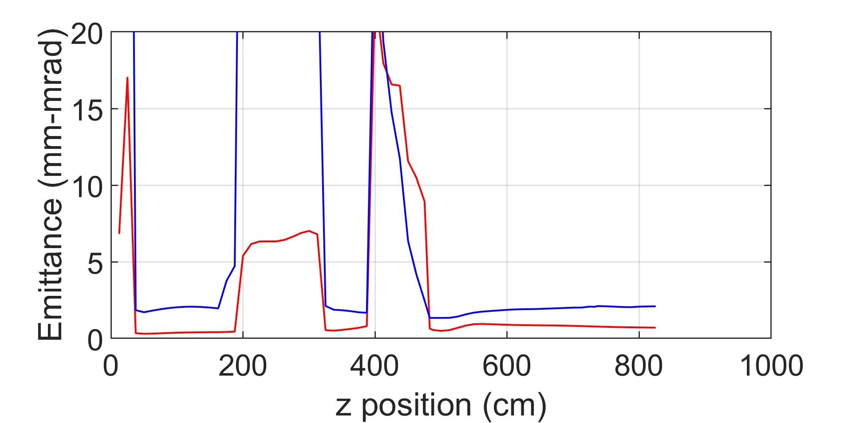
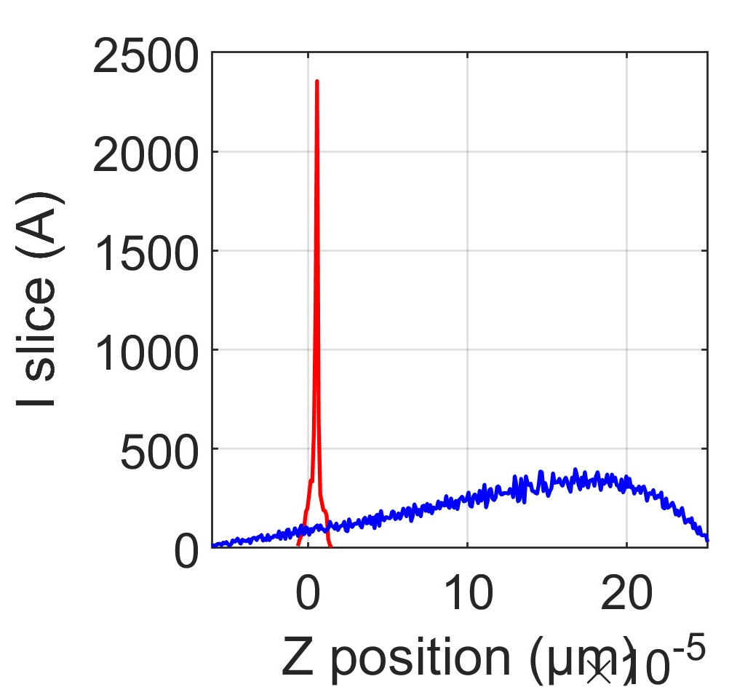
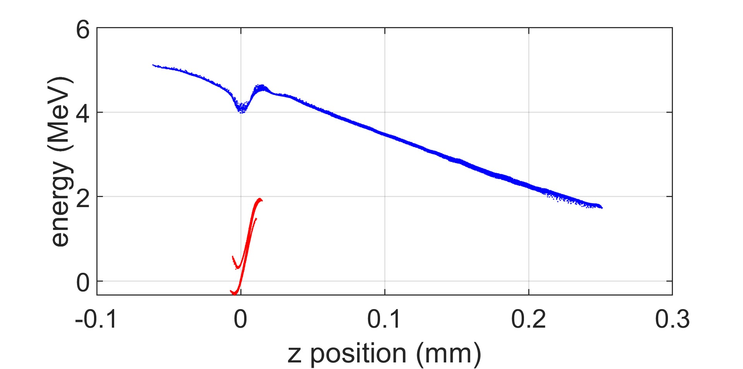
Beam dynamics optimization with Genetic Algorithm
Driver
Witness
Driver
Witness
Driver
Witness
Energy (MeV)
Bunch length (ps)
Energy spread (MeV)
Z (cm)
Z (cm)
Z (cm)
Driver
Witness
Bunch separation (ps)
Emittance (mm-mrad)
Z (cm)
Driver
Witness
Z (cm)
Driver
Witness
ΔE (MeV)
I slice (A)
Z (mm)
Beam dynamics studies for advanced-compact RF injector for PWFA
Z (μm)

Slide 16
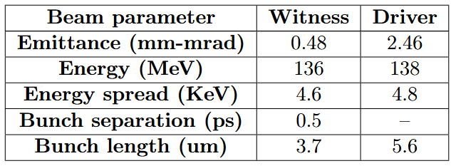

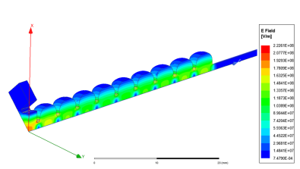
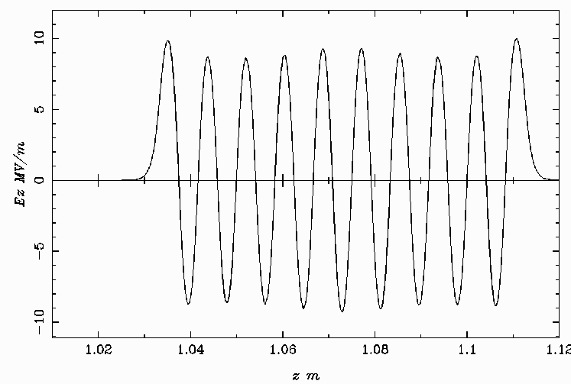
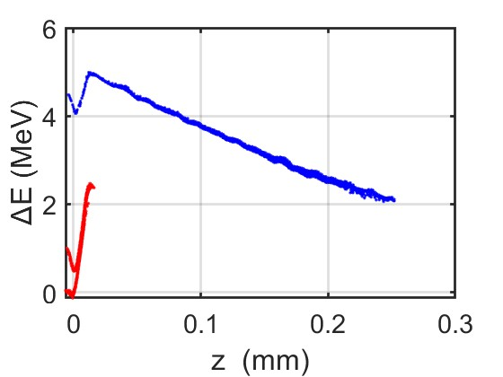
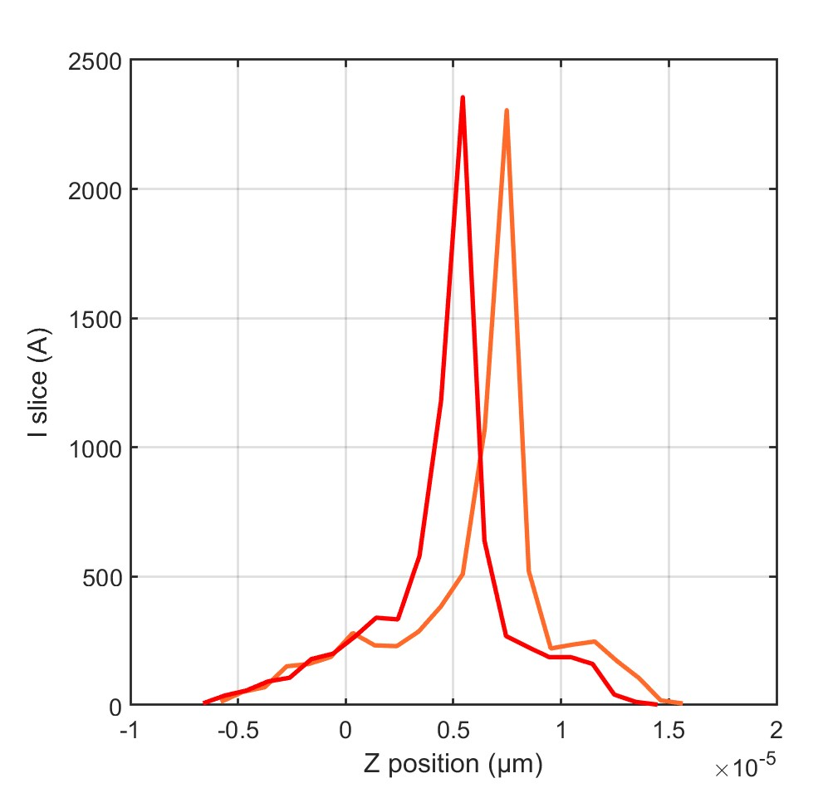
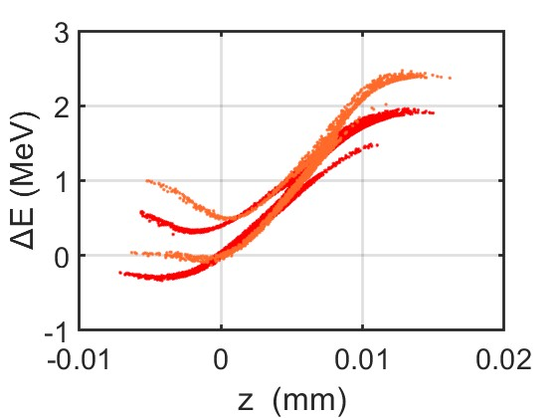

HHC for LPS manipulation
Ka-band
8 m
J. Scifo et al. ‘BEAM DYNAMICS STUDIES IN A
STANDING WAVE Ka-BAND LINEARIZERIPAC2021, Campinas, SP, Brazil, doi:10.18429/JACoW-IPAC2021-MOPAB270
A. Castilla, R. Apsimon, G. Burt, X. Wu, A. Latina, X. Liu, I. Syratchev, W. Wuensch, B. Spataro, and A. W. Cross
Phys. Rev. Accel. Beams 25, 112001 – Published 9 November 2022
M. Behtouei et al. ‘A SW Ka-Band linearizer structure with minimum surface electric
field for the compact light XLS project, NIMA vol 894 (2020) https://doi.org/10.1016/j.nima.2 020.164653
M Behtouei et al 2023 J. Phys.: Conf. Ser. 2420 012031
Witness peak current
Driver
Witness
W/ Ka-band
W/o Ka-bank
W/ Ka-band
W/o Ka-bank
W/ Ka-band
W/o Ka-bank
I slice (A)
Witness
Driver
Z (μm)
Beam dynamics studies for advanced-compact RF injector for PWFA

Slide 17



Photoelectron source investigation
Among the metal cathodes, Y and Cu are the candidates for the electron beam sources for such applications
Y on Cu plug
Beam dynamics studies for advanced-compact RF injector for PWFA

Slide 18



Experimental setup
1400 nm
.89 eV
The Palitra achieves high conversion efficiency through 2 amplification stages
1st stage
  White light continuum signal is generated in sapphire crystal S1 and used, along with the 800nm pump, to seed the OPA process in crystal X1.
2nd stage
  Signal from 1st stage is amplified in crystal X2 using the 800nm pump
Wavelength extensions
  Two BBO crystals, VIS2 & UV2, double and quadruple the amplified signal
Wavelength is tuned by rotating X1, X2, VIS2 & UV2 crystals and adjusting D1 & D2 delay stages
800 nm
1.55 eV
1866 nm
.66 eV
Energy diagram of the OPA process
VIS2
UV2
Courtesy of D. Garcia
Beam dynamics studies for advanced-compact RF injector for PWFA

Slide 19



Yttrium characterization
Charge (pC)
Charge (pC)
Normalized emittance (nm)
Energy (uJ)
Energy (uJ)
wavelength (nm)
Charge (pC)
Charge (pC)
Energy (uJ)
Energy (uJ)
Beam dynamics studies for advanced-compact RF injector for PWFA

Slide 20








Emittance measurement setup
The emittance of the photocathode can be obtained by fitting the measured beam spot sizes on the screen as a function of the solenoid strength.
PEGASUS photo gun
$$σ_{x}$$
$$σ_{y}$$
$$ε_{n}= 84,84 \text{±} 3,69 nm$$
Load lock
$$σ(μm)$$
solenoid
gun
suitcase
Solenoid current (A)
The beam transverse emittance can be written, assuming no correlation between each term, as the sum in quadrature of the different contributions. Ideally, it is possible to restore the initial emittance value by properly setting the magnetic field of the solenoid surrounding the gun to counteract the beam internal space charge forces and the external RF kick.
Beam dynamics studies for advanced-compact RF injector for PWFA

Slide 21



Machine learning-based studies for RF photo gun
PEGASUS photo gun NN model with 50K solenoid scan simulations.
5-layer feedforward network with layer size 20 and Levenberg-Marquardt training algorithm.
Beam dynamics studies for advanced-compact RF injector for PWFA

Slide 22






Markov Chain Monte Carlo algorithm
The algorithm has been tested with several solenoid scans to predict the MTE comparing the algorithm prediction with the actual measurement.
Spot size (mm)
*${10}^{4}$
Use a reliable model to determine a posterior probability distribution function after measurements have been taken of parameters that are known to affect the measurements
The MCMC sampling aims to match the given data’s model parameters.
MCMC sampling can be used to predict the high probability region in parameter space that matches data.
Posterior distribution
Likelihood
Prior distribution
Average Likelihood
Jonathan Goodman and Jonathan Weare. Ensemble samplers with affine invariance. PublisherCopyright: © 2010 by Mathematical Sciences Publishers.
Siddhartha Chib and Edward Greenberg. Understanding the metropolis-hastings algorithm. The American Statistician, 49(4):327–335, 1995.
Daniel Foreman-Mackey, David W. Hogg, Dustin Lang, and Jonathan Goodman. Emcee: The mcmc hammer. Publications of the Astronomical Society of the Pacific, 125(925):306, Feb 2013.
Beam dynamics studies for advanced-compact RF injector for PWFA

Slide 23





MCMC chain convergence, Gelman-Rubin statistic
The Gelman-Rubin R̂ statistic assesses the convergence of Markov Chain Monte Carlo (MCMC) simulations in Bayesian analysis.
Gelman-Rubin Formula:
• Interpretation of R̂
R̂ ≈ 1: Chains have likely converged.
R̂ > 1: Indicates non-convergence; more iterations may be needed.
Beam dynamics studies for advanced-compact RF injector for PWFA

Slide 24
Conclusions and future prospectives
Optimization of the EuPRAXIA@SPARC_LAB injector baseline adding an HHC to improve the temporal distance of the beams and working point stability in terms of D-W separation.
Proposal of a C-band RF injector for the EuPRAXIA@SPARC_LAB upgrade to operate at higher repetition rate with a reduced injector footprint while maintaining high-quality beams.
Machine learning for advanced beam diagnostic. These studies could be implemented for the PWFA working point virtual diagnostics in the low-energy region where the beams are still overlapped.
Further optimizations of the new C-band injector are ongoing, including jitters. Additional focus will be placed on beam dynamics simulations to address the time separation required for PWFA application.
  Further investigation into the layout, including the Ka-band cavity, is needed to assess its impact on the bunch separation and stability.
    Ka-band technological feasibility must be demonstrated.
Improvement of the photoemission model to investigate the advantages of yttrium cathode transition.
Beam dynamics studies for advanced-compact RF injector for PWFA

Slide 25
Published papers
11573/1707552 - 2024 - Manipulation and wakefield effects on multi-pulse driver beams in PWFA injector stages
Bosco, F.; Andonian, G.; Camacho, O.; Carillo, M.; Chiadroni, E.; Giribono, A.; Lawler, G.; Majernik, N.; Manwani, P.; Migliorati, M.; Mostacci, A.; Palumbo, L.; Silvi, G. J.; Spataro, B.; Vaccarezza, C.; Yadav, M.; Rosenzweig, J. - 01a Articolo in rivista
rivista: INSTRUMENTS (Basel : MDPI AG, 2016-) pp. 1-10 - issn: 2410-390X - wos: (0) - scopus: 2-s2.0-85188952506 (0)
11573/1704992 - 2024 - Advanced studies for the dynamics of high brightness electron beams with the code MILES
Bosco, F.; Behtouei, M.; Camacho, O.; Carillo, M.; Chiadroni, E.; Faillace, L.; Ficcadenti, L.; Francescone, D.; Giannessi, L.; Giribono, A.; Giuliano, L.; Nguyen, F.; Palumbo, L.; Rosenzweig, J.; Silvi, G. J.; Spataro, B.; Vaccarezza, C.; Migliorati, M. - 01a Articolo in rivista
rivista: JOURNAL OF PHYSICS. CONFERENCE SERIES (Bristol : Institute of Physics Publishing) pp. 1-8 - issn: 1742-6588 - wos: (0) - scopus: 2-s2.0-85184147510 (0)
11573/1706356 - 2024 - Beam dynamics optimization for high gradient beam driven plasma wakefield acceleration at SPARC-LAB
Carillo, M.; Alesini, D.; Anania, M. P.; Behtouei, M.; Bellaveglia, M.; Biagioni, A.; Chiadroni, E.; Cianchi, A.; Costa, G.; Crincoli, L.; Dotto, A. D.; Giorno, M. D.; Pirro, G. D.; Faillace, L.; Francescone, D.; Galletti, M.; Giannessi, L.; Giribono, A.; Giuliano, L.; Iovine, P.; Mostacci, A.; Petrillo, V.; Pompili, R.; Parise, G.; Romeo, S.; Rossi, A. R.; Silvi, G. J.; Shpakov, V.; Vaccarezza, C.; Villa, F.; Ferrario, M. - 04c Atto di convegno in rivista
rivista: JOURNAL OF PHYSICS. CONFERENCE SERIES (Bristol : Institute of Physics Publishing) pp. 1-8 - issn: 1742-6588 - wos: (0) - scopus: 2-s2.0-85184151381 (0)
congresso: 14th International Particle Accelerator Conference, IPAC 2023 (Venice Convention Centre, ita)
11573/1722306 - 2024 - Experimental characterization of the timing-jitter effects on a beam-driven plasma wakefield accelerator
Demurtas, F.; Anania, M. P.; Biagioni, A.; Carillo, M.; Chiadroni, E.; Cianchi, A.; Costa, G.; Crincoli, L.; Del Dotto, A.; Del Giorno, M.; Ferrario, M.; Galletti, M.; Giannessi, L.; Giribono, A.; Pompili, R.; Romeo, S.; Rossi, A. R.; Shpakov, V.; Silvi, G. J.; Vaccarezza, C.; Villa, F. - 02a Capitolo o Articolo
libro: 15th International Particle Accelerator Conference - Proceedings Volume - (978-3-95450-247-9)
11573/1707554 - 2024 - On the betatron radiation in cylindrically symmetric plasma-ion channels
Francescone, D.; Bosco, F.; Carillo, M.; Chiadroni, E.; Curcio, A.; Cianchi, A.; Ferrario, M.; Galletti, M.; Giuliano, L.; Migliorati, M.; Mostacci, A.; Palumbo, L.; Rossi, A. R.; Shpakov, V.; Silvi, G. J. - 04c Atto di convegno in rivista
rivista: JOURNAL OF PHYSICS. CONFERENCE SERIES (Bristol : Institute of Physics Publishing) pp. 2170-2173 - issn: 1742-6588 - wos: (0) - scopus: (0)
congresso: 14th International Particle Accelerator Conference, IPAC 2023 (Venice Convention Centre, ita) (Venezia)
11573/1722309 - 2024 - UV-Soft X-ray betatron radiation characterization from laser-plasma wakefield acceleration
Francescone, D.; Carillo, M.; Chiadroni, E.; Curcio, A.; Cianchi, A.; Ferrario, M.; Gatti, G.; Galletti, M.; Giuliano, L.; Migliorati, M.; Mostacci, A.; Palumbo, L.; Rossi, A. R.; Stocchi, F.; Silvi, G. J. - 02a Capitolo o Articolo
libro: 15th International Particle Accelerator Conference - Proceedings Volume - ()
11573/1722312 - 2024 - NaKSb photocathode tests in a high gradient S-band photoinjector
Garcia, D.; Schaap, B.; Ody, A.; Musumeci, P.; Pennington, C.; Maxson, J.; Silvi, G. J.; Mostacci, A.; Chiadroni, E.; Giribono, A. - 02a Capitolo o Articolo
libro: 15th International Particle Accelerator Conference - Proceedings Volume - ()
11573/1706354 - 2024 - Electron beam analysis and sensitivity studies for the EuPRAXIA@SPARC LAB RF injector
Giribono, A.; Alesini, D.; Bacci, A.; Bellaveglia, M.; Cardelli, F.; Chiadroni, E.; Del Dotto, A.; Faillace, L.; Ferrario, M.; Gallo, A.; Ghigo, A.; Giannetti, G.; Mostacci, A.; Opromolla, M.; Petrillo, V.; Piersanti, L.; Pompili, R.; Romeo, S.; Rossetti Conti, M.; Rossi, A. R.; Shpakov, V.; Silvi, G. J.; Vaccarezza, C. - 04c Atto di convegno in rivista
rivista: JOURNAL OF PHYSICS. CONFERENCE SERIES (Bristol : Institute of Physics Publishing) pp. 1-7 - issn: 1742-6588 - wos: (0) - scopus: 2-s2.0-85184137576 (0)
congresso: 14th International Particle Accelerator Conference, IPAC 2023 (Venice Convention Centre, ita)
11573/1712232 - 2024 - Design of machine learning-based algorithms for virtualized diagnostic on SPARC_LAB accelerator
Latini, Giulia; Chiadroni, Enrica; Mostacci, Andrea; Martinelli, Valentina; Serenellini, Beatrice; Silvi, Gilles Jacopo; Pioli, Stefano - 01a Articolo in rivista
rivista: PHOTONICS (Basel : MDPI) pp. 1-10 - issn: 2304-6732 - wos: WOS:001240359100001 (2) - scopus: (0)
11573/1712231 - 2024 - Guiding of charged particle beams in curved plasma-discharge capillaries
Pompili, R.; Anania, M. P.; Biagioni, A.; Carillo, M.; Chiadroni, E.; Cianchi, A.; Costa, G.; Curcio, A.; Crincoli, L.; Del Dotto, A.; Del Giorno, M.; Demurtas, F.; Frazzitta, A.; Galletti, M.; Giribono, A.; Lollo, V.; Opromolla, M.; Parise, G.; Pellegrini, D.; Di Pirro, G.; Romeo, S.; Rossi, A. R.; Silvi, G. J.; Verra, L.; Villa, F.; Zigler, A.; Ferrario, M. - 01a Articolo in rivista
rivista: PHYSICAL REVIEW LETTERS (American Institute of Physics:2 Huntington Quadrangle, Suite 1NO1:Melville, NY 11747:(800)344-6902, (631)576-2287, EMAIL: subs@aip.org, INTERNET: http://www.aip.org, Fax: (516)349-9704) pp. 1-5 - issn: 0031-9007 - wos: WOS:001231921500001 (0) - scopus: 2-s2.0-85193957624 (1)
11573/1717453 - 2024 - Recovery of hydrogen plasma at the sub-nanosecond timescale in a plasma-wakefield accelerator
Pompili, R.; Anania, M. P.; Biagioni, A.; Carillo, M.; Chiadroni, E.; Cianchi, A.; Costa, G.; Crincoli, L.; Del Dotto, A.; Del Giorno, M.; Demurtas, F.; Ferrario, M.; Galletti, M.; Giribono, A.; Jones, J. K.; Lollo, V.; Pacey, T.; Parise, G.; Di Pirro, G.; Romeo, S.; Silvi, G. J.; Shpakov, V.; Villa, F.; Zigler, A. - 01a Articolo in rivista
rivista: COMMUNICATIONS PHYSICS ([London]: Springer Nature, 2018-) pp. 1-8 - issn: 2399-3650 - wos: WOS:001269841900001 (0) - scopus: 2-s2.0-85198667393 (0)
11573/1712230 - 2024 - Acceleration and focusing of relativistic electron beams in a compact plasma device
Pompili, R.; Anania, M. P.; Biagioni, A.; Carillo, M.; Chiadroni, E.; Cianchi, A.; Costa, G.; Curcio, A.; Crincoli, L.; Del Dotto, A.; Del Giorno, M.; Demurtas, F.; Galletti, M.; Giribono, A.; Lollo, V.; Opromolla, M.; Parise, G.; Pellegrini, D.; Di Pirro, G.; Romeo, S.; Silvi, G. J.; Verra, L.; Villa, F.; Zigler, A.; Ferrario, M. - 01a Articolo in rivista
rivista: PHYSICAL REVIEW. E (Ridge, NY: American Physical Society, [2016]-) pp. -1 - issn: 2470-0045 - wos: WOS:001221545400001 (0) - scopus: 2-s2.0-85192456424 (0)
Beam dynamics studies for advanced-compact RF injector for PWFA

Slide 26
Published papers
11573/1704456 - 2024 - Beam dynamics optimization of EuPRAXIA@SPARCLAB RF injector
Silvi, G. J.; Bacci, A. L.; Carillo, M.; Chiadroni, E.; Faillace, L.; Francescone, D.; Giribono, A.; Iovine, P.; Mostacci, A.; Ferrario, M.; Pompili, R.; Vaccarezza, C. - 04c Atto di convegno in rivista
rivista: JOURNAL OF PHYSICS. CONFERENCE SERIES (Bristol : Institute of Physics Publishing) pp. 1-8 - issn: 1742-6588 - wos: (0) - scopus: 2-s2.0-85184153030 (0)
congresso: 14th International Particle Accelerator Conference, IPAC 2023 (Venice; Italy)
11573/1722314 - 2024 - Optimizing beam dynamics in the EuPRAXIA@ SPARCLAB RF injector
Silvi, G. J.; Bacci, A. L.; Carillo, M.; Chiadroni, E.; Faillace, L.; Giribono, A.; Mostacci, A.; Ferario, M.; Vaccarezza, C. - 04c Atto di convegno in rivista
rivista: IL NUOVO CIMENTO C (Bologna: Società italiana di fisica) pp. - - issn: 2037-4909 - wos: WOS:001302453000021 (0) - scopus: 2-s2.0-85202067051 (0)
congresso: 109th National Congress of the Italian Physical Society (Salerno, Italy)
11573/1716056 - 2024 - Experimental observation of space-charge field screening of a relativistic particle bunch in plasma
Verra, L.; Galletti, M.; Pompili, R.; Biagioni, A.; Carillo, M.; Cianchi, A.; Crincoli, L.; Curcio, A.; Demurtas, F.; Di Pirro, G.; Lollo, V.; Parise, G.; Pellegrini, D.; Romeo, S.; Silvi, G.; Villa, F.; Ferrario, And M. - 01a Articolo in rivista
rivista: PHYSICAL REVIEW LETTERS (Woodbury, NY : American Physical Society) pp. - - issn: 1092-0145 - wos: (0) - scopus: (0)
11573/1704633 - 2023 - Dynamics studies of high brightness electron beams in a normal conducting, high repetition rate C -band injector
Giribono, A.; Alesini, D.; Cardelli, F.; Di Raddo, G.; Faillace, L.; Ferrario, M.; Gallo, A.; Gizzi, A.; Lauciani, S.; Liedl, A.; Pellegrino, L.; Piersanti, L.; Vaccarezza, C.; Vannozzi, A.; Scifo, J.; Ficcadenti, L.; Castorina, G.; Pedrocchi, G.; Silvi, G. J.; Lucas, T. G. - 01a Articolo in rivista
rivista: PHYSICAL REVIEW. ACCELERATORS AND BEAMS (College Park, MD : American Physical Society, [2016]-) pp. 1-13 - issn: 2469-9888 - wos: WOS:001061331100001 (2) - scopus: 2-s2.0-85171644403 (3)
11573/1707591 - 2023 - Recent experimental results on the particle driven acceleration at the SPARC_LAB test facility
Giribono, A.; Rossi, A.; Del Dotto, A.; Ghigo, A.; Biagioni, A.; Vaccarezza, C.; Alesini, D.; Villa, F.; Costa, G.; Di Pirro, G.; Giannessi, L.; Crincoli, L.; Bellaveglia, M.; Anania, M.; Galletti, M.; Ferrario, M.; Behtouei, M.; Pompili, R.; Romeo, S.; Shpakov, V.; Cardelli, F.; Faillace, L.; Gallo, A.; Piersanti, L.; Cianchi, A.; Mostacci, A.; Chiadroni, E.; Iovine, P.; Carillo, M.; Petrillo, V.; Opromolla, M.; Silvi, G. - 04c Atto di convegno in rivista
rivista: JOURNAL OF PHYSICS. CONFERENCE SERIES (Bristol : Institute of Physics Publishing) pp. 2038-2041 - issn: 1742-6588 - wos: (0) - scopus: (0)
congresso: 14th International Particle Accelerator Conference, IPAC 2023 (Venice Convention Centre, ita) (Venezia)
11573/1707592 - 2023 - SAFEST. A compact C-band linear accelerator for VHEE-FLASH radiotherapy
Palumbo, L.; Sarti, A.; Mostacci, A.; De Gregorio, A.; De Arcangelis, D.; Francescone, D.; Chiadroni, E.; Franciosini, G.; Ficcadenti, L.; Magi, M.; Carillo, M.; Patera, V.; Gallo, A.; Vannozzi, A.; Spataro, B.; Alesini, D.; Cardelli, F.; Romano, F.; Cuttone, G.; Mauro, G.; Franzini, G.; Milluzzo, G.; Cirrone, G.; Torrisi, G.; Piersanti, L.; Giuliano, L.; Faillace, L.; Di Raddo, R.; Bosco, F.; Di Martino, F.; Bisogni, M.; Silvi, G.; Migliorati, M.; Sorbello, G. - 04c Atto di convegno in rivista
rivista: JOURNAL OF PHYSICS. CONFERENCE SERIES (Bristol : Institute of Physics Publishing) pp. 5079-5082 - issn: 1742-6588 - wos: (0) - scopus: (0)
congresso: 14th International Particle Accelerator Conference, IPAC 2023 (Venice Convention Centre, ita) (Venezia)
11573/1707589 - 2023 - Numerical studies for EuPRAXIA@SPARC_LAB plasma beam driven working point
Romeo, S.; Del Dotto, A.; Rossi, A.; Giribono, A.; Vaccarezza, C.; Ferrario, M.; Silvi, G. J. - 01a Articolo in rivista
rivista: JOURNAL OF PHYSICS. CONFERENCE SERIES (Bristol : Institute of Physics Publishing) pp. 2042-2045 - issn: 1742-6588 - wos: (0) - scopus: (0)
11573/1689539 - 2023 - Evaluation of the transfer matrix of a plasma ramp with squared cosine shape via an approximate solution of Mathieu differential equation
Romeo, S; Biagioni, A; Crincoli, L; Del Dotto, A; Ferrario, M; Giribono, A; Parise, G; Rossi, A R; Silvi, G J; Vaccarezza, C - 01a Articolo in rivista
rivista: PLASMA PHYSICS AND CONTROLLED FUSION (IOP Publishing Limited:Dirac House, Temple Back, Bristol BS1 6BE United Kingdom:011 44 117 9297481, EMAIL: custserv@iop.org, INTERNET: http://www.iop.org, Fax: 011 44 117 9294318) pp. 1-10 - issn: 0741-3335 - wos: WOS:001079340500001 (0) - scopus: 2-s2.0-85175347498 (0)
11573/1707551 - 2023 - EuPRAXIA@SPARC_LAB status update
Villa, Fabio; Alesini, D.; Anania, M. P.; Angelucci, M.; Bacci, A.; Balerna, A.; Bellaveglia, M.; Biagioni, A.; Buonuomo, B.; Cantarella, S.; Cardelli, F.; Carillo, M.; Carpanese, M.; Castellano, M.; Chiadroni, E.; Cianchi, A.; Cioeta, F.; Conti, M. R.; Coreno, M.; Crincoli, L.; Costa, G.; Curcio, A.; Doria, A.; Del Dotto, A.; Del Franco, M.; Del Giorno, M.; Di Mitri, S.; Di Pasquale, E.; Di Pirro, G.; Drago, A.; Ebrahimpour, Z.; Esposito, A.; Faillace, L.; Falone, A.; Ferrario, M.; Ficcadenti, L.; Franzini, G.; Galletti, M.; Gallo, A.; Ghigo, A.; Giannessi, L.; Giribono, A.; Incremona, S.; Iovine, P.; Iungo, F.; Lauciani, S.; Liedl, A.; Lollo, V.; Lupi, S.; Marcelli, A.; Mostacci, A.; Nguyen, F.; Opromolla, M.; Parise, G.; Pellegrino, L.; Petralia, A.; Petrillo, V.; Piersanti, L.; Pioli, S.; Pompili, R.; Principi, E.; Ricci, R.; Romeo, S.; Rossi, A. R.; Rotundo, U.; Sabbatini, L.; Selce, A.; Spallino, L.; Spataro, B.; Silvi, G. J.; Stecchi, A.; Stella, A.; Stellato, F.; Stocchi, F.; Vaccarezza, C.; Vannozzi, A.; Vescovi, S. - 04b Atto di convegno in volume
congresso: SPIE Optics + Optoelectronics, 2023, Prague, Czech Republic (Prague, Czech Republic)
libro: Proceedings of SPIE - (9781510662827; 9781510662834)
11573/1682213 - 2022 - Design, optimization and experimental characterization of RF injectors for high brightness electron beams and plasma acceleration
Shpakov, V.; Alesini, D.; Anania, M. P.; Behtouei, M.; Buonomo, B.; Bellaveglia, M.; Biagioni, A.; Cardelli, F.; Carillo, M.; Chiadroni, E.; Cianchi, A.; Costa, G.; Del Giorno, M.; Faillace, L.; Ferrario, M.; Del Franco, M.; Franzini, G.; Galletti, M.; Giannessi, L.; Giribono, A.; Liedl, A.; Lollo, V.; Mostacci, A.; Di Pirro, G.; Piersanti, L.; Pompili, R.; Di Raddo, G.; Romeo, S.; Silvi, G. J.; Stella, A.; Vaccarezza, C.; Villa, F.; Vannozzi, A. - 01a Articolo in rivista
rivista: JOURNAL OF INSTRUMENTATION (Bristol : IOP Publishing Ltd, 2006-) pp. - - issn: 1748-0221 - wos: WOS:000906931400001 (2) - scopus: 2-s2.0-85151057981 (2)
Beam dynamics studies for advanced-compact RF injector for PWFA

Slide 27
Conferences
September 2024: EuPRAXIA PP, Isola D’Elba, Italy, “High repetition rate C-band photoinjector”, invited talk in plenary session.
September 2023: European Advanced Accelerator Concept (EAAC), Isola D’Elba, Italy, “Beam dynamics simulation of a High Brightness High repletion rate RF C-band Photoinjector for future EuPRAXIA@SPARC_LAB upgrade”, contributed oral in parallel session.
September 2023: Italian Physics Society National Congress, Fisciano, Italy, “Beam dynamics optimization of the EuPRAXIA@SPARC_LAB RF injector”, contributed oral in parallel session.
June 2023: Physics and Application of high brightness beams (PAHBB), San Sebastian, Spain “Beam Dynamics simulations with X-band linearizer cavity for the EuPRAXIA@SPARC_LAB RF injector”, Poster.
May 2023: 14th International Particle Accelerator Conference (IPAC), Venice Italy, “Beam dynamics optimization of the EuPRAXIA@SPARC_LAB RF injector” and “Numerical Studies for EuPRAXIA@SPARC_LAB plasma beam driven working point”, Posters.
September 2022: EuroNNAC Special Topic Workshop, Isola D’Elba, Italy, “Beam dynamics studies with comb electron beams for Particle driven Wakefield Acceleration”, Poster.
Beam dynamics studies for advanced-compact RF injector for PWFA

Slide 28
Acknowledgments
Gilles Jacopo Silvi*
Ph.D. School in ACCELERATOR PHYSICS – XXXVII cycle
Sapienza University of Rome
*gillesjacopo.silvi@uniroma1.it
Special acknowledgments to:
My supervisors Prof E. Chiadroni, Dott. A. Giribono, and Prof. A. Mostacci.
Prof. L. Palumbo, Prof. M. Migliorati, Dott. L. Giuliano, Dott. D. Francescone, Dott. M. Carillo, Dott. F. Bosco Dott. B. Spataro, Dott. A. Curcio, Dott. L. Ficcadenti and Dott. S. Farina from the SBAI department.
Dott. M. Ferrario, Dott. C. Vaccarezza, all the SPARC_LAB and the EuPRAXIA@SPARC_LAB WP1 teams.
Prof. P. Musumeci and all the PBPL group at the University of California Los Angeles

Slide 29
Thank you for your attention!
Gilles Jacopo Silvi*
Ph.D. School in ACCELERATOR PHYSICS – XXXVII cycle
Sapienza University of Rome
Supervisors: Prof. Enrica Chiadroni (Sapienza University of Rome)
Prof. Andrea Mostacci (Sapienza University of Rome)
Dott. Anna Giribono (INFN-LNF)
*gillesjacopo.silvi@uniroma1.it

Slide 30
Backup slides
Gilles Jacopo Silvi*
Ph.D. School in ACCELERATOR PHYSICS – XXXVII cycle
Sapienza University of Rome
Supervisors: Prof. Enrica Chiadroni (Sapienza University of Rome)
Prof. Andrea Mostacci (Sapienza University of Rome)
Dott. Anna Giribono (INFN-LNF)
*gillesjacopo.silvi@uniroma1.it

Slide 31







Emittance and Brightness
Rms emittance can be introduced from second-order momenta as follows
$$ε_{x}=\sqrt{σ_{x}^{2}σ_{x^{′}}^{2}−σ_{xx^{′}}^{2}}$$
Systems obeying Hamiltonian mechanics are symplectic: they conserve phase space volumes upon evolution
Linear symplectic systems conserve, in addition, one emittance $ε_{i}$ per degree of freedom (particular case from Liouville theorem)
In case of energy variations, the normalized emittance is conserved
$$ε_{nx}=βγε_{x}$$
$β=\left|v\right|/c$, $γ={\left(1−β^{2}\right)}^{−1/2}$
Average and Normalized (5D)
Local definition
$${\overline{B}}_{n}=\frac{I/β^{2}γ^{2}}{V_{4}}=\frac{2I}{πε_{nx}ε_{ny}}$$
Total beam current confined within a given 4D trace-space volume $V_{4}$
Not only phase space volume matter but also beam intensity
Brightness accounts for both
Six-Dimensional Brightness
$$B=\frac{∂^{2}I}{∂S∂Ω}$$
Current density per unit solid angle: it varies across the beam
Most demanding applications require high 6D brightness: high current, low emittance and low energy spread
$${\overline{B}}_{6D}∝\frac{Ne}{ε_{nx}ε_{ny}σ_{t}σ_{γ}}$$
Courtesy of F. Bosco
Beam dynamics studies for advanced-compact RF injector for PWFA

Slide 32




Stability requirements
We consider a scenario involving a total blow-out with an immobile ion background under a one-dimensional approximation, where no current flows inside the plasma bubble. In this context, Gauss’s law simplifies to:
Assuming ideal beam loading compensation, the electric field is flat within the witness region. Let z0 denote the position of the zero-crossing of the electric field with respect to the driver beam and ∆z the separation between the driver and witness beams. Under these conditions, the accelerating gradient is given by:
For simplicity, we neglect the dependency of the zero-crossing position on plasma density. We further assume that, under realistic working conditions, the witness beam is positioned near the trailing edge of the plasma bubble, such that $∆z − z0 ≈ {(λ}_{p}/2)$. The resulting expression for relative energy jitter becomes:
Where E is the final energy and E0 is the initial energy. For our setup, where $E = 2E_{0}$, this simplifies to:
For the EuPRAXIA working point, a temporal jitter between the driver and witness beams of δt ≈ few fs corresponds to an energy jitter of <1 %.
Beam dynamics studies for advanced-compact RF injector for PWFA

Slide 33


C-Band vs S-Band Technology
The RF energy entering an accelerating cavity is divided into:
Useful power Pacc​, which accelerates the beam.
Dissipated power Pdiss​, which is lost as heat in the cavity walls
The power transfer efficiency is given by:
A lower $\frac{P_{diss​}}{P_{input}}$​ ratio results in higher efficiency.
In the case of C-band:
Cavities are smaller, which reduces the conductive surface area that dissipates heat.
The surface resistance Rs​ increases with frequency f, but the volume-to-surface ratio in C-band cavities is more favorable compared to S-band, leading to lower power losses.
The quality factor Q0​ of a cavity is defined as:
$Q_{0}​=\frac{Uω}{P_{diss}}$​where:
U is the stored energy in the cavity,
Pdiss​ is the dissipated power.
C-band cavities generally have a higher Q0​ than S-band cavities, meaning they dissipate less power for the same stored energy.
The coupling coefficient β between the cavity and the RF waveguide is:
$$β=\frac{P_{input}}{P_{diss}}$$
​​Due to the improved cavity design and the scaling of dimensions with wavelength, C-band cavities can be optimized for better power transfer, minimizing losses. For the same input power, a C-band cavity dissipates less energy as heat compared to an S-band cavity, thanks to a more efficient power transfer to the accelerating structure. Lower heat dissipation also reduces the thermal load on cooling systems, which is a key advantage for high-repetition-rate operations.
Beam dynamics studies for advanced-compact RF injector for PWFA

Slide 34

Ka-band klystron
Beam dynamics studies for advanced-compact RF injector for PWFA

Slide 35




Y Photocathode
QE vs wavelength
Lower Work Function:
  Y has a lower work function (3,1 eV) than copper (4,7 eV).
Visible Laser Illumination:
  Use of visible laser pulses increases energy per pulse.
High Repetition Rate Photoinjectors:
  Higher energy per pulse enables elevated repetition rates.
Avoiding Higher Harmonic Conversion:
  Direct use of visible radiation simplifies the system.
Electron Bunches with Higher Charge:
  Increased pulse energy results in electron bunches with greater available charge.
$$QE∗10^−5$$
wavelength (nm)
*Measured $QE=\left(1,3±0,3\right)∗{10}^{−5}$ with respect to the $QE=\left(1,4\right)∗{10}^{−5}$ from the theory.
*J. Scifo et al. Photoemission studies of yttrium photocathodes by using the visible radiation. Phys. Rev. Accel. Beams, 23:123401, Dec 2020.
Beam dynamics studies for advanced-compact RF injector for PWFA

Slide 36


Cu Photocathode
Beam dynamics studies for advanced-compact RF injector for PWFA

Slide 37






Laser distribution at cathode
The laser distribution on the cathode is often not ideal.
Images from the virtual cathode camera are numerically integrated to calculate the form factor
Beam dynamics studies for advanced-compact RF injector for PWFA

Slide 38



Levenberg-Marquardt backpropagation
The Levenberg-Marquardt backpropagation (LMBP) algorithm is an optimization method that combines the Gauss-Newton method with gradient descent. It is particularly effective for training feed forward neural networks in regression and curve-fitting problems.
The Levenberg-Marquardt (LM) algorithm is an iterative technique for solving nonlinear least-squares minimization problems of the form:
where ei are the errors between model predictions and target values. The weight update rule follows:
where: - J is the Jacobian matrix of errors with respect to the network weights.
e is the error vector.
λ is a damping parameter that balances between the Gauss-Newton method (λ → 0) and gradient descent (large λ).
Traditional backpropagation updates weights as:
where ∇E is the error gradient and η is the learning rate. In contrast, LMBP replaces the gradient with an approximate Hessian inverse, allowing for faster and more stable updates.
Beam dynamics studies for advanced-compact RF injector for PWFA

Slide 39



The Gelman-Rubin statistic
• The Gelman-Rubin R̂ statistic assesses the convergence of Markov Chain Monte Carlo (MCMC) simulations in Bayesian analysis.
• Key Components:
- Within-Chain Variance (W): Measures variance within individual chains.
Between-Chain Variance (B): Measures variance between different chains.
Overall Variance (σ̂²):
Gelman-Rubin Formula:
• Interpretation of R̂
R̂ ≈ 1: Chains have likely converged.
R̂ > 1: Indicates non-convergence; more iterations may be needed.
Beam dynamics studies for advanced-compact RF injector for PWFA

