Slide 1
Technical Report (TA/VA)– important deadlines
7 March, 2025
→ Project Repository:
an internal project tool used to collect the information necessary for the
Technical Report:
TA data files (TA application-data)
continuous reporting
TA data files (TA ExperimentReport)
continuous reporting
- Publication list For each partner, the Facility Coordinator
is responsible of uploading the data
TA data and
Publication list on the Repository
FC upload the data on the repository
The deadlines are mandatory!!
M.Colonna - EURO-LABS

Slide 2
Workflow (Technical Report, Part A + Part B)
Requested information
provided from TLs and FCs
before 2 Jan 2025
31 Jan
14 March
4 Apr
18 Apr
24 Apr
30 Apr 2025
Instructions are sent
Input from Benef. & Partners
WP Activity Report
P2 report assembled by SC
Project Office
GB chairperson approval
Final submission
WP Activity Report
WP coordinators send detailed instructions (to Task Leaders and Facility Coordinators)
TLs and FCs assemble the requested material & submit it to the WP Coordinators
WP Coordinators assemble the WP Activity Report & submit it to the SC
SC assembles the P2 report and sends it to the PO
PO puts the document in the requested format and sends it to SC for approval
Report document sent to the GB chairperson for approval
Project office submits the report to the EC
The deadlines are mandatory!!
M.Colonna - EURO-LABS

Slide 3
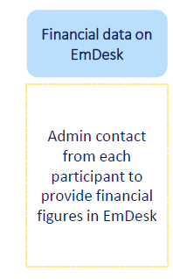
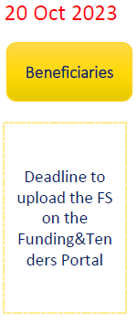
Financial Report (FR)– important deadlines
21 March, 2025
21 April 2025
→ EmDesk platform:
an internal project tool used to collect the information necessary for the
Financial Report. For each partner, the administrative contact
is responsible for EmDesk
Financial Statement
to be uploaded on the EC portal
M.Colonna - EURO-LABS

