Slide 1
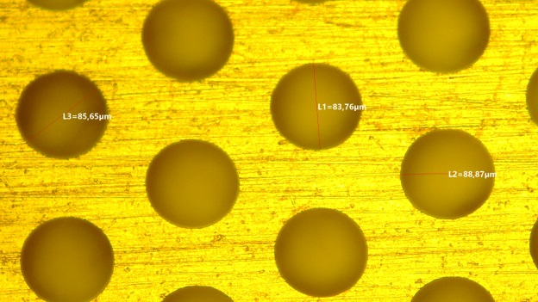
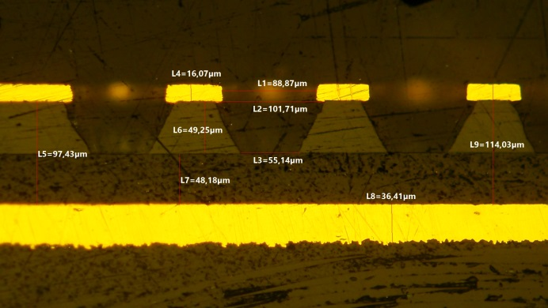
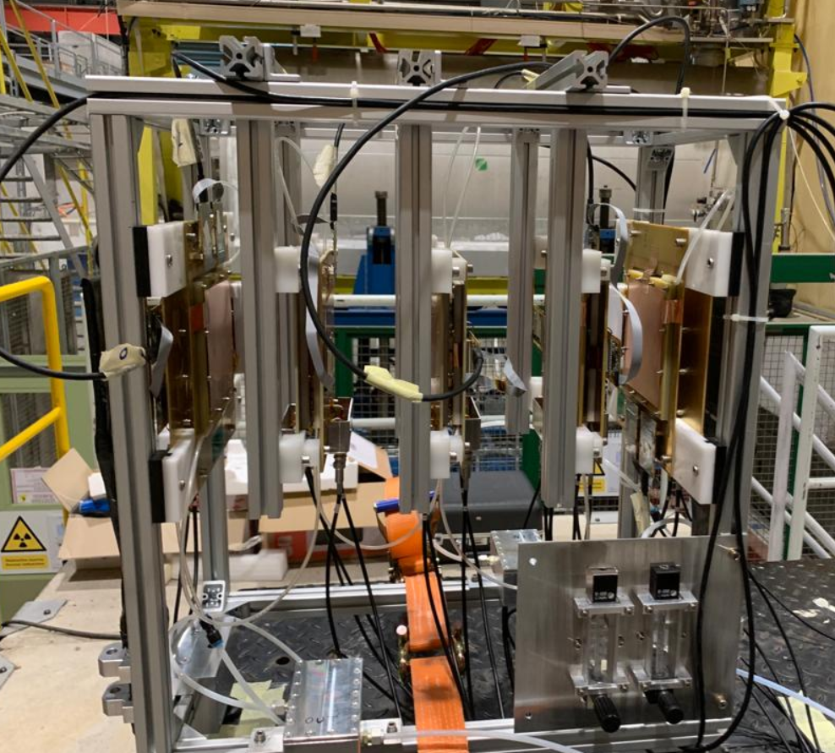
2025 Planning: Detector, FEE, Simulation, TB
Marco Poli Lener
on behalf of INFN – FCC group

Slide 2
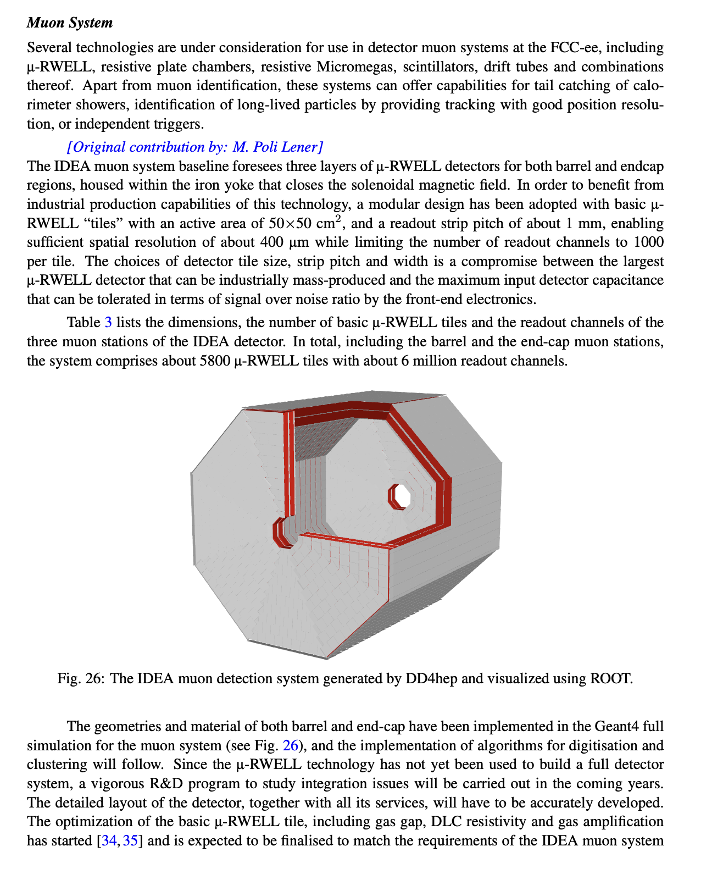
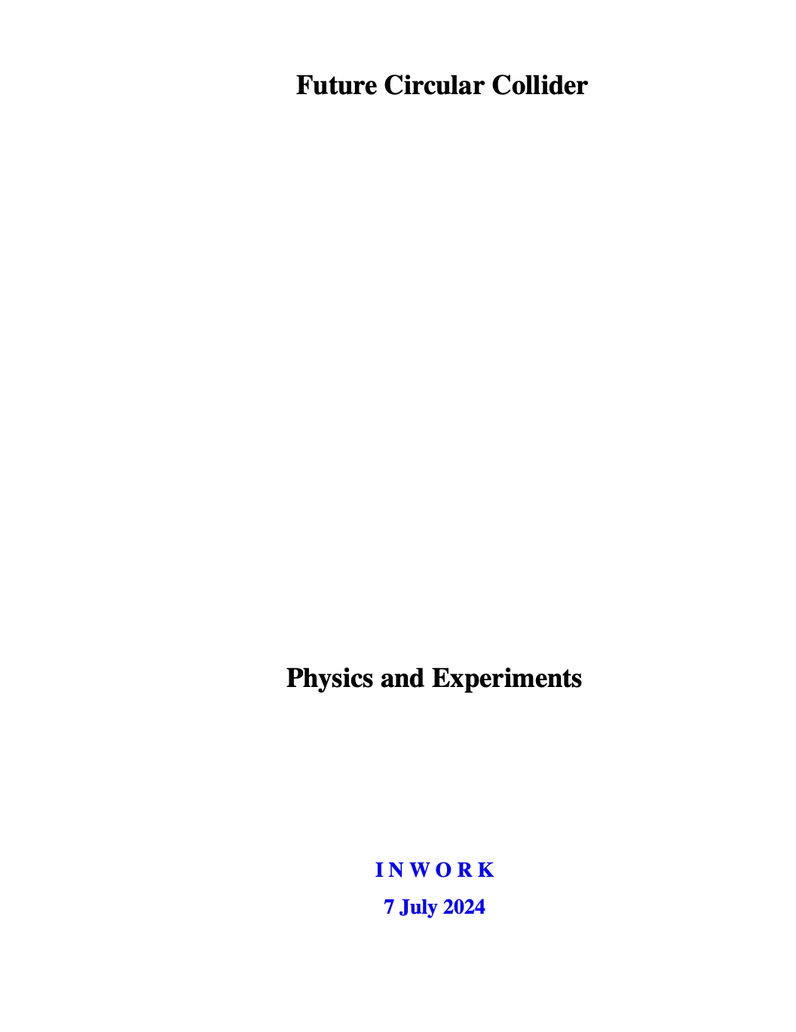
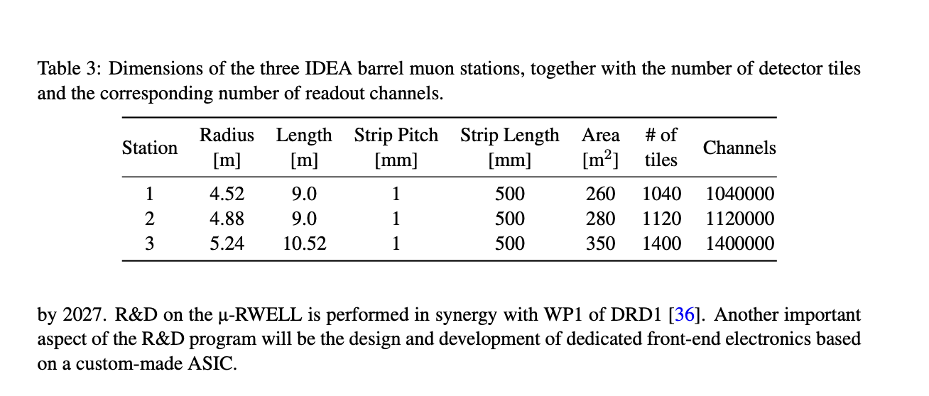
FCC Papers & EOI documents
FCC-PED-Final-Report-Detector-Concepts-branch→ completed
(Paper on all technology suitable for FCC)
1 page for the Muon apparatus

Slide 3
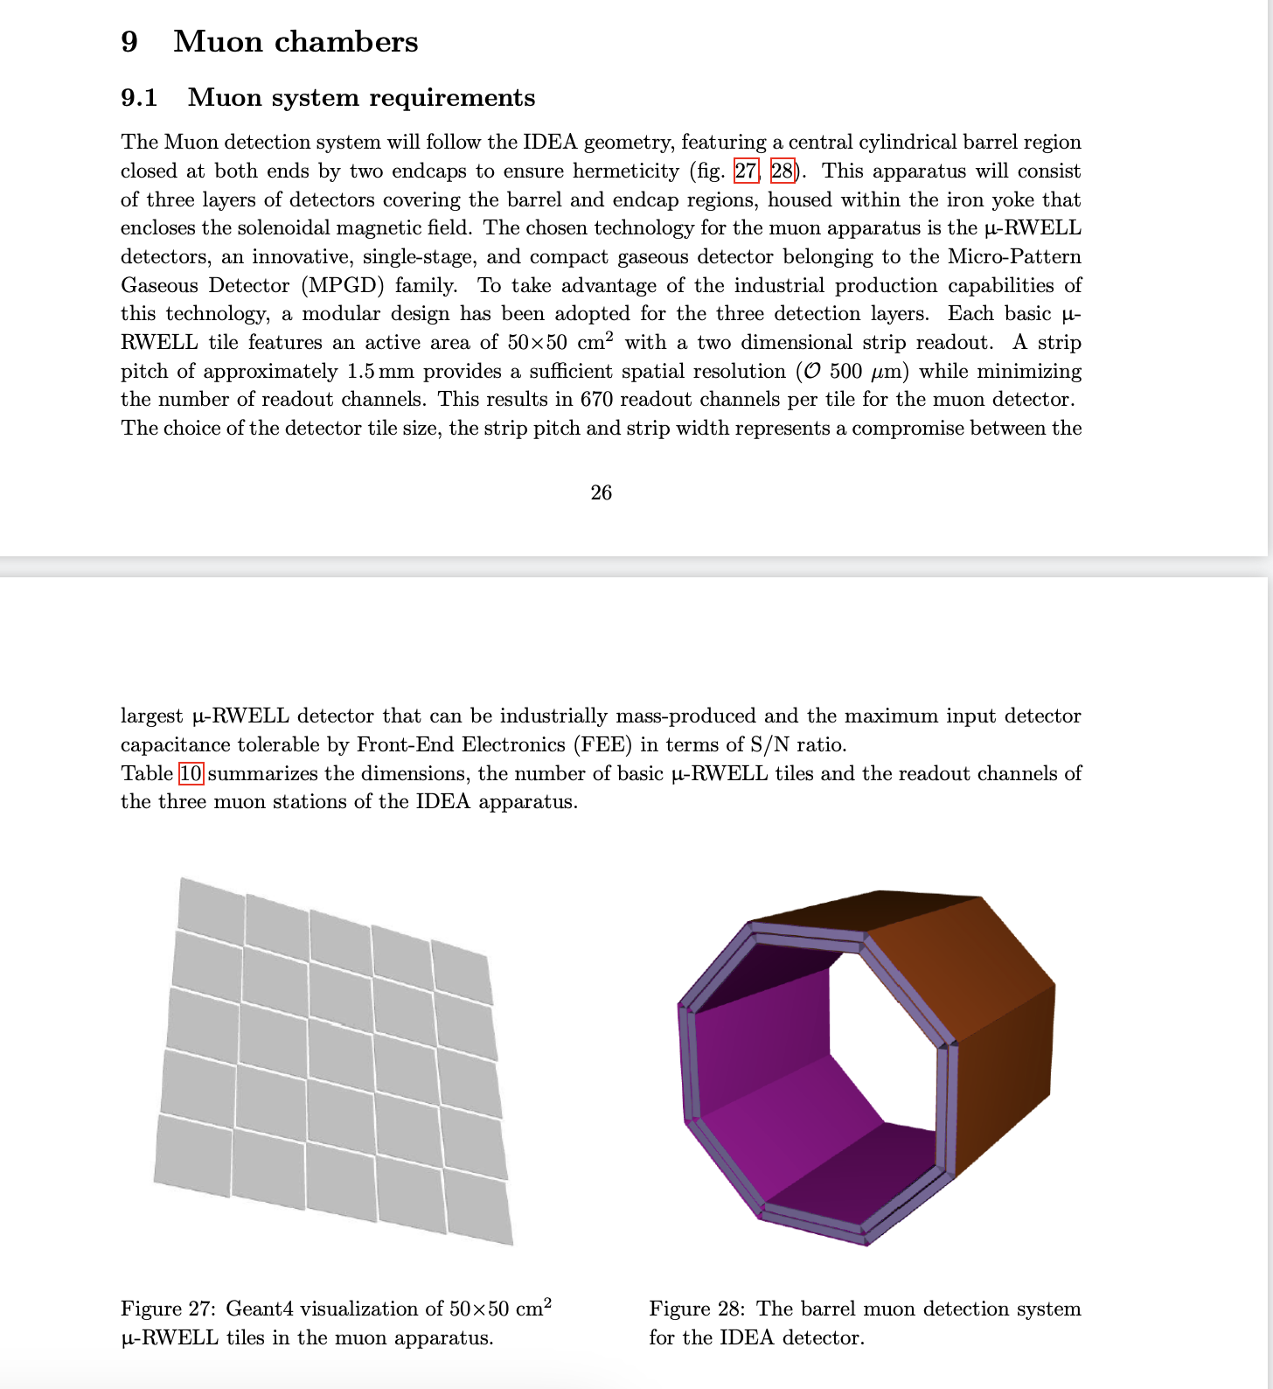
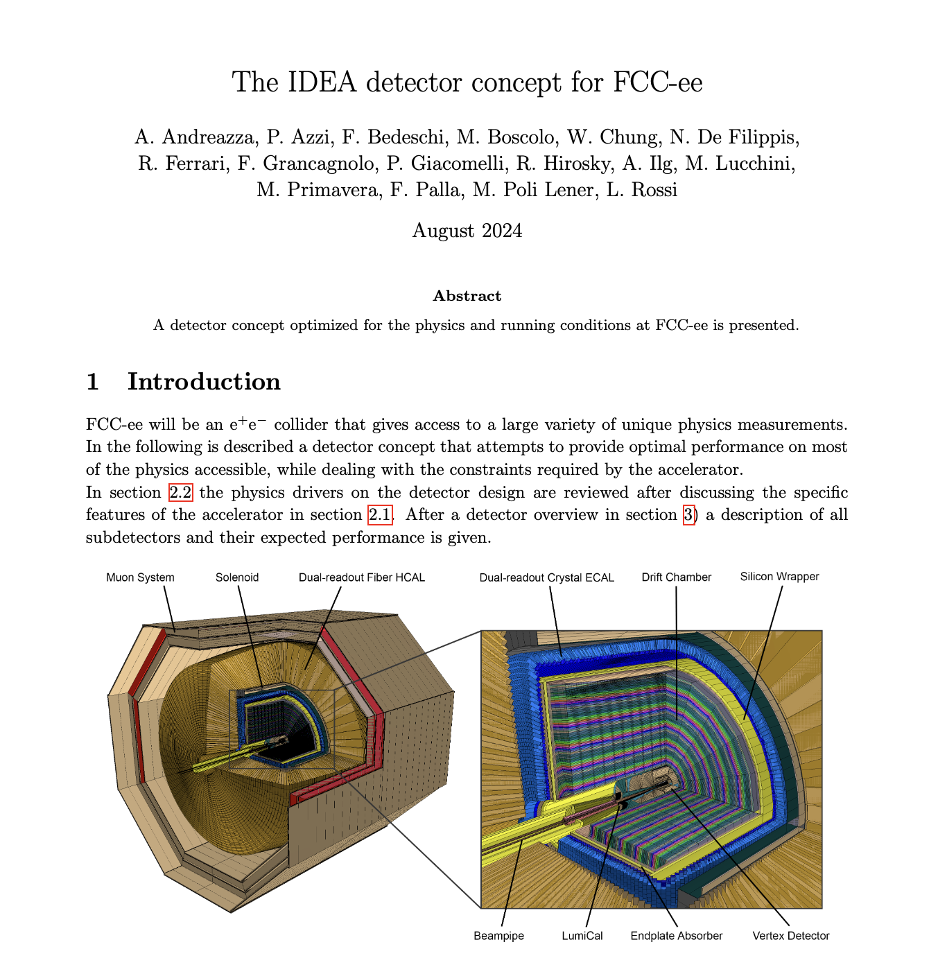
FCC Papers & EOI documents
IDEA_Detector_EUupdate2026 → completed
Paper of IDEA in FCC
10 pages for the Muon apparatus

Slide 4
FCC Papers & EOI documents
2 slides presented @ 8th FCC Physics Workshop – 17 January 2025
https://indico.cern.ch/event/1439509/timetable/#b-597055-satellite-meeting-pre

Slide 5
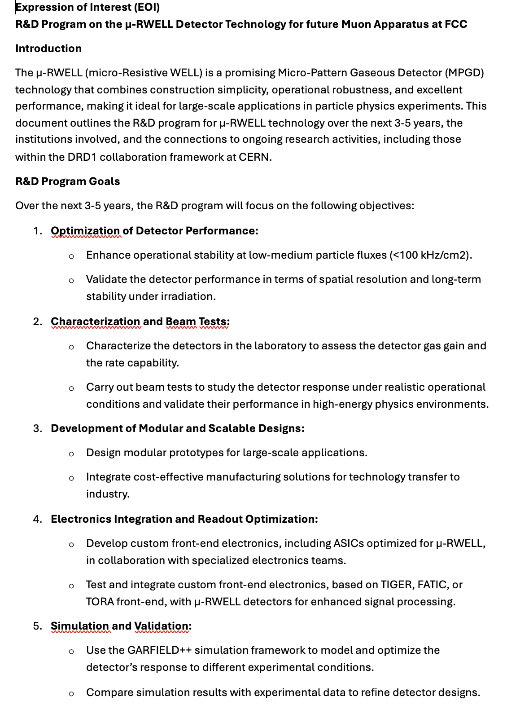
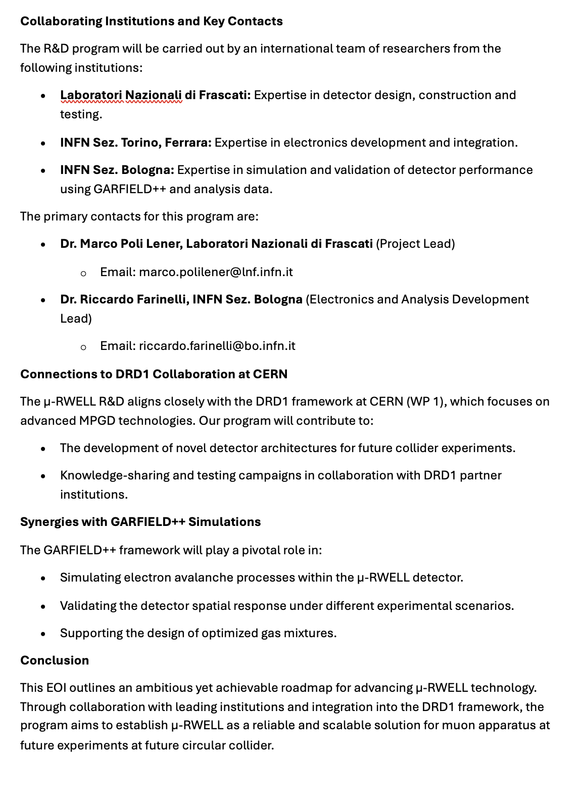
FCC Papers & EOI documents
For the end of January the EOI (2 pages) must be sent to FCC organization

Slide 6
Detector Concept @ FCC (3 proposals)

Slide 7
Designed by Italian groups

Slide 8
Designed by French groups

Slide 9
7 layers of RPC or scintillators bars
Designed by German/Japanese groups

Slide 10
MUONS appartus @ FCC

Slide 11
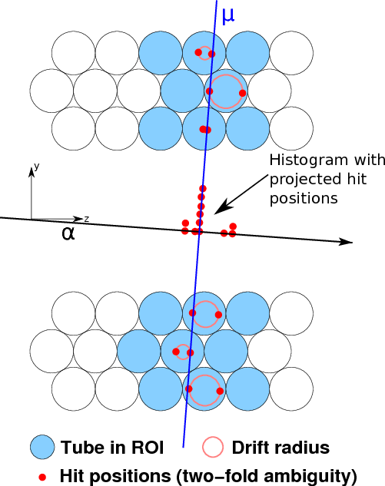
Muon Apparatus
Gaseous detectors have historically been favored for muon detection at colliders like LEP and LHC due to their cost-effectiveness for large areas, good position resolution and robustness.
The detectors are designed for
Muon tagging to echance inner tracker momentum measurements: mm hit resolutions (e.g. ALEPH, OPAL)
Independent muon momentum measurement: ~100 μm hit resolution (e.g.Examples: L3, ATLAS) → not our case
ATLAS MDT muon detector
Decades have passed since the last collider muon apparatus, with significant advancements in detector technologies since then
Micro-Pattern Gaseous Detector (MPGDs):
Micro-Megas and GEM are used for ATLAS and CMS muon detector upgrade in the endcap region to handle the LHC rate
μ-RWELL, an innovative type of gaseous detector, expected to have significantly improved capabilities in high-rate intensity environments such as the HL-LHC.
11

Slide 12
Muon Apparatus @ FCC ( 6 technology EOI proposed)
12

Slide 13
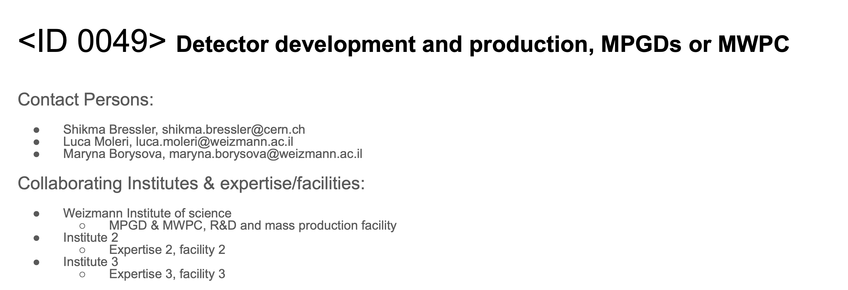
Muon Apparatus @ FCC ( 6 technology EOI proposed)
13

Slide 14
uRWELL in IDEA

Slide 15
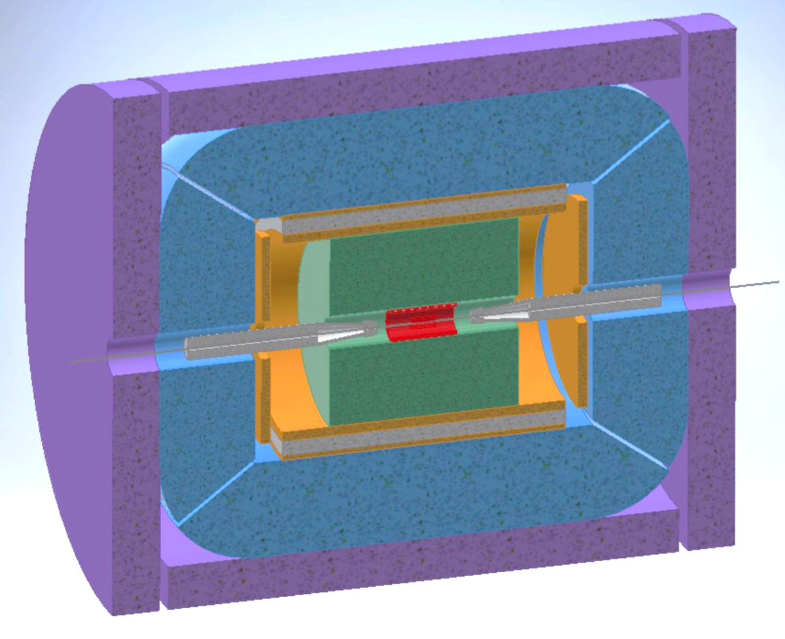
IDEA→ μ-RWELL for muon apparatus
The IDEA detector is a general purpose detector designed for experiments at future e⁺e⁻ colliders.
Pre-shower detector and the Muon system are designed to be instrumented with μ-RWELL technology.
Muon requirements:
Tiles: 50x50 cm² with X-Y readout
Efficiency ≥ 98%
Space resolution
≤ 400 µm (Muon)
Particle Flux
< 1HZ/cm² (Muon)
Instrumented Surface/FEE:
1500 m², 6000 det., 5×10⁶ ch. (1.2 mm strip pitch)
Mass production → Technology Transfer to Industry
FEE Cost reduction → custom made ASIC (TIGER, TORA,…..)
u-RWELL pre-shower replace with EC cristalls
→ to reduce the number of FEE
average over the whole solid angle w/out machine background
Muon system
Reconstruct and tag the muon with 3 - 4 layers in between the iron return yoke and reconstruct LLP
Italian Institute involved: Laboratori Nazionali di Frascati, Bologna, Ferrara, Torino
15

Slide 16
DETECTORS LAYOUT

Slide 17
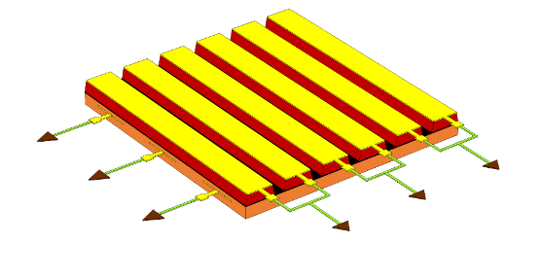
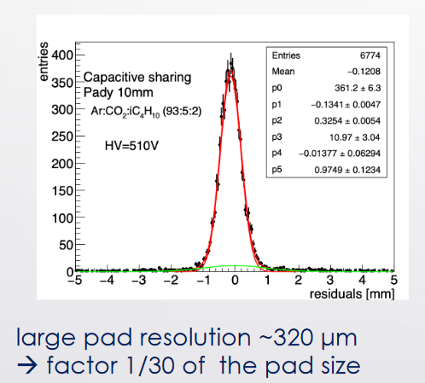
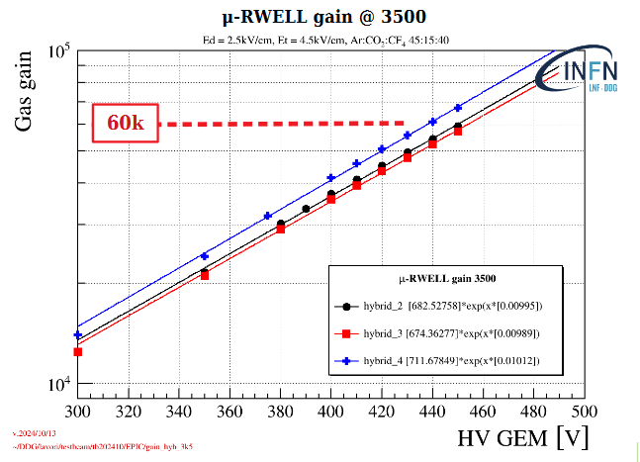
R&D program 2024-2025
Presented to Referees
The production of the 2024 layouts has been delayed due to the increased workload at the Rui’s workshop
Solution under study to increase detector stability:
µ-RWELL "well optimization" → This study was done with GEM detectors but never with uRWELL → well pitch from 140 µm to 90 µm with an increase in gain of about a factor of 2 → ARRIVED
New layouts under study for Pre-shower and Muon systems:
µ-RGroove layout→ new layout, where the amplification stage is not based on the «wells» but on the «grooves». This facilitates the realization of the strip readout on the top, without introducing dead-zones (introduced by Z. Yi in RD51). → ARRIVED with 2 different layouts ( 3 OR-STRIPS, 2 OR-STRIPS both with 400 um)
" µ-RWELL CS" layout with pad readout → new layout, where the readout PCB is not segmented in strips but with pad. This choice allows to collect all the charge on a single readout electrode with a small increase of FFE channels (30%). With pad of few cm2 a spatial resolution of ∼300 um has been achieved (introduced by M. Iodice in RD51) → WILL BE PRODUCED IN THE FIRST PART OF 2025
"GEM + µ-RWELL CS" (strip)→ GEM pre-amplification stage, to lower the operating point, greatly improving the RWELL stability and maintaining high spatial performance with millimetric pitches. GEM production will be produced in January 2025 → GEMs PRODUCED IN THE FIRST PART OF 2025
(Hybrid) CS µ-RWELL 50X50 CM2 → → GEMs PRODUCED IN THE FIRST PART OF 2025
2D-readout (XY) μRGroove
Y strips
X strips
Z. Yi
M. Iodice

Slide 18
R&D Summary
Layout | Advantage | Disavantage | Note
2 x 1D µRWELL | -Huge efficiency plateau (∼ 140 V) -High spatial resolution | -Doubles the cost of the detector - Layout only for the pre-shower | TB 2022
Top readout | -Large efficiency plateau (∼ 90 V) -High spatial resolution | -Low detection efficiency due to dead zone in the active area (70%) | TB 2023
CS µRWELL with strip readout | -FEE channels reduction -Matches very well the Muon requirements | -Reduced efficiency plateau (∼ 50 V) | TB 2023
µRGroove with strip readout
CS µRWELL with pad readout
Hybrid- CS uRWELL with strip readout

Slide 19
Test Beam

Slide 20
Possible Setup
No angle scan
uGroove
CS a pad
#2 uGrooves
#2 CS a pad
S1
S2
S1
S2
TRK
Hybrid CS
TRK
REF
#2 Hybrid CS
REF
# FEE boards/HV ch.:
TRK strip (?). → 8 FEB/8 HV neg.
uRGroove strip → 4 FEB/1 HV neg. & 1 HV pos.
Hybrid CS strip → 2 FEB/4 HV neg.
CS a pad → 1 FEB/2 HV neg.
→17 FEB/15 HV neg. & 1 HV pos.
# FEE boards/HV ch.:
uRGrooves strip → 8 FEB/2 HV neg. & 2 HV pos.
Hybrid CS strip → 4 FEB/8 HV neg.
CS a pad → 2 FEB/4 HV neg.
REF a pad → 2 FEB/4 HV neg.
→ 16 FEB/18 HV neg. & 2 HV pos.

Slide 21
FRONT END

Slide 22
Richiesta finanziaria 2025 (Fe/To): Setup di test ed integrazione elettronica
Presented to Referees
Produzione FEB per TIGER -> 4 k€ SJ Produzione DLVPC per TIGER -> 3k€ SJ Il recente TB con µRWELL e TIGER e la sua futura analisi dati definirà la attuale baseline di performance. In parallelo il nuovo setup di integrazioni pianificato a Bologna è finalizzato a produrre nuovi schemi per il miglioramento dell'integrazione tra rivelatore ed elettronica. La produzione di nuove FEB e DLVPC sono quindi dipendenti dalle indicazioni che seguiranno dalle precedente attività e dalla finalizzazione del design. Produzione FEB per TORA -> 3 k€ SJ presso la sezione di Torino si sta finalizzando la modifica di un chip già in uso ai fini della lettura di rivelatori a gas innovativi, fra cui micromegas e uRWELL. In funzione di possibili attività future si vuole iniziare una caratterizazione di questo chip, il cui design è affine a TIGER, con il nostro sistema attuale e futuro. La richiesta è SJ alla disponibilità del nuovo chip TORA ed alla finalizzazione del suo pcb di lettura.

Slide 23
Richiesta finanziaria 2025 (Bo): Setup di test ed integrazione elettronica
Presented to Referees
Si richiedono 6.0 k€ per la costruzione di un setup ex-novo per testare l’elettronica TIGER esistente e confrontarla con le nuove FEB che verranno prodotte durante il 2025. L’attività di questa richiesta è focalizzata a studiare il sistema nel suo complesso, tenendo in considerazione il rivelatore, l’elettronica e tutte le sorgenti di rumore associate alla meccanica di supporto, il power supply e la catena di lettura.
0.5 | k€ | Filtri RCR tra mainframe CAEN e detector con shield
0.5 | k€ | Sistema di distribuzione HV con filtri
1.0 | k€ | Cavi SHV
2.0 | k€ | Meccanica ITEM di supporto ed isolamento del sistema detector e power supply
0.5 | k€ | Barre di rame per grounding e treccia di massa per grounding
0.75 k€
Multimetro per misurare le dispersioni di corrente
0.75 k€
Minuterie (ferrite, cavi di messa a terra 4mm, connettori, distanziali isolanti) Faraday cage per elettronica
Faraday cage per rivelatore
Messa in sicurezza delle connessioni HV

Slide 24
FEE discussion
Possible FEE for uRWELL:
TIGER → Status & Plans
TORA → Status & Plans
Other possibility

Slide 25
SIMULATION

Slide 26
8th FCC Physics workshop
Mahmoud Ali
Delphes study: Tracks from Standalone Muon-system
Tests have been done by emulating LLPs decays in two muons in the calorimeter volume @ 3.5 m away from the IP, muon maximum P_{T} =45 GeV.
10 K events → 20 k muons.
Cuts on the selected events:
- Choosing only events have two muons at final states.
- Maximum P_{T} =100 GeV for combined two muons.

Slide 27
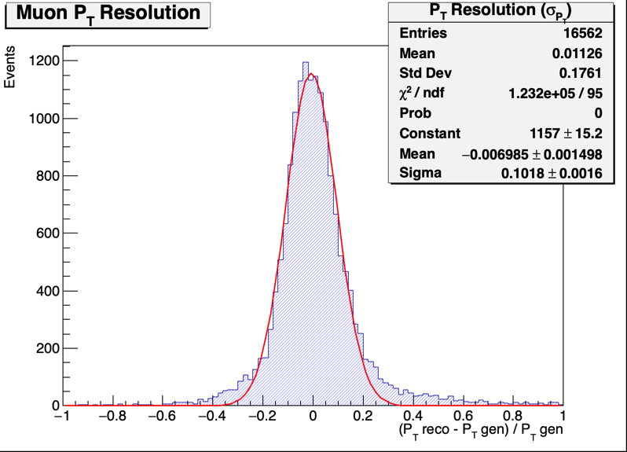
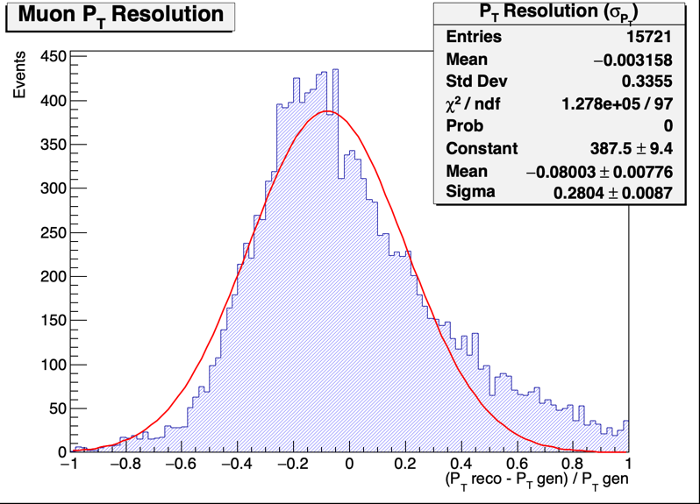
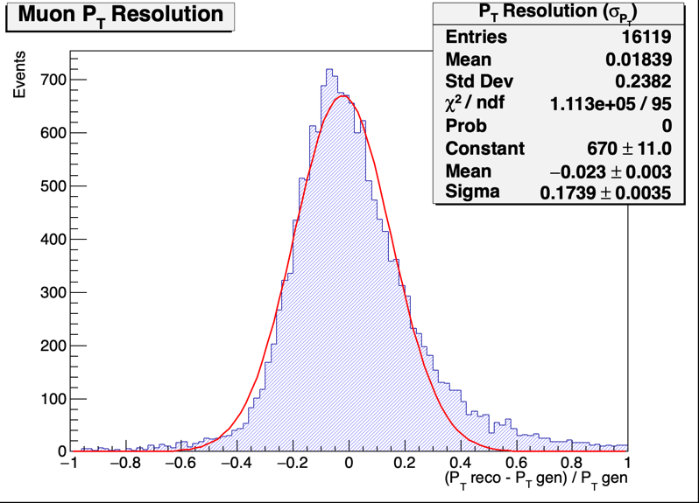
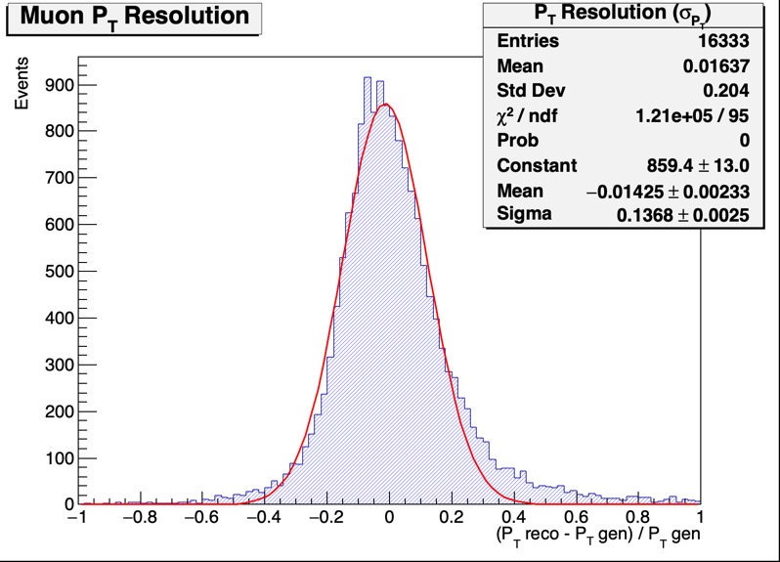
8th FCC Physics workshop
Mahmoud Ali
Delphes study: Tracks from Standalone Muon-system Varying number of Detector layers:
All 400 µm space resolution
The primarly design of IDEA muon-system consists of 3 detector layers and 2 return yokes.
6 Layers
10 cm
30 cm
3 Layers
4 Layers
5 Layers

Slide 28
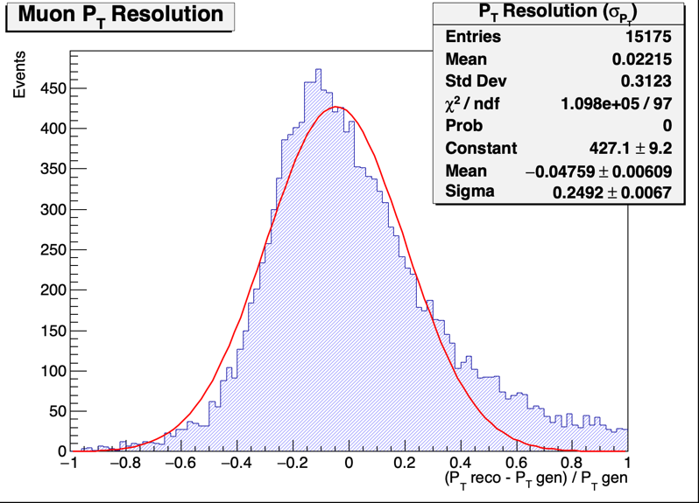
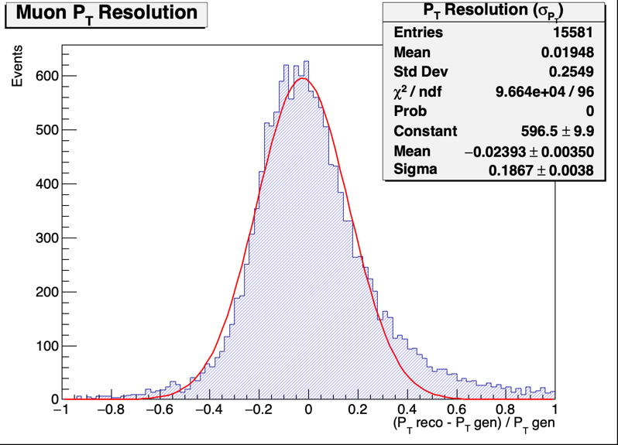
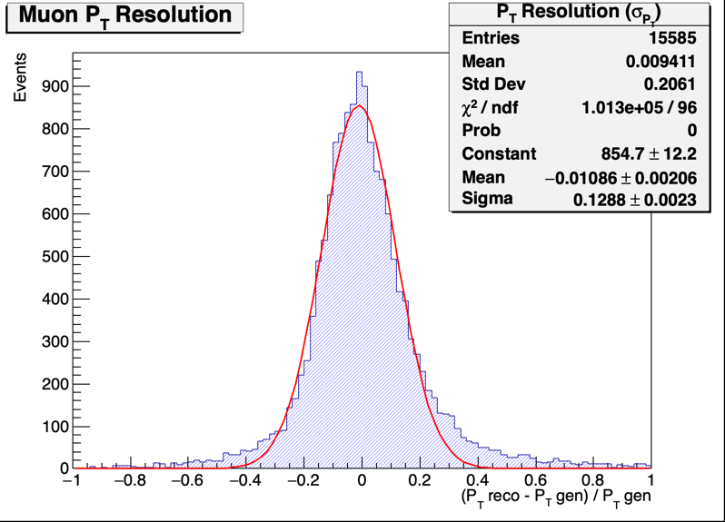
8th FCC Physics workshop
Mahmoud Ali
Delphes study: Tracks from Standalone Muon-system
Varying level arm distance:
All 400 µm space resolution
The distance between every two detectors layers
10 cm
50 cm

Slide 29
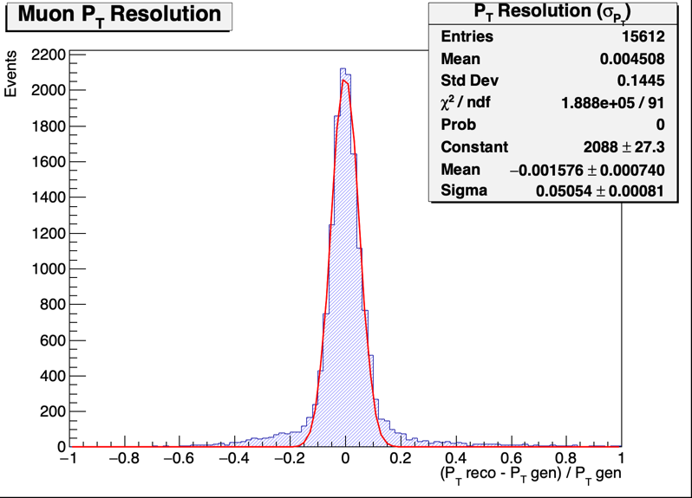
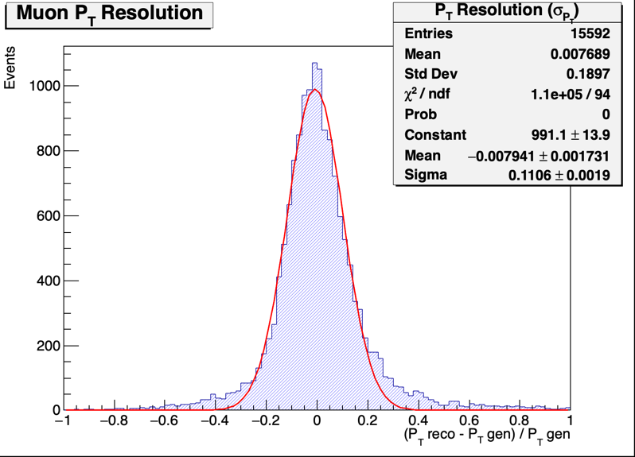
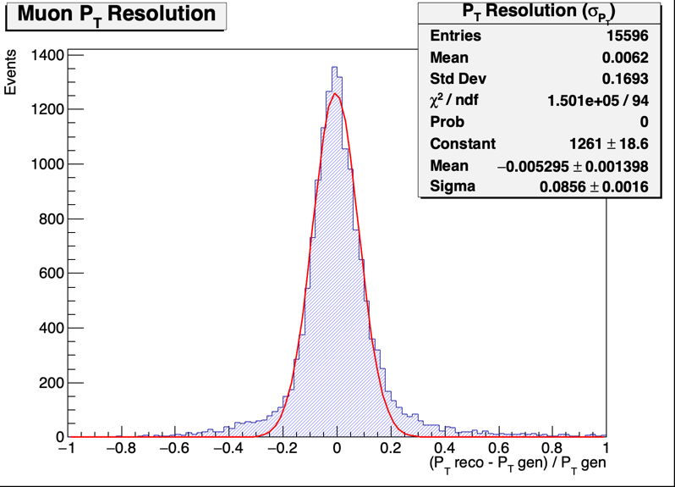
8th FCC Physics workshop
Mahmoud Ali
Delphes study: Tracks from Standalone Muon-system
Varying detector space resolution:
4 Layers with level-arm = 50 cm, and only two yokes.
100 µm
400 µm
300 µm
200 µm

Slide 30
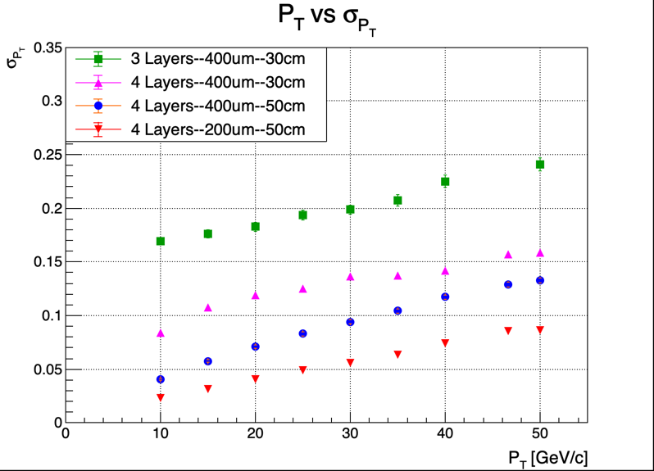
8th FCC Physics workshop
Mahmoud Ali
Scanning over transverse momentum:
To summarize, 4 different muon-system apparatuses in comparison.
# Layers – detector space resolution- level-arm distance(cm).
Full-SIM: Standalone Muon-system Reconstruction
The plan is to start from the dd4hep implementation of IDEA detector and adopting CLD tracking on our IDEA muon-system.
Applying surface plugin to be able to use it in DDPlanarDigi. Which will smear the hit positions.
The using the output as an input to SiliconTracking_MarlinTrk.

