Slide 1

Project Repository @ CERNBOX
From discussion and first tests with Barbara

Slide 2
Project Repository
Working disk space to store project datafiles
Which files?
  TA data:
    excel files
    project description (doc or word)
  Periodic Report files and data
    For the PR2 we said to move towards using Overleaf
    we can fetch the data from overleaf and store it here for reference and easier access with regular updates
    More on the PR and Overleaf later….
Do you think/need of something else?

Slide 3
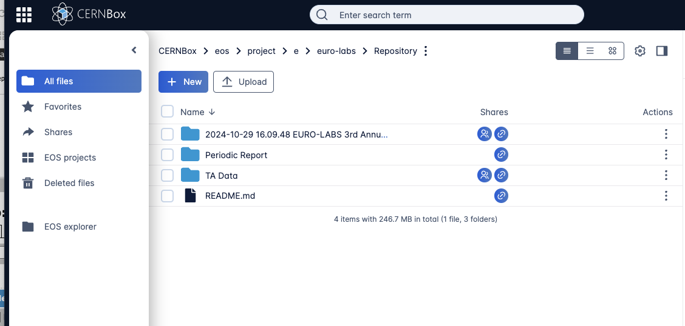
The repository
Created in CERNbox space as euro-labs project
How to access it?
  From inside CERN/linux boxes as : /eos/project-e/euro-labs/Repository
  Through the CERNbox web interface:
    you will receive or have already received invitation e-mail

Slide 4
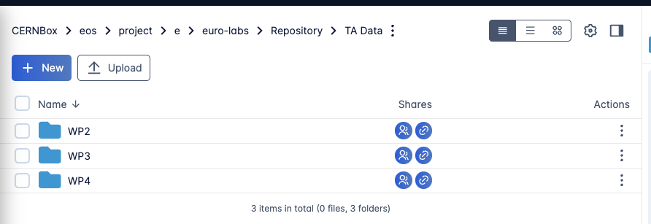
TA-Data – structure 1st level
Folders per WP
Access rights for the FC can be configured per WP
  no visibility between the WPs, mainly to avoid mistakes

Slide 5
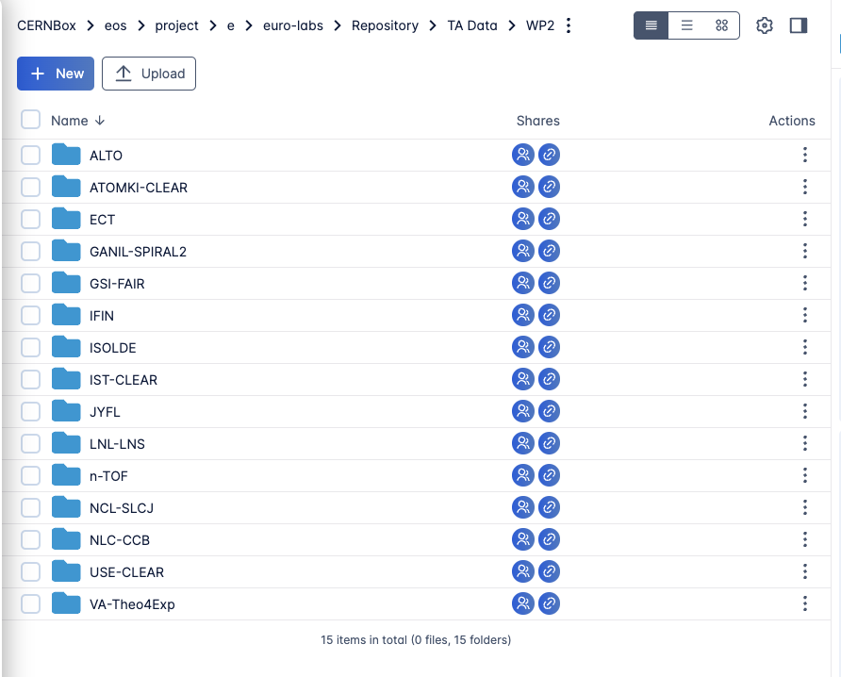
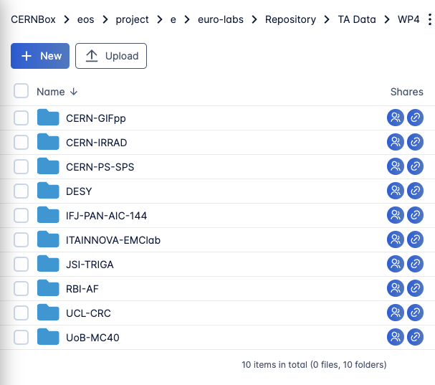
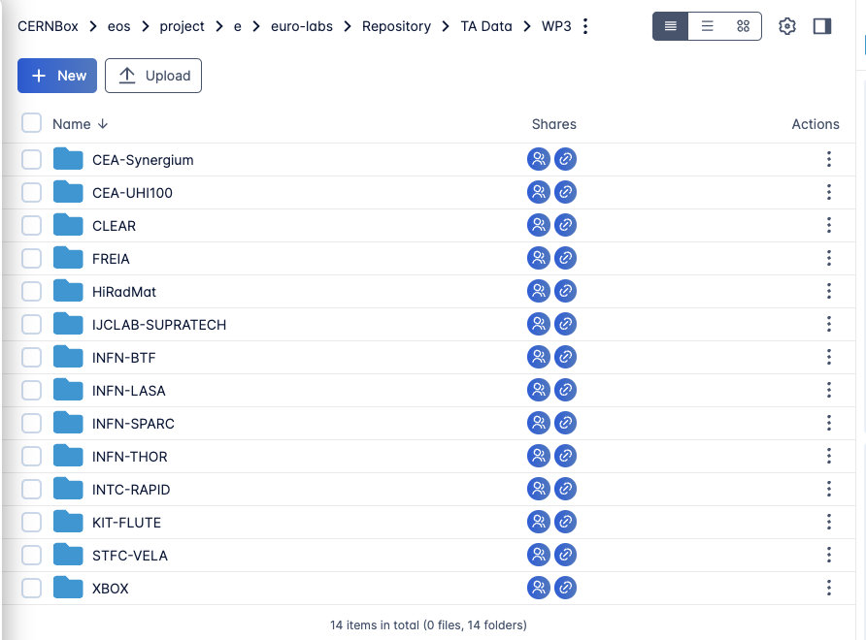
TA-Data – structure 2nd level
Folders per facility
  I used the Facility names as presented in the WP reports in TAM
WP2
WP3
WP4

Slide 6
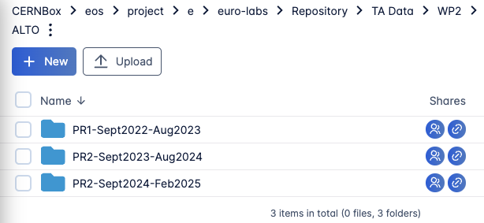
TA-Data – structure 3rd level
Option A: Per periods
  see the example here from ALTO
  Pros:
    gives some freedom on the file names
  Cons:
    needs some work to setup these sub-folders in all facilities…
Option B: simple list and use the file names: ALTO-2023-<expID>.xlsx, ALTO-2023-<expID>.pdf
  Pros:
    Less work to setup the sub-folders
  Cons:
    Might be difficult to separate files per PRr
Whatever we decide, some discipline must be enforced (by the WP coordinators?)

Slide 7
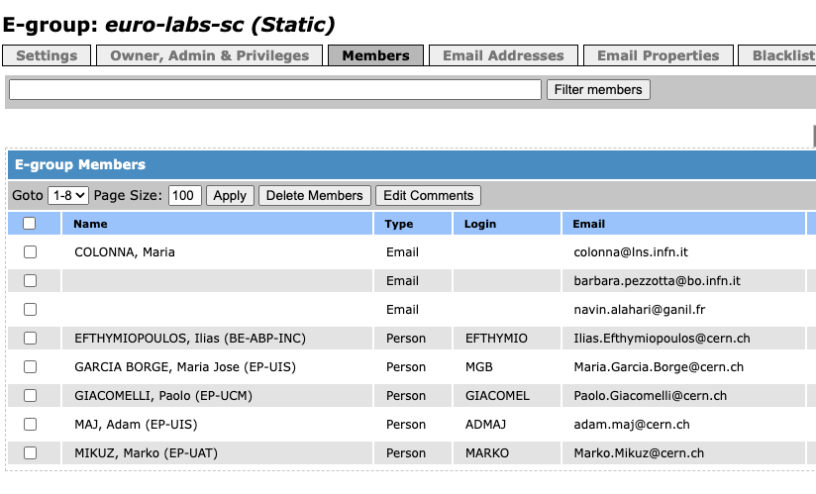
The repository - Access
At top level editor access to the SC members
  propagated to all sub-folders
  give access rights to the sub-folders
Editor access to the FC per WP folder
  the FC could see all files from other facilities within the WP
  the (disciplined) FCs should manage the files only in their folder: upload, edit, rename, delete…
  there is no issue with personal data as anyhow all information will be eventually uploaded to the EC portal, where each partner has access to all data
More complicated access restrictions can be applied but why?
Note: I used your CERN e-mails if available. Only using those you can have access to the repository.
Someone else I missed?

Slide 8
Next steps
We must converge to the repository asap (today!), as we announce it at the TAM and people expect to upload their files by November 15th
Invite the FC to upload the data for the COMPLETED projects in the reference period (excel and pdf)
To unload some work from Barbara, I can setup a script to:
  check the excel files and in case of errors send e-mail(s) to the FC (and/or WPC?)
    I can send e-mails every hour until they correct it! 🤣🤣🤣
  And if interested:
    fill the summary tables with the list of projects for the report
    harmonize the excel files to a single unique version (also including the old ones from PR1)
    prepare anonymous data for statistics

