Slide 1
An argentinian guide to understand inflation
Iván Queirolo
Instituto Sábato, UNSAM / Sapienza, Università di Roma
Notes:
Cotutela con Italia
Silvia Masi
Al menos dos estadias de seis meses en Roma
comencé el primero de diciembre

Slide 2
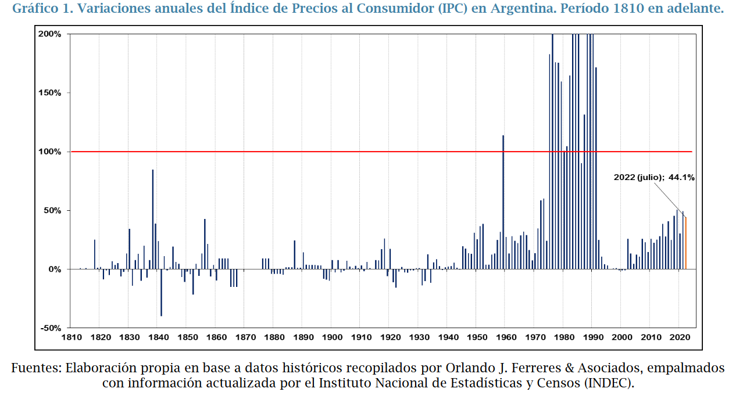

Slide 3
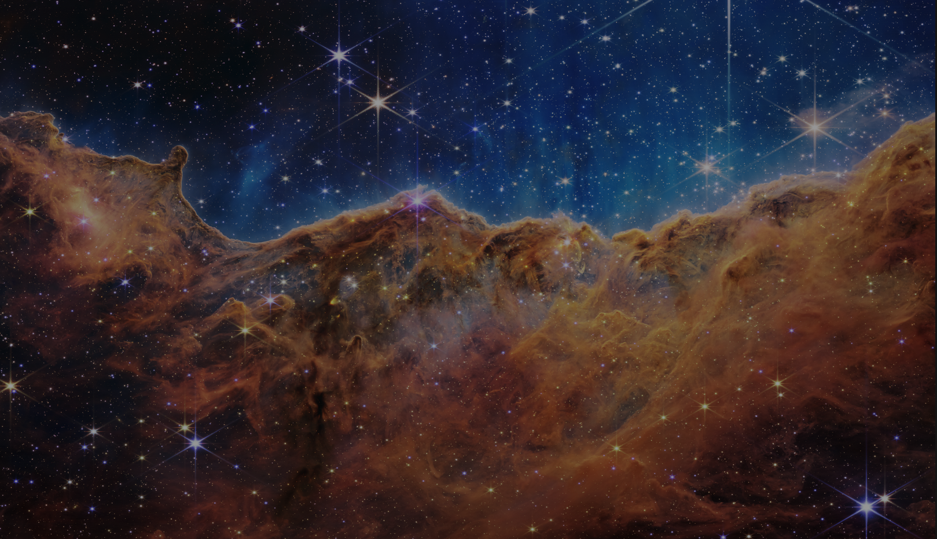
The talk
Big Bang Model
Problems of the model and new hypothesis
How do we measure?
QUBIC

Slide 4
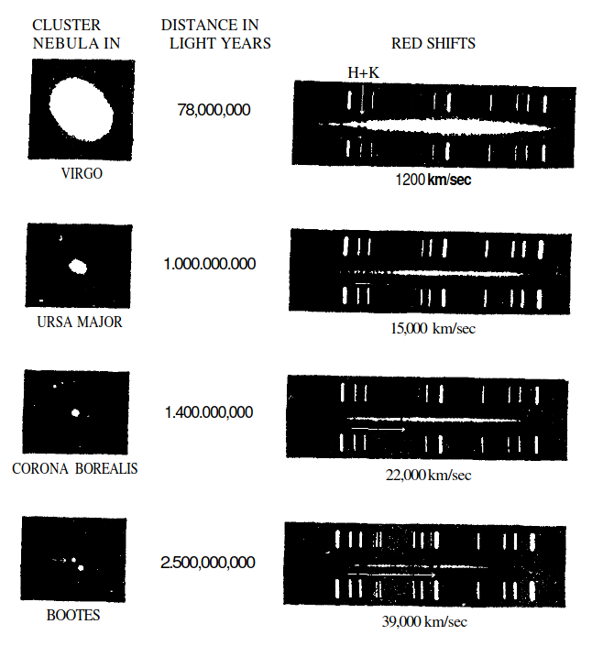
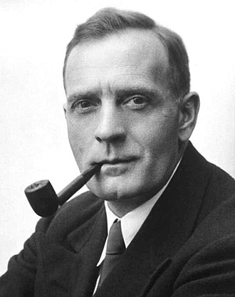
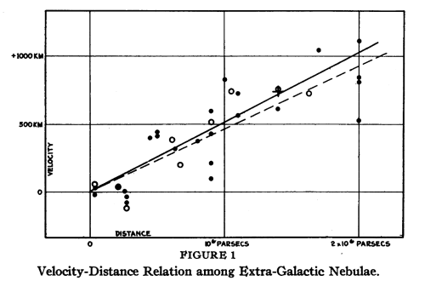
Universe expansion

Slide 5
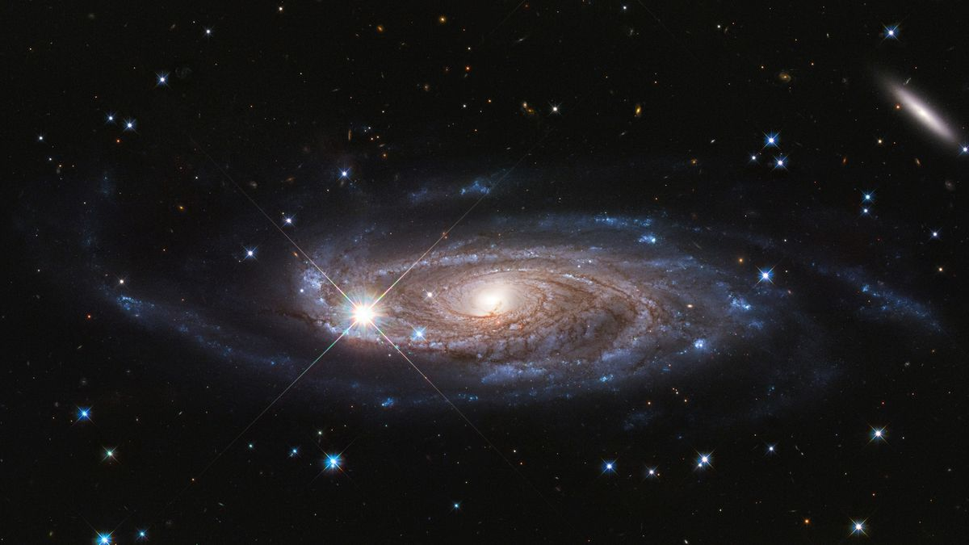
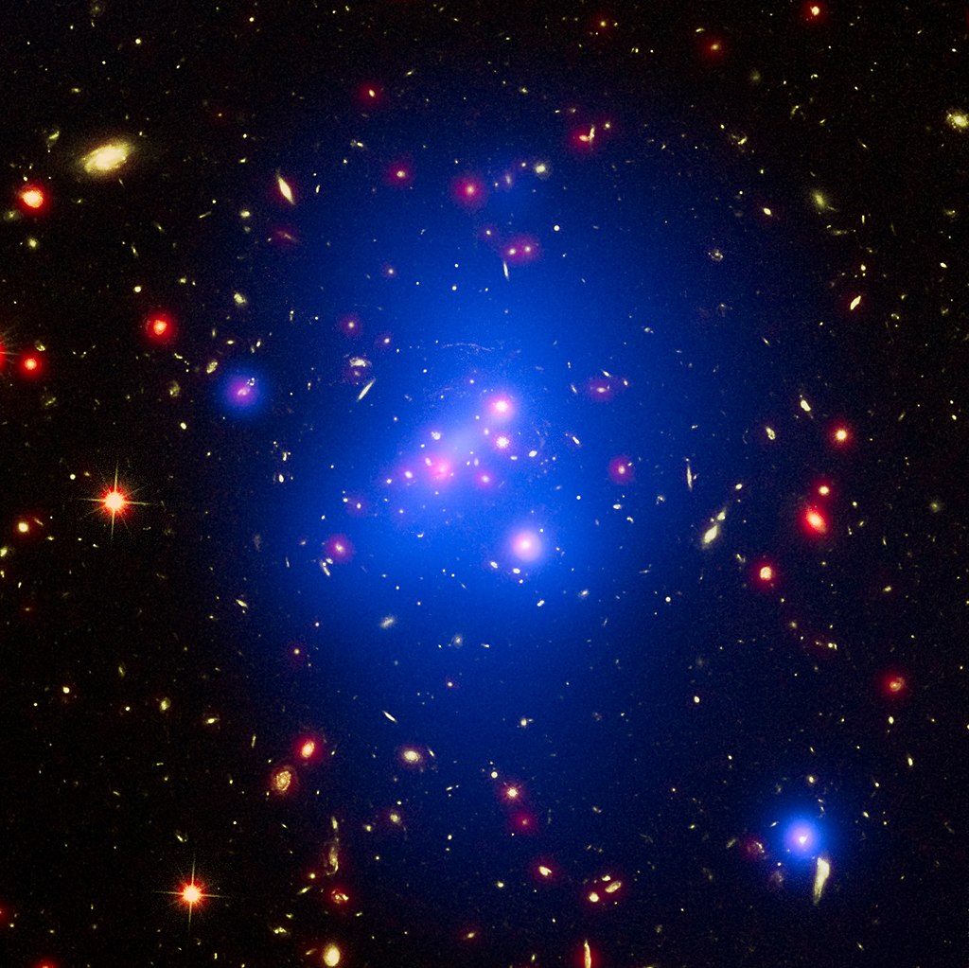
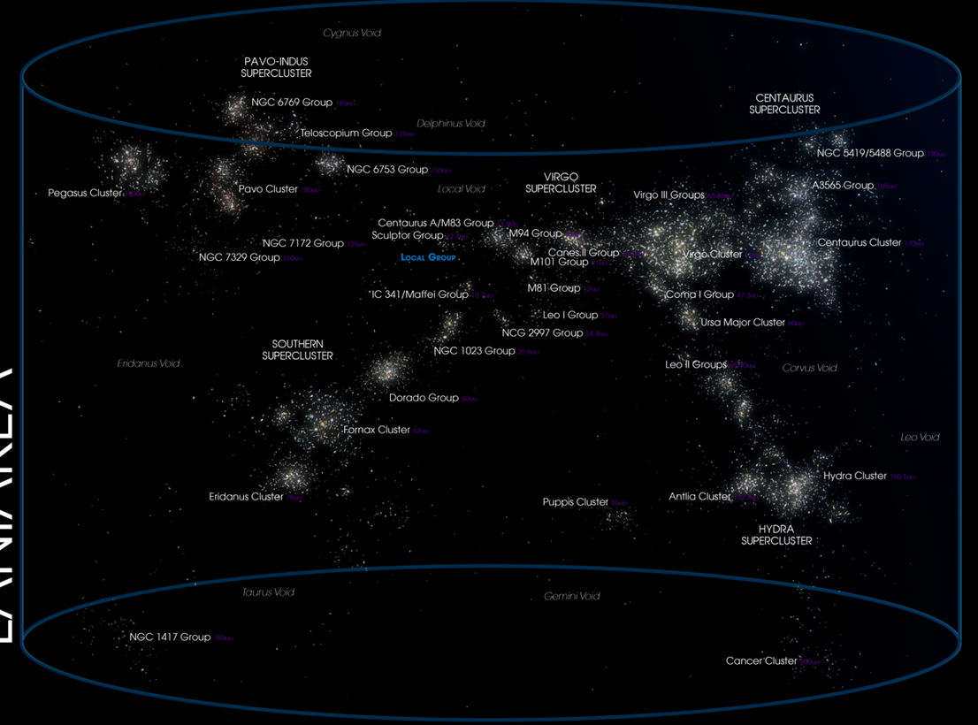
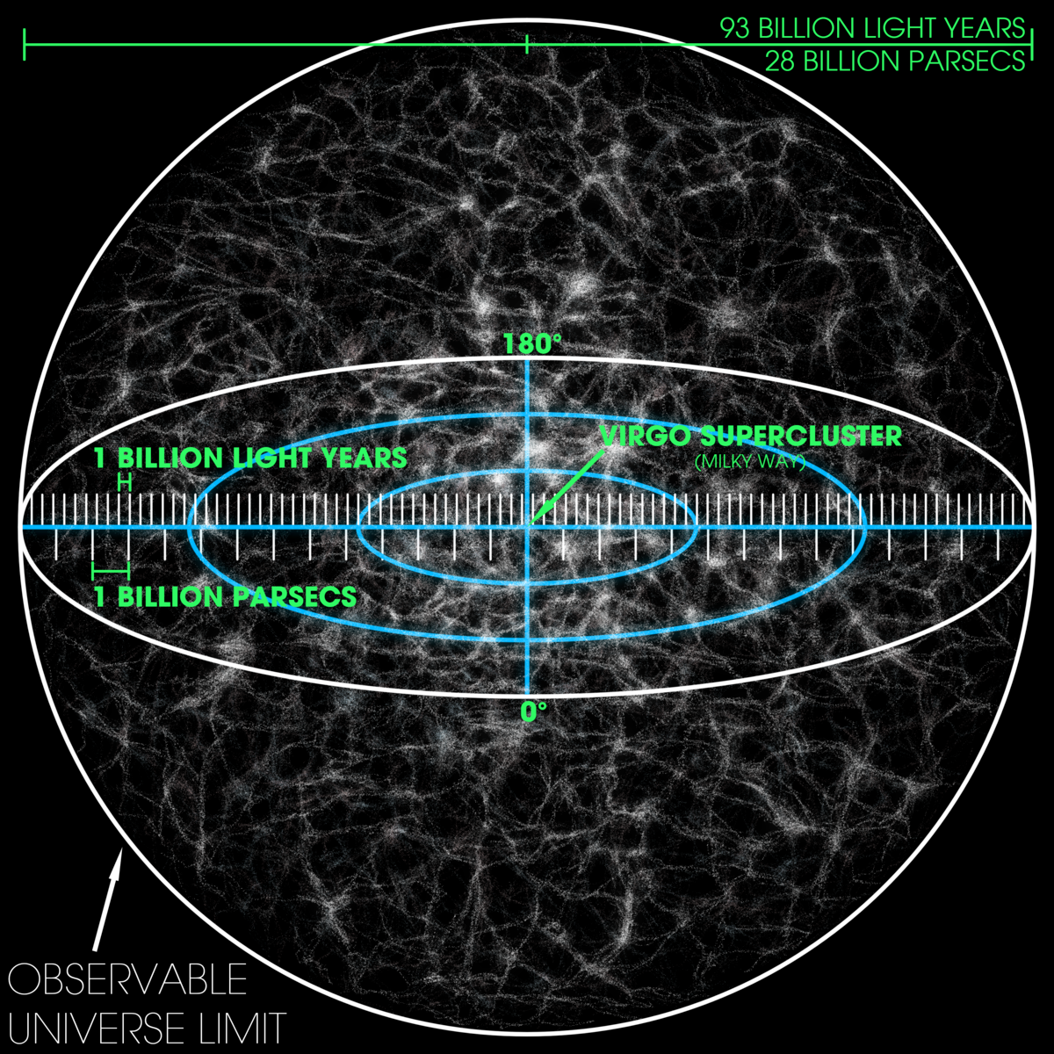
What are the distances in a cosmological scale?
10 kpc
1-10 Mpc
100 Mpc
14 Gpc
10 zeros more than average distances between stars
→ We can assume it is a fluid
OBSERVABLE Universe =/= Universe

Slide 6
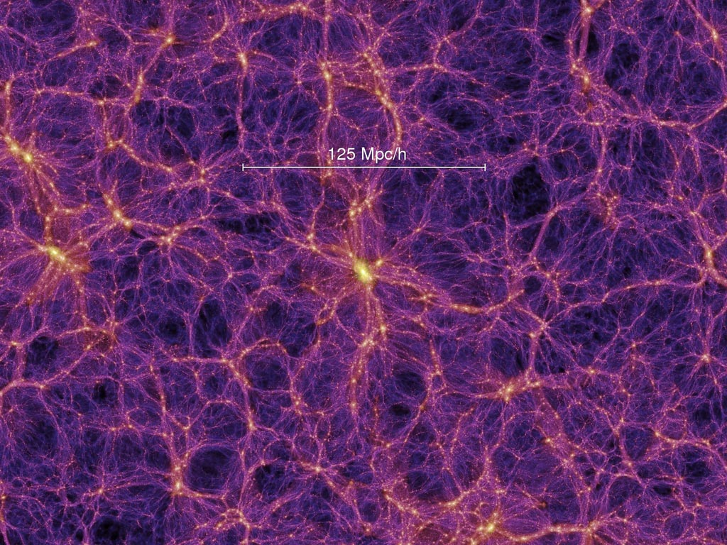
Our vision of the universe before 1920
Isotropic→ we see the same in every direction
→
Homogeneous → Constant density in every part
Friedmann-Lemaître-Robertson-Walker (FLRW) →
Einstein eqs→ Eqs for scale factor a(t)
We can see its expanding, so what if we go back in time → BIG BANG

Slide 7
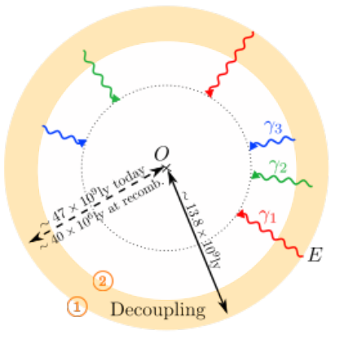
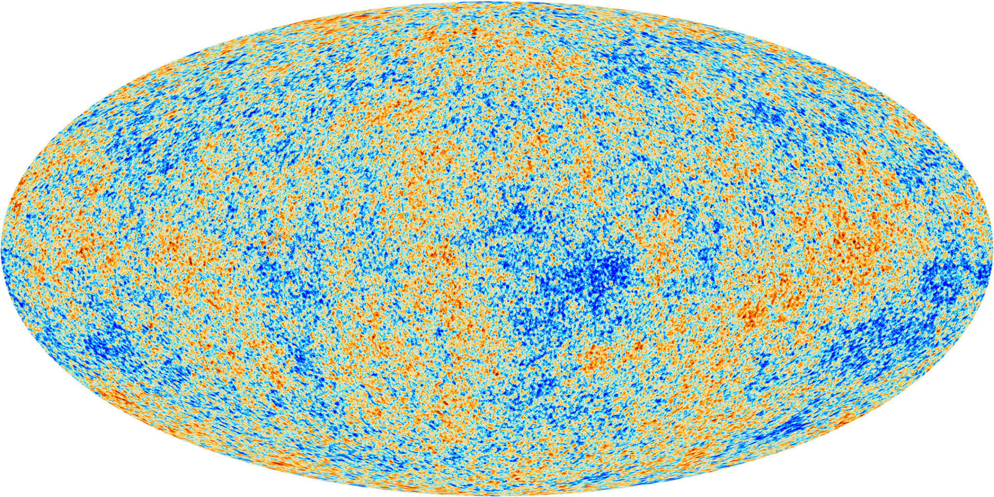
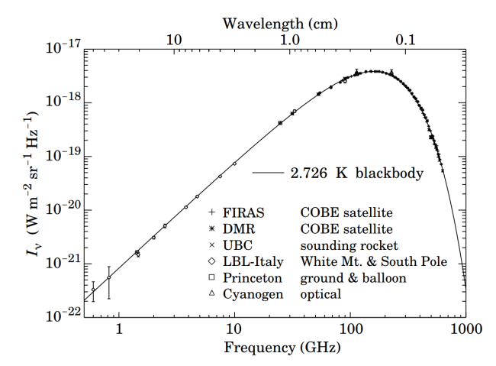
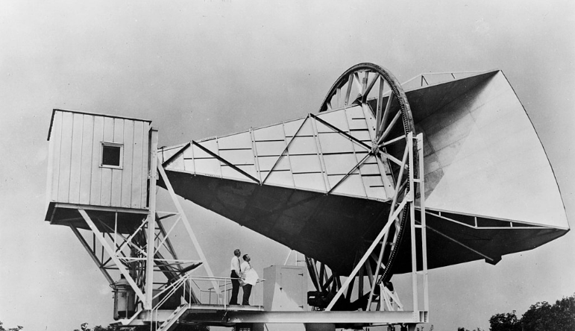
The Hot Big Bang Model
Planck (2018)
Plasma is interacting A LOT.
At some point photons can move freely without interacting
Penzias and Wilson in front of their
radio antenna (1964)

Slide 8
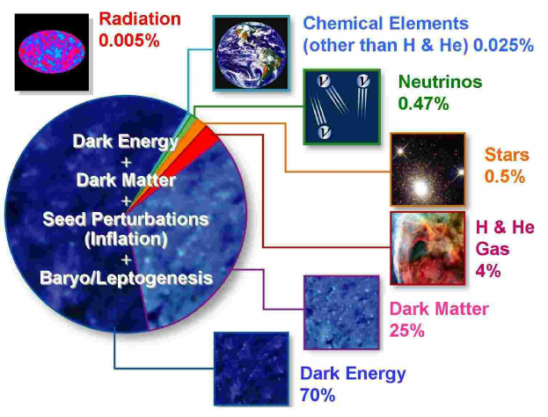
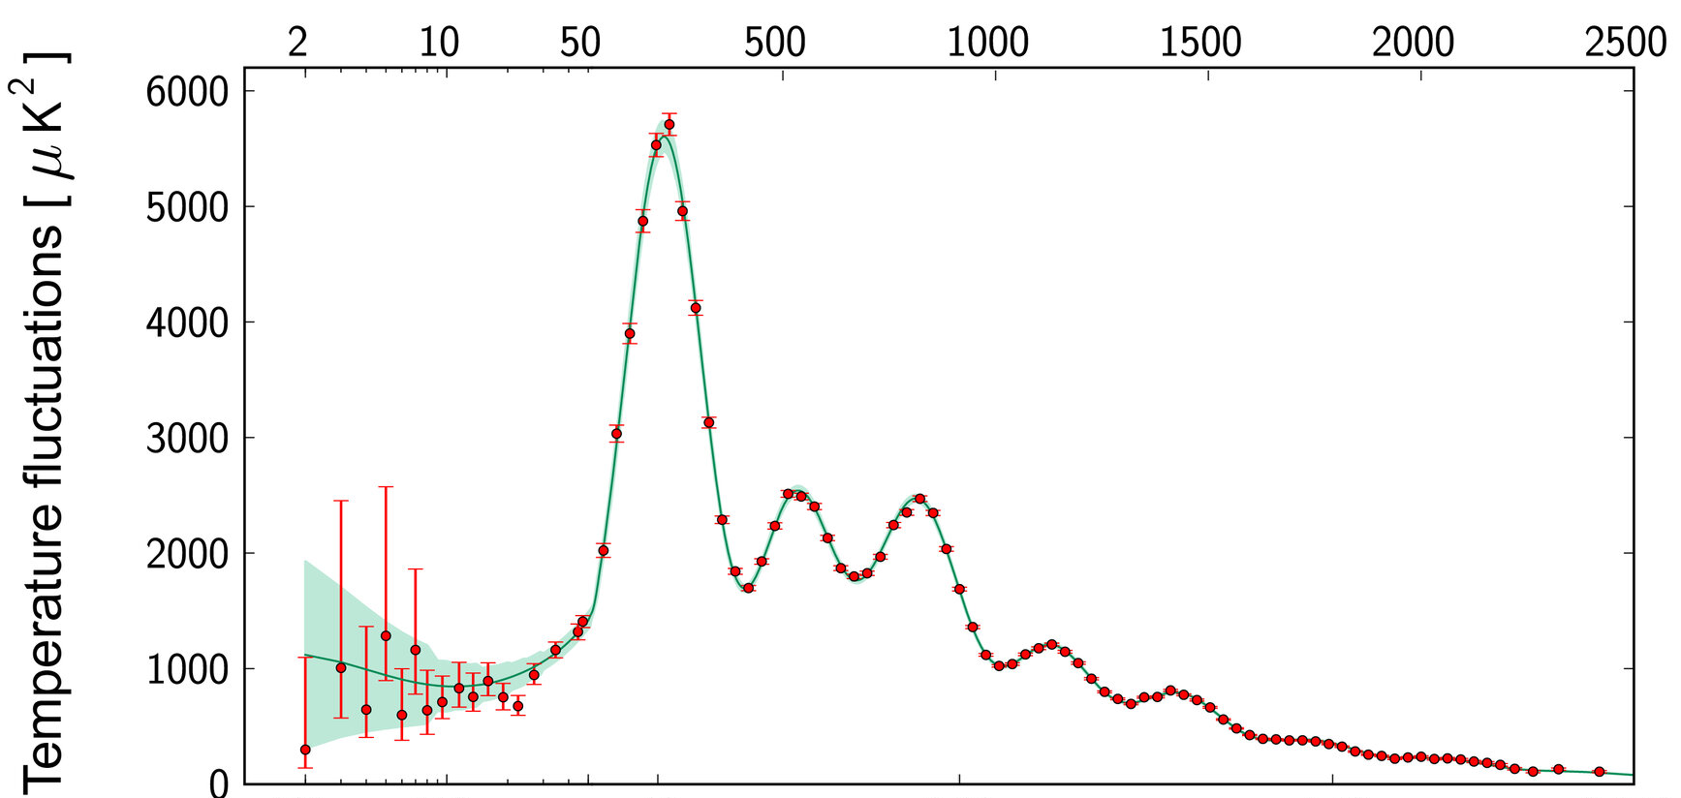
What about the predictions of the model?
Big bang nucleosynthesis → the observed abudance matches the predictions of BBN
Accurate measurement of the E-mode polarization of the CMB
Accurate modeling the high-precision CMB angular distribution measure by the Planck mission
Not this yet

Slide 9
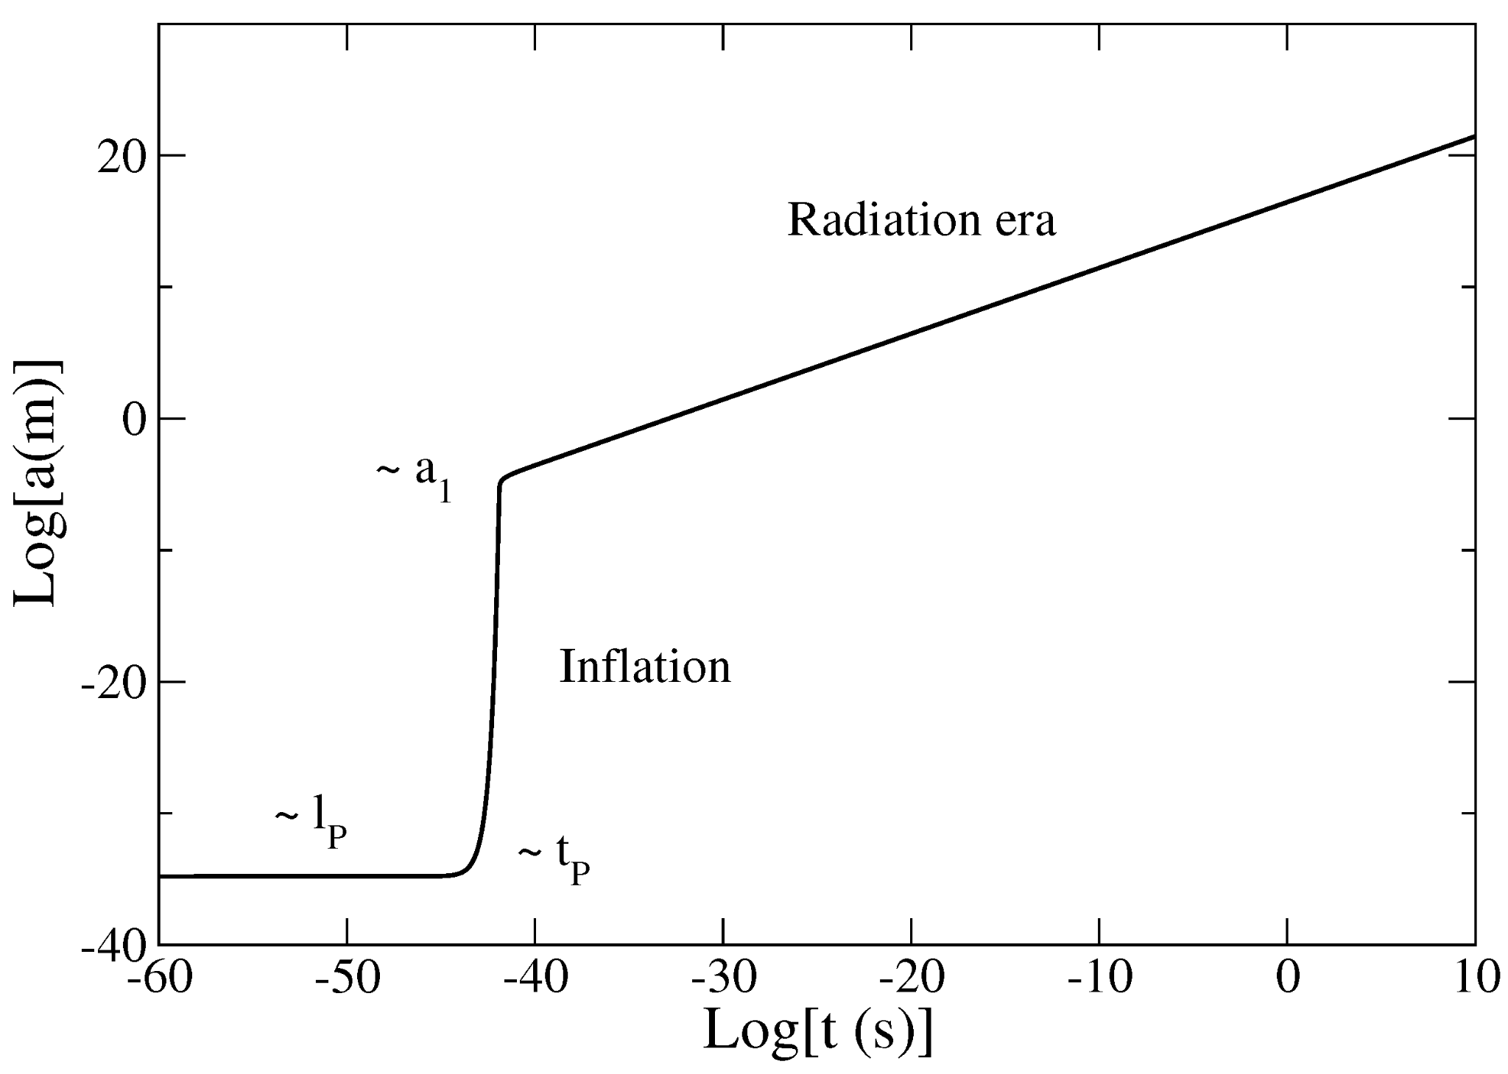
So where does it fail?
The universe is really really smooth. 10^5 differences … Why?
Horizon problem
Inflation
Shouldn’t there be a mechanism that generates this?

Slide 10
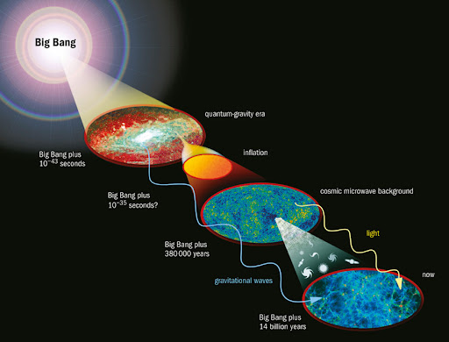
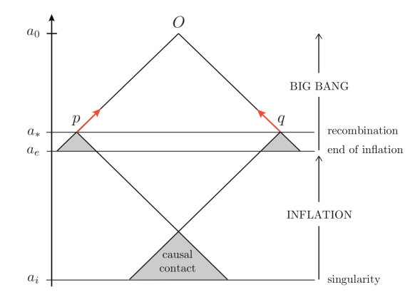
Lambda-CDM model
(Standard model of cosmology)
Great! We surely have a lot of proofs to this
... not really

Slide 12
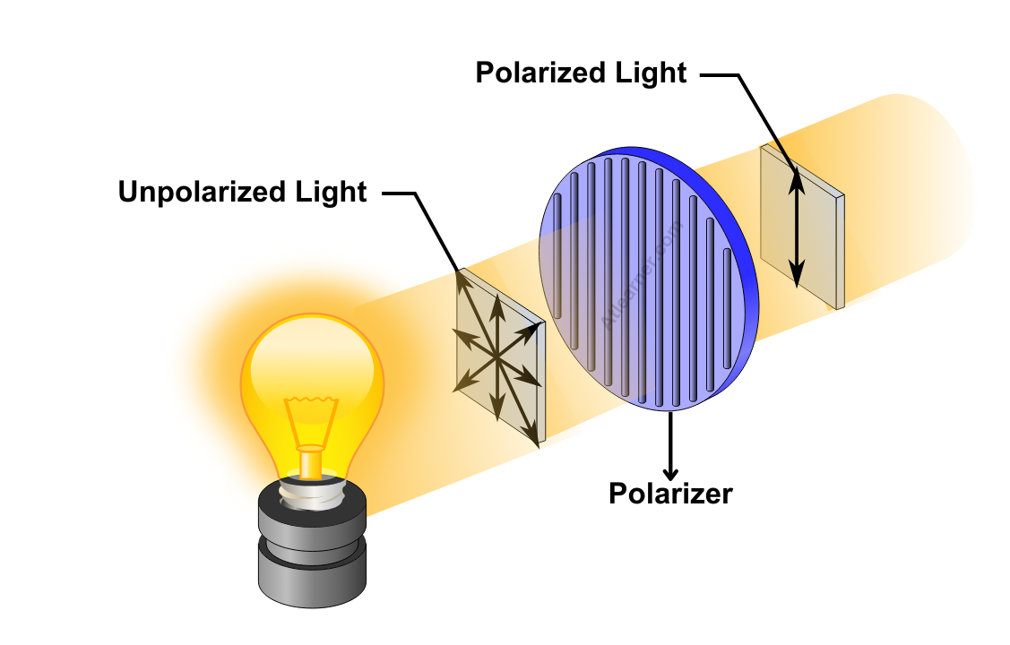
Stokes parameters
E-Modes → well measured and correspond with predictions
Inflation → Primordial gravitational waves → B-Modes in the CMB

Slide 13
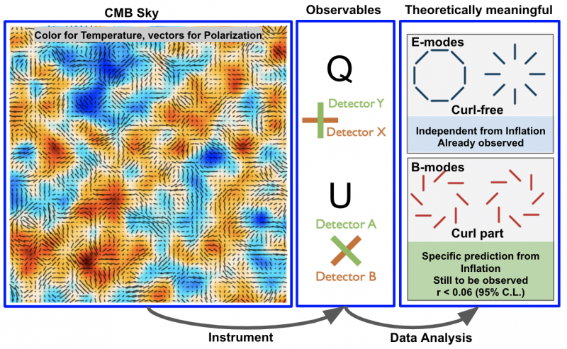
Tensor to scalar ratio

Slide 14
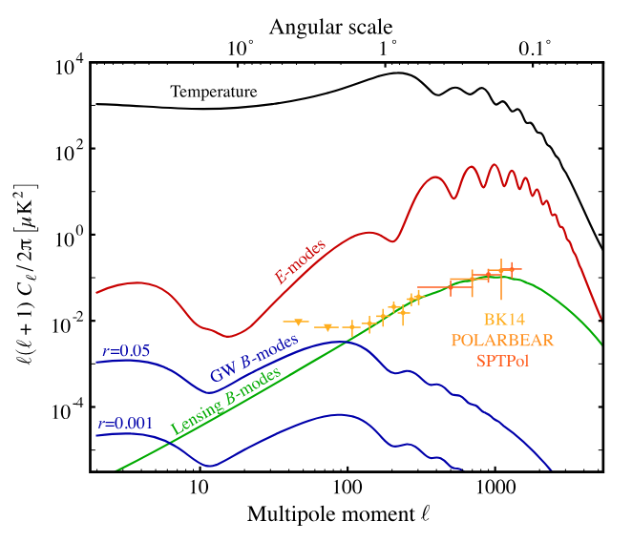
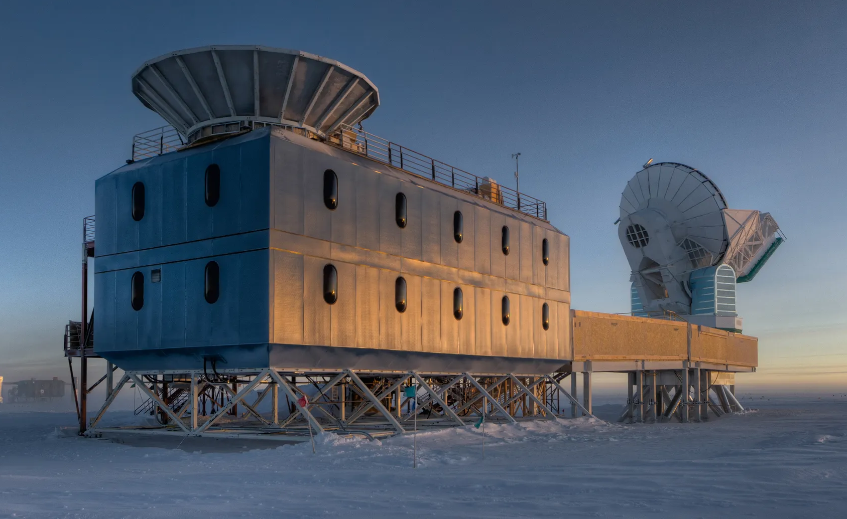
Where are those B-Modes?
We can see them… but just because of gravitational lensing effect

Slide 15
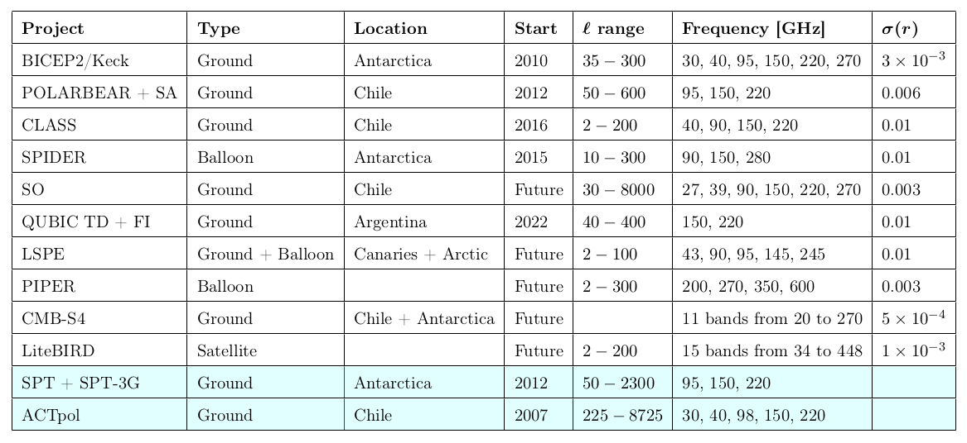
Many experiments search for this
Notes:
MARCAR EN ROJO QUBIC

Slide 16
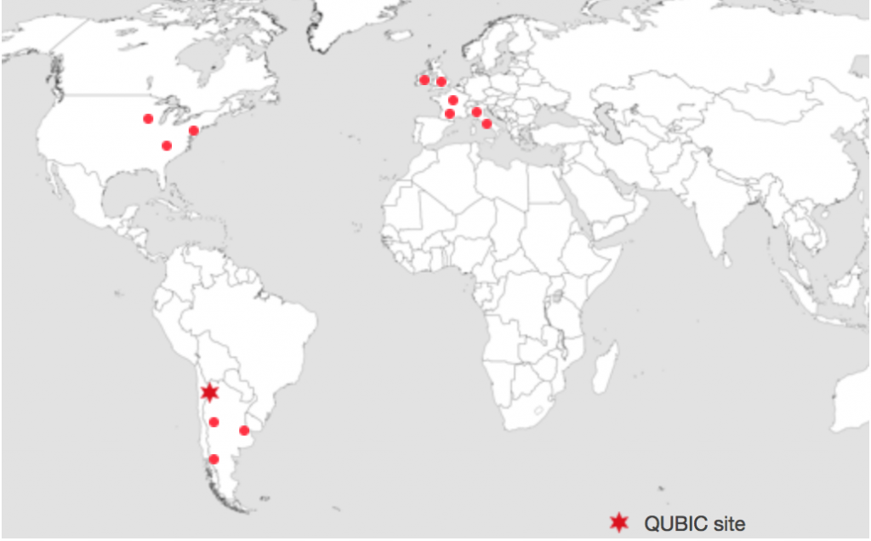
The QUBIC collaboration
ITALY INFN- Sezione di Rome UNIVERSITA DI MILANO-BICOCCA UNIVERSITA DEGLI STUDI DI MILANO UNIVERSITA LA SAPIENZA, ROMA ROMA TOR VERGATA UNIVERSITY Physics Dep.
FRANCE APC PARIS
C2N SACLAY
IAS ORSAY
IEF ORSAY
IRAP TOULOUSE
IJC Lab ORSAY
IRLANDA MAYNOOTH UNIVERSITY
UK CARDIFF UNIVERSITY UNIVERSITY OF MANCHESTER
USA BROWN UNIVERSITY RICHMOND UNIVERSITY UNIVERSITY OF WISCONSIN
ARGENTINA COMISIÓN NACIONAL DE ENERGÍA ATÓMICA - CAC / CAB Universidad Nacional de la Plata – ING-GEMA / FCAGLP / IAR UNCUYO-INSTITUTO BALSEIRO INSTITUTO DE TECNOLOGÍAS EN DETECCIÓN Y ASTROPARTÍCULAS (CNEA, CONICET, UNSAM)
https://www.qubic.org.ar/colaboradores-internacionales/
Notes:
QUBIC es un esfuerzo colaborativo internacional con contribuciones de Francia, Italia, Irlanda, Inglaterra y Argentina. Cada país aporta a diferentes aspectos del diseño y construcción del instrumento, con Argentina enfocada en la infraestructura y adecuación del sitio.
complejidad logistica para meterlo en la antartida
aproximadamente 120 integrantes

Slide 17
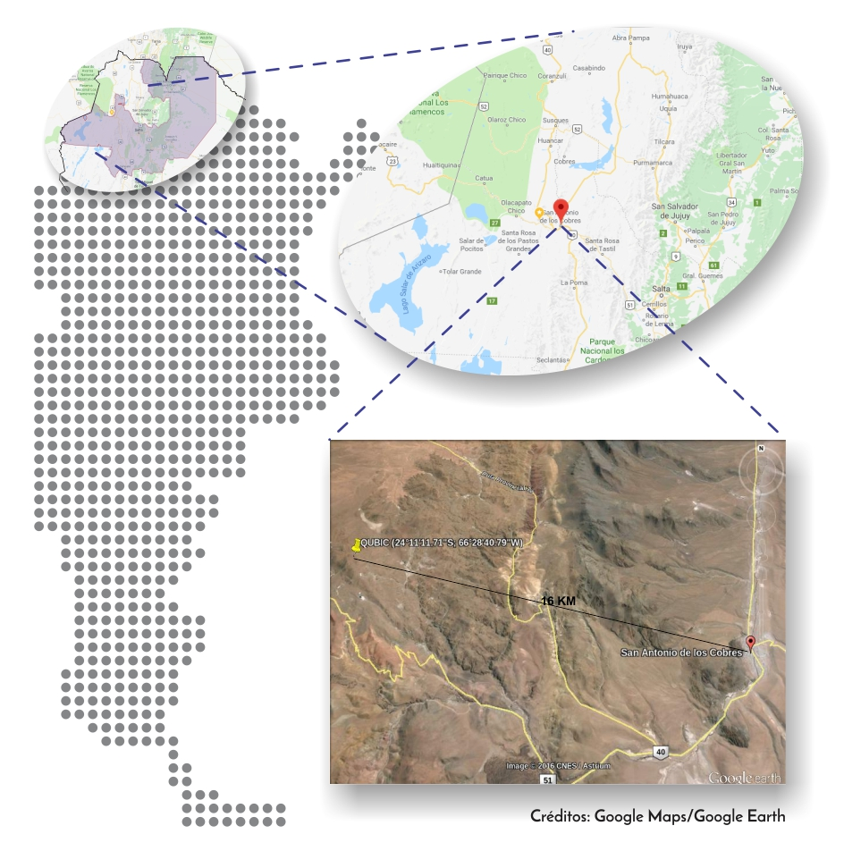
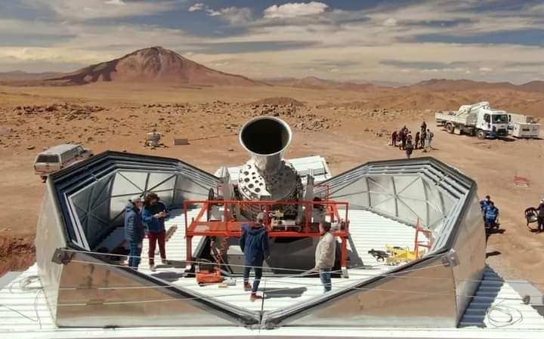
Q-U Bolometric Interferometer for Cosmology (QUBIC)
The site
material having a temperature-dependent electrical resistance.
Altos Chorrillos, Salta, Argentina
24° 11' 13.1" S 66° 28' 41.6" W
4869 m Height
Taking data since 2022
Shares site with Large Latin American Millimetre Array (LLAMA), ARG- BRA
The anisotropies of the Cosmic microwave background (CMB) as observed by Planck.
https://www.qubic.org.ar/el-sitio/
Notes:
donde esta desde cuando está funcionando
interfrometro bolometrico
que significa la sigla
modos B de la polarizaicon de CMB
mapa del CMB con mediciones de cuerpo negro y esas cosillas.

Slide 18
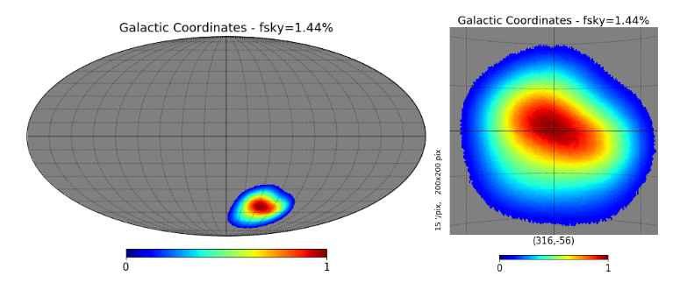
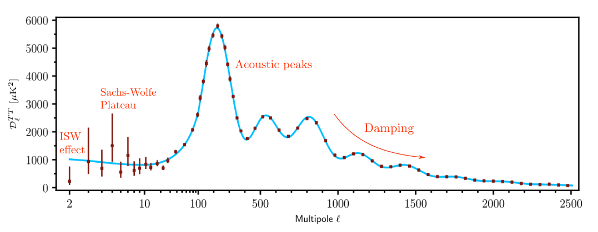
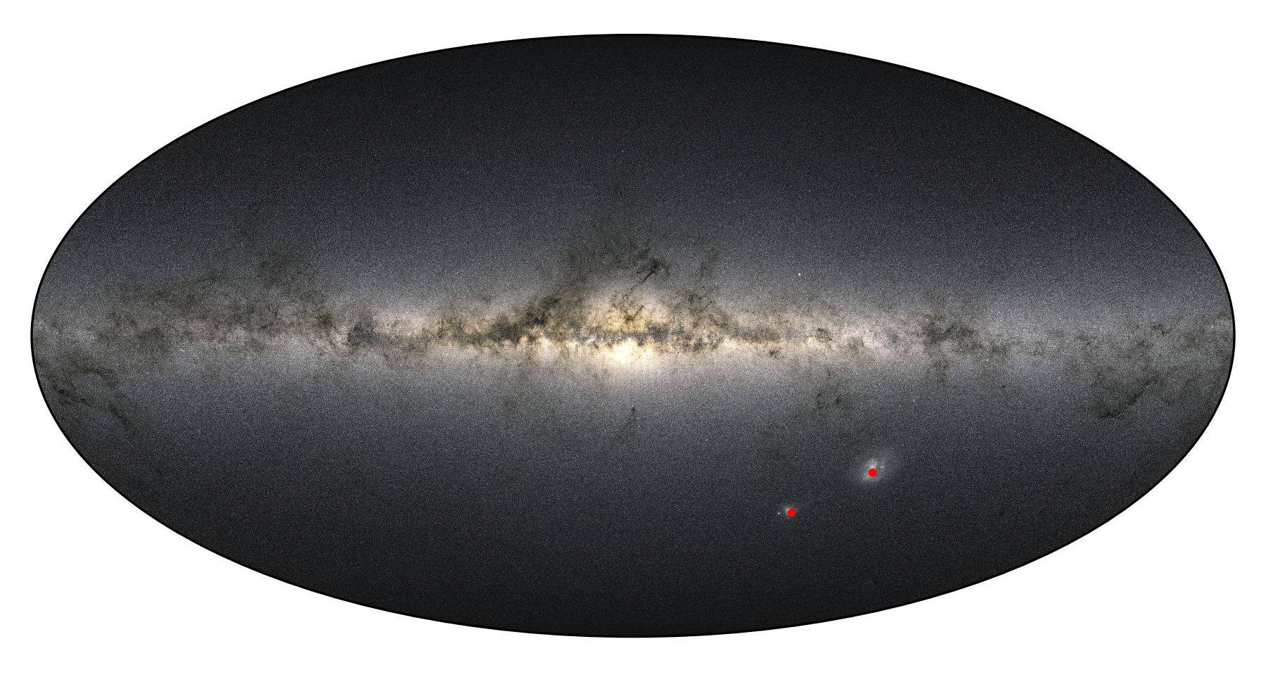
Sky coverage
QUBIC
150 GHz
220 GHz
Visual spectrum → outside galactic plane
40 - 400

Slide 19
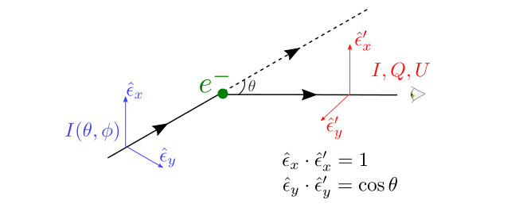
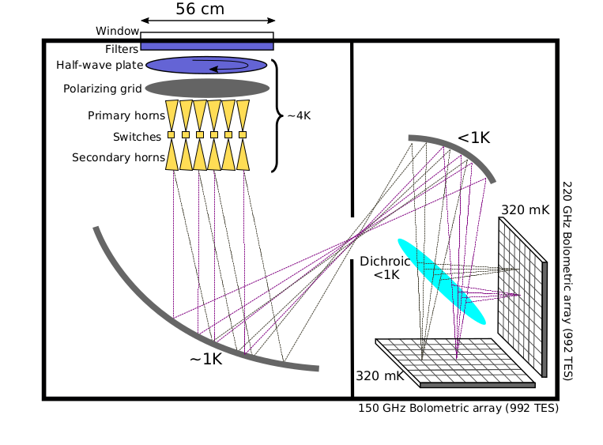
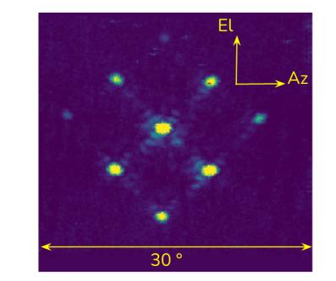
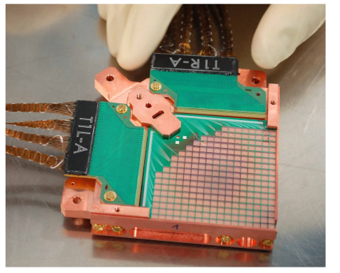
QUBIC observatory: an overview
Cryostat
The instrument itself
https://www.qubic.org.ar/el-instrumento/
Notes:
Combina bolometria con interferometria
Tengo bolometros y los horns, que es la parte interferometricas, ayuda a remover los foregrounds
I, Q, U son todas intensidades pero a partir de Q y U puedo pedir se pueden inferir las polarizaciones
Esquemtias en el design report. QUBIC I quizá
Grafico 3d donde está hecho en cortes parciales todas las partes donde

Slide 20
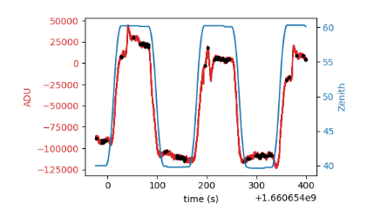
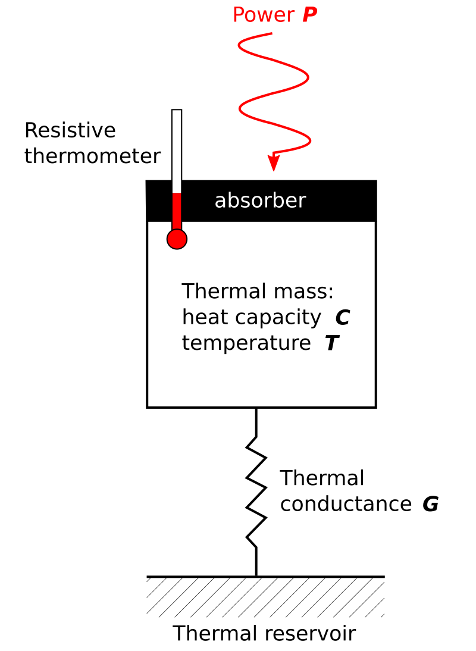
Bolometers: Transition-Edge Sensors (TES) array
Standard method in the area

Slide 21
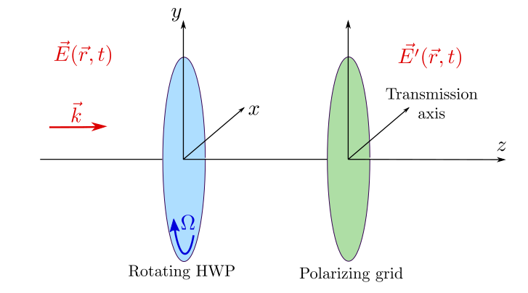
Polarization scheme

Slide 22
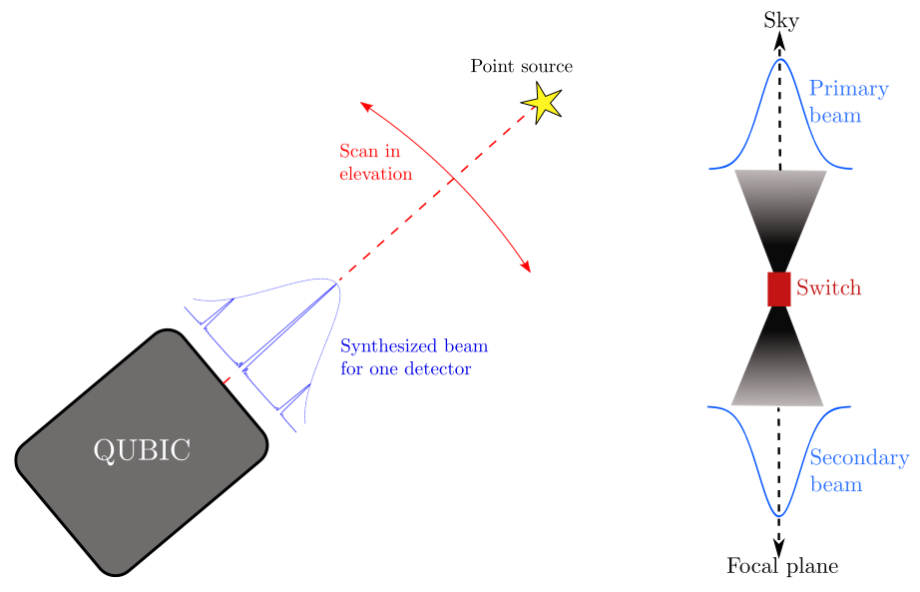
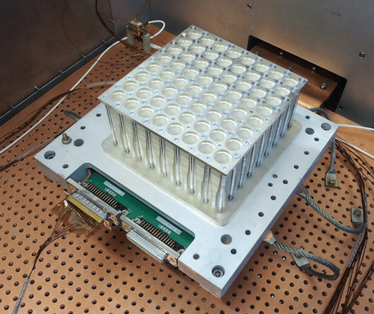
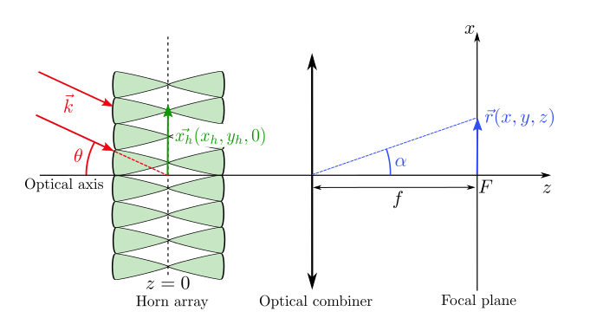
Interference array
This helps a lot restraining systematics errors
We can do spectroscopy of the signal
(differentiate between contaminants and CMB)

Slide 23
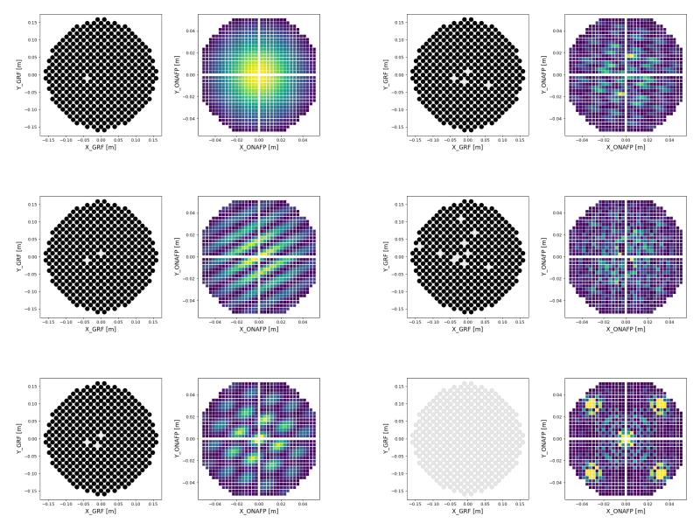
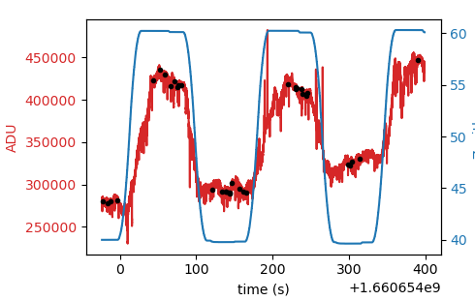
Another advantage: Self Calibration
For the same signal completely different outcomes in each TES
Notes:
aclarar que ilumino todo con la misma intensidad

Slide 24
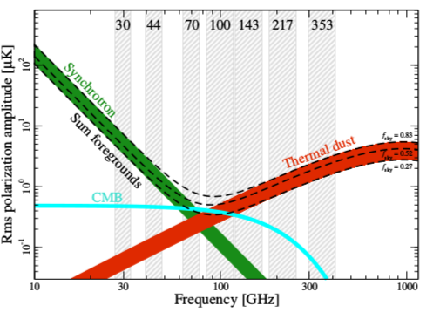
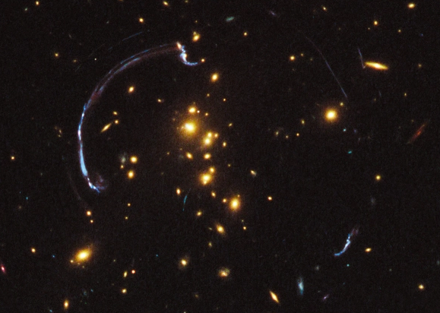
Foregrounds :(
Gravitational lensing
Notes:
Tengo que aclara que mientras uno baja el otro sube y que el CMB es aproximadamente constante en el rango de medición.

Slide 25
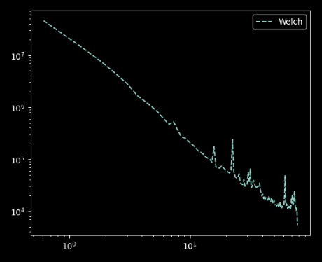
What am I doing??
My own work : characterizing the noise
Signal
Welch method summed up: it splits the signal in many pieces, with a shared frontier between pieces. Computes the FFT in each piace and averages

Slide 26
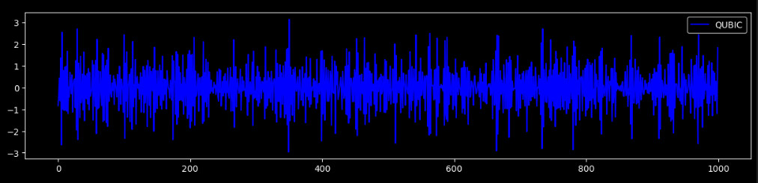
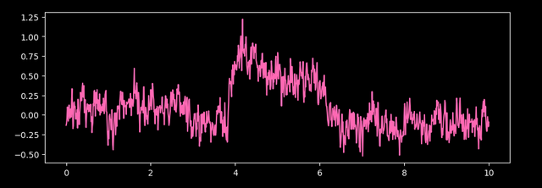
What am I doing??
My own work : characterizing the noise and taking out CRs
QUBIC noise
Add CR signal and try to take it out using CNN 1D
WORK IN PROGRESS

Slide 27
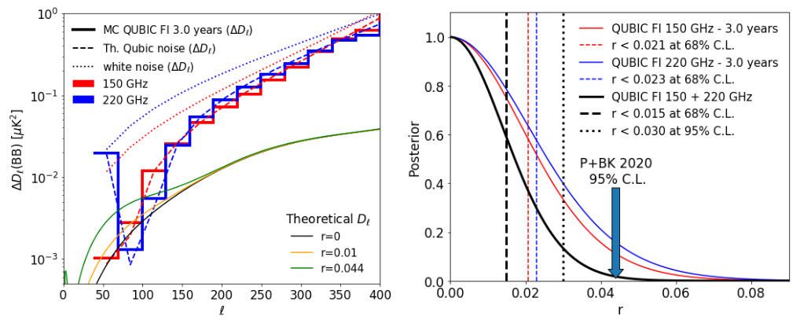
Conclusions
Inflation comes to patch the Big bang model
Inflation → primordial GW→ B-modes
B-Mode is way dimmer than other signals
Most experiments use bolometers
QUBIC adds interferometry
In three years of data taking it should restrain r<0.03

Slide 28
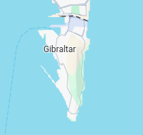
02/04/1982

Slide 29
He robs them before their eyes. Thus, the greater, the infinitely more enormous and outrageous robbery is return with another.
“You will have to excuse me”, by Eduardo Sacheri

Slide 30
¡Grazie!

Slide 31
Any questions?

Slide 32
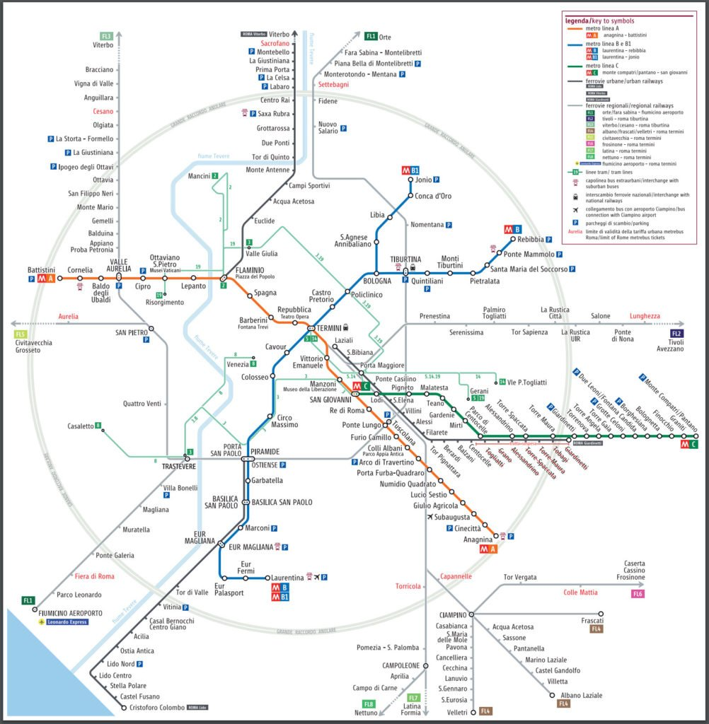
B-Modes and Rome public transport
The same as the CMB, Rome public transport has a strong E-mode component and a really weak B-mode componente

Slide 33
Cryogenic system

Slide 34
Inflación por una vez podría ser la solución (1970-1980)
Lambda-CDM model
(Standard model of cosmology)

Slide 35
Cómo podemos inferir la existencia de inflación con el CMB?

Slide 36
Espectro de potencias observado

Slide 37
Polarización de la Luz

Slide 38
Observed power spectrum

Slide 39
The standard cosmological model
Vision of the universe until 1920
Friedmann-Lemaître-Robertson-Walker (FLRW)
links the theoretical scale factor a(t) which with an observable quantity, the redshift z
Notes:
agregar los valores de k psibles

Slide 40
QUBIC for Dummies (myself included)
Lic. Iván Queirolo
Director Dr. Diego Gabriel Melo
Notes:
Cotutela con Italia
Silvia Masi
Al menos dos estadias de seis meses en Roma
comencé el primero de diciembre

Slide 41
Sky dip signal

Slide 42
Sky dip signal
Unknown
Data
Fit/guess

Slide 43
Nuestra visión del universo antes de 1920
Kepler’s Laws (1619)
Newton’s Laws
→ Kepler’s Laws
Gravity is a force proportional to the masses and inversely proposed to the distance squared (1686)

Slide 44
Nuestra visión del universo antes de 1920
In GR gravity is not a force but a consequence of the presence of matter
John Wheeler: “Space-time tells matter how to move; matter tells space-time how to curve.”
10 independent equations
(1915)
Space-time geometry
Matter distribution

Slide 45
Saving the Big Bang Model with cosmic inflation
Relación escalar-tensorial
Notes:
si r es distinto de cero entonces tenemos una prueba muy fuerte de la teoria inflacionaria.
varios experimentos deberían confirmar el resultado

Slide 46
Recipe for noise and offset removal
We assume same atmospherical conditions when the slab measurement was made

Slide 47
Recipe for noise and offset removal
Here tau0 is a guess value based in previous data (0.1 according to LLAMA)
This method seems to be working fine except for a factor 2 in Tatm

Slide 48
Sky dip signal simulation and reconstruction of initial values
First method
Tatm=564 K using Slab data
Tatm=256 K using Slab Sim
Second method
We were able to reconstruct the seed values of the simulations
The method seems to be pretty sensitive to initial seed values. There are many curves with different tuples (Tatm,tau0) that fit.
Using simulated slab
Using slab
data
WORK IN PROGRESS
WORK IN PROGRESS

