Slide 1
Announcements
from the PhD seminars committee

Slide 2
Today’s seminars
Unfortunately, we’ll have only one talk because the speaker has personal issues
Today we’ll have a two stage coffee break
NOW… important stuff

Slide 3
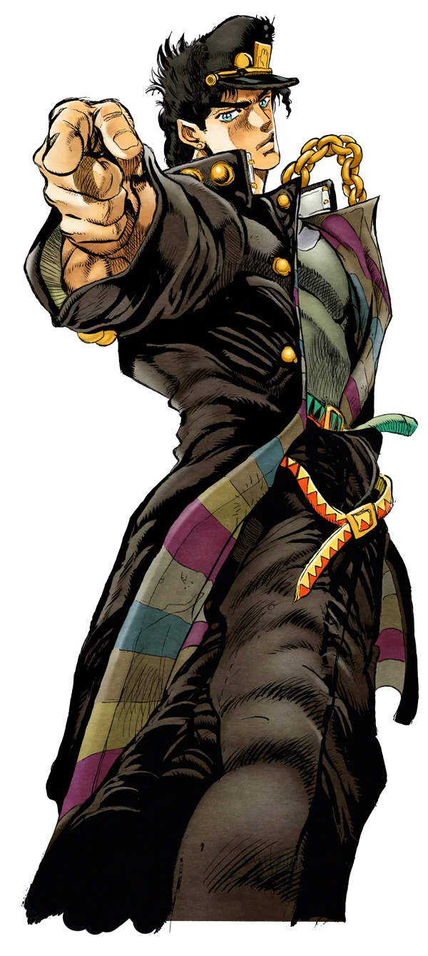
We are looking for at least one
PhD student from the 39th cycle.
PhD student from the 40th cycle.
WE WANT YOU!

Slide 4
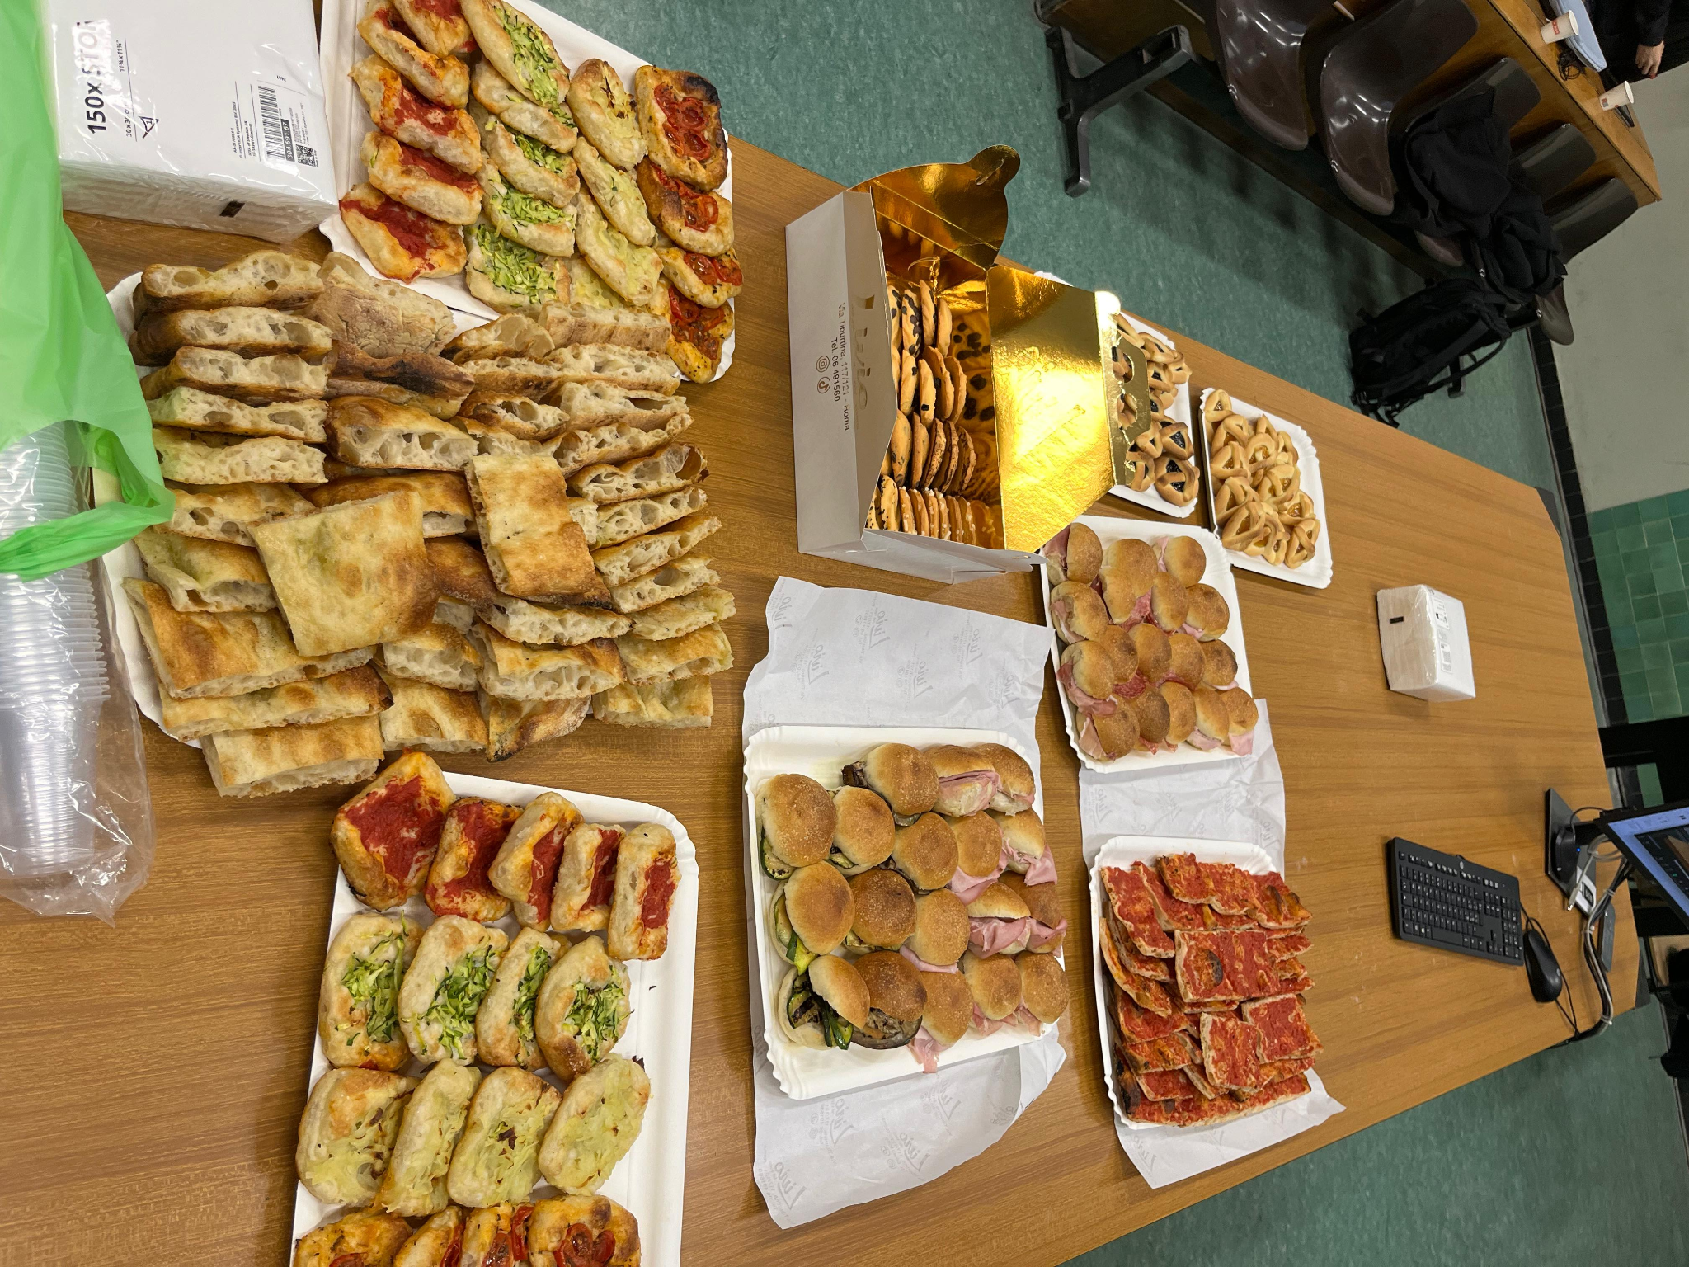
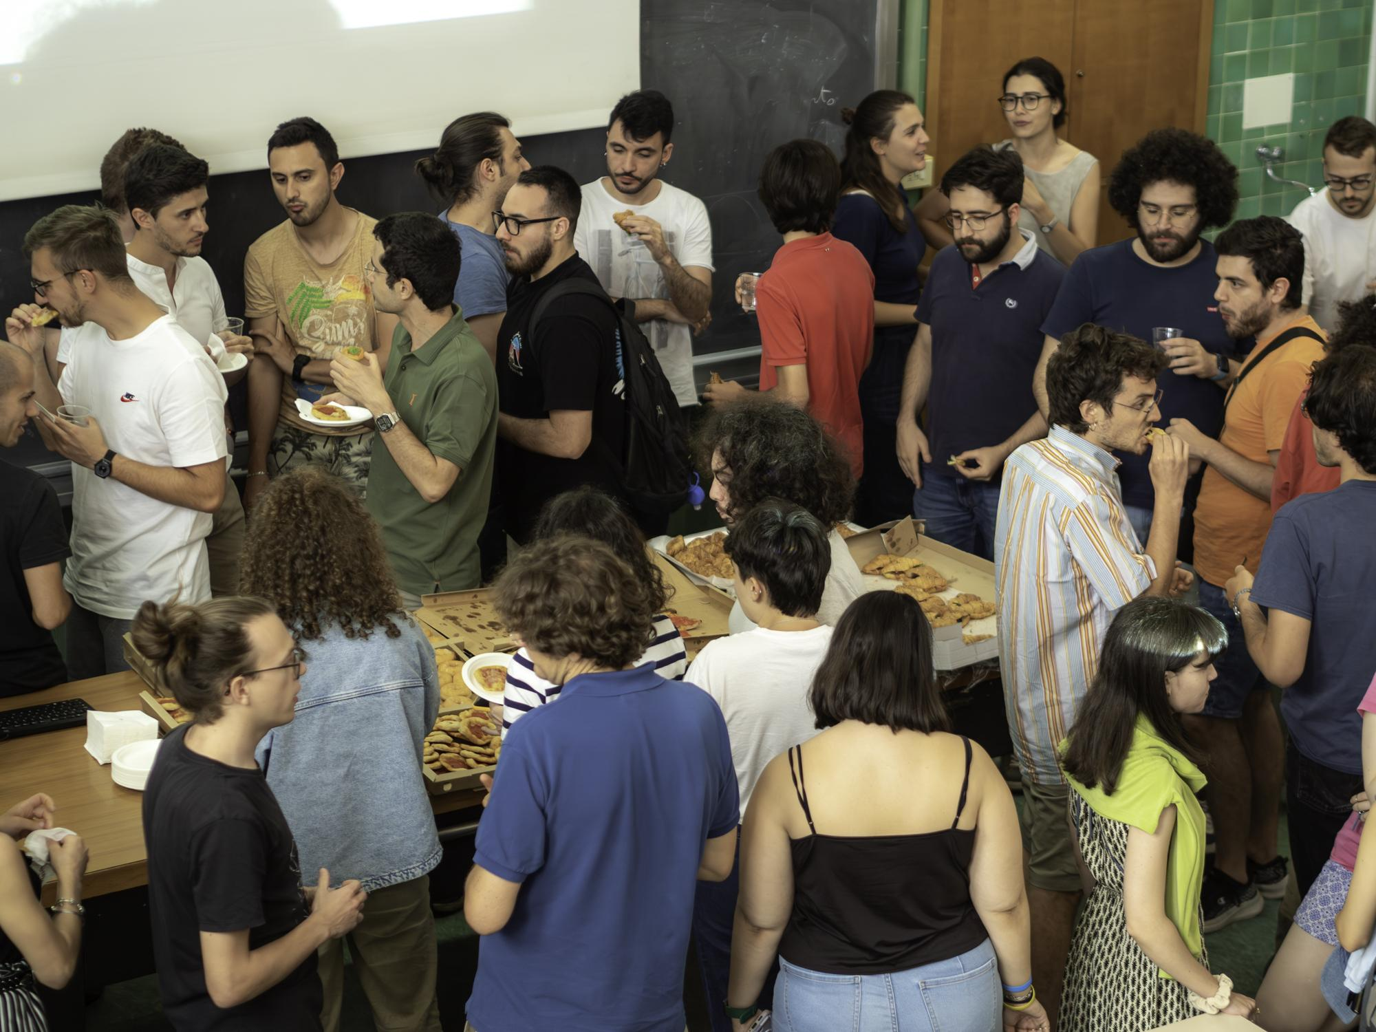
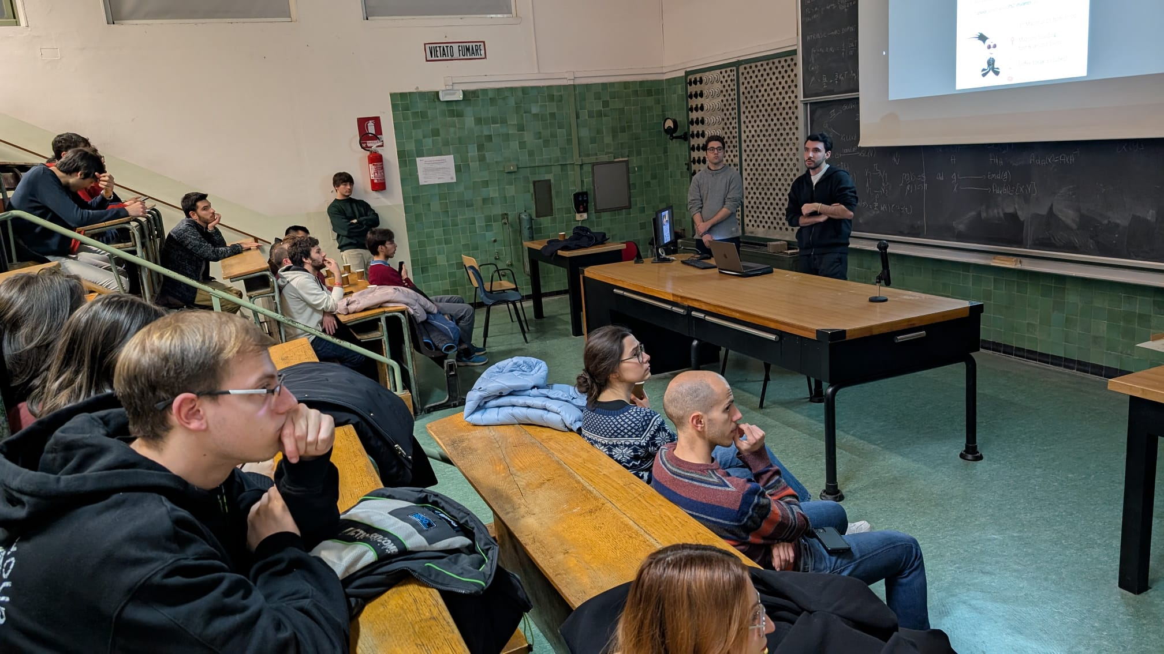
A bit of context…
Even though the coffee break on a wednesday late afternoon is amazing, and crucial…
The whole point of this series of seminars is to give ourselves
A safe and chill environment to improve public speaking.
Hear about difficult concepts from other physics branches in simple terms
Meet other people outside your research group.

Slide 5
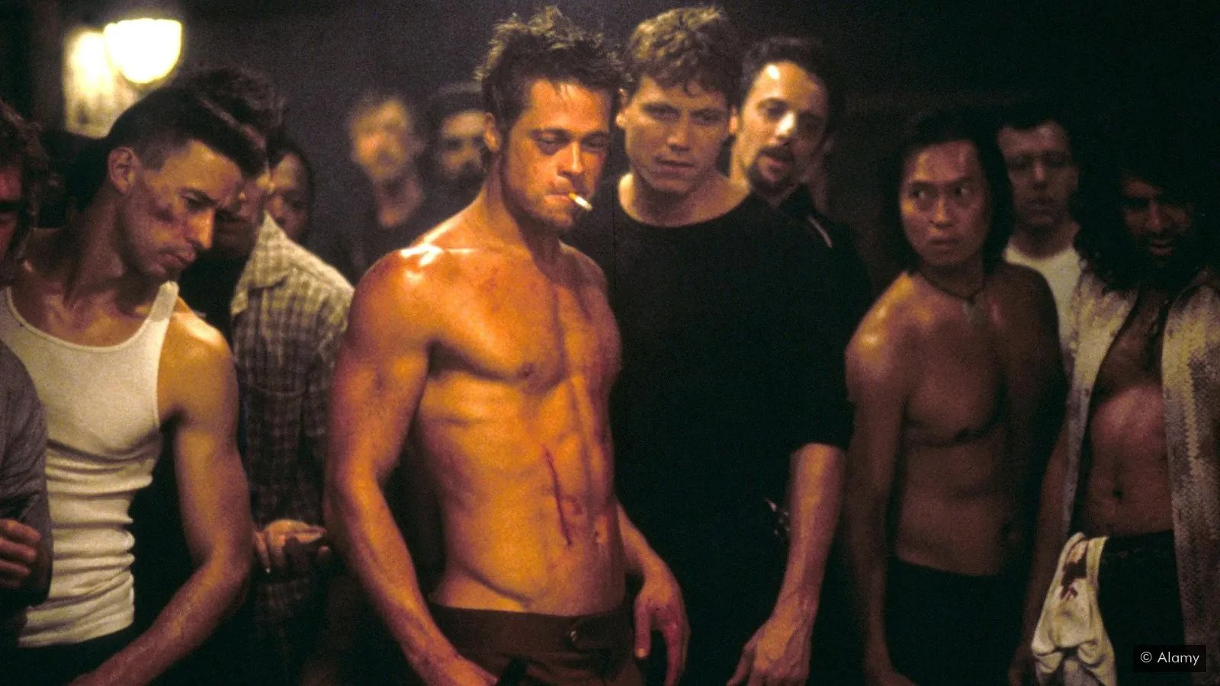
That’s why :
No professors & Detailed talks aimed only at experts are discouraged.
FIRST RULE OF FIGHT CLUB…

Slide 6
These events have been historically organized by students for students
Ideal case:
40% 3rd year phds
40% 2nd year phds
20% 1st year phds
Current situation:
15% postdocs
70% 3rd year phds
15% 2nd year phds

Slide 7
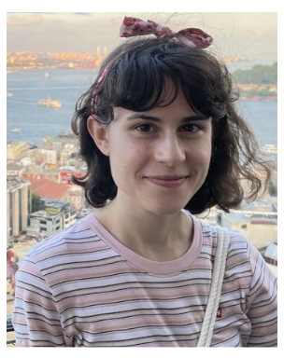
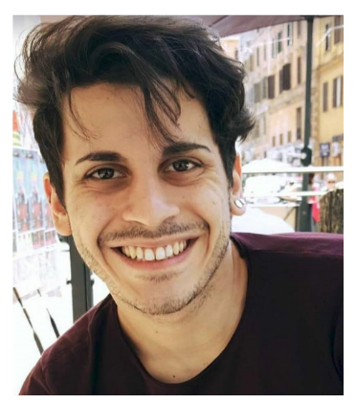
We know, we know… (you are all very busy)
But…
Member of the ET and GW astronomer
Neutrino astronomer
recent KM3NeT discovery
Particle physicist
moving to postdoc life
Particle physicist
starting the postdoc life
FRANCESCO CRESCIMBENI
ALESSANDRO VEUTRO
PIERGIUSEPPE CATINARI
GRAZIELLA RUSSO
Condensed matter physicist in his final year
Biophysicist in his last year
- > (flying to Japan right now)
Condensed matter physicist starting the postdoc life
TBW
PAOLO FACHIN
CARLO GIORGETTI
BEATRICE D’ALÒ
GIUSEPPE RONCO

Slide 8
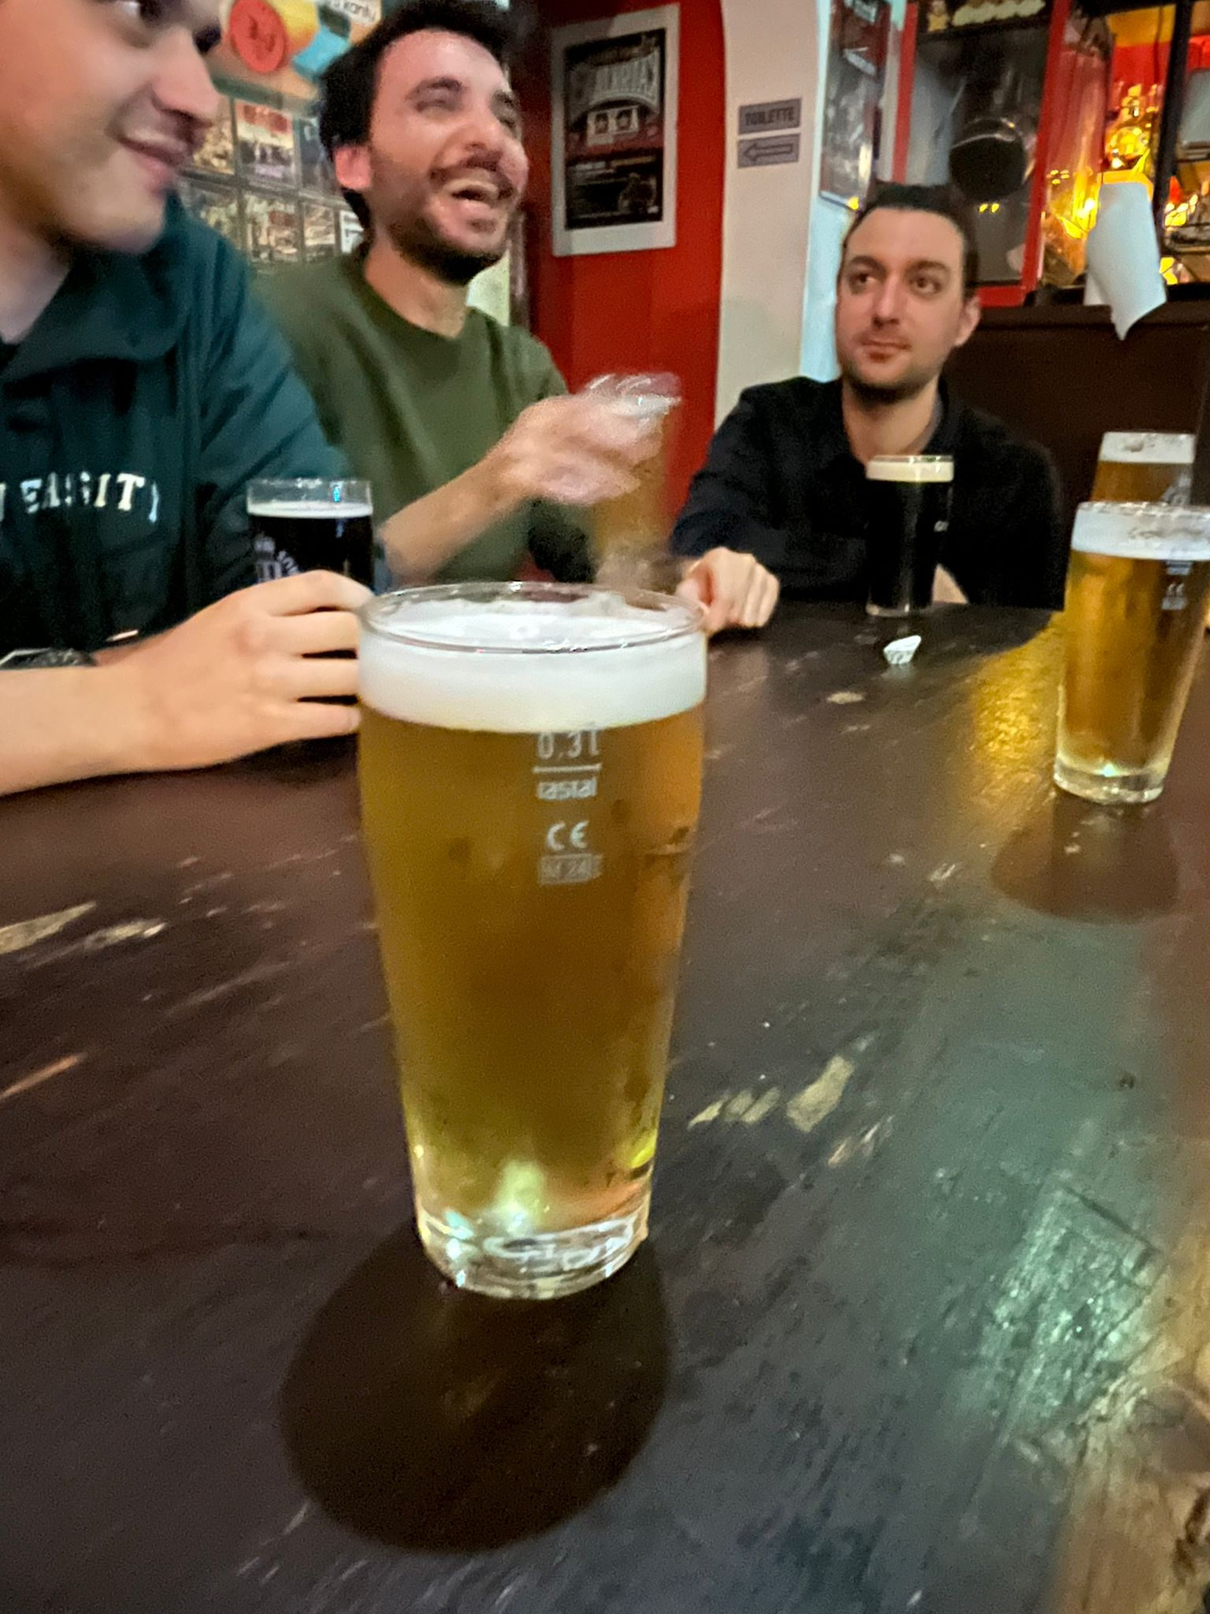
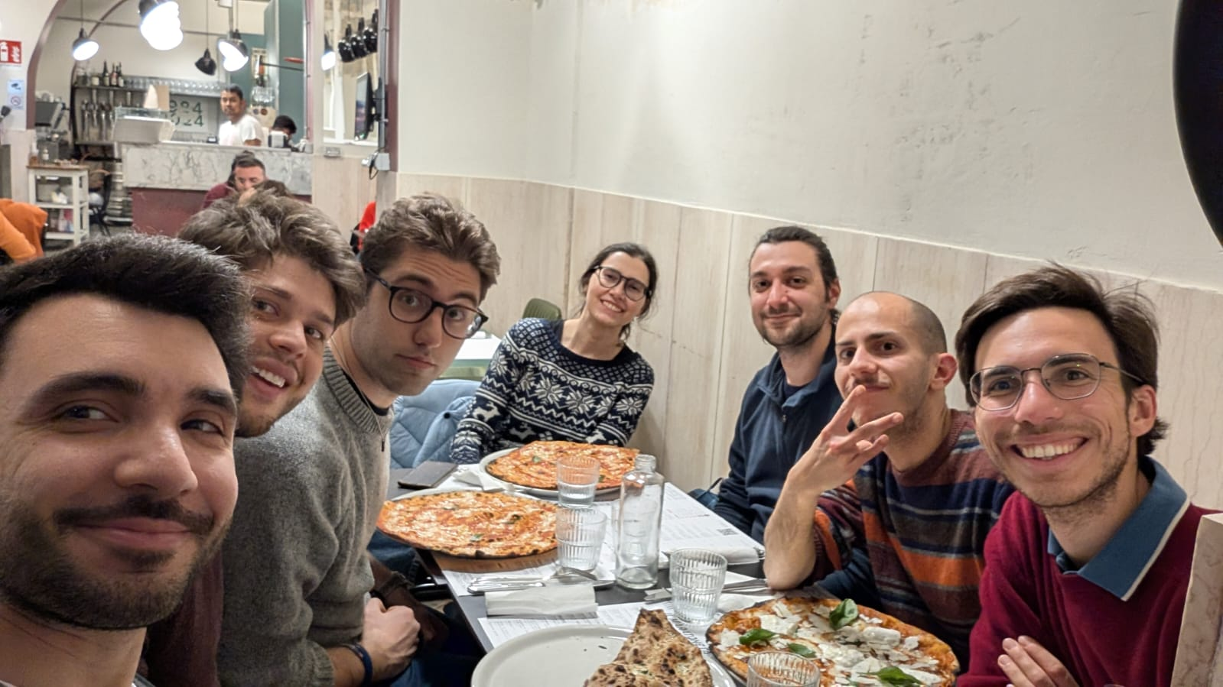
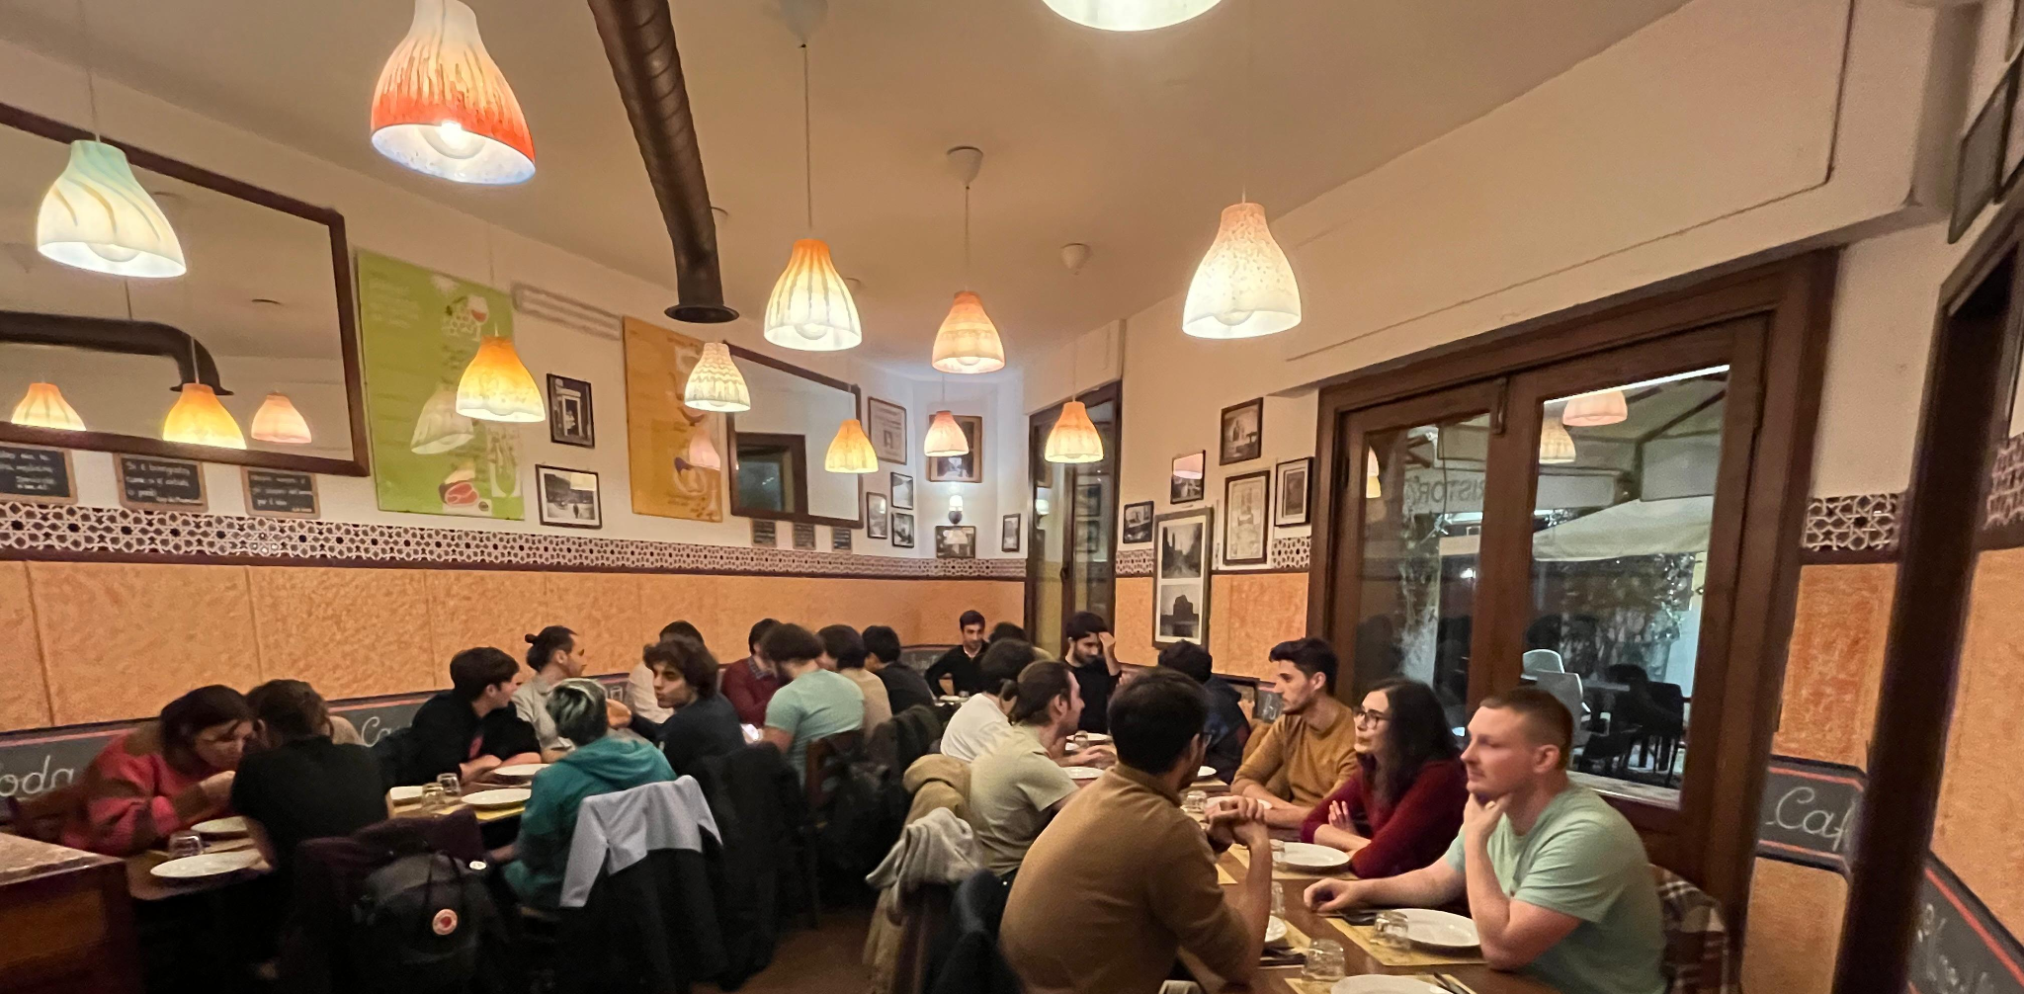
Let’s preserve this useful space for ourselves and the ones to come:
And lets fight back the stereotype of a scientist always working insla his lab/laptop
join us for beers and dinner afterwards, Not just the talks.

