Slide 1
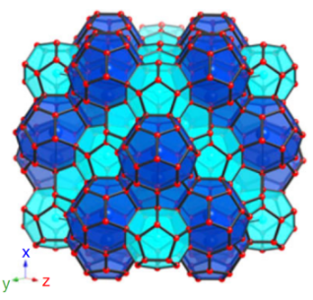


PhD seminars
Season 12 Ep. 2
Exploring the world of clathrates: nature’s cages of ice and gas
Maria Rescigno

Slide 2
PhD seminars
Season 12 Ep. 2
Outline of this seminar
What are clathrate hydrates?
Interest behind clathrate hydrate research
Possible applications
Some experimental results on hydrogen hydrate

Slide 3
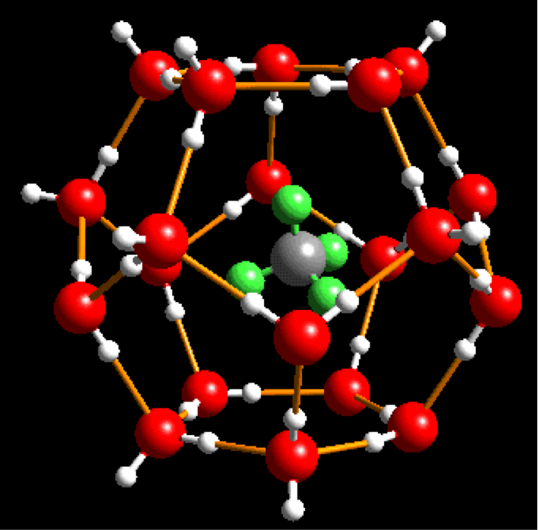
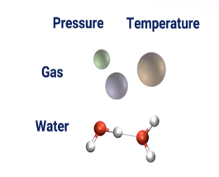
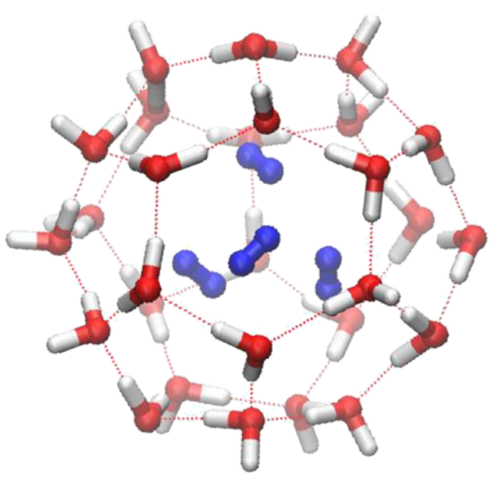

What are clathrate hydrates?
Hydrogen bonded (HB) polyhedral cages of water molecules in which gas molecules are encaged

Slide 4
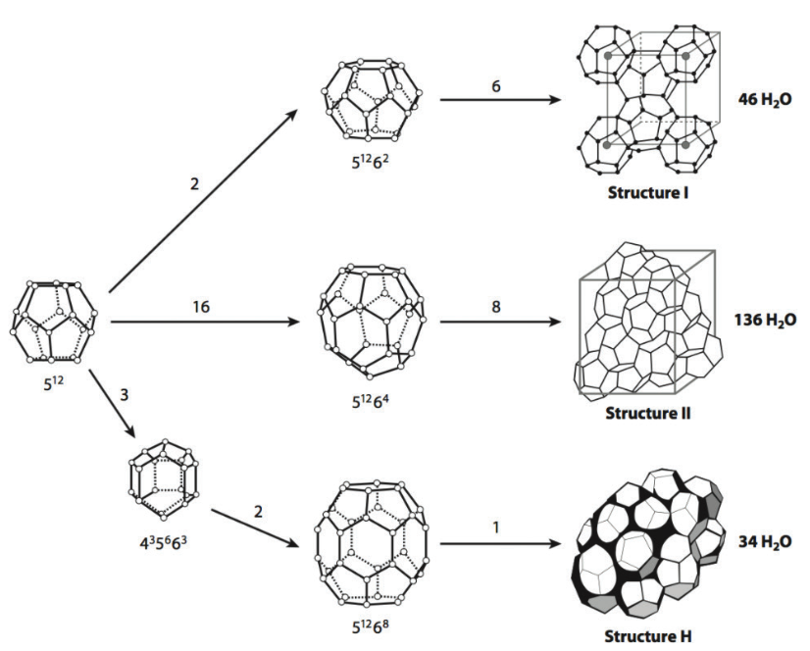
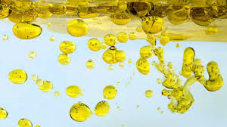
Forces at play: hydrogen bond interactions between water molecules and Wan Der Waals interactions between the guest molecules and the cage
How can - generally small and non polar molecules – form such compounds?

Slide 5
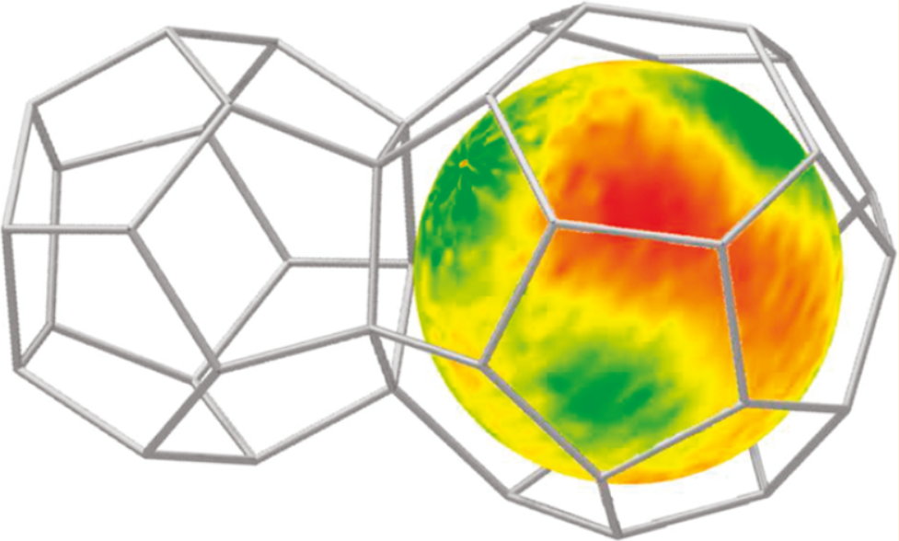
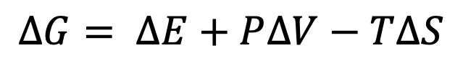
Why do clathrate hydrates form?
It’s a matter of balance between enthalpy and entropy cost!
$$∆G= ∆E+P∆V−T∆S$$

Slide 6
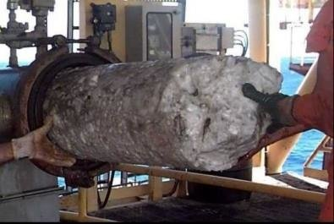
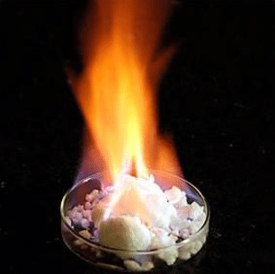
Brief history of clathrate hydrate science
First observations in 1700
Over the centuries chemists started characterizing these systems
In the 1930s it was observed that natural-gas pipe lines were clogged with “ice”
Research on this systems started to be funded and the field expanded

Slide 7
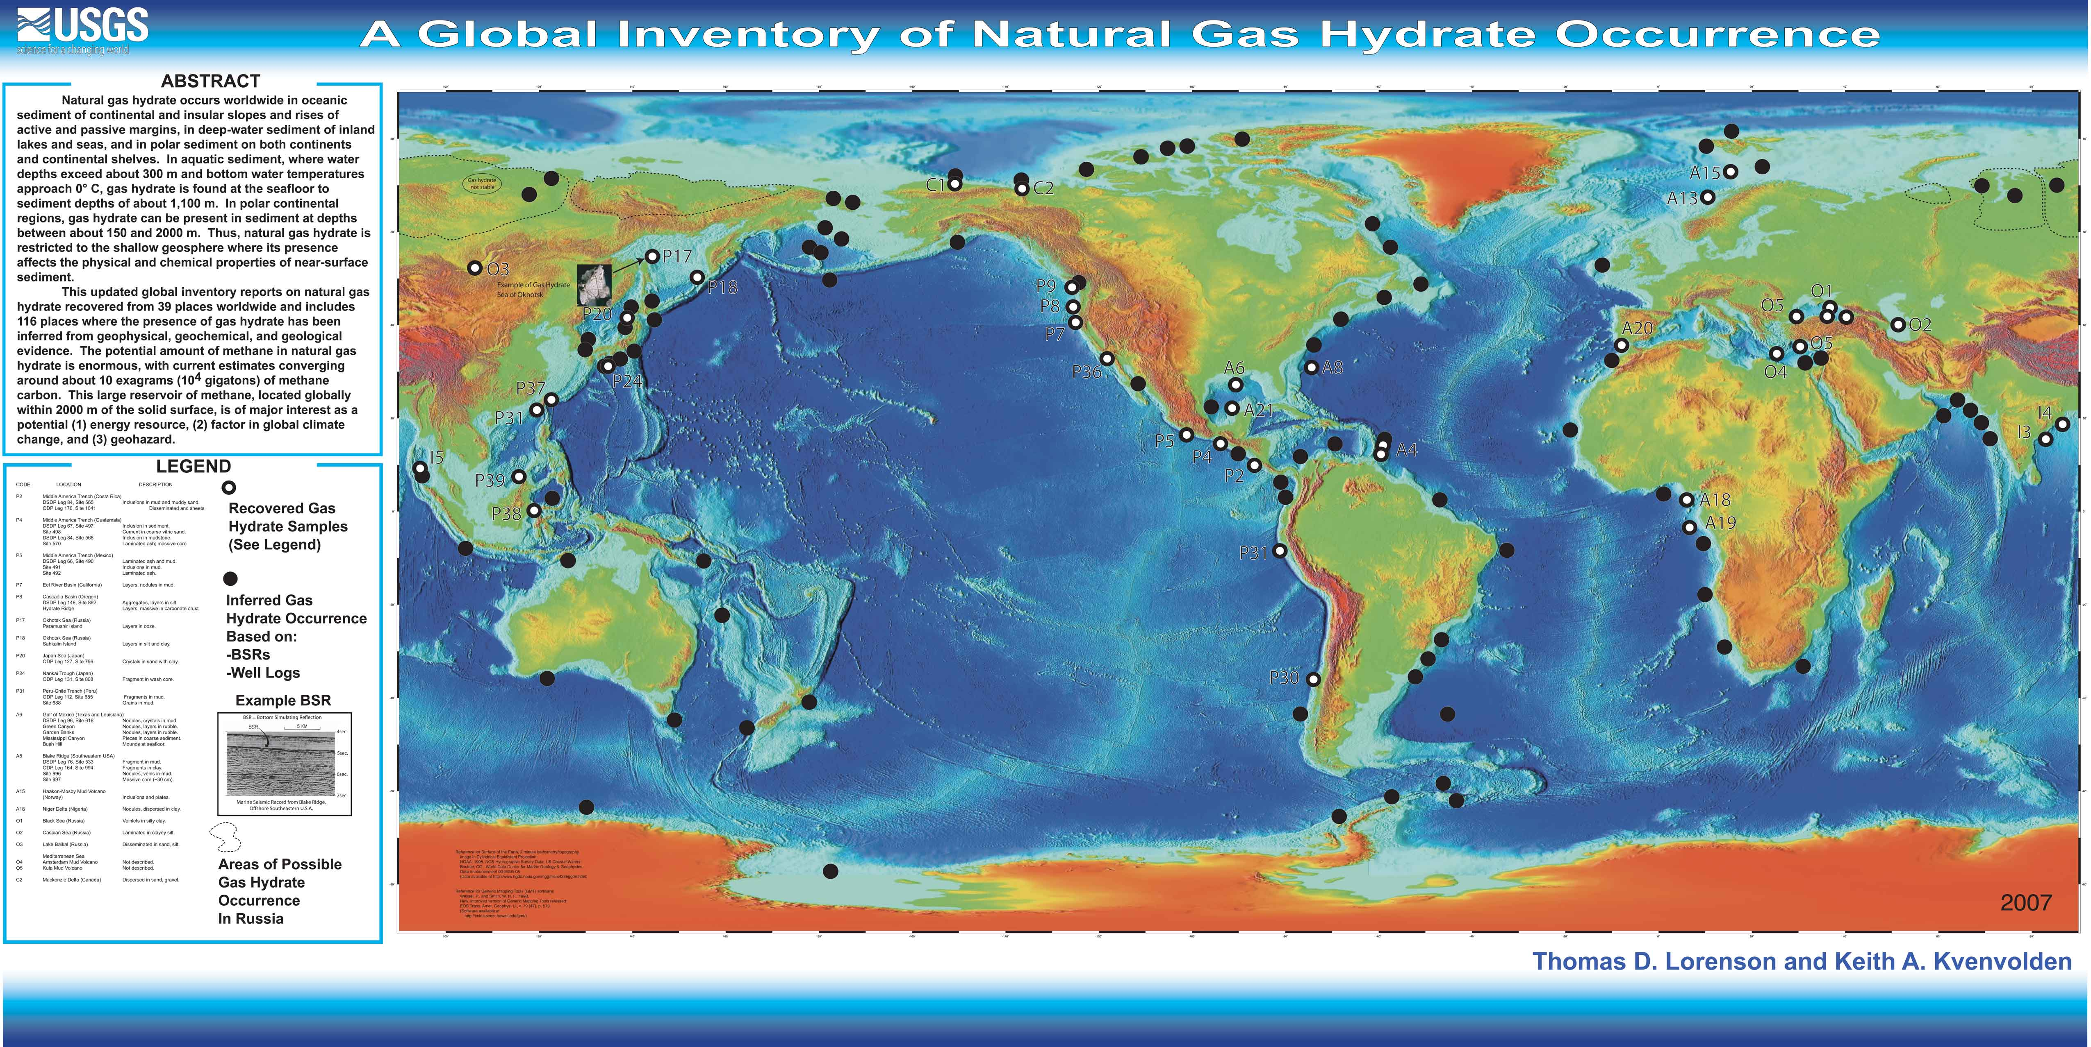
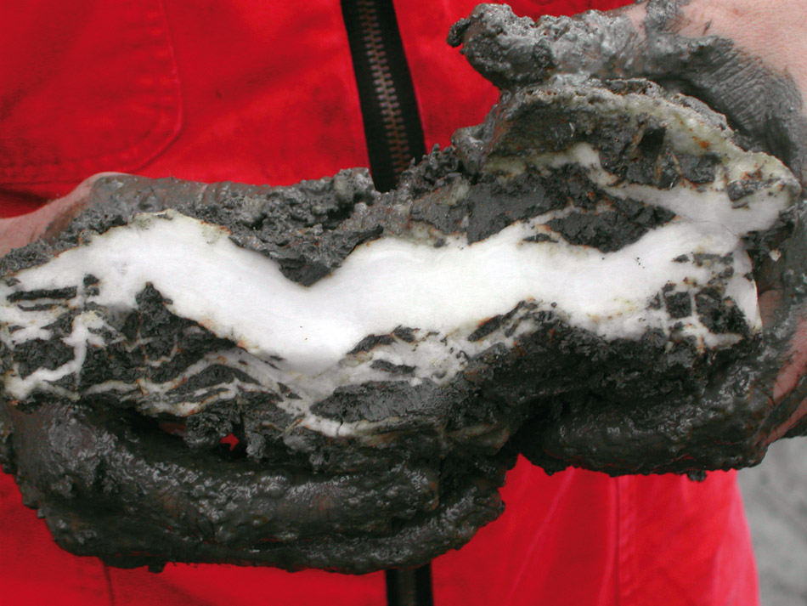
Methane clathrate in the geosphere:
Useful or harmful?
Methane clathrate on our planet is a possible energy source but its possible destabilization raises concerns
CO₂ sequestration
CH₄ recovery

Slide 8
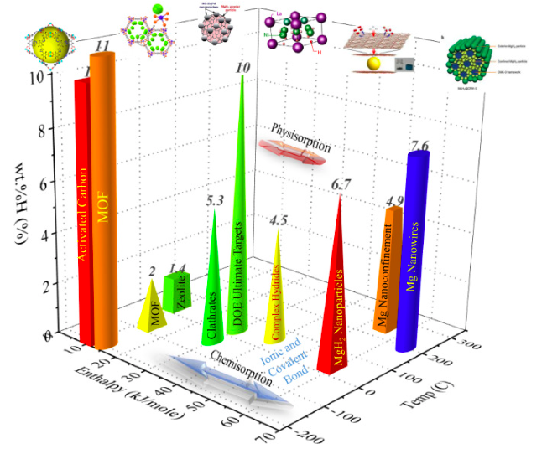
Hydrogen storage applications
What do you want for hydrogen storage?
• high hydrogen content per unit mass
• high hydrogen content per unit volume
• moderate pressure and temperature
for synthesis
• near ambient pressure and easily
accessible temperature for storage
• easy hydrogen release
• environmentally friendly materials

Slide 9
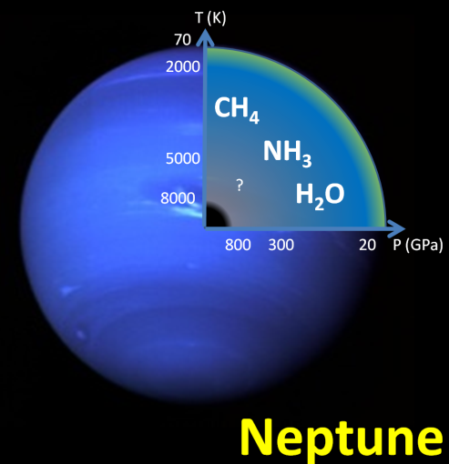
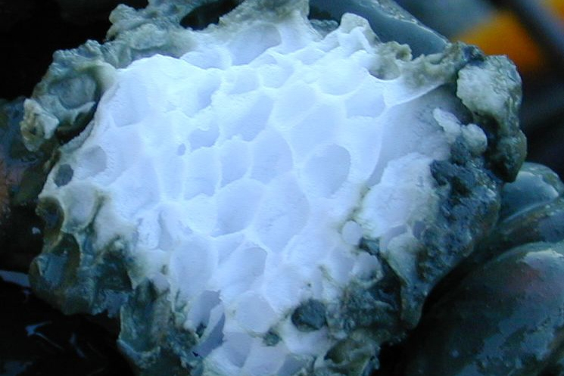
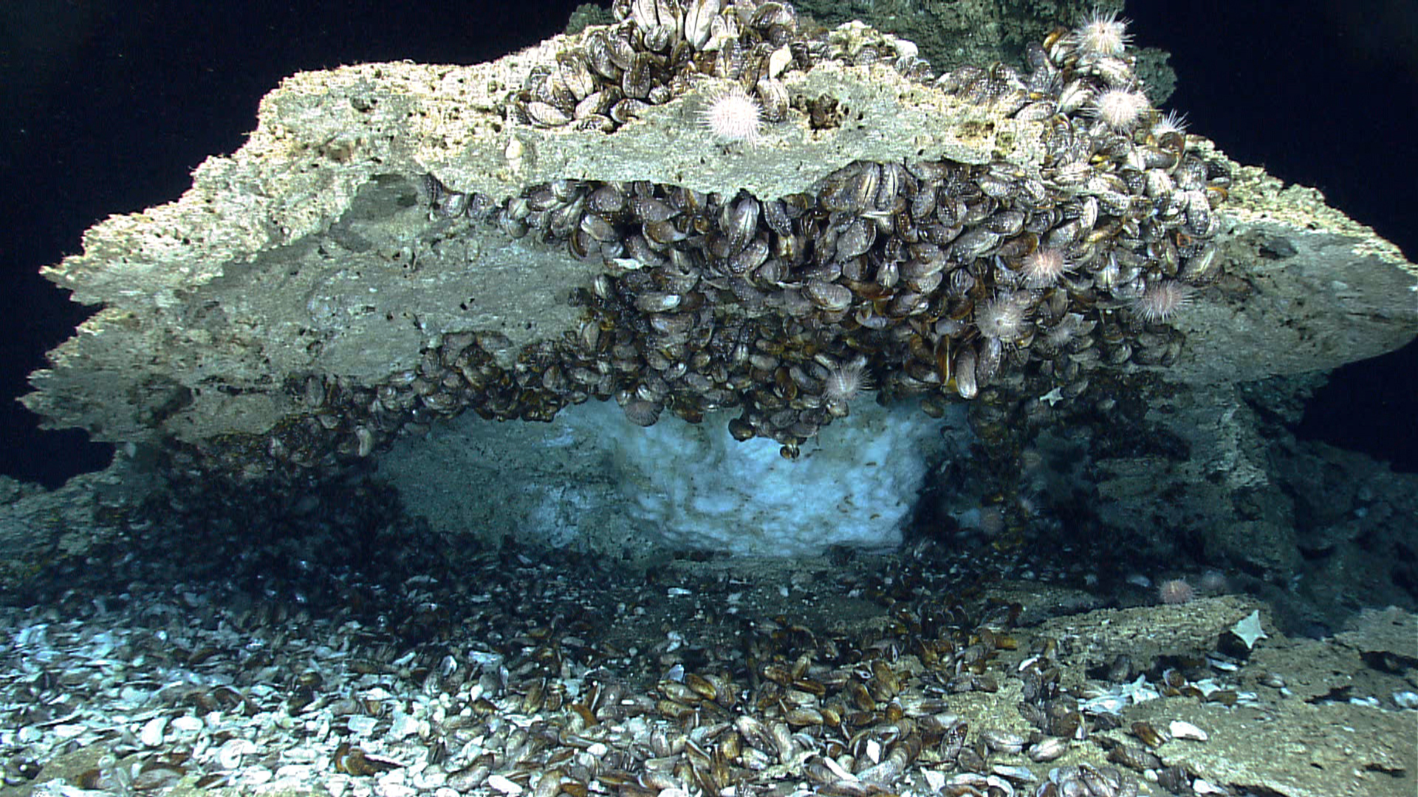
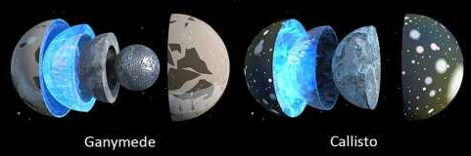

Slide 10
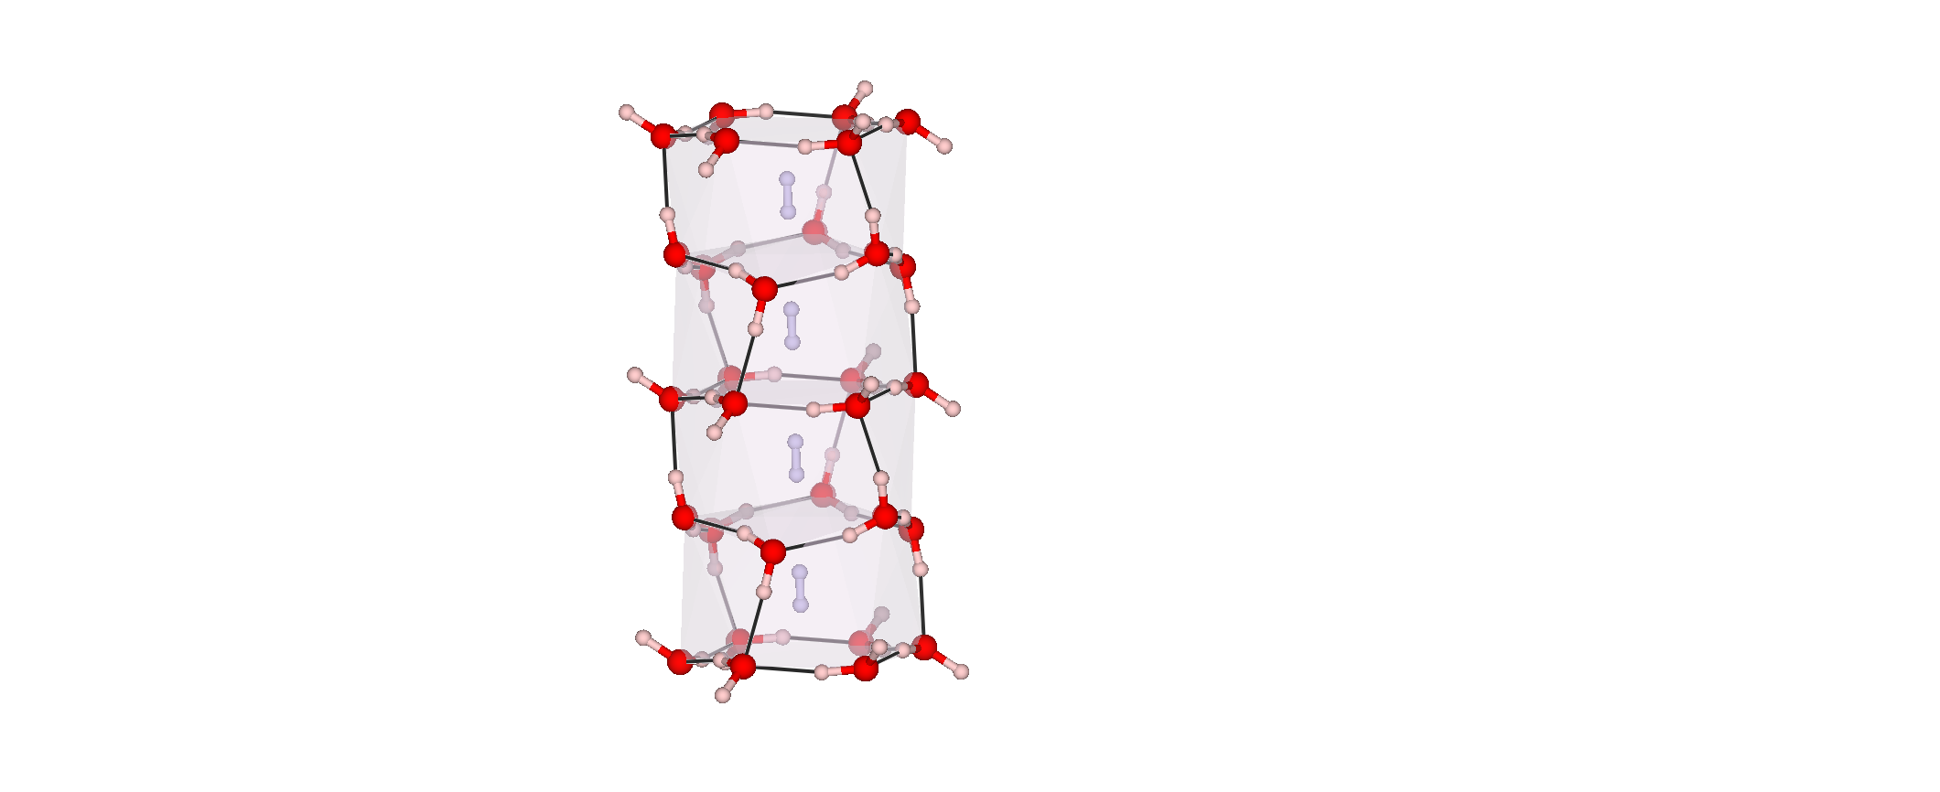
Filled ice phases
Clathrate structures:
Apply
pressure

Slide 11


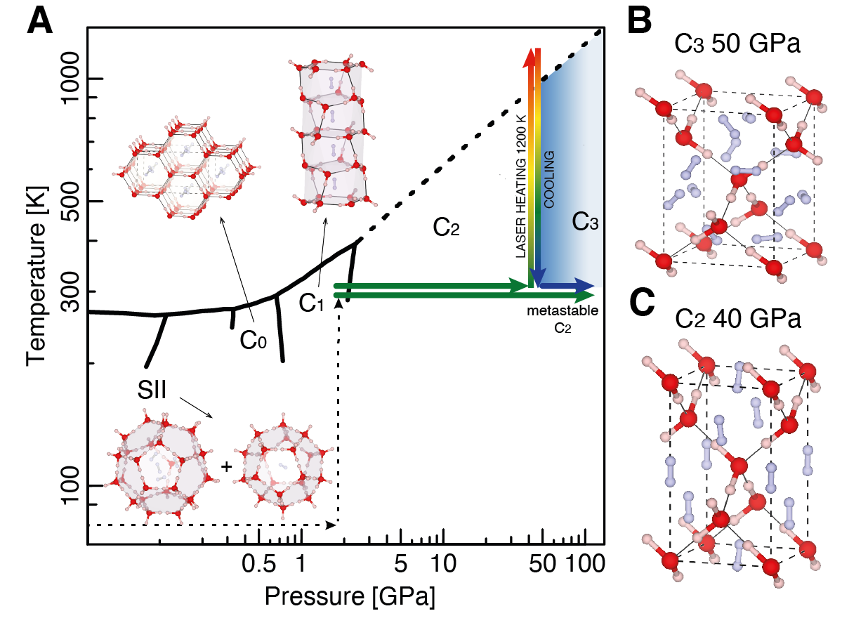
Ic structure for water molecules
H2:H2O ratio is 2:1
Ic structure for water molecules
H2:H2O ratio is 1:1
Notes:
While working on this system with Simone Di Cataldo, a theoretitian from Sapienza university he performed MD simulations in order to study the hydrogen dynamics in the C2 phase..

Slide 12
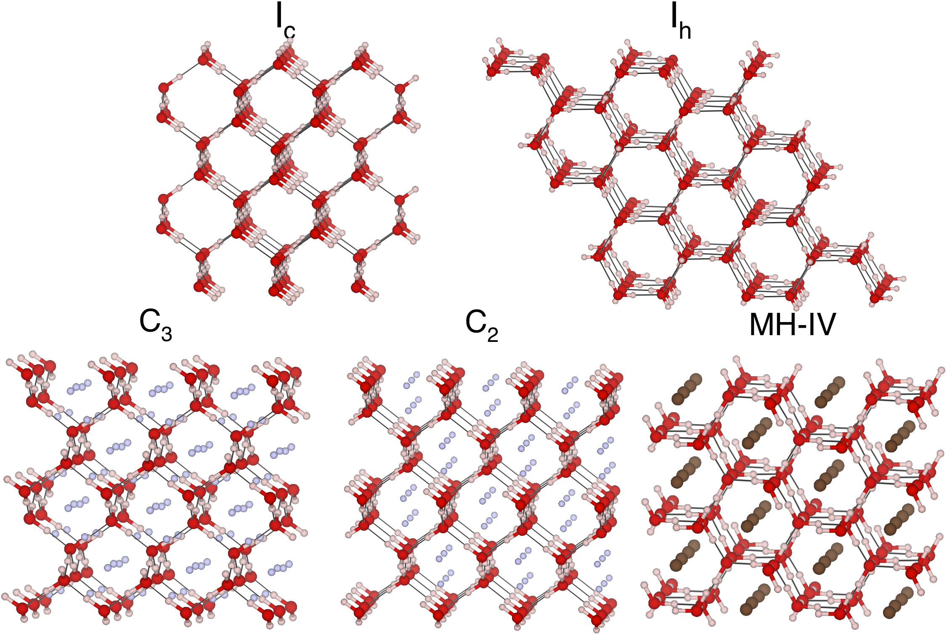
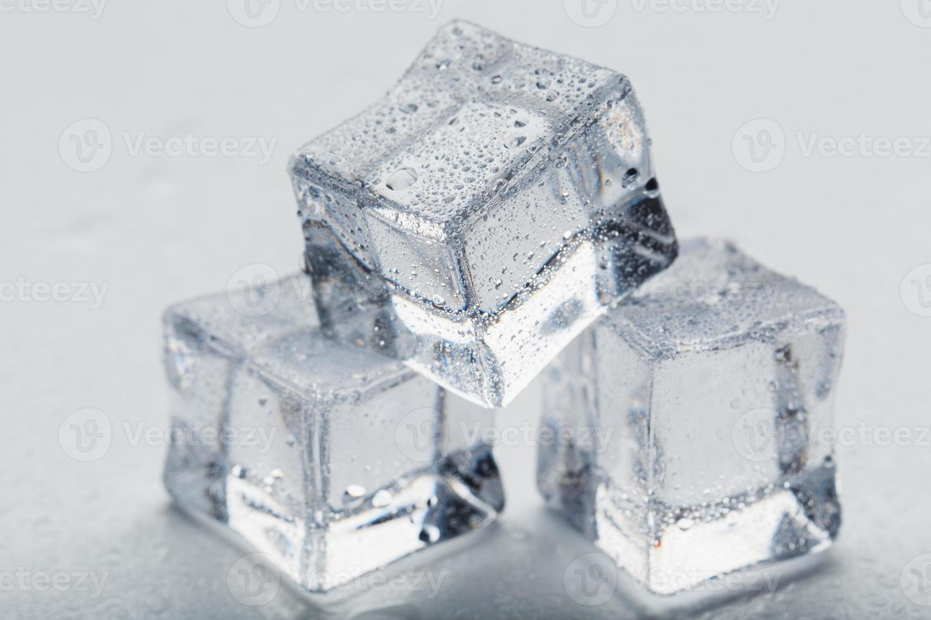
Notes:
While working on this system with Simone Di Cataldo, a theoretitian from Sapienza university he performed MD simulations in order to study the hydrogen dynamics in the C2 phase..

Slide 13
Hydrogen storage applications
Notes:
If we mix water with most gas at low temperature and a little bit of pressure, they form gas clathrates…
These systems are widely studied for several reasons, both for foundamental and astrochemical reasons, but also for applications porpuses. As an example Co2 and methane clathreate, and their mixed clathrate, are studied for their potential applications for co2 sequestration and methane recovery. I have been essentially working on hydrogen hydrate, which is really interestening for its potential appications as hydrogen storage material. What is interesting is that many of these clathrate phases do not collaps when compressed…

Slide 14
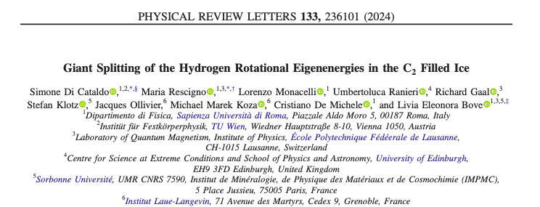

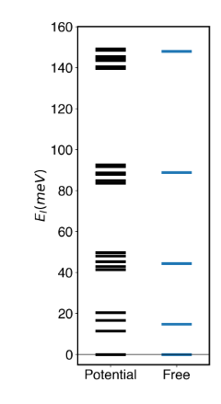
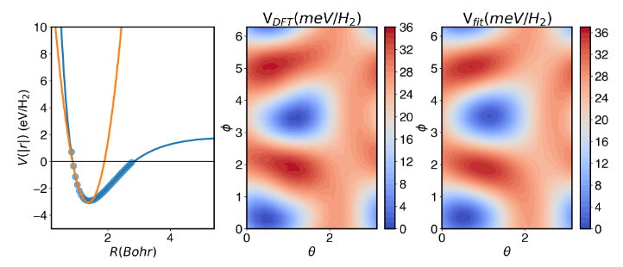

An effective potential is computed from the DFT relaxed C2 structure
The non-harmonic potential breaks the degeneracy in m of the l=1 rotational level

Slide 15
We can measure the splitting of the ortho-para peak with incoherent inelastic neutron scattering

Slide 16
Take home message?
Neutrons are cool
The potentials can be used to then predict other hydrogen dense structures which might be stable at milder conditions
We can simulate the water-gas interaction potential that allows to constrain hydrogen in such small volumes
We can then validate the potential with experimental data

Slide 17

Summary and perspectives
Clathrates are interesting compounds for the chemistry and physics which govern their behaviour and for their potential energetic applications
Future research in this field should be oriented in reducing the barriers to their technological applications:
Pressure-temperature stability regions
Characterization of the mechanism of gas realise and gas uptake
Can we use our fridge ice to store hydrogen?

Slide 18
EXTRA SLIDES

Slide 19
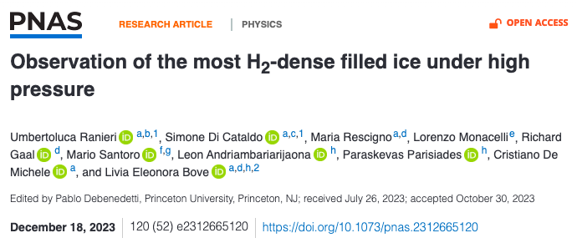

Slide 20
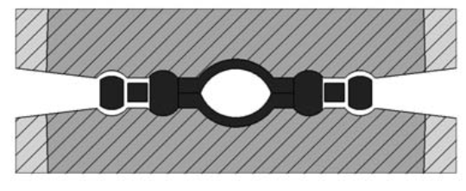
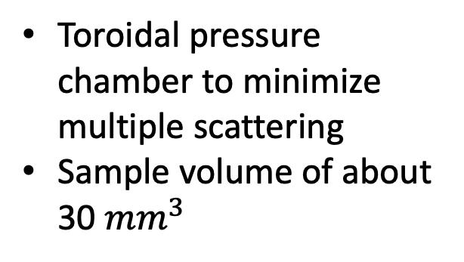
HP-HT QENS setup
Paris Edinburgh Cell
Integrated heating system: max T 650 K
Pmax= 10 GPa Tmax= 650 K
Also normal gasket geometry with spherical sample chamber
Integrated heating system
Toroidal pressure chamber to minimize multiple scattering
Sample volume of about 30 ${mm}^{3}$
L.E.B., S. Klotz, J. Philippe., Patent n° F2314567 (2016)

Slide 21
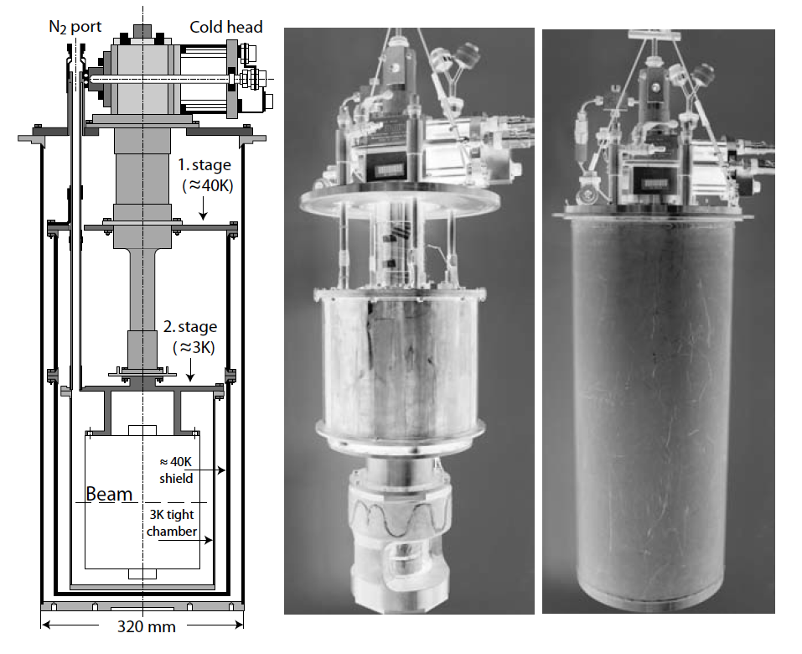
HP-LT setup
PEC can be inserted in a cryostat and cooled down to 4 K
Maximum pressure for QENS or INS is about 10 GPa
Lab meeting- December 7th
Notes:
20

Slide 22
Hydrogen Hydrate sample preparation
1st method: ice-gas interface.
2nd method: gas loading

Slide 23
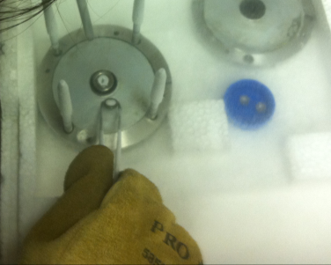
Cryo-loading the Paris-Edinburgh Press (Pmax=20 GPa)
The powder sample is pelleted to have the same hemispherical shape of the gasket
The pellet is then transferred in the two hemispheres of the gasket
Lab meeting- December 7th
Notes:
22

Slide 24
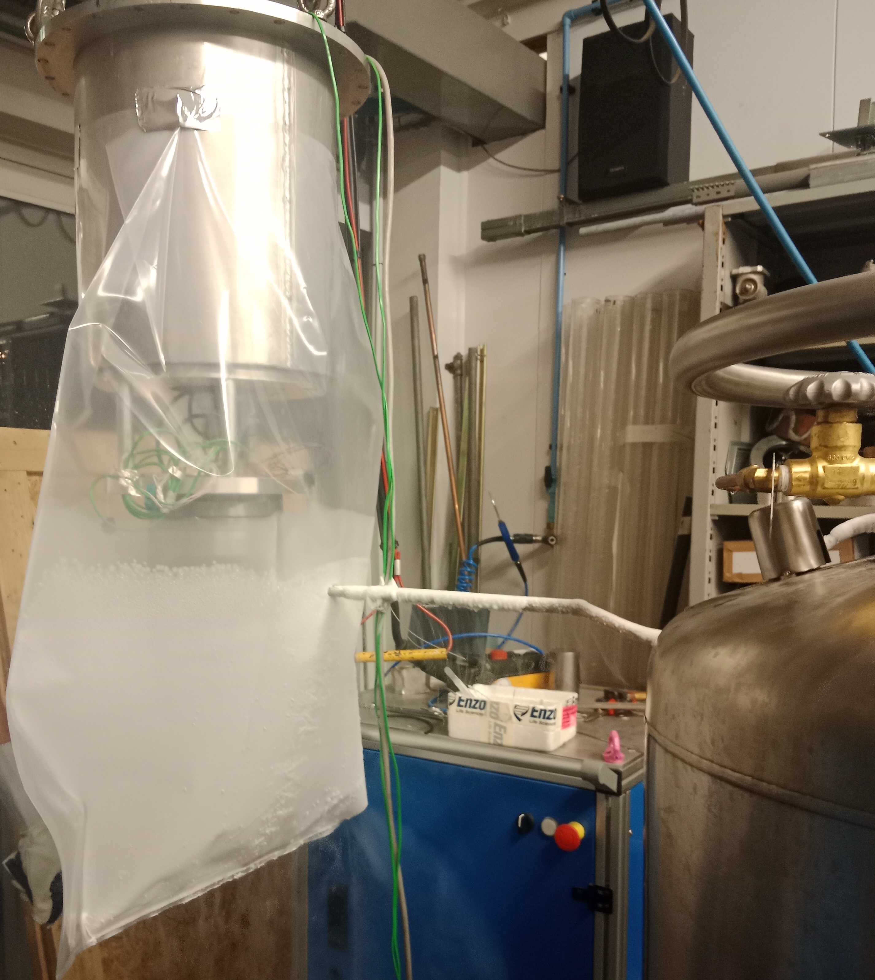
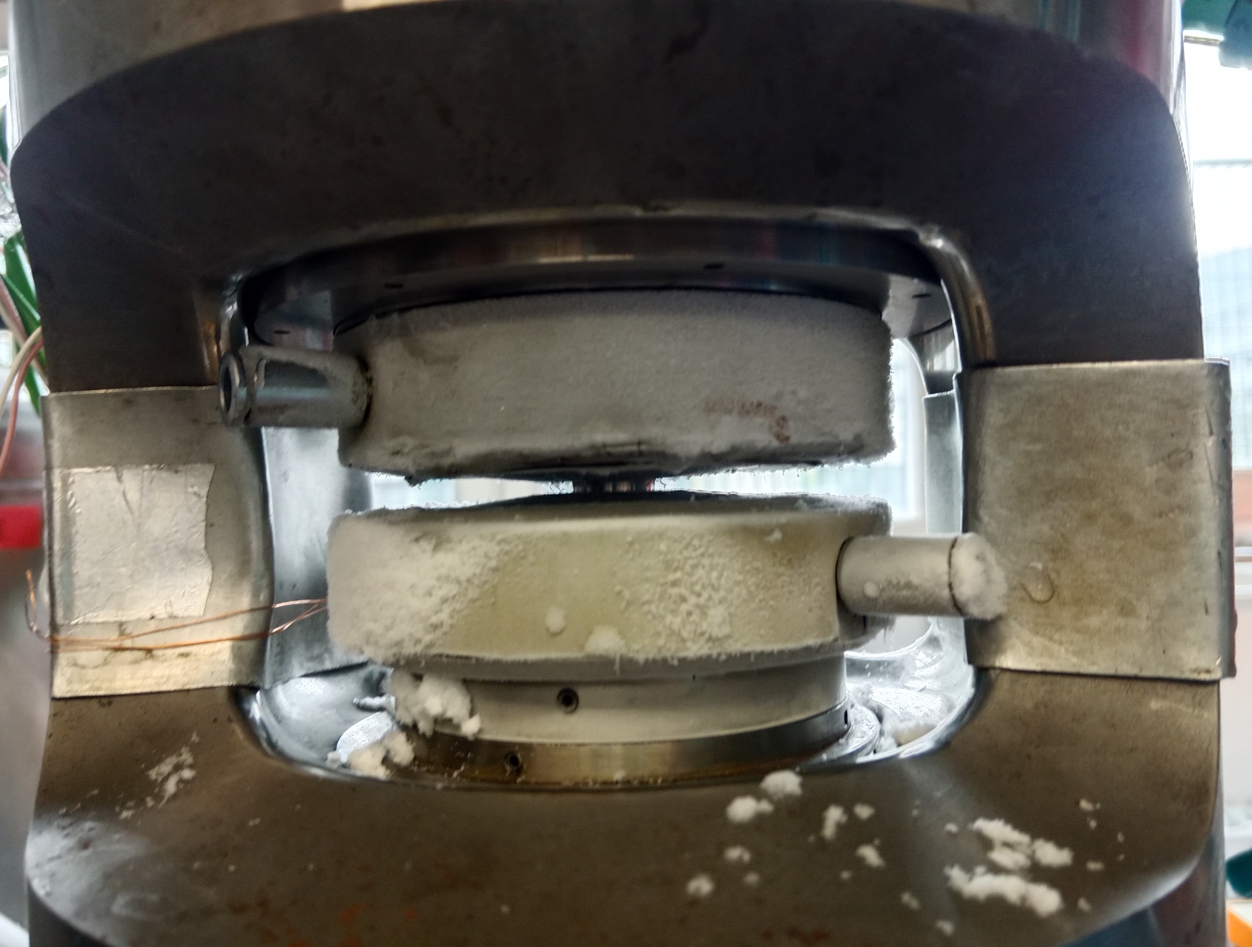
Cryo-loading the Paris-Edinburgh Press (Pmax=20 GPa)
The loaded gasket is then transferred in a clamp modulus, which can be inserted in the PE for further compression and cooling
The loaded gasket can also be quickly transferred in the HP-HT PE setup with pre-cooled anvils
Lab meeting- December 7th
Notes:
This complex sample environment is then inserted in the instrument. In particular we perform most of our experiments on IN5
23

Slide 25
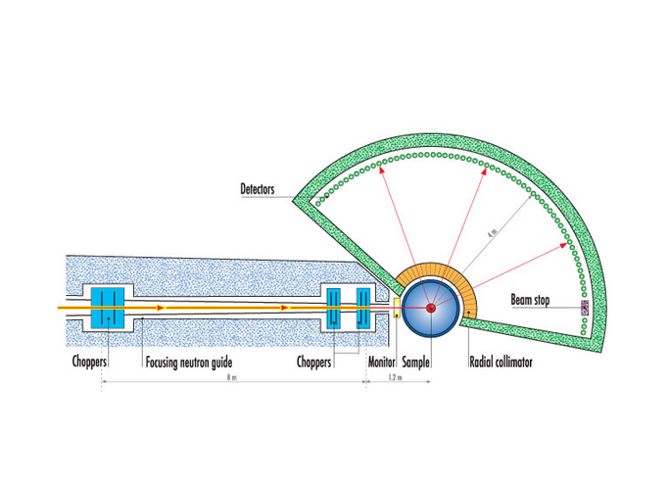
Time of Flight spectrometer: IN5
Monochromatic neutron beam
Position sensitive He3 detectors
Notes:
This concludes my introduction and

Slide 26
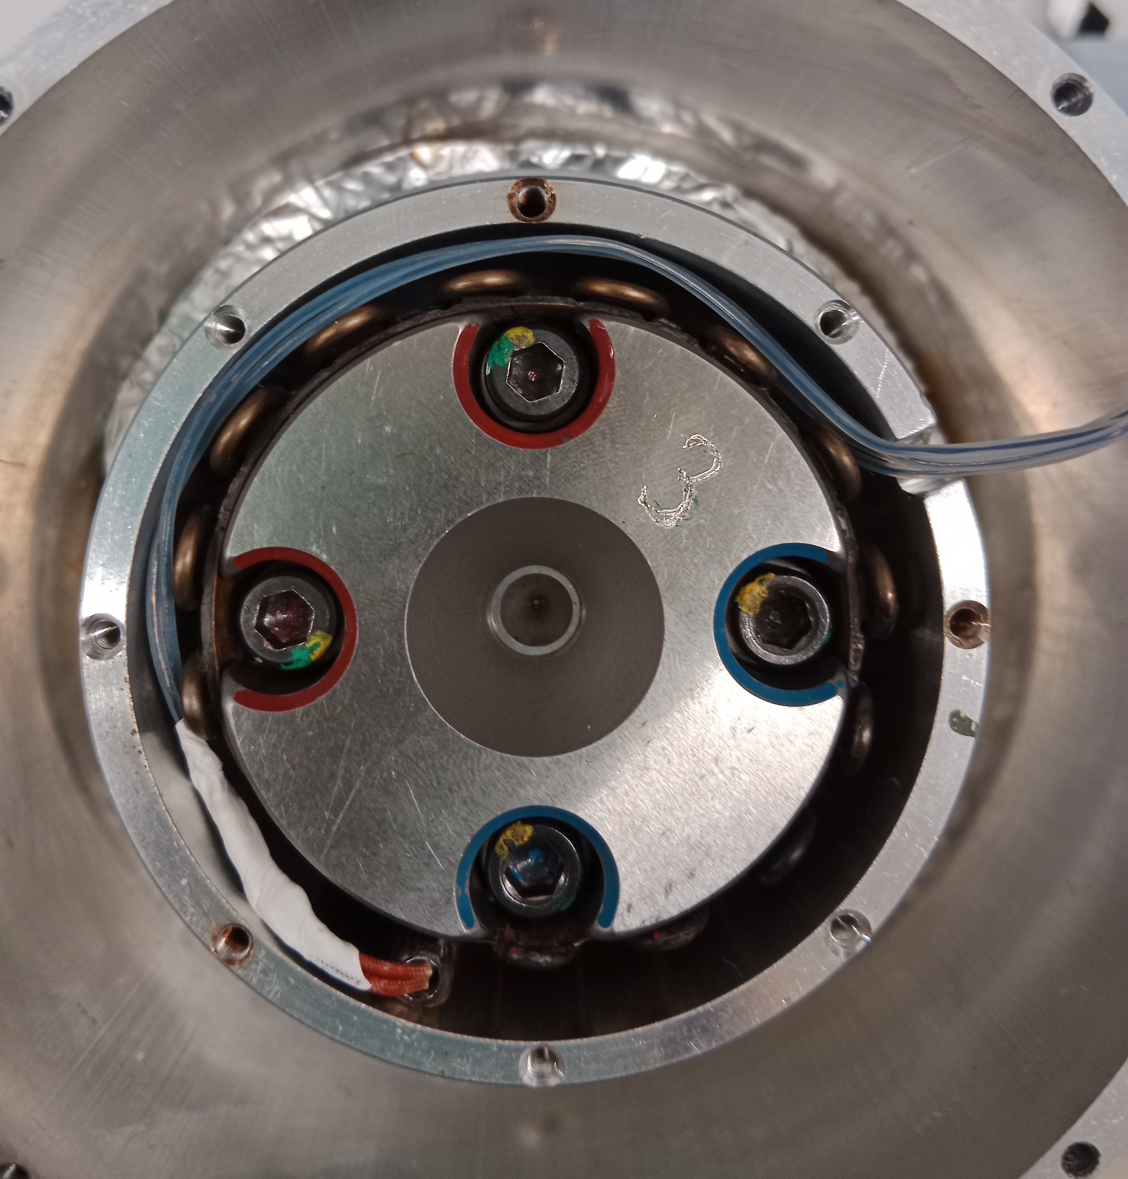

H2O: HP – Raman experiment
Oven that allows to heat up to 600 K
Temperature is controlled through a thermocouple glued to the gasket
Very stable temperature
thermocouple

Slide 27
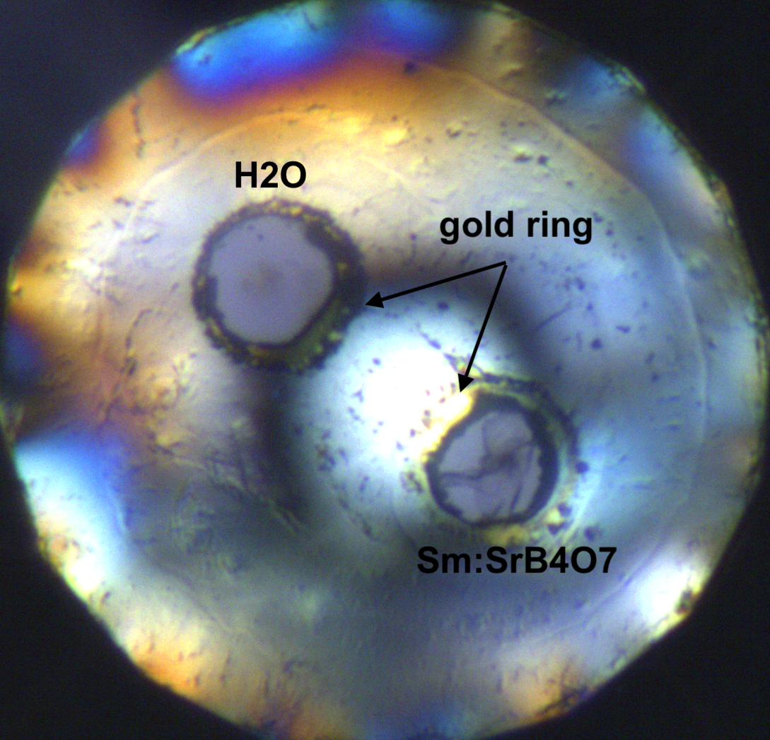
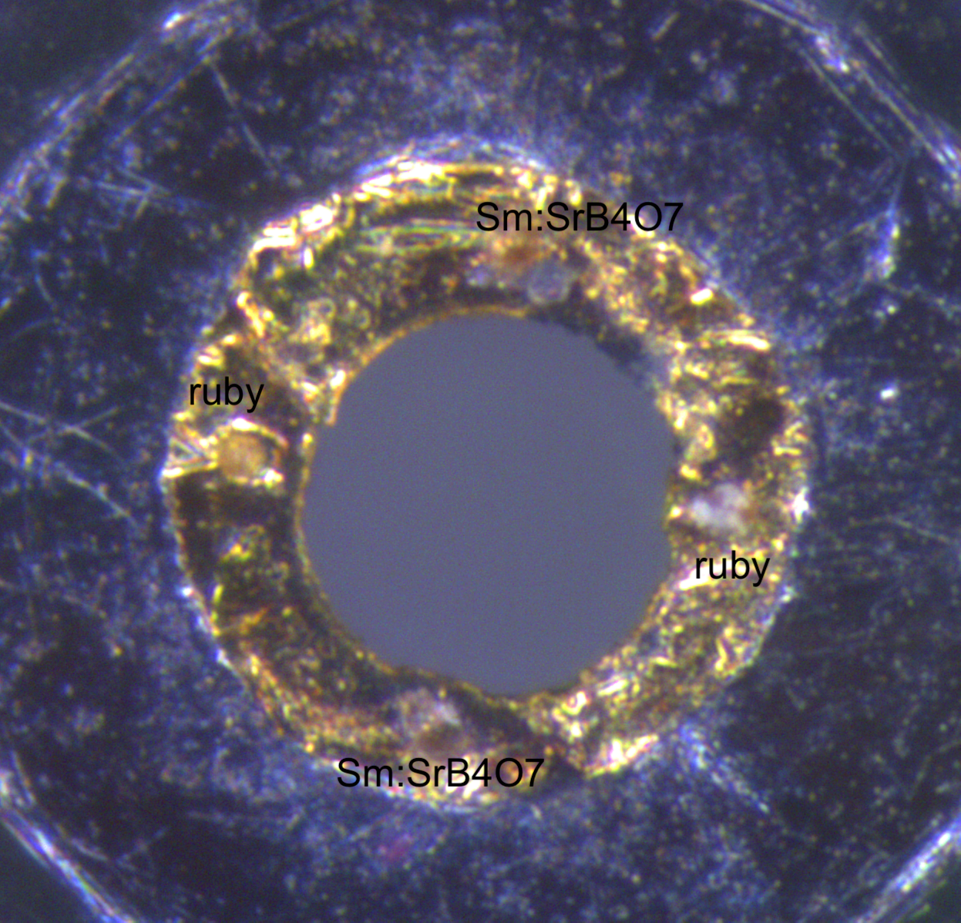
H2O: HP HT– Raman experiment

Slide 28

Hydrogen Hydrate HP
X-ray diffraction at ID15B, ESRF
U. Ranieri*, S. Di Cataldo*, M. Rescigno, L. Monacelli, R. Gaal, M. Santoro, L. Andriambariarijaona, P. Parisiades, C. De Michele, and L.E. Bove, PNAS, accepted

Slide 29
Hydrogen Hydrate HP Raman experiment
U. Ranieri*, S. Di Cataldo*, M. Rescigno, L. Monacelli, R. Gaal, M. Santoro, L. Andriambariarijaona, P. Parisiades, C. De Michele, and L.E. Bove, PNAS, accepted

Slide 30
Hydrogen Hydrate HP Raman experiment
U. Ranieri*, S. Di Cataldo*, M. Rescigno, L. Monacelli, R. Gaal, M. Santoro, L. Andriambariarijaona, P. Parisiades, C. De Michele, and L.E. Bove, PNAS, accepted

Slide 31
C3: the most hydrogen dense filled ice

Slide 32
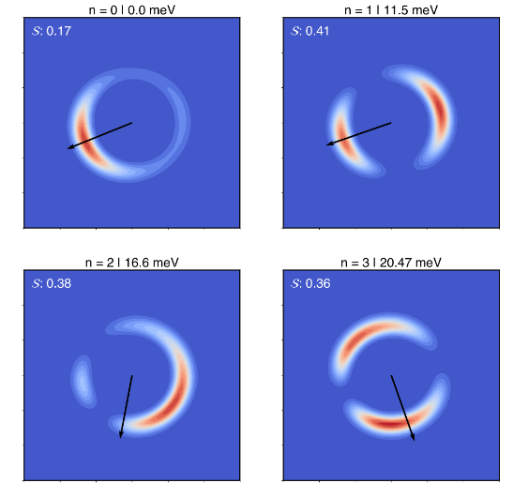
DFT calculations and Schrödinger equation solution
n = 0 J=0
n = 0 J=1 m=-1
J=1
The first excited
state wavefunction is oriented along the same axis as the
ground state
n = 0 J=1 m=0
n = 0 J=1 m=1

Slide 33
Gas Hydrates
Ice Ih
Ice II
Ice Ic
Notes:
But they transform into filled ice phases

Slide 34
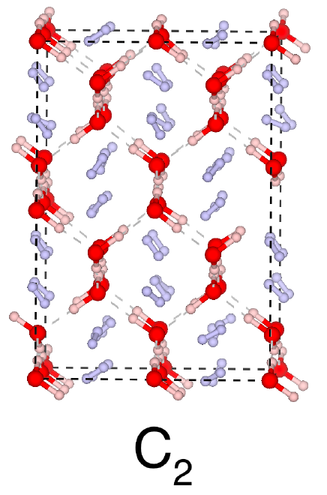
Molecular Dynamics simulations
S. Di Cataldo & M. Rescigno et al, under submission
Notes:
He observed locking …
We wanted to probe this dynamics but with neutrons for the moment we cannot go to 40 Gpa and as we cool down the hydrogen dynamics becomes quicly quantum, so with simulations we started to look at the quantum dynamics of this system. To do so

Slide 35
DFT calculations and Schrödinger equation solution
The non-harmonic potential breaks the degeneracy in m of the l=1 rotational level
An effective potential is computed from the DFT relaxed C2 structure
S. Di Cataldo & M. Rescigno et al, under submission
Notes:
Simone computed an effective potential starting from the DFT relaxed C2 structure solved the shrodinger equation and found that this lifts the degeneracy of the l quantum number we can probe with INS the splitting of the l=1 level

Slide 36
Inelastic Neutron Scattering Experiment
We can measure the splitting of the l=1 level with INS
Ortho-para metastability
l=1 m= -1 is always occupied even at low temperature
I = 1
I = 0
S. Di Cataldo & M. Rescigno et al, under submission
Notes:
Hydrogen has two different spin isotopes ortho I =0 para I = 1 and for total wavefunction symmetri constraints

Slide 37
Inelastic Neutron Scattering Experiment
We can measure the transitions in the neutron energy gain side of the dynamical structure factor
S. Di Cataldo & M. Rescigno et al, under submission

Slide 38
Inelastic Neutron Scattering Experiment
As temperature is raised the higher energy levels populate and we can measure also the transitions from m=0 l=1 and m=1 l=1
S. Di Cataldo & M. Rescigno et al, under submission

Slide 39
Inelastic Neutron Scattering Experiment
We performed two experimental runs on IN5, ILL
The sample is cryogenically loaded in the LT PE setup
The sample is then compressed to 6 GPa and cooled down
We then measure the dynamical structure factor while heating
S. Di Cataldo & M. Rescigno et al, under submission

