Slide 1
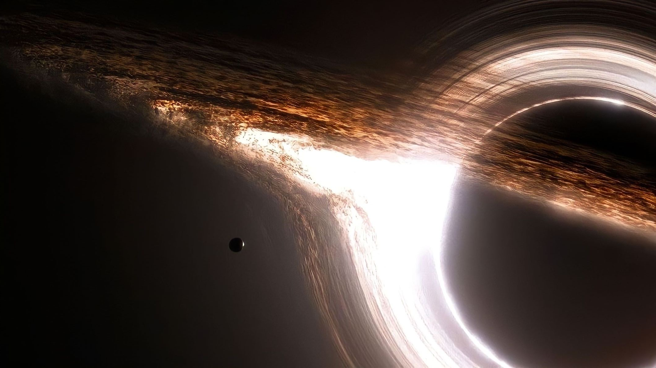
RINGING BLACK HOLES:
the soundtrack of spacetime
05/02/2025
PhD student
Romeo Felice Rosato

Slide 2
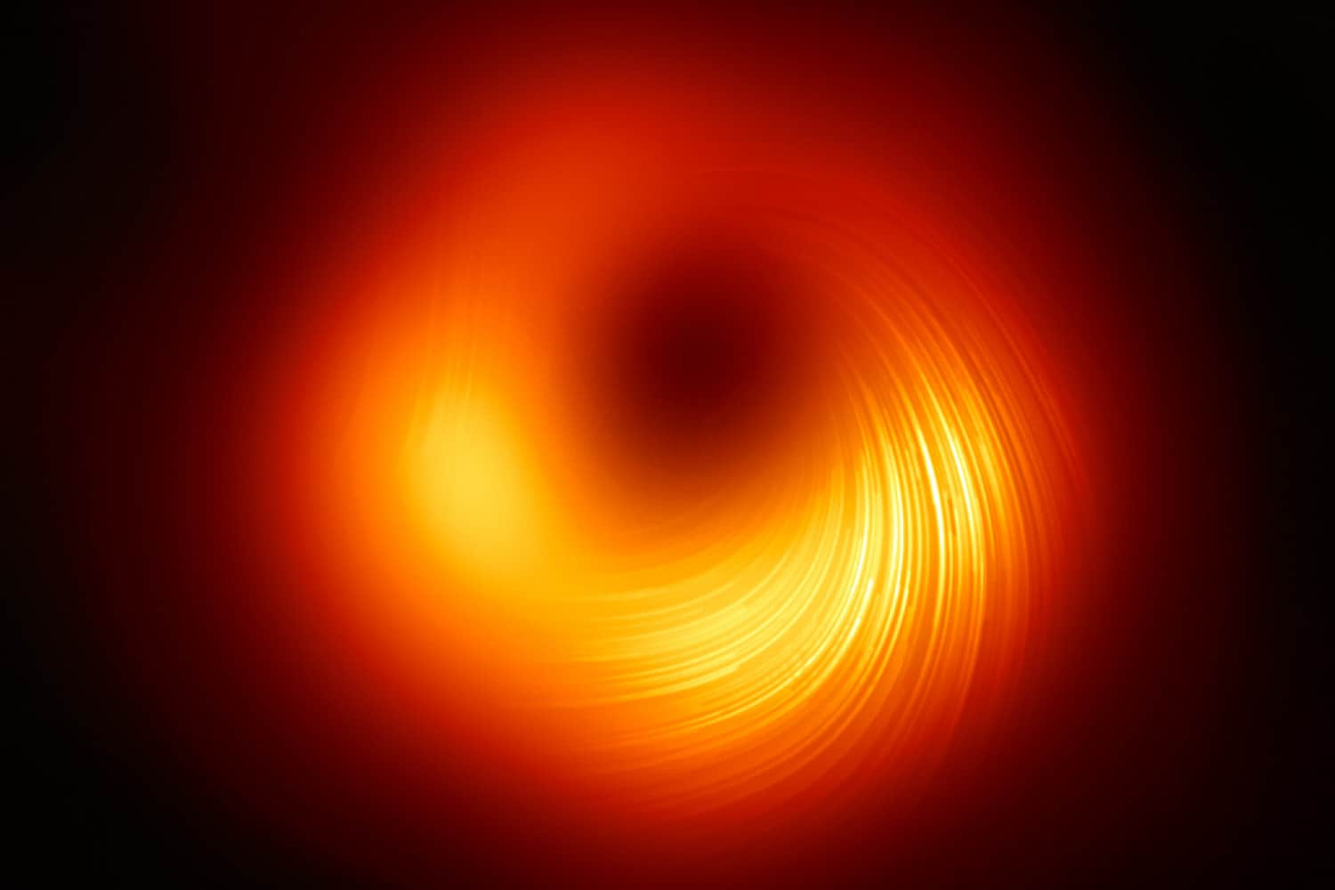
Overview of the talk
Binary coalescences & Perturbation theory: easy introduction and main ideas.
Quasinormal modes: definition and general properties.
Environmental effects & stability.

Slide 3
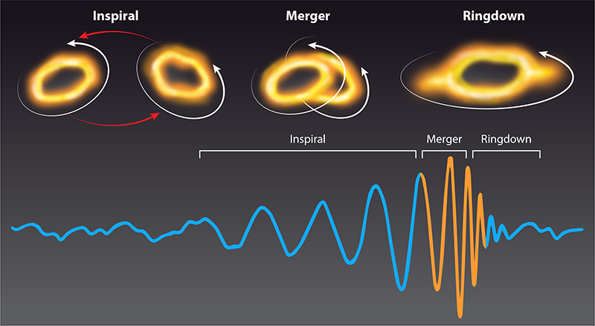
1. BINARY COALESCENCES
Binary coalescences are strong gravitational events. Their phenomenology is really rich.
In black hole physics, perturbation theory provides a framework to study the final stage of the coalescence signal: the relaxation phase, during which the system settles into a new configuration - specifically, the newly formed black hole.

Slide 4
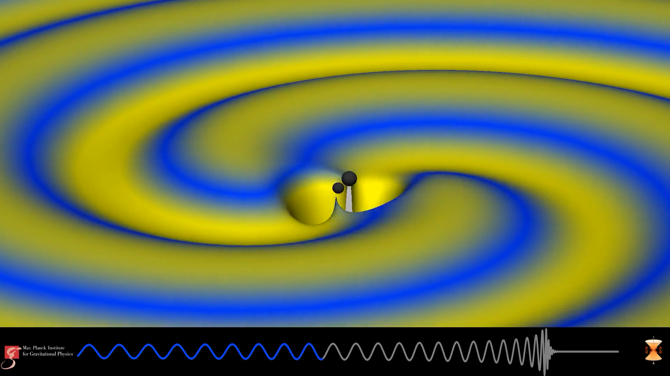

Slide 5
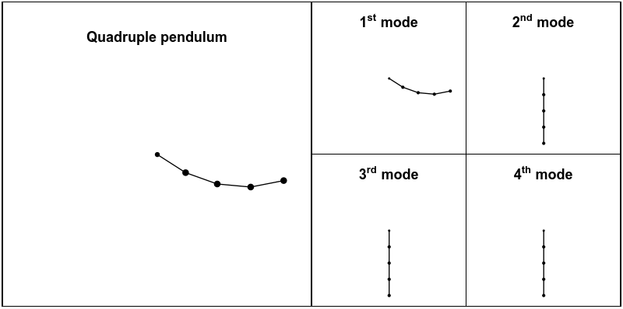
1.1 PERTURBATION THEORY
General Relativity describes gravitational phenomena within a purely geometrical framework. How can we apply perturbation theory to spacetime?
Let's go back a step: CLASSICAL MECHANICS!
When a system is perturbed, it reacts by oscillating in specific normal modes.
specific pattern of oscillation in which all parts of the system move with the same frequency.
NORMAL MODE

Slide 6
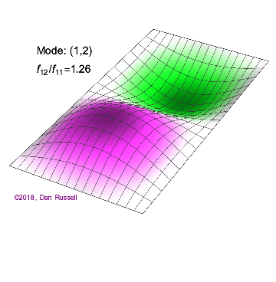
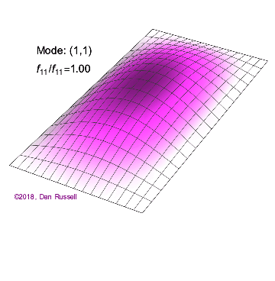
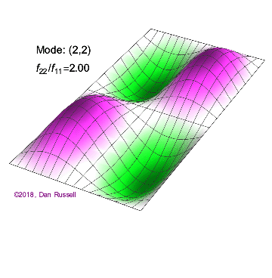
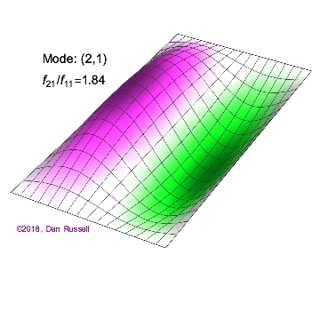
E.g. elastic trampoline

Slide 7
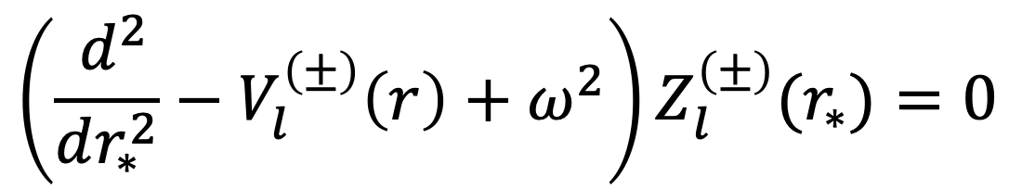
1.2 PERTURBATIONS OF A SCHWARZSCHILD BLACK HOLE
Perturbations of a Schwarzschild BH can be described through Regge-Wheeler and Zerilli equations.
REGGE-WHEELER ZERILLI EQUATIONS
$$\left(\frac{ d^{2}}{dr_{∗}^{2}}−V_{l}^{\left(±\right)}\left(r\right)+ω^{2}\right)Z_{l}^{\left(±\right)}(r_{∗})=0$$
$\left(+\right)→$Polar perturbation $\left(−\right)→$ Axial perturbation
$Z_{l}^{\left(±\right)}(r_{∗})$ is a radial function connected to the emitted gravitational waves at infinity.

Slide 8
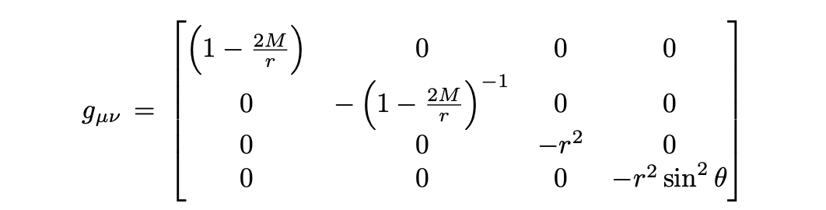
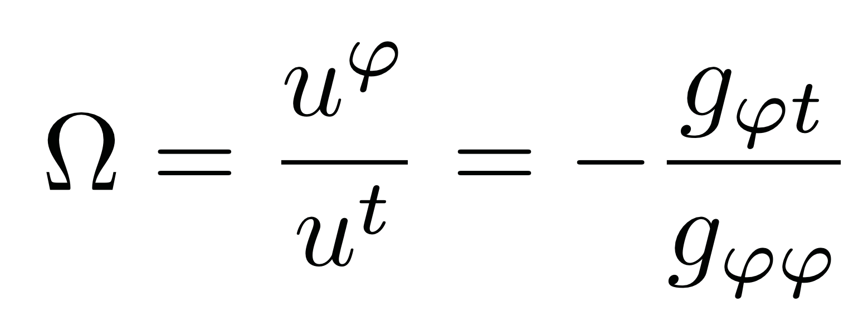

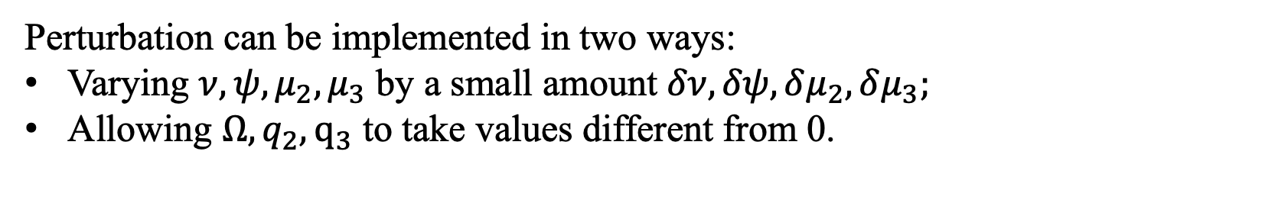
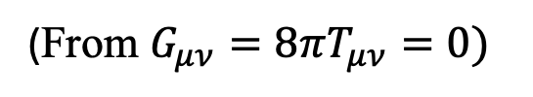
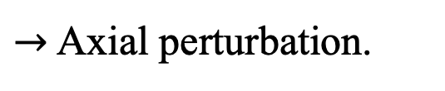

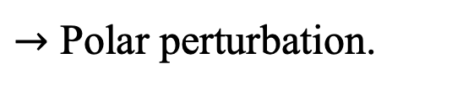
1.2 PERTURBATIONS OF A SCHWARZSCHILD BLACK HOLE
Background metric
This solves Einstein Equations in vacuum
$$R_{μν}=0.$$
(From $G_{μν}=8πT_{μν}=0)$
$$g_{μν}→g_{μν}+h_{μν}$$
Because of a small perturbation:
$$R_{μν}→R_{μν}^{(0)}+R_{μν}^{(1)}$$
Background.
Perturbations.
Perturbations will obey the equation $R_{μν}^{(1)}=0.$
Perturbation can be implemented in two ways:
Varying $ν,ψ,μ_{2},μ_{3}$ by a small amount $δν,δψ,δμ_{2},δμ_{3};$
Allowing $Ω,q_{2},q_{3}$ to take values different from 0.
$→$ Polar perturbation.
$→$ Axial perturbation.
Frame dragging, as example:

Slide 9




2. QUASINORMAL MODES
We seek to determine those frequency eigenvalues of previous equation corresponding to free oscillations of the system.
Notice: Regge-Wheeler and Zerilli equations admit plane waves as asymptotic states ($r_{∗}→±∞$).
EVENT HORIZON: $r_{∗}→−∞$
FAR REGION: $r_{∗}→+∞$
Purely ingoing waves.
Purely outgoing waves.
$${Z\left(r_{∗}→−∞\right)=e}^{−iωr_{∗}}$$
$${Z\left(r_{∗}→+∞\right)=e}^{+iωr_{∗}}$$

Slide 10
2. QUASINORMAL MODES
QNMS BOUNDARY CONDITIONS
$e^{ıω_{ql}r_{∗}}$ $r_{∗}→∞$
$Z_{l}^{\left(±\right)}\left(r_{∗}\right)$
$e^{−ıω_{ql}r_{∗}}$ $r_{∗}→−∞$

Slide 11
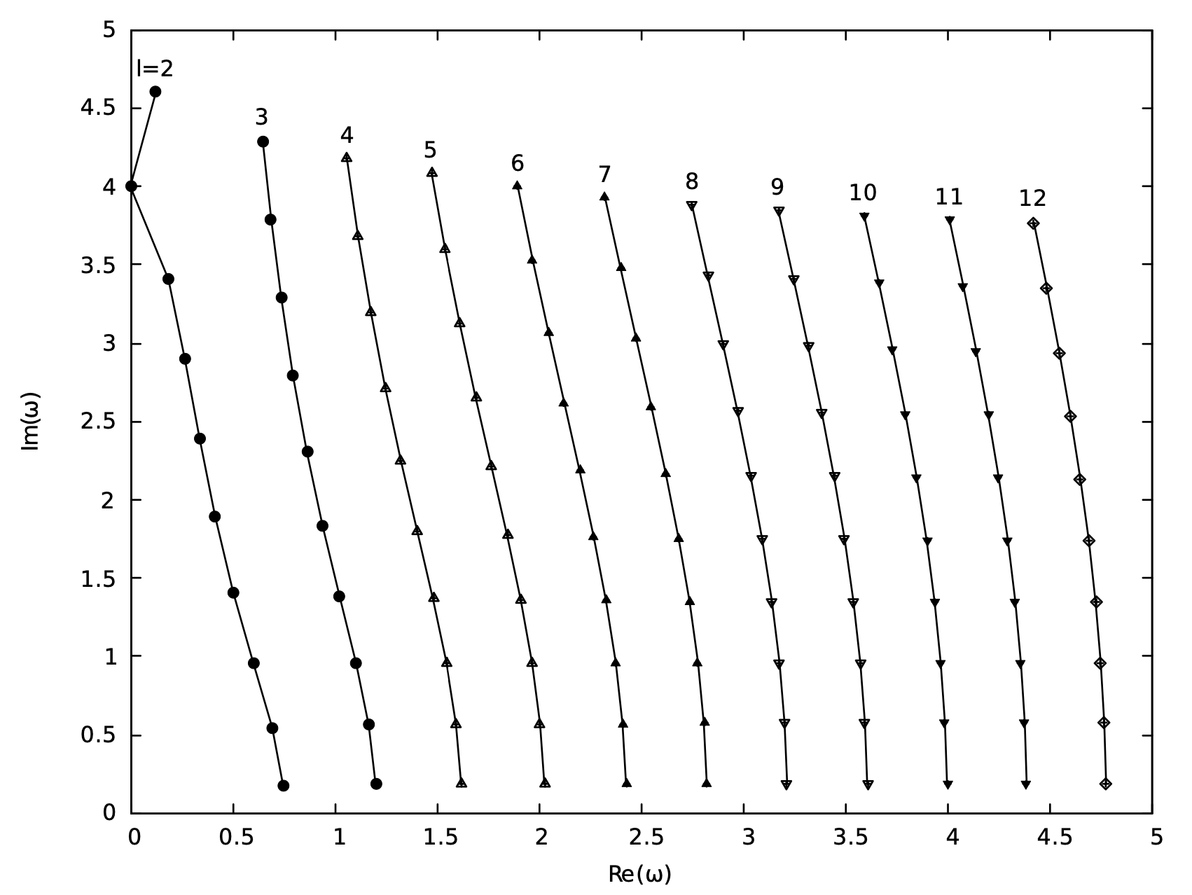
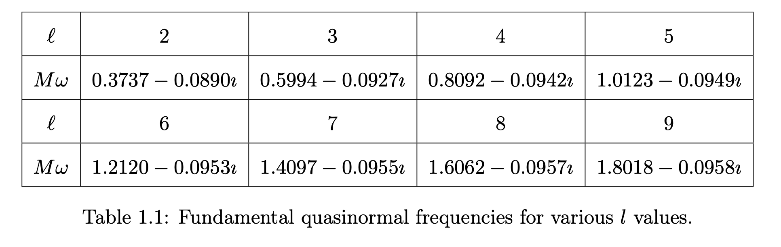
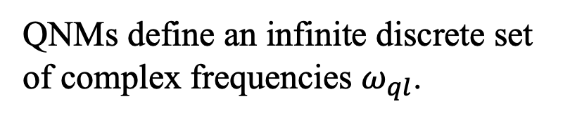
2. QUASINORMAL MODES
QNMs define an infinite discrete set of complex frequencies $ω_{ql}$.
2M
FUNDAMENTAL MODE!
2M
(1) An analytic representation for the quasi-normal modes of Kerr black holes, E.W. Leaver, Proc. R. Soc. Lond. A 402, 10.1098/rspa.1985.0119, 1985.

Slide 12

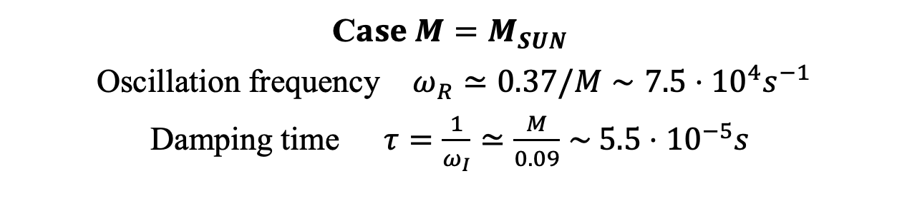
2. QUASINORMAL MODES
E.G. fundamental mode $l=2$.
$$ω_{q}=ω_{R}−iω_{I}$$
$$e^{−iωt}={e^{iω_{R}t}e^{−ω_{I}t}}_{ }$$
In the Fourier mode
C$ase M=M_{SUN}$
Oscillation frequency $ω_{R}≃0.37/M∼7.5⋅{10}^{4}s^{−1}$
Damping time $τ=\frac{1}{ω_{I}}≃\frac{M}{0.09}∼$ $5.5⋅{10}^{−5}s$

Slide 13
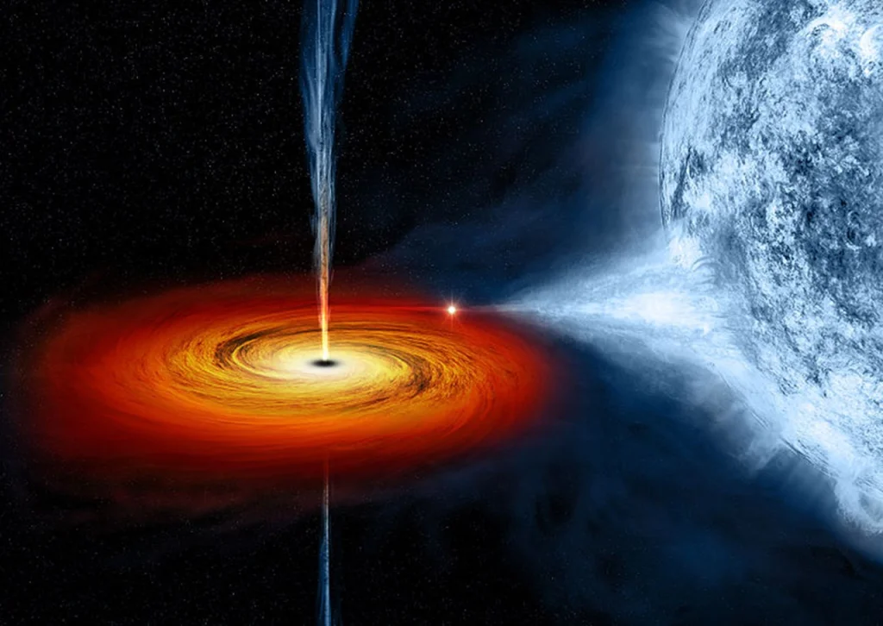
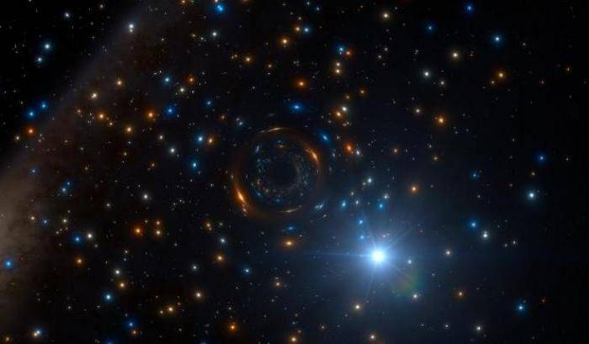
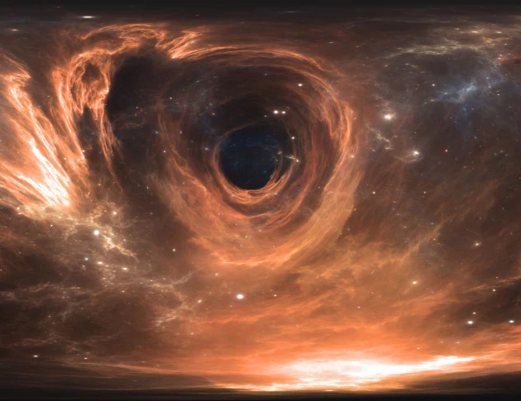
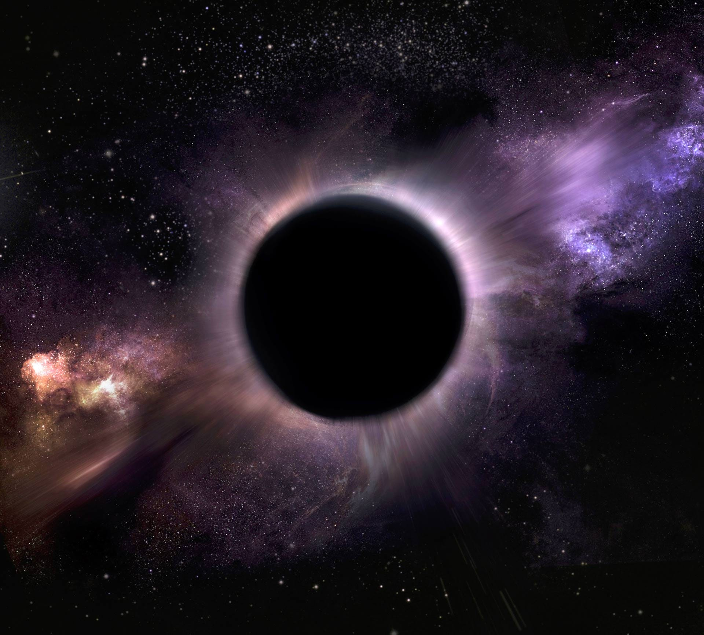
3. ENVIRONMENTAL EFFECTS

Slide 14
3. ENVIRONMENTAL EFFECTS
BHs are immersed in an astrophysical environment. Such an environment can affect the study of perturbations.
TOY MODEL
$$V_{l}^{new}\left(r\right)=V_{l}\left(r\right)+\frac{ε}{M^{2}}{sech}^{2}\left(\frac{r_{∗}−c}{M}\right)$$
BUMP
(2) Can environmental effects spoil precision gravitational-wave astrophysics?, E. Barausse et al., P. R. D, 89, A.P.S., https://link.aps.org/doi/10.1103/PhysRevD.89.104059, 2014.

Slide 15


3. ENVIRONMENTAL EFFECTS
We want to determine wether physical quantities are stable or not under environmental effects.
STABLE QUANTITY
UNSTABLE QUANTITY
It perturbatively reacts to the environment.
It completely changes because of the environment.
Relative variation $𝒪\left(ε\right).$
Relative variation >>$𝒪\left(ε\right).$

Slide 16
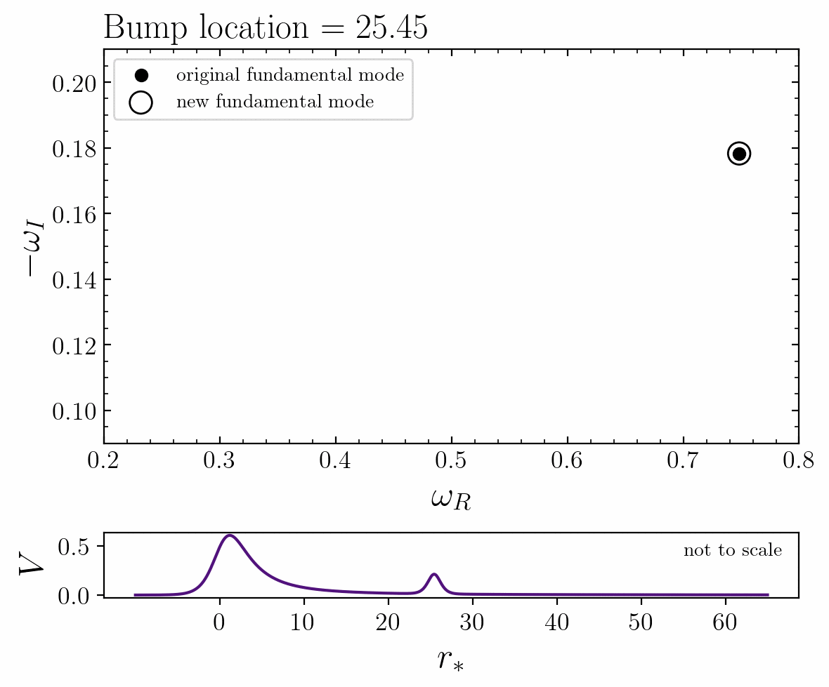
3.1 QNMS REACTION
$$ε={10}^{−6}$$
$2M=1$ units
(2) Destabilizing the Fundamental Mode of Black Holes: The Elephant and the Flea, M.H. Cheung et. al., PRL 128, http://dx.doi.org/10.1103/PhysRevLett.128.111103, 2021.

Slide 17
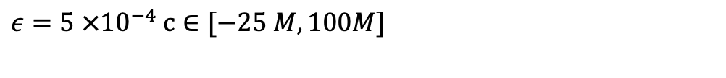
3.1 QNMS REACTION
$ε={5 ×10}^{−4}$ $c∈[−25 M,100M]$
(3) Ringdown stability: greybody factors as stable gravitational wave observables, Romeo Felice Rosato, Kyriakos Destounis, Paolo Pani.Phys.Rev.D 110 (2024) .

Slide 18
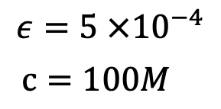
3.2 TIME-DOMAIN STABILITY
$$ε={5 ×10}^{−4}$$
$c=100M$
(3) Ringdown stability: greybody factors as stable gravitational wave observables, Romeo Felice Rosato, Kyriakos Destounis, Paolo Pani.Phys.Rev.D 110 (2024) .

Slide 19
Main takeaways
Some gravitational events can be described using regular perturbation theory, leading to a Schrödinger-like wave equation.
Black holes oscillate at characteristic frequencies called quasi-normal modes, which are complex due to energy loss in the process.
If a black hole is immersed in an astrophysical environment, the latter will influence the study of perturbations.

Slide 20
Thank you for listening ☺.

