Slide 1
A sub 100-ps LSB Time-to-Digital Converter based on a Pseudo-Differential Ring Oscillator in a 110 nm CMOS Technology
differential ring oscillator in
Master’s Degree of
Tommaso Maria Floris
Supervisor: Prof. Lodovico Ratti

Slide 2
Outline
Time-to-Digital Converter (TDC)
Architecture: Interpolation based TDC
Resolution Control System
Simulation Results
digital Silicon Photo Multiplier (dSiPM)
Synthesizable dSiPM: Recursive structure
Tools: Xcelium, Genus and Innovus
Preliminary Results

Slide 3
Outline
Time-to-Digital Converter (TDC)
Architecture: Interpolation based TDC
Resolution Control System
Simulation Results
digital Silicon Photo Multiplier (dSiPM)
Synthesizable dSiPM: Recursive structure
Tools: Xcelium, Genus and Innovus
Preliminary Results

Slide 4
Architecture: Interpolation TDC
$$Q_{tot}= 12 bits$$
Notes:
3 LSB + 9 MSB

Slide 5
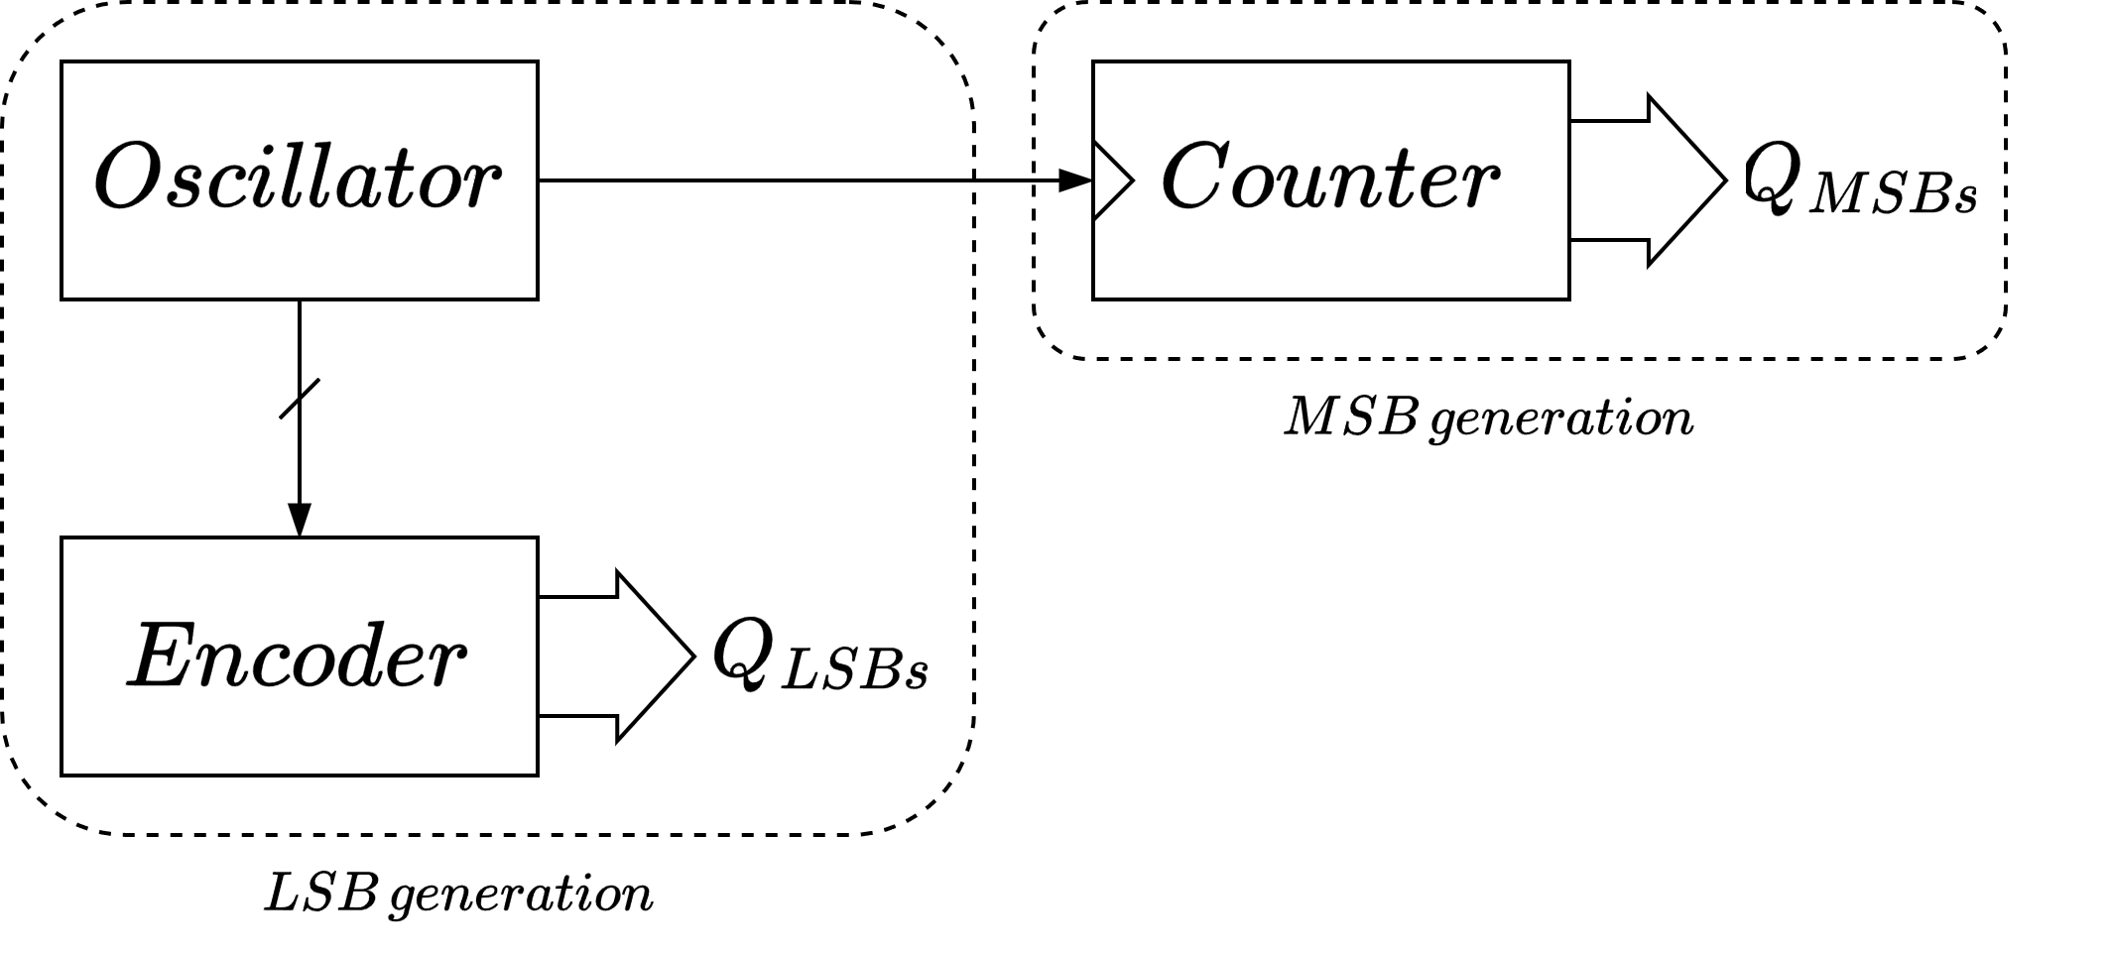
LSBs Generation
$$Q_{LSBs}=3 bits$$

Slide 6
Oscillator Waveforms

Slide 7
Oscillator Waveforms

Slide 8
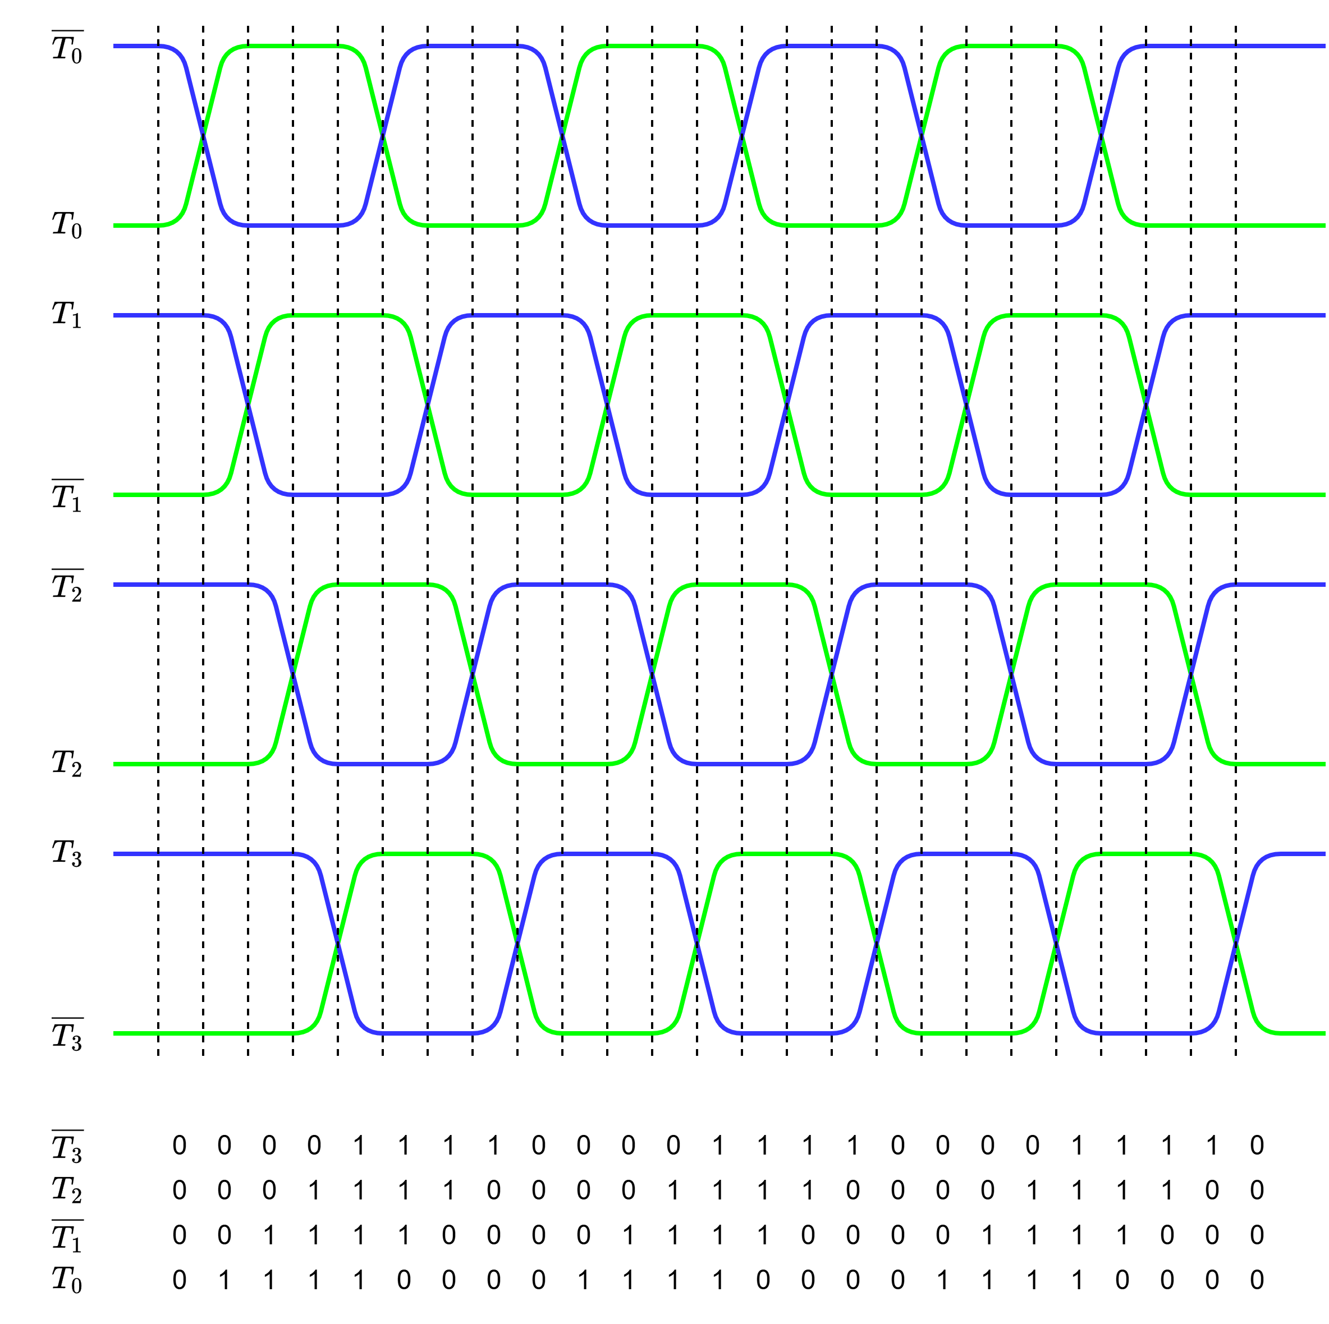
Oscillator Waveforms

Slide 9
Output Decoding
$$LSB: \frac{1}{8}th period$$
Johnson Encoding
$$\overline{T_{3}}T_{2}\overline{T_{1}}T_{0}$$ | Binary Code
0000 | 000
0001 | 001
0011 | 010
0111 | 011
1111 | 100
1110 | 101
1100 | 110
1000 | 111

Slide 10
Pseudo-Differential Ring Oscillator

Slide 11
Oscillator Pseudo-Differential Cell

Slide 12
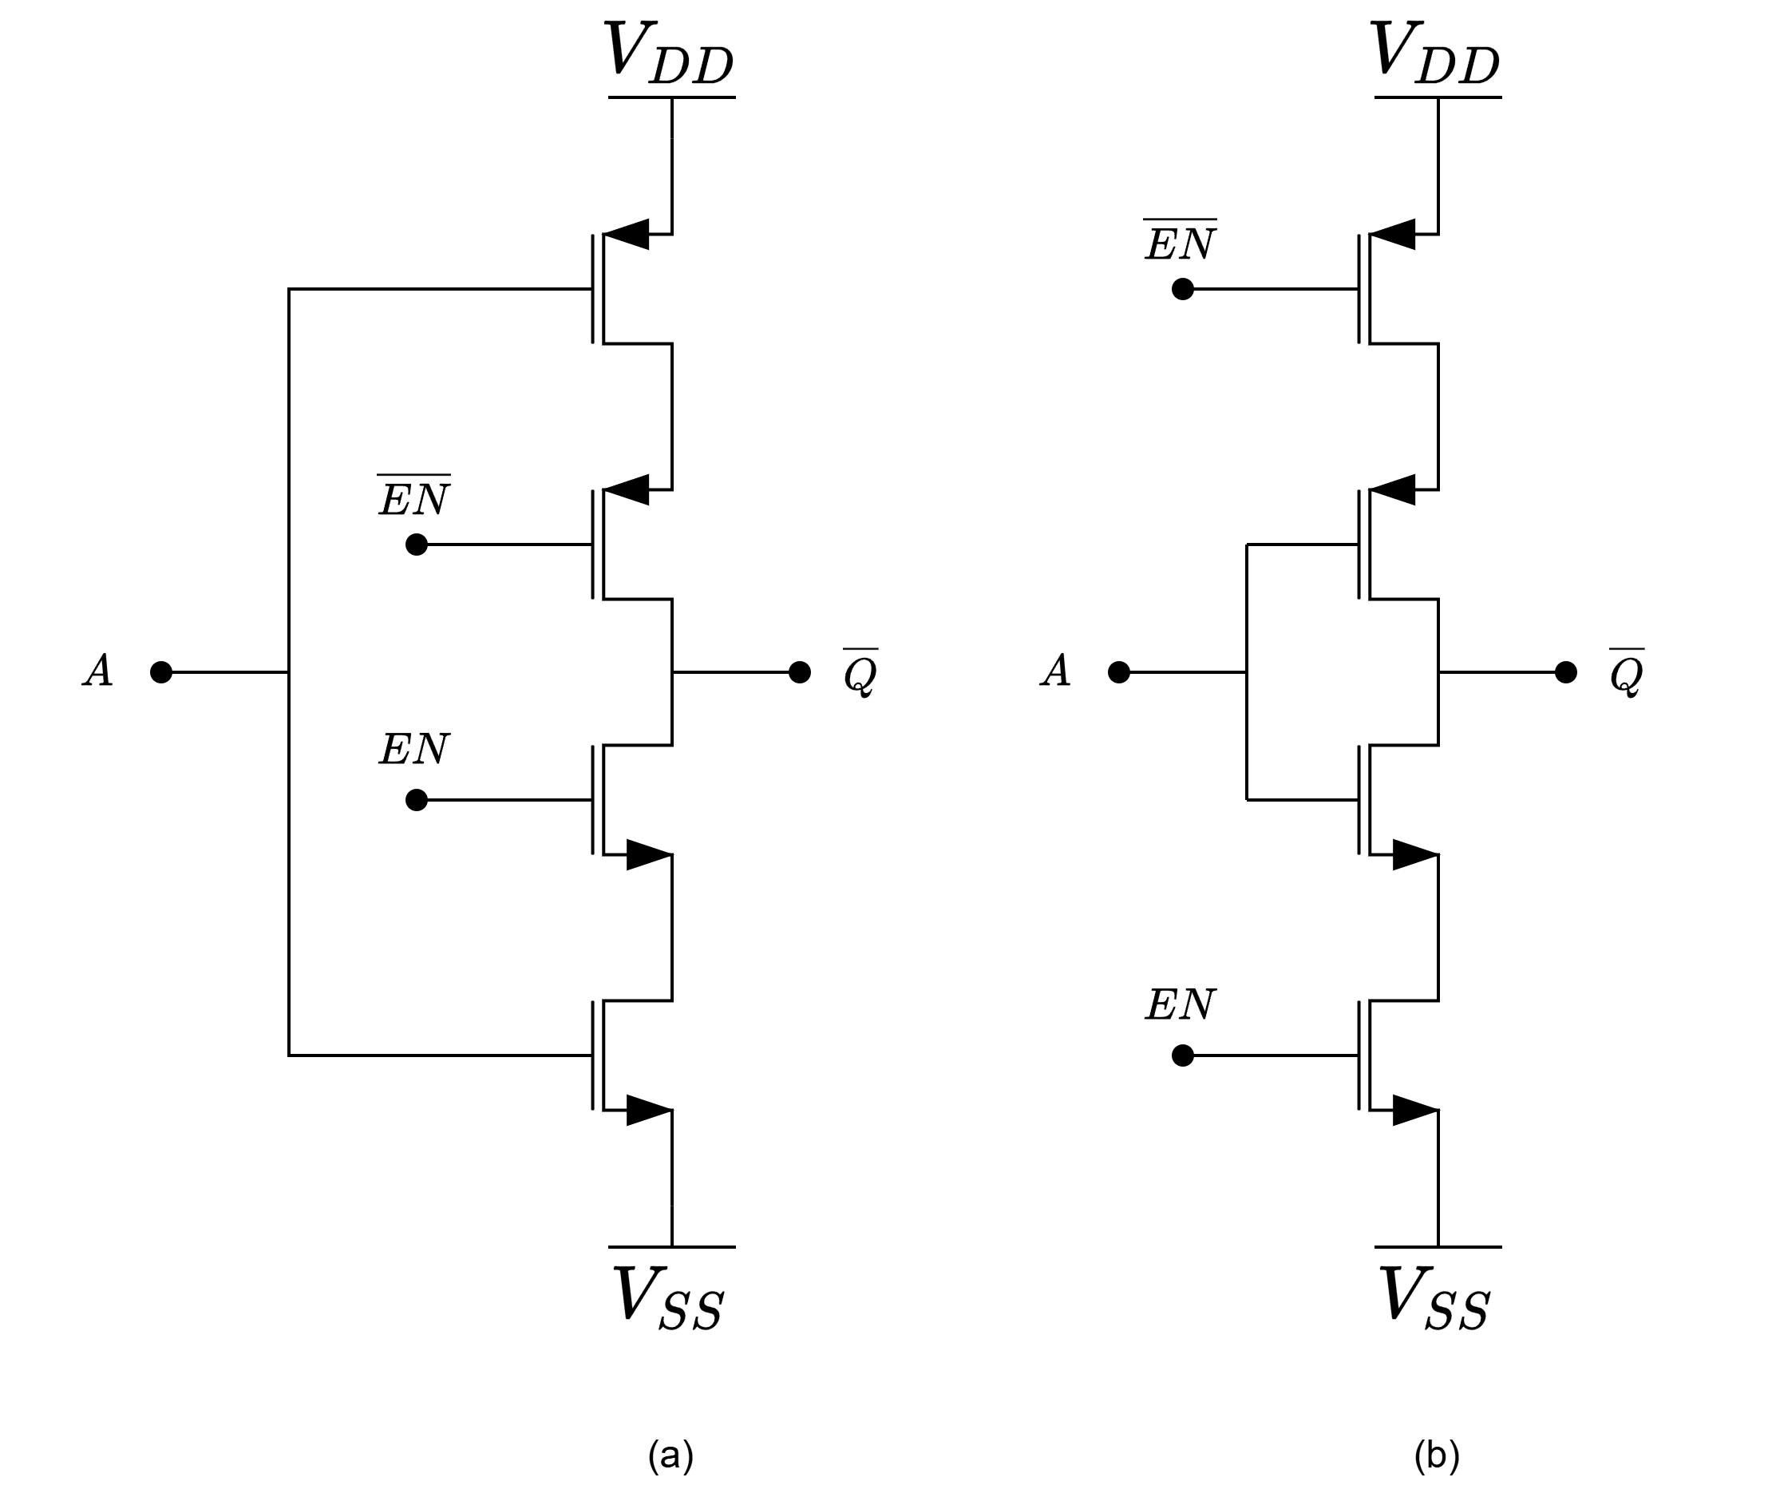
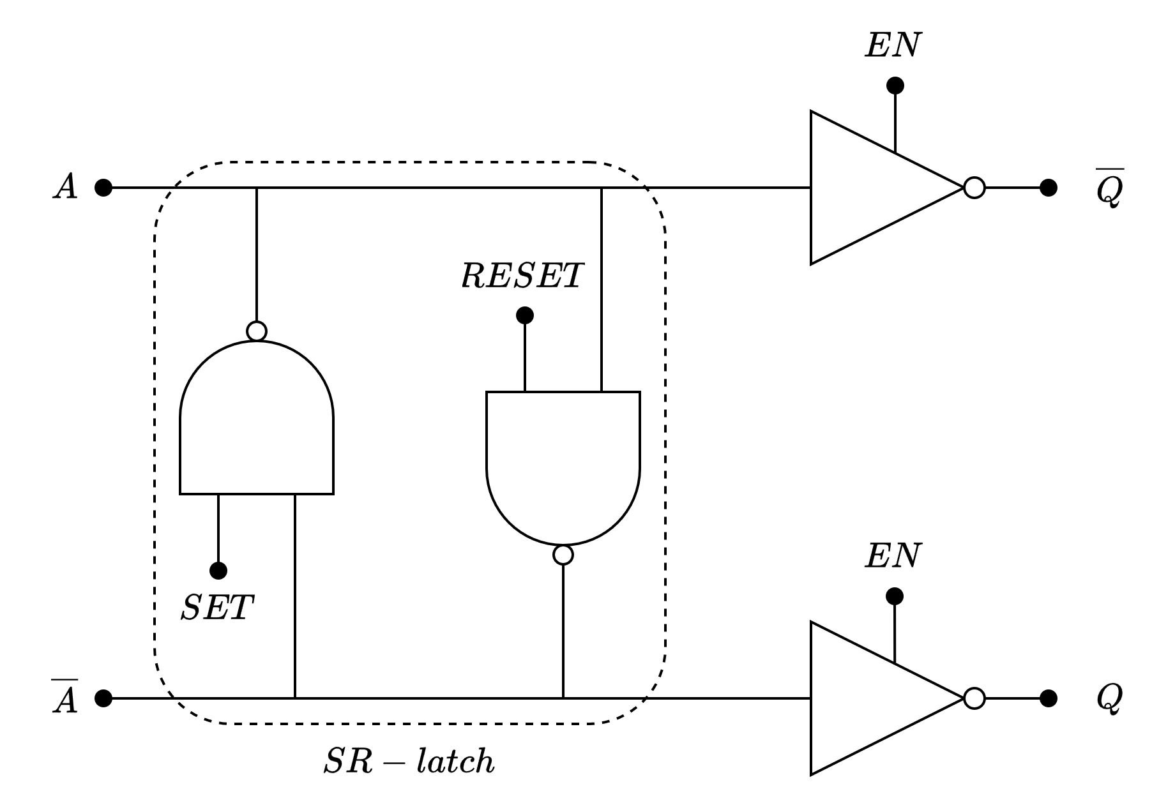
Tri-state Inverter
Conventional
Modified

Slide 13
Modified Tri-state Inverter
Pre-charged
Reduces the switching time

Slide 14
Modified Tri-state Inverter
Parasitic Capacitance
Mitigate the disturbances from the power supply

Slide 15
MSBs Generation
$$Q_{MSBs}=9 bits$$

Slide 16
Asynchronous Ripple Counter
$$f_{max}=\frac{1}{T_{min}}$$
$$T_{min}=t_{ckq}+t_{su}$$

Slide 17
Asynchronous Ripple Counter (9 bits)
$$f_{max}=\frac{1}{T_{min}}$$
$$T_{min}=t_{ckq}+t_{su}$$
$$T_{d}={9t}_{ckq}$$

Slide 18
Outline
Time-to-Digital Converter (TDC)
Architecture: Interpolation based TDC
Resolution Control System
Simulation Results
digital Silicon Photo Multiplier (dSiPM)
Synthesizable dSiPM: Recursive structure
Tools: Xcelium, Genus and Innovus
Preliminary Results

Slide 19
Resolution Control System
A
A
A
A
Control the Frequency
Notes:
3 LSB + 9 MSB

Slide 20
Resolution Control System
Voltage Control
Current Control

Slide 21
Voltage Control System

Slide 22
Current Control System

Slide 23
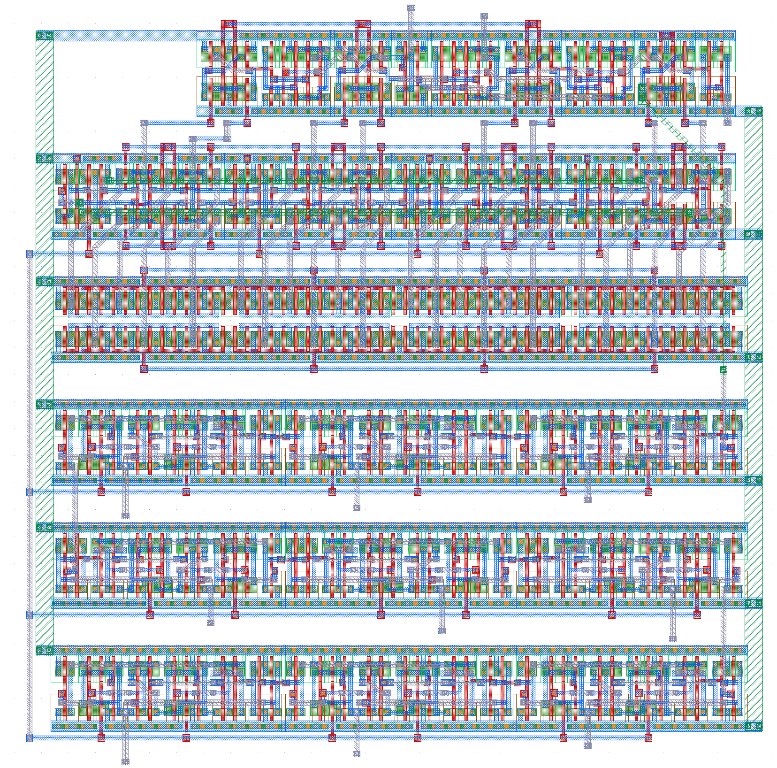
Layout
Voltage Control
Current Control
27 µm
27 µm
26 µm
26 µm

Slide 24
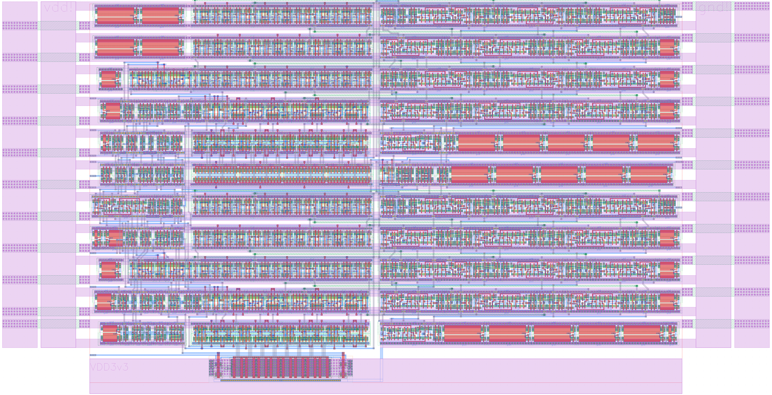
56 µm
109 µm

Slide 28
Outline
Time-to-Digital Converter (TDC)
Architecture: Interpolation based TDC
Resolution Control System
Simulation Results
digital Silicon Photo Multiplier (dSiPM)
Synthesizable dSiPM: Recursive structure
Tools: Xcelium, Genus and Innovus
Preliminary Results

Slide 29
Results: LSB

Slide 30
Results: Power

Slide 31
Results: DNL & INL

Slide 32
Results: DNL & INL

Slide 33
Results: Jitter

Slide 34
Results Summary
 | Voltage Control | Current Control
LSB | 72.07 ps | 80.71 ps
FSR | 295.13 ns | 330.5 ns
Power | 1.589 mW | 0.9091 mW
Nominal Condition:
TT corner
$V_{n}=1,4 V$ $V_{p}=0,4 V$ $V_{ctrl}=2,9 V$

Slide 35
Outline
Time-to-Digital Converter (TDC)
Architecture: Interpolation based TDC
Resolution Control System
Simulation Results
digital Silicon Photo Multiplier (dSiPM)
Synthesizable dSiPM: Recursive structure
Tools: Xcelium, Genus and Innovus
Preliminary Results

Slide 36
A synthesizable digital Silicon Photon Multiplier with N input bits in a110 nm CMOS Technology
differential ring oscillator in
PhD project of
Tommaso Maria Floris
Supervisor: Prof. Lodovico Ratti

Slide 37
Outline
Time-to-Digital Converter (TDC)
Architecture: Interpolation based TDC
Resolution Control System
Simulation Results
digital Silicon Photo Multiplier (dSiPM)
Synthesizable dSiPM: Recursive structure
Tools: Xcelium, Genus and Innovus
Preliminary Results

Slide 38
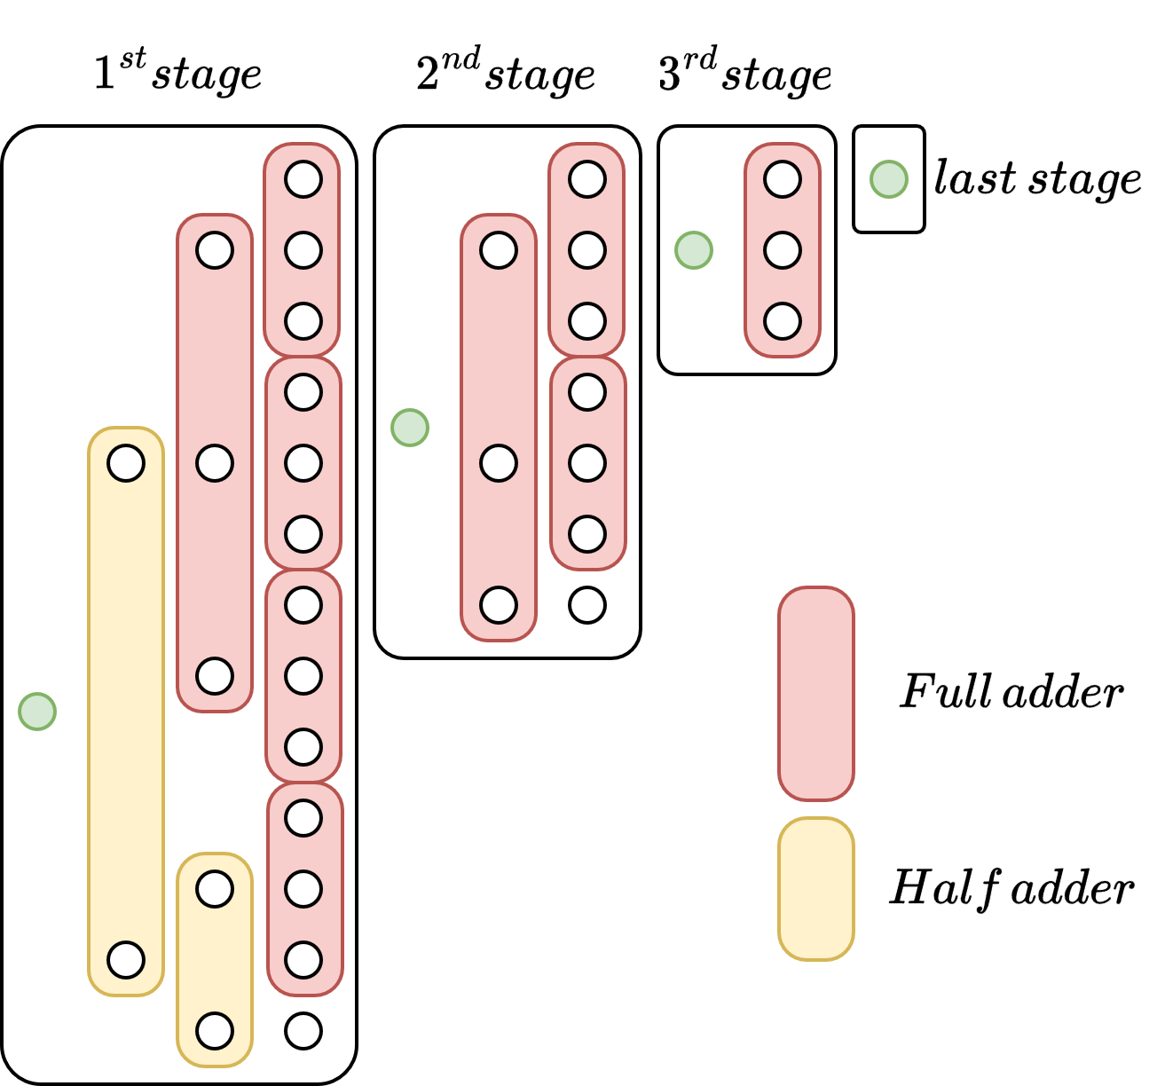
Recursive Structure
Basic building block: compressor
Each stage is built with the same procedure
The input of the first stage is the binary vector coming from the array
The input of the following stage is the total carry vector of the previous one

Slide 39
Outline
Time-to-Digital Converter (TDC)
Architecture: Interpolation based TDC
Resolution Control System
Simulation Results
digital Silicon Photo Multiplier (dSiPM)
Synthesizable dSiPM: Recursive structure
Tools: Xcelium, Genus and Innovus
Preliminary Results

Slide 40
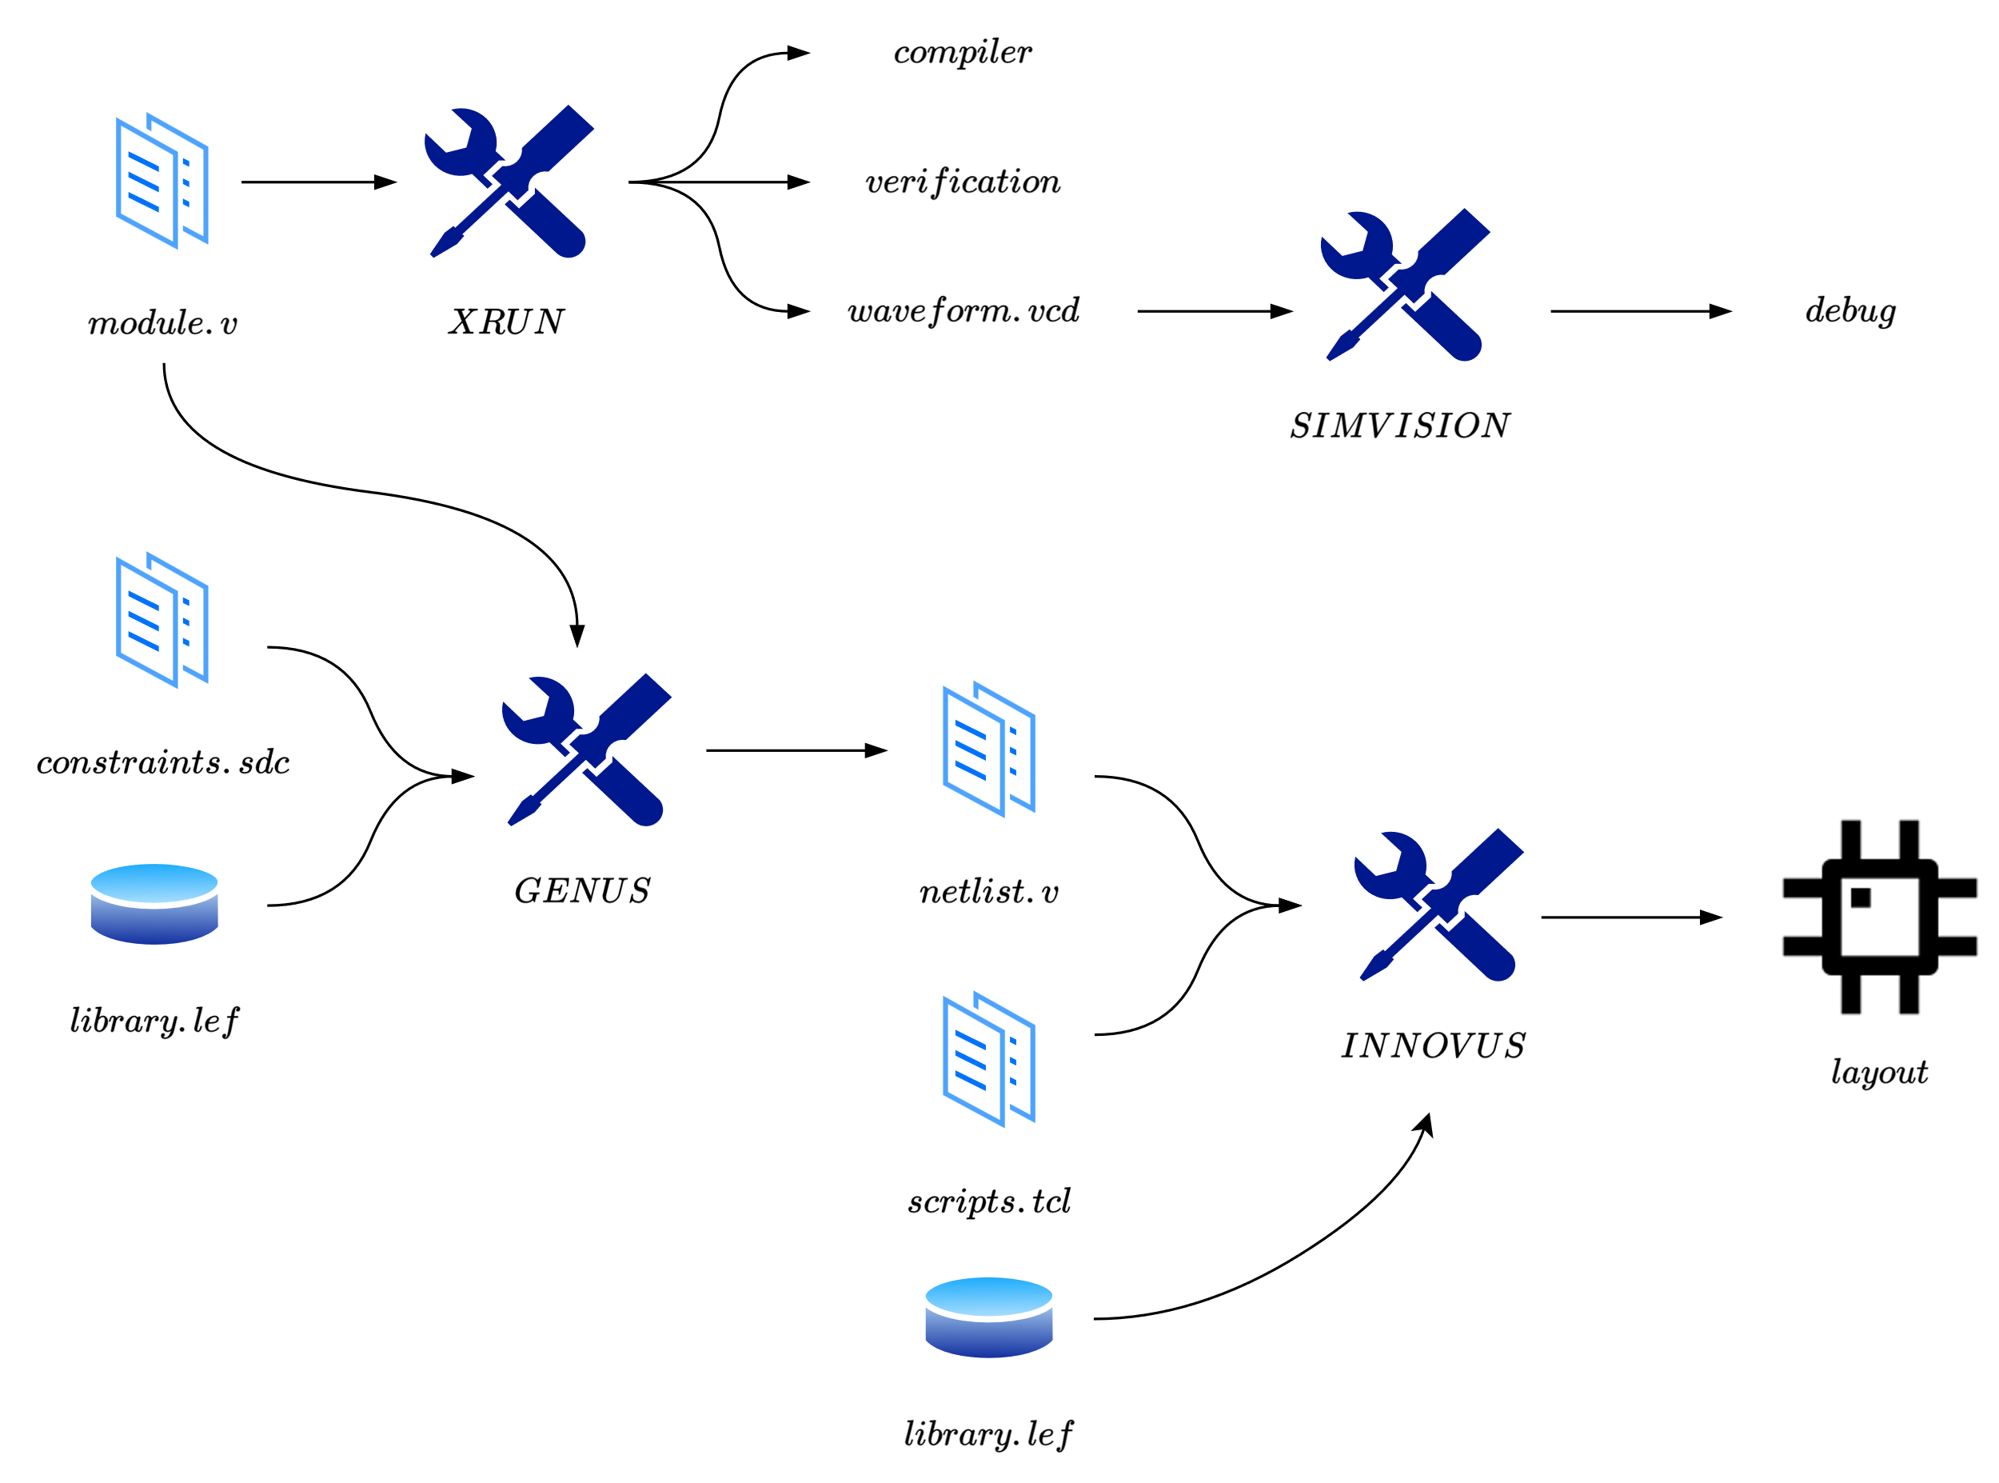
Digital synthesis flow

Slide 41
Outline
Time-to-Digital Converter (TDC)
Architecture: Interpolation based TDC
Resolution Control System
Simulation Results
digital Silicon Photo Multiplier (dSiPM)
Synthesizable dSiPM: Recursive structure
Tools: Xcelium, Genus and Innovus
Preliminary Results

Slide 42
32x32 matrix
Matrix shape obtained with a script
The parameters are:
Rows & columns number
Width & height of each cell
Number of stdCell rows allocated for the digital logic
The percentage of the cell area left available for routing

Slide 43
32x32 matrix
Cell width & height : 19,6 µm
Free stdCell row : 2*2,8 = 5,6 µm
Routing : 0,4*19,6 = 7,84 µm
Sensor area : 164,64 µm^2
42% of the total cell area

Slide 44
32x32 matrix

Slide 45
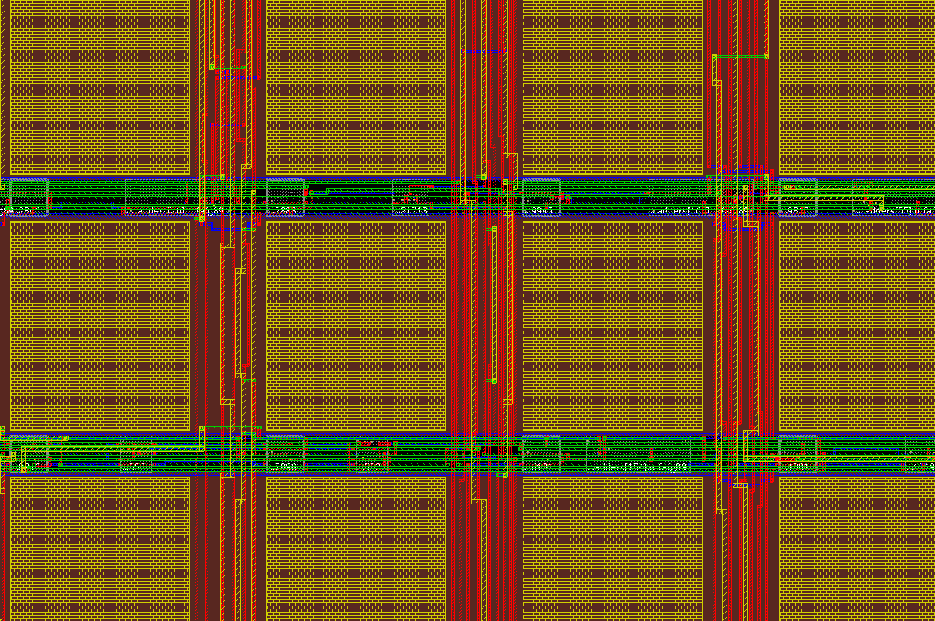
32x32 matrix
Cell width & height : 19,6 µm
Free stdCell row : 1*2,8 = 2,8 µm
Routing : 0,3*19,6 = 5,88 µm
Sensor area : 230,5 µm^2
60% of the total cell area

Slide 46
