Slide 1



Mini-SiPM Characterization in the ASAP110LF Test Chip
F. Shojaei & L. Ratti
ASPIDES kick-off meeting
January 29-31, 2025

Slide 2
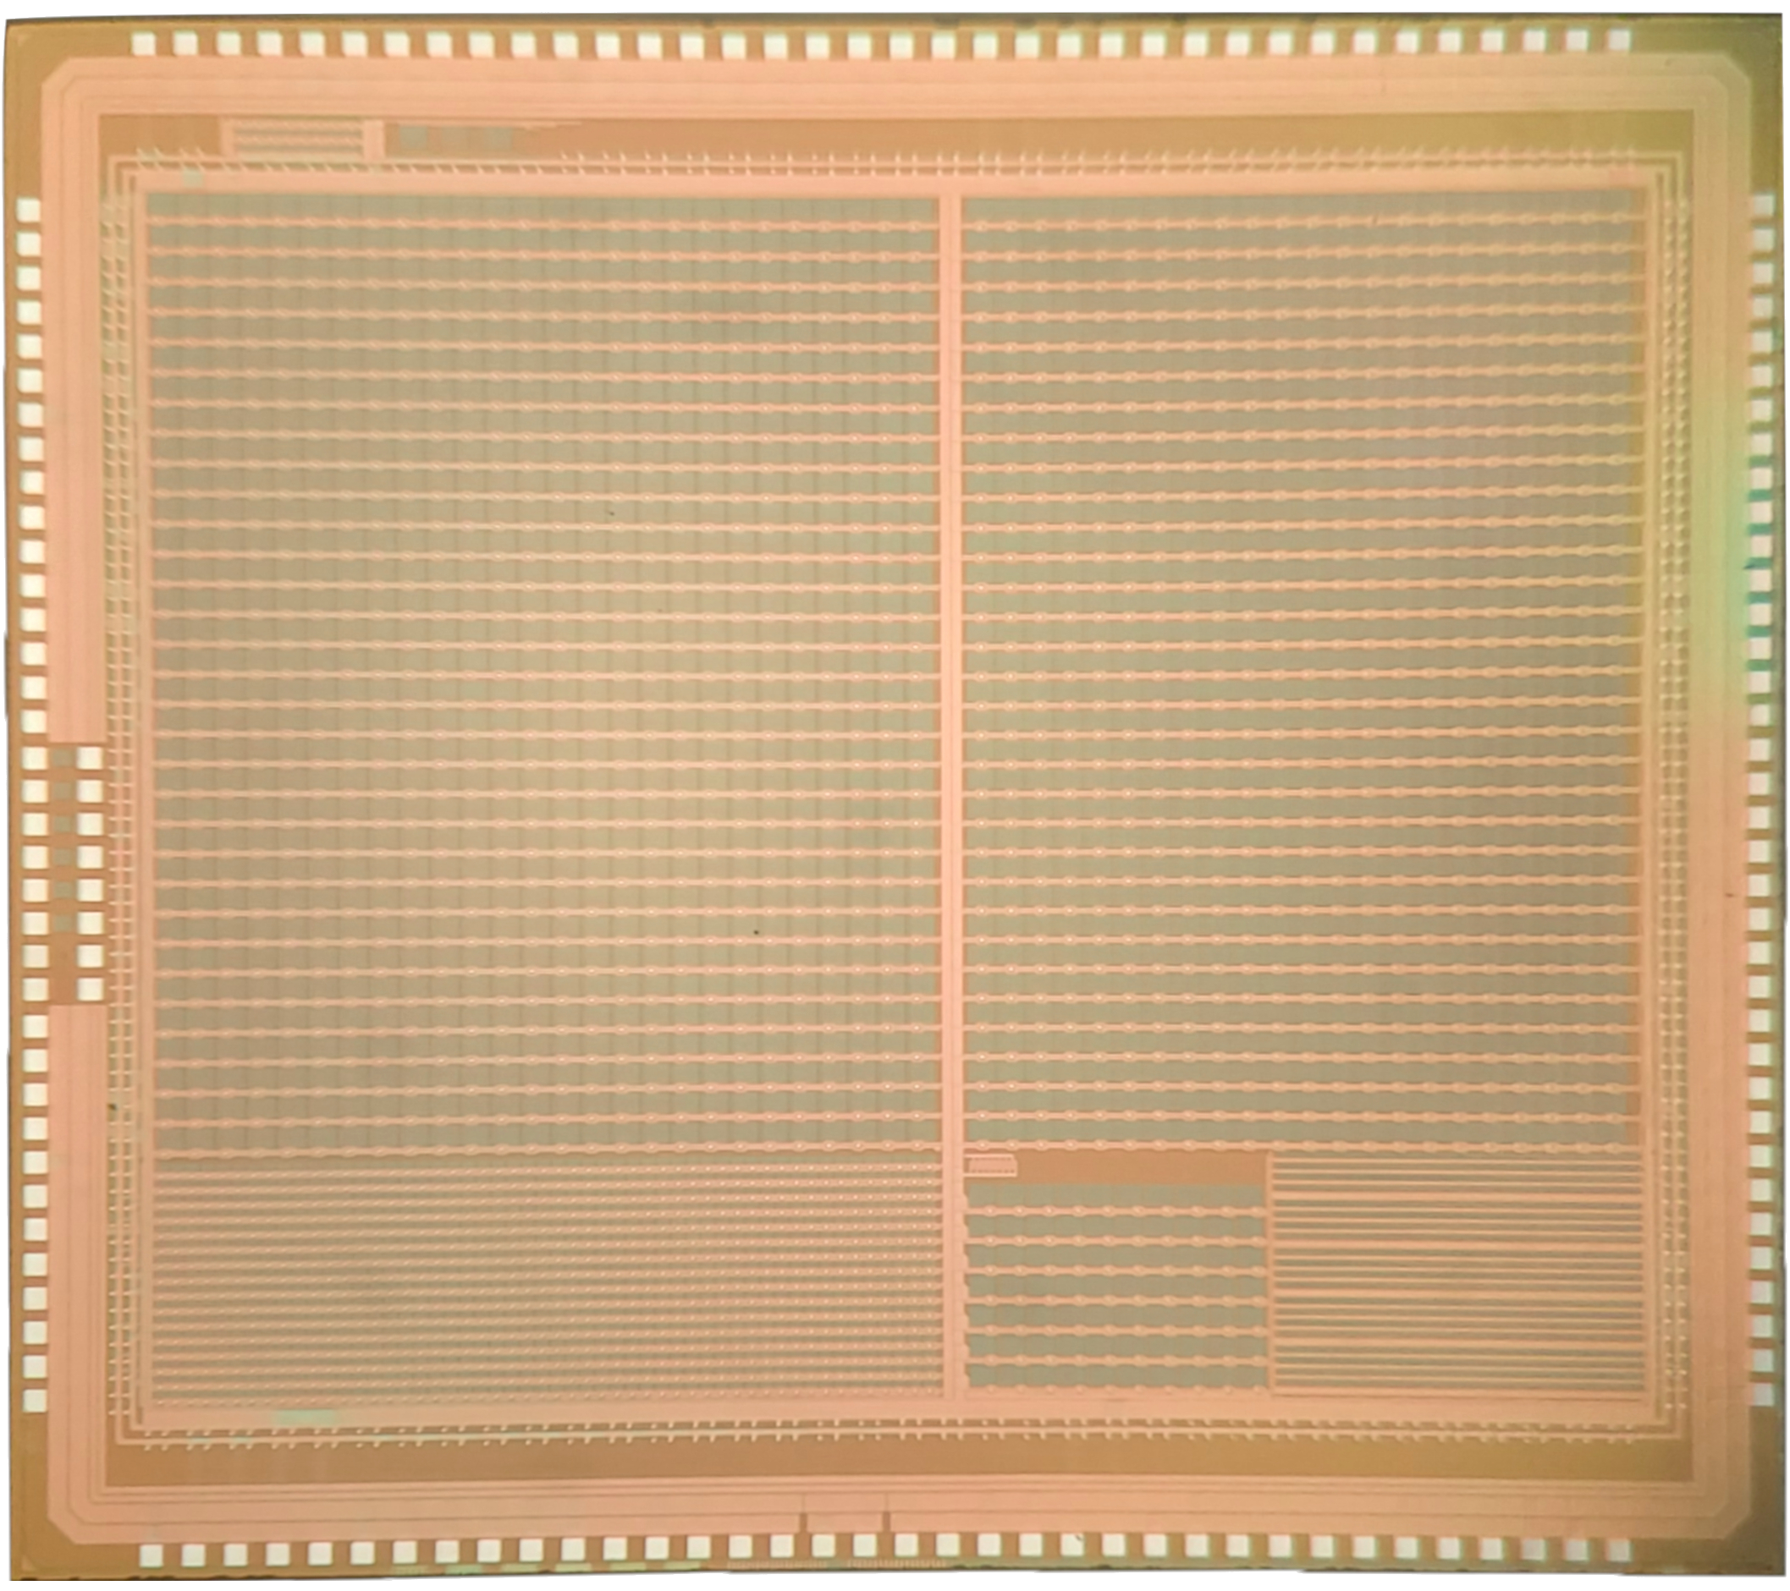
ASAP110LF test chip designed in 110 nm CIS technology
structures for timing and ionizing radiation tolerance study
A2: 100 um pitch, passive quenching,
10 bit, FF=64%
(32x22)
A1: 100 um pitch, passive quenching,
1 bit, FF=67%
(32x26)
10b/20b TDC and ring oscillator
single SPADs
AAQ: 100 um pitch, active quenching,
1 bit, FF=67%
(7x10)
A3: 50 um pitch, passive quenching,
1 bit, FF=48%
(16x52)
Mini-SiPMs (4x4),
160 um pitch, FF=41% (5x12)

Slide 3
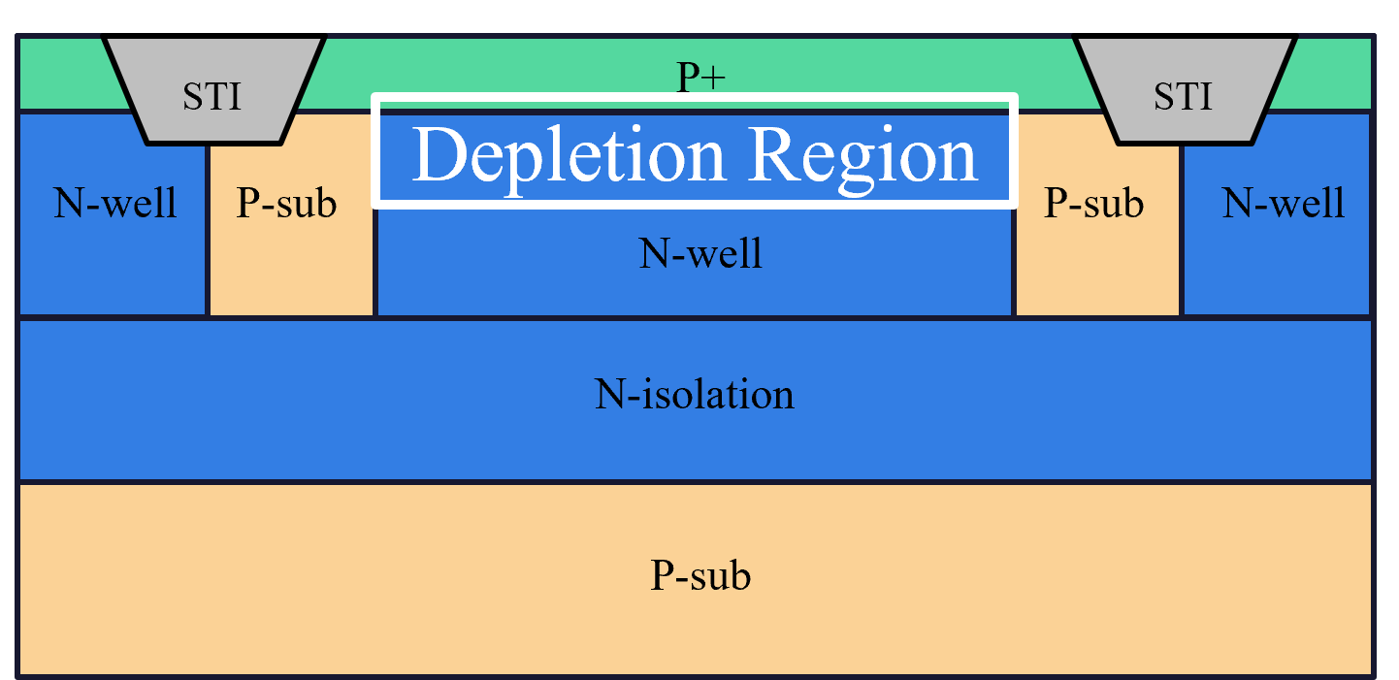
Mini-SiPM characterization
Mini-SiPMs (4x4),
160 um pitch, FF=41% (5x12)

Slide 4
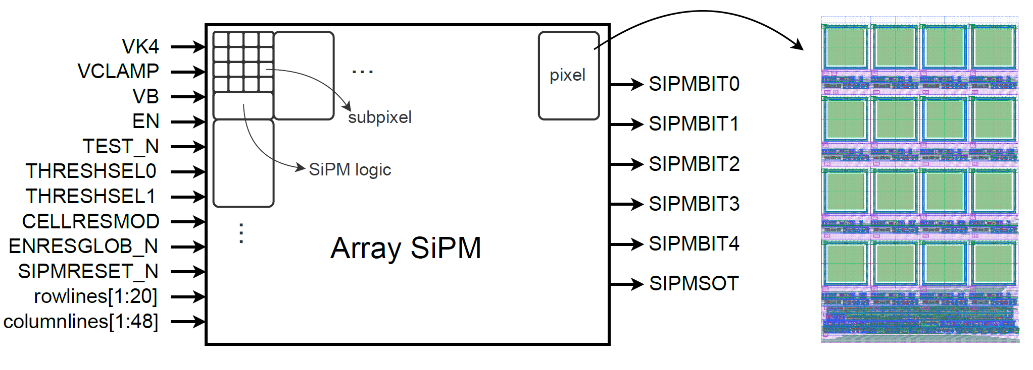
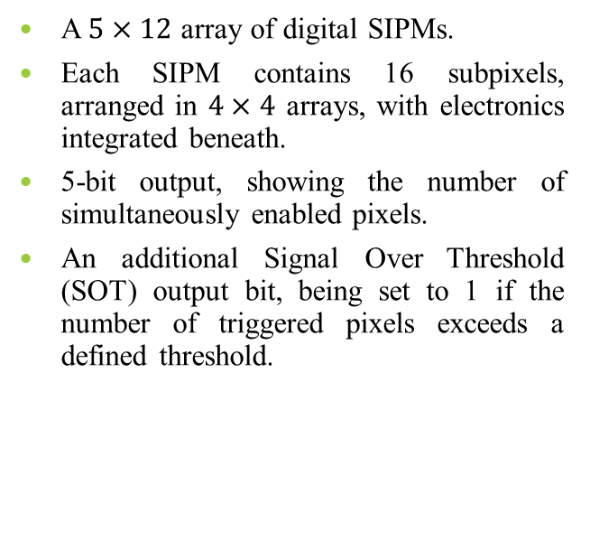
Mini-SiPM with parallel counter
A $5×12$ array of digital SIPMs.
Each SIPM contains 16 subpixels, arranged in $4×4$ arrays, with electronics integrated beneath.
5-bit output, showing the number of simultaneously enabled pixels.
An additional Signal Over Threshold (SOT) output bit, being set to 1 if the number of triggered pixels exceeds a defined threshold.

Slide 5
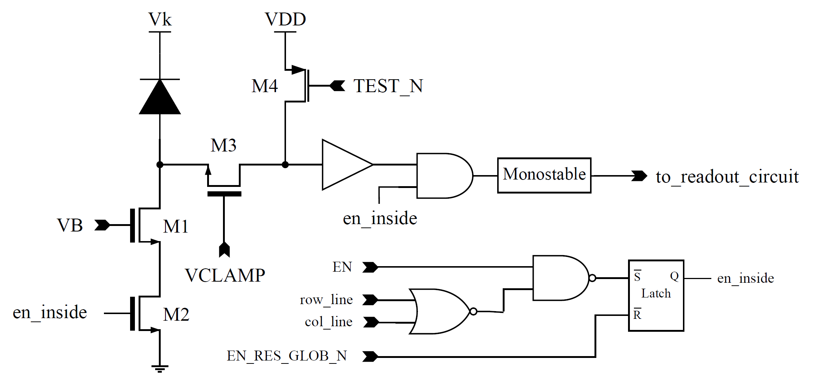
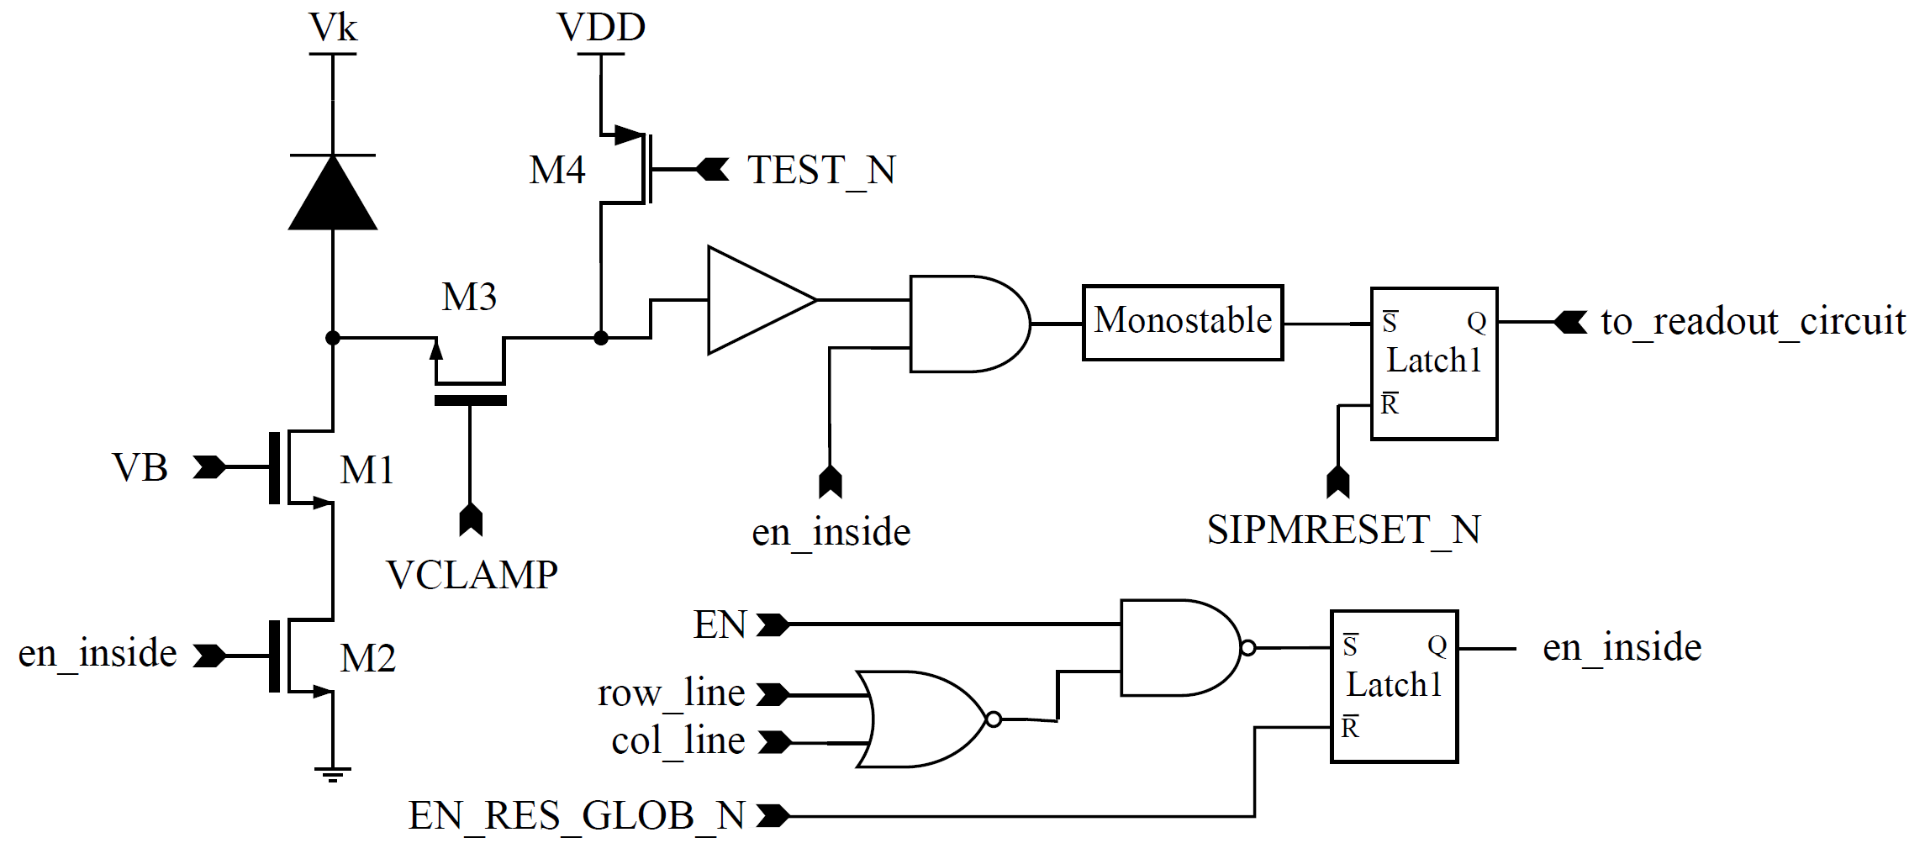
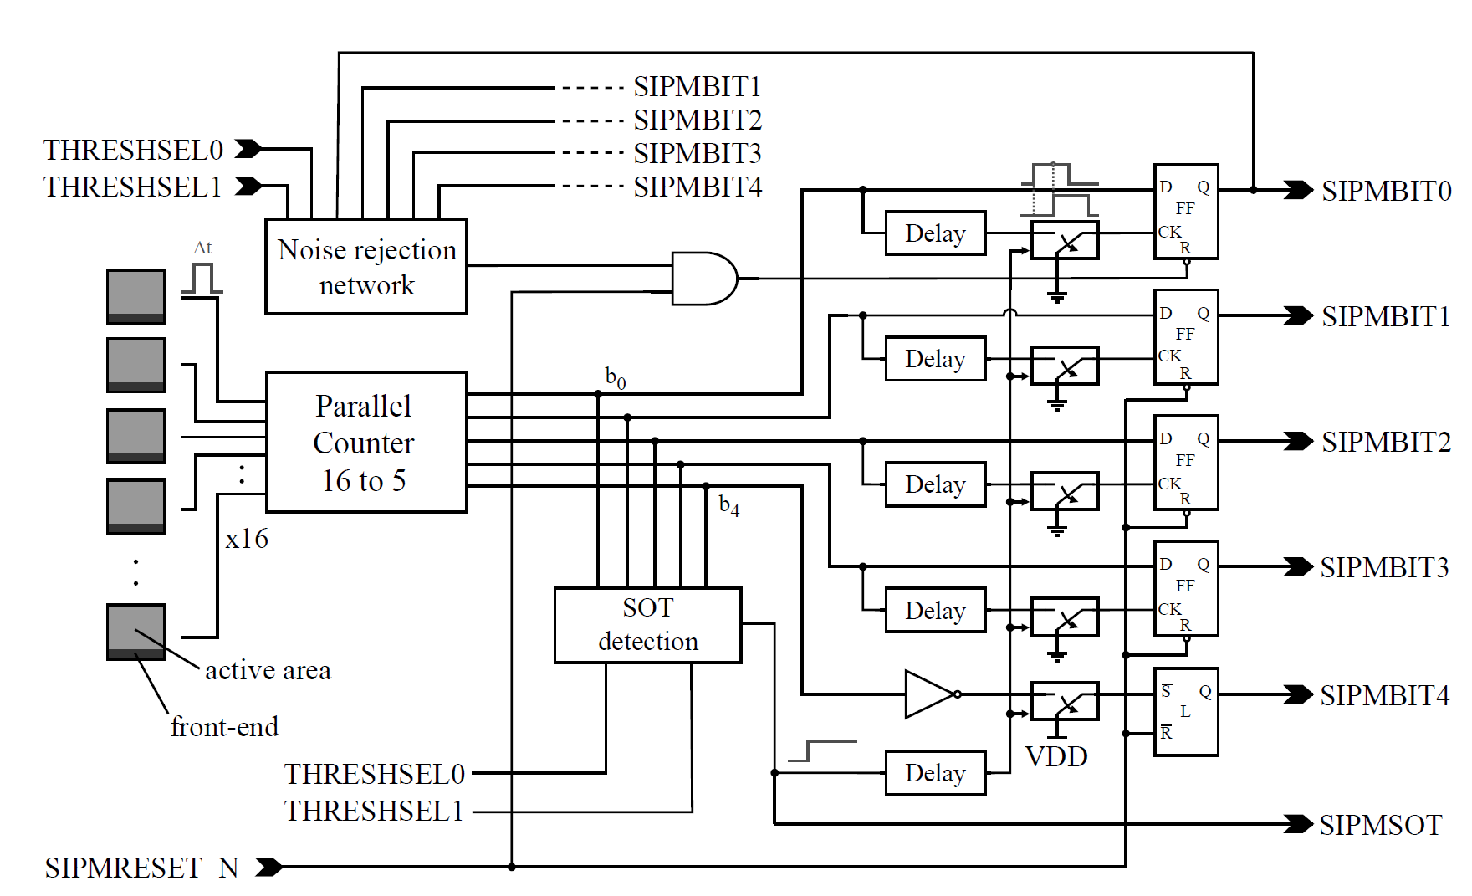
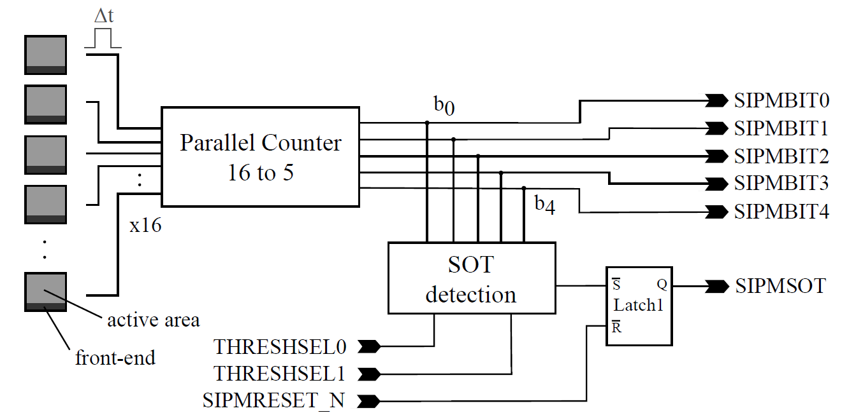
SiPM readout electronics
Type 1
Type 2
Sub-pixel electronics
Sub-pixel electronics
SIPM electronics
SIPM electronics

Slide 6
Measurement setup

Slide 7
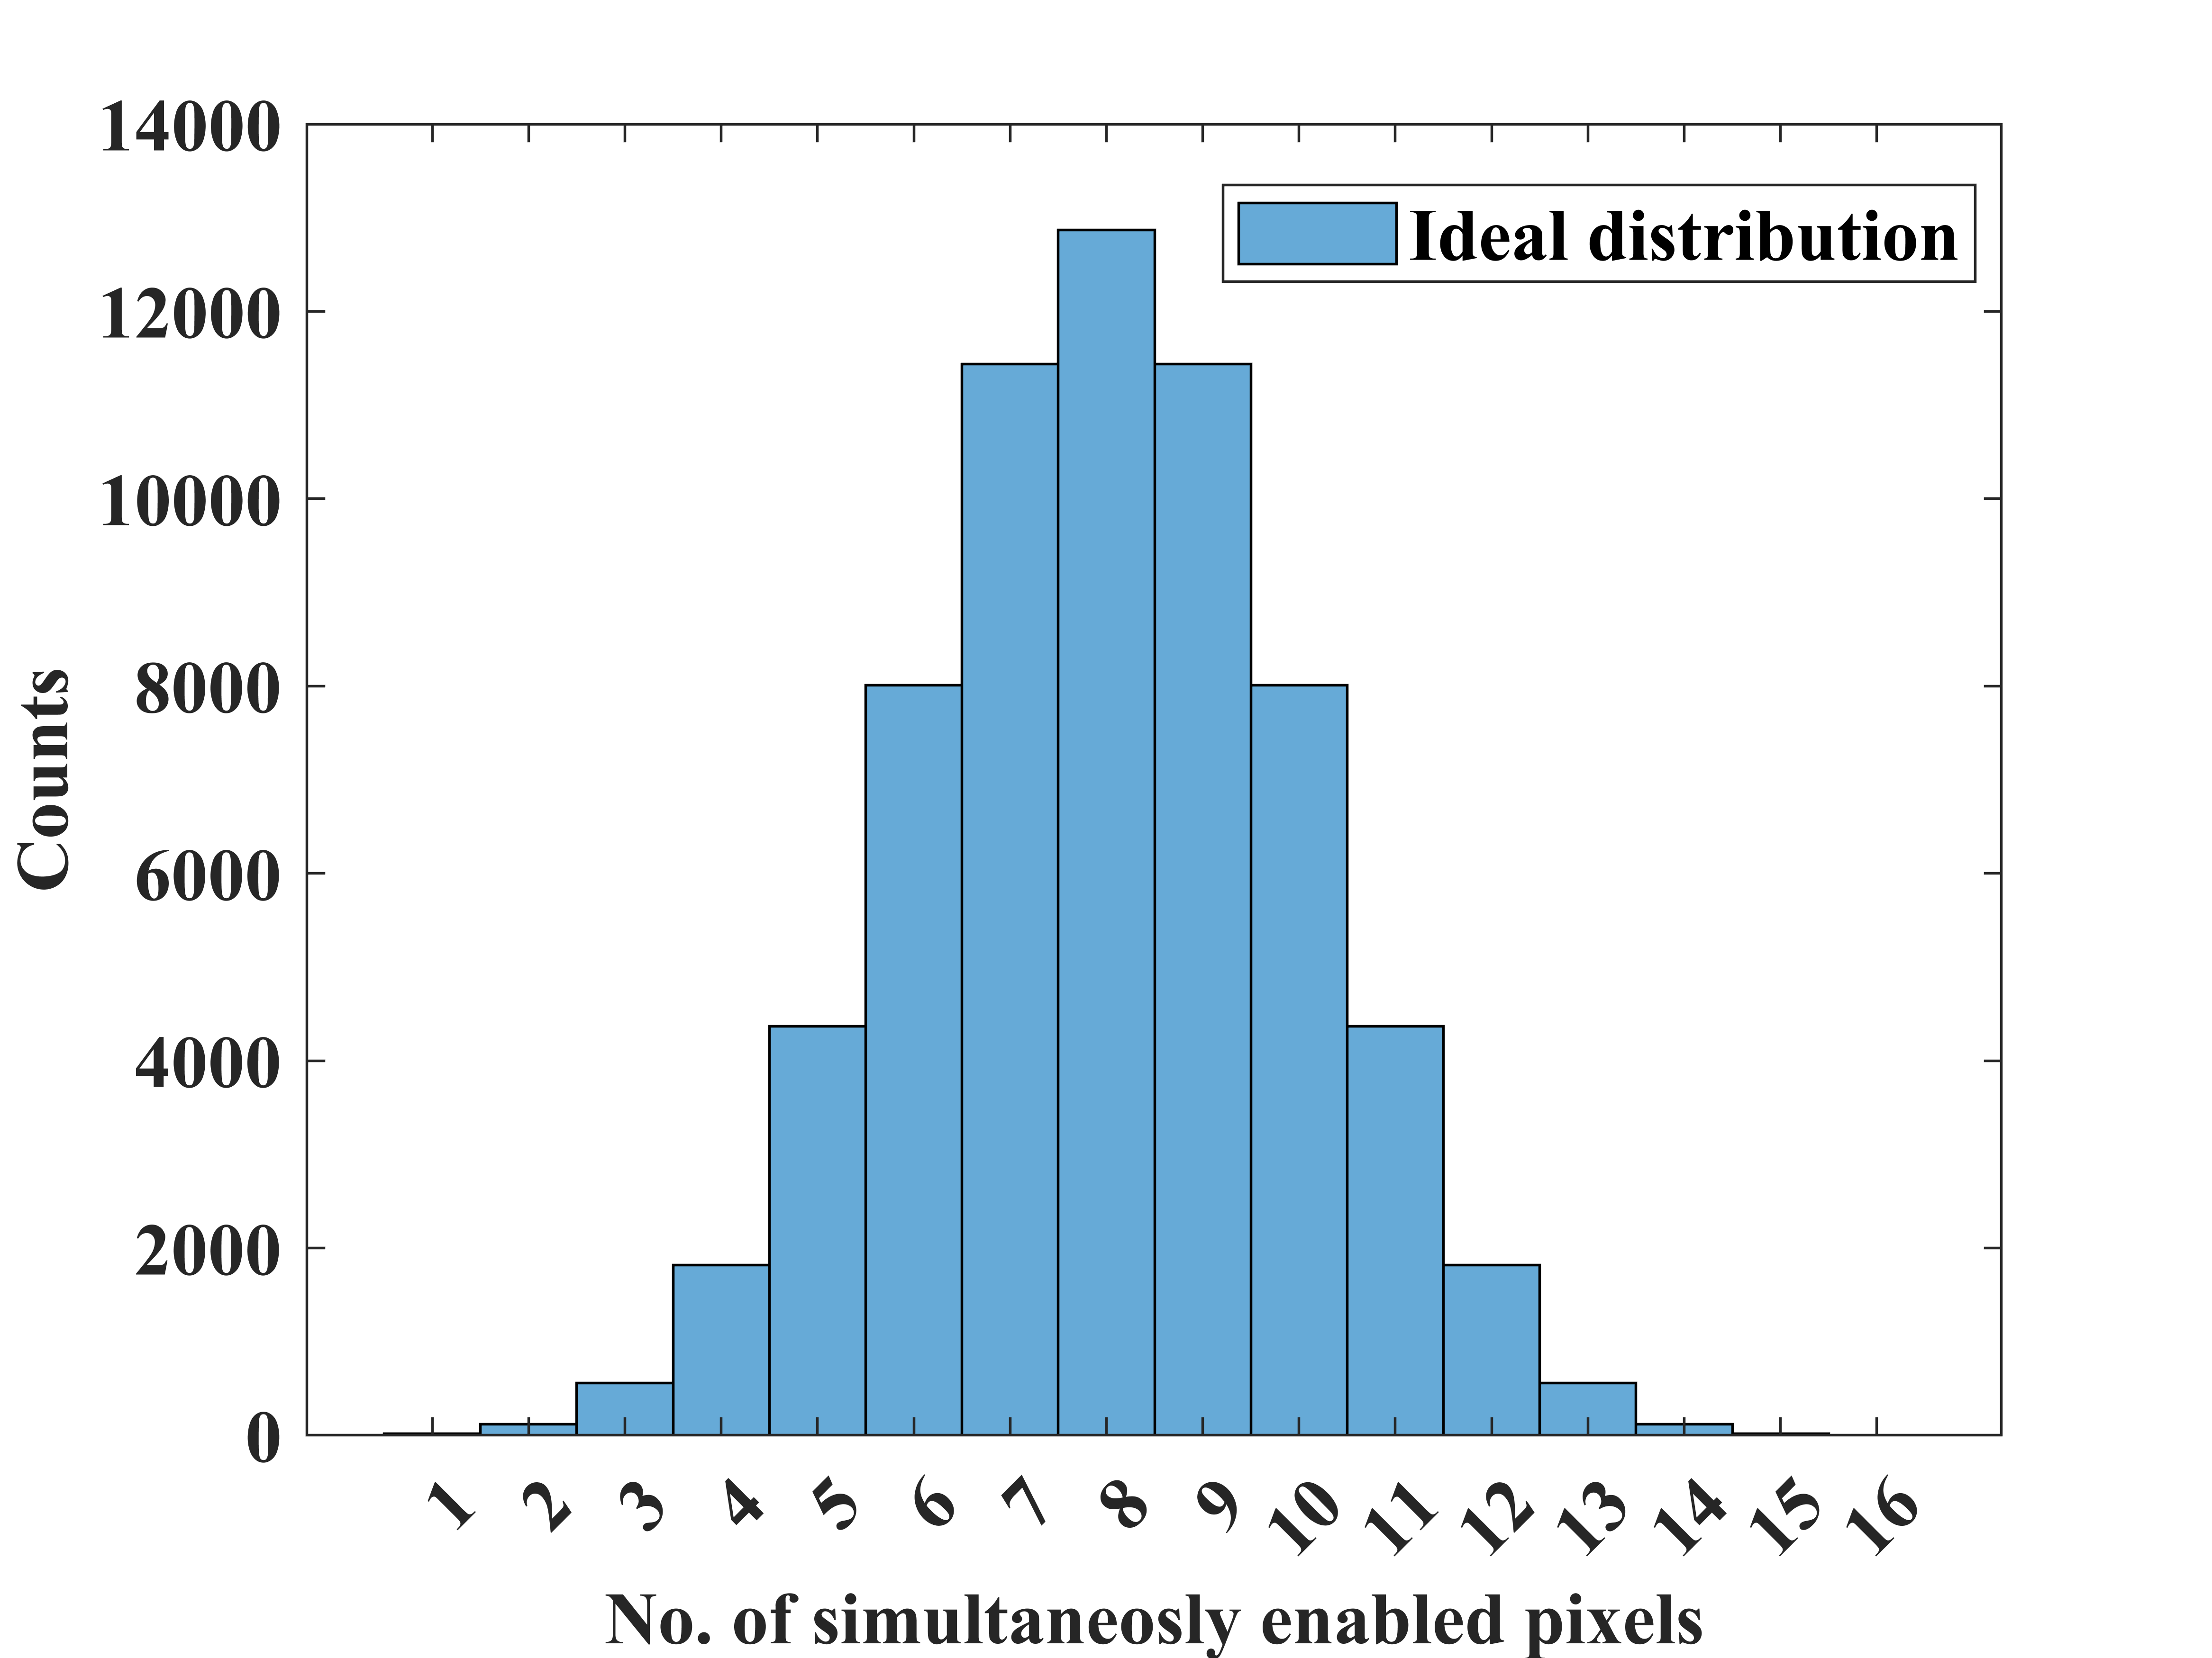
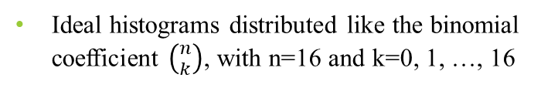
Readout electronics characterization
+ 5 V
Ideal histograms distributed like the binomial coefficient $\left({n \atop k}\right)$, with n=16 and k=0, 1, …, 16
All combinations of enabling 16 subpixels

Slide 8
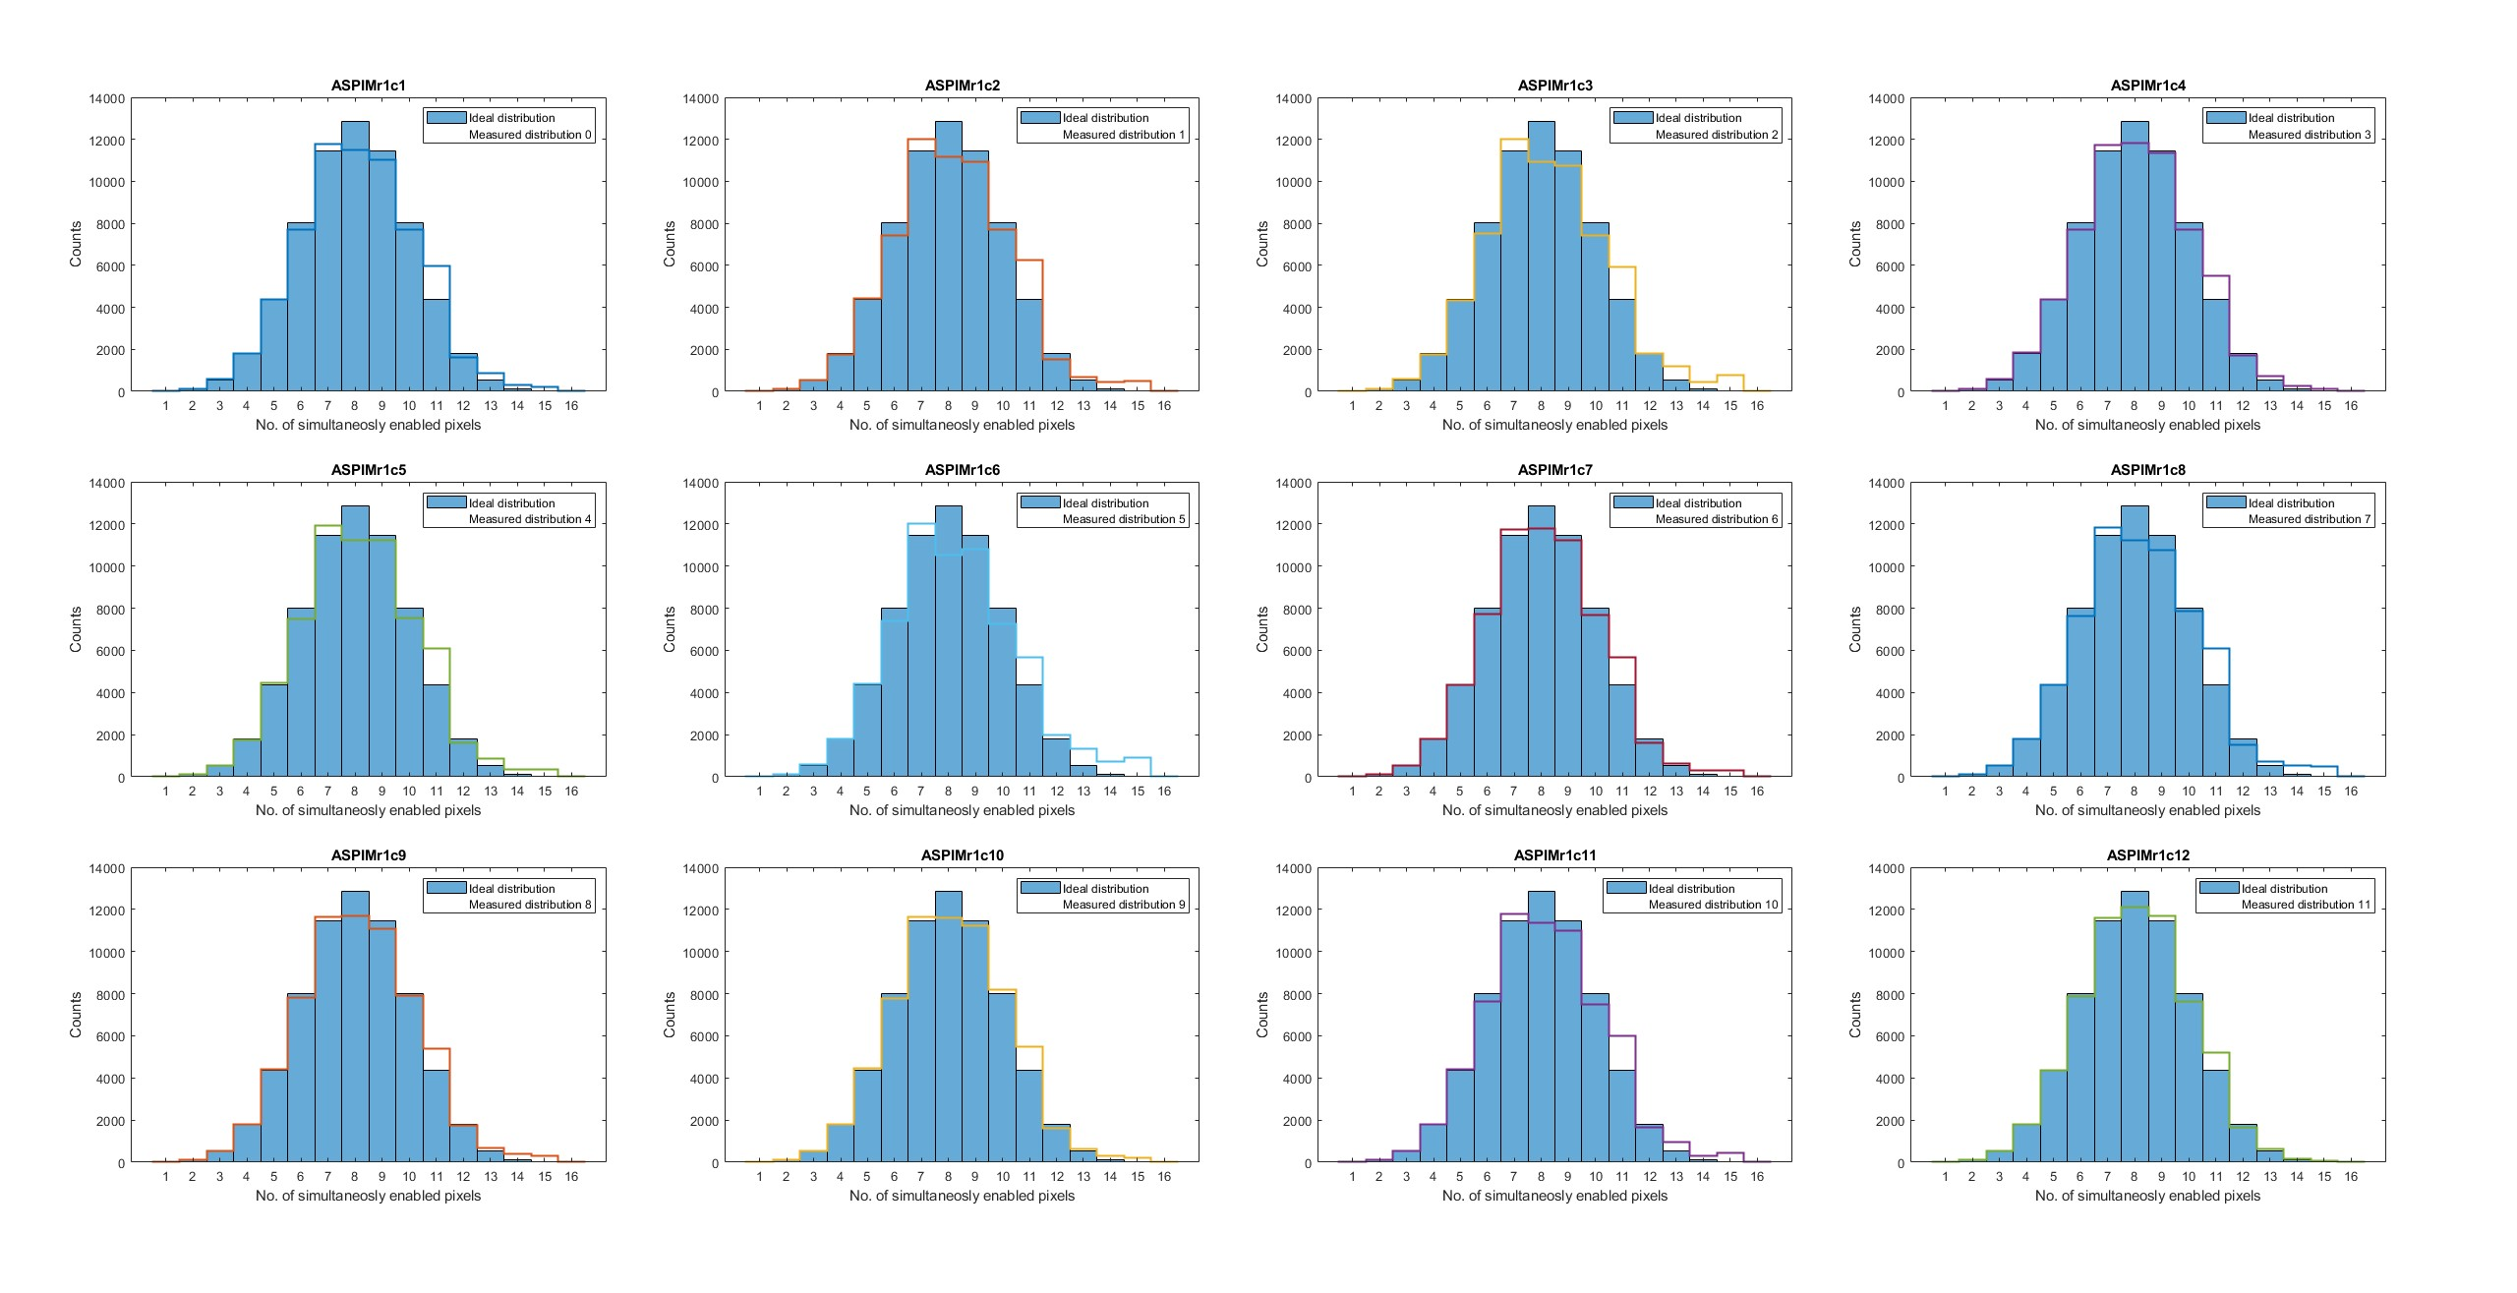
The difference is due to residual glitches in the parallel counter
Readout electronics characterization - type1

Slide 9
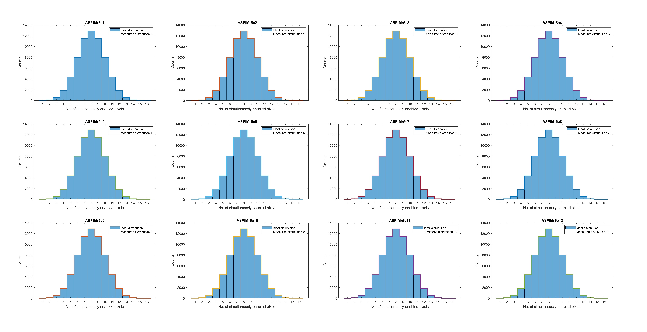
Readout electronics characterization – type2

Slide 10
Percentage of faulty occurrences in all SiPMs except row 5
col 1
row 1
7.09 | 8.01 | 8.34 | 5.45 | 7.75 | 10.05 | 5.88 | 8.04 | 4.45 | 5.23 | 7.29 | 3.83
28.34 | 8.71 | 6.83 | 5.77 | 7.81 | 5.00 | 7.16 | 4.26 | 9.62 | 7.49 | 5.28 | 18.48
4.74 | 11.12 | 10.69 | 12.22 | 11.83 | 5.29 | 4.97 | 4.21 | 7.93 | 5.09 | 5.03 | 9.01
7.07 | 6.51 | 7.73 | 7.43 | 7.67 | 7.01 | 11.64 | 9.30 | 6.94 | 9.57 | 6.30 | 5.31

Slide 11
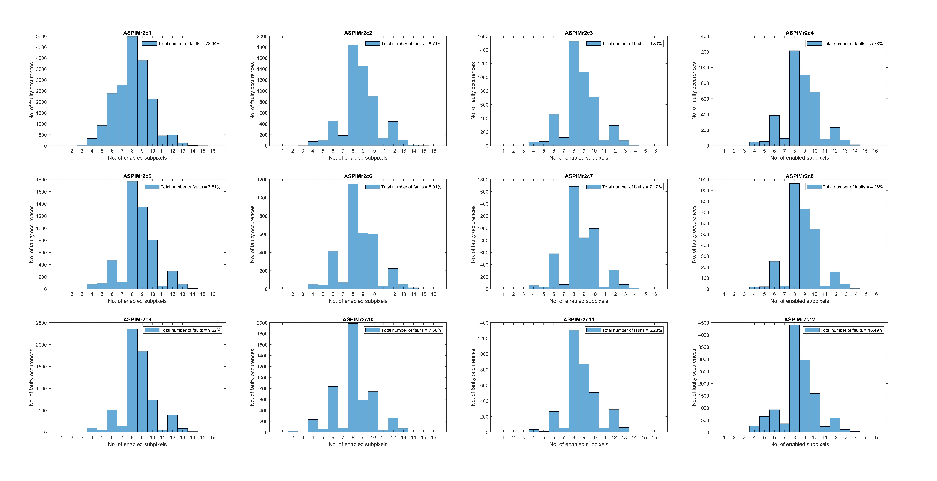
Faulty occurrences vs different configurations
On average for all SIPMS
8 | 2.7402%
9 | 1.7778%
10 | 1.3107%
6 | 0.8465%
12 | 0.4751%
7 | 0.2712%
5 | 0.1384%
4 | 0.1367%
11 | 0.1095%
13 | 0.1003%
14 | 0.0223%
3 | 0.0046%
2 | 0.0023%
15 | 0.0018%
16 | 0%
1 | 0%

Slide 12
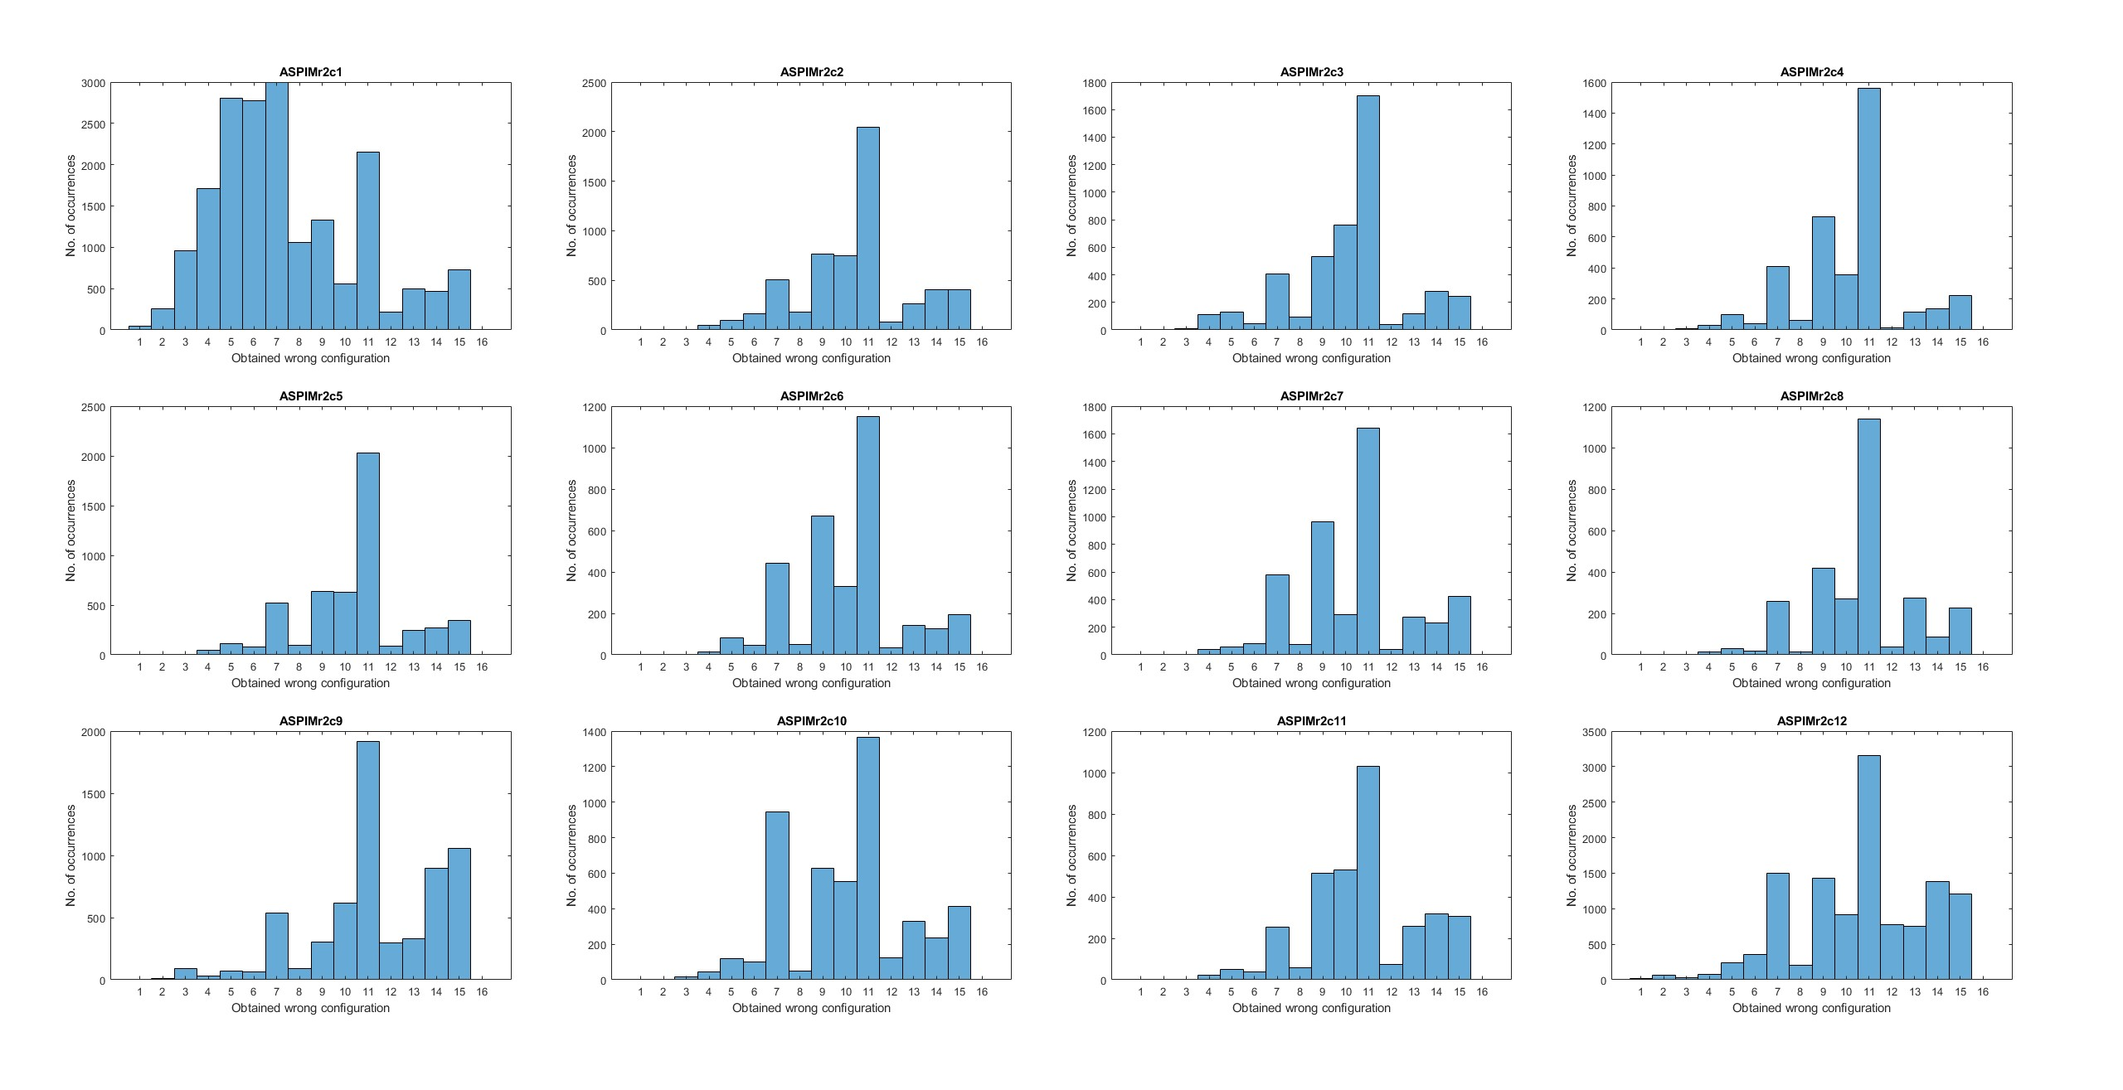
Obtained wrong configuration distribution
On average for all SIPMS
11 | 2.4243%
9 | 1.0593%
7 | 0.9293%
15 | 0.7602%
10 | 0.6900%
13 | 0.5618%
14 | 0.4888%
6 | 0.2431%
5 | 0.2122%
12 | 0.2076%
8 | 0.1757%
4 | 0.1206%
3 | 0.0425%
2 | 0.0145%
1 | 0.0027%
16 | 0%

Slide 13
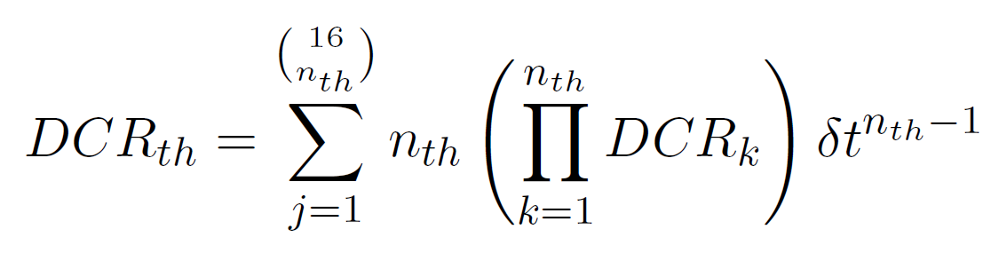
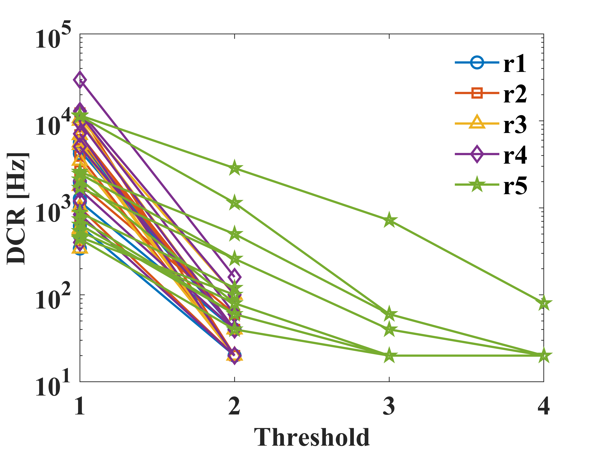
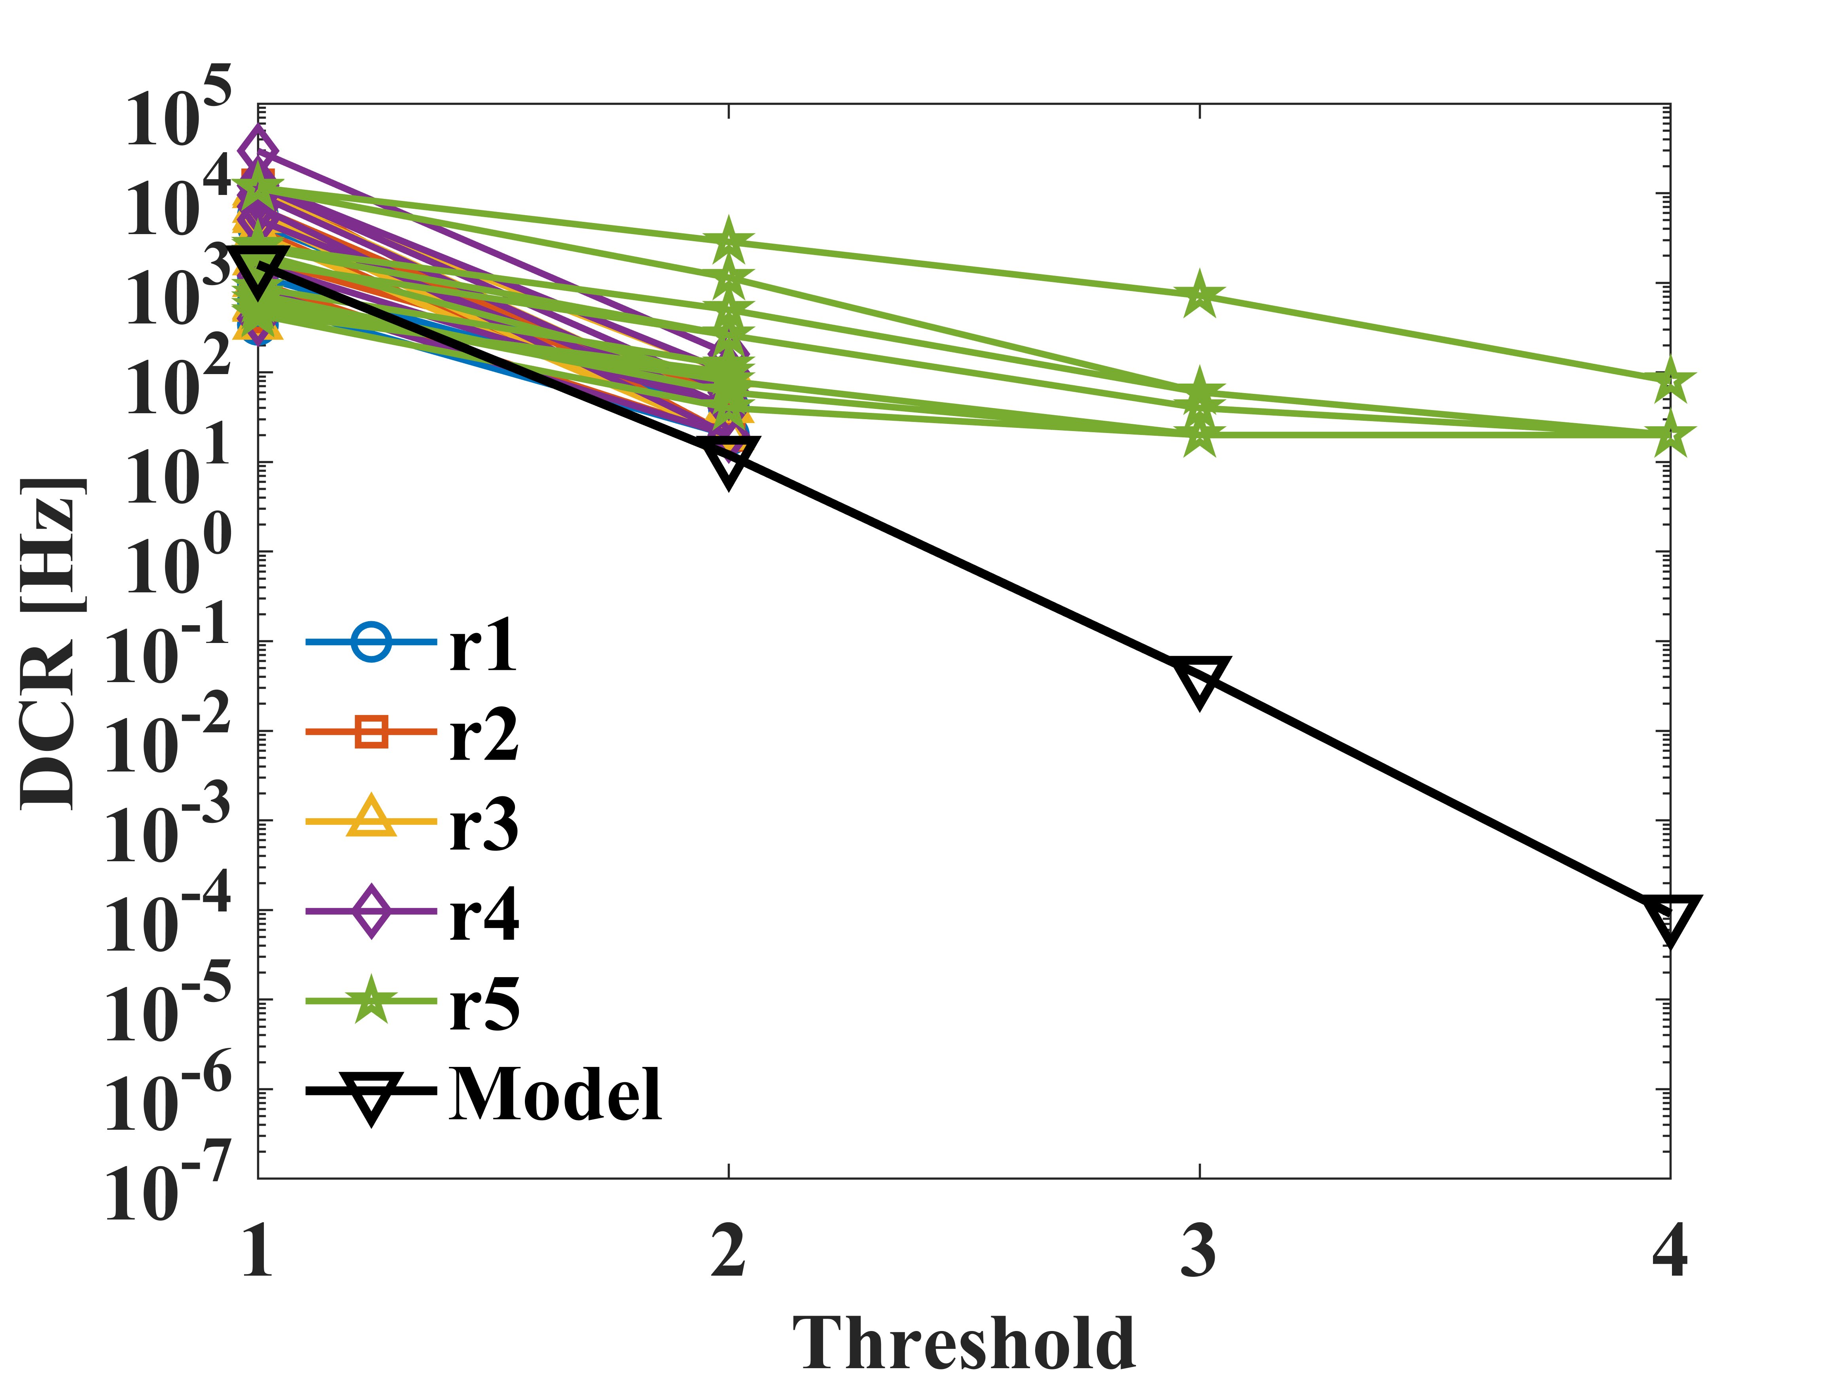
DCR vs threshold
(type 2)

Slide 14
Thank you for your attention

