Slide 1
ASPiDeS
A CMOS SPAD and Digital SiPM platform for High Energy Physics
Lodovico Ratti
Università di Pavia and INFN Pavia
(lodovico.ratti@unipv.it)
ASPIDES kick-off meeting
Università di Bologna, Dipartimento di Fisica, Aula Biomedica
January 30, 2025

Slide 2
Welcome everybody to the ASPIDES kick-off meeting!
Thanks to Luigi and Davide for organizing the meeting here in Bologna

Slide 3
Proposal for the ASPIDES logo (by Fatemeh Shojaei)

Slide 4
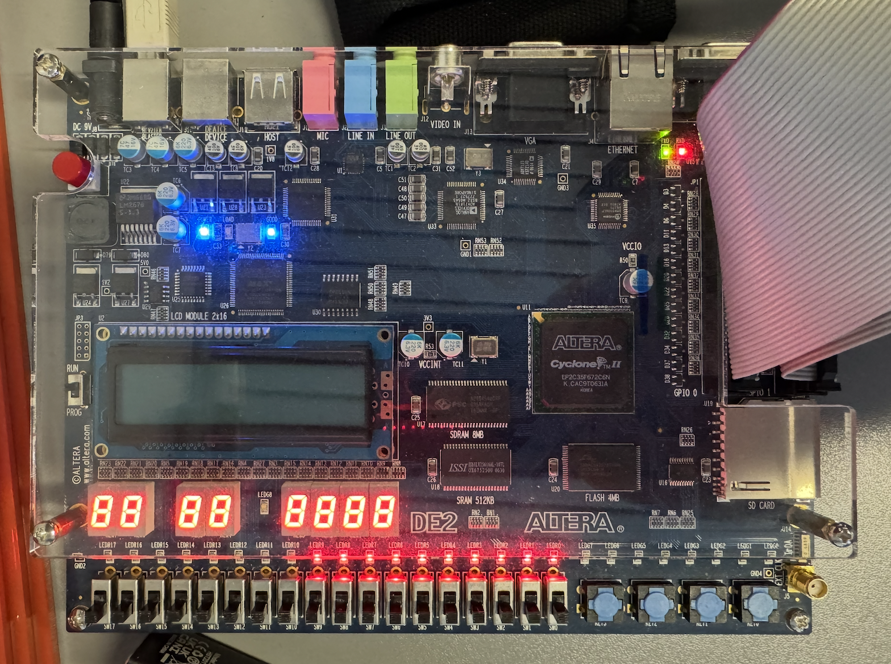
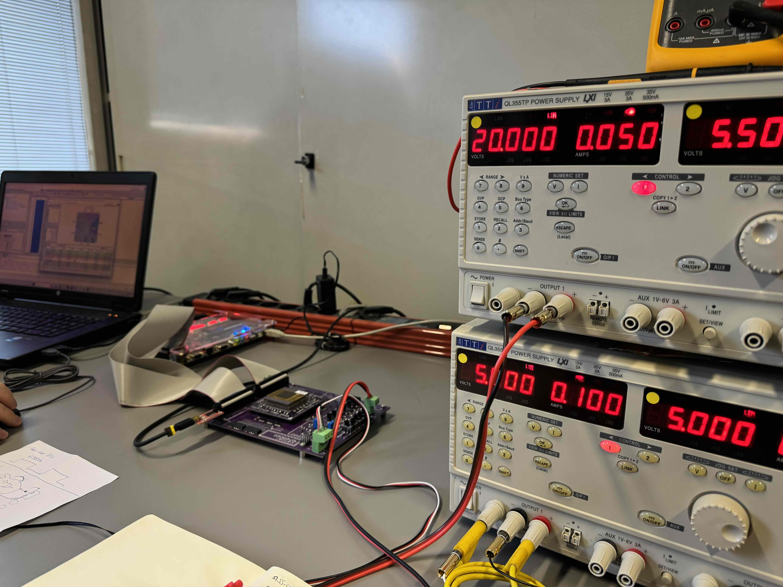
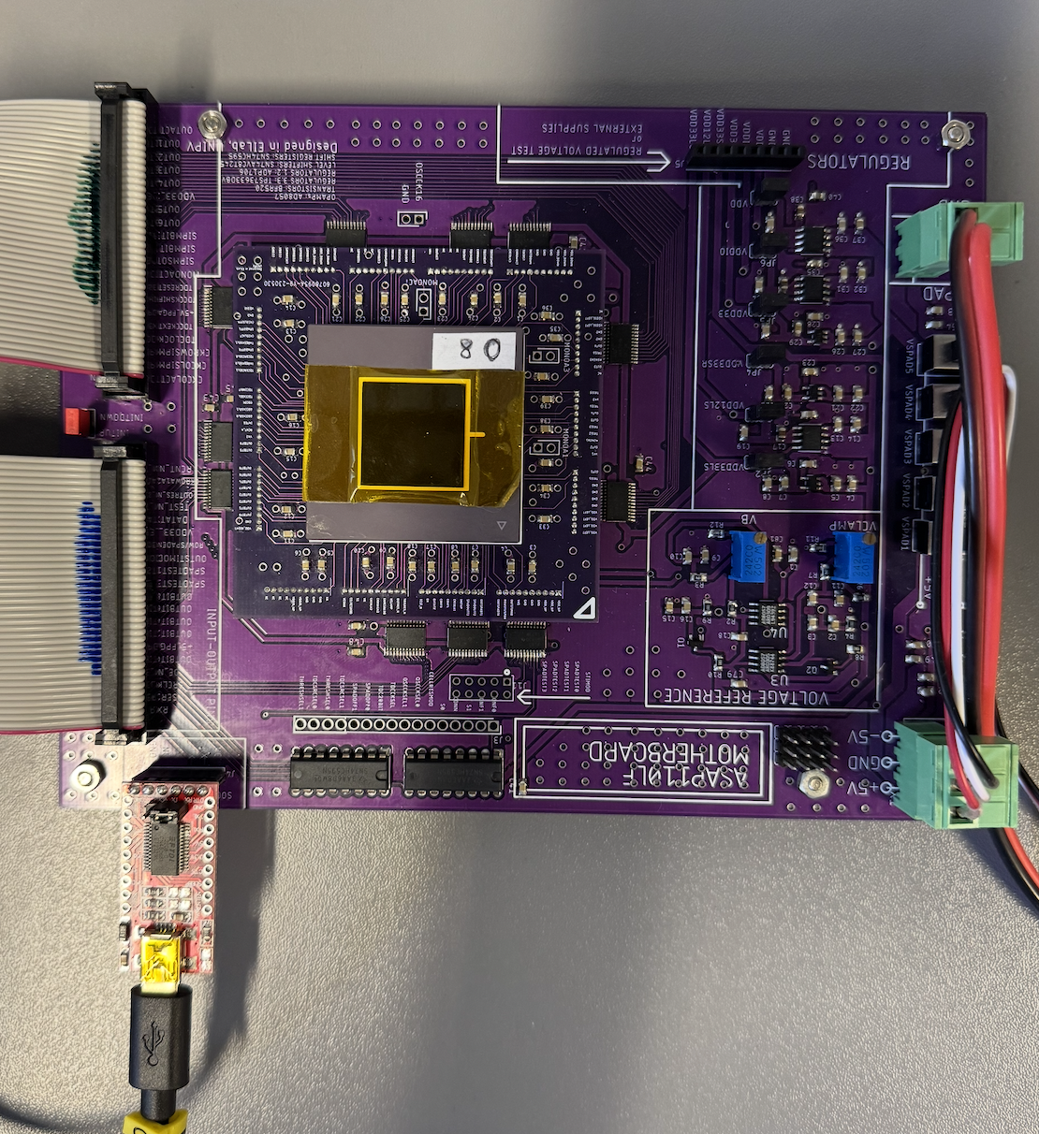
Test chip measurement setup in operation in the lab

Slide 5
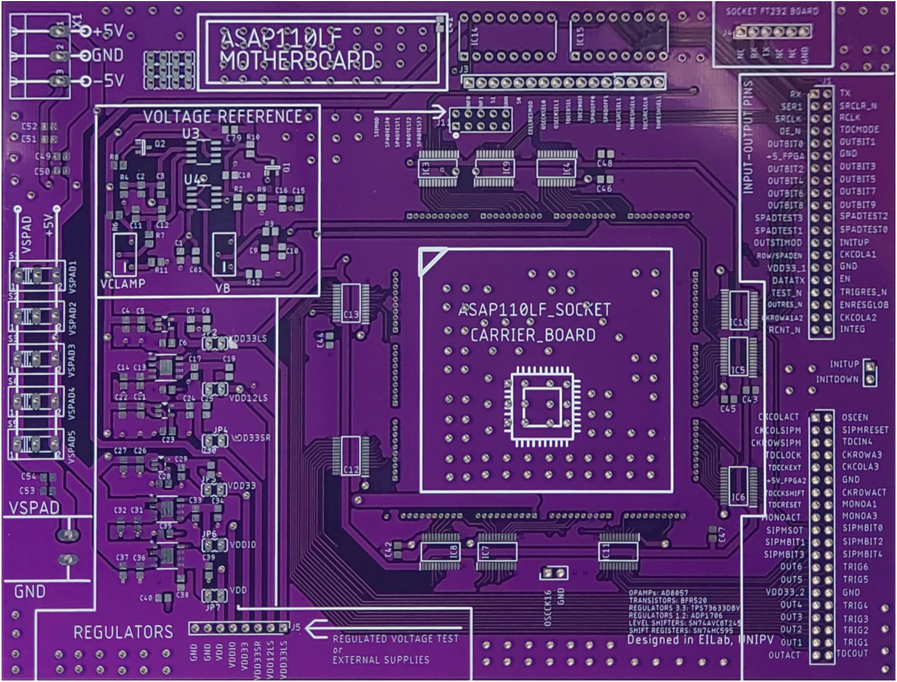
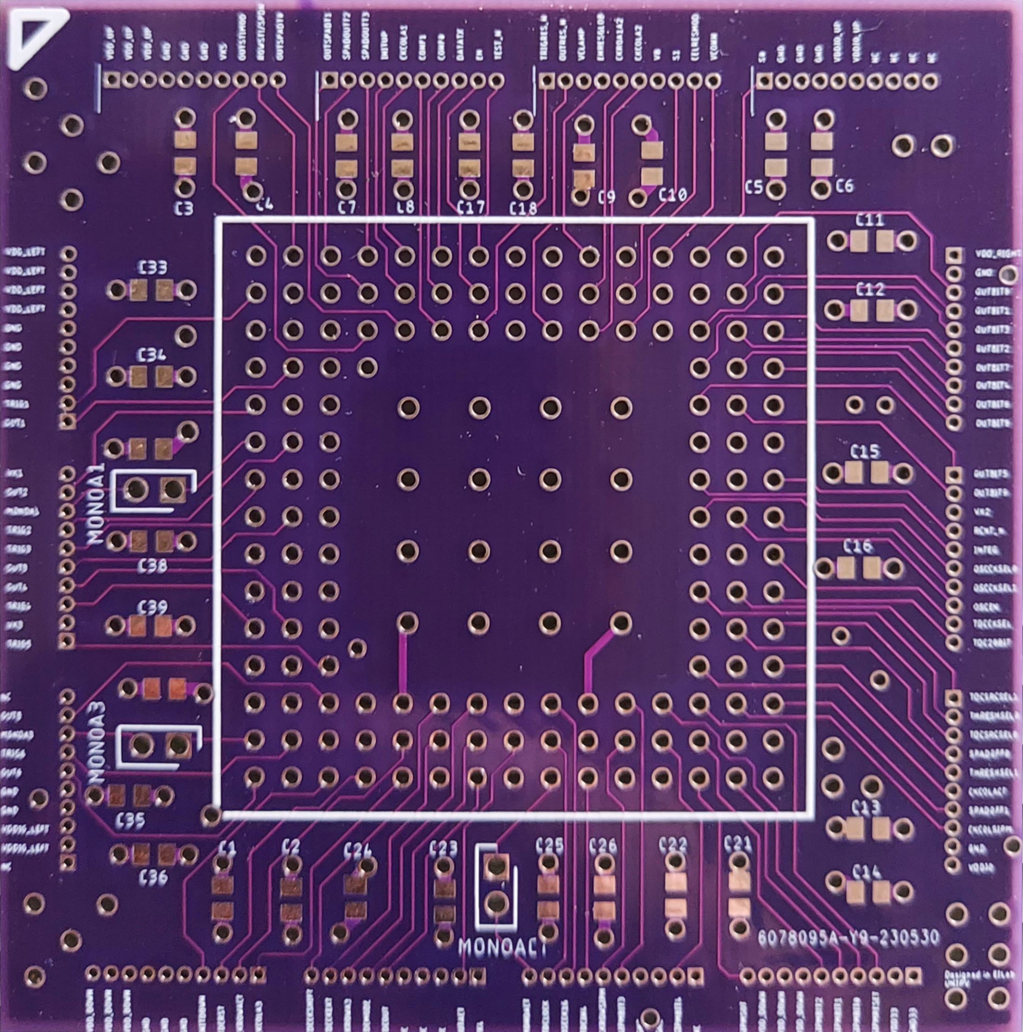
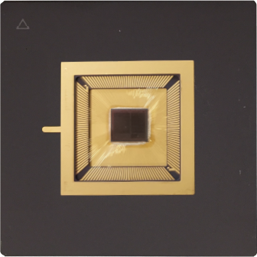
From Pavia
2x
2x
3x

Slide 6
The ASPIDES project
Goal: develop SiPMs in CMOS technology (digital SiPMs or dSiPMs) for fast (high time density), high dynamic range counting and high accuracy timing – application to dual readout calorimetry, RICH, dark matter and neutrino experiments
Participating units: Bari (N. Mazziotta), Bologna (L. Rignanese), Milano (R. Santoro), Pavia (L. Ratti), Trento (L. Pancheri), Napoli (M. Campajola), Padova (G. Collazuol), Torino (M. Da Rocha Rolo)
People involved: 7.85 FTE (27 researchers, 9 technologists)
Research area: Detectors and electronics
Duration: 3 years

Slide 7
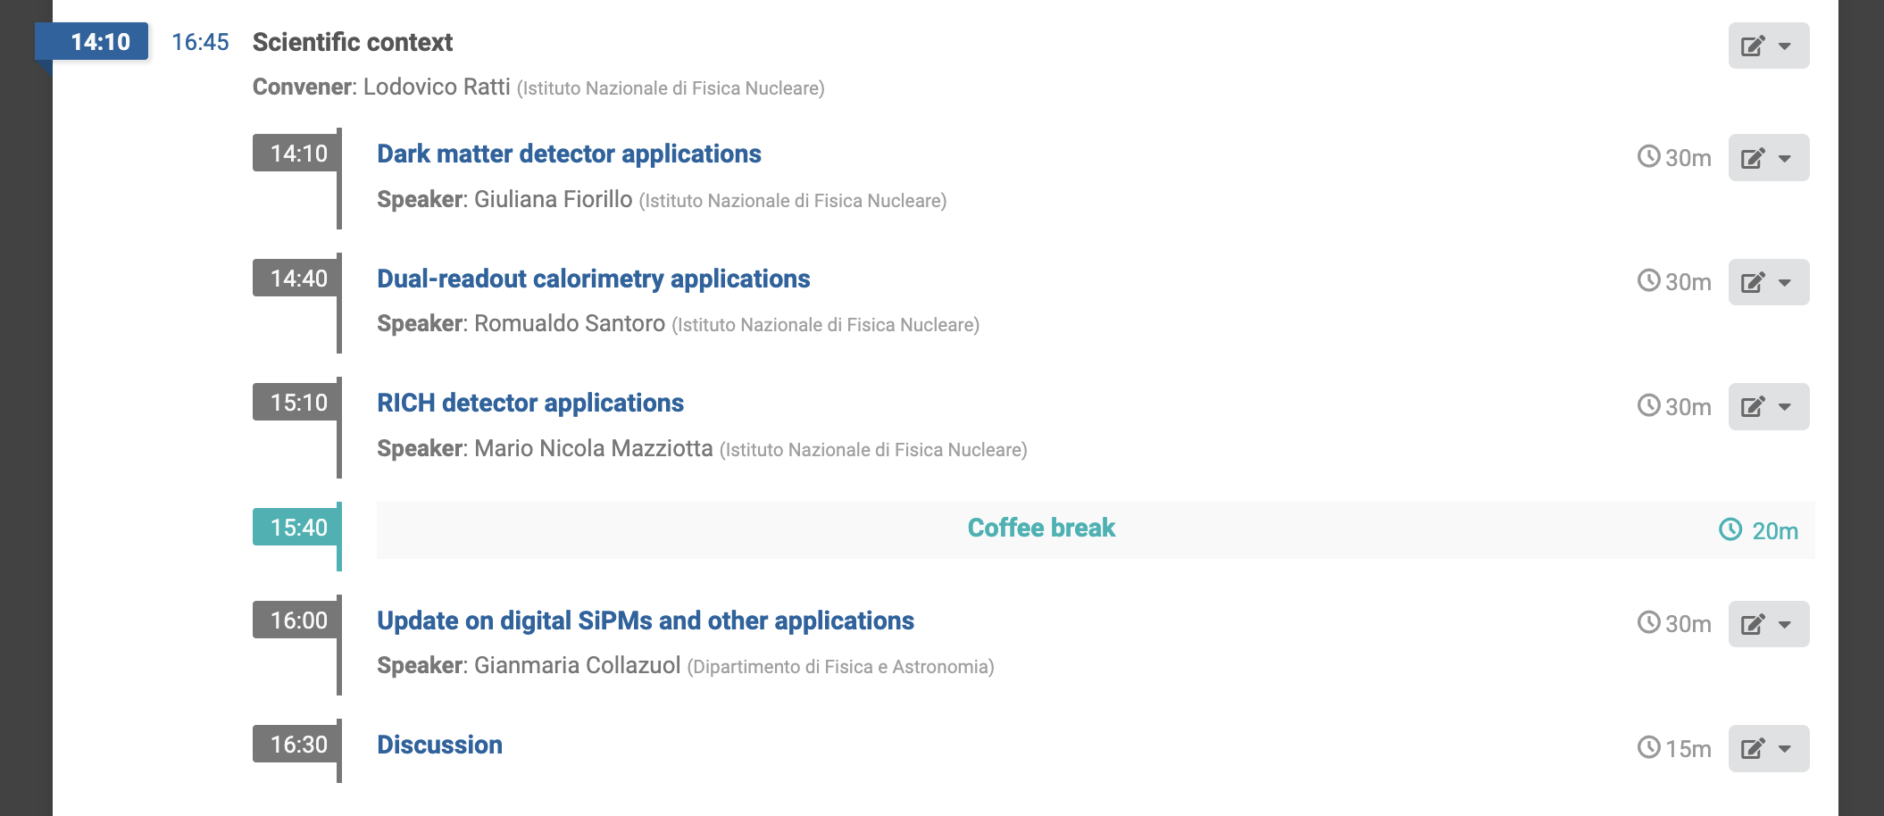
Meeting agenda – January 30

Slide 8
Meeting agenda – January 30-31
January 30
January 31

Slide 9
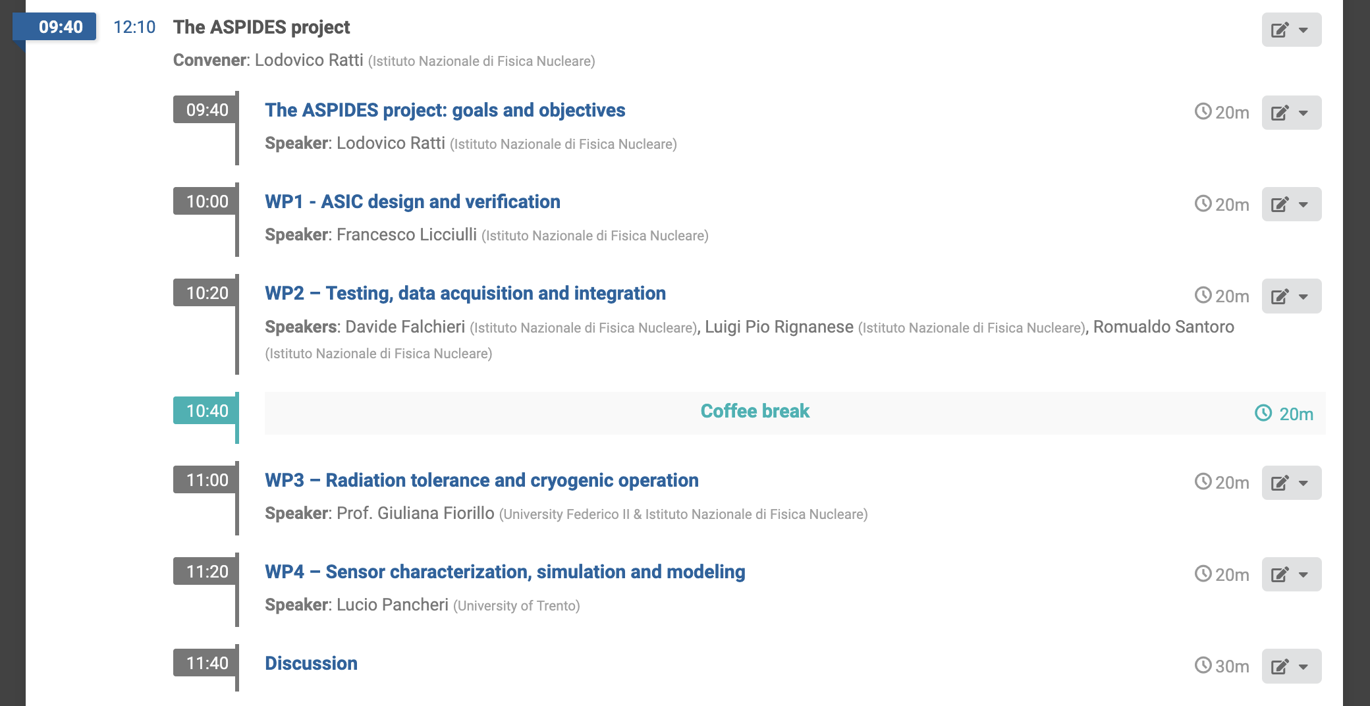
Meeting agenda – January 31

Slide 10
Specifications
Requirements | Dual readout calorimetry | Cherenkov (eg RICH, IACT) | DM | neutrino
SiPM Unit area (mm^2) | 1x1 | mm scale | 10x10 | 6x6
Micro-cell pitch (um) | 10-15 | 40-50 | 25-30 | 50-150
Macro-pixel area (um^2) | 500x500
PDE (%) | >20 | > 40 | >45 | >35
DCR (kHz) | <100 kHz/mm² | very low for single pe detection | <0.1 Hz/mm² (at LN) | <0.2 Hz/mm² (at LN)
AP (%) | <1 | few | Total Correlated Noise Probability (Xtalk + AP) < 60 % | <5%
Xtalk (%) | few | few |  | <35%
Trigger | external, self | self, external | self
Output data: light intensity | no. of fired cells in 1 or 2 time windows (10's of ns long)
Output data: time | time of arrival of the first photon in the window, possibly of the last photon (TOT) | ToA and ToT | ToA and TOT
Time resolution (ps) | <100 | < 100 single pe
Module size and form factor | strip with 8 units (1mm x 16 mm), pitch of 2 mm
Connection | BGA

