Slide 1
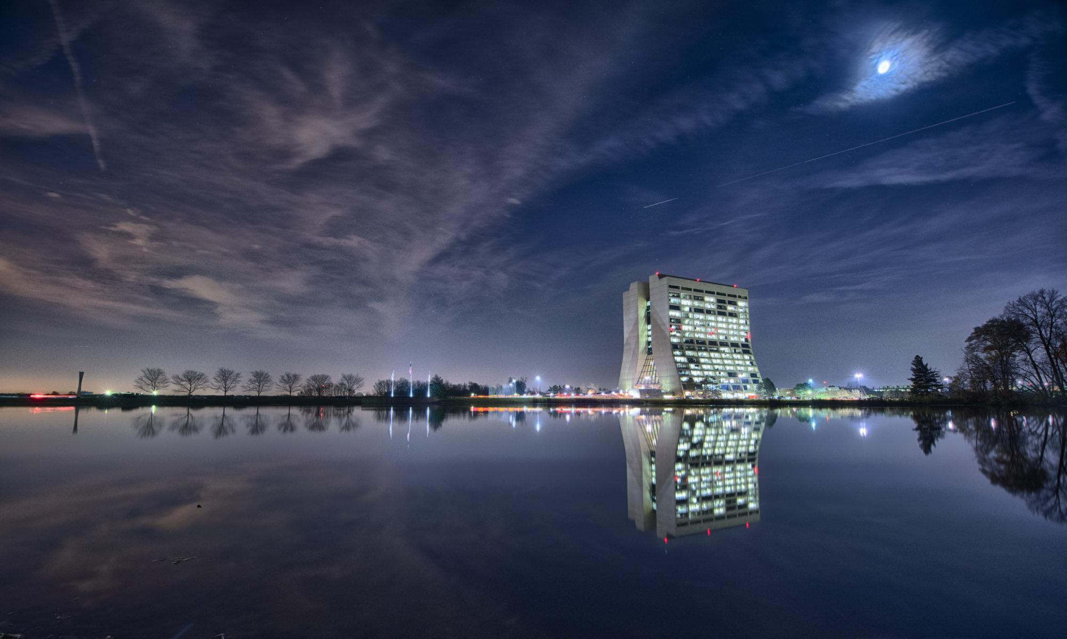
SENSE –NSearch for new physics and technological advancements from neutrino experiments at the high intensity frontier.
A cooperative Europe-United States–Brazil effort
WP5 Dissemination and Outreach
Christian Farnese
SENSE MidTerm Review Meeting

Slide 2
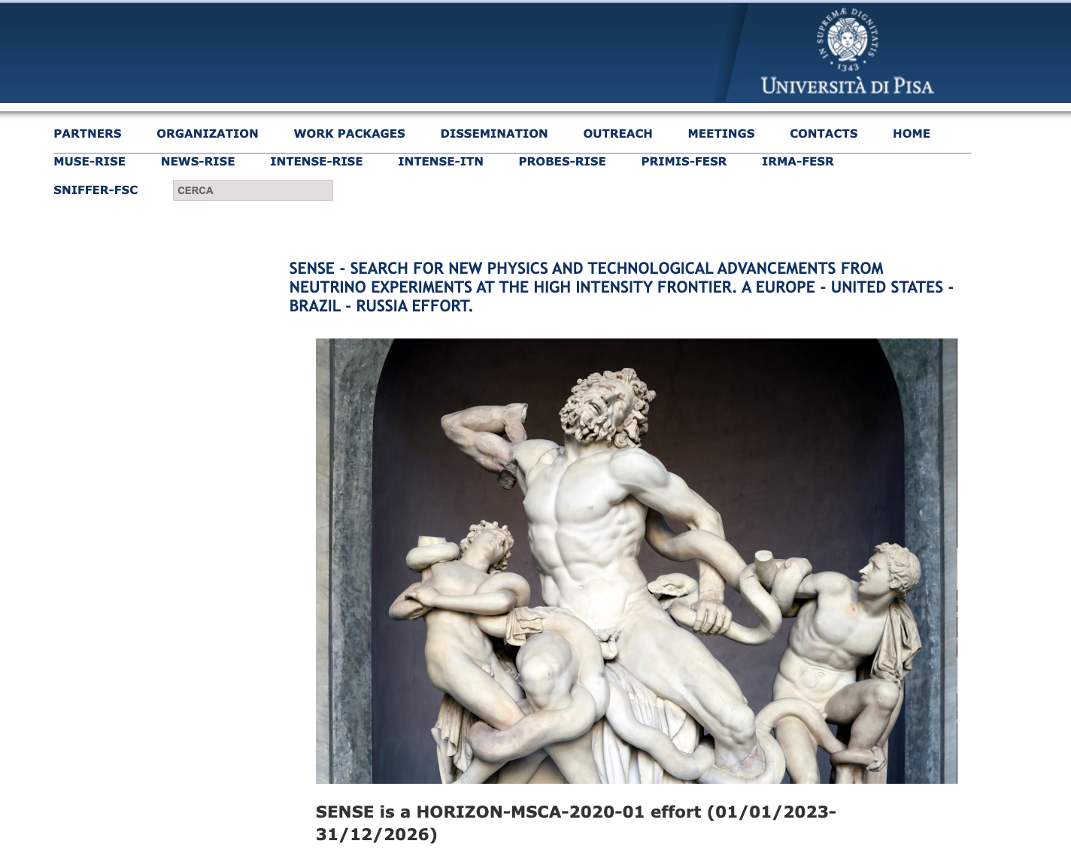
SENSE Web page
http://sesense.df.unipi.it
The web site reports the relevant project information, as well as a list of scientific publications and contributions to International Conferences and Workshops

Slide 3
DISSEMINATION: Conferences and Articles
There has been a wide participation in International Conferences and Workshops of the staff researchers, which included oral (Talks) and written contributions (Posters) to numerous International Conferences, and publication of articles in physics and instrumentation journals.
In the 1.2.5 Section of the Report we include some examples of participation at Conferences and articles

Slide 4
Papers: ICARUS
P . Abratenko et al. [ICARUS Collaboration], “ICARUS at the Fermilab Short-Baseline Neutrino program: initial operation”, Eur. Phys. J.C. 83 (2023) 6, 467, e-Print: 2301.08634 [hep-ex];
Maria Artero Pons for the ICARUS Collaboration, “Status and perspective of ICARUS at the Fermilab Short-Baseline Neutrino Program”, PoS EPS-HEP2024 (2024) 177;
C. Farnese et al. [ICARUS Collaboration], “Implementation of the trigger system of the ICARUS-T600 detector at Fermilab”, Nucl. Instrum. Meth. A 1045 (2023) 167498;
Magda Cicerchia et al. [ICARUS Collaboration], “Study of cosmic rays in the ICARUS-T600 detectors”, PoS TAUP2023 (2024) 165;
P. Abratenko et al. [ICARUS Collaboration], “Calibration and simulation of ionization signal and electronics noise in the ICARUS liquid argon time projection chamber”, e-Print: 2407.11925 [hep-ex] (2024);
P. Abratenko et al. [ICARUS Collaboration], “Angular dependent measurement of electron-ion recombination in liquid argon for ionization calorimetry in the ICARUS liquid argon projection chamber”, e-Print: 2407.11969 [physics.ins-det] (2024);

Slide 5
Francesco Poppi et al [IACRUS Collaboration], “Status and perspective of ICARUS-T600 detector at the Fermilab Short-Baseline Neutrino program”, Nucl. Instum. Meth. A 1072 (2025) 170113;
F. Abd Alrahaman et al. [ICARUS Collaboration], “Search for a Hidden Sector Scalar from Kaon Decay in the DI-Muon Final State at ICARUS”, e-Print 2411.02727 [hep-ex]; B. Baibussinov et al. “Study of charging-up of PCB planes for neutrino experiment readout”, JINST 19 (2024) 11, P11012, e-Print: 2407.19105 [physics.ins-det];
B. Baibussinov et al. “A novel liquid argon purity monitor based on 207 Bi”, e-Print: 2411.10796 [physics.ins-det];
Clara Saia et al. [ICARUS Collaboration], “Gain stability of Hamamatsu R5912-MOD photomultipliers at low temperature”, Nucl. Instrum. Meth. A 1069 (2024), 169861;
Laura Pasqualini et al. [ICARUS Collaboration], “Status and perspective of the ICARUS experiments at the Fermilab Short Baseline Neutrino Program”, PoS HQL2023 (2024) 020;

Slide 6
Papers: SBND and DUNE
P. Abratenko et al. [SBND Collaboration¶, “Scintillation light in SBND: simulation, reconstruction, and expected performance of the photon detection system”, Eur. Phys. J. C 84 (2024), no. 10, 1046;
A. Abed Abud et al. [DUNE Collaboration], “Impact of cross-section uncertainties on supernova neutrino spectral parameter fitting in the Deep Underground Neutrino Experiment”, Phys. Rev. D 107 (2023) 11, 112012, e-Print: 2303.17007 [hep-ex];
A. Abed Abud et al. [DUNE Collaboration], “Highly-parallelized simulation of a pixelated LArTPC on a GPU”, JINST 18 (2023) 04, P04034, e-Print: 2212.09807 [physics.comp-ph];
A. Abed Abud et al. [DUNE Collaboration], “Identification and reconstruction of low-energy electrons in the ProtoDUNE-SP detector”, Phys. Rev. D 107 (2023) 9, 092012, e-Print: 2211.01166 [hep-ex];
A. Abed Abud et al. [DUNE Collaboration], “Reconstruction of interactions in the ProtoDUNE-SP detector with Pandora”, Eur. Phys. J. C 83 (2023) 7, 618, e-Print: 2206.14521 [hep-ex];

Slide 7
A. Abed Abud et al. [DUNE Collaboration], “DUNE Phase II: scientific opportunities, detector concepts, technological solutions”, JINST 19 (2024) 12, P12005, e-Print: 2408.12725 [physics.ins-det];
A. Abed Abud et al. [DUNE Collaboration], “First measurement of the total inelastic cross section of positively charged kaons on argon at energies between 5.0 and 7.5 GeV”, Phys. Rev. D 110 (2024) 9, 092011, e-Print: 2408.00582 [hep-ex];
A. Abed Abud et al. [DUNE Collaboration], “Performance of a Modular Ton-Scale Pixel-Readout Liquid Argon Time Projection Chamber”, Instruments 8 (2024) 3, 41, e-Print: 2403.03212 [physics.ins-det];
A. Abed Abud et al. [DUNE Collaboration], “Doping liquid argon with xenon in ProtoDUNE Single-Phase: effects on scintillation light”, JINST 19 (2024) 08, P08005, e-Print: 2402.01568 [physics.ins-det];
A. Abed Abud et al. [DUNE Collaboration], “The DUNE Far Detector Vertical Drift Technology. Technical Design Report”, JINST 19 (2024) 08, T08004, e-Print: 2312.03130 [hep-ex];

Slide 8
International Conferences & Workshops
Some examples
2023
CHEP 2023
EPS-HEP 2023
TAUP 2023
SIF 2023
XX International Workshop on Neutrino Telescopes
XII International Conference on New Frontiers in Physics
IPRD 2023
ACHEP 2023
HQL 2023
New Perspectives 2023
LIDINE 2023
ISAPP 2023
2024
ICHEP 2024
PM 2024
NEUTRINO 2024
XIII International Conference on New Frontiers in Physics
NOW 2024
SIF 2024
35° Rencontres de Blois
PIC 2024
LIDINE 2024
LLP 2024
XVI CPAN days

Slide 9
EPS-HEP 2023
https://www.eps-hep2023.eu/
Emanuela Barzi, G. Bellettini, S. Donati, M. Mambelli, “The Italian Summer Students Program at Fermilab: 40 years of education in particle physics and technology”.
Maria Artero Pons, “Status and perspective of ICARUS at the Fermilab Short-Baseline Neutrino Program”.
LIDINE 2023
https://agenda.ciemat.es/event/4282/timetable/?view=standard
Francisco Javier Nicolas, “Using scintillation light to tag events in SBND”
Francisco Javier Nicolas, “A novel Amorphous selenium based photosensor for liquid noble detectors”.
Rodrigo Álvarez Garrote, “The SBND photon detection system”.

Slide 10
TAUP 2023
https://indico.cern.ch/event/1199289/
Emanuela Barzi, G. Bellettini, S. Donati, M. Mambelli, “The Italian Summer Students Program at Fermilab: 40 years of education in particle physics and technology”.
Magda Cicerchia, “Study of cosmic rays in the ICARUS-T600 detectors”.
José I. Crespo-Anadón, “Searches for Beyond Standard Model Physics in the SBND neutrino experiment”
Clara Cuesta, “Supernova and solar neutrino searches at DUNE”.

Slide 11
NEUTEL 2023
https://agenda.infn.it/event/33107/
Maria Artero Pons, “Neutrino Reconstruction Analysis at ICARUS Detector”.
Filippo Varanini, “Short Baseline Neutrino Oscillations at Fermilab”.
Francesco Poppi, “The cosmogenic background rejection of the ICARUS detector at Fermilab”.
(Venice, Italy, 23-27 October 2023);
IPRD 2023
https://www.dsfta.unisi.it/it/eventi/16th-topical-seminar-innovative-particle-and-radiation-detectors-iprd23
D. Pasciuto (UNIPI), “Development of the Mu2e Electromagnetic Calorimeter Mechanical Structures” (Talk)
A. Gioiosa (UNIPI), “Mu2e TDAQ and Slow Control Systems” (Talk)
F. Spinella (INFN), “Development of the Mu2e Electromagnetic Calorimeter Front-End and Readout Electronics” (Talk)

Slide 12
NEUTRINO 2024
https://neutrino2024.org/
D. Gibin, “ICARUS at the Short-Baseline Neutrino Program: First Results”, Talk;
F. Poppi, “Cosmic background rejection of the ICARUS Experiment at Fermilb”, Poster;
M. Cicerchia, “Data vs Monte Carlo comparison of light signal from cosmic rays in the ICARUS detectors”, Poster;
A. Campani, “Track vs shower discrimination in the event reconstruction of the ICARUS Experiment”, Poster;
Francisco Javier Nicolas, “The SBND detector at Fermilab”, Poster;
Sergio Manthey Corchado, “DUNE’s sensitivity to solar neutrinos”, Poster;
Laura Pérez-Molina, “Efficiency of the Photon Detection System in DUNE Far Detectors”, Poster.

Slide 13
ICHEP 2024
https://indico.cern.ch/event/1291157/
L. Di Noto et al., “ICARUS at the Short-Baseline Neutrino program: first results”, Talk;
M. Cicerchia et al., “Light signal study of the cosmic rays in the ICARUS detector”, Talk;
D. Cherdack, “Numi at ICARUS Flux, Cross Section, and BSM Physics”, Talk;
Inés Gil Botella, “The Deep Underground Neutrino Experiment (DUNE) program”, Talk;
Sergio Manthey Corchado, “DUNE’s low energy physics searches”, Poster;
NOW 2024
https://home.ba.infn.it/~now/now2024/
Christian Farnese, “Searching for sterile neutrinos with ICARUS at FNAL”; Talk.

Slide 14
SIF 2024
https://2024.congresso.sif.it/info
Laura Pasqualini, “ICARUS at the Short-Baseline Neutrino program: First results”, Talk;
Francesco Poppi “Cosmic background rejection in the ICARUS experiment at Fermilab”, Talk;
Riccardo Triozzi, “Performance of the ICARUS trigger system at the booster and NuMI neutrino beams”, Talk;
Vanessa Brio, “Neutrino event detection in ICARUS: Analysis of photomultiplier waveforms and Monte Carlo validation”, Talk;
Giovanni Chiello, “Muon momentum reconstruction in ICARSU-T600 LAr-TPC via multiple scattering” , Talk.

Slide 15
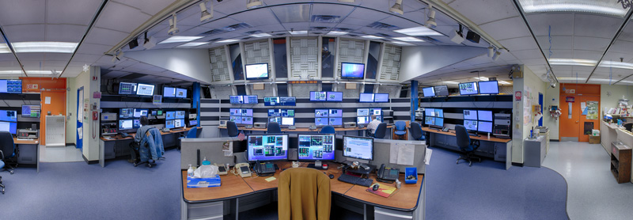
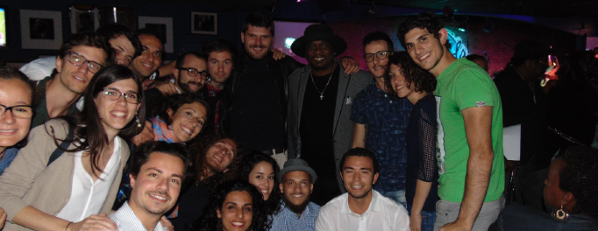
THE ITALIAN SUMMER STUDENTS PROGRAM AT FERMILAB
A multi-disciplinary 9-week internship for Physics and Engineering students
Hands-on training on Fermilab high-tech research
2024 program just concluded (13 Summer Students)
$\sim$600 SUMMER STUDENTS IN THE PROGRAM SINCE 1983
Many former Summer Students have developed their career at Fermilab with a Master Thesis and a PhD

Slide 16
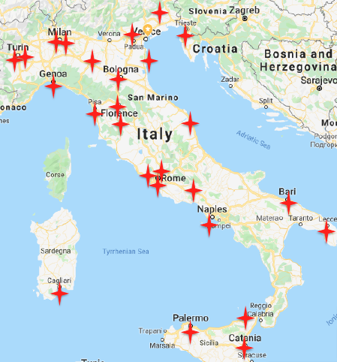
Students’ Recruitment
THE ITALIAN SUMMER STUDENTS PROGRAM AT FERMILAB
INTERNATIONAL PROGRAM
Applications from most Italian
and some European Universities
MASTER STUDENTS
Physics/Applied Physics
Engineering, Materials Science
Computer Science
ADMISSION
Curriculum Vitae
Recommendation Letters
Motivation Letter
Interview
Good knowledge of English

Slide 17
Training Programs
THE ITALIAN SUMMER STUDENTS PROGRAM AT FERMILAB
AUGUST – SEPTEMBER (9 WEEKS)
PROGRAMS FOR PHYSICISTS
Design, construction, commissioning of particle detectors/accelerators
Simulation of particle detectors/accelerators and particle physics experiments
Analysis of data collected by particle physics experiments
PROGRAMS FOR ENGINEERS
Design/Test of particle detectors/accelerator components
Design/Test of superconducting materials and magnets for particle accelerators
Development of fast electronics components/high precision mechanics
Development of advanced computing infrastructures
UNIVERSITY CREDITS (acknowledged by the UNIPI Summer School)
6 ECTS credits (ECTS, European Credit Transfer and Accumulation System)

Slide 18
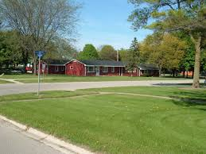
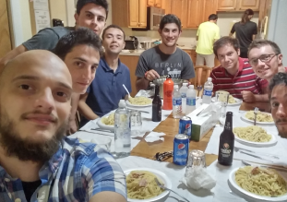
Applicants Benefits
THE ITALIAN SUMMER STUDENTS PROGRAM AT FERMILAB
WHAT FERMILAB PROVIDES
Weekly stipend
Free housing in Fermilab Dorms
Free shared rental car
Total cost $\sim$17000 $/student
WHAT FERMILAB DOES NOT PROVIDE
Round-trip journey from Italy to Chicago
Health insurance: mandatory
STUDENTS’ TO-DO LIST
Valid passport
Employment and J1 Visa bureaucracy with
the help of Fermilab’s administrative offices

Slide 19
Important Actions/Dates
THE ITALIAN SUMMER STUDENTS PROGRAM AT FERMILAB
January – March
Receive Students’
Applications
January – April
Receive Supervisors’
Training Programs
March – April
Students’ Interviews
In 2024 we received
> 100 Applications
> 30 Training Programs
13 Summer Students at Fermilab
April - May
Students’ Selection
TP Assignment
Last weekend of July
Fly to Chicago
Fermilab Hiring
+5 weeks (August)
MidTerm Review
+9 weeks (September)
Final Review
October
Final Exam at UNIPI

Slide 20
Summer Students Statistics (1983 – 2024)
THE ITALIAN SUMMER STUDENTS PROGRAM AT FERMILAB
C
O
V
I
D
- Total (613 students since 1983)
- Physics students
- Engineering students
C
O
V
I
D
X
2024

Slide 21
Training Programs (2017-2024, last 6 “years”)
THE ITALIAN SUMMER STUDENTS PROGRAM AT FERMILAB
- 78 Physics students
- 66 Engineering students

Slide 22
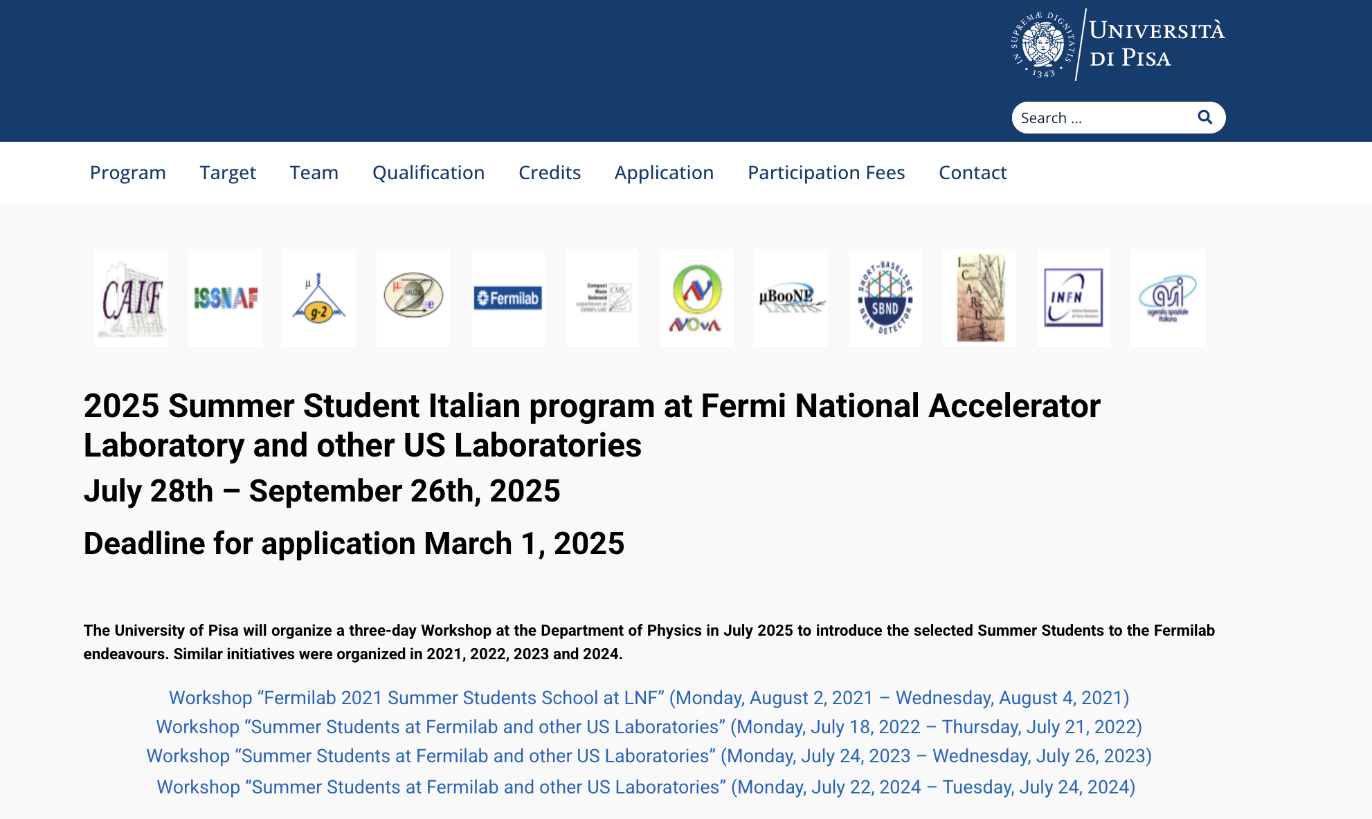
THE ITALIAN SUMMER STUDENTS PROGRAM AT FERMILAB

Slide 23
Outreach Activity : European Researchers’ Night – September 29, 2023 September 27, 2024
The event aims to bring researchers closer to the general public and to increase public awareness of research and innovation activities with a view to supporting the public recognition of research and innovation activities, creating an understanding of the impact of researchers’ work on citizens’ daily lives and encouraging young people to embark on research careers
Plenty of events across Europe:
INFN and UNIPI researchers contributed to organize events in several Italian cities
As an example: Science4 all organized at Padova-Italy in 2023 and 2024

Slide 24
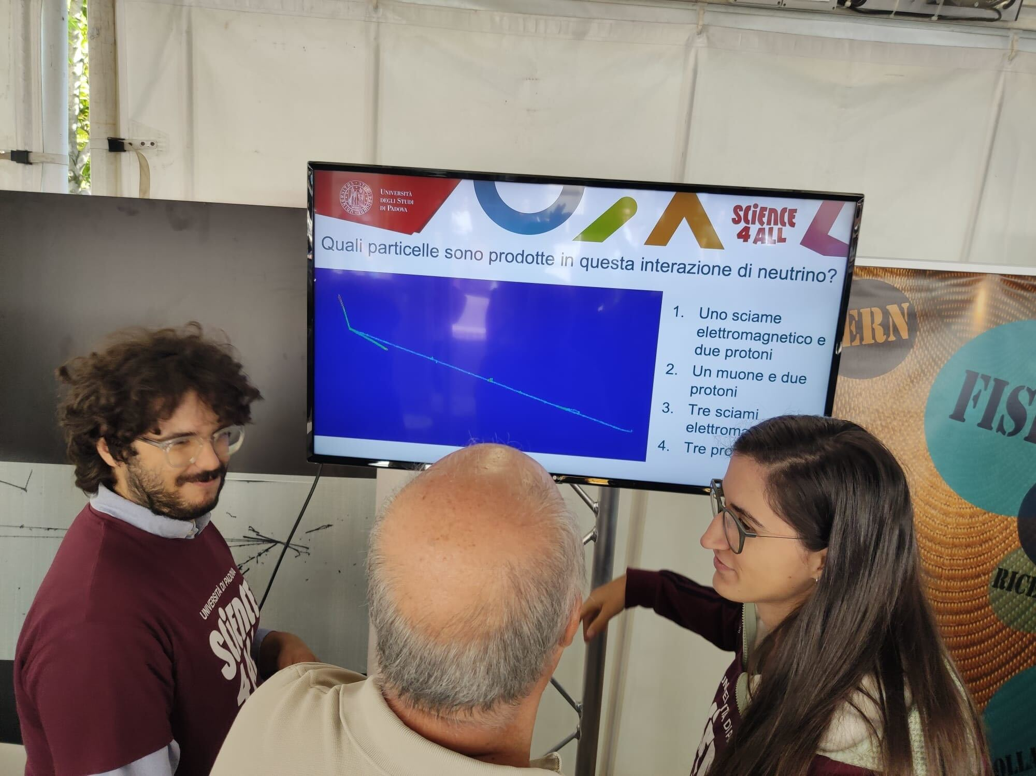
Outreach Activity:
Science4All, a scientific communication project organized by the Padova University that aimed to communicate science in a simple and fun way to everyone.
INFN and University of Padova researchers contribute to Science4All, presenting theneutrinos, showing the neutrino events recorded by the ICARUS experiment and involving the Participants to a Quiz Game «Recognize the particles in ICARUS»
M. Artero Pons and R. Triozzi asking “Is the event in the picture a neutrino interaction?”

Slide 25
The «PICO» PhysICs fOr all project
https://picoproject.eu/
The EU-funded PICO project aims to increase citizens’ awareness of fundamental physics and of the impact that discoveries in these fields have on their everyday lives.
PICO will coordinate Researchers’ Night activities and satellite events in 4 countries (Greece, Italy, France, Spain). The main events will take place in person, with a remote component to open the door of world-famous laboratories and research infrastructures, which participate in international collaborations.

Slide 26
Thank you for your attention and…
…have fun with physics!!

