Slide 1
State of Storage
CdG 17 Gennaio, 2025
?

Slide 2
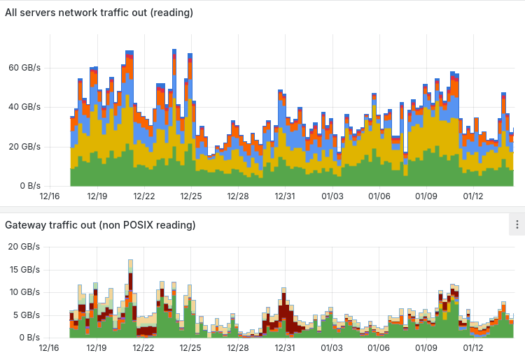
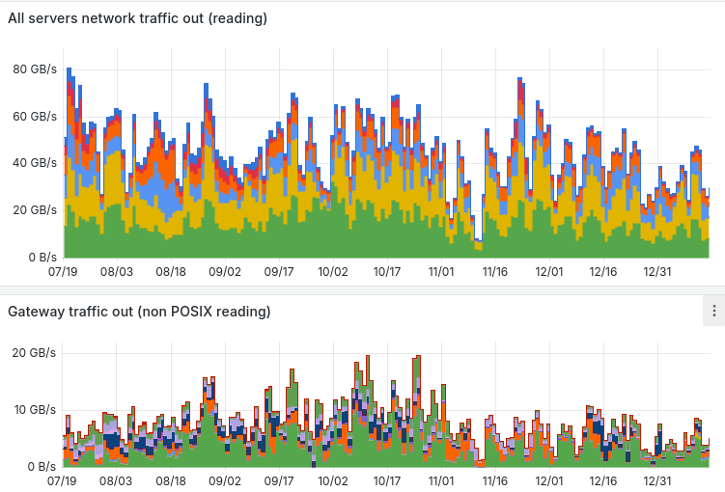
Business as usual + migration to TP
Last month
Last 6 months

Slide 3
Disk storage in produzione 77.5PB
Installed: 101.4PB; Pledge 2025/01: 86.95PB; Pledge 2025/04: 101PB; Used: 60PB
Storage system | Model | Net capacity, TB | Experiment | End of support
os5k8-1,os5k8-2 | Huawei OS5800v5 | 8999 | GR2 | 2027
ddn-12, ddn-13 | DDN SFA 7990 | 5840 | GR2,GR3 (commissioning) | 2025
ddn-14, ddn-15 | DDN SFA 2000NV (NVMe) | 24 | Metadata (commissioning) | 2025
ddn-16 | DDN SFA 2000NVX2 (NVMe) | 96 | LHCb metadata, hotdata | 2031
ddn-17,ddn-18,ddn-19 | DDN SFA 7990X | 14000 | LHCb | 2031
od1k6-1,2,3,4,5,6 | Huawei OD1600 | 60000(-10%!) | ALICE,ATLAS,CMS, GR2 | 2031
od1k6-7,8 | Huawei OD1600 | 18000 | Buffer for remake of above | 2031
od1k5-1,2 | Huawei OD1500 (NVMe) | 400 | Metadati, LHCb hotadata | 2031

Slide 4
Disk storage in dismissione: 32.2PB
Storage system | Model | Net capacity, TB | Experiment | End of support
os6k8 | Huawei OS6800v3 | 3400 | Virgo | 07/2024
ddn-10, ddn-11 | DDN SFA12k | 10120 |  | 12/2022
md-1,md-2,md-3,md-4 | Dell MD3860f | 2308 | Virgo, Archive | 12/2024
md-5,md6,md-7 | Dell MD3820f | 50 | metadati, home, SW | 11/2023 e 12/2024
os18k1, os18k2 | Huawei OS18000v5 | 6520 | AMS | 7/2024
os18k3, os18k5, os18k5 | Huawei OS18000v5 | 9780 | ATLAS,ALICE (buffer tape) | 6/2024

Slide 5
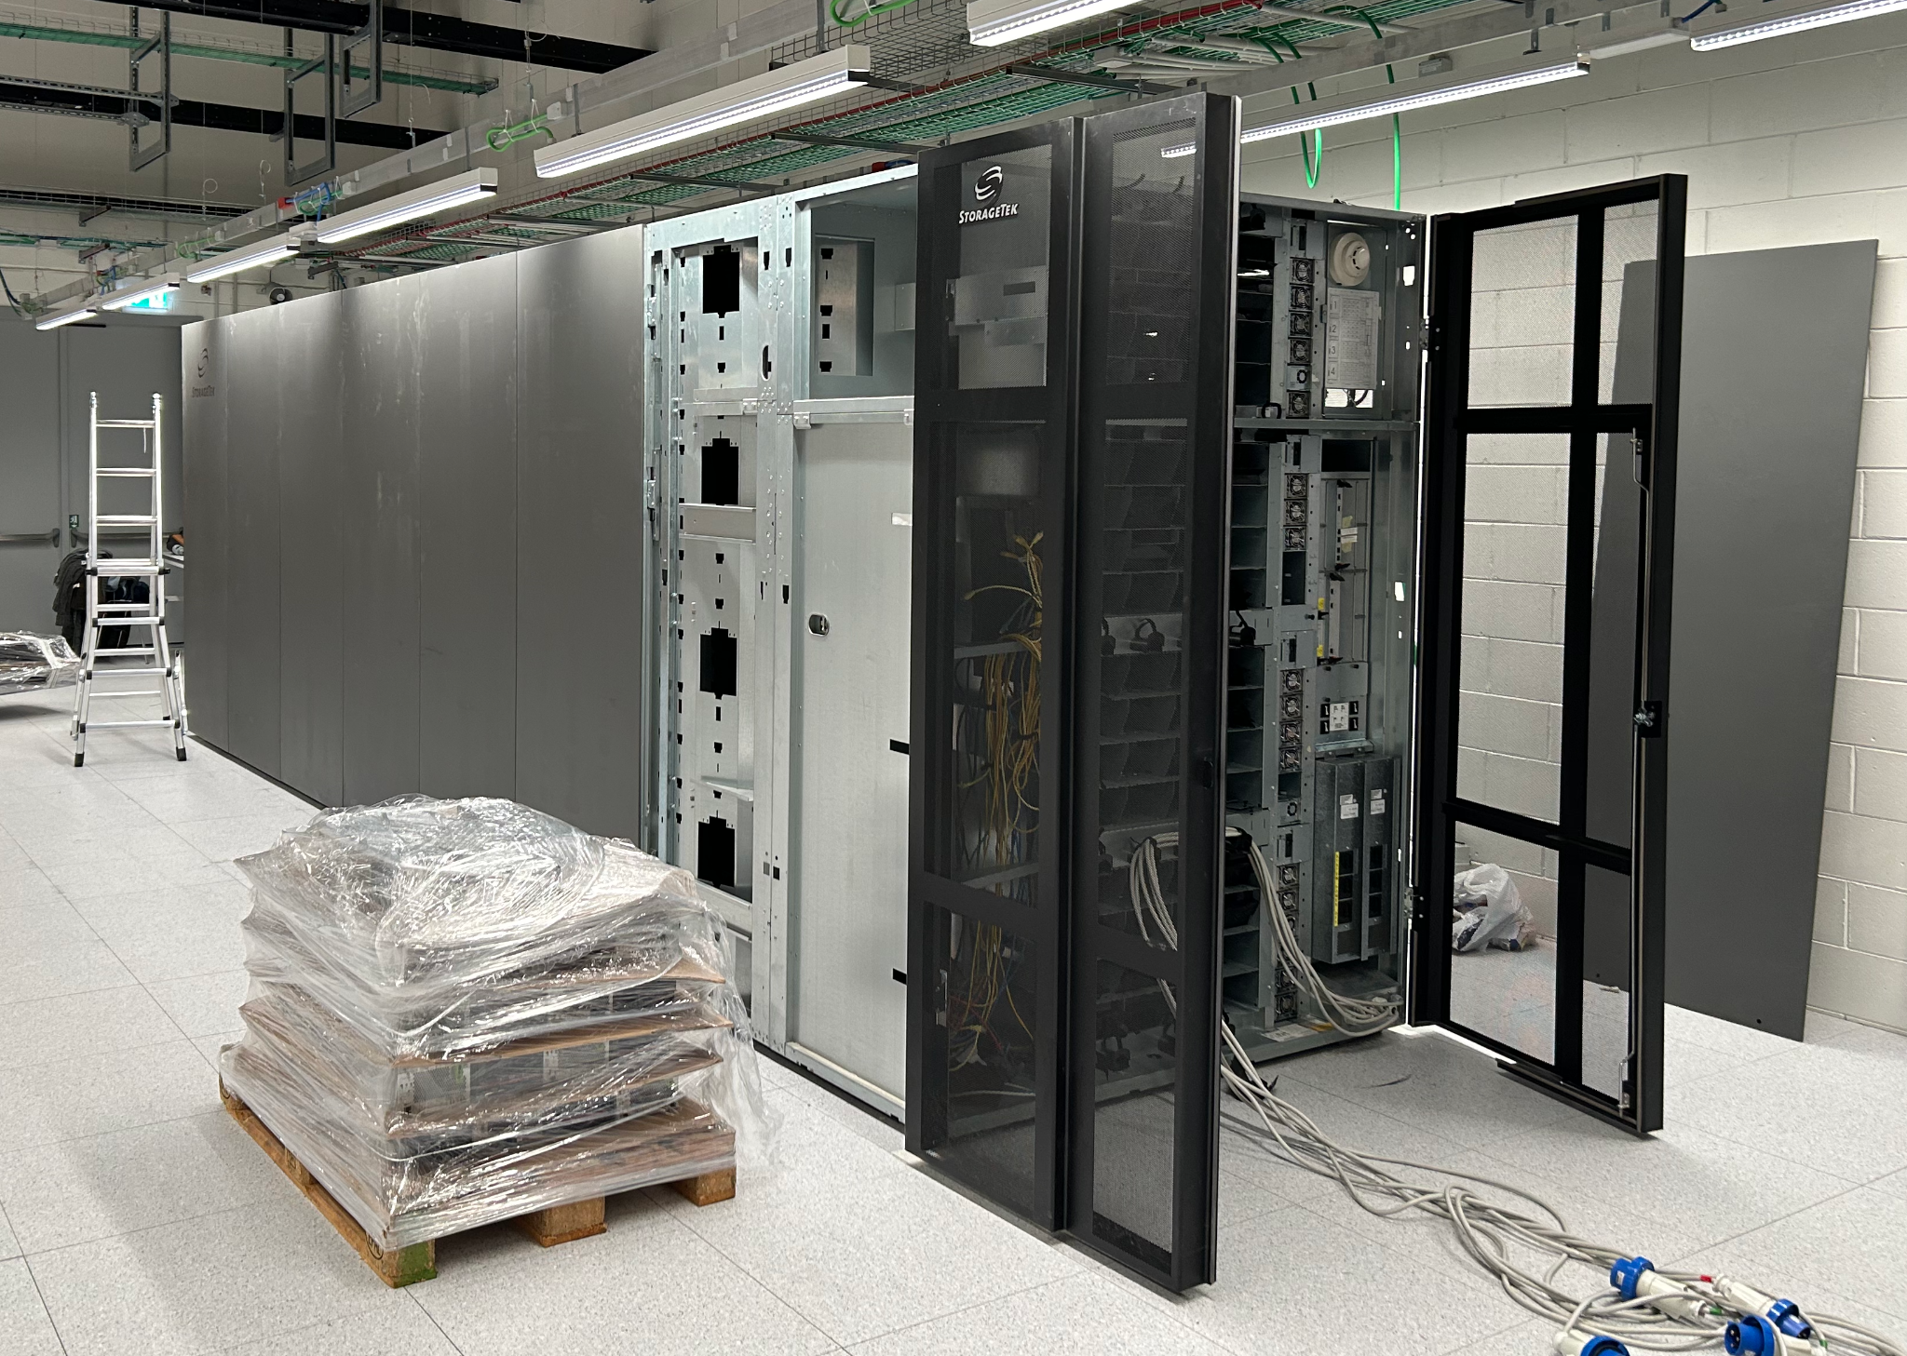
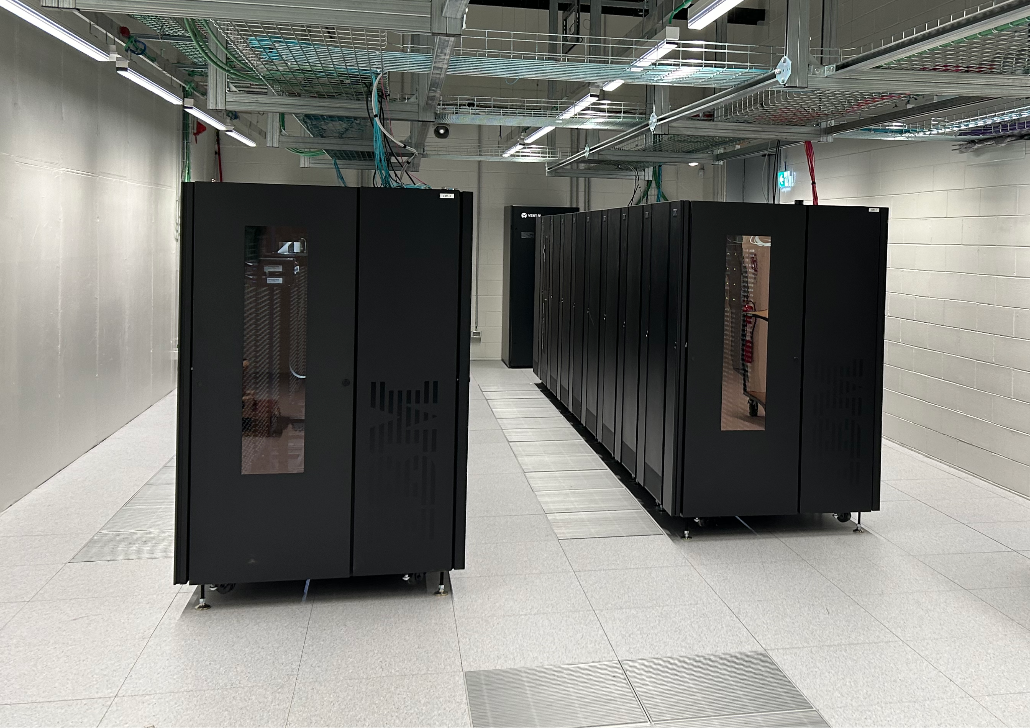
Traslochi recenti e futuri
Trasloco della libreria IBM: completato
Trasloco della libreria Oracle: in corso
Gare nastri conclusa
96PB di tape JF (50TB/casetta) in arrivo

Slide 6
Problemi LHCb
Abbiamo creato “buffer disco” per i dati “hot” con un fileset dedicato: LHCb-Buffer Linked /storage/gpfs_lhcb/disk/lhcb/buffer
Abbiamo definito la Placement policy: RULE 'HOTDISK' SET POOL 'hotdata' FOR FILESET ('LHCb-Buffer') LIMIT(99) WHERE NAME LIKE '%.dst'
200 TB NVMe
Il buffer tape è stato rimesso sull’HW condiviso con il resto dei dati.
Dopo la migrazione sullo storage DDN, abbiamo riscontrato problemi con schede della rete dei nuovi server Lenovo

Slide 7
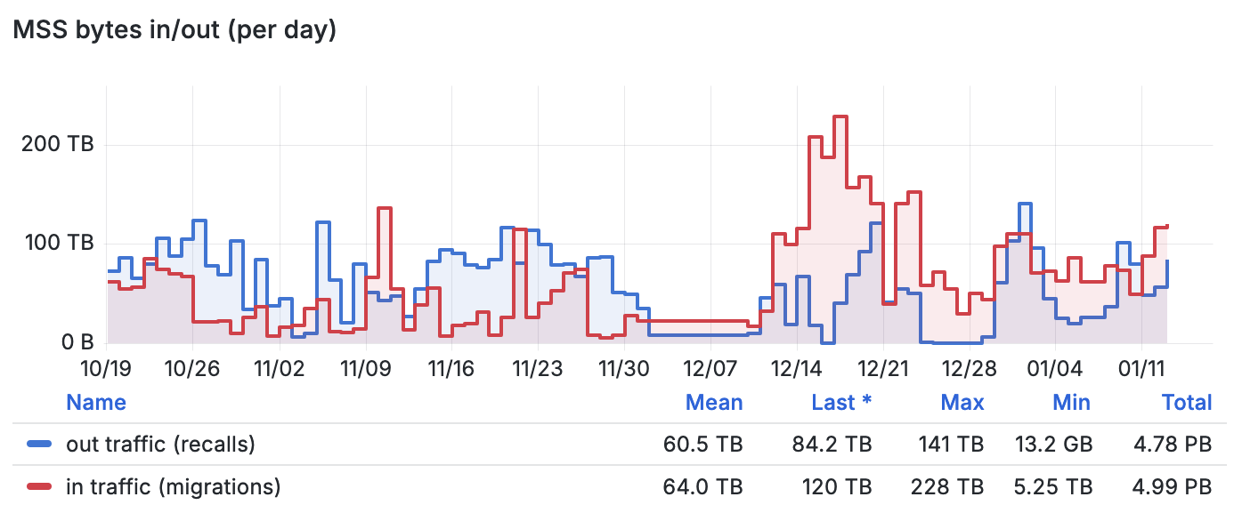
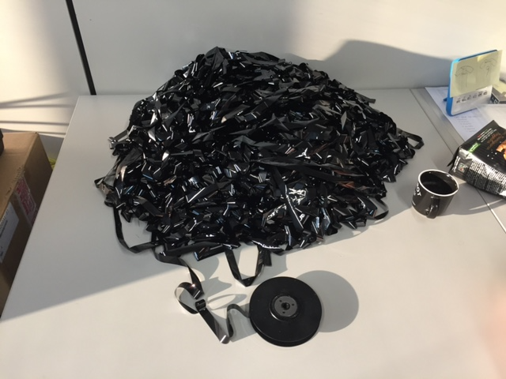
Stato tape
Last 2 months
Down for movement IBM library
5 PB of new data written to tapes in two month (since last CdG)
Tape system DOWN 13-23 Jan 2025 (per trasloco della libreria Oracle a Tecnopolo)

Slide 8
Stato tape
Liberi ~40 PB (Scratch tape inclusi libreria Oracle).
Usati 149 PB.
Spazio tape sulla libreria IBM praticamente esaurito
La nuova libreria IBM non è ancora funzionante a causa di problemi di compatibilità con la versione TSM in produzione.
Library | Tape drives | Max data rate/drive, MB/s | Max slots | Max tape capacity, TB | Installed cartridges | Used space, PB | Free space, PB
SL8500 (Oracle) | 16*T10KD | 250 | 10000 | 8.4 | ~10000 | 47 | 32
TS4500 (IBM) | 19*TS1160 | 400 | 6198 | 20 | 5100+380 | 102 | 0.6
TS4500-2(IBM) | 18*TS1170 | 400 | 7844 | 50 | 165 | 0 | 8.2

Slide 9
Current SW in PROD
GPFS 5.1.9-4, in migrazione to 5.1.9-7
StoRM BackEnd 1.11.22 (latest, 1.12.0 in test)
StoRM FrontEnd 1.8.15 (latest, 1.8.16 in test)
StoRM WebDAV 1.4.3 (latest)
StoRM Tape 0.8.0 (latest)
StoRM globus gridftp 1.2.4
XrootD 5.5.4-1
LHCb updated to 5.5.5-1
Ceph 16.2.6 (Pacific)
GEMSS and tape drive orchestrator updated to support X tape libraries

Slide 10
Tickets and more
ALICE
Open action: finalize the configuration for the XrootD tape cluster (xs-204, xs-304)
Waiting for the migration of servers to EL9 to install and test rpm for interaction xrootd-tape
ATLAS
GGUS 169504 (closed): Lukas Pfaffenbichler overloaded StoRM WebDAV servers
GGUS 169404, 169472 (closed): StoRM WebDAV threads saturation; a restart solved the issue
GGUS 169311 (closed): tape downtime
GGUS 169259 (closed): report.json no longer available on the “xfer” endpoint
GGUS 169250 (closed): the file system was left unmounted after a reboot
GGUS 168988 (closed): tape library downtime, the recovery of the services was a bit slower than expected
GGUS 168445 (closed): failed transfers due to “tape buffer full”
We highly recommend not to exceed the mean daily writing rate limit (recalls included) of 1.0GB/s
GGUS 167957 (on hold): StoRM WebDAV does not permit the creation of non-existent parent directory even if the scope does it,
Waiting for a fix from StoRM developers

Slide 11
Tickets and more
CMS
GGUS 169589 (closed): tape downtime, still ongoing
GGUS 169260, 169319 (closed): tape downtime (on Dec); but CMS used xfer-cms (disk endpoint) for SAM tests
GGUS 168610 (closed): StoRM WebDAV threads saturation
GGUS 168538 (closed): StoRM Tape returned NONE instead of DISK for 0-size files
Fixed by StoRM developers
GGUS 167995 (on hold): StoRM WebDAV does not permit the creation of non-existent parent directory even if the scope does it
Waiting for a fix from StoRM developers

Slide 12
Tickets and more
LHCb
GGUS 169478 (in progress): 19/12/24 - Massive transfer failures to/from CNAF
20/12/24 - 40GB/s POSIX traffic, migration away from HUAWEI disk storage
Increased the number of StoRM WebDAV servers up to 8
Concurrent FTS/job transfers reduced by LHCb
27/12/24 - Internal network issues with the new DDN disk storage
StoRM Tape REST API showed 502 errors (connection timeout)
07/01/25 - TPCs failed with timeout expiration
concurrent FTS transfers were not enough to transfer all the files before that the garbage collector removed them from the tape buffer
13/01/25 - Migration to DDN storage completed
GGUS 169555 (in progress): corrupted files
Network issues resulted in 1696 corrupted files, for a total size of 461 GB
For comparison, we checked 2312 files (461 GB) written between 12:40 and 13:20 of Jan 12th, and we could not find any evidence of corruption

Slide 13
Tickets and more
Gsiftp protocol via StoRM backend is still available for two experiments
New StoRM release or new StoRM Tape REST API release should finally allow to switch GridFTP off (Xenon, CTA-LST)
Dampe
GridFTP “plain” no more used
Rucio+FTS (https) replaced the current gsiftp transfers (WP6-DataCloud)

