Slide 1




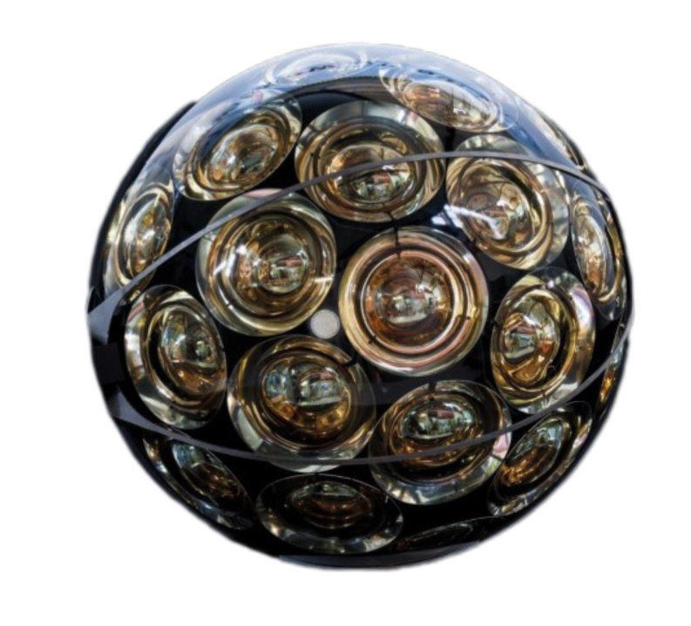


Il telescopio sottomarino
alla ricerca di
neutrini cosmici nel
Mar Mediterraneo
Il detector e i sensori di KM3NeT
Emanuele Leonora-INFN Catania
CATANIA, 21 GENNAIO 2025
Missione 4 • Istruzione e Ricerca

Slide 2


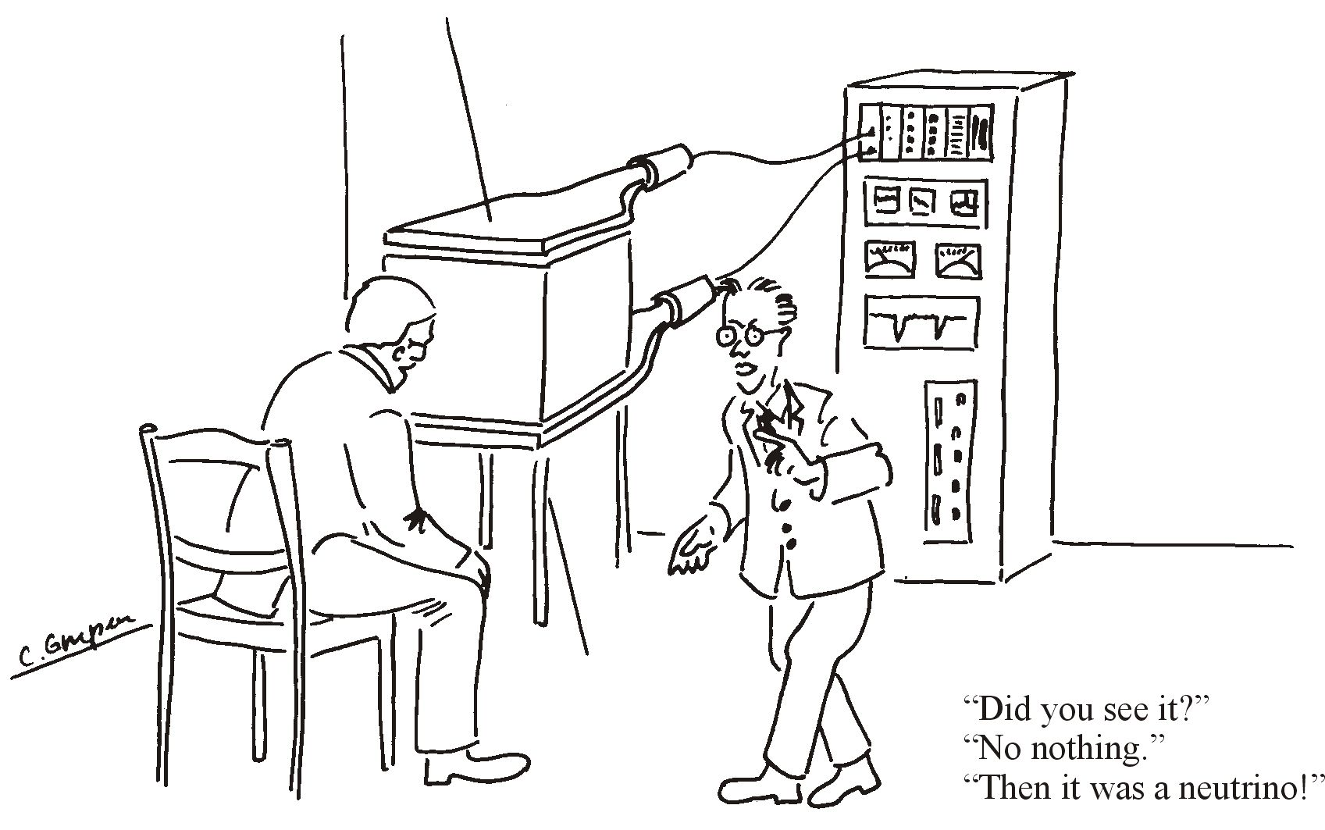

Missione 4 • Istruzione e Ricerca
Missione 4 • Istruzione e Ricerca

Slide 3
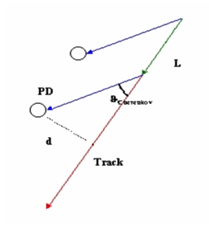
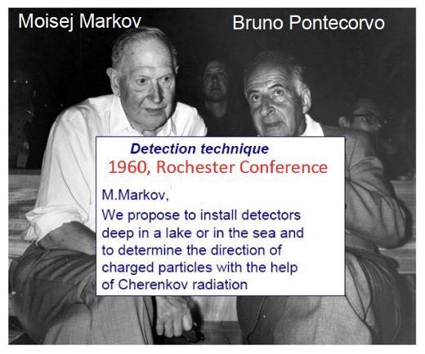
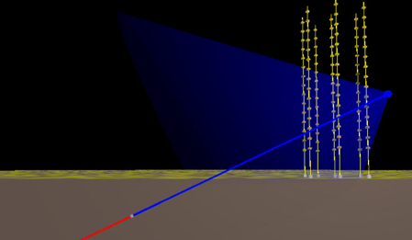

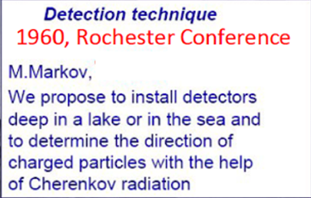
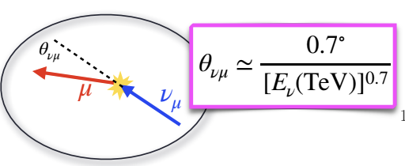
Neutrino detection technique
Cherenkov light
from μ
OM
Interaction with matter
42°
μ
νμ
The detector is a 3D array of photosensors sensitive to the Cherenkov radiation emitted by charged products of neutrino.
The arrival time of the Cherenkov light, together with the knowledge of the sensor position, are used to reconstruct the trajectory of the particles.
The amount of detected light can in addition provide information about the energy of the particle
The photosensors are called Optical Modules

Slide 4
General requirements and main components of an optical modules
Photosensor to detect faint Cherenkov light
Light collection and detection must be optimized.
Power supply and sensor signals digitization are needed
Photosensors and associated electronics must be housed into transparent vessels resistant to water and to the hydrostatical pressure
The vessel must withstand to environmental conditions such as corrosion and mechanical shocks
The optical coupling between the water and photosensors must be the best possible, together with a mechanical coupling for handling and vibrations
Outside connection for DATA transmission and control signals is needed
Electronics for power supply and data read-out
Externall transparent watertight vessel
Glue for optical and mechanical coupling
System to allow outside communication

Slide 5
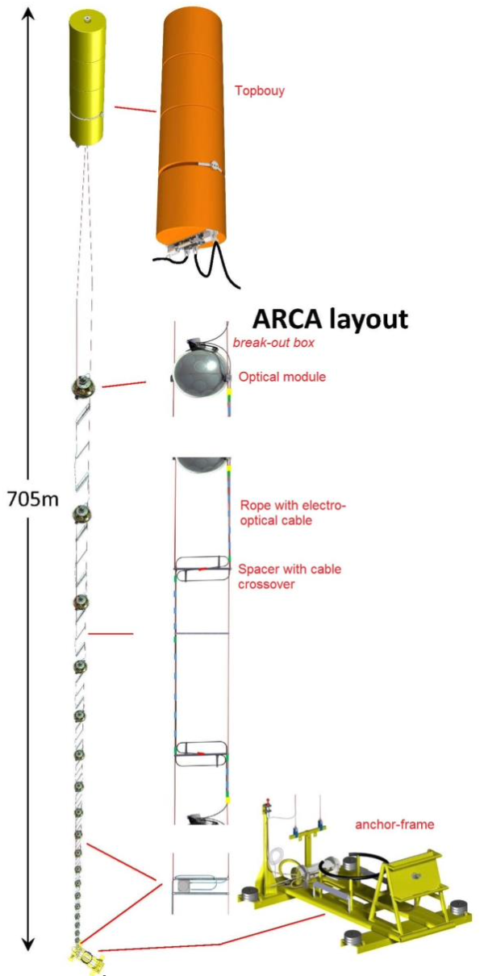
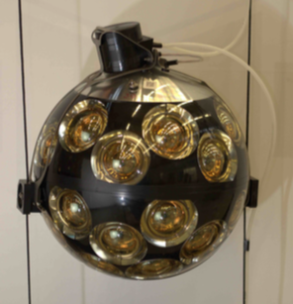
KM3NeT Digital Optical Module
The digital optical module (DOM) is composed by a transparent spherical vessel that contains:
31 small-area PMTs
the associated front-end and readout electronics,
calibration components and systems for monitoring and controls.
In the sea, the DOM are suspended in vertical structures, called Detection Units (DUs).
The Detection Unit (DU) each hosts 18 DOMs, 36-m vertically spaced.
Each DU comprises two parallel Dyneema® ropes to which the DOMs are attached by an external collar.
Each DU is anchored to the seabed and kept taut by a system of submerged buoy at the top
Each DU is about 700 m in height, with an horizontal space of about 90 m.

Slide 6
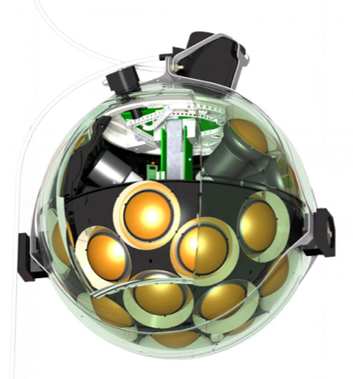
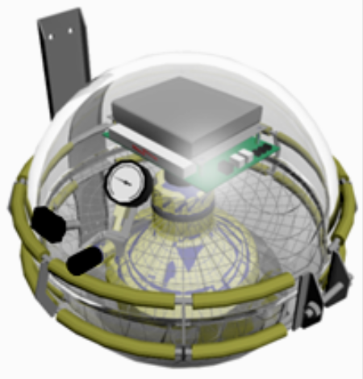
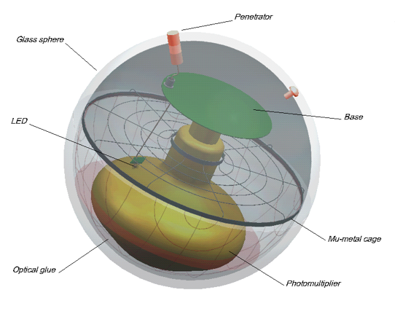
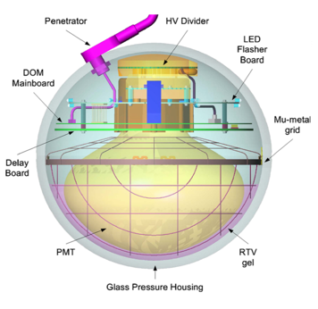
Advantages of multi-PMT design respect to a single large PMT layout
a photocathode area almost three times of a single 10” PMT (used by other the projects)
an almost isotropic field of view
the influence of the Earth’s magnetic field on small size PMTs is negligible
a magnetic shield is not required.
accurate photon counting of the detected radiation
directional information about the detected radiation just at a single DOM level
more efficient rejection of the optical background caused by K⁴⁰ and bioluminescence in water
lower impact of single PMTs failure
The ICECUBE optical module
13-inch vessel; 10-inch PMT
The ANTARES
optical module
17-inch vessel
10-inch PMT
The GVD- Baikal
optical module
17-inch vessel
10-inch PMT

Slide 7
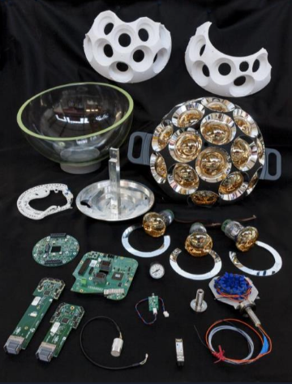
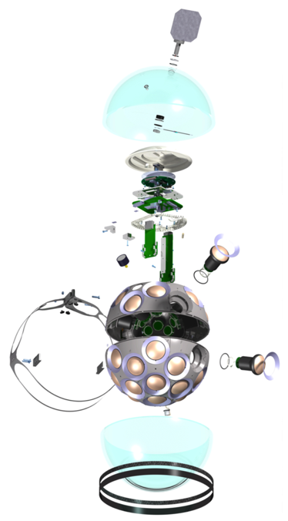
KM3NeT DOM components
Over 80 different elements
- Photosensors
- Mechanichs
- Electronics
- FPGA processor
- Electrical-Optical transmission
- Heat dissipation
All is inside the DOM !!!
Electronics, power and sensors.
A transparent 17-inch Nautilus pressure resistant glass sphere
31 PMTs of 3-inch. 19 in the lower hemisphere. 12 in the upper hemisphere.
Each photomultiplier works as an individual optical sensor with a 1-ns synchronization
The PMTs are kept in place by a support structure
The photon collection increases by 20–40% by a reflector ring surrounding the PMTs.
The space between support, PMTs and glass sphere is filled with an optical gel
An alluminium mushroom allows heat dissipation towards outside
An external titanium collar close the DOM and take it in place in the Detection Unit

Slide 8
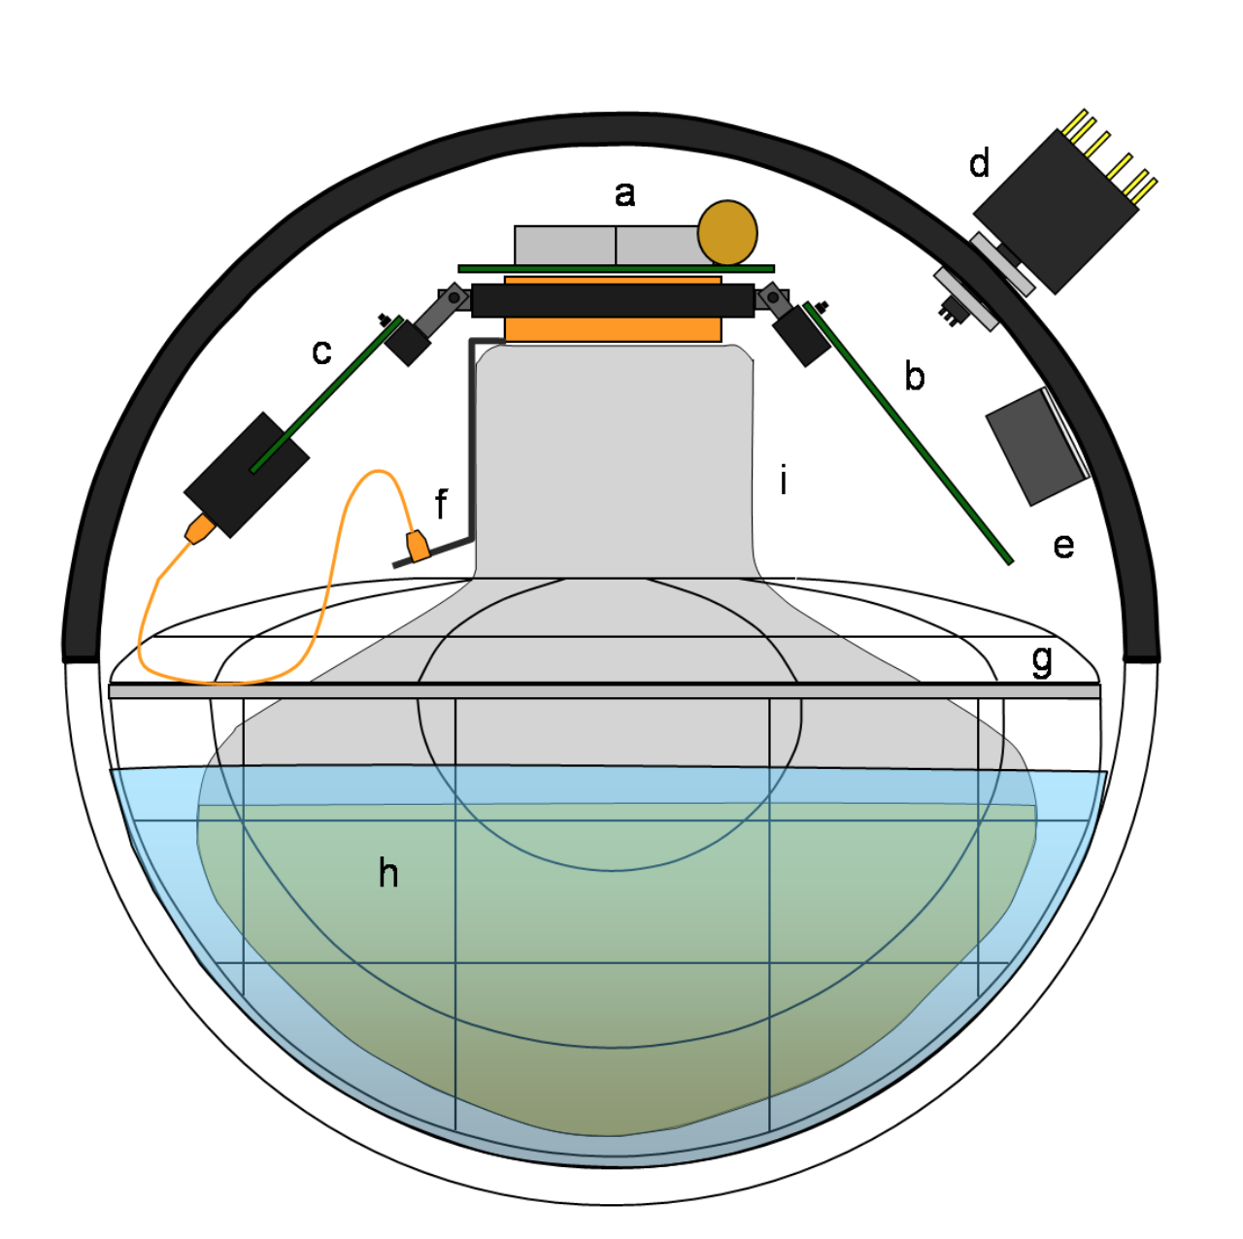
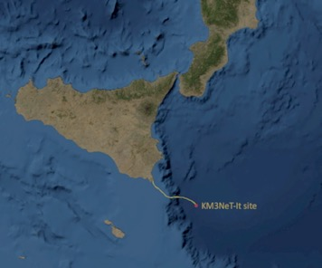
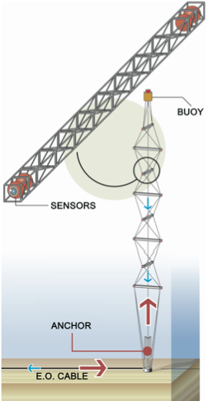
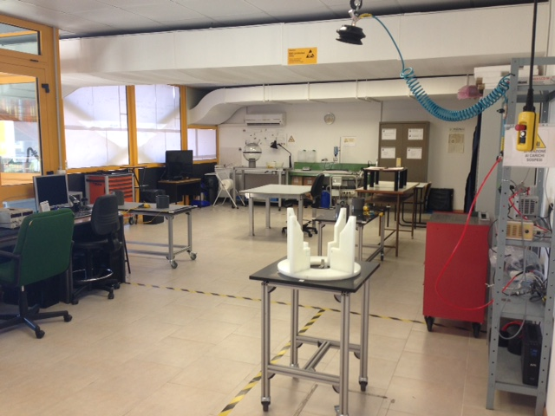
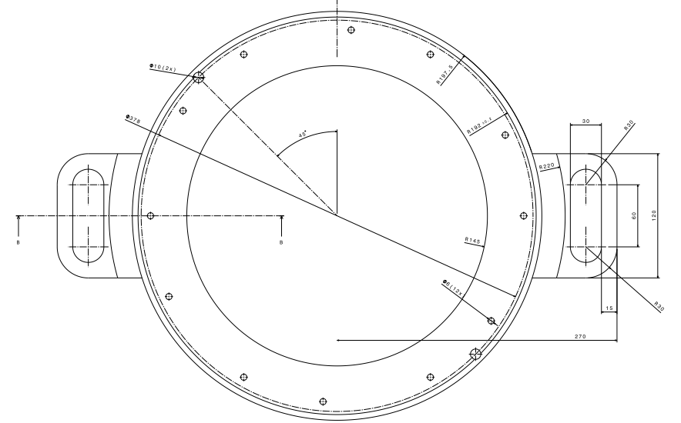
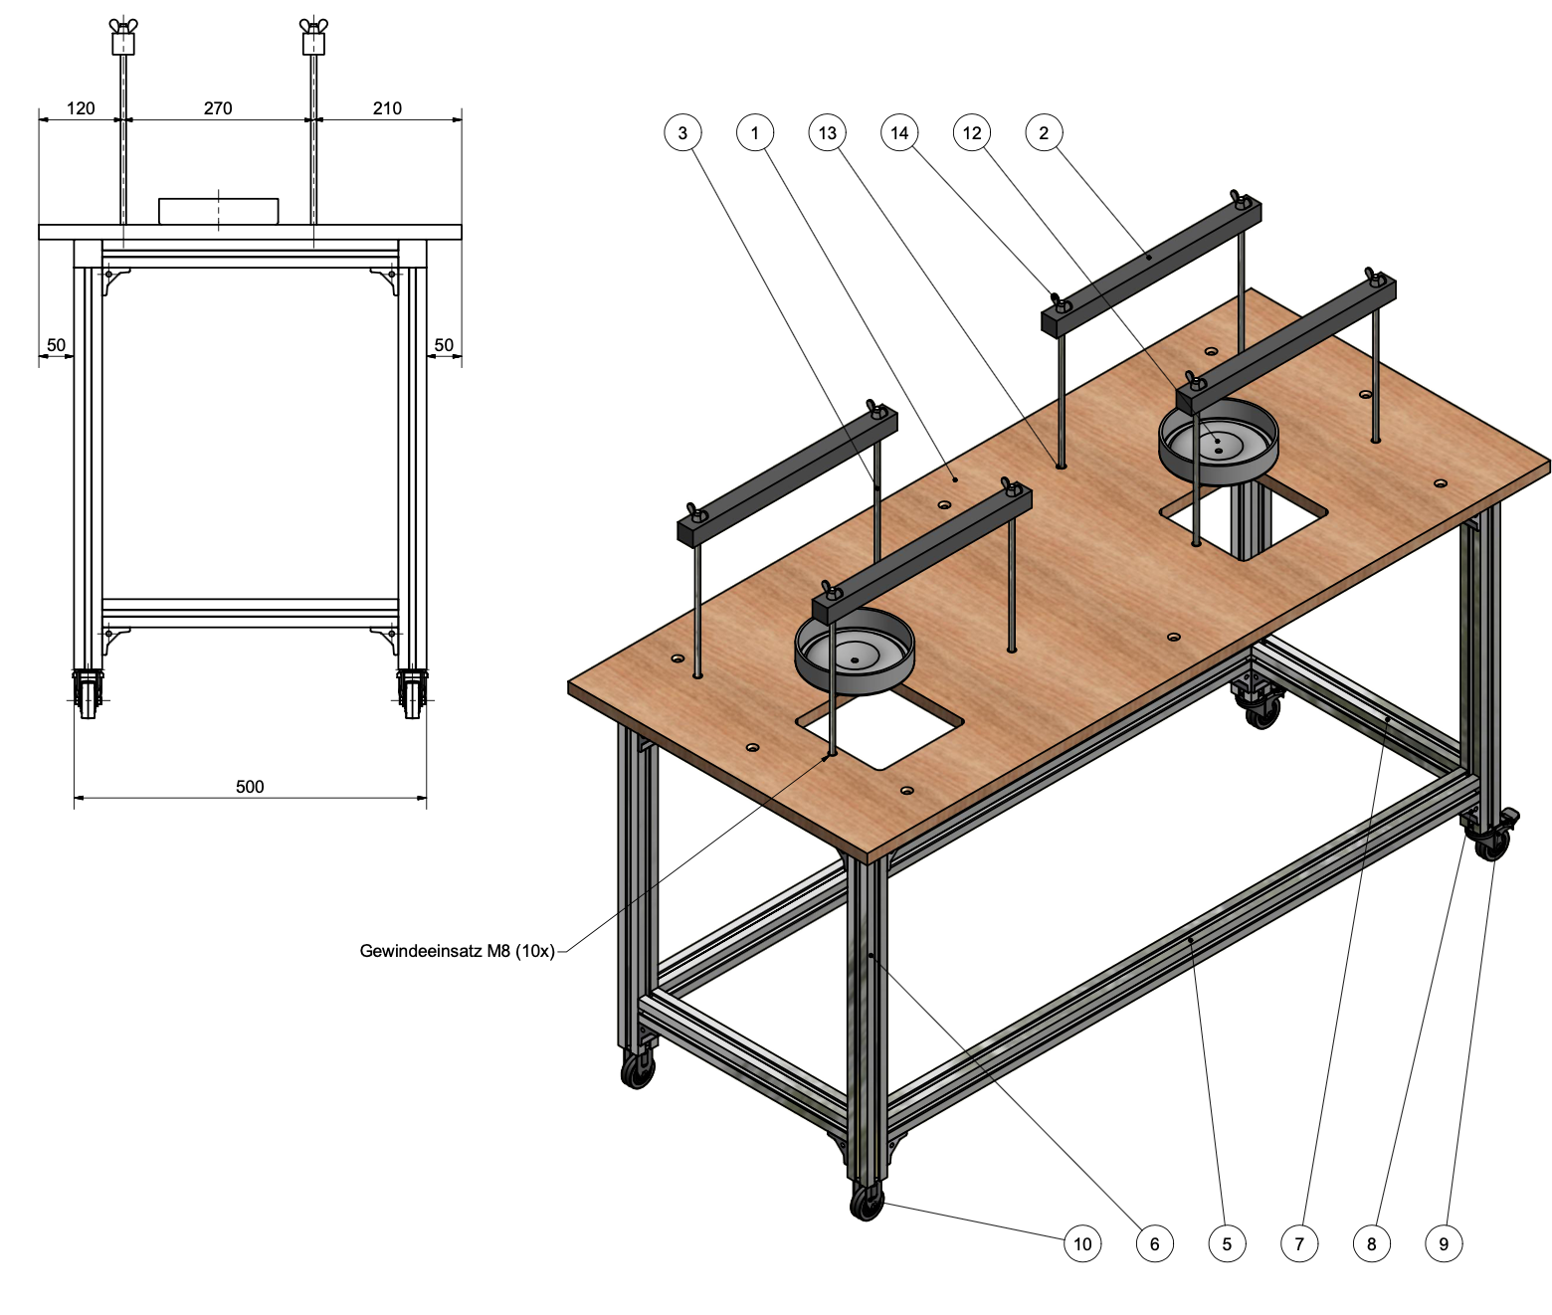
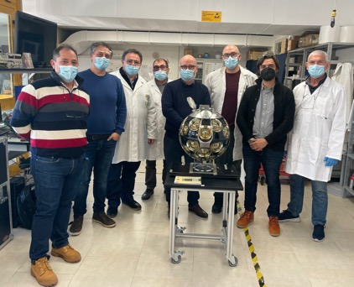
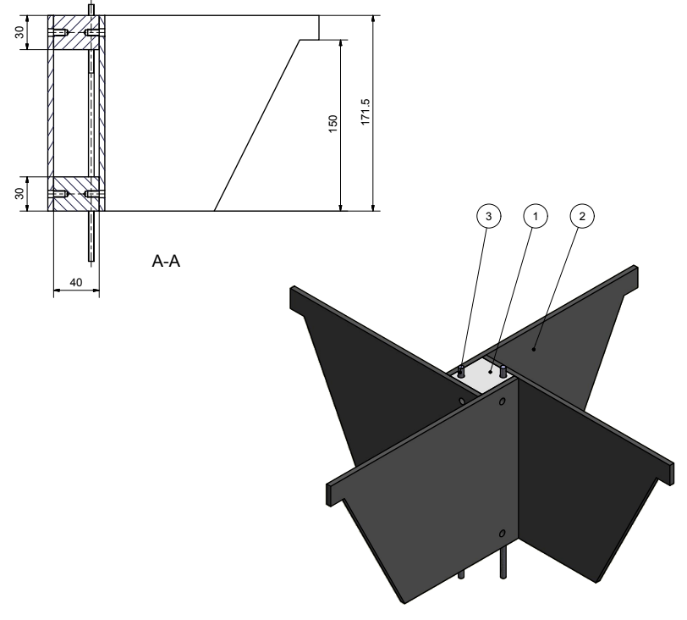
A DOM integration site in Catania
In March 2013, in the NEMO-Phase 2 a prototype has been installed in the Capo Passero site at a depth of 3500 m
Since 2008 the Catania group is involved in design and
construction of Optical Modules for Underwater Neutrino Telescopes
32 Optical Modules with a single 10’ PMT
designed and produced in INFN-Catania
Since 2014 we joined the design of KM3NeT DOM
Long phase of R&D of the components
Design of all the custom tools to perform all the integration phases
Since 2015 is active a DOM integration site at INFN-sezione di Catania: 100 m²
Dark room for DOM storage temperature and humidity controlled : 10 m²
Storage for components and consumables : 18 m²
KM3NeT-It
KM3NeT-It

Slide 9
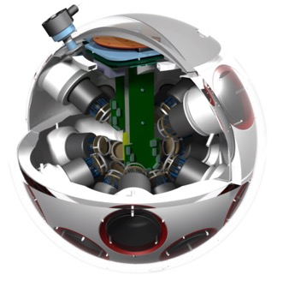

DOM production and test phases
The integration process is divided in many phases of a well defined procedure
Extensive Quality Control activities follows the whole production
A dedicated software (KM3DIA) guides all the production phases.
All components are registered with a Unique Product Identifier code (UPI).
Many components are tested before their integration
Each DOM is submitted to functional tests during the integration
Each completed DOM is submitted to an acceptance test
Currently the KM3NeT project has 8 different DOM integration sites
They allows a production rate of about 100 DOMs per month.
Amsterdam
Strasbourg
Erlangen
Nantes
Napoli
Athens
Rabat
Catania

Slide 10
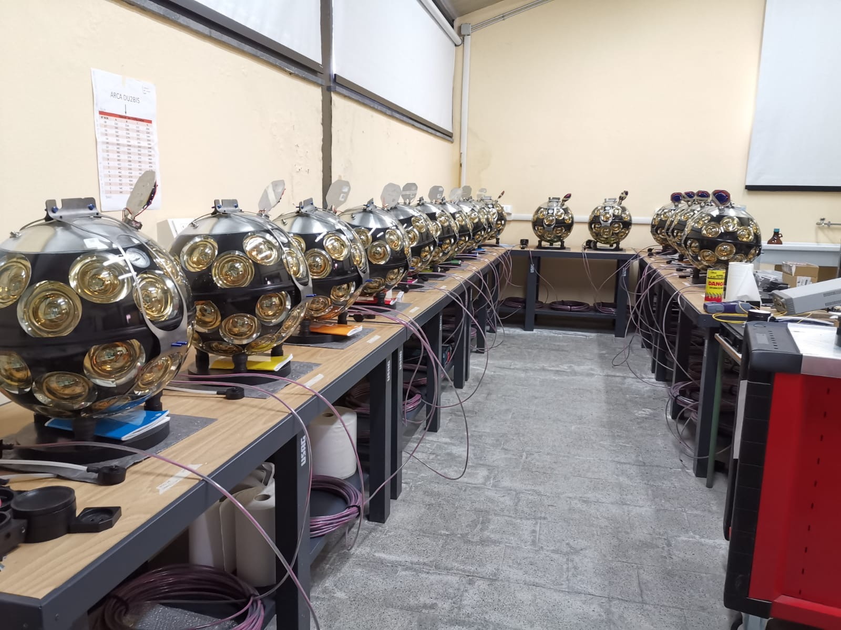
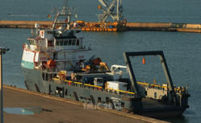
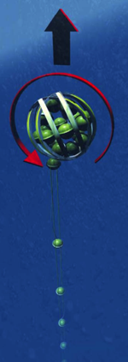
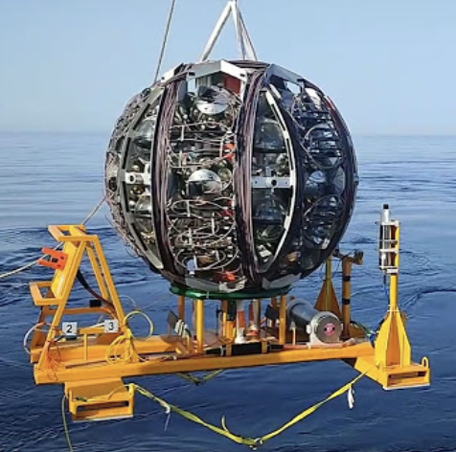
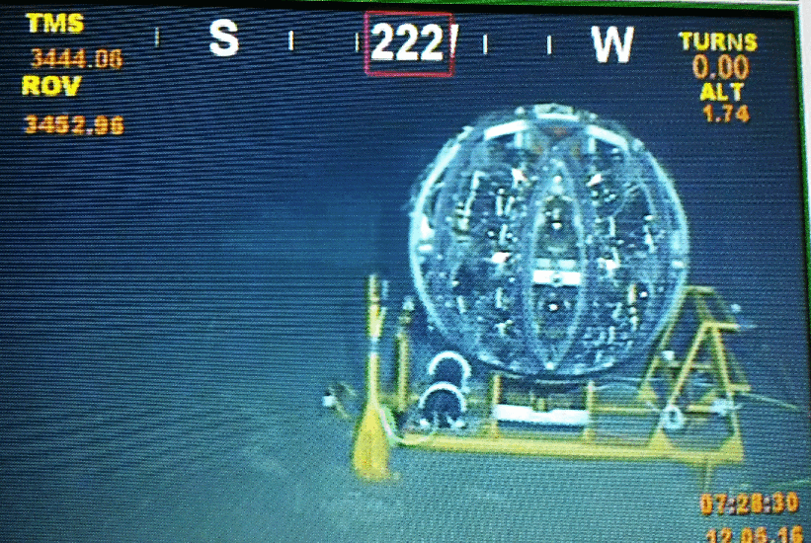
KM3NeT marine deployment principle
The launcher vehicle starts to rise to the surface while slowly rotating and releasing the DOMs.
A vessel is used to deploy the launcher vehicle on the seabed with a 1-m accuracy
At the DU integration site 18 DOM are connected to a 700-m cable for power and data transmission and to the ropes to compose a string (DU)
The DU string is coiled around a large spherical frame, the LOM, in which the DOMs slot into cavities.
Catania 21/01/2025

Slide 11
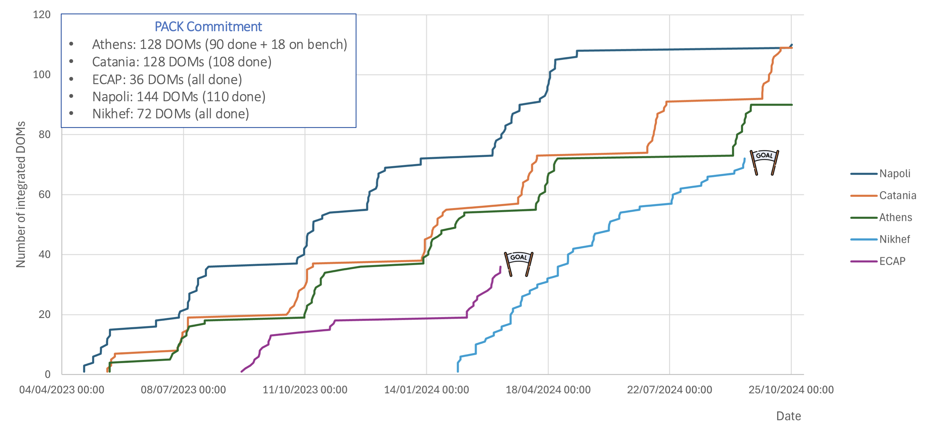
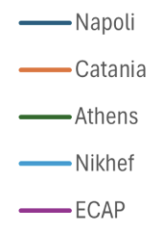
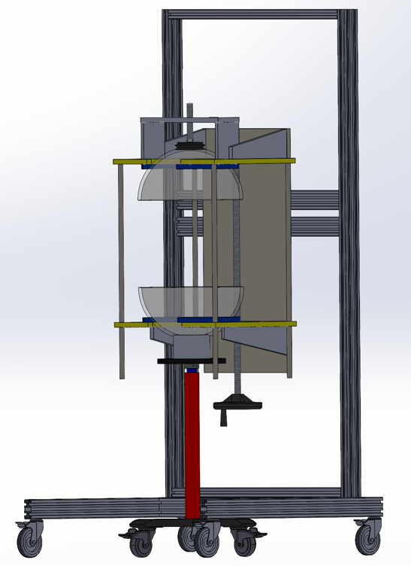
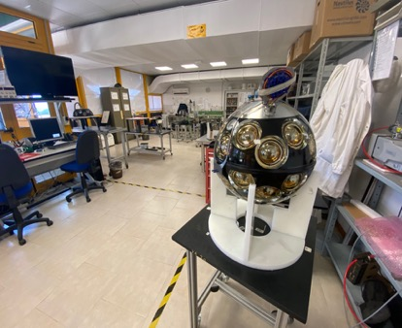
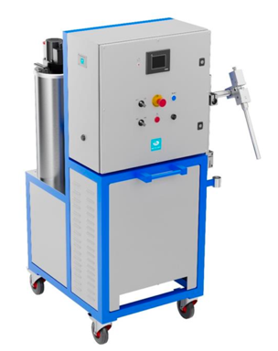
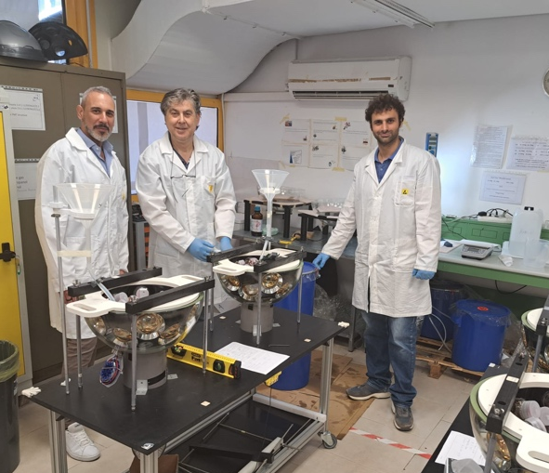

PNRR Activity 2.4: upgrade of the Catania DOM integration site in order to increase the mass production rate.
Design and construction of new tools and scientific instruments to speed up the production
purchasing of gel mixing machines
design and construction of machines to rotate and close the DOM
Increasing the technical personnel full-time working in integration
high skills required: electronic, optical and mechanical procedures
Construction of a second DOM site to proceed with a parallel production
Catania DOM production from May 2023:
stable production rate of 5 DOM/week
over 120 DOMs produced

Slide 12
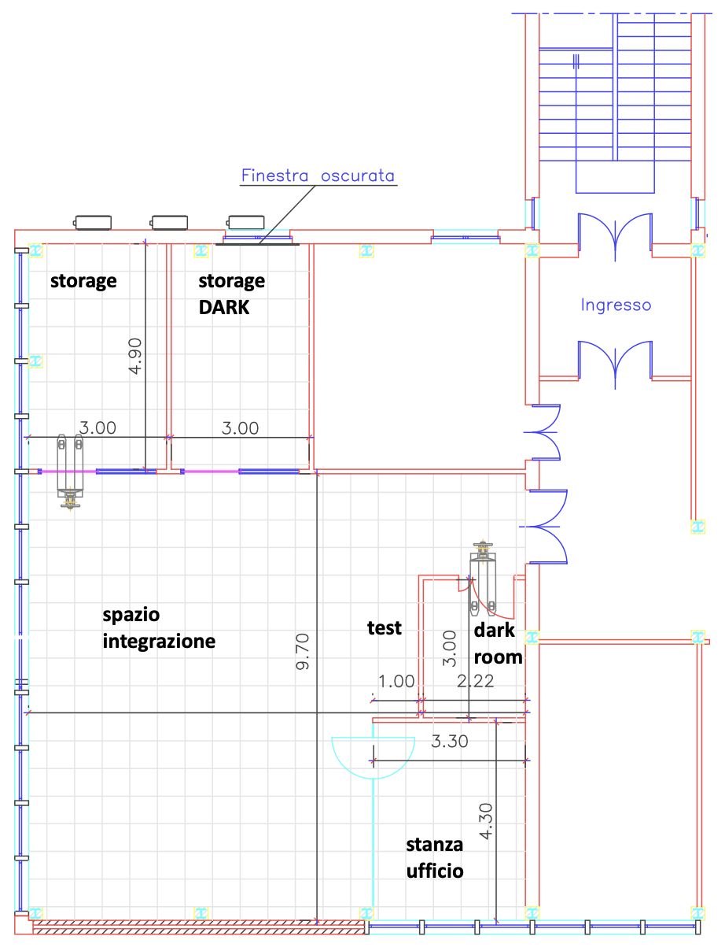
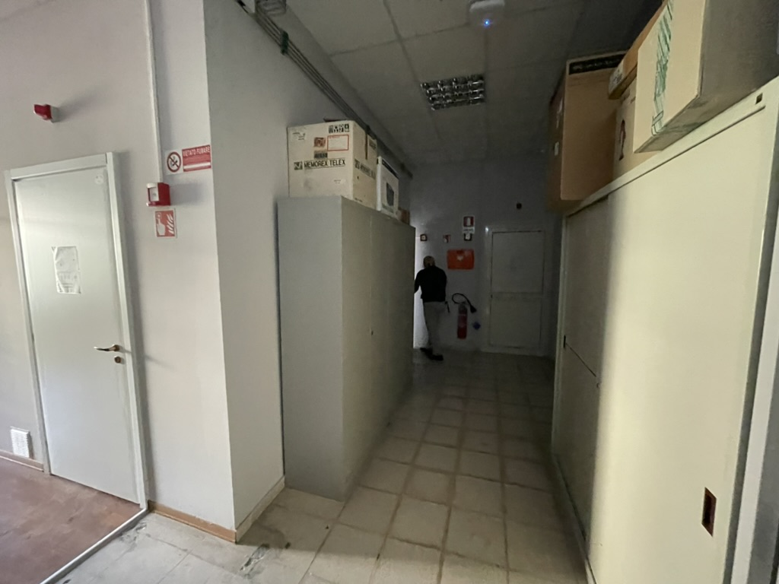
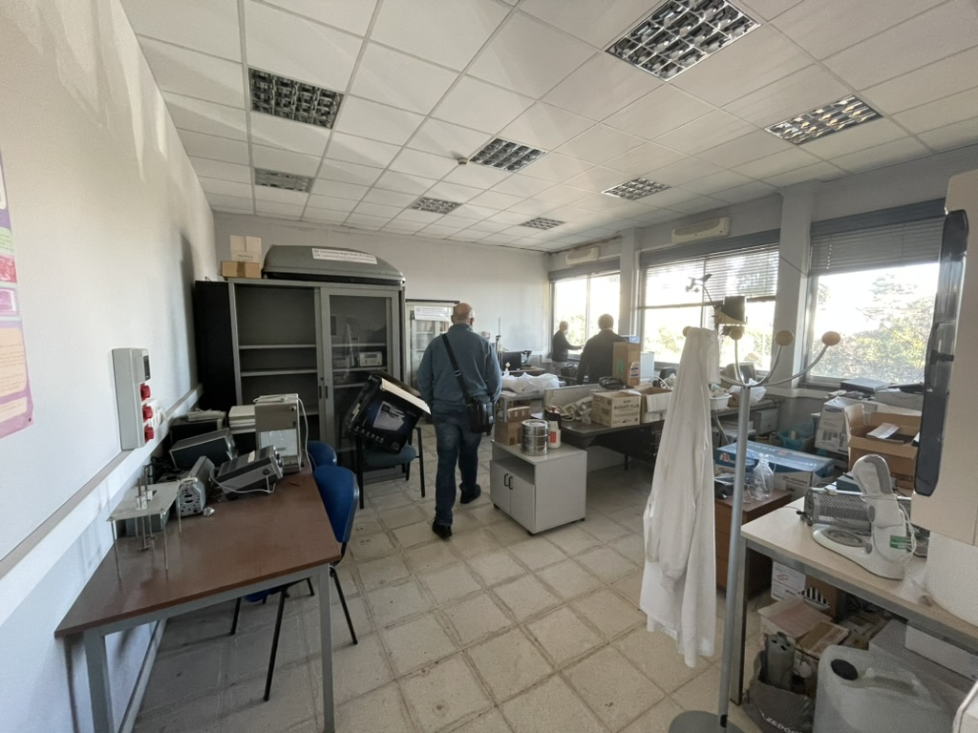
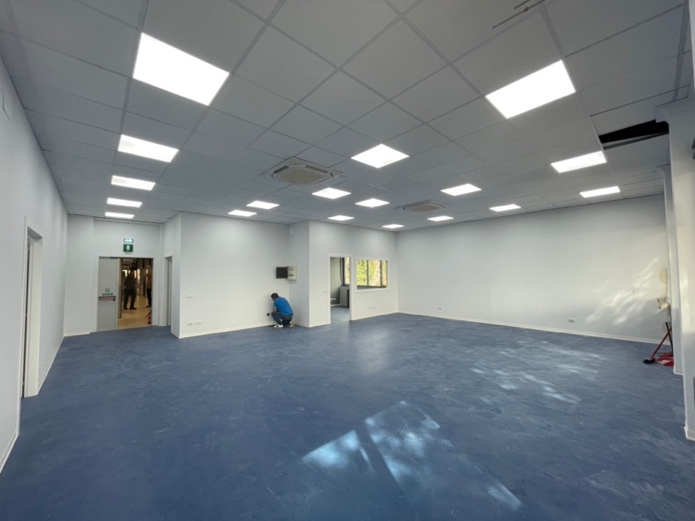
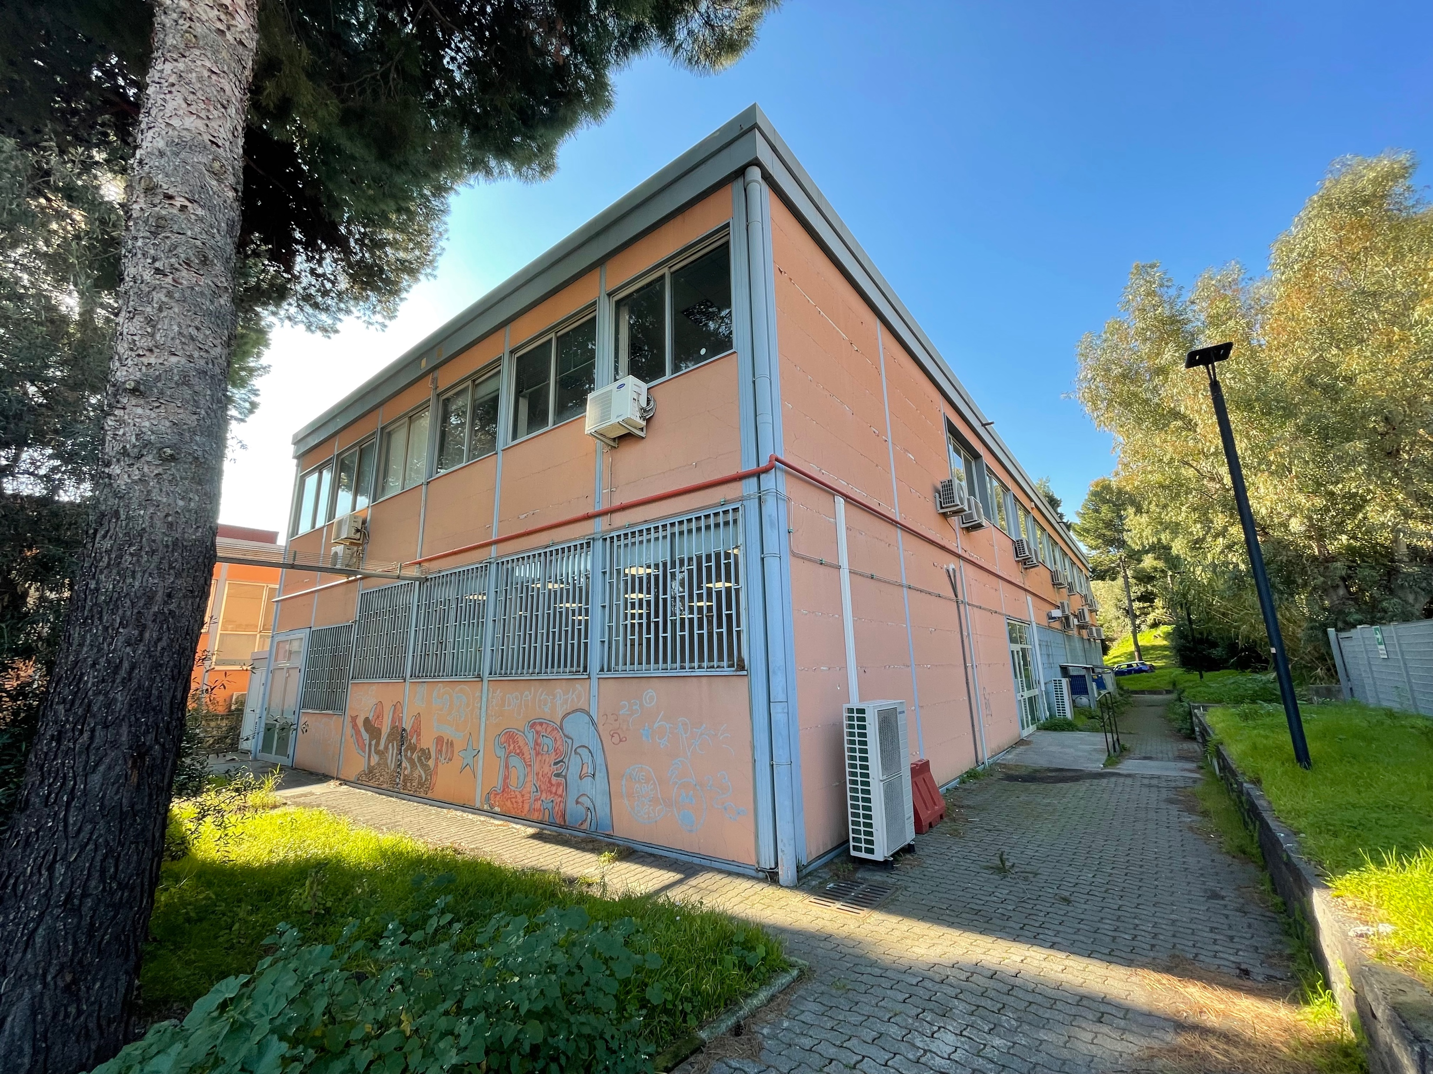
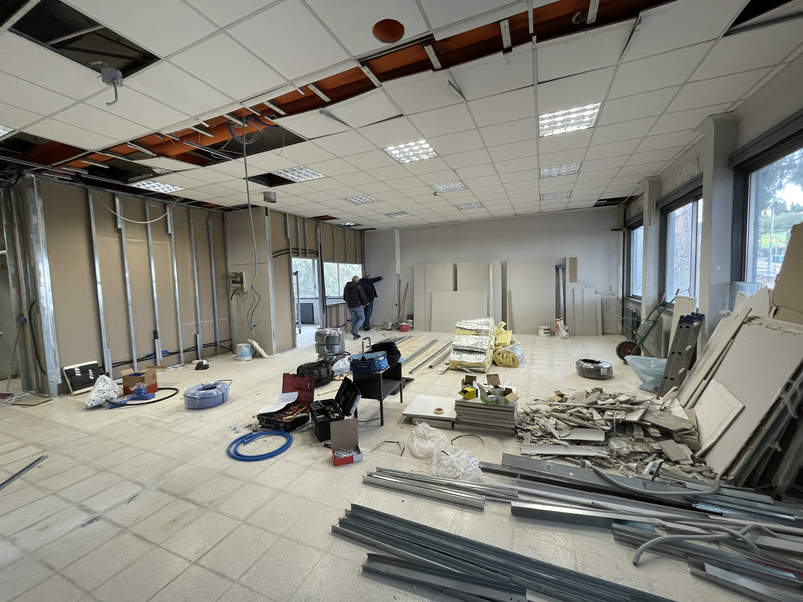
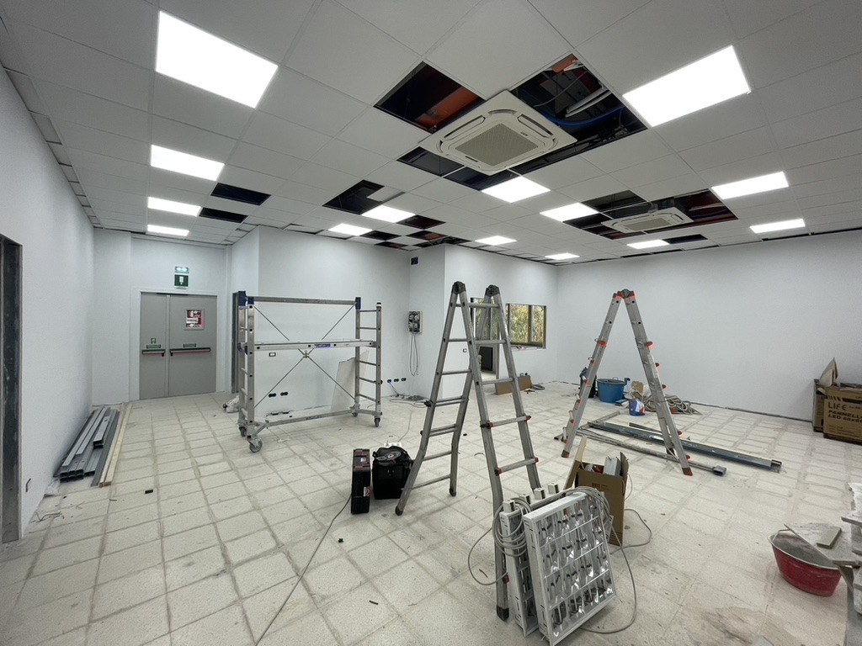
Construction of the second DOM integration site
The civil infrastructure already exists at 1^ floor of Edificio 10 of Cittadella Uiversitaria di Catania.
Refurbished with all the KM3NeT requirements (Storage, Test room, LED illumination, antistatic floor, temperature and humidity control…)
Equipped with all the tools and scientific instrumentation
An external lift has been constructed for moving all the components and the produced DOM
5 purchasing procedures for building, tools and instrumentation: 450 k euros
2024
2022
2023

Slide 13
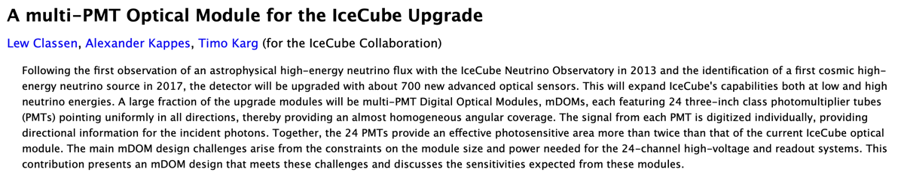
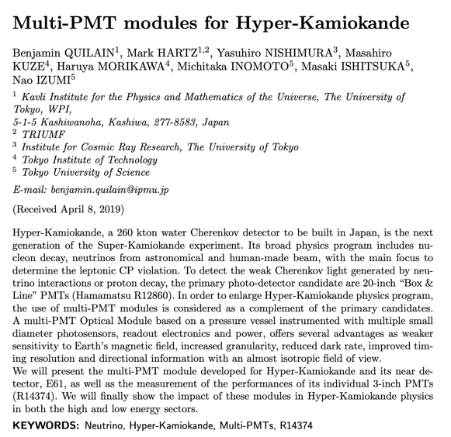
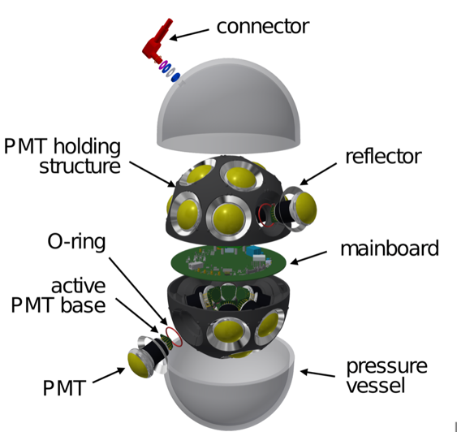

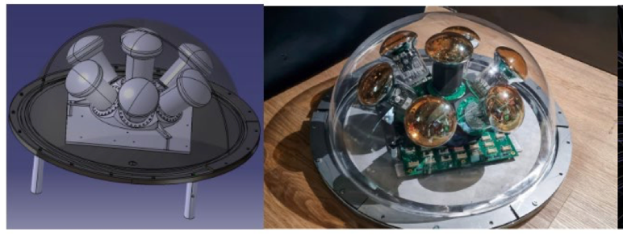
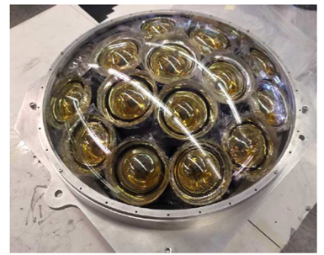
KM3NeT Multi-PMT layout: a design for next Water Cherenkov detectors

Slide 14
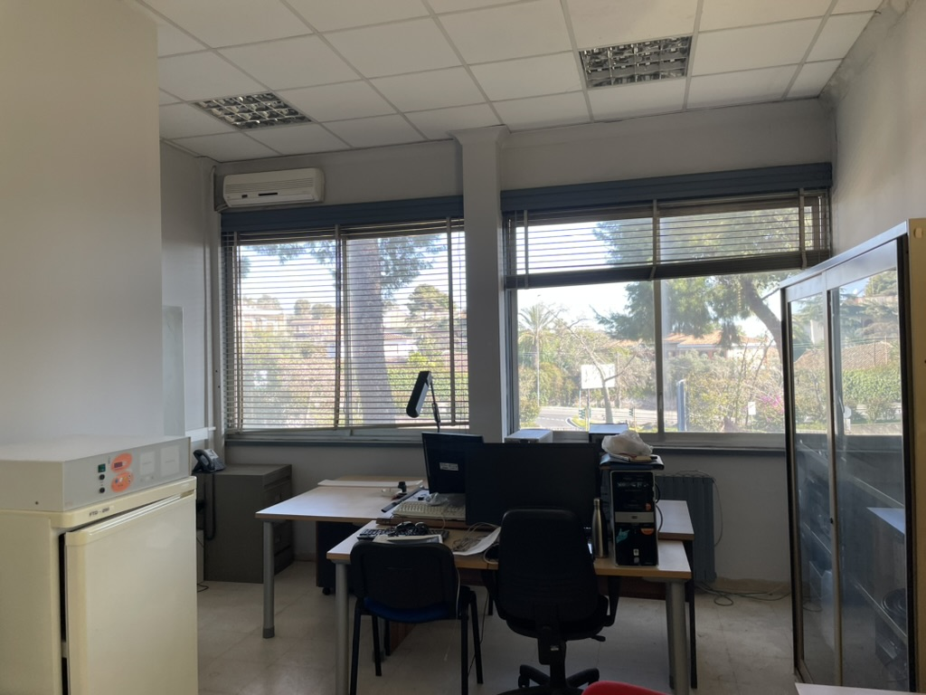
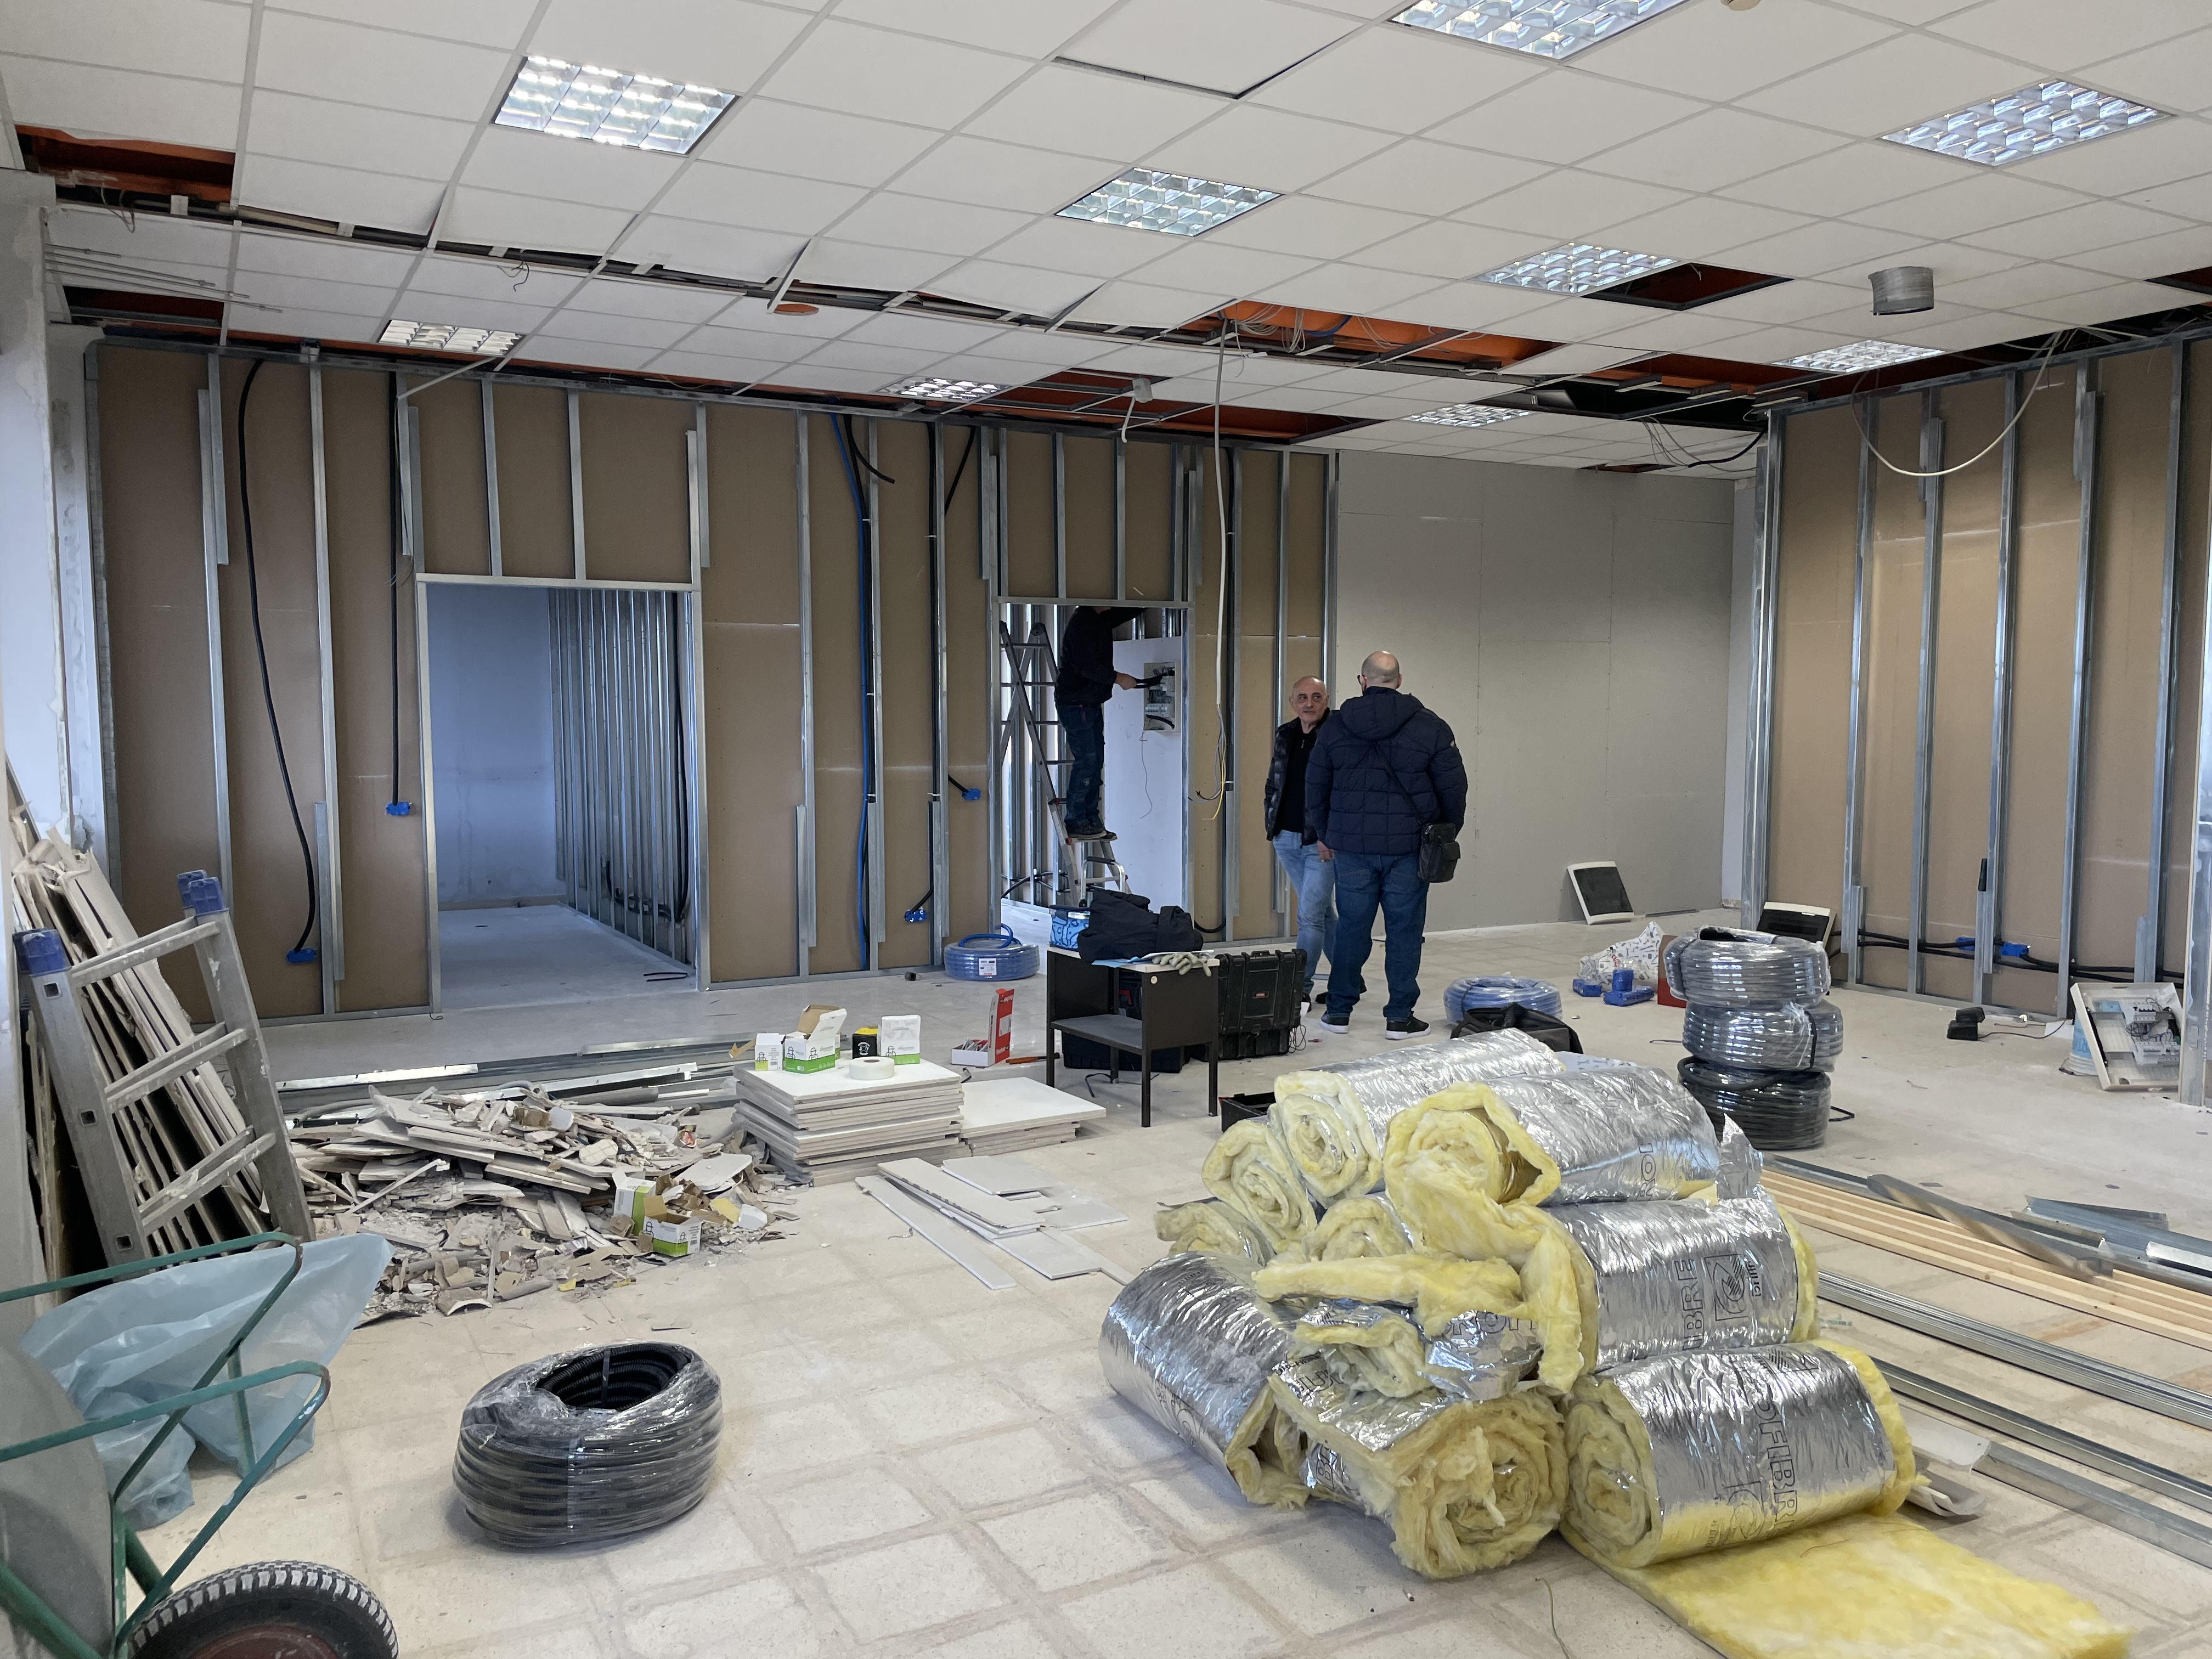
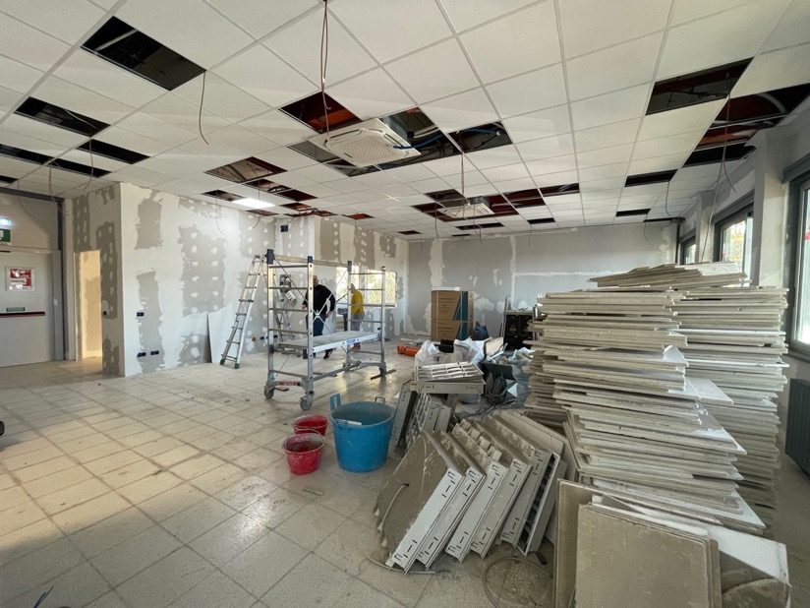





?
Thanks for your attention
…all of you are invited to visit the new DOM integration site at Edificio 10 !!!

