Slide 1



LNF contribution to the Design of the FCC-ee Injector Complex
Milardi C., De Santis A., S. Spampinati (LNF-INFN, Italy)
Etisken O., (Kirikalle University, Turkey and LNF-INFN, Italy )
C. Milardi, LNF contribution to the FCC-ee Injector, Meeting INFN-A Esteso del 23-1-2025

Slide 2
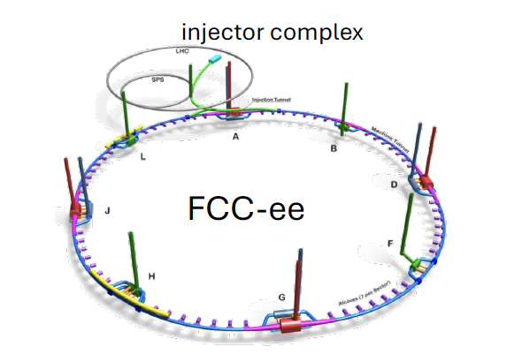
FCC-ee, the future high-energy circular collider proposed for CERN, requires high performances injector that, among other features, will include the most intense ever realized source of positrons providing a bunch charge of the order of 5 nC.
The FCC-ee injector complex must provide e⁻ and e⁺ bunch trains for alternating bootstrapping injection during, both, top-up and filling-from-scratch operations.
Considering the current per bunch, and the beam lifetime in the collider, alternating injection of e⁻ and e⁺ trains approximately every few tens of seconds is required to ensure the correct balance between e- and e⁺ bunch current.
C. Milardi, LNF contribution to the FCC-ee Injector, Meeting INFN-A Esteso del 23-1-2025
Notes:
High performances reliable and reproducible

Slide 3
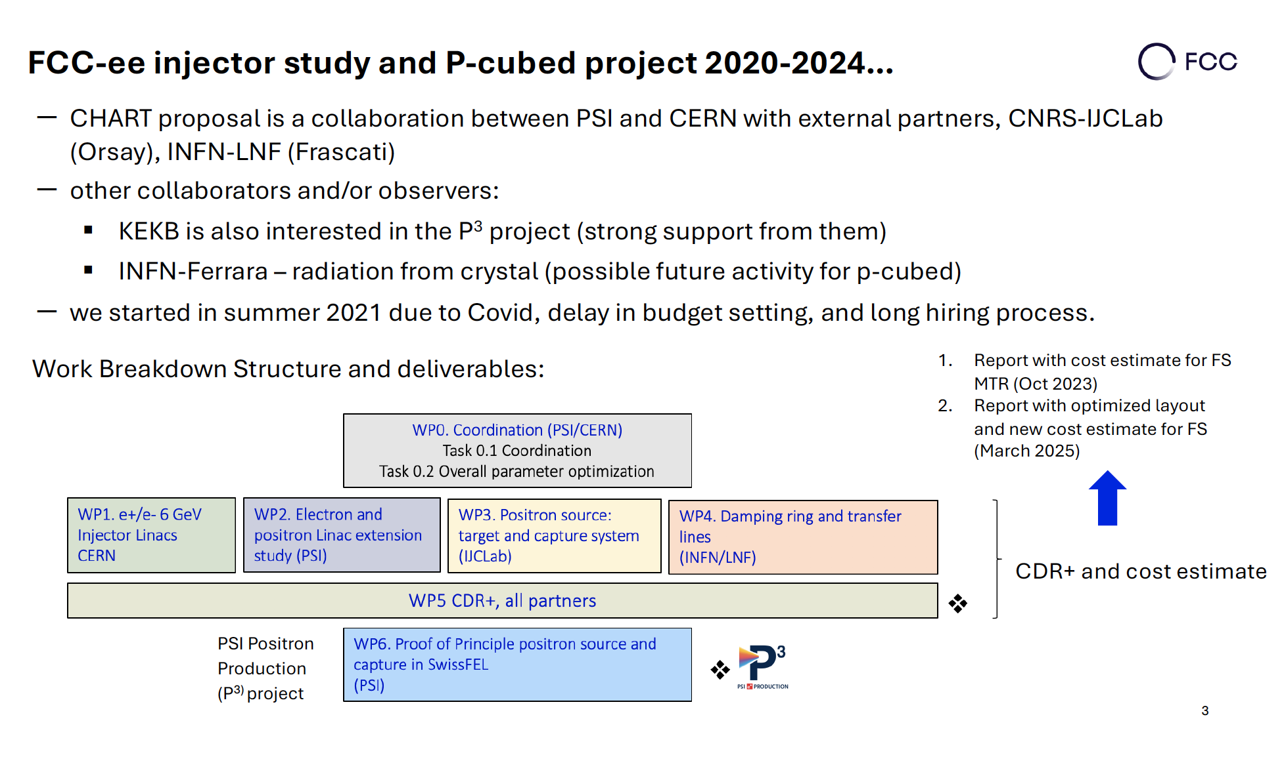


Structure of the Project
C. Milardi, LNF contribution to the FCC-ee Injector, Meeting INFN-A Esteso del 23-1-2025

Slide 4
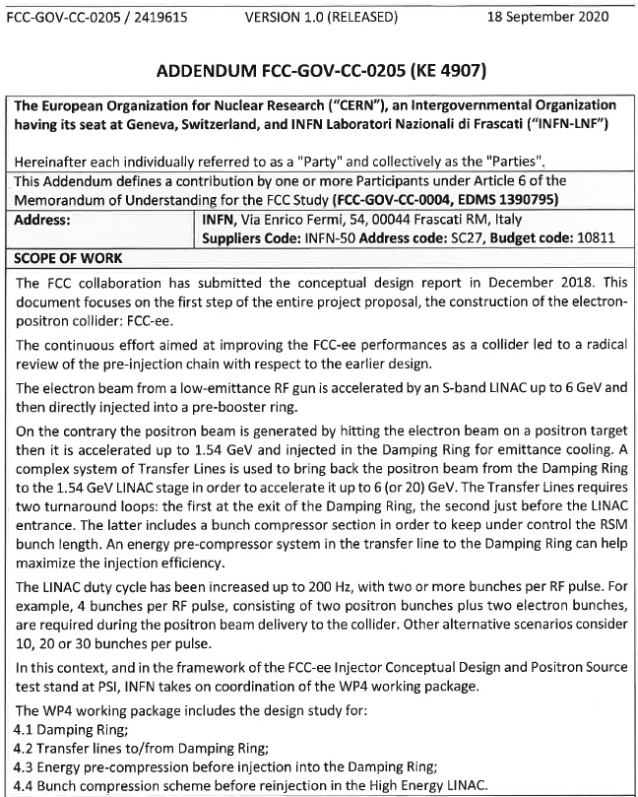
CERN-INFN Addendum
(KE 4907 – Damping Ring/TL design)
Estimated value of INFN-LNF human resources contribution: CHF 360.000.
the old INFN-CERN agreement expired on past November 2023, was retroactively extend till the end of August 2025.
A new addendum will be signed in the framework of the new CHART 2025 – 2028, agreement among Switzerland, PSI, and CERN which will be hopefully finalized in the first months of 2025
C. Milardi, LNF contribution to the FCC-ee Injector, Meeting INFN-A Esteso del 23-1-2025
Notes:
Signed in October 2020
Expired in October 2023
WP4 includes 4 tasks
Dal CERN abbiamo avuto 120 KCHF

Slide 5
WP4 Manpower and Present Organization
WP4 structure (coordinator C. Milardi)
WP4 includes 3 tasks
New resources
The procedures to assign two research grant contracts at LNF have been completed two physicists have been selected:
  Shalva Bilanishvili already signed the contract he will work on beam coupling impedance and related collective instabilities in DR.
  Yongke Zhao will take over ECS, BCS design and contribute to start to end simulations.
Mikhail Zobov will join the collaboration 30%.
Damping Ring design (C. Milardi)
  A. De Santis,
  O. Etisken* (ended his contract on Apr 2024)
  Y. Dutheil (Injection equipment: septa & kickers)
  CERN collaboration on RF systems.
Transfer Lines design (A. De Santis):
  C. Milardi,
  S. Spampinati * (left on Dec 5th 2024)
Energy/Bunch Compression design (coord. S. Spampinati):
  C. Milardi,
  A. De Santis,
  CERN collaboration (e+ LINAC group)
* associate
C. Milardi, LNF contribution to the FCC-ee Injector, Meeting INFN-A Esteso del 23-1-2025
Notes:
Selection procedured completed by the end of 2024

Slide 6
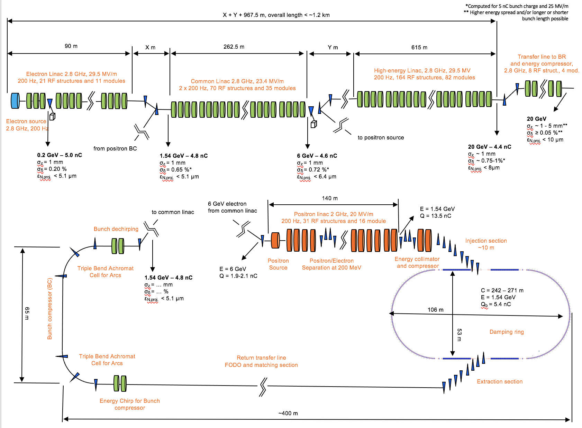
Baseline Layout
Presented at the Middle Term Review
e⁻ source
Linac (1) up to 1.54 GeV
LINAC (2) Common LINAC up to 6 GeV
e+ production at 6 GeV
DR at 1.54 GeV
Energy compressor (EC) for e+ to DR, and bunch compressor (BC) for e+ to Common LINAC
C. Milardi, LNF contribution to the FCC-ee Injector, Meeting INFN-A Esteso del 23-1-2025
Notes:
Mid-term review was helde in October 2023

Slide 7
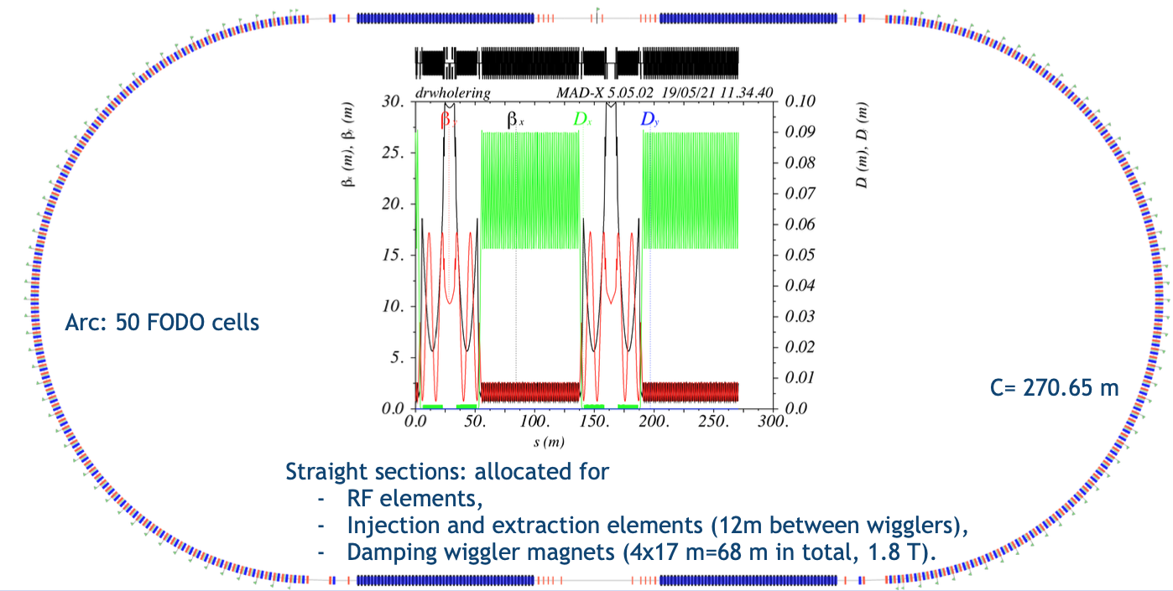
WP4: Damping Ring, Transfer Lines, and Compressors
Damping Ring DR, Transfer Lines TLs, and Energy/Bunch compressors ECS/EBS have been designed for the injector baseline energy @ 1.54 GeV.
DR acceptance of the order of 83% including ECS was achieved.
A Bunch Compressor (factor 5 compression) has been included between the DR and the Common LINAC.
A preliminary costs estimate has been delivered and positively received by the Review Panel.
to common linac
E = 1.54 GeV
Q = 13.5 nC
Energy Compressor
Bunch dechirping
Injection section
~10 m
Energy collimator
and compressor
Cell for Arcs
Triple Bend Achromat
1.54 GeV – 4.8 nC
σ_{z} = … mm
σ_{δ} = … %
ε_{N,proj.} < 5.1 μm
C = 242 – 271 m
E = 1.54 GeV
Q_{b} = 5.4 nC
Bunch compressor (BC)
106 m
65 m
53 m
Damping Ring
Cell for Arcs
Triple Bend Achromat
Return transfer line
FODO and Matching Section
Extraction section
Energy Chirp for Bunch compressor
~400 m
C. Milardi, LNF contribution to the FCC-ee Injector, Meeting INFN-A Esteso del 23-1-2025
Notes:
DR optics was optimized wrt the CDR version
Comprehensive beam dynamics studies have been done to evaluate and optimize the ring dynamic aperture and

Slide 8

Distribution of the particle accepted in the Damping Rin from the e⁺ LINAC
Start-to-End simulation: from positron source to Damping Ring stored beam.
C. Milardi, LNF contribution to the FCC-ee Injector, Meeting INFN-A Esteso del 23-1-2025
Notes:
8 msec ~ 1 damping time ~ 10kTurn

Slide 9
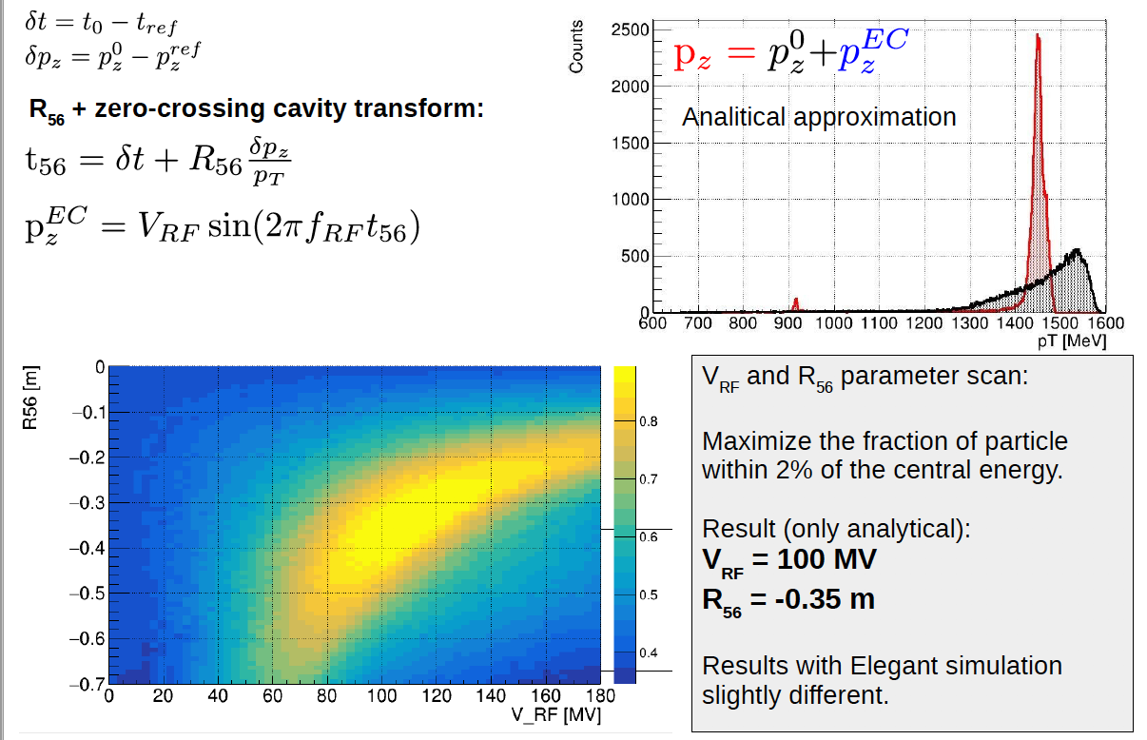
Energy Compressor Optimization (ECS)
C. Milardi, LNF contribution to the FCC-ee Injector, Meeting INFN-A Esteso del 23-1-2025
Notes:
ENERGY compressor design
Four bending C-shape chicane with dispersion and second order dispersion are intrinsically closed.
Two cavities of the type used for the positron LINAC ( PSI design. LINAC THPOJO08 LINAC 2022) at zero crossing
The beam exit ECS on the same LINAC axis, thus same diagnostics can be used for LINAC and ECS tuning.

Slide 10
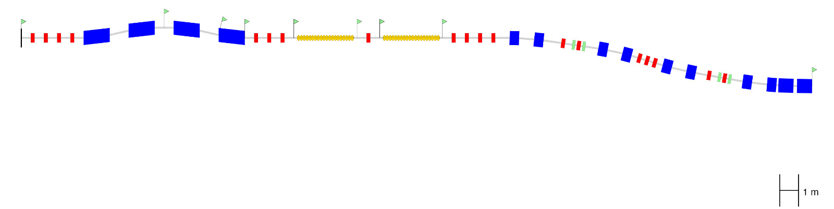
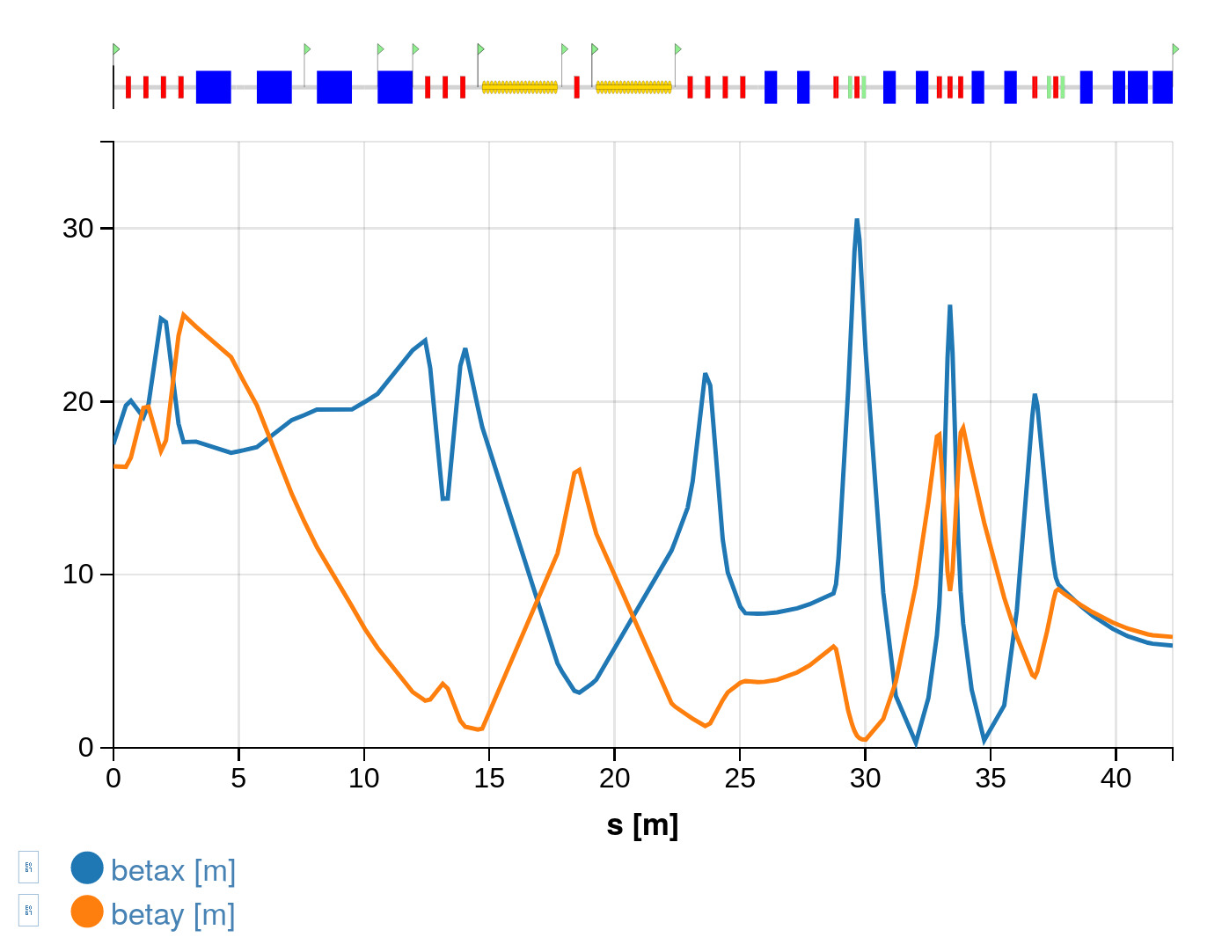
pLINAC to DR TL
DR
pLINAC
C. Milardi, DR and TLs for FCC-ee pre-injector,
FCC Week, Jun 5-9 2023, London, Great Britain.
Notes:
ECS + Matching section + Injection section

Slide 11
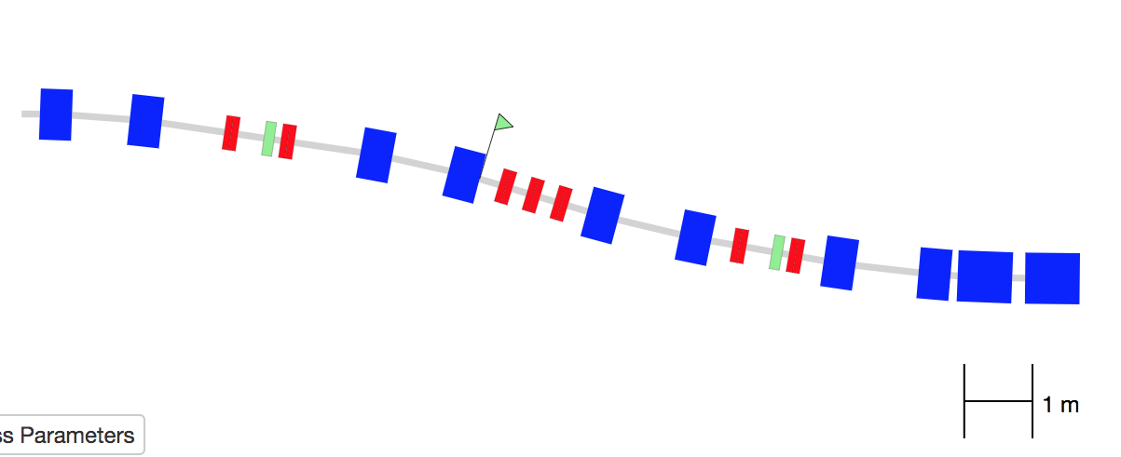
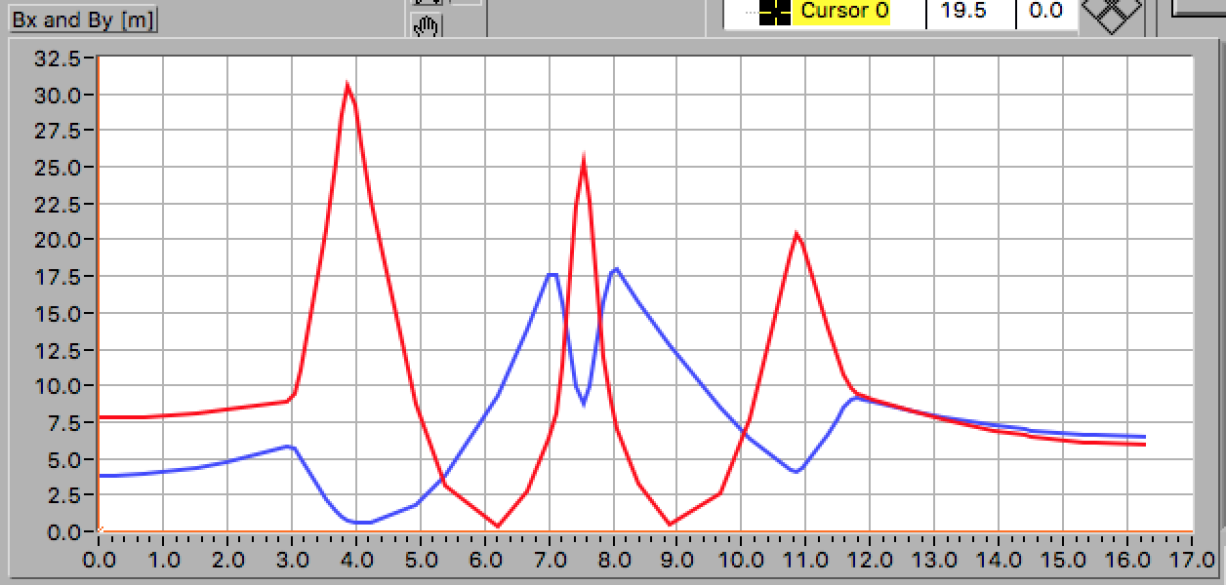
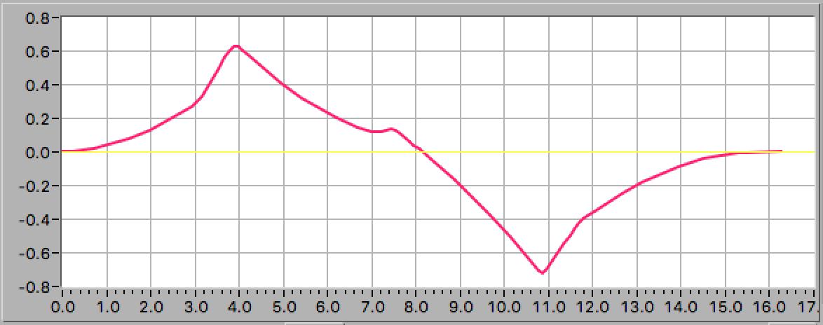
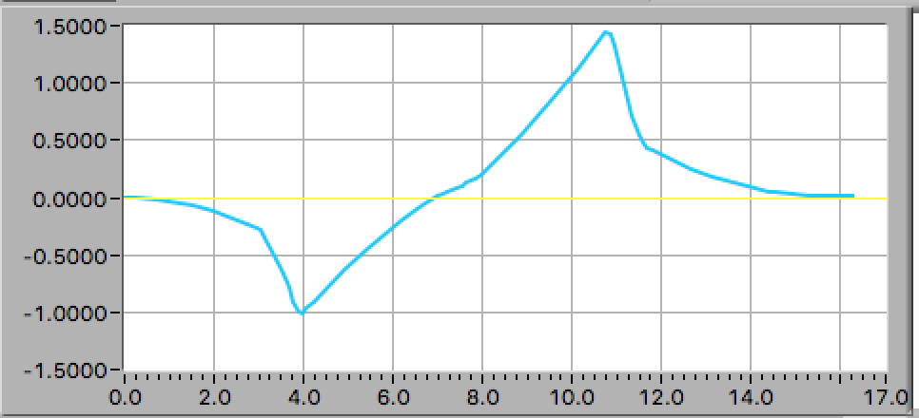
TL Injection Section
β_{x} [m]
β_{y} [m]
[m]
flexible
achromatic
η_{x} [m]
η”_{x}
 | Angle [degree] | Length [m] | Field [T] | Thickness [mm]
B1 | 4.2 | 0.47 | 0.8
B2 | -3.4 | 0.47 | -0.65
SPT1 | -2 | 0.8 | -0.044 | 7
SPT2 | -1.2 | 0.8 | -0.026 | 2 - 4
[m]
[m]
C. Milardi, DR and TLs for FCC-ee pre-injector,
FCC Week, Jun 5-9 2023, London, Great Britain.
Notes:
16.3 m long
2.5 transverse displacement
Adding 7 cm to the dipole length is possible to reduce the B1 magnetic field intensity to 0.7 T
R56 can be used for bunch compression providing a suitable chirp to the incoming bunch

Slide 12
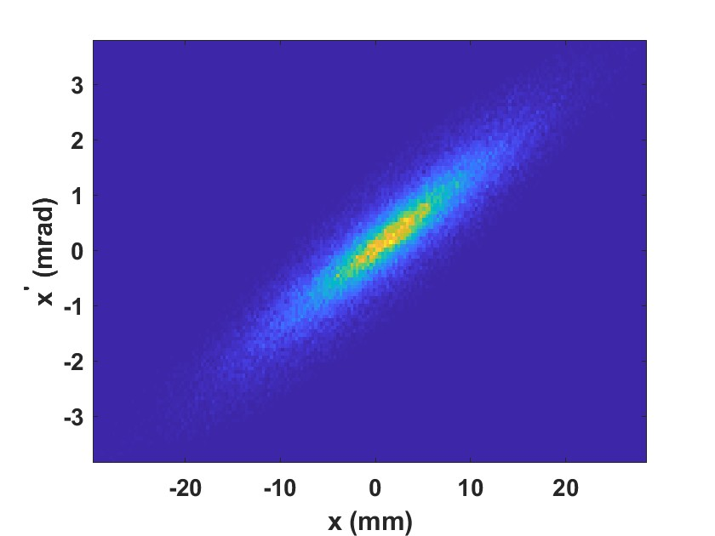
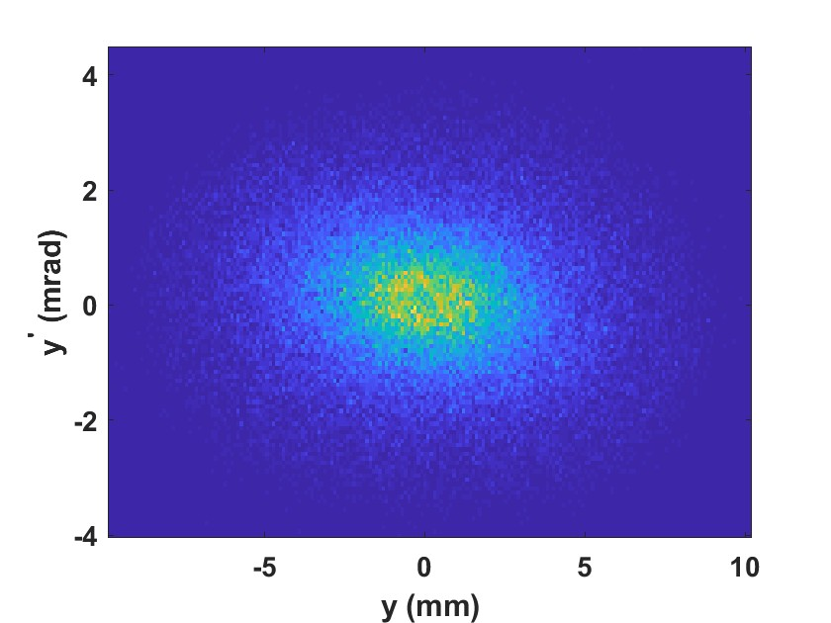
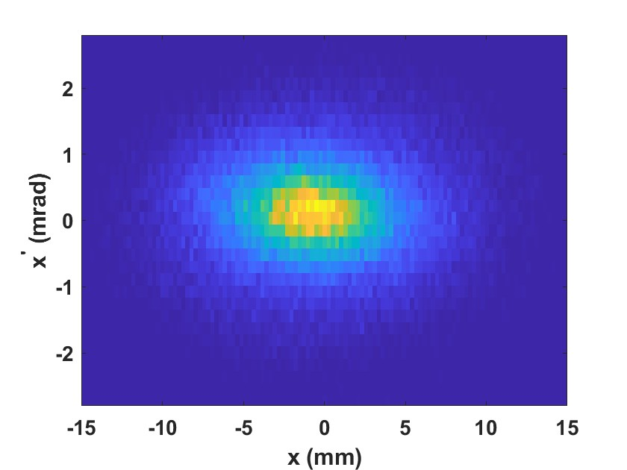
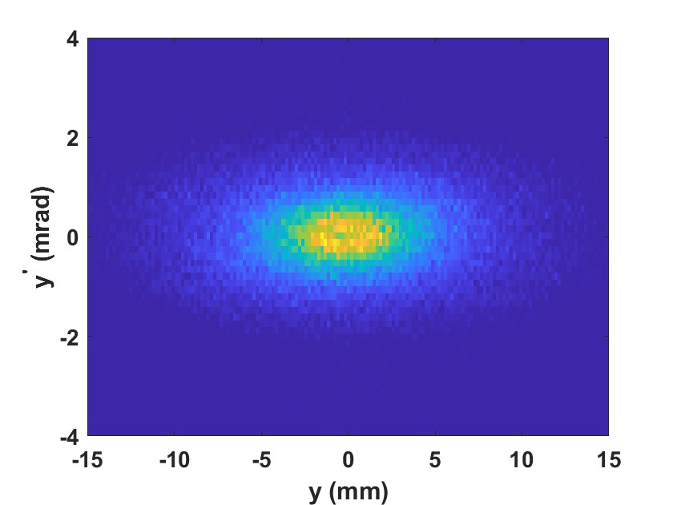
Transvers Distribution Evolution from pLINAC to DR
Transvers emittance is preserved
ε_{x} = 2.86 mm-mrad
ε_{y} = 3 mm-mrad
End of pLINAC
End of the injection transfer line
C. Milardi, DR and TLs for FCC-ee pre-injector,
FCC Week, Jun 5-9 2023, London, Great Britain.
Notes:
Geometrical emittance

Slide 13
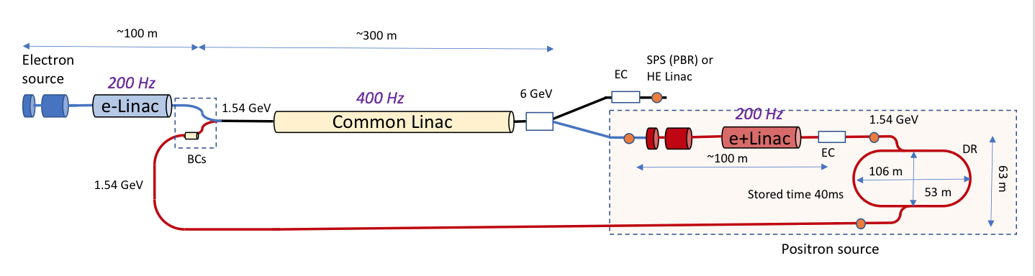
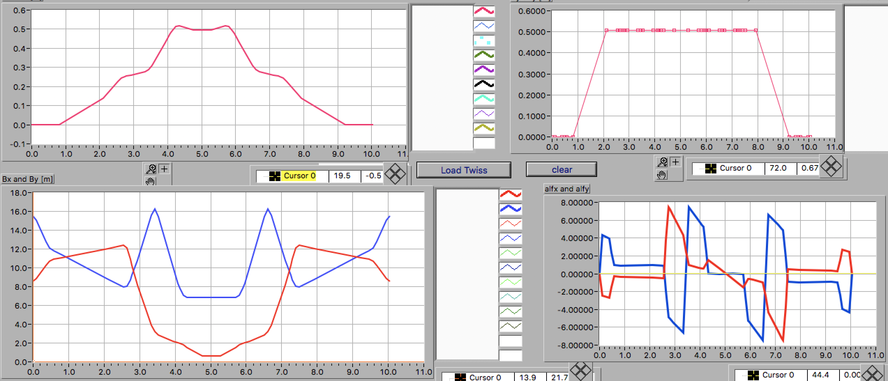
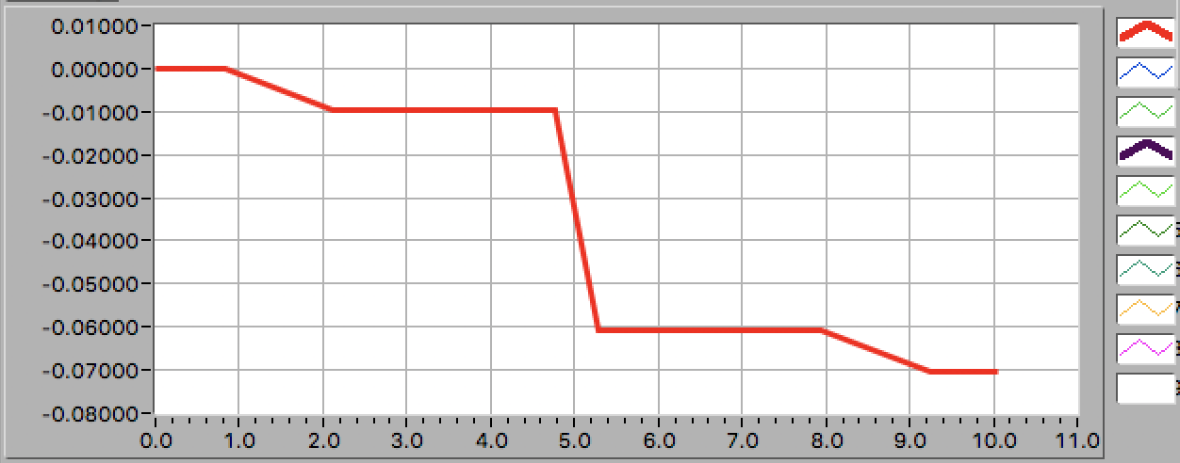


TBA Cell with R56 for Arcs
θ_{b} total [rad] | π/2
L_{b} [m] | 1.0/0.5767
ρ [m] | 5.736/3.304
B [T] | 0.5366/0.9315
nQUADS | 10
L_{QUA} [m] | 0.2
L_{cell} [m] | 10.0
η_{x} [m]
$ℋ_{x}$ [m]
[m]
$$ℋ_{x}=γ_{x}η_{x}^{2}+2α_{x}η_{x}η_{px}+β_{x}η_{x}^{2}$$
β_{x} [m]
β_{y} [m]
Quadrupole gradient m⁻²
K1qf 3.47714
K1qd -4.47514
K1qfe 1.1759
K1qde -2.84811
Sextupole gradient m⁻³
K2sf 1.7
K2sd -2.8
R₅₆
[m]
β _{x,y} < 16 m
low η _{x}
α _{x,y} = 0 both ends
achromatic
low invariant
R56 ~ 0.07 m
C. Milardi, DR and TLs for FCC-ee pre-injector,
FCC Week, Jun 5-9 2023, London, Great Britain.
Notes:
Isomagnetic cell (dipoles: bend in the same direction, and do not have magnetic gradient)
Deflection angle 12/6 degrees for the long and short dipole respectively
3 cell -> 90 degrees
Moderate beta function excursion through the cell
Low value for the invariant, curly H, which helps in preventing beam emittance dilution after passing in the Damping Ring
FILE: tlArcCellforR56_1.mad

Slide 14
DR to common LINAC TL
C. Milardi, DR and TLs for FCC-ee pre-injector,
FCC Week, Jun 5-9 2023, London, Great Britain.

Slide 15
Bunch Compressor Design
Beam parameters after Damping Ring
Equilibrium (zero current) bunch length 2.9mm assuming V_{RF} = 4MV
Expected bunch length < 5mm
Equilibrium zero current bunch energy spread 0.07%
Expected Bunch energy spread ≈ 0.1%
Equilibrium emittance 0.96 nm (normalized emittance 2.9 mm*mrad)
Beam parameters at the common LINAC entrance
Bunch length ≈1mm
Relative bunch energy spread σ_{γ} < 0.65% at 1.54 GeV
Normalized transverse emittance 3.4 mm*mrad
Bunch Compressor requirements
Compressor factor 1-5 variable
Final relative energy spread after BCS σ_{γ} < 0.65%
Preserve transverse emittance.
C. Milardi, DR and TLs for FCC-ee pre-injector,
FCC Week, Jun 5-9 2023, London, Great Britain.
Notes:
BC purposes and constrains
20% between emittance required by the common LINAC and the equilibrium emittance of the Damping Ring

Slide 16




BCS Design
In order to achieve σ_{γ} < 0.65% after BCS
$h=\frac{σ_{γ}}{σ_{z}}$ < 1.3 m⁻¹
Max C$=\frac{1}{1−R56∗h}=5$
|R56|>0.62m
R56 high for a single chicane
A de-chirper after the dispersive section can reduce |R56|
$h=\frac{σ_{γ}}{σ_{z}}$ < 2.2 m⁻¹
Max C$=\frac{1}{1−R56∗h}=5$
|R56|>0.4m
Cavity parameters ( PSI design of the common LINAC THPOJO08 LINAC 2022)
frequency 2.80 GhZ
84 cells for 3m structure
One structures operating at a gradient of 20MV/m (60MV total) to chirp the beam
Two structures operating at a gradient of 25MV/m (75MV total) to de-chirp the beam
Tunable |R56| > 0.42 m is provided by the arc cells of the TL connecting DR to common LINAC
C. Milardi, DR and TLs for FCC-ee pre-injector,
FCC Week, Jun 5-9 2023, London, Great Britain.
Notes:
Sigma(gamma) relative energy spread
h is the correlation factor the chirp
C is maximum compression factor
A de-chirper after the dispersive section is used to reduce the requirements on R56
( R56 * $σ_{γ}$/ γ > 400 µm microbunching instability suppressed by energy spread ) ??

Slide 17
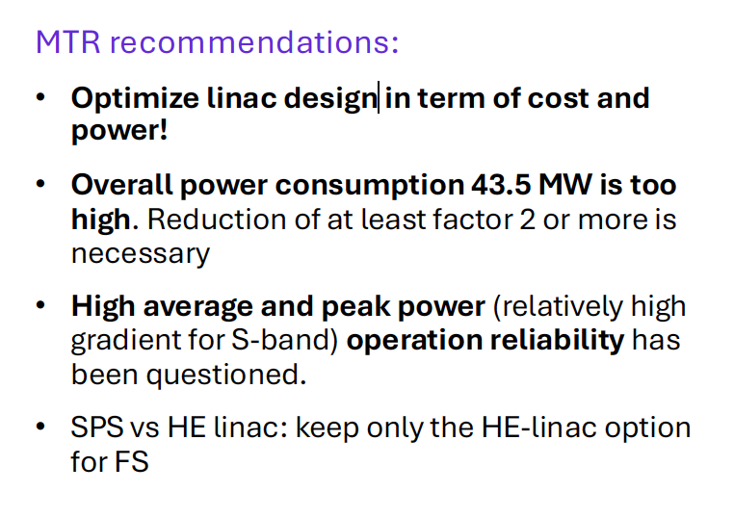
Mid-term Review Recommendations
The new optimized FCC-ee injector layout imposed to review the intrinsic structure of Damping.
Ring (DR) and Transfer Lines (TLs). The presence of two independent LINACs for electron and
positron beams, and the elimination of common LINAC, naturally led to increase DR energy
which, to avoid spin resonances, was set at the value of 2.86 GeV.
C. Milardi, LNF contribution to the FCC-ee Injector, Meeting INFN-A Esteso del 23-1-2025
Notes:
The new layout imposed a deep revision of DR and TLs layout

Slide 18
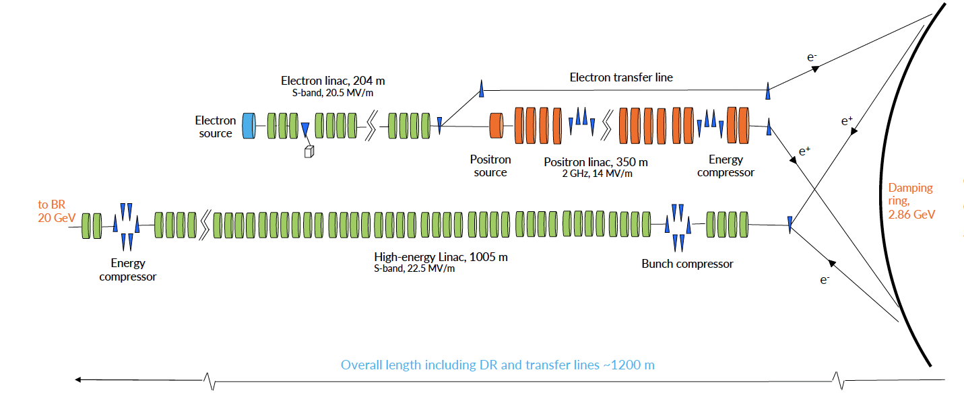
New Injector Layout
4 ASs for module, 4 bunches (25 ns), 100 Hz
New damping ring at higher energy 2.86 GeV,
No common LINAC which requires doubling repetition rate, for both species with flat emittances
C. Milardi, LNF contribution to the FCC-ee Injector, Meeting INFN-A Esteso del 23-1-2025
Notes:
AS accelerating structure
However, in the latest injector layout, the DR will be also used for electron beam cooling
in order to cure possible emittance dilution induced by misalignments and space charge effects.

Slide 19
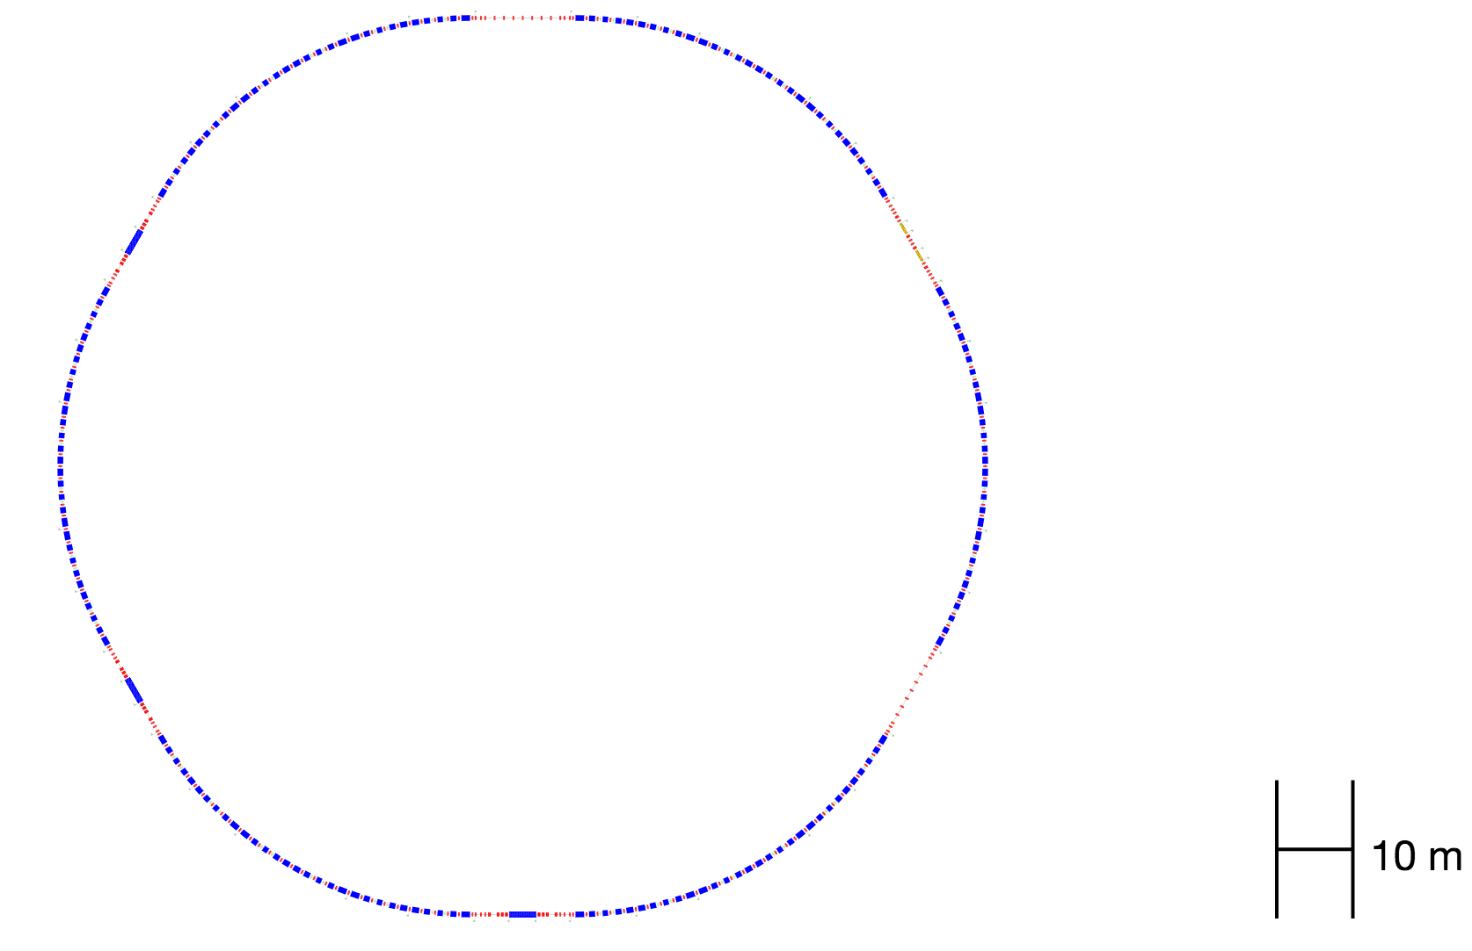
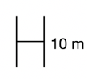
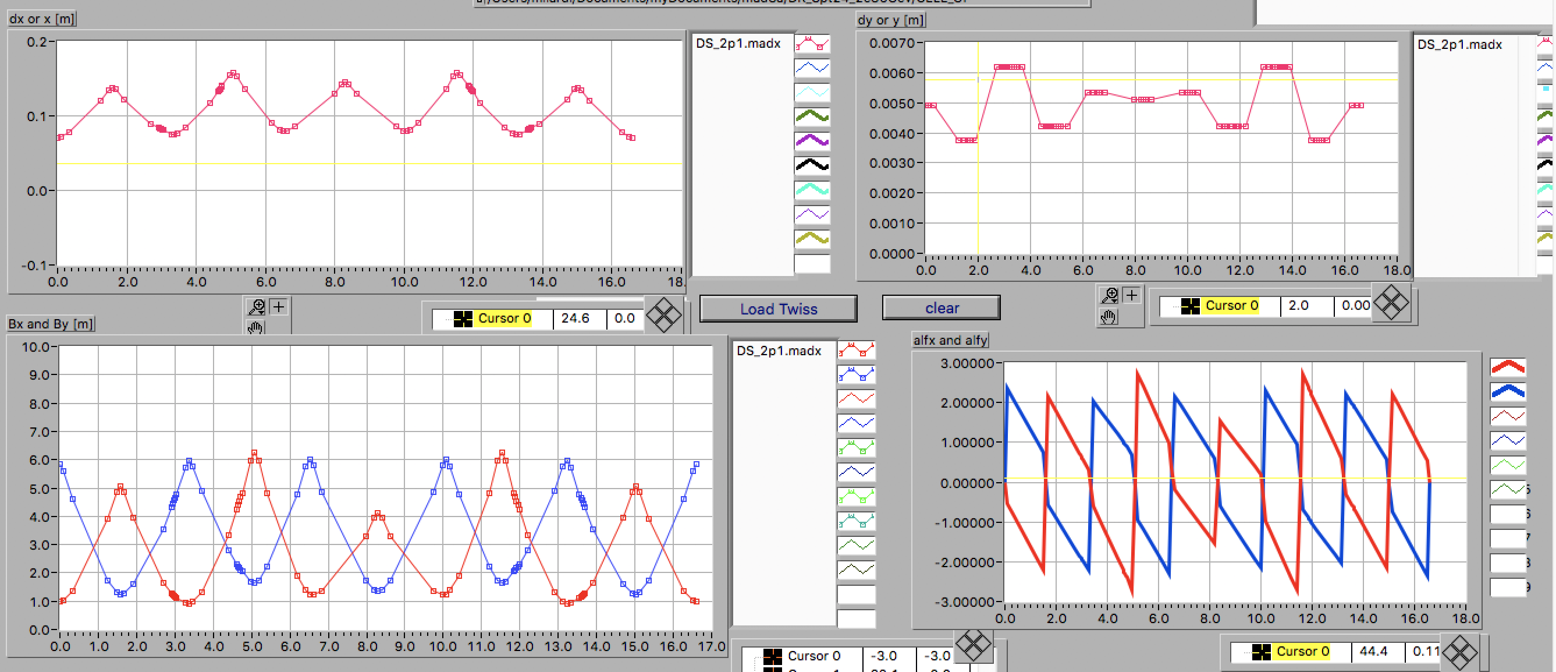
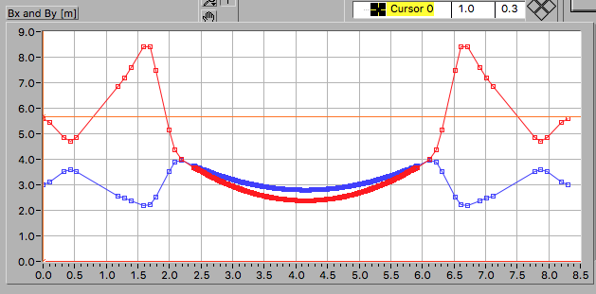
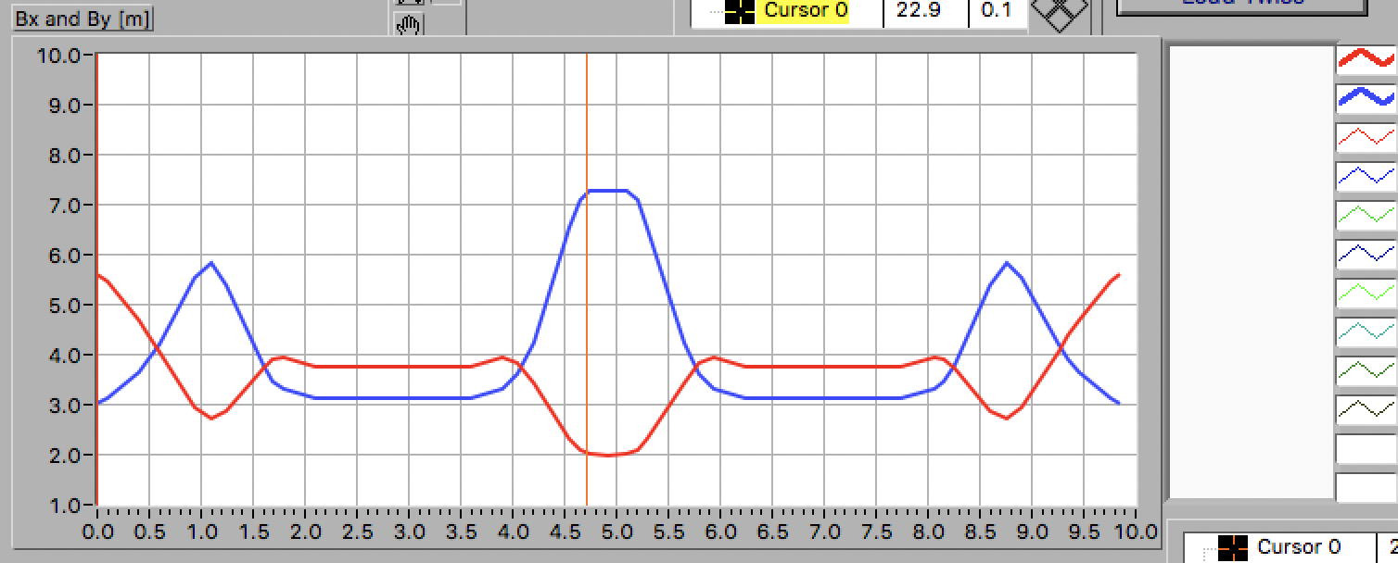


High Energy Damping Ring
Three Options are under study
1 Ring:
  3- fold symmetry
  FODO cell for the arcs.
2 Rings which are converging to common design concepts indeed:
  6-fold simmetry layout in order to achieve:
    best use of allocated space;
    flexible dedicated injection/extraction sections;
    dedicated Rf section;
    wide flexibility in independently tuning the ring working point, and in general operations;
    overall dimension 122m x 122m.
  multibend arc cell
  moderate use of wiggler magnets
  moderate betatron oscillation amplitude
Injection/
extraction
RF
Injection/
extraction
  3 WIGGLER insertions
Arc Cell
Wiggler Insertion
nper = 6.900000000e+01
lw = 0.05 m
angwig = 1.625014651e-01 degree
pole length ~ 0.02 m
RF section
$ℋ_{x}$ [m]
η_{x} [m]
$$ℋ_{x}=γ_{x}η_{x}^{2}+2α_{x}η_{x}η_{px}+β_{x}η_{x}^{2}$$
β_{x} [m]
β_{y} [m]
Wiggler magnet length and field
3.5 m
1.8 T
τ_{x,y} ~ 16.9 msec (using 3 insertion)
10 Bends of 5 different type, 11 Quads, 4 SXTs
C. Milardi, LNF contribution to the FCC-ee Injector, Meeting INFN-A Esteso del 23-1-2025
Notes:
Smooth trends
Moderate betatron oscillation amplitude
focusing strength compatible with present technology
Very low chromaticity and, in turn, reduced nonlinearities
Dipoles have different lenghts and bending angle.

Slide 20
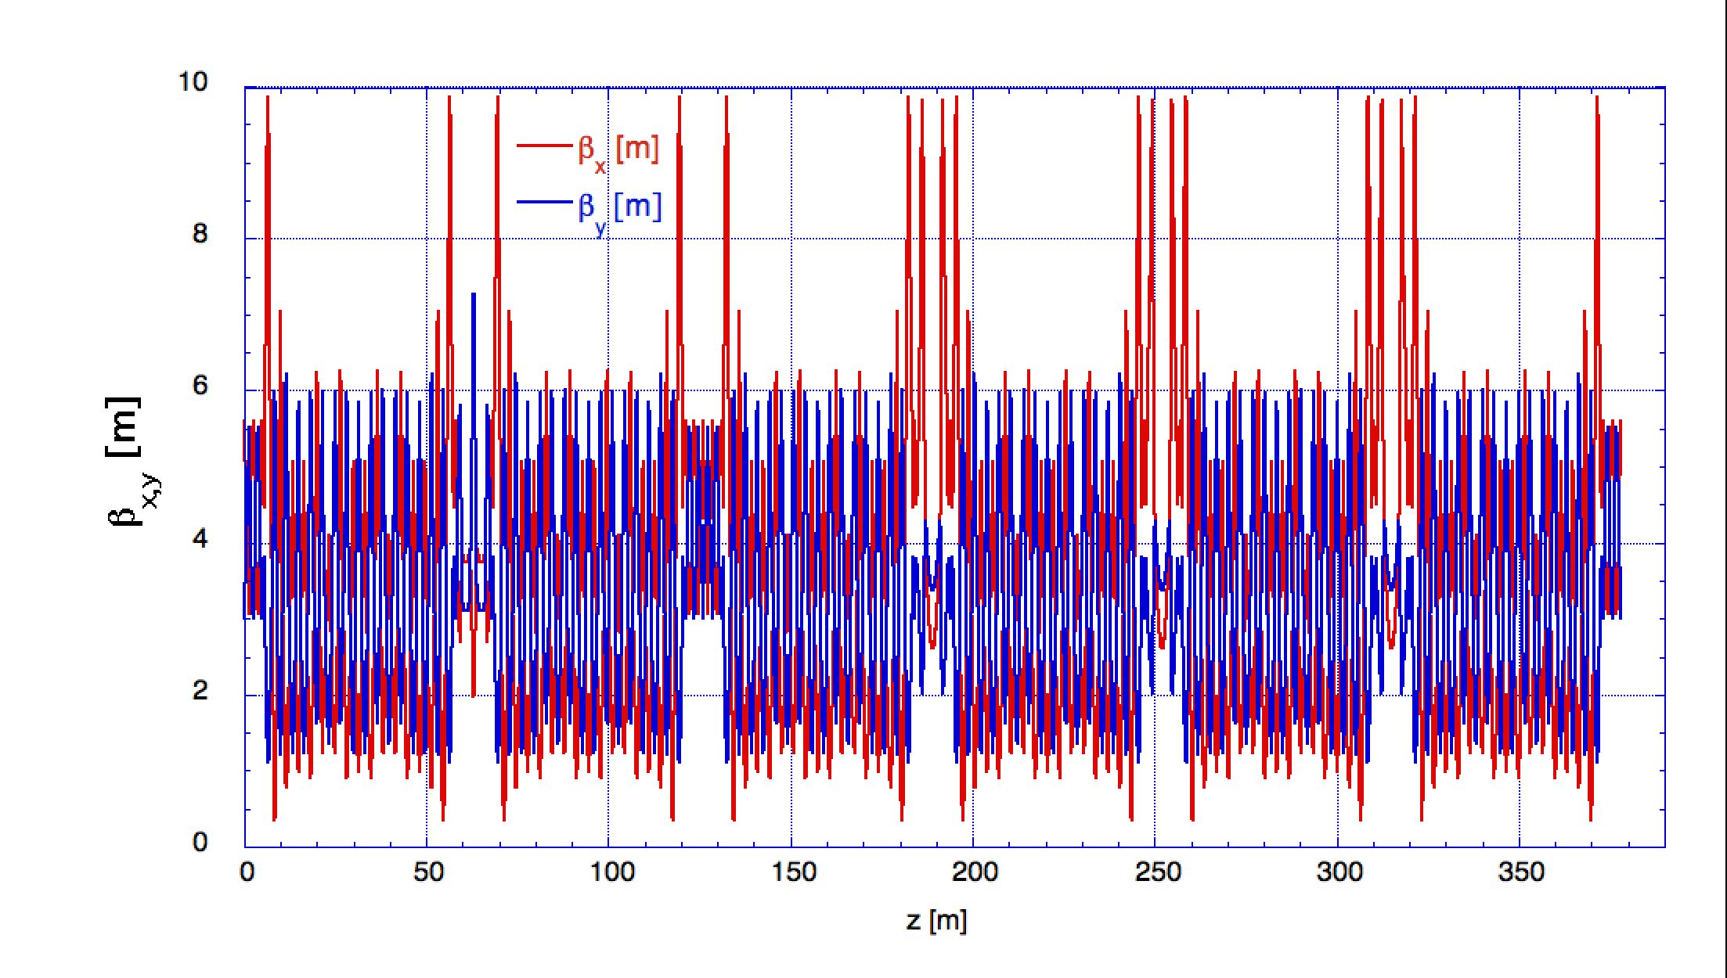
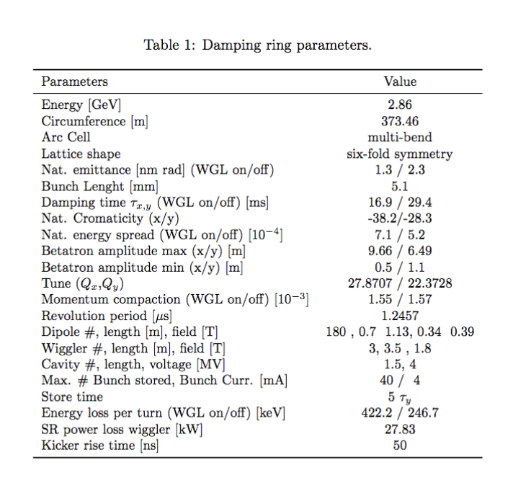
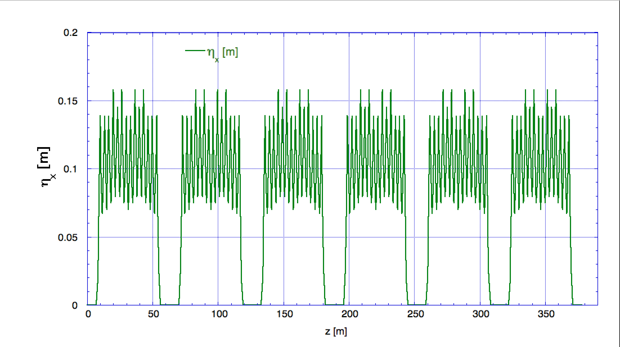
DR Parameters ad Optics
C. Milardi, LNF contribution to the FCC-ee Injector, Meeting INFN-A Esteso del 23-1-2025

Slide 21
Longitudinal Beam Dynamics Parameters
RF as in the CDR
  LHC type 400 MHz,
  SC cavities.
  two RF modules providing 2 MV each,
  1.5 m long (3.5 with cryostat).
RF system to use is still under discussion
 | V= 4MV | V= 8MV
U₀ [KeV] | 422.13 0. 7219 • 10⁻³ | 422.13
DE |  | 0. 7219 • 10⁻³
Ω_{s} [KHz] | 10.4545 | 14.7849
T₀ [μsec] | 1.26134 | 1.26134
ω₀ [s⁻¹ rad] | 4.98134E+6 | 4.98134E+6
ν_{s} | 0.00209874 | 0.002968
L_{bunch}[m] | 0.00511 | 0.00361
ϕ_{s} [rad] | 0.10573 | 0.0527913
Assuming that each pulse from the e(p)LINAC consists of 4 bunches carryng at last 5 nC each, filling the DR with 10 pulses implies to reach the following upper limits:
    Npart ~ 3.12075E+10
    I_{bunch} ~ 0.00396402 A
    I ~ 0.158561 A
C. Milardi, LNF contribution to the FCC-ee Injector, Meeting INFN-A Esteso del 23-1-2025
Notes:
Natural energy spread
Natural zero current bunch lenght

Slide 22
Short Term Plan after the Feasibility Study 2025-2028
FCC-ee Injector: Technical Design Report, 2025-2028:
Following the completion of the Feasibility Study phase (March 2025), a preliminary technical design report (pre-TDR) will be produced by mid-2027.
The objective of the pre-TDR is to provide detailed specifications for the accelerator and technical infrastructure requirements necessary for the initial phase of the civil engineering (CE) design.
By the end of 2028, the final Technical Design Report (TDR) for both the accelerator and the technical infrastructure will have been completed.
Injector Project schedule (as proposed by Michael Benedikt in preliminary discussion)
Start 2028 – end 2030 CE design and tendering (3 years)
Start 2029 – end 2031 Accelerator engineering and technical infrastructure designs
Start 2030 – end 2033 Civil construction (4 years)
Start 2031 – end 2040 Component production (assuming similar production rates for RF structures as for SwissFEL)
Start 2034 – end 2036 Technical infrastructure installation
Start 2035 – end 2040 Component installation and testing
Start 2042 beam commissioning
C. Milardi, LNF contribution to the FCC-ee Injector, Meeting INFN-A Esteso del 23-1-2025

Slide 23
Thank you
C. Milardi, LNF contribution to the FCC-ee Injector, Meeting INFN-A Esteso del 23-1-2025

