Slide 1


Targeting the message

Slide 2

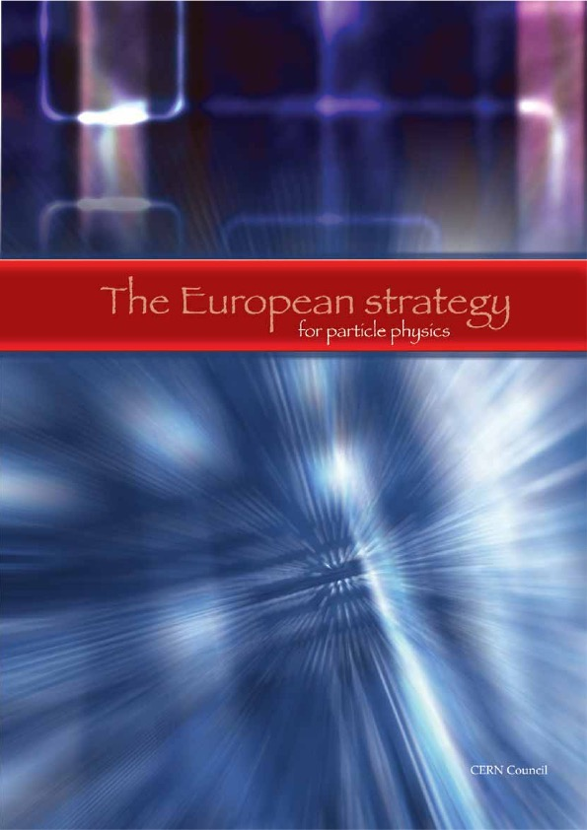

2006
Single brochure (40pp)
covering physics,
impact & recommendations
2013
Societal benefits
brochure (24pp)
Member State
summaries (1-2pp)
2020
Recommendations
brochure (20pp)
Deliberation
document (36pp)

Slide 3

2026
Politicians
Scientists & policymakers
General public
Global HEP community
The case for Europe’s next flagship collider
Impact on other fields
Why we explore the smallest scales
ESPP 2026 Recommendations
Deliberation document
THINKING BIGGER
COMMON EFFORT
CURIOUS MINDS
4pp
4pp
4pp
~12pp
~36pp

Slide 4
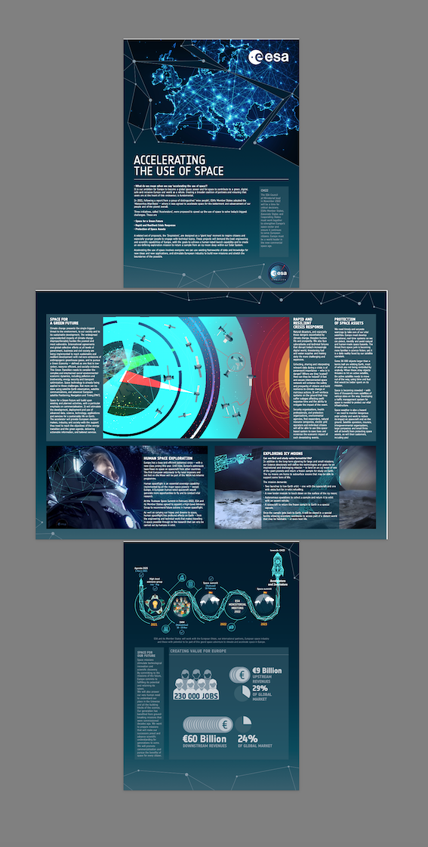
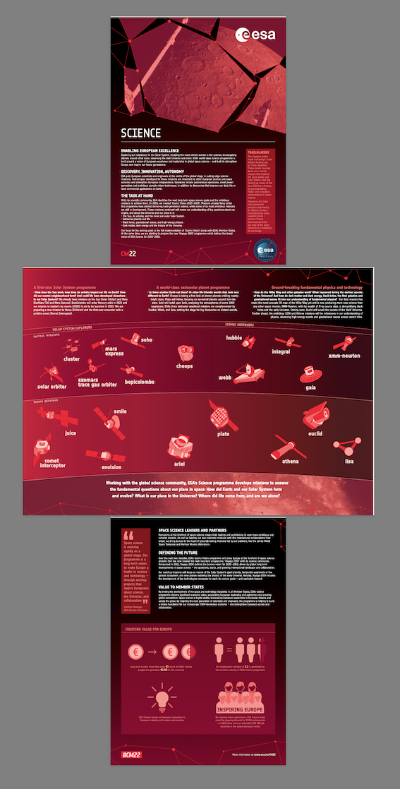
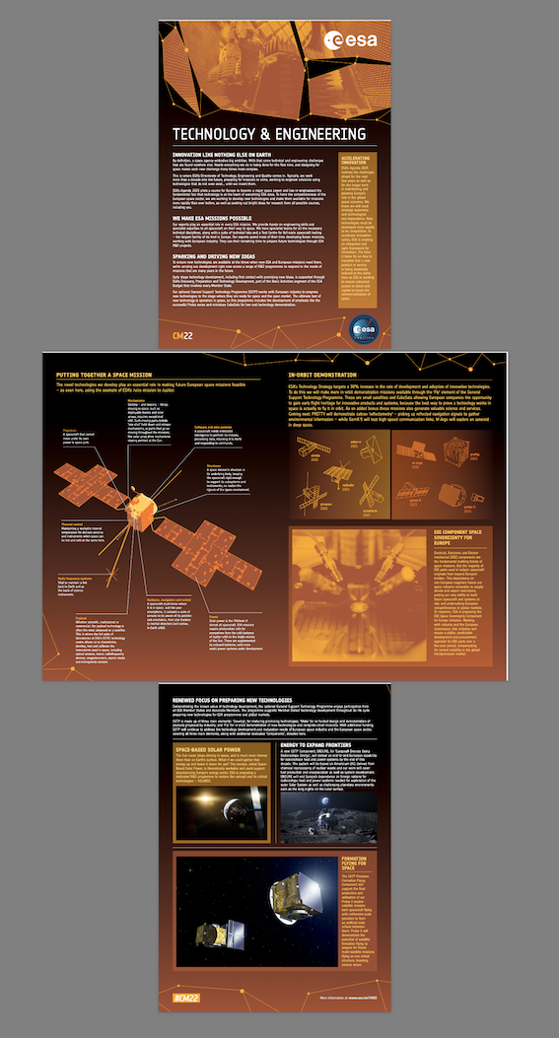

Slide 5
Spark a sense of strategic urgency by conveying the scientific, technological and socioeconomic importance of an unprecedented global research infrastructure in Europe for the 21st century
Global leadership in the heart of Europe
Large research infrastructures are engines of knowledge and innovation
Pursuit of basic knowledge -> delivery of modern world
Science goals: guaranteed outcomes
Socioeconomic impact: colliders are an investment, not a cost
HEP’s success in realising large projects
Model for environmentally responsible research
Open science
Bridging nations
ESPP context / competition

Slide 6
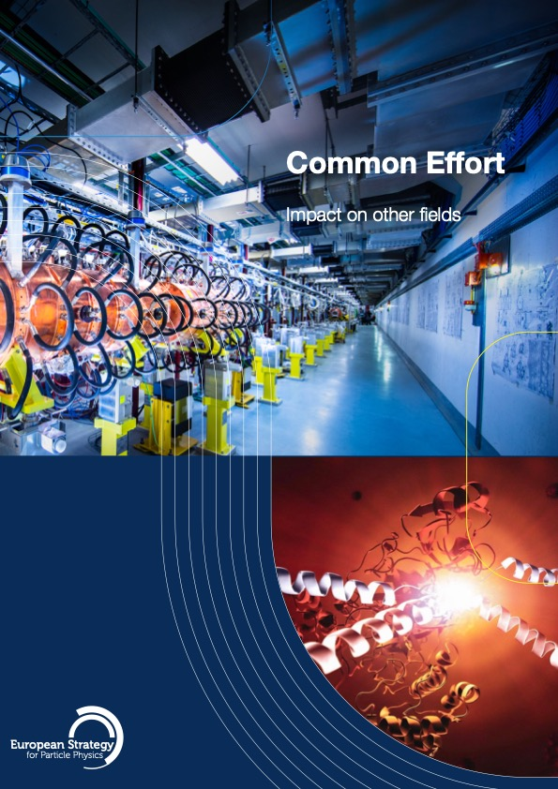
HEP pushes the limits of technology & innovation and inspires & trains new generations, driving progress and synergies across disciplines
Funding for a flagship collider is an investment for science in general
Particle physics is the foundation for advancing understanding across disciplines*
Core technology & innovation (SC, vacuum, cryo, electronics, big data, AI, …)
Health (cancer therapy, imaging, radioisotopes); energy/environment (fusion, power transmission); ICT (Web, Grid, networking), …
Cosmology & astroparticle, nuclear science, condensed matter, AMO, quantum technologies, life sciences & others via synchrotron X-ray facilities, …
Synergistic relationship between national labs and CERN
Attracting young minds to STEM
Training and capacity building
High-tech industry ecosystem (partnership, series production, company premiums, MS return on investment ...)
€440M EC projects linked to CERN/ESPP 2020 recommendations, 85% for MS
*NAS brochure!

Slide 7

People are innately fascinated by the big questions in physics. Tell them what it is that we have learned about the universe, and why it’s exciting to explore further
Connect particle physics with evolution of the universe
Story so far: what colliders have taught us about the fundamental composition of our Universe
The Higgs boson has opened the door to a new, more profound journey
Understanding nothingness
The open questions addressed by a future collier
Forensic physics: discovery via precision (cf. CMB)
A bigger bang: direct exploration into unknown realms (cf. astronomy)
We are in the business of engagement, not education
‘Self-coupling’, ‘electroweak symmetry’, ‘new physics’,..

