Slide 1
Communicating the case for CERN’s next flagship collider
https://vevox.app/#/m/104624912
Arnaud Marsollier – Head Education, Communications & Outreach

Slide 2
Last week I asked ChatGPT…
«Could you please tell me how to pitch for the CERN next collider, to convince general public audience about the interest of the project?»
«Pitching CERN’s next Collider to the general public is very different from pitching to scientists or funders. Your goal is to spark curiosity, convey purpose, and inspire support—not to dive into technical specifics.
🎯 Goal: Make the Public Care
Your pitch should answer:
“Why should I care?”
“How does this benefit society?”
“Is it worth the cost and effort?”

Slide 3
Last week I asked ChatGPT…
1. Big Questions: "What is the universe made of? How did it begin? Why does anything exist at all?"
Start with awe. The new collider aims to explore these fundamental mysteries of nature—that have fascinated humanity for millennia.
2. Human Ingenuity and Ambition: "The collider is one of the most ambitious scientific projects in history, pushing the boundaries of technology, energy, and collaboration."
Emphasize that it is a monument to what humans can achieve together—uniting countries, disciplines, and cultures to seek truth.
3. Everyday Benefits: "You’ve already benefited from particle physics. The World Wide Web, advanced cancer treatments, and even new materials for smartphones trace back to CERN and similar research."
Explain how investing in basic science leads to new technologies, training next generations and innovators, global peaceful collaboration
4. A Legacy Project
"This isn’t just for us. It’s for future generations. The collider could be the telescope of the 21st century—the tool that reshapes our understanding of reality.» Highlight the long-term vision. Like building a cathedral or launching space telescopes, the collider is a gift to the future
📺 Bonus: Use Storytelling & Visuals
🙋‍♀️ Tailor to the Crowd: students, sceptics, general public…

Slide 4
« We choose to go to the Moon »
https://vevox.app/#/m/104624912
Notes:
Ambition – leadership!

Slide 5
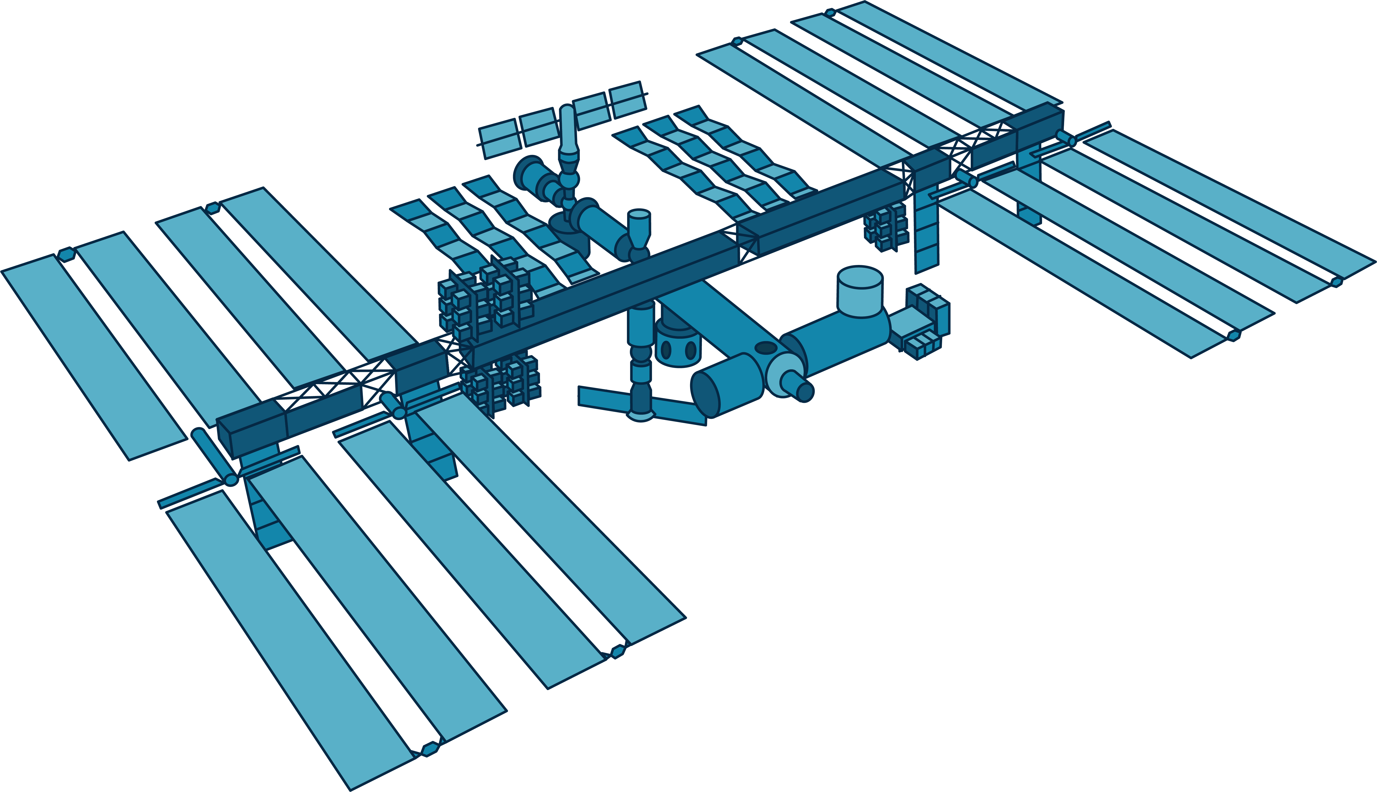
Among challenges, the funding…

Slide 6
Challenges?…
. Funding
. Climate Change & the Environment
. Trust in Science, fake news, conspiracies
. Global context
https://infn.display.vevox.com/ - /present/757564/92I72I48LESV48P99YCA

Slide 7
Benefits to Society?
If you had to mention one word only on why a new collider would matter?
. The importance of knowledge?
. Training?
. Higgs Higgs Higgs?
. Inspiration?
. Big questions?
. New technologies?
… Anything you have in mind!
https://infn.display.vevox.com/ - /present/757564/92I72I48LESV48P99YCA

Slide 8
We will need everybody
. Many national inputs highlight the importance of communications for a next flagship project.
. We’ve been successful with the LHC, but we will need to do more
. Especially, we will need a strong and coherent narrative to be relevant – not only a strong scientific case
– and we can tackle this together, coordination will be of paramount importance
. Networks exist to support upcoming activities, but should be strengthened: EPPCN, IPPOG, collaborations etc. and will need to commitment of the overall community to develop more direct outreach
. All scientists should engage with all kind of audiences: politicians, media, general public etc.

