Slide 1
PARALLEL SESSION / FLAVOUR PHYSICS
Theoretical landscape in flavour physics
Gino Isidori (University of Zürich)

Slide 2
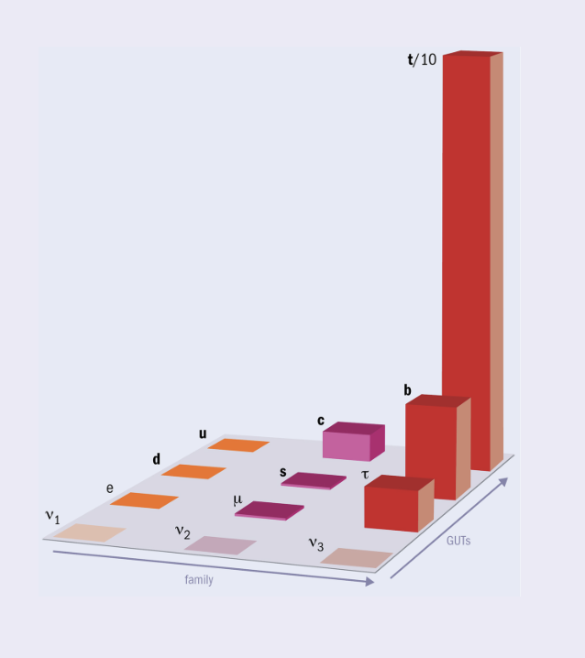
The open questions: the SM flavour puzzle
Fermion masses are the results of the Yukawa interactions → Inescapable link between Higgs and flavor, whose origin can be addressed only beyond the SM…
High-energy
degrees of freedom
(UV theory)
q_{L}^{i}
???
H
u_{R}^{j}
_
Y_{U}^{ij} q_{L}^{i} u_{R} ^{j} H
“Message from the UV”
that we need to “decode”

Slide 3
The open questions: the NP flavour puzzle
On general grounds, the flavor non-universal dynamics in the UV should give rise to effective contact interactions → violations of exact & approximate symmetries of the SM:
E.g.:
q_{L}^{i}
μ_{R}
γ
b_{L}
H
H
???
???
???
u_{R}^{j}
s_{L}
H
e_{L}
H
_
Y_{U}^{ij} q_{L}^{i} u_{R} ^{j} H
Effective interaction which violates an approximate symmetry of the SM
Effective interaction which violates an exact symmetry
of the SM
< 0.01
< 0.1
Y_{U} ~
Strength of the contact interaction ~ C_{eff} /Λ²
1
B_{s} → μμ
μ → eγ

Slide 4
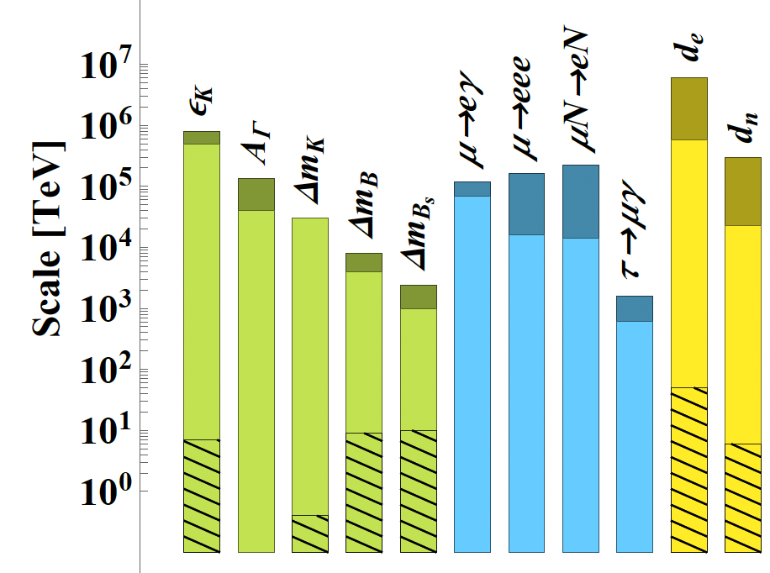
The open questions: the NP flavour puzzle
On general grounds, the flavor non-universal dynamics in the UV should give rise to effective contact interactions → violations of exact & approximate symmetries of the SM.
At present we do not see any of these effects, and this is often expressed in terms of strong bounds on effective NP scales:
N.B.: These bounds are obtained assuming unit couplings for the effective coefficients
E.g.:
C_{μeγ}
Λ²
1
Λ²
→
Useful to show the potential,
but rather misleading…

Slide 5
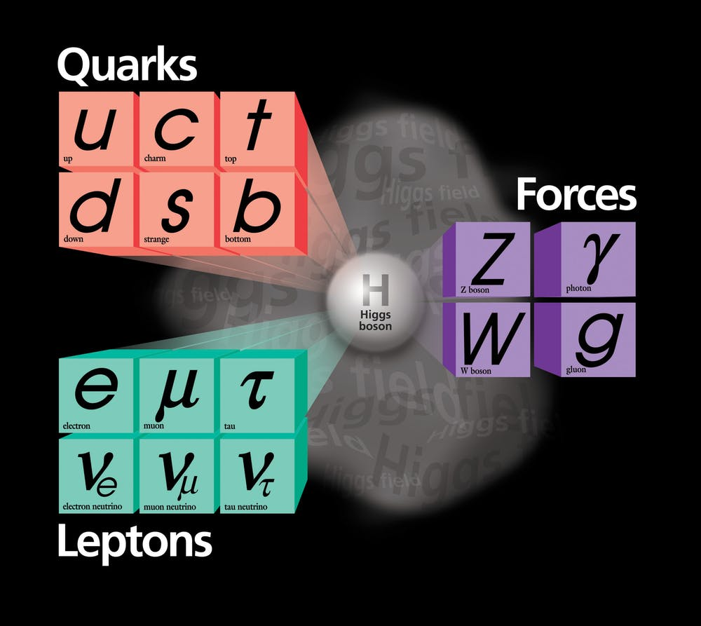
How to address the challenges: Flavour in the SM EFT
No matter if NP is at the TeV scale or well above, it is always very heavy compared to the energy scale of low-energy flavour experiments → systematic description via the “SM EFT”
c_{i}^{[d]}
Λ^{d-4}
Σ
ℒ_{SM-EFT} = ℒ_{gauge} + ℒ_{Higgs} +
O_{i}^{[d]} (ψ_{SM})
^{d > 4}
Long-range structure of the theory
SM field
g₁
g₂
Most general description of heavy NP that we are not able to directly “excite”
SM field
g₁
g₂
M²

Slide 6
How to address the challenges: Flavour in the SM EFT
No matter if NP is at the TeV scale or well above, it is always very heavy compared to the energy scale of low-energy flavour experiments → systematic description via the “SM EFT”
c_{i}^{[d]}
Λ^{d-4}
Σ
ℒ_{SM-EFT} = ℒ_{gauge} + ℒ_{Higgs} +
O_{i}^{[d]} (ψ_{SM})
^{d > 4}
Don’t be scared by the large number of independent couplings of eff. operators!
Understanding the flavour structure of the SM EFT is a question of pivotal importance.
N. of independent couplings:
M
g
flavor
They do not indicate model parameters, but rather the number
of observables we can probe
(whose correlations depend on the
unknown underlying model)
No flavor symmetry 2499 [@d=6]
Maximal flavor symmetry 47 [@d=6]

Slide 7
How to address the challenges @ large-scale facilities [b,c,τ]
γ quarks μ e τ ν
_
b → s μμ R_{bs} (e/μ) b → s ττ b → s νν
b → c μν R_{bc} (e/μ) b → c τν
3_{q} → 2_{q}
b → s γ B_{s} ⟷ B_{s}
_
_
B(B_{s} → μμ),
B(B → K* μμ),
A_{FB}(B → K *μμ),
…
_
B(B → K νν),
B(B → K *νν),
…
b → d μμ R_{bd} (e/μ) b → d ττ b → d νν
b → u μν R_{bu} (e/μ) b → u τν
3_{q} → 1_{q}
b → d γ B_{d} ⟷ B_{d}
R^{τ/μ}(D),
R^{τ/μ} (D*), …
c → u μμ R_{cu} (e/μ) c → u νν
c → s μν R_{cs} (e/μ)
c → d μν R_{cd} (e/μ)
2_{q}
1_{q}
_
2_{q} →
c → u γ D ⟷ D
N.B.: several observables for each transition
2_{l}
1_{l}
τ → μ γ τ → μ qq τ → μ μμ τ → μ ee τ → μ νν
τ → e γ τ → e qq τ → μ ee τ → e ee τ → e νν
3_{l} →

Slide 8
How to address the challenges @ dedicated facilities [K, π, μ, EDMs]
γ quarks μ e τ ν
s → d μμ R_{sd} (e/μ) s → d νν
s → u μν R_{su} (e/μ)
d → u μν R_{du} (e/μ)
2_{q}
1_{q}
_
→1_{q}
s → d γ K ⟷ K
2_{l} → 1_{l}
μ → e γ μΝ → eN μ → e ee μ → e νν
2_{l} → 2_{l}
g_{μ}
d_{μ}
1_{l} → 1_{l}
d_{e}
1_{q} → 1_{q}
d_{N}

Slide 9
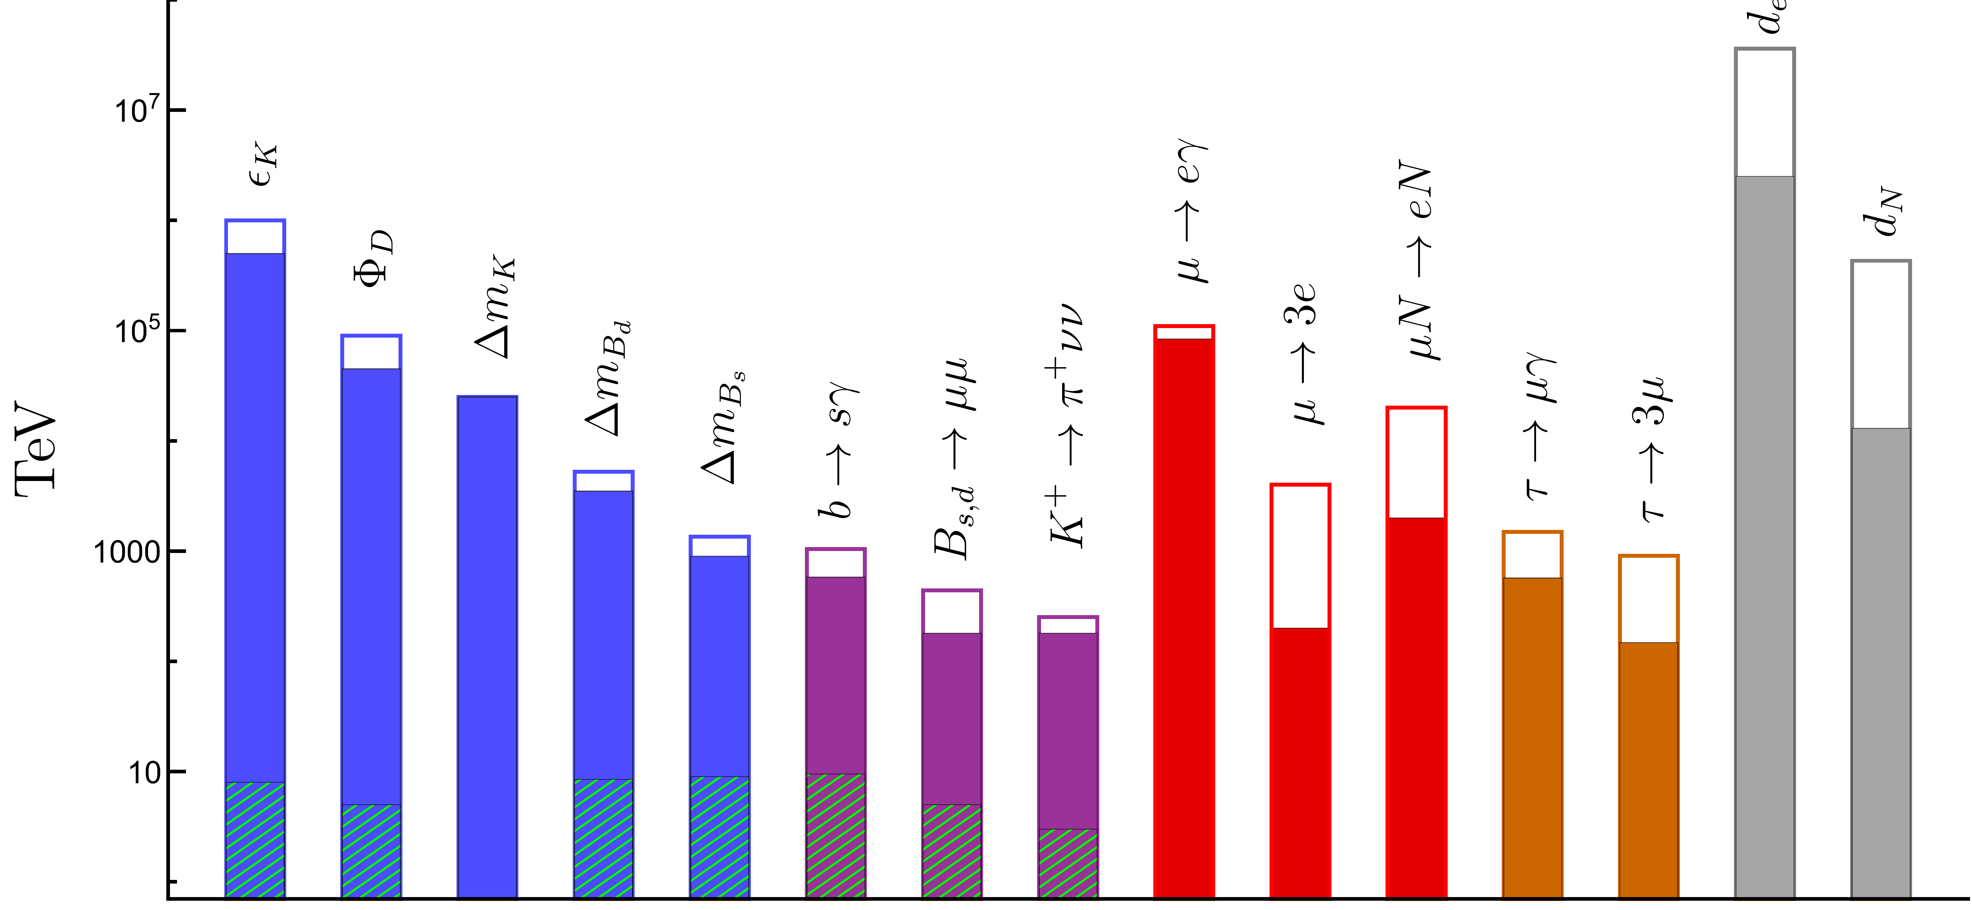
I. Bounds on effective scales for generic (unit) couplings
Expected improv.
Current bound
ESPP2026 Preliminary
Most of the improv. here
comes from improved
CKM determination
ΔF=2
(ΔF=1)_{quarks}
LFV(μ→e)
LFV(τ →e)
EDMs

Slide 10
I. Bounds on effective scales for generic (unit) couplings
Expected improv.
Current bound
ESPP2026 Preliminary
Possible reach of
a dedicated exp.
ΔF=2
(ΔF=1)_{quarks}
LFV(μ→e)
LFV(τ →e)
EDMs

Slide 11
I. Bounds on effective scales for generic (unit) couplings
Main message of these bounds: high discovery potential
of selected flavour observables
ESPP2026 Preliminary
To understand the impact of the whole flavour program in constraining (realistic) BSM -> need more hypotheses
CKM-like
couplings (MFV)
ΔF=2
(ΔF=1)_{quarks}
LFV(μ→e)
LFV(τ →e)
EDMs

Slide 12
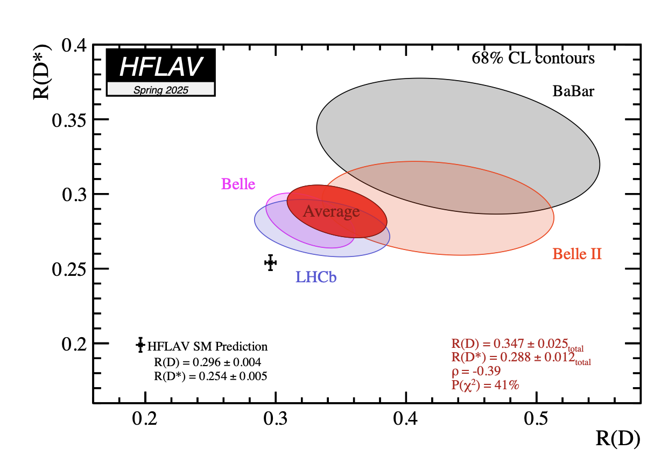
II. An explicit example of flavour – EW interplay (assuming NP)
Looking at bounds from individual observables misses the main point of indirect NP searches,
which is the interplay of a large number of observables in “decoding” the underlying theory
To illustrate this point worth to consider an explicit example assuming a NP signal
2026 ESPPU – Open Symposium (Venice, June 2025) G. Isidori - Status and open questions in Flavour Physics
12

Slide 13
II. An explicit example of flavour – EW interplay (assuming NP)
Looking at bounds from individual observables misses the main point of indirect NP searches,
which is the interplay of a large number of observables in “decoding” the underlying theory
b_{L}
ν_{L}
b_{L}
τ_{L}
s_{L}
τ_{L}
s_{L}
ν_{L}
B →K νν
B →K ττ
W
τ_{L}
b_{L}
τ_{L}
Z
τ_{L}(ν_{L})
ν_{L}
b_{L}
τ_{L}
Ζ → ττ (νν)
τ →μνν
σ(pp →ττ)
τ_{L}(ν_{L})
2026 ESPPU – Open Symposium (Venice, June 2025) G. Isidori - Status and open questions in Flavour Physics
13

Slide 14
II. An explicit example of flavour – EW interplay (assuming NP)
Looking at bounds from individual observables misses the main point of indirect NP searches,
which is the interplay of a large number of observables in “decoding” the underlying theory
A simple, consistent, description
of the system involves (at least)
3 parameters:
Two Wilson coefficients,
One flavour-mixing parameter, ε = O(1): = b_{L} + ε |V_{ts}| s_{L}
2026 ESPPU – Open Symposium (Venice, June 2025) G. Isidori - Status and open questions in Flavour Physics
14

Slide 15
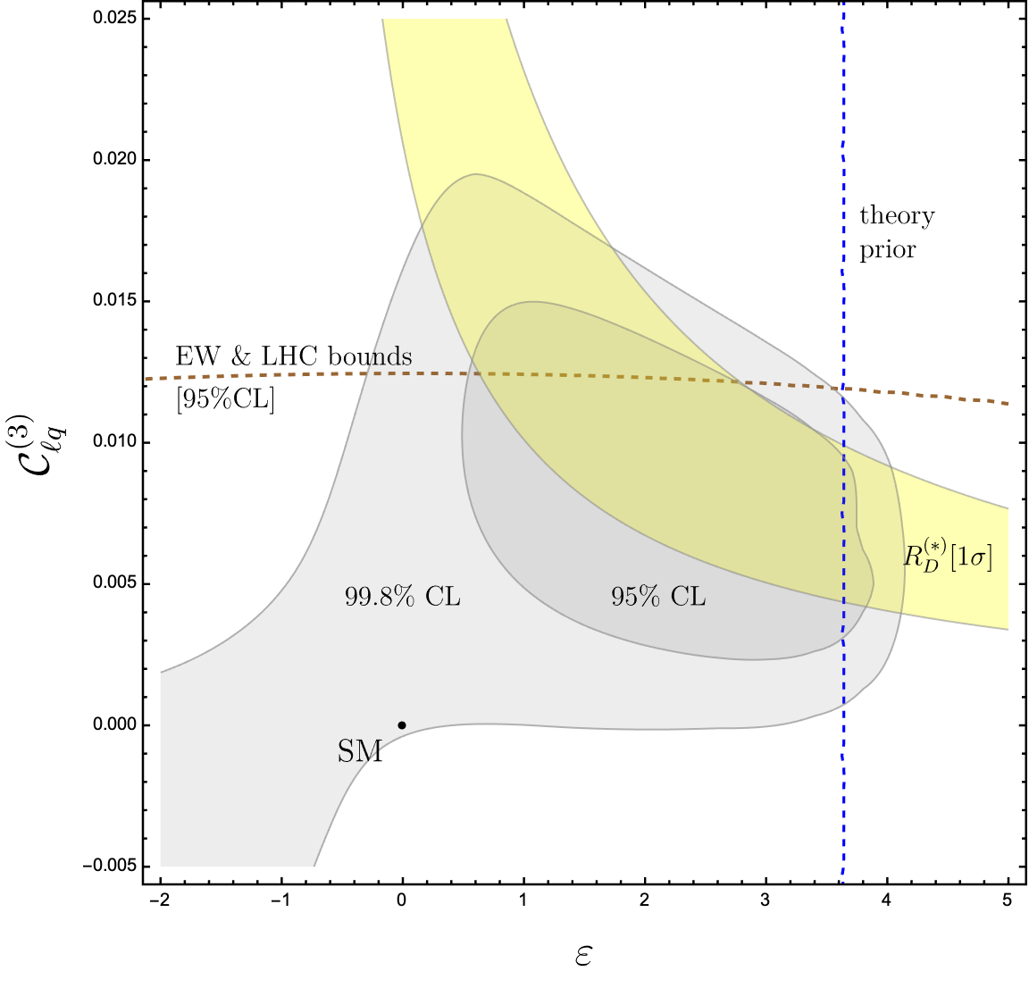
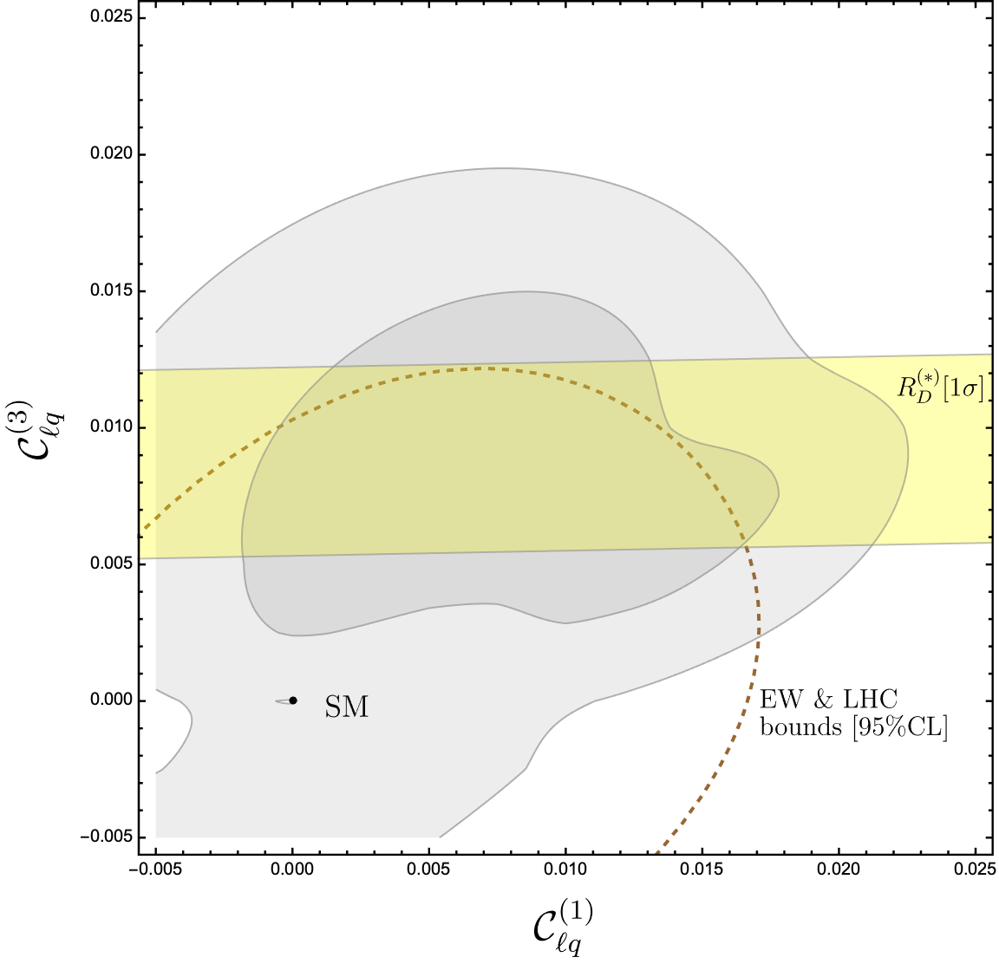
II. An explicit example of flavour – EW interplay (assuming NP)
ESPP2026 Preliminary
W_{i}’
ESPP2026 Preliminary
g/M
U_{i}
1 TeV
2 TeV
Z’
2026 ESPPU – Open Symposium (Venice, June 2025) G. Isidori - Status and open questions in Flavour Physics
15

Slide 16
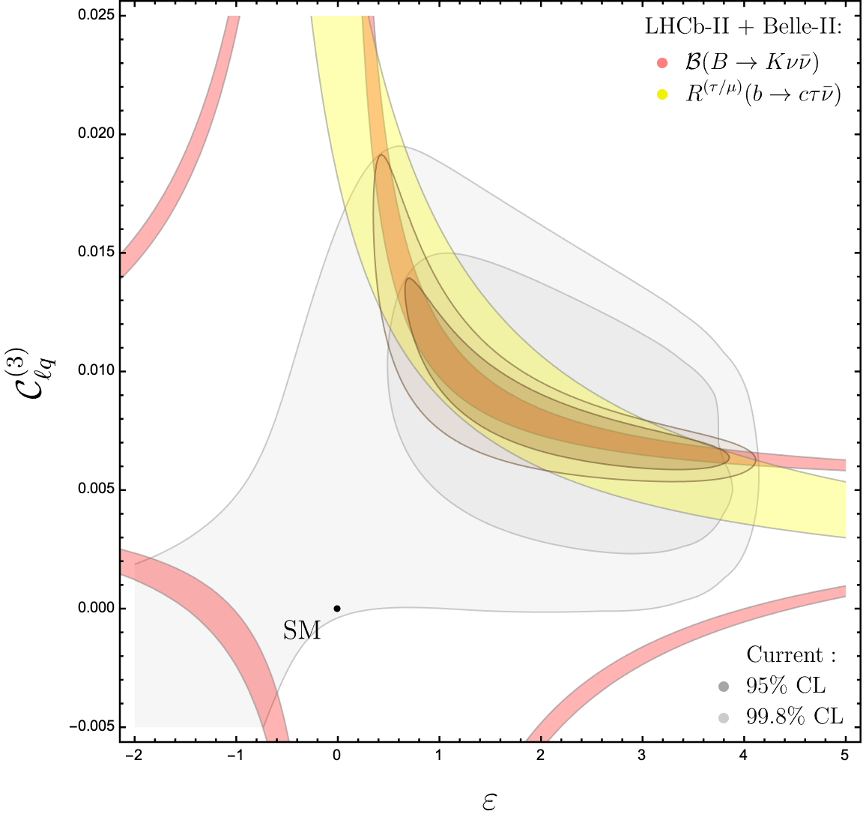
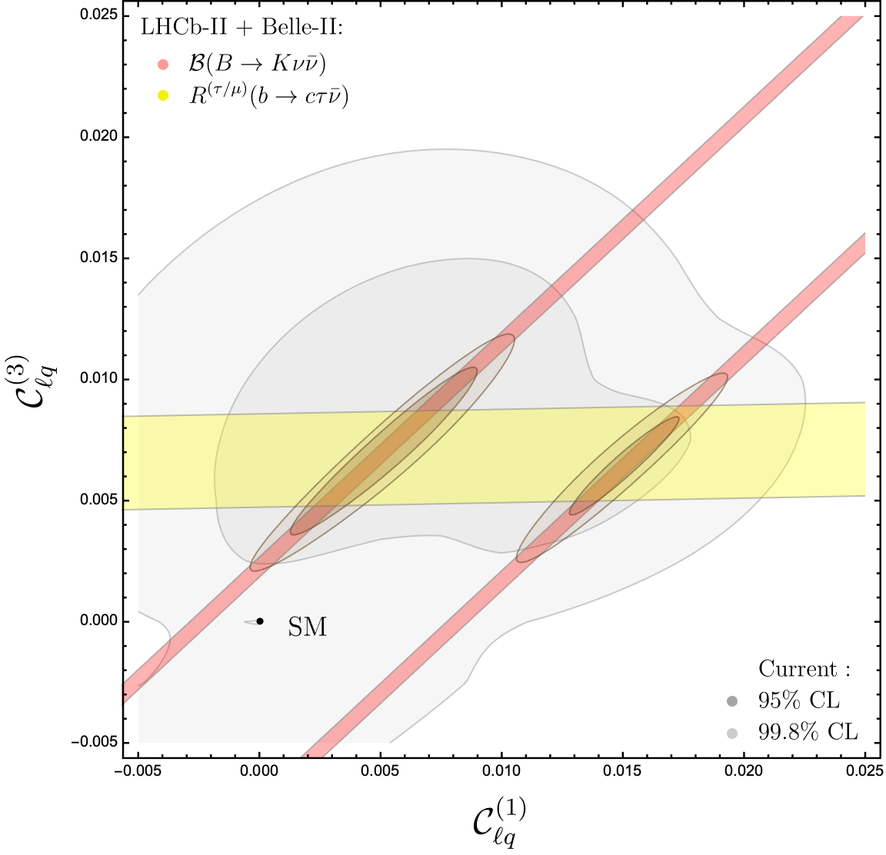
II. An explicit example of flavour – EW interplay (assuming NP)
ESPP2026 Preliminary
ESPP2026 Preliminary
2026 ESPPU – Open Symposium (Venice, June 2025) G. Isidori - Status and open questions in Flavour Physics
16

Slide 17
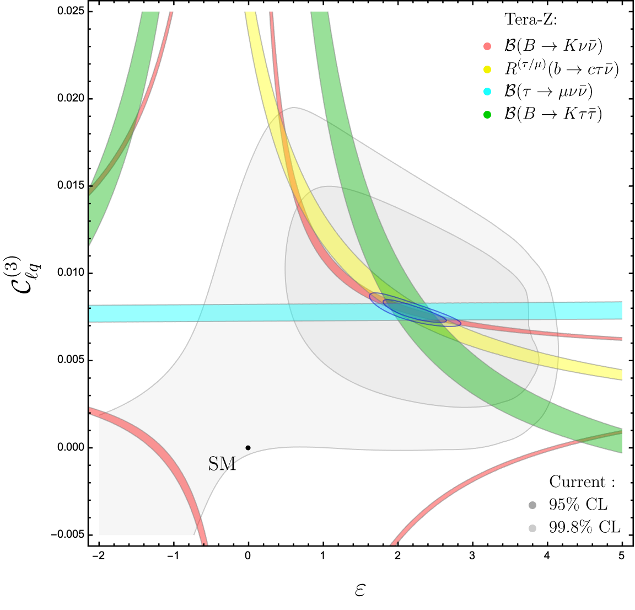
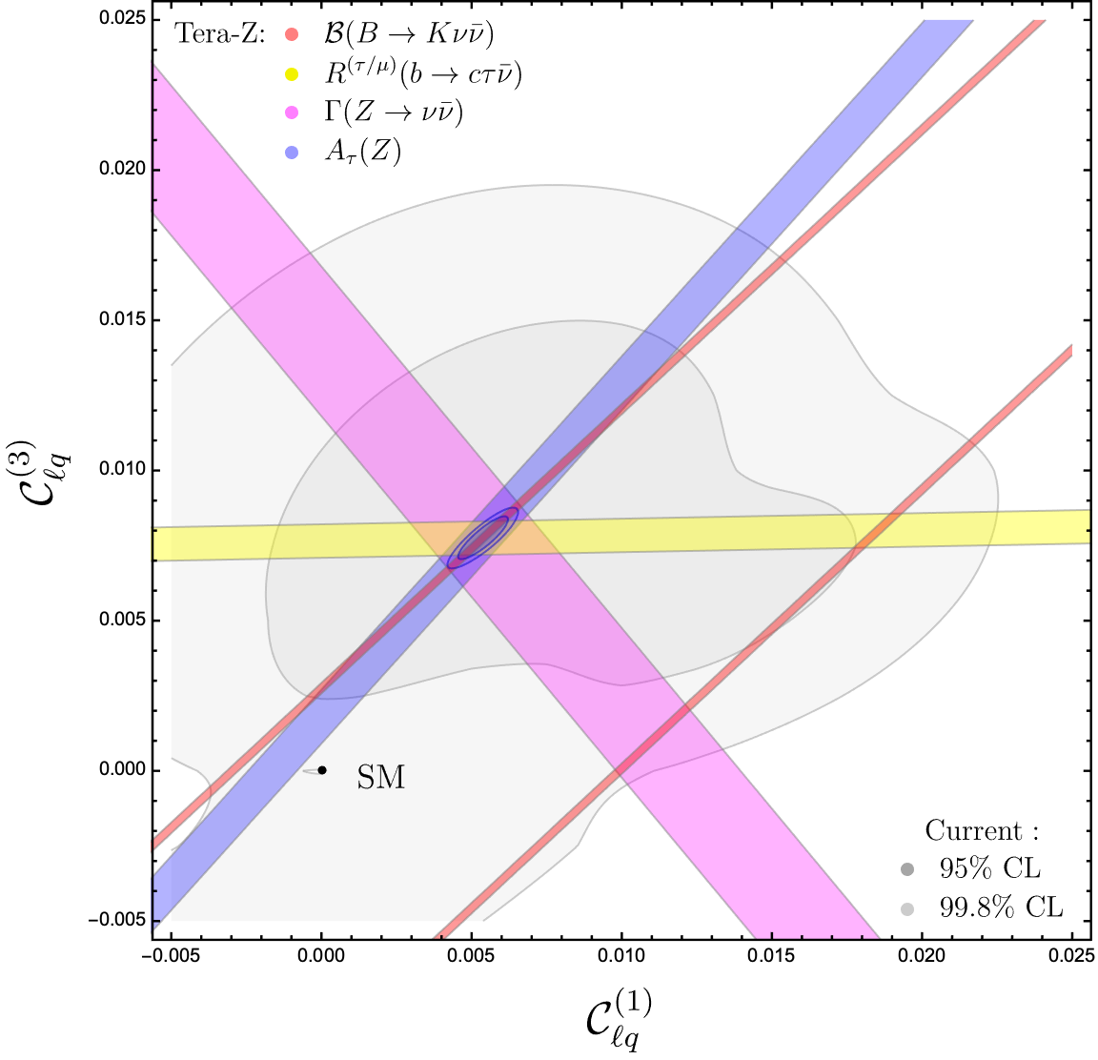
II. An explicit example of flavour – EW interplay (assuming NP)
ESPP2026 Preliminary
ESPP2026 Preliminary
2026 ESPPU – Open Symposium (Venice, June 2025) G. Isidori - Status and open questions in Flavour Physics
17

Slide 18
About flavour, EW, and Higgs physics interplay
What I have illustrated is only an example, but the conclusions are very general:
The interplay of a large number of observables is a key ingredient if we aim to “decode” the underlying theory via indirect measurements and/or “validate” indirect BSM evidences (in concrete models there are no hundreds parameters, but likely more than three…) and flavour physics represent a particularly “rich” domain of NP sensitive observables.
Precision Higgs, electroweak, and flavour physics are three faces of the same strategy:
for all of them the primary objective is indirect discovery
in realistic models, with TeV-scale NP, they provide very complementary information
2026 ESPPU – Open Symposium (Venice, June 2025) G. Isidori - Status and open questions in Flavour Physics
18

