Slide 1


Hot and Dense QCD: future prospects in heavy-ion collisions
Venice, 23 June 2025
Urs Achim Wiedemann
CERN Theory Department
Notes:
The stated aim of this European Strategy Update is to develop a visionary and concrete plan that greatly advances human knowledge in fundamental physics through the realisation of the flagship project at CERN. The plan should also clarify the scope of the HL-LHC physics programme.

Slide 2
Heavy Ion Physics: 5 decades of discoveries and surprises
1973 QCD
Asymptotic freedom
1974 – 78
QGP
1978 - ….
QGP signatures
QCD thermodynamics
QCD hydrodynamics
QCD kinetic theory
Politzer; Gross+Wilczek
T.D. Lee, Cabbibo+Parisi,
Collins+Perry, Shuryak
Bjorken, Baym, McLerran,
Kajantie, Gyulassy, many more
TH ⬄ EXP
interplay
Bevalac
BNL AGS
CERN SPS
BNL RHIC
CERN LHC
1974 , E/m ~ 1
first ion beams
1987
Relativistic HI
1992
1987
Relativistic HI
1994
2000
First HI Collider
2010
Kinetic Equilibration:
Chemical Equilibration:
In-medium dissociation & hadronization:
QGP radiation:
Inner workings of the QGP:
Flow v2 v2 v2, v3 v2,v3,v4,v5, …
----- Strangeness enhancement ------------- + charm sector + beauty
J/Psi suppression J/Psi enhancement Ypsilon & J/Psi
el mag radiation ………………………………………………………………
hard probes, jet quenching, jet substructure …
Much more!
Systematic Exploration of the QGP
Yayun He et al, arXiv:2201.08408

Slide 3
To frame the following discussion
a sketch of the
State of the art
Yayun He et al, arXiv:2201.08408

Slide 4
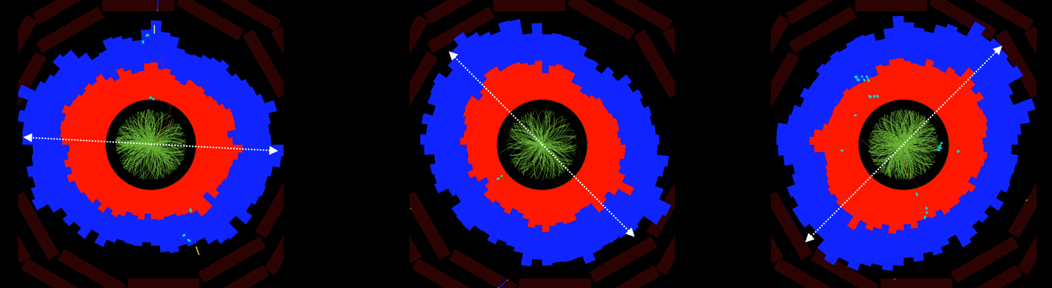
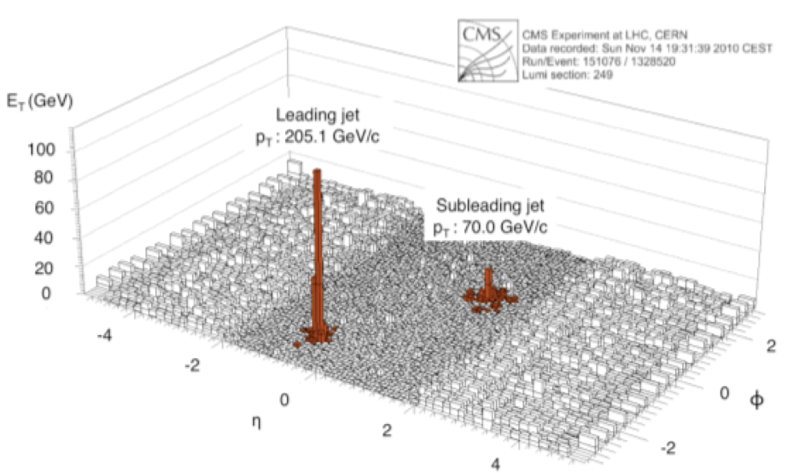
Heavy-ions: generic & large emergent phenomena
FLOW
Collective Motion of essentially all soft hadrons.
Jet Quenching
These phenomena are:
Numerically large
Generic
Quantified on top of pp baseline.
Allows for detailed experimentation of collective phenomena.
Yayun He et al, arXiv:2201.08408

Slide 5
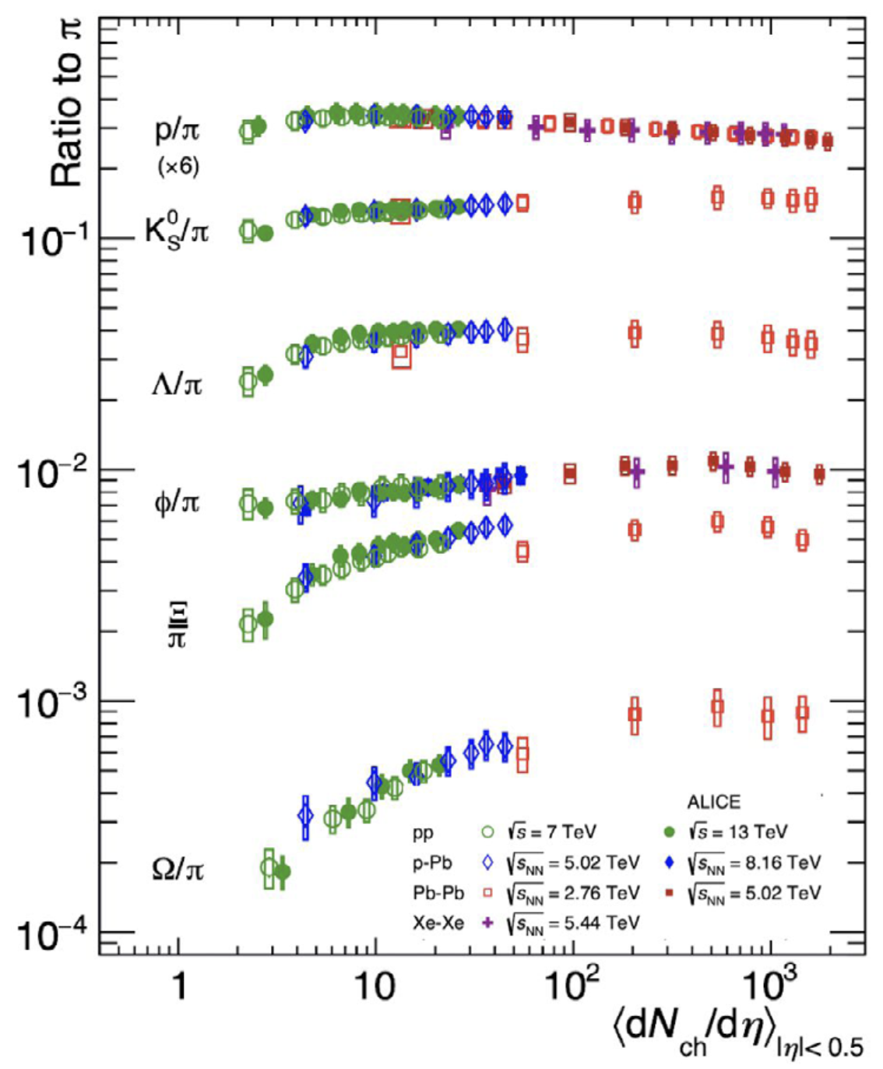
… continued
Strangeness enhancement
“Hadrochemistry” changes generically with system size.
“ Collective effects are observed in high-multiplicity pp events, similar to the signals traditionally attributed to the formation of a Quark Gluon Plasma in heavy ion collisions … there is still not a unified framework.”
Torbjörn Sjöstrand, “Collective Effects, the viewpoint of HEP MC Codes” 1808.03117
ALICE Coll, arXiv:2211.04384
Yayun He et al, arXiv:2201.08408

Slide 6
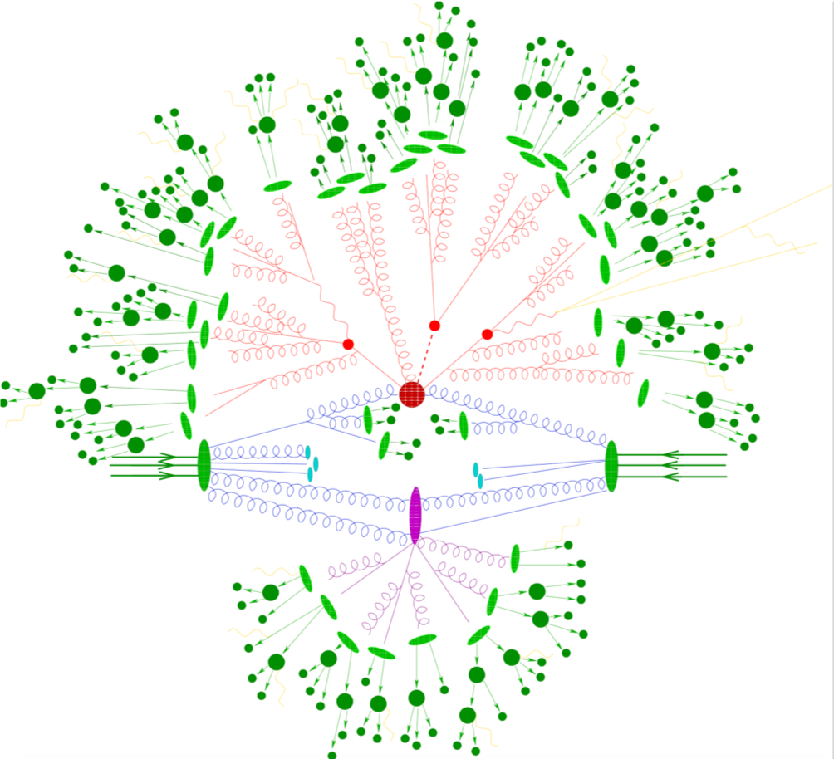
These emergent phenomena are not accounted for in the
default (MC) picture of proton-proton collisions
A free-streaming but fragmenting “gas”
Included:
Multiple Parton Interactions
Hard Processes
Parton Showers
Hadronization
Hadronic decays
Electroweak processes
BSM
Not included:
any notion of “medium-dependence”, such as jet quenching, flow, hadrochemistry
Yayun He et al, arXiv:2201.08408

Slide 7
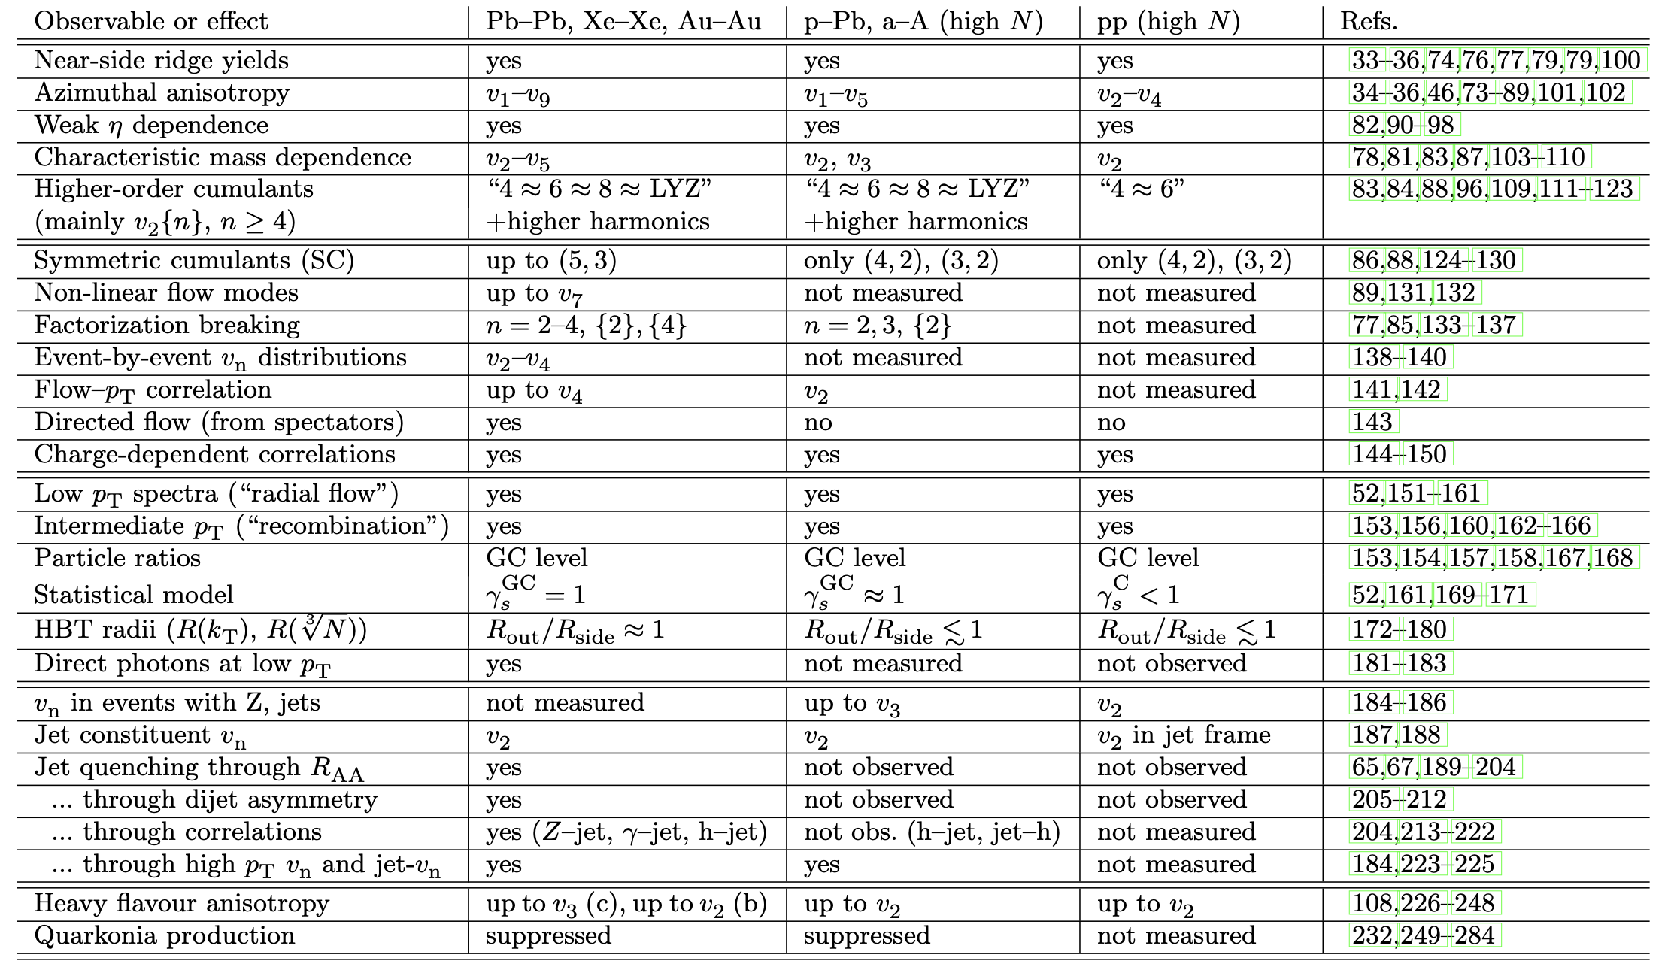
and yet, they smoothly extend to proton-proton collisions
200 publications from all LHC and RHIC collaborations:
Precursor phenomena of collectivity seen in pp and pA.
Table from: Jan Fiete Grosse-Oertringhaus & UAW, arXiv:2407.07484
Yayun He et al, arXiv:2201.08408

Slide 8
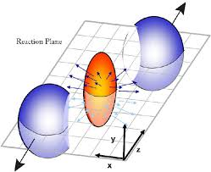
Why is quantifying fluid dynamics in AA-collisions of fundamental interest?
Flow translates spatial gradients into momentum gradients.
Fluid dynamics gives access to QGP
properties that can be calculated from
1st principles in quantum field theory.
… in more detail ….
Yayun He et al, arXiv:2201.08408

Slide 9
Dissipative fluid dynamics gives access to QGP properties calculable from first principles in QCD
Based on: E-p conservation:
2nd law of thermodynamics:
Sensitive to properties of matter that are
calculated from first principles in quantum field theory
- EOS: and sound velocity
- transport coefficients: shear , bulk viscosity, conductivities …
- relaxation times: , , …
Lattice QCD =>
Finite Temp pQCD =>
AdS/CFT =>

Slide 10
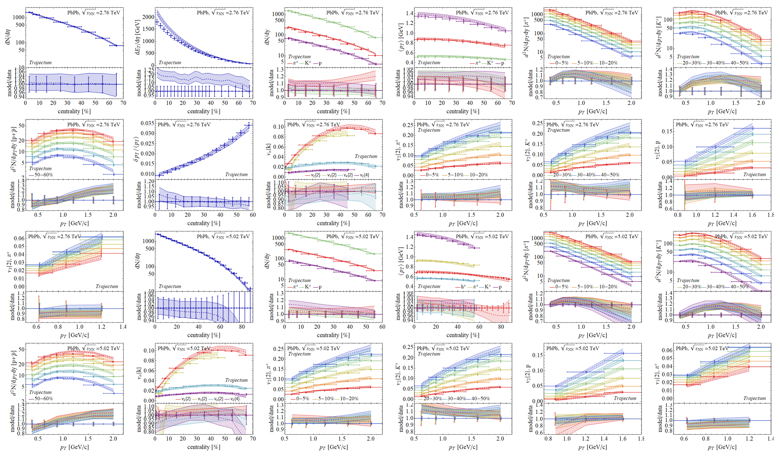
Comparison to Hydro-Models
Quantifies QGP properties and QGP evolution
Largely restricted to light-flavored hadron species so far.
Bayesian inference analysis involving 670 LHC data points.
* G. Nijs, W. van der Schee, 2304.06191,
Yayun He et al, arXiv:2201.08408
Notes:
In little bangs as in the Big Bang, material properties are accessed by fluctuation studies

Slide 11
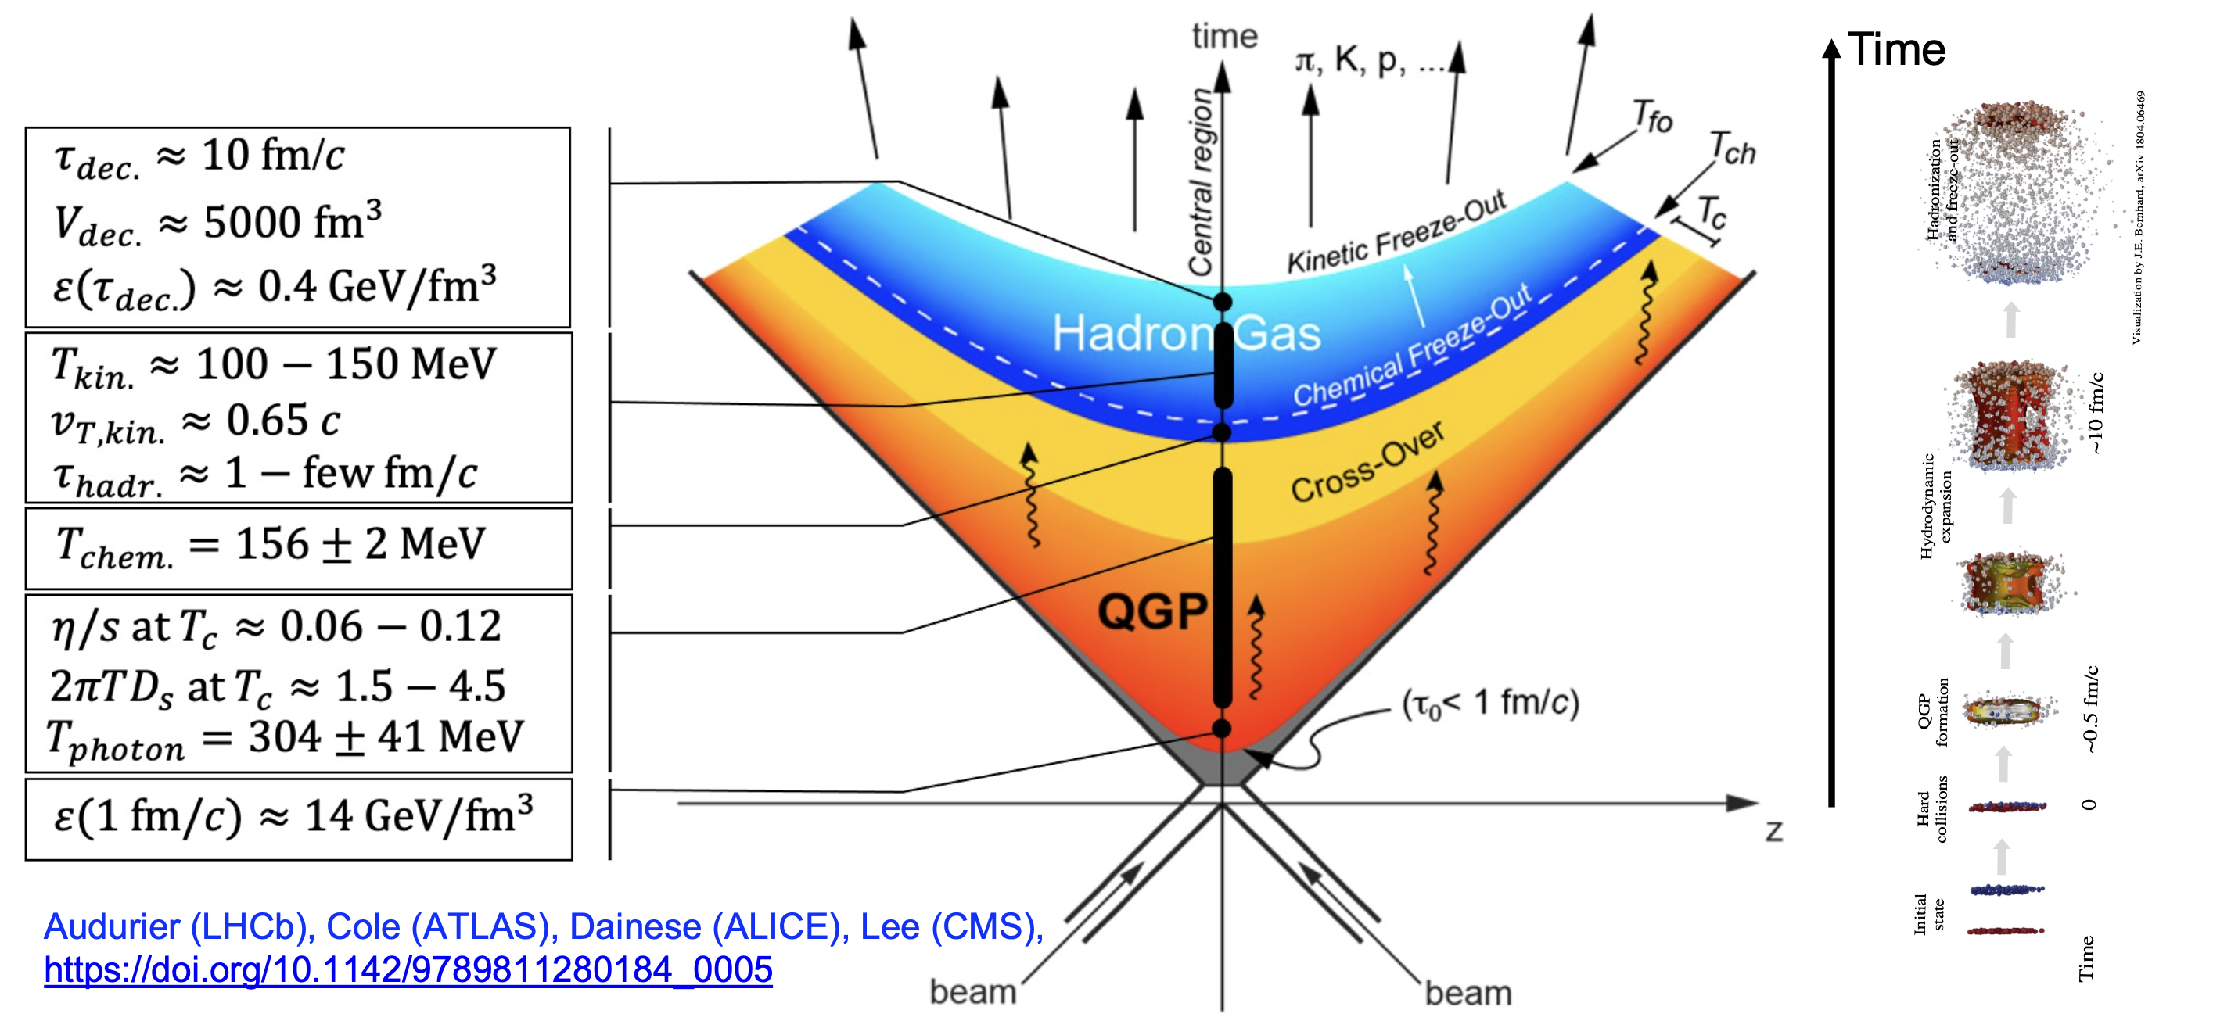
Quantitative support for a default picture of AA
Yayun He et al, arXiv:2201.08408
Notes:
In little bangs as in the Big Bang, material properties are accessed by fluctuation studies

Slide 12
New Detectors and Detector Upgrades
needed to address open questions
Yayun He et al, arXiv:2201.08408

Slide 13
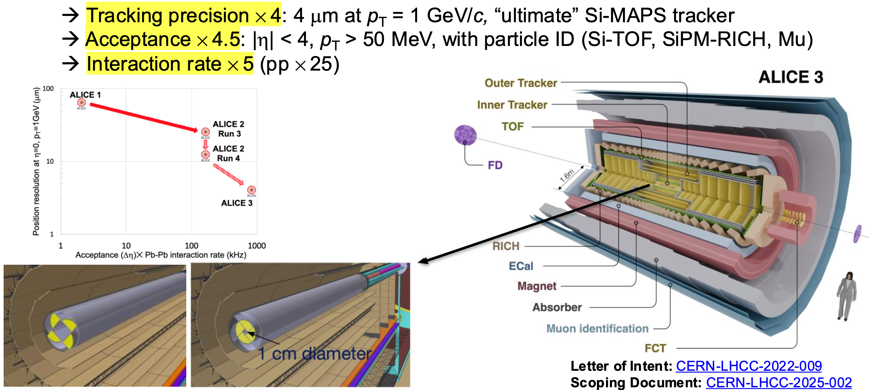
ALICE 3
Id68:ALICE
Id7:HITownMeeting
Id106:NuPECC
Yayun He et al, arXiv:2201.08408

Slide 14
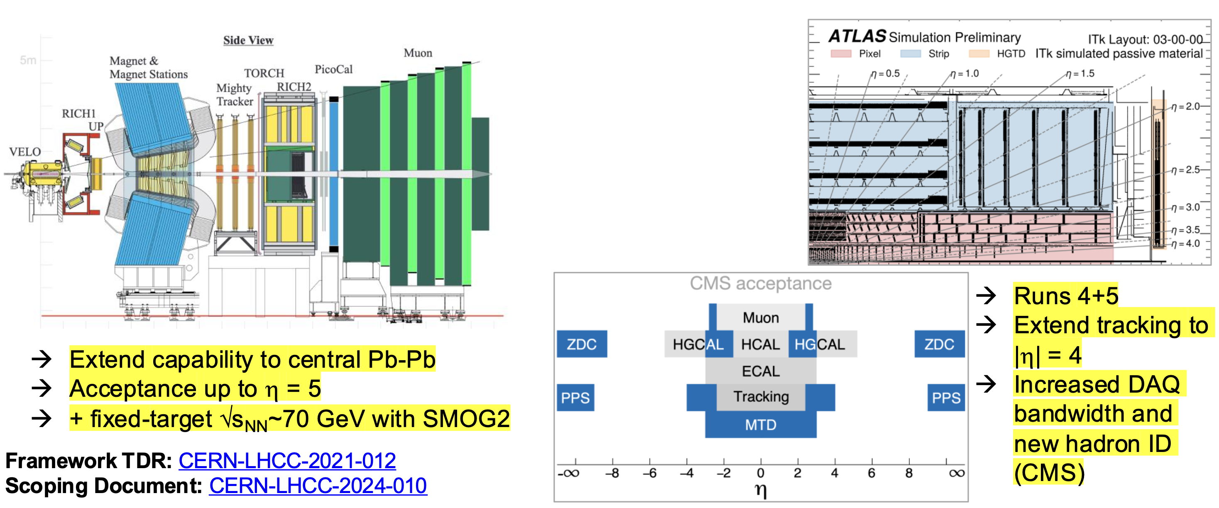
LHCb
ATLAS, CMS
Id82:LHCb
Id7:HITownMeeting
Id106:NuPECC
Id170:ATLAS+CMS
Id7:HITownMeeting
Id106:NuPECC
Yayun He et al, arXiv:2201.08408

Slide 15
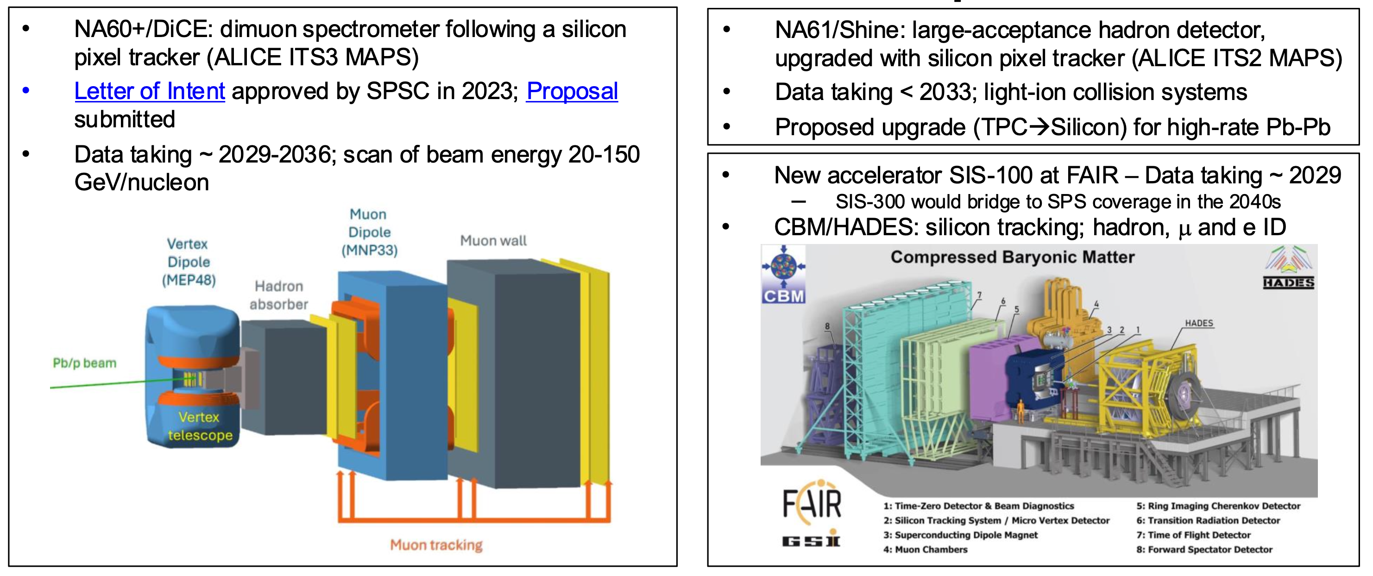
NA60+/DICE
NA61/SHINE
Id171:NA61
Id7:HITownMeeting
Id106:NuPECC
Id131:NA60+
Id7:HITownMeeting
Id106:NuPECC
Id235:PBC
Yayun He et al, arXiv:2201.08408

Slide 16
Open Questions
that drive future experimentation
Microscopic mechanisms of quark interactions in the QGP
Quark-mass dependence of thermal equilibration
Mechanisms of hadron formation in high-density QCD environment
QGP electromagnetic radiation throughout its temporal evolution
Mechanism of chiral symmetry restoration in the QGP
Inner workings of the QGP
QGP substructure and medium-response via jets and rare probes
Yayun He et al, arXiv:2201.08408

Slide 17
Open Question
Microscopic mechanisms of quark interactions in the QGP
Quark-mass dependence of thermal equilibration
Mechanisms of hadron formation in high-density QCD environment
QGP electromagnetic radiation throughout its temporal evolution
Mechanism of chiral symmetry restoration in the QGP
Inner workings of the QGP
QGP substructure and medium-response via jets and rare probes
Yayun He et al, arXiv:2201.08408

Slide 18
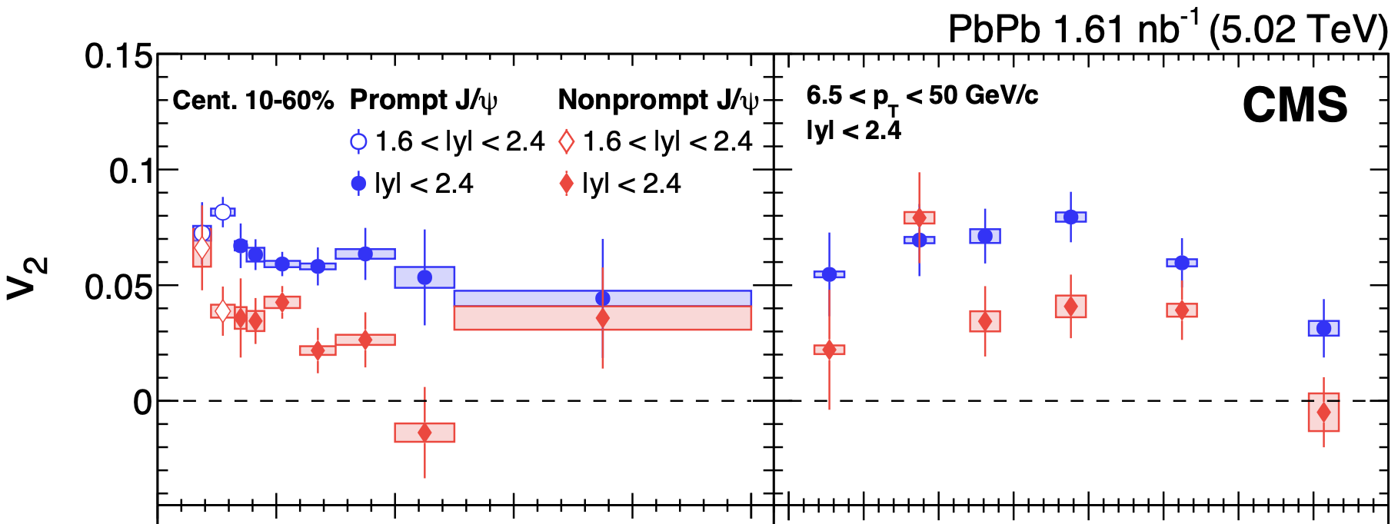
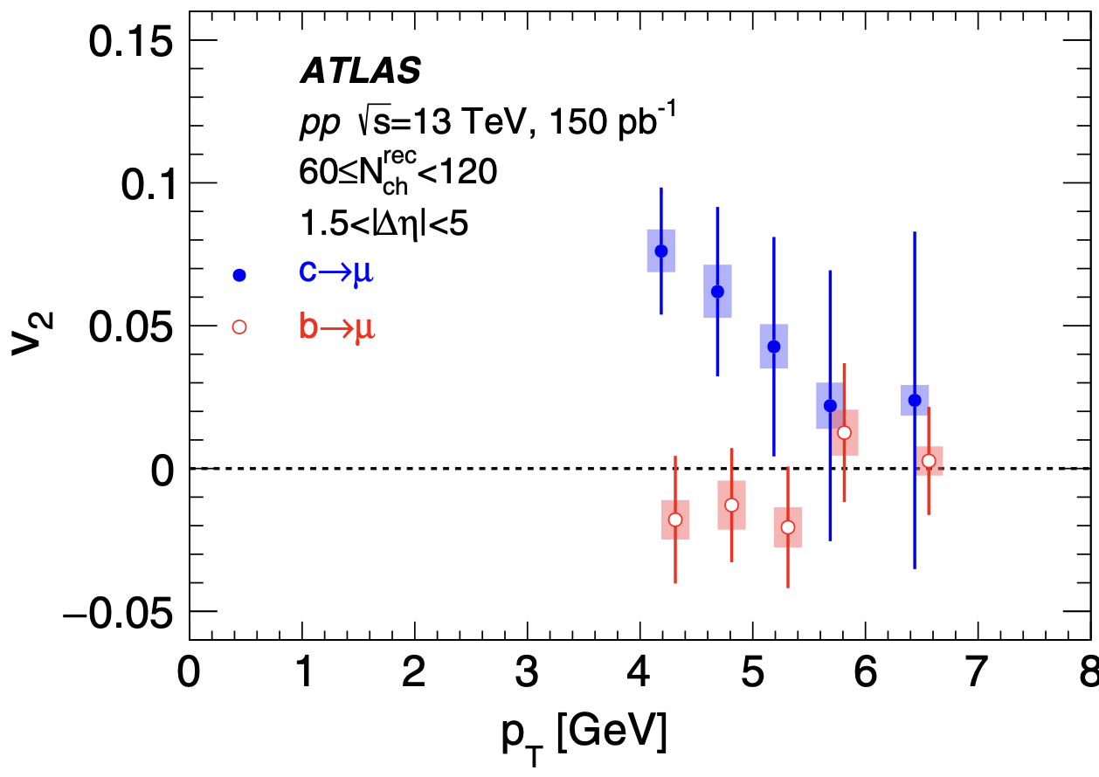
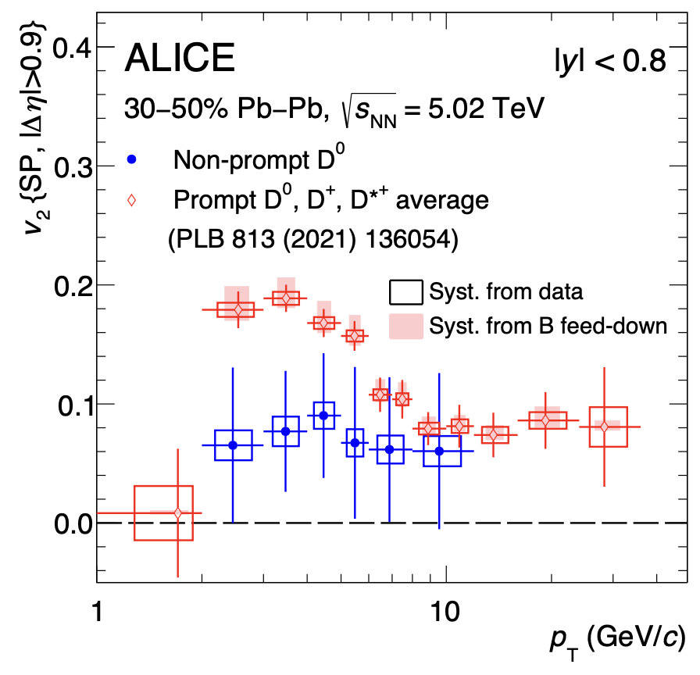
Heavy Flavor – unique opportunities
EXP: evidence that beauty flows less¹ and is less quenched than charm.
CMS
CMS
Mass hierarchy of incomplete kinetic equilibration ?
b presents interesting mass scale for testing QCD transport
Precision down to p_{T} = 0 needed!
CMS, JHEP10 (2023) 115; ATLAS PRL 124, 082301 (2020)
2. R. Rapp et al Nucl.Phys.A 979 (2018) 21-86;

Slide 19
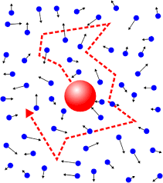
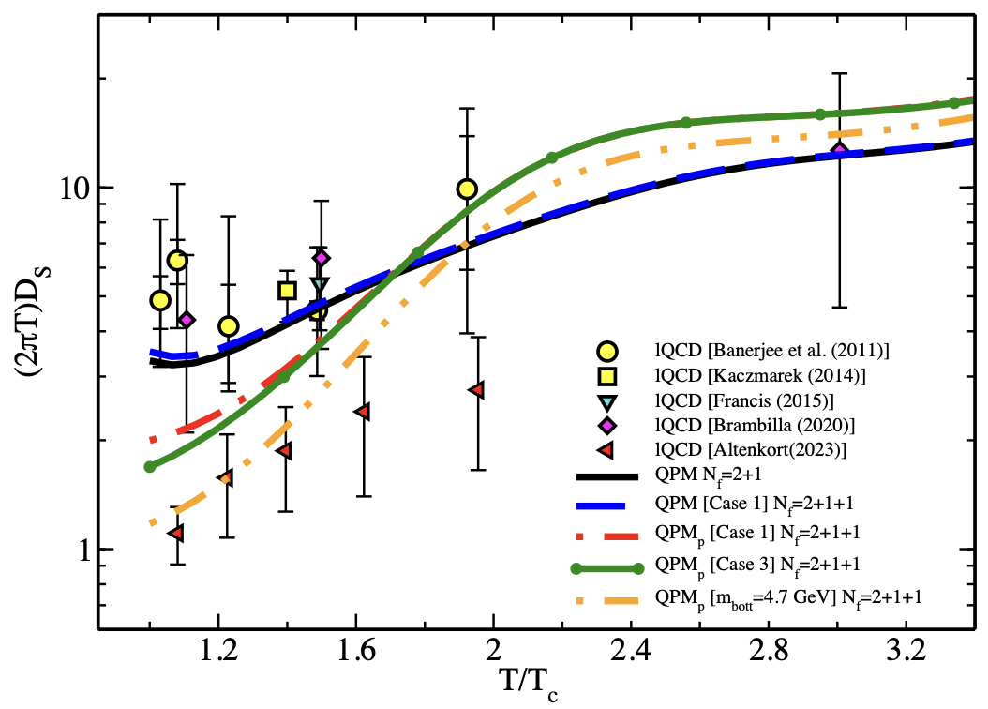
Heavy Flavor – unique opportunities
Theory:
Heavy flavor transport is governed by drag and diffusion calculable from 1st principles in QFT. Testable relations
Einstein relation
Velocity dep. at strong coupling^{3,4}:
Aim: extraction of heavy flavor transport coefficients¹
Charm equilibrates a factor faster than beauty => test incomplete b equilibration.
Lattice QCD and model calculations of the
heavy quark diffusion coefficient²
1. R. Rapp et al Nucl.Phys.A 979 (2018) 21-86;
2. Sambataro et al, Eur. Phys. J. C84 (2024) 9,881
3. S. Gubser, Nucl. Phys. B 790 (2008) 175
4. K. Rajagopal, B. Scheihing-Hitschfeld UAW, JHEP 2501.06289

Slide 20
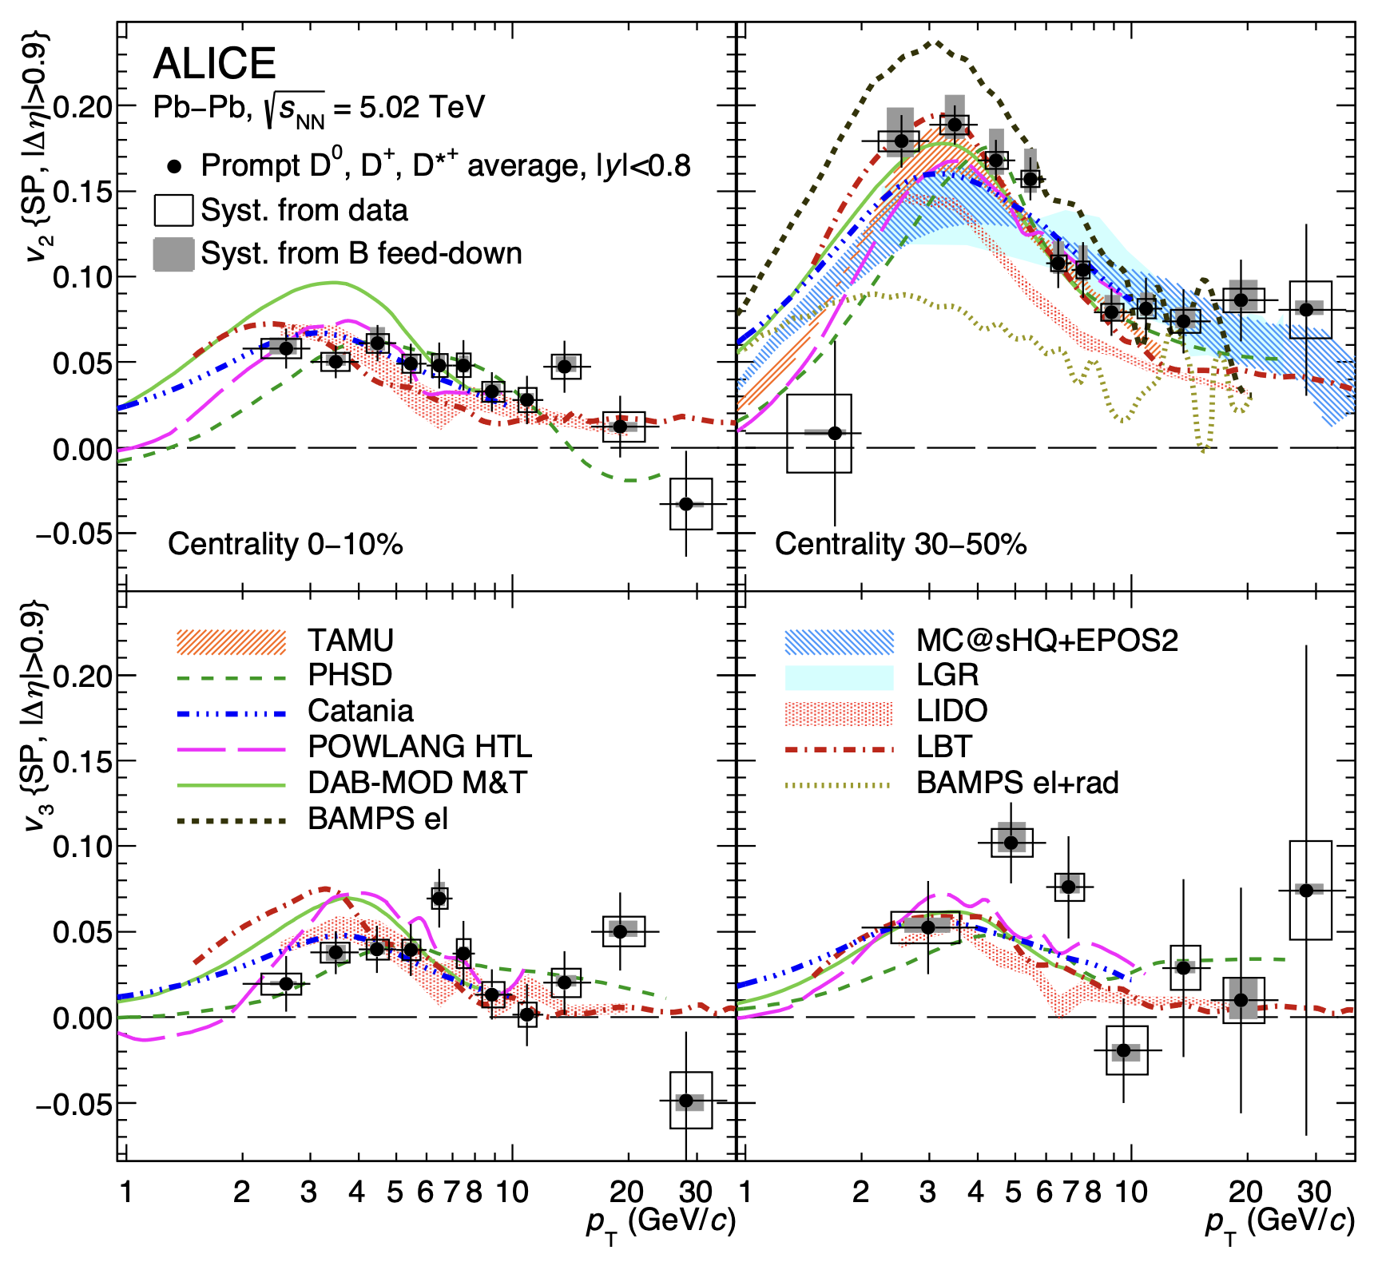
Heavy Flavor flow: model comparisons
TH/models
  sensitivity to HF transport established
  Today: rough estimates
  inclusion in global Bayesian inference analysis to be done
Exp:
  HF flow needs to be known with precision of light-flavored flow.
  Coverage towards p_{T}=0 needed.
In reach of ALICE3, LHCbUpg2 at fwd y, NA60+.
ALICE, Phys.Lett. B813 (2021) 136054

Slide 21
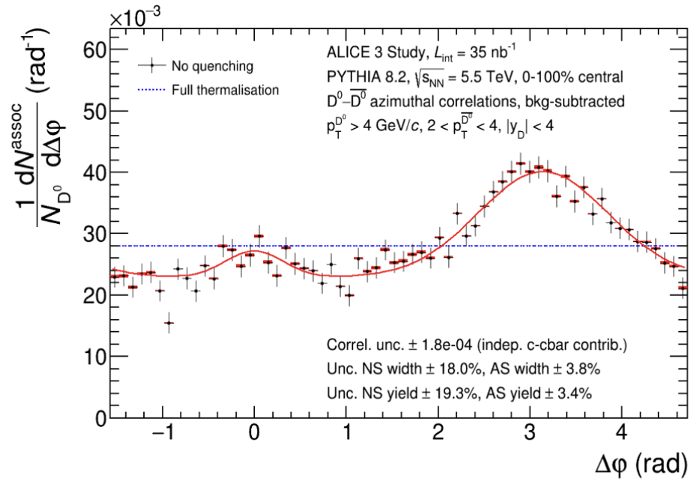
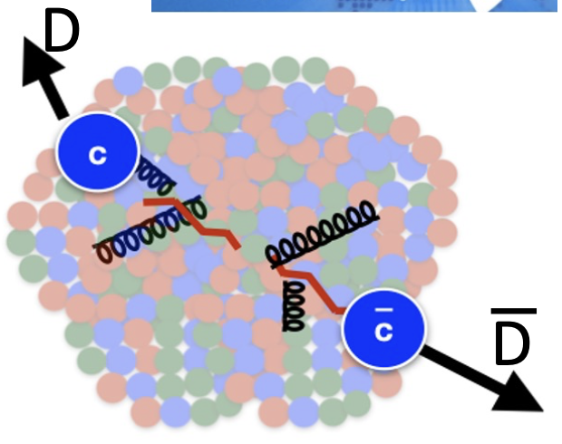
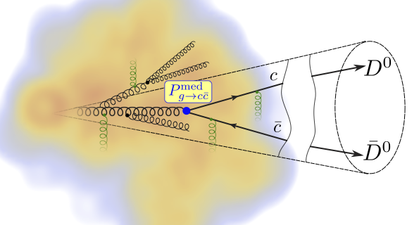
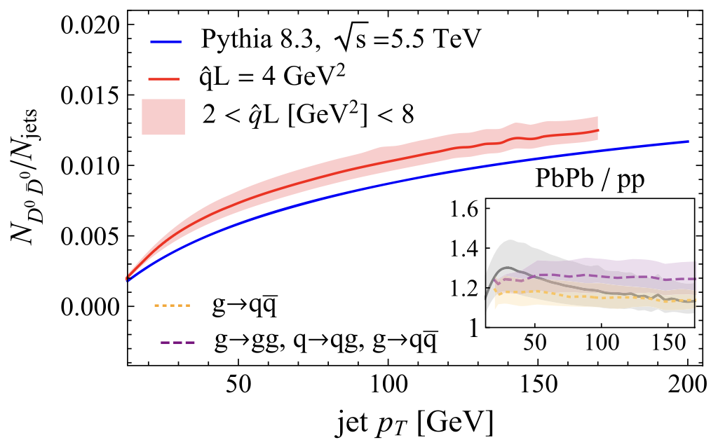
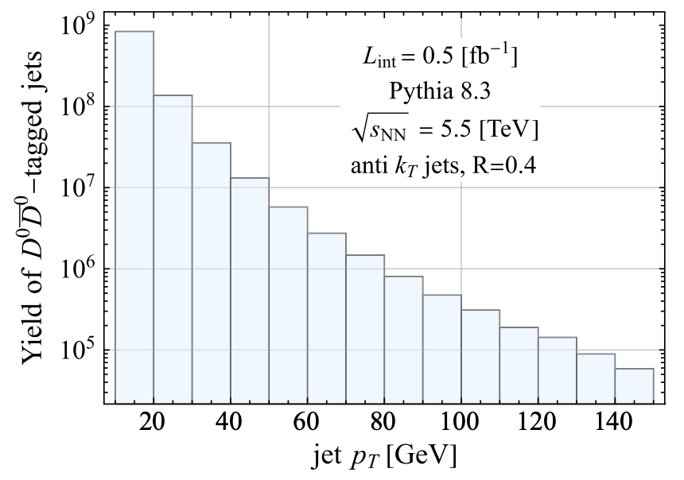
Heavy flavor - continued
Back-to-back open charm correlations
  Access to QGP constituents via
  Rutherford-like experiment.
  Constrains e-loss and angular decorrelation simultaneously.
Near-side open charm correlations
  Access to medium-modified splitting function
  Unique enhancement as a consequence of quenching
  Requires > 10 nb⁻¹ PbPb
Attems et al. PRL 132 212301 (2024)

Slide 22
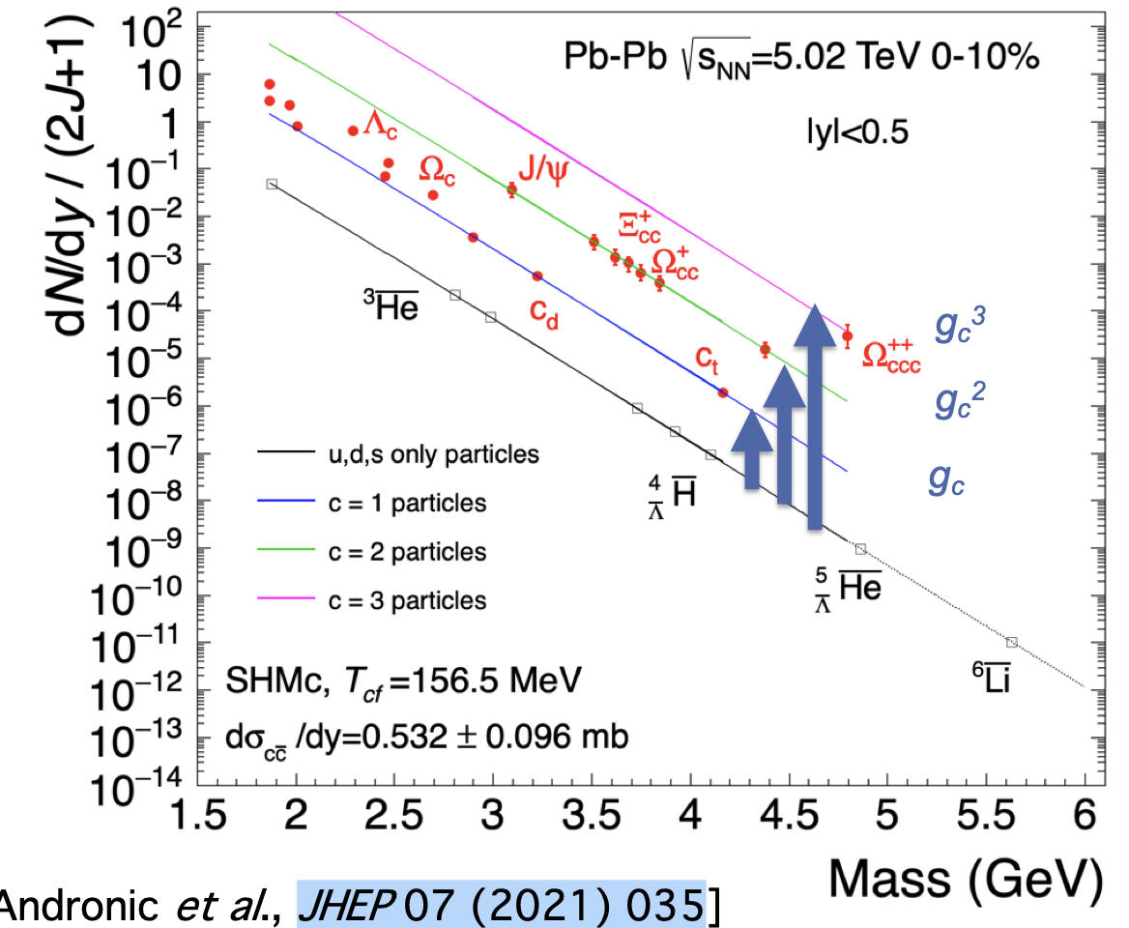
Heavy flavor – chemical equilibrium
Charm is not produced thermally, but it can be distributed statistically in hadronization.¹
Hadronization via fragmentation versus hadronization via recombination.
Multi-charmed baryons (accessible in run 5) particularly important since negligible production rate in single parton scatterings.
In reach of HL-LHC runs 3-5.
Huge enhancements predicted, up to factor 10³ w.r.t. pp for .^{2,3}
1. A. Andronic et al. JHEP 07 (2021) 035
2. F. Becattini, Phys.Re.Lett. 95 (2005) 022301
3. V. Minissale et al., Eur.Phys.J. C. 84 (2024) 3, 228

Slide 23
Open Question
Microscopic mechanisms of quark interactions in the QGP
Quark-mass dependence of thermal equilibration
Mechanisms of hadron formation in high-density QCD environment
QGP electromagnetic radiation throughout its temporal evolution
Mechanism of chiral symmetry restoration in the QGP
Inner workings of the QGP
QGP substructure and medium-response via jets and rare probes
Yayun He et al, arXiv:2201.08408

Slide 24
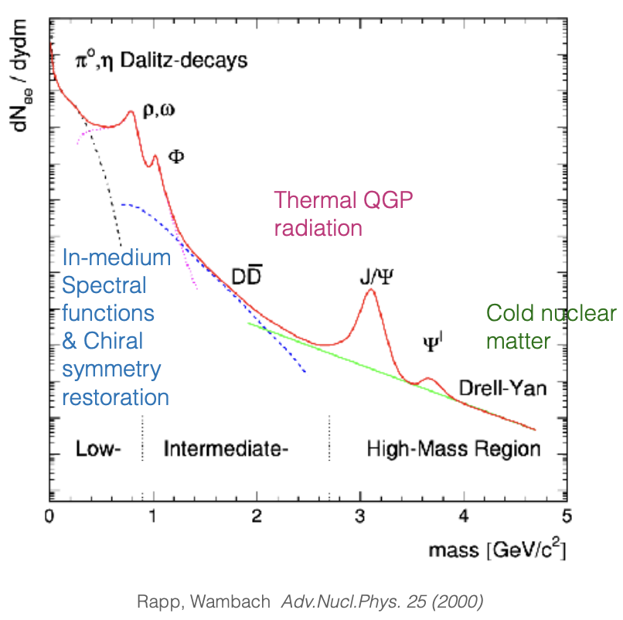
Electromagnetic radiation of QGP
TH: thermal production sensitive to EM spectral function and bkg QGP evolution.
Photon spectrum:
Blue-shifted spectrum!
Difficult to disentangle early and late time contributions.
Dilepton spectrum:
Varying invariant mass M_{ee} => disentangling contributions
from different times.
Dilepton invariant mass spectrum needs excellent knowledge of background to address QGP-induced electromagnetic signals.

Slide 25
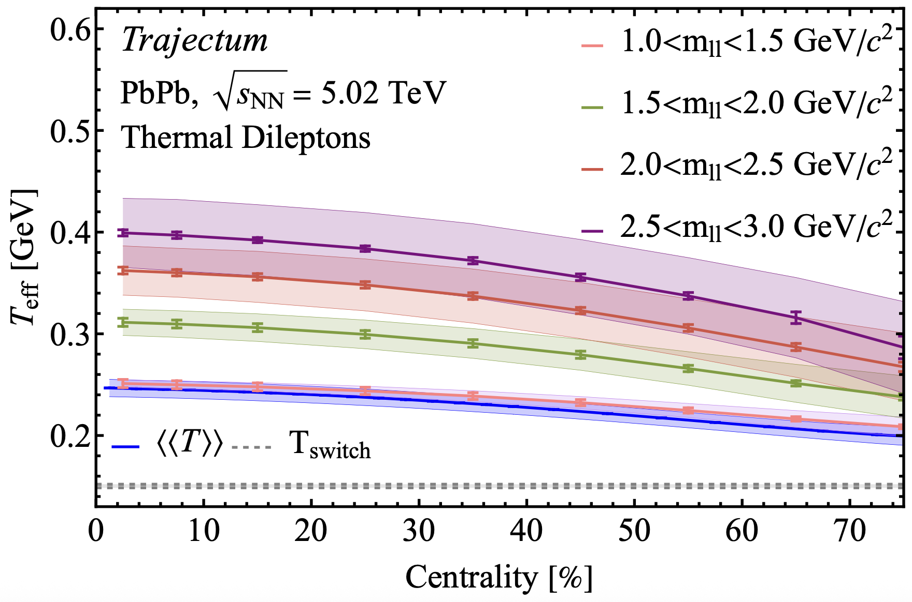
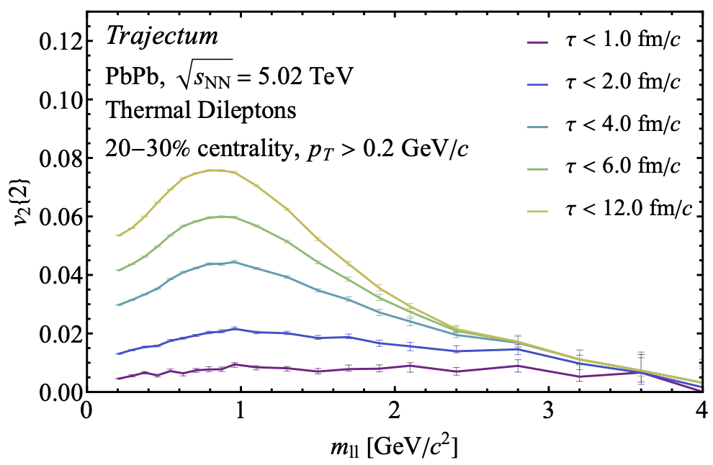
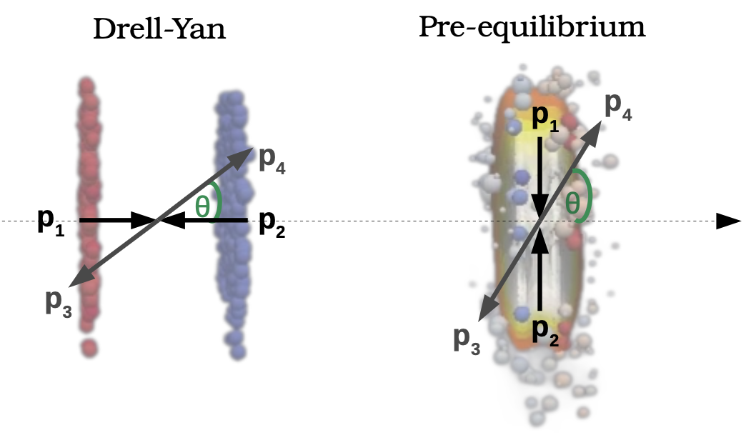
Dilepton flow and spectrum
Dileption spectrum and flow can provide differential picture of QGP time evolution.^{1,2}
Later
Later
High-precision di-lepton measurements:
access to signatures of chiral symmetry restoration.
There is room for more ambition:
In dileption rest frame, opening angle of dilepton pair preferentially aligned with opening angle of quark pair.
This polarization³ in Collins-Soper frame is sensitive to the QGP bulk anisotropy at early times.
O. Massen et al. arXiv:2412.09671;
Kasmaei et al, PRD 99 (2019) 3
3. Coquet et al, Phys.Rev.Lett. 132 (2024) 23, 232301

Slide 26
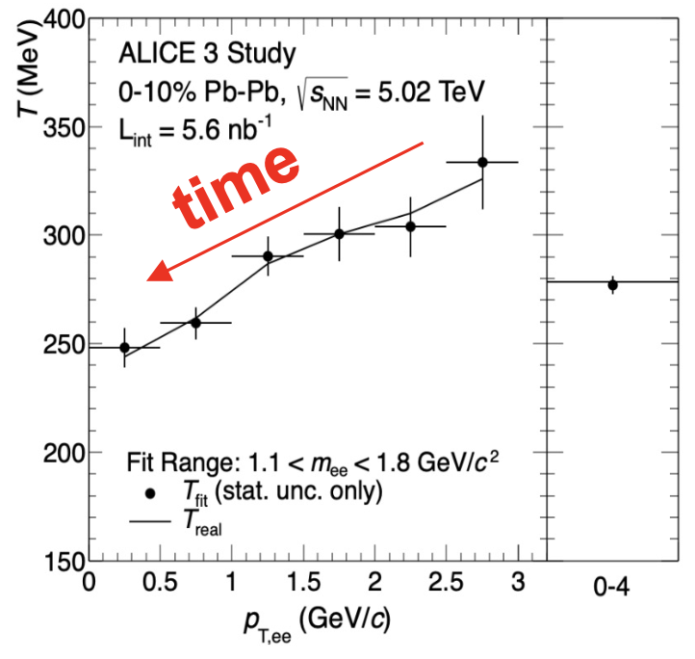
QGP time evolution via dileptons in reach of ALICE 3

Slide 27
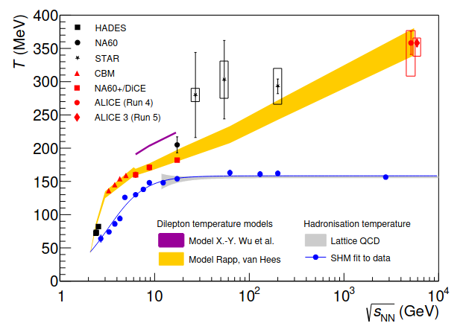
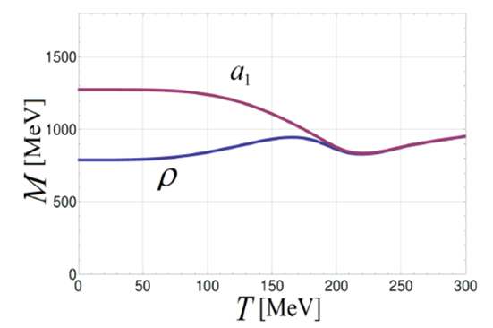
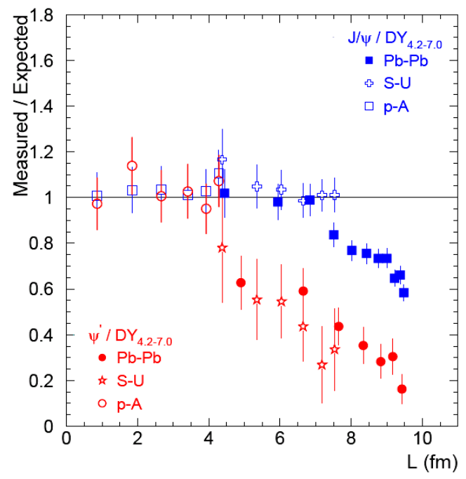
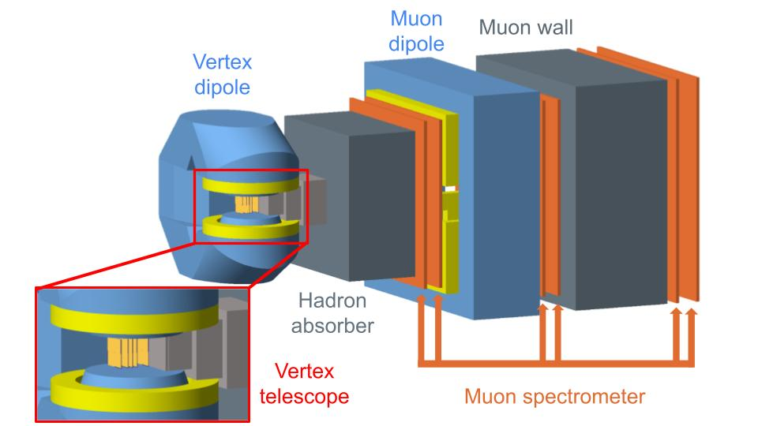
One slide on: CERN SPS (DICE/NA60+)
Caloric curve^{1,2}:
Dileptons vs.
i.e. vs.
towards critical endpoint.
Chiral symmetry restoration³:
Charmonium and open charm production at SPS⁴:
A novel detector to address open questions at CERN SPS energies⁵.
Rapp& v. Hees, PLB753 (2016) 586
T. Galatyuk et al, EPJA52 (2016) 131
3. C. Jung et al, PRD 95 (2017) 036020
4. NA50, PLB 477 (2000) 23 and EPJC49 (2007) 559
5. CERN-SPSC-2025-023

Slide 28
Open Question
Microscopic mechanisms of quark interactions in the QGP
Quark-mass dependence of thermal equilibration
Mechanisms of hadron formation in high-density QCD environment
QGP electromagnetic radiation throughout its temporal evolution
Mechanism of chiral symmetry restoration in the QGP
Inner workings of the QGP
QGP substructure and medium-response via jets and rare probes
Yayun He et al, arXiv:2201.08408

Slide 29
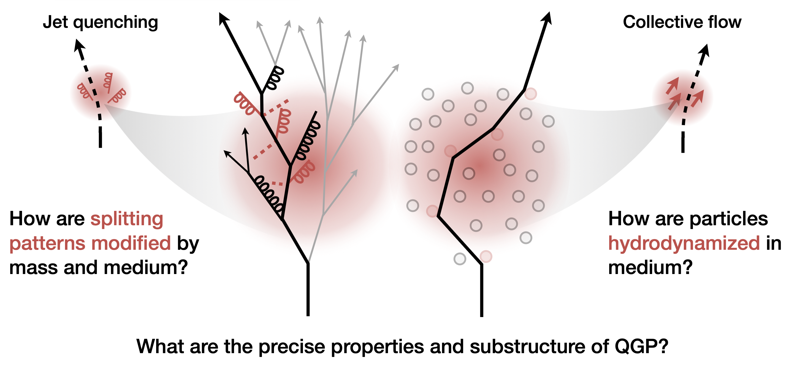
Open questions
Inner Working of the QGP?
Yayun He et al, arXiv:2201.08408

Slide 30
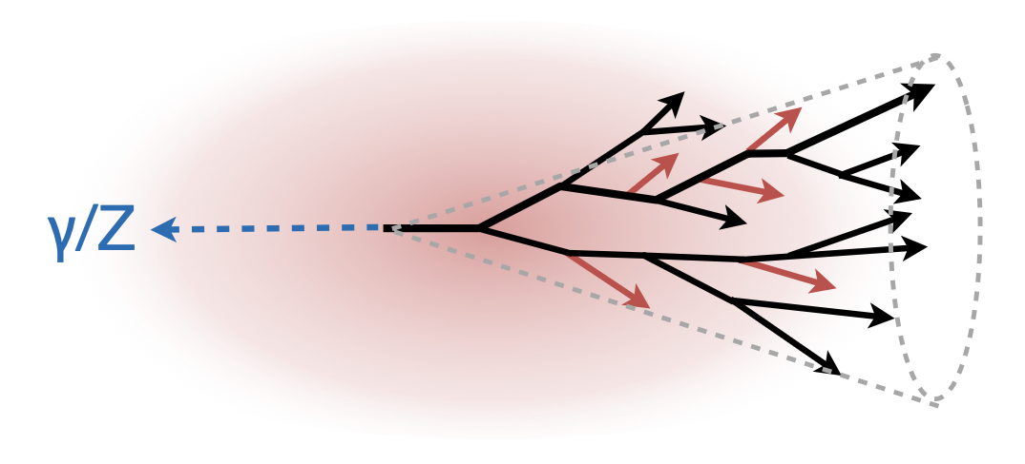
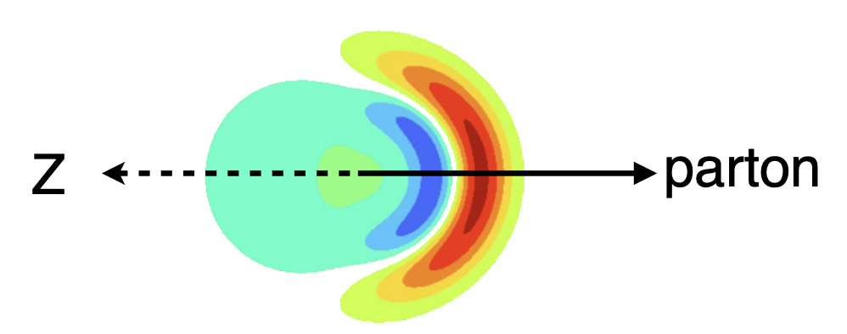
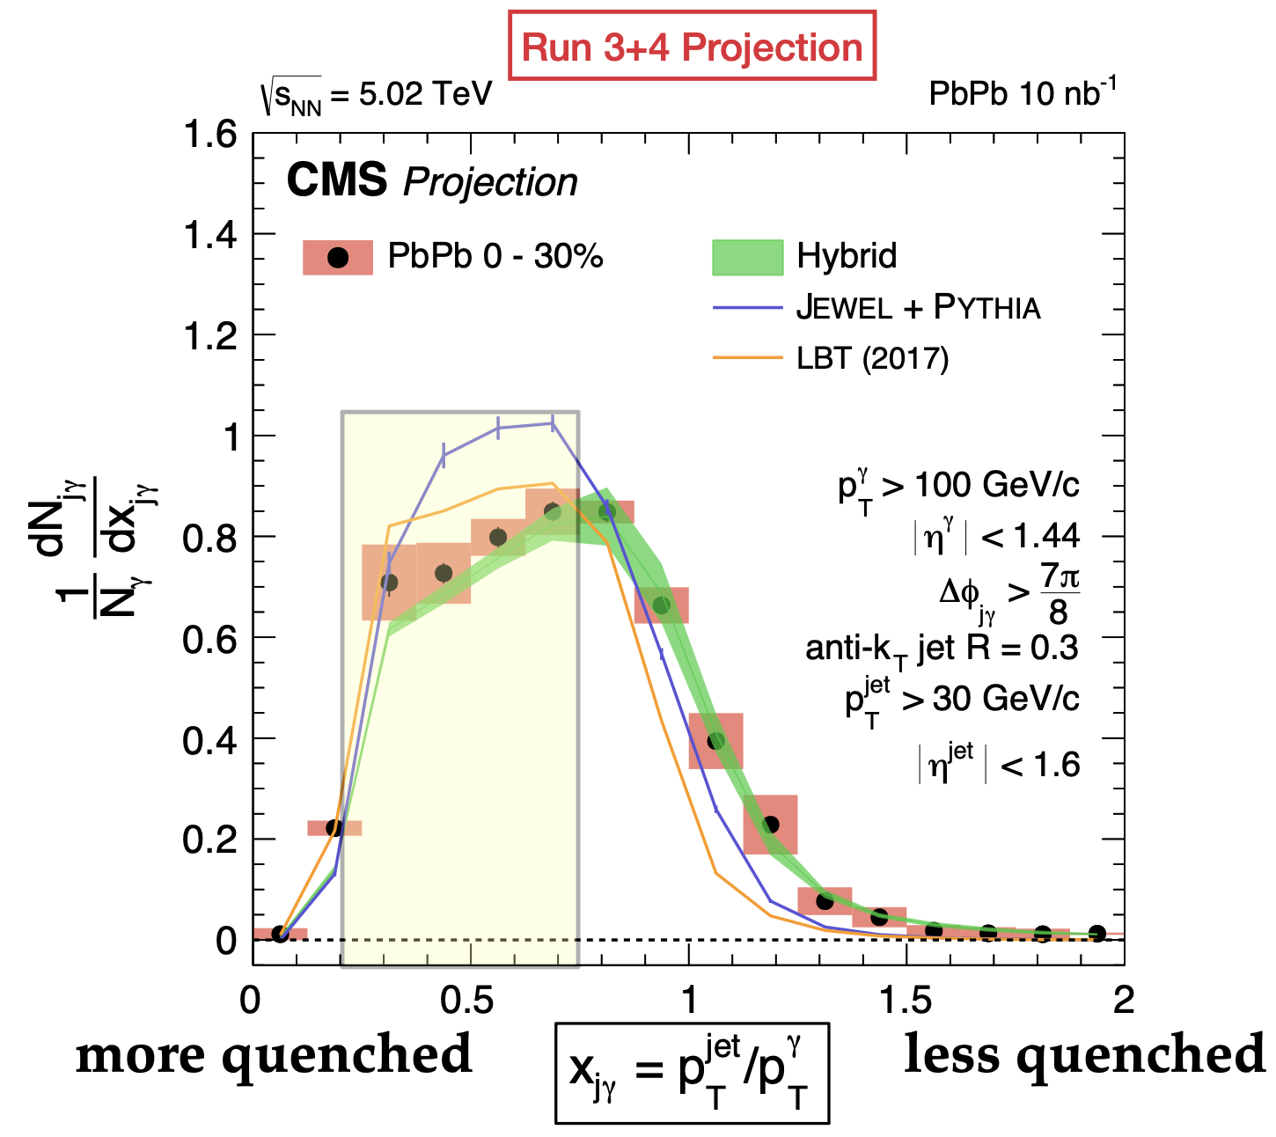
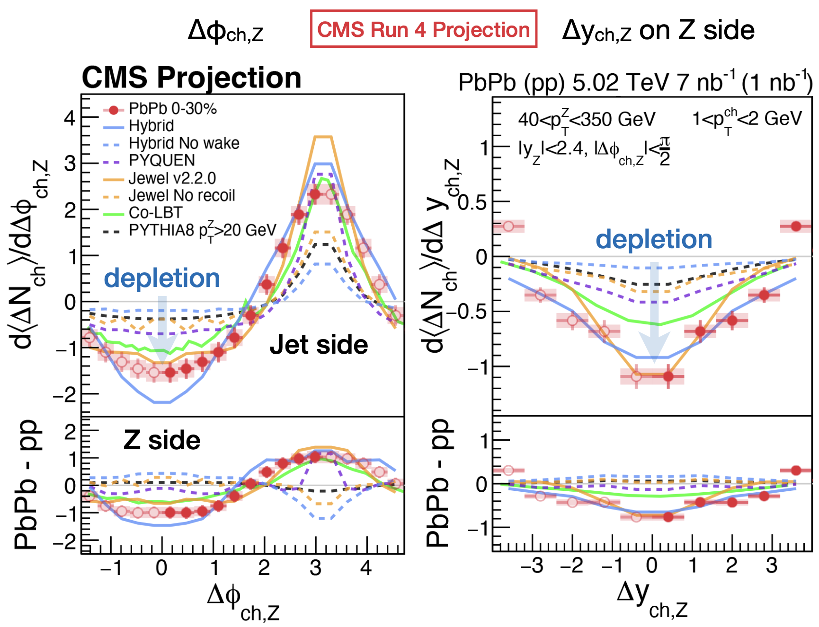
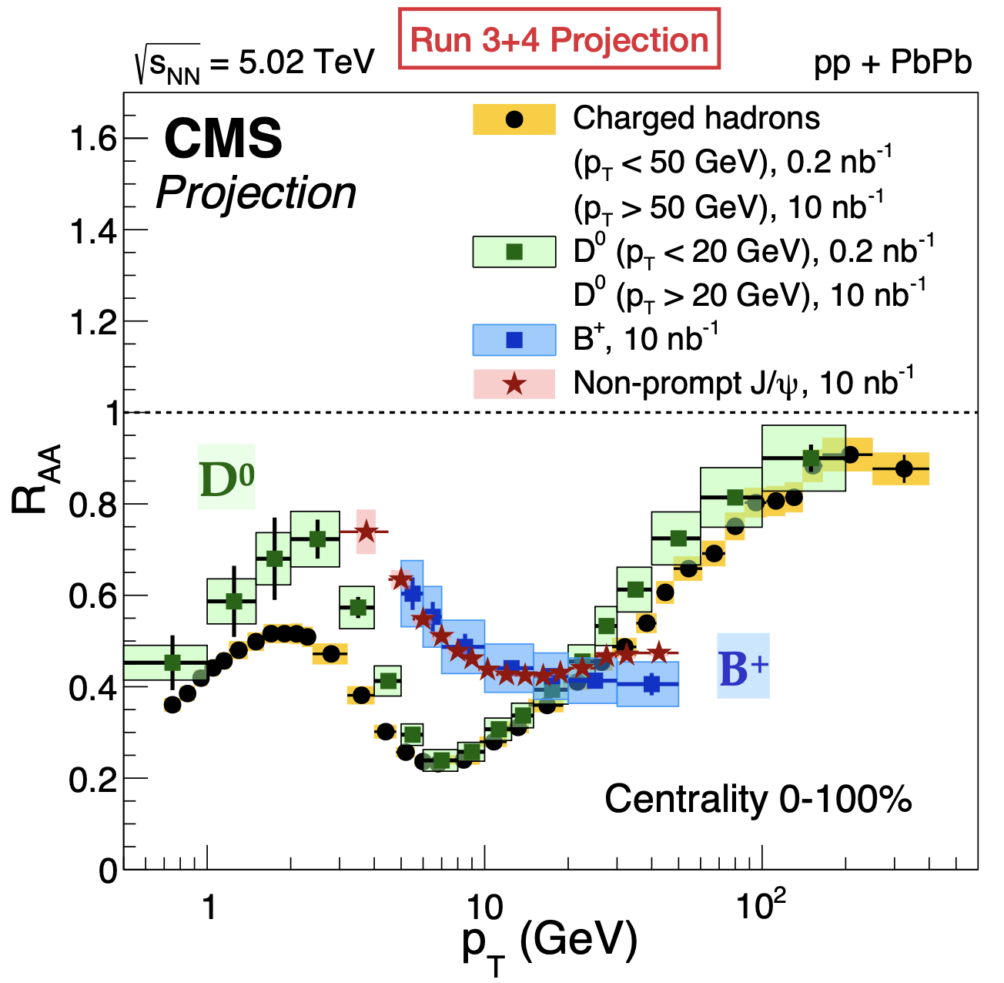
Rare hard probes¹
Precision in heavy flavor quenching
J. Wang (CMS) in Town Meeting on Heavy Ion and QGP Physics, 17 Feb 2025, https://indico.cern.ch/event/1483832/
Yayun He et al, arXiv:2201.08408

Slide 31
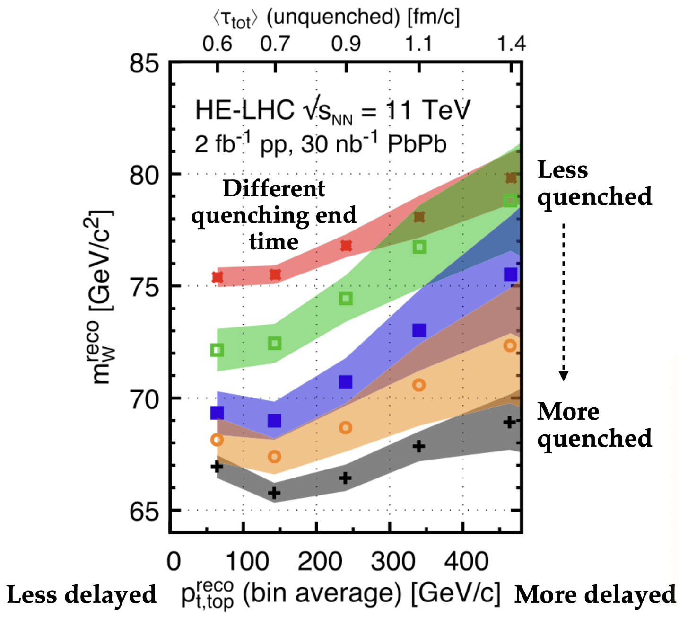
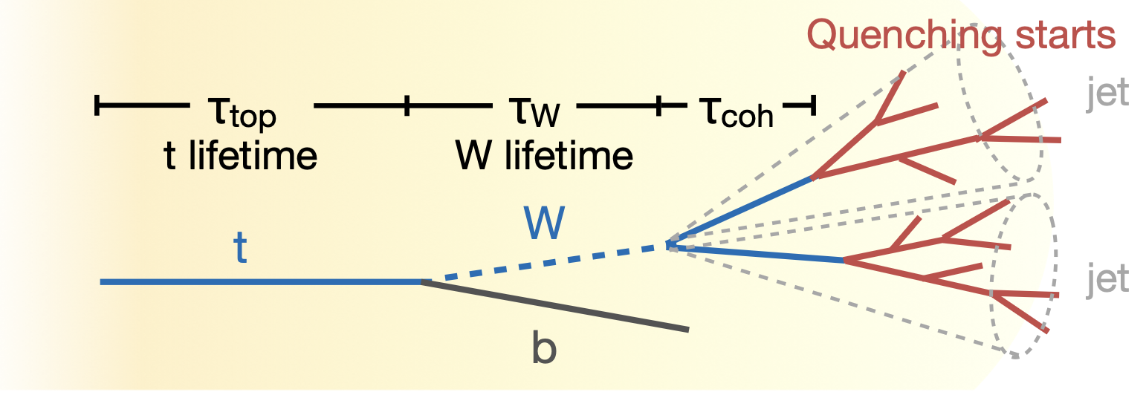
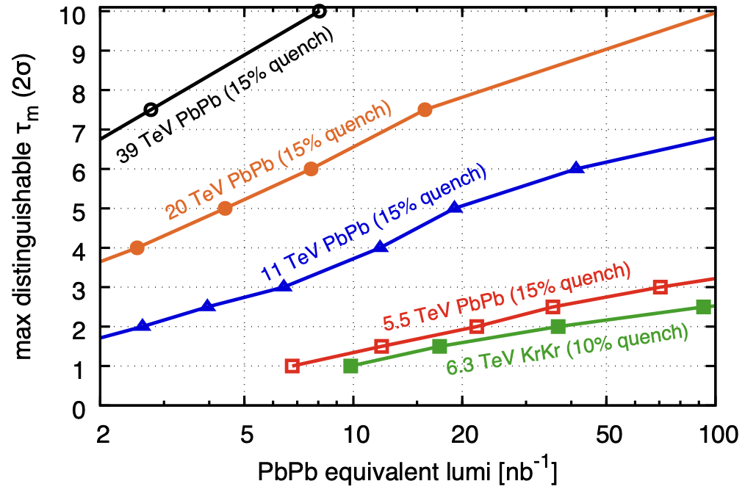
Testing QGP evolution with time-delayed quenching
. : time-delayed hard partons in QGP¹. Quenching changes reconstructed W-mass.
CMS expects first 3.8 modification in run2.
Luminosity-limited throughout HL-LHC.
Much better @ FCC-hh.
1 Apolinario et al., PRL 120 (2018) 23, 232301
Yayun He et al, arXiv:2201.08408

Slide 32
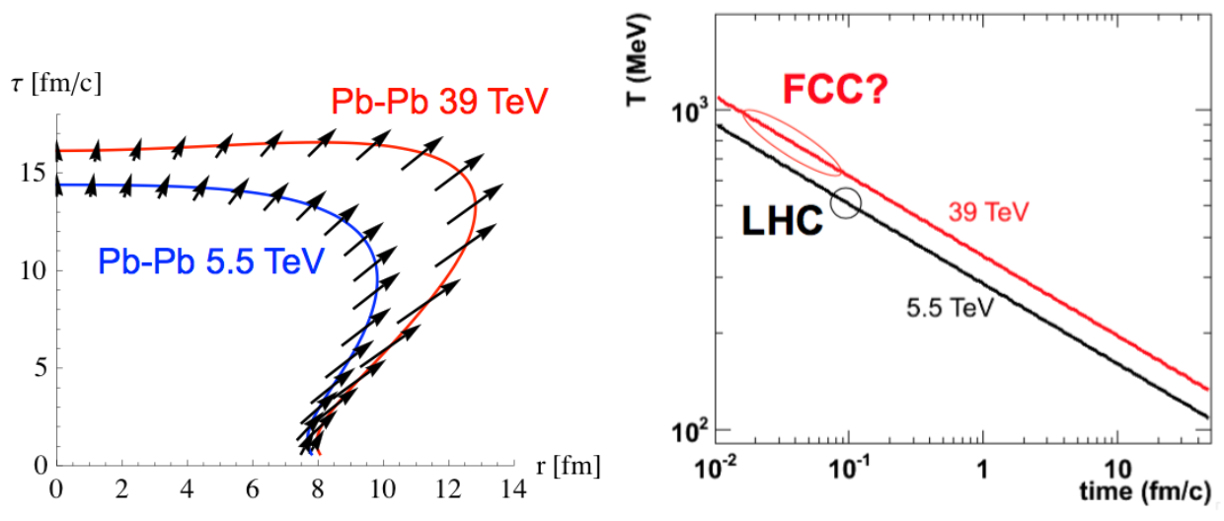
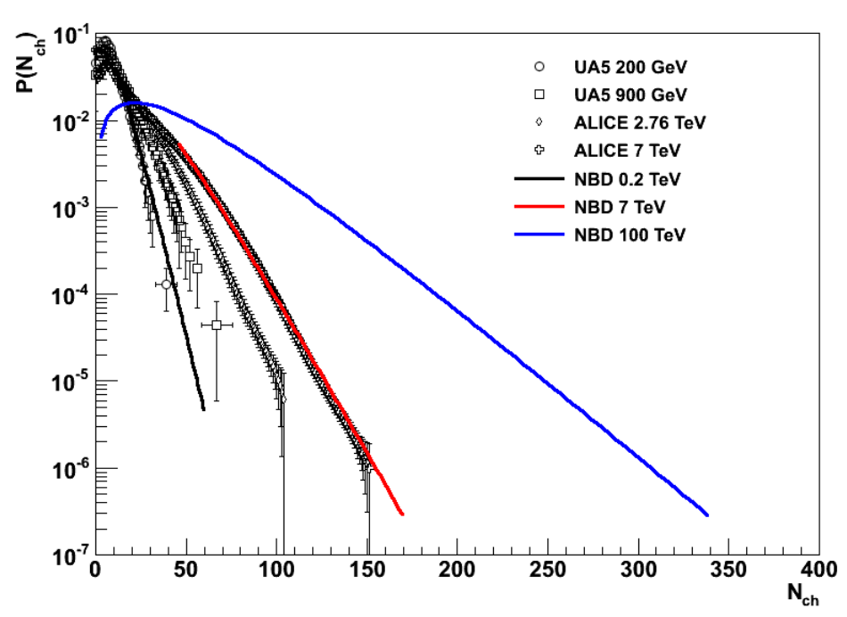
One slide on FCC-hh as heavy ion collider
Pb+Pb @ FCC-hh¹:
Hotter, denser, faster expanding.
Charm as QGP constituent?
High multiplicity pp implies
high collectivity in pp!
Full exploitation of HL-LHC as heavy ion collider will shape heavy-ion physics programme at FCC-hh.
The design choices for FCC-hh and its injectors should allow for the possibility to inject heavy ions.
Dainese, Wiedemann (editors) Yellow Report 1605.01389

Slide 33
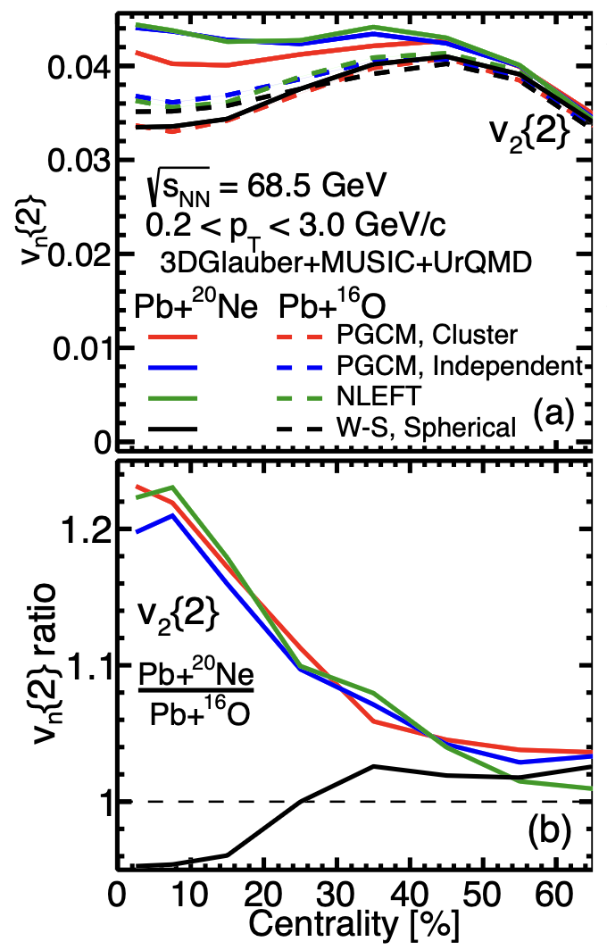
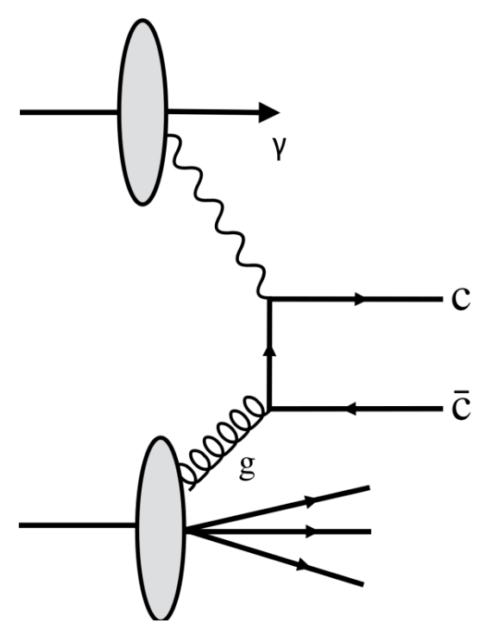

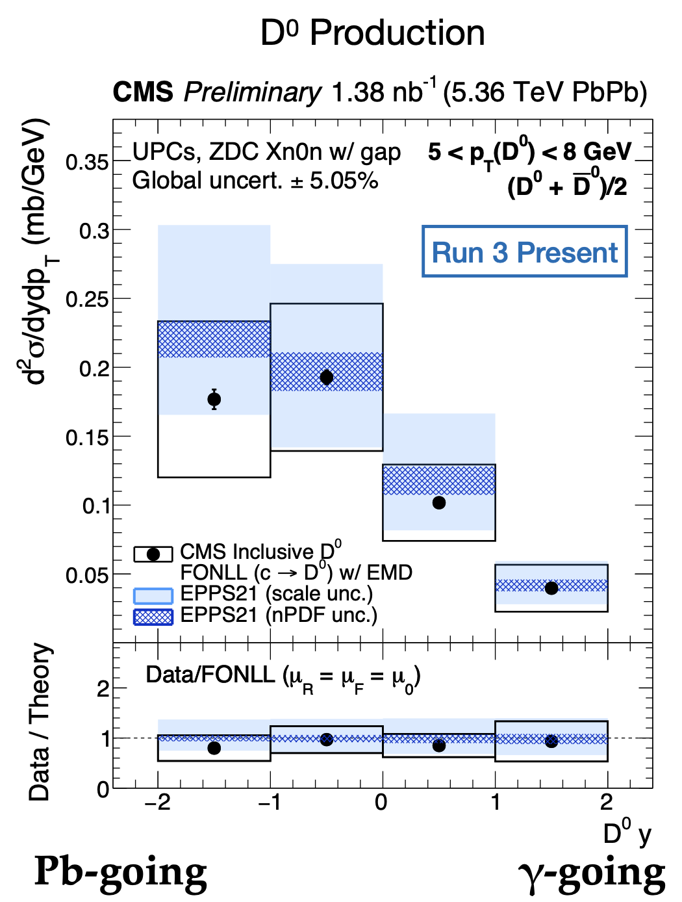
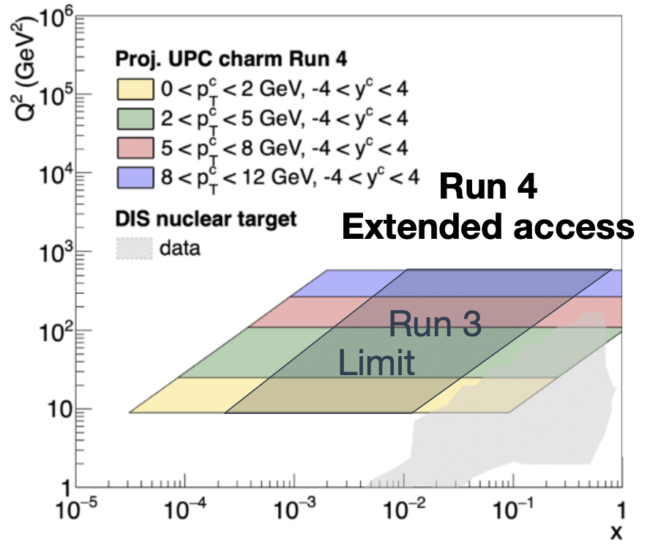
Diversity of research with nuclear beams at HL-LHC
Precise understanding of flow response gives now access to nuclear structure¹
UPC programme throughout HL-LHC
(e.g. constraining gluon nuclear pdfs)
Neon is a bowling pin.
Oxygen is spherical.
Different spatial deformations lead to different flow responses.
Difference could be visible in LHCb SMOG2.
Opportunities with short light ion beams.²
1. G. Giacalone et al., Phys.Rev.Lett. 134 (2025) 8, 082301
2. CERN TH workshop: Light ion collisions at the LHC, https://indico.cern.ch/event/1436085/

Slide 34
Conclusion
The top priority for quark matter research in Europe is to fully exploit the physics opportunities presented by nuclear beams throughout the entire HL-LHC program.
(Conclusion of Town Meeting, 17 Feb. 2025)
Full exploitation of HL-LHC as a heavy ion collider will address central open questions in the field of Quark Gluon Plasma research, including
  Determining the transport properties of heavy flavor.
  Determining how the QGP radiates throughout its evolution.
  Determining the inner workings of the QGP via hard probes.
Full exploitation of HL-LHC as a heavy ion collider requires new detectors with frontier technology. High integrated luminosities during runs 4 and 5 are essential.
Town meeting: https://indico.cern.ch/event/1483832/
Yayun He et al, arXiv:2201.08408

Slide 35
Back-up
Yayun He et al, arXiv:2201.08408

Slide 36
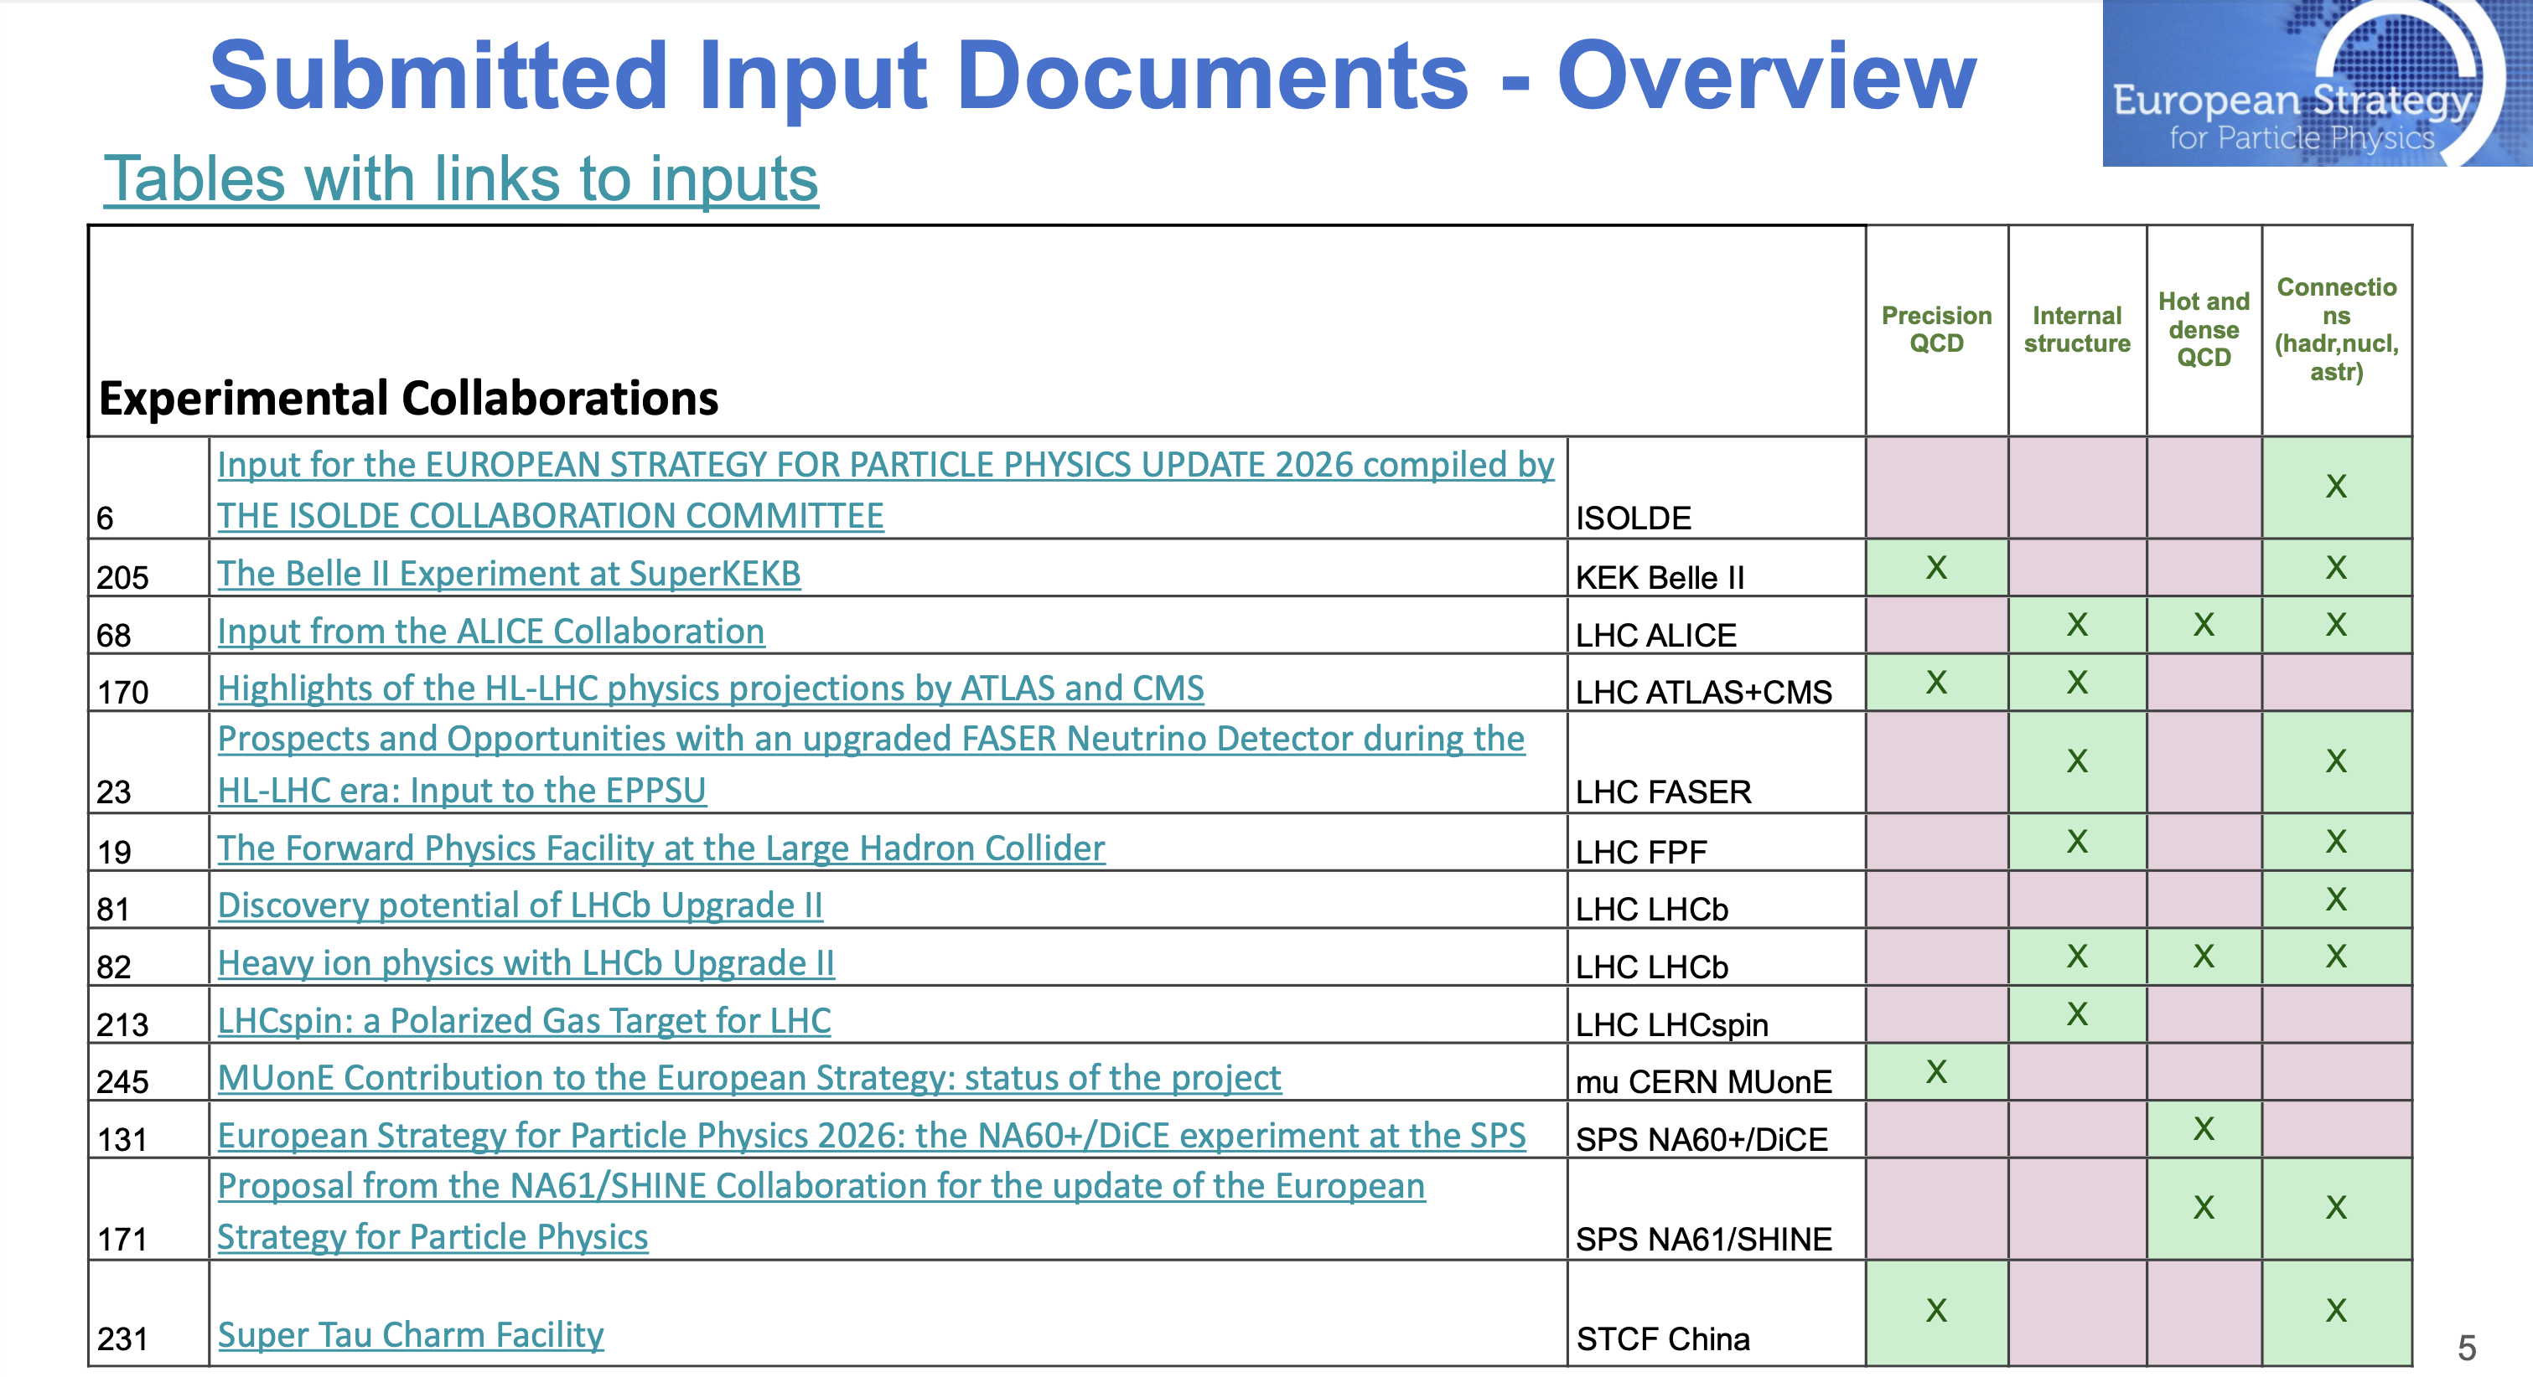
Yayun He et al, arXiv:2201.08408

Slide 37
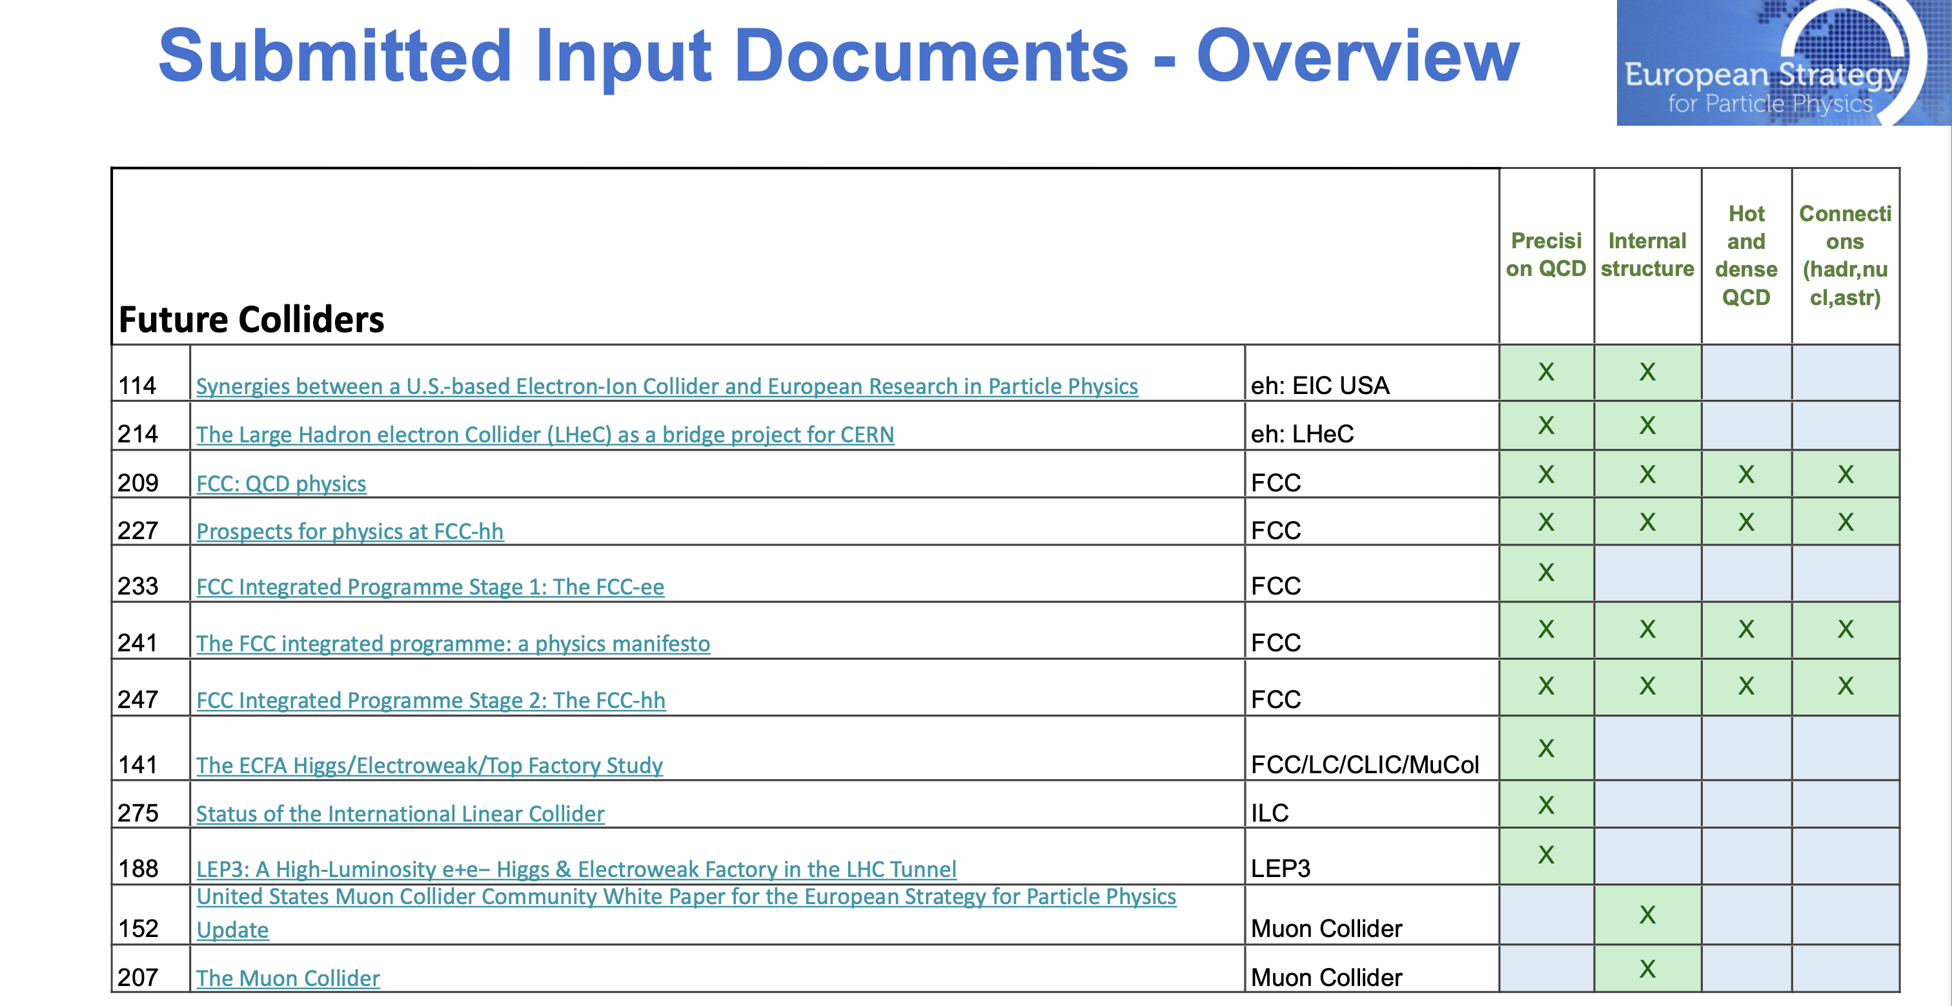
Yayun He et al, arXiv:2201.08408

Slide 38
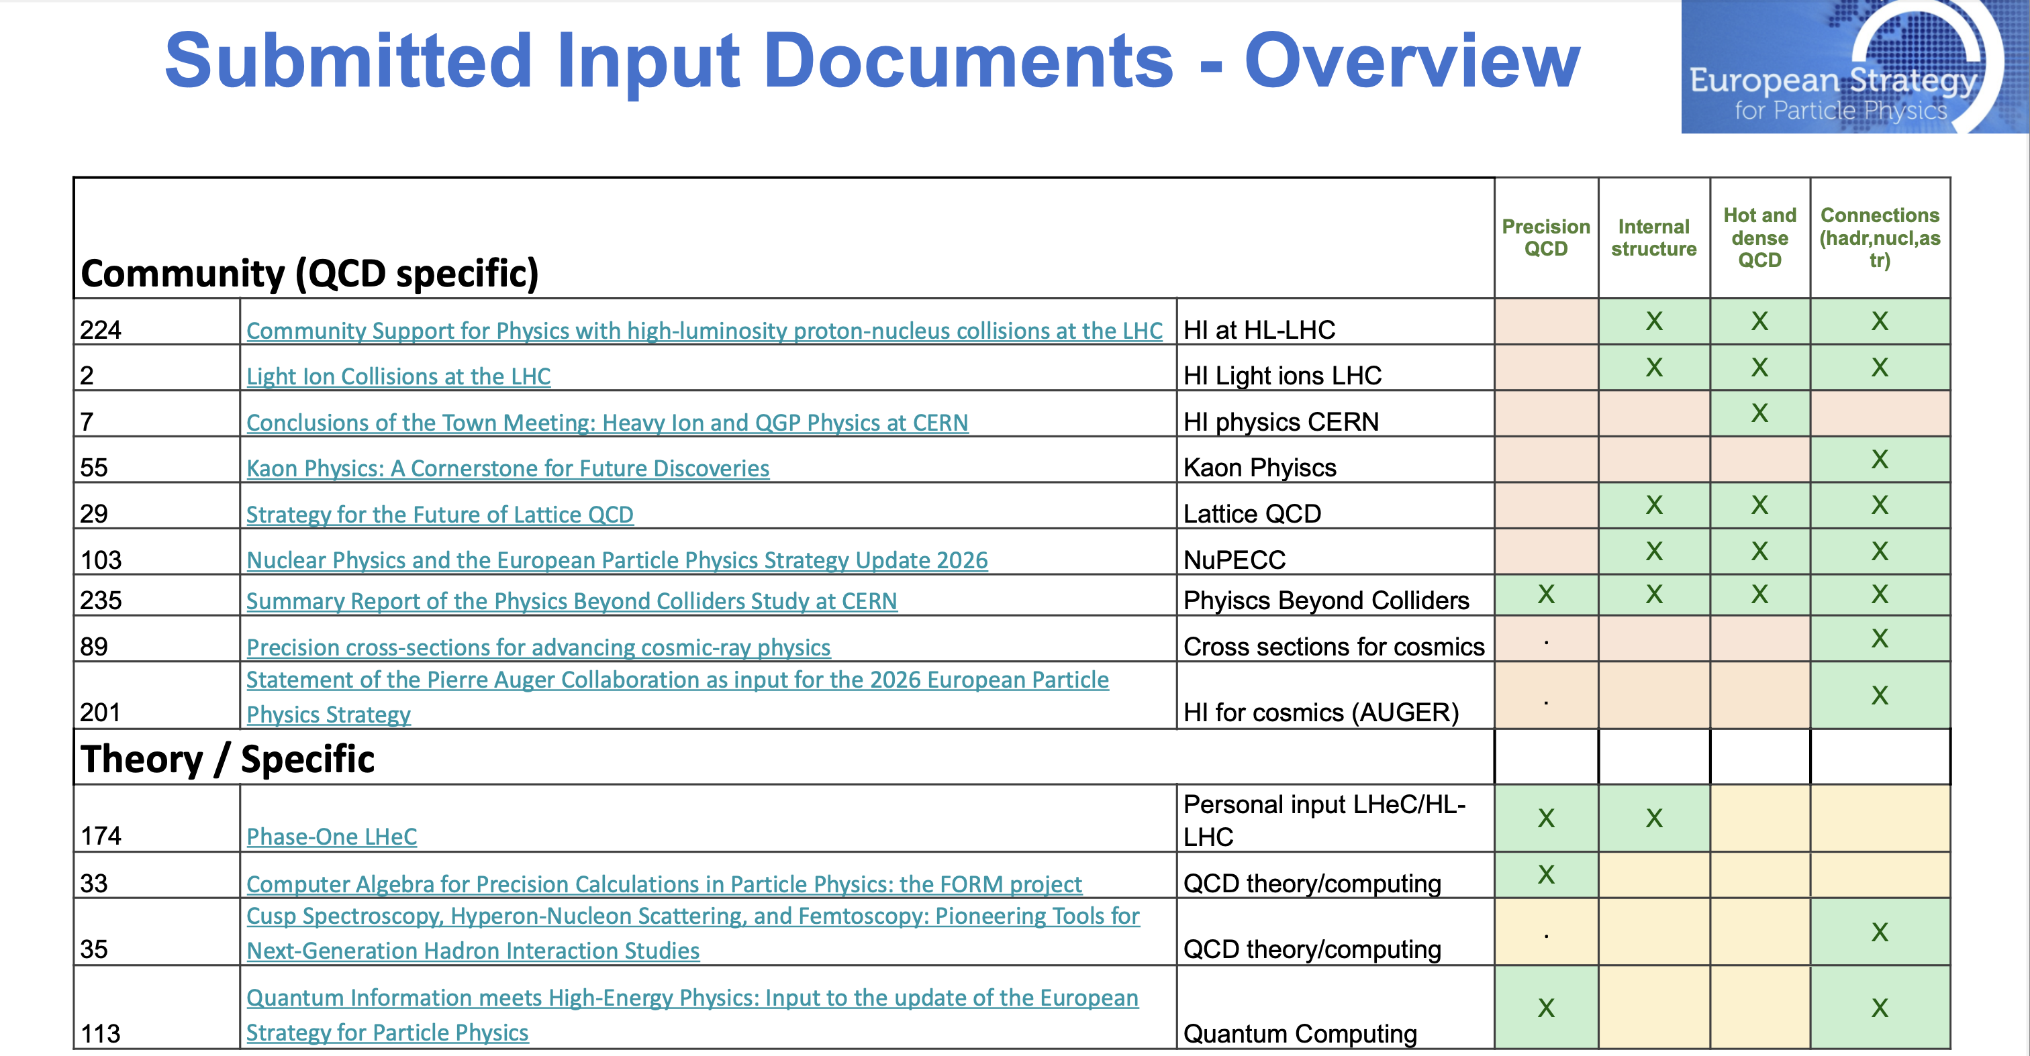
Yayun He et al, arXiv:2201.08408

Slide 39

Yayun He et al, arXiv:2201.08408

