Slide 1


PARALLEL 6 / DETECTOR TECHNOLOGIES
Optimizing The Environment
for Detector R&D
J. Vermeer
The Astronomer (1668)
Marcel Demarteau
(demarteau@ornl.gov)

Slide 2
What Drives the Ecosystem for Detector R&D
Coordinated Community
for Directed and
Blue-Sky Research
Well-trained
Workforce
and schools
Projects
and their respective timescales
State of the Art
Test Facilities
with good access
Participation and Leadership
in technical and multi-disciplinary conferences
Industry Partners and connection to industrial developments
Advanced Software
AI/ML and HPC
Society and Outreach
Societal benefits and next-gen workforce

Slide 3
Expect the Unexpected
The Standard Model is incomplete; we pretty much don’t quite know where the new physics will appear.
The task is to make discoveries that withstand the scrutiny of our peers.
So, expect the unexpected that will be truly revolutionary; the onus is on the detectors.
Be prepared for “revolutions”
Adapted from Sam Ting

Slide 4
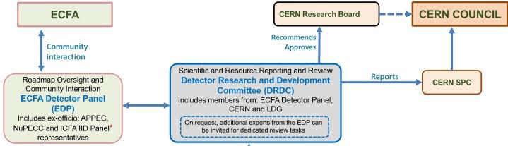
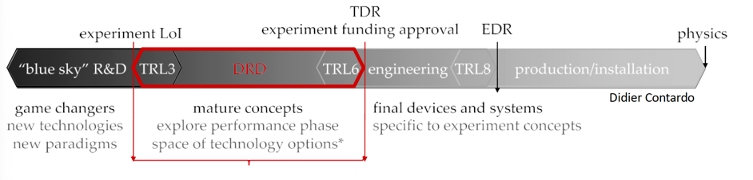
Coordinated Community
In response to the previous ESPP update, the US Basic Research Needs (BRN) workshop on Instrumentation, AIDAInnova, a strong, reinvigorated detector community has been established.
Each DRD has well-established internal organizational structure with working packages, deliverables and milestones.
Close coordination with ECFA Detector Panel and CPAD
DRD focus is on TRL3 – TRL6

Slide 5
Future Flagship Projects and their Characteristics
2030 - 2035
2040 - 2045
2035 - 2040
2045 - 2050
> 2050
Dark Matter Gen 3
Atom Interferometer
Neutrinos – Phase II/III
Belle –II (LS2)
0νββ
Fixed Target
ALICE 3
CMB-S4
EIC
LFV
ILC
CepC
CLIC
ESSνSB
FCC-ee
Mu-C
FCC-hh
Future flagship projects: large, complex, unresolved technical challenges, long timescales being developed within a fast-moving technological landscape.
Balancing multiple aspects:
  Generic R&D targeting novel capabilities
  Strategic R&D targeting specific projects
  Diversity of techniques and technologies;
  Agility and new technology developments;
  Industry collaborations;
  …

Slide 6
Balancing Needs
Community for Instrumentation:
Blue-sky R&D as integral part of R&D portfolio.
Directed R&D to tackle known challenges and requirements.
System aspects for the extreme environments of fundamental physics need to be (more) integrated in the R&D program.
Blue-Sky
R&D
Strategic
R&D
Systems Engineering

Slide 7
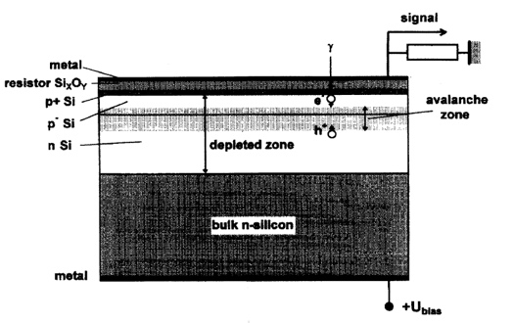
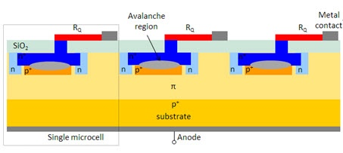
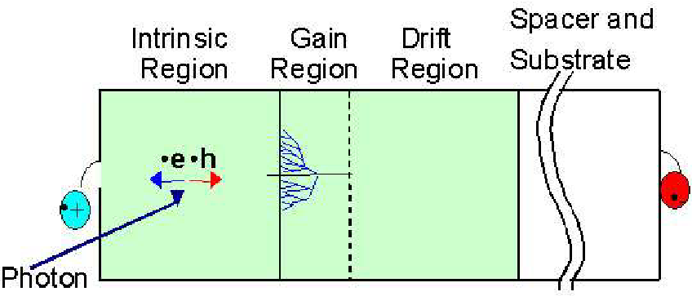
The Underpinning Of Scientific Progress
VLPC
(Rockwell, 1987)
MRS APD
(Russia, ~1995)
MPPC
(Russia, ~2003)
Bross et al., NIM A477, 172 (2002)
Antich et al., NIM A 389 (1997) 491
Dolgoshein et al., NIM A 504 (2003) 48
Sadygov patent (1998)
From difficult beginnings (VLPC operated at 7K for Dzero scintillating fiber tracker) to being a workhorse for the field in a mere twenty years.
VLPC: Visible Light Photon Counter
MRS: Metal- Resistor-Semiconductor
MPPC: Multi-Pixel Photon Counter (SiPM)

Slide 8
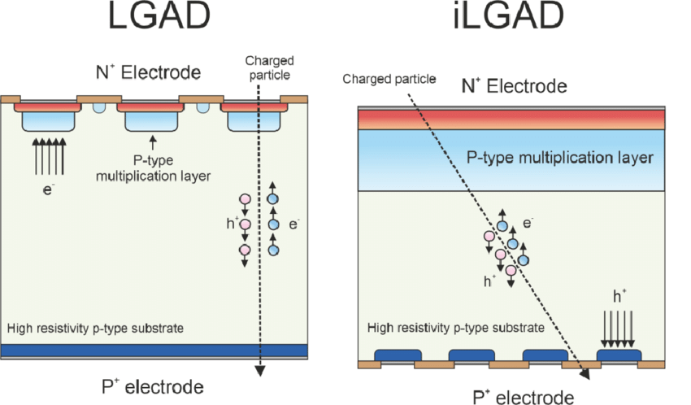
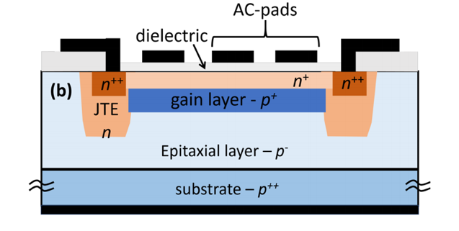
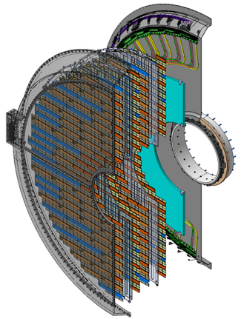
The Underpinning Of Scientific Progress
LGAD
(UCSC, 2012)
AC-LGAD (RSD)
(UCSC/INFN, ~2019)
CMS ETL (2023)
ATLAS HGTD (2023)
From inception to development to full-scale detector in a short 10 years.
LGAD: Low-Gain Avalanche Diode
RSD: Resistive Silicon Detector
UFSD: Ultra-Fast Silicon Detector

Slide 9
TPC evolution
10¹⁰
10⁹
10⁸
10⁷
10⁶
10⁵
10⁴
ALICE2
ALICE
sPHENIX
readout rate (s⁻¹) x #channels
STAR
NA49
CERES
One order of magnitude
improvement in this metric
per decade.
ALEPH
STAR
PEP/4
EOS
1980 1990 2000 2010 2020
year
From Harald Appelshäuser (CPAD 2024)

Slide 10
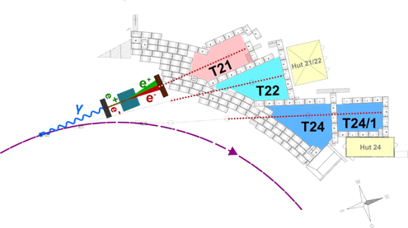
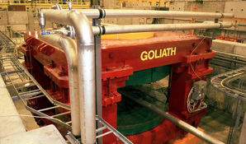
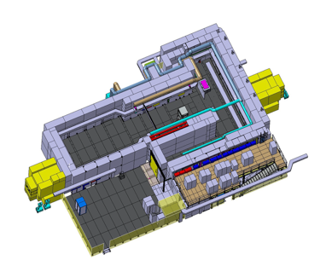
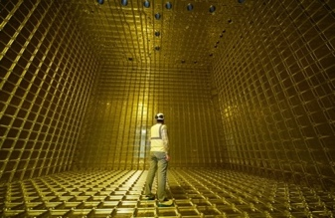
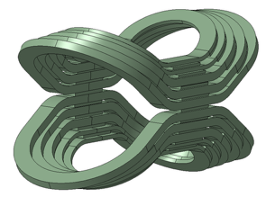
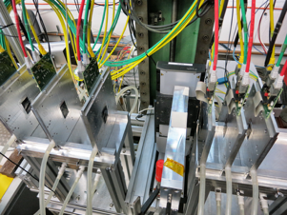
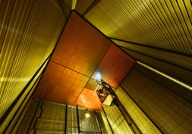
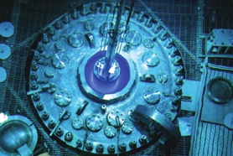
Test Facilities
Future experiments will operate in demanding environments: temperature, magnetic field, radiation field, low-background, low-power, …
Test Beams
Irradiation
Magnet
Noble Liquid
Test beams with expanded capabilities
High-flux irradiation facilities using different particle types
General-purpose high-field magnet platform
Noble Liquid platform for neutrino and other cryogenic experiments
DESY Test Beam
CERN Goliath
GIF++
Magnadon
CERN Neutrino Platform
Tracking Telescope
Reactors
Notes:
Travis Humble provided

Slide 11
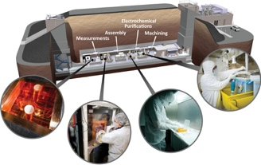
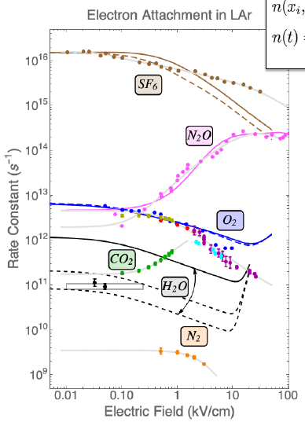
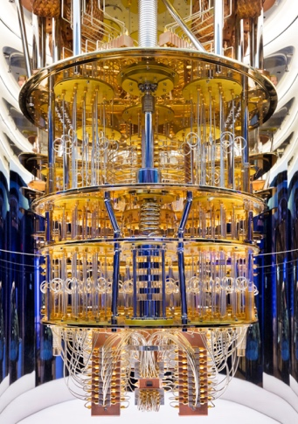
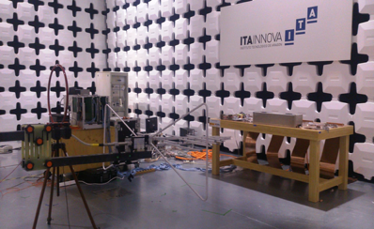
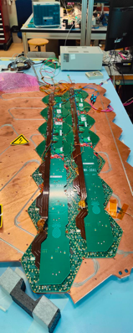
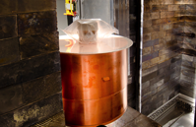
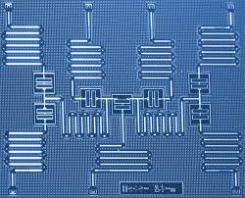
Test Facilities
Future experiments will operate in demanding environments: temperature, magnetic field, radiation field, low-background, low-power, …
Quantum Systems
Low-Background
Characterization
Calibration
General-purpose platform for quantum sensors
Assay and low-background facilities
Platforms for fundamental properties studies
Platform for calibration and systems design
Assay Facilities (PNNL)
ITAInnova
HP-Ge
Dilution Refrigeration Platform
Notes:
Travis Humble provided

Slide 12



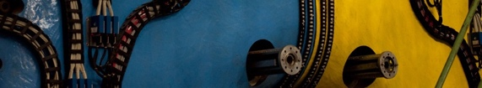
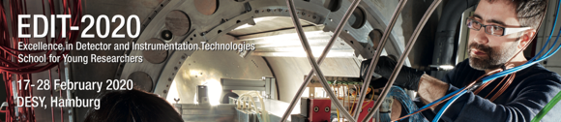
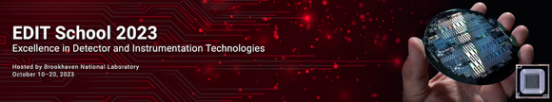
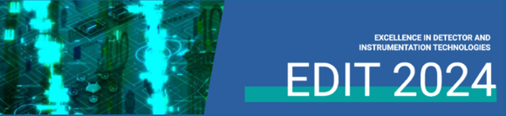
Workforce
Given the scale and complexity of proposed new projects,
the community needs to address several challenges:
  Train a new workforce fluent in detector building and analysis;
EDIT 2011
European School of Instrumentation in Particle and Astroparticle Physics (ESIPAP)
Excellence in Detectors and Instrumentation Technologies (EDIT)
International School of Trigger and Data Acquisition (ISOTDAQ)
INtelligent Fast Interconnected and Efficient Devices for Frontier Exploration (INFIERI)
ICFA Instrumentation Schools
AIDAInnova Schools
DRD – Schools:
  DRD1 Gaseous Detectors School
  DRD5 Quantum Technologies and Techniques
  …
EDIT 2015
INFN - Laboratori Nazionali di Frascati, Italy October 20-29, 2015
12

Slide 13
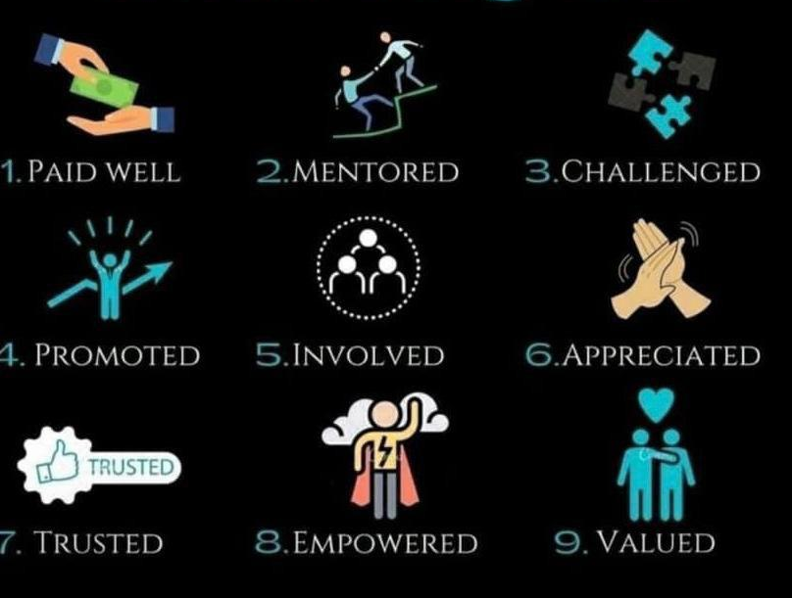
Workforce
Given the scale and complexity of proposed new projects,
the community needs to address several challenges:
  Train a new workforce fluent in detector building and analysis;
  Retain the younger workforce and provide strong career opportunities;
Rules for Staff Retention
Appreciation for junior scientists through various awards
  DPF and ICFA instrumentation awards for junior scientists
Work is being valued through publication in instrumentation journals.
DRDs can be an excellent forum to address junior staff retention:
  Venue for mentoring, involvement and community building
The value for career growth – or even obtaining a permanent position – remains a challenge.
As a first step, recognize training with academic credits.
X

Slide 14





















Workforce
Given the scale and complexity of proposed new projects,
the community needs to address several challenges:
  Train a new workforce fluent in detector building and analysis;
  Retain the younger workforce and provide strong career opportunities;
  Not only retain but grow the current workforce through challenging projects and provide continuous education to keep up with rapid technology development;
Cryogenics
Electronics
Software/AI
The attraction from outside of the field can be very strong, which we need to resist.

Slide 15
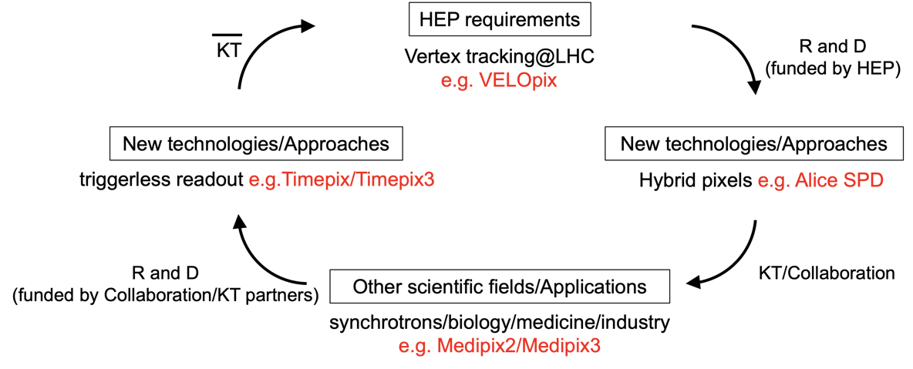
Workforce
Given the scale and complexity of proposed new projects,
the community needs to address several challenges:
  Train a new workforce fluent in detector building and analysis;
  Retain the younger workforce and provide strong career opportunities;
  Not only retain but grow the current workforce through challenging projects and provide continuous education to keep up with rapid technology development;
  Provide an environment for continuous deployment of new technologies;
From Michael Campbell: submission 161

Slide 16

Partnerships
HEP detectors are electronic detectors with highly specific, “niche” requirements for which the market potential is limited. Electronics is developing – in all aspects – at an accelerated pace that the field is not able to keep up. The field will be forced to rely more on industry (e.g. 4nm ASICs).
HEP will continue to offer intellectual challenges that industry is interested in, which should be leveraged.
To keep up with the developments, and keep scientists engaged, collaborations with neighboring fields need to be nurtured and commercial partnerships developed.

Slide 17
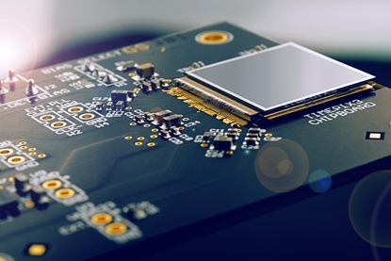
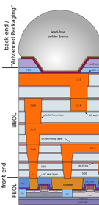
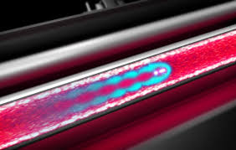

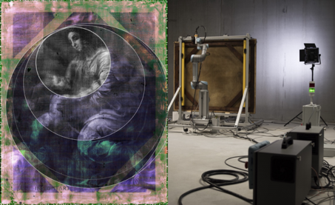
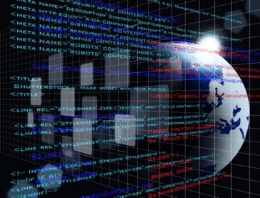
Partnerships
Industrial Research Partnership
Develop new research capabilities through privileged relationship
(FBK, HPK, Mecaro, IZM, …)
Industrial Partnership
Keep up to date with latest developments; mitigate obsolescence
Science Research Partners
Continuous engagement in science projects (photon sources, imaging, NASA, … )
Commercial Partnerships
Knowledge transfer, licensing, scientific engagement (AdvaFab, MediPix, Arronax, …)
HEP
Community Partnerships
HEP pertinent expertise applied to local real-world topics (cultural heritage, activation,
Partnerships with other academic areas
Mutual beneficial engagement with other areas of science
Partnerships, privileged or otherwise, will become increasingly more important for the field and need to be nurtured.

Slide 18
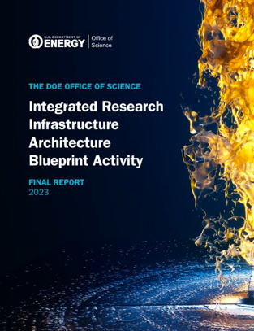
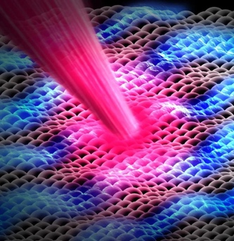
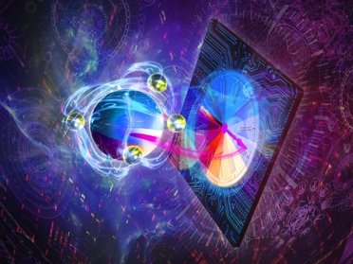


A Multi-Disciplinary Environment
1
2
3
4
5
Quantum Sensing and Quantum Technologies
AI/ML development and integration in instruments.
Connect with Advanced Scientific Computing Facilities and Tools
Electronics and instrument development for speed and data challenges.
Cross cutting technology innovation through cross-disciplinary science.
Collaboration with other science disciplines will become mandatory to achieve the science goals; they are delivering impactful advances relevant to instrumentation as well as in physics impact, that need to be leveraged. As a first step, joined DRD meetings and meetings of DRDs with other fields.

Slide 19
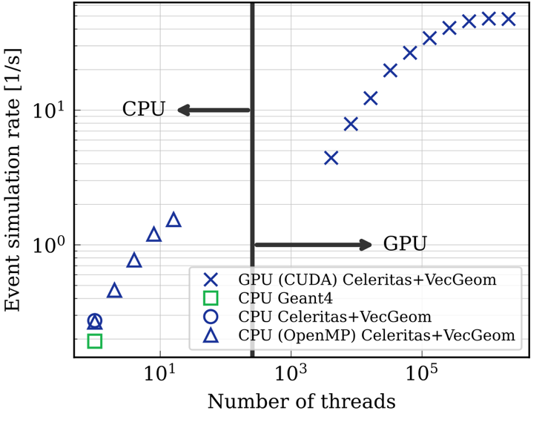
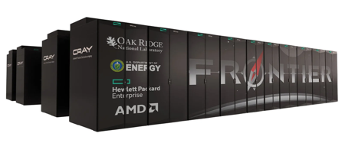
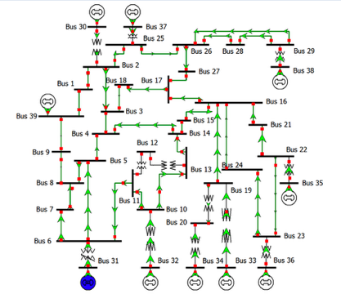
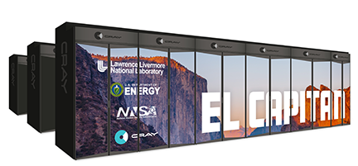
Advanced Software: AI/ML and HPC
High Performance Computing, AI and ML are transformative technologies that need to be fully integrated into the workflow of detector design, simulation, front-end processing and data taking ushering in a new paradigm for collider physics.
Autonomy
of detectors
and labs
AI &
Simulation
methodologies
HPC
Leadership
computing
Frontier (ORNL)
Fluency in AI using HPC
is mandatory
El Capitan (LLNL)

Slide 20
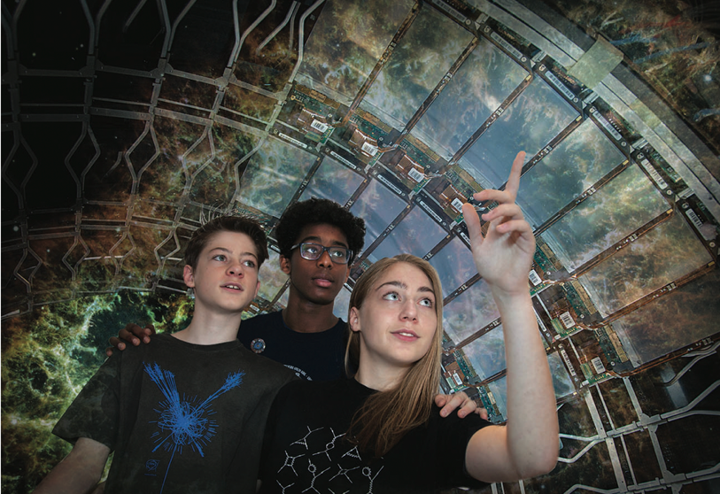
Society and Outreach
We all have brains to nurture!
A pipeline of enthusiastic new scientists needs to be grown to realize projects that starts at elementary school: Brain Gain!
General outreach to local schools, community talks, TED talks, Radio Cafés, any event will do, especially after a major announcement.
Photo credit: Michael Hoch (CERN)

Slide 21
General Strategic Recommendations
The ECFA Detector Roadmap formulated ten General Strategic Recommendations (GSR):
GSR 1: Supporting R&D facilities (test beams, large-scale generic prototyping and irradiation)
GSR 2: Engineering support for detector R&D (access to (mechanical, electrical and microelectronics)
GSR 3: Common access to specific softwarefor instrumentation (simulation and design tools)
GSR 4: International coordination and organization of R&D activities
GSR 5: Distributed R&D activities with centralized facilities (pooling activities through a network of national hubs; due to increasing costs of solid-state and microelectronics)
GSR 6: Establish long-term strategic funding programs
GSR 7: Continued support for “Blue-sky” R&D
GSR 8: Attract, nurture, recognize and sustain the careers of R&D experts
GSR 9: Industrial partnerships:
GSR 10: Open Science: routes to ensuring instrumentation results are as publicly available

Slide 22
Summary
The General Strategic Recommendations from the 2021 ECFA Detector R&D Roadmap still hold, although in a more challenging environment:
  Very long timescales and the draw from other science fields;
  Rapid technological advances, with HEP not leading the technologies anymore;
  Increasing difficulties for technological progress with current technologies, ….
A healthy environment for detector R&D in the current, fast-paced society, a strong and dedicated community has been formed through the DRD collaborations.
This needs to be strongly augmented with support for blue-sky R&D, a suite of exquisite test facilities, training for “young” and ”old”, an open-mindedness and embrace of new technologies, strong partnerships, outreach and most importantly, good career opportunities for detector-oriented scientists.

Slide 23
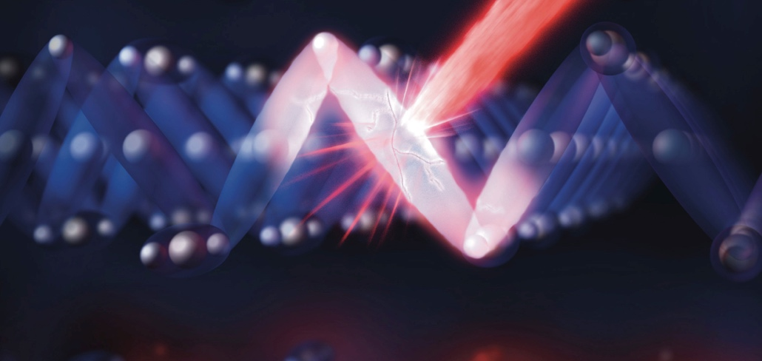
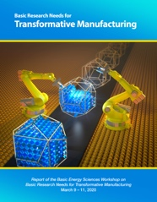
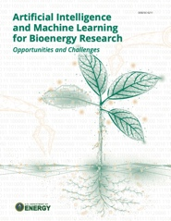
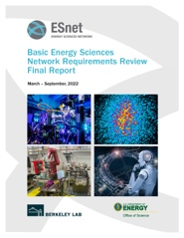

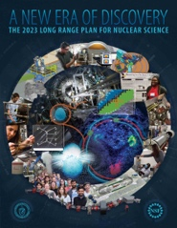

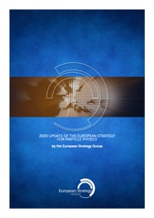
The best way to predict
the future is to create it.
-- Abraham Lincoln

Slide 24
With many thanks to the authors of submissions used as input
93: Strengthening the Instrumentation Programme
157: Towards instrumentation for future HEP experiments
30: European training in instrumentation and particle accelerators
161: Call for a new approach to detector developments involving microelectronics
229: Development of Gaseous Detector Technologies: CERN-DRD1 Collaboration Model
17: Enabling future detector technology within ePIC at the EIC
108: DRD 6 Calorimetry - Input to European Strategy of Particle Physics Update (ESPPU)
204: R&D on quantum sensors for particle physics: the DRD5 collaboration
229: Development of Gaseous Detector Technologies: CERN-DRD1 Collaboration Model
133: A High-Precision, Fast, Robust, and Cost-Effective Muon Detector Concept for the FCC-ee
77: A Silicon-Tungsten ECAL for Higgs Factory Detectors
211: Expression of Interest for the ALLEGRO Full-Detector Concept for FCC-ee
262: Expression of Interest Toward MCMOS Time of Flight Tracking Layers for a detector at FCC-ee
95: Expressions of Interest for the Development of Detector Concepts and Sub-detector Systems for the FCC
61: MATHUSLA: An External Long-Lived Particle Detector to Maximize the Discovery Potential of the HL-LHC
266: Novel 3D-Projection Pixelated Detector for Next-Generation High-Energy Physics Experiments
32: Performance study of the MUSIC detector in sqrt{s}=10 TeV muon collisions
53: P-ONE: The Pacific Ocean Neutrino Experiment A Next-Gen Deep-Sea Neutrino Detector for Fundamental Physics
44: Proposal for a shared transverse LLP detector for FCC-ee and FCC-hh and a forward LLP detector for FCC-hh
119: The DUNE Phase II Detectors
232: The Short-Baseline Near Detector at Fermilab

