Slide 1

PARALLEL 2 / ACCELERATOR TECHNOLOGIES
High Field Magnets
B. Auchmann (PSI, HFM Programme co-leader)
A. Ballarino (CERN, HFM, HTS RD line coordinator)
L. Bottura (CERN, HFM, MuCol workpackage leader)
A. Milanese (CERN, Magnet Superconductors and Cryostats group leader)
E. Todesco (CERN, HFM Programme leader)

Slide 2


Outline
Low-temperature superconducting (LTS) magnet technology for FCC-hh
High-temperature superconducting (HTS) magnet technology for FCC-hh
Muon collider magnet studies
Synergies and impact

Slide 3
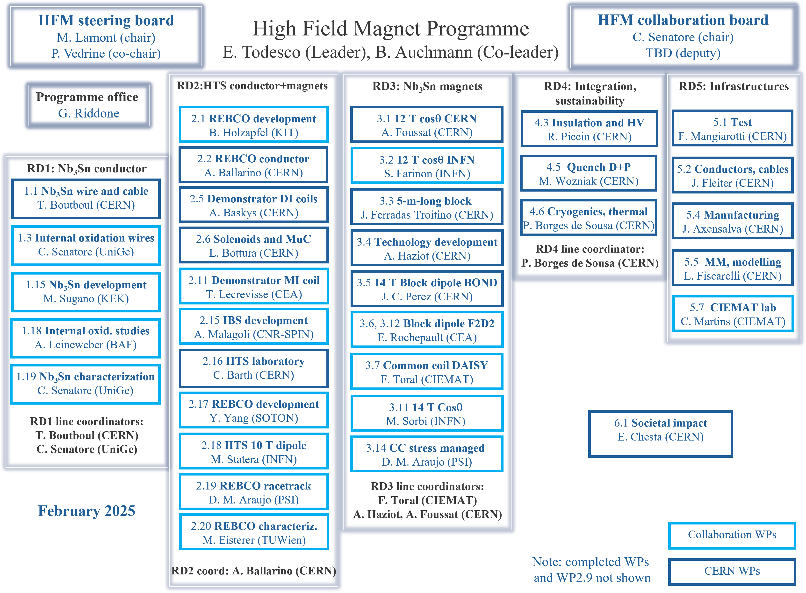
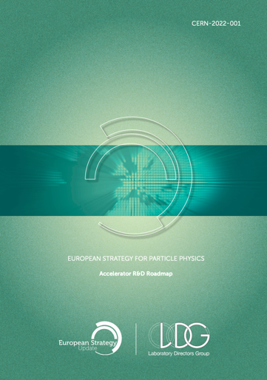
HFM Programme
http://cern.ch/hfm
since 2022, 11 collaborating institutes
40-50 FTEs, 33 WPs, half from CERN
23/06/2025
High Field Magnets – Open Symposium ESPP, Venice

Slide 4












HFM Programme
http://cern.ch/hfm
since 2022, 11 collaborating institutes
40-50 FTEs, 33 WPs, half from CERN
Mission (2024):
Develop an Nb₃Sn accelerator dipole with 14 T operational field for FCC-hh, [..] with a focus on sustainability, cost versus performance, and large scale production.
Explore the HTS magnet technologies for accelerator applications in the range from 14 T up to 20 T
23/06/2025
High Field Magnets – Open Symposium ESPP, Venice

Slide 5
Low-Temperature Superconductor
(Nb₃Sn, Nb-Ti) technology for FCC-hh
Nb₃Sn technology has reached a high level of maturity

Slide 6

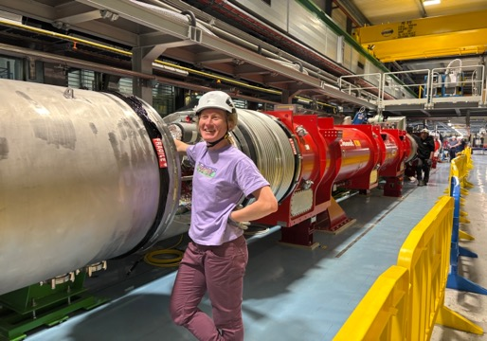
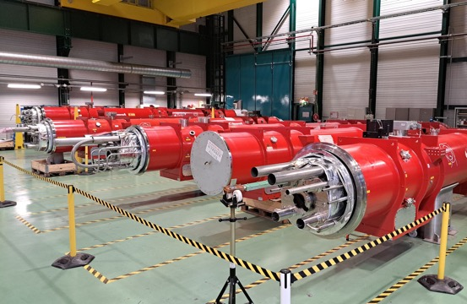
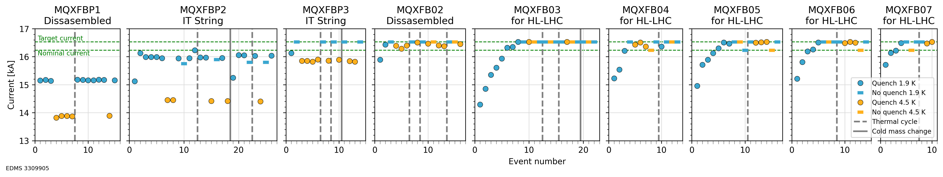
What is being achieved by HL-LHC
HL-LHC is building 30 quadrupole magnets, 4 to 7 m long, with 11.5 T peak field.
  Performance achieved with good
  margins and reproducibility.
  All required features for operation
  (field quality, protection).
  Long term stability tests successful.
  Magnets have been interconnected
  in the string test.
Performance of MQXFB quadrupoles [S. Izquierdo Bermudez, P. Ferracin, et al.]

Slide 7

2025 Updated Baseline Parameters for LTS Magnets
The main change is the reduction of the operational field from 16 T to 14 T and energy from 100 TeV to 85 TeV.
  ~50% reduced synchrotron radiation
This provides a consistent baseline with high confidence level based on HL-LHC
Increased operational margins (from 14% to 20% loadline fraction)
Reduced coil stress (from 200 MPa to 150 MPa)
Baseline field is achievable with present state-of-the-art Nb₃Sn conductor
Open the possibility of hybrid Nb₃Sn/Nb-Ti coils, leading to a 50% reduction of Nb₃Sn mass
 |  | CDR 2019 | 2025
Dipole field | (T) | 16.0 | 14.0
Dipole aperture | (mm) | 50 | 50
Magnetic length | (m) | 14.3 | 14.3
Operational temp | (K) | 1.9 | 1.9
Tunnel length | (km) | 100 | 90.7
Arc length | (km) | 82.0 | 76.9
Arc filling factor | (1) | 0.80 | 0.83
Energy c.o.m. | (TeV) | 50+50 | 42.5+42.5
Loadline fraction | (1) | 0.86 | 0.80
J_{c} at 16 T and 4.2 K | (A/mm²) | 1500 | 1200
# dipoles | (1) | 4587 | 4463
# quadrupoles | (1) | 760 | 520
[E. Todesco, et al. FCC week 2025]
[M. Benedikt, F. Zimmermann, et al., FCC Feasibility Study Report, Vol. 3,
https://arxiv.org/abs/2505.00273 ]

Slide 8
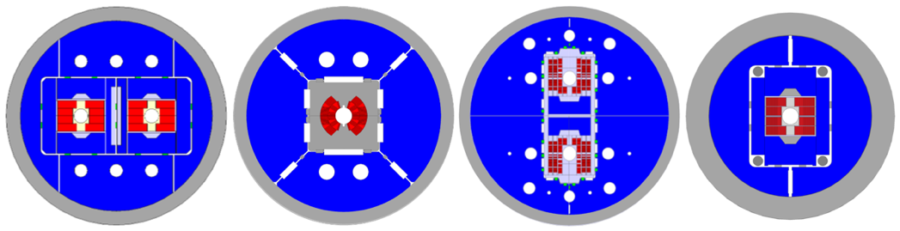
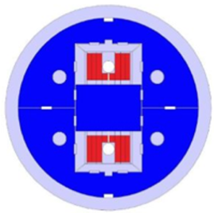
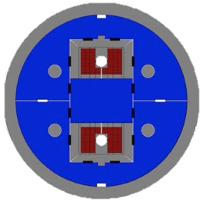





Demonstration of Baseline Parameters
  Note the difference between operational field and maximum achieved field! HL-LHC short models systematically reached 13 T peak field but operate at 11.5 T peak field
  With an eye on cost, length scaling, and industrialization, the primary goal is to:
    Demonstrate the baseline parameters with short model magnets reaching 15-15.5 T
    Down-select to one or two designs for further optimization and demonstration of reproducibility
  These magnets are under construction; first tests will be in 2026 and 2027

Slide 9
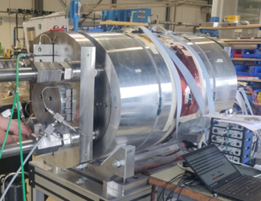
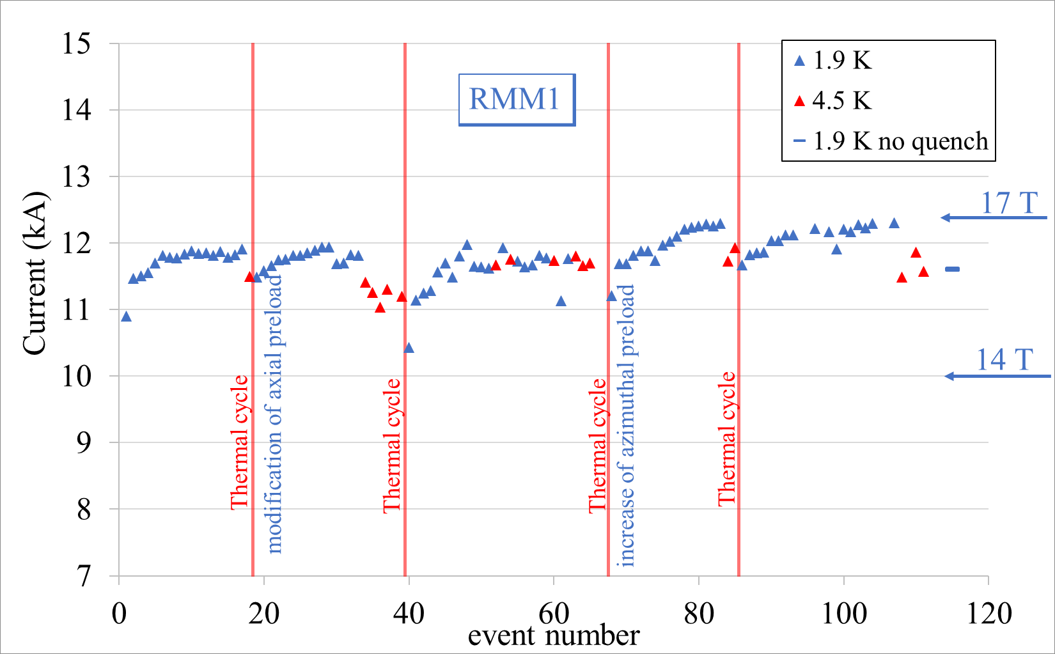
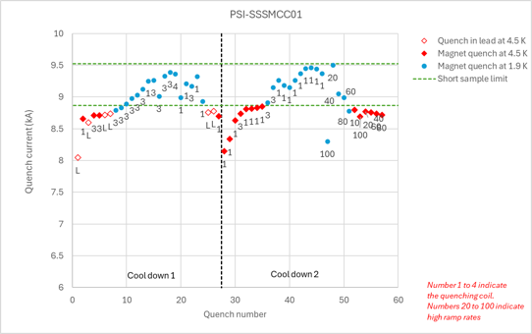


What has been achieved with demonstrators
Demonstrators: magnets not having all features of a short model, but proving a part of the technology
  RMM, based on block design, 50 mm aperture, but without flared ends, and very large coil,
  achieved fields of 16-17 T.
  subSMCC, demonstrates novel concepts (stress managed common coil), reached 5 T central field.
5 T
WP Leader D. Araujo,
Work launched by D. Tommasini, WP Leader J.-C. Perez
More info: [https://hfm.web.cern.ch/news/cern/rmm-demonstrator-gets-close-17-t-50-mm-bore]

Slide 10

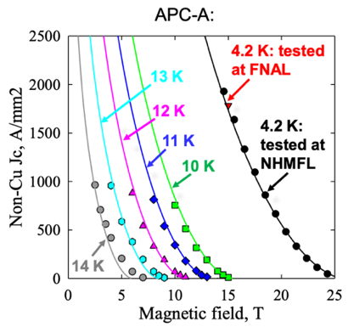


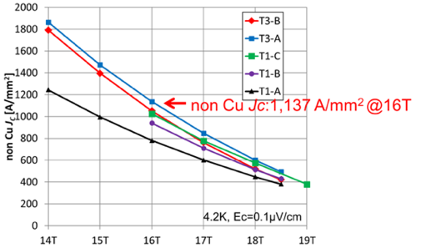


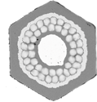








Research Directions for Improved
Performance/Cost 1/3
A. Improved conductor performance / availability:
  Enlarge the supply base for high-performance Nb₃Sn wire to reduce the reliance on a single supplier; demonstrate baseline performance or better.
  Demonstrate increased Nb₃Sn non-copper J_{c} and steps towards
  industrial production.
Tarantini et al 2019, SuST. 32, 124003
7/7 Wire
Nb-Ta-Hf subelement
Internal Oxidation
Simplified Multifilamentary wire
Cold Deformed Internal Sn Internal
Oxidation
Subelement
43 Nb-Ta-Hf filaments Cold Deformed
Internal Oxidation
2019-2020
2023
2025
2021-2022
2024
Monofilamentary wire
Cold Deformed
Internal Oxidation
Subelement
192 Nb-Ta filaments
Hot Extruded
Subelement
192 Nb-Ta-Hf filaments
Hot Extruded
Internal Oxidation
KAT (Korea) and JASTEC/KEK (Japan)
30/37 Wire
Nb-Ta subelement
[F. Buta et al., J.Phys. Mater. 4025003 (2021)]
[S. Hopkins et al., IEEE TAS 33()5, 6000609 (2023)]

Slide 11


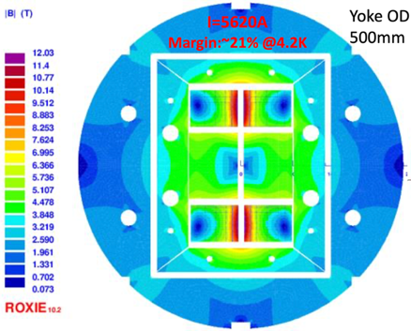

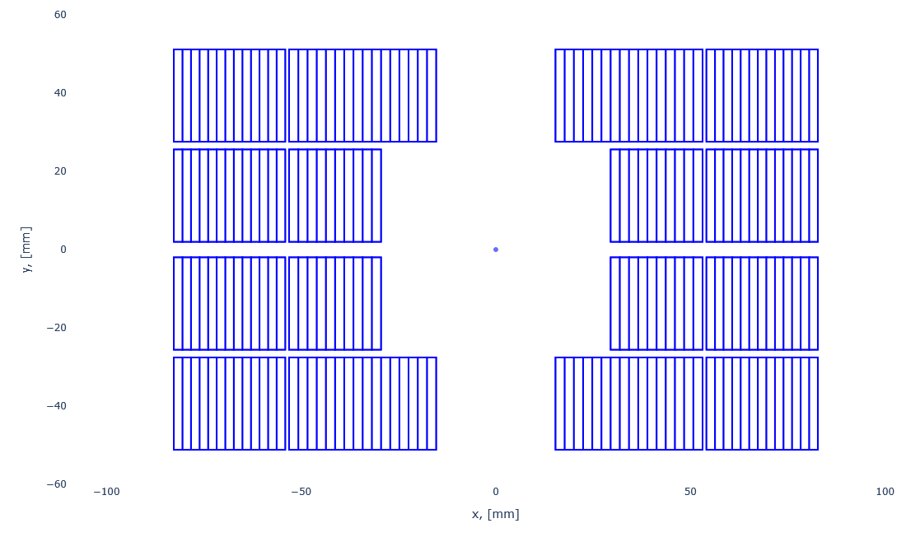
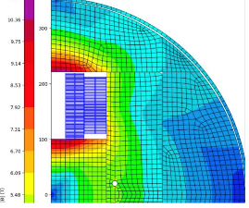
Research Directions for Improved
Performance/Cost 2/3
B. Nb₃Sn/Nb-Ti hybrid magnets at 1.9 K :
  Explore the hybrid design using Nb-Ti in low field regions – this gives a reduction of 50% of Nb₃Sn for a 14 T block design
    12.6 T achieved in IHEP with Nb₃Sn/Nb-Ti common coil
Nb₃Sn
NbTi
Hybrid Nb₃Sn / Nb-Ti LPF1 10 T dipole
Q. Xu, et al., https://indico.cern.ch/event/556692/]
WP Leader F. Toral
WP Leaders A. J. C. Perez, A. Haziot

Slide 12

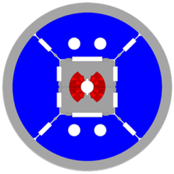
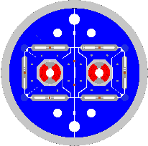
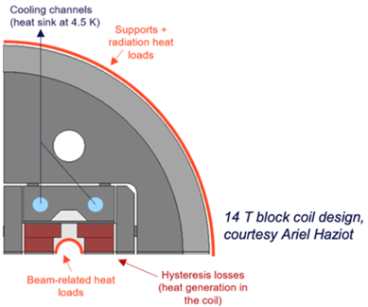
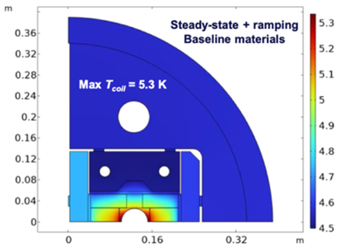
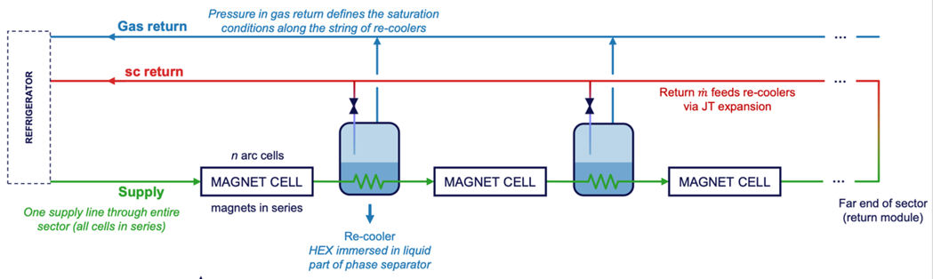
Research Directions for Improved
Performance/Cost 3/3
C. 12 T magnets:
  This option has the advantage of a reduced mass of conductor (30% less)
D. 4.5 K operation:
  This option can lead to a reduction of the required power (30% less)
WP Leader S. Farinon
WP Leader A. Foussat
[P. Borges de Sousa, https://indico.cern.ch/event/1449712/ (2024)]

Slide 13
Timeline for LTS
Select the design by 2028/29 (first indications from HFM tests in 2026-2027)
Short model program to verify reproducibility and optimize manufacturing processes: in 2029-2031
Scaling in length in two steps: TRL 7 achieved between 2032 and 2040
Industrialization for final magnets, with pre-series
9 years of production, installation and commissioning in parallel
First selection
of design
5-m-long prototypes
(>5 each type)
Industrialization (pre-series magnets)
Short model program on two selected designs
(>5 each type)
15 m long prototypes (>5)
Feedback
HL-LHC operation
Production and test
Ongoing
12 T and 14 T short models
Selection of final design
to start long magnets
Installation and commissioning
Tender
for the series
`25
`26
`27
`28
`29
`30
`31
`32
`33
`34
`35
`36
`37
`38
`39
`40
`41
`42
`43
`44
`45
`46
`47
`48
`49
`50
`51
`52
`53
`54
RunIII
HL-LHC RunIV
HL-LHC RunV
Nb₃Sn timeline for FCC-hh [January 2024, E. Todesco, et al.]
23/06/2025
High Field Magnets – Open Symposium ESPP, Venice

Slide 14
Timeline for LTS
Select the design by 2028/29 (first indications from HFM tests in 2026-2027)
Short model program to verify reproducibility and optimize manufacturing processes: in 2029-2031
Scaling in length in two steps: TRL 7 achieved between 2032 and 2040
Industrialization for final magnets, with pre-series
9 years of production, installation and commissioning in parallel
First selection
of design
5-m-long prototypes
(>5 each type)
Industrialization (pre-series magnets)
ACCELERATED TIMELINE
Industry is heavily engaged in length scale-up.
Short model program on two selected designs
(>5 each type)
15 m long prototypes with industry (>5)
Production and test
Feedback
HL-LHC operation
Ongoing
12 T and 14 T short models
Selection of final design
to start long magnets
Tender
for the series
Installation and commissioning
`25
`26
`27
`28
`29
`30
`31
`32
`33
`34
`35
`36
`37
`38
`39
`40
`41
`42
`43
`44
`45
`46
`47
`48
`49
`50
`51
`52
`53
`54
RunIII
HL-LHC RunIV
HL-LHC RunV
Nb₃Sn timeline for FCC-hh [January 2024, E. Todesco, et al.]
23/06/2025
High Field Magnets – Open Symposium ESPP, Venice

Slide 15
High-Temperature Superconductor
technology for FCC-hh
REBCO for FCC-hh must meet challenges unique to particle accelerators

Slide 16
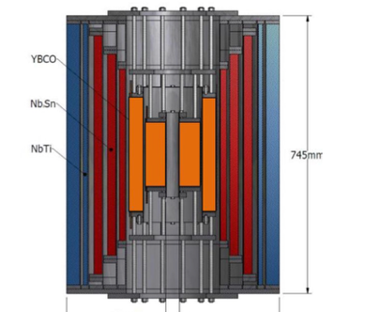
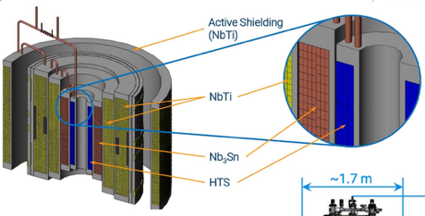
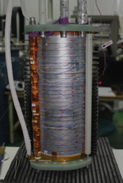


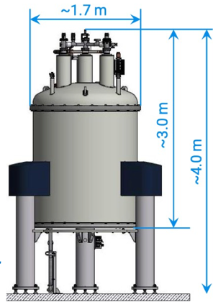
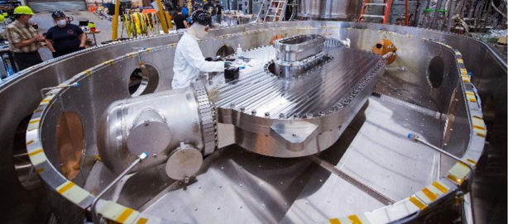
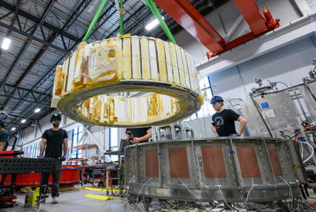
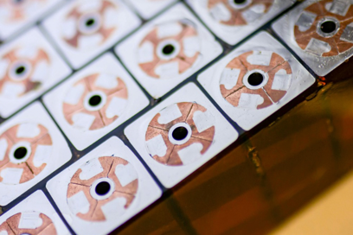


Notable Progress with REBCO
The late 2010s have seen key milestones reached with
REBCO high-field solenoids
  NHMFL 32 T hybrid solenoid, 32 mm aperture.
  Bruker BioSpin 1.2 Ghz NMR, 28.2 T
  hybrid solenoid 54 mm aperture.
  MIT/SUNAM/NHMFL, 26 T all-REBCO NI 35 mm apert.
REBCO magnets for commercial fusion
  MIT and Commonwealth Fusion Systems CFS
  all-REBCO Toroidal-Field Model Coil (TFMC),
  1.6x2.6 m, 20 T on conductor.
  lately, Central-Solenoid Model Coil (CSMC):
  windability and ramped operation, 1.2 m ID, 5.7 T.
Long-term operation still to prove: degradation on leads and
heaters in NHMFL magnet and a burn-out quench in TFMC

Slide 17
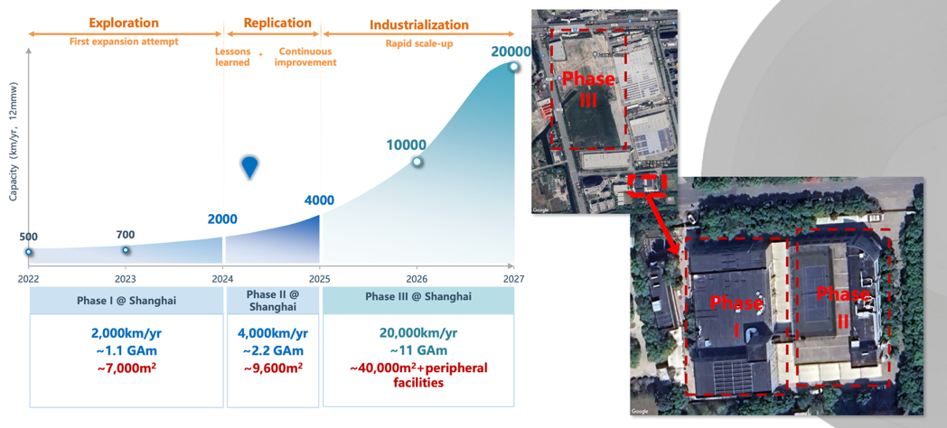

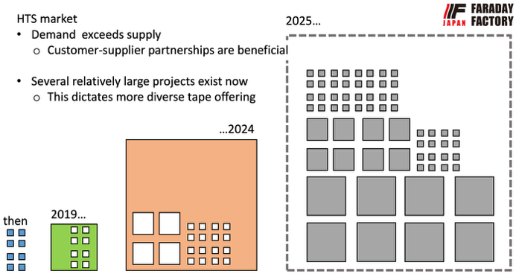
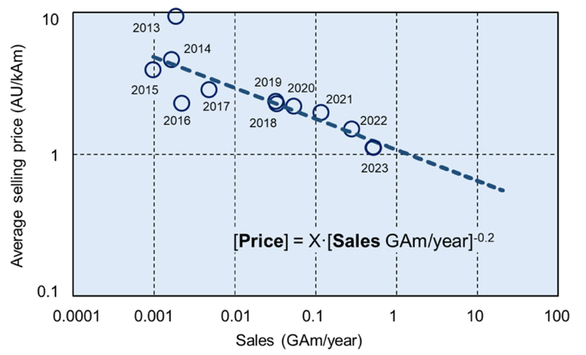

REBCO Market Growth
To date supply comes mostly from Asia, with only one supplier in Europe (Teva).
But the market is dynamic and new actors appear every year.
Citation from Faraday Factory talk at
CCA workshop
Fusion creates demand, promotes capacity; large volume drives the cost down.
HTS price halves with every 10-fold volume increase
Other applications will DO benefit
    [B. Song, et al., https://indico.cern.ch/event/1347361/ (2025)]
    [A. Molodyk, https://indico.cern.ch/event/1347361/ (2025)]

Slide 18

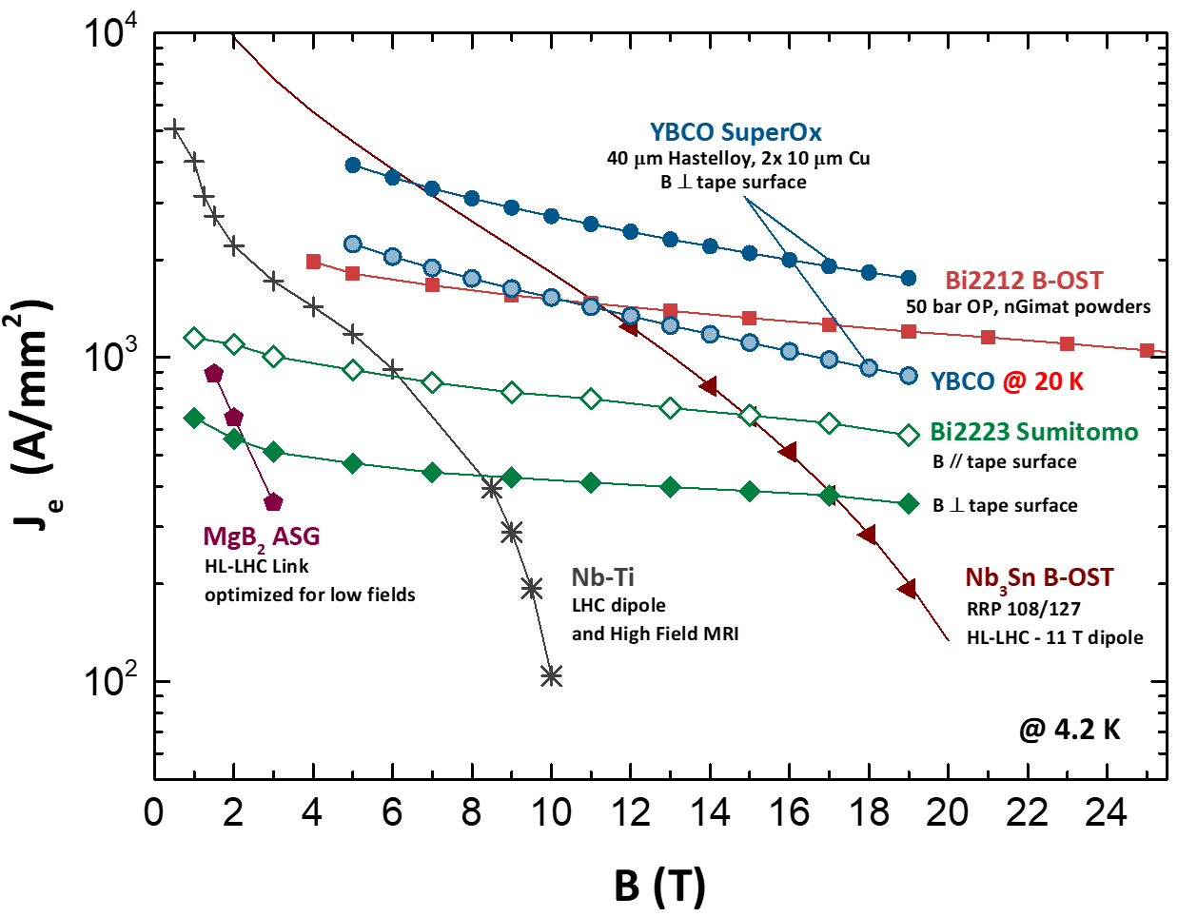

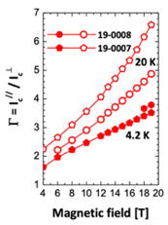


HTS R&D Directions
A. Conductor Choice:
  RD: Develop REBCO tape technology in view of accelerator needs.
  RD: Monitor developments in BSCCO technology closely in cooperation with US-MDP.
  RD: Study potential of IBS round wire conductor in
  view of competitive specifications and timeline.
B. HTS magnet specifications and requirements:
  RD: In an iterative process that involves all relevant subsystems (with particle physics, cryogenics, beam dynamics, feedback systems, powering/protection, instrumentation, vacuum, beam-induced losses, etc), determine HTS magnet specifications and requirements.
Value | Range (to be negotiated with …)
Main field | 14-20 T (cost, sync. rad., cryo, physics)
Operating temp | 4.2-20 K (cost, cryo)
Field quality (accuracy, stability, reproducibility) | Traditionally rel. errors 10⁻⁴ (beam-dynamics and feedback)
Ramp losses | 10-100 J/m.cycle? (cryo, sustainability)
Outer diam | 800 mm
Cryo interface | High-pressure, high-massflow supercritical He?
Vacuum interface | 4.5 K cryo-pumping liner for 20 K magnets?
Enthalpy Margin | 0.1-1 J/cm³ (cryo and beam-losses)
Protection | Max. temp. and volt. – or quench prevention?
Operating current | >10 kA? (powering and protection)

Slide 19
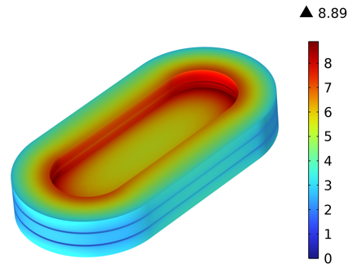
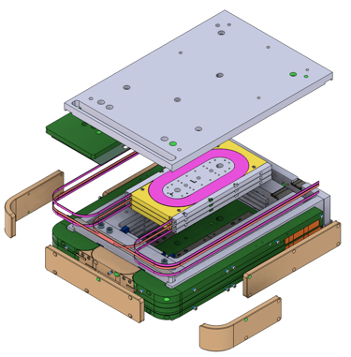
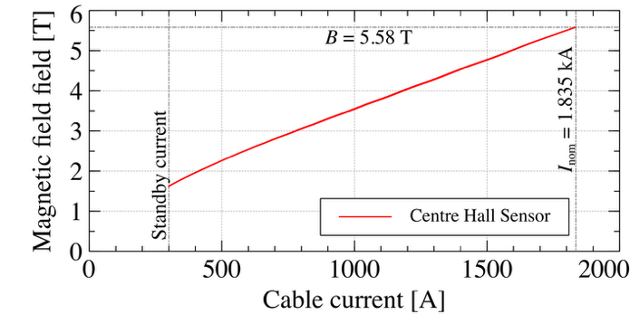
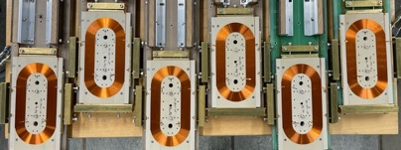
HTS R&D Directions
C. HTS magnet technology:
  RD: Develop and validate a cable for REBCO accelerator magnets.
  RD: Determine how to wind and insulate, mechanically load, cool, and protect REBCO dipoles.
  RD: Demonstrate accelerator quality at an intermediate field level and short length, before scaling up to nominal field.
WP Leader A. Ballarino
A. Baskys, D. Perini
Magnetic flux density [T]
Dipole demonstrator (no aperture) with 5.58 T central field with electrically insulated cable from REBCO tape-stack. Quenched with no degradation.

Slide 20
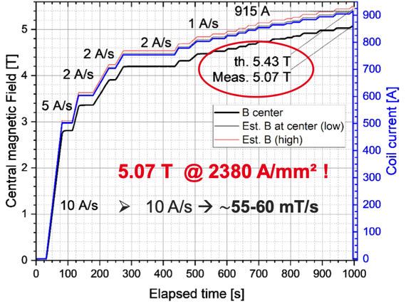
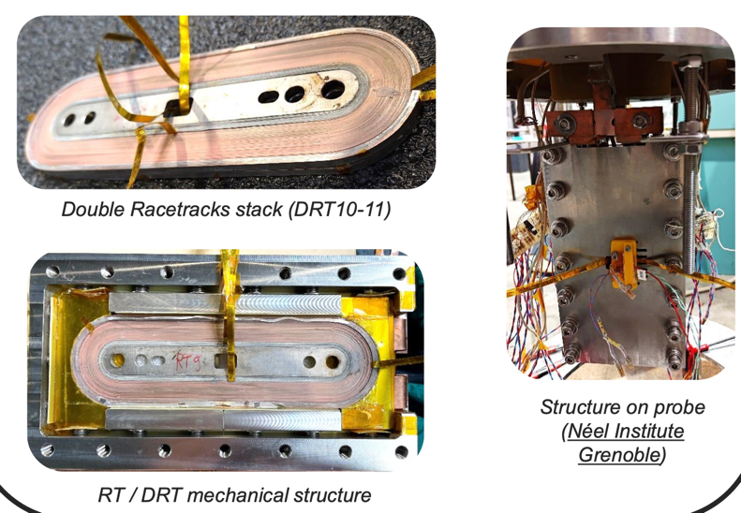

HTS R&D Directions
C. HTS magnet technology:
  RD: Develop and validate a cable for REBCO accelerator magnets.
  RD: Determine how to wind and insulate, mechanically load, cool, and protect REBCO dipoles.
  RD: Demonstrate accelerator quality at an intermediate field level and short length, before scaling up to nominal field.
WP Leader T. Lecrevisse
Metal-insulated double racetrack demonstrator (no aperture) magnet reached 5.1 T in 4.2 K and quenched without degradation.

Slide 21
Timeline for HTS
Target: 2035 a proof of a short model dipole with all features for FCC
  Aperture, field ≥14T, field quality, protection, …
Development of LTS and HTS technology in parallel at least until 2035.
Selection of cable and
insulation technology.
Partial demonstration
of accelerator specs.
FEASIBILITY
Reproducibility and first scaling in length
SCOPING
Short model ≥14 T
PROTOTYPING
PRE-SERIES
CANAVASSING
Demonstrators to select cable
and coil design
Proof of short model
with all requirements
Proof of reproducibility
and first long magnets
INDUSTRIALIZATION
`25
`26
`27
`28
`29
`30
`31
`32
`33
`34
`35
`36
`37
`38
`39
`40
`41
`42
`43
`44
`45
`46
`47
`48
`49
`50
`51
`52
`53
`54
RunIII
HL-LHC RunIV
HL-LHC RunV
HTS timeline for FCC-hh [FCC FS midterm report, August 2023, B. Auchmann, et al.]
23/06/2025
High Field Magnets – Open Symposium ESPP, Venice

Slide 22




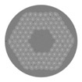

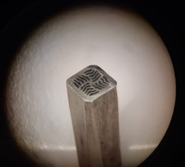

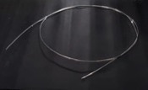

IBS State of the Art
Iron-based superconductors (IBS) were discovered in 2008 in Japan. The Ba-122 variant was found shortly thereafter in Germany.
IBS Ba-122 is being developed towards and industrial product by the Chinese Academy of Science for SppC magnets. IBS status:
Bc2 ∼70 T @ 20 K, Tc ∼ 38 K
Lower Anisotropy than REBCO
Potentially low cost
Wind&react conductor
Performance increase x4 since 2016.
Another x3-4 from IBS@4.2 K to REBCO@20 K.
For the time being, IHEP (Beijing) develops hybrid accelerator magnets with Nb₃Sn and REBCO.
CNR-SPIN in the HFM Programme performs
R&D from powder synthesis to
multi-filamentary PIT wires.
IBS SotA:
420 A/mm²
@ 10 T, 4.2 K
[A. Ballarino, presented at the LDG Mtg and Acc. R&D Workshop at BNL, June 5, 2024]
[Q. Xu, High Performance and Cost-Effective Superconducting Accelerator Magnet R&D at IHEP, Submission 49 to ESPP]
[A. Ballarino, Progress towards HTS HFM Magnets and Conductor Strategy, https://indico.cern.ch/event/1408515/timetable/]
[A. Malagoli, Progress on development of iron based superconducting wire, https://indico.cern.ch/event/1471305/timetable/]

Slide 23
Muon collider magnet studies
Muon collider magnets are pushing the boundaries of technical feasibility.

Slide 24

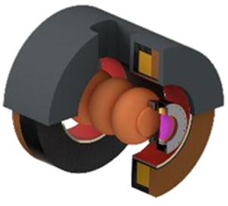
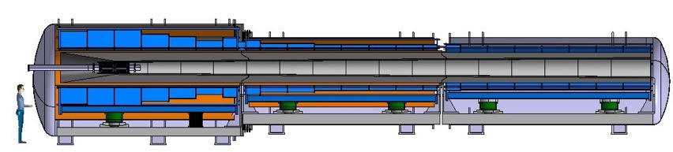
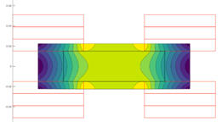
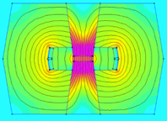
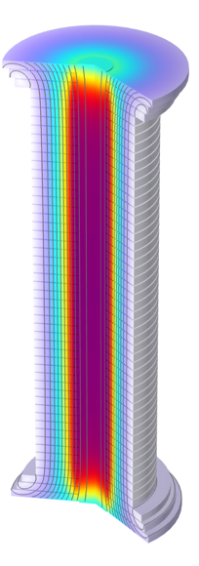
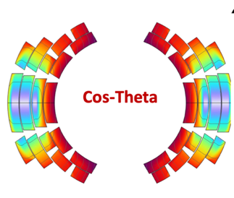
Muon Collider Magnets
SC dipole
NC dipole
NC dipole
SC dipole
RCS
Slides courtesy of L. Bottura for the for the Muon Magnets Working Group

Slide 25
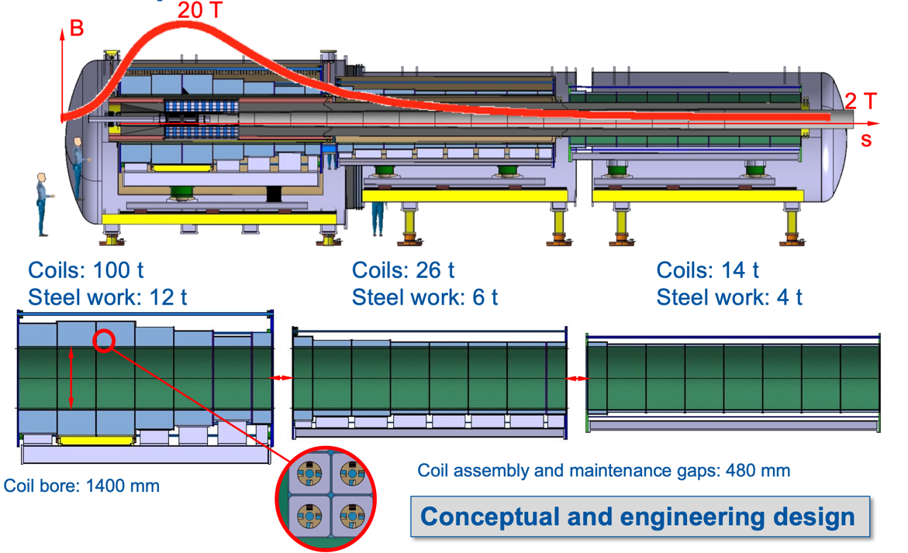
Target Solenoid
Specs/Challenges:
20 T, 1400 mm coil bore
Radiation heat load ≈ 5…10 kW
Radiation dose: 80 MGy
20 K, helical tape stacks in
steel conduit.
SotA:
CFS’s Central Solenoid
Model Coil (CSMC)
fast-ramping, 1200 mm
bore, 5.7 T
ITER Central solenoid
13 T, 2000 mm bore
individual modules tested
[C. Accettura, et al, IEEE TAS Vol 34(5), 4101705 (2024)]
[C. Sanabria, et al., SUST Vol 37(11), 115010, (2024)[

Slide 26



6-D Cooling Solenoid System
Specs/Challenges:
Bore fields 2.6-18 T
Bore diam. 60-800 mm
Stored energy 5-75 MJ
Strong axial magnetic
coupling
10s of MN axial force
2x3030 solenoids
20 K, no-insulation or
metal-insulation
SotA: FCCee positron
capture NI solenoid
15 T bore field
120 mm bore diam.
0.4 MJ stored energy
30 kN axial force
[S. Fabbri, et al, https://indico.desy.de/event/45968/]
[J. Kosse, et al., SUST Vol 38, 035008 (2025)[

Slide 27



Final Cooling Solenoid
Specs/Challenges:
73 cm height
40 T, 50 mm aperture
1% field homogeneity
quench protection with
highest current density
high mechanical strain in
operation and protection
20 solenoids
4.5 K, no-ins. or metal ins.
SotA:
MIT/SUNAM/NHMFL
26 T all-REBCO NI
35 mm ID, 33 cm height
ASIPP/IEE-CAS
26.86 T all-REBCO NI
30 mm ID, 100 m height
B [T]
[B. Bordini et al., IEEE TAS Vol 34, 4301310 (2024)]
[C. Accettura, et al., IEEE TAS Vol (35), 4600305 (2025)]
[T. Mulder, et al., IEEE TAS Vol 35, 4602805 (2025)]
[S. Yoon, SUST Vol 29, O4LT04, (2016)]
[X. Zhang, SUST Vol 37, 085003 (2024)]

Slide 28






Collider Ring Magnets
Specs/Challenges:
IR: 10 T, 300 mm aperture
Arc: 5/11/16 T (Nb-Ti/Nb₃Sn/REBCO)
130-140 mm aperture
DC operated (eases ramp-loss,
field quality specs)
LTS@4.5 K, REBCO@20 K.
REBCO: tape-stack cable?
SotA: US-MDP stress-managed
outsert magnets
12 T, 120 mm aperture
    [I. Novitski IOP:MSE, 012049 (2022)]
    [L. Brouwer, IEEE TAS Vol. 32, 4001805, (2023)]
    [F. Mariani, https://indico.desy.de/event/45968, (2025)]
    [L. Alfonso, https://indico.desy.de/event/45968, (2025)]

Slide 29







Technology Demonstrators
Target solenoid model coil (20@20)
Objectives: Generate a bore field of 20 T,
and operating at a temperature of 20 K.
Time: 2033
Technology R&D
Prototypes and Industrialization
Demonstrators
Production
Split Solenoid integration for 6D cooling cell (SOLID)
Objectives: Demonstrator of HTS split solenoid
representative of a 6D cooling cell.
Time: 2032
Final cooling UHF solenoid (UHF-Demo)
Objectives: HTS final cooling solenoid,
40 T in a 50 mm bore, 150 mm length.
Time: 2034
Wide-aperture, DC Nb₃Sn dipole (MBHY)
Objectives: Demonstrate wide-ap. LTS dipole
Time: Short model 2034, long model 2036
Wide-aperture DC HTS dipole (MBHTSY)
Objectives: Demonstrate wide-ap. HTS dipole
Time: Short model 2041, long model 2045
Wide aperture HTS IR quadrupole (MQHTSY)
Objectives: Demonstrate wide-ap. HTS
quadrupole for the collider IR.
Time: Short model 2041, long model 2045
    [L. Bottura, https://indico.desy.de/event/45968, (2025)]

Slide 30
Synergies and Impact

Slide 31













Ongoing practical impact collaborations based on HEP competence in SC magnets
High-energy physics:
Light sources, neutron spectroscopy
Medical applications
Energy
NMR spectroscopy
ee
SINQ
SLS
Innovative technologies, training of personnel, and open-access
publications make HEP magnet R&D an important focal point
for applications of superconductivity in labs and in industry.
For more info, see:
[https://indico.cern.ch/event/1439855/abstracts/191170/attachments/19999/HFM_ESPP_Input.pdf]

Slide 32





Practical Impact Examples from MuCol
Fusion for Energy (ITER EU Domestic Agency)
  Contribution to the design of the HTS target solenoid, relevant to the central solenoid of DTT
EUROFusion (next step European fusion reactor)
  Contribution to the design of the HTS target solenoid, relevant to the magnets of a Volumetric Neutron Source proposed as next step in the European fusion strategy
Gauss Fusion (one of the leading EU fusion start-ups)
  CERN contribution to the design of the LTS/HTS GIGA stellarator magnets, based on advances in the HTS target solenoid
ENI (oil and gas energy giant)
  Collaboration on the conceptual design and project proposal for the CERN construction of a large bore HTS solenoid (20@20 model coil) relevant to the muon collider and fusion
    [L. Bottura, https://indico.desy.de/event/45968, (2025)]

Slide 33
Summary
Nb₃Sn technology has reached a high level of maturity.
The updated specification (14 T, Nb₃Sn at 1.9 K) with adjusted requirements provides a consistent baseline with high confidence level based on HL-LHC experience.
Current priorities include the down-selection of candidate designs by 2028, cost and sustainability optimization, and scale-up of magnet length.
Multiple promising paths are being pursued to meet cost targets, such as increase of conductor supply base, improved conductor performance, and hybrid Nb₃Sn/Nb-Ti magnets.
REBCO for FCC-hh must meet challenges unique to particle accelerators
Accelerator magnets must enable fast turn-around time with low ramp losses, and with field quality at injection, ramp, and collision.
Over the next 10 years, the community will search for technical solutions for conductor, cable, coil winding, cryogenics, mechanics, protection, and iterate magnet specifications (B, T, margins, field quality) to demonstrate REBCO technology readiness.
Muon collider magnets are pushing the boundaries of technical feasibility.
Core technologies (cable type, winding, mechanics) for solenoids (target, 6D cooling, final cooling) are established and shared with other fields like high-field science and fusion – but a 1 km channel of solenoids strongly coupled poses challenges that have never been taken so far
Collider magnets specs differ from FCC-hh in their large aperture and DC operation mode.

Slide 35


LHC Timeline
23/06/2025
High Field Magnets – Open Symposium ESPP, Venice

Slide 36



Timeline for HL-LHC
All development and production in labs (4 different ones: BNL, FNAL, LBNL, CERN)
Design study HiLumi
MQXFB production and test (10 magnets)
HL-LHC
project
MQXFB
prototypes
(2 each type)
LARP
approval
Selection of aperture
and cable
MQXF short models (7) ……..
MQXFA production and test (20 magnets)
Demonstrators (TQ, HQ, LQ) including scaling to 4 m, plus first MQXF in the US
MQXFA
prototypes
(2 each type)
`00
`01
`02
`03
`04
`05
06
`07
`08
`09
`10
`11
`12
`13
`14
`15
`16
`17
`18
`19
`20
`21
`22
`23
`24
`25
`26
`27
`28
`29
LHC RunI
LHC RunII
LHC RunIII

Slide 37














HTS Dipole Magnets
State-of-the-Art
EPFL SPC LASSO Racetrack
EUCARD2 Feather M2 (CERN)
EUCARD2 Cos Theta (CEA)
CERN insulated
tape-stack cable racetracks
REBCO NI racetrack IHEP (20 mm)
REBCO MI racetrack CEA
Ins. tape-stack cable racetrack CERN
CEA MI
Racetrack
C3 REBCO CCT with CORC ® Cable
7 T insert coils by IHEP
REBCO no bore
BSCOO no bore
REBCO with bore
BSCOO with bore
References

Slide 38

From LDG’s Midterm Review
HFM WP | RISK* | Comments by the proponents why color is correct
Nb3Sn conductor |  | One supplier delivers updated target specs. Larger supply base needed
HTS conductor |  | Cable concepts exist, to be demonstrated in magnets.
Nb3Sn magnets |  | 7-m-long 12-T class for HL LHC, 14 T short models by 2026
HTS magnets |  | New technology stack to be developed.
Insulation, cryogenics, modeling |  | Integration is commensurate to R&D progress
Magnet protection LTS |  | 12 m, 7-m-long proven
Magnet protection HTS |  | To be demonstrated
Infrastructure and instruments |  | Ready on time for each scale-up step
Submission 154, M. Seidel et al., Midterm Review of the European Accelerator R&D Roadmap
* TRL Level assessment for the present status = Jan 2025

Slide 39



Research Plan
We wish to reach a TRL 6 for the decision of construction, the level of readiness appropriate to enter the industrialization
    [L. Bottura, https://indico.desy.de/event/45968, (2025)]

Slide 40

Muon Collider Magnets Specs
23/06/2025
High Field Magnets – Open Symposium ESPP, Venice

