Slide 1
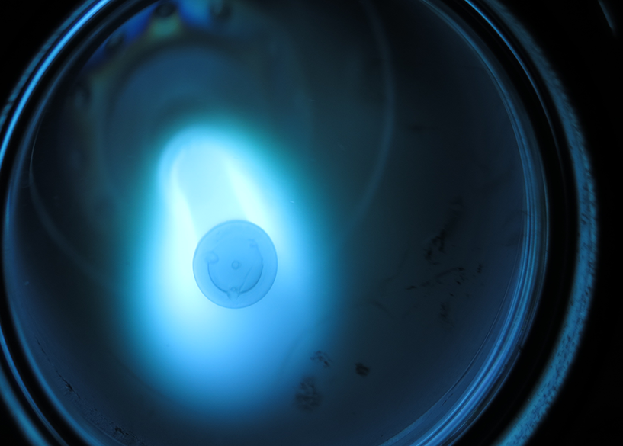
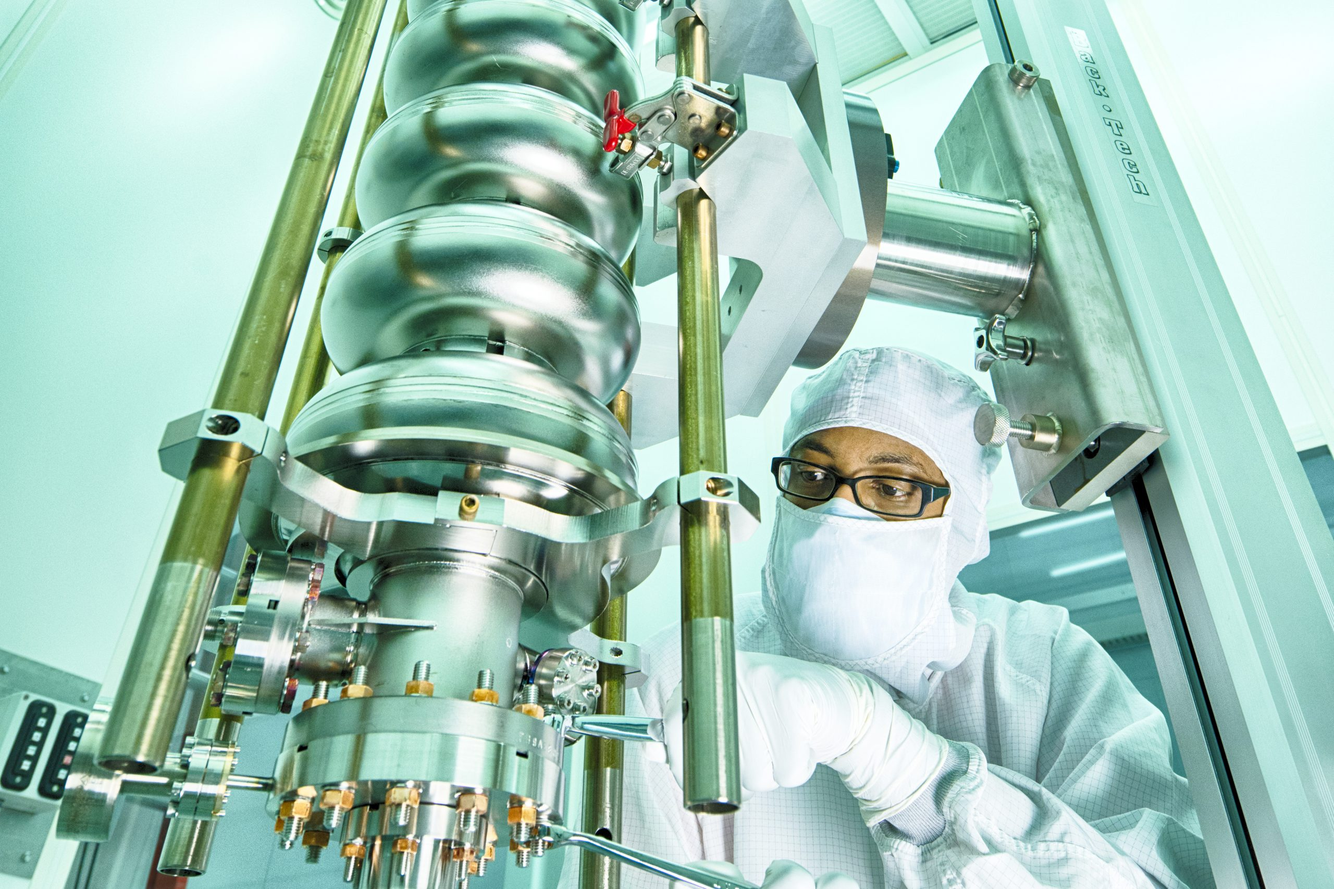
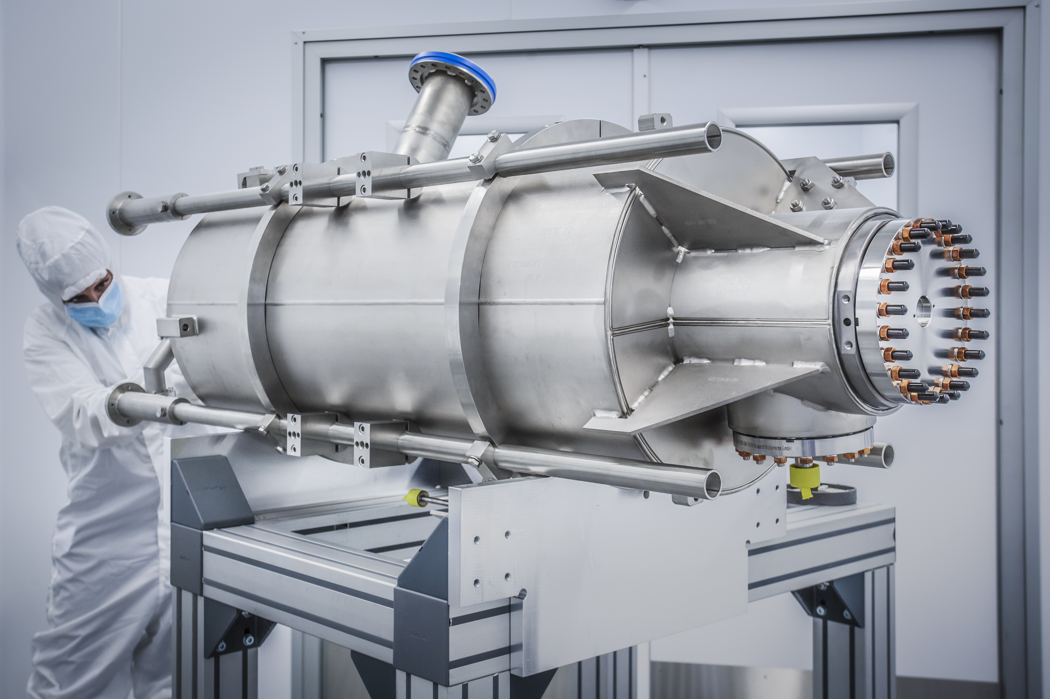

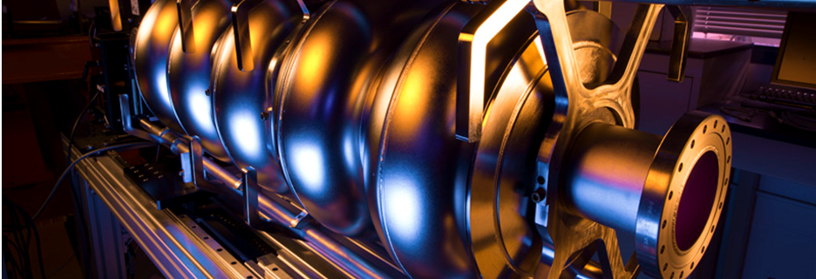
Superconducting RF
Peter McIntosh
STFC Daresbury Laboratory

Slide 2
Outline
HEP Facility SRF Requirements:
  FCC
  ILC
  Muon Collider – High SRF performance targeted!
  LHeC (ERL) – Highest SRF sustainability targeted!
R&D Priorities and Timescale Expectations.
SRF Technology Developments:
  Bulk-Nb cavities.
  Thin Film cavities.
  Ferro-Electric Fast Reactive Tuners (FE-FRT).
Sustainability Priorities.
Outlook.
}
Highest SRF performance targeted!

Slide 3
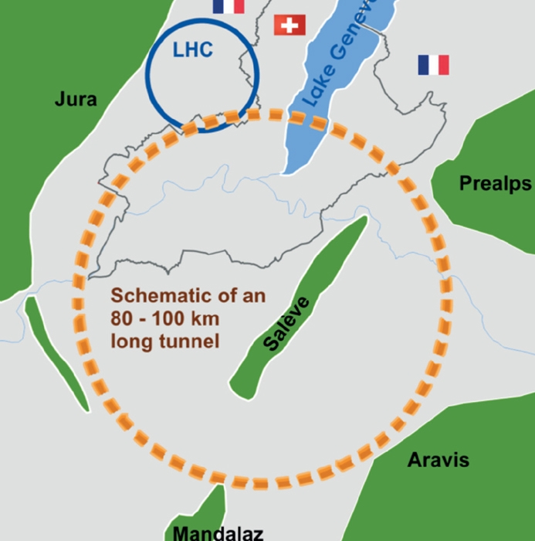
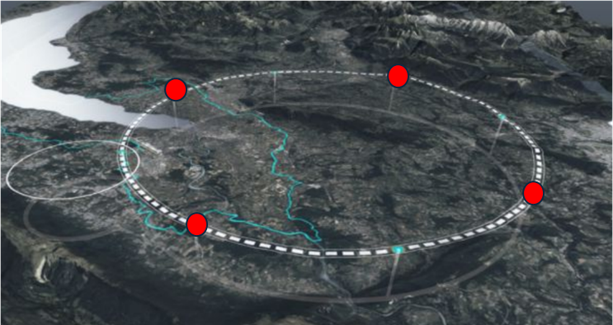
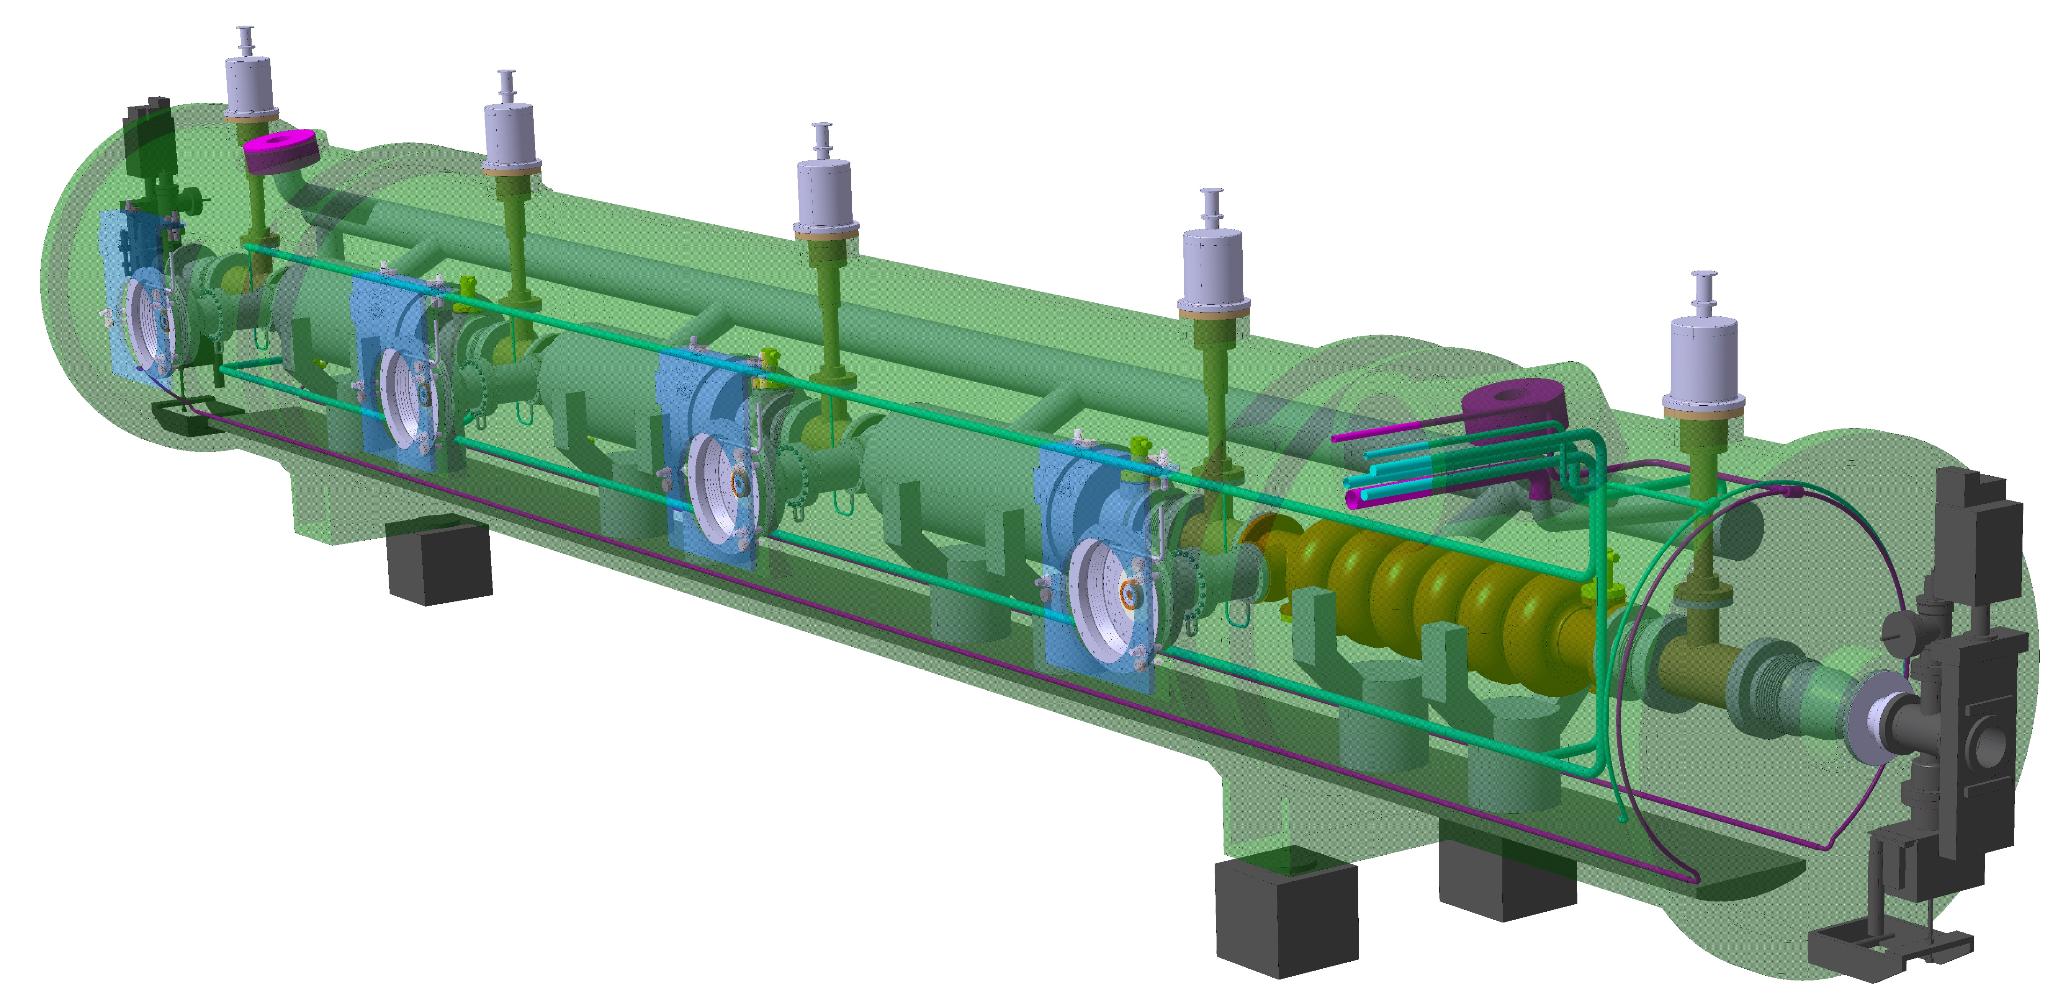
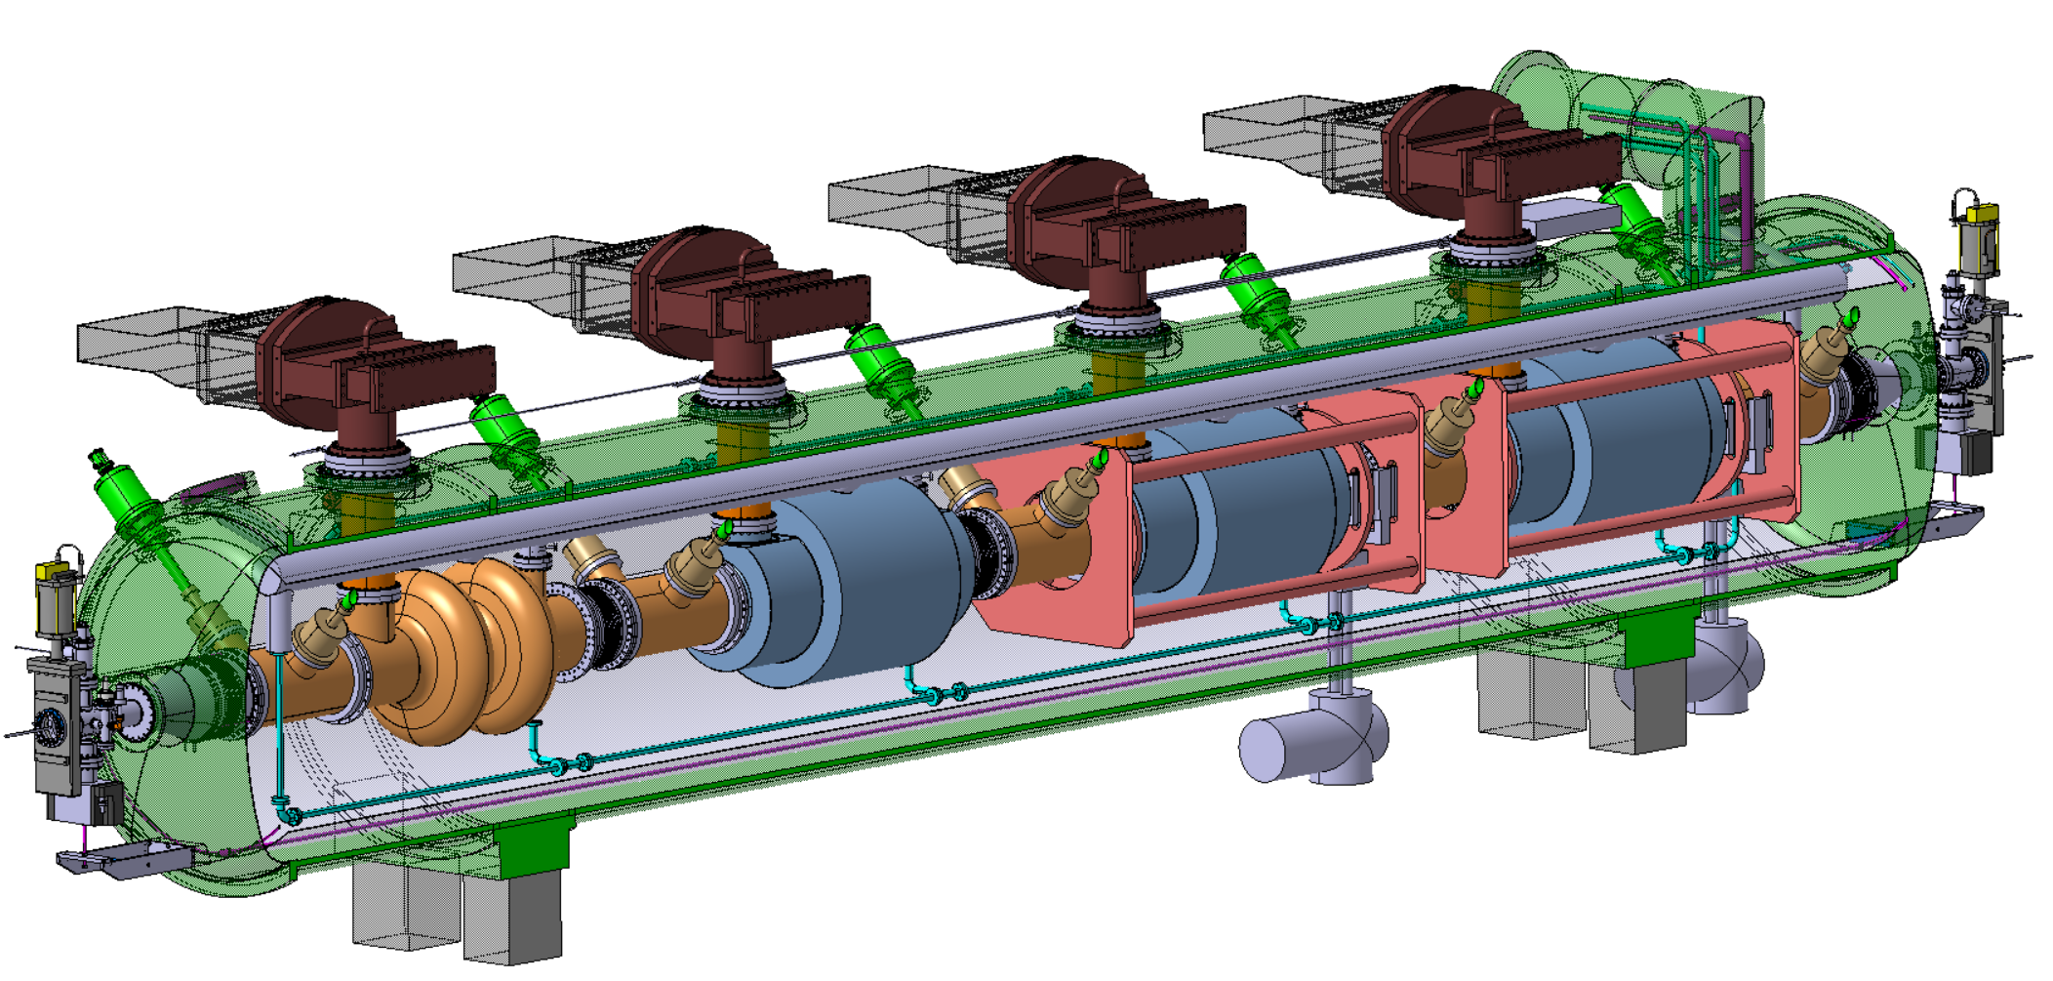
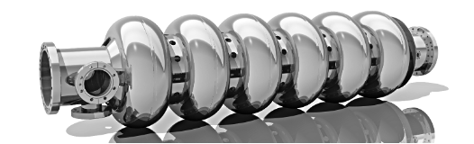
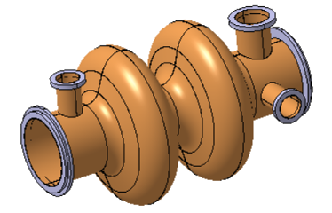

FCC_{ee} SRF Systems
Collider RF system (400 MHz and 800 MHz)
Booster RF system (800 MHz)
Z-WW-ZH
ttbar
448
264
408
+
112
66
102

Slide 4
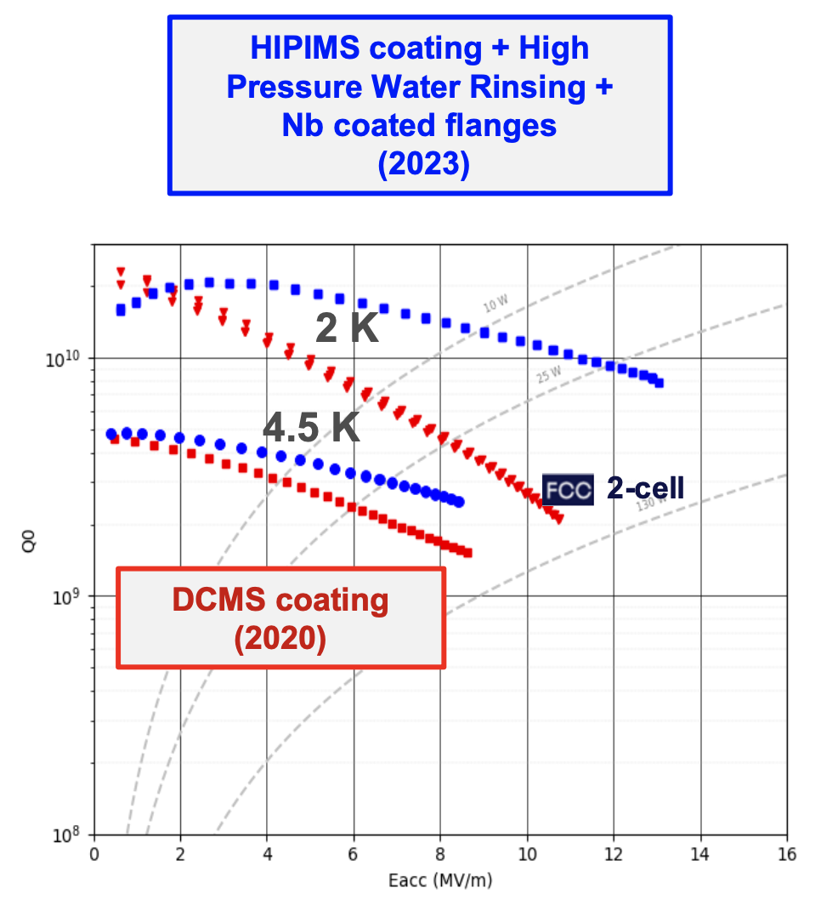
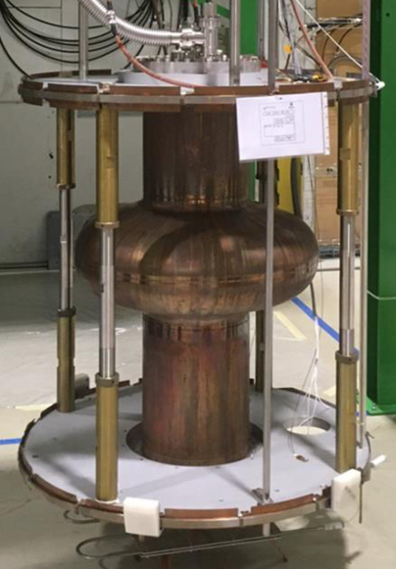

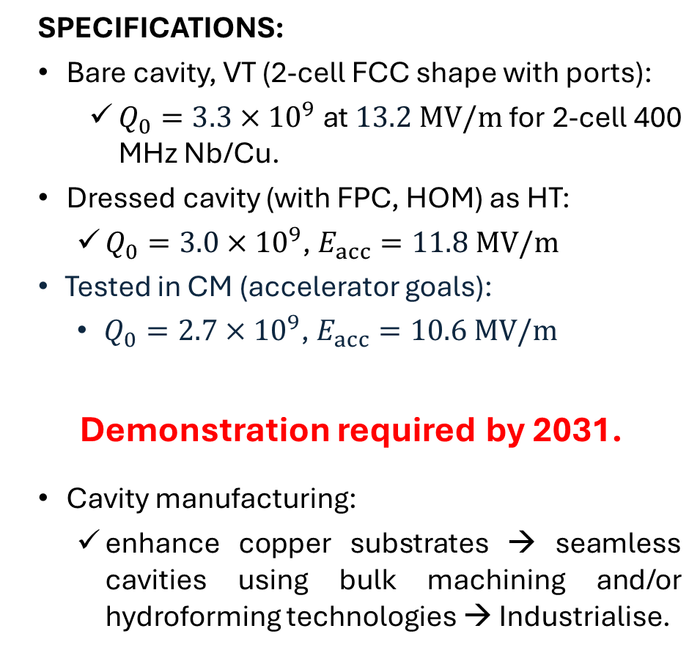
400 MHz, 2-cell, Nb/Cu (thin film sputtering)
SPECIFICATIONS:
Bare cavity, VT (2-cell FCC shape with ports):
  $Q_{0}=3.3×{10}^{9}$ at $13.2 MV/m$for 2-cell 400 MHz Nb/Cu.
Dressed cavity (with FPC, HOM) as HT:
  $Q_{0}=3.0×{10}^{9}$, $E_{acc}=11.8 MV/m$
Tested in CM (accelerator goals):
  $Q_{0}=2.7×{10}^{9}$, $E_{acc}=10.6 MV/m$
Demonstration required by 2031.
Cavity manufacturing:
  enhance copper substrates → seamless cavities using bulk machining and/or hydroforming technologies → Industrialise.
TODAY:
Single-cell LHC bare cavity, no ports:
  $Q_{0}=\sim 2.2×{10}^{9}$ at $E_{acc}=\sim 8.2 MV/m$
TRL4
Pre-
prototype
TRL5 pre-prototype in lab
TRL6
TRL7
Prototype
approved
See Michael Benedikt (CERN) talk @ ESPPU2025
4

Slide 5
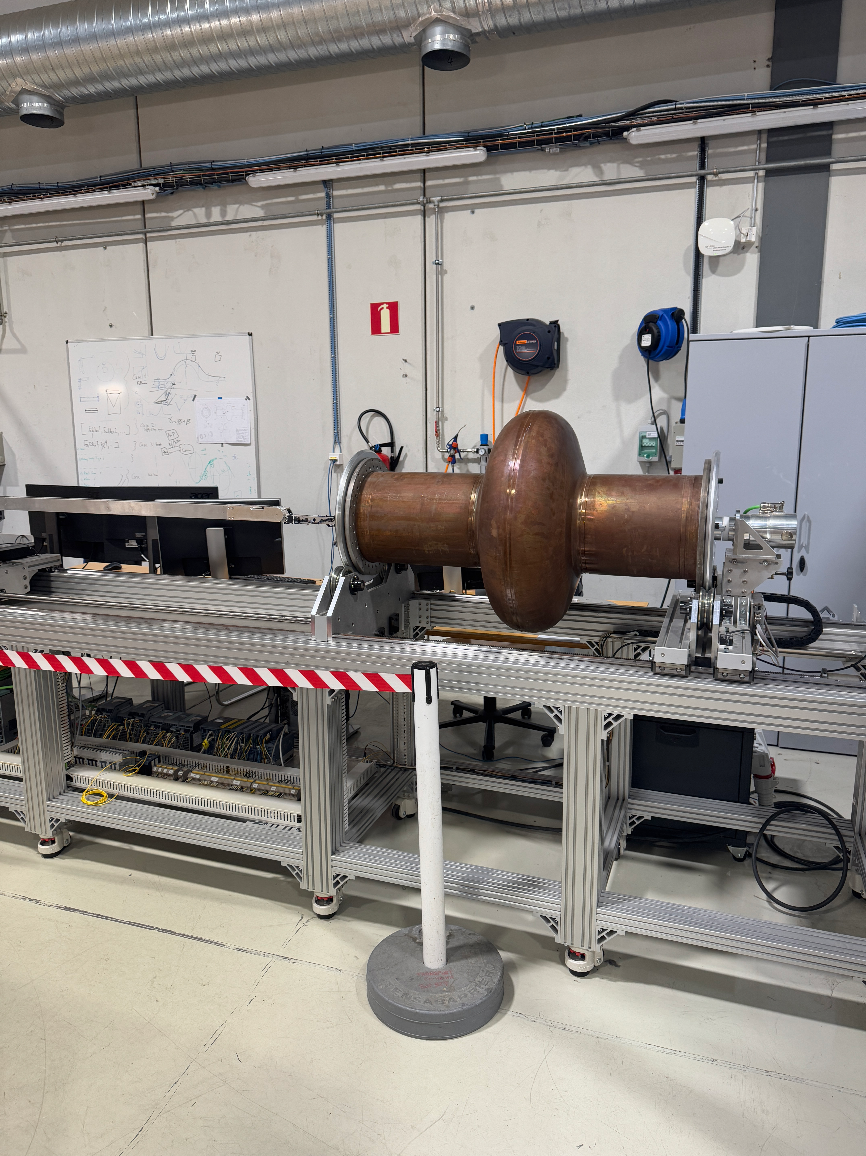
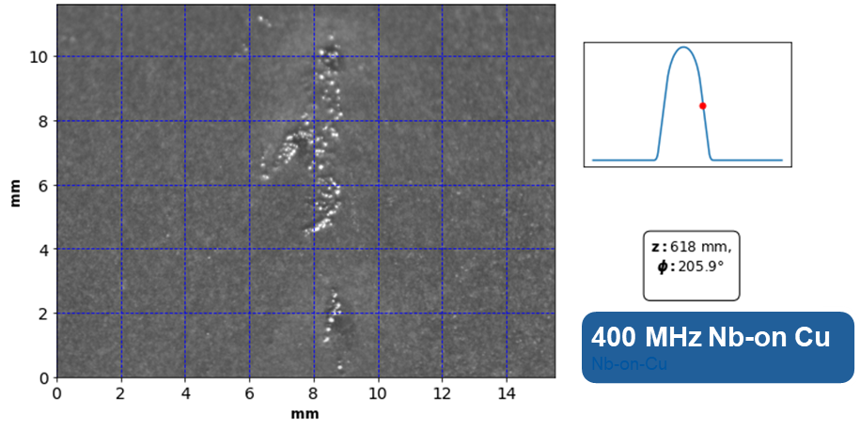
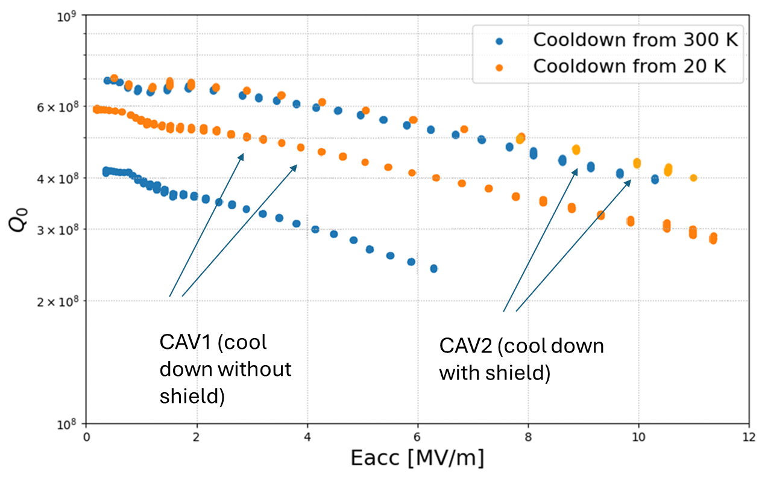
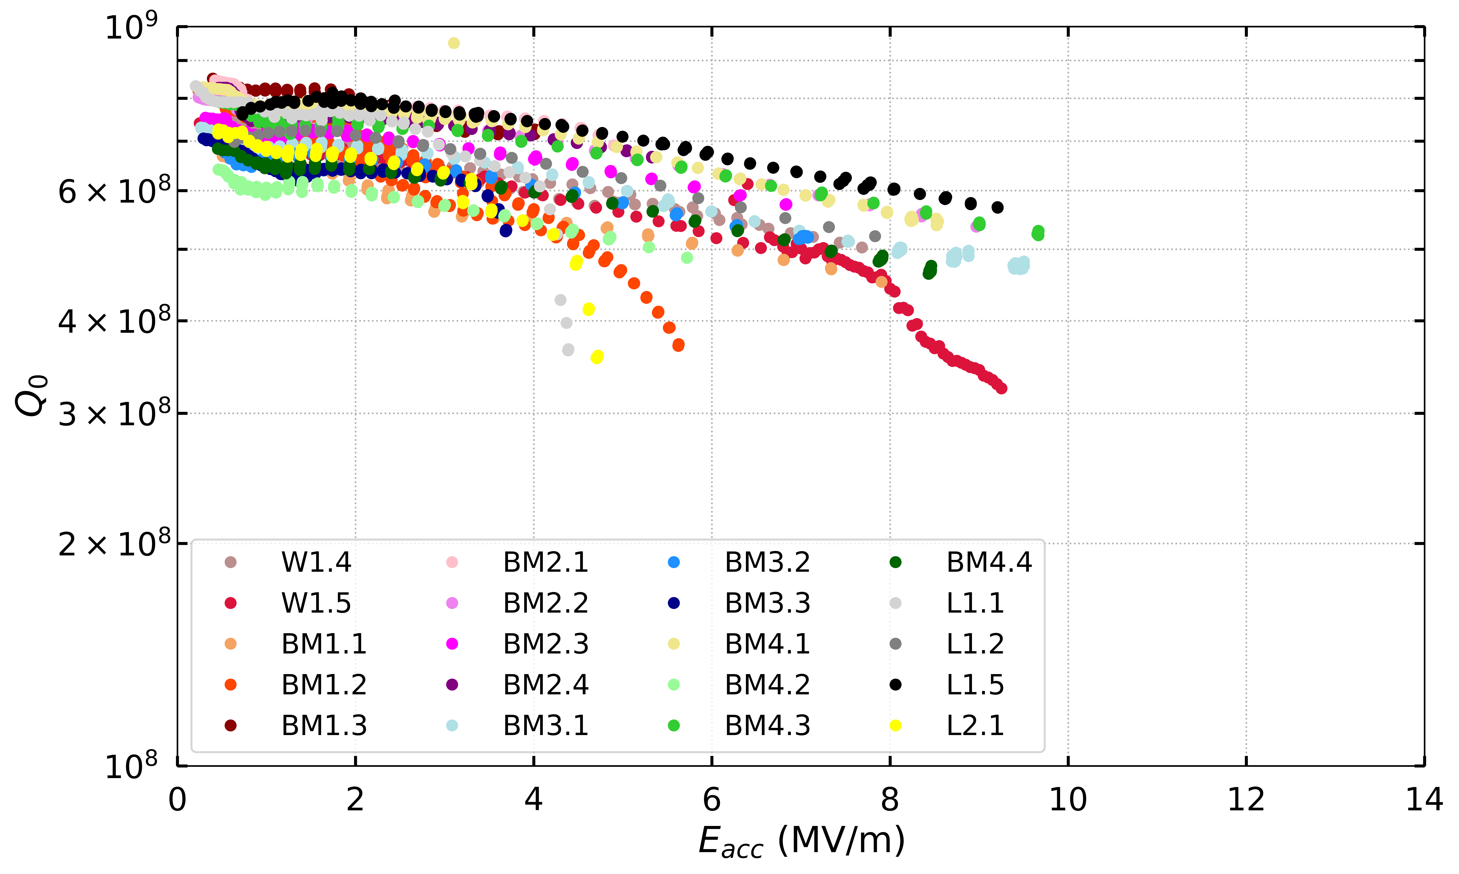
Thin-Film Developments (Nb and Nb₃Sn)
High Q (understand mechanisms of spurious losses/residual resistance):
  Refine substrate preparation and coating parameters.
  Thermal mapping + optical inspection.
  Flux trapping in different SRF structures.
High field:
  Improving cleanliness chain, SRF process infrastructure.
  Moderate activity on bulk Nb and SIS structures.
Optical Bench
Thermoelectric Currents – flux trapping
Rs Control
W Venturini and S Zadeh (CERN), FCC Week, May 2025

Slide 6
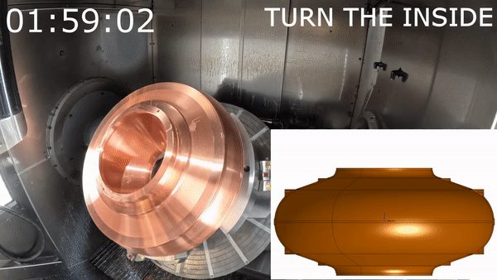
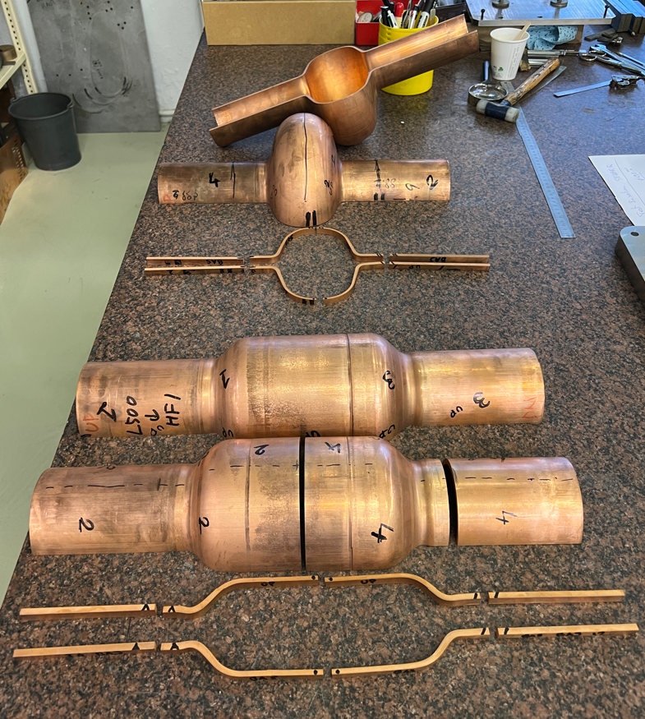
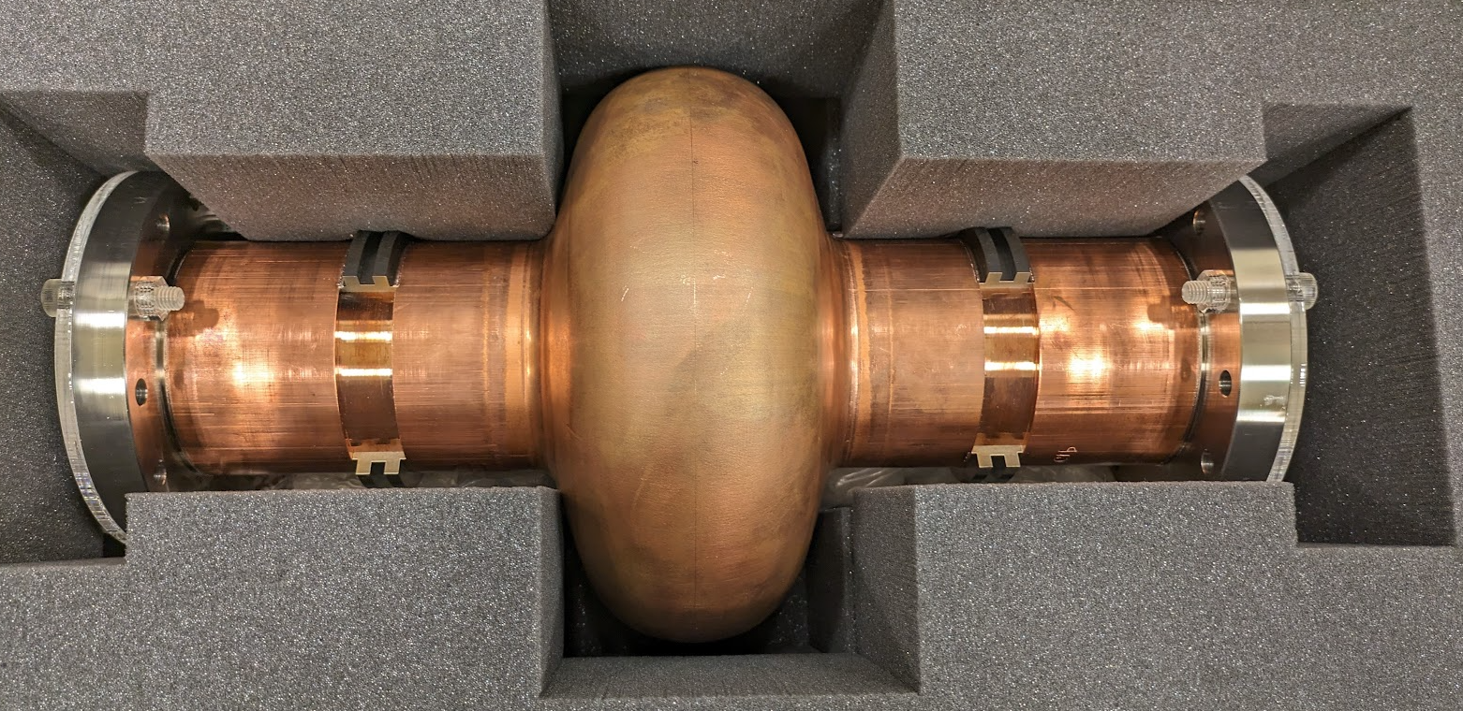
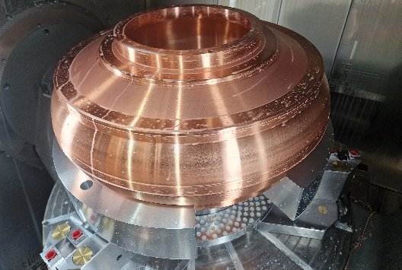
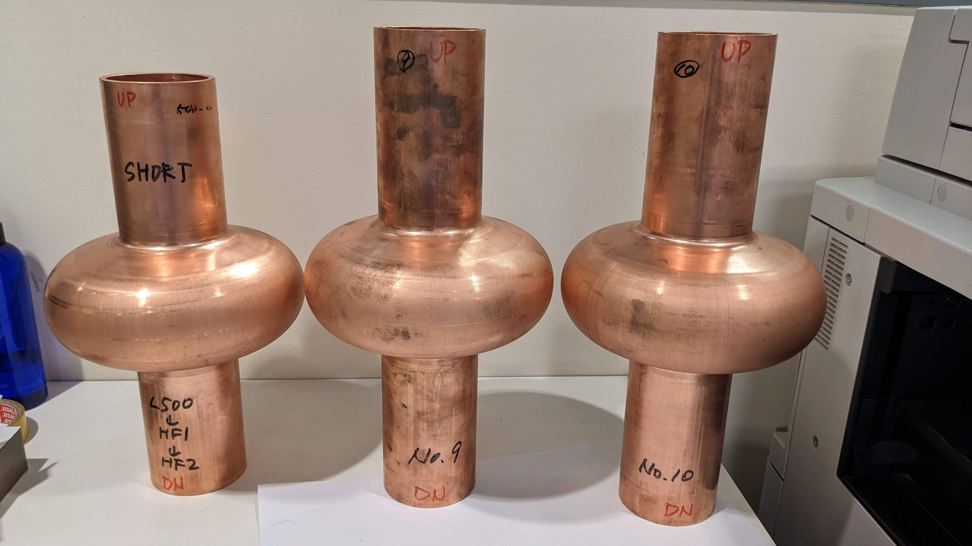
Substrate Cavity Manufacturing
Explore novel fabrication methods: Bulk machining, Hydroforming, Electro-forming.
Develop non mechanical tuning.
Explore novel cooling methods.
400 MHz Monoblock prototype
1.3 GHz hydroforming (KEK Collaboration)
M. Garlasche, S. Atieh, et. al

Slide 7
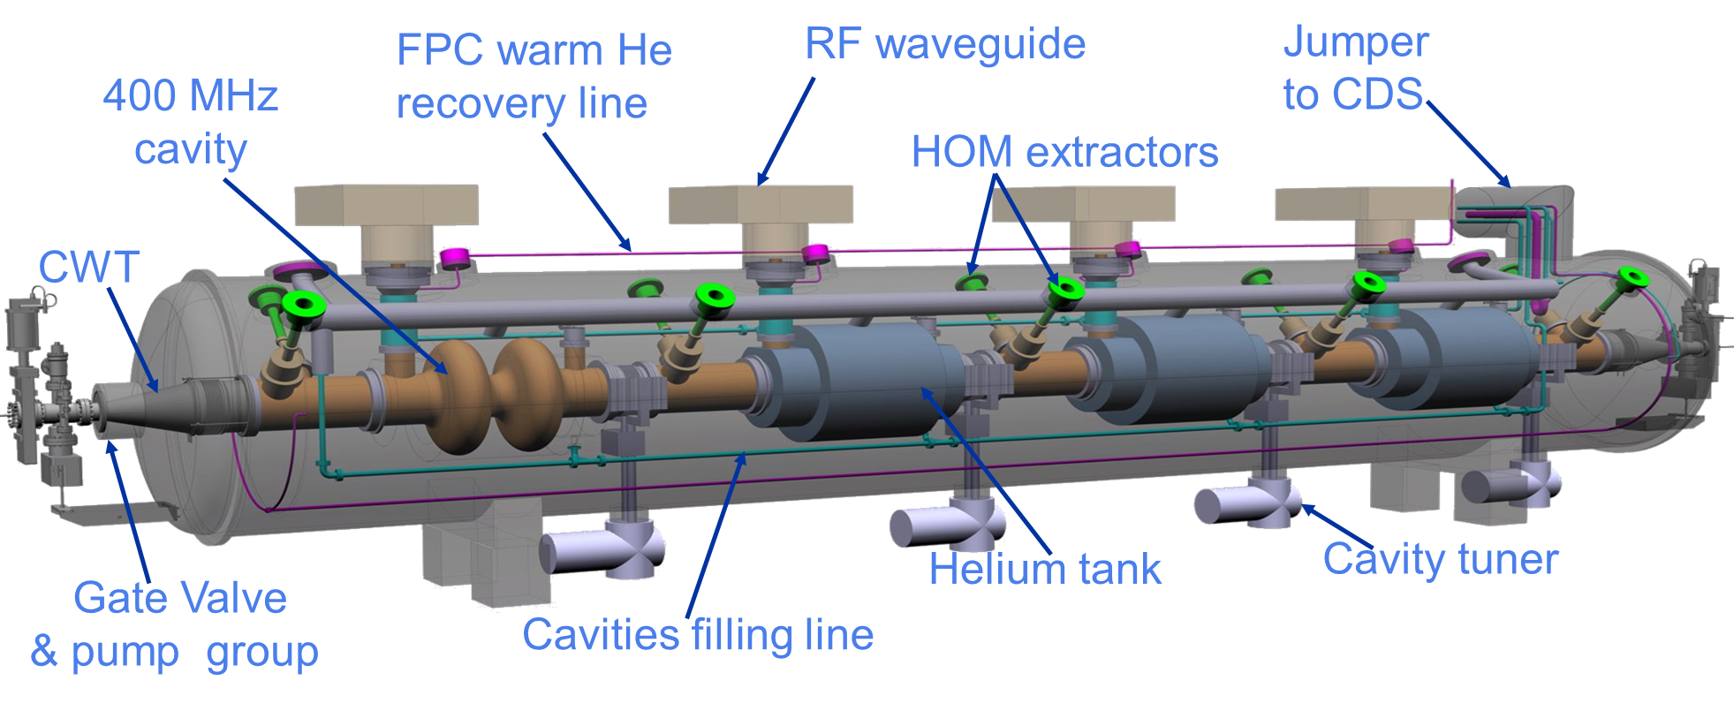
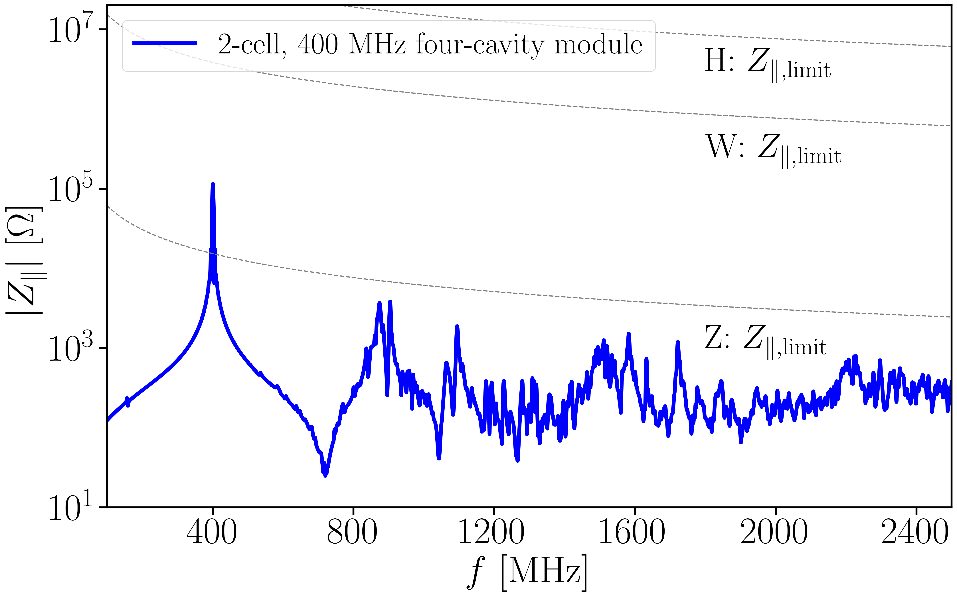
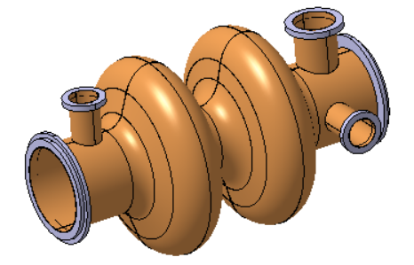
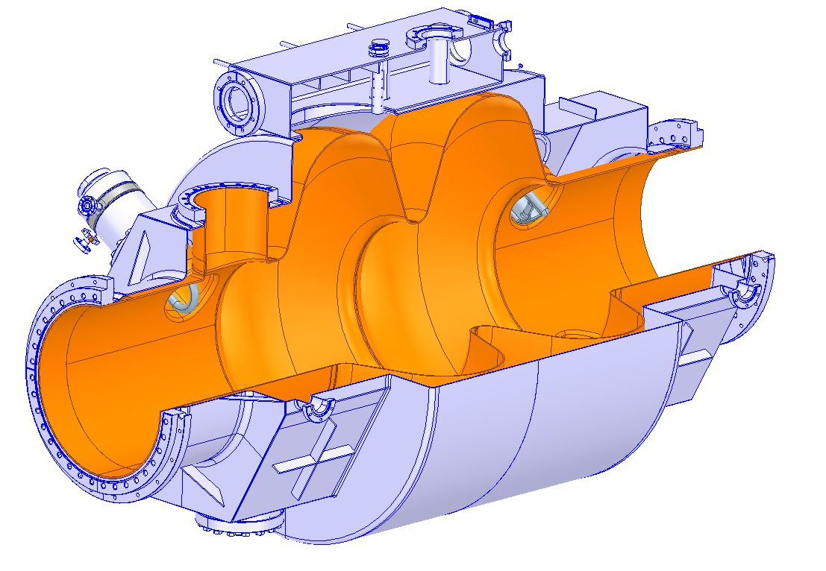
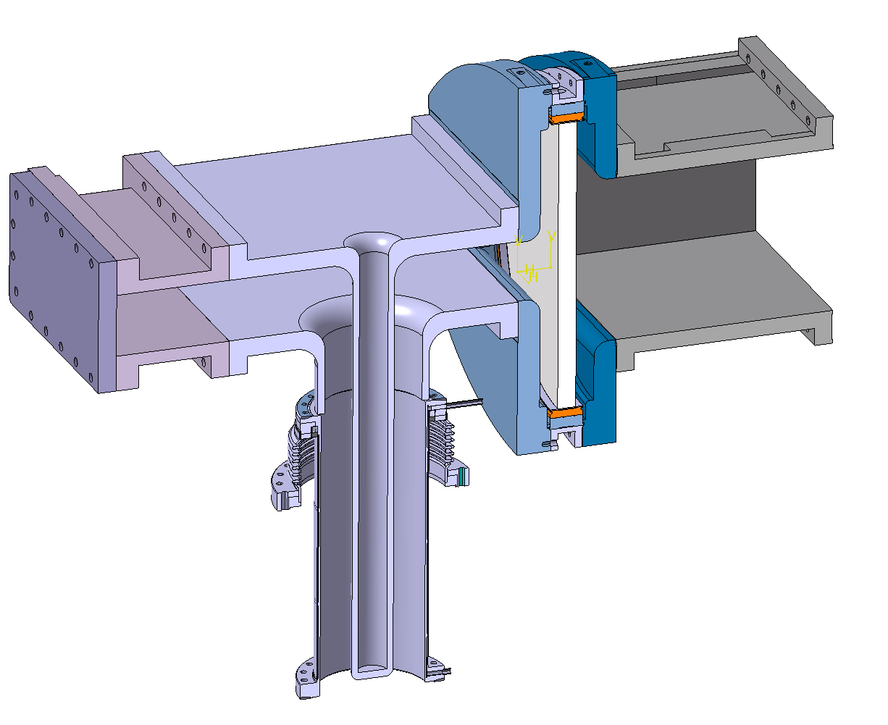
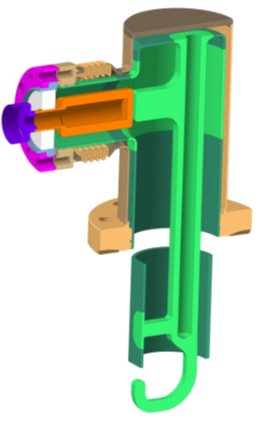
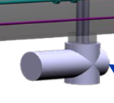
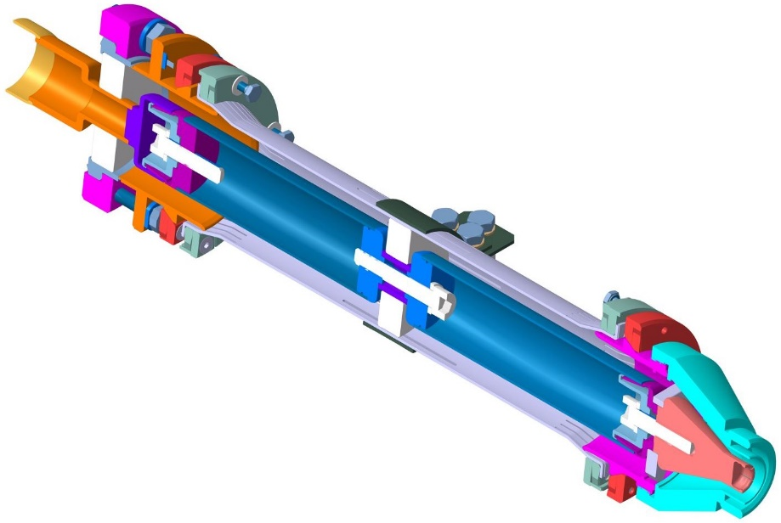
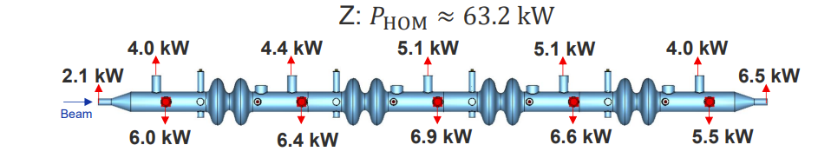
400 MHz Demonstration - Full-size Cryomodule
Parameter (machine installed) | Value
No. cryomodules | 66
2-cell cav/CM | 4
CM length | ~ 11 m
RF frequency (MHz) | 400.79
Cavity voltage (MV) | 7.95
Cavity gradient Eacc (MV/m) | 10.6
Qo | 2.7E+09
Dyn. HL (CW)/cavity at 4.5 K | 129 W
Stat. HL/CM | 197 W
Environ. Magnetic field | ≤ 5 mG
RF power (kW, CW) | 380
Q _{L} (optimum coupling) | 9.2E+05
HOM power per CM: Z (W/H/ttbar) | 63.2 kW (coax. Extractor for 15/20 kW peak!)
Items to be designed, built and qualified (non exhaustive list!)
Cavity Nb sputtered
He tank (LHC design shown)/cavity assy
Tuning system
FPC (with WG windows)
HOMs, RF extraction lines (LHC/Crab designs shown)
V Parma (CERN), FCC Week, May 2025

Slide 8
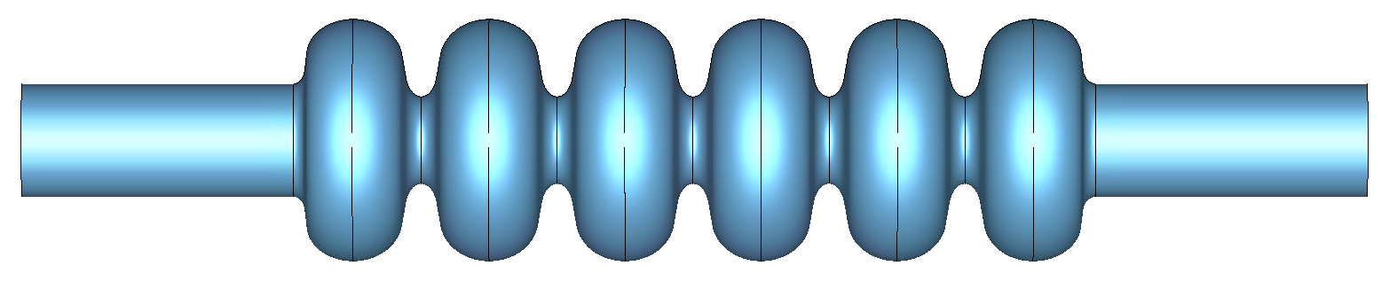
800 MHz, 6-cell, Bulk-Nb
SPECIFICATIONS:
6-cell (FCC shape) prototype with ports: 3.8 x 10¹⁰, ~25 MV/m in VT.
Tested in HT with FPC and HOMCs with 3.5 x 10¹⁰, 22.5 MV/m.
Tested in CM with 3 x 10¹⁰, 20.25 MV/m.
Demonstration required by 2031.
TODAY:
5-cell prototype w/o ports, built by JLAB: 3 x 10¹⁰, ~30 MV/m in VT.
JLAB shape (all cells the same)
TRL5
Pre-prototype
in lab
TRL4
Pre-
prototype
TRL6
TRL7
Prototype
approved
FCC
F Marhauser (Jlab), IPAC18, THPAL146

Slide 9
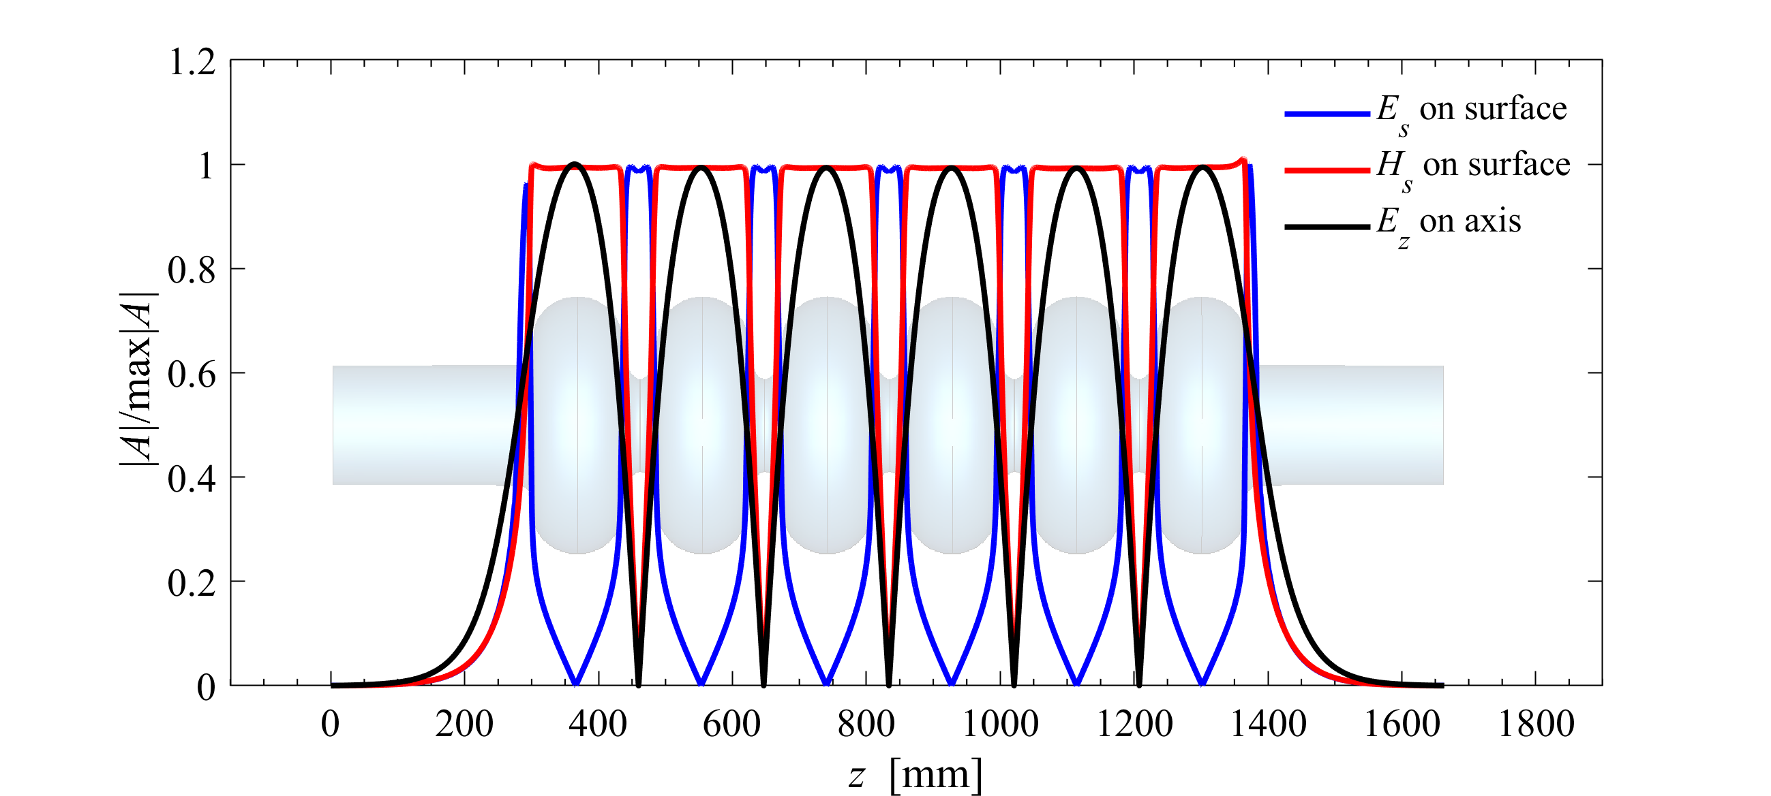
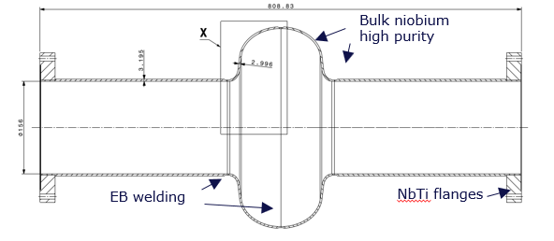
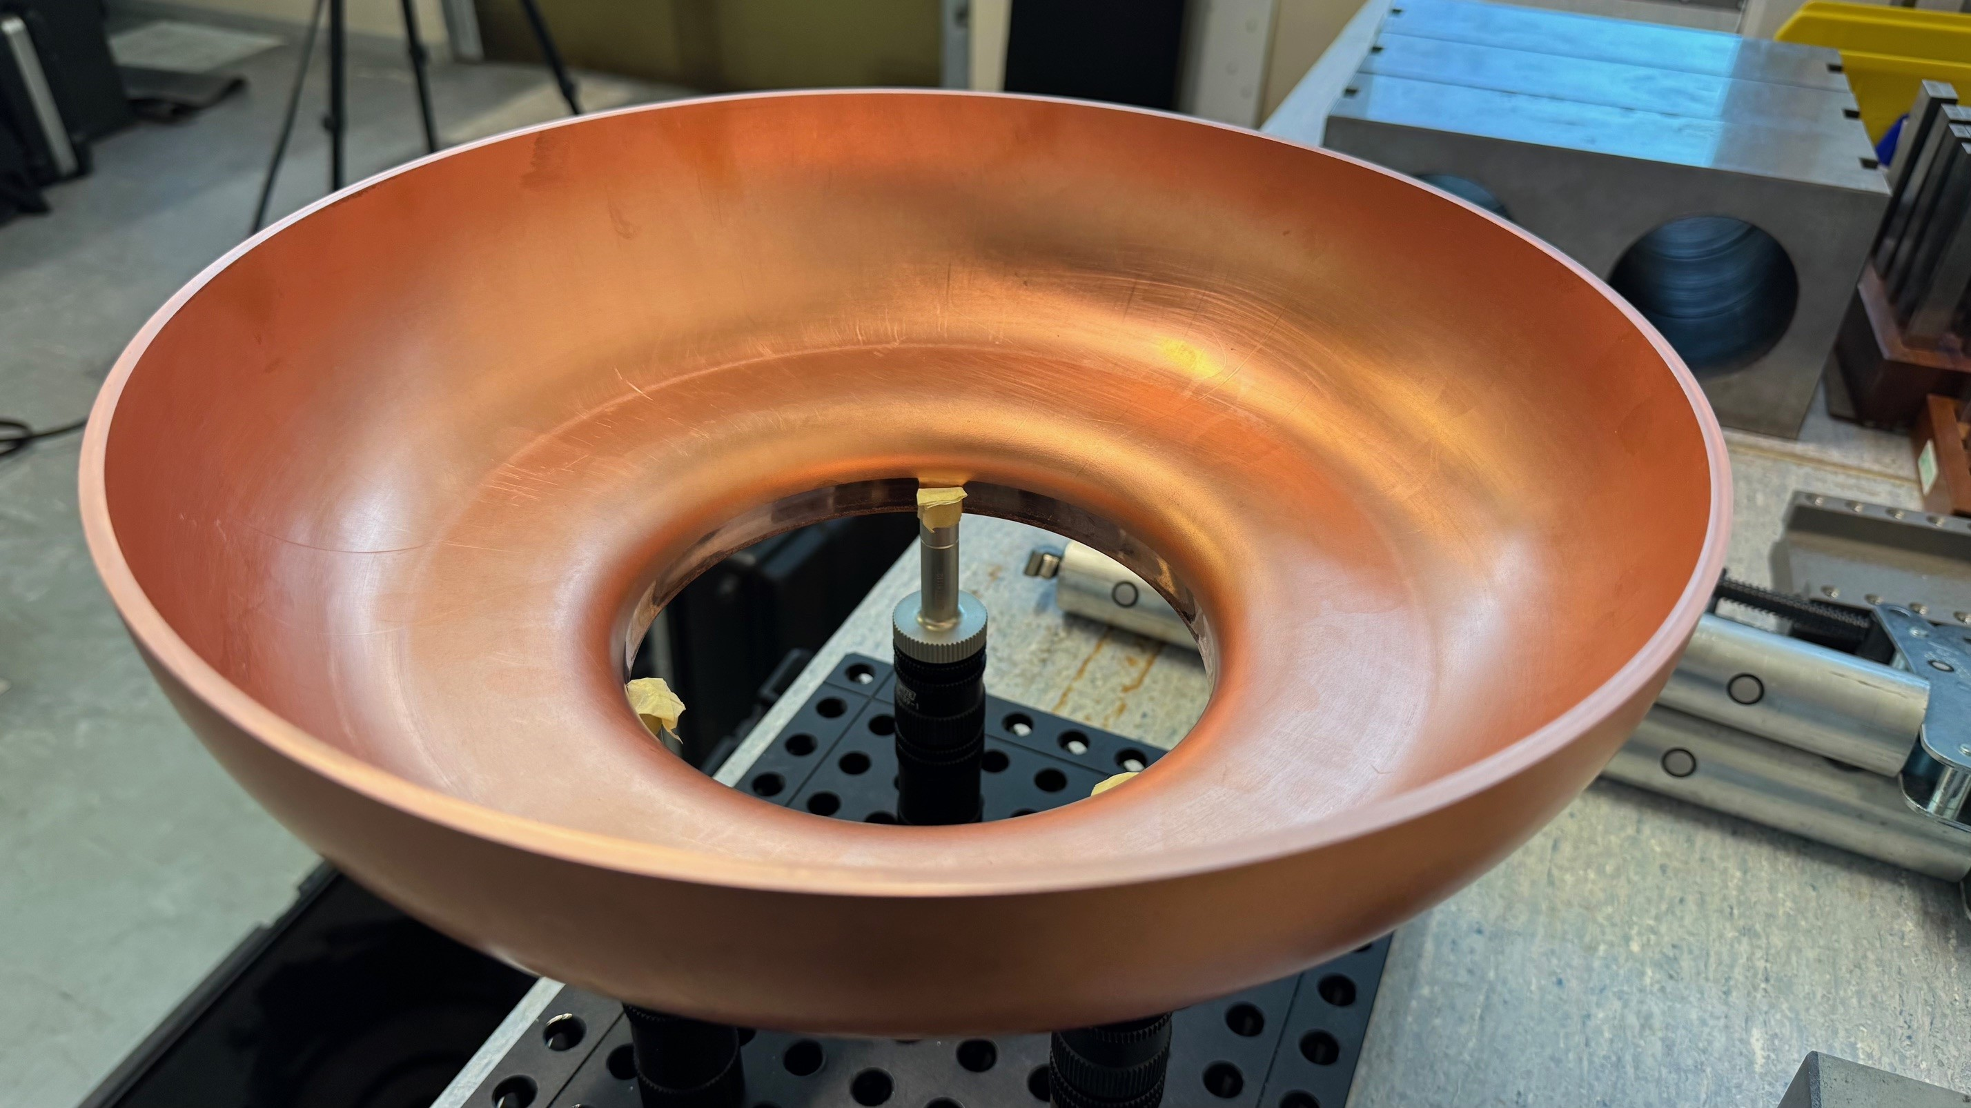
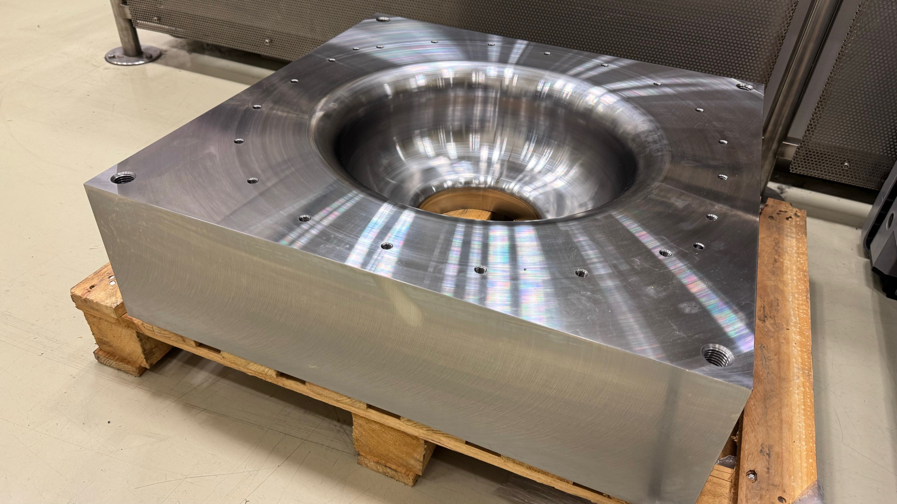
6-cell 800 MHz Cavity
Courtesy Marco Chiodini
Cavity shape:
  6-cell 800 MHz cavity → in total 856 cavities for booster and tt-bar collider.
  Asymmetric end-cell shape for better HOM damping
  1 port for FPC, 4 ports for HOM couplers, 1 port for pick up antenna and 1 port for FRT.
Material:
  Bulk Nb with EP and doped RF surface.
  Nb₃Sn coating as an option to operate at 4.5 K.
Fabrication and R&D program:
  Fabrication of 10 single-cell cavities at CERN.
  Collaboration with international partners to achieve required high Q₀: FNAL, IJCLab (LHeC/PERLE) and Cornell.
112 cavities for Z, W and H booster
408+336 additional cavities for ttbar operation
Courtesy Laurent Prever-Loiri
Deep drawing tests performed on copper sheets
Courtesy F. Peauger (CERN)

Slide 10
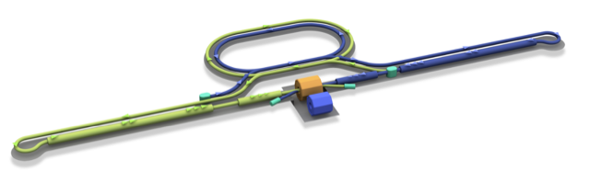
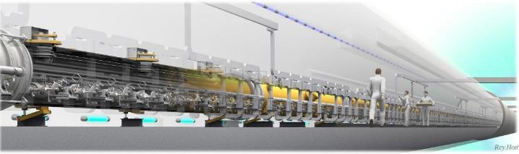

ILC250 RF Requirements (incl. input to LC Vision)
Damping Ring
e+ Source
e- Source
e- Main Linac
Interaction point
Parameters | Value
Beam Energy | 125 + 125 GeV
Luminosity | 1.35 / 2.7 x 10³⁴ cm²/s
Beam rep. rate | 5 Hz
Pulse duration | 0.73 / 0.961 ms
# bunch / pulse | 1312 / 2625
Beam Current | 5.8 / 8.8 mA
Beam size (y) at FF | 7.7 nm
SRF Field gradient | < 31.5 > MV/m (+/-20%) Q₀ = 1x10¹⁰
#SRF 9-cell cavities (CM) | ~ 8,000 (~ 900)
AC-plug Power | 111 / 138 MW
~20km
e+ Main Liinac
Detectors
e+
e-
TDR was published in 2013 and SRF technology became matured by large-SRF accelerators (European XFEL, LCLS-II etc.).
Source
Nano-Beam Technology
SRF Technology
See Shoji Asai (KEK) talk @ ESPPU2025

Slide 11
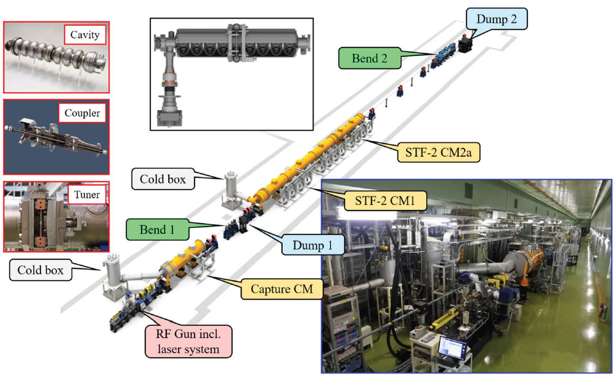
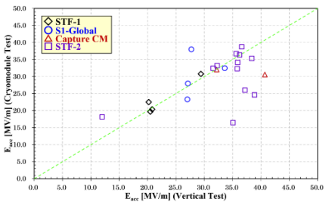
1.3 GHz, 9-cell, Bulk-Nb
TODAY:
STF-2 CM achieved Avg. E_{acc} of 32.9 MV/m @ Q₀ > 1 x 10¹⁰.
SPECIFICATIONS:
Demonstrate cavity performance improvement using alternative processing i.e. N2-doping/infusion and/or mid-T/2-step baking.
Cavity industrialisation to robustly achieve >35 MV/m (± 20%) at >1 x 10¹⁰ in VT.
Cavities tested in CM with >31.5 MV/m (± 20%) at >1 x 10¹⁰.
TRL7
Approved
prototype
TRL7
Approved prototype
TRL8
TRL8
Pre-
production
ready
EP
Note:
LCF@CERN increased Q₀ specification to 2 x 10¹⁰
8/14 cavities reached 31.5 MV/m
Y. Yamamoto (KEK), SRF21, Jun 2021
See S. Stapnes (CERN) talk @ ESPPU2025

Slide 12
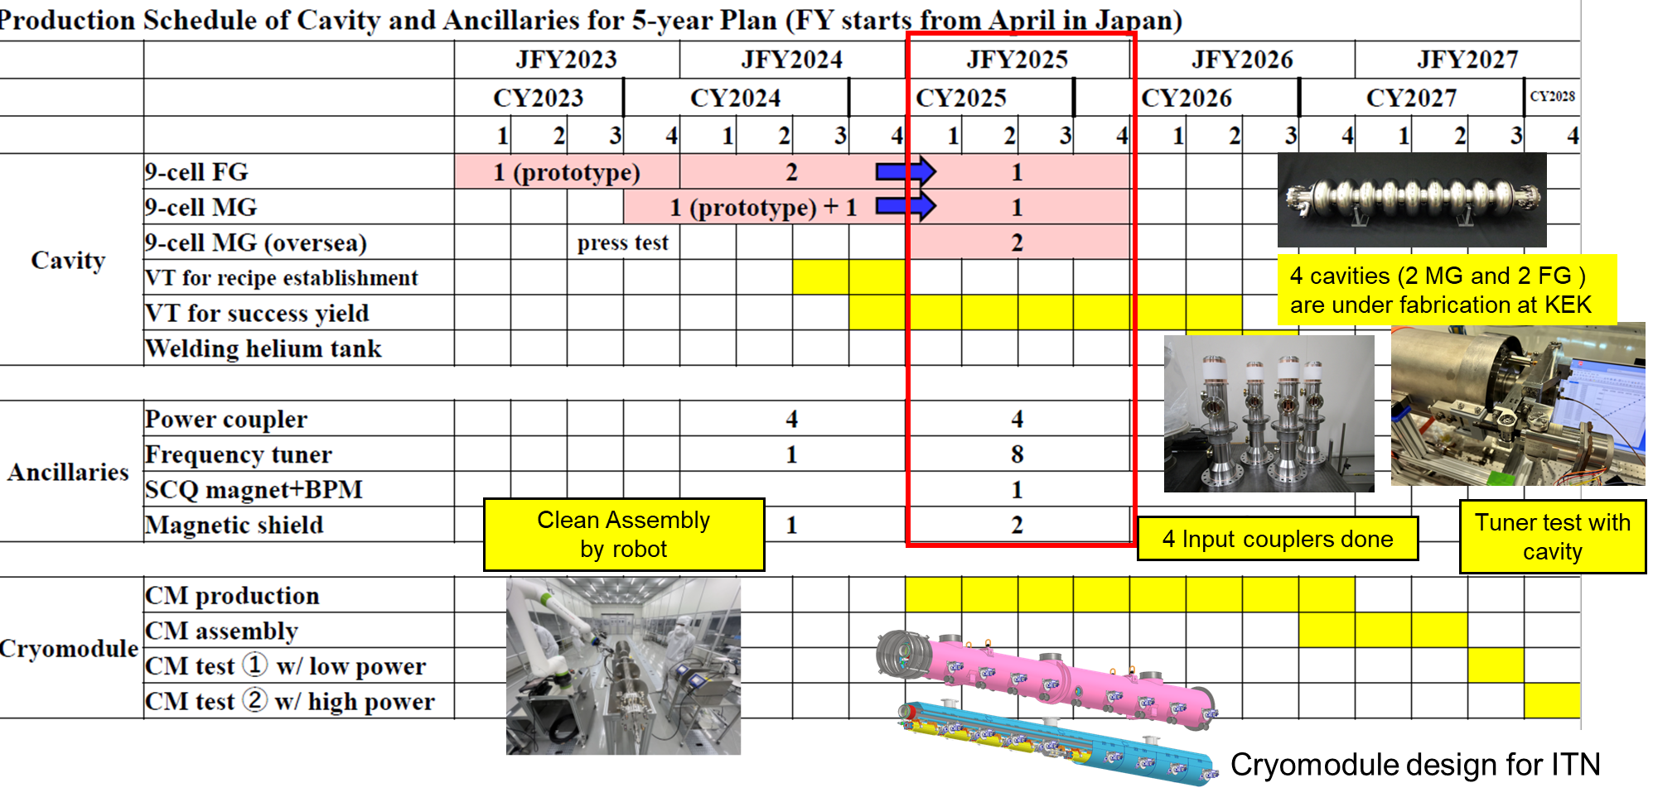
ITN 5-yr plan (FY2023～27) under MEXT/ATD
In 2027, we plan to complete ITN cryomodule and perform high power test at KEK.
H Sakai (KEK), IPAC25, Jun 2025

Slide 13
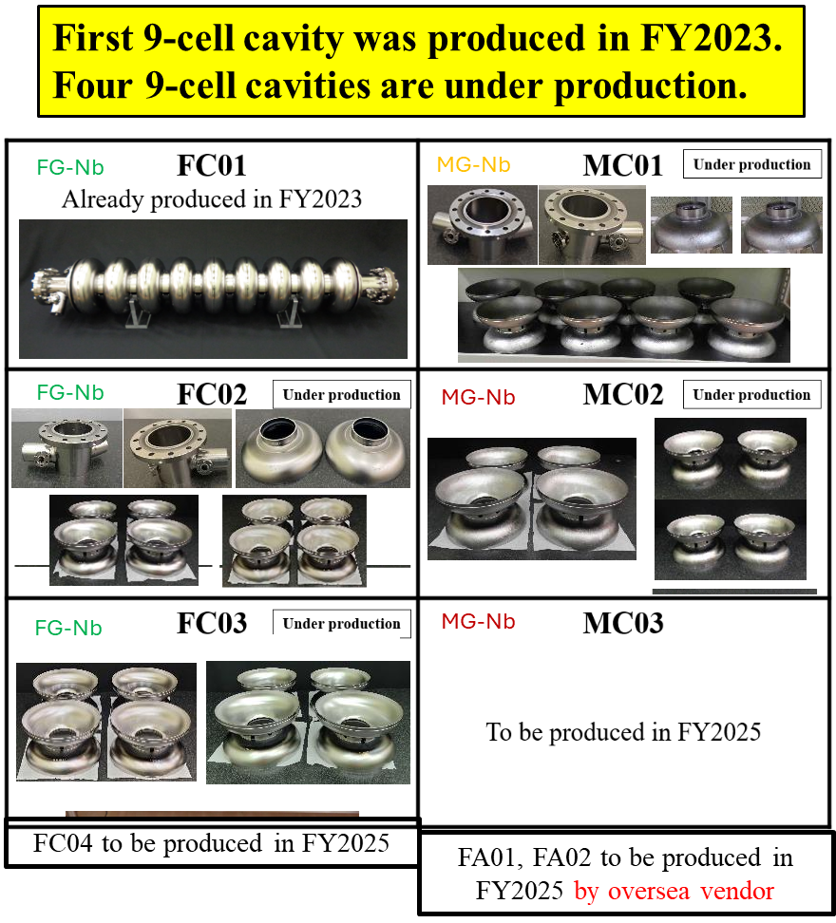
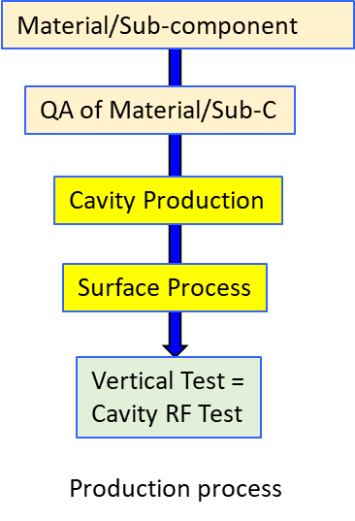
Cavity Fabrication (1-cell and 9-cell)
In Asia at KEK and Korea U:
In Europe at CEA, CERN and INFN:
  9-cell Industrialisation: Objectives:
  Production of 9-cell jacketed cavities at EU industries (RI and Zanon).
  Qualification of EU Industries in terms of High Pressure Gas Safety (HPGS) regulations in Japan.
  Nb material to be ECS qualified in 2025.
  Installation into an ILC type cryomodule (KEK) of 2 EU cavities by end 2026.
Fine Grain
Medium Grain
Nb: MG cheaper (~35%), but more difficult to manufacture than FG.

Slide 14
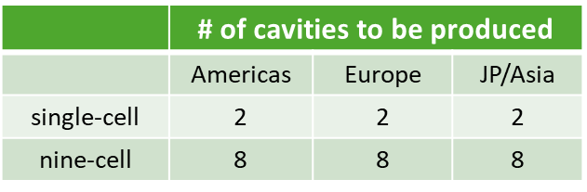

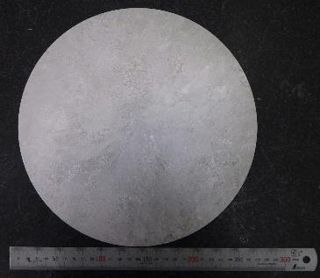
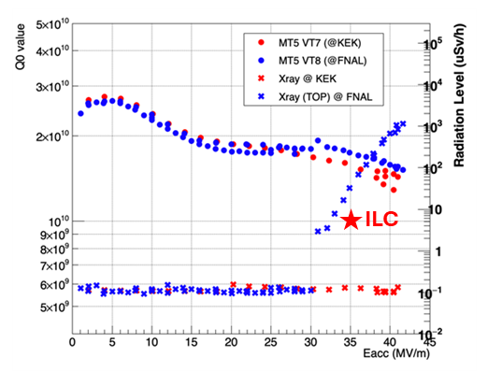

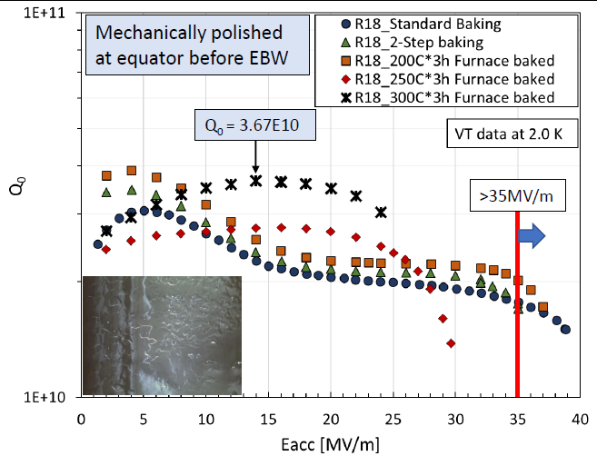
SRF Cavity Industrial Production Readiness
R&D with single-cell cavities to establish the best production process incl:
  Advanced Nb sheet production method.
  Advanced surface treatment recipe (mainly developed by FNAL).
Globally common design with compatible High Pressure Gas Safety (HPGS) regulation.
24 x 9-cell cavities to be developed for industrial-production readiness:
  8 cavities in each region.
  Production Yield Targeted = ≥90%.
Results from FG 9-cell cavity using 2-step baking KEK and FNAL
Possible to achieve > 40 MV/m with high Q₀
  Advanced Nb sheet production by direct slicing
Advanced surface treatment technologies pioneered by FNAL
MG Nb sheet

Slide 15
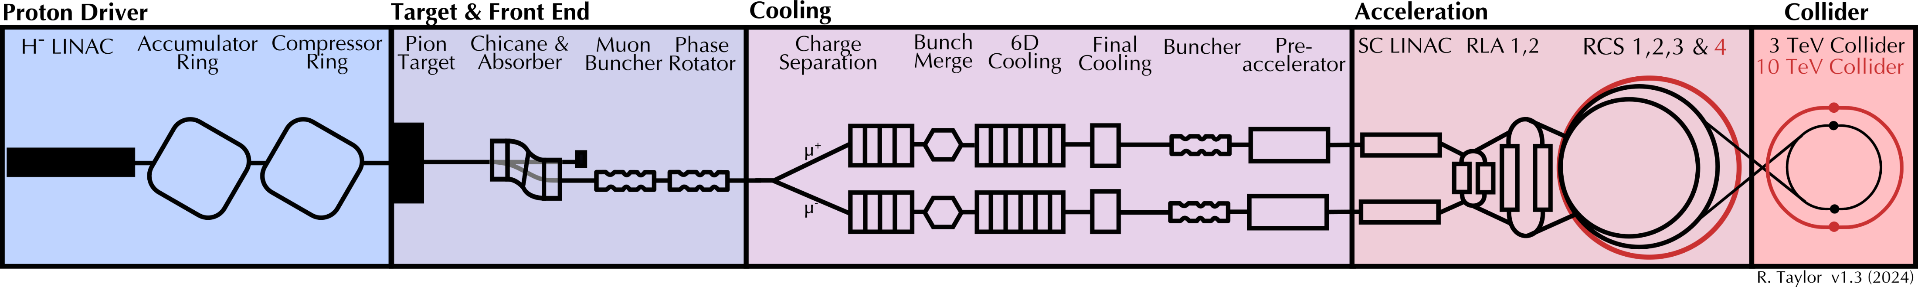
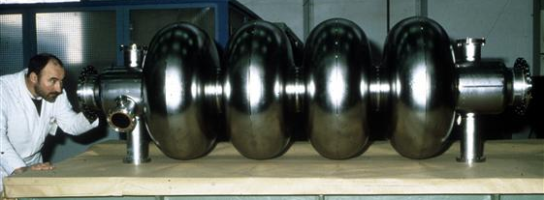

Muon Collider RF Requirements
RF
RF
RF
RF
RF
RF
RF
RF
RF
RF
RF
RF
RF
352/1056 MHz, SRF
352/704 MHz, NC in high B-field
1.3 GHz, SRF
Super-conducting RF for acceleration:
High charge, short bunch.
High efficiency at high gradient.
Maintain beam quality.
Longitudinal and transverse stability.
Fast frequency tuning to match magnet ramp.
Management of beam loading/wakefields.
TRL 3
Proof of Concept
LEP2 (352 MHz)
TRL 3
ILC (1.3 GHz)
See Daniel Schulte (CERN) talk @ ESPPU2025

Slide 16




MC SRF Specifications
Proton Driver
Acceleration
 | RLA2
 | Acc. Cav. | Lin. cav. | Total
RF frequency [MHz] | 352 | 1056
Number of cells per cavity | 4 | 6
Synchronous phase [deg] | 95 | 275
Nominal Gradient: E_{acc} [MV/m] | 15 | 25
Combined beam current (µ+, µ-) [mA] | 134
Q_{ext} of the input coupler | 0.4E6 | 0.2E6
Total RF voltage [GV] | 15.2 | 1.7 | 16.9
Number of cavities | 600 | 80 | 680
Number of cryomodules | 200 | 16 | 216
Total RF section length [m] | 1110.6 | 80.8 | 1191.4
RF duty factor [%] | 0.19 | 0.05
Peak RF power [kW/cavity] | 3425 | 2965
Total average RF power [MW] | 5.16 | 0.16 | 5.32
 | RCS
RCS | 1 | 2 | 3 | 4 | Total
RF frequency [MHz] | 1300
Number of cells per cavity | 9
Synchronous phase [deg] | 135
Nominal Gradient: E_{acc} [MV/m] | 30
Combined beam current (µ+, µ-) [mA] | 43.3 | 39 | 19.8 | 5.5
Q_{ext} of the input coupler | 0.7E6 | 0.8E6 | 1.5E6 | 5.5E6
Total RF voltage [GV] | 20.9 | 11.2 | 16.1 | 90 | 138.2
Number of cavities | 683 | 366 | 524 | 2933 | 4506
Number of cryomodules | 76 | 41 | 59 | 326 | 502
Total RF section length [m] | 962 | 519 | 746 | 4125 | 6351
RF duty factor [%] | 0.19 | 0.57 | 1.22 | 3.36
Peak RF power [kW/cavity] | 1128 | 1017 | 516 | 144
Total average RF power [MW] | 1.9 | 2.8 | 4.4 | 18.9 | 28
Gradients
Power
A Grudiev (CERN), IMCC & MuCol Annual Meeting, DESY, May 2025

Slide 17
MC SRF R&D Timescales (to be initiated)
First 5-years:
Design:
Final frequency choice, re: power and beam dynamics.
Optimisation of cavity for low-energy linac and RLAs and high-energy RCSs.
HOM Coupler and FPC re: collective effects and beam dynamics.
Cavity Tuner for necessary speed/ranges and precision.
Cavity into cryomodule integration.
Challenges:
High muon bunch intensity – larger cavity apertures ⇒ lower RF freq.
Small aperture of 1.3 GHz cavity, may require lower freq.
High gradient demo of multi-cell, low freq cavities.
Low freq cavities, likely to utilise Nb/Cu SRF technology.
Stray magnetic fields and muon decay impacts may degrade SRF cavity performance – need further study.
Next 5-years:
Full RF system conceptual design for linac and RCS’s developed, will include:
  CM designs for cavities at different frequencies,
  RF power and cryogenic distribution, tunnel layout, etc.
Prototypes of the cavities and possibly CMs built and tested to verify the designs.
Improvements in SRF technology over previous 5-yr could increase E_{acc} specs:
  No of cavities could reduce, decreasing the complexity of integration and size of cryo plant.
  Overall power consumption could reduce.
  Further iteration of overall SRF system design might be necessary.
LDG RF Coordination Panel (RFCP) becoming more strongly engaged.

Slide 18


LHeC (ERL) SRF Requirements
802 MHz cavity design for high gradient > 22 MV/m and Q₀ of > 3 x 10¹⁰ (re: FCC_{ee}) and low HOMs. ➔ J-Lab demo and PERLE (IJCLab).
Coupler design: HOM, FPC and FE-FRT couplers ➔ IJCLab, J-Lab and CERN.
CM design and integration ➔ iSAS and ESS collaboration with PERLE.
LLRF tools feedback development with multiple beam energies and acceleration/deceleration modes ➔ PERLE ➔ by 2030.
PERLE test facility at IJCLab to be used as a technology demonstrator.
TRL6
Prototype in
operational
environment
TRL7
Approved prototype
See Jorgen D’Hondt (Nikef) talk @ ESPPU2025
O Bruning (CERN), Front. Phys. 10.886473, Feb 2022

Slide 19



PERLE-LHeC 802 MHz SRF Cavity Development
Challenges:
High dynamic losses → High Q₀.
High HOM excitation → Extraction.
Microphonics detuning and mechanical stability → Fast tuning → FE-FRT.
TODAY:
TRL3
Proof of
Concept
Strong synergy with FCC developments
First Nb 800 MHz 5-Cell cavity
fabricated @ JLAB
Powerful ERL for Experiments (PERLE) at IJCLab
Principal SRF technology demonstrator for LHeC
F Marhauser (JLab), IPAC18, THPAL146
Electron
DC-Photo
Gun
Booster
Cryomodule
ERL
Cryomodule
Dump

Slide 20







Innovate for Sustainable Accelerator Systems (iSAS)
Horizon Europe: Innovate for Sustainable Accelerator Systems (iSAS):
  13 M€, 1000 person months,
  17 partners for 4 yrs (from Mar24).
Incl: CEA, CERN, CNRS, DESY, EPFL, ESS, HZB, INFN, Nikhef, UKRI, ULAN, VUB.
Strong LDG RFCP integration.
PERLE 1st cryomodule adapted from ESS design and optimised for efficient, high current ERL operation.
In-kind from ESS, re-use MB prototype components
iSAS has broad accelerator applicability:
Bulk-Nb
SRF thin films
FE-FRT’s
RF Controls
HE Amplifiers
By 2028
https://isas.ijclab.in2p3.fr/

Slide 21


Bulk-Nb to Date (non-ESPP)
Eu-XFEL
Project | Frequency (GHz) | Processing | Specification Eacc (MV/m) and Q₀ | Achieved Average Eacc (MV/m) and Q₀ | # Cavities Needed
CEPC* | 0.650 1.3 | Mid-T bake, N-infusion, BCP, HPR | 27.5 @ 3 x 10¹⁰ 21.8 @ 3 x 10¹⁰ | 31 @ 6.3 x 10¹⁰ 31 @ 4.3 x 10¹⁰ | 240 256
E-XFEL | 1.3 | HT treatment, BCP, EP, HPR | 23.6 @ 1 x 10¹⁰ | 29.8 @ 1.4 x 10¹⁰ | 800
ESS (MB/HB) | 0.704 | BCP, HPR | 16.7 @ 5 x 10⁹ 19.9 @ 5 x 10⁹ | 20 @ 1.7 x 10¹⁰ 22.7 @ 1.2 x 10¹⁰ | 36 84
LCLS-II-HE | 1.3 | HT treatment, Cold-EP, N2-doping, HPR | 21 @ 2.7 x10¹⁰ | 27.3 @ 3.2 x 10¹⁰ | 184
PIP-II (LB/HB)* | 0.650 | HT treatment, N2-doping, HPR | 16.9 @ 2.9 x 10¹⁰ 18.8 @ 4 x 10¹⁰ | TBC 21.6 @ 5 x 10¹⁰ | 36 18
SHINE* | 1.3 | HT treatment, N2-doping, mid-T bake, HPR | 16 @ 2.7 x 10¹⁰ | 27 @ 3.3 x 10¹⁰ | 600
Range | 0.65 – 1.3 | Mixed | Eacc: 16 – 27.5 Q₀: 1 x 10¹⁰ – 4 x 10¹⁰ | 20 – 31 MV/m 1.2 – 6.3 x 10¹⁰
LCLS-II-HE
SHINE
*Limited testing to date
15 - 70% Eacc
15 – 340% Q₀

Slide 22



Bulk-Nb Performance Developments
Cleanroom contamination:
  Cobots (CEA, FNAL, IJCLab, Jlab).
FE diagnostics:
  For VTs and for CM operation (CEA, INFN, ESS).
FE processing:
  Plasma, Ozone (JLab, FNAL, CEA, IJCLab, INFN-LASA, ESS)
ALD coatings:
  Tune electron emission and conductivity (CEA, Hamburg-U, IJCLab).
Plasma Electro Polishing (INFN):
  No acids/HF, higher etch rate than EP, 10nm roughness achieved.
Supplier constraints:
  Nb material: 2 in China, 1 in Japan, 1 in USA → only 2 can deliver at large scale & high performance.
  Cavities: 2 in Europe, 2 - 3 in China, 1 in Japan, 1 in Korea → few can deliver at large scale.
ALD AlN + NbTiN
ALD AlN
O3 processing

Slide 23


Thin-Film Developments to Date
Technique | Achievements | Challenges | Who
Nb on Cu | 10 MV/m @ 5 x 10⁸ achieved @ 4.2K at 1.3 GHz (CERN) | Cavity substrates, deposition optimisation, flux trapping, thermos currents, role of H2. | CERN, INFN-LNL, STFC/CI, CEA Jlab, FNAL, Cornell U IMP, Peking U
Nb3Sn on Cu or Nb | 15.5 MV/m @ 1 x 10¹⁰ achieved at 4.2K at 1.5 GHz for Nb3Sn/Nb (Jlab/FNAL, China) | Deposition optimisation, deposition targets for PVD, flux trapping, thermos currents, tuning. | CERN, CEA, INFN-LNL, HUH/DESY, STFC/CI, USI JLab, FNAL, Cornell U, KEK, IHEP
Other SCs (A15, MgB2, etc) on Cu or Nb | Early stage 2D sample verification. | Deposition optimisation, deposition targets for PVD, lack of expertise. | STFC/CI, USI Temple U, JLab, LANL, U Tennessee KEK
Multilayer SIS on Nb | First deposition on 1.3 GHz cavities (delamination) | Delamination, insulating layer performance, thermal stress, | CEA, HUH/DESY, STFC/CI, USI Jlab, FNAL KEK, CAS
Nb on Cu, 1.3 GHz, single-cell
4.2K
Nb3Sn on Nb, 1.5 GHz, 5-cell
4K

Slide 24

Thin-films Challenges/Limitations
Seamless substrate manufacture:
  Machining, hydroforming, electro-forming, spinning, etc.
Magnetic flux sensitivity mitigation:
  Material, thickness, quality, cooling, thermo-current mitigation etc.
Provision of deposition targets – industry capability:
  Cylindrical alloy/compound targets for cavity deposition.
Optimise deposition processes:
  PVD, CVD, HIPIMS, ALD, etc.
Validate deposition from 2D to 3D:
  Surface analysis capabilities: SEM, FIB, AFM, XPS, XRD, RBS, TEM, etc
Enhance cryogenic testing infrastructures:
  Characterise: T_{c}, RRR, AC/DC magnetic susceptibility, H_{c}, H_{fp}, H_{sh}, Field penetration
  RF: QPR, choke cavity, VT facilities.
Validate cavity deposition:
  Over wide frequency range (400 MHz to 1.3 GHz)
Qualify thin film project focussed cavities to high TRL level:
  Industrialise thin-film cavity deposition.

Slide 25


European SRF Thin Film Roadmap
European SRF Thin films recommendations
IFAST Del 9.1 (2024)
https://zenodo.org/records/14731412

Slide 26



Sustainability Priorities – Thin Films
In last 5-years, prices have increased:
Bulk-Nb material by factor of 3!
LHe by factor 10!
Grid Power by factor 3!
Operating at 4 K (from 2 K) reduces cryo power by factor of 3!
3 x COP
reduction
S. Posen (FNAL), Supercond. Sci. Technol. 30 033004, 2017
Estimated cryogenic costs of ESS (M€)
Infrastructure
Operation
2 K (Bulk Nb)
40
11
4.5 K (Thin Film)
25
4
C Antoine (CEA), IPAC2023
C. Antoine (CEA), IFAST Del.9.1 (2024)
See Maksym Titov (CEA) talk @ ESPPU2025

Slide 27



Sustainability Priorities - FE-FRT
Ferro-Electric Fast Reactive Tuners (FE-FRT):
Potential game-changer for SRF cavity tuning, transient beam loading/microphonics – particularly beneficial for ERL applications (LHeC).
Short coaxial structure, with FE element:
  RF power in and reflected back. FE permittivity changed by an applied voltage → change of Prefl → rapid change of frequency.
  Tuning speed > 600 ns (HV cct limit), deliver power savings (x10) and improved stability.
LHeC Power Savings
FE-FRT Device and Equivalent Cct
10x
15x
7.5x
https://euclidtechlabs.com/fast-reactive-tuner/
M Baylac (CNRS/LPSC), Energy saving performance (iSAS task 9.5).

Slide 28

Outlook
Many future HEP facilities demand high performance SRF technology capability.
SRF cavity gradient and Q factor continue to improve, for both bulk-Nb and thin films.
Recent surface processing advances (N-doping/infusion, HT/mid-T/2-step baking, PEP) enabling much higher project specs to be realised.
SRF can fundamentally drive higher sustainability provision for future large-scale facilities:
Next ESPP R&D programme (>2026) will be critical to reach high SRF TRL verifications.
Higher gradients & Q-factors, breakthrough for thin-films and FE-FRT integration verification.

Slide 29
Acknowledgements
LDG RF Coordination Panel
Claire Antoine (CEA)
Maud Baylac (CNRS/LPSC)
Giovanni Bisoffi (INFN)
Frank Gerigk (CERN)
Catherine Madec (CEA)
Oleg Malyshev (STFC)
Laura Monaco (INFN)
Axel Neumann (HZB)
Walter Wuensch (CERN)
THANK YOU
HEP Projects
Oliver Bruning (CERN)
Jorgen D’Hondt (Nikhef)
Shin Michizono (KEK)
Daniel Schulte (CERN)
Akira Yamamoto (KEK)

Slide 30
Backup Slides

Slide 31


The LDG RF Coordination Panel (RFCP)
11/2022: RF Coordination Panel nominated, to follow the concrete implementation of the roadmap recommendations”:
FROM:
What R&D needs to be done (priorities, time/resources, scope of demonstrators)
THROUGH:
Coordination of R&D for HEP accelerator across national institutes and CERN
TO:
serve the update of ESPP on benefits, challenges, feasibility, risk and costs, with top priorities to make needed technology jumps.
RFCP is not funded and has no direct coordination responsibility – we drive RF HEP priorities through LDG for Europe!
With a significant SUSTAINABILITY focus:
Hardware: Simpler, easier and cheaper to manufacture, more industry sources.
Operability: higher performance, more stable, cheaper to operate.
https://ldg.web.cern.ch/
https://ldg-rfcp.com/
Notes:
Including: 3 M€ and 18 FTE in 5 years for MC test stand (obsolete)

Slide 32



What is Global LC Vision?
The exploration of the fundamental laws of our universe requires, in addition to the HL-LHC and Belle-II, a long-term e+e- program over a wide range of energies.
This program should start “now” by unveiling the mysteries of the Higgs boson, with an affordable project based on current technologies – and then evolve from there.
The long-term program should not be statically defined “today” for decades into the future, but instead the initial facility must be sufficiently versatile to allow choices to be taken as scientific knowledge and technologies advance – or even see revolutions.
This applies to the evolution of the e+e- facility itself as well as for the choices to eventually explore to the 10-TeV parton-energy scale - sufficient resources for R&D and demonstrators must remain available.
Developing LC Vision is a community effort!
Recent ESPP submissions:
“A Linear Collider Vision for the Future of Particle Physics” was published in arXiv in Mar25.
https://arxiv.org/pdf/2503.19983
“Status of the International Linear Collider (ILC)” submitted in Apr25.
https://linearcollider.org/wp-content/uploads/2025/04/IDT-EB-2025-001.pdf
“Think-tank” formed to reflect ideas and discuss at LCWS24!

Slide 33
From Bulk Nb To Thin Films
Today
Future
Protection, low secondary emission yield
RF side
Native oxide
Unstable upon annealing
High T_{c} SC
S-I-S multilayers
Image © STFC John Dawson
High purity Niobium Optimized only for thermal conduction
Nb or NbN, Nb₃Sn, NbTiN, V₃Si, MgB₂ (~ 3 μm)
Structure, high thermal conductivity (OFE Copper)
Native oxide
Not optimized for thermal transfer
External layer, optimised for thermal transfer
LHe side
Image courtesy: C. Antoine (CEA)

Slide 34



Future ILC Cavity Developments
Nb3Sn thin-film:
High-Tc:
  Operate at 4.2K
Lower losses:
  x5 – conduction cooling possibility?
Higher superheating field:
  higher gradients (40 - 80 MV/m)?
Travelling Wave:
Higher energy gain in one cavity with higher transit time factor T (SW ~0.7, TW ~0.9).
Higher energy gain in one CM with longer cavities (more acceleration field).
Higher Q₀ and R/Q (lower heat load & cryo power).
Significant reduction in machine length! – HELEN proposal.
Standing Wave
9-cell structure
Increase Transit Time Factor (TTF) for HG
KEK-Jlab-FNAL funding secured.
Traveling Wave
16-cell structure
S Posen et al 2021 Supercond. Sci. Technol. 34 025007
Conceptual design by P Avrakhov (FNAL)

Slide 35

Technology Readiness Level

