Slide 1

PARALLEL 2 / Accelerator Technologies
Normal Conducting RF and
Power Sources
Walter Wuensch (CERN)

Slide 2
Outline
Normal Conducting RF
CLIC
FCCee
Muon Collider
Plasma
C³
Power Sources
FCCee
CLIC
ILC and LCF
Muon Collider

Slide 3
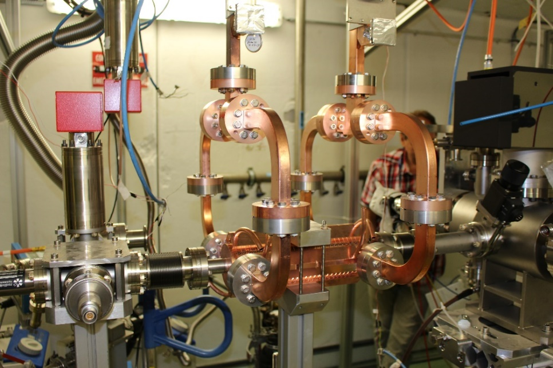
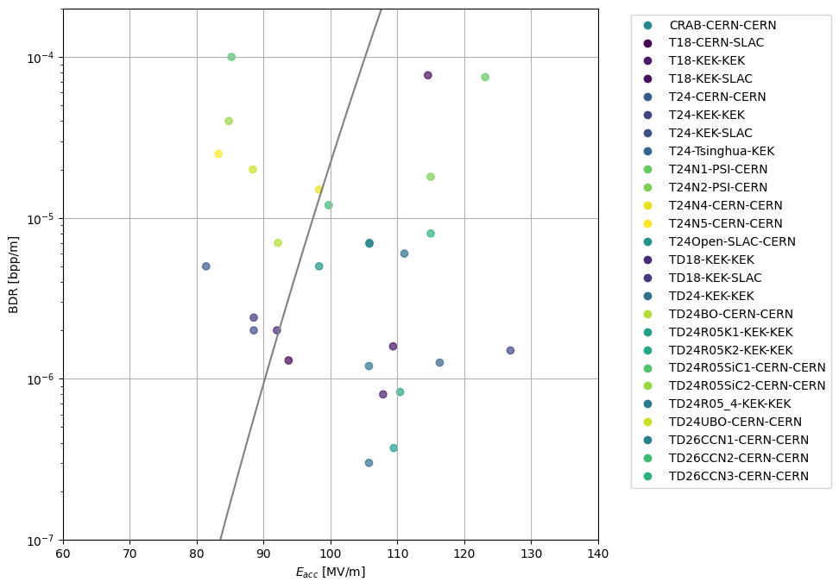
NCRF - CLIC
Normal conducting RF is a key technology for energy reach, luminosity/power and cost.
Most challenging in main linac, but also used in injectors, drive beam accelerator and two-beam power generation.
Gradient – 72 MV/m loaded gradient in 380 GeV stage, 100 MV/m introduced in later stages with low, O(10⁻⁷/m), breakdown rate. 70-100+ MV/m gradient demonstrated in tens of test, prototype and application structures. Good understanding of fundamentals of high fields. Test infrastructure exists but requires continuation.

Slide 4
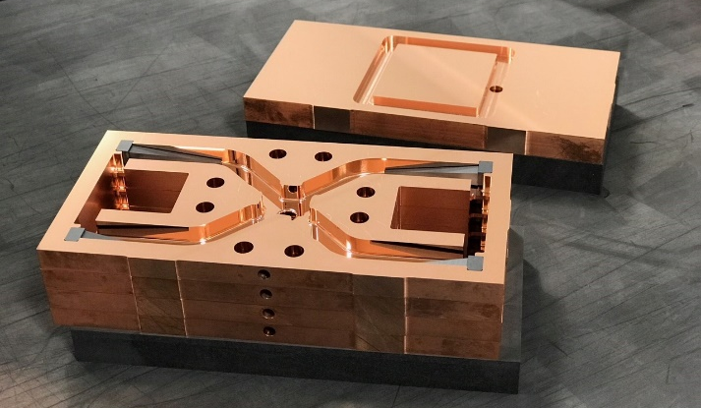
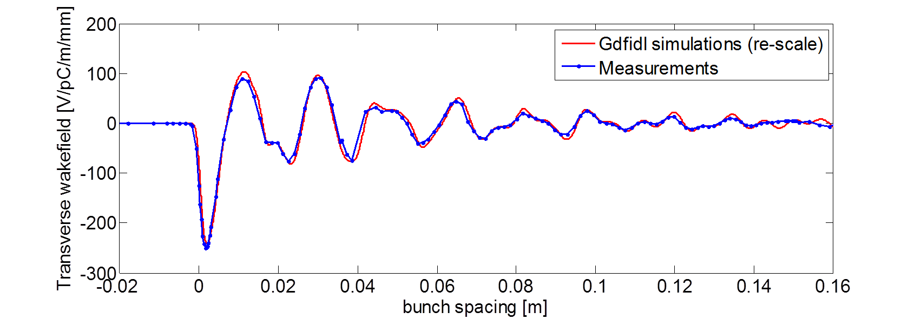
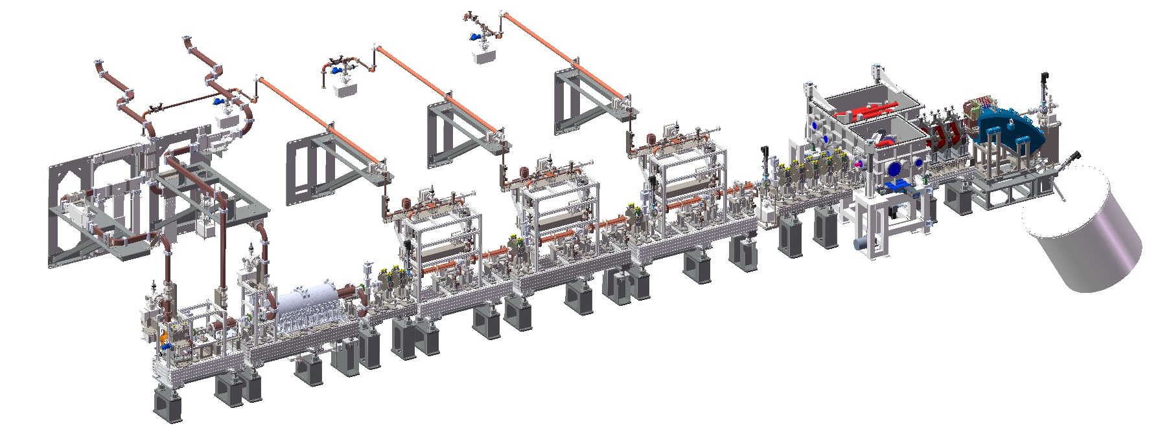
NCRF - CLIC
Higher-order-mode suppression – Critical for luminosity/power allowing stable beam in heavy beam loading conditions. Baseline is waveguide damping. Directly demonstrated at ASSET/FACET.
Micron-level fabrication – Critical for control of short-range wakefields for high luminosity. Achieved in prototypes and application structures with commercial fabrication technology.
Engineering – Prototypes made but mass production design needs further development. Small to medium series production of simpler structures in applications, e.g. SwissFEL, SACLA, VIGAS, Smart*Light, linearizers, deflectors etc.
Synergies– Strong community of small to medium sized application using high-gradient and high-frequency technology. See for example HG2025 https://indico.fnal.gov/event/65159/.

Slide 5
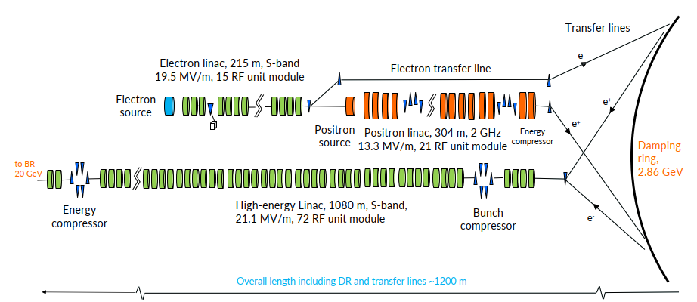
NCRF – FCCee injector
FCCee injector uses normal conducting RF. At 20 GeV is a major installation, to be compared to SwissFEL which is 6 GeV.
Frequency - 2 GHz for positron linac, 2.8 GHz for electrons – near standard frequency. May move to 3 GHz.
Gradient – Intentionally conservative 21 MV/m.
Wakefields – 4-bunch operation, HOM suppression via detuning, no damping is required.
Engineering – Will be based on SwissFEL-type fabrication technology.

Slide 6
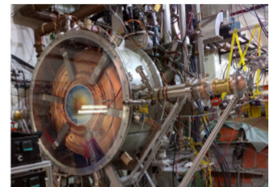
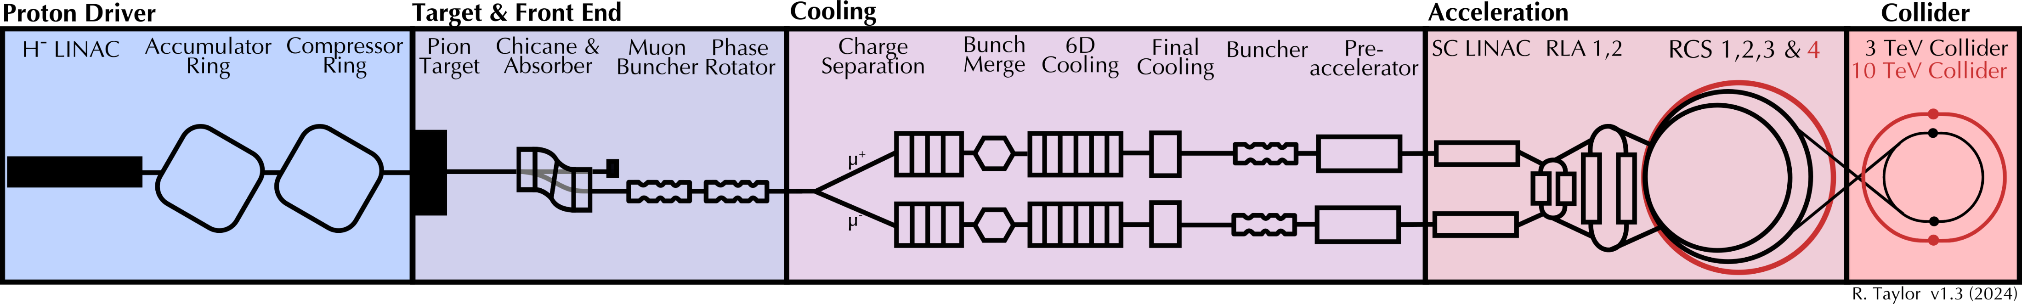
NCRF – Muon Collider
Key technology for the muon capture and cooling channel.
High-Gradient - 20 to 30 MV/m, in high, 2 to 17 T external magnetic field, 10, 352 and 704 MHz – Unique challenge. Requires new test infrastructure and extensive testing program. High-gradient fundamentals will build on CLIC effort.

Slide 7
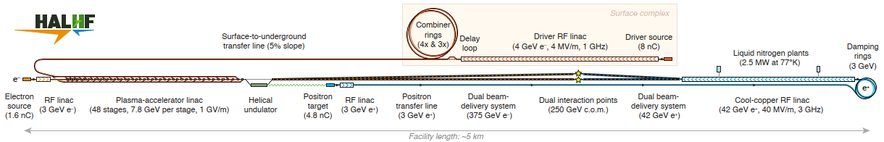
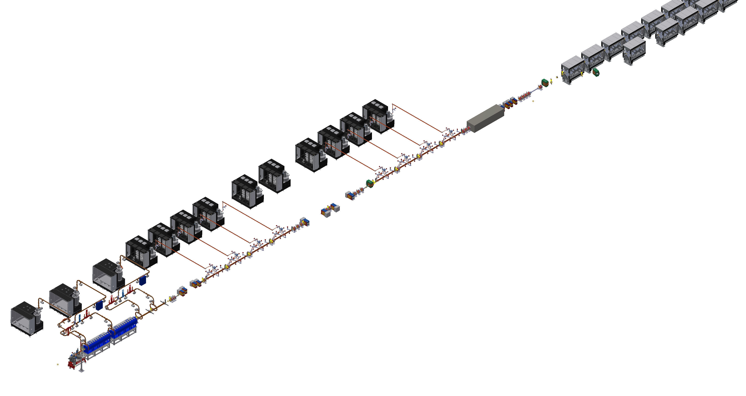
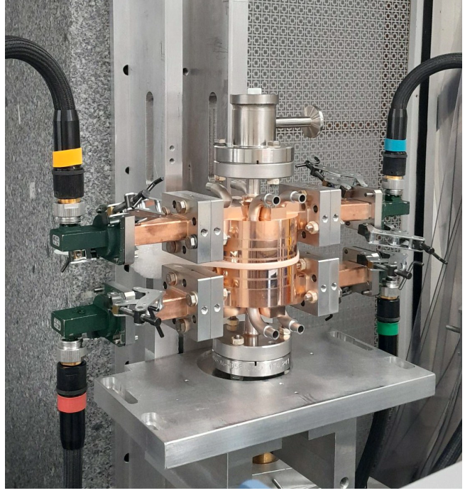
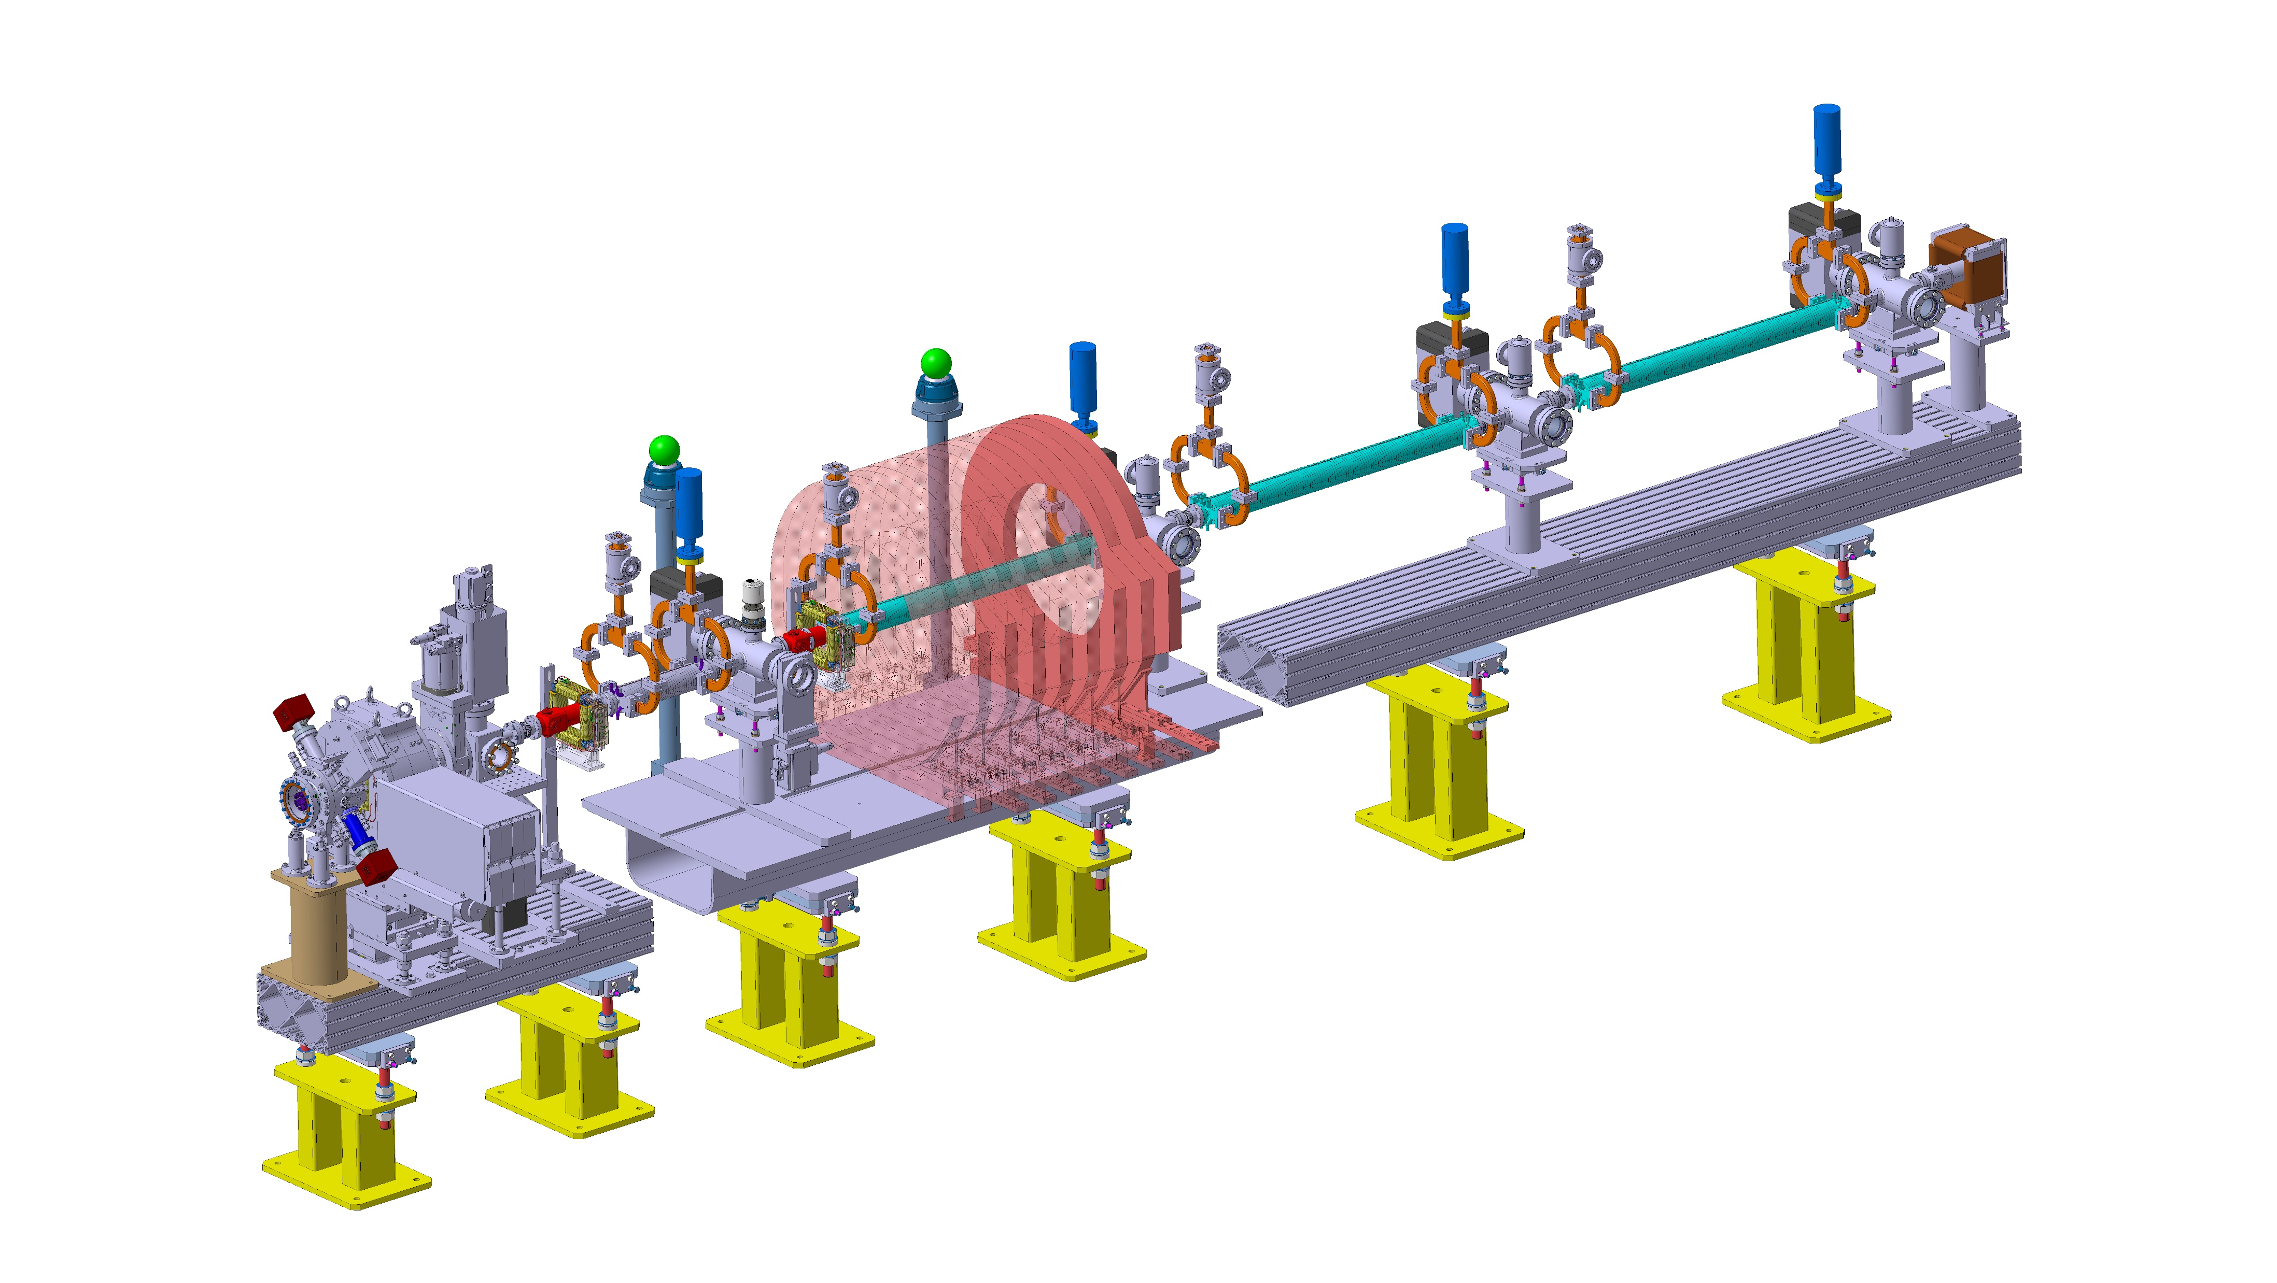
NCRF – Plasma
HALHF – Positron acceleration using C³ technology, e- drive beam based on CLIC.
AWAKE- Electron injection based on CLIC linac technology, combination of CTF/CLEAR and X-band.
EuPRAXIA – Electron drive beam and beam preparation based on high-gradient X-band technology.

Slide 8
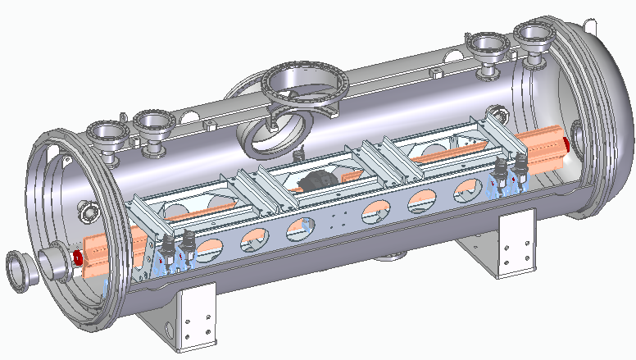
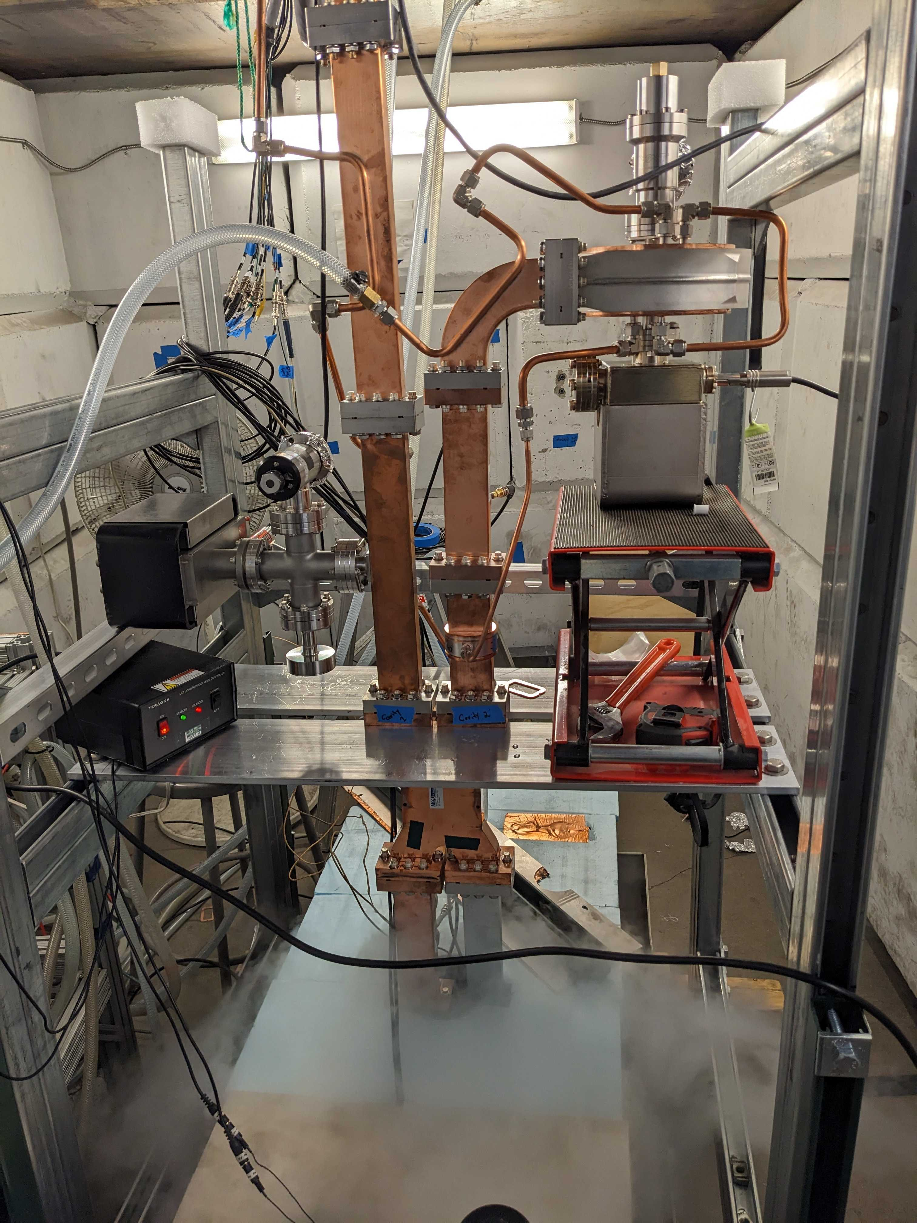
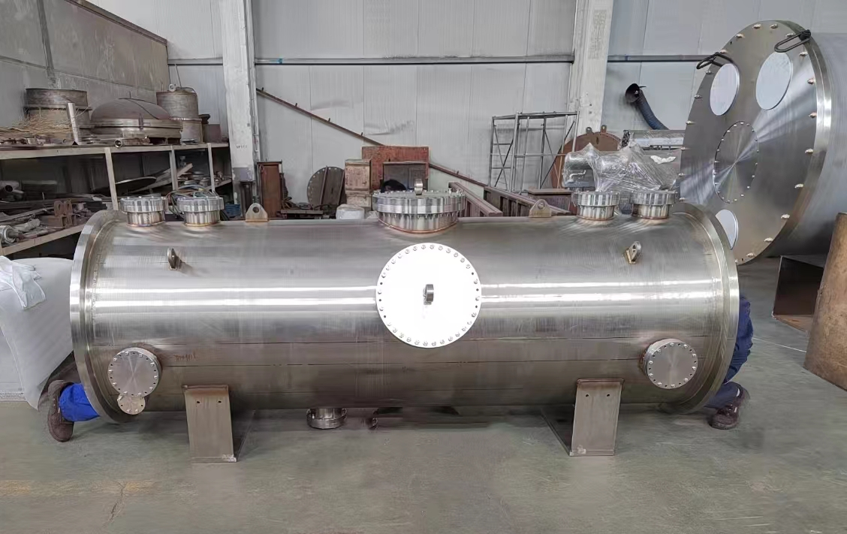
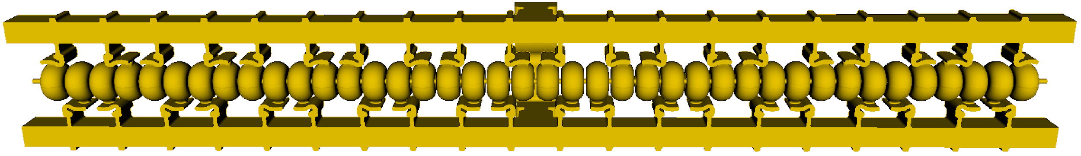
NCRF – C3
Gradient – 70 MV/m for 250 GeV and 120 MV/m for 550 GeV.
Cryogenic copper – For reduced peak power requirement, significant cost saving. Gives higher gradient. Somewhat less efficient than room temperature.
Distributed coupling structures – High shunt impedance for high efficiency. HOM suppression open issue

Slide 9
Outline
Normal Conducting RF
CLIC
FCCee
Muon Collider
Plasma
C³
Power Sources
FCCee
CLIC
ILC and LCF
Muon Collider

Slide 10
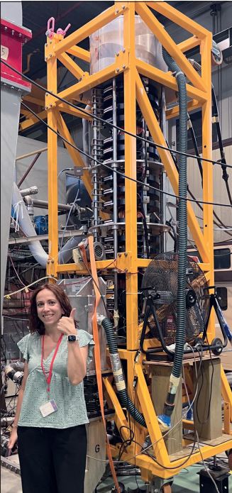
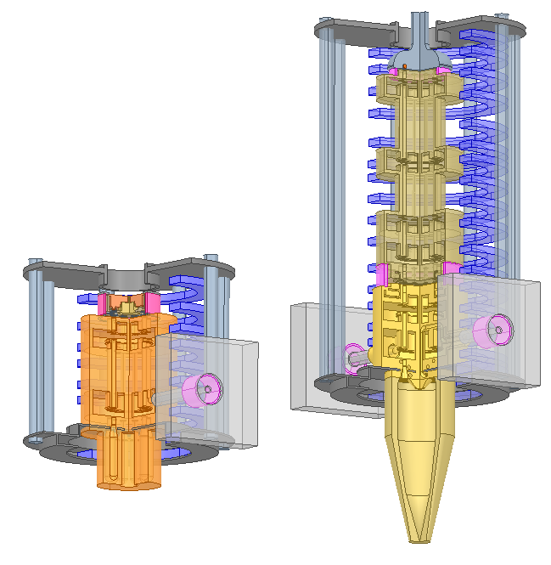
Power Sources - FCCee
Injector – 2 and 3 GHz, 80 MW, 3 and 5 µs, 100 Hz, 108 units. Similar to common 3 GHz tubes. Same power tubes exist but 40 MW is most common. Design, prototype-to-series remains to be carried out.
Main ring – Efficiency is a key parameter. For main ring Higgs stage, 100 MW RF required from 264 klystron+cavity units, 400 MHz CW. 380 kW, η = 70% prototype exists (HL-LHC). Two-stage klystron design made for η = 86%, similar to CLIC drive-beam and ILC klystrons. Concept for Tristron, η = 93%, high over wider range of powers. Two-stage and tristron are more compact.
HL-LHC
(relevant prototype)
Two-stage klystron
(design)
Tristron
(concept)

Slide 11
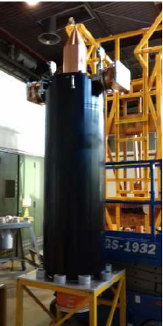
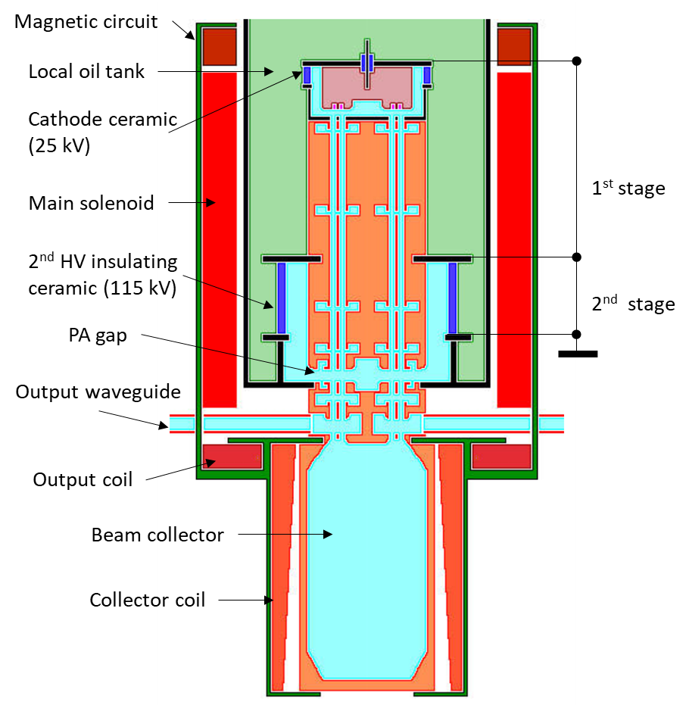
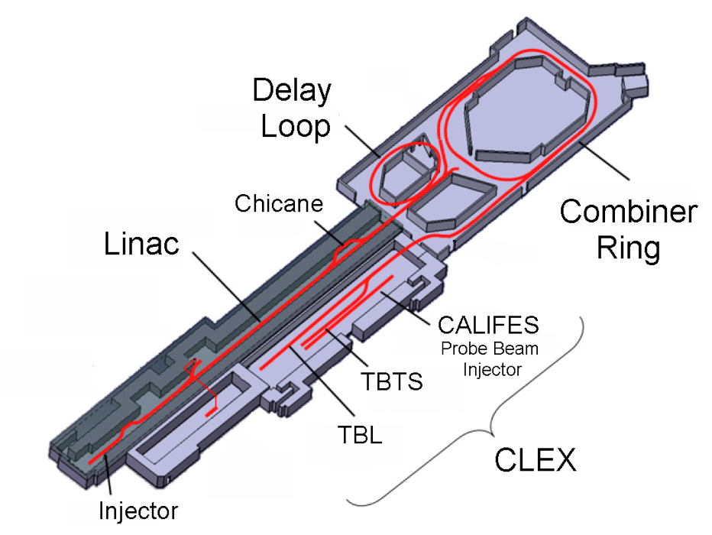
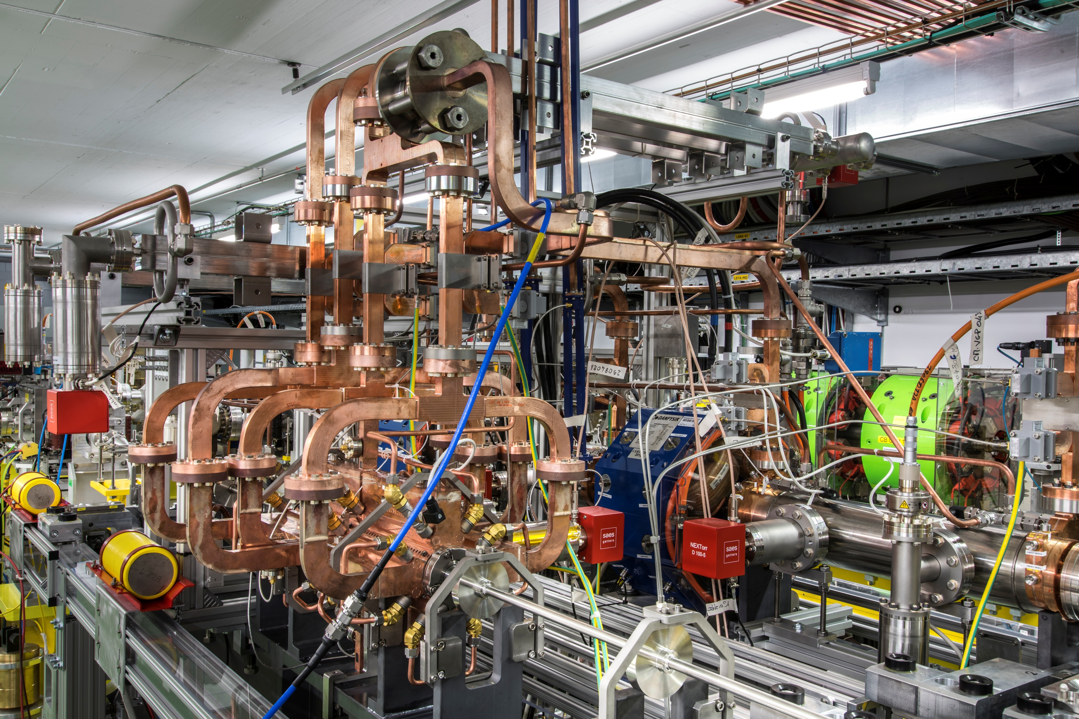
Power Sources - CLIC
Drive beam injector – 1 GHz, 21 MW, 50 µs, η = 71.5%, 100 Hz, 480 units. Prototype exists. Design made for two-stage η = 80 % klystron, synergetic with FCCee and ILC.
Two-beam – 12 GHz, unique power source subject of extensive testing and demonstration in CTF, CTF2 and CTF3. The latter showed combination, a beam-based form of pulse compression, and two-beam deceleration/acceleration.

Slide 12
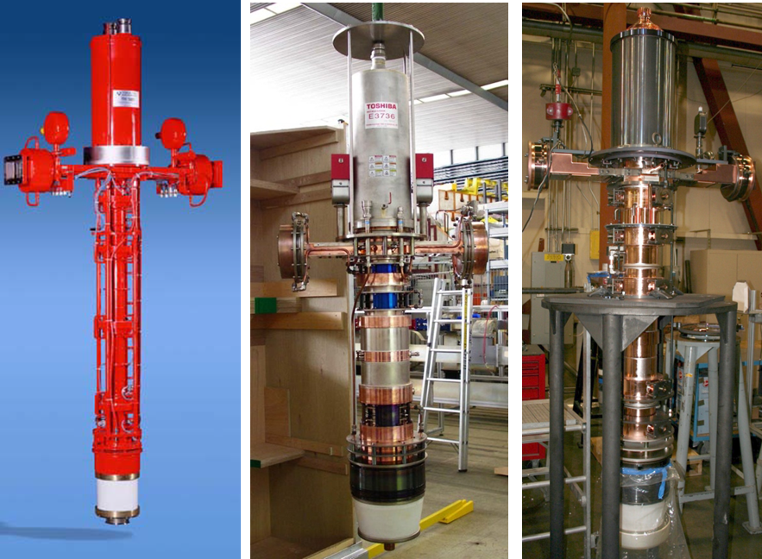
Power Sources – ILC and LCF
ILC baseline – 1.3 GHz, 20 MW, η = 70 %. 750 units. Similar to EuropeanXFEL tube.
LCF two-stage design – Same technology as CLIC drive beam and FCCee intermediate version.
CLIC drive-beam similar

Slide 13
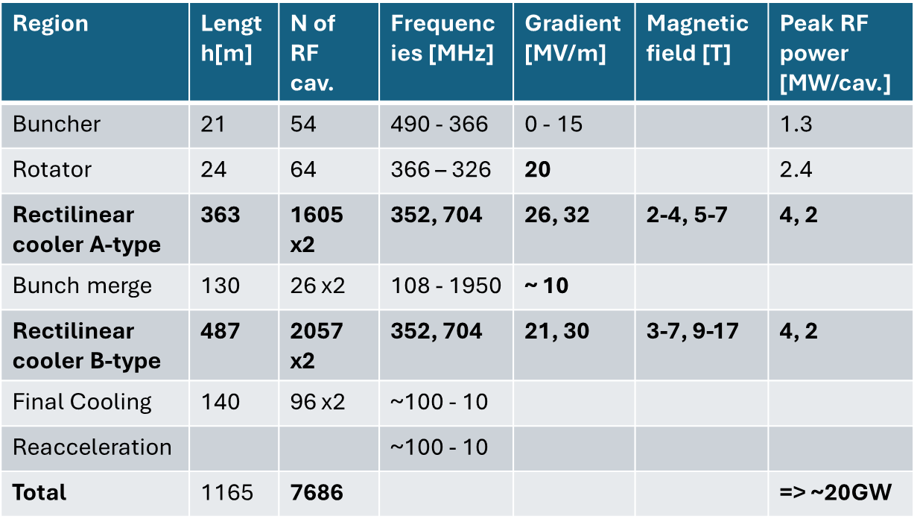
Power Sources – Muon collider
Muon capture – High peak power, 24 MW pulsed klystron for 352 and 704 MHz systems. Further power sources needed for other frequencies.
Rings – Basically 1.3 GHz ILC powering system. Pulsed.
Many aspects still need to be studied and hardware specifications produced.

Slide 14
Power Sources – General comments
Power sources are a key technology for ALL proposed future projects.
European laboratories have depended on a limited industrial supplier base of 3 companies (only 1 European).
Large number of units required for all projects, well beyond current capacity of suppliers.
High-power vacuum tubes have a very limited range of applications making a very irregular market.
Limited accelerator laboratory capability to design and fabricate (SLAC) even prototype devices in contrast to superconducting magnets.
Critical situation.

Slide 15
Thank you for your attention!

