Slide 1
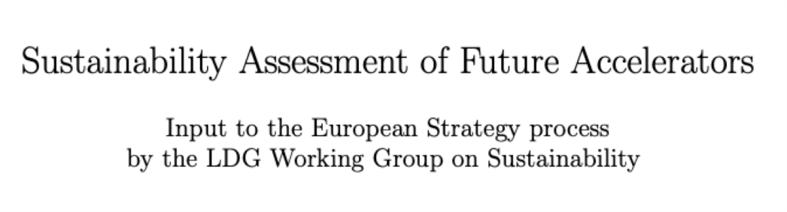
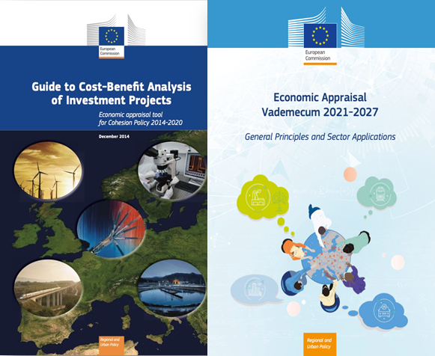
Final report will be available:
https://ldg.web.cern.ch/working-groups/sustainability-assessment-of-accelerators
Environmental Impact and Considerations for Future
Accelerator Facilities
Caterina Bloise / INFN Frascati,
Maxim Titov / CEA Saclay
(on behalf of LDG Sustainability WG)
ESPPU Input #162 / arXiv: 2504.01235;
also in ESPPU Input #220 (LDG Submission)
Open Symposium on the European Strategy for Particle Physics
Venice, Italy June 23-27, 2025

Slide 2
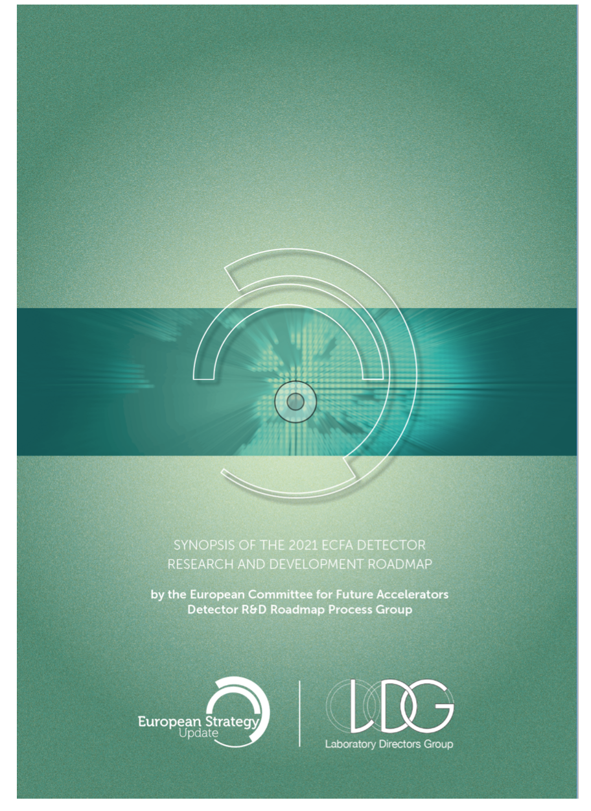
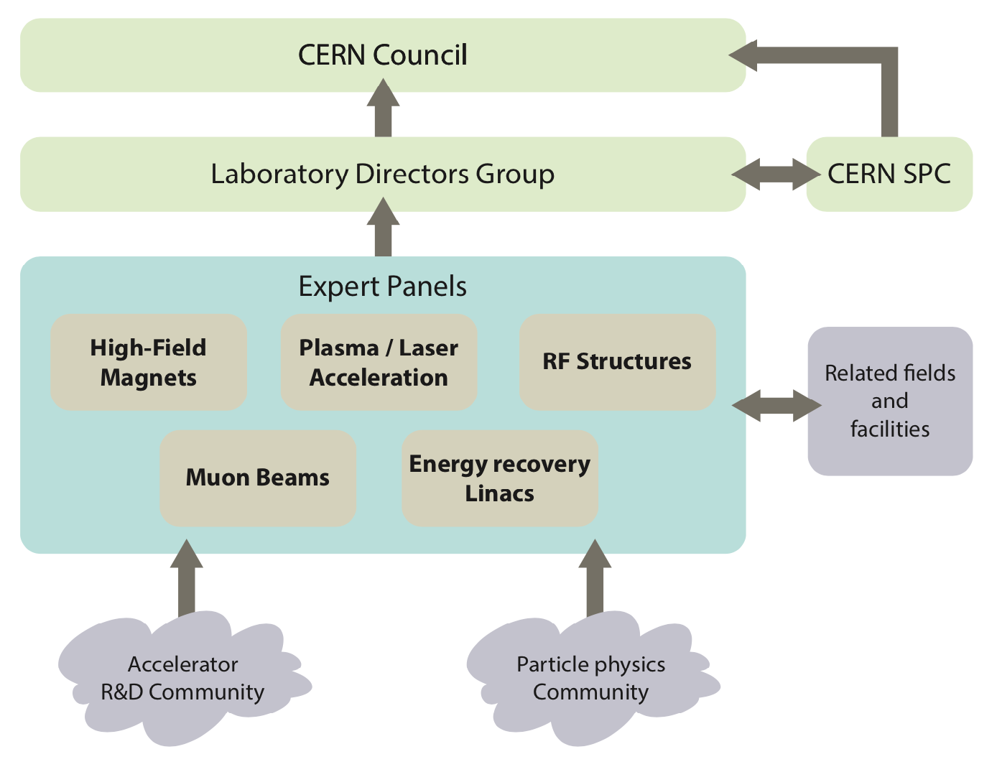
CERN Council has mandated the Laboratory Directors Group (LDG) to define and maintain a prioritized accelerator R&D roadmap towards future large-scale facilities for particle physics.
https://cds.cern.ch/record/2800190/files/146-138-PB.pdf
Sustainability Working Group added since January 2024 (in addition to 5 LDG Expert Panels)

Slide 3
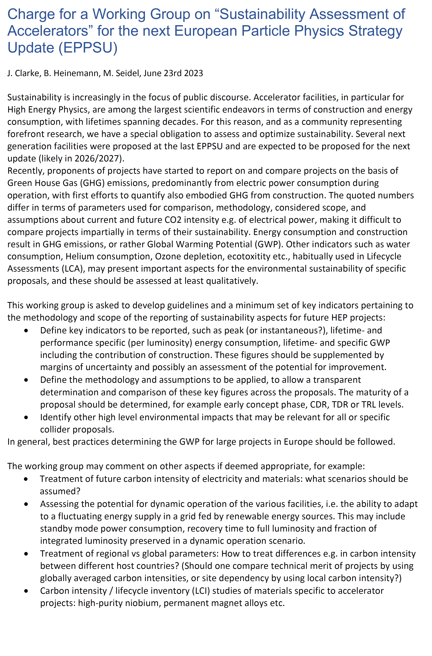
LDG Sustainability Working Group : Mandate / Charge
Definition of key indicators
→ small numbers of “figures of merit”
Possible examples:
- Peak / instantaneous lifetime- & specific (per
luminosity) energy consumption
- Lifetime and specific Global Warming Potential
(GWP), including construction
- Include margins of uncertainty and possibly an
assessment of the potential for improvement
Definition of methodology & assumptions to be applied for transparent determination of key figures across proposals.
- The maturity of a proposal should be determined, for
example, at early concept phase, CDR, TDR levels
Identification of additional high level environmental impacts that may be relevant
for all or specific collider proposals
Public perception of the value of the investments in large accelerator-based RI’s relies on the efforts and performance for explaining scientific potential and the returns for the society in knowledge, technology & education

Slide 4
LDG Sustainability Working Group : Membership
Development of guidelines and a minimum set of key Indicators for the sustainability assessment of future accelerators
Panel consisting of 15 members with technical expertize in evaluation of accelerator sustainability and future collider project representatives
Ensuring broad
community representation:
Sustainability Lab. Panels established at CERN, DESY, ESS, NIKHEF, STFC
ICFA Sustainability Panel
EU- Horizon Programs
Future accelerator projects: FCC, ILC, CePC, CLIC/Muon, LHeC, C3
Invited experts on specific topics
Walib Kaabi - PERLE, EU-iSAS
Mats Lindroos - ESS (deceased May 2, 2024)
Roberto Losito - CERN Sust. Panel
Ben Shepherd - STFC Sust. Task Force
Andrea Klumpp - DESY Sust. Panel, EU-iFAST
Hannah Wakeling - ISIS-II Neutron & Muon Source
Patrick Koppenburg - NIKHEF Sust. Panel
Johannes Gutleber - FCC
Yuhui Li - CePC
Benno List - ILC
Emilio Nanni - ICFA Sust. Panel & C3
Vladimir Shiltsev - LHeC
Steinar Stapnes - CLIC & Muon collider
Caterina Bloise - Co-Chair
Maxim Titov - Co-Chair, EU-EAJADE
also invited to the Editorial Board:
Enrico Cennini (CERN), Luisa Ulrici (CERN).
Beatrice Mandelli (CERN), Niko Neufeld (CERN)
Thomas Schoerner (DESY)

Slide 5
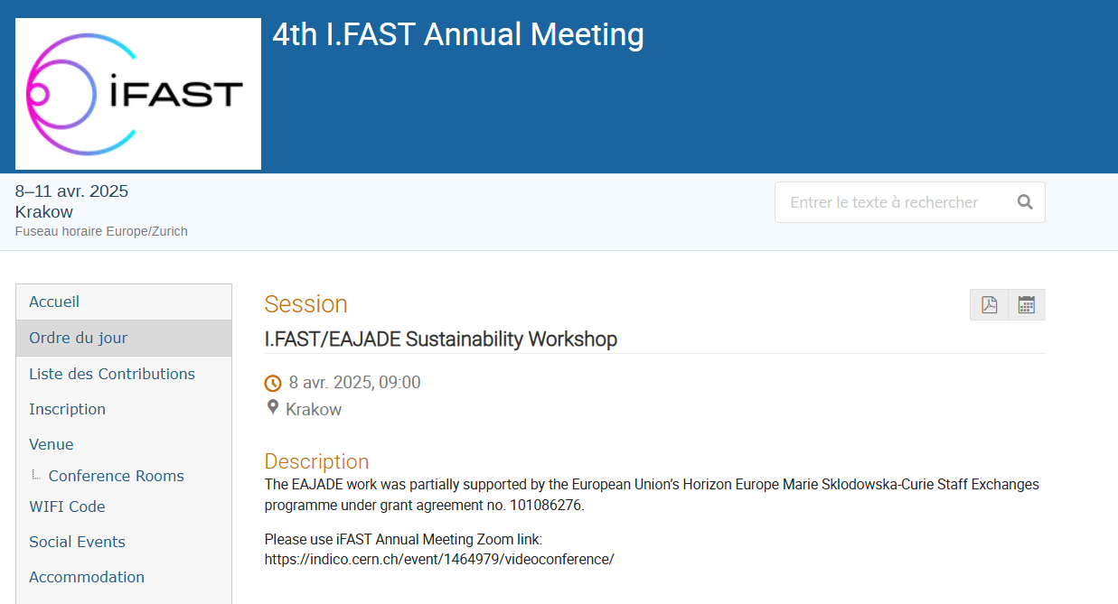
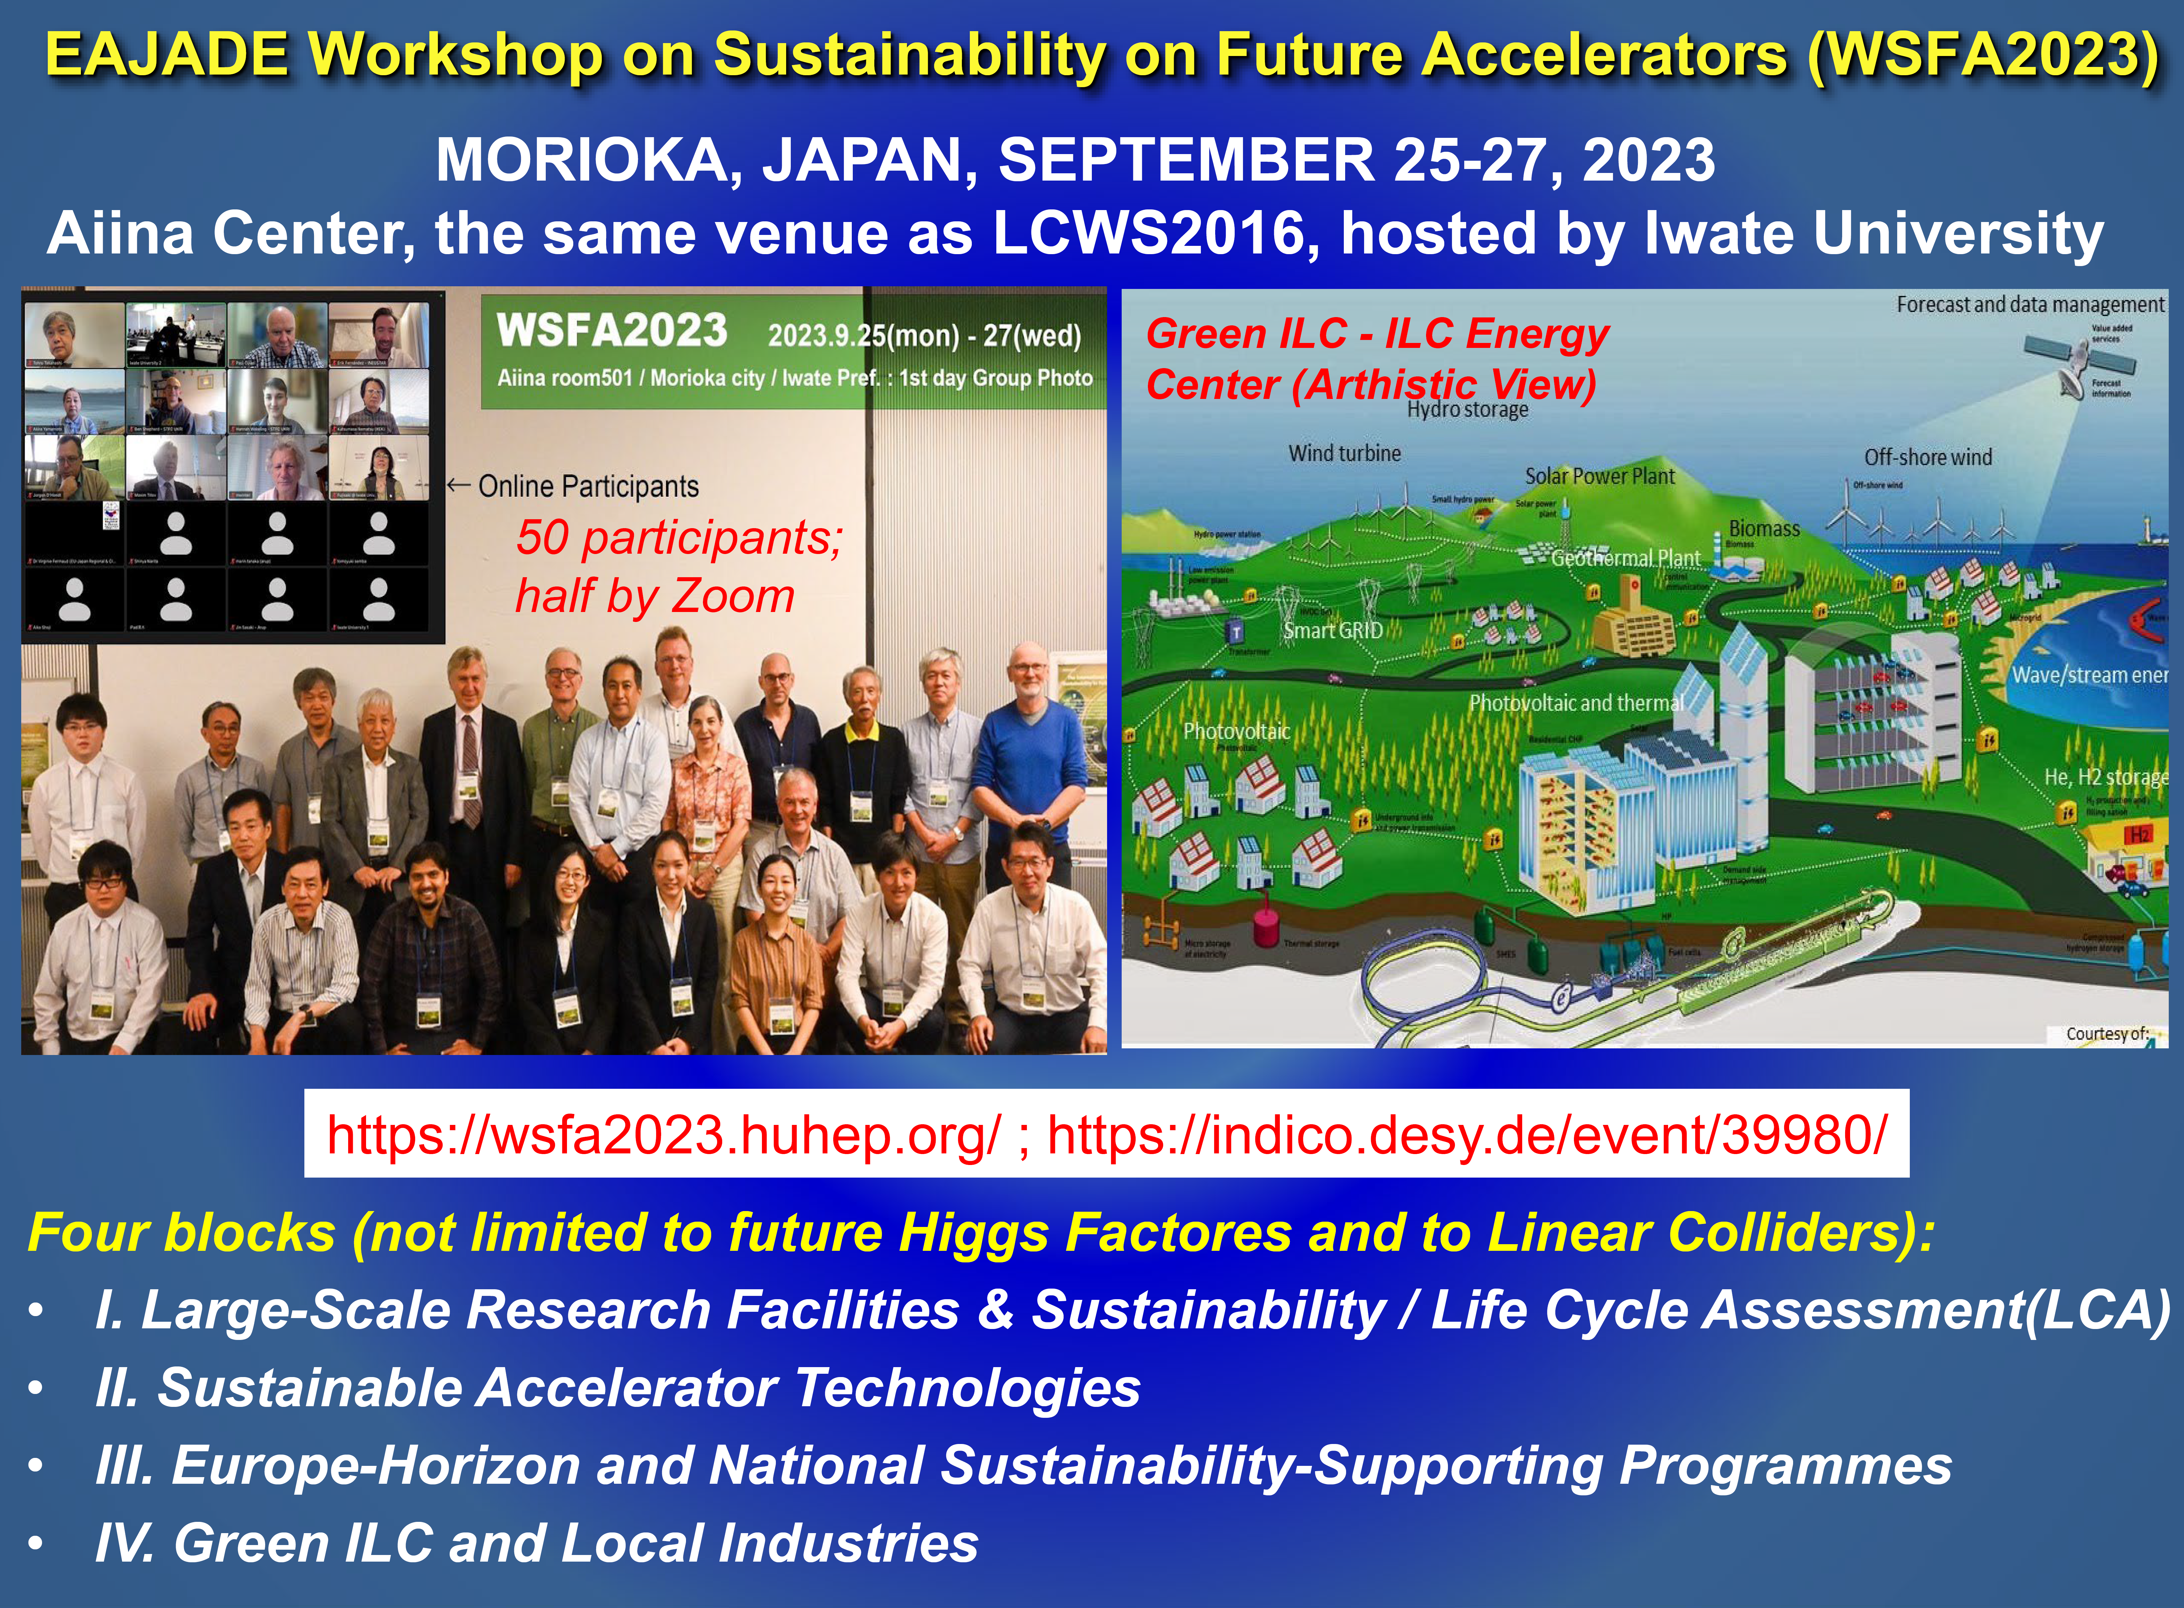
EU-Horizon: Sustainability Programs for Future Accelerators
Committed to the advancement of innovative solutions to contain the energy demand:
Innovation Fostering in Accelerator Science and Technology (I.FAST): https://ifast-project.eu
Europe-America-Japan Accelerator Development Exchange Programme (EAJADE): https://www.eajade.eu/
Innovate for Sustainable Accelerating Systems (iSAS): https://indico.ijclab.in2p3.fr/event/9521/
RF2.0 – sustainable and efficient design and operation of accelerator-based Ri’s.: https://rf20.eu/
https://indico.cern.ch/event/1464979/sessions/596359/#20250408
April 2025:
iFAST / EAJADE workshop
March 25:
iSAS First Annual Meeting
→ See P. McIntosh talk @ ESPPU2025
https://indico.ijclab.in2p3.fr/event/11291
https://wsfa2023.huhep.org/

Slide 6
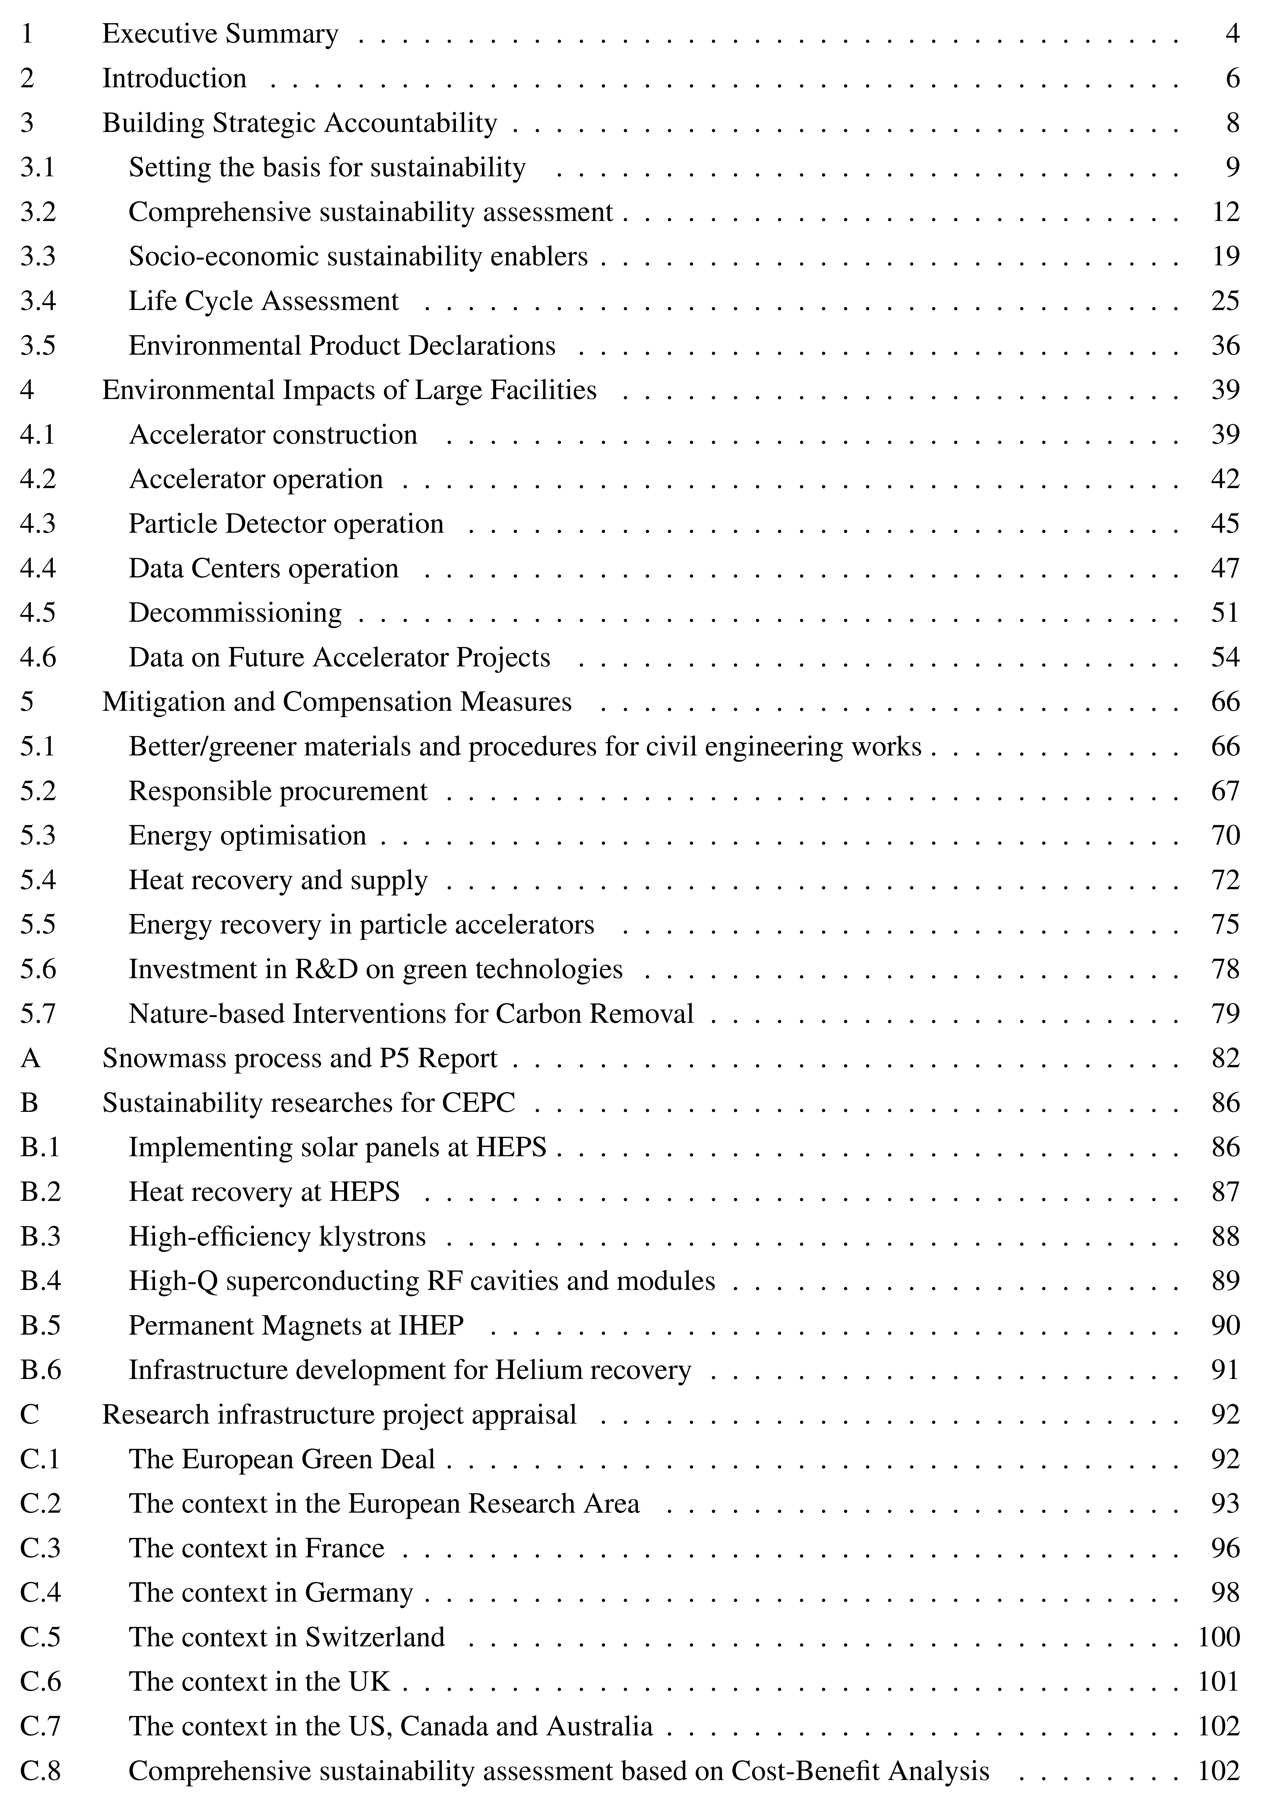
LDG Sustainability Working Group Report Outline
Reference Framework for Sustainability Assessment of Future Accelerators:
Landscape of comprehensive sustainability analysis (best practices adopted by RI’s)
Basis of LCA - Status & recommendations for developing analysis for accelerator infrastructures, components and systems
Environmental impact of Large RI’s during construction, operation & decommissioning phases
Mitigation and Compensation Measures
- Targets future accelerators & particle physics
projects, relevant for other research infrastructures
- Promotes transparent, open discussions within
research communities, to adequately convey
the information to a broader set of stakeholders
- Establishing “Guidelines” is the responsibility of
each RI, based on national & local legislations
~ 100 pages document
Not all of sustainability-related topics have been addressed in the WG report due to the short timescale
A homogeneous evaluations of all issues deserves a future strategy to be pursued

Slide 7
Setting Sustainability Basis: Society, Economy, Environment
Comprehensive sustainability assessment includes evaluation of all costs and benefits of the project – as recommended by the OECD – and is based on quantative Cost-Benefit Analysis (CBA) that integrates economic, social, environmental benefits, and the total costs including indirect costs from environmental impact
Cost – Benefit Analysis of RI’s:
The EU-funded project RI-PATHS has developed a toolkit federating research infrastructures across various domains, including particle accelerator facilities, such as ALBA, CERN and DESY
Socio-economic pathways are a valuable inventory of sustainability enablers:
→ Future projects are encouraged to carry out a comprehensive charting of the impact pathway
potentials to develop sustainability-enabling plans:
Fundamental Physics Knowledge
Sustainability through education and training
Sustainability through engagement of international research communities and collaborations
Sustainability through industrial spillovers.
Sustainability through open information and computing technologies
Sustainability through cultural goods
Sustainability through positive environmental externalities
Innovation and R&D
The challenge to reduce environmental impact of a new particle accelerator creates an opportunity for industrial innovations:
e,g, developing, low-carbon concrete production process or improving construction techniques that make use of natural materials as wood and compressed earth.
Comprehensive sustainability assessment, based on CBA, are required by several countries for public investment, including science projects

Slide 8
Social – Economic Impact Analysis
Comprehensive sustainability assessment based on quantitative Cost-Benefit Analysis was performed for the FCC @ CERN: state-of-the-art economics knowledge that integrates total costs, negative environmental externalities, and industrial, social and environmental benefits
Benefits and positive externalities are not fully captured: RIs should “Develop internal expertise for impact assessment” and “define relevant impact dimensions in a proactive way”
Reference for the FCC integrated mode:l
Social “Benefit / Cost ratio” for FCC was evaluated to be 1.2:
https://doi.org/10.5281/zenodo.10653395
As challenging global technological enterprises, HEP accelerator RI’s generate socio-economic impact beyond scientific knowledge across several of the UN Sustainable Development Goals (SDGs):
- good health and well-being (3)
- high-quality education (4)
- industry, innovation and infrastructure (9)
- climate action (13)
- piece, justice and strong institutions (16)
- partnership for the goals (17)

Slide 9
Building Strategic Accountability: Sustainability Assessment
Report provides a reference framework to enable coherent flux of information
- Focused on future colliders - much of the
work is relevant for current and future RIs
- Summary of current best practices,
obligations, and standards
Socio-economic impact has become one of the important considerations in the ESFRI roadmapping process that identifies European investment priorities in Research Infrastructures
Sustainability assessment is complex
- Criteria to be tailored to the maturity of the
project
- Separately developed for scientists, policy-
and decision- makers, and society
Economists and environmental scientists contributed a range of work
- Used in setting guidelines, standards, legislations
EU Policies / Enrironmental & Sustainability performance reporting standards:
- Global Reporting Initiative
- European Sustainability Reporting Standards
- European Union Eco-Management and Audit
Scheme (EMAS)
- EC Economic Appraisal Vademecum
National Guidelines (France, Germany, Swiss, …)
ESFRI Roadmap 2026 will put significant focus on the financial sustainability of the RI ecosystem, while introducing the new dimension of ‘environmental considerations’ to foster environmental sustainability

Slide 10
Life-Cycle Assessment (LCA) Methodology
Quantifies environmental impact (ISO14040 standard)
:
  LCA Goal and Scopes Definition
  - project stages: design, construction, operation, decommissioning
  - functional units: accelerator, supporting infrastructures, cryogenic
  systems, detector, computing
  - boundaries: Cradle-to-gate, Cradle-to-grave
  LCA Methodology
    - Impact Categories (Midpoint vs Endpoint)
    - Impact of Emission on Climate Change: GWP100
    - Beyond GWP : ReCiPe2016, ILCD2011, CML-IA2012
  LCA Inventory Analysis
  - infrastructure, materials,
  energy, production process
    Construction Phase
    Operation Phase
    Decommissioning
  LCA Assessment and
  Interpretation
  - environmental impact,
  - methodology, specific
  software, databases,
  - evaluation of uncertainties

Slide 11
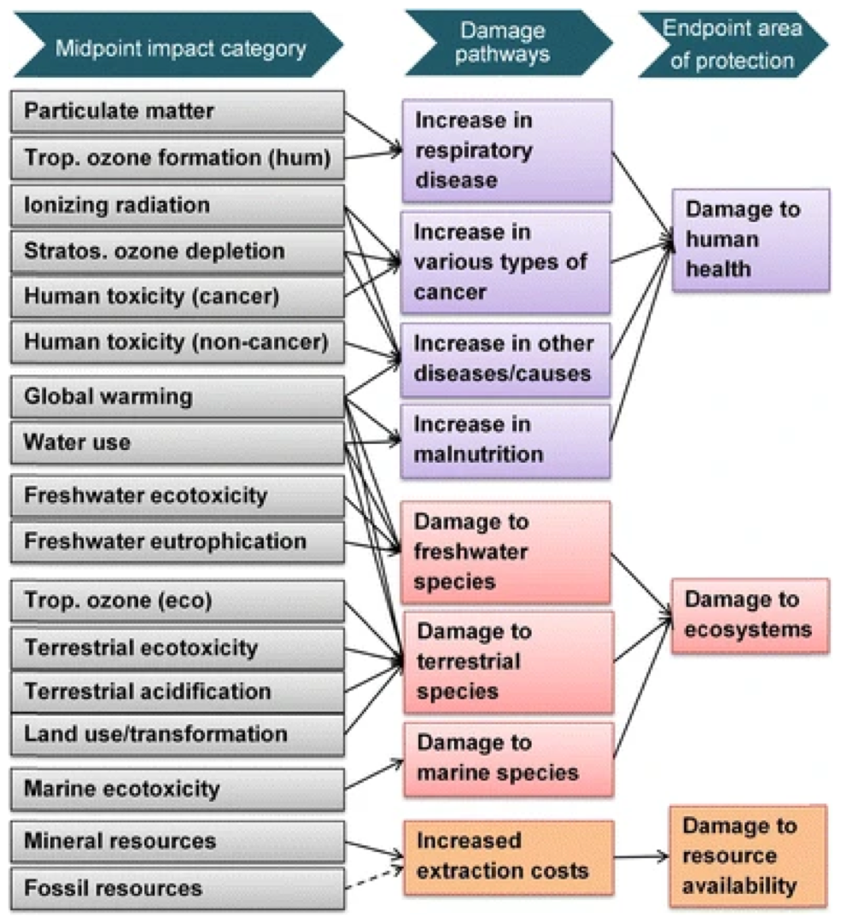
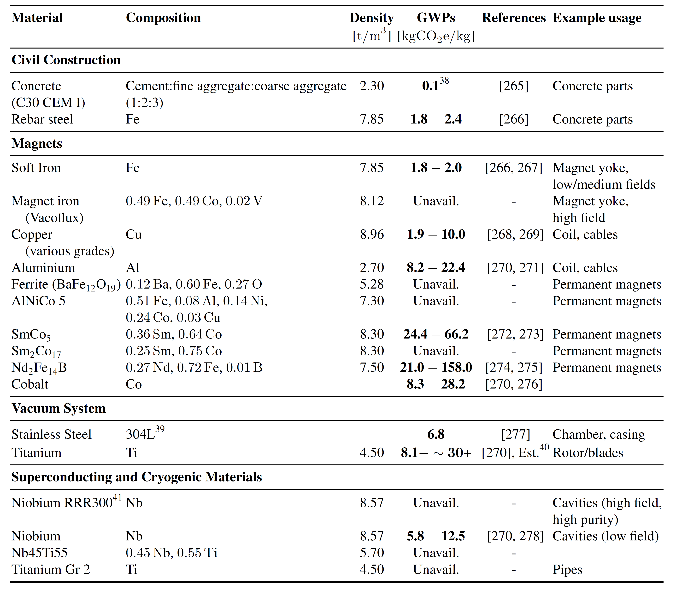
LCA for Accelerator Facilities
Goals & Scope also depends on target audience:
Optimize facility (scientists)
Recommend improvements (decision-makers)
Communicate global performance (society)
ReCiPe2016
LCA quantifies impact, help to compare design alternatives and identifies reduction potential
Adoption of a common, widely-used LCIA method with ReCiPe 2016 midpoint (H) or the ILCD method
LCA standards for the assessment of future accelerators are not well set:
- Many LCA software available → different packages
can give different results (data handling)
- Chosen LCA database is the most impactful element
(input data and DQ, global vs. local, age of database);
- Collect reference data on materials and specific
fabrication methods for accelerators
Snaphot of reference data for accelerator materials (started to be compiled by WG)
→ very preliminary, not comprehensive
Coordinated effort is needed from all accelerator-based laboratories to establish a centralized databases of materials and components
in relation to accelerators

Slide 12
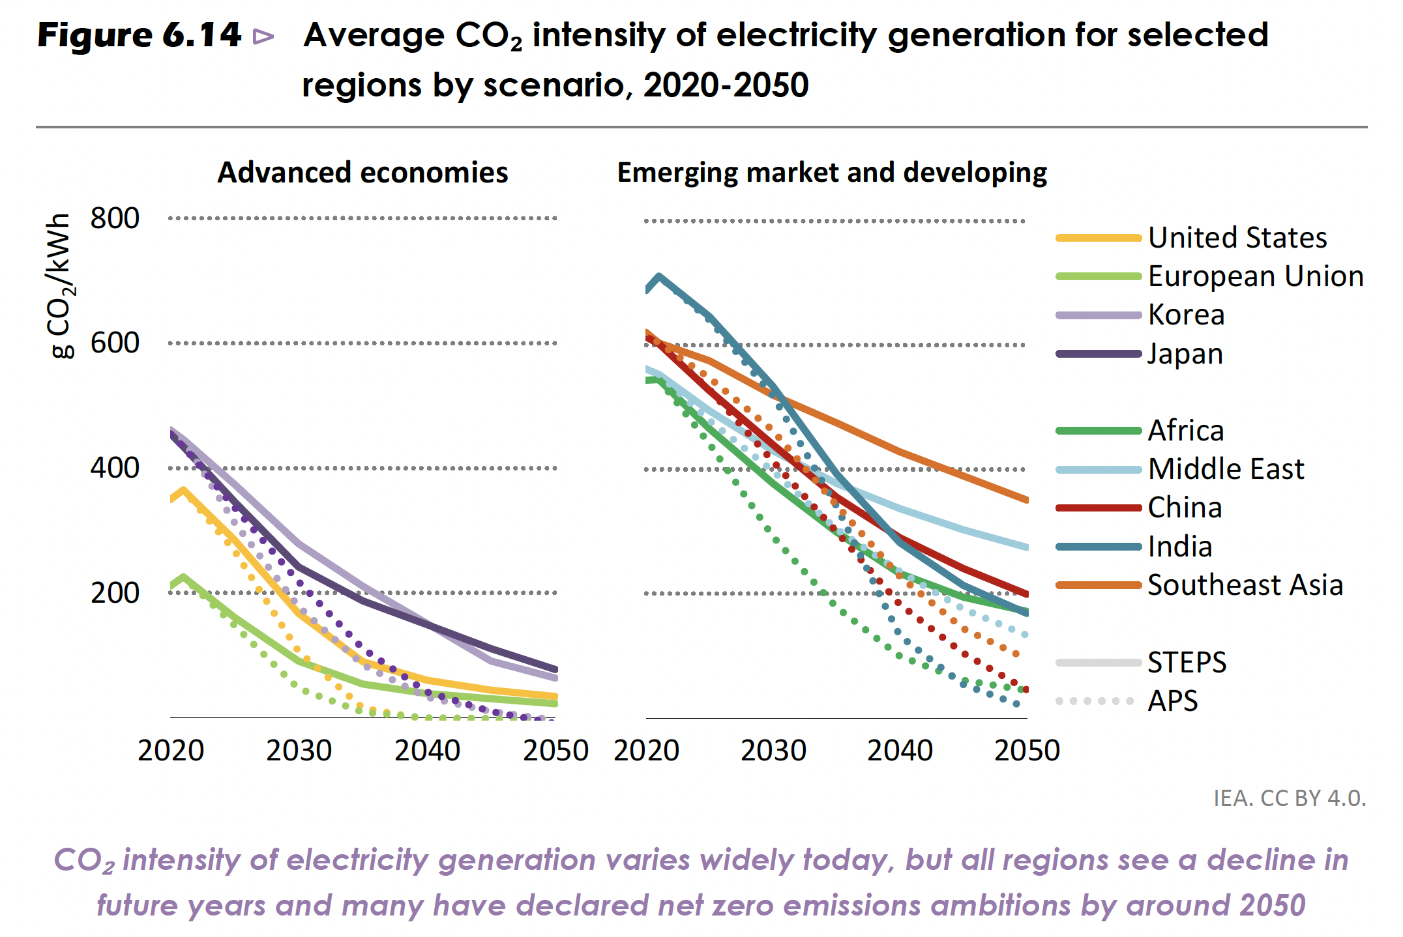
LCA for Accelerator Systems: Uncertainties
Uncertainty is key factors to
LCA reliability:
Widely-used Ecoinvent Data Quality System
Assumptions / simplifications adopted, and sources of uncertainty within the LCAs (e.g. accuracy of input data and accuracy of extrapolations with time) deserves proper consideration and reporting:
Accelerator laboratories should collaborate to provide open-source and cost-free
LCA tools, data and software (e.g. accelerator specific extension to Ecoinvent), in a similar manner as open-access publishing
Carbon intensity of electricity production varies enormously across regions &countries
Carbon intensity of materials also varies
  Different local standards
  Different geology, primary minerals, concentrations
  Different carbon intensity for local energy, esp. electricity (-> copper, niobium)
Civil construction: steel and cement mostly from local sources, adhere to local codes
Result of LCA depends heavily on
  Source of used materials
  Construction and operation site
  LCA: use local values or global averages
IEA (2022), World Energy Outlook 2022, IEA, Paris https://www.iea.org/reports/world-energy-outlook-2022,
License: CC BY 4.0 (report); CC BY NC SA 4.0 (Annex A)

Slide 13
Environmental Impacts of Large Accelerator Facilities (I)
The construction phase (LCA stages A1 to A5), covers the environmental impact up to the start of accelerator operation, considering all processes necessary to build CE infrastructure, from raw material supply (stage A1), transport (A2) to manufacturing (A3), as well as the assembly, from transport (A4) to installation at the site (A5).
Civil engineering’s works: excavation material and concrete shielding constitute core subjects of sustainability assessment for CE infrastructure (e.g. tunnels, caverns):
→ civil engineering's works give a substantial contribution
- we might soon see a rapid change in the market of materials with lower carbon footprint (at an extra cost)
- reuse or recovery of the inert materials from excavation → two ways to preserve natural resources
Accelerator construction: assessment of areas with the largest emission (beam line shielding, steel girders and supporting structures, magnets, RF cavities, power supplies, …)
- material manufacturing: resources for and emissions during fabrication (e.g. high-purity Ni, permanent
magnet alloys) and transport are relevant and should be considered
- construction of accelerators will always rely on mining and mineral processing that is a hard-to-abate
activity (independently of the energy used…)
Future Accelerators are encouraged to perform LCAs at each project stage:
- understand the most critical elements in the design
→ largest sources, what to focus on and not to focus
- provide input for technological choices → look for mitigation strategies
- fulfill legal requirements for project submission and develop LCA tools
to do this type of analysis for the future

Slide 14
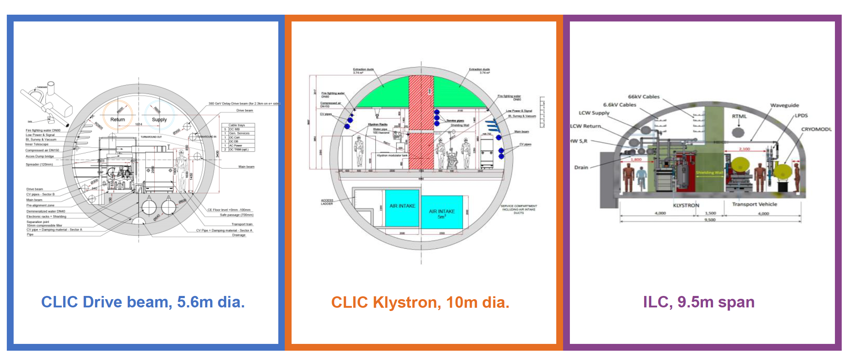
Example: ILC & CLIC LCA Study
LCA study of CE (tunnels, shafts and caverns):
ILC/CLIC ARUP LCA: https://edms.cern.ch/document/2917948/1
LCA study of Accelerators and Detectors
(ILC cryomodule, CLIC 2-beam module):
ILC/CLIC ARUP LCA: https://edms.cern.ch/document/3283864/1
Civil Engineering:
Significant reduction potential ILC (41%) / CLIC (37%) from optimized design & use of lower carbon material
FCC LCA shows similar reduction potential (~50%)
- 20% from using low carbon cement (CEM III/A)
- 12% from thinner lining
- 9% from future electricity mix ( not a project decision)
FCC LCA: https://zenodo.org/records/13899160
Accelerator and Detector GWP “hotspots”:
Main linac: dominated by stainless steel, niobium, aluminium in cryo modules
Damping rings: dominated by iron for magnet yokes
Detectors ILC & SiD: Dominated by steel for magnet yokes
→ Overall, Iron and steel are dominant GHG source :
- huge reduction potential
→ Others: Niobium ~11%. Cu: ~10%, Al ~ 6%

Slide 15
V. Environmental Impacts of Large RI’s Facilities (II)
Operation (stages B1 to B7) covers the environmental impact of the operational lifetime of an accelerator project: necessary to operate (B1) and maintain (B2) the accelerator and experiments, including repairs (B3), replacement of components (B4) and refurbishments (B5); particular interest are the impact of energy (B6) and water (B7)
Accelerator operation: electricity consumption, power for operation (air conditioning, water cooling, cryogenic plants, RF and klystrons, magnets):
→ currently assessment of accelerator operation concentrate mostly on the electricity consumption,
assuming it is the dominant source to GHG emissions (high dependency on electricity from the
country of origin -> procurement policy important)
Particle detectors operation & computing: impact of gas emissions in detectors, optimization of power consumption & environmental impact of computing:
→ assume that future RI’s will overcome the current situation, where direct (Scope 1) emissions from
particle detectors & cooling plants are the most abundant ones, by elimination of GHGs and/or
implementation of gas recirculation/recuperation systems
→ adoption of sustainable and responsible procurement criteria for computing infrastructure: power
consumption and effective usage are to be considered over full lifetime of experiment (e.g. the best
performing and most expensive chips are the most power-efficient)
Decommissioning (stages C1- C4): analysis of recycling and disposal of used components, radioactive waste, land re-use
→ global approach, which takes into consideration the entire life-cycle of waste from the design phase
of the facilities to the disposal of waste shall be implemented
→ early consideration of radioactive waste disposal pathways simplifies the entire industrial disposal process

Slide 16
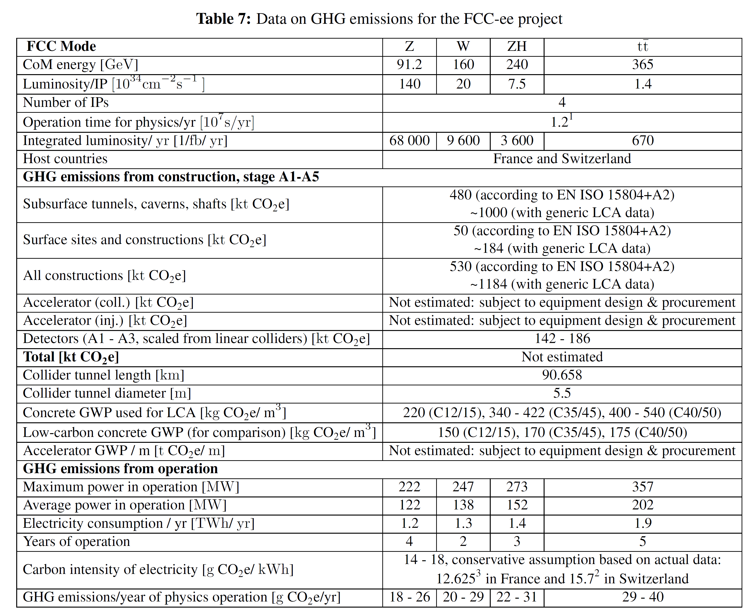
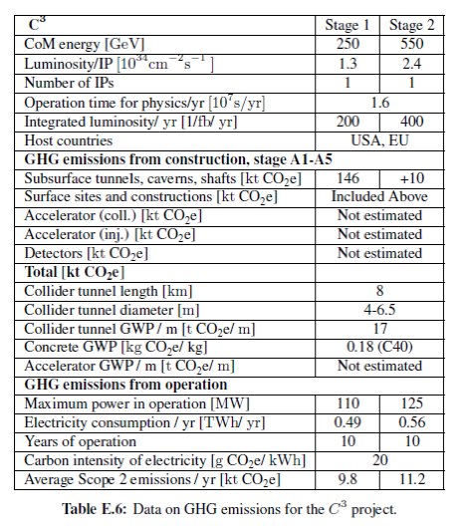
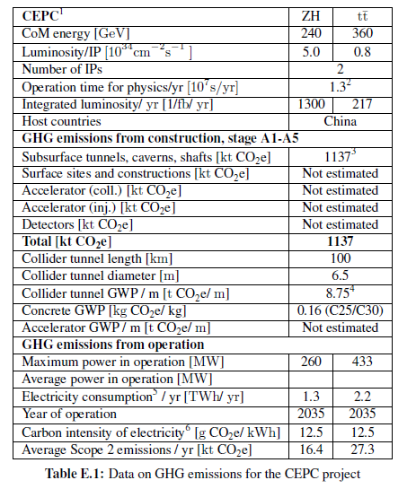
Future Accelerator Projects (I) : FCC, CEPC, C3
Key parameters (small numbers of Figures of Merit) for GHG emissions in construction and operation of future collider projects, as discussed and agreed by the Sustainability WG
Concurrent reporting of methods, assumptions and simplifications adopted to evaluate carbon footprint is needed to clarify the boundaries of the assessment
C3: PRX Energy, vol. 2, no. 4, p. 047 001, 2023.
Reporting in the common format → but separate tables for different accelerator facilities
FCC: https://arxiv.org/pdf/2505.00273

Slide 17
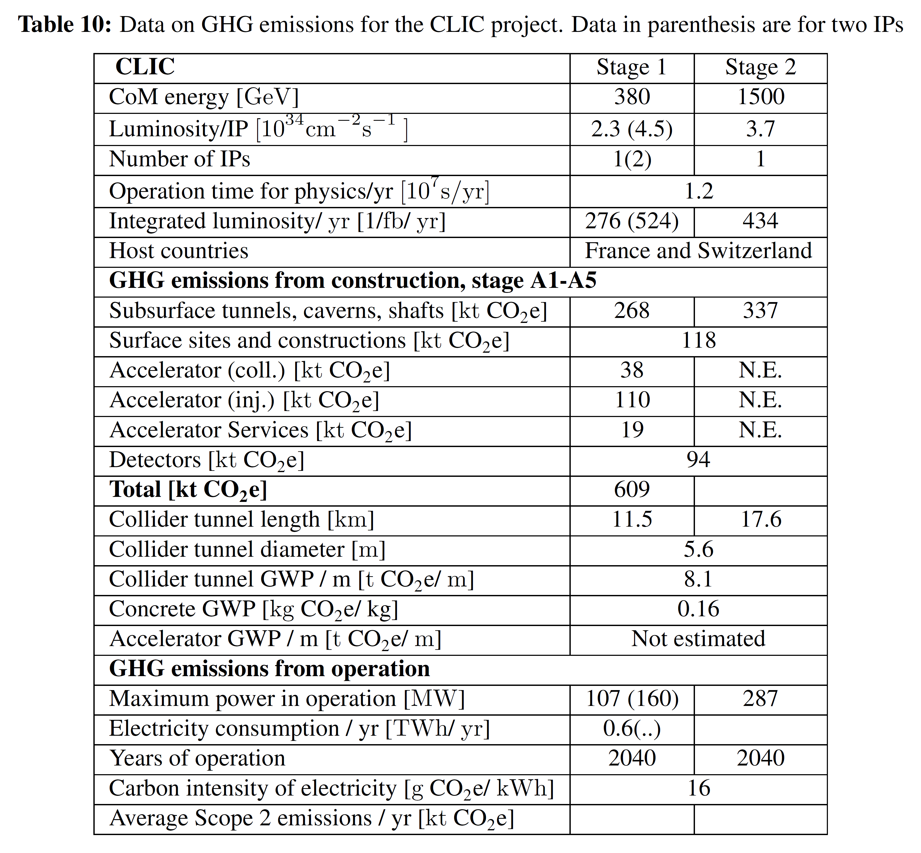
Future Accelerator Projects (II): ILC, CLIC, LCF@ CERN
Key parameters (small numbers of Figures of Merit) for GHG emissions in construction and operation of future collider projects, as discussed and agreed by the Sustainability WG
Concurrent reporting of methods, assumptions and simplifications adopted to evaluate carbon footprint is needed to clarify the boundaries of the assessment
ILC / LCF: arXiv:2503.24049
Comprehensive overview of GHG emissions from construction and operation:
Available for ILC in Japan and scaled / adapted for an LCF at CERN
→ Tunnels: emission factors for tunnels in Japan and CLIC tunnel in Geneva almost identical – keep
→ Scale up main linac and damping ring component for longer main linac and 3rd damping ring
CLIC: arXiv:2503.24168

Slide 18
Mitigation and Compensation Strategies (I)
RI’s Design with Sustainability as a Goal → optimization of CE works & greener materials:
- establishing performance oriented requirements (architecture and design optimized from
construction, operation and maintainace perspectives)
- optimizing tunnel shape and evacuation methods
- detailed geological assessment
- use of precast concrete segments, fiber reinforced concrete
Adoption of Responsible Procurement Policy (ISO20400) is a key to reduce an impact
- balancing of the initial, purchasing cost with total lifecycle cost (maintenance, operation,
disposal)
- environmental impact against a given set of environmental objectives (reduction
of CO2 emissions, minimization of radiological impact)
- social responsibility (e.g. extraction of raw materials)
Sustainable operational concepts and power purchase agreements (PPA)
- portfolio of energy supply contracts or PPA (procurement action) constitutes a strategic
choice to foster transition to renewables and reduce the GWP impact of accelerator-based RiI’s
Implementation of Energy management plans (ISO 50001):
- development of a policy for the efficient use of energy and identification of targets & objectives,
- implementation of procedures and systems to gather data on energy consumption
- planning of review processes to enable further improvement in the energy management
Energy Recovery Concepts → highest SRF sustainability targeted
- demonstrate the full potentiality of ERL’s (PERLE, LHeC)

Slide 19
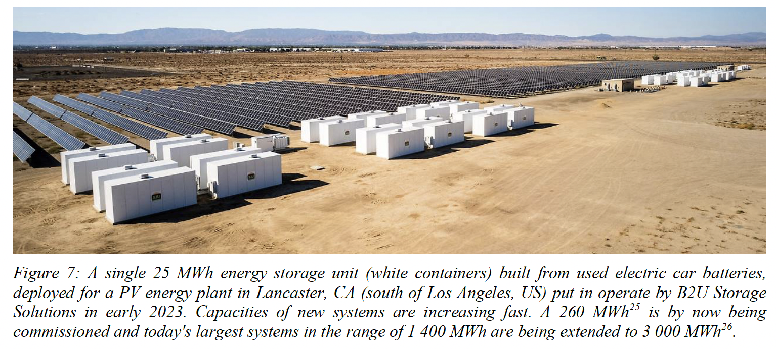
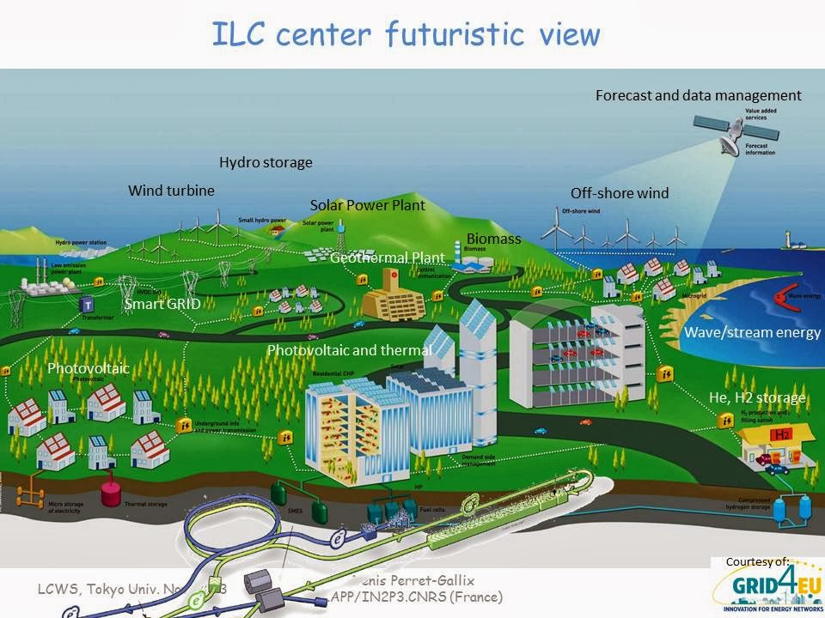
Mitigation and Compensation Strategies (II)
Heat Recovery and Supply
- comprehensive cost-benefit (LCA) assessment can be used to understand if heat recovery
is viable for a specific project and to develop the most suited heat recovery and supply scenario
Investment in R&D for “green” accelerator technologies → greener materials & procedures:
- improve the efficiency of the RF systems (vacuum electron devices & solid state amplifiers)
- design advanced permanent magnets
- use HTS (!) in high-field magnets
- innovative solutions to contain the energy demand of accelerators (iFAST/iSAS/EAJADE/RF2.0)
Nature-Based Interventions for Carbon Removal → also termed ‘Nature-based climate
solutions’ (NbCS) - conservation, restoration and improved management strategies (pathways)
in natural and working ecosystems with the primary motivation to mitigate GHG emissions
- decreasing GHG emissions related to deforestation/land use, capturing CO2 from atmosphere
- enhancing the resilience of ecosystems
“Green ILC Concept”,
paper in preparation
J. Gutleber, FCC Renewable Energy Supply Feasibility Study,
https://zenodo.org/records/10023947
CERN/OpenSkyLab –
Excavated material management

Slide 20
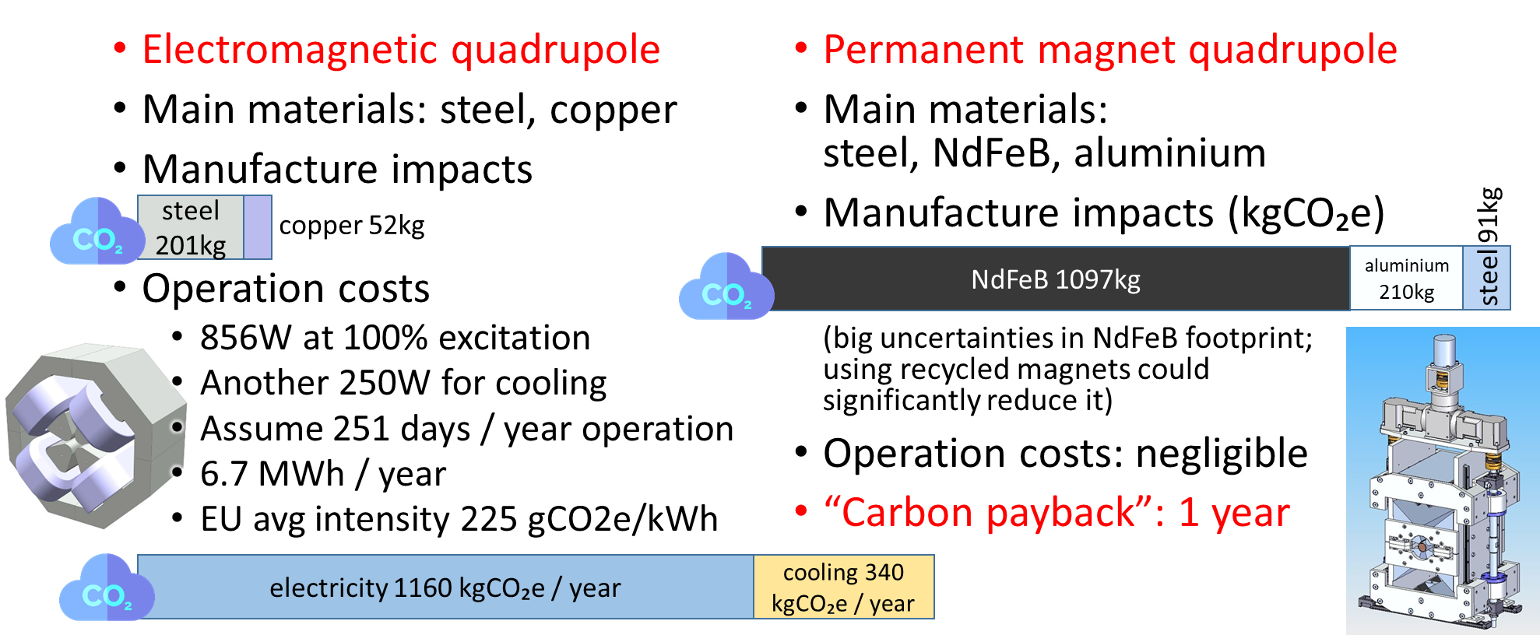
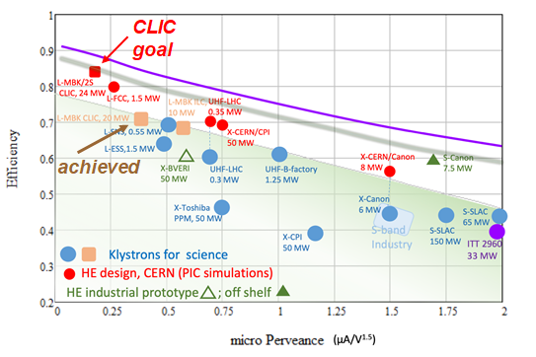

Energy Efficient Accelerator Technologies
Improving the key technology
for energy efficiency:
High E_{acc} gradient and Q₀ cavities, operation at higher T
High efficiency RF sources (klystrons)
Permanent magnets
Wider Deployment of Permanent Magnets
(ZEPTO: Electromagnet Operation vs. Manufacturing Footprin)t
Energy efficiency and reduced energy consumption for all facilities as an important part of reducing carbon emissions
→ Complementary to the transition to low-carbon energy sources
RF Source Efficiency is a Limiting Factor for Sustainability
SRF can fundamentally drive higher sustainability for future large-scale facilities
https://indico.cern.ch/event/1138197/contributions/4821294/attachments/2474897/4246880/HE_WS_2022_Syratchev.pdf
→ See P. McIintosh talk @ ESPPU2025
R&D into replacement of bulk Ni- cavities with thin-fillm-SRF (e.g. Nb or Nb3Sn coated Cu): reduce Nb consumption, higher T operation (2→ 4.5 K) → reduces cryo power by factor 3
Ferro-Electric Fast Reactive Tuners (FE-FRT):
potential game-changer for SRF cavity tuning,
particularly beneficial for ERL applications.

Slide 21
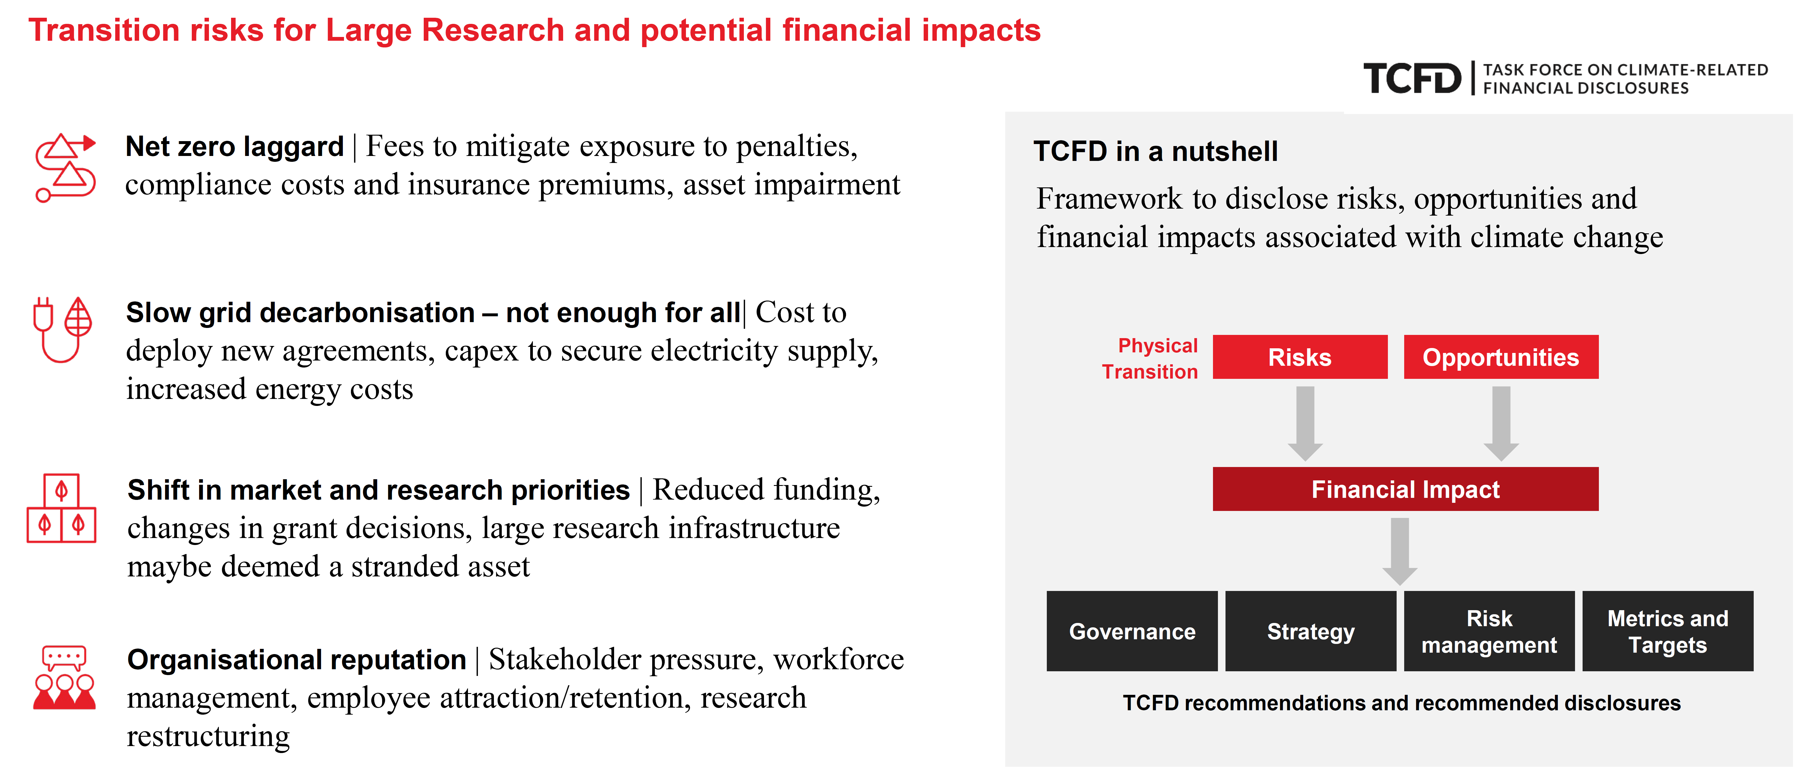
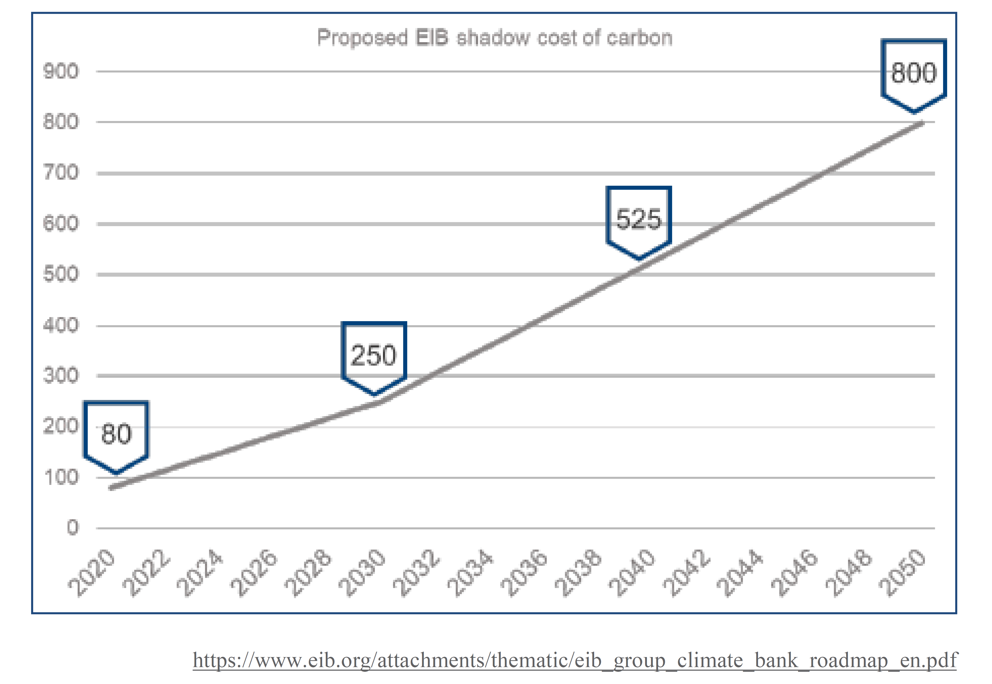
Decarbonisation and Large Accelerator RI’s
Construction of accelerator large-scale RI’s has to face decarbonisation path:
Cost optimisation for large facilities is often weighted heavily in favour of upfront costs, which will reduce the chances of funding being available for environmental
improvements.
H. Pantelidou / ARUP
Project costing must be done on a project lifetime basis: number of examples of sustainability interventions that come with a higher initial price tag, but over the multi-decade life of a typical accelerator will pay for themselves several times over.
Smaller environmental footprint from re-use of planned / existing CE facilities:
- FCC-ee → FCC-hh
- conventional LCF → LC based on
wakefield acceleration (shorter length)
Carbon Footprint Accounting and Reporting
Shadow Carbon Cost:
Penalising the economic performance of carbon intensive projects sends an important signal to the market
→ See M. Turner talk @ ESPPU2025

Slide 22
Summary and Outlook
Funding landscape are rapidly changing in Europe and beyond:
→ requires a long-term vision and “culture” for all aspects of the project, including
decarbonization path of RI’s - which help to demonstrate the laboratory’s
commitment to sustainability to the state and public
Sustainability assessment for future large-scale accelerator infrastructures is complex:
→ criteria needs to be properly tailored to the maturity of the project (stage)
→ developed differently for scientists, decision and policy makers, and society
Coordinated approach to develop a common database for accelerator materials and components and to provide open-source and cost-free LCA tools and software is
strategic to establish a framework for project accountability
The bulk of the issues elaborated in the LDG Sustainability WG report pertain to:
→ socio-economic benefits of accelerators-based RI’s
→ basis of LCA methodology and reporting for sustainability assessment in HEP projects
→ environmental impacts of Large RI’s during construction, operation, decommissioning phases
→ mitigation and compensation strategies
The LDG Sustainability WG Report proposes common format for sustainability reporting –
small numbers of “figures of merit” - relevant for the construction and operation of future accelerators
Input to the European Strategy process has been submitted [arXiv:2504.01235]
Final WG report will become public in the next few weeks

Slide 23
BACK-UP SLIDES

Slide 24
Some Other (More Technical) Objectives
LDG WG may comment on other aspects if deemed appropriate, for example:
• Treatment of future carbon intensity of electricity and materials:
- what scenarios should be assumed?
• Assessing the potential for dynamic operation of the various facilities:
- i.e. the ability to adapt to a fluctuating energy supply in a grid fed by renewables. This
may include standby mode power consumption, recovery time to full luminosity and
fraction of integrated luminosity per year preserved in a dynamic operation scenario.
• Treatment of regional vs global parameters:
- how to treat differences e.g. in carbon intensity between different host countries?
• Carbon intensity / lifecycle inventory (LCI) studies of materials specific to the
accelerator projects: high-purity niobium, permanent magnet alloys etc.
• How to interface with open-source LCI databases and LCA tools to potentially
ease/automate the assessment for future research infrastructures
• How the recommendations for colliders can be extended to other scientific /endeavours
related to HEP
• How HEP labs represented in the LDG can share/build up expertise jointly

Slide 25
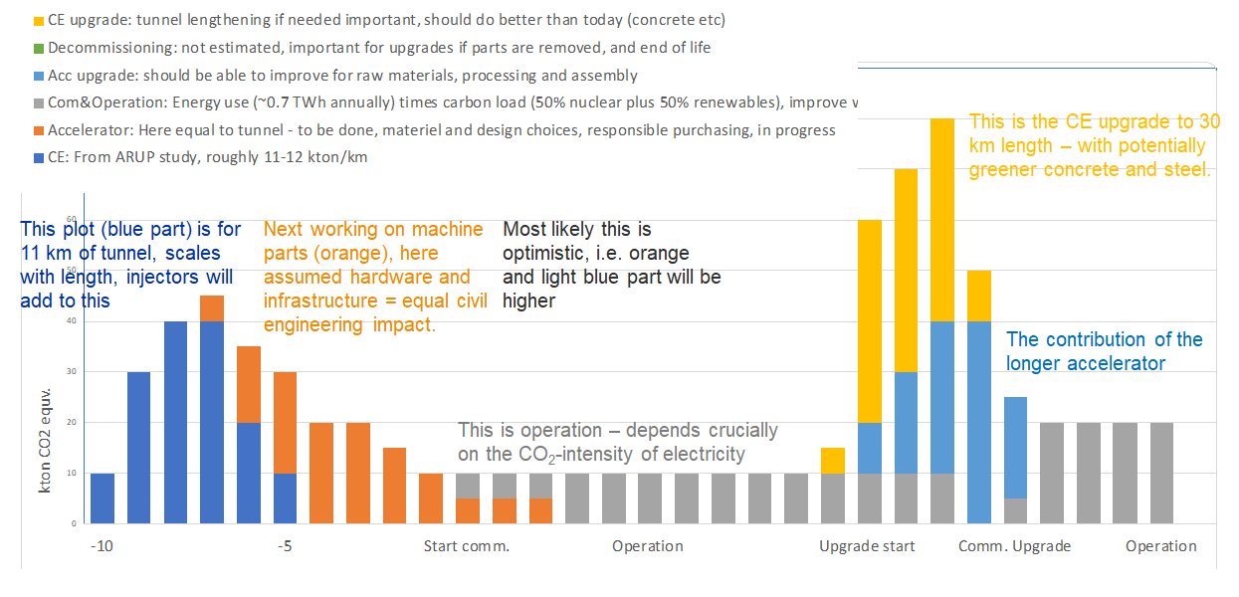
LC Example: Towards Carbon Accounting with LCA
CLIC example,
S. Stapnes

Slide 26
Future Colliders: Running on Renewables
There will be no future large-scale collider project without an energy management component:
fluctuating sustainable energy - energy management / dynamic operation → use surplus energy for RIs
Modulate power according to availability (price)
CERN
Energy
Use in
2017
R. Losito
FCC-ee: has warm magnets but a large SRF system with stable power required for cryogenics:
- Large oscillations among operational modes makes it difficult to manage the excess energy with the legal framework of today.
- Energy required in stand-by ~25% of energy during beam operation.
Two factors provide uncertainty today in a scenario fully based on renewables:
  Lack of one or more efficient technology to store energy in order to provide a sufficiently stable baseload → adapt to fluctuating power supply will remain a concern
  Lack of capacity and of the possibility to reserve capacity to move energy across borders

Slide 27
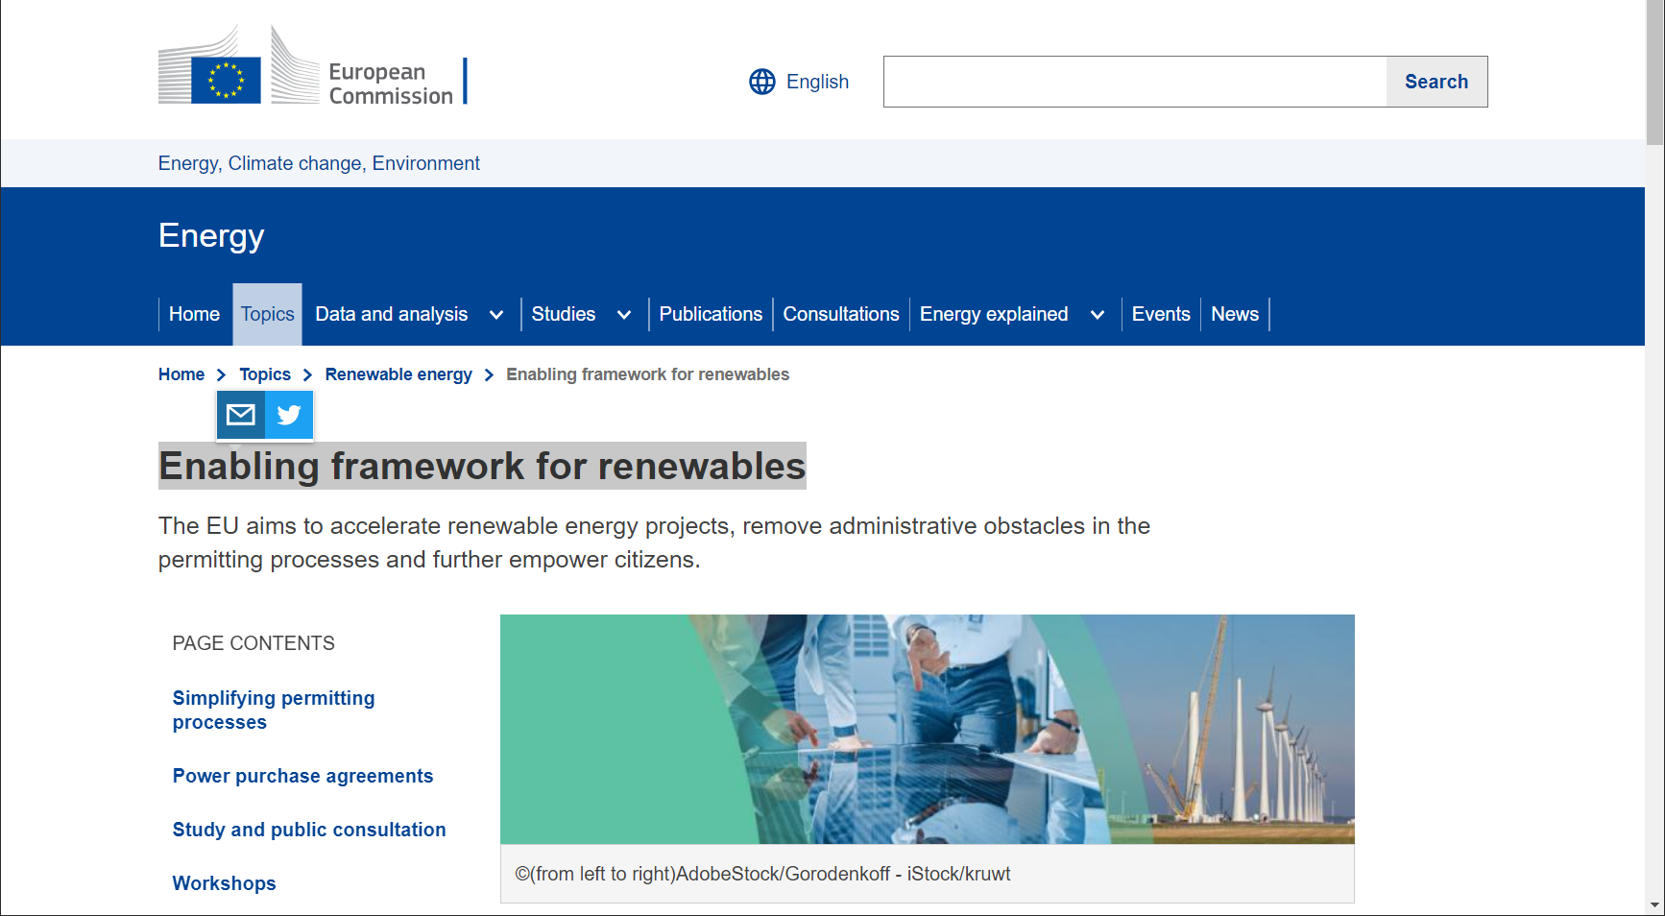
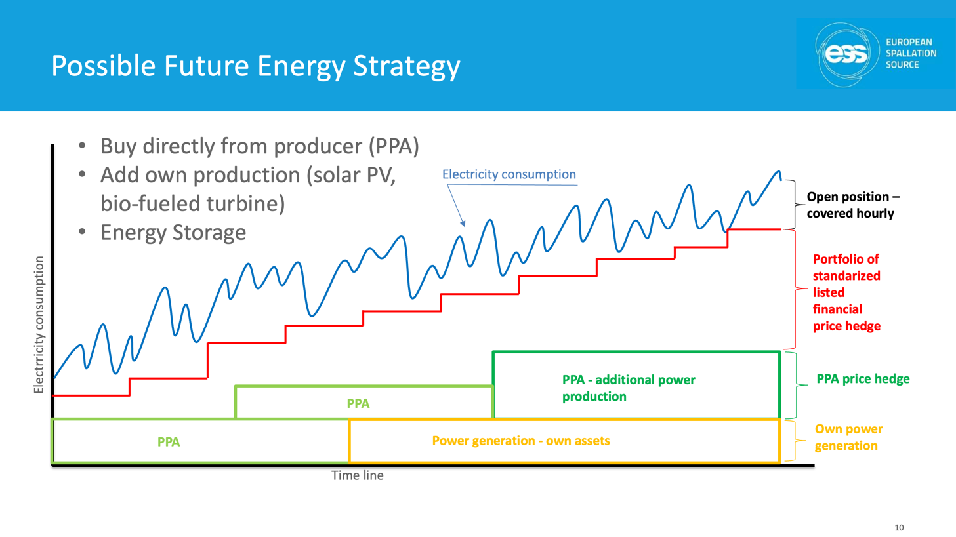
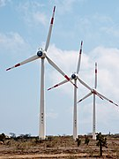
Fluctuating Energy Sources: PPA & Running on Renewables
Switch to carbon-neutral energy sources &enabling framework for renewables:
power purchase agreement (PPA) - long-term contract for the electricity supply (~ 20 years)
A. Sunesson
R. Losito
Power
purchase
agreement
Linear
Colliders
full collider operation at times of high grid production
reduced operation or standby modes with fast L recovery otherwise
Study by Fraunhofer institute (2018) considered running CLIC (380 GeV) for a total power of 200 MW (in reality only 110 MW needed) on renewables and participating in demand side flexibility:
CLIC’s total energy consumption could be generated from renewables (using local solar plant of 330 MWp a local wind farm of 220 MWp), but still needs public grid for continuity
Operating modes with power modulation were investigated
https://edms.cern.ch/document/2065162/1

Slide 28
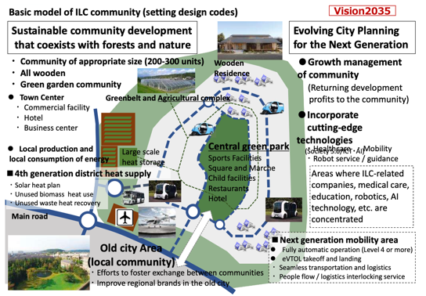
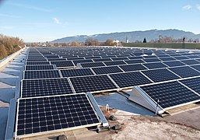
Prioritising Nature-Based Interventions (ILC Example)
Identifying relevant initiatives to complement decarbonisation:
- prioritising nature-based
interventions for NEW RI’s:
integration in local environment
as part of the asset management
(e.g. CERN. Green ILC concept)
- potential to contribute towards
carbon removal through
environmental enhancement
For ILC: renewable energy available (Tohoku Electric Power) in local grid at ~23% level, need 0.5-1 % for ILC. Additionally considers increased CO2 absorption to be fully neutral
Asurnipal CC-BY-SA-4.0

