Slide 1
PARALLEL 2 / ACCELERATOR TECHNOLOGIES
Lessons from Current e⁺e⁻ Colliders
Yukiyoshi / Ohnishi (KEK)

Slide 2
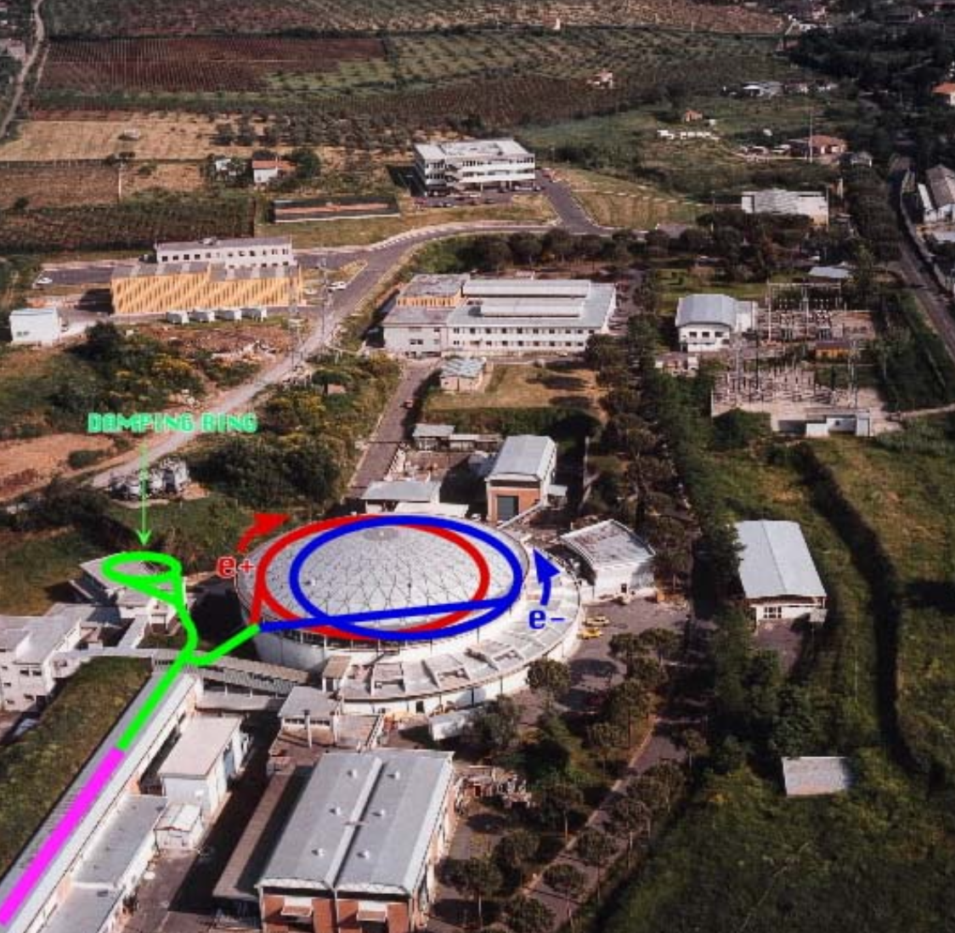
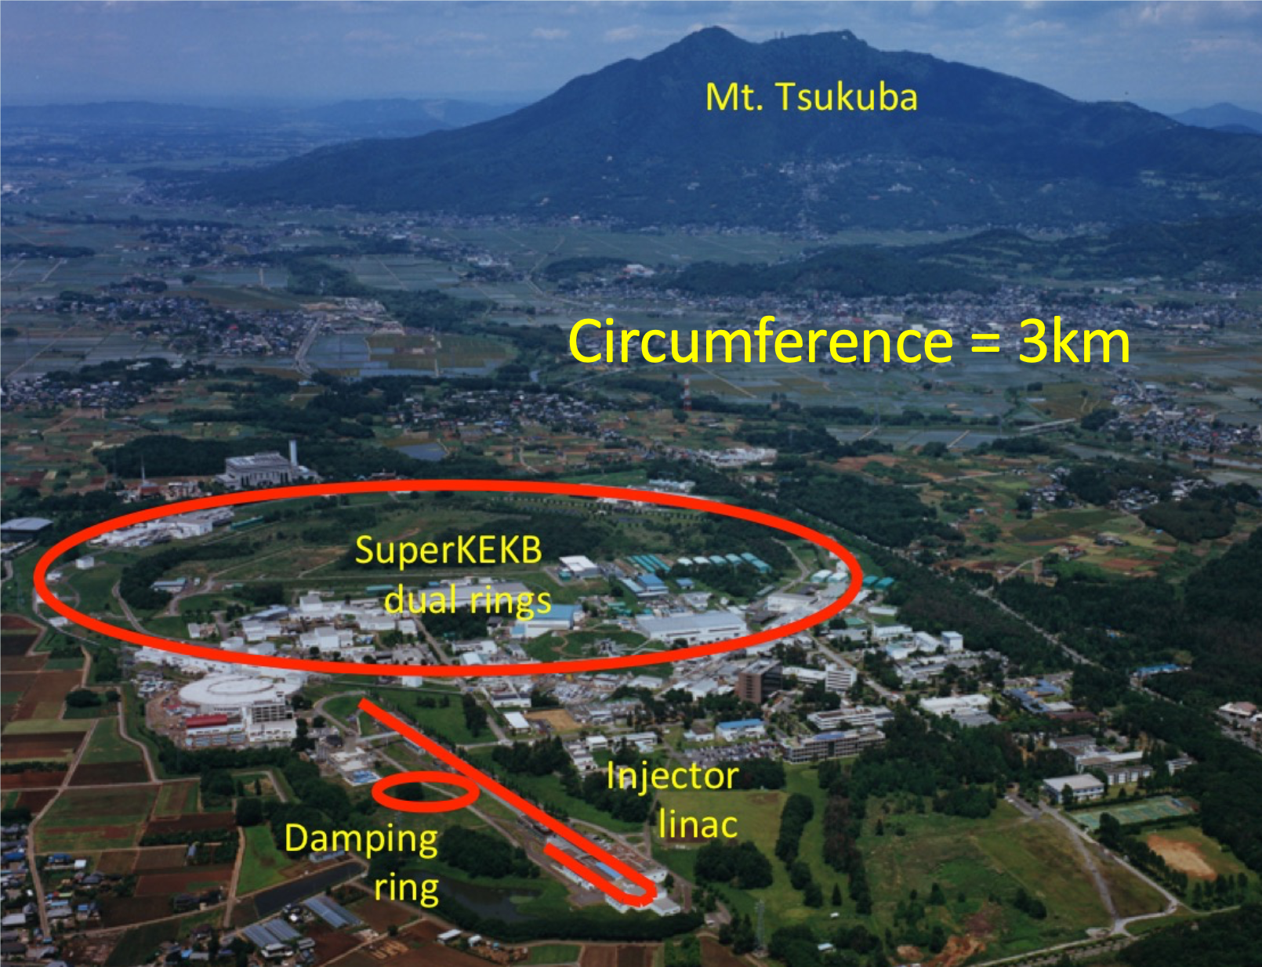
Contents
e+
Ring Colliders: DA$Φ$NE and SuperKEKB
Current Status and Achievements
Experiences and What is Challenge ?
Path Forward and Useful Experiences for Future Collider Projects

Slide 3
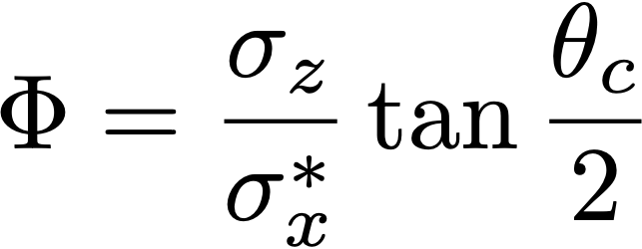
Luminosity Challenge
Geometrical Loss
Hourglass Effect, Crossing Angle.
In the flat beam, $σ_{y}^{*}$ = 30 - 50 nm is a target. $→$ $β_{y}^{*}$ < 1 mm and $ε_{y}$ < 10 pm
Overcoming hourglass effect to squeeze $β_{y}^{*}$
Difficult to make $σ_{z}$ shorter
$←$ Creating a Large Piwinski Angle
to Make Short "Bunch"
Large Crossing Angle and Low Emittance = Nano-Beam Scheme
$$θ_{c}$$
DA$Φ$NE: $Φ$ = 1.7
SuperKEKB: $Φ$ = 12.3 / 12.7

Slide 4
Luminosity Challenge (cont'd)
Beam-Beam Parameter
Ratio of $β_{y}^{*}$ to $ε_{y}$
Vertical Beam Size at the IP
Waist position
is adjusted.
Vertical Dispersion
X-Y Couplings
$←$ Machine Imperfection
Vertical Emittance
Combined Effect of Collimator Impedance and BxB Feedback Noise $→$ -1 Mode Instability
Optics Distortion due to Machine Imperfection
Beam-Beam Blowup
Betatron Resonance $→$ Crab Waist Scheme can mitigate.
Combined Effect of Lattice Nonlinear, Beam-Beam, and Wakefield

Slide 5
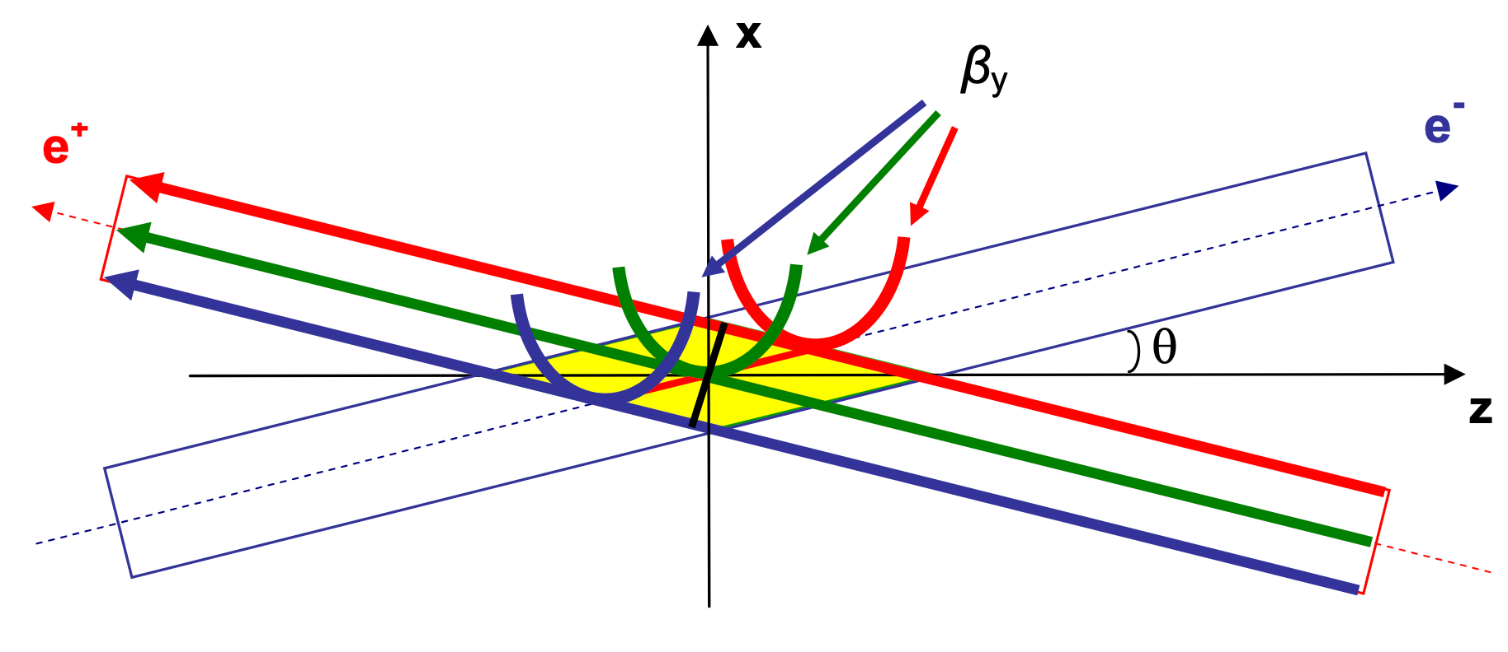
Two New Technologies
P. Raimondi et al., LNF-07/003
1. Nano-Beam Scheme
2. Crab-Waist Scheme
$$β_{y}$$
"waist"
$$Δψ_{x}=πΔψ_{y}=π/2$$
$2\frac{σ_{x}^{*}}{(θ_{c}/2)}$
< Focal Depth ($β_{y}^{*}$)
Collision Region
$$σ_{z}θ_{c}$$
/2
Waist moves to
the opposite beam center.
Effectively Very Short Bunch $→$ "Hourglass"
"Head-On Collision"
Suppression of Betatron Resonance
$$<1mm$$
$σ_{z}$ = 6 mm
SuperKEKB
Related to Beam-Beam Interaction
Key: Large Crossing Angle with Low $ε_{x}$
Key: Strong Sextupoles with Specific Optics

Slide 6
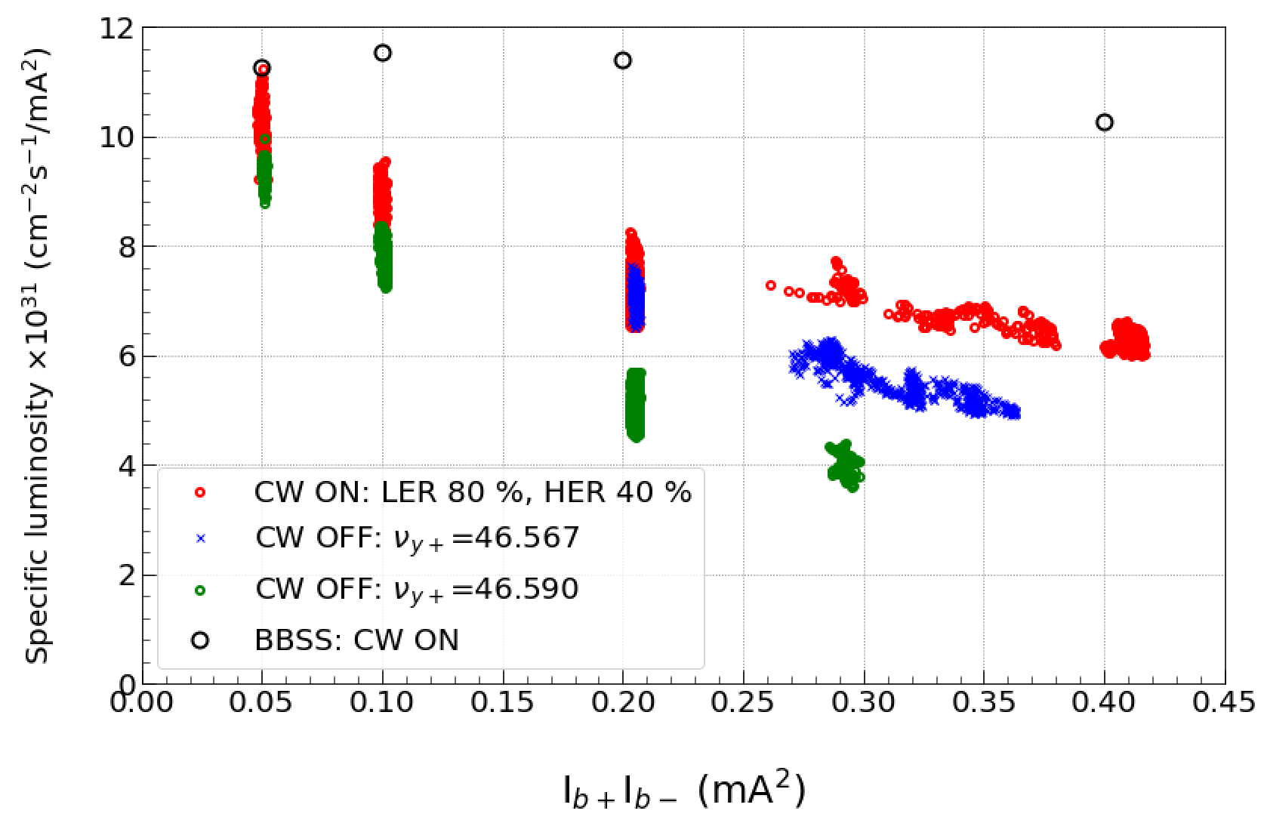
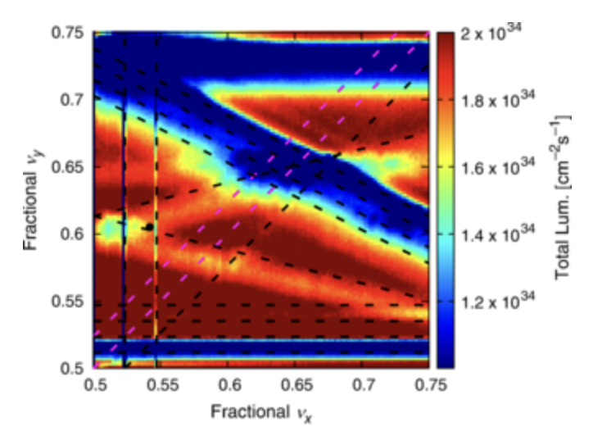
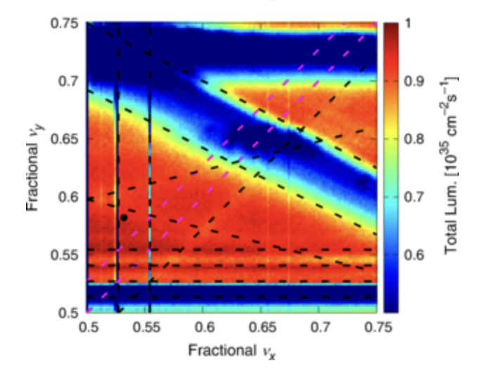
Crab Waist ON and OFF
Experiment on March 12 and March 21-22 2024
SuperKEKB Machine Study in 2024
393 Bunches
CW OFF
$ε_{y}$ = 20 pm
Beam-Beam Blowup
We don't know the reason.
Lsp decreases by 30 %
Lattice Nonlinear ?
Space Charge ?
Combined Effect ?
ON
OFF
$ν_{y+}$ = .570
CW ON
OFF
$ν_{y+}$ = .567
$ν_{y+}$ = .59
Simulation
Beam-Beam Simulations
D. Zhou et al.,
Phys. Rev. AB 26 071001
Crab waist is effective at high intensity.
Luminosity is OK for small $I_{b+}I_{b-}$.
Crab waist changes betatron resonance structure.

Slide 7
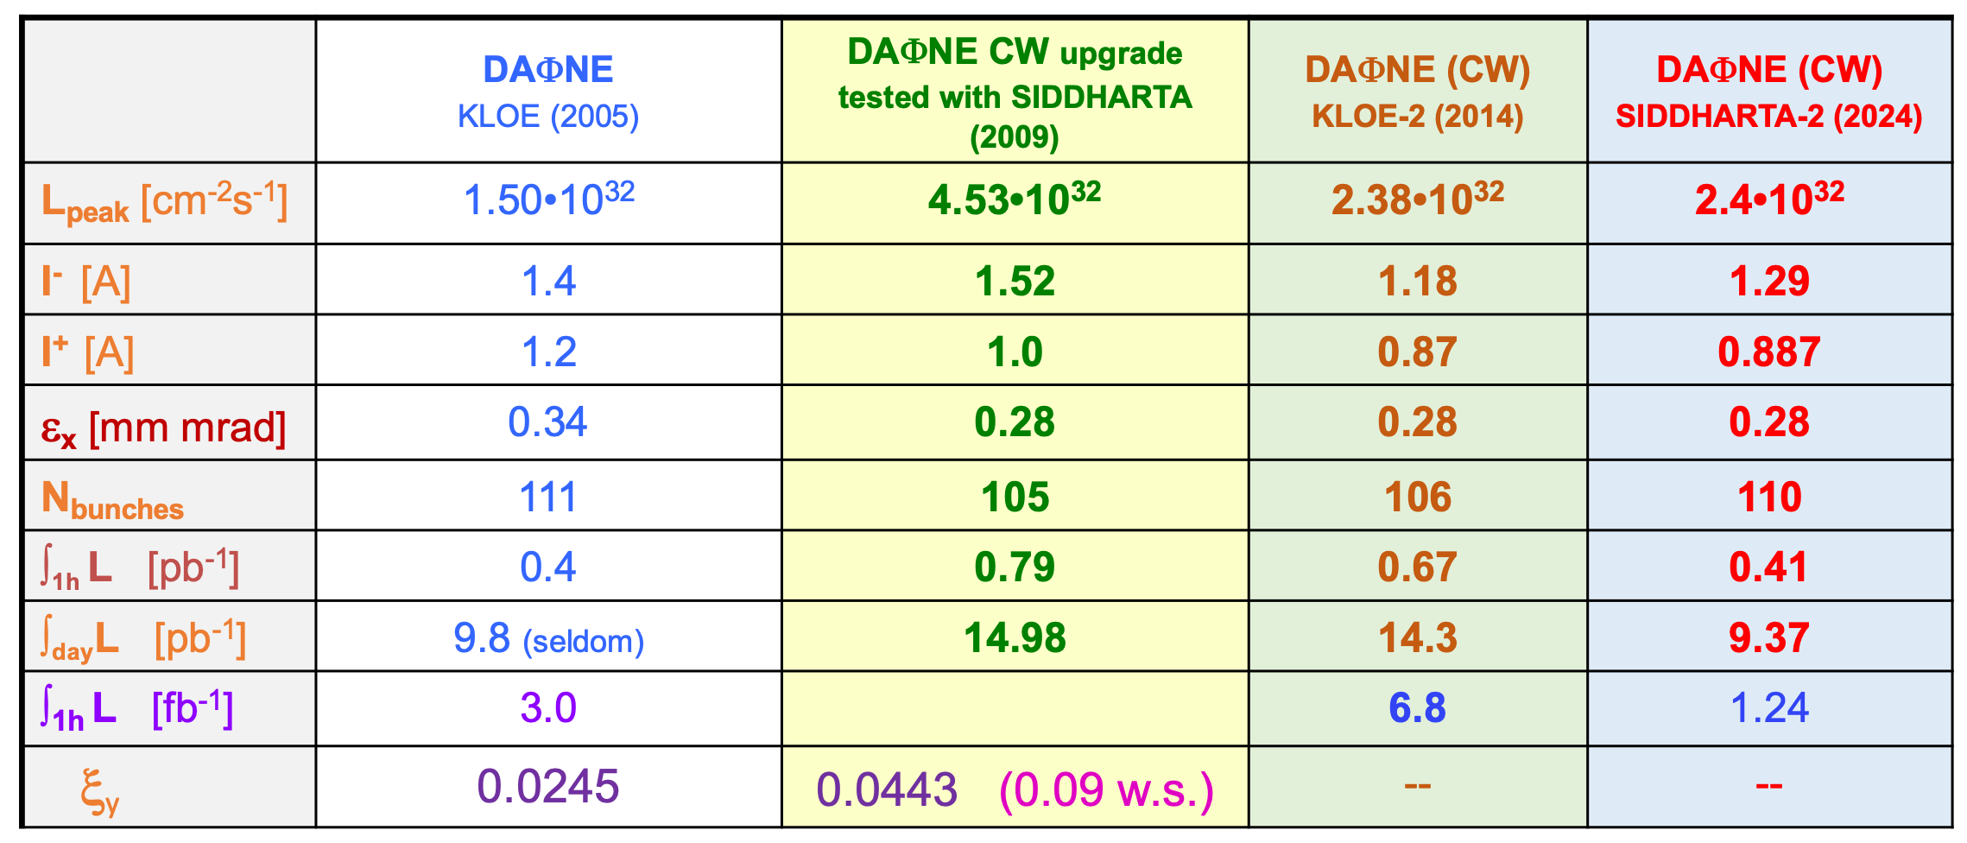
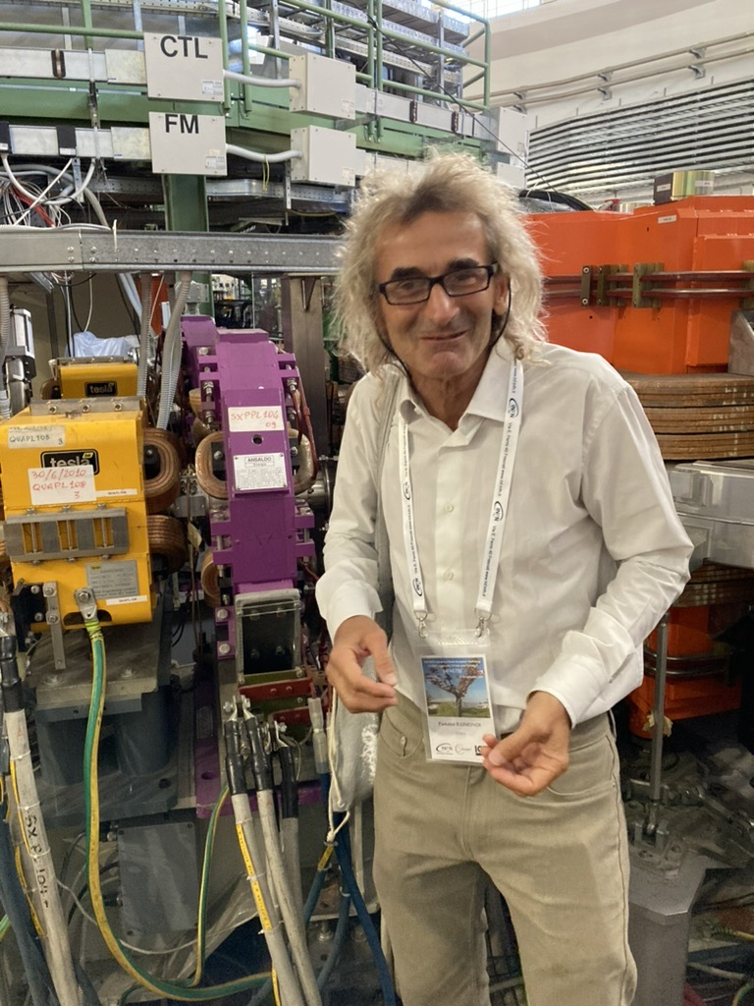
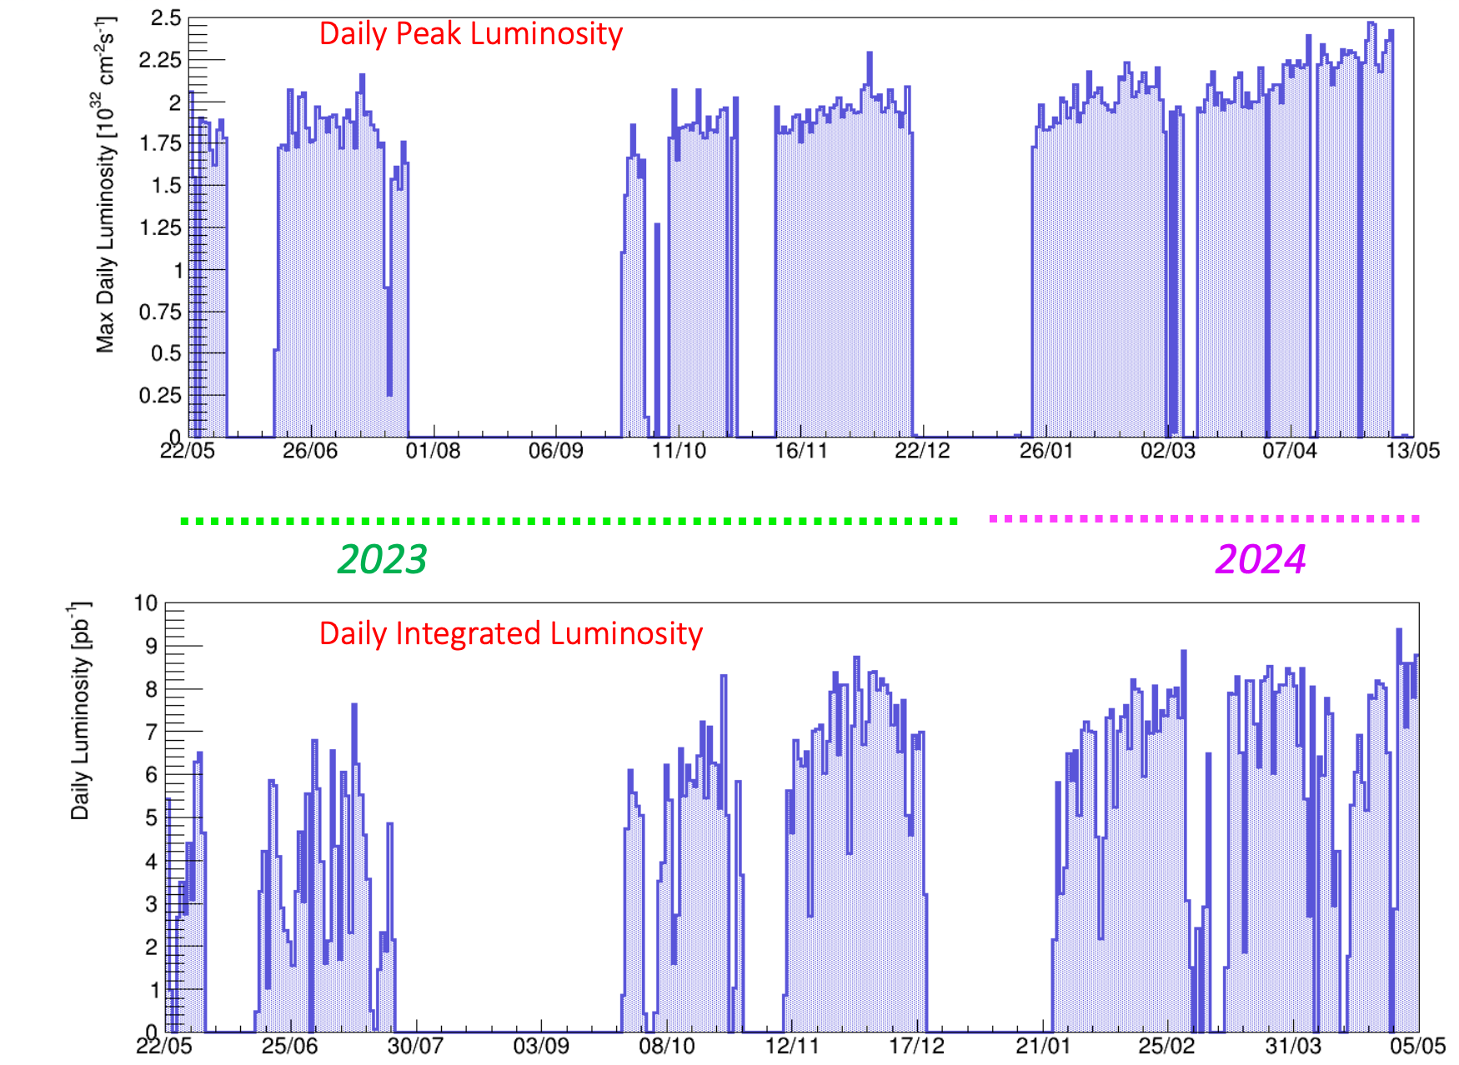
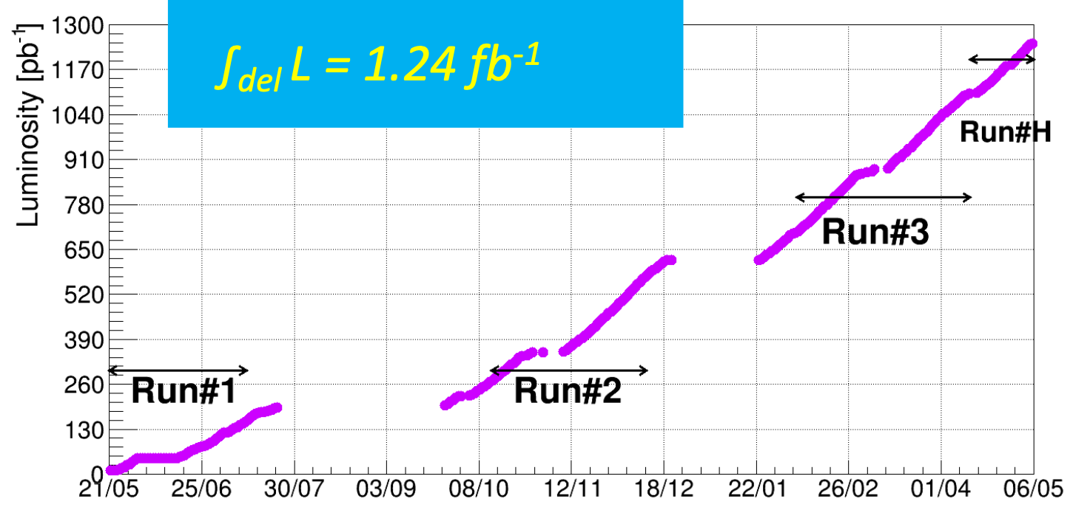
Simple IR
Physics for IR
DA$Φ$NE Performance Summary
Crab Waist Sextupole
P. Raimondi et al.
The first crab sextupole in the world (DA$Φ$NE).
Successfully tested in 2008 - 2009
Physics events evaluated on the base of preliminary conservative considerations exhibit a signal to noise ratio 3 time higher with respect to the one measured in 2009.
SHIDDHARTA-2
2.4 x 10³² cm⁻²s⁻¹
Lsp [cm⁻²s⁻¹/mA²]
0.99 x 10²⁸
3.13 x 10²⁸
2.46 x 10²⁸
2.31 x 10²⁸
High Intensity
Axial Field in IR
Peak Luminosity
Integrated Luminosity
Daily Int. L
C. Milardi, eeFACT2025
2023
2024

Slide 8
SuperKEKB Operation History
Crab Waist
$$β_{y}^{*}=1mm$$
$$β_{y}^{*}=3mm$$
$$β_{y}^{*}=2mm$$
$$β_{y}^{*}=0.8mm$$
1.3 A
Electron
Beam
(7 GeV)
$$β_{y}^{*}=0.8mm$$
1.7 A
Positron
Beam
(4 GeV)
New Record !
5.1 x 10³⁴ cm⁻²s⁻¹
Peak Luminosity
Long Shutdown
LS1
Int. Luminosity

Slide 9
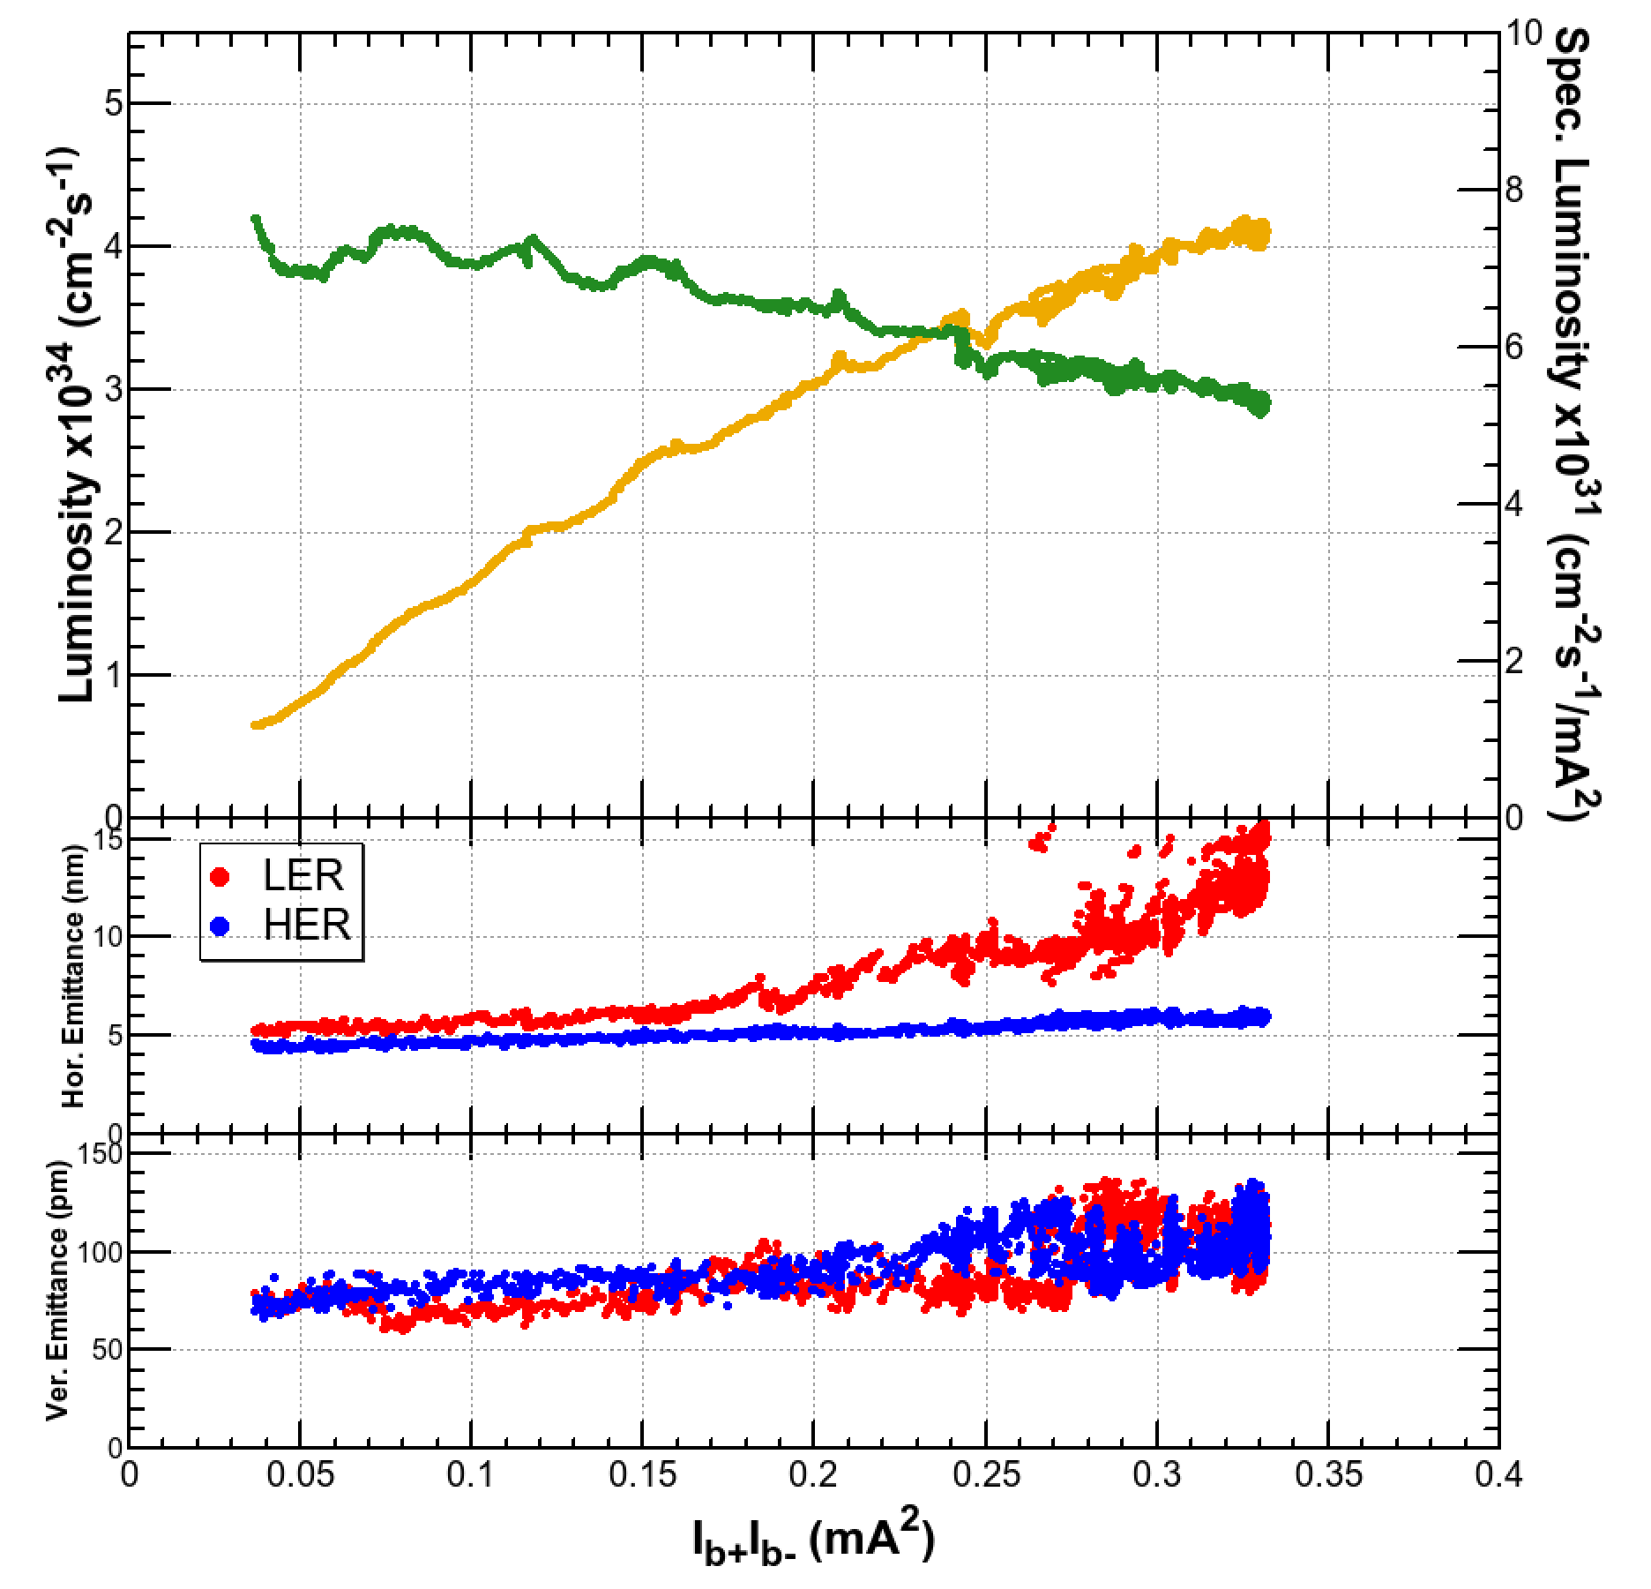
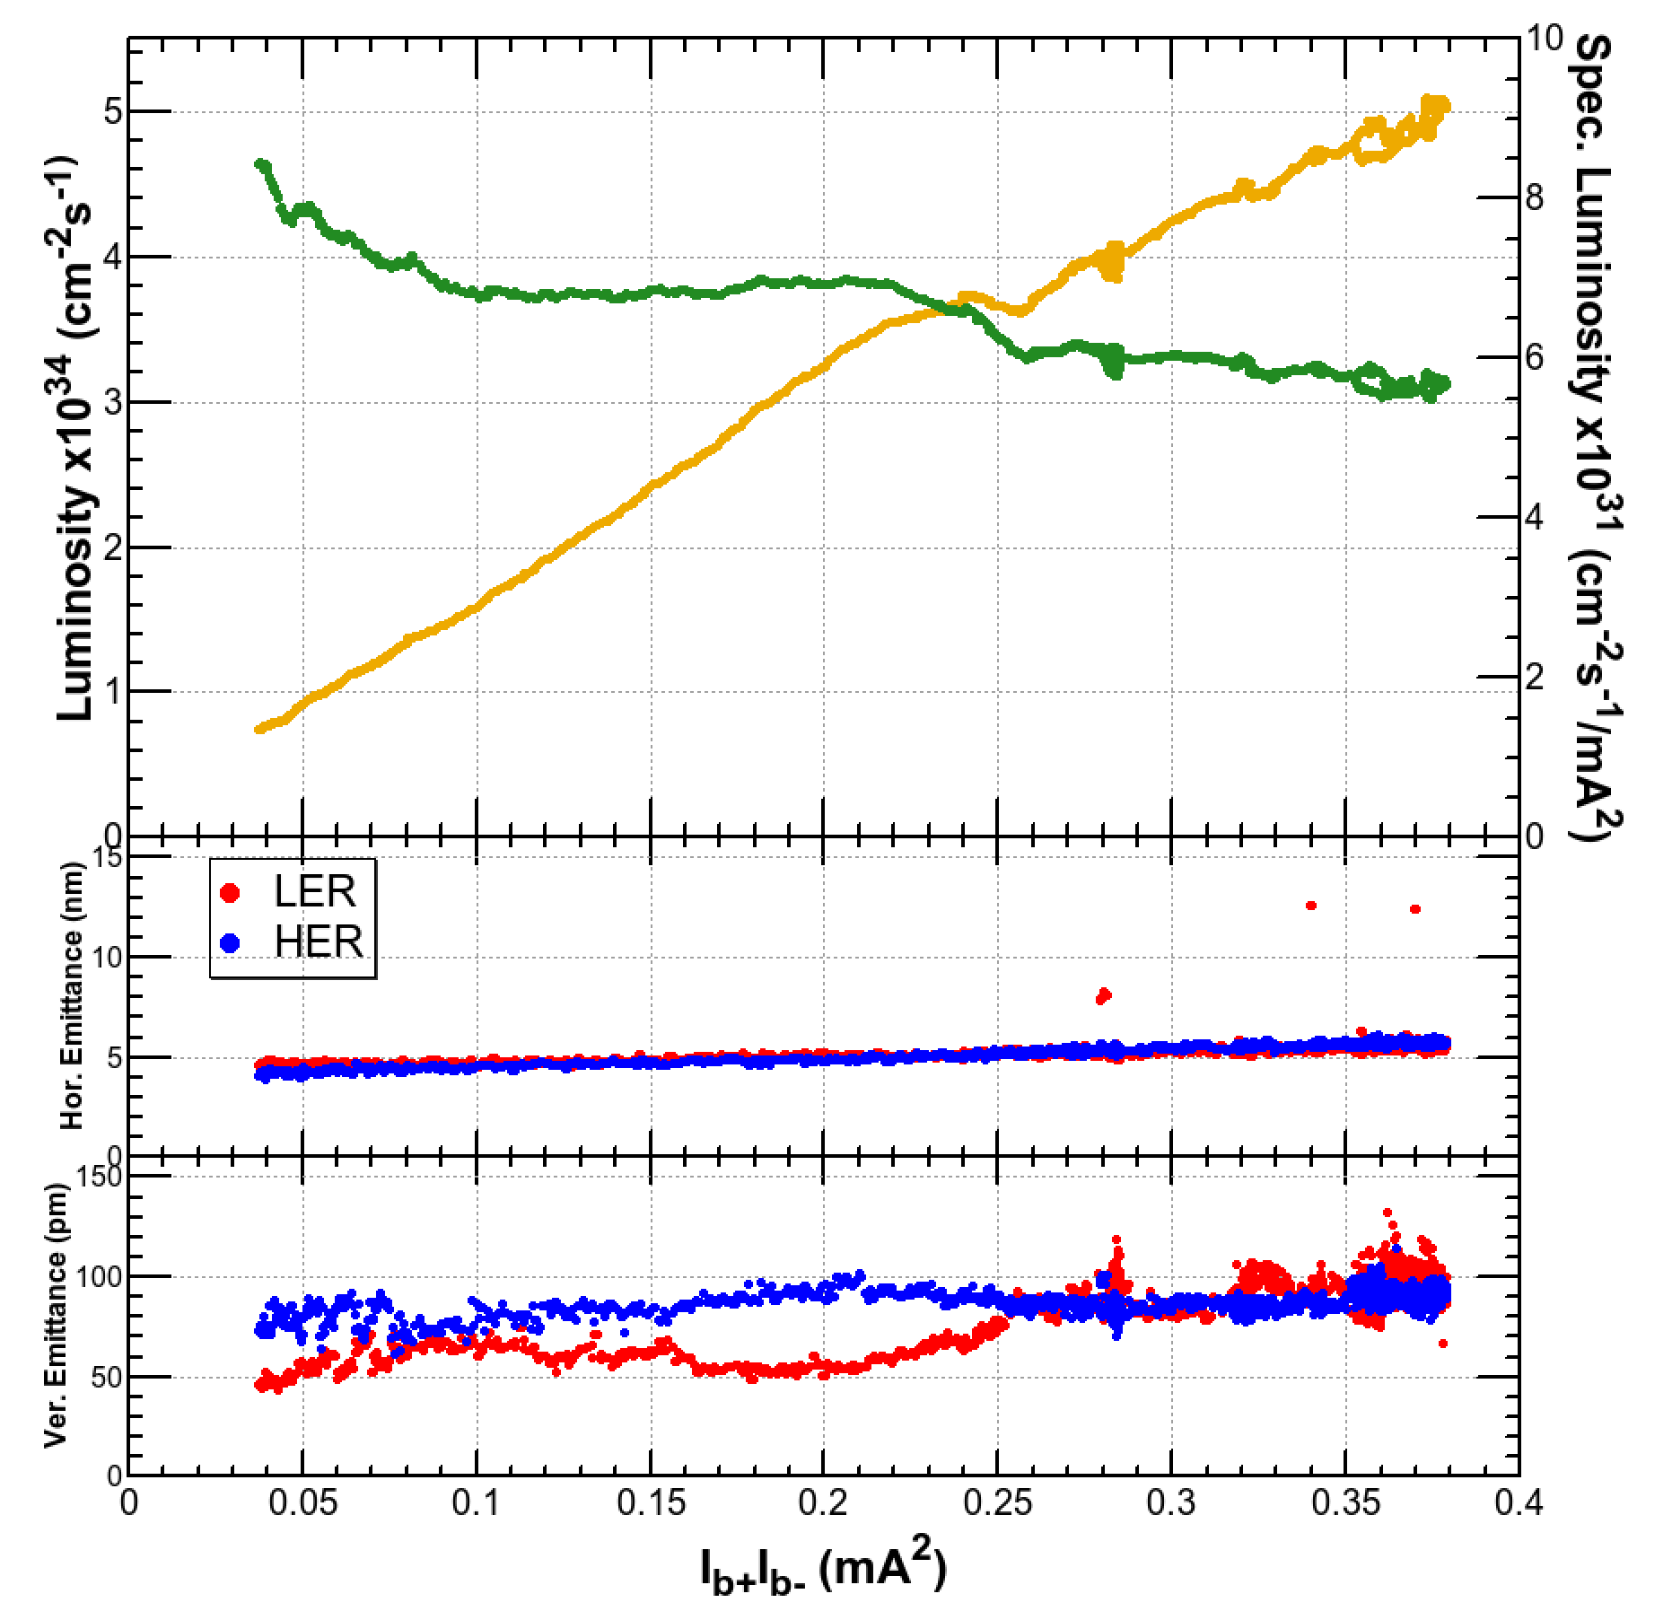
Beam-Beam Issue
Large Crossing-Angle Collision
$$θ_{c}=83mrad$$
$$β_{x}^{*}=60mm/β_{y}^{*}=1mm(HER)$$
After Squeezing $β_{x}^{*}$ in LER
nb = 2346
$$β_{x}^{*}=80mm/β_{y}^{*}=1mm(LER)$$
$$β_{x}^{*}=60mm/β_{y}^{*}=1mm(Both)$$
5.1 x 10³⁴
Luminosity
Lsp
Luminosity
Lsp
X-Z Beam-Beam Instability
Horizontal emittance blowup in LER
Lower $β_{x}^{*}$ helps reduce X-Z instability.
Difficult
LER
Injection
Horizontal emittance becomes stable.
Vertical emittance is unstable.
2024 Dec. 24 09:55 - 10:58
2024 Dec. 27 01:00 - 01:44

Slide 10
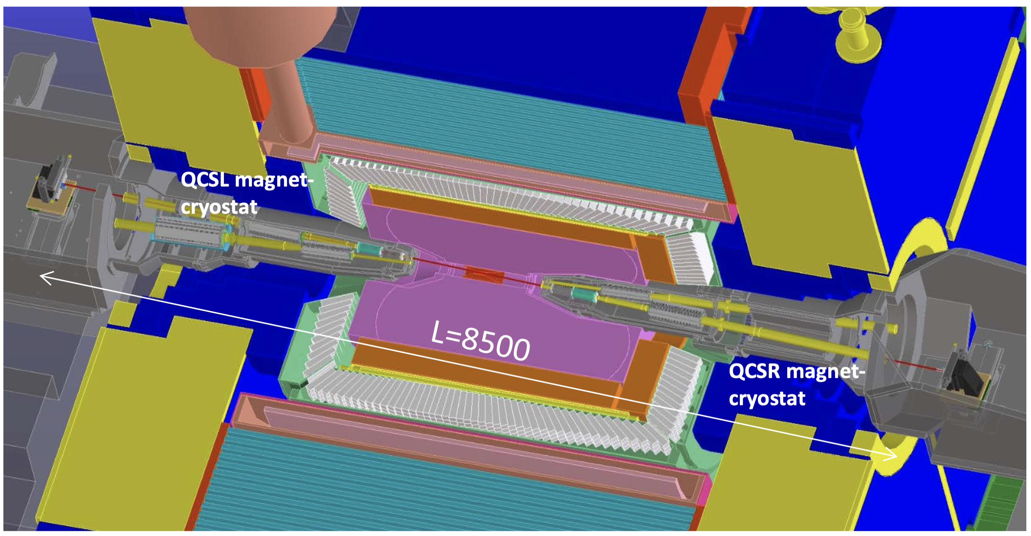
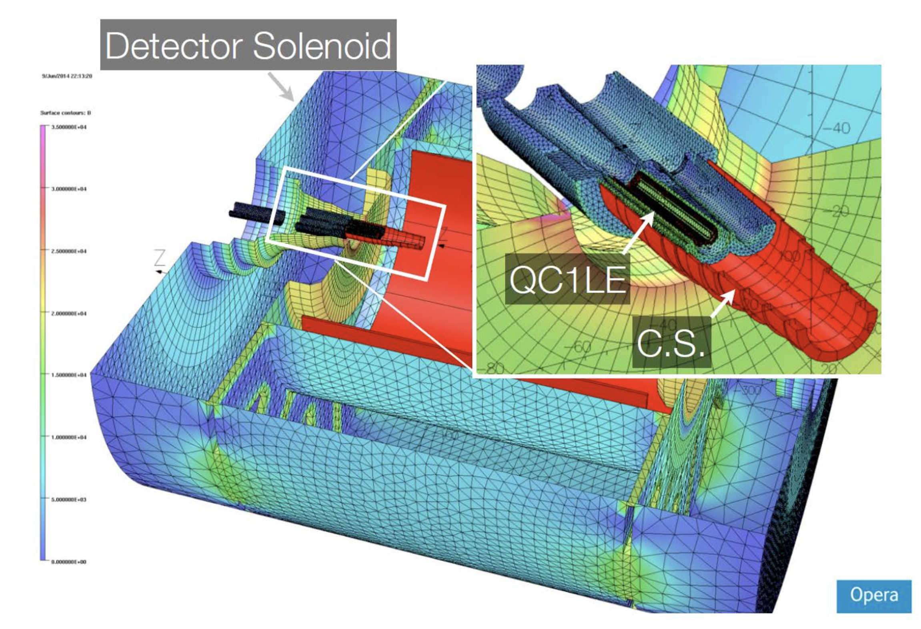
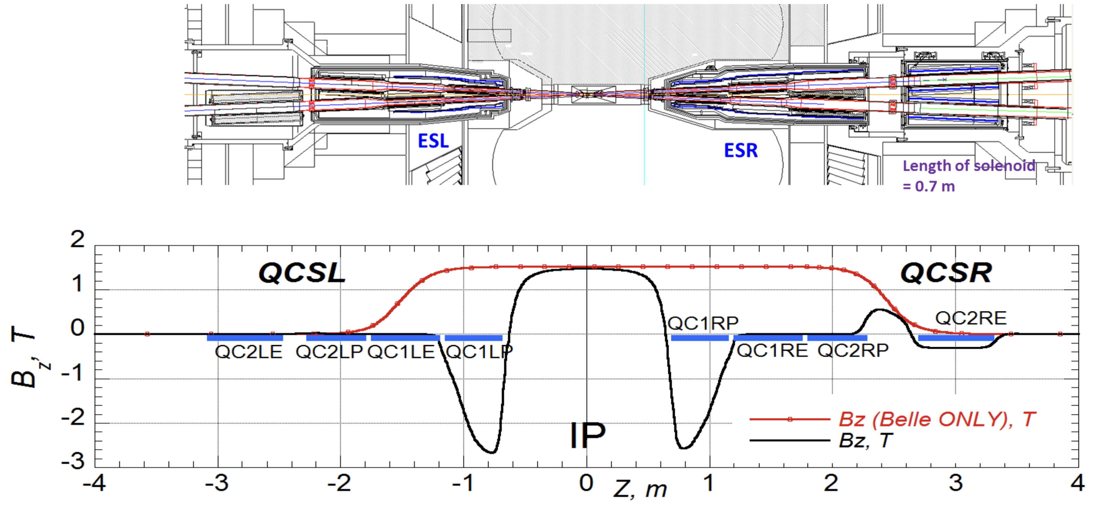
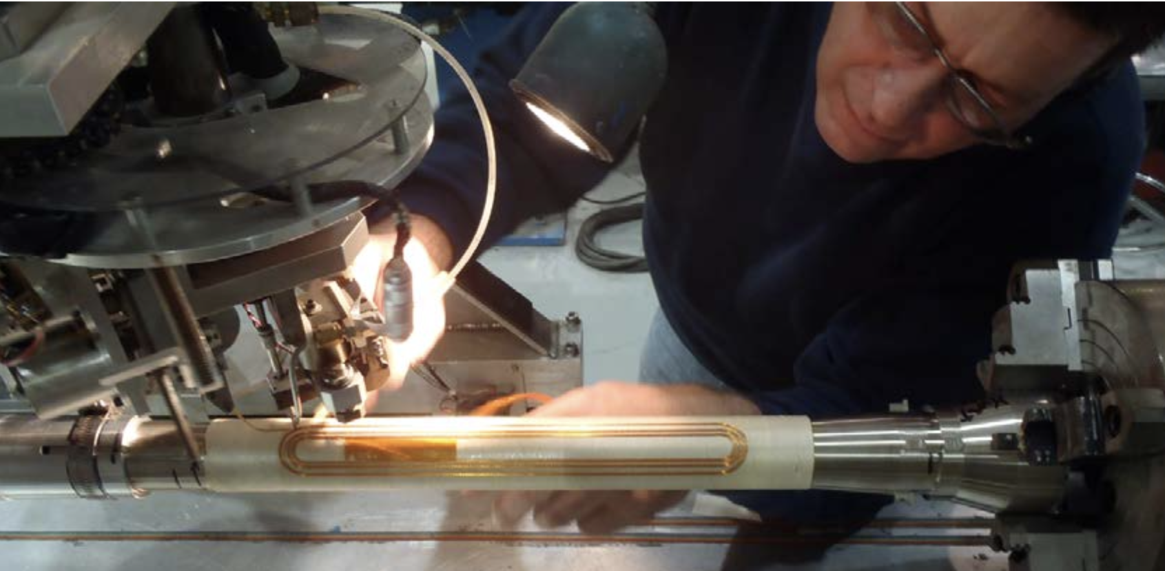
Interaction Region at SuperKEKB
Detector Coverage and Accel. Region
Alignment of the components affects performance. (Larger Impact)
Reducing Error Field to Improve Luminosity.
Small Space !
Solenoid Field
Direct Winding of SC Corrector Coil (BNL)
1.5 T
Using Many Corrector Coils
to Correct Error Field

Slide 11
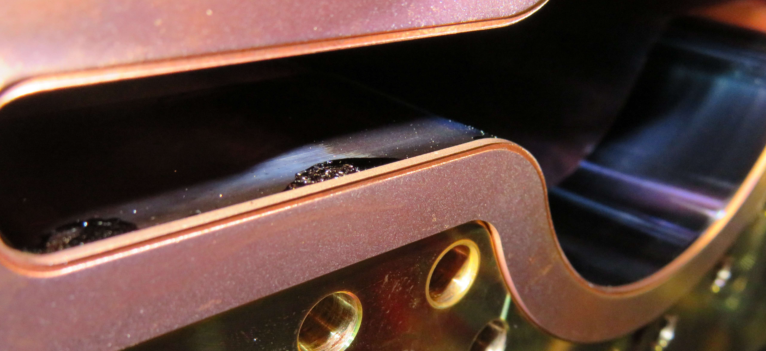
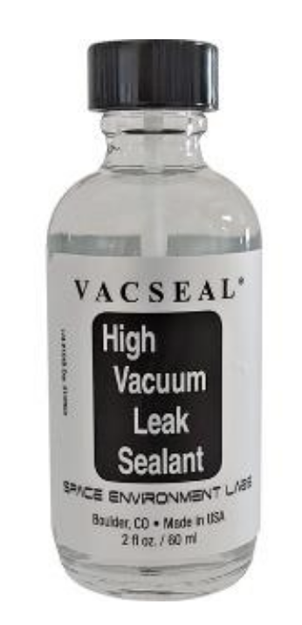
Obstacles to Increase Beam Current
Sudden Beam Loss $→$ Quench of SC Final Focus Magnet, Collimator Damage, Detector Damage
Large beam loss (~40 %) within a few turns
Quit different from known beam instabilities
"VACSEAL" (Vacuum Sealant)
Specific to Wiggler and IR because VACSEAL was used there.
Changes Black Stain
Baked by SR $→$ Amorphous Graphite
MO-Type Flange
Beam-Dust interaction is a candidate of SBL events.
Cleaning Work $→$ SBL events are significantly reduced.
Wiggler
Wiggler
Beam
Current
Cleaning Work at Wiggler Flange on November 6

Slide 12
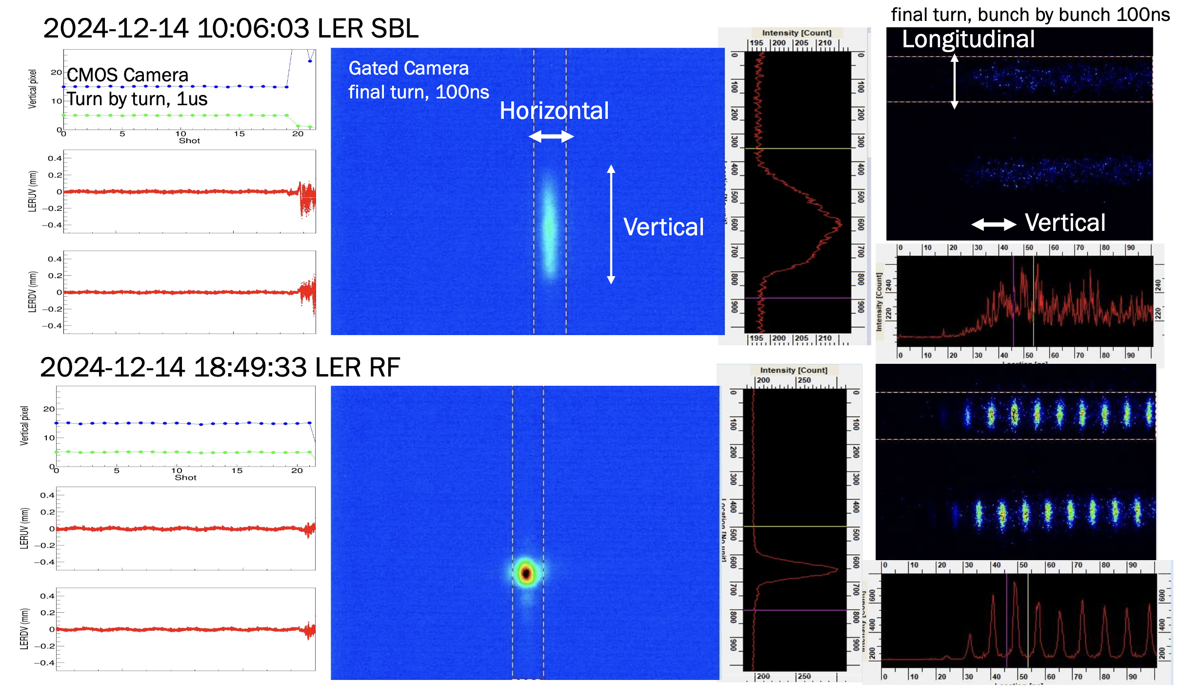
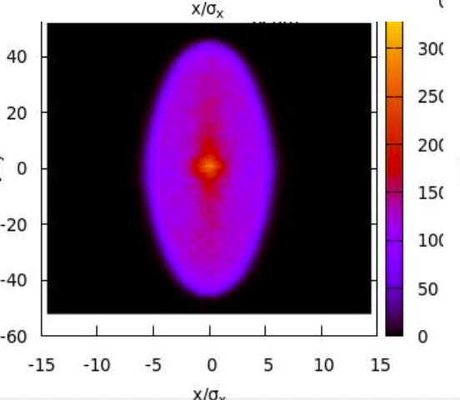
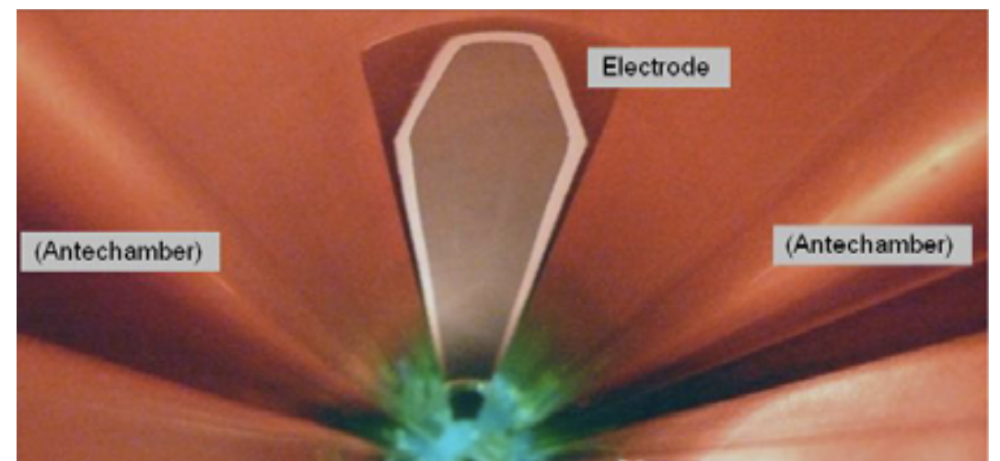
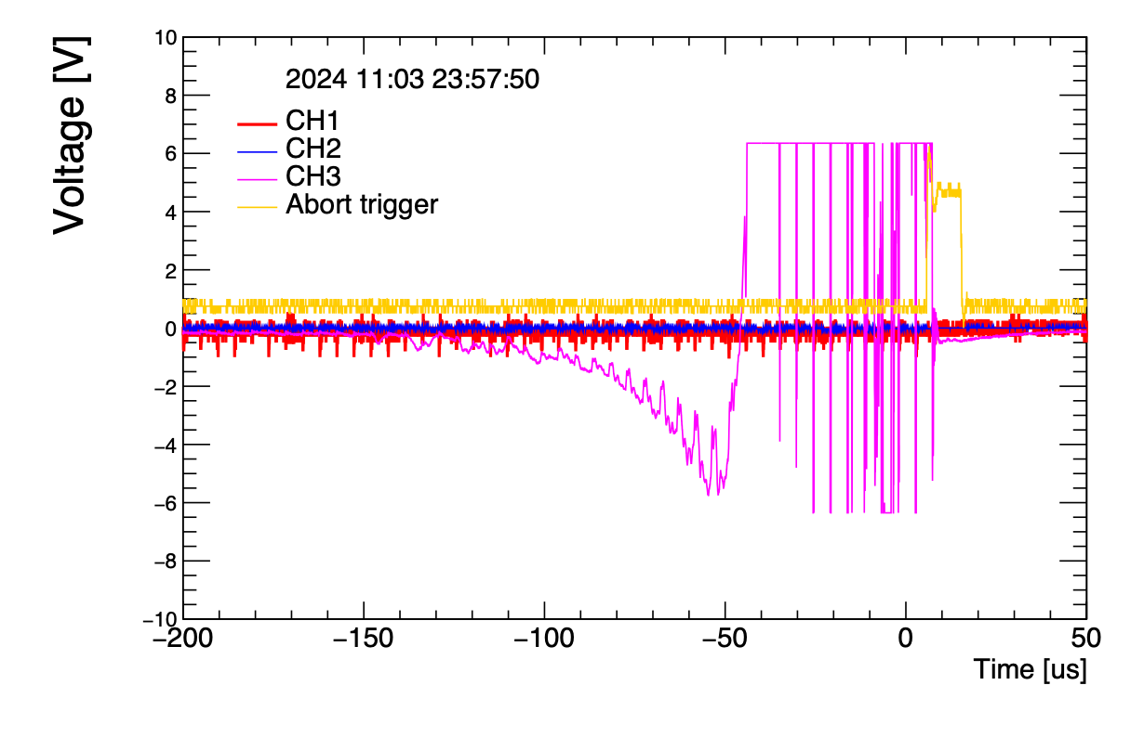
Beam-Dust, Ion, Electron Cloud Interaction
Ionization
Simulation
Observation by Streak Camera
4th turn: e⁺ beam
$$y/{σ_{y}}$$
SBL Event
Heating
No SBL Event
$$x/{σ_{x}}$$
Fission and Evaporation
Vertical Beam Size Enlargement in SBL Event
Shape of Charged Dust = Flat Beam
50 $μs$
Pick-up probe
Positive
Beam Pipe
Charged Dust, Ion and Electron Clouds
e-
Clearing Electrode
Negative
e-
+
e-
+
+
Simulations of Beam-Dust interaction is on-going.
KEKB < FCC-ee < SuperKEKB
K. Ohmi, eeFACT2025; S. Heifets, PR ST-AB 8 061002 (2005)

Slide 13
Long Shutdown
(LS2)
We are here.
Long Shutdown
(LS1)

Slide 14
Machine Parameters of SuperKEKB
Step-by-Step Improvement
 | December 27, 2024 |  | Next Target |  | Target before LS2 |  | Unit
Ring | LER | HER | LER | HER | LER | HER
Emittance | 4.0 | 4.6 | 4.0 | 4.6 | 4.0 | 4.6 | nm
Beam Current | 1632 | 1259 | 2080 | 1480 | 3026 | 2000 | mA
Number of bunches | 2346 |  | 2346 |  | 2346
Bunch current | 0.696 | 0.537 | 0.89 | 0.63 | 1.29 | 0.85 | mA
Horizontal size σx* | 15.5 | 16.6 | 15.5 | 16.6 | 15.5 | 16.6 | μm
Vertical cap sigma Σy* | 375 |  | 217 |  | 159 |  | mm
Vertical size σy* | 265 |  | 154 |  | 112 |  | nm
Betatron tunes νx / νy | 44.525 / 46.589 | 45.531 / 43.599 | 44.525 / 46.589 | 45.532 / 43.573 | 44.525 / 46.589 | 45.532 / 43.573
βx* / βy* | 60 / 1.0 | 60 / 1.0 | 60 / 0.8 | 60 / 0.8 | 60 / 0.6 | 60 / 0.6 | mm
σz | 4.6 (6.0*) | 5.1 (6.1*) | 4.6 (6.5*) | 5.1 (6.4*) | 4.6 (7.5*) | 5.1 (6.9*) | mm
Piwinski angle | 12.3 | 12.7 | 12.3 | 12.7 | 12.3 | 12.7
Crab waist ratio | 80 | 60 | 80 | 80 | 80 | 80 | %
Beam-Beam ξy | 0.036 | 0.027 | 0.0444 | 0.0356 | 0.0549 | 0.0475
Specific luminosity | 5.8 x 10³¹ |  | 7.62 x 10³¹ |  | 9.30 x 10³¹ |  | cm⁻²s⁻¹/mA²
Luminosity | 5.1 x 10³⁴ |  | 1 x 10³⁵ |  | 2.4 x 10³⁵ |  | cm⁻²s⁻¹
* Bunch lengthening is considered by using streak camera measurements.

Slide 15
Stand-By
On-Going
Future Collider Projects
e⁺ / e⁻ | DAΦNE Crab Waist (2024) | SuperKEKB (2024) | FCC-ee (ZH) | CEPC (ZH)
Energy E (GeV) | 0.51 | 4 / 7 | 120 | 120
Emittance εx (nm) | 280 | 4.0 / 4.6 | 0.66 | 0.64
σy* (nm) | 3100 (low current) | 265 | 32 | 36
βx* (mm) | 230 | 60 | 240 | 300
βy* (mm) | 8 | 1 | 1 | 1
Bunch Length σz (mm) | 15 | 4.6 (6.0) / 5.1 (6.1) | 3.3 (5.6) | 2.3 (4.1)
Piwinski Angle Φ | 1.7 | 12.3 (16) / 12.7 (15) | 3.8 (6.5) | 2.8 (4.9)
Bunch Population N (x10¹⁰) | 1.63 / 2.37 | 4.37 / 3.37 | 12.7 | 13
Number of Bunches nb | 110 | 2346 | 440 | 268
L (cm⁻²s⁻¹) / IP | 2.4 x 10³² | 5.1 x 10³⁴ | 7.5 x 10³⁴ | 5.0 x 10³⁴
eeFACT 2025
eeFACT 2025
FCC Integrated Program Stage 1: The FCC-ee
CEPC TDR

Slide 16
Salient Points
High Intensity Machine $→$ Very Interesting and Big Challenge
Reducing Impedance
Nonlinear collimator helps reduce the impedance with background mitigation. (Full-Swing in the Next Run)
Design of the IR should be simple as much as possible.
Lattice nonlinear in the IR reduces dynamic aperture (Touschek lifetime) and can also affect Beam-Beam performance.
Try to correct imperfections. SuperKEKB has sextupole, skew sextupole, octupole correctors in the final focus.
Beam-Beam Blowup
Combined effect of Beam-Beam, lattice nonlinear, and wakefield can affect luminosity.
Squeezing $β$* and increasing beam currents form the basis toward higher luminosity.
Lower $β$* with small emittance reduces dynamic aperture. Chromaticity correction is big challenge.

Slide 17
DA$Φ$NE Team
C. Milardi, D. Alesini, S. Bilanishvili, S. Bini, M. Boscolo, B. Buonomo, S. Cantarella, A. Ciarma,
A. Drago, A. De Santis, E. Di Pasquale, D. Di Giovenale, C. Di Giulio, G. Di Pirro, L. Foggetta,
G. Franzini, A. Gallo, R. Gargana, S. Incremona, A. Liedl, A. Michelotti, L. Pellegrino, L. Piersanti,
R. Ricci, U. Rotundo, S. Spampinati, A. Stella, A. Vannozzi, M. Zobov, LNF-INFN Frascati
Contributions from:
P. Raimondi, Fermilab
J. Chavanne, G. Le Bec, ESRF
O. R. Blanco-Garcia, ALBA
O. Etisken, Kirikalle University
SuperKEKB Team
T. Abe, Y. Arimoto, H. Ikeda, T. Ishibashi, F. Ito, S. Iwabuchi, R. Ueki, S. Enomoto, X. Wang,
T. Oki, Y. Ohnishi, T. Okada, S. Ogasawara, H. Kaji, T. Kawamoto, H. Koiso, T. Kobayashi, K. Shibata,
H. Sugimura, H. Sugimoto, M. Tawada, M. Tobiyama, S. Nakamura, M. Nishiwaki, Y. Funakoshi,
M. Masuzawa, G. Mitsuka, T. Mimashi, A. Morita, S. Yoshimoto, T. Yamaguchi, Y. Yamamoto,
K. Watanabe, Y. Mu-Lee, O. E. Driss, M. Kurata, N. Iida, T. Kamitani, Y. Seimiya, K. Furukawa, T. Yoshimoto,
F. Miyahara, K. Matsuoka, K. Ohmi, D. Zhou, H. Nakayama, S. Tanaka, I. Nakamura, T. Koga, K. Uno, S. Uno, KEK
Contributions from:
G. Broggi, J. Keintzel, M. L. Garrec, M. Ady, J. Salvesen, K. Oide, R. Soos, F. Zimmermann, R. Tomas, CERN
B. Dalena, Q. Buruant, CEA/Sacley
M. Li, IHEP/IJCLab; S. Wallon, IJCLab
I. Agapov, DESY
M. Migliorati, Sapienza University of Rome
L. Ruckman, SLAC

Slide 18
Conclusion
Sudden Beam Loss in SuperKEKB
Beam-Dust interactions; Amorphous Graphite: VACSEAL Baked by Intense SR in the Flange Connection
Cleaning work is on-going. $→$ Expected to Be Solved.
Comparison between experiments and simulations is also on-going.
Don't use VACSEAL for MO-type flange. (Not found inside HELICOFLEX-type flange)
Beam-Beam Issues
X-Z instability can be understood. Reason for the Beam-Beam blowup is still unclear.
Beam-Beam simulations on GPU machines (Weak-Strong and Strong-Strong include lattice, machine imperfections, and wakefield) are on-going.
Very Short Lifetime in Nono-Beam Scheme with Crab Waist Scheme $→$ Injection Performance
Small dynamic aperture and Beam-Beam may require longitudinal phase-space injection.
International collaboration with CERN, IJCLab, DESY, IHEP, Frascati, SLAC, BNL, and Fermilab works to overcome these challenges.

