Slide 1
PLENARY / OVERARCHING TOPICS
WG2a report: Project comparison (status)
Gianluigi Arduini, Phil Burrows for WG2a
K. Desch, S. Farrington, F. Gianotti, K. Hanagaki, J. Keintzel, B. Kilminster, T. Lesiak, F. Sabatié, M. Tuts, A. Zoccoli
Acknowledgements: Future Colliders Comparative Evaluation WG
27th June 2025

Slide 2
Outlook
WG2a – charge and status
Summary of the report of the Future Colliders Comparative Evaluation WG
Next steps

Slide 3
WG2a – charge
For projects to be considered for realisation as the next flagship project at CERN, several aspects need to be thoroughly evaluated and compared. Two sub-groups tasked:
2a) Project assessment
Technical feasibility, required R&D
Risks
Timeline
Costs and human resources (including estimates for the associated detectors)
Environmental impact
2b) Physics potential
Two WG2a meetings held, so far:
Assigned “reviewers” for the large-scale project proposals submitted to the ESPP2026
Discussion on the report of the Future Collider Comparative Evaluation WG

Slide 4
Future Colliders Comparative Evaluation
Working group established by CERN Directorate in June 2023, involving Project Leaders of main projects and other experts
Membership: G. Arduini, M. Benedikt, F. Gianotti, K. Jakobs, M. Lamont, R. Losito, M. Meddahi, J. Mnich, N. Mounet, D. Schulte, F. Sonnemann, S. Stapnes, F. Zimmermann
Goal: compare FCC and alternative scenarios in a consistent way, using common assumptions and methodology, in view of the ESPP Update 2026
Deliverables:
Summaries of FCC-ee and alternative options for implementation at CERN
Metrics for comparison
Comparative evaluation of the potential options for realization at CERN
Credible and consistent timelines for implementation and time to first physics
Summary of options considered elsewhere in the world that could be realized within the given time frame
Working Group report submitted as input to ESPP2026 on 26/5/2025
https://indico.cern.ch/event/1439855/contributions/6542430/

Slide 5
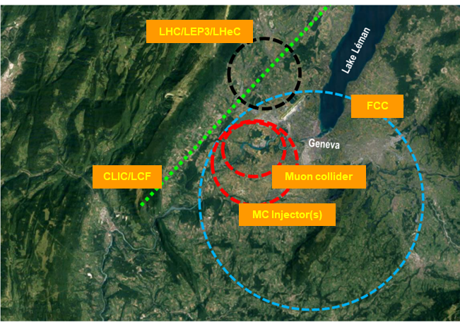
FCC and alternatives at CERN
Within the time frame of operation starting in mid-2040s
CLIC 380 GeV
FCC-ee
LCF@CERN 250 GeV
… and their evolution (outside the above time frame):
CLIC energy upgrades
FCC-hh
LCF@CERN energy upgrades
Muon collider (outside the above time frame)
Also included:
Proposed reuse the LHC tunnel (LEP3, LHeC)
International landscape (CEPC, ILC 250 GeV in Japan)
Notes:
Considered the projects for which input following the Guidelines for large-scale projects has been provided

Slide 6
Methodology
Key aspects analysed:
main parameters and performance
environmental aspects (carbon footprint)
technical readiness
material costs for accelerator and experiments construction and installation
human resources for accelerator construction and installation
project timeline
material and personnel costs for operation
Contributed to standardise/normalise the input provided by the projects to the ESPP2026
only for first phase e⁺e⁻ colliders starting in the mid 2040s
Notes:
Contributed to standardise/normalise the input provided by the large scale projects to the ESPP2026

Slide 7
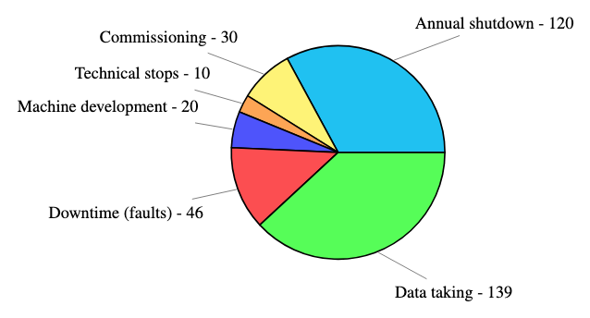
Performance comparison
Common assumptions for the operational scenarios for e⁺/e⁻ colliders
integrated luminosity estimate per year (summed over all IPs)
electricity consumption per year, knowing the peak wall plug power and the fraction used during each operation phase, provided by the projects.

Slide 8
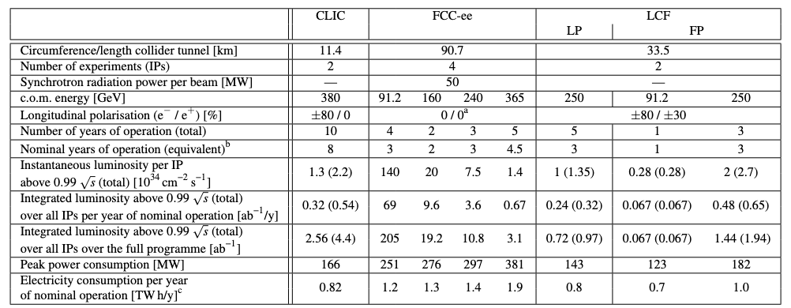
Performance comparison
LP: low power
FP: full power
Comparison table for e⁺e⁻ colliders starting in the mid 2040s:

Slide 9
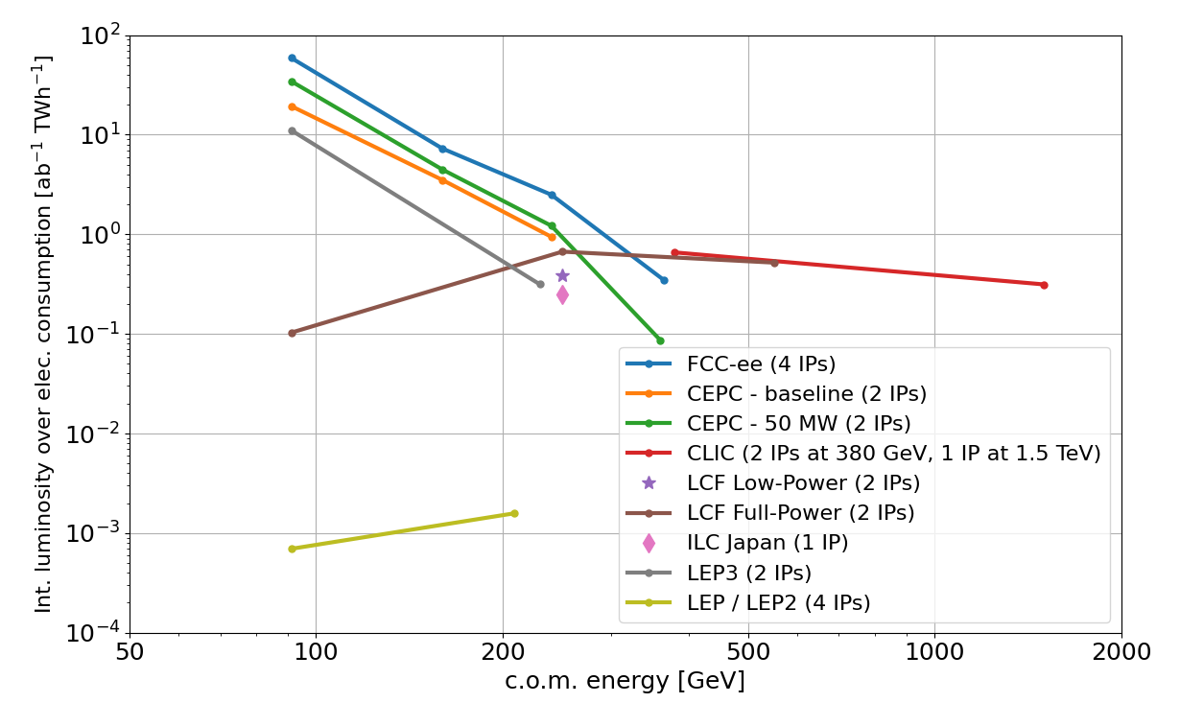
Performance comparison
Circular colliders (CC) are more efficient than Linear Colliders (LC) at energies up to 300-350 GeV. Note the improvement w.r.t. LEP/LEP2
LC can reach the O(TeV) region (no synchrotron radiation loss)
CC can accommodate more experiments operating in parallel
FCC-ee collision energy can be varied between 90 and 240 GeV seamlessly at unparalleled luminosity.
LC baselines include polarized e⁻ beam. For LCF e⁺ too.
LEP3 proposal still at pre-conceptual design level: larger uncertainty on luminosity, power consumption
Notes:
FCC-ee energy flexibility is reduced after the upgrade for operation at the highest energy
and operation at lower energy will be possible, albeit at lower luminosity.

Slide 10
Environmental aspects
Life Cycle Assessment (LCA) is an internationally standardised method to assess environmental impact
Focus on Greenhouse Gas (GHG) emissions:
Civil Engineering (modules A1 to A5*)
HW components of accelerators, technical infrastructure, detectors (modules A1 to A3**)
GHG emissions associated with electricity consumption
Worked with LDG sustainability panel to guarantee coherence of the methodology
*raw material supply, transport, manufacture, transport to work site, construction process on the work site
** raw material supply, transport, manufacture
Notes:
French Electricity Transmission system operator
RTE=Reseau de Transport d’Electricite’

Slide 11
Environmental aspects
Range of values: estimates based on presently known technologies and potential for realistic reduction (e.g. taking into account the roadmap established by the European Cement Association for CE)
Major contributions expected from:
HW components of accelerators, detectors and technical infrastructure (ongoing, limited to A1-A3). Data for FCC-ee expected in summer
Civil Engineering
GHG emissions related to electricity consumption are lower thanks to the low carbon intensity of the electricity produced in France (2050s)
Reuse of infrastructure (e.g. CE) for future upgrades will benefit the sustainability of projects
Notes:
CEMBUREAU = European cement association has established a Net Zero Roadmap targeting carbon neutrality of the EU cement industry by 2050
Aims for a 37% reduction by 2030 and 78% reduction in GHG emissions by 2040

Slide 12
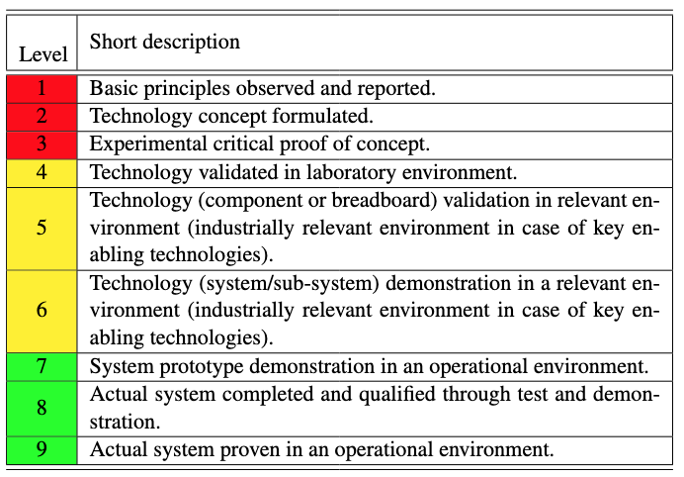
Technical readiness
Building on Snowmass’21 Implementation Task Force review and on the LDG accelerator R&D review held in February 2025:
TRL of the accelerator components / subsystems representing the highest technical risk
Improvement factor on critical components, R&D effort needed to reach it
Technical readiness of CLIC, FCC-ee and LCF are comparable
LCF benefitting of the RF developments for XFEL and LCLS-II
IP spot size control and position stabilisation remain one of the main challenges for LCs
e⁺ production rate for LCF is particularly demanding (even higher than ILC)
TRL could provide guidance in prioritizing efforts in accelerator R&D considering the ESPP2026 recommendations

Slide 13
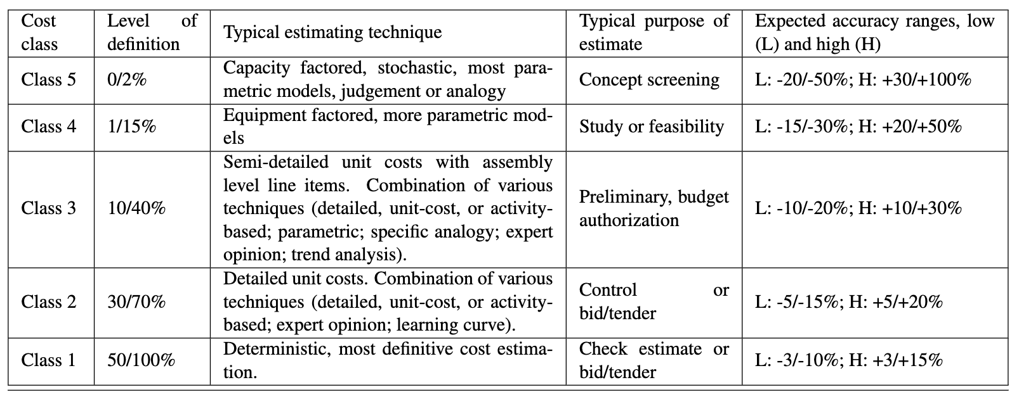
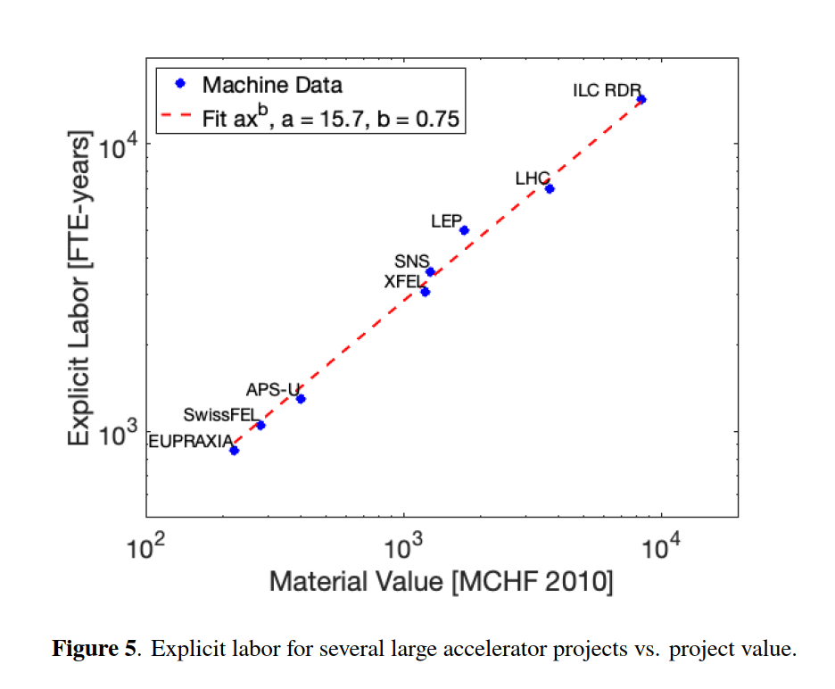
Construction and Installation Costs: Material and Personnel
Detailed costing for CLIC, FCC-ee, LCF (the latter considering ILC cost update, 2 IPs, CERN implementation):
Main tunnel accelerators, (pre-)Injectors & transfer lines, Civil Engineering, Technical infrastructures, Experiments
with cost uncertainty class
Have different level of uncertainty (and scrutiny):
FCC-ee has generally the most accurate cost estimate: CE highest contributor but with good accuracy as the placement scenario has been fully defined. Cost has been reviewed by expert committees, CERN Council and its subordinate bodies
Personnel for the construction of the accelerators ranges between 10 and 15 kFTEy. Consistent with scaling law developed by Snowmass’21 ITF
Notes:
Cost excludes: explicit labour / contingency / costs prior to project approval / off-line computing / spares & maintenance / beam commissioning

Slide 14
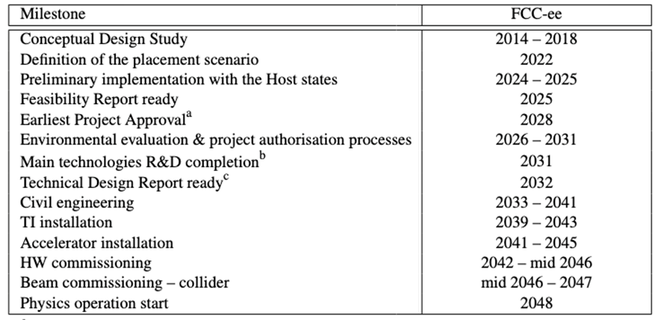
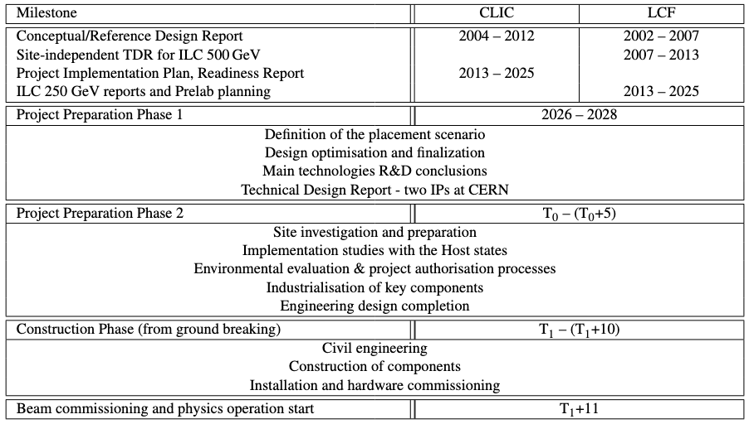
Project timeline
Financial and personnel commitments for HL-LHC operations imply that a future collider cannot realistically start operation before mid 40s
FCC feasibility study completed and detailed timeline established considering the above constraints
CLIC, and particularly LCF@CERN, would require a preparation phase (with corresponding resources) to reach a level of detail comparable to the FCC FS ➔ Difficult to conduct two territorial implementation studies in parallel in the Host States
CLIC/LCF: only relative timelines with respect to decision points (and considering the above constraint)
Notes:
For CLIC & LCF, timeline depends on several dates which will be defined later:
T₀ is determined by a process in 2028-29 to validate the progress and promise of the project for a further development towards implementation.
T₁ for Preparation Phase 2 will be determined by the processes needed, by the CERN Council and with host-states, for project approval and to start construction.

Slide 15
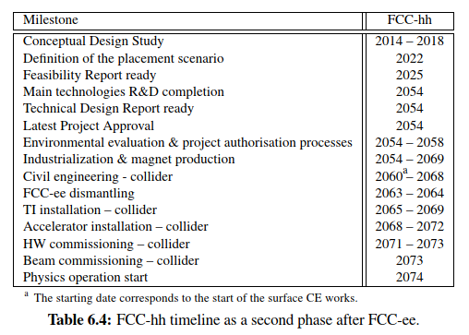
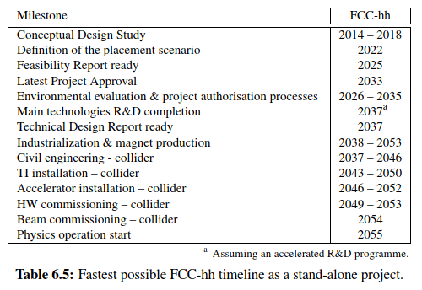
Project timeline
As a 2nd phase after FCC-ee, FCC-hh could start operation in mid 2070s
On a technically-limited timescale (assuming accelerated R&D) a stand-alone FCC-hh with 14 T Nb₃Sn dipoles could start operation around mid 2050s

Slide 16
Operation: resources (annual requirements)
Material:
Maintenance and replacement costs:
3% of powering systems (e.g. klystrons, RF and magnet power converters) CAPEX, considering the limited lifetime of these parts;
1% of remaining accelerator HW (RF cavities/structures, magnets) CAPEX for replacements
5% of technical infrastructure (e.g. cooling, ventilation, electronics and electrical infrastructures, access and safety systems, cryogenics, computer and network infrastructure, control systems, robotics, lifts and transport system) CAPEX. It includes the cost of contractors;
Electricity cost (assumed 80 €/MWh)
Personnel:
Based on LHC experience
Notes:
These estimates might be pessimistic and represent an upper limit considering the expected impact
of modern controls, Artificial Intelligence (AI) and robotics by the time of the operation of the future
colliders.

Slide 17
Muon Collider
Muon Collider (MC) ambitions to approach 10 TeV pCM energy.
MC has not yet reached a maturity level that gives sufficient confidence in its feasibility.
Demonstration of 6D cooling is a necessary condition to assess feasibility and performance
A variety of technological challenges are associated with the various acceleration steps
The technical design of the demonstrator and its construction demand resources significantly exceeding the present level.
A detailed timeline cannot be defined at present but only sketched with some decision points.

Slide 18
Re-use of the LHC tunnel
LEP3:
Pre-conceptual design with operation limited to 230 GeV, but not yet validated by simulation studies to confirm performance (luminosity, power consumption, …)
Large SC RF system, possible need for SC magnets, and high-energy booster installed in the same tunnel of the collider demand for integration studies to assess extent of the civil engineering
Prospected luminosity x IP number lower by a factor 6 to 10 as compared to FCC-ee, power consumption comparable to that of FCC-ee (at low energy).
Resources for operation comparable to LHC

Slide 19
Re-use of the LHC tunnel
LHeC:
Detailed conceptual design developed and based on high-current high-energy ERL
Civil engineering required for the ERL tunnel
Requires demonstration of high-current multi-turn energy recovery ➔ PERLE @ IJCLab
Technically-driven schedule for LHeC implies operation after the end of the presently planned HL-LHC programme at the earliest
Yearly electricity consumption comparable to FCC-ee at low energy and expected operation resources comparable to LHC
General considerations for options using the LHC tunnel:
major infrastructure investments and operating costs
delay of the implementation of a next-generation collider by at least one decade
cannot be considered as “bridge” options but as alternative to other proposed colliders

Slide 20
Next steps (WG2a)
Future Collider Comparative Evaluation WG report as (one of the) input
Cost estimates and associated uncertainties used in the report have been mostly based on the Projects input
Some of them went through international reviews but need to make sure that the level of scrutiny and the methodologies used are comparable
Plan to co-opt external experts involved in the cost and schedule reviews of the large-scale projects (but not involved directly in any of the projects) to make sure that:
Construction costs and their uncertainties
Risks
Timelines
are assessed in a similar fashion across projects

Slide 21
Related submissions
ID | Title | Contact
40 | The Linear Collider Facility (LCF) at CERN | Jenny List
57 | HALHF: a hybrid, asymmetric, linear Higgs factory using plasma- and RF-based acceleration | Brian Foster
78 | The Compact Linear e+e- Collider (CLIC) | Erik Adli
97 | ESPPU INPUT: C3 within the "Linear Collider Vision" | Emilio Nanni
140 | A Linear Collider Vision for the Future of Particle Physics | Jenny List
152 | US Muon Collider Community White Paper for the European Strategy for Particle Physics Update | Sergo Jindariani
154 | Midterm Review of the European Accelerator R&D Roadmap | Mike Seidel
165 | A Possible Future Use of the LHC Tunnel | Marco Drewes
174 | Phase-One LHeC | Krzysztof Piotrzkowski
188 | LEP3: A High-Luminosity e+e− Higgs & Electroweak Factory in the LHC Tunnel | Tiziano Camporesi

Slide 22
Related submissions
ID | Title | Contact
207 | The Muon Collider | Federico Meloni
214 | The Large Hadron electron Collider (LHeC) as a bridge project for CERN | Jorgen D'Hondt
233 | FCC Integrated Programme Stage 1: The FCC-ee | Panagiotis Charitos
243 | High Field Magnet Programme – European Strategy Input | Bernhard Auchmann
247 | FCC Integrated Programme Stage 2: The FCC-hh | Panagiotis Charitos

