Slide 1


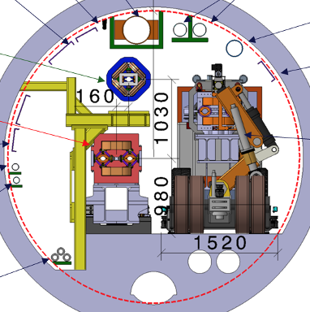

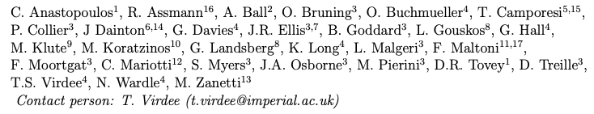
LEP3: A high luminosity electron-positron Higgs boson factory in the LHC tunnel
A possible back-up to the preferred option (FCC-ee and FCC-hh) for the next accelerator for CERN
In the
LHC Tunnel

Slide 2
Layout of Talk
Introduction
Technical Parameters and key issues
R&D needs – in general are similar to those for FCC-ee.
Two are of particular relevance for LEP3 – high power fundamental power couplers, nested superconducting quadrupoles/sextupoles. Plus dedicated studies (see later)
Physics running scenarios: (centre-of-mass energies, luminosities, ..);
Resource requirements (capital cost for construction of the accelerator and the detectors)
Annual cost of operation at each stage, human resources;
Environmental impact (peak (MW) and integrated energy consumption:
250 MW at ZH and 185 MW at Z), ~TWh/yr during running.
CO₂ equivalent cost of construction – much lower “cost” as little construction is envisaged
Timeline (technically limited? Start data-taking ~ 5 years after HL-LHC stop; time for approval/feasibility? TDRs by mid-2030’s).
Physics potential - will also be compared by Physics Preparatory Groups (PPG)

Slide 3
Introduction: Possibilities for PP’s Future
Long-Term Aim in particle physics: an accelerator with √ŝ ~10 times higher than LHC (1-2 → ~10 TeV).
If FCC(ee) or CEPC is built then a ~100 TeV hadron collider would be the obvious next step.
Muon colliders may provide alternative approach to reach constituent com energies of 10 TeV or higher.
This programme could have milestones along the way that would deliver physics as the R&D progresses - muon driven neutrino beams for experiments such as nuSTORM or those on neutrino/antineutrino factories.)

Slide 4
Setting the Scene 2: ESPP Request for Alternatives
We support FCC-ee and FCC-hh as the preferred option for CERN’s future, as it addresses two key recommendations from ESPP2020.
However, the ESG's remit explicitly states that “The Strategy update should include the preferred option for the next collider at CERN and prioritised alternative options to be pursued if the chosen preferred plan turns out not to be feasible or competitive”.
In this context we take “not feasible” to mean “not affordable”.
So, by definition, any alternative plan would have to represent lower cost while allowing simultaneous pursuit of the long-term √ŝ ~10 TeV machine.
We propose reusing the existing LHC tunnel for an electron-positron collider, called LEP3, as a back-up/alternative if the FCC cannot proceed.
Notes:
At the Large Hadron Collider (LHC) at CERN, Geneva we can probe Nature moments after the Big Bang to tackle the questions about the origin, evolution and composition of our universe. These include: What is the origin of mass? What constitutes dark matter? How many dimensions of space and time do we live in? Why is the universe composed of matter and not antimatter? The answers have the potential of altering our perception of how Nature operates at the fundamental level.
The discovery in July 2012 of the Higgs boson at the Large Hadron Collider (LHC), one of the most important of this new century, completes the particle content of the standard model (SM) of particle physics, a theory that describes our visible universe in exquisite detail.
This talk will briefly look into the evolution of our universe from the Big Bang, the fundamental particles and their interactions, the journey to the discovery of the Higgs boson, and look ahead. The CMS experiment is used as an example to briefly recall the physics of the LHC, outline some of the challenges faced during its construction, and major physics results produced so far, including the searches for widely anticipated new physics beyond the SM.

Slide 5
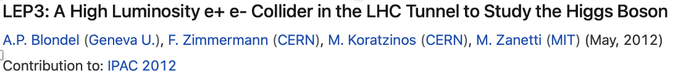
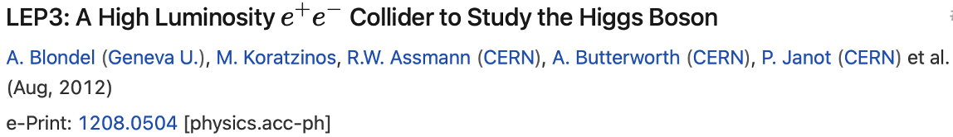
LEP3: Key Issues
This is not a new proposal! Several others have also discussed such a possibility in the past.
e.g. 2013 ESPP, a Higgs factory (LEP3) was proposed but not pursued any further. [https://cds.cern.ch/record/1471486].
During the last 9 mo. progress has been made on several fronts, mostly using work done for FCC-ee. It is clear further progress needs to be made to solidify the proposal.
What instantaneous luminosity is achievable?
LEP3 lattice: a preliminary LEP3 lattice was proposed in 2017 (K.Oide & D. Shatilov).
But high power-consumption requires superconducting quadrupoles/sextupoles
What RF cavities should be used?
Much work has been done by the CERN RF group. We have adopted their proposal.
What are the implications of introducing a crossing angle (30 mrad)?
We have examined the necessity of civil engineering works. We aim to limit excursion of beams and attain their crossing at the centre of existing caverns. Needs further study.
What is the cost?
We have used FCC-ee costs and scaled according to the number of components needed. The RF costs have been given by the CERN RF Group. Cost to the community can be contained by reusing ATLAS and CMS experiments
Notes:
At the Large Hadron Collider (LHC) at CERN, Geneva we can probe Nature moments after the Big Bang to tackle the questions about the origin, evolution and composition of our universe. These include: What is the origin of mass? What constitutes dark matter? How many dimensions of space and time do we live in? Why is the universe composed of matter and not antimatter? The answers have the potential of altering our perception of how Nature operates at the fundamental level.
The discovery in July 2012 of the Higgs boson at the Large Hadron Collider (LHC), one of the most important of this new century, completes the particle content of the standard model (SM) of particle physics, a theory that describes our visible universe in exquisite detail.
This talk will briefly look into the evolution of our universe from the Big Bang, the fundamental particles and their interactions, the journey to the discovery of the Higgs boson, and look ahead. The CMS experiment is used as an example to briefly recall the physics of the LHC, outline some of the challenges faced during its construction, and major physics results produced so far, including the searches for widely anticipated new physics beyond the SM.

Slide 6
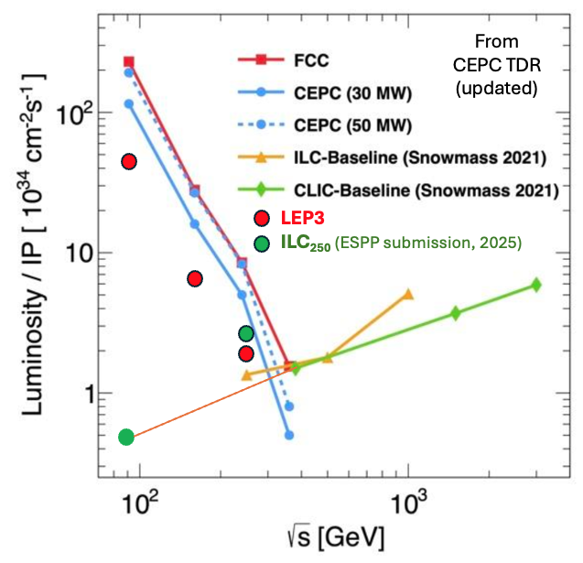
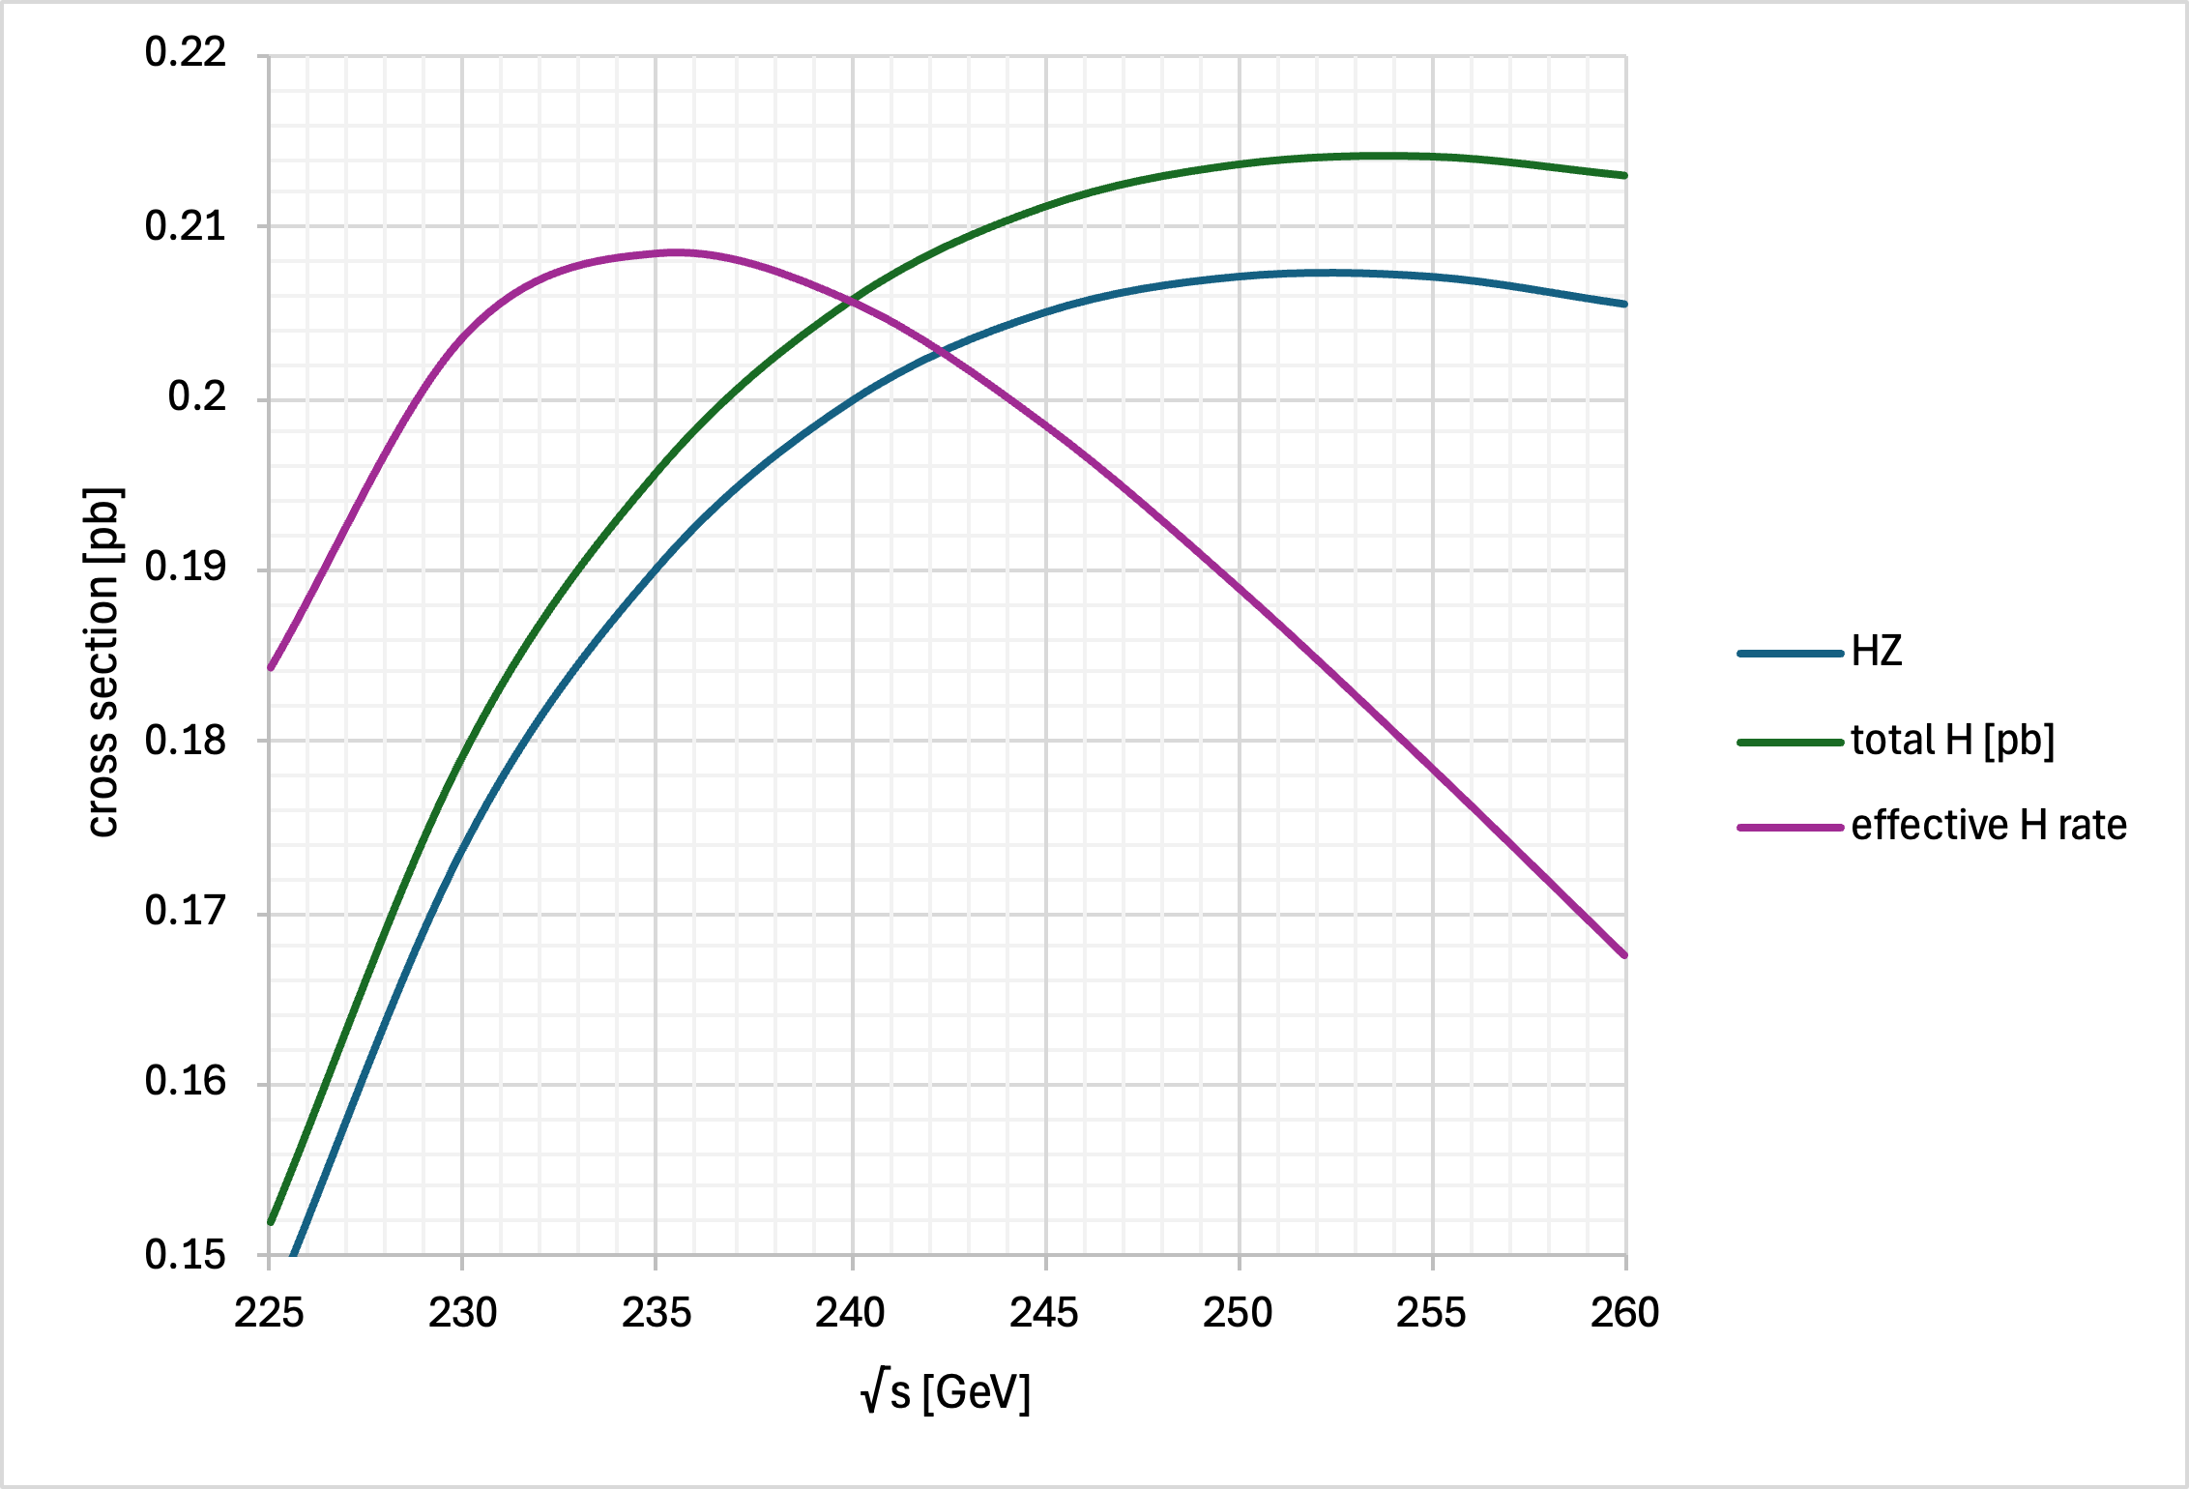
e⁺e⁻ Colliders: Instantaneous Luminosity & √s
In circular e+e- colliders, for the same synchrotron power loss, at a lower energy, more current can be put to increase luminosity.
LEP3: Run at √s =230 GeV
Only 10% higher energy than LEP.
18% lower synchrotron power loss at √s=230 GeV compared with 240 GeV.

Slide 7
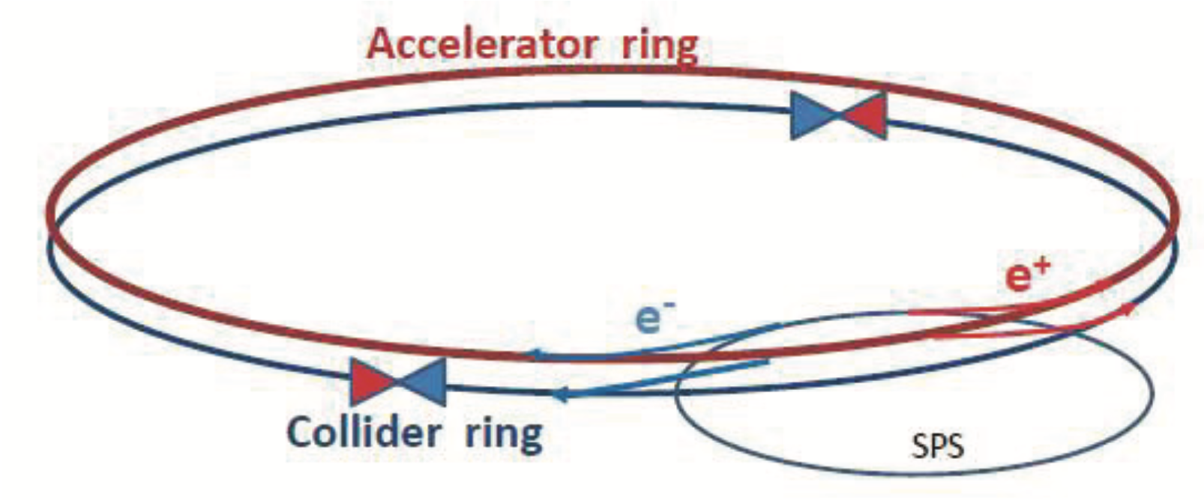
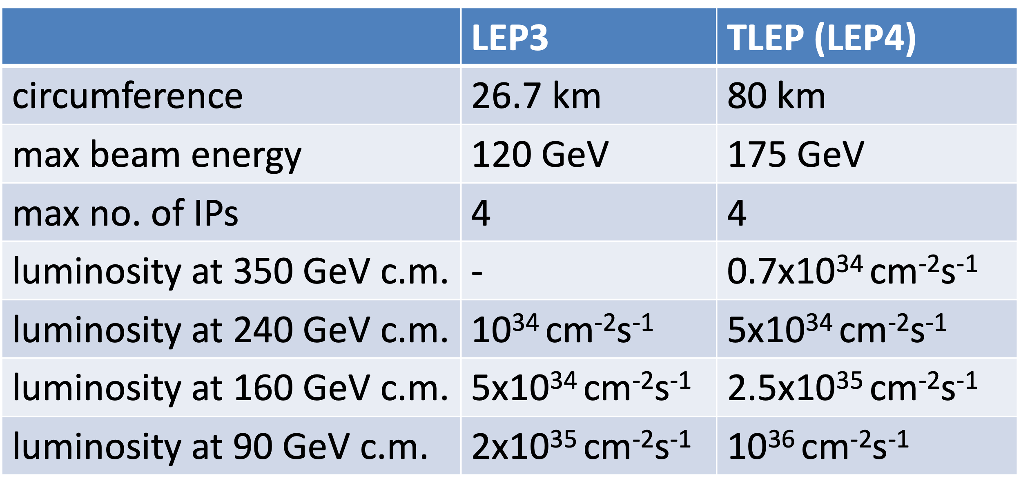
Follow ESPP2013 proposal & FCC(ee) Design
Compared with LEP : Two beam pipes (larger no. of bunches 800 v/s 8 @Z), higher SR power (50 vs 0.33 MW), lower β_{y}*, √s=230 GeV for ZH running (v. similar no. of Higgs bosons produced as at √s=240 GeV but with 18% lower SR loss)…
Design of LEP3 follows closely that outlined in FCC MTR and [ESPP 2013: https://cds.cern.ch/record/1471486]. Separate full energy collider and accelerator (booster), the latter for top-up injection. Electrons and positrons in the collider ring travel in separate beam pipes.
With top-up as beam lifetime is expected to be ~ 15 minutes (loss due radiative Bhabhas) top up ~ few 10¹⁰ electron/s
Earlier work (2013)
Note ratio of Lumi (1/5)

Slide 8
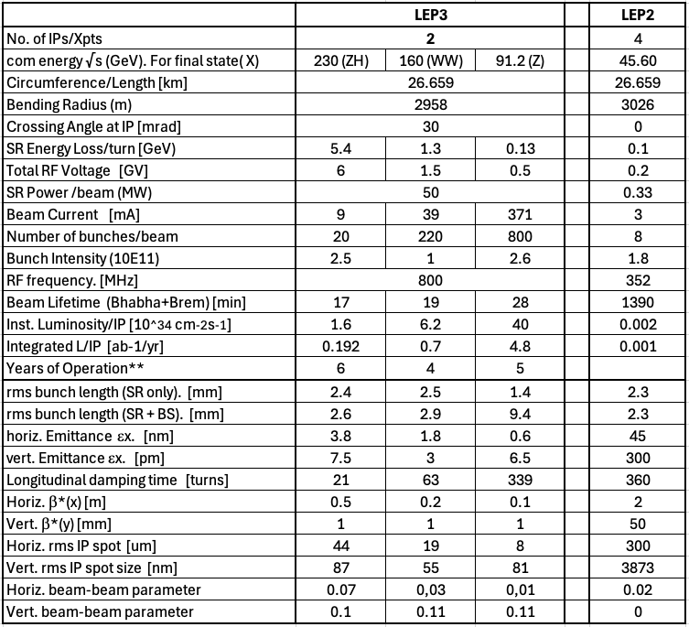
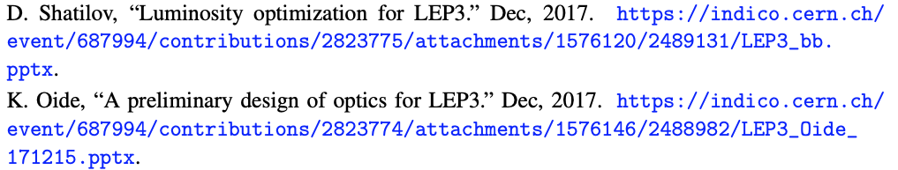
LEP3 Principal Technical Parameters
Our List of Parameters
Preliminary 2017 Optics design from Oide/Shatilov gives
(for 4 expts at 240 GeV)
√s (GeV). 10³⁴ cm⁻²s⁻¹
240 1.1
91.2 52
4 → 2 Xpts: L/IP increases by ~ 1.15
240 → 230: L/IP increases by ~1.14
1.1 → 1.44 10³⁴ cm⁻²s⁻¹
However, we prefer to quote a Luminosity Range
√s (GeV). 10³⁴ cm⁻²s⁻¹
1 → 2.5
5.0 → 7.5
91.2 30 → 50

Slide 9
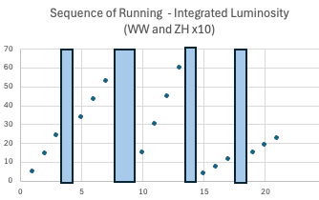
LEP3 Significant Parameters and the Running Sequence
No. of IPs 2
Can’t reach t-tbar threshold
Energy for ZH 230 GeV
Fix SR power loss at 50 MW/beam
SR energy loss/turn ~ 5.4 GeV
Total RF voltage installed ~ 6 GV
Crossing angle 30 mrad
For event numbers - use Inst. L values of
L /IP~ 1.6, 6.2, 40 (10³⁴ cm⁻²s⁻¹) at Z, WW, ZH
One Running Scenario e.g. 6 yrs at 230 GeV, 4 years around WW, 6 years around Z
Est. total no. of Events 4.2 x10⁵ H,
3.7 x 10⁷ WW at 157 and 163 GeV,
1.7 x 10¹² Z at & around 91.2 GeV (cf. 10⁹/ 6.10¹²Z for ILC/FCC-ee)
Long Shutdowns
1yr
2yr
1yr
1yr
LEP3 is competitive with alternatives/Plan B projects wrt Higgs and E-W physics Superior for WW and Z running
Running time: 185 days of operation at 75% efficiency, with top-up running, giving 1.2 10⁷ s/year of running

Slide 10
Higgs boson physics
The errors evaluated for the determination of the Higgs boson couplings, tend to be dominantly statistical, which scale as the √(ratio of event numbers)
The event numbers are
~ 4 x10⁵ H bosons for LEP3 and LC, and 22 x10⁵ H bosons for FCC-ee (240 only)
i.e. ratio of 1:1:~5.5
For equal power of the experiments error bars for LEP3 and LC will be a factor >2 larger than for FCC-ee.
Detailed comparison will be presented by the ESPP Physics Group in the Briefing Book. Also see talks in Monday’s EWK parallel session.

Slide 11
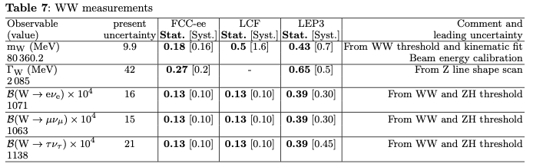
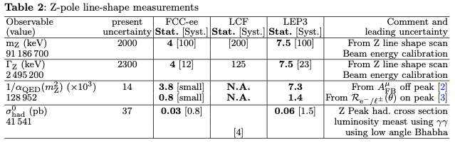
E-W physics
~1.7x10¹² Z bosons (over 6 yrs), LEPZ proposal would give similar/same results
and ~ 3.6×10⁷ WW pairs (over 4 yrs at/around √s=163 GeV)
The event numbers are
~ 1.7 x10¹² Z bosons for LEP3, 10⁹ for LC, and 6 x10¹² for FCC-ee at & around Z-pole
i.e. in the ratio of ratio of 1:10⁻³:3.5
Search for HNL requires as large a Z-boson sample as possible.
For equal power of the experiments LEP3 is superior to LC
Detailed comparison will be made by the ESPP Physics Group. Also see talks in Monday’s EWK parallel session.
The comparison made here is taken from “Z Factory Options for CERN”, A. Blondel & M. Selvaggi https://doi.org/10.17181/0zn0c-3xe20.
The systematic and statistical errors are mostly scaled by event numbers
Z-pole
WW
sin²θ_{W}

Slide 12
Further Studies and R&D
Follow FCC(ee) design for most components
Dipole magnets, injector, collimation and vacuum systems, synchrotron energy loss absorbers etc.
Differences
800MHz RF; ZH running at 115 GeV instead of 120 GeV, 2 experiments instead of 4,
Injection energy of 10 GeV (instead of 20 GeV), …
We need further studies on the following items:
Developing LEP3 Lattice, IR design
Crossing angle and its implications
Integration studies (e.g. RF system, of power sources in klystron galleries….)
Radioprotection and LHC dismantling
We would also require R&D on
RF – cavities and fundamental power couplers,
superconducting quadrupoles and sextupoles to reduce power consumption and improve fill factor

Slide 13
RF System: Current Recommendation of CERN RF Group
Key determining drivers: beam current, power, acceleration gradient
RF: Energy loss/turn @ √s=230 GeV: 5.4 GeV → 6.0 GV has to be installed, keeping the same margin as FCCee.
Installed in even number LSSs (~560m, φ= 4.4m) (two LSSs for the collider, two LSSs for the booster)
As overall cost is dominated by the cost of the RF system (~1.5 BCHF),
Current thoughts from CERN RF Group; deploy 800MHz bulk Nb cavities run at 2K, two types (1-cell and 4-cells) for the collider and one for the booster (6-cells), all inspired by FCC designs. ALL CRMs costed as FCC-ee 6-cell cavities.
For Z running: 800MHz 1-cell bulk niobium cavities. Keep existing QRL. The beam current is too high to use 800 MHz multi-cell cavities. Separate cavities for electrons and positrons.
Reuse the power generation hardware (costly item) for WW and ZH running
For WW and ZH running: 800 MHz 4-cell sc bulk niobium cavities. The two colliding beams share RF at ZH energy.
For Booster: 800 MHz 6-cell sc bulk niobium cavities.

Slide 14
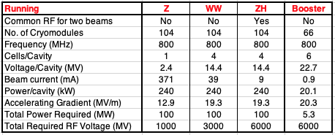
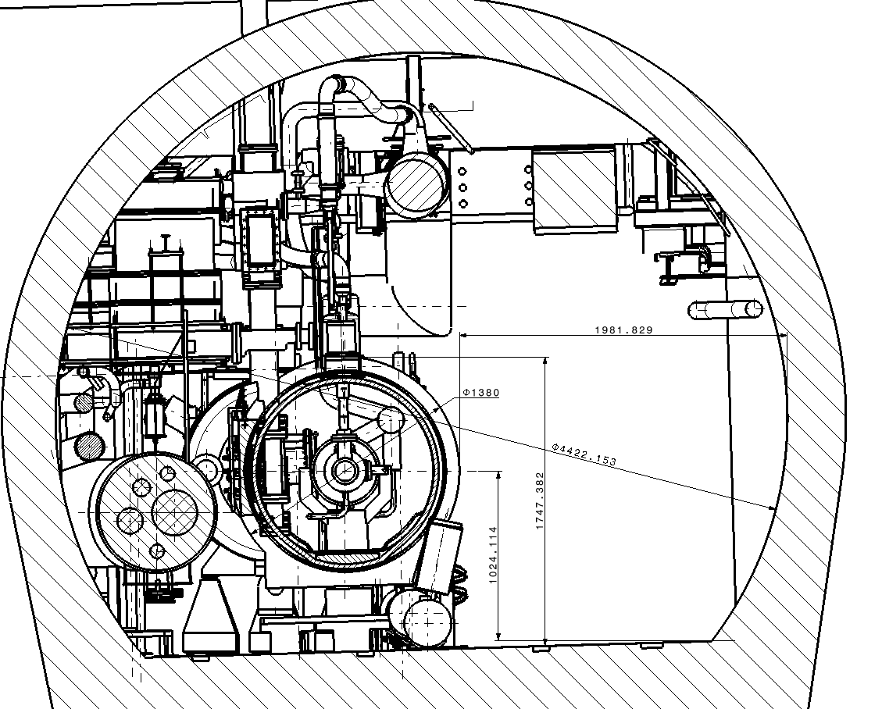
Choice of Components: RF System
Current Thoughts
Integration of FCC-ee 800 MHz Cryomodule into LEP/LHC tunnel
e.g. Point 4

Slide 15
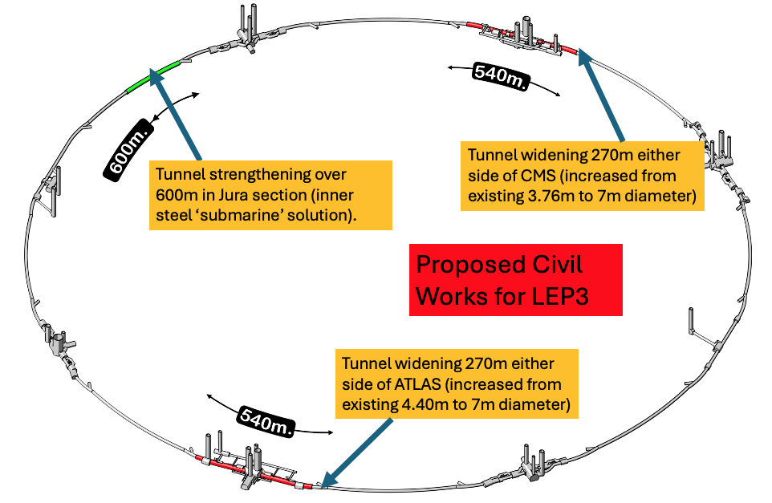
Civil Engineering
  40 years old infrastructure, some parts need maintenance
  High lumi achieved by crab-waist → large xing-angle → need to widen the LSS cross section on either side of the experiments
  LEP3 should have a low environmental impact
  booster by-pass (possibly not needed)
  Overall civil engineering cost estimated: 165 MCHF

Slide 16
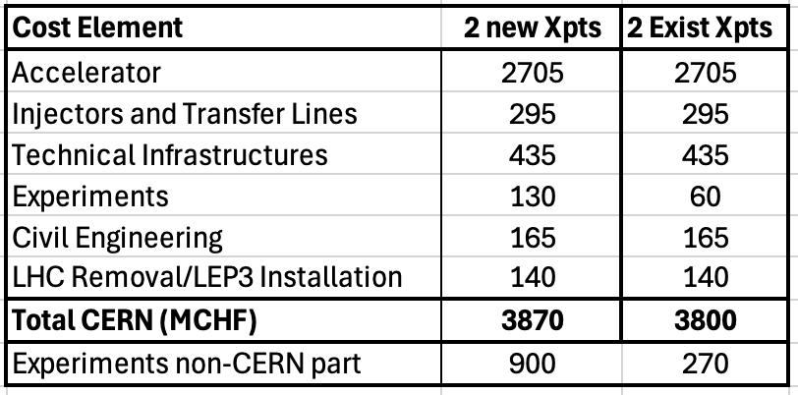
Cost
Use the FCCee costing methodology.
Costs from FCC(ee) MTR : scaled according to numbers of components required.
RF costs from CERN-RF Group.
Cost: assumes careful removal of LHC machine in case it is needed later as an injector.
We believe that LEP3 will allow pursuit of other future-oriented initiatives [e.g. R&D on RF cavities (high gradient, low power), RF fundamental power couplers, nested sc quads/sextupoles, high-field magnets, muon collider demonstrator etc.]
Sustainability is an important issue: LEP3 should have a much lower environmental impact than a new flagship project but can still use ideas/proposals from the other projects

Slide 17
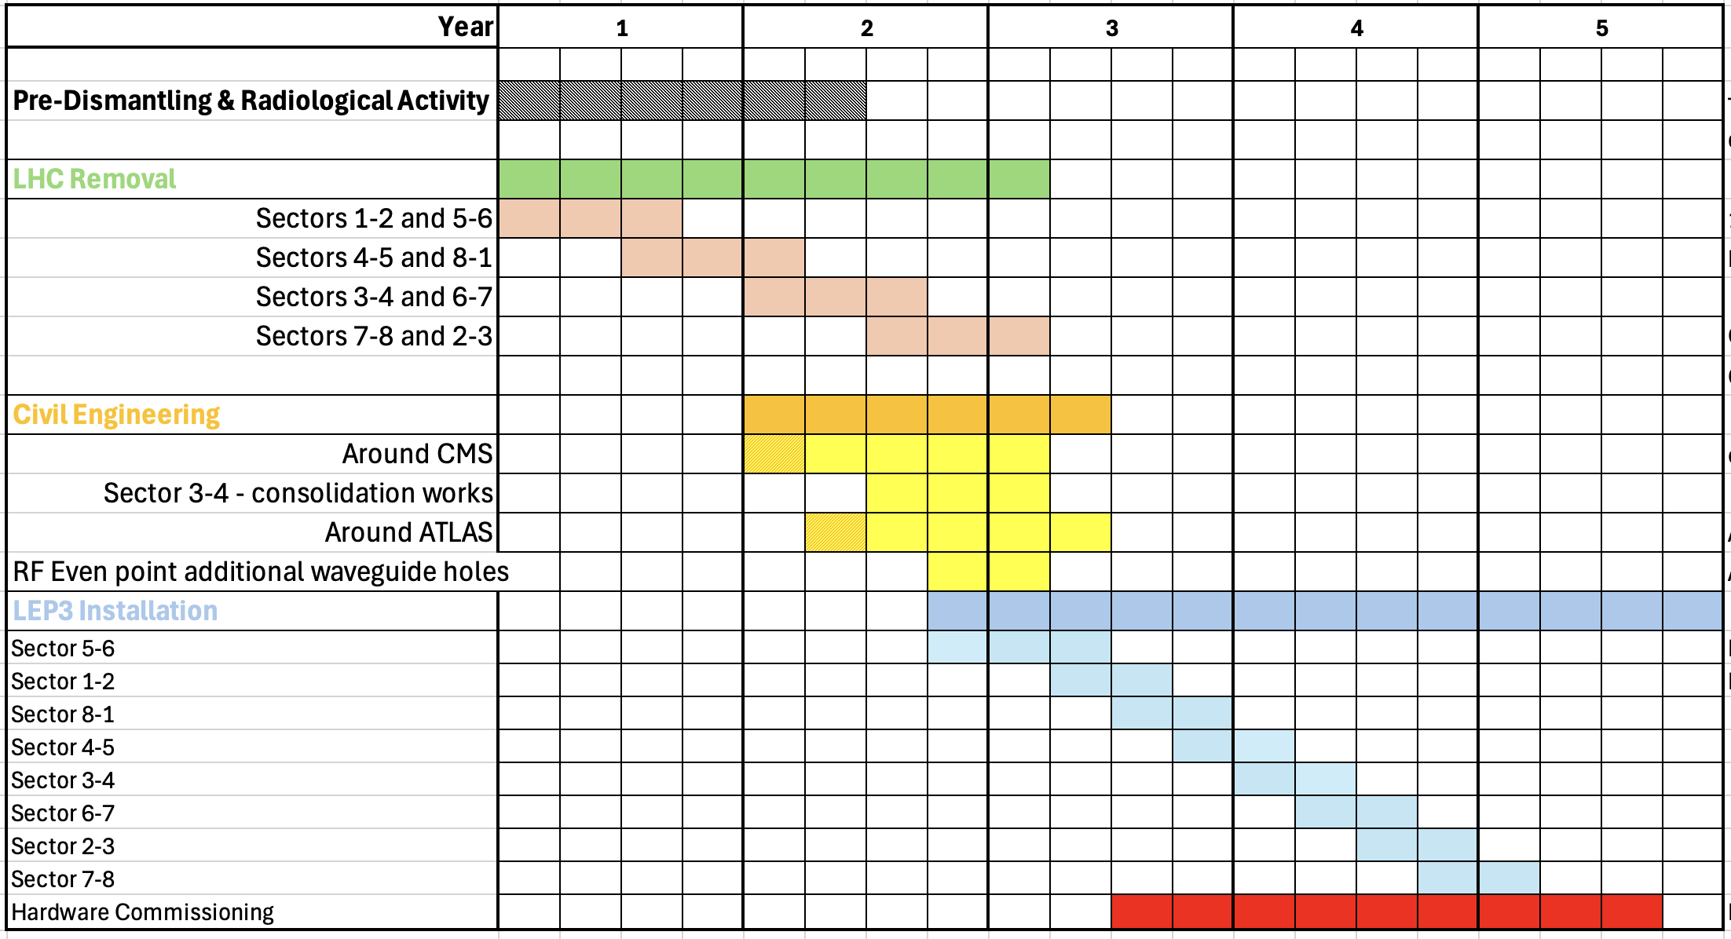
Example Shutdown Schedule: After LHC stops

Slide 18
Summary
We assume that FCC-ee and FCC-hh will be the preferred option (justifiably so) for CERN’s future
We believe that the preferred scenario is technically feasible. If it is deemed to be not feasible financially, then the intermediate solution en-route to the next collider that will probe √ ŝ ~10 TeV must be significantly less costly than the FCC-ee.
LEP3 is a reasonable (perhaps the best) backup option,
Compared to the linear e⁺e⁻ colliders proposed, LEP3 provides similar luminosity for ZH production, higher luminosity at lower energies and options for multiple experiments, all at a much lower cost.
Leaves room (time, budget, resources) for further development of THE machine that can probe directly the energy frontier at a √ŝ ~ 10 times LHC.
A real strategy for Europe, when resorting to such a plan “B” MUST include a long-term plan beyond LEP3, as well.
No showstoppers have yet been identified, and we consider this proposal to be sufficiently interesting to deserve further study. We have identified important areas that would require deeper investigation before CERN could commit to LEP3.

