Slide 1
A linear collider @ CERN
Outline
LC @CERN – key motivations and implementation parameters
Technical developments – some examples
Next steps and concluding slide
Steinar Stapnes – CERN
ESPP Open Symposium Venice - June 2025
1/24

Slide 2
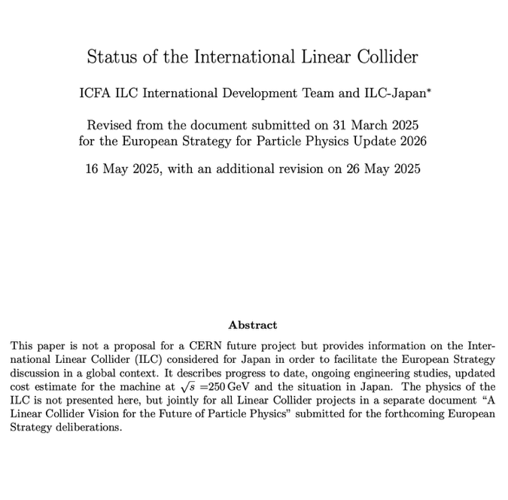
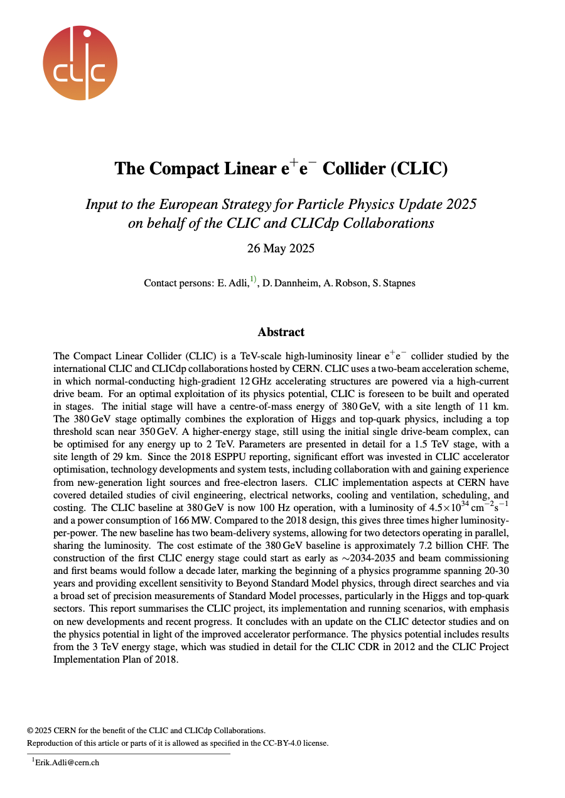
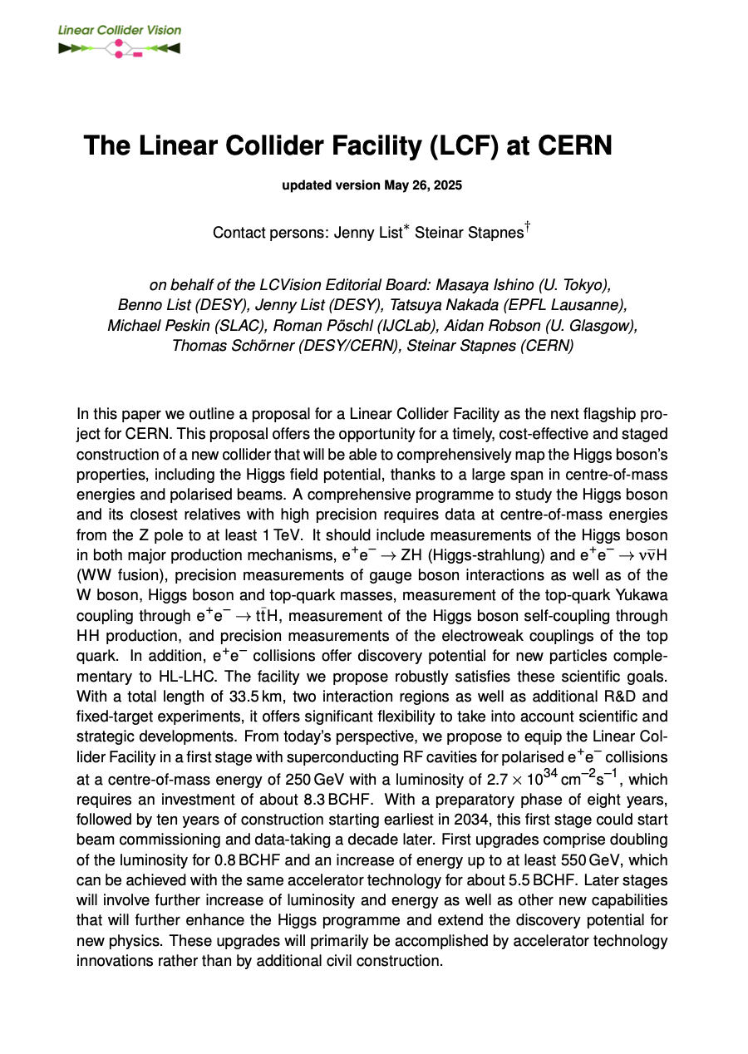
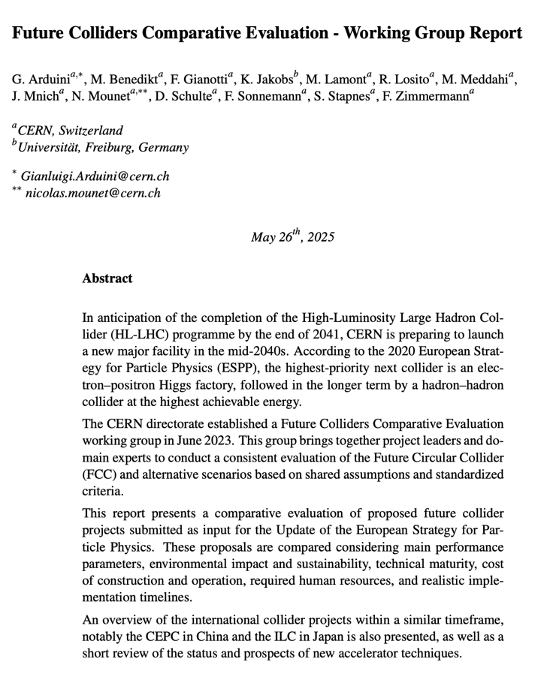
ESPP LC inputs - the ones discussed in this talk
Linear Collider Facility (LCF) @ CERN – common implementation studies for two starting technologies:
CLIC@CERN, Linear Collider Facility starting with NCRF technology:
https://indico.cern.ch/event/1439855/contributions/6461475/
Normal conducting RF, parameters for 90, 250, 380, 550, 1500 GeV
LCF@CERN focussed on starting with ILC SCRF technology; benefits from all the ILC developments, CLIC CE and infrastructure studies at CERN, and link to new technologies as potential upgrades: https://indico.cern.ch/event/1439855/contributions/6461433/
Superconducting RF, parameters for 90, 250, 350, 550 GeV
Comparative report:
https://indico.cern.ch/event/1439855/contributions/6542430/
Later today (Jenny List) “Linear Collider Vision: future perspectives with advanced technologies”
2/24

Slide 3
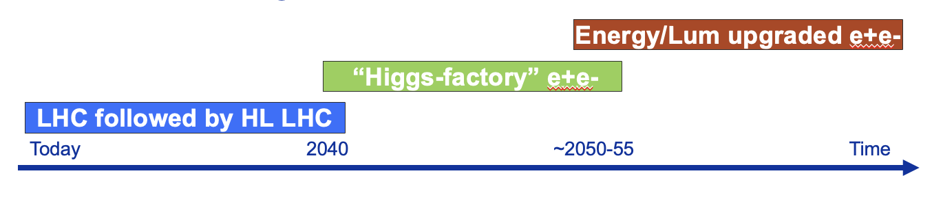
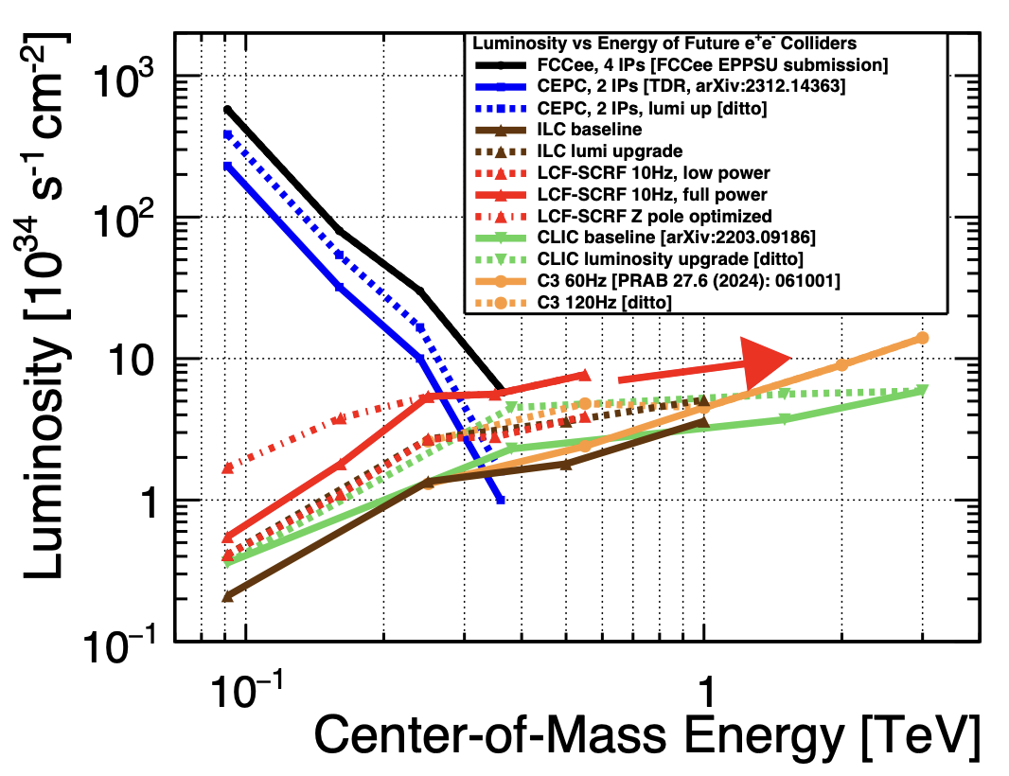
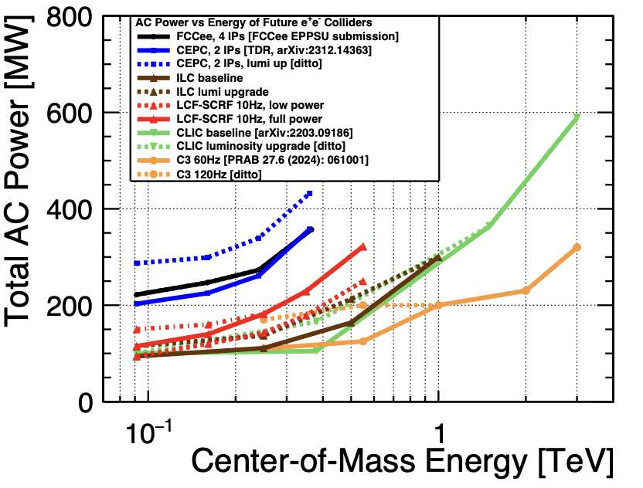
General goals for LCs
Start with mature technology, can expand in length and/or technology
Energy reach and flexibility:
Physics opportunities from Z-pole to TeV(s) – next slide
Flexible (E,L,cost, power) to adapt to development in physics and technology
Footprint, cost, power – next next slides:
Lower cost to get to Higgs and top than a circular machine (initial machine)
Power similar to LHC, or lower, for initial configuration
Footprint (length/location) similar to LHC
Provide many opportunities and increased flexibility for the future:
Does not determine footprint of future energy frontier machines (hadrons or muons), and it has its own upgrade opportunities
Encourage accelerator and detector R&D for all these options
3
3/24

Slide 4
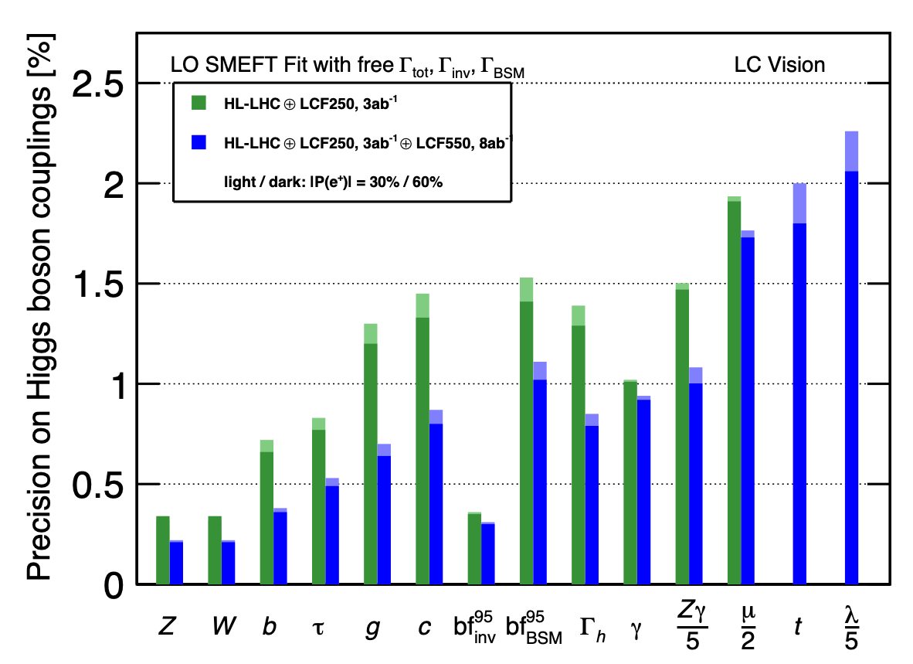
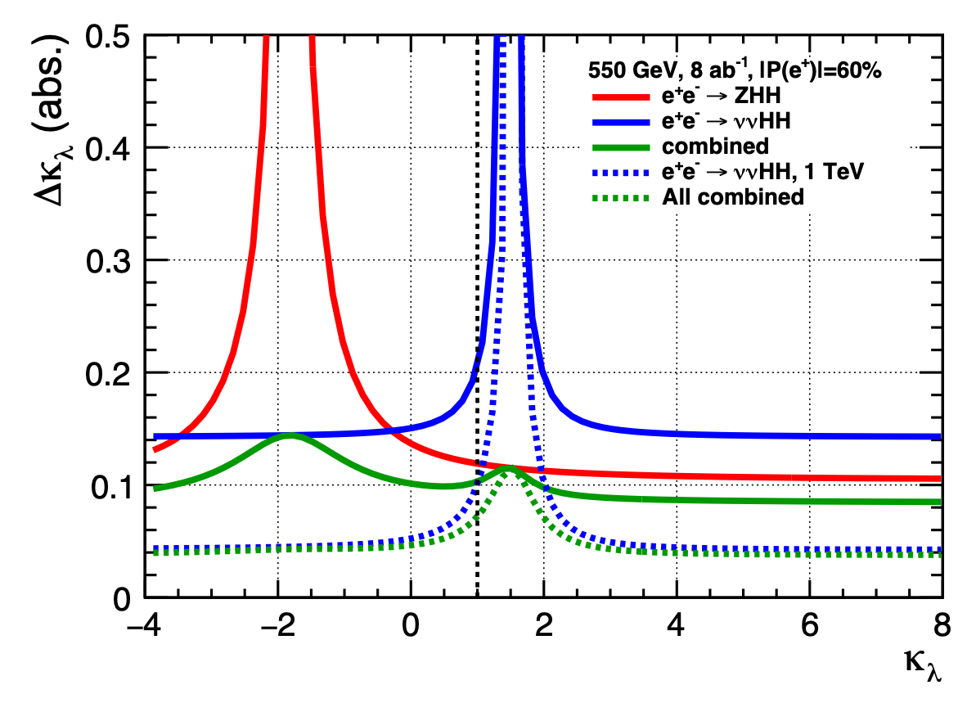
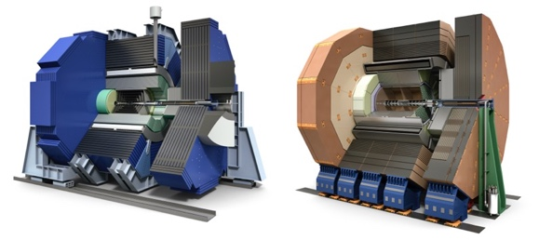
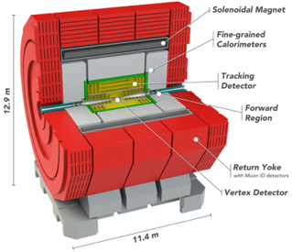
A physics-driven, polarised operating scenario for a Linear Collider
Stage 1: 250-380 GeV
precision Higgs mass and total σ(ΖΗ)
precision Higgs couplings and total width to % level
resonance/compositeness search in ffbar, WW to 10’s TeV
1-yr excursion to the Z pole - sin²θ_{W} to 3e-6
Stage 2: 550 GeV
precision Higgs couplings and total width to sub-% level
top quark Yukawa to 3%, Higgs self-coupling to 11%
top quark electroweak couplings to 0.1%
resonance/compositeness search in ffbar, WW to 50 TeV
1-yr excursion to the ttbar threshold - mt to 40 MeV
Higher energies: 1000 GeV or above
top quark Yukawa to 1%, Higgs self-coupling in WW fusion
Higgsino search to 500 GeV
follow up HL-LHC discoveries of new Higgs and electroweak states
Fixed target program: dark sector, nonlinear QED
All discoveries of deviations from the SM can be verified in complementary reactions at higher energy, e.g. H self-coupling visible in two complementary HH production rxns.
4
ZHH
The projections are supported
by full-simulation studies with detailed
detector designs and machine bkgds.
WW fusion
combined
Much more in arXiv:250319983
4/24
From J.List/M.Peskin

Slide 5
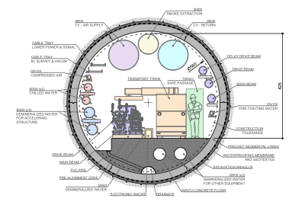
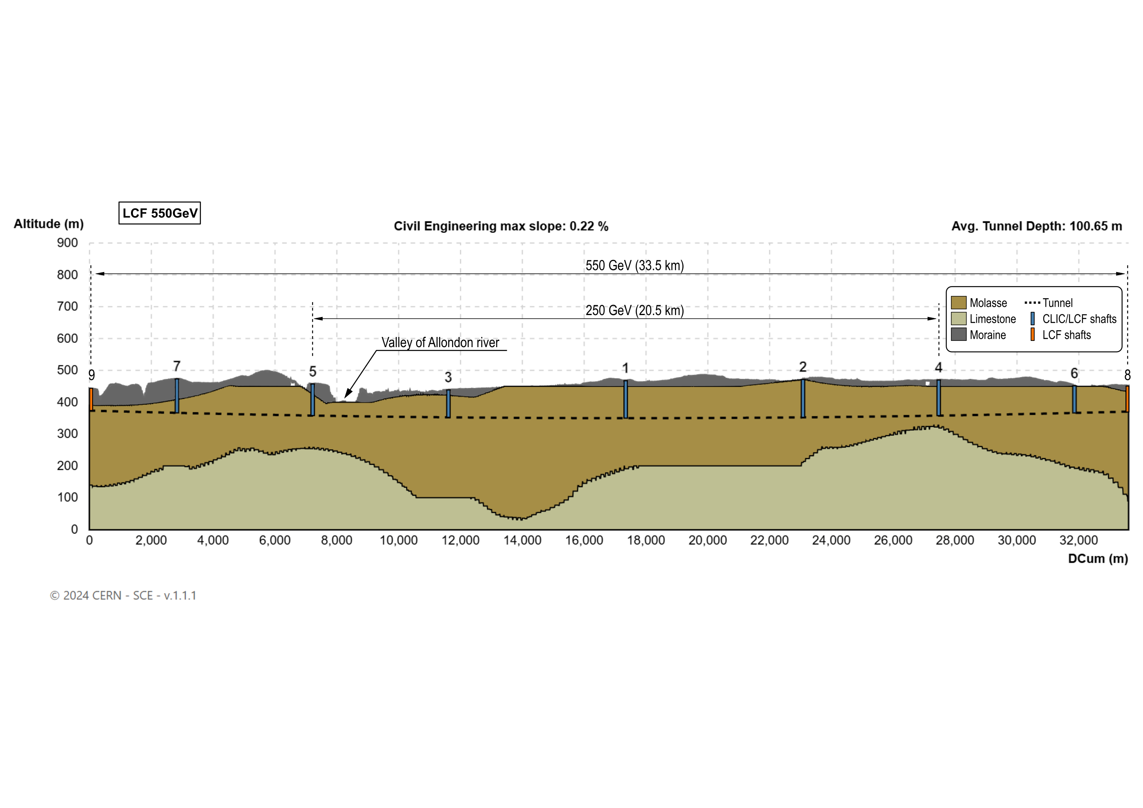
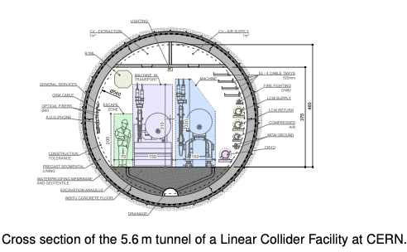
Linear Collider @ CERN – Civil Engineering I
Layout used for costing and drawings. Not final, can be translated, rotated and shafts can be moved.
Shallower profile, 29 km at 1.5 TeV, injectors and IPs on CERN land, one drive-beam
5
5/24

Slide 6
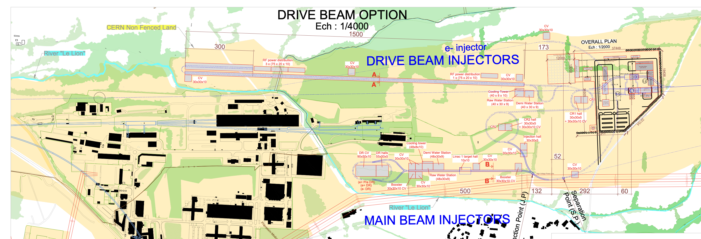
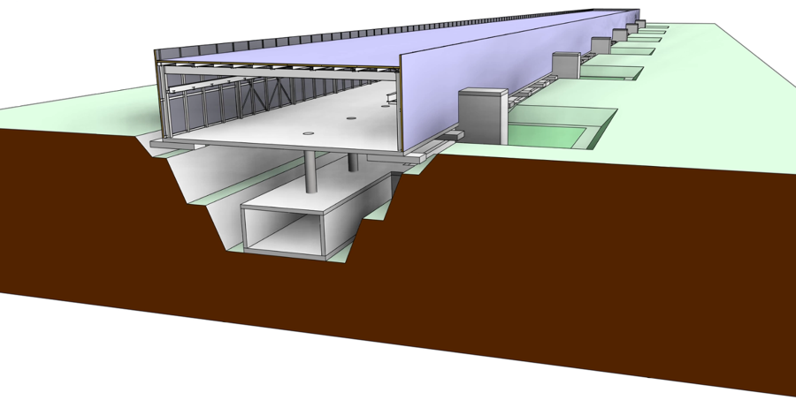
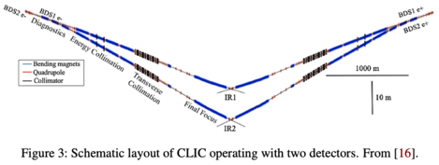
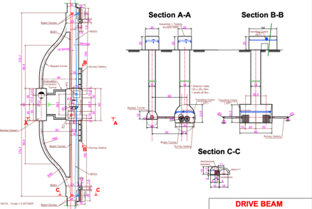
Linear Collider @ CERN – Civil Engineering II
CE studies for LC at CERN over the last ~15 years:
CLIC, up to 3 TeV. Contract with Amberg Engineering for CDR in 2012-2013.
ILC up 1 TeV. Contract with Amberg Enginering for the TDR in 2012-13.
CLIC up to 3 TeV, TOT (layout tool) with ARUP (engineering/consulting company), for the Project Implementation Report 2018
For the ESPP 2025, LCF/ILC up to 550 GeV, CLIC NCRF to 1.5 TeV, in both cases ~30km (29.5 and 33.5), using Geoprofiler layout tool
Injectors and experimental areas on Prevessin site (“CERN attributed land”)

Slide 7
Costs – for construction
Unit: MCHF | LCF 250 (LP) | Δ LCF 550 (FP) | CLIC 380 | Δ CLIC 1500 | Cost Class
Collider | 3864 | 4204 | 2471 | 4684 | 3/3-4
Main Beam inj./transfer | 1181 | 86 | 1046 | 23 | 3/3-4
Drivebeam inj./transfer | - | - | 1060 | 302 | 3/3-4
Civil Engineering | 2338 | 0 | 1403 | 703 | 4
Technical Infrastructure | 1109 | 1174 | 1361 | 1404 | 4
Sum | 8492 | 5464 | 7341 | 7116
From “comparative report” (LINK):
Low Power (1312 bunches per train),
Full Power (2625 bunches per train)
CLIC 550 GeV is 30% higher than CLIC 380
In the report two experiments (not in table on the right) are estimated to 795 MCHF
ILC/LCF Cost exercises – and international reviews:
ILC TDR 2012-13, 500 GeV primarily (LINK)
ILC in Japan 2017-18, 250 GeV, reviewed by LCC (LINK)
Updates and review recently done for ILC Japan 19-20.12.2024 (LINK)
For “ILC like” implementation at CERN:
Redid Civil Engineering (CE) costing (previous slide); CE costs based on CLIC and other CERN projects, based on ILC layout with same linac footprint as for CLIC
Redid CF costing (EL, CV, etc)
Use 2024 costing for all components in their respective currencies, and change to
CHF with exchange rate
CLIC cost exercises – and international reviews:
CLIC CDR 2012-13, 3 TeV primarily and 500 GeV (LINK)
CLIC PiP 2018, 380 GeV primarily (LINK)
Updated 2024-25
7/24

Slide 8
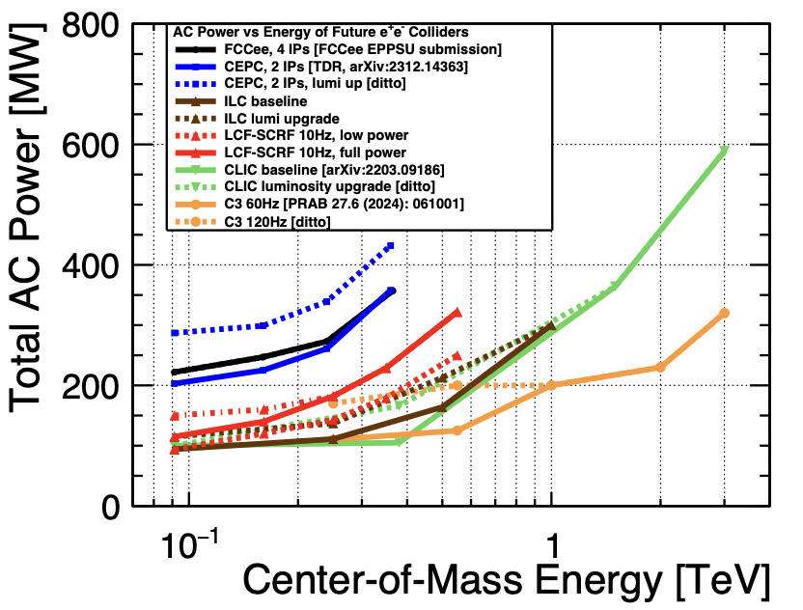
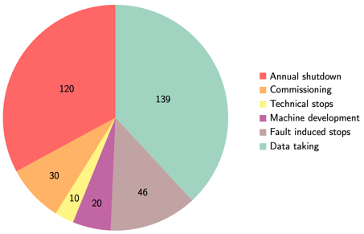
Power and energy
Power at 250-550 GeV in the 140-320 MW range for the LC projects above
Depends on energy AND luminosity (as shown earlier)
With a running scenario on the right this corresponds to 0.8 - 1.8 TWh annually
CERN is currently consuming 1.2 – 1.3 TWh annually
CERN “standard” running scenario used to convert to annual energy use, specify power for each state → energy
A decade of studies to reduce power:
Designs optimisations, SRF cavities (grad,Q), cryo efficiency, RF power system (klystrons, modulators, components), RF to beam efficiencies, improved magnets, operation when power is abundant, heat recovery, nanobeams and more.
 | LCF 250 (LP) | LCF 550 (FP) | CLIC 380 | CLIC 1500
Power (MW) | 144 | 320 | 166 | 287
Energy annually (TWh) | 0.8 | 1.8 | 0.8 | 1.4
8/24

Slide 9
Technology studies – brief
After (briefly) covering physics (covering 90 GeV-TeV(s), footprint/CE (up to ~33km), costs (7-9 BCHF initially) and power (150 MW initially), with deltas to higher energies, some examples of technical studies follow below, for both technologies
First RF, which are different for the two, then several other topics where there have been common working groups the last ~12 years
The projects are technically very well developed over a long time, so this is very incomplete – apologies in advance
9

Slide 10
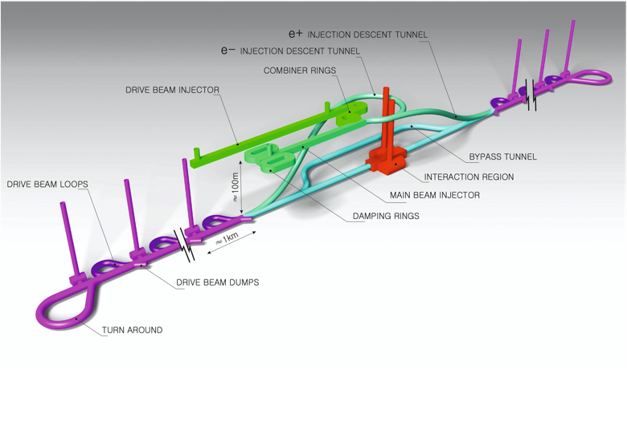
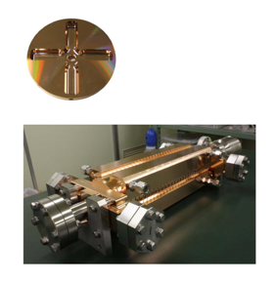
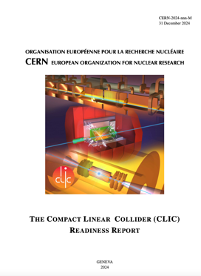
The Compact Linear Collider (CLIC)
  Timeline: Electron-positron linear collider at CERN for the era beyond HL-LHC
  Compact: Novel and unique two-beam accelerating technique with high-gradient room temperature RF cavities (~20’500 structures at 380 GeV), ~11.5 km in its initial phase
  Expandable: Staged programme with collision energies from 380 GeV (Higgs/top) up to 1.5 TeV
  CDR in 2012 had focus on 3 TeV. Project Implementation Plan in 2018 with focus in 380 GeV
  Readiness Report submitted for the ESPP with focus 380 GeV for Higgs and top, upgradable to 1.5 TeV
  Running at 100 Hz with two beam-delivery systems and two IP
Accelerating structure prototype for CLIC: 12 GHz (L~25 cm), 100 MV/m

Slide 11
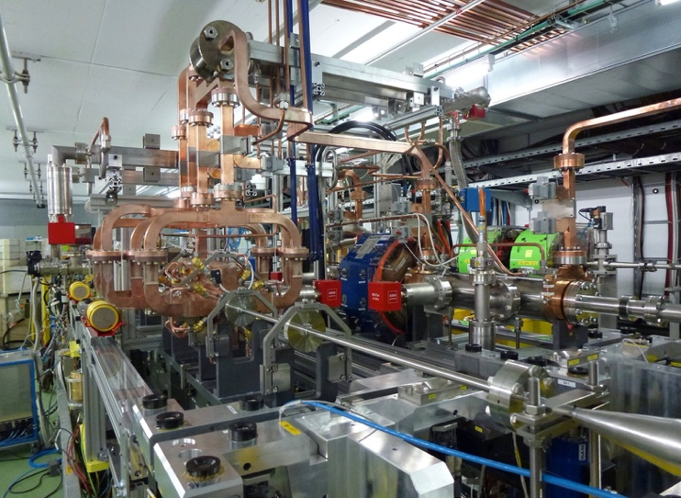
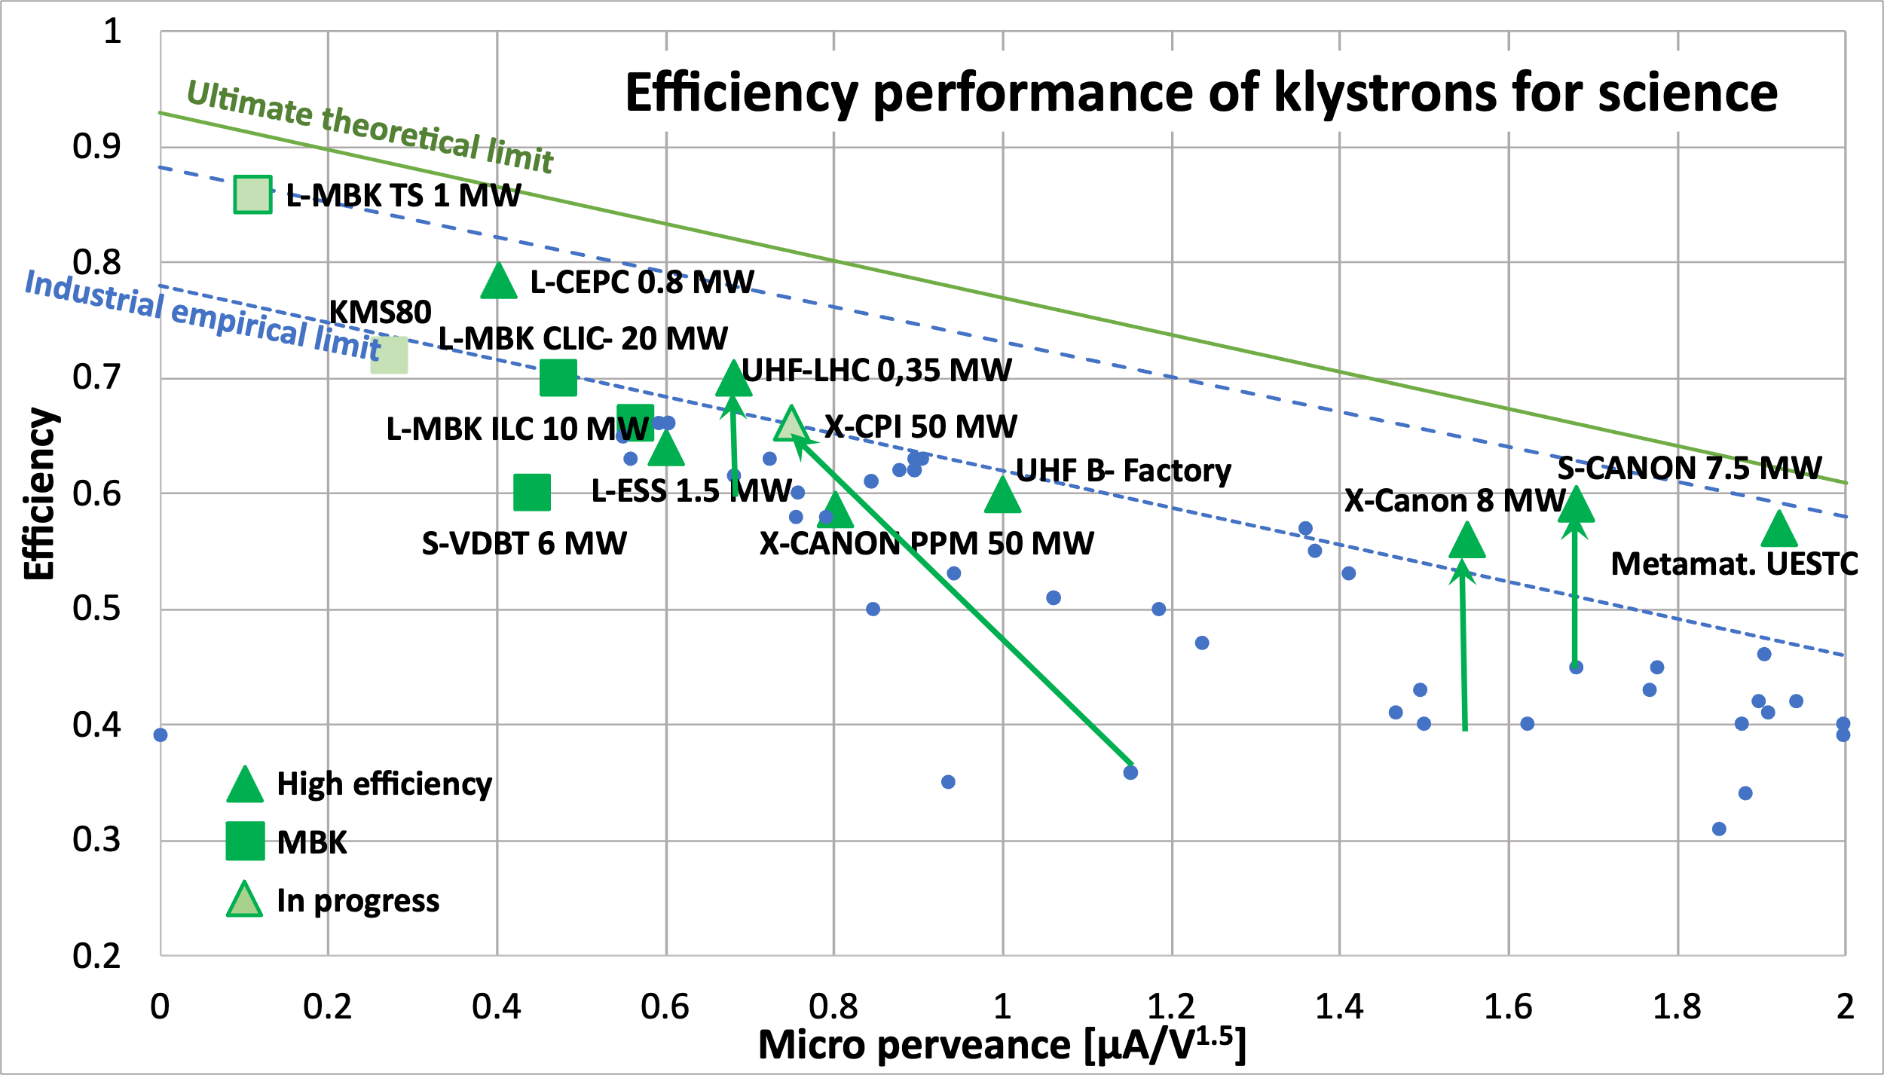
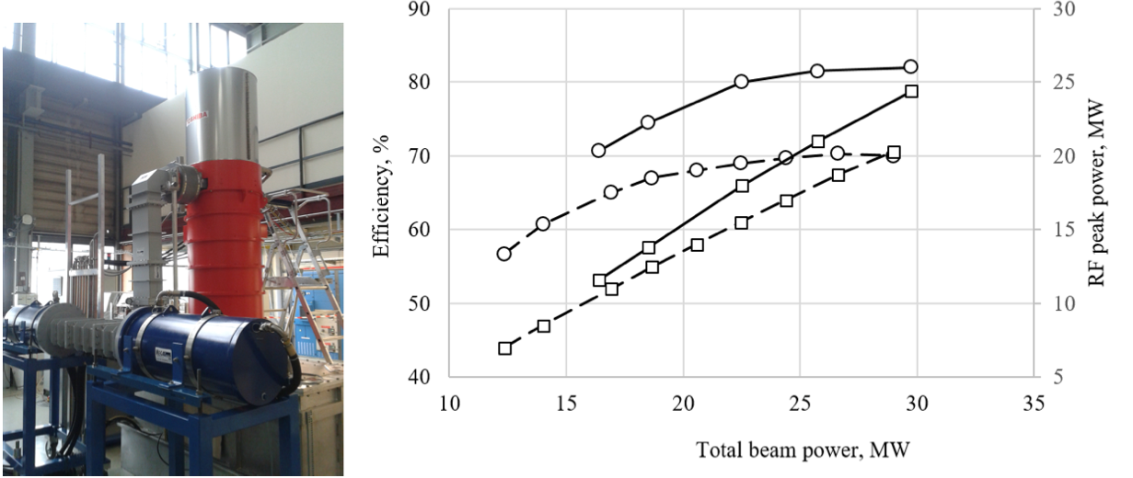
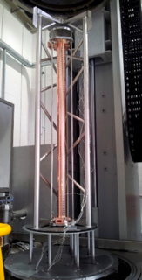
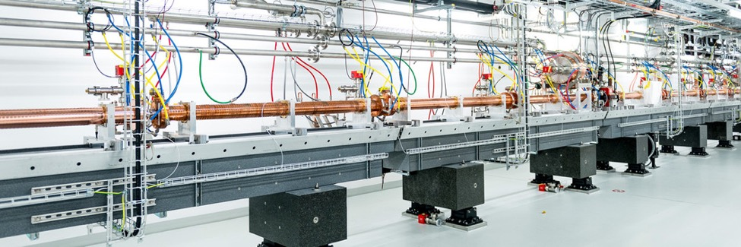
CLIC RF
CLIC baseline – a drive-beam based machine with an initial stage at 380 GeV
RF challenges
  High-current drive beam bunched at 12 GHz
  Power transfer and main-beam acceleration, efficient RF power
  Towards 100 MV/m gradient in main-beam X-band cavities
The CTF3 (CLIC Test Facility at CERN) programme addressed all two-beam issues
X-band technology developed and verified with prototyping, test-stands, and use in smaller systems and linacs
Two C-band XFELS (SACLA and SwissFEL – the latter particularly relevant) now operational: large-scale demonstrations of normal-conducting, high-frequency, low-emittance linacs. Also ongoing, 1 GeV X-band linac at LNF (EUPRAXIA)
High efficiency power sources
See much more in talk yesterday by Walter Wuensch: (LINK)
11/24

Slide 12
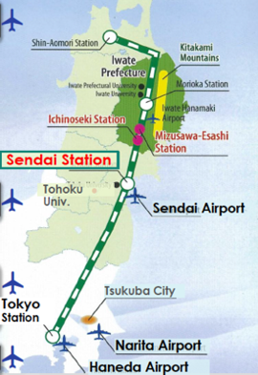
From the ILC250 accelerator facility to the CERN SCRF LCF
See more details in the presentation of Peter McIntosh yesterday (LINK)
Undulator based polarized positron source
The ILC implementation is extensively studies in Japan, civil engineering, integration locally, environmental impacts, etc
How would we implement a SCRF based LC at CERN:
Consider implementation of energies above 250 GeV (even initially), similar to the ILC TDR, specifically 550 GeV
Increase luminosity wrt to parameters used recently (ILC@Japan) and share on two IPs
  Key changes: Bunch trains 5 Hz to 10 Hz, double numbers of bunches per train
Consider if such a facility can use improved or other RF technologies in the future (a true LC facility) – stimulate wide R&D and open options for the future (see talk later today by J.List)
Combine with CLIC footprint/studies as much as possible.
Cost estimate as for CERN projects in CHF, with CE costs from CERN
12/24

Slide 13
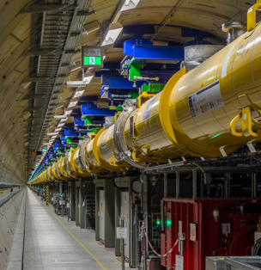
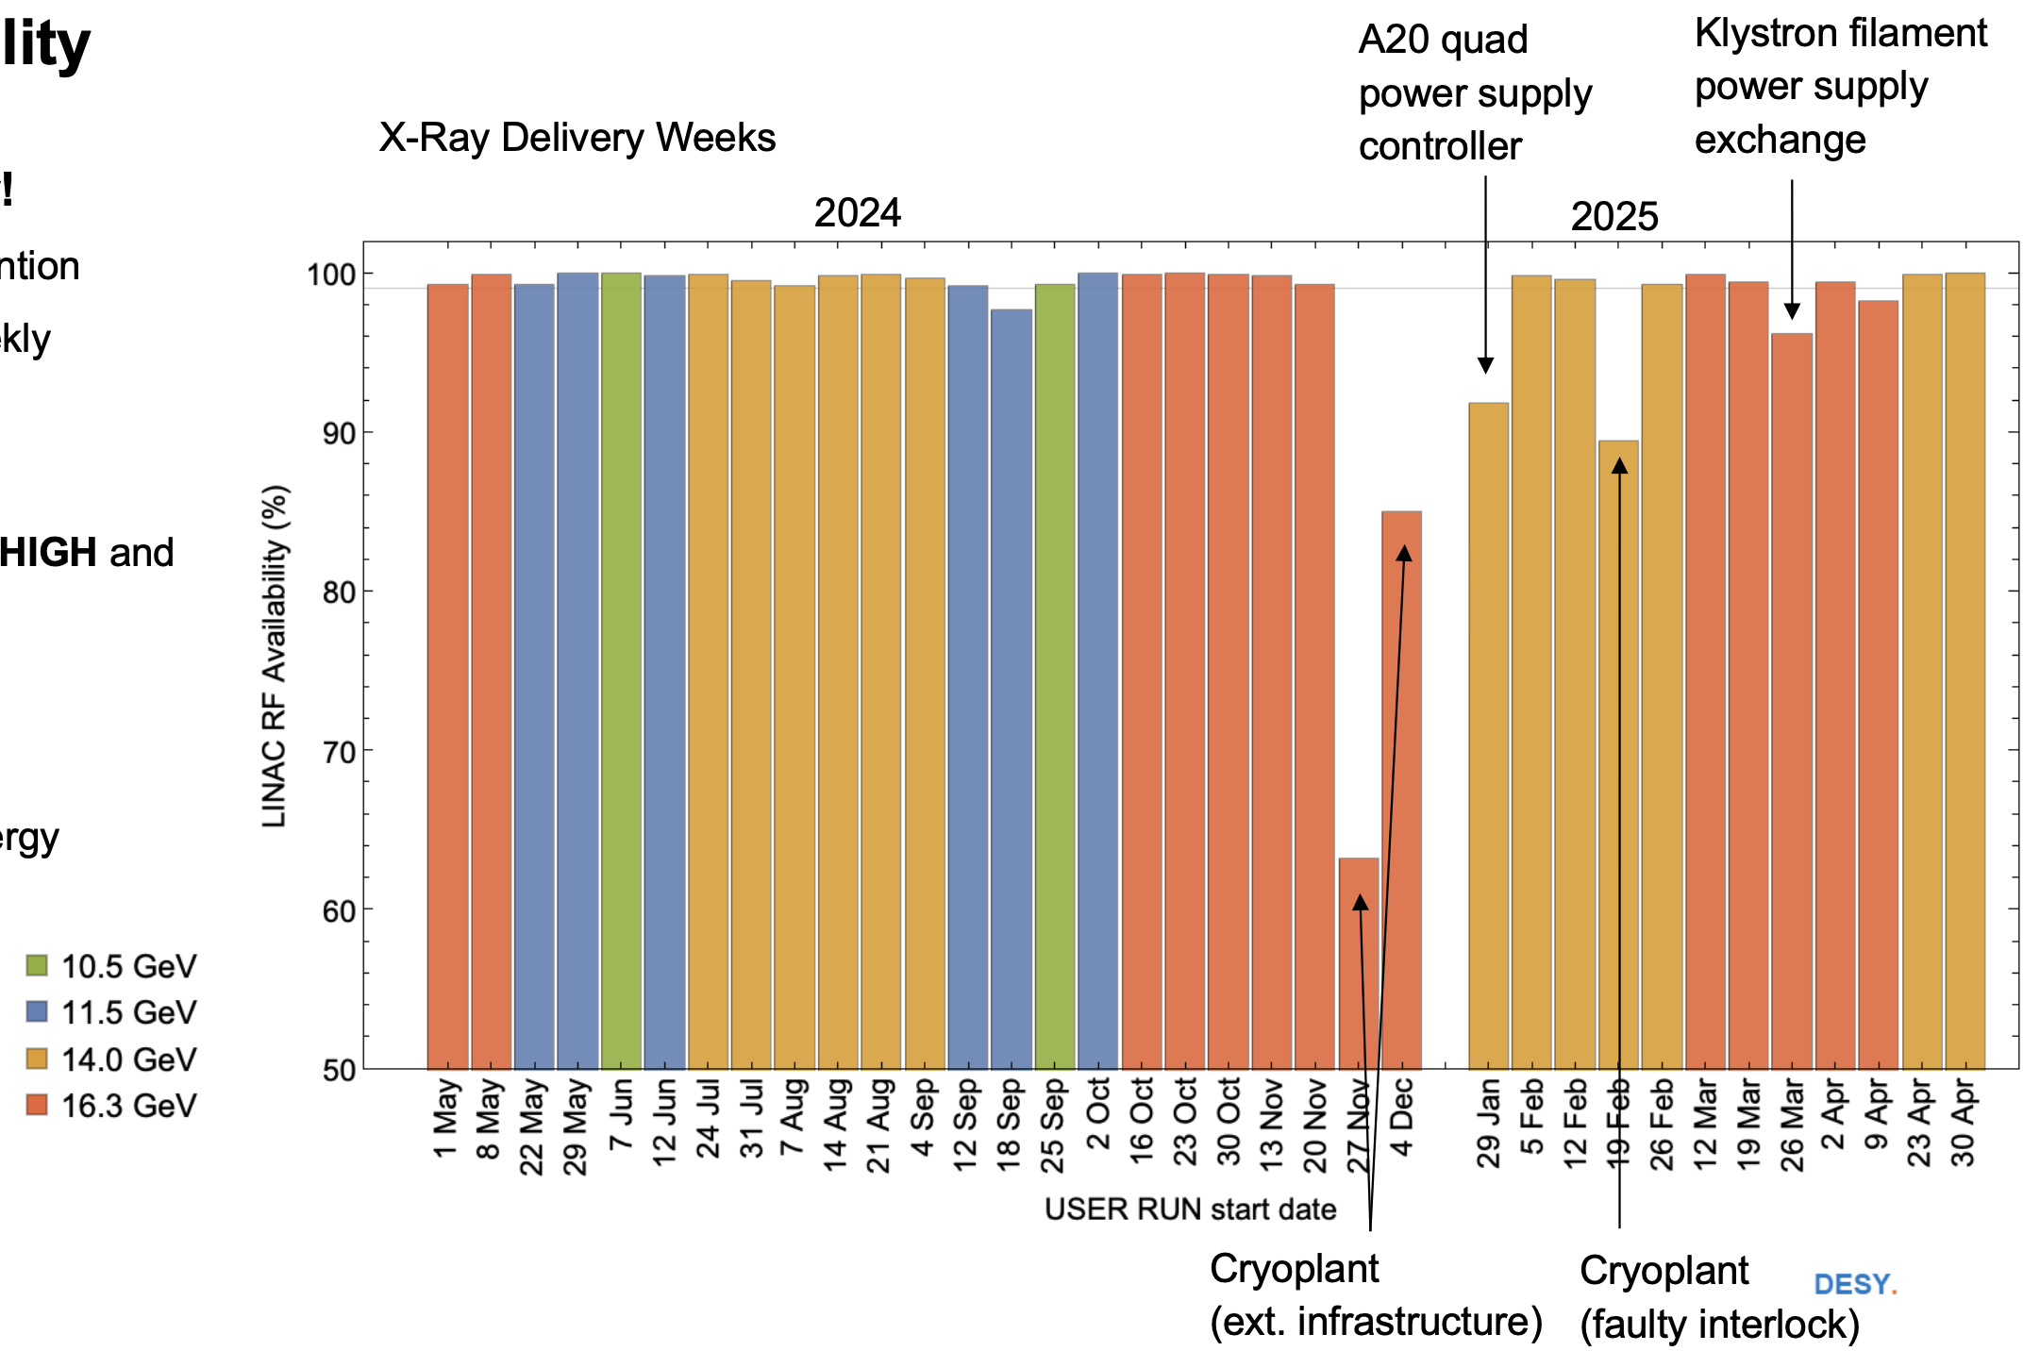
LCF with SCRF
Why SCRF:
Very detailed and mature technical design and industrialisation, several FEL linacs build and being operated
Can be upgraded in Energy and Luminosity
Worldwide interest in technology
Large technology interest in Europe (EUXFEL and several other projects), and leading industries in Europe
  Could it be exploited to reduce work and financial load on CERN during the HL period (lab support outside for in-kind cryomodules for example as foreseen for ILC – and also in Europe) ?
  Can this be turned into a financing advantage and/or schedule advancement ?
EU-XFEL performance 2024-25
13/24

Slide 14
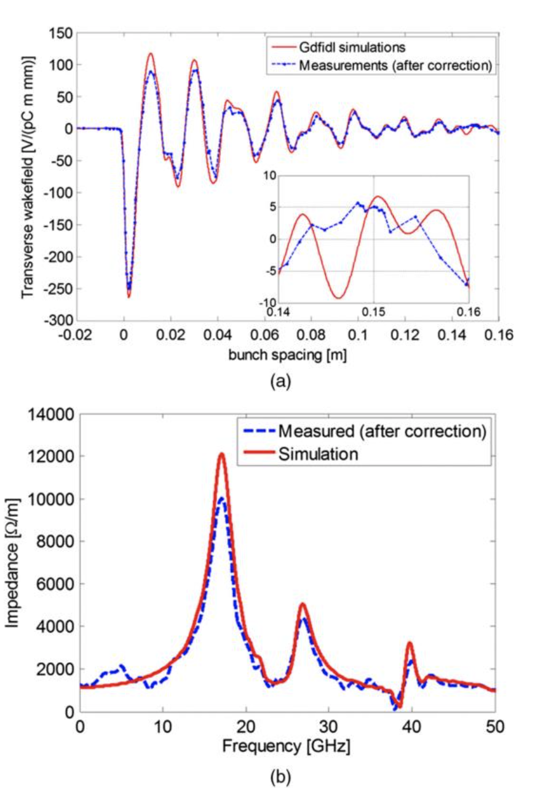
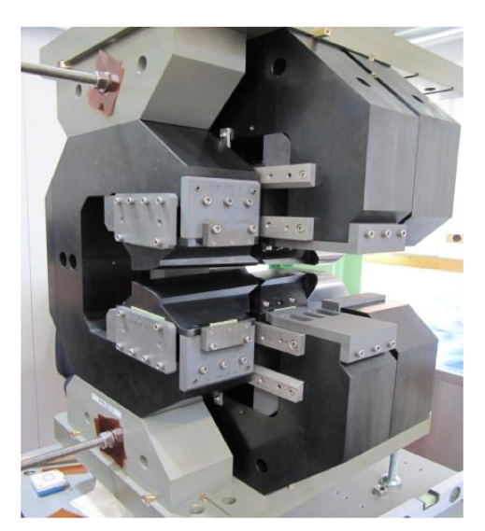
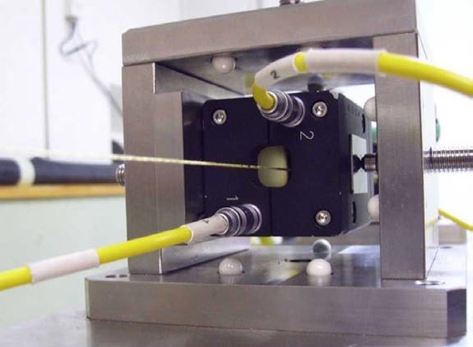
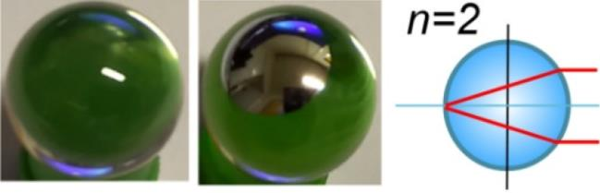
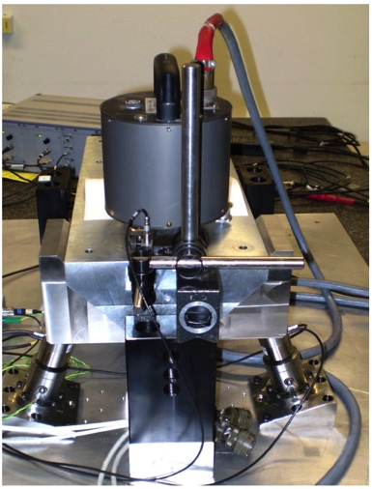
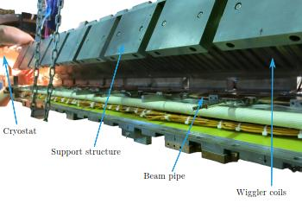
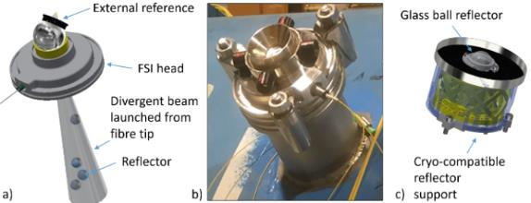
Luminosity related studies – examples
Target and achieved emittance in existing and planned machines
2018
Low emittance damping rings, preservation to the IP, final focus
Align components (10 μm over 200 m)
Control/damp vibrations (from ground to accelerator)
Beam based measurements
– allow to steer beam and optimize positions
Algorithms for measurements, beam and component optimization, feedbacks
Experimental tests in existing accelerators of equipment and algorithms (FACET at Stanford, ATF2 at KEK, CTF3, Light-sources)
Final focus optimization, components, instrumentation and test (ATF the central facility)
2008
Longitudinal variable magnet for CLIC damping rings, wiggler prototype in KARA, extraction kicker in ALBA
Wake-field measurements in FACET
(a) Wakefield plots compared with numerical simulations.
(b) Spectrum of measured data versus numerical simulation.
Alignment and stability components, also used in HL LHC
ATF2-3 at KEK:
Damping Ring and Final Focus beamline
14/24

Slide 15
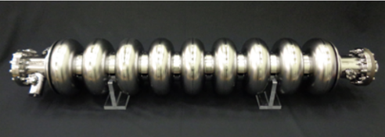
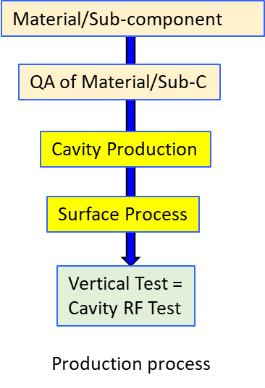
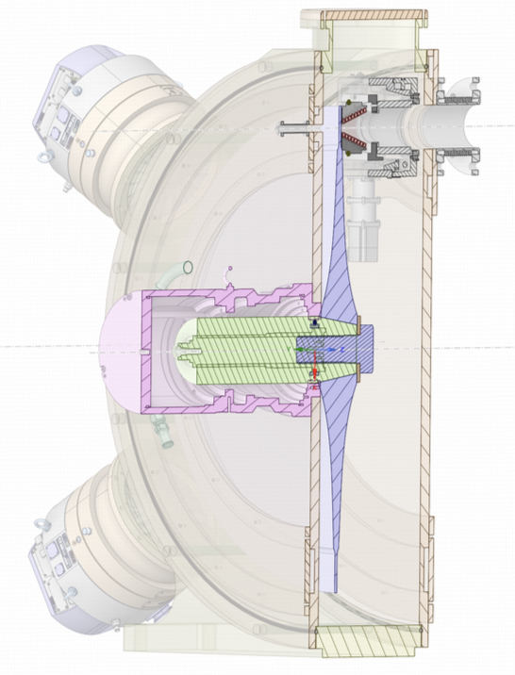
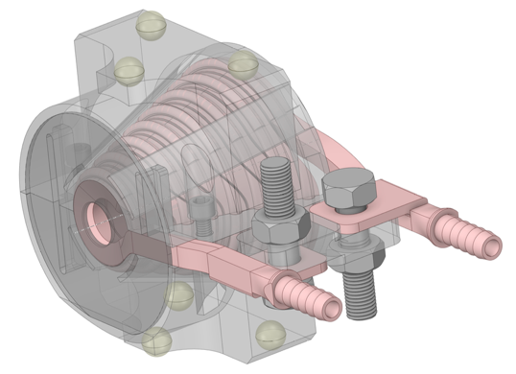
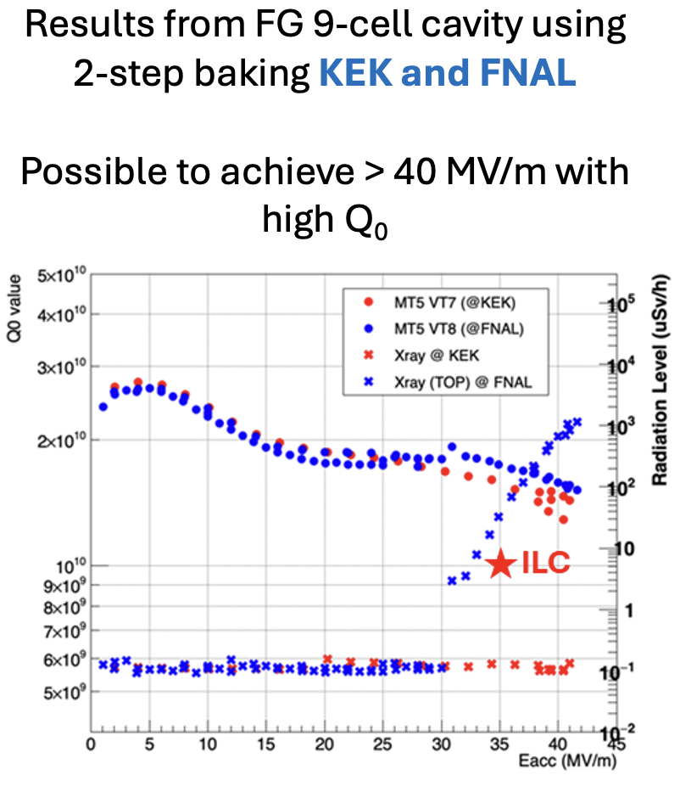
On-going technical studies in Europe – the ILC technology network topics
European ITN related studies (dedicated funding from Japan combined with European resources) are distributed over five main activity areas:
ML related tasks
SRF and ML elements: Cavities and Cryo Module,
Crab-cavities, ML quads and cold BPMs
Sources
Pulsed magnet and wheel/target
Damping Ring including kickers
Low Emittance Rings
ATF activities, final focus and nanobeams
ATS and MDI
Implementation
CE, Cryogenics
Sustainability, Life Cycle Assessments
EAJADE (EU funding) for training of young scientists (linear and circular machines)
Studies in labs distributed across CERN, UK, Germany, France, Italy, Spain
See more details in the presentation of Peter McIntosh yesterday (LINK)
and
Angeles Faus-Golfe on ATF2-3 (LINK)

Slide 16
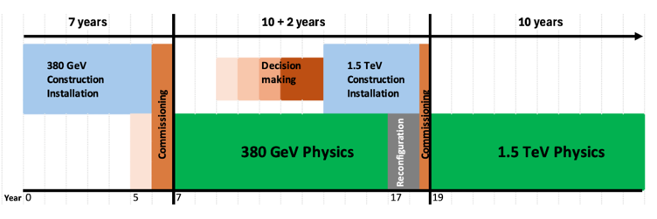
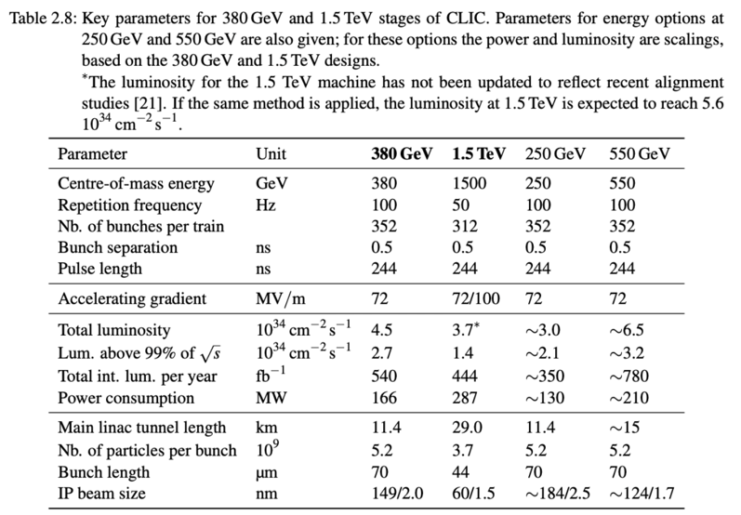
The CLIC ESPP parameters
Key parameters for 380 GeV and 1.5 TeV stages of CLIC. Parameters for energy options at 250 GeV and 550 GeV are also given; for these options the power and luminosity are scaled, based on the 380 GeV and 1.5 TeV designs.
∗The luminosity for the 1.5 TeV machine has not been updated to reflect recent alignment studies [15]. If the same method is applied, the luminosity at 1.5 TeV is expected to reach 5.6 x 10³⁴ cm⁻² s⁻¹
4.3 ab⁻¹
4 ab⁻¹
    Z pole performance, 6.3x10³² – 1.2x10³⁴ cm⁻² s⁻¹
      The latter number when accelerator configured for Z running (e.g. early or at the end of the first stage)
An alternative upgrade to 550 GeV, maintaining the repetition rate at 100 Hz and two IPs, is also considered. A possible implementation would be to start with a longer tunnel by 5 km from the beginning adding about 25 % to the initial cost of the CE of the baseline 380 GeV machine.

Slide 17
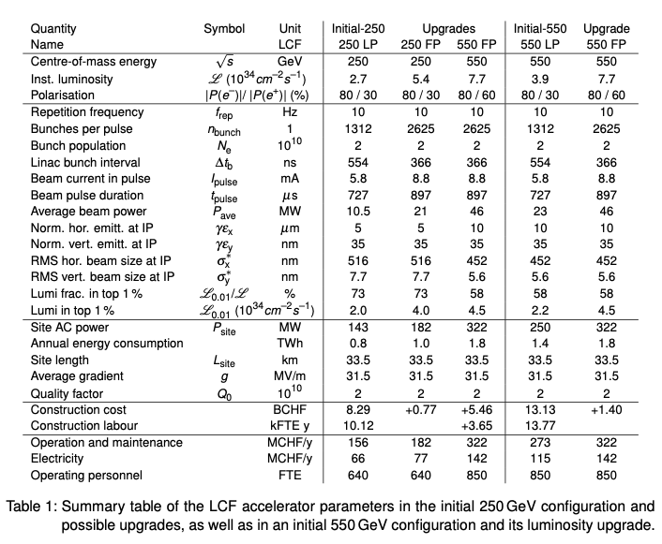
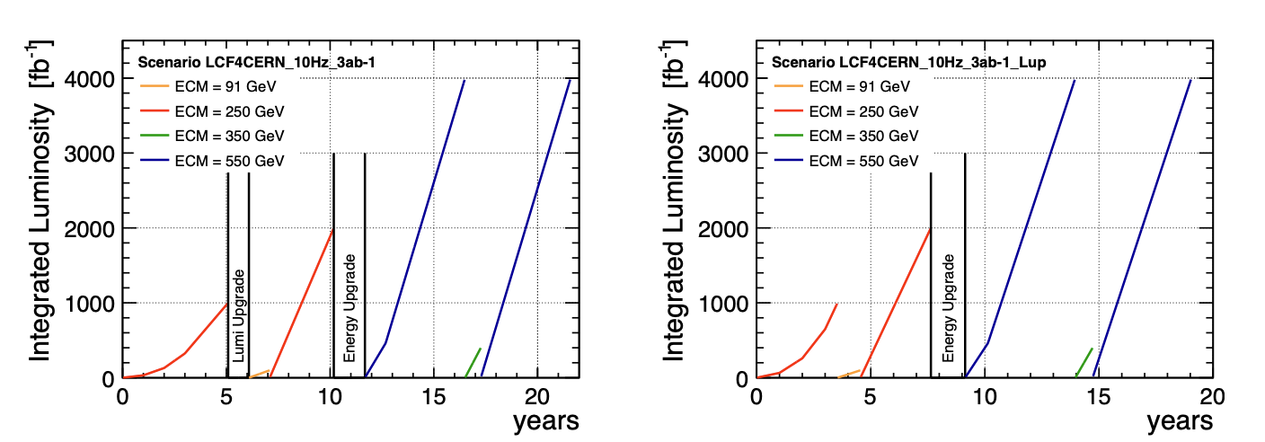
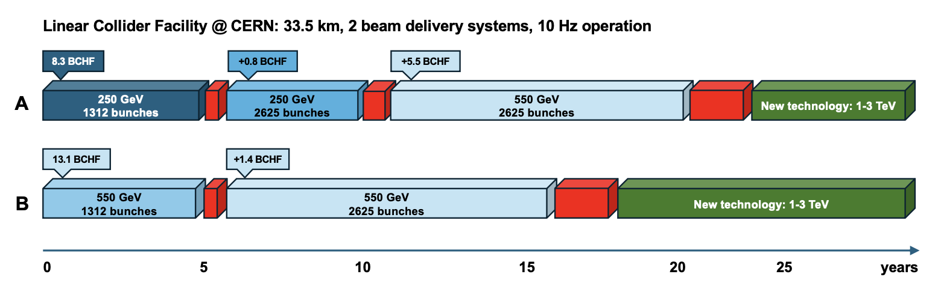
LCF – SCRF – ESPP parameters
Baseline (10Hz rate)
Start immediately with full power (1316->2625 bunches in train)
Summary table of the LCF accelerator parameters in the initial 250 GeV configuration and possible upgrades, as well as in an initial 550 GeV configuration and its luminosity upgrade
Note: tunnel extension to allow a 550 GeV upgrade is included in the initial programme
17/24

Slide 18
Recent common studies and next steps
Recent project studies, schedule and the next steps
18/24

Slide 19
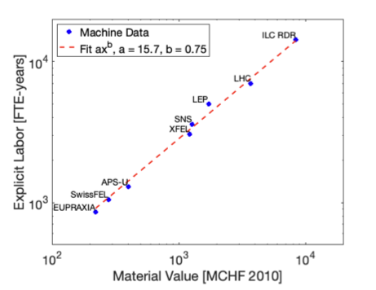

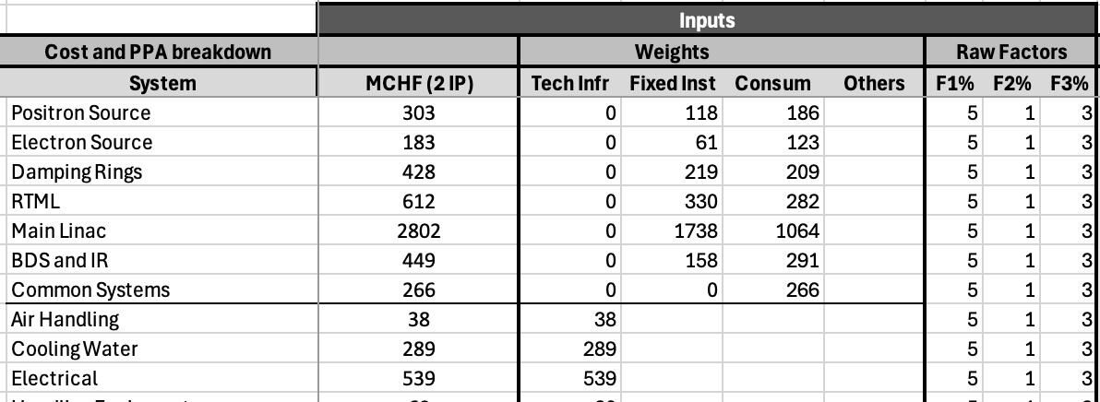
Personnel and Operation Costs
Estimated according to guidelines in comparative study (LINK)
Plot on the right from Snowmass Implementation Report (LINK)
Personnel for construction is estimated in the 10000-11000 FTEy range, according to the formula (value excludes civil engineering):
Explicit Labour = 15.7 x (value)^{0.75}
Operation cost (material replacements, energy costs, and personnel for operation) also updated, important for overall affordability
 | CLIC 380 | LCF 250 (ave. LP,FP)
Maintenance and replacement costs (MCHF) | 137 | 170
Electricity costs (MCHF – using 80 EURO/MWh) | 63 | 69
Personnel for operation (FTE) | 650 | 800
Cost items are distributed on three maintenance groups, with 1,3,5 % annual replacement estimates
19/24

Slide 20




Sustainability: Life Cycle Assessment (LCA)
Civil engineering
Operational Power/Energy
The carbon intensity of energy in ~2050 (operation):
Use 14-18g/kWh
Hardware (both for NCRF and SCRF)
See also:
LDG sustainability panel group yesterday (LINK)
LCA reports (by ARUP): LINK

Slide 21
Towards Carbon Accounting with LCA
Unit (kton CO2) | LCF LP 250 (33.5 km) | LCF FP 550 (33.5 km) | CLIC 380 (11.5km) | CLIC 1500 (29.5 KM) | Reductions and comments
CE underground A1-A5 | 380 | 0 | 286 | 199 | ~50%
CE surface (for injectors & sites) A1-A5 | Only site buildings (small) | Only site buildings (small) | 118 | 0 | ~50%
Machine elements incl. injectors A1-A3 | 236 | 394 | 140 | ~135 | ~25%
Tunnel Services A1-A3 | 46 |  | 19 | ~20 | ~25%
Two detectors A1 | 94 | Upgrades | 94 | Upgrades | ~25%, very incomplete estimate
Operation annually | 13 | 28 | 13 | 22 | Assume 2050 numbers (prev. slide)
General comments:
LCAs are becoming very useful tools for design optimisation, material and supplier choices
Several parts will evolve (usually increase) with more studies, in particular hardware and services
Hardware the dominant contribution

Slide 22
Schedule towards a LC@CERN
2026-28
Prep phase I:
T0, T0+5
Prep phase II:
Site investigation and preparation
T1, T1+10
Construction*:
Civil engineering
T1+11
Beam-commissioning
followed by physics
Design optimisation and finalization
Main technologies R&D conclusions
(Pre)Technical Design Report - two IPs at CERN
Definition of the placement scenario
Implementation studies with the Host states
Environmental evaluation & project authorisation processes
Industrialisation of key components
Engineering design completion
Construction of components
Installation and hardware commissioning
T0 is determined by a process in 2028-29 to validate the progress and promise of the project for a further development towards implementation.
*The construction phase is extended with respect to the technically-limited schedules to allow a transfer time into construction, and to avoid the resource conflict between HL-LHC operation and initiating beam commissioning for a next collider
T1 will be determined by the processes needed, by the CERN Council and with host-states, for project approval and to start construction

Slide 23
Next Steps towards a Linear Collider @ CERN
Project implementation: foresee 3+5-year preparatory periods, then construction ~10 years
  Ideally starting preparation after conclusion of EPPSU in mid-2026
  Split in two phases, the first to establish final parameters and layout for a LC (see main points below)
  2026-28 (resource estimate ~25-35 MCHF and ~150-180 FTEy), main topics below
Site Layout Refinement:
The next step is to refine the LC site layout, including shaft placement and detailed designs for surface and underground areas.
Accelerator Complex Design Optimisation:
The detailed design of the LC accelerator complex, especially its interfaces with civil engineering and detector systems (BDS and interaction area), will be further developed, with a particular focus on optimising the LC@CERN parameters.
Technology R&D with international partners:
Research on SCRF and X-band technologies, including RF sources, e- and e+ sources, nanobeam systems, beam delivery and damping rings.
Detector R&D:
Aligned with Higgs factory and broader technology initiatives

Slide 24
Main points
A Linear Collider at CERN has a very attractive and broad physics programme and is a very flexible facility
A Linear Collider as a staged project can be implemented at 7-9 BCHF for the first stage
Upgrading to - at least - 550 GeV is possible, to be implemented taking into account physics and resources as the programme and field evolve
A ~3 year programme is suggested to establish a LC baseline, building on and extending existing international collaborative R&D
  Need more detailed implementation study to validate and optimize an LC@CERN (as outlined for 2026-28)
  Guidance about energy, performance and cost goals from the ESPP update crucial
An LC can be completed in parallel with the HL LHC programme (to the extend resources allow)
There are many opportunities for international support (technology and capabilities) in the preparation phases and during a potential construction

Slide 25
Many thanks to many
Slides/plots/information from the three submissions mentioned on slide 2

Slide 26





Costs – more details
Cost matrix, updating SCRF and CFS (~75%), escalation and currency updates for the rest (~25%)
The cost composition and values of the 1.5 TeV complex have also been estimated. The energy upgrade to 1.5 TeV has a cost estimate of∼7.1billion CHF, including the upgrade of the drive-beam RF power needed for the 1.5 TeV stage.
The 250 GeV configuration will cost around 10% less than the 380 GeV complex.
A 550 GeV configuration around 30% more

