Slide 1

PLENARY / Large-scale accelerator projects at CERN, part I
FCC-hh
Frank Zimmermann (CERN)
Warm thanks to the FCC Collaboration, and in particular, to Bernhard Auchmann, Amalia Ballarino, Michael Benedikt, Jean-Paul Burnet, Massimo Giovannozzi, Mike Koratzinos, Elliot Lipeles, Michelangelo Mangano, Thys Risselada, Gustavo Perez Segurana, Florian Sonnemann, and Ezio Todesco !

Slide 2
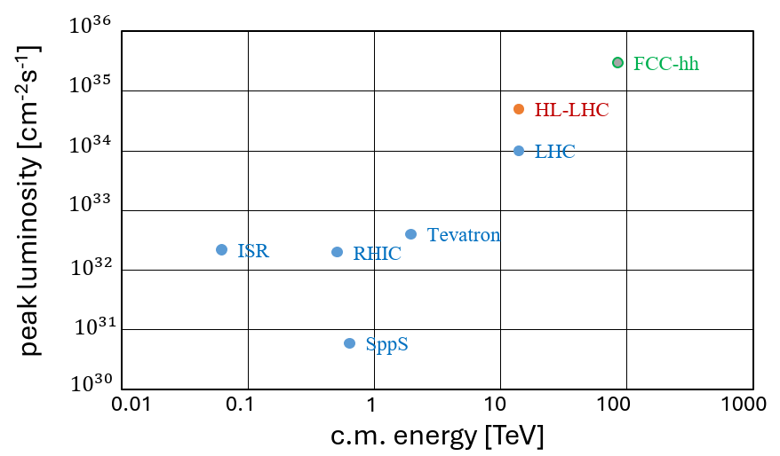
hadron collider peak luminosity versus centre-of-mass energy
the proposed FCC-hh
HL-LHC collider
under construction
past & present hadron colliders

Slide 3
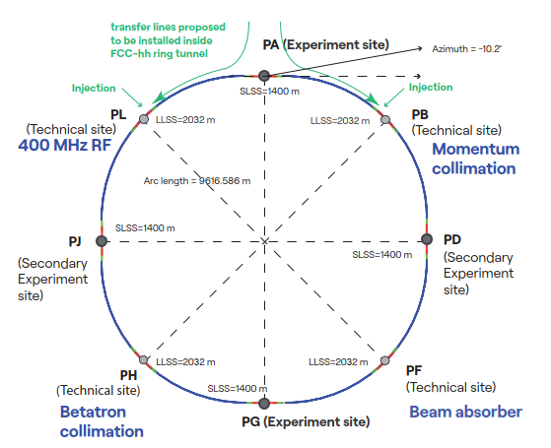
future circular hadron collider FCC-hh
Parameter optimization to lower electricity consumption (~max. consumption of FCC-ee)
Magnetic field considered realistic with today’s technologies (Nb₃Sn, ~14T, 1.9 K)
Main parameters FSR 2025
FCC-hh functional layout
parameter | FCC-hh | FCC-hh CDR | HL-LHC
collision energy cms [TeV] | 85 | 100 | 14
dipole field [T] | 14 | 16 | 8.33
circumference [km] | 90.7 | 97.8 | 26.7
beam current [A] | 0.5 | 0.5 | 1.1
synchr. rad. per ring [kW] | 1200 | 2400 | 7.3
peak luminos. [10³⁴ cm⁻²s⁻¹] | 30 | 30 | 5 (lev.)
events/bunch crossing | 1000 | 1000 | 132
stored energy/beam [GJ] | 6.5 | 8.3 | 0.7
integr. luminosity / IP [fb⁻¹] | 20000 | 20000 | 3000

Slide 4
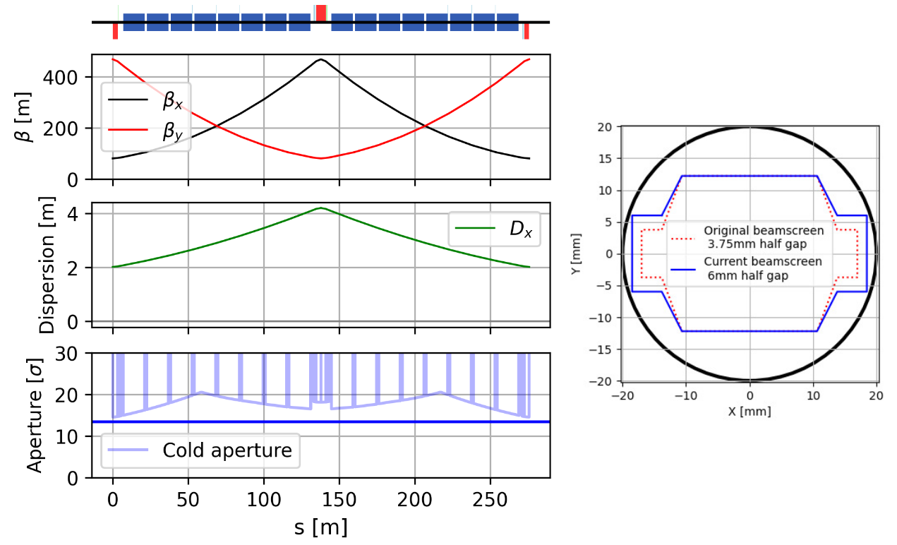
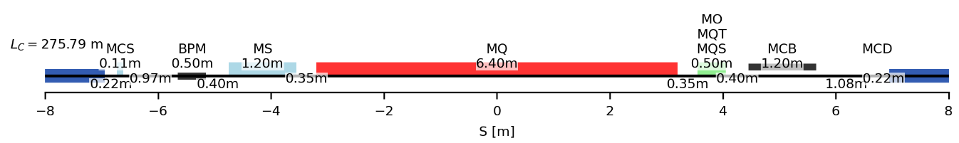
FCC-hh beam optics perfectionated for highest energy !
regular arc cell
~275m
 | CDR cell 12-dipole | 12-dipole | 16-dipole
# dipoles | 4668 | 4288 | 4464
Cell length [m] | 213.030 | 213.030 | 275.792
Circumference [km] | 97.75 | 90.657 | 90.657
CM energy @14T [TeV] | 88.477 | 81.275 | 84.611
Short Straight Section
M. Giovannozzi, G. Perez Segurana, T. Risselada, E. Todesco

Slide 5
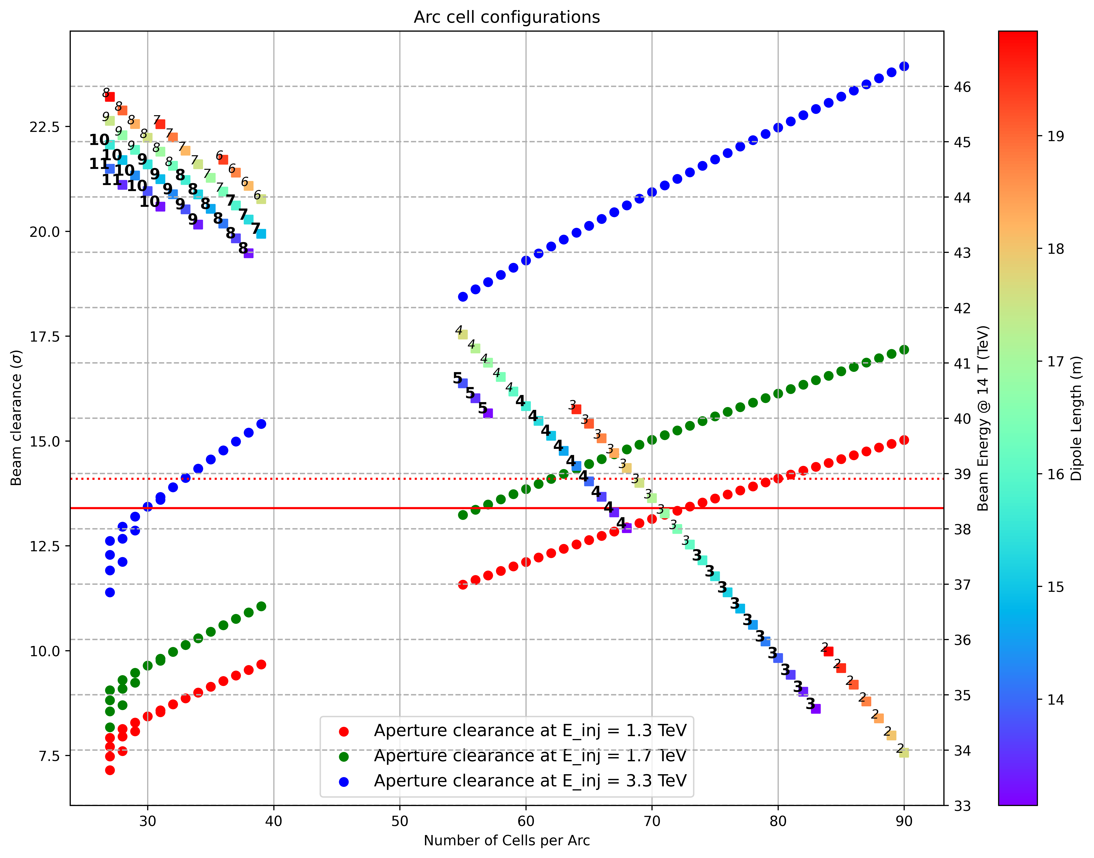
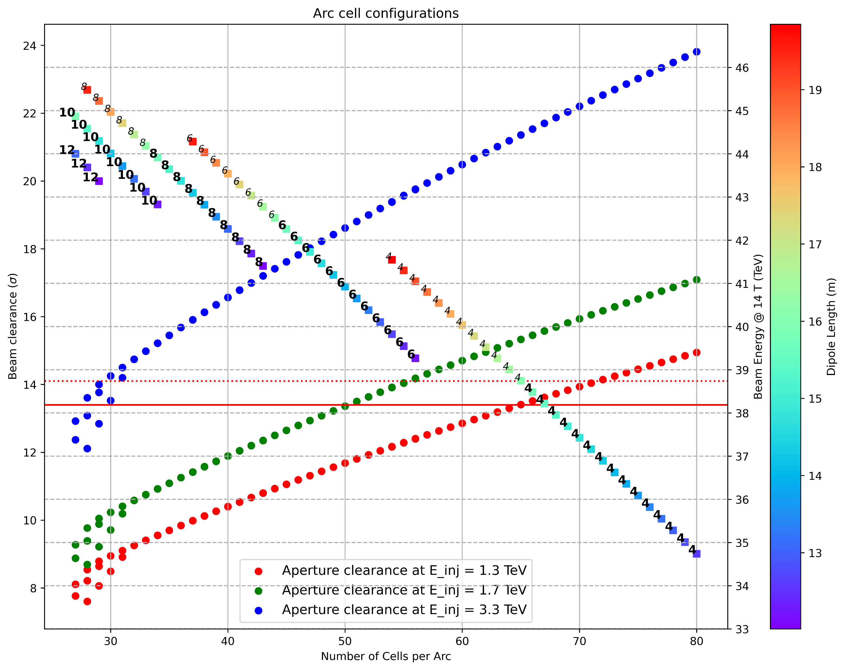

optimisation of main magnet length
energy reach and aperture clearance for different injection energies
Combined-function main magnets
Separate-function main magnets
# MB/half-cell
$$≤16 m$$
$$>16 m$$
Flat top energy
M. Giovannozzi, G. Perez Segurana, E. Todesco

Slide 6
FCC-hh injector options
superconducting machine in the SPS tunnel (scSPS)
modified faster-ramping LHC
new 4 T machine in the LHC tunnel
2 T superferric machine in the LHC tunnel (1.75 TeV, not shown in the table), resulting energy swing x14, similar to LHC (~15)
 | unit | scSPS | modif. LHC | 4 T LHC
circumference | km | 6.8 | 26.7 | 26.7
#apertures |  | 1 | 2 | 1
injection energy | GeV | 26 | 450 | 450
extraction energy | TeV | 1.3 | 3.3 | 3.3
injection field | T | 0.12 | 0.6 | 0.6
maximum field | T | 6 | 6 | 6
energy/field swing |  | 50 | 7 | 7
#dipoles |  | 372 | 1232 | 1232
#bunches |  | 640 | 2600 | 2600
stored energy | MJ | 15 | 167 | 167
collider filling time | min | 37 | 46 | 39

Slide 7
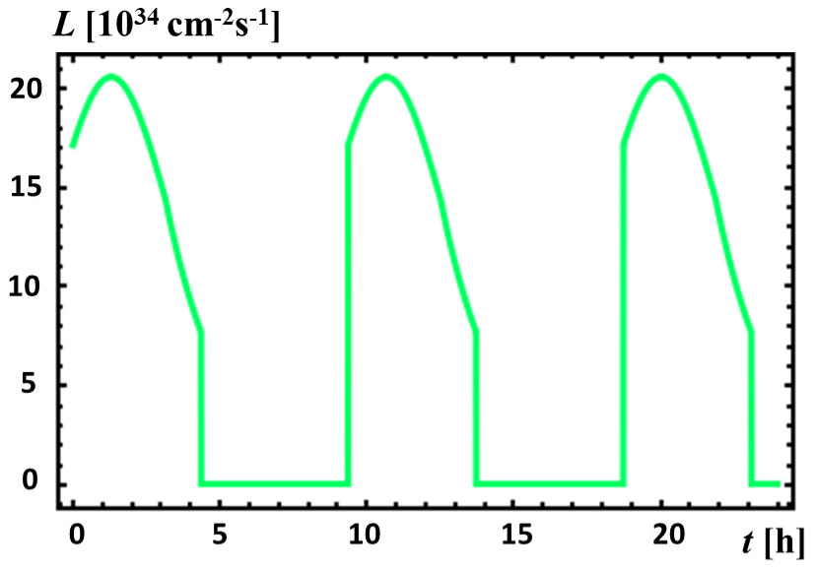
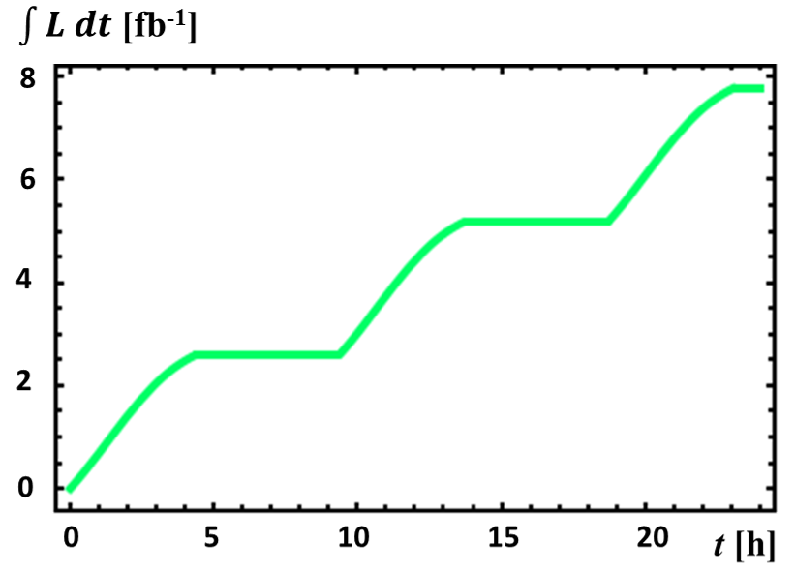
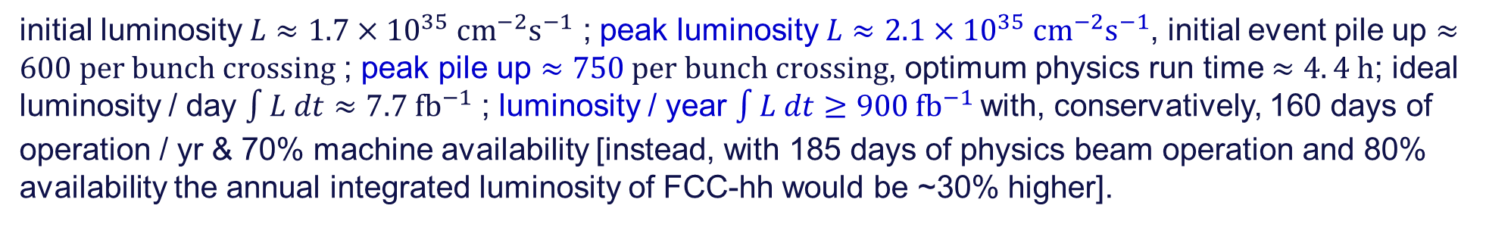
FCC-hh instantaneous & ideal integrated luminosity over 24 h
initial luminosity $L≈1.7×{10}^{35} {\text{cm}}^{−2}{\text{s}}^{−1}$ ; peak luminosity $L≈2.1×{10}^{35} {\text{cm}}^{−2}{\text{s}}^{−1}$, initial event pile up $≈600 per bunch crossing$ ; peak pile up $≈750 per bunch crossing$, optimum physics run time $≈4. 4 h$; ideal luminosity / day $\int{L dt}≈7.7 {\text{fb}}^{−1}$ ; luminosity / year $\int{L dt}≥900 {\text{fb}}^{−1}$with, conservatively, 160 days of operation / yr & 70% machine availability [instead, with 185 days of physics beam operation and 80% availability the annual integrated luminosity of FCC-hh would be ~30% higher].

Slide 8
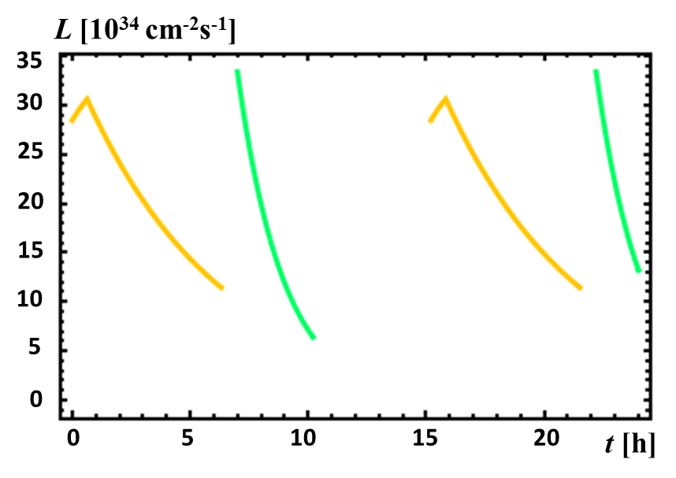
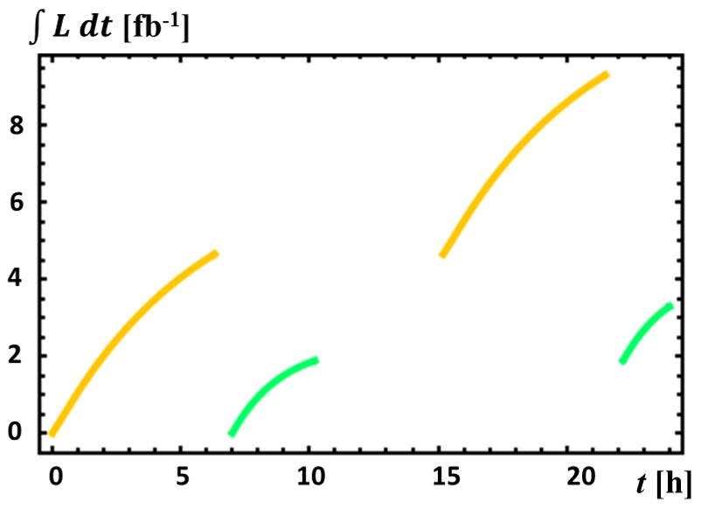








FCC-hh – SR power leveling !?!
Leveling synchrotron radiation (SR) power: start with higher current and highest luminosity – up to maximum pile up – at lower energy and ramp up energy when current has decreased – either in discrete steps (below) or continually
E. Lipeles
$E_{cm}$=85 TeV
$P_{SR,0}≈$2 MW
ramp
12 → 14 T
$E_{cm}$=73 TeV
$P_{SR,0}$=5 MW
turnaround
$E_{cm}$=73 TeV
$E_{cm}$=85 TeV
$P_{SR,0}$=5 MW
$P_{SR,0}≈$2 MW
over one day: ~8.5 fb⁻¹ at 73 TeV and 3.5 fb⁻¹ at 85 TeV
Strategic Joint Meeting of the HFCC, Stony Brook University, , 8–9 Nov 2024

Slide 9
technical readiness and R&D requirements for FCC-hh
Component /Subsystem | TRL | Main parameter to be improved | Improvement factor | R&D effort (CERN contributions)
 |  |  |  | Personnel [FTEy] | Material [MCHF] | Timescale [years]
Nb₃Sn conductorª | 7 | Cost & industrialisation (more manufacturers) | 3 | 10 | 30 | 7
Nb₃Sn magnet short model | 6 | max. field^{b} | 20% | 100 | 20 | 5
Nb₃Sn scaling to 5 m | 5 | length | 3 | 100 | 40 | 10
Nb₃Sn scaling to 15 m | 4 | length | 3 | 100 | 100 | 15
HTS magnet short model 20 T | 3 | field^{c} & all accelerator magnet features | 5-10 | 100 | 50 | 10
HTS long magnet 20 T | 1 | length | 15 | 100 | 150 | 25
ªThis includes only contracts to lower the price and to have more manufacturers.
^{b}Target of 15 T, for operation at 14 T.
^{c}2 to 4 T already achieved, but not with all requirements.
E. Todesco, B. Auchmann

Slide 10
14 T Nb₃Sn “accelerated” roadmap: short models & scaling in length
Select the design by 2028/29 (first indications from HFM tests in 2026-2027)
Short model program to verify reproducibility and optimize manufacturing processes: in 2029-2031
Scaling in length in two steps: TRL 7 achieved between 2032 and 2040
Industrialization for final magnets, with pre-series
9 years of production, installation and commissioning in parallel
First selection
of design
2055 as possible date for FCC-hh start as a standalone project
5-m-long prototypes
(>5 each type)
Industrialization (pre-series magnets)
Short model program on two selected designs
(>5 each type)
15 m long prototypes (>5)
Feedback
HL-LHC operation
Production and test
Ongoing
12 T and 14 T short models
Selection of final design
to start long magnets
Installation and commissioning
Tender
for the series
`25
`26
`27
`28
`29
`30
`31
`32
`33
`34
`35
`36
`37
`38
`39
`40
`41
`42
`43
`44
`45
`46
`47
`48
`49
`50
`51
`52
`53
`54
RunIII
HL-LHC RunIV
HL-LHC RunV
E. Todesco, B. Auchmann

Slide 11
14 T Nb₃Sn further “accelerated” roadmap w. early industry involvement & parallelisation
First selection
of design
5-m-long prototypes
(>5 each type)
Industrialization (pre-series magnets)
Short model program on two selected designs
(>5 each type)
15 m long prototypes (>5 each type)
Production and test
Ongoing
12 T and 14 T short models
(7 designs, 1 or 2 of each type)
Selection of final design
to start long magnets
Installation and commissioning
Tender
for the series
`25
`26
`27
`28
`29
`30
`31
`32
`33
`34
`35
`36
`37
`38
`39
`40
`41
`42
`43
`44
`45
`46
`47
`48
`49
`50
`51
`52
`53
`54
RunIII
HL-LHC RunIV
HL-LHC RunV
this roadmap indicates 2051 as possible date for FCC-hh start as a standalone project
E. Todesco

Slide 12
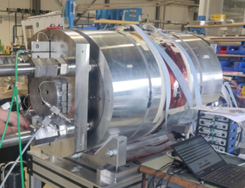
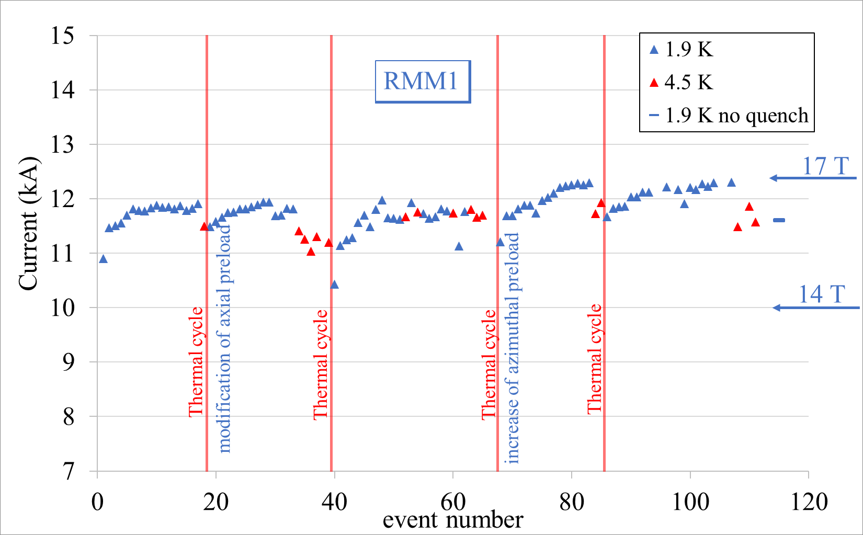
what has been achieved
Demonstrators: magnets not having all features of a short model, but proving a part of the technology
  RMM, based on block design, 50 mm aperture, but without flared ends, very large coil (not affordable for FCC)
  reached 17T and 15.7 T in stable operation; it proves that technology can go there !
  launched by FCC in the CDR phase (well before HFM)
Work launched by D. Tommasini, WP Leader J.-C. Perez
D. Tommasini, E. Todesco, B. Auchmann

Slide 13
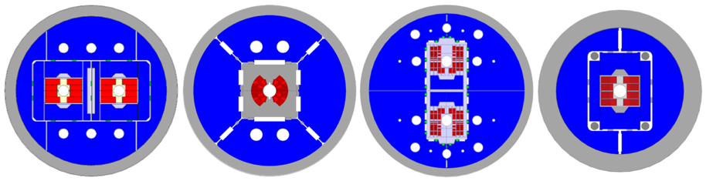
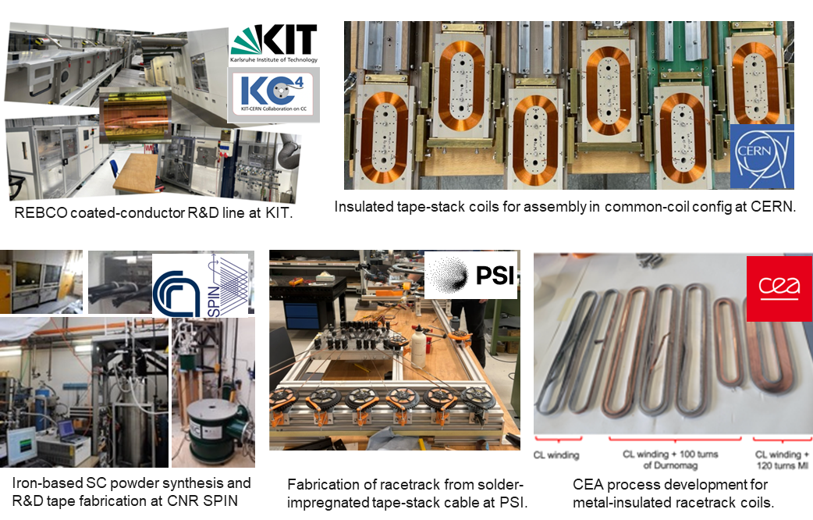


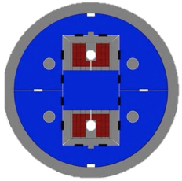



FCC-hh High-Field Magnet Nb₃Sn and HTS R&D ongoing
Nb₃Sn:
12- and 14-T short demonstrators
different coil geometries
tests scheduled for 2026
HTS R&D in various domains:
REBCO and IBS Conductor R&D
racetrack coil developments
E. Todesco, B. Auchmann

Slide 14
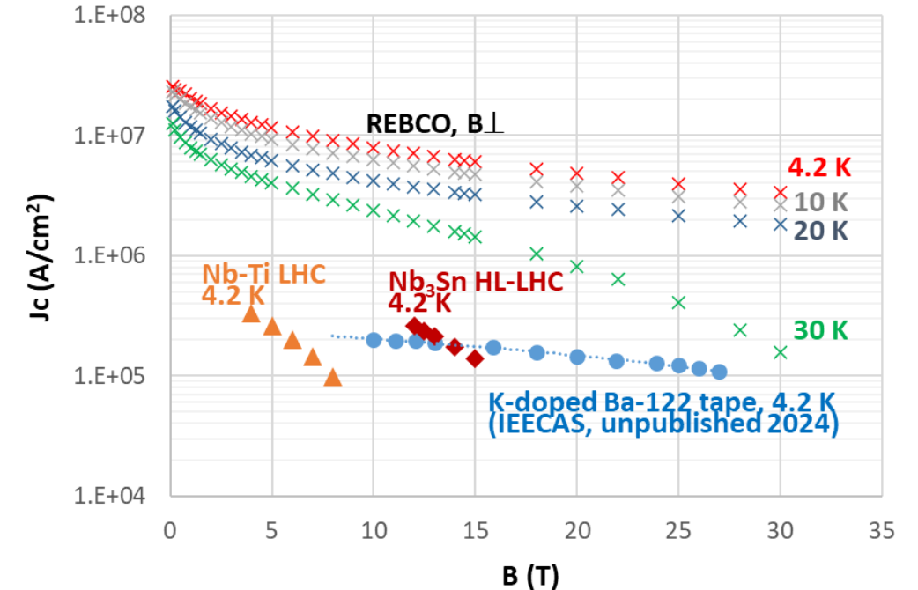
ReBCO – Why ?
ReBCO
performance refers to conductor recently procured by CERN in unit lengths > 200 m.
Cost (E/m) reduced by a factor ~3 in the last two years
A. Ballarina

Slide 15

ReBCO production plan in China – Shanghai Superconductor
>5x rest of the world
Amalia Ballarino, Bai Song

Slide 16
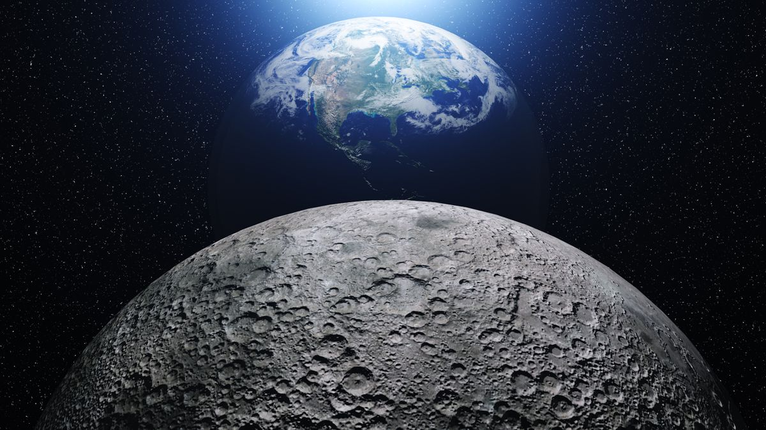
How much ReBCO might we need to build an FCC-hh ?
Order of 0.5 to 1 TA m: half to one million of km of cable carrying 1 kA
  Equivalent to 1 kA superconducting cable/wire connecting 1.5 to 3 times the distance of the Earth to the Moon
 |  | Energy c.o.m. | Field | Current density | Ampere turns per meter of magnet | Magnet lenght | Number of magnets | Total
 |  | (TeV) | (T) |  | (A) | (m) | (adim) | (TA m)
LHC | Nb-Ti | 7.0 | 8.3 | 380/480 | 3800 | 14.3 | 1232 | 0.067
FCC-hh | Nb₃Sn | 90 | 14 | 360 | ~8000 | 14.3 | ~4500 | ~0.5
FCC-hh | HTS | 125 | 20 | 400 | ~14000 | 14.3 | ~4500 | ~0.9
SPPC | HTS | 125 | 20 | ~400 | ~14000 | 14.3 | ~4500 | ~0.9
Applied Superconductivity Conference, SLC, 4 Sept. 2024
E. Todesco

Slide 17
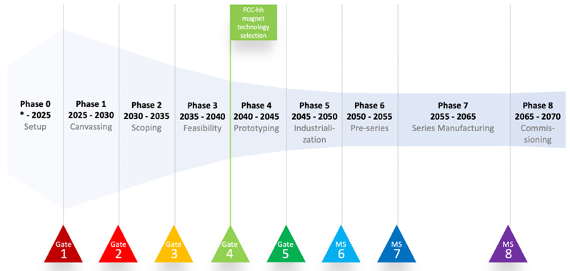
HTS roadmap
Target: by 2035 a proof of a short model dipole with all features for FCC
  Aperture, field ≥14T, field quality, protection, …
Target: TRL 7 in 2040-2045
This timeline gives FCC-hh operation in 2070
FEASIBILITY
Reproducibility and first scaling in length
Selection of cable and
insulation technology
SCOPING
Short model ≥14 T
PROTOTYPING
PRE-SERIES
CANAVASSING
Demonstrators to select cable
and design
Proof of short model
with all requirements
Proof of reproducibility
and first long magnets
INDUSTRIALIZATION
`25
`26
`27
`28
`29
`30
`31
`32
`33
`34
`35
`36
`37
`38
`39
`40
`41
`42
`43
`44
`45
`46
`47
`48
`49
`50
`51
`52
`53
`54
RunIII
HL-LHC RunIV
HL-LHC RunV
B. Auchmann, E. Todesco

Slide 18
resource requirements – capital cost and operation
Cost summary table in 2024 MCHF for the construction of FCC-hh.
The annual cost of operation has not been determined.
The cost of electricity is of order 150–200 MCHF p.a.
The human resources required for FCC-hh have not been estimated.
Domain | FCC-hh Cost [MCHF]
FCC-ee dismantling | 200
Collider* | 13400
Injectors and transfer linear | 1000
Civil Engineering | 520
Technical infrastructures | 3960
Experiments | N/A
Total | 19080
*target price of 2.0 MCHF per 14.3 m long magnet with 1.0 MCHF of conductor, 0.5 MCHF for assembly, and 0.5 MCHF for components
A. Unnervik, F. Sonnemann, et al.

Slide 19
Environmental impact (peak & integrated energy consumption)
FCC-hh power demand by technical systems at 85 TeV beam centre-of-mass energy
FCC-hh power demand during different operational periods for operation at collision energy of 85 TeV, with cryo eco-mode
system | power [MW]
radiofrequency | 17
cryogenics | 207
cooling & ventilation | 40
magnet powering | 33
experiments | 24
data centre | 8
general services | 26
total | 355
period | days / year | power [MW]
shutdown | 120 | 122
technical stop | 10 | 122
downtime | 37 (=185*0.2) | 122
commissioning | 30 | 324
machine development | 20 | 324
beam operation | 148 (=185x0.8) | 355
J.-P. Burnet et al.

Slide 20
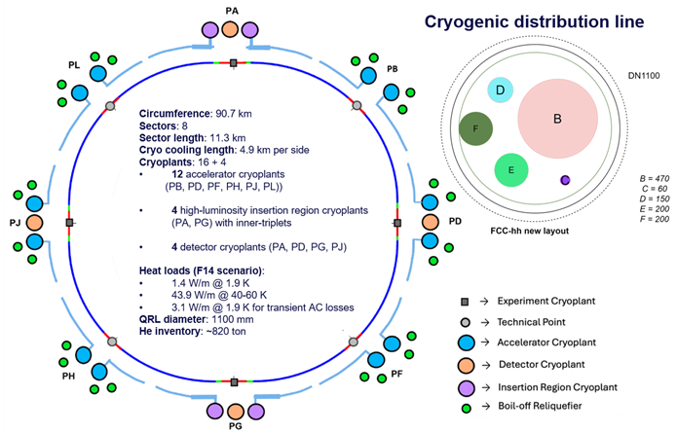
Cryogenic parameters – 1.9 and 4.5 K options
Parameter | 1.9 K | 4.5 K
Circumference [km] | 90.7 | 90.7
Dipole field [T] | 14 | 14
Centre of mass energy [TeV] | 85 | 84
Sync. Rad. for 2 beams [MW] | 2.4 | 2.4
Magnet temperature [K] Beam screen temperatures [K] | 1.9 [40 – 60] | 4.5 [40 – 60]
Helium Cryogenic Capacity @ 4.5 K equivalent [kW] | 1040 | 698
Number of cryo islands [-] | 8 | 8
Number of cryoplants in total [-] | 16 | 16
Arc cooling length [km] | 16 x 4.9 = 78.4 km | 16 x 4.9 = 78.4 km
Electrical power [MW] | 206 | 139
Helium inventory [tons] | 820 | 390
FCC-hh total annual energy consumption:
<2.5 TWh for 1.9 K Nb₃Sn
<2.0 TWh for Nb₃Sn magnets at 4.5 K
P. Borges de Sousa

Slide 21
CO₂ equivalent cost of construction and operation
GHG emissions for FCC-hh following FCC-ee
domain / activity | GHG [kt CO₂]
CE underground | 50
CE surface sites | 10
Accelerator hardware | 1500ª
Electricity consumption during operation pear year | 28-42 (22-32 for 4.5 K)
Number of years of operation | 25
Total | 2100-2600
Average/yr for 35 year lifecycle | 60-75
ª1234 kt CO2(eq) for 366 kt of raw material used for the arc dipoles and quadrupoles (cold masses and cryostats) based on EPDs of raw materials available today on the market.
G. Arduini, J. Gutleber, R. Losito, et al.

Slide 22
timeline
Milestone | Date
Conceptual design study | 2014-18
Definition of placement scenario | 2022
Feasibility Report ready | 2025
Main technologies R&D completion | 2054
Technical Design Report ready | 2054
Latest Project Approval | 2054
Environmental evaluation & project authorization processes | 2054-2058
Industrialisation & magnet production | 2054-2069
Civil engineering – collider | 2060-2068
FCC-ee dismantling | 2063-2064
TI installation – collider | 2065-2069
Accelerator installation – collider | 2068-2072
HW commissioning – collider | 2071-2073
Beam commissioning – collider | 2073
Physics operation start | 2074
Milestone | Date
Conceptual design study | 2014-18
Definition of placement scenario | 2022
Feasibility Report ready | 2025
Latest Project Approval | 2033
Environmental evaluation & project authorization processes | 2026-35
Main technologies R&D completion | 2037
Technical Design Report ready | 2037
Industrialisation & magnet production | 2038-2053
Civil engineering – collider | 2037-2046
TI installation – collider | 2043-2050
Accelerator installation – collider | 2046-2052
HW commissioning – collider | 2049-2053
Beam commissioning – collider | 2054
Physics operation start | 2055
Fastest possible FCC-hh timeline as a stand-alone project.
FCC-hh timeline as a second phase after FCC-ee.

Slide 23
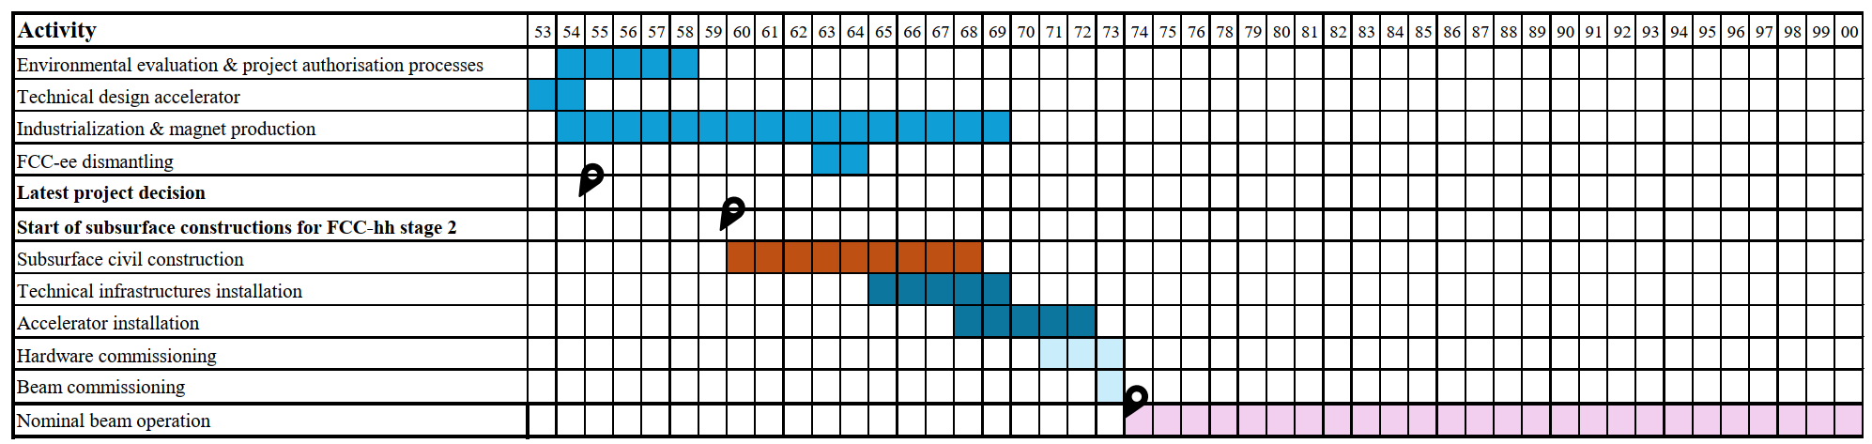
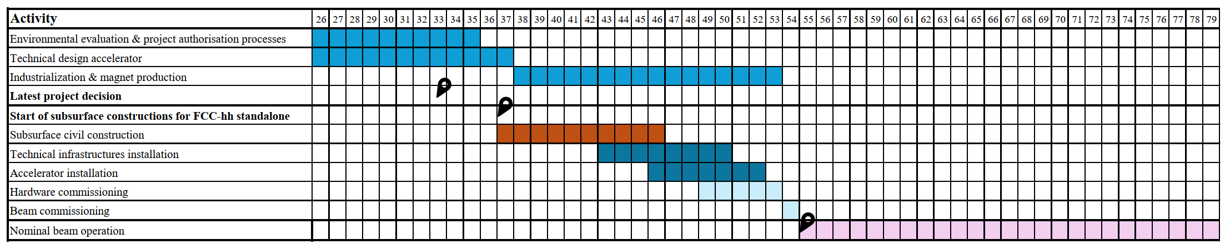
timeline in graphical form
FCC-hh timeline as a second phase after FCC-ee.
Fastest possible FCC-hh timeline as a standalone project.

Slide 24
a few take-home messages
FCC-hh as FCC’s 2nd stage, possibly based on HTS, could start operation in ~2074; it will be a formidable machine, SR leveling etc.
FCC-hh based on 14 T Nb₃Sn magnets could start operation in ~2055, centre-of-mass energy ~85 TeV, as a standalone project
Higher magnet temperature of 4.5 K, or even 10 K (HTS), reduces the electrical power required; important for societal acceptance
Worldwide HTS conductor development driven by other fields & applications is expected to lower the cost of future HTS magnets

Slide 25
spare slides

Slide 26
why 14 T dipoles ?
A 14 T magnet for FCC must reliably deliver 15-15.5 T on the test bench. (Similarly, 16 T magnets would have to deliver 17-17.5 T - difficult given the decrease of Nb3Sn Ic at high fields.)
The 16 T target considered in the FCC CDR (2018/19) as attainable on paper only with parameters that go beyond what has been found to be good engineering in HL-LHC. The CDR designs for 16 T had
  up to 200 MPa coil stress (risky, given HL-LHC experience!),
  a relatively small margin of 14% to critical field/current (as compared to 22% in HL-LHC; 14% margin in the LHC comes with a larger enthalpy margin due to the presence of superfluid helium inside the coil; Nb3Sn coils have to be impregnated and cannot benefit from helium heat capacity),
  and the designs used a conductor with aspirational properties (1500 A/mm2 at 16 T, 4.2 K) that have not been demonstrated yet in a multi-filamentary wire, much less in industrial production (SotA is 1200 A/mm2 at 16 T, 4.2 K).
The updated 14 T target allows to
  increase operational margins from 14 to 20%
  reduce coil stresses to about 150 MPa, deemed reasonable based on HL-LHC experience
  use industrially available conductor (we continue to work on improved performance wires, but now with the goal of building more compact and thus cheaper coils)
  reach 85 TeV c.o.m energy with an improved filling factor, and potentially 90 TeV if we can improve more (e.g., stronger HTS sextupoles, etc.)
  reduce the synchrotron radiation by 50% for 15% lower c.o.m. energy, which helps to reach the accelerator-wide sustainability goals
  substitute a sizable part (up to 50%) of the coils' conductor with the much cheaper Nb-Ti, thus reducing dramatically the conductor cost. (The same is not possible for 16 T magnets; this was studied in EuroCirCol)
  In short, the updated parameters and the 14 T field targe are based on experience gathered after the CDR (2019).
E. Todesco, B. Auchmann

Slide 27
physics coverage: 85 TeV vs 100 TeV
Going from 85 to 100 TeV extends by 20% the possible discovery reach at the highest masses and increases by similar amounts the production rates for Higgs bosons or other SM objects. The critical targets that defined the 100 TeV goal could be fulfilled with improved detector performance at 85 TeV to compensate for the slight rate loss. This includes:
the precision targets of Higgs measurements (which are by and large dominated anyway by experimental systematics), including the Higgs self-coupling measurement
the exploration of the full theoretically-allowed mass range for WIMP DM candidates
the exploration of BSM models with a strong first-order phase-transition
Where 100 TeV gave us an extra edge and safety buffer (e.g. for the detection of the higgsino WIMP DM candidate, where the theoretical upper limit is around 1.1 TeV and 100 TeV gives sensitivity up to 1.3 TeV), 85 TeV can still make it, although counting on improved detector sensitivity (eg at 85 TeV we just make it to 1.1 TeV for the higgsino). If 85 TeV give more operational margin for the operation of Nb₃Sn dipoles, 100 TeV give more operational margin in terms of exploration and measurement precision.
The example above of the higgsino indicates that further reducing further the energy below 80-85 TeV starts getting us in a region where the complete coverage of interesting regions of BSM parameter space cannot be guaranteed. As we go down below 80 TeV we could in principle increase the luminosity, since synchrotron radiation is reduced and the luminosity could double wrt the 85/100 TeV luminosity. This allows to partially compensate for the lower energy, but ability to cope with the challenge of operating with a pileup of 2000 is well beyond what we can assess today.
What is certainly lost at 85 TeV, which cannot be regained, is sensitivity to resonances in the 40-45 TeV mass range… However, we have no compelling model today that points to this specific mass range as a mandatory target. Incidentally, if a 40 TeV Z' existed, 85 TeV would at least show a few sigma evidence, even though it could not make it to the full 5 s discovery that is possible with 100 TeV.
M. Mangano

Slide 28
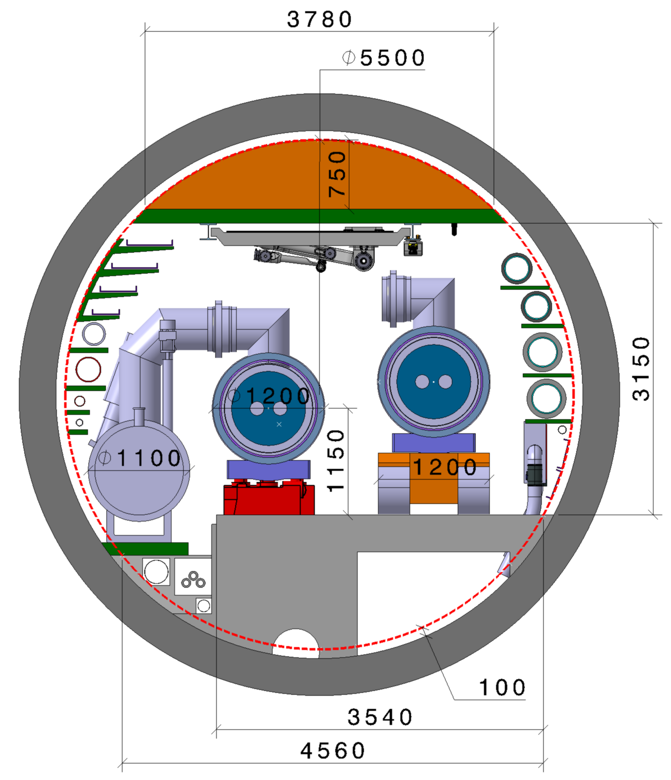
FCC-hh integration – it fits into the 5.5 m tunnel !
F. Valchkova

Slide 29
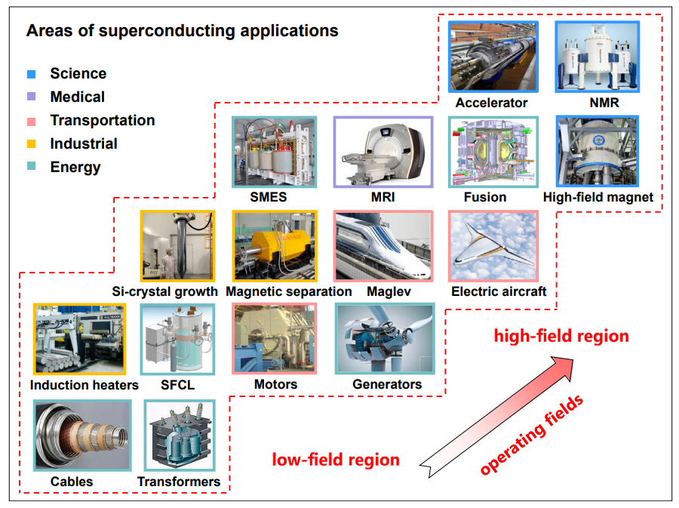
Main applications of superconducting power and magnetic technologies
Chao Yao and Yanwei Ma,
Superconducting materials: Challenges and opportunities for large-scale applications,
iScience 24, 102541, June 25, 2021

Slide 30
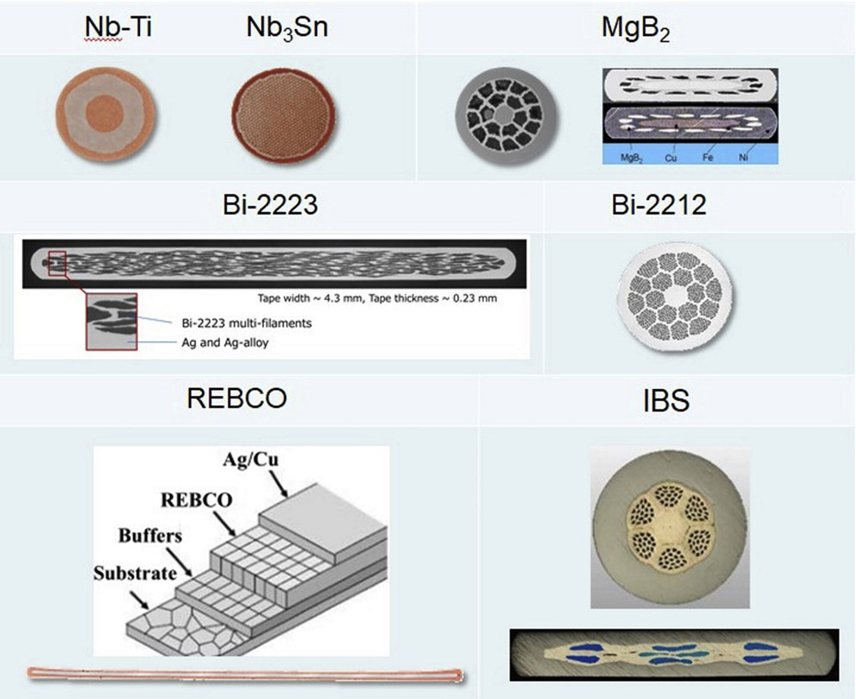
illustration & conductor forms for practical superconducting materials
Chao Yao and Yanwei Ma, iScience 24, 102541, 2021

