Slide 1

Large-scale particle physics
projects in the US and plans
for participation in projects outside
Hitoshi Murayama (Berkeley)
June 24, 2025
Open Symposium European Strategy for Particle Physics

Slide 2
Process for Future Planning
“Snowmass”
Community Study
Organized by
APS / DPF
Particle Physics Project
Prioritization Panel (P5)
Organized by
HEPAP
Community
DOE HEP
NSF PHYS
White House
Congress
Charge
Budget scenario
DOE HEP
NSF PHYS

Slide 3
1800 LoIs
548 White Papers
>1500 people
Final workshop of Snowmass 2021 Community Study
University of Washington, July 2022

Slide 4
Budget Scenarios and Projects
$M
on-shore Higgs factory excluded
DOE only

Slide 5
US Process
broader scope of science: dark matter, CMB, galaxy surveys, etc
follows Snowmass Community Study organized by APS/DPF
quantitative exercise with budget constraints
  subcommittee studied costs/risks of large projects (chair: Jay Marx)
Panel members are not representing countries, fields, collaborations, etc
  individual scientists of excellent caliber and good judgment
4+2 Town Halls, 4 Closed Meetings
  followed by many zoom meetings to write the report

Slide 6
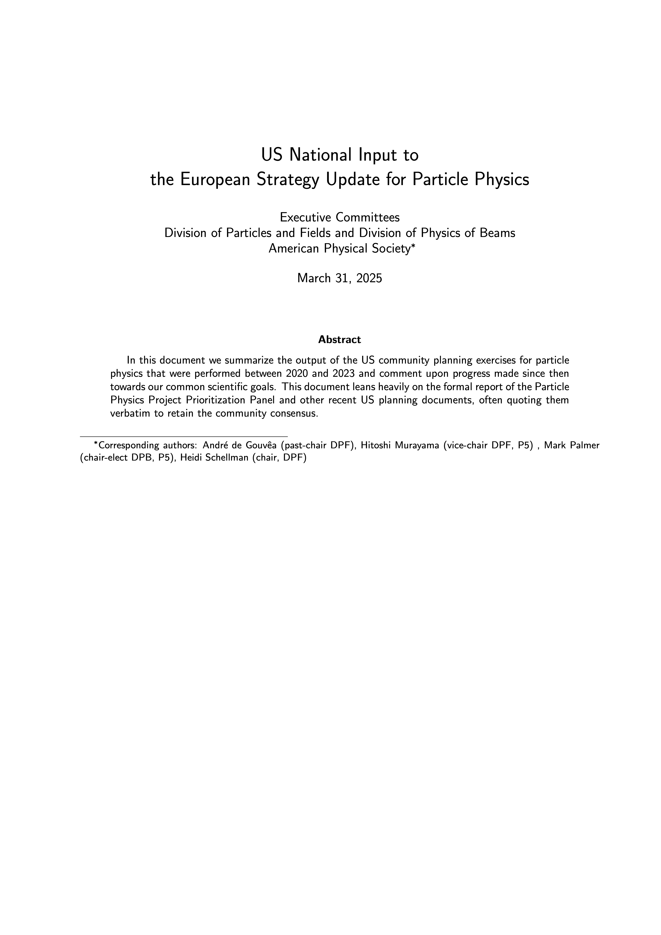
Contribution ID: 230
https://arxiv.org/abs/2504.01804

Slide 7
Recommendation 1
Not Rank-Ordered
Reaffirm critical importance of the ongoing projects
As the highest priority independent of the budget scenarios, complete construction projects and support operations of ongoing experiments and research to enable maximum science. We reaffirm the previous P5 recommendations on major initiatives:
HL-LHC (including ATLAS and CMS detectors, as well as Accelerator Upgrade Project) to start addressing why the Higgs boson condensed in the universe (reveal the secrets of the Higgs boson, section 3.2), to search for direct evidence for new particles (section 5.1), to pursue quantum imprints of new phenomena (section 5.2), and to determine the nature of dark matter (section 4.1).
The first phase of DUNE and PIP-II to determine the mass ordering among neutrinos, a fundamental property and a crucial input to cosmology and nuclear science (elucidate the mysteries of neutrinos, section 3.1).
The Vera C. Rubin Observatory to carry out the LSST, and the LSST Dark Energy Science Collaboration, to understand what drives cosmic evolution (section 4.2).
DOE & NSF PHY
Mostly DOE
US leadership in key areas of particle physics
DOE & NSF AST

Slide 8
https://rubinobservatory.org/gallery/collections/first-look-gallery/n4kvj0cemd5pbdqgtjdgp2jg2t

Slide 9
Recommendation 1
Not Rank-Ordered
Reaffirm critical importance of the ongoing projects
In addition, we recommend continued support for the following ongoing experiments at the
medium scale (project costs > $50M for DOE and > $4M for NSF), including completion
of construction, operations, and research:
NOvA, SBN, T2K, and IceCube (elucidate the mysteries of neutrinos, section 3.1).
DarkSide-20k, LZ, SuperCDMS, and XENONnT (determine the nature of dark matter, section 4.1).
DESI (understand what drives cosmic evolution, section 4.2).
Belle II, LHCb, and Mu2e (pursue quantum imprints of new phenomena, section 5.2).
The agencies should work closely with each major project to carefully manage the costs
and schedule to ensure that the US program has a broad and balanced portfolio.
NSF
dark matter direct detection DOE+NSF
DOE but on Mayall 4m Kitt Peak

Slide 10
Recommendation 2
Rank-Ordered
New exciting initiatives
CMB-S4, which looks back at the earliest moments of the universe to probe physics at the highest energy scales. It is critical to install telescopes at and observe from both the South Pole and Chile sites to achieve the science goals (section 4.2).
Re-envisioned second phase of DUNE with an early implementation of an enhanced 2.1 MW beam—ACE-MIRT—a third far detector, and an upgraded near-detector complex as the definitive long-baseline neutrino oscillation experiment of its kind (section 3.1).
An off-shore Higgs factory, realized in collaboration with international partners, in order to reveal the secrets of the Higgs boson. The current designs of FCC-ee and ILC meet our scientific requirements. The US should actively engage in feasibility and design studies. Once a specific project is deemed feasible and well-defined (see also Recommendation 6), the US should aim for a contribution at funding levels commensurate to that of the US involvement in the LHC and HL-LHC, while maintaining a healthy US on-shore program in particle physics (section 3.2).
An ultimate Generation 3 (G3) dark matter direct detection experiment reaching the neutrino fog, in coordination with international partners and preferably sited in the US (section 4.1).
IceCube-Gen2 for study of neutrino properties using non-beam neutrinos complementary to DUNE and for indirect detection of dark matter covering higher mass ranges using neutrinos as a tool (section 4.1).
DOE & NSF
Mostly DOE
DOE & NSF PHY
DOE & NSF PHY
NSF

Slide 11
Recommendation 3
Not Rank-Ordered
Balanced Portfolio from small to large
Create an improved balance between small-, medium-, and large-scale projects to open new scientific opportunities and maximize their results, enhance workforce development, promote creativity, and compete on the world stage.
In order to achieve this balance across all project sizes we recommend the following:
Implement a new small-project portfolio at DOE, Advancing Science and Technology through Agile Experiments (ASTAE), across science themes in particle physics with a competitive program and recurring funding opportunity announcements. This program should start with the construction of experiments from the Dark Matter New Initiatives (DMNI) by DOE-HEP (section 6.2).
Continue Mid-Scale Research Infrastructure (MSRI) and Major Research Instrumentation (MRI) programs as a critical component of the NSF research and project portfolio.
Support DESI-II for cosmic evolution, LHCb upgrade II and Belle II upgrade for quantum imprints, and US contributions to the global CTA Observatory for dark matter (sections 4.2, 5.2, and 4.1).
The Belle II recommendation includes contributions towards the SuperKEKB accelerator.

Slide 12
Recommendation 4
Support a comprehensive effort to develop the resources—theoretical, computational, and technological—essential to our 20-year vision for the field. This includes an aggressive R&D program that, while technologically challenging, could yield revolutionary accelerator designs that chart a realistic path to a 10 TeV pCM collider.
Investing in the future of the field to fulfill this vision requires the following:

Slide 13
Recommendation 4
Not Rank-Ordered
Investment in the future
Support vigorous R&D toward a cost-effective 10 TeV pCM collider based on proton, muon, or possible wakefield technologies, including an evaluation of options for US siting of such a machine, with a goal of being ready to build major test facilities and demonstrator facilities within the next 10 years (sections 3.2, 5.1, 6.5, and Recommendation 6).
Enhance research in theory to propel innovation, maximize scientific impact of investments in experiments, and expand our understanding of the universe (section 6.1).
Expand the General Accelerator R&D (GARD) program within HEP, including stewardship (section 6.4).
Invest in R&D in instrumentation to develop innovative scientific tools (section 6.3).
Conduct R&D efforts to define and enable new projects in the next decade, including detectors for an e⁺e– Higgs factory and 10 TeV pCM collider, Spec-S5, DUNE FD4, Mu2e-II, Advanced Muon Facility, and line intensity mapping (sections 3.1, 3.2, 4.2, 5.1, 5.2, and 6.3).
Support key cyberinfrastructure components such as shared software tools and a sustained R&D effort in computing, to fully exploit emerging technologies for projects. Prioritize computing and novel data analysis techniques for maximizing science across the entire field (section 6.7).
Develop plans for improving the Fermilab accelerator complex that are consistent with the long-term vision of this report, including neutrinos, flavor, and a 10 TeV pCM collider (section 6.6).

Slide 14
Recommendation 6
Mechanism for decision making
Convene a targeted panel with broad membership across particle physics later this decade that makes decisions on the US accelerator-based program at the time when major decisions concerning an off-shore Higgs factory are expected, and/or significant adjustments within the accelerator- based R&D portfolio are likely to be needed. A plan for the Fermilab accelerator complex consistent with the long-term vision in this report should also be reviewed.
The panel would consider the following:
The level and nature of US contribution in a specific Higgs factory including an evaluation of the associated schedule, budget, and risks once crucial information becomes available.
Mid- and large-scale test and demonstrator facilities in the accelerator and collider R&D portfolios.
A plan for the evolution of the Fermilab accelerator complex consistent with the longterm vision in this report, which may commence construction in the event of a more favorable budget situation.

Slide 15
2.3 The Path to a 10 TeV pCM
Realization of a future collider will require resources at a global scale and will be built through a world-wide collaborative effort where decisions will be taken collectively from the outset by the partners. This differs from current and past international projects in particle physics, where individual laboratories started projects that were later joined by other laboratories. The proposed program aligns with the long-term ambition of hosting a major international collider facility in the US, leading the global effort to understand the fundamental nature of the universe.
…
In particular, a muon collider presents an attractive option both for technological innovation and for bringing energy frontier colliders back to the US. The footprint of a 10 TeV pCM muon collider is almost exactly the size of the Fermilab campus. A muon collider would rely on a powerful multi-megawatt proton driver delivering very intense and short beam pulses to a target, resulting in the production of pions, which in turn decay into muons. This cloud of muons needs to be captured and cooled before the bulk of the muons have decayed. Once cooled into a beam, fast acceleration is required to further suppress decay losses.
…
Although we do not know if a muon collider is ultimately feasible, the road toward it leads from current Fermilab strengths and capabilities to a series of proton beam improvements and neutrino beam facilities, each producing world-class science while performing critical R&D towards a muon collider. At the end of the path is an unparalleled global facility on US soil. This is our Muon Shot.

Slide 16
2.5 International and Inter-Agency Partnerships
In the case of the Higgs factory, crucial decisions must be made in consultation with potential international partners. The FCC-ee feasibility study is expected to be completed by 2025 and will be followed by a European Strategy Group update and a CERN council decision on the 2028 timescale. The ILC design is technically ready and awaiting a formulation as a global project. A dedicated panel should review the plan for a specific Higgs factory once it is deemed feasible and well-defined; evaluate the schedule, budget and risks of US participation; and give recommendations to the US funding agencies later this decade (Recommendation 6). When a clear choice for a specific Higgs factory emerges, US efforts will focus on that project, and R&D related to other Higgs factory projects would ramp down.
Parallel to the R&D for a Higgs factory, the US R&D effort should develop a 10 TeV pCM collider (design and technology), such as a muon collider, a proton collider, or possibly an electron-positron collider based on wakefield technology. The US should participate in the International Muon Collider Collaboration (IMCC) and take a leading role in defining a reference design. We note that there are many synergies between muon and proton colliders, especially in the area of development of high-field magnets. R&D efforts in the next 5-year timescale will define the scope of test facilities for later in the decade, paving the way for initiating demonstrator facilities within a 10-year timescale (Recommendation 6).

Slide 17
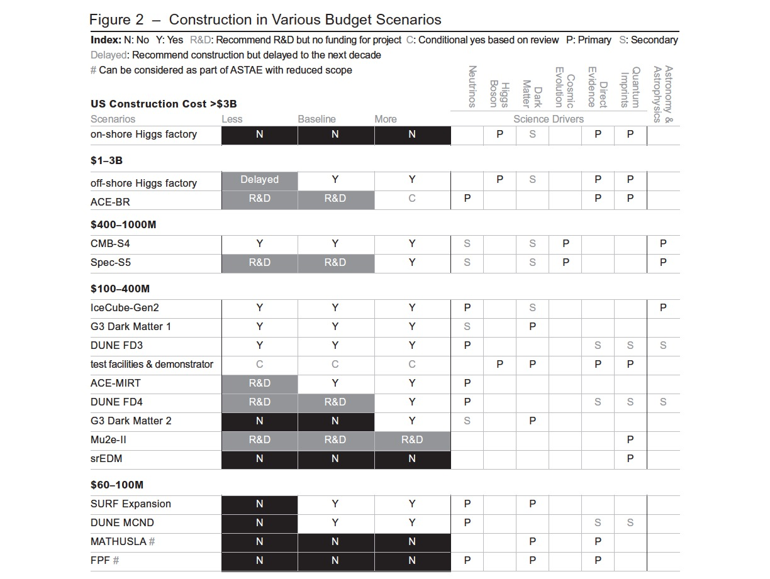
Difficult
Choices

Slide 18
Development since P5
DOE and NSF created the Higgs Factory Coordination Consortium (HFCC)
US-CERN Statement of Intent signed
Later in this decade, the funding agencies intend to form three dedicated panels to implement Recommendation 6. These panels will determine 1. the US commitment to a Higgs factory, 2. iterate the roadmap for technical R&D, and 3. develop long-term strategies for the Fermilab accelerator complex.
The formation of a US Muon Collider Collaboration
A 10 TeV Wakefield Collider Design Study
NSF will not move the original CMB-S4 proposal to the next stage. Following NSF/DOE instructions, the CMB-S4 collaboration presented a revised proposal with new telescopes only in Chile and working with SO and SPO. Community is advocating for improvements to South Pole infrastructure both for CMB-S4 and Ice-Cube
Active discussion of the potential host country for the G3 dark matter direct detection.

Slide 19
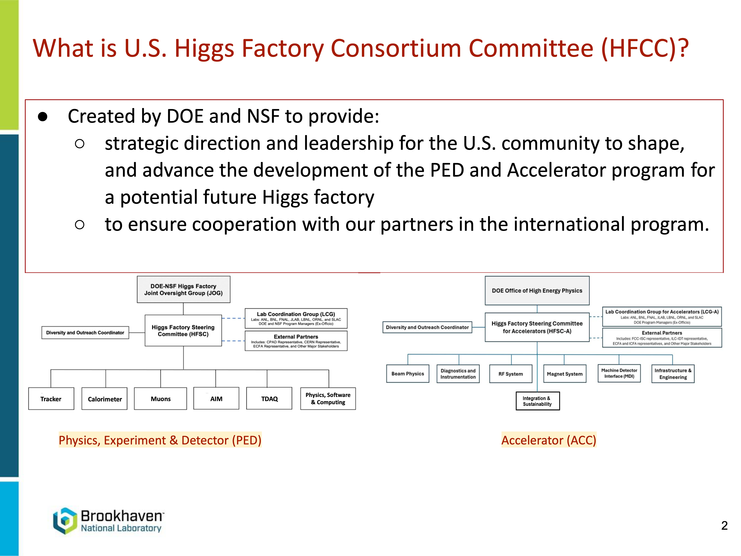
Viviana Cavaliere
Slide by Viviana Cavaliere

Slide 20
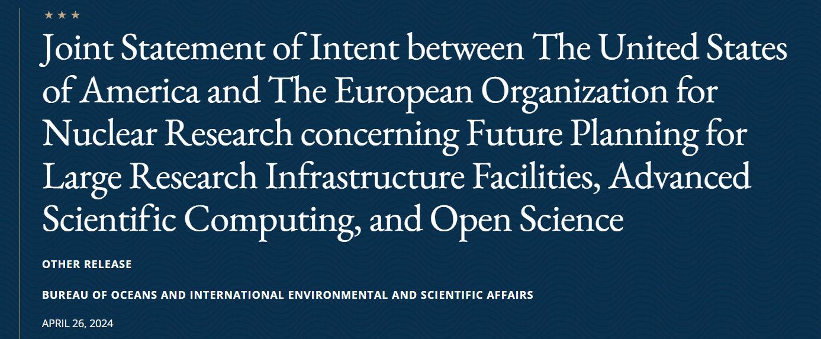

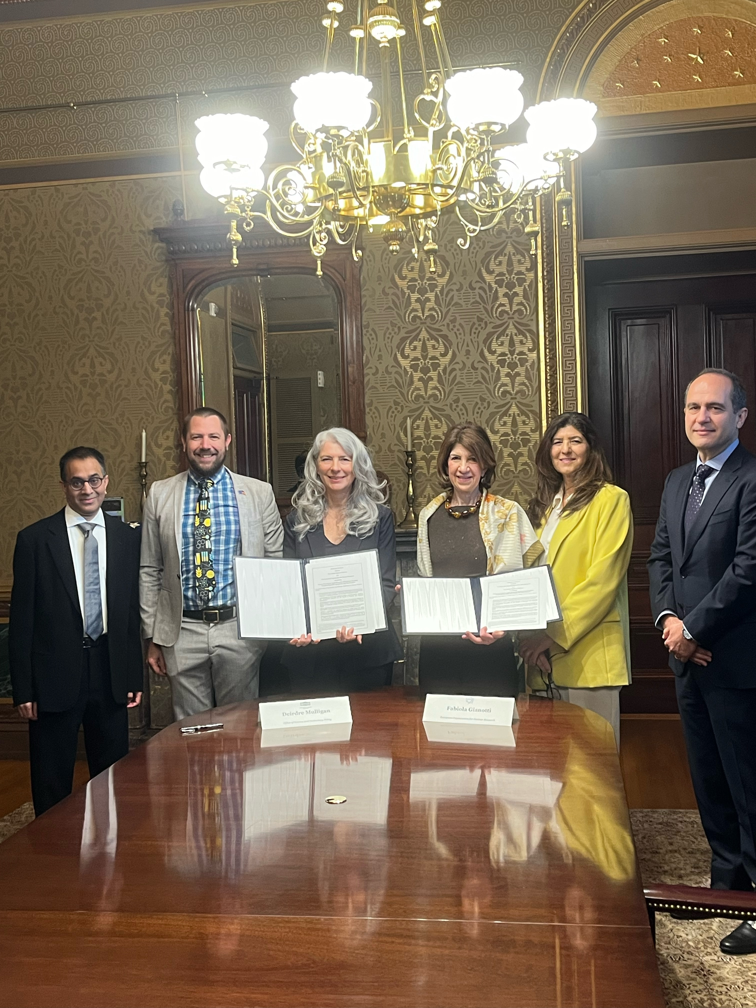
U.S.-CERN Statement of Intent (II)
The text of the following statement was released by the Government of the United States of America and the European Organization for Nuclear Research (CERN), an Intergovernmental Organization having its seat at Geneva, Switzerland. White House Office of Science and Technology Policy Principal Deputy U.S. Chief Technology Officer Deirdre Mulligan signed for the United States while Director-General Fabiola Gianotti signed for CERN.
Text available at: U.S. Department of State Remarks & Releases site
Among the topics in the Statement,
  Expresses intentions by the U.S. and CERN to continue collaborating in the FCC Higgs Factory feasibility study
  Subject to appropriate processes, the intention for the U.S. to collaborate on the FCC-ee, should the CERN
  Member States determine the FCC-ee is likely to be CERN’s next research facility following the HL-LHC
Statement aligned with P5: should FCC-ee receive a “green-light” following the next update of the European Strategy, U.S. intends to collaborate; and nature of the contributions to be discussed by the panel prescribed in 6.1.
Regina Rameika, FCC Week in San Francisco

Slide 21

Nuclear Physics
Contribution ID: 246
How do quarks and gluons make up protons, neutrons, and, ultimately, atomic nuclei?
How do the rich patterns observed in the structure and reactions of nuclei emerge from the interactions between neutrons and protons?
What are the nuclear processes that drive the birth, life, and death of stars?
How do we use atomic nuclei to uncover physics beyond the Standard Model?
The highest priority of the nuclear science community is to capitalize on the extraordinary opportunities for scientific discovery made possible by the substantial and sustained investments of the United States. We must draw on the talents of all in the nation to achieve this goal. This includes completing the RHIC science program and taking the full advantage from the heavy-ion program at the LHC.
As the highest priority for new experiment construction, we recommend that the United States lead an international consortium that will undertake a neutrinoless double beta decay campaign, featuring the expeditious construction of ton-scale experiments, using different isotopes and complementary techniques.
We recommend the expeditious completion of the Electron–Ion Collider (EIC) as the highest priority for facility construction.
https://nuclearsciencefuture.org/wp-content/uploads/2024/03/23-G06476-2024-LRP-8.5x11-pcg-v1.5-3.14.24.pdf

Slide 22
Development since P5
Unfortunately the budget seems even worse than Scenario A
DOE intends to implement an ASTAE funding line to enable small-scale agile experiments but not possible at this time
  TESSERACT is already moving forward thanks to a French commitment
Coordinating Panel on Advanced Detectors (CPAD) building strong connections with the ECFA Detector R&D collaborations.
National Academy of Sciences “Elementary Particle Physics: The Higgs and Beyond” released June 11, looking into the 40-year vision of the field
The current budget for particle physics is unfortunately near the less favorable funding scenario. That scenario would limit the implementation of the P5 recommendations beyond the current commitments.
US community is looking forward to engagement of the European community in US-hosted initiatives and to continued collaboration on European-sited projects

Slide 23
US-European Partnerships
Contribution ID: 230
Continue support for and actively seek engagement with international collaborations and partnerships of all sizes.
The U.S. particle physics program should 1) strive to engage as partners in the construction and operation of major future particle physics accelerator facilities constructed outside the U.S. and 2) actively seek international partners to engage in the construction and operation of major future particle accelerator facilities constructed in the U.S.
Implement structures for hosting strong international collaborations, act with timeliness, consistently meet obligations, and facilitate open communication with partners

Slide 24
Examples of Cooperation
Eight US national labs and over 80 universities have participated in LHC experiments both to the machine and the experiments. US scientists in ATLAS (18%) and CMS (30%), also in LHCb and ALICE. Committed to continue in HL-LHC
Superconducting quadrupole magnets and RF systems to the accelerator complex
DOE and NSF launched initiatives for advanced computing and software techniques for HL-LHC and DUNE
DUNE/LBNF with European involvement (39%). ~50% of the detector components and computing resources from Europe. CERN Neutrino Platform, provides far detector cryostats
PIP-II depends upon accelerator components from France, India, Italy, Poland, and the UK
In response to P5, DOE fully supports the first phase of DUNE and PIP-II, the second phase of DUNE with a focus on ACE-MIRT, a third far detector and MCND.
EIC has strong participation in the detector collaboration and engagement on accelerator concepts and technologies that are relevant both for the EIC and FCC development
Broad European participation in US experiments such as g–2, Mu2e, LZ, SBND, and IceCube
US accelerator physicists engaged strongly with ESPPU – Accelerator R&D Roadmap
Strong connections in Detector R&D between US and European efforts

Slide 25
ECFA guidelines for inputs from national HEP communities
to the European Strategy for Particle Physics
3) Questions to be considered by countries/regions when forming and submitting their “national input” to the ESPP:
  a) Which is the preferred next major/flagship collider project for CERN?
    The preferred next collider should be a Higgs factory.
  b) What are the most important elements in the response to 3a)?
    Physics potential is the primary motivation.
  c) Should CERN/Europe proceed with the preferred option set out in 3a) or should alternative options be considered:
    Recommendation 6 from P5 is that the US should revisit this question in light of international developments later in this decade.
  d) Beyond the preferred option in 3a), what other accelerator R&D topics (e.g. highfield magnets, RF technology, alternative accelerators/colliders) should be pursued in parallel?
    The US is working closely with our European colleagues to develop new technologies. Development of high-field magnets, RF technology, and collider concepts that can achieve a 10 TeV pCM scale are high priorities for the US. A US white paper focused on R&D for a future muon collider was submitted as a separate document. These priorities will be revisited later this decade.
  e) What is the prioritised list of alternative options if the preferred option set out in 3a) is not feasible (due to cost, timing, international developments, or for other reasons)?
  f) What are the most important elements in the response to 3e)? (The set of considerations in 3b should be used).
    These questions should be answered later in this decade when the global situation is better understood.
More from HFCC later

Slide 26
ECFA guidelines for inputs from national HEP communities
to the European Strategy for Particle Physics
4) The remit given to the ESG also specifies that “The Strategy update should also indicate areas of priority for exploration complementary to colliders and for other experiments to be considered at CERN and at other laboratories in Europe, as well as for participation in projects outside Europe.” It would thus be most useful if the national inputs explicitly included the preferred prioritisation for non-collider projects. Specific questions to address:
  a) What other areas of physics should be pursued, and with what relative priority?
  b) What are the most important elements in the response to 4a)? (The set of considerations in 3b should be used).
  c) To what extent should CERN participate in nuclear physics, astroparticle physics or other areas of science, while keeping in mind and adhering to the CERN Convention? Please use the current level and form of activity as the baseline for comparisons.
  We provide a combined answer to questions 4a), b), and c): As noted in P5 recommendations 2 and
  3, major efforts in neutrino physics, dark matter, and cosmic microwave background (CMB) should be
  aggressively pursued, in parallel to a suite of smaller experiments, both in the US and in Europe. In
  addition to the particle physics recommendations, the EIC and double-beta decay are top priorities for US
  nuclear science.
More from HFCC later

Slide 27
Repository for Inputs to the US presentation at ESPPU Venice Meeting
Higgs Factories
Muon Colliders
DUNE/neutrino experiments
Fermilab Accelerator Complex Evolution
10 TeV pCM Wakefield Collider
The Electron Ion Collider
Training and education
Instrumentation
A near-term 70 TeV Proton-Proton Collider
HL-LHC
LC Vision
SBND
Forward Physics Facility at the LHC
pEDM
REDTOP: Rare Eta Decays TO Explore New Physics
MINERvA
The COHERENT Experiment
The Elastic Analysis Facility’s (EAF’s)
United States Early Career Researchers in Collider Physics
T2K Experiment: future plans and capabilities
Contributions to ESPPU
150 authors with (US) affiliations
https://indico.global/event/14242/timetable/

Slide 28
Higgs Factory Coordination Consortium
Contribution ID: 202
3) Questions to be considered by countries/regions when forming and submitting their “national input” to the ESPP:
  a) Which is the preferred next major/flagship collider project for CERN?
    The FCC Feasibility Study has been completed and is now under consideration by the ESG. To date, the FCC feasibility studies have revealed no technical show-stoppers for FCC-ee. Given the comprehensive breadth of the physics program; the technical, cost, and siting maturity of the FCC-ee program; and the need for a timely decision, we strongly support FCC-ee as the next major flagship project at CERN.
  b) What are the most important elements in the response to 3a)?
  A number of elements factor into the decision for the next preferred project. The two most important elements are:
  ■ Physics must be the driving priority for any current or future programs. It is the primary reason for constructing and operating research facilities.
  ■ A timely decision and the subsequent realization of physics from the next project are critical. A timely decision is necessary to motivate and guide the next generation of physicists and engineers, maintain the expertise, unify the community, and create a new talent pool. It is also critical to achieve a constant steady flow of scientific results, advance scientific progress, and ensure a seamless and rapid transition from the HL-LHC program to the next flagship project.
  Other elements relevant to the decision-making process include sufficient Financial and Human resources to execute the project, the long-term perspective of the physics program, as well as Careers and Training. It has been recognized by several in the U.S. community that a large gap between HL-LHC and the next project would erode the talent pool of engineers and physicists and adversely affect the training of next-generation scientists.

Slide 29
Higgs Factory Coordination Consortium
Contribution ID: 202
3) Questions to be considered by countries/regions when forming and submitting their “national input” to the ESPP:
  e) What is the prioritised list of alternative options if the preferred option set out in 3a) is not feasible (due to cost, timing, international developments, or for other reasons)?
  The P5 report supports a program that would explore Higgs physics on the timescale of the 2040’s at CERN. If the FCC-ee is not feasible, an alternative consistent with the P5 vision is the ILC. The ILC has been developed for several decades and has an advanced technical design. Both scientific and technical expertise also exists in the U.S. to advance an ILC or similar machine to its next phase.
  Although not considered by P5, other alternatives, where U.S. scientific and technical expertise exist and benefit consideration, include LEP3, CLIC, and a lower energy hadron collider. Noteworthy is the compelling physics case offered by a lower energy hadron collider, but which requires investments in developing cost-effective high field magnets.
  It is difficult to prioritize the alternatives at this time because none of them have completed Feasibility Studies18 and the potential challenges facing the preferred option are currently unknown. The basis for any alternative plan should be a timely decision and realization of physics, and the smallest possible compromise in expected physics output compared to the preferred option. As with FCC-ee, U.S. participation will need to be consistent with the broader U.S. program.

Slide 30
Higgs Factory Coordination Consortium
Contribution ID: 202
Summary: The U.S. is enthusiastic for a Higgs Factory as the next major collider and strongly supports FCC-ee, intending to collaborate on its construction and physics exploitation if it is chosen as the next major research infrastructure project at CERN. The U.S. recommends that appropriate steps be taken to develop a realizable plan in the coming 3-5 years. The U.S. would also support an LC if the CERN Council approves such a project in a timely manner. The U.S. eagerly awaits a CERN Council decision and looks forward to partnering with CERN on the next future collider project.
  ★ if the US proceeds with a muon collider?
  The U.S. is not planning to build a muon collider in the same time scale of FCC-ee construction. A demonstrator has been proposed for the 2030s, and the earliest likely launch of a U.S. based muon collider will likely follow the completion of the FCC-ee construction. P5 has suggested budget scenarios where both muon collider demonstrator and FCC-ee could be accommodated and minimal conflicts are expected, although, in some funding scenarios, the level of U.S. contribution to FCC-ee may be impacted. Given this, a planned muon collider effort in the U.S. should not influence the decision to move forward with the FCC-ee program at CERN.

Slide 31
Higgs Factory Coordination Consortium
Contribution ID: 202
Technical capabilities and opportunities for engagement in Experiments
  Tracking Detectors
  Calorimeters
  Muon Spectrometer
  AI and Microelectronics
  Trigger & DAQ
  Software & Computing
Technical capabilities and opportunities for engagement in Accelerators
  Beam Dynamics
  Diagnostics and Instrumentation
  Magnets
  RF Systems
  MDI
  Engineering and Infrastructure
  Sustainability and Integration

Slide 32
US Muon Collider Collaboration
Contribution ID: 152
Inaugural US Muon Collider Community Meeting hosted by Fermilab Aug 2024
Inform and engage broader US community on Muon Collider R&D, provide education via dedicated tutorials
300+ participants with over 260 attending in person, IMCC Leadership participated
IMCC Demonstrator workshop hosted by Fermilab in Oct 2024
Refine goals and design of the Ionization Cooling demonstrator, discuss possible sitings
100+ participants from around the globe
Formation of USMCC to support execution of P5 Muon Collider recommendations:
National coordination body to help organize US community activities
Engagement with international efforts coordinated by the IMCC
Preparation of US site proposals for the ionization cooling demonstrator and, eventually, the collider
Other sources of funding
Sloan Fellowship, Cottrell Awards, Kavli Foundation, Simons Foundation
Laboratory Directed R&D (LDRD) funds and Generic R&D funds, where appropriate
This August: 1st US Muon Collider Accelerator School and 2nd US Muon Collider Community Meeting at U. of Chicago for anybody from around the world

Slide 33
US Muon Collider Collaboration
Contribution ID: 152
Realization of the (muon collider) plan relies on sustained and adequate funding in both the US and Europe, and a close collaboration between the two regions …. Regardless of the ultimate location, we hope that the US, Europe, and other partners from around the world can benefit from the ongoing close collaboration and mutual support, building on the lessons learned from their partnership at the LHC, HL-LHC, and neutrino programs.

Slide 34
DUNE
Contribution ID: 118, 119, 120, 121
39% of DUNE collaboration is European
DUNE relies on CERN’s continued support, specifically by:
providing infrastructure, technical expertise, resources, support for DUNE R&D, and detector technology and physics validation through the Neutrino Platform and the Pro-toDUNE facilities;
additional support of the far site facility (LBNF) through the procurement of cryostats for the third and fourth modules;
continued technical and engineering support during the DUNE construction phase;
CERN support for addressing growing DUNE computing needs;
support and coordination of the DRD collaborations;
providing important physics and technical leadership on DUNE through CERN’s EP-NU group and CERN’s Neutrino Platform;
providing facilities for GeV-scale beam tests for detector R&D at CERN, and by supporting dedicated experiments to measure hadron production cross-sections for the DUNE environment
e.g., NA61/SHINE

Slide 35
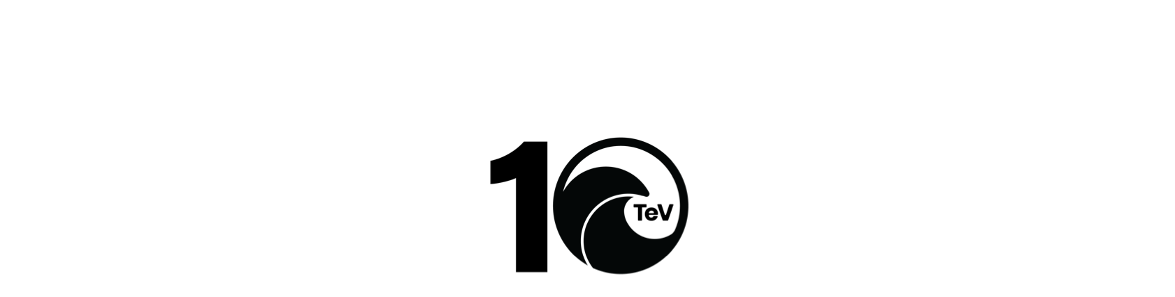
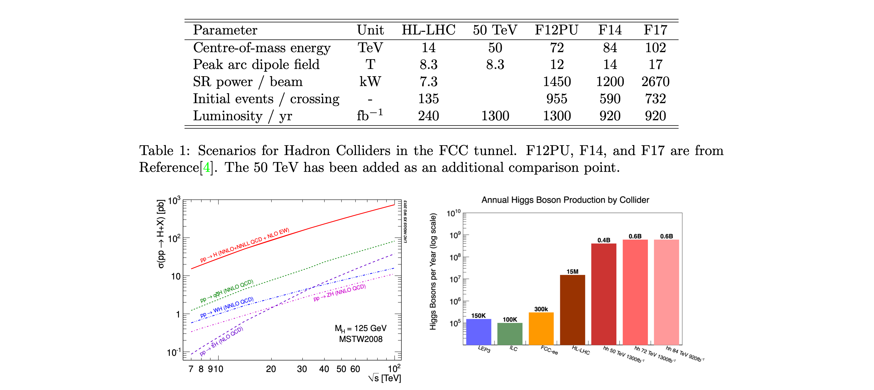
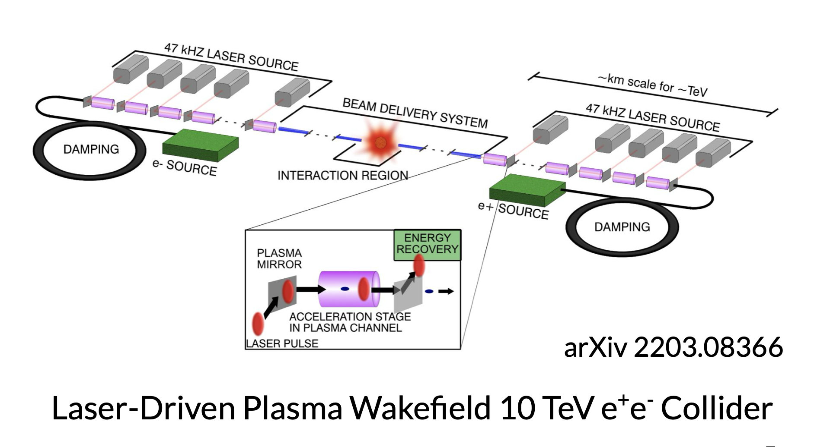
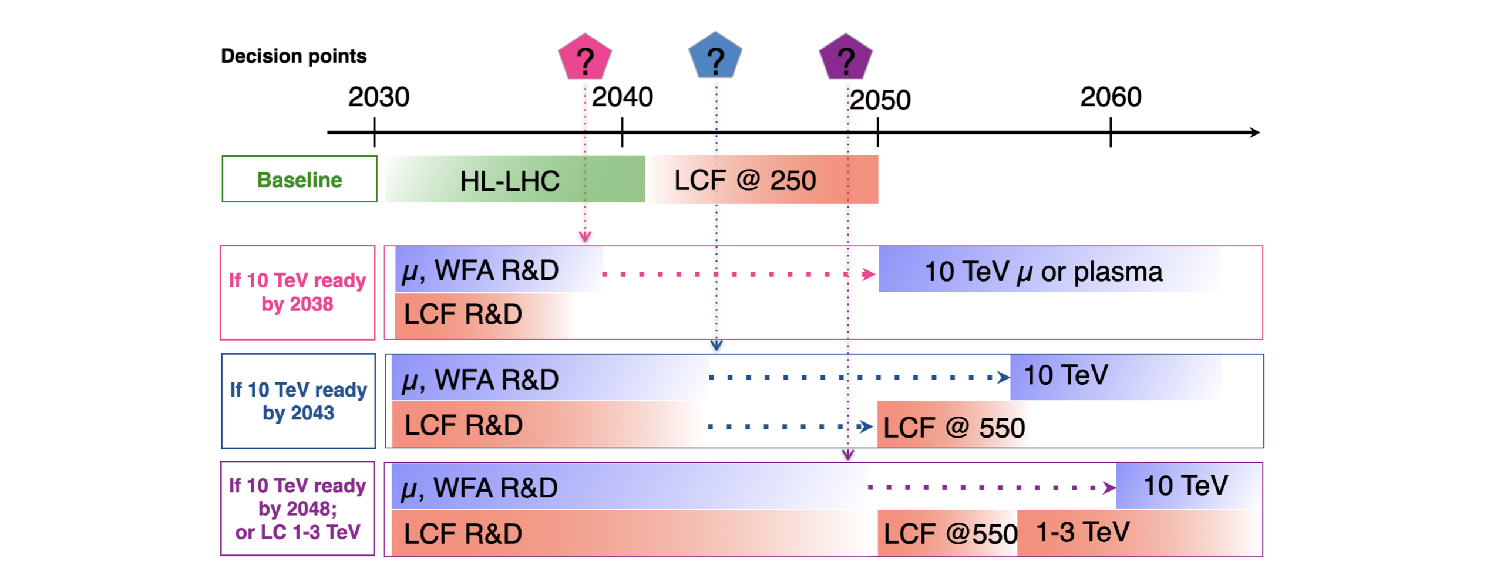
Contribution ID: 239
HL-LHC quadrupole magnet
FNAL, BNL and LBNL
Contribution ID: 140

Slide 36
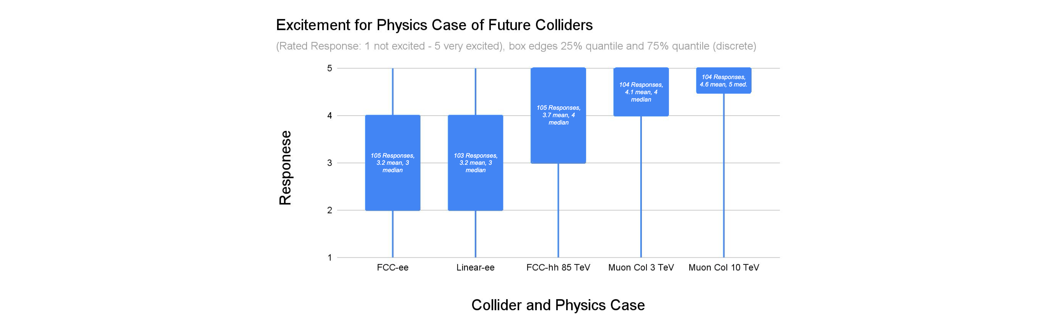
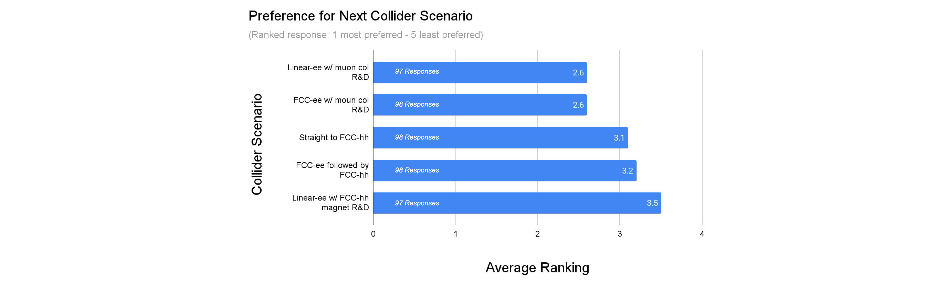
US Early Career Researchers in Collider Physics input to the ESPPU
Contribution ID: 91
105 Respondents
very
excited
not
excited
“significant heterogeneity and diversity of opinion”

Slide 37
NASEM Studies
US National Academies of Sciences, Engineering and Medicine
This study also reports to DOE / NSF, not so regularly
This time: 40-year vision for particle physics, no budgetary constraints
Started July 2022, released report on June 11, 2025
1998
2003
2003
2006
2025

Slide 38
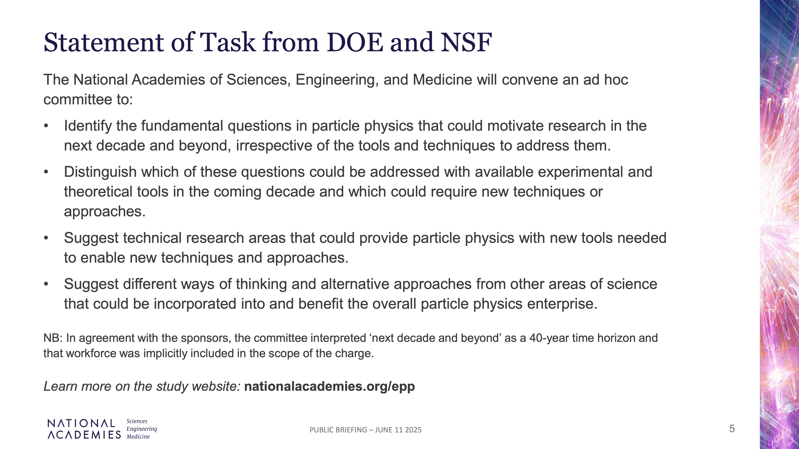

Slide 39
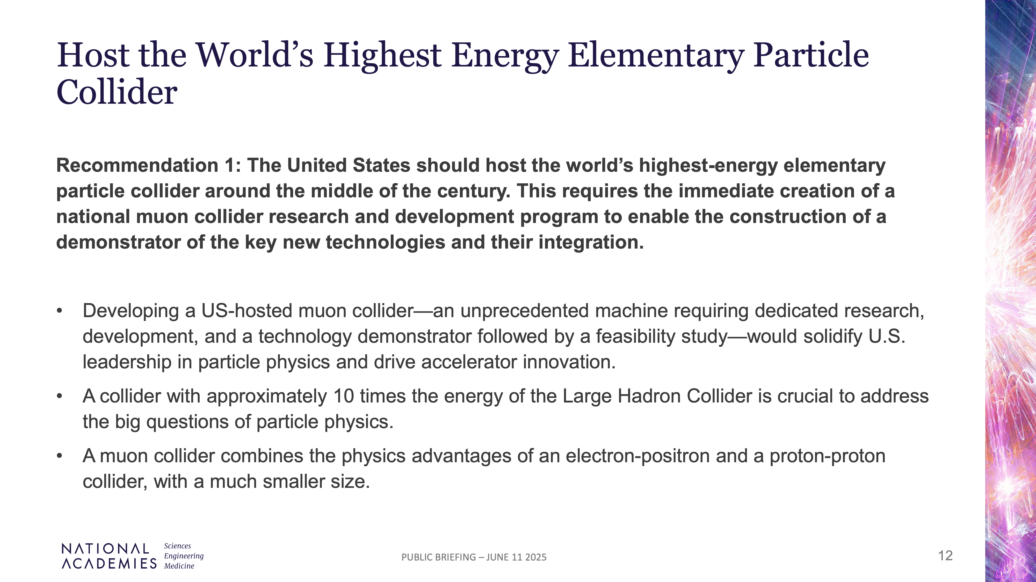

Slide 40
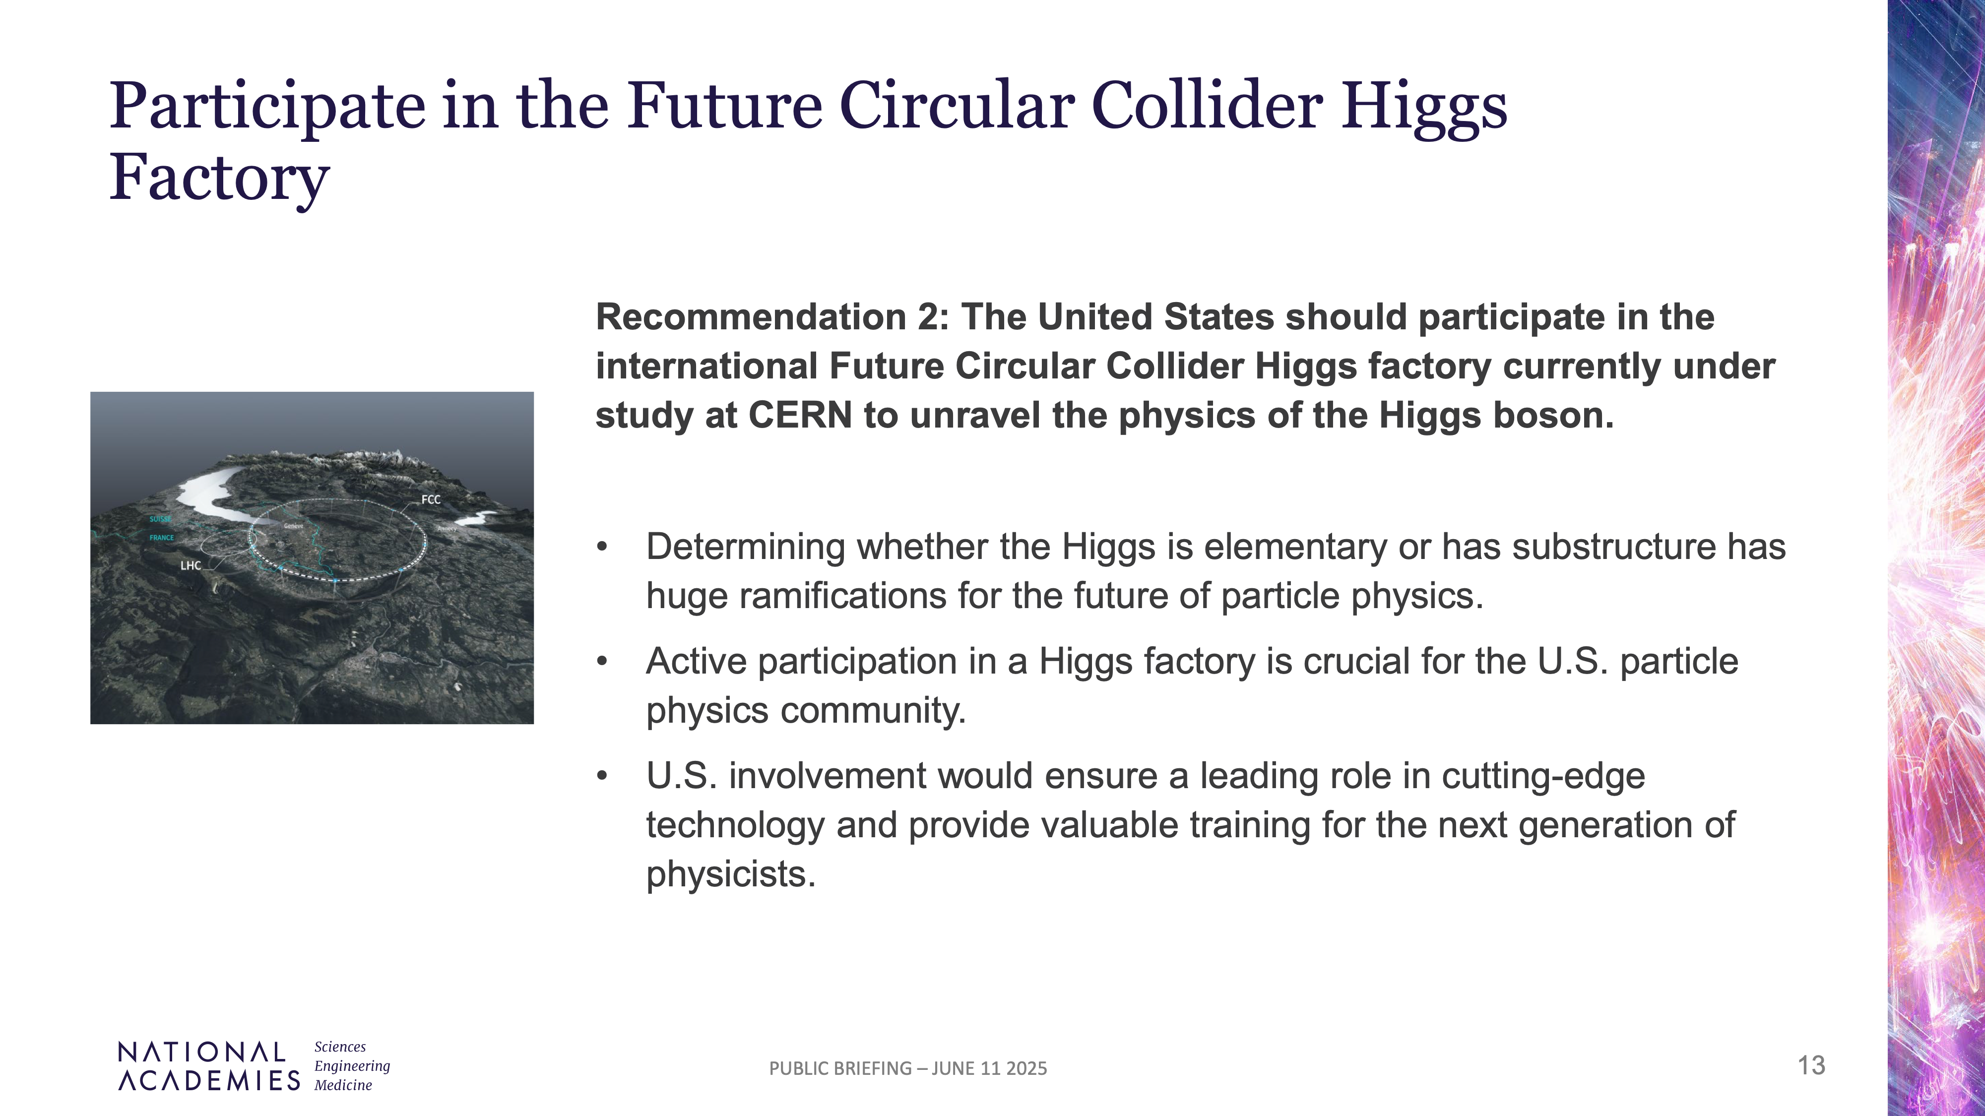
It follows HFCC preference to FCC-ee

Slide 41
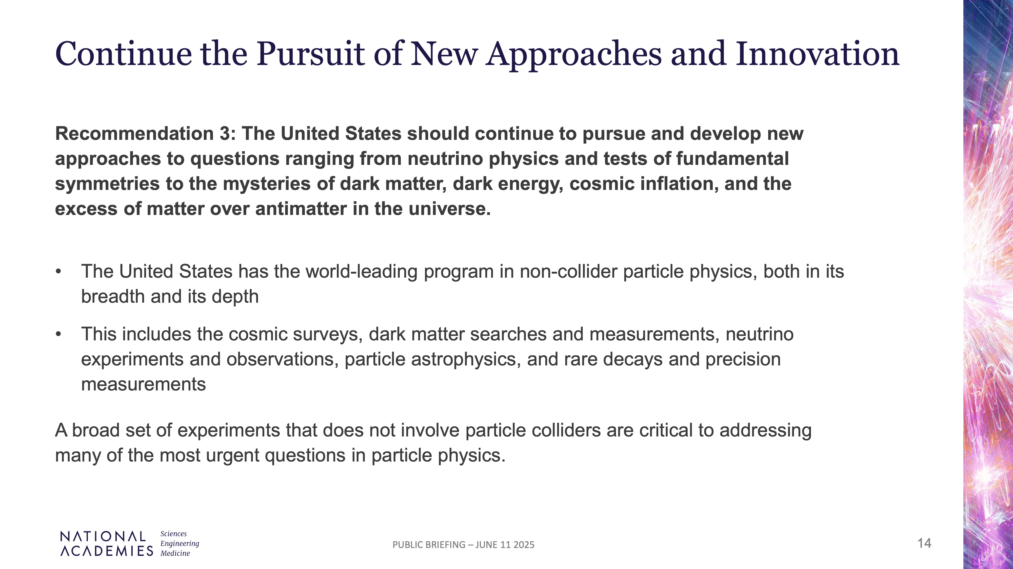

Slide 42
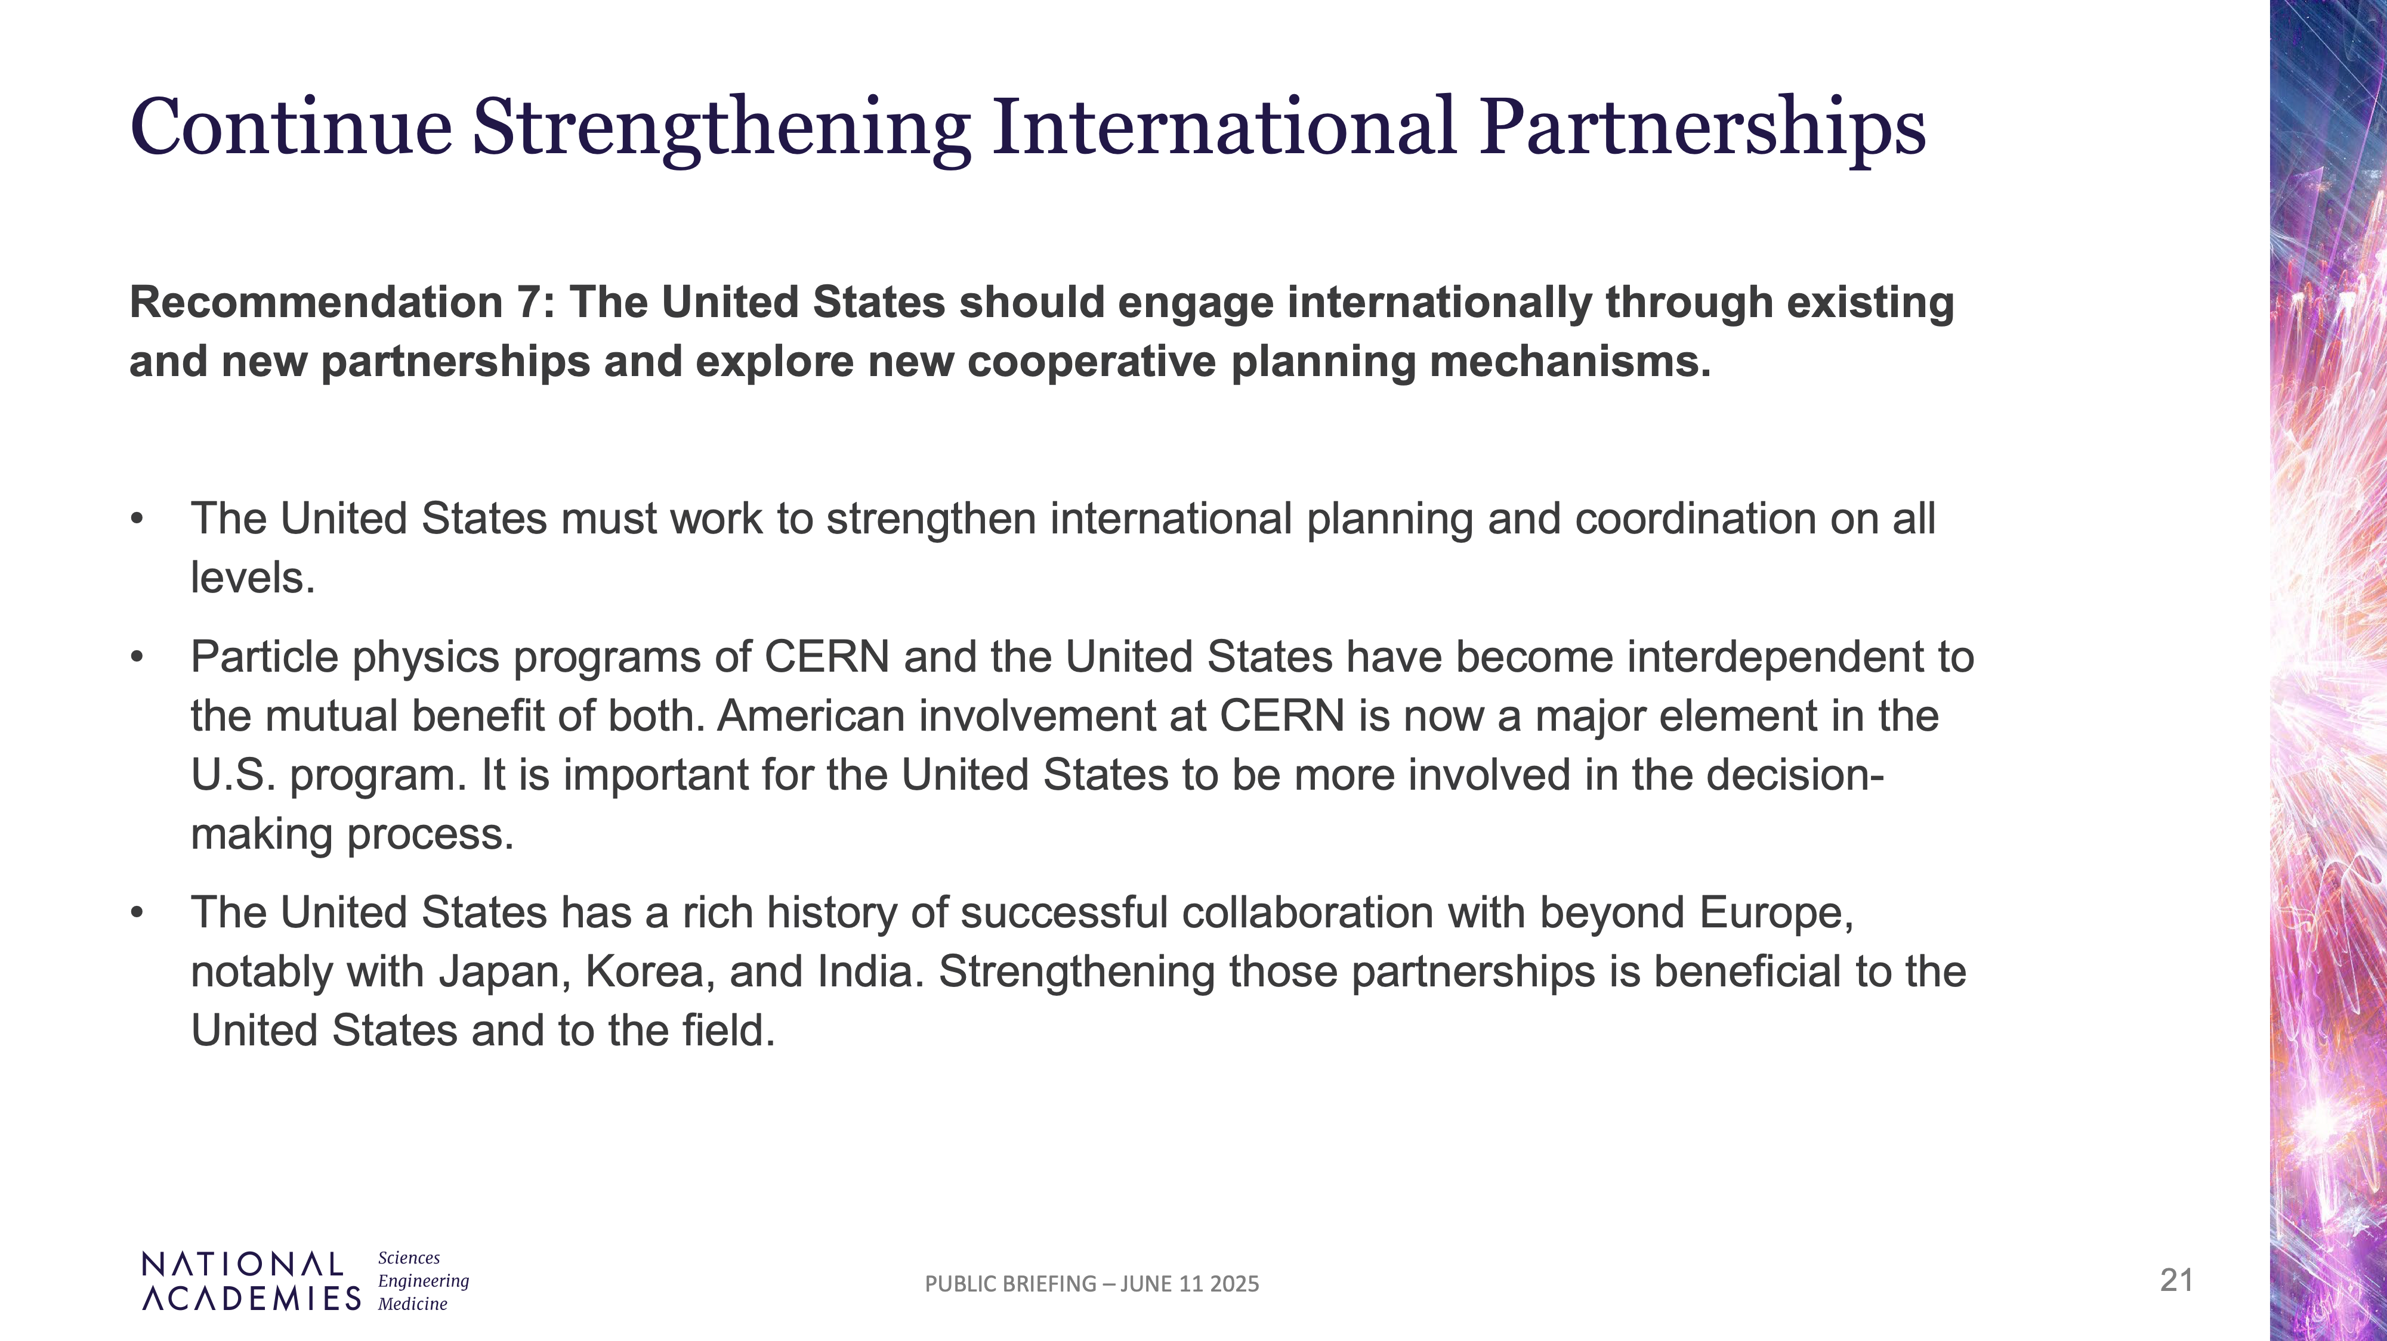

Slide 43
Mutual
Worldwide resources in particle physics are limited, need to maximize their use
International cooperation is now a must
US community is definitely interested in projects hosted by Europe
US community also invites European community to participate in projects hosted by the US
Priorities for CERN do remain a dominantly European decision but our mutual goal should be for a timely realization of high-impact science with an optimization of worldwide resources.

Slide 44


