Slide 1
European Strategy for Particle Physics: 2026 Update
- Introductory Remarks -
Karl Jakobs
- Chair of the Strategy Secretariat -
Venice, 23rd June 2025

Slide 2
A warm Welcome to all Participants

Slide 3
The European Strategy for Particle Physics
The European Strategy for Particle Physics is a cornerstone of Europe’s decision-making process for the long-term future of the field.
Mandated by the CERN Council, the Strategy is formed through a broad consultation of the particle physics communities in the CERN Member and Associate Member States, and beyond.
In the Strategy process recommendations are developed which will be submitted to the CERN Council for an update of the Strategy.
The European Strategy for Particle Physics is not a project approval process. Projects are approved by the
CERN Council through a separate decision process, taking the Strategy recommendations into account.
Original Strategy (2006): LHC, mooting of luminosity upgrade of LHC, R&D in accelerator technologies,
coordination with a potential ILC project
1st Update (2013): High Luminosity LHC, need for a post-LHC programme
2nd Update (2020): FCC feasibility study
3rd Update (2026): → recommendation for the next large-scale accelerator project at CERN
(reach consensus on the preferred option and possible alternatives)

Slide 4
Remit of the European Strategy Group (ESG)
The aim of the Strategy update should be to develop a visionary and concrete plan that greatly advances human
knowledge in fundamental physics through the realisation of the next flagship project at CERN. This plan should
attract and value international collaboration and should allow Europe to continue to play a leading role
in the field.”
The ESG should take into consideration:
- Input of the particle physics community;
- Status of implementation of the 2020 Strategy update;
- Accomplishments over recent years
(Results from the LHC and other experiments and facilities worldwide, progress in the construction of the High-Luminosity LHC,
outcome of the FCC Feasibility Study, recent technological developments in accelerator, detector and computing areas)
- International landscape of the field
The Strategy update should include the preferred option for the next collider at CERN and prioritised
alternative options to be pursued if the chosen preferred plan turns out not to be feasible or competitive.
The Strategy update should also indicate areas of priority for exploration complementary to colliders and for
other experiments to be considered at CERN and at other laboratories in Europe, as well as for participation in
projects outside Europe.

Slide 5
(in Venice)
We are here
(Monte Verita /
Ascona, CH)
More details on ESPP web page: https://europeanstrategyupdate.web.cern.ch/

Slide 6
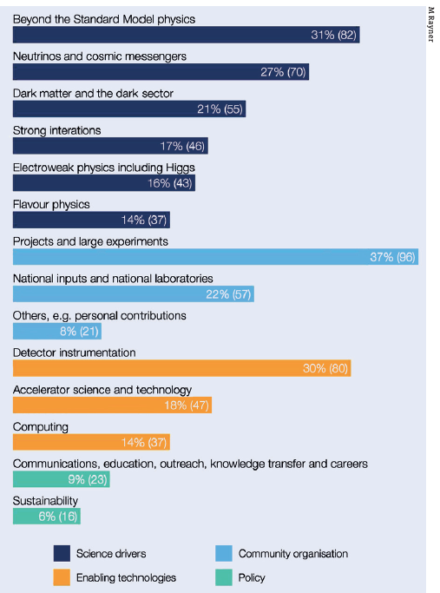
Input received
263 contributions received by 31 March,
+ 3 new contributions + updates by 26 May:
- Major flagship projects
- Many projects in other physics areas
- Input from national HEP communities in ECFA countries and beyond
- Input from National European Labs (e.g. DESY, Frascati, …)
- Input from Early Career Researchers (via ECFA ECR panel)
- Input from APPEC, NuPECC, ..
All contributions are public: https://indico.cern.ch/event/1439855/contributions/
Alphabetical list: https://europeanstrategyupdate.web.cern.ch/sites/default/files/Submitted_Input_2025.03.04.pdf
These submissions have been analysed by the Physics Preparatory Group (PPG) and ESG working groups;
They provide the input for the presentations and discussions at this Open Symposium
Self-attributed themes of the 263 community
inputs

Slide 7
Purpose of the Open Symposium
The Open Symposium is an important step in the process of updating the European Strategy
The community is invited to debate the scientific input, to define the scientific goals and priorities for the
upcoming generation of facilities and experiments
→ Ample time for discussions foreseen in each of the physics and technology sessions;
The focus is on physics potential and priorities
→ Get engaged in discussions in the Parallel (Monday) and Plenary Sessions
The submitted input and the outcome of the discussions at the Symposium will provide the basis for writing the Physics Briefing Book (to be released on 30 Sept. 2025)
The Physics Briefing Book in turn – together with final input from the National HEP communities –
will provide the basis for drafting the final recommendations in Dec. 2025

Slide 8
Layout of the Open Symposium
Social events: - Welcome cocktail (Monday)
- Dinner (Wednesday)
- Get Together event (Thursday)
Large part of the programme devised by the
PPG and co-conveners

Slide 9
Looking forward to an interesting week,
with fruitful discussions
Enjoy the meeting and Venice!

