Slide 1
Status and open questions in flavour physics
Gino Isidori (University of Zürich)

Slide 2
Outline
Part I: The open questions
The SM flavour puzzle
The NP flavour puzzle
Part II: How to address them
The flavour of the SM-EFT
NP-sensitive flavour transitions
A closer look to FCNCs, LFU ratios & EDMs
Part III: Where we are & where we could go
Generic bounds on NP scales
Bounds under motivated flavour assumptions
An explicit example of flavour-EW interplay

Slide 3
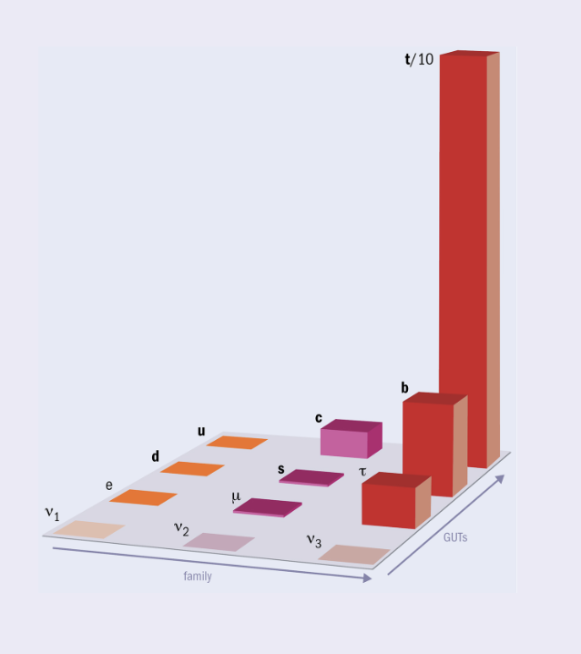
Part I. The open questions

Slide 4
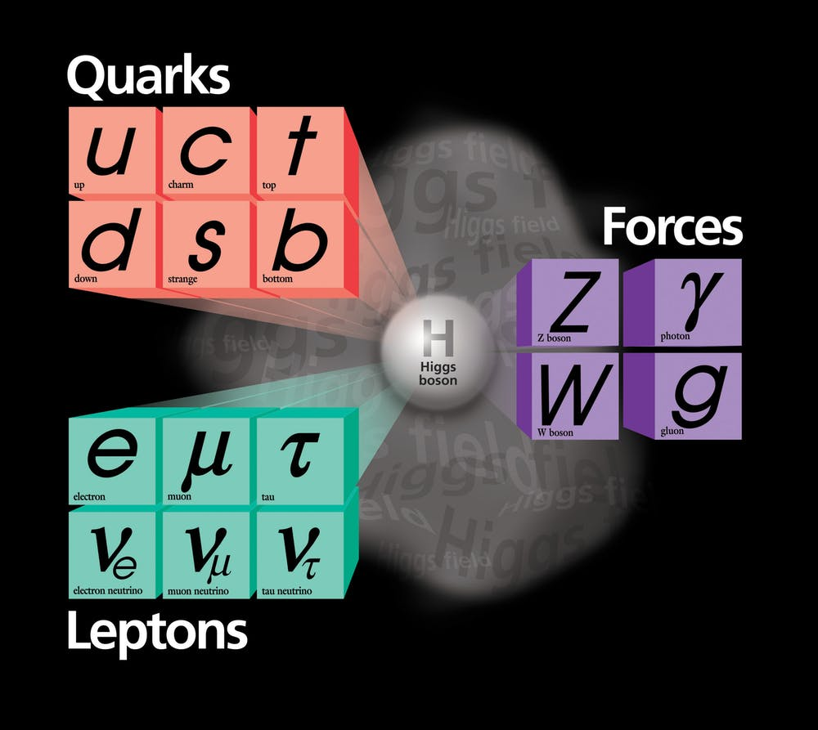
The open questions: the SM flavour puzzle
The “flavor puzzle” is an old problem, that emerged well before the Standard Model (SM) was conceived [ “Who ordered the muon ?” - I. Rabi (∼1950) ].
Current (SM version) of the puzzle:
Why do we have 3 copies of fermions with identical gauge quantum numbers
What determines their highly non-trivial mass matrices?

Slide 5
The open questions: the SM flavour puzzle
Fermion masses are the results of the Yukawa interactions → Inescapable link between Higgs and flavor, whose origin can be addressed only beyond the SM…
High-energy
degrees of freedom
(UV theory)
q_{L}^{i}
???
H
u_{R}^{j}
_
Y_{U}^{ij} q_{L}^{i} u_{R} ^{j} H
“Message from the UV”
that we need to “decode”

Slide 6
The open questions: the SM flavour puzzle
Fermion masses are the results of the Yukawa interactions → Inescapable link between Higgs and flavor, whose origin can be addressed only beyond the SM…
Contrary to gauge interactions, which are “protected” by gauge symmetries
[universal couplings controlled only by field charges] the values of the Yukawa couplings provide more information about UV dynamics
q_{L}^{i}
???
H
u_{R}^{j}
_
The UV dynamics responsible for
the Higgs-fermion couplings is
not universal among generations
Y_{U}^{ij} q_{L}^{i} u_{R} ^{j} H

Slide 7
The open questions: the SM flavour puzzle
Fermion masses are the results of the Yukawa interactions → Inescapable link between Higgs and flavor, whose origin can be addressed only beyond the SM…
The UV dynamics responsible for the Higgs-fermion couplings is flavor non universal and exhibits a strongly hierarchical pattern:
Which is the nature of this dynamics?
Which are the energy scales characterizing it?
E.g.:
0.003
< 0.01
Y_{U} ~
0.04
Y_{U} in the basis
where Y_{D} is diagonal
Key questions to investigate the nature of the Higgs field and, more generally, the
UV completion of the the SM
1
√2 m_{u}
〈Η〉
y_{u} = ≈ 10⁻⁵
√2 m_{t}
〈Η〉
y_{t} =

Slide 8
The open questions: the NP flavour puzzle
On general grounds, the flavor non-universal dynamics in the UV should give rise to new effective contact interactions → violations of exact & approximate symmetries of the SM:
E.g.:
q_{L}^{i}
μ_{R}
γ
b_{L}
H
H
???
???
???
u_{R}^{j}
s_{L}
H
e_{L}
H
_
Y_{U}^{ij} q_{L}^{i} u_{R} ^{j} H
Effective interaction which violates an approximate symmetry of the SM
Effective interaction which violates an exact symmetry
of the SM
< 0.01
< 0.1
Y_{U} ~
Strength of the contact interaction ~ C_{eff} /Λ²
1
B_{s} → μμ
μ → eγ

Slide 9
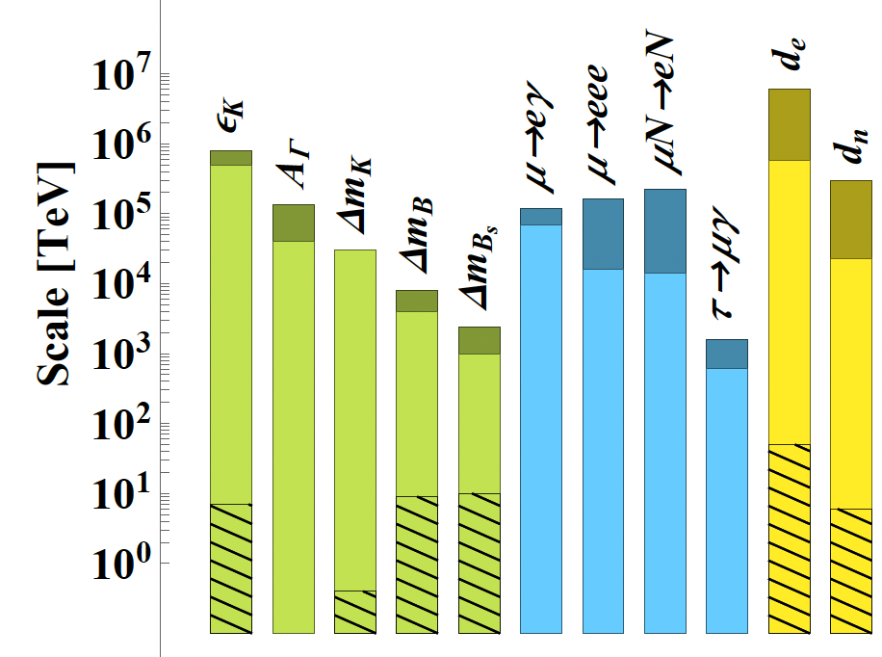
The open questions: the NP flavour puzzle
On general grounds, the flavor non-universal dynamics in the UV should give rise to new effective contact interactions → violations of exact & approximate symmetries of the SM.
At present we do not see any of these effects, and this is often expressed in terms of strong bounds on effective NP scales:
N.B.: These bounds are obtained assuming unit couplings for the effective coefficients
E.g.:
C_{μeγ}
Λ²
1
Λ²
→
Useful to show the potential,
but rather misleading…

Slide 10
The open questions: the NP flavour puzzle
Two possible interpretations of the strong bounds on effective New Physics scales from CP-violating & flavor-changing processes
Hypothesis: NP “badly violates” flavour [ OK to assume C=O(1) ]
Hypothesis: Light families couple to NP (at least to flavour non-universal NP) via small couplings
NP scale must be very high
NP scale can be as low as few TeV
Problems:
We do not understand why the Yukawa coupl. are hierarchical
Huge tuning problem in the Higgs potential (EW hierarchy problem)
Virtues:
We do understand why the Yukawa couplings are hierarchical
Reduced tuning in the Higgs potential

Slide 11
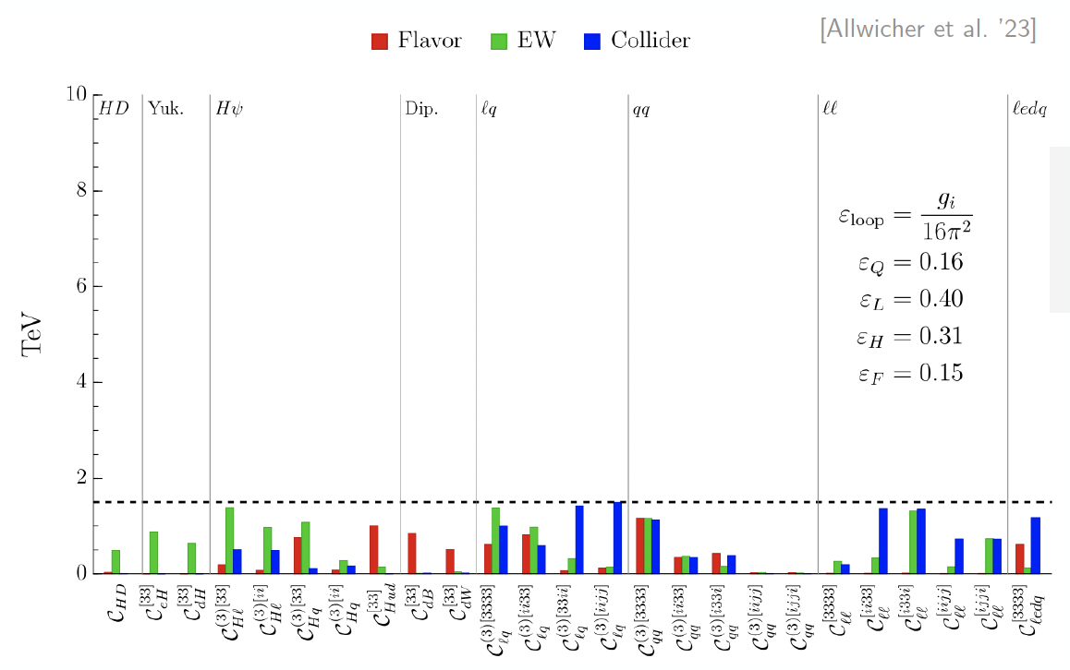
The open questions: the NP flavour puzzle
Two possible interpretations of the strong bounds on effective New Physics scales from CP-violating & flavor-changing processes
Hypothesis: Light families couple to NP (at least to flavour non-universal NP) via small couplings
Caveats:
The couplings cannot be zero (Yukawa couplings provide a minimum benchmark… → MFV)
With a simple motivated flavour ansatz, all bounds on d=6 contact interactions from all processes can be as low as 1-2 TeV
NP scale can be as low as few TeV
Virtues:
We do understand why the Yukawa couplings are hierarchical
Reduced tuning in the Higgs potential
Reducing the scale to 1-2 TeV (minimal Higgs tuning) requires flavour non-universality (and flavour alignment in the light sector)

Slide 12
The open questions: the NP flavour puzzle
Energy
A possible multi-scale UV completion of the SM
> 100 TeV
NP that “badly violates” flavor
Non-universality among 1st & 2nd generations
NP with small (universal) couplings to the light families
NP coupled mainly to the 3rd generation
“stabilization” of the Higgs sector
Few TeV
Low-energy imprint of flavour non-universality in the Yukawa couplings
< 0.01
< 0.1
EW scale
Y ~
1

Slide 13
The open questions: the NP flavour puzzle
Two possible interpretations of the strong bounds on effective New Physics scales from CP-violating & flavor-changing processes
NP that “badly violates” flavour at high energies
NP with small flavour-violating couplings to light family at nearby energies
In both cases exp. + th. progress in the flavor sector is a must !
Unique access to high scales not directly accessible at colliders
Key interplay with electroweak
and Higgs physics to indirectly “decode” NP at nearby energies

Slide 14
Part II. How to address the open questions
M
g
flavor

Slide 15
How to address the challenges: Flavour in the SM EFT
No matter if NP is at the TeV scale or well above, it is always very heavy compared to the energy scale of low-energy flavour experiments → systematic description via the “SM EFT”
c_{i}^{[d]}
Λ^{d-4}
Σ
ℒ_{SM-EFT} = ℒ_{gauge} + ℒ_{Higgs} +
O_{i}^{[d]} (ψ_{SM})
^{d > 4}
Long-range structure of the theory
SM field
g₁
g₂
Most general description of heavy NP that we are not able to directly “excite”
SM field
g₁
g₂
M²

Slide 16
How to address the challenges: Flavour in the SM EFT
No matter if NP is at the TeV scale or well above, it is always very heavy compared to the energy scale of low-energy flavour experiments → systematic description via the “SM EFT”
c_{i}^{[d]}
Λ^{d-4}
Σ
ℒ_{SM-EFT} = ℒ_{gauge} + ℒ_{Higgs} +
O_{i}^{[d]} (ψ_{SM})
^{d > 4}
Understanding the flavour structure of the SM EFT is a question of pivotal importance.
N. of independent couplings:
M
SM field
g₁
g₂
g
SM field
flavor
g₁
g₂
M²
No flavor symmetry 2499 [@d=6]
Maximal flavor symmetry 47 [@d=6]

Slide 17
How to address the challenges: Flavour in the SM EFT
No matter if NP is at the TeV scale or well above, it is always very heavy compared to the energy scale of low-energy flavour experiments → systematic description via the “SM EFT”
c_{i}^{[d]}
Λ^{d-4}
Σ
ℒ_{SM-EFT} = ℒ_{gauge} + ℒ_{Higgs} +
O_{i}^{[d]} (ψ_{SM})
^{d > 4}
Don’t be scared by the large number of independent couplings of eff. operators!
Understanding the flavour structure of the SM EFT is a question of pivotal importance.
N. of independent couplings:
M
g
flavor
They do not indicate model parameters, but rather the number
of observables we can probe
(whose correlations depend on the
unknown underlying model)
No flavor symmetry 2499 [@d=6]
Maximal flavor symmetry 47 [@d=6]

Slide 18
How to address the challenges @ large-scale facilities [b,c,τ]
γ quarks μ e τ ν
_
b → s μμ R_{bs} (e/μ) b → s ττ b → s νν
b → c μν R_{bc} (e/μ) b → c τν
3_{q} → 2_{q}
b → s γ B_{s} ⟷ B_{s}
_
_
B(B_{s} → μμ),
B(B → K* μμ),
A_{FB}(B → K *μμ),
…
_
B(B → K νν),
B(B → K *νν),
…
b → d μμ R_{bd} (e/μ) b → d ττ b → d νν
b → u μν R_{bu} (e/μ) b → u τν
3_{q} → 1_{q}
b → d γ B_{d} ⟷ B_{d}
R^{τ/μ}(D),
R^{τ/μ} (D*), …
c → u μμ R_{cu} (e/μ) c → u νν
c → s μν R_{cs} (e/μ)
c → d μν R_{cd} (e/μ)
2_{q}
1_{q}
_
2_{q} →
c → u γ D ⟷ D
N.B.: several observables for each transition
2_{l}
1_{l}
τ → μ γ τ → μ qq τ → μ μμ τ → μ ee τ → μ νν
τ → e γ τ → e qq τ → μ ee τ → e ee τ → e νν
3_{l} →

Slide 19
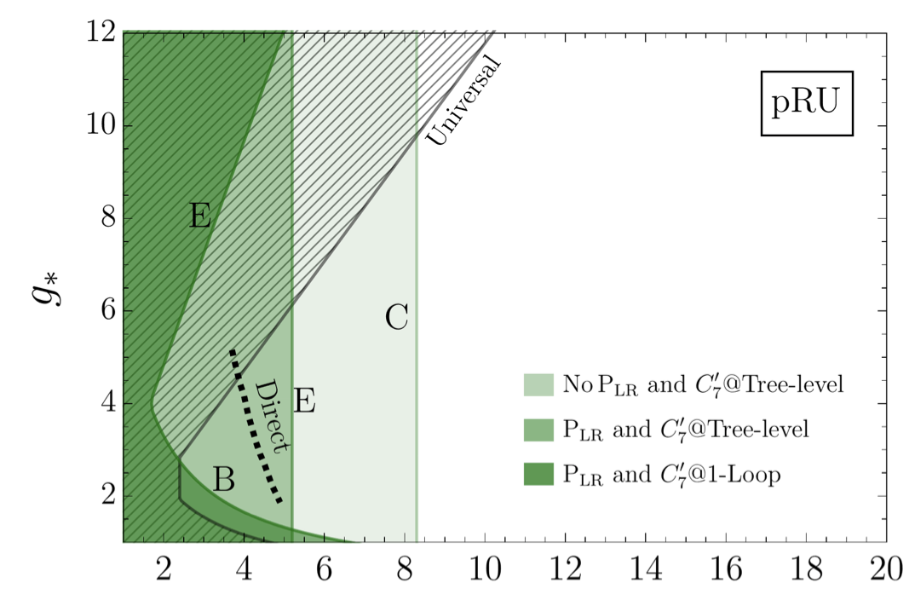
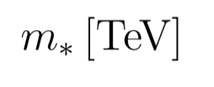
How to address the challenges @ large-scale facilities [b,c,τ]
γ quarks μ e τ ν
_
b → s μμ R_{bs} (e/μ) b → s ττ b → s νν
b → c μν R_{bc} (e/μ) b → c τν
3_{q} → 2_{q}
b → s γ B_{s} ⟷ B_{s}
E.g.: Partial fermion compositeness
_
b → d μμ R_{bd} (e/μ) b → d ττ b → d νν
b → u μν R_{bu} (e/μ) b → u τν
3_{q} → 1_{q}
b → d γ B_{d} ⟷ B_{d}
[Glioti et al. ‘24]
c → u μμ R_{cu} (e/μ) c → u νν
c → s μν R_{cs} (e/μ)
c → d μν R_{cd} (e/μ)
2_{q}
1_{q}
_
2_{q} →
c → u γ D ⟷ D
FCNCs currently @ 10-30%
B_{s} →μμ
TeV-scale constraints in realistic models
B → K*ee
2_{l}
1_{l}
ΔM_{Bs}
τ → μ γ τ → μ qq τ → μ μμ τ → μ ee τ → μ νν
τ → e γ τ → e qq τ → μ ee τ → e ee τ → e νν
Current theory errors 5% - 20% → will reach 1-2%
3_{l} →

Slide 20
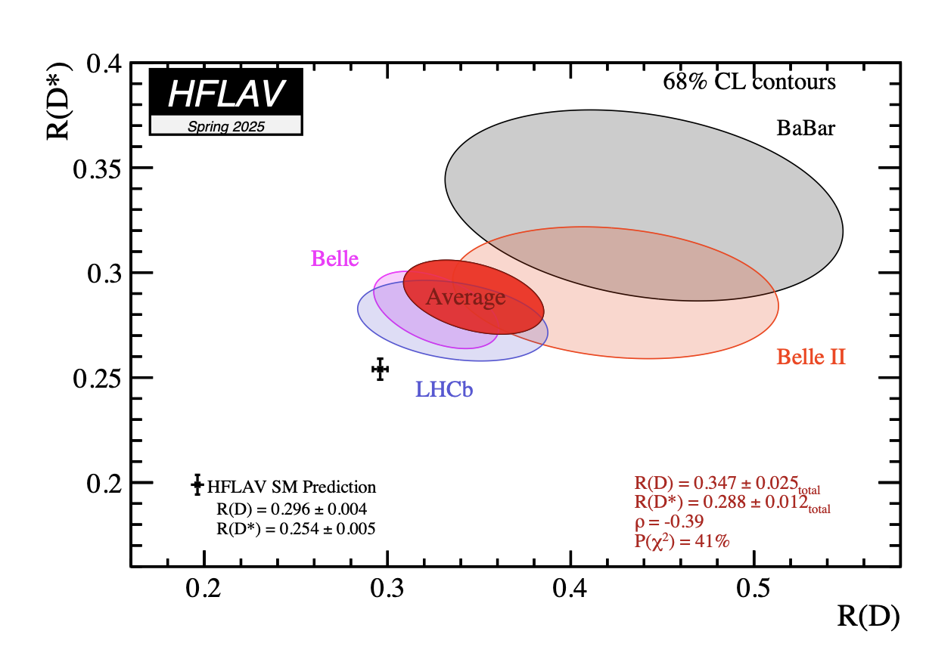
How to address the challenges @ large-scale facilities [b,c,τ]
γ quarks μ e τ ν
Tests of Lepton Universality @ 5-10% in
b → s μμ R_{bs} (e/μ) b → s ττ b → s νν
b → c μν R_{bc} (e/μ) b → c τν
3_{q} → 2_{q}
b → s γ B_{s} ⟷ B_{s}
τ/μ (charged-current)
μ/e (FCNCs)
b → d μμ R_{bd} (e/μ) b → d ττ b → d νν
b → u μν R_{bu} (e/μ) b → u τν
3_{q} → 1_{q}
b → d γ B_{d} ⟷ B_{d}
E.g.:
R(D ^{(*)}) =
B(B → D^{(*)} τν)
B(B → D^{(*)} μν)
“Clean” probes of a variety of motivated BSM (e.g. flavour non-universal gauge groups) → large room for improv.
c → u μμ R_{cu} (e/μ) c → u νν
c → s μν R_{cs} (e/μ)
c → d μν R_{cd} (e/μ)
2_{q}
1_{q}
2_{q} →
c → u γ D ⟷ D
2_{l}
1_{l}
τ → μ γ τ → μ qq τ → μ μμ τ → μ ee τ → μ νν
τ → e γ τ → e qq τ → μ ee τ → e ee τ → e νν
3_{l} →

Slide 21
How to address the challenges @ large-scale facilities [b,c,τ]
A. Jüttner,
Flavour WG session

Slide 22
Large-scale facilities [b,c,τ]: overview of present status
γ quarks μ e τ ν
_
b → s μμ R_{bs} (e/μ) b → s ττ b → s νν
b → c μν R_{bc} (e/μ) b → c τν
3_{q} → 2_{q}
b → s γ B_{s} ⟷ B_{s}
_
b → d μμ R_{bd} (e/μ) b → d ττ b → d νν
b → u μν R_{bu} (e/μ) b → u τν
3_{q} → 1_{q}
b → d γ B_{d} ⟷ B_{d}
FCNC @ 10-30% LFU @ 0.1%
FCNC @ 50-100%, LFU @ 5-10%
Far from SM level / NP sensitivity
Null SM test
c → u μμ R_{cu} (e/μ) c → u νν
c → s μν R_{cs} (e/μ)
c → d μν R_{cd} (e/μ)
2_{q}
1_{q}
_
2_{q} →
c → u γ D ⟷ D
2_{l}
1_{l}
τ → μ γ τ → μ qq τ → μ μμ τ → μ ee τ → μ νν
τ → e γ τ → e qq τ → μ ee τ → e ee τ → e νν
3_{l} →

Slide 23
Large-scale facilities [b,c,τ]: future prospects
γ quarks μ e τ ν
_
b → s μμ R_{bs} (e/μ) b → s ττ b → s νν
b → c μν R_{bc} (e/μ) b → c τν
3_{q} → 2_{q}
b → s γ B_{s} ⟷ B_{s}
_
b → d μμ R_{bd} (e/μ) b → d ττ b → d νν
b → u μν R_{bu} (e/μ) b → u τν
3_{q} → 1_{q}
b → d γ B_{d} ⟷ B_{d}
Progress from HL-LHC & Belle-II:
σ reduction by 4 – 10 times
c → u μμ R_{cu} (e/μ) c → u νν
c → s μν R_{cs} (e/μ)
c → d μν R_{cd} (e/μ)
2_{q}
1_{q}
_
2_{q} →
c → u γ D ⟷ D
Possible Tera-Z impact [ 6 x 10¹² Z ]:
Further σ reduction by 5 – 10
Further σ reduction $≥$ 10
2_{l}
1_{l}
τ → μ γ τ → μ qq τ → μ μμ τ → μ ee τ → μ νν
τ → e γ τ → e qq τ → μ ee τ → e ee τ → e νν
3_{l} →

Slide 24
How to address the challenges @ dedicated facilities [K, π, μ, EDMs]
γ quarks μ e τ ν
s → d μμ R_{sd} (e/μ) s → d νν
s → u μν R_{su} (e/μ)
d → u μν R_{du} (e/μ)
2_{q}
1_{q}
_
→1_{q}
s → d γ K ⟷ K
2_{l} → 1_{l}
μ → e γ μΝ → eN μ → e ee μ → e νν
2_{l} → 2_{l}
g_{μ}
d_{μ}
Extremely powerful probes of new sources of CP violations
1_{l} → 1_{l}
d_{e}
Most sensitive probe of the θ-term [QCD vacuum]
1_{q} → 1_{q}
d_{N}

Slide 25
How to address the challenges @ dedicated facilities [K, π, μ, EDMs]
γ quarks μ e τ ν
K_{L} → π⁰μμ _{s} R_{sd} (e/μ) K_{L} → π⁰ νν
s → u μν R_{su} (e/μ) K⁺ → π⁺ νν
d → u μν π⁺ → π⁰ eν
R_{du} (e/μ)
2_{q}
1_{q}
→1_{q}
s → d γ K ⟷ K
2_{l} → 1_{l}
μ → e γ μΝ → eN μ → e ee μ → e νν
2_{l} → 2_{l}
g_{μ}
d_{μ}
Long-term plans:
one or more dedicated projects
clean mode lacking dedicated project
1_{l} → 1_{l}
d_{e}
1_{q} → 1_{q}
d_{N}

Slide 26
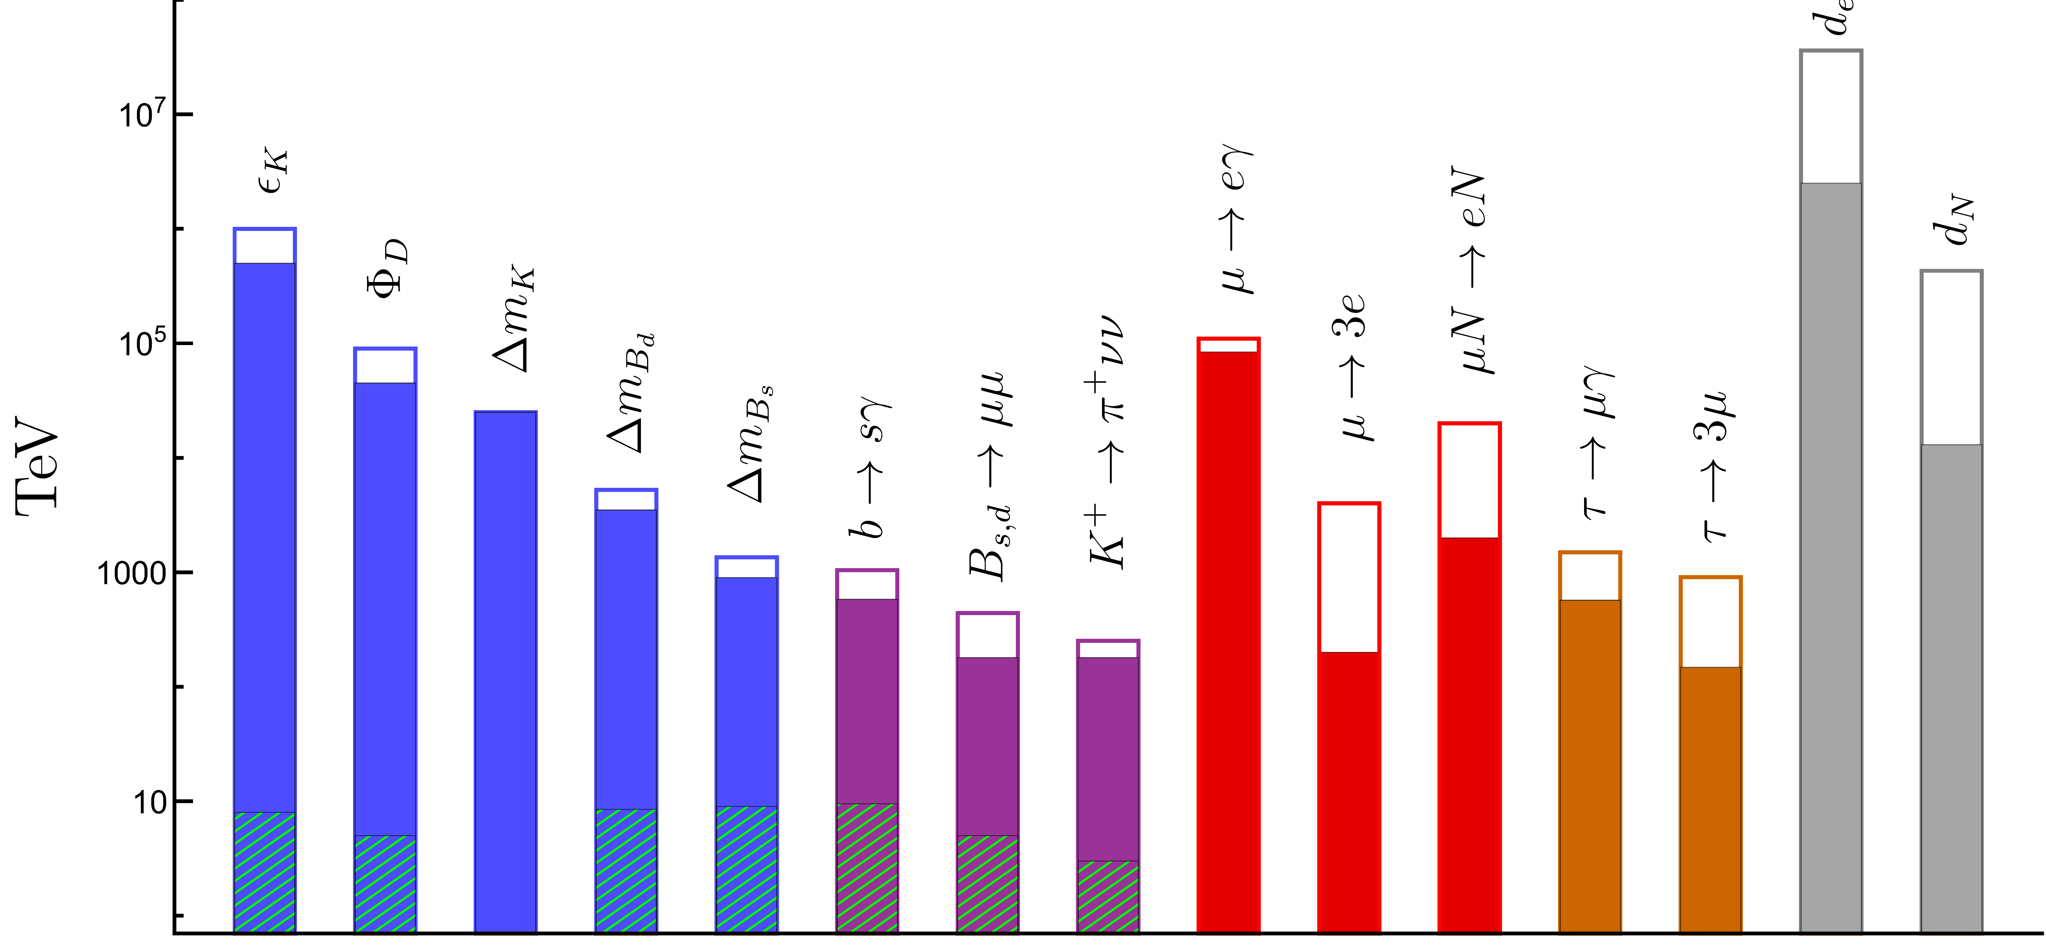
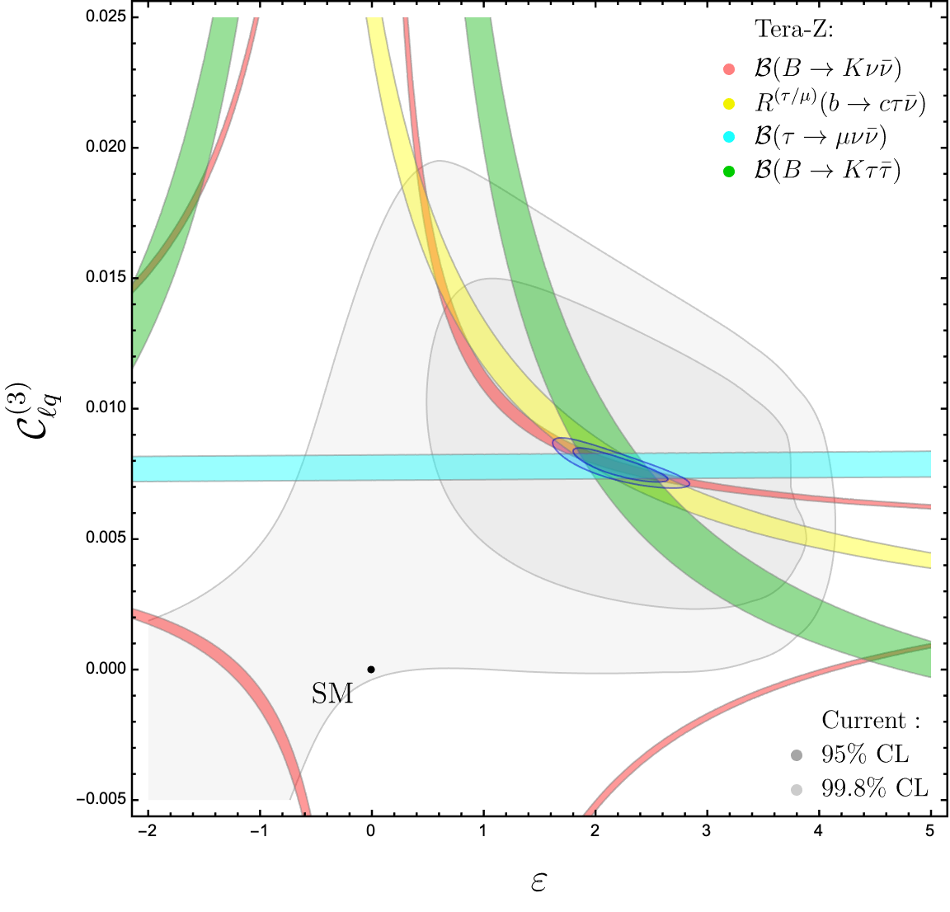
Part III. Where we are and where we could go
[ From agnostic bounds to
flavour-EW-Higgs interplay
in concrete cases ]

Slide 27
Bounds on effective scales for generic (unit) couplings
Expected improv.
Current bound
ESPP2026 Preliminary
Most of the improv. here
comes from improved
CKM determination
Possible reach of
a dedicated exp.
ΔF=2
(ΔF=1)_{quarks}
LFV(μ→e)
LFV(τ →e)
EDMs

Slide 28
Bounds on effective scales for generic (unit) couplings
Main message of these bounds: high discovery potential
of selected flavour observables
ESPP2026 Preliminary
To understand the impact of the whole flavour program in constraining (realistic) BSM -> need more hypotheses
CKM-like
couplings (MFV)
ΔF=2
(ΔF=1)_{quarks}
LFV(μ→e)
LFV(τ →e)
EDMs

Slide 29
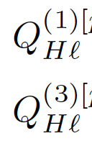
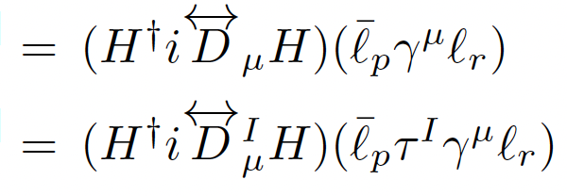
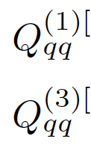
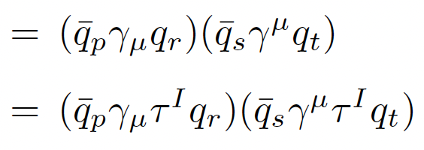
Bounds on effective scales in motivated setup (low-scale NP)
Conservative reference framework: NP with no new sources of quark flavour mixing, that differentiates between 3rd and light generations [e.g. it couples mainly to the 3rd gen., as in many motivated models] → analysis of all the contact interactions involving 3rd gen. quarks and lepton doublets:
E.g.:
3
3
3
3
3
3
3
3
3
3
3
3
H
q₃
H
ν
τ
Z
W
b
b
b
Z
ν
ν
s
s
b
Z → νν
τ → lνν
+ …
Δm_{Βs}
Z → bb
+ …

Slide 30
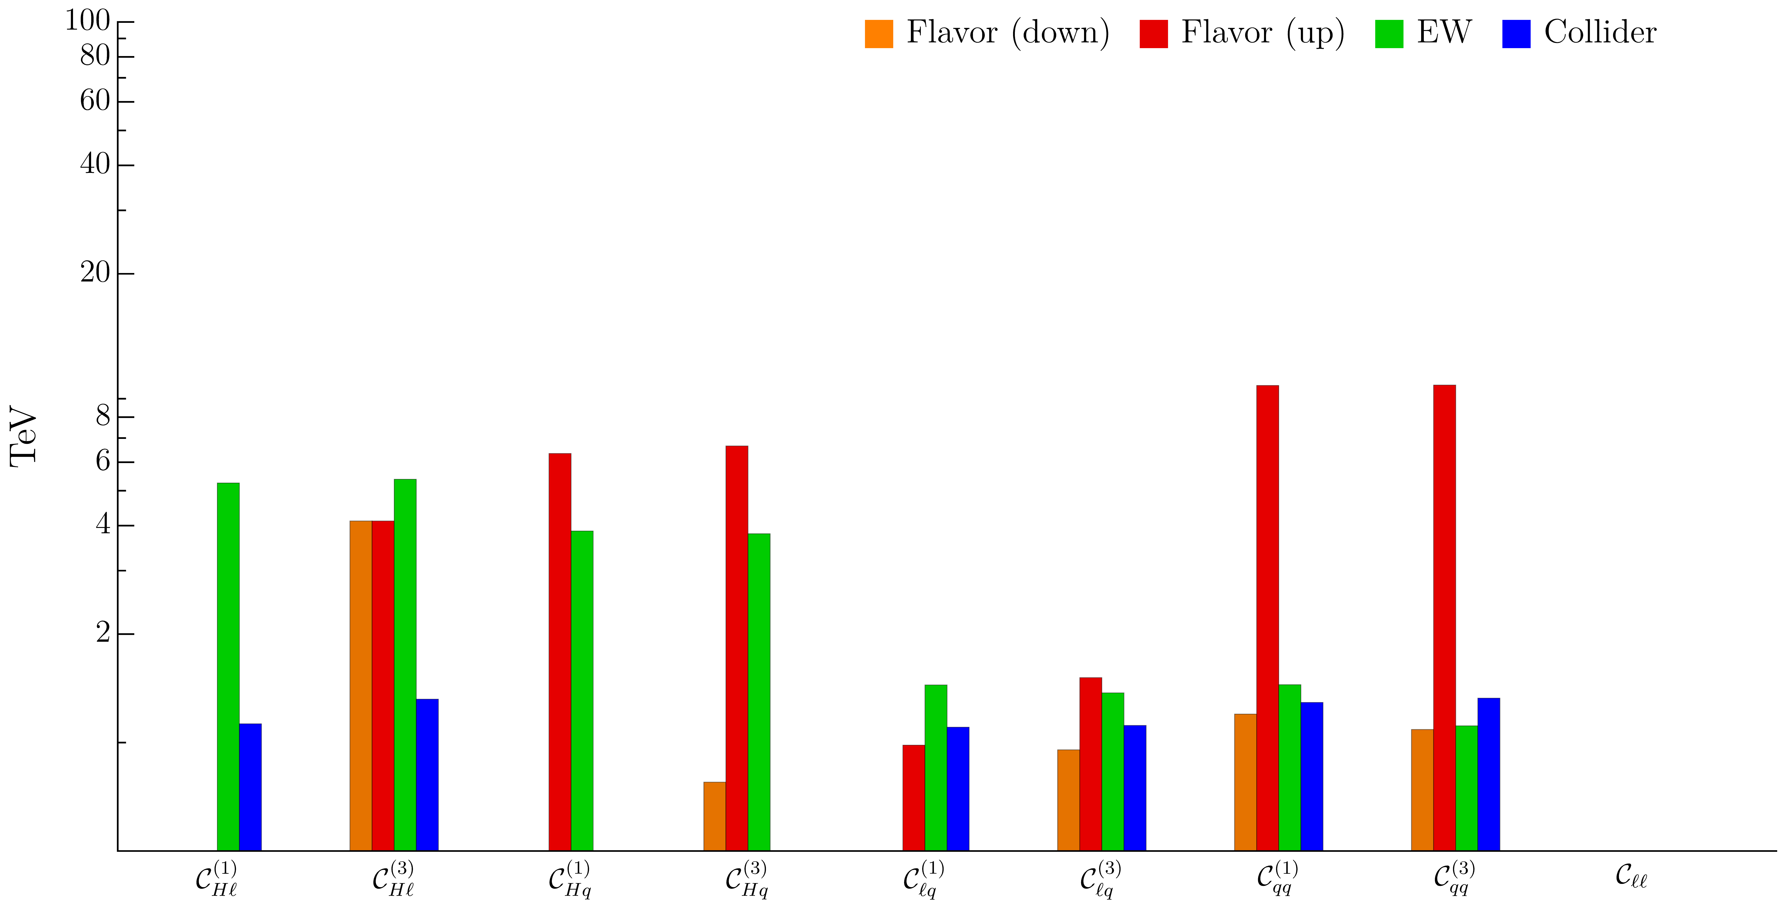
Bounds on effective scales in motivated setup (low-scale NP)
Analysis of all the contact interactions involving 3rd gen. quarks and lepton doublets:
ESPP2026
Preliminary
H
q₃
H
q₃
q₃
H
H

Slide 31
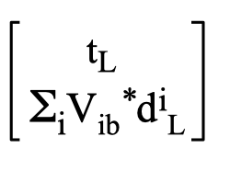
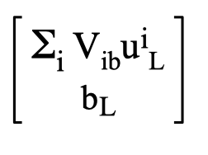
Bounds on effective scales in motivated setup (low-scale NP)
Analysis of all the contact interactions involving 3rd gen. quarks and lepton doublets:
ESPP2026
Preliminary
τ→μνν
B_{s}→μμ
Β→Kνν
Β→Kττ
R_{D(*)}
τ→μνν
Β→Kνν
Β→Kττ
Δm_{Bs}
φ_{D}
=
_{ti}
up
=
down

Slide 32
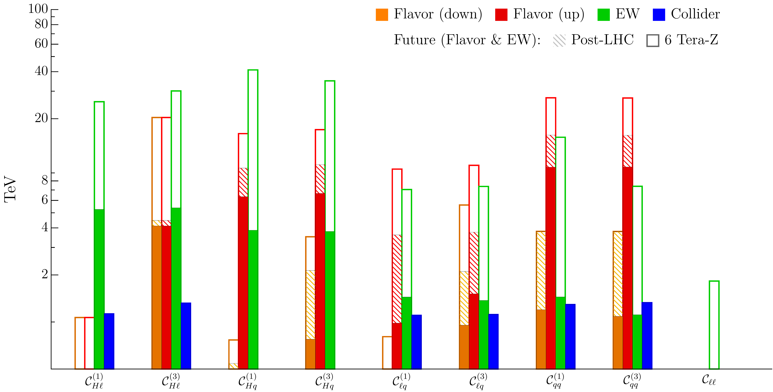
Bounds on effective scales in motivated setup (low-scale NP)
Analysis of all the contact interactions involving 3rd gen. quarks and lepton doublets:
ESPP2026
Preliminary

Slide 33
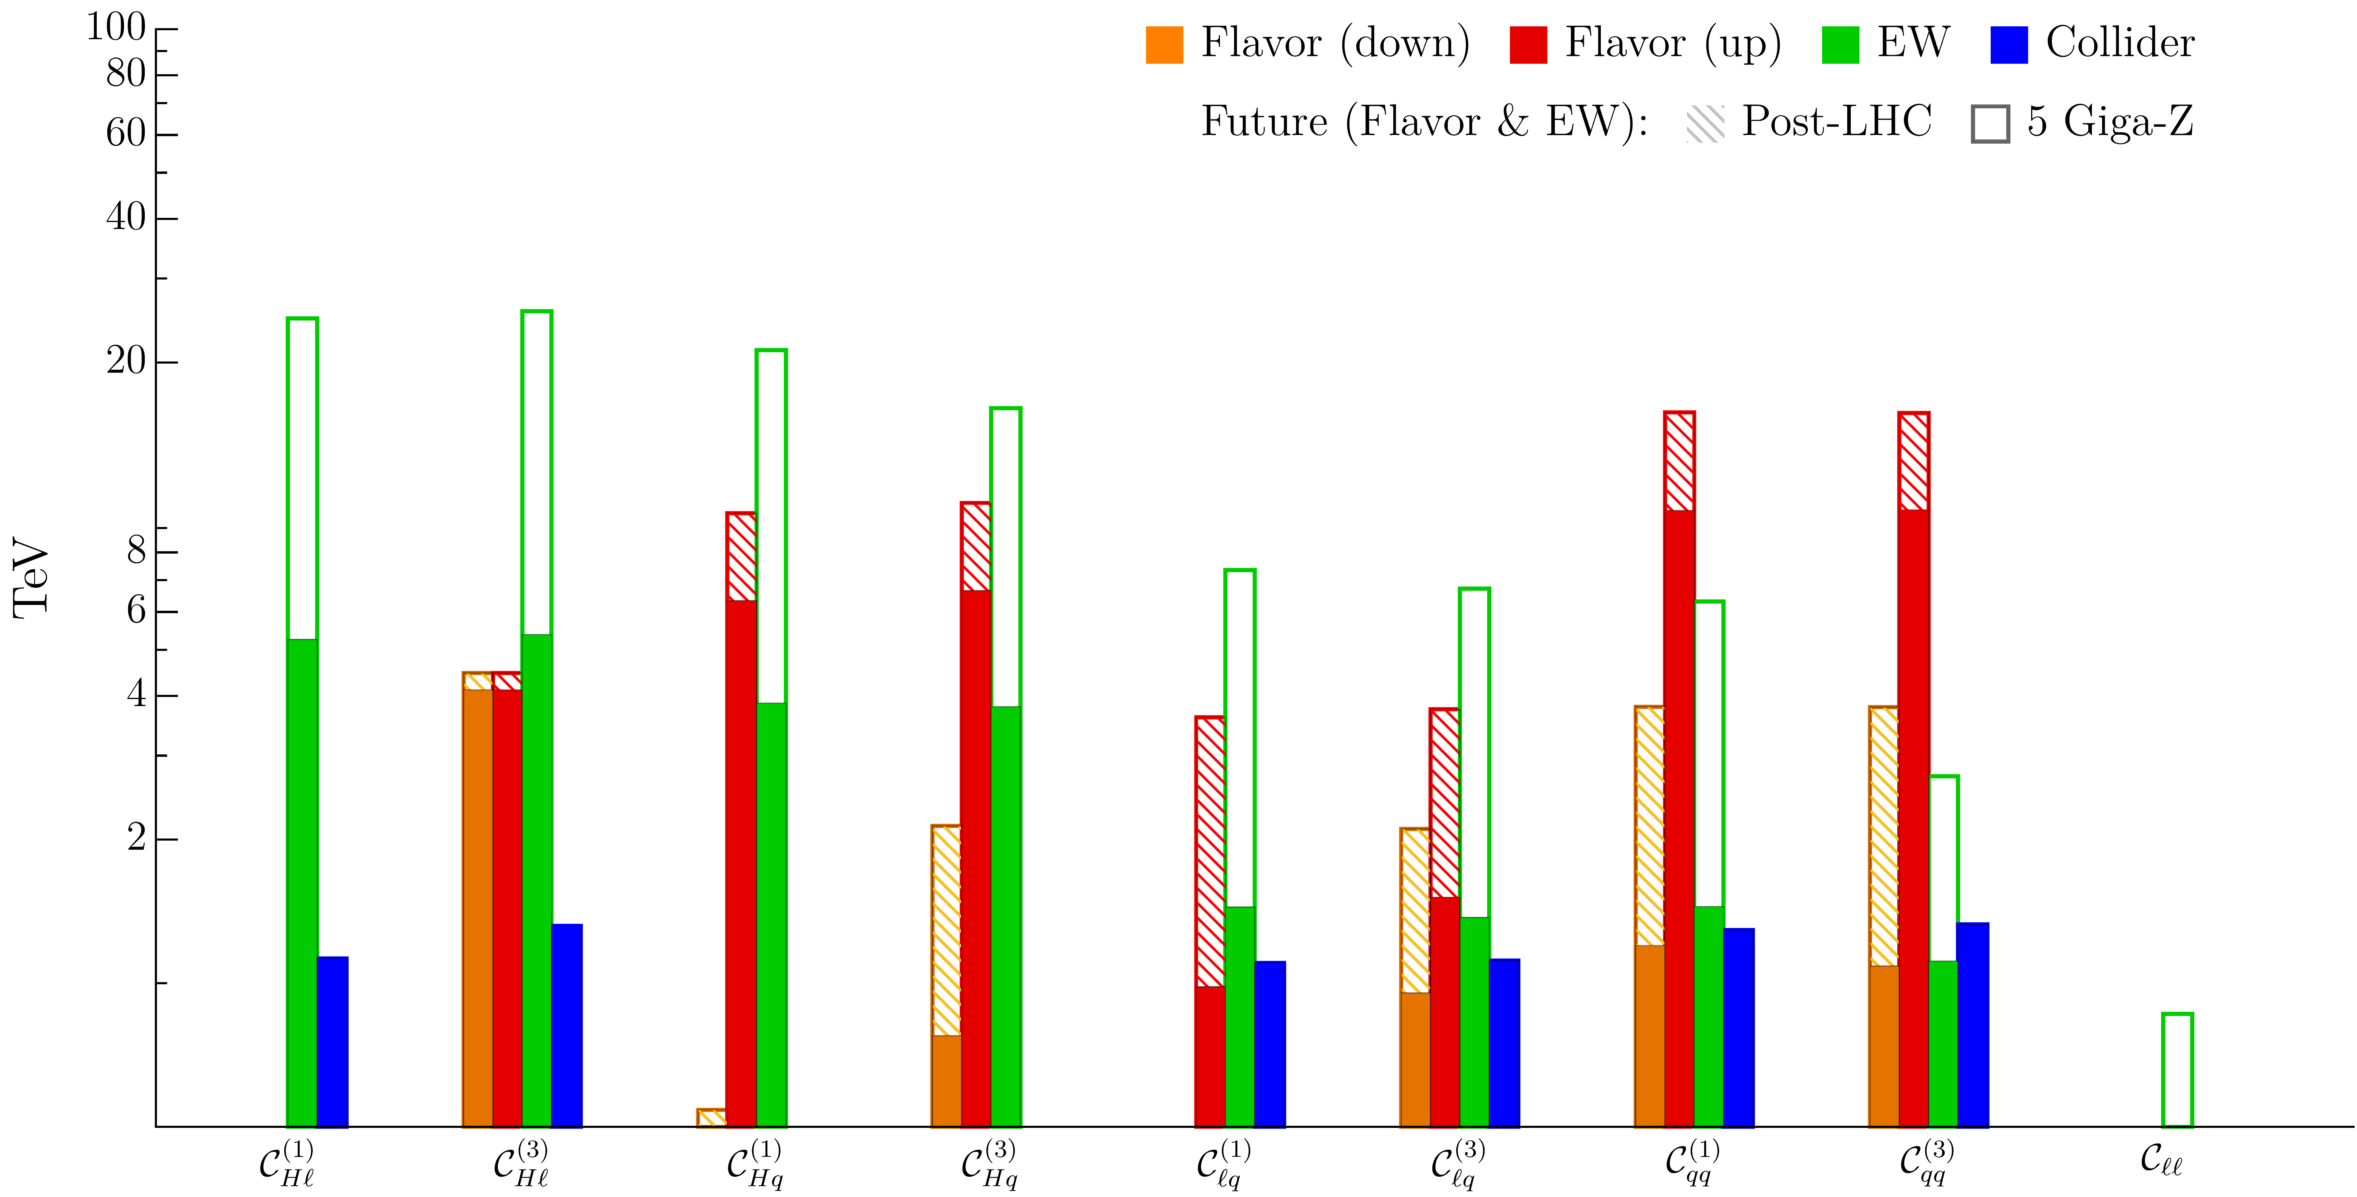
Bounds on effective scales in motivated setup (low-scale NP)
Analysis of all the contact interactions involving 3rd gen. quarks and lepton doublets:
ESPP2026
Preliminary
[LCF]

Slide 34
An explicit example of flavour – EW interplay (assuming NP signal)
Looking at bounds from individual observables misses the main point of indirect NP searches,
which is the interplay of a large number of observables in “decoding” the underlying theory
To illustrate this point worth to consider an explicit example assuming a NP signal
B(B → D^{(*)} τν)
B(B → D^{(*)} μν)
R(D ^{(*)}) =
2026 ESPPU – Open Symposium (Venice, June 2025) G. Isidori - Status and open questions in Flavour Physics
34

Slide 35
An explicit example of flavour – EW interplay (assuming NP signal)
Looking at bounds from individual observables misses the main point of indirect NP searches,
which is the interplay of a large number of observables in “decoding” the underlying theory
b_{L}
ν_{L}
b_{L}
τ_{L}
s_{L}
τ_{L}
s_{L}
ν_{L}
B →K νν
B →K ττ
W
τ_{L}
b_{L}
τ_{L}
Z
τ_{L}(ν_{L})
ν_{L}
b_{L}
τ_{L}
Ζ → ττ (νν)
τ →μνν
σ(pp →ττ)
τ_{L}(ν_{L})
2026 ESPPU – Open Symposium (Venice, June 2025) G. Isidori - Status and open questions in Flavour Physics
35

Slide 36
An explicit example of flavour – EW interplay (assuming NP signal)
Looking at bounds from individual observables misses the main point of indirect NP searches,
which is the interplay of a large number of observables in “decoding” the underlying theory
A simple, consistent, description
of the system involves (at least)
3 parameters:
Two Wilson coefficients,
One flavour-mixing parameter, ε = O(1): = b_{L} + ε |V_{ts}| s_{L}
2026 ESPPU – Open Symposium (Venice, June 2025) G. Isidori - Status and open questions in Flavour Physics
36

Slide 37
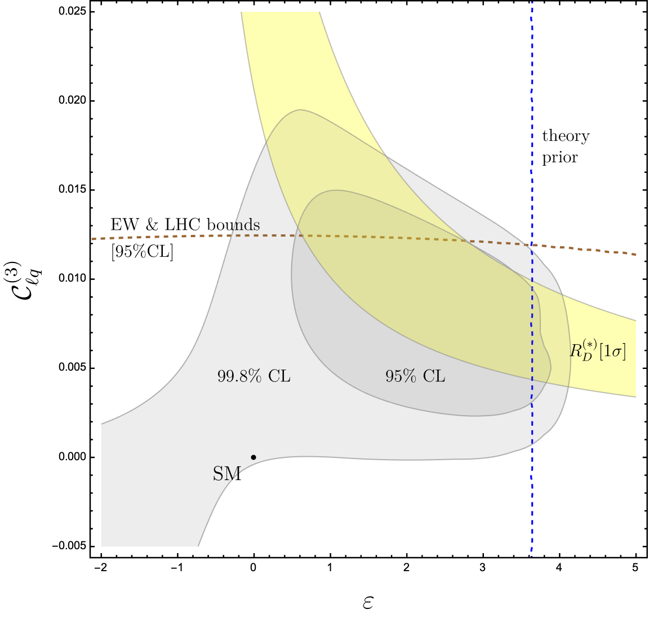
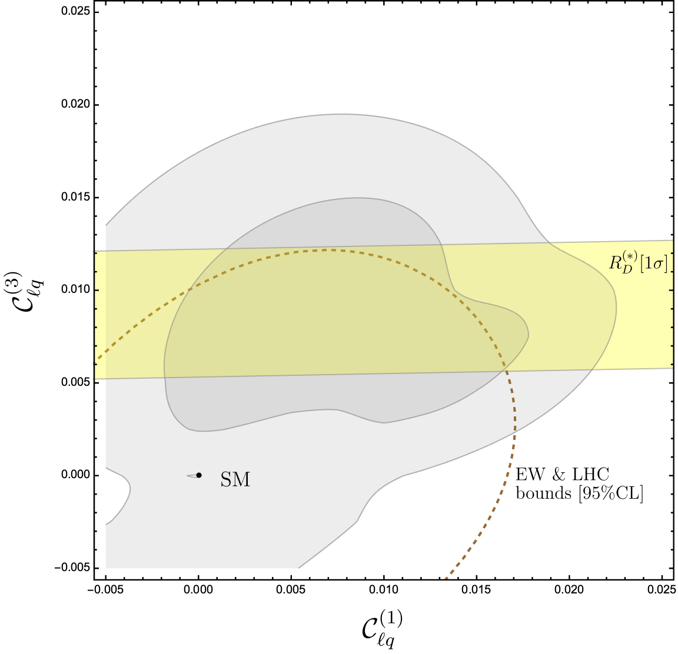
An explicit example of flavour – EW interplay (assuming NP signal)
ESPP2026 Preliminary
W_{i}’
ESPP2026 Preliminary
g/M
U_{i}
1 TeV
2 TeV
Z’
2026 ESPPU – Open Symposium (Venice, June 2025) G. Isidori - Status and open questions in Flavour Physics
37

Slide 38
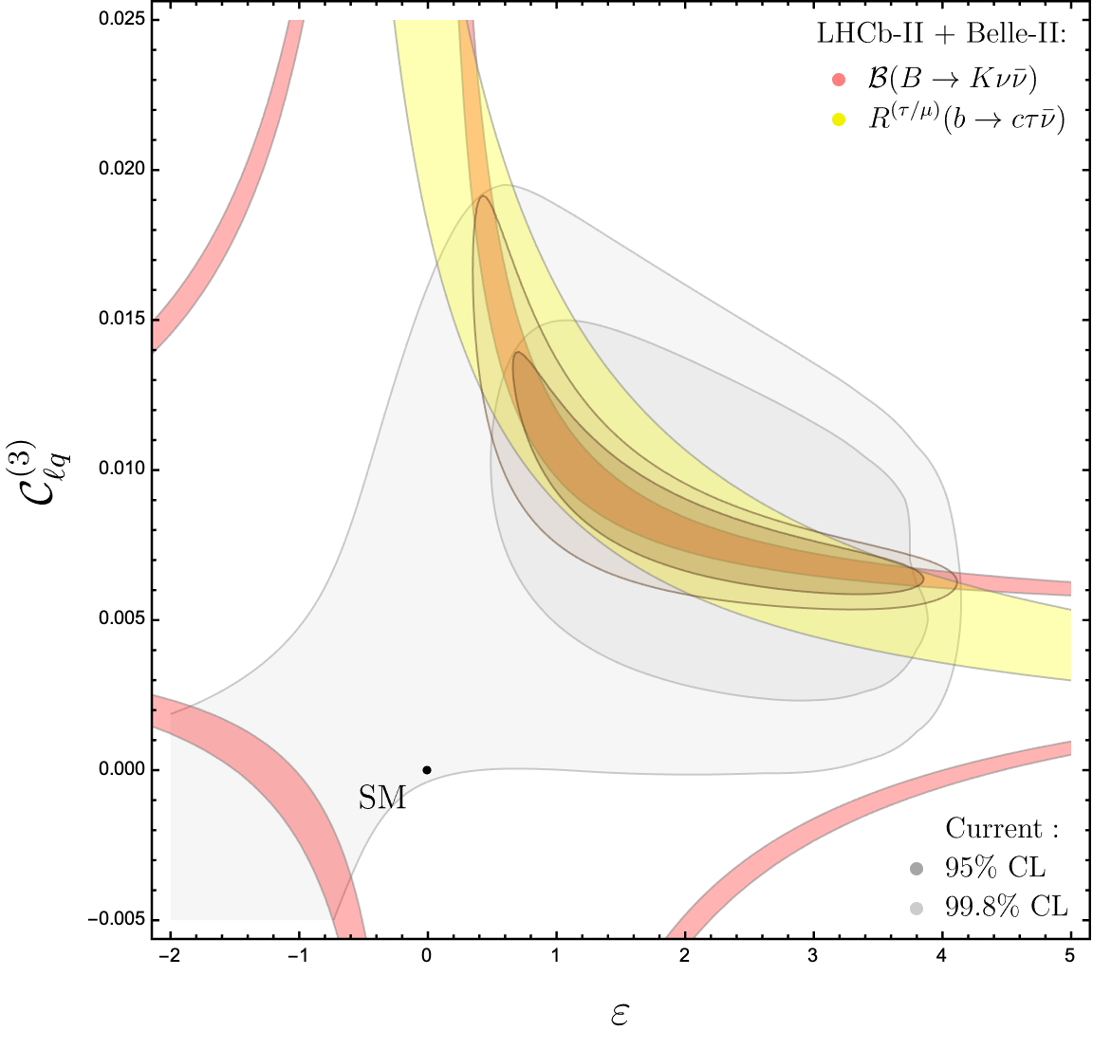
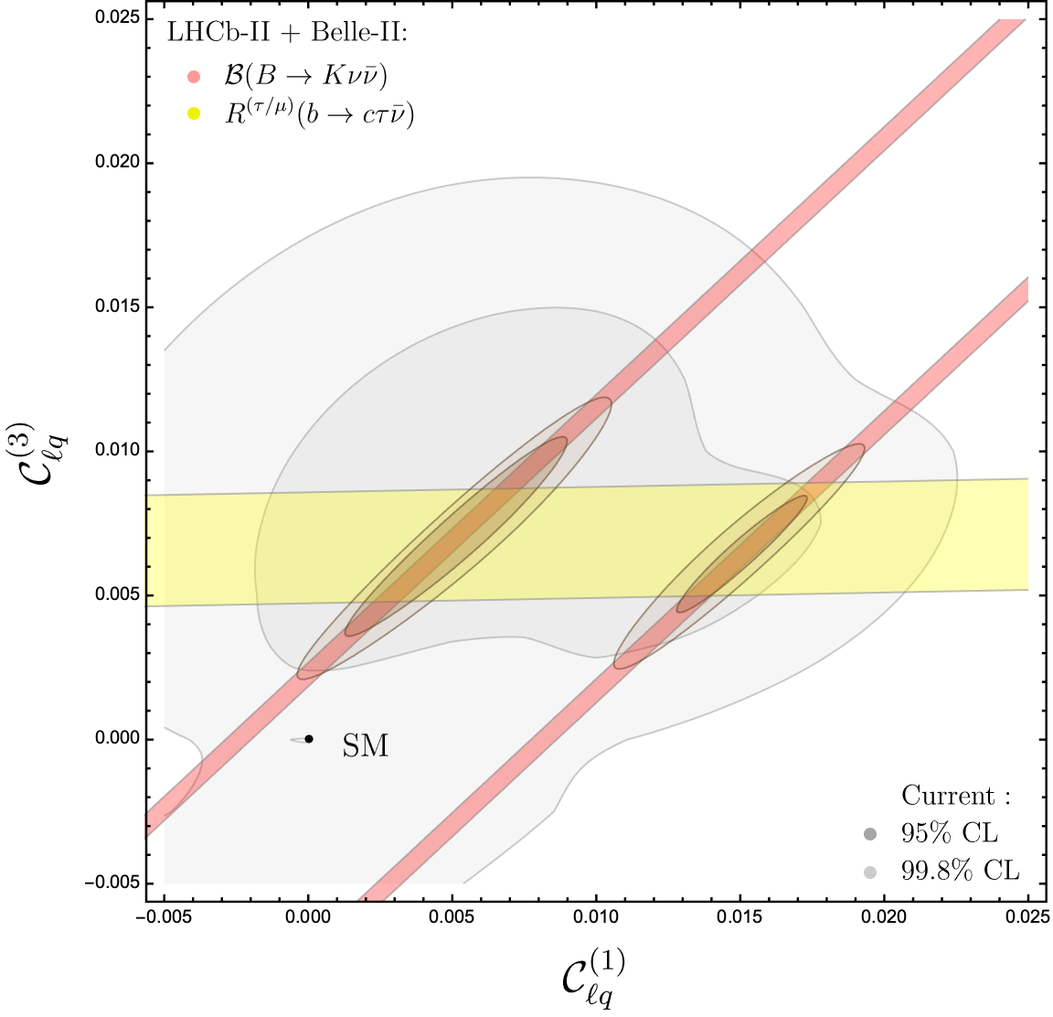
An explicit example of flavour – EW interplay (assuming NP signal)
ESPP2026 Preliminary
ESPP2026 Preliminary
2026 ESPPU – Open Symposium (Venice, June 2025) G. Isidori - Status and open questions in Flavour Physics
38

Slide 39
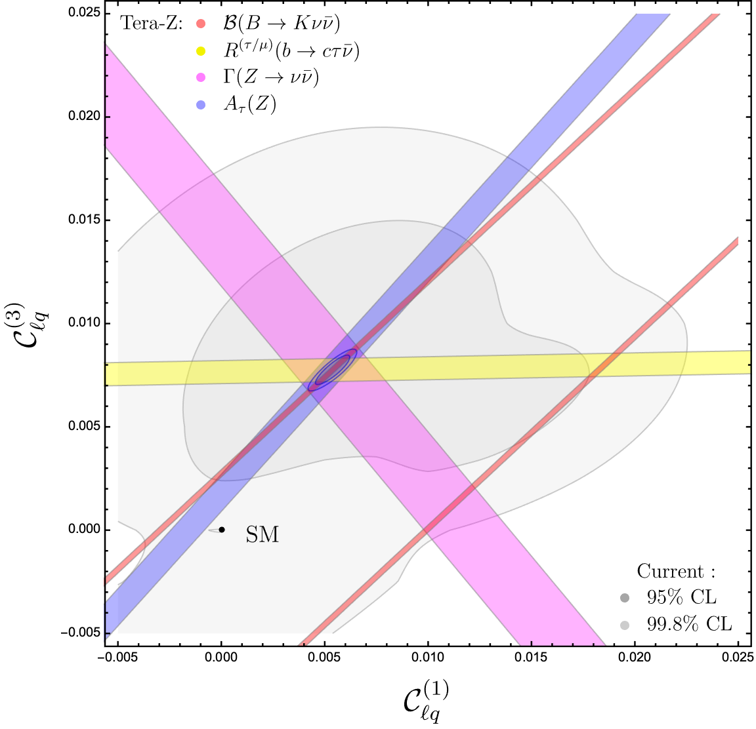
An explicit example of flavour – EW interplay (assuming NP signal)
ESPP2026 Preliminary
ESPP2026 Preliminary
2026 ESPPU – Open Symposium (Venice, June 2025) G. Isidori - Status and open questions in Flavour Physics
39

Slide 40
About flavour, EW, and Higgs physics interplay
What we have illustrated is only an example, but the conclusions are very general:
The interplay of a large number of observables is a key ingredient if we aim to “decode” the underlying theory via indirect measurements and/or “validate” indirect BSM evidences (in concrete models there are not hundreds parameters, but likely more than three…) and flavour physics represent a particularly “rich” domain of NP sensitive observables.
Precision Higgs, electroweak, and flavour physics are three faces of the same strategy:
for all of them the primary objective is indirect discovery
in realistic models, with TeV-scale NP, they provide very complementary information
2026 ESPPU – Open Symposium (Venice, June 2025) G. Isidori - Status and open questions in Flavour Physics
40

Slide 41
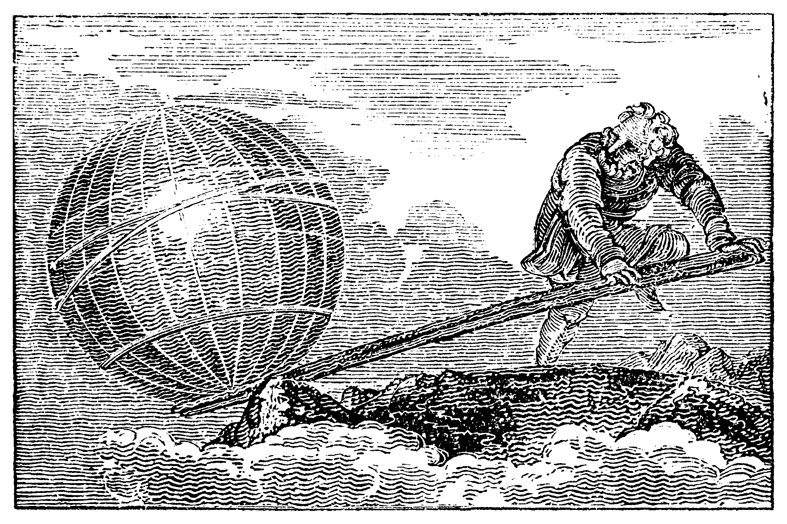
“Give me enough statistics for flavour physics, precision in theory & experiment to exploit it ^{(*)} and I will unveil what’s beyond the SM !”
Conclusions
What Archimedes would have said, in 200 B.C., if he knew about our strategy…
SM
^{(*)} Next talk will clarify
what this really means…
Image from Wikimedia Commons
2026 ESPPU – Open Symposium (Venice, June 2025) G. Isidori - Status and open questions in Flavour Physics
41

Slide 42
Backup
2026 ESPPU – Open Symposium (Venice, June 2025) G. Isidori - Status and open questions in Flavour Physics
42

Slide 43
Large-scale facilities [b,c,τ]: future prospects
γ quarks μ e τ ν
b → s μμ R_{bs} (e/μ) b → s ττ b → s νν
b → c μν R_{bc} (e/μ) b → c τν
3_{q} → 2_{q}
b → s γ B_{s} ⟷ B_{s}
b → d μμ R_{bd} (e/μ) b → d ττ b → d νν
b → u μν R_{bu} (e/μ) b → u τν
3_{q} → 1_{q}
b → d γ B_{d} ⟷ B_{d}
Processes with sub-leading theory/parametric errors in
the post LHCb-II + Tera-Z era:
c → u μμ R_{cu} (e/μ) c → u νν
c → s μν R_{cs} (e/μ)
c → d μν R_{cd} (e/μ)
2_{q}
1_{q}
2_{q} →
c → u γ D ⟷ D
Interesting prospects
@ FCC-hh & muC
More Z would
help…
2_{l}
1_{l}
τ → μ γ τ → μ qq τ → μ μμ τ → μ ee τ → μ νν
τ → e γ τ → e qq τ → μ ee τ → e ee τ → e νν
3_{l} →

