Slide 1
PLENARY SESSION / ACCELERATOR TECHNOLOGIES
Guided Discussion on Accelerator Challenges
The PPG Accelerator Working Group
Discussion led by Tor Raubenheimer
June 24, 2025

Slide 2
Questions for Discussion
How realistic are the luminosity extrapolations for the various projects? (8 min)
How should we approach baselining project R&D? (8 min)
What scale of systems demonstrations and (test) facilities are needed to "validate" technology? (8 min)
Looking forward, how do we balance the investment in accelerator R&D for a 10 TeV pCM collider and beyond? (8 min)
Open floor (10 min)
Bonus questions

Slide 3
Guidelines
The goal of this discussion is to exchange ideas and concerns between experimentalists, theorists, and the accelerator folks
The overall European strategy is beyond this discussion’s purview
Lets avoid discussion of detailed project parameters or costs but we should discuss R&D and project risk. If the discussion gets too detailed, I will redirect it.
Please remain respectful at all times! Although we may prioritize different paths, our goals are similar, namely a vibrant physics program at CERN in the post-LHC era

Slide 4
Question 1
How realistic are the luminosity extrapolations for the various projects?
We heard from the projects this morning and then a summary of the luminosity challenges from Gianluigi this afternoon.
We have experience with many colliding beam storage rings, experience with one linear collider, and no muon colliders. That said, in all cases designs are pushing beyond the SOA so does this matter?
Physics models and benchmarked simulations have greatly increased fidelity. Reasonable full Start-2-End simulations have been developed for ILC and CLIC, are being developed for FCC-ee, and will be developed for MC and LCF. How much can we rely on simulations for luminosity extrapolations?

Slide 5
Question 1a
How do we give confidence in these luminosity calculations to the community?
Understanding the performance parameters and the risks from the different projects is critical to make informed decisions but difficult to do!
Internal reviews and backing of laboratories with successful track records provide some reference
Expert reviews (especially if the summaries are made public) can provide another reference
Operating accelerators and test facilities also provide some reference but frequently require some interpretation
How do we balance project management, community needs, and technical progress?

Slide 6
Question 2
How should we approach baselining project R&D?
In the past, designs have been based on "reasonable" extrapolations of the existing technology
For example, the LHC dipole design was 'frozen' 5 years after project approval and the LCLS-II SRF Q0 was not achieved until after the production of the 1st few CM a few years after the project start.
Not driving reasonable technological improvements may lead to increased costs and reduce interest in the project from the community and more broadly across society. However, this approach may be more challenging in a more risk-adverse current climate.

Slide 7
Question 3
What scale of systems demonstrations and (test) facilities are needed to "validate" technology?
There are many levels of validation, including full component prototyping before series production, that will happen after approval.
Here would like to focus on systems-level validations. For example, one could consider the EuXFEL as a systems validation for ILC albeit at 2/3 the ILC SRF gradient. Other examples might be the SLC for a linear collider and LEP/LEP2, PEP-II, KEKB, DAPHNE and SuperKEKB for FCC/CEPC.
Many dedicated test facilities have been or will be constructed: ATF, CESR-TA, CTF3, FFTB, ATF2, P3, MC demonstrator, …
Many of these test facilities have not met their design goals but still provide very important benchmarks. What else is needed?

Slide 8
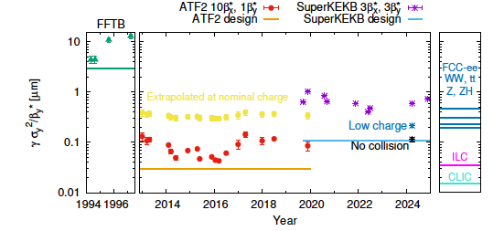
Question 3 (plot)
What scale of systems demonstrations and (test) facilities are needed to "validate" technology?
This plot of “effective normalized emittance” illustrates the optics challenges.
One can also plot the vertical spot size but that is more pessimistic for the future colliders at high energy since the beam size naturally decreases as the sqrt of energy.
https://arxiv.org/pdf/2506.12361, Tomas, Ohnishi, Zimmermann (2025)

Slide 9
Question 4
Looking forward, how do we balance the investment in accelerator R&D for a 10 TeV pCM collider and beyond?
Large investments will be needed in high field magnets, Muon Collider, and/or Plasma for a future high energy collider. When should we down-select between options?
What about other blue-sky R&D ideas that are not directed at a specific approach?
How do we ensure that this R&D is relevant to the HEP future?
In a zero-sum funding world, how do we balance the timescale for project completion versus R&D for future projects and blue-sky R&D versus "directed" R&D?

Slide 10
Question 5
Open discussion

Slide 11
Bonus Questions
How can we increase engagement between particle physicists and the accelerator community?
How should think about the balance between investing in construction and investing in operations?
Does anybody have a better name for the acronym FCC (it will never get built if it remains a Future circular collider)

