Slide 1
ACCELERATOR TECHNOLOGIES
Challenges for high intensity accelerators
Chris Rogers (STFC Rutherford Appleton Laboratory)
With thanks to many colleagues for valuable suggestions and contributions

Slide 2
High Intensity Concepts
Many particle physics applications need high intensity accelerated particle beams
Neutrino oscillation physics
Meson physics (muons, kaons, pions)
Baryon physics
Many more…
Mostly generated from hadronic interactions → high intensity proton accelerators
Addressing intensity limitations important for current & next generation facilities
Non-Collider physics @ CERN
Swiss muon source @ PSI
Non-European facilities e.g. JPARC, Fermilab
Other European facilities – FAIR, ESS, ISIS
For many applications, seek highest possible intensities
Where are the limits?
2

Slide 3
Limits to High Intensity Operation
Ion source
Charge exchange
injection
p
H⁻
π, μ, K, ++
p
Extraction
Target
p
Acceleration loss
& collimation
p
Two classes of limit – losses during acceleration and load on beam intersecting devices
Losses during acceleration
As intensity increases, beam-destructive forces increase i.e. harder to control the beam
Meanwhile as intensity increases, fractional loss must decrease to maintain 1 W/m
Beam Intersecting Devices
Must withstand huge energy
Energy of a speeding truck hitting device every second
E.g. charge exchange injection & target
3

Slide 4
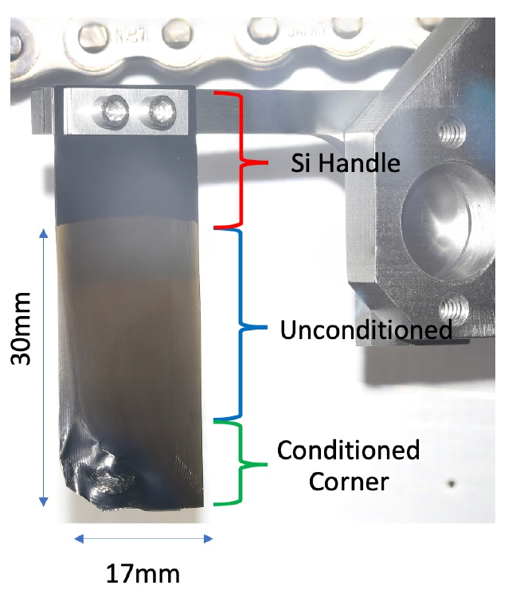
Injection Foil
Injected H⁻
Thin foil
Most proton accelerators do ring injection using charge exchange injection
Accelerate H⁻ in a linac
Get energy above space charge limit
Strip excess electrons using a foil
Allows accumulation of proton beam
Can combine long H⁻ pulse
Limited by heat deposition on foil
Advanced foil materials
E.g. nanocrystalline Carbon foils
Dipoles
Circulating
protons
N. Evans, Operational Experience with Nano-crystalline Injection Foils at SNS, HB2021, 2021
4

Slide 5
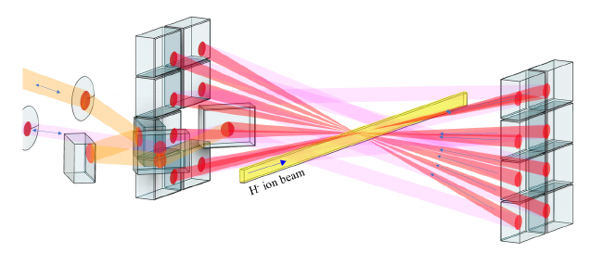
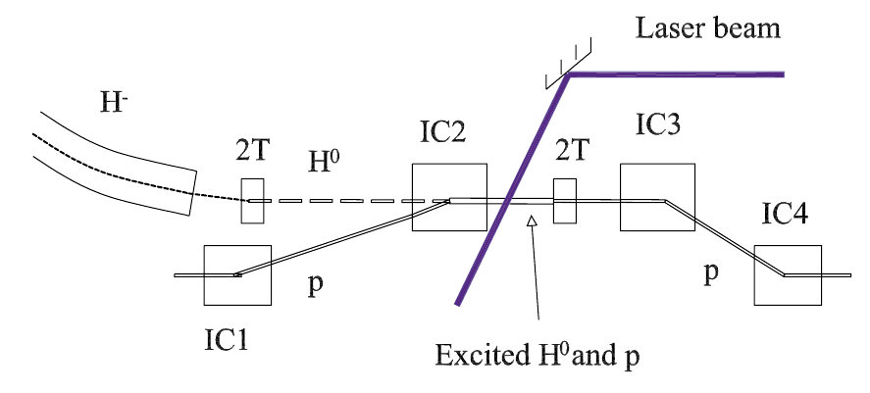
Laser Stripping
J-PARC scheme:
Strip H⁻ → H⁰ using first laser
Excite H⁰ → H⁰* using second laser
Strip H⁰ → p using third laser
Enhance laser power using resonant laser cavity
SNS scheme:
Relativistically boosted B-field strips H⁻ → H⁰
Further magnet excites H⁰ → H⁰*
Laser finally strips remaining electron H⁰* → p
P.K. Saha et al, Status of the Laser Manipulations of H- Beam at J-PARC, IPAC2023
V. Danilov et al, Three Step H- Charge Exchange Injection with a narrow-band laser, PRSTAB 6 (2003)
5

Slide 6
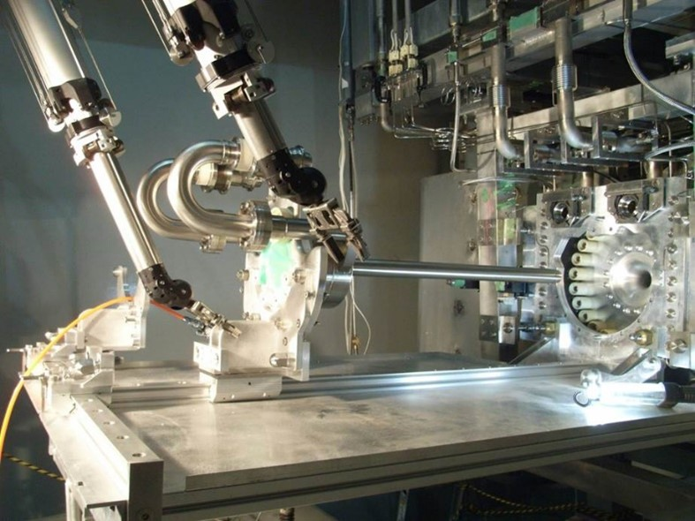
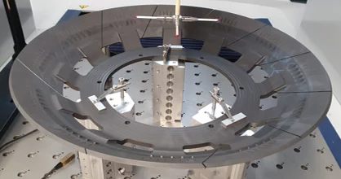
Target
Production of secondary particles by firing protons onto target
Fixed targets currently in use at neutrino facilities
Rotating wheels at PSI
Rapid temperature cycling
Active cooling e.g. forced flow Helium
Extreme radiation damage
Swelling
Structural degradation
Horn or solenoid focusing
Must withstand intense secondary hadronic flux
C. Densham et al, Design of the T2K Target for a 0.75-MW
Proton Beam, HB2010
Credit: PSI
6

Slide 7
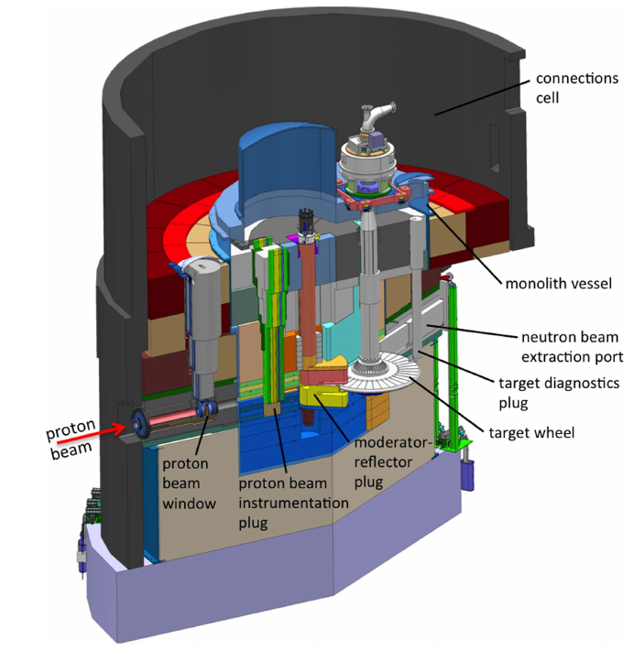
Target – Advanced Concepts
11 m
T. Davenne et al, Observed proton beam induced disruption of a tungsten powder target, PRAB 21, 2018
Advanced concepts to move target material away from beam
Rotating disks
Conveyors
Fluidised powders
Flowing liquid metal targets
Roland Garoby et al, The European Spallation Source Design, Phys. Scr. 93 014001, 2018
7

Slide 8
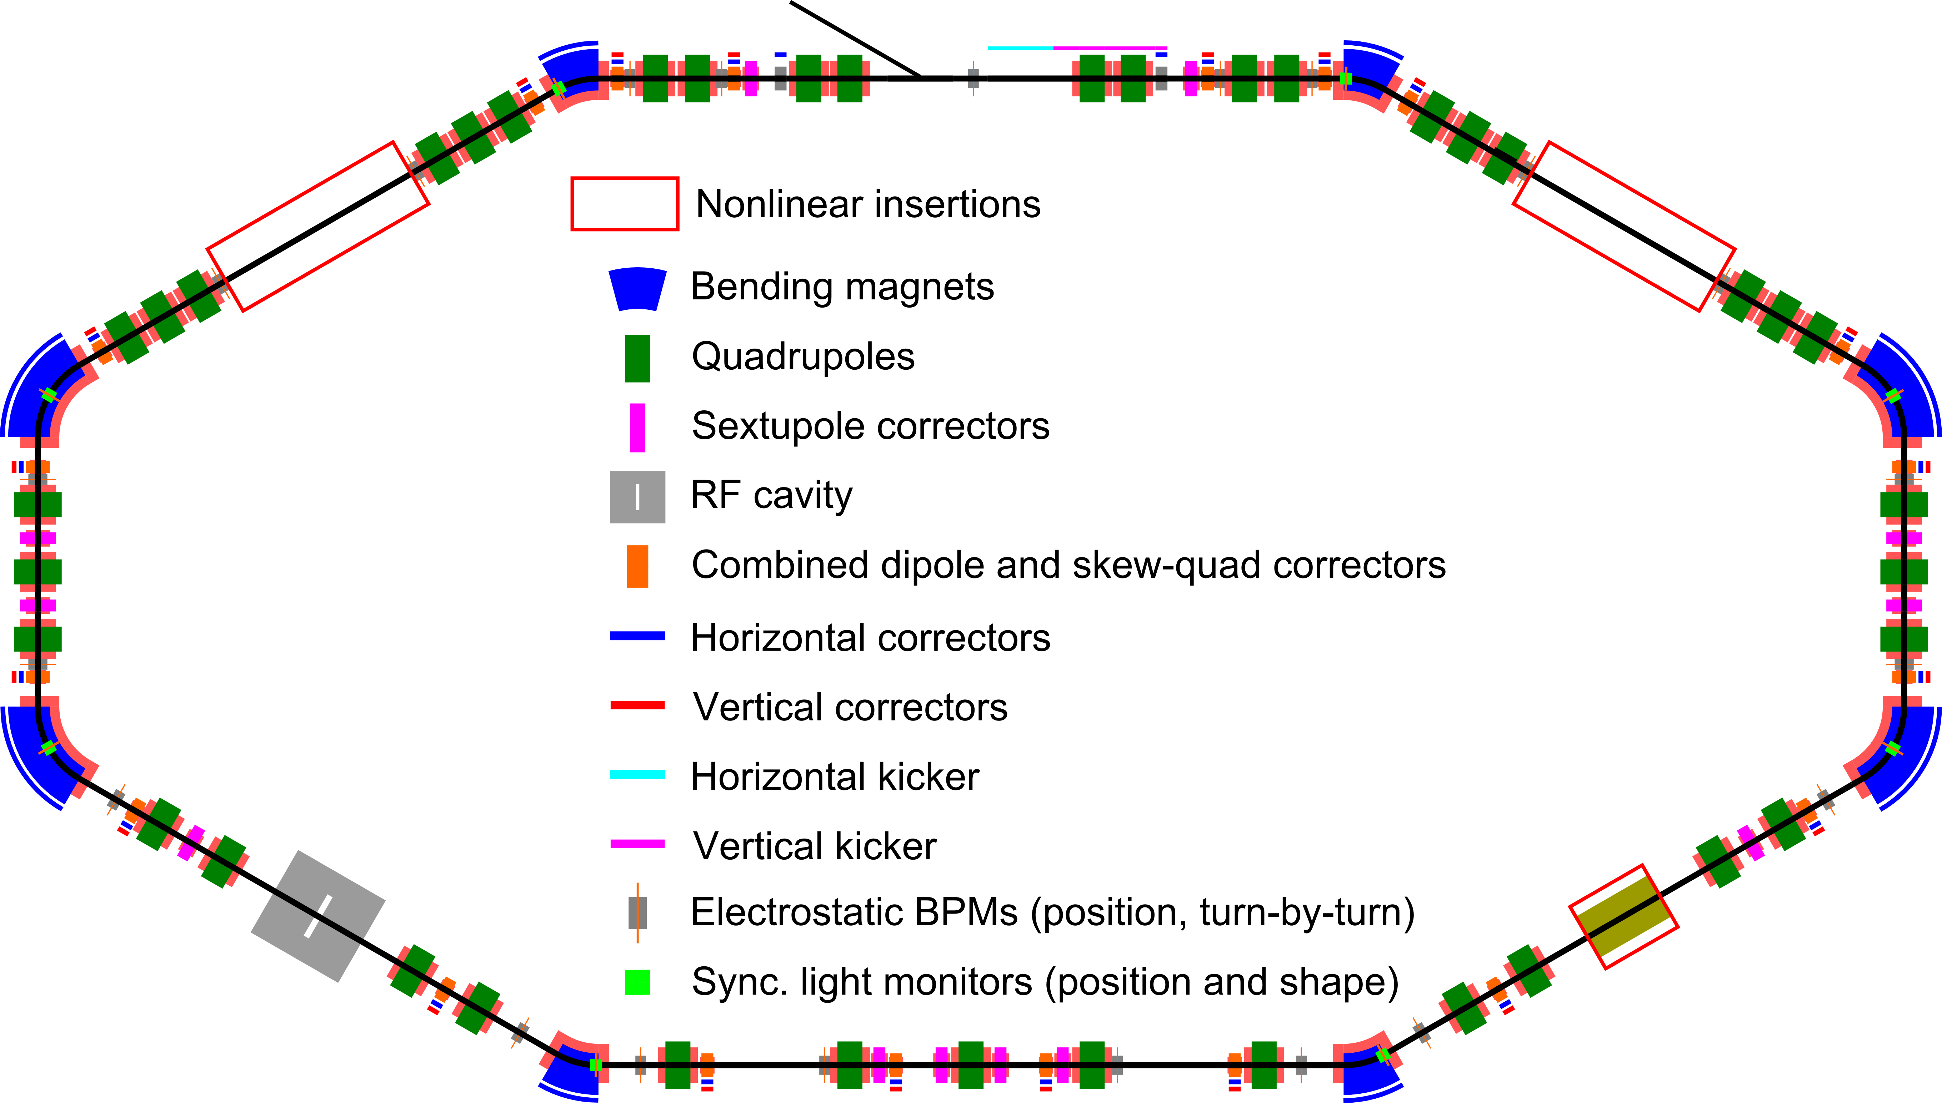
High Intensity Limitations during Acceleration
Space charge
Particles repulse each other from intrinsic charge
Causes a defocusing force that is stronger at low energy
Destroys high intensity beams
Wakefields
Particles induce EM waves in the beam pipe
Dependent on properties of beam & beam pipe
Destroys high intensity beams
Mitigations
Precise beam shaping
Detailed analysis of hardware EM properties
Careful lattice design e.g. to high order multipoles
A. Romanov, The IOTA/FAST Facility: Status, Performance, Upgrades, IOTA/Fast Collaboration Meeting 2024
8

Slide 9
Simulation Codes
Many important codes
PyOrbit, Impact, OPAL, Warp, G4Beamline, Zgoubi and many more…
CERN-led Xsuite initiative
Integration of many different accelerator packages
Share common code tools
Bespoke packages for simulating different physics problems
Accelerator lattice development
Beam-matter interactions
Error analysis & correction
Collective effects
Many others
https://xsuite.readthedocs.io/en/latest/
9

Slide 10
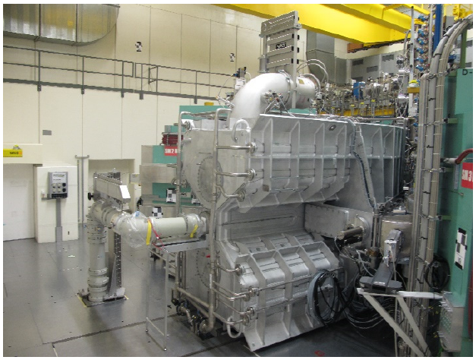
Addressing the Challenges at existing facilities
Increase beam power:
Suppression of space charge
Increase number of pulses per second (rep rate)
LHC Injectors Upgrade completed 2021
Upgrade initial linac to 160 MeV H⁻
Continuing R&D to high energy complex supporting CERN fixed-target programmes
PSI Cyclotron upgrade ongoing
Improved RF systems to suppress halo formation
Enables clean extraction
PIP2 linac at Fermilab under construction
Increased rep rate at JPARC
M. Schneider et al, Upgrade of the PSI Injector 2 Cyclotron, Cyclotrons2019
10

Slide 11
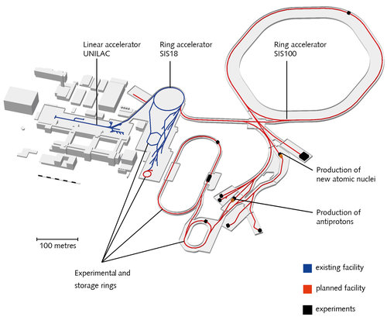
New facilities under construction
European Spallation Source
Long pulse proton linac for neutron production
2 MW, 800 MeV beam in first phase
Facility for Anti-proton and Ion Research
29 GeV protons
Multi-GeV/u ions (depending on species)
Fast ramping superconducting dipoles
Target stations and storage/cooling rings
Credit: ESS
Credit: FAIR
11

Slide 12
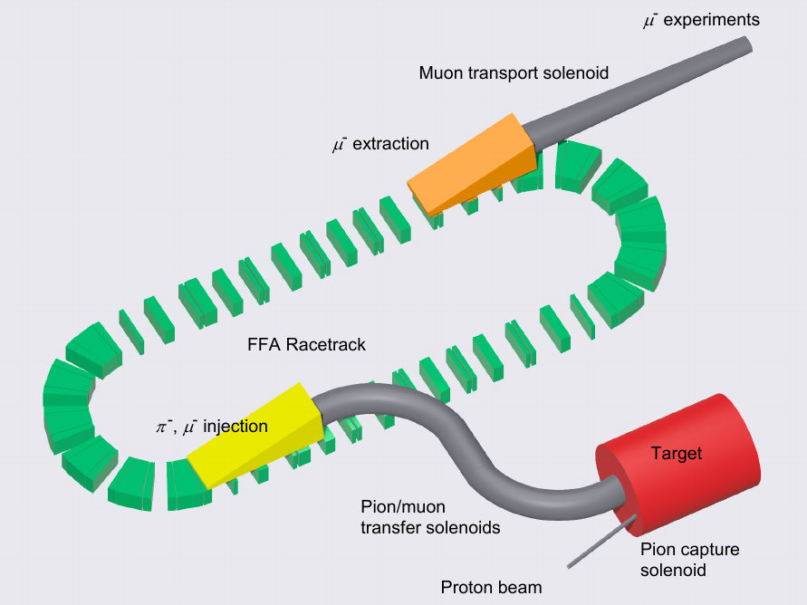
Advanced Muon Beams
PSI
Improved solenoids for muon beam transport
Transverse muon cooling using modified Wien filter
Longitudinal frictional muon cooling
Under construction
Fermilab advanced muon facility (proposed)
High acceptance storage ring
Time-Energy phase rotation
At planning stage
A. Antognini et al, Phase space compression of a positive muon beam in two spatial dimensions, https://arxiv.org/abs/2410.21162
D. Hitlin, The Advanced Muon Facility, CLFV23
12

Slide 13
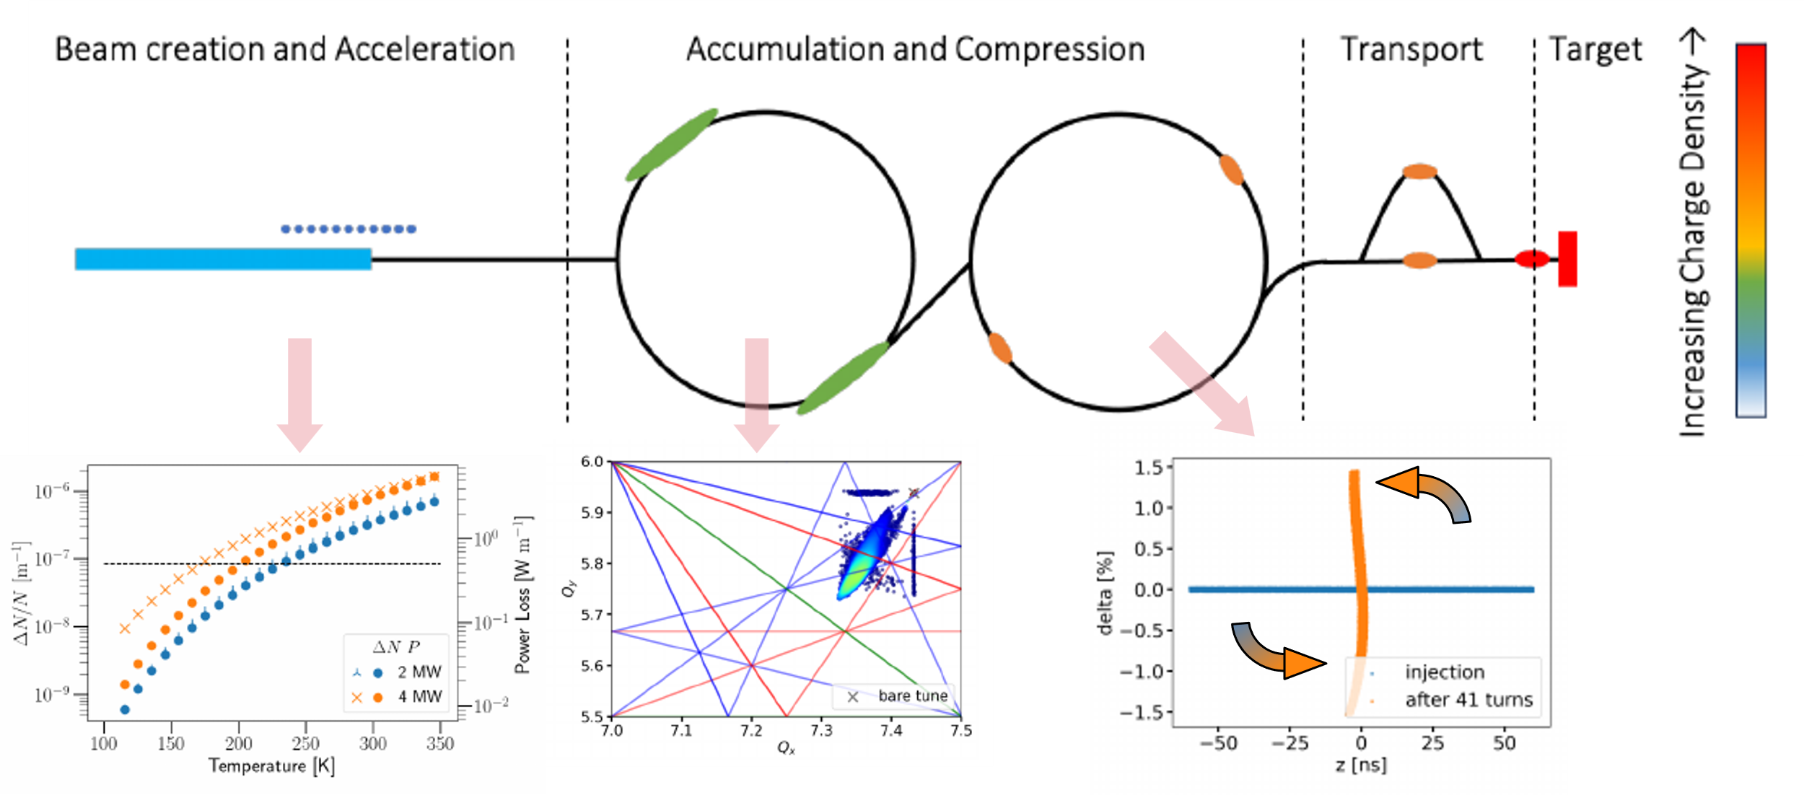
Muon Collider source
D. Schulte et al, The Muon Collider, 2025
Muon collider proton driver high power proton source
2 MW proton source comparable to state of the art
Short proton pulse
Proposed to host high intensity experimental programme
13

Slide 14
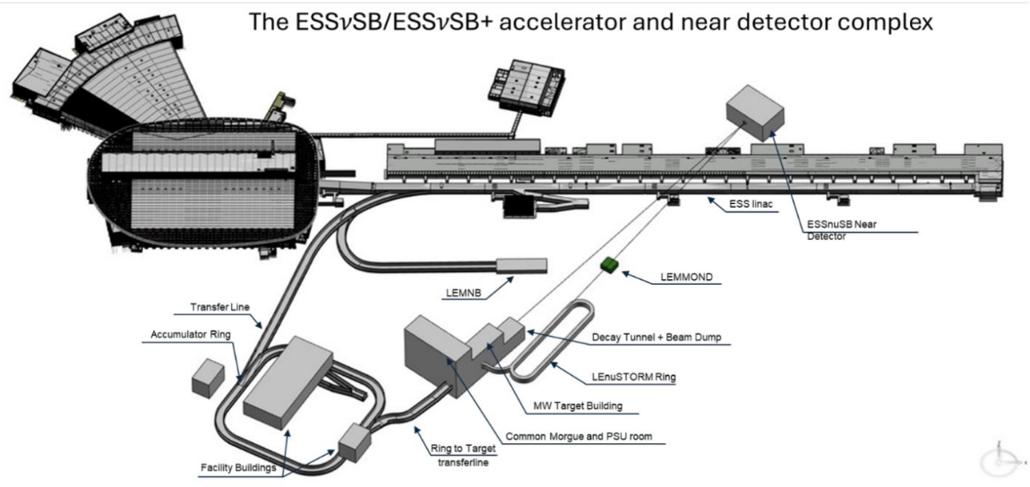
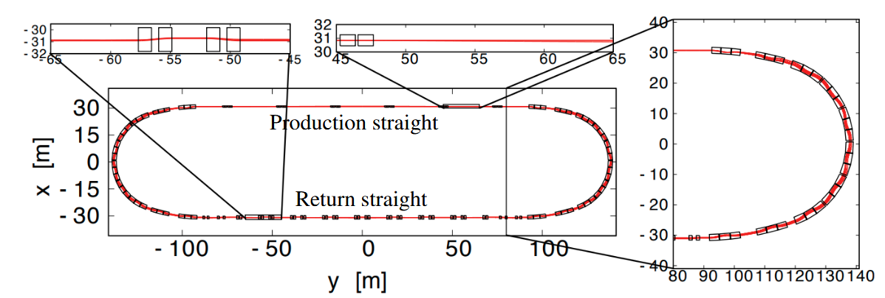
Advanced Neutrino Beam Facilities
Two new accelerator facilities proposed for neutrino production
ESSnuSB
Add H- capability & Accumulator ring to ESS
Short baseline experiments
Long baseline oscillation experiment
nuSTORM
Store O(GeV) muons
Create high intensity & well-characterised neutrino beam for cross-section measurement
M. Drakos et al, ESSnuSB input to 2026 ESPPU
J.B. Lagrange et al, Racetrack FFAG muon decay ring for nuSTORM with triplet focusing JINST 13 no 9, 2018
14

Slide 15
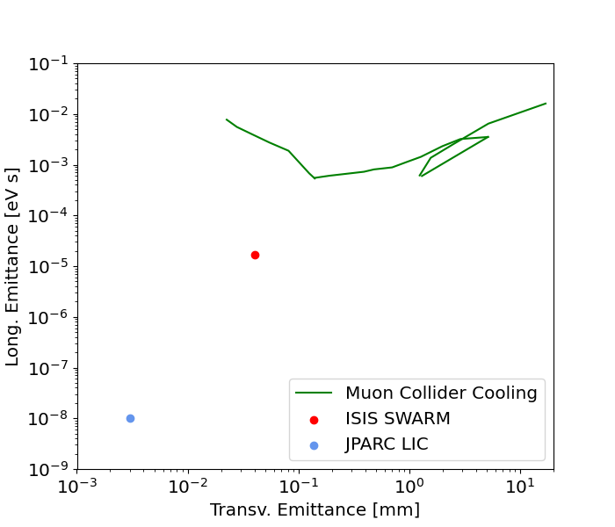
Synergy with other programmes
Many shared technologies with colliders
Many linac upgrades benefit from linear collider cavity R&D
Low energy muon beam cooling may be beneficial for muon collider
Linac4 supports HL-LHC operation
FCCee collimators for Beamstrahlung
Proton accelerators are important facilities for chemistry, material, nuclear and life science
J-PARC multiphysics facility – Materials and Life Science experimental facility
PSI μSR beamlines and neutron spallation source
Other non-HEP facilities
ISIS (UK), ESS (Sweden), SNS (US), CSNS (China) & many others
D. Schulte et al, The Muon Collider, 2025 (Abridged)
S. Aritome et al, Acceleration of cooled positive muons by a Radio-frequency cavity, PRL 134, 2025
15

Slide 16
Conclusion
High intensity facilities important for delivering secondary particle sources
Neutrinos, pions, muons, kaons, neutrons …
High intensity facilities major outcome of the 20th century HEP programme
This is your technology
Vibrant community dedicated to delivering beams at the highest intensities
Huge challenges
Overcome by brilliant teams
Essential to support ongoing R&D to maintain delivery of higher and higher fluxes
CERN
Other European facilities
Facilities outside Europe
16

Slide 17
Further Information
24th June 2025
Open Symposium on the European Strategy for Particle Physics

Slide 18
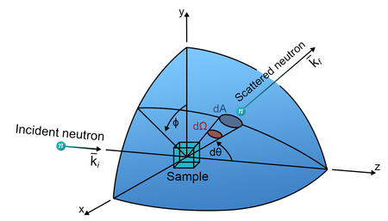
Synergy with other Sciences
Accelerator technology major outcome of HEP programme in C20th
Proton accelerators are important facilities for chemisty, material, nuclear and life science
J-PARC multiphysics facility – Materials and Life Science experimental facility
PSI μSR beamlines and neutron spallation source
Other non-HEP facilities
ISIS (UK), ESS (Sweden), SNS (US), CSNS (China) & many others
High intensity essential to improve resolutions
Very active R&D ongoing between major labs
Credit: ICRU
18

Slide 19
Strategic Considerations
Intensity frontier has important synergies with other programmes
Return on investment & impact important for any facility
In the event of a future e+e- collider, should Europe support intensity frontier?
At CERN?
At other European facilities? Noting heavy oversubscription
At other facilities outside Europe
19

Slide 20
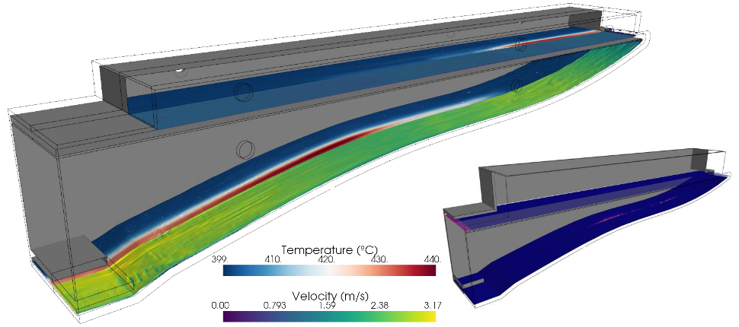
Synergy with Collider programme
D. Schulte et al, The Muon Collider, 2025 (Abridged)
S. Aritome et al, Acceleration of cooled positive muons by a Radio-frequency cavity, PRL 134, 2025
S Candido, presentation at FCC week, 2025
Important synergy between high intensity non-collider and collider facilities
Many shared technologies
Many linac upgrades benefit from linear collider cavity R&D
Low energy muon beam cooling may be beneficial for muon collider
Linac4 supports HL-LHC operation
FCCee collimators for Beamstrahlung
20

Slide 21
Synergy with other Sciences
Accelerator technology major outcome of HEP programme in C20th
Proton accelerators are important facilities for chemisty, material, nuclear and life science
J-PARC multiphysics facility – Materials and Life Science experimental facility
PSI μSR beamlines and neutron spallation source
Other non-HEP facilities
ISIS (UK), ESS (Sweden), SNS (US), CSNS (China) & many others
High intensity essential to improve resolutions
Very active R&D ongoing between major labs
Credit: ICRU
21

Slide 22
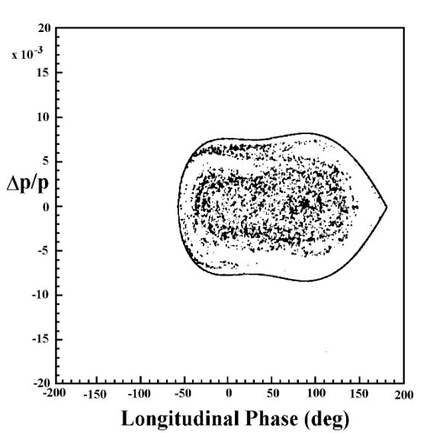
Mitigations
Mitigation of wake-field driven losses requires great care
Suppress wakefield build-up by controlling EM properties of beam pipe
E.g. careful design of accelerator equipment
Precise beam shaping
Beam painting techniques during injection
Second (and higher) harmonic RF cavities
Careful choices in lattice design can reduce impact of space charge
Controlling field up to high order multipoles
Damping of resonance effects
E.g. IOTA/FAST test facility
M R Harold, A possible upgrade for ISIS, PAC97
A. Romanov, The IOTA/FAST Facility: Status, Performance, Upgrades, IOTA/Fast Collaboration Meeting 2024
22

Slide 23
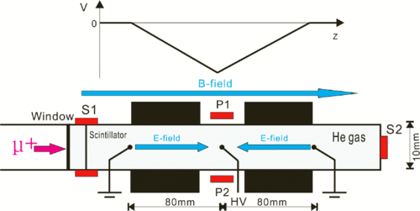
PSI High Intensity Muon Beamline
A. Antognini et al, Phase space compression of a positive muon beam in two spatial dimensions, https://arxiv.org/abs/2410.21162
A. Antognini et al, Phase space compression of a positive muon beam in two spatial dimensions, https://arxiv.org/abs/2410.21162
Improved muon beam transport
Solenoid focused transport channel
Muon beam cooling
Compression of horizontal and vertical beam by modified Wien filter
Compression of longitudinal beam by frictional cooling
23

Slide 24
Advanced Muon Facility
D. Hitlin, The Advanced Muon Facility, CLFV23
Fermilab proposes advanced muon facility
High acceptance storage ring and energy-time phase rotation
Make bunch longer but with smaller energy spread
Strongly reduced energy spread of muon beam
24

Slide 25
Addressing the Challenges at existing facilities
LHC Injectors Upgrade
Upgrade initial linac to 160 MeV
Bring energy above space charge limit
Upgrade to charge exchange injection
Upgrades to acceleration chain to support higher power
Serves both high energy and high intensity programme
Completed 2021
25

Slide 26
Fermilab Synchrotron
M. Ball et al, The PIP-II CDR, 2017
PIP-II Upgrade: New linear accelerator to 800 MeV
Get above space charge limit
Adjustments to boosters to manage new energy/current
Deliver 1.2 MW beam power on target
Studying options to go beyond 2 MW
Accelerator Complex Evolution
26

Slide 27
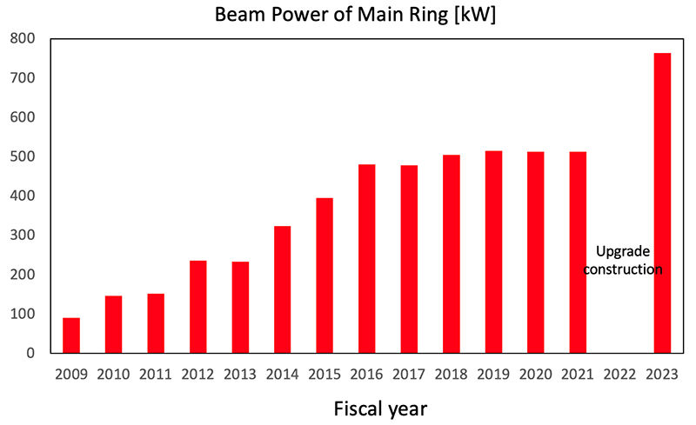
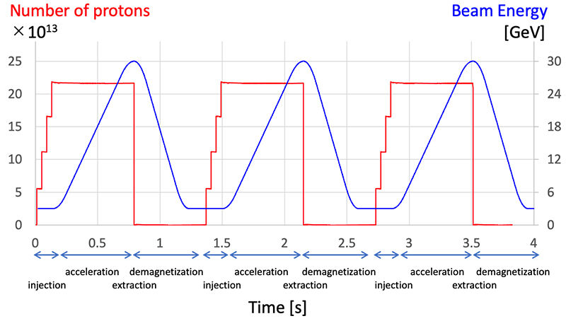
JPARC Synchrotron
Credit: J-PARC
Credit: J-PARC
Steady increase in achieved beam current
Detailed modelling of the accelerator
Understanding of loss-generating processes
Improved injection systems
More than double pulse frequency (rep rate)
Further improvement in beam performance
27

Slide 28
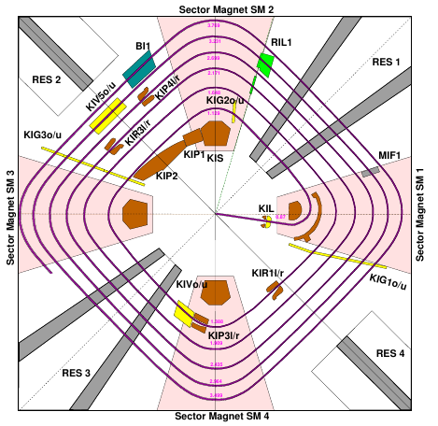
PSI Cyclotron
Direct extraction of accelerated bunches needs good bunch separation
Space charge causes halo formation
Beam hits the extraction septum
Stronger accelerating RF
Blocks the space charge smearing
Accelerates faster than space charge smearing
Injector upgrade complete 2026
Main ring upgrade in design phase
C. Baumgarten et al, PSI Injector and the 72 MeV Transfer Line: MinT-Simulations vs Measurements, Cyclotrons2019
28
M. Schneider et al, Upgrade of the PSI Injector 2 Cyclotron, Cyclotrons2019

