Slide 1
Accelerator Technology R&D
for Proposed Colliders
Philip Burrows
Director, John Adams Institute
24th June 2025

Slide 2

Outline
LDG Accelerator R&D roadmap
Key technology areas:
  High-field magnets
  Radio Frequency systems
  Energy Recovery Linacs
  Bright muon beams & muon collider
  Plasma wakefield acceleration
Outlook
For reference: submissions
24/06/2025
Physics Preparatory Group - Accelerator Science and Technology WG
2

Slide 3
Outcomes of the 2020 ESPPU
The European particle physics community must intensify accelerator R&D and sustain it with adequate resources. A roadmap should prioritise the technology, taking into account synergies with international partners and other communities such as photon and neutron sources, fusion energy and industry. Deliverables for this decade should be defined in a timely fashion and coordinated among CERN and national laboratories and institutes.
24/06/2025
Physics Preparatory Group - Accelerator Science and Technology WG
3

Slide 4
Outcomes of the 2020 ESPPU
The European particle physics community must intensify accelerator R&D and sustain it with adequate resources. A roadmap should prioritise the technology, taking into account synergies with international partners and other communities such as photon and neutron sources, fusion energy and industry. Deliverables for this decade should be defined in a timely fashion and coordinated among CERN and national laboratories and institutes.
Lab Directors’ Group (LDG) Accelerator R&D Roadmap set up in 2022
https://doi.org/10.23731/CYRM-2022-001
Five R&D panels established:
  High Field Magnet (HFM) development for a future hadron collider
  Radio Frequency (RF) systems (superconducting + normal-conducting)
  Plasma wakefield acceleration (laser- and beam-driven)
  Muon beams/colliders
  Energy-recovery linacs (ERLs)
  + sustainability panel
First phase to conclude in 2026
24/06/2025
Physics Preparatory Group - Accelerator Science and Technology WG
4

Slide 5
Mid-term Review (February 2025)
  Report: https://indico.cern.ch/event/1439855/abstracts/191018/
24/06/2025
Physics Preparatory Group - Accelerator Science and Technology WG
5

Slide 6
LDG Accelerator R&D Roadmap
Mid-term review February 2025:
24/06/2025
Physics Preparatory Group - Accelerator Science and Technology WG
6

Slide 7
Setting the scene for this talk
The LDG and the expert Review Panel invested considerable effort in conducting the R&D review
Their conclusions on the R&D status and future directions are incisive
Our expert parallel session speakers yesterday gave much more technical detail
all are available to provide more information + contribute to the discussion
Apologies in advance for any errors / misunderstandings on my part
24/06/2025
Physics Preparatory Group - Accelerator Science and Technology WG
7

Slide 8
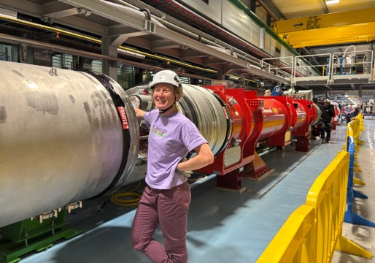
High Field Magnets (HFMs)
Priority: HFMs > 10T as a key technology for high-energy circular hadron colliders (FCChh)
Very different HFMs are also needed for a muon collider
Strong coordinated effort across European labs and industries with international collab.
HL-LHC: 11.5T Nb3Sn accelerator-grade magnets established in small-series production
as required for the ATLAS + CMS Inner Triplet upgrades
24/06/2025
Physics Preparatory Group - Accelerator Science and Technology WG
8

Slide 9
High Field Magnets (HFMs)
Priority: HFMs > 10T as a key technology for high-energy circular hadron colliders (FCChh)
Very different HFMs are also needed for a muon collider
Strong coordinated effort across European labs and industries with international collab.
HL-LHC: 11.5T Nb3Sn accelerator-grade magnets established in small-series production
as required for the ATLAS + CMS Inner Triplet upgrades
Two approaches: LTS (Nb3Sn) + HTS (REBCO) conductors
Long-term programme requires sustained investment (20MChF/ yr materials → 2030s)
Completion of HL-LHC should free up additional expert personnel for HFM
HL-LHC: 11T Nb3Sn accelerator-grade magnets established in small-series production
as required for the ATLAS + CMS Inner Triplet upgrades
24/06/2025
Physics Preparatory Group - Accelerator Science and Technology WG
9

Slide 10
FCChh arc magnet baseline
consistent baseline with high confidence level based on HL-LHC experience
HFM Programme ESPPU #243
24/06/2025
Physics Preparatory Group - Accelerator Science and Technology WG
10

Slide 11
FCChh arc magnet baseline
consistent baseline with high confidence level based on HL-LHC experience
HFM Programme ESPPU #243
24/06/2025
Physics Preparatory Group - Accelerator Science and Technology WG
11

Slide 12
FCChh arc magnet baseline
consistent baseline with high confidence level based on HL-LHC experience
HFM Programme ESPPU #243
24/06/2025
Physics Preparatory Group - Accelerator Science and Technology WG
12

Slide 13
FCChh arc magnet baseline
consistent baseline with high confidence level based on HL-LHC experience
I / Imax
HFM Programme ESPPU #243
24/06/2025
Physics Preparatory Group - Accelerator Science and Technology WG
13

Slide 14
FCChh arc magnet baseline
consistent baseline with high confidence level based on HL-LHC experience
best available today
HFM Programme ESPPU #243
24/06/2025
Physics Preparatory Group - Accelerator Science and Technology WG
14

Slide 15
FCChh arc magnet baseline
consistent baseline with high confidence level based on HL-LHC experience
200 → 150 MPa stress
HFM Programme ESPPU #243
24/06/2025
Physics Preparatory Group - Accelerator Science and Technology WG
15

Slide 16

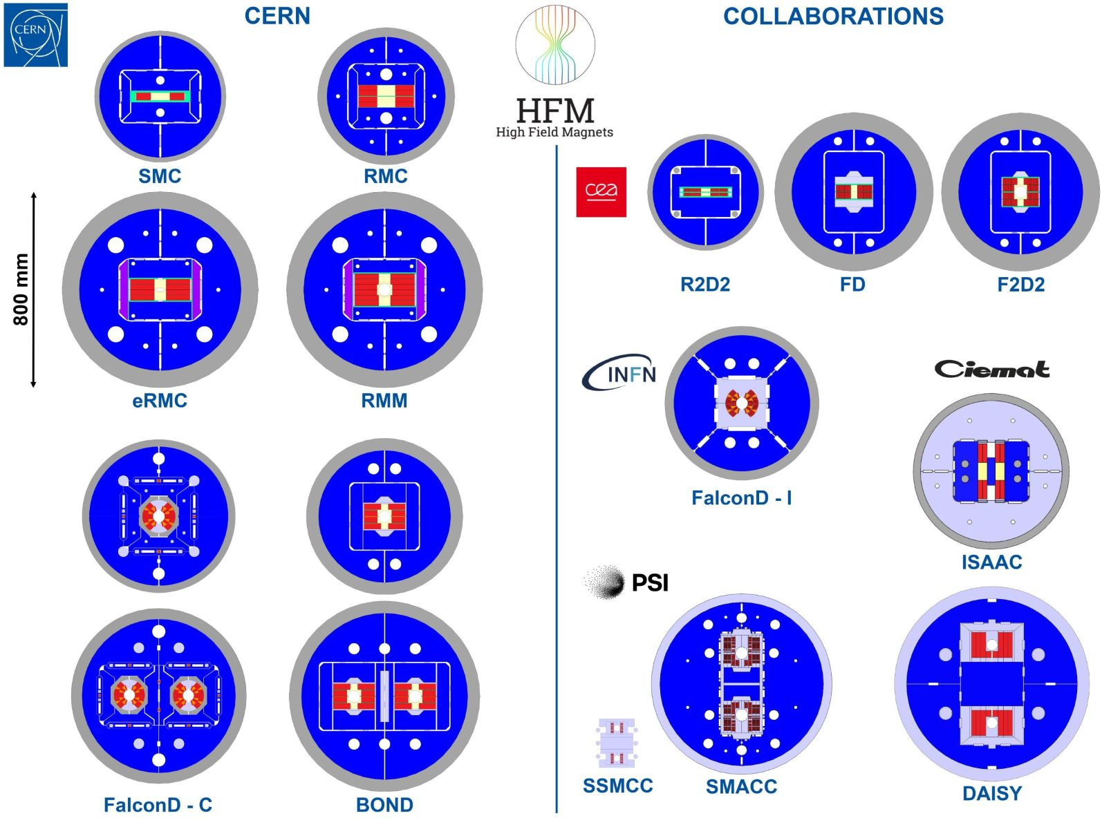
Demonstration of Baseline Parameters
New layouts also being investigated
eg. ‘common-coil’ vs. ‘block-coil’
With an eye on cost, length scaling, and industrialization
First tests expected 2026-27
  Demonstrate the baseline parameters with short magnets reaching 15-15.5 T
  Down-select to one or two designs for further optimization and demonstration of reproducibility.
From B. Auchmann

Slide 17
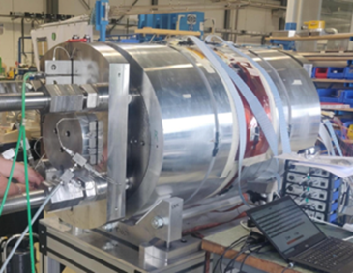

Demonstrator: 17 T achieved
Demonstrators: magnets not having all features of a short model, but proving a part of the technology
  RMM, based on block design, 50 mm aperture, but without flared ends, and very large coil,
  achieved fields of 16-17 T.
D. Tommasini et al
More info: [https://hfm.web.cern.ch/news/cern/rmm-demonstrator-gets-close-17-t-50-mm-bore]
From B. Auchmann

Slide 18
LTS R&D directions:
improved performance / cost
Improved conductor performance/availability
currently only one major Nb3Sn conductor supplier
→ improve supply base
Nb3Sn / NbTi hybrid magnets at 1.9K
→ reduction in Nb3Sn mass ~ 50%
4.5K operation
→ reduce cryogenic system complexity, cost + power
12T magnets (73 TeV for same filling factor)
→ 30% less conductor, 20% lower stress
24/06/2025
Physics Preparatory Group - Accelerator Science and Technology WG
18

Slide 19
LTS timeline
Select the design by the end of LS3 (we should start having some indications from tests in 2026-2027)
Have a full short model program to verify reproducibility and margins in 2029-2031
Scaling in length in two steps: TRL 7 achieved between 2036 and 2040
Industrialization for final magnets, with pre-series
9 years of production, installation and commissioning in parallel
First selection
of design
5-m-long prototypes
(>5 each type)
Industrialization (pre-series magnets)
Short model program on two selected designs
(>5 each type)
15 m long prototypes (>5)
Production and test
Ongoing
12 T and 14 T short models
(7 designs, 1 or 2 of each type)
Selection of final design
to start long magnets
Installation and commissioning
Tender
for the series
`25
`26
`27
`28
`29
`30
`31
`32
`33
`34
`35
`36
`37
`38
`39
`40
`41
`42
`43
`44
`45
`46
`47
`48
`49
`50
`51
`52
`53
`54
RunIII
HL-LHC RunIV
HL-LHC RunV
B. Auchmann
24/06/2025
Physics Preparatory Group - Accelerator Science and Technology WG
19

Slide 20
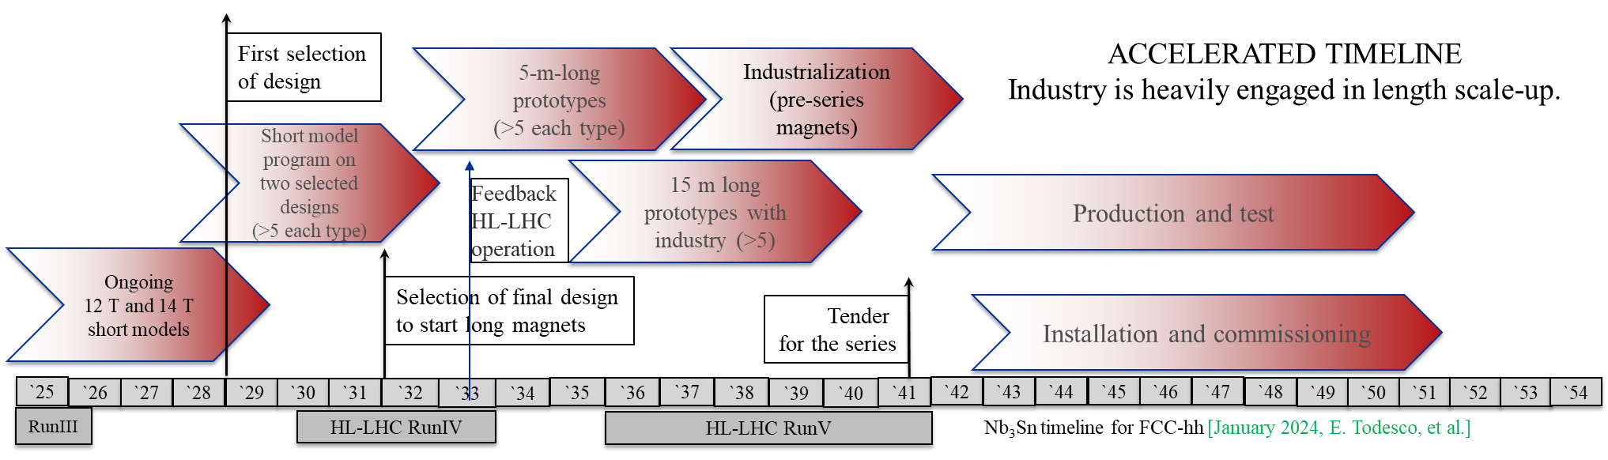
LTS timeline
Select the design by the end of LS3 (we should start having some indications from tests in 2026-2027)
Have a full short model program to verify reproducibility and margins in 2029-2031
Scaling in length in two steps: TRL 7 achieved between 2036 and 2040
Industrialization for final magnets, with pre-series
9 years of production, installation and commissioning in parallel
B. Auchmann
24/06/2025
Physics Preparatory Group - Accelerator Science and Technology WG
20

Slide 21
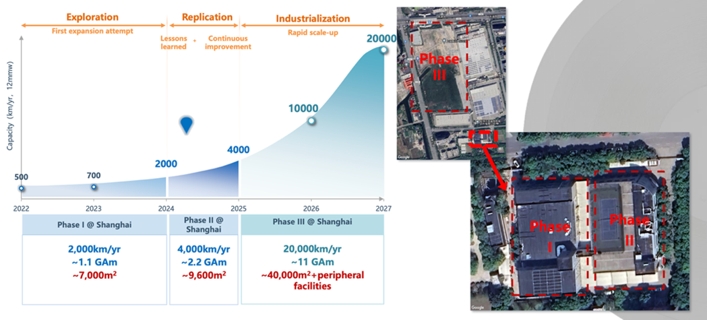
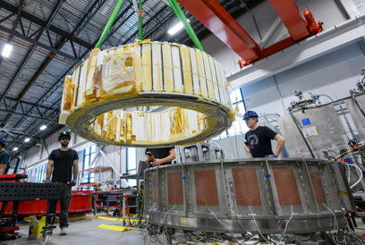

HTS potential
    [B. Song, et al., https://indico.cern.ch/event/1347361/ (2025)]
Possibilities for i) J → 1000 A/mm^2, ii) B > 20T, iii) T > 20K
Conductors: ReBCO, BSCCO, IBS
REBCO (+ BSCCO) commercially available
REBCO dynamic market, industrial-scale production
Interest from other communities (eg. fusion, NMR, high-field science)
demonstrations with REBCO of high-field
solenoids (28T, Bruker) + toroidal coils (20T, TFML)
(issues of degradation / quench losses)
FCChh demands: field quality, reproducibility, stability, uniformity
24/06/2025
Physics Preparatory Group - Accelerator Science and Technology WG
21

Slide 22
HTS R&D directions
Conductor choice:
Develop REBCO tape, monitor BSSCO, study IBS potential (round wire)
Magnet specifications + requirements:
Including cryo, beam dynamics, feedbacks, powering/protection, instrumentation, vacuum …
Magnet technology:
Develop/validate REBCO cable + learn how to wind, insulate, load, cool, protect dipoles
Demonstrate accelerator quality at intermediate field + short length, then scale up
HTS/LTS hybrid technology:
Possible cost saving but still need T = 1.9 or 4.5K for LTS sections
Quantify potential gains vs. drawbacks and risks
24/06/2025
Physics Preparatory Group - Accelerator Science and Technology WG
22

Slide 23
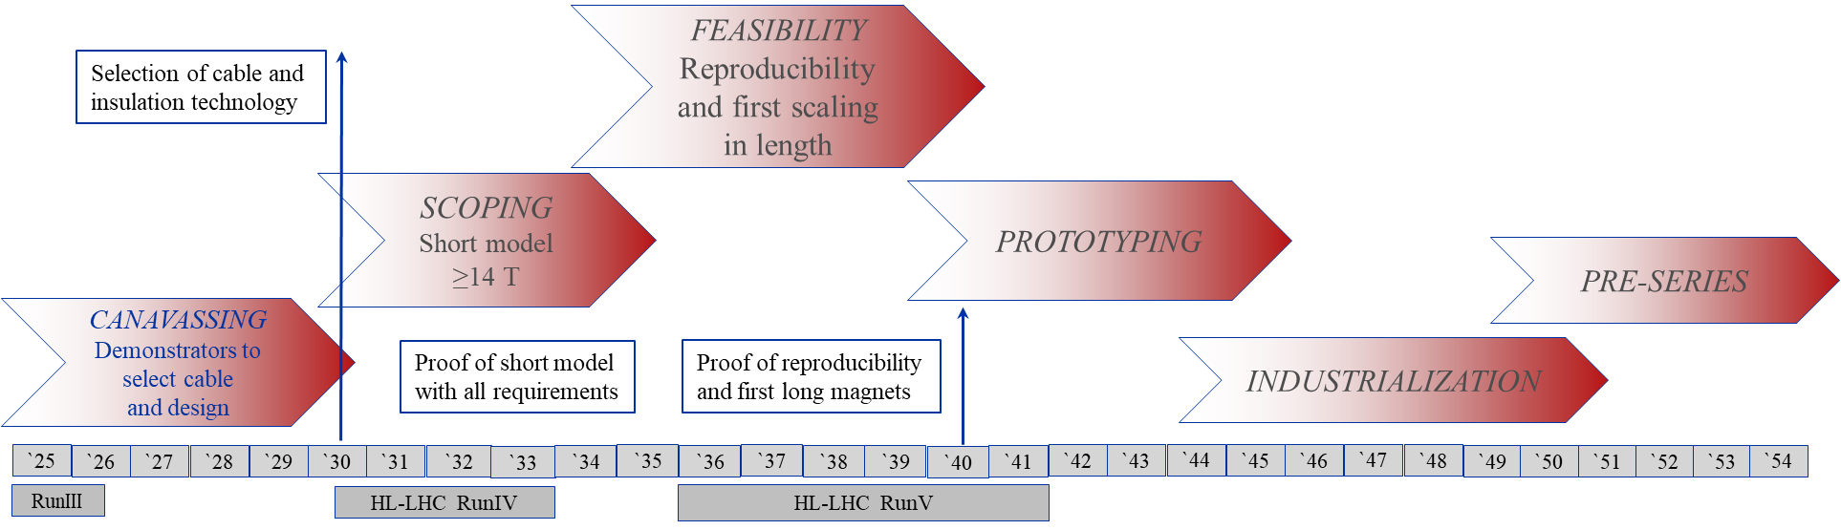
HTS timeline
HTS timeline for FCC-hh [FCC FS midterm report, August 2023, B. Auchmann, et al.]
Target: 2035 a proof of a short model dipole with all features for FCC
  Aperture, field ≥14T, field quality, protection, …
Development of LTS and HTS technology in parallel at least until 2035.
The limit for HTS R&D today is the availability of trained and experienced engineers.
B. Auchmann
24/06/2025
Physics Preparatory Group - Accelerator Science and Technology WG
23

Slide 24
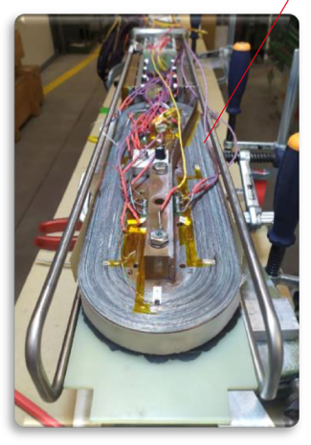


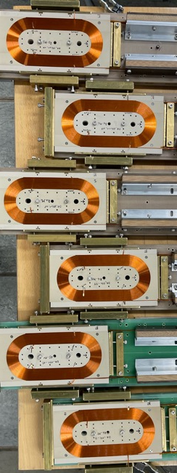
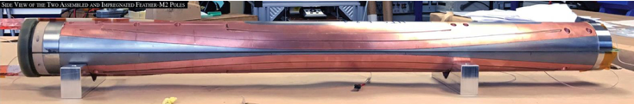

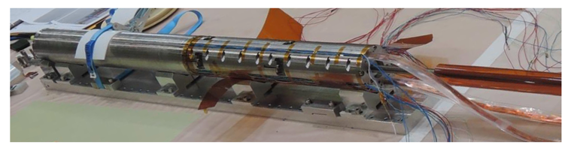


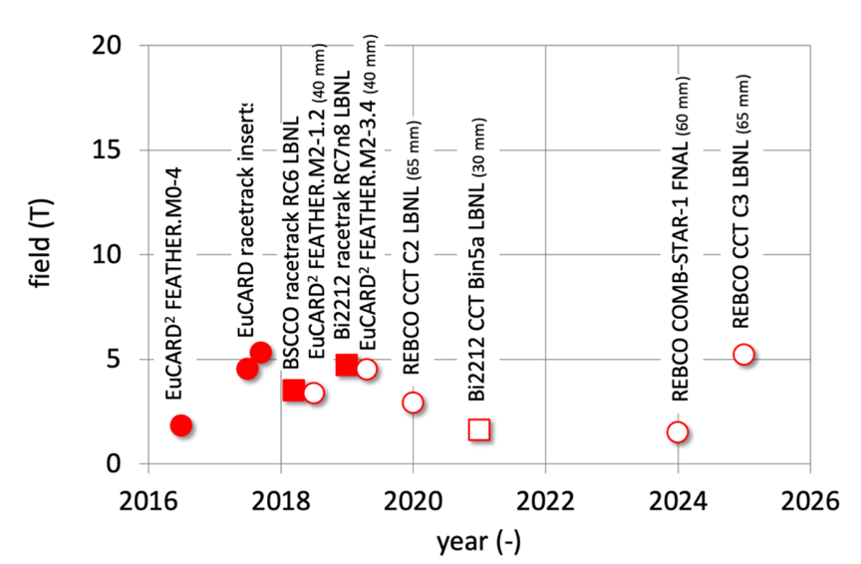

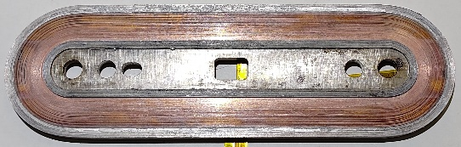
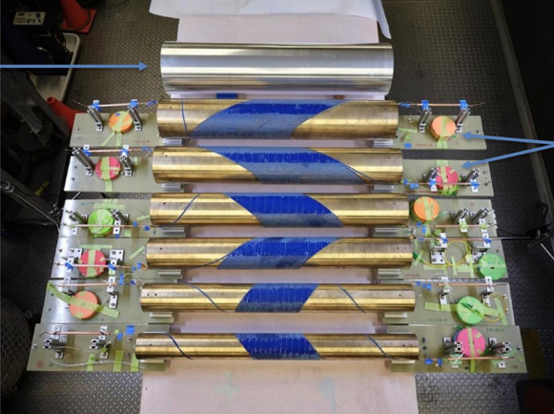
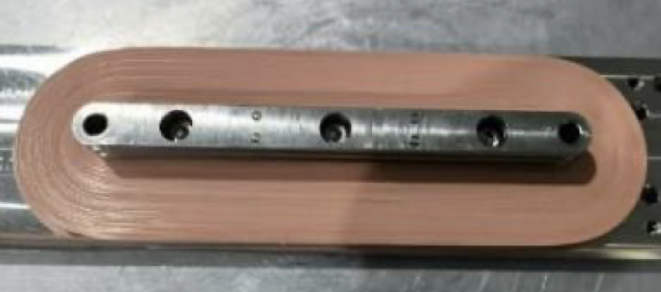
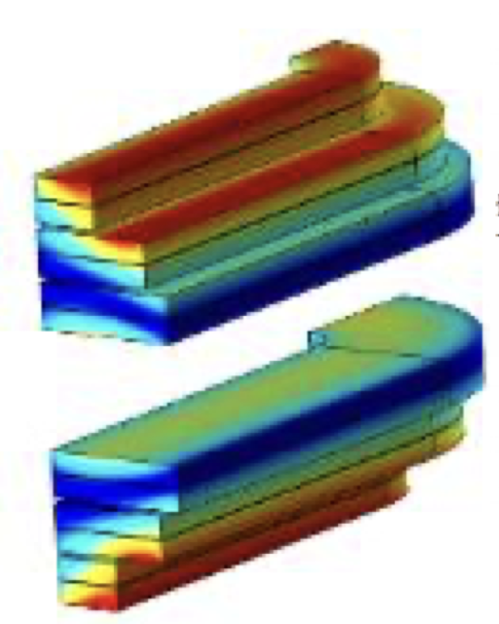

HTS Accelerator Magnets
State-of-the-Art
EPFL SPC LASSO Racetrack
EUCARD2 Feather M2 (CERN)
CERN insulated
tape-stack cable racetracks
EUCARD2 Cos Theta (CEA)
REBCO NI racetrack insert IHEP (20 mm)
REBCO MI racetrack CEA
Ins. tape-stack cable racetrack CERN
CEA MI
Racetrack
6 T insert coils by IHEP
C3 REBCO CCT with CORC ® Cable
B. Auchmann

Slide 25
Status assessment based on TRL
LDG Mid-term Review
24/06/2025
Physics Preparatory Group - Accelerator Science and Technology WG
25

Slide 26
HFMs: FCChh status assessment
LDG Mid-term Review
24/06/2025
Physics Preparatory Group - Accelerator Science and Technology WG
26

Slide 27
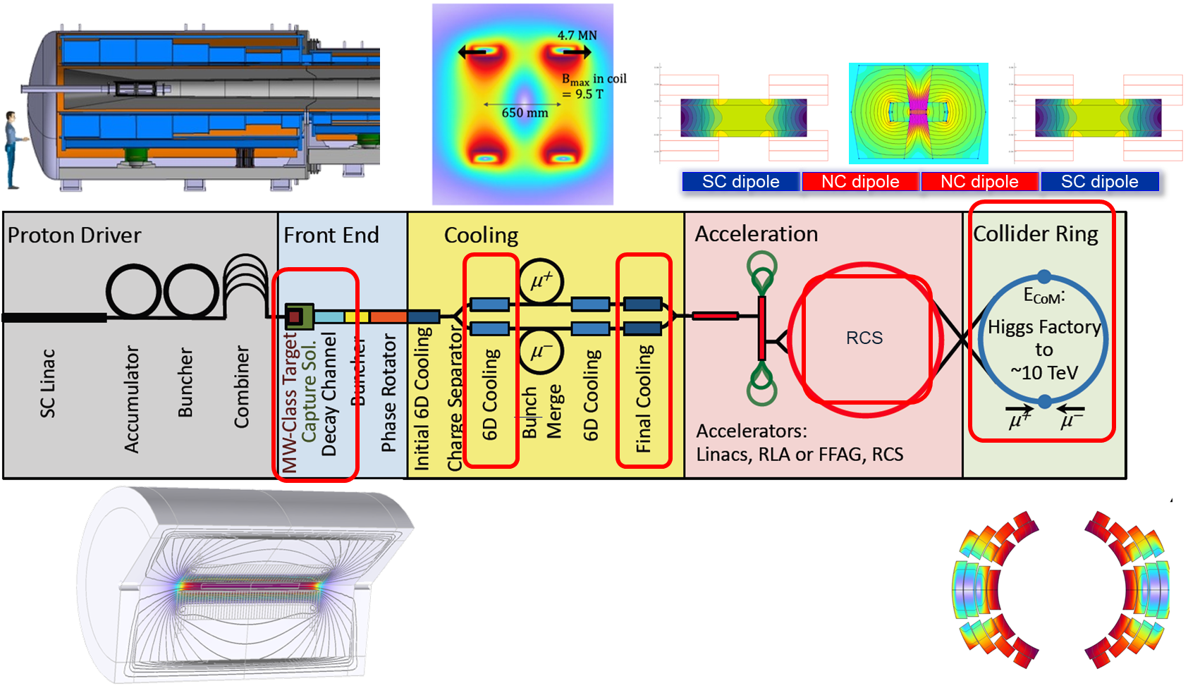
Muon collider magnets
B. Auchmann
24/06/2025
Physics Preparatory Group - Accelerator Science and Technology WG
27

Slide 28

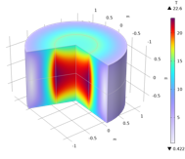
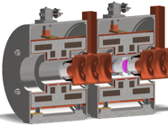
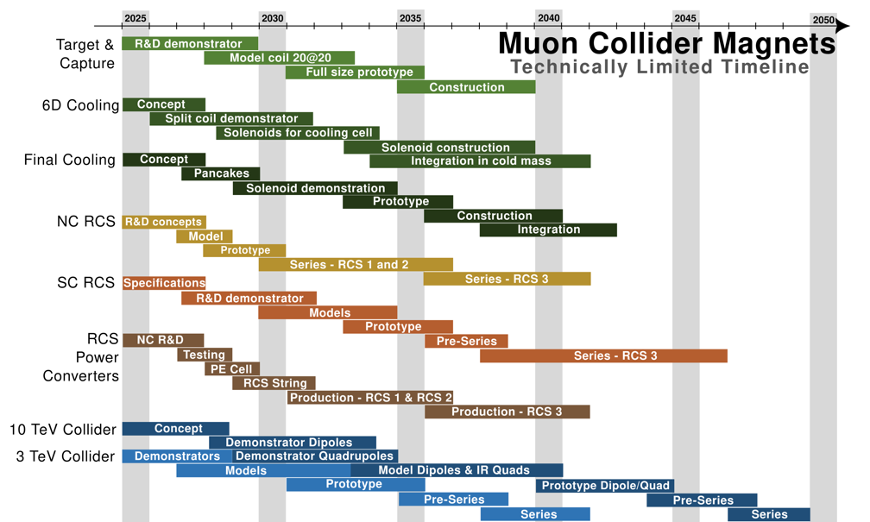
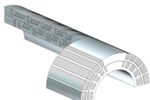

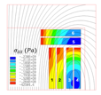
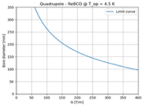
Technology Demonstrators
Target solenoid model coil (20@20)
Objectives: Generate a bore field of 20 T,
and operating at a temperature of 20 K.
Time: 2033
Technology R&D
Prototypes and Industrialization
Demonstrators
Production
Split Solenoid integration for 6D cooling cell (SOLID)
Objectives: Demonstrator of HTS split solenoid
representative of a 6D cooling cell.
Time: 2032
Final cooling UHF solenoid (UHF-Demo)
Objectives: HTS final cooling solenoid,
40 T in a 50 mm bore, 150 mm length.
Time: 2034
Wide-aperture, DC Nb₃Sn dipole (MBHY)
Objectives: Demonstrate wide-ap. LTS dipole
Time: 2036
Wide-aperture DC HTS dipole (MBHTSY)
Objectives: Demonstrate wide-ap. HTS dipole
Time: (2045)
Wide aperture HTS IR quadrupole (MQHTSY)
Objectives: Demonstrate wide-ap. HTS
quadrupole for the collider IR.
Time: (2045)
B. Auchmann

Slide 29
HFM summary
Nb₃Sn technology has reached a high level of maturity
The updated specification (14 T, Nb₃Sn at 1.9 K) with adjusted requirements provides a consistent baseline with high confidence level based on HL-LHC experience.
Current priorities include the down-selection of candidate designs by 2028, cost and sustainability optimization, and scale-up of magnet length.
Multiple promising paths are being pursued to meet cost targets, such as increase of conductor supply base, improved conductor performance, and hybrid Nb₃Sn/Nb-Ti magnets.
REBCO for FCC-hh must meet challenges unique to particle accelerators
Accelerator magnets must enable fast turn-around time with low ramp losses, and with field quality at injection, ramp, and collision.
Over the next 10 years, the community will search for technical solutions for conductor, cable, coil winding, cryogenics, mechanics, protection, and iterate magnet specifications (B, T, margins, field quality) to demonstrate REBCO technology readiness.
Muon collider magnets are pushing the boundaries of technical feasibility
Core technologies (cable type, winding, mechanics) for solenoids (target, 6D cooling, final cooling) are established and shared with other fields like high-field science and fusion – but a 1 km channel of solenoids strongly coupled poses challenges that have never been taken so far
Collider magnets specs differ from FCC-hh in their large aperture and DC operation mode.
B. Auchmann

Slide 30
High Gradient RF structures/systems
Relevant to essentially all future Particle Physics projects
LDG activity organised around Working Groups:
  Bulk Niobium
  Thin films
  Power couplers
  NC high-gradient technology
  RF power sources
  LLRF, Artificial Intelligence, Machine Learning
Include both project-specific and generic technology goals, some of which are aspirational
Good collaboration, however funding + priorities largely set at lab level
24/06/2025
Physics Preparatory Group - Accelerator Science and Technology WG
30

Slide 31
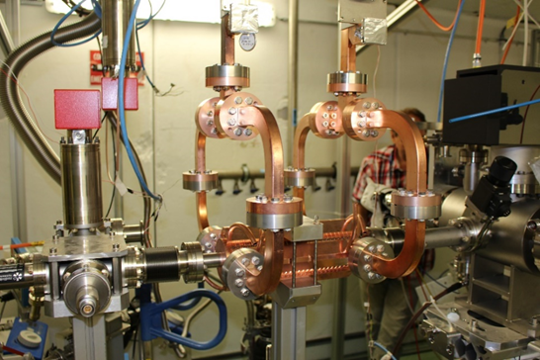
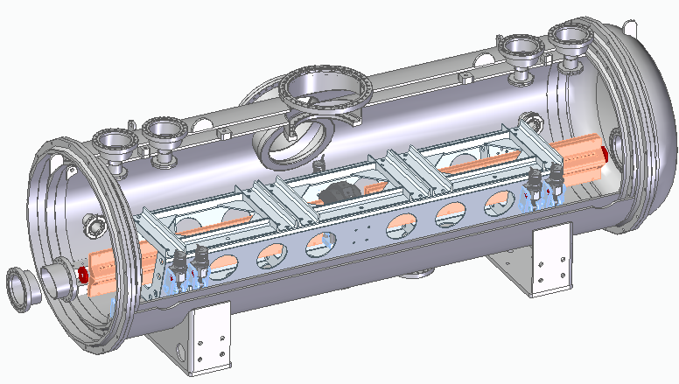
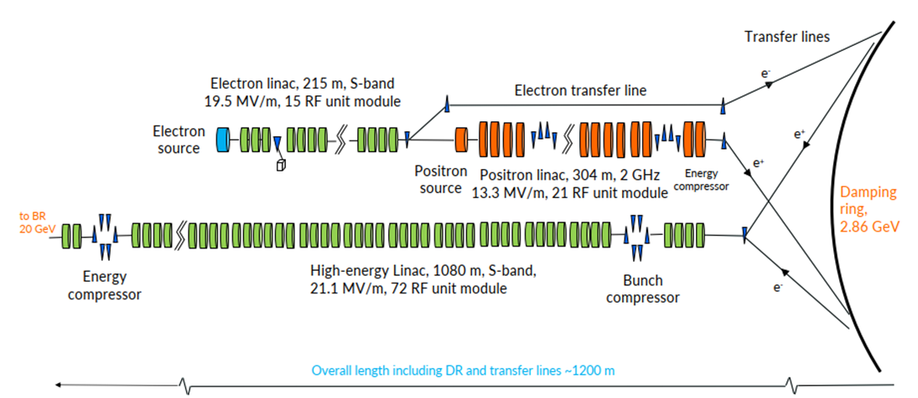
NC RF cavities (1)
CLIC main linac:
72 MV/m loaded gradient (380 GeV) → 100 MV/m (1.5TeV) with O(10⁻⁷) breakdown rate
70 – 100+ MV/m demonstrated in prototypes + applications
SwissFEL (6 GeV): large-scale Cu-structure system with similar um-level tolerances
Industrialisation needs to be advanced – many smaller-scale facility applications (VHEE, ICS …)
C³:
70 (250 GeV) → 120 (550 GeV) MV/m based on cryo-cooled Cu structures
FCCee injector at 20 GeV would be a major linac installation > SwissFEL
2 / 2.8 GHz, gradient intentionally conservative ~ 21 MV/m
Will be based on SwissFEL-type fabrication technology
Adapted from Walter Wuensch
24/06/2025
Physics Preparatory Group - Accelerator Science and Technology WG
31

Slide 32
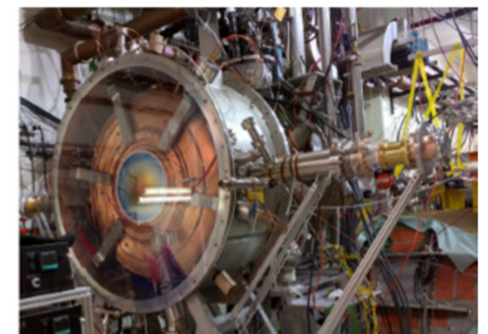
NC RF cavities (2)
Muon Collider:
Key technology for the performance of the muon capture and cooling channel
High-Gradient - 20-30 MV/m, in 2-17 T external magnetic field – unique challenge
Requires new test infrastructure and extensive testing programme
Synergistic with CLIC and C³ high-gradient structure development
Beam-driven wakefield acceleration:
HALHF e- drive beam and positron linac based on equivalent CLIC/C³ systems
AWAKE electron injection based on CLIC linac technology, combination of CTF/CLEAR and X-band
EuPRAXIA electron drive beam and beam preparation based on high-gradient X-band technology
→ Consider ongoing high-gradient NC structure test capability
Adapted from Walter Wuensch
24/06/2025
Physics Preparatory Group - Accelerator Science and Technology WG
32

Slide 33
SC RF cavities
24/06/2025
Physics Preparatory Group - Accelerator Science and Technology WG
33

Slide 34
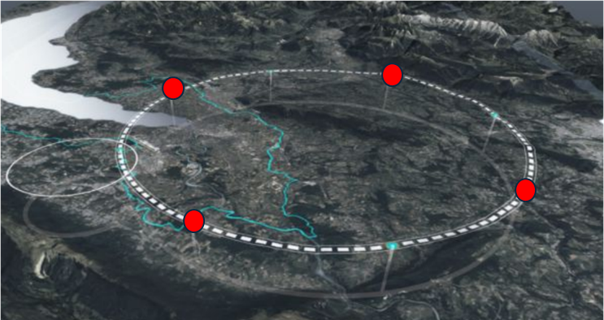
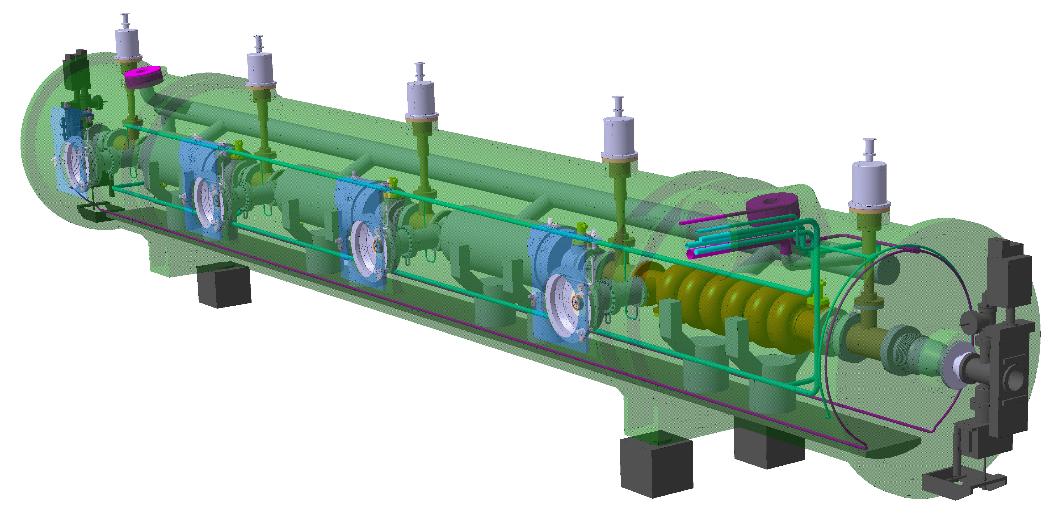
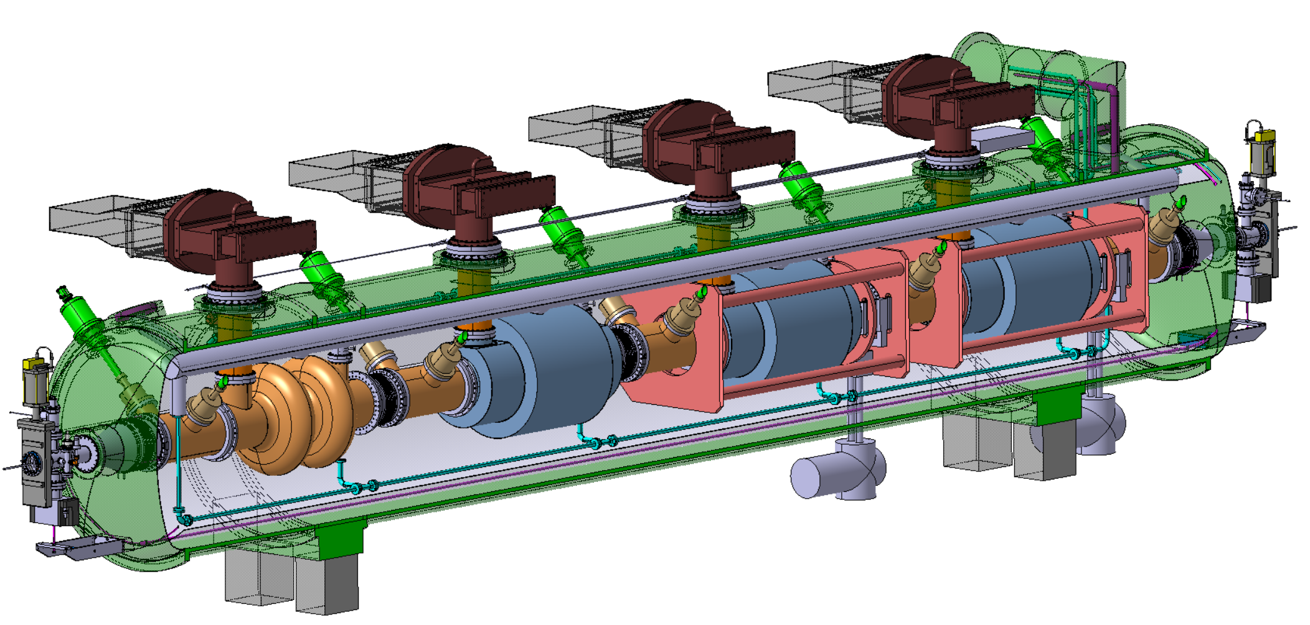
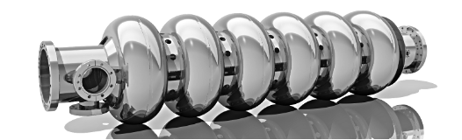
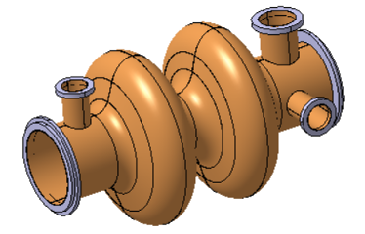

FCC: SC RF cavities + cryomodules (CM)
Peter McIntosh
Collider RF system (400 MHz and 800 MHz)
Booster RF system (800 MHz)
Z-WW-ZH
ttbar
448
264
408
+
112
66
102

Slide 35
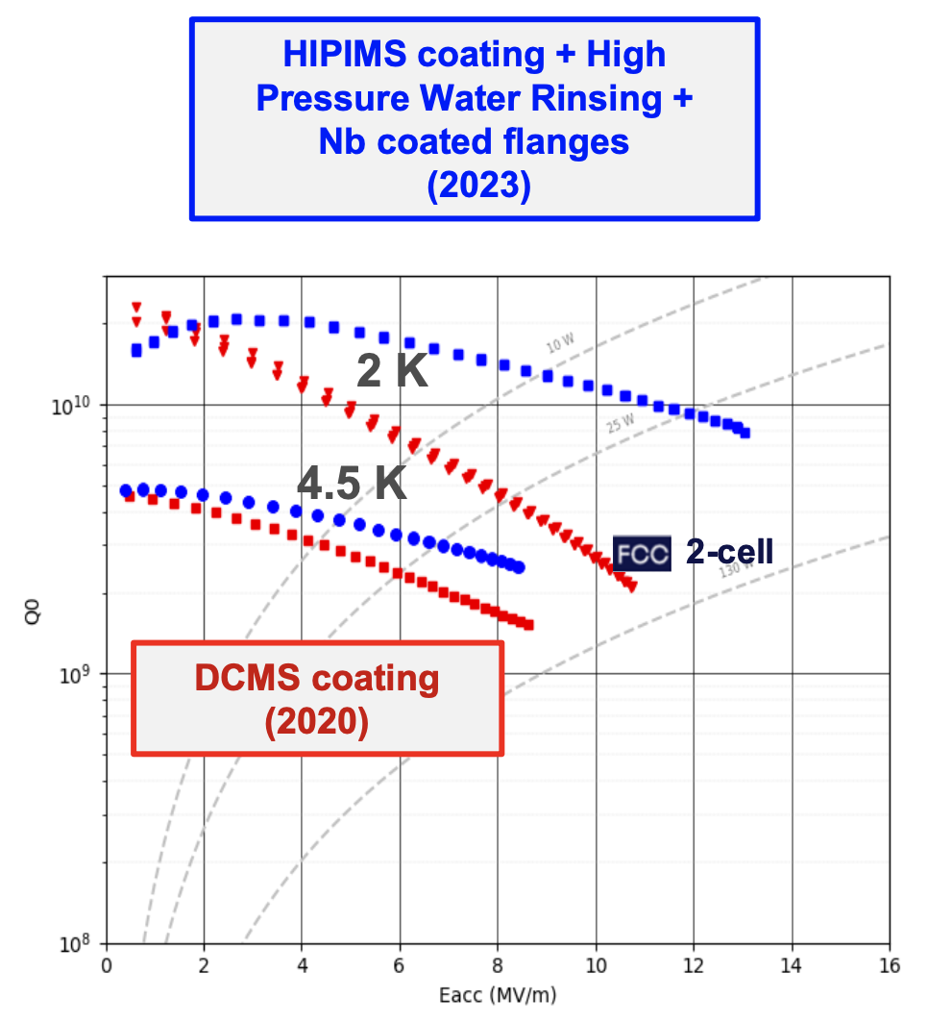
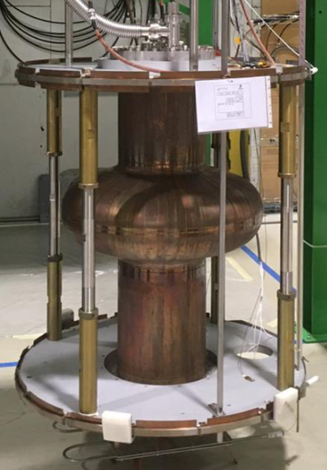

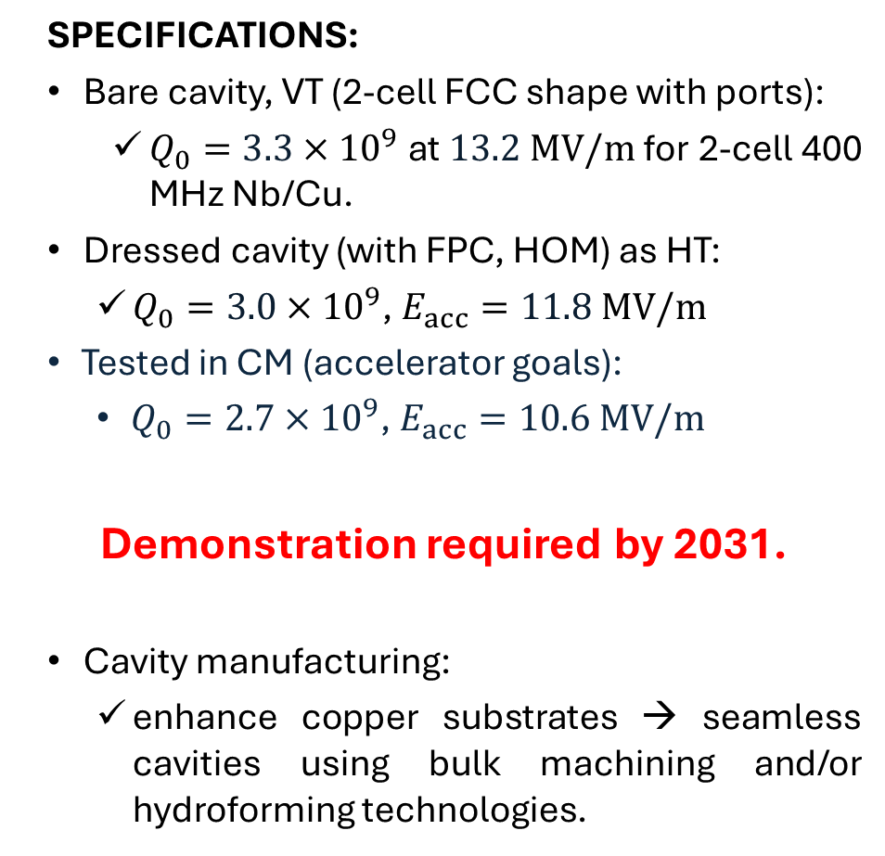
400 MHz, 2-cell, Nb/Cu (thin film sputtering)
TODAY:
Single-cell LHC bare cavity, no ports:
  $Q_{0}=\sim 2.2×{10}^{9}$ at $E_{acc}=\sim 8.2 MV/m$
SPECIFICATIONS:
Bare cavity, VT (2-cell FCC shape with ports):
  $Q_{0}=3.3×{10}^{9}$ at $13.2 MV/m$for 2-cell 400 MHz Nb/Cu.
Dressed cavity (with FPC, HOM) as HT:
  $Q_{0}=3.0×{10}^{9}$, $E_{acc}=11.8 MV/m$
Tested in CM (accelerator goals):
  $Q_{0}=2.7×{10}^{9}$, $E_{acc}=10.6 MV/m$
Demonstration required by 2031.
Cavity manufacturing:
  enhance copper substrates → seamless cavities using bulk machining and/or hydroforming technologies.
TRL4
TRL5
TRL6
TRL7
Peter McIntosh

Slide 36
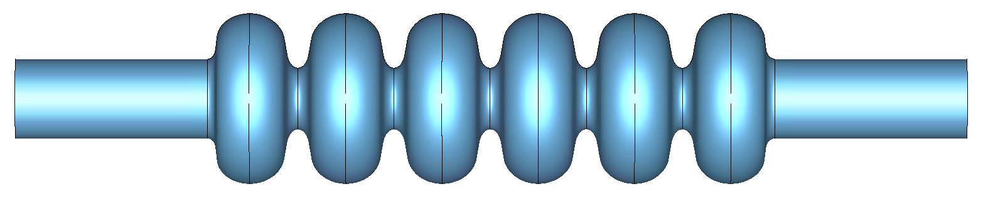
800 MHz, 6-cell, Bulk-Nb
TODAY:
5-cell prototype w/o ports, built by JLAB: 3 x 10¹⁰, ~30 MV/m in VT.
JLAB shape (all cells the same)
SPECIFICATIONS:
6-cell (FCC shape) prototype with ports: 3.8 x 10¹⁰, ~25 MV/m in VT.
Tested in HT with FPC and HOMCs with 3.5 x 10¹⁰, 22.5 MV/m.
Tested in CM with 3 x 10¹⁰, 20.25 MV/m.
Demonstration required by 2031.
TRL4
TRL5
TRL6
TRL7
FCC
F Marhauser (Jlab), IPAC18, THPAL146
Peter McIntosh

Slide 37
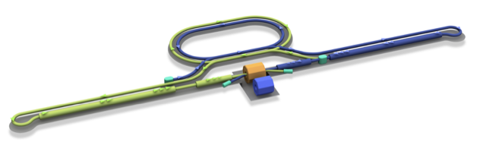
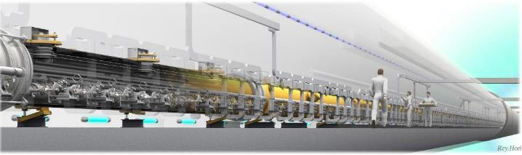

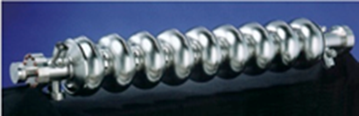
ILC250 RF Requirements (incl. input to LC Vision)
Damping Ring
e+ Source
e- Source
e- Main Linac
Interaction point
Parameters | Value
Beam Energy | 125 + 125 GeV
Luminosity | 1.35 / 2.7 x 10³⁴ cm²/s
Beam rep. rate | 5 Hz
Pulse duration | 0.73 / 0.961 ms
# bunch / pulse | 1312 / 2625
Beam Current | 5.8 / 8.8 mA
Beam size (y) at FF | 7.7 nm
SRF Field gradient | < 31.5 > MV/m (+/-20%) Q₀ = 1x10¹⁰
#SRF 9-cell cavities (CM) | ~ 8,000 (~ 900)
AC-plug Power | 111 / 138 MW
~20km
e+ Main Liinac
Detectors
e+
e-
TDR was published in 2013 and SRF technology became matured by large-SRF accelerators (European XFEL, LCLS-II etc.).
Adapted from Peter McIntosh

Slide 38
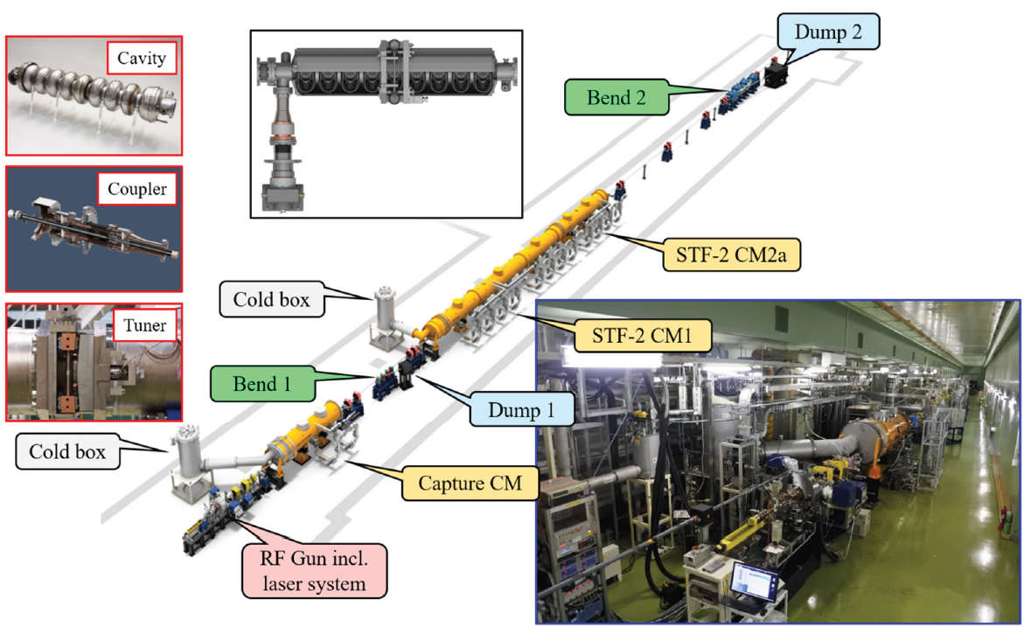
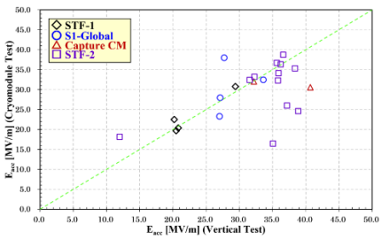
1.3 GHz, 9-cell, Bulk-Nb
TODAY:
STF-2 CM achieved Avg. E_{acc} of 32.9 MV/m @ Q₀ > 1 x 10¹⁰.
SPECIFICATIONS:
Demonstrate cavity performance improvement using alternative processing i.e. N2-doping/infusion and/or mid-T/2-step baking.
Cavity industrialisation to robustly achieve >35 MV/m (± 20%) at >1 x 10¹⁰ in VT.
Cavities tested in CM with >31.5 MV/m (± 20%) at >1 x 10¹⁰.
TRL7
TRL7
TRL8
TRL8
EP
Note:
LCF@CERN increased Q₀ specification to 2 x 10¹⁰
8/14 cavities reached 31.5 MV/m
Peter McIntosh
Y. Yamamoto (KEK), SRF21, Jun 2021

Slide 39
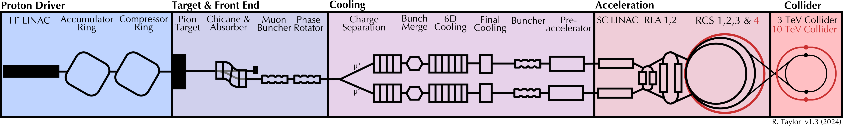
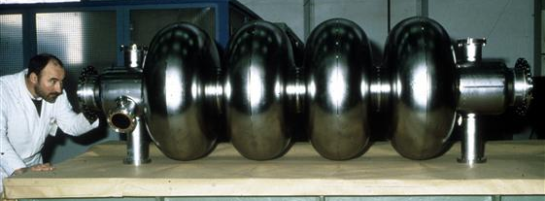
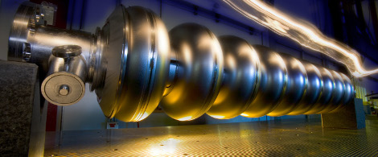
Muon Collider RF Requirements
RF
RF
RF
RF
RF
RF
RF
RF
RF
RF
RF
RF
RF
352/1056 MHz, SRF
352/704 MHz, NC in high B-field
1.3 GHz, SRF
LEP2 (352 MHz)
Super-conducting RF for acceleration:
High charge, short bunch.
High efficiency at high gradient.
Maintain beam quality.
Longitudinal and transverse stability.
Fast frequency tuning to match magnet ramp.
Management of beam loading/wakefields.
TRL 3
ILC (1.3 GHz)
TRL 3
Peter McIntosh

Slide 40
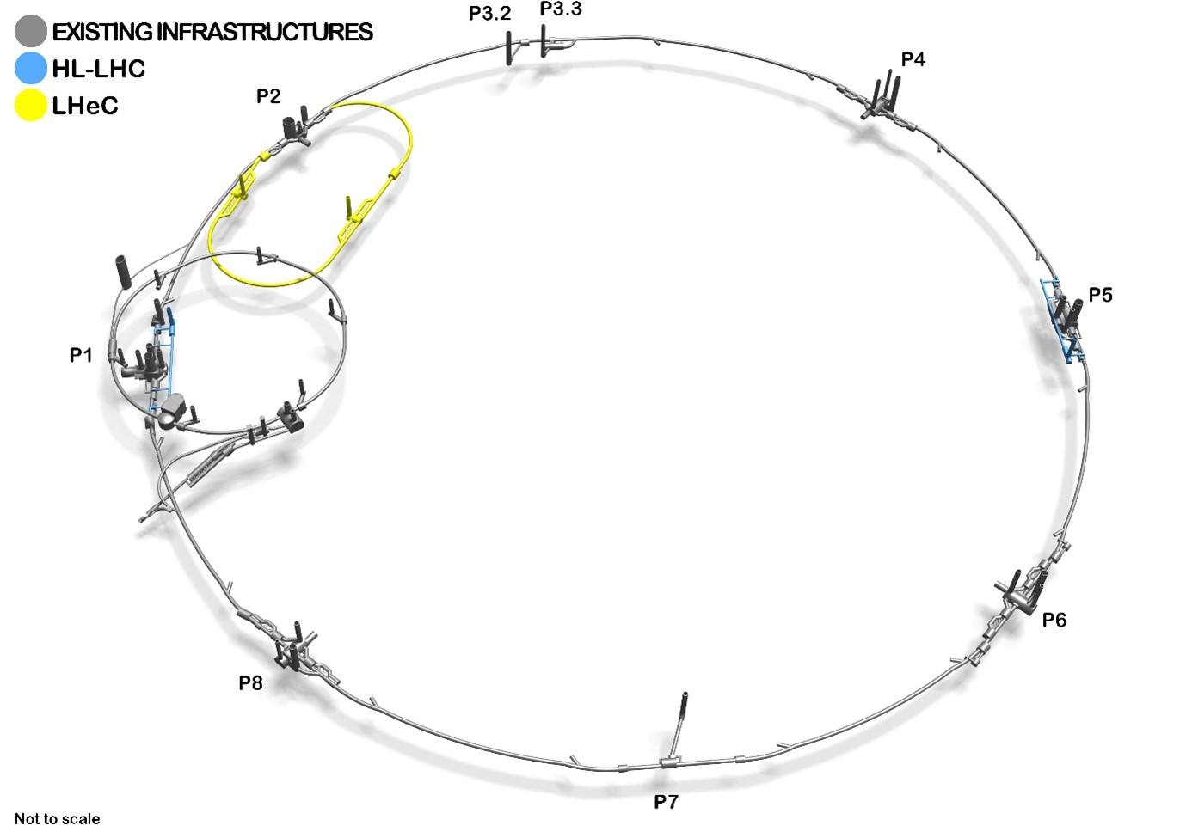
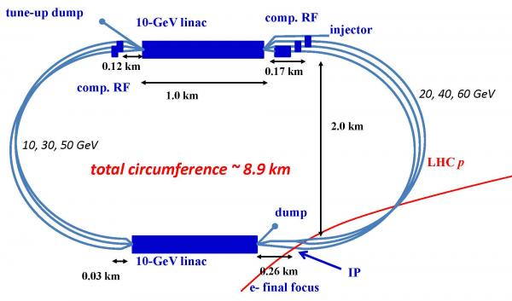
LHeC (ERL) SRF Requirements
802 MHz cavity design for high gradient > 20 MV/m and Q₀ of > 3 x 10¹⁰ (re: FCC_{ee}) and low HOMs. ➔ J-Lab demo and PERLE (IJCLab).
Coupler design: HOM, FPC and FE-FRT couplers ➔ IJCLab, J-Lab and CERN.
CM design and integration ➔ iSAS and ESS collaboration with PERLE.
LLRF tools feedback development with multiple beam energies and acceleration/deceleration modes ➔ PERLE ➔ by 2030.
PERLE test facility at IJCLab to be used as a technology demonstrator.
Peter McIntosh
O Bruning (CERN), Front. Phys. 10.886473, Feb 2022

Slide 41
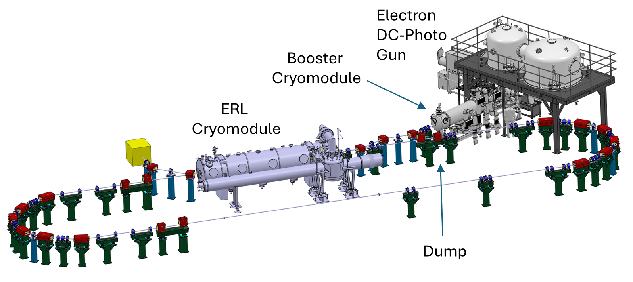
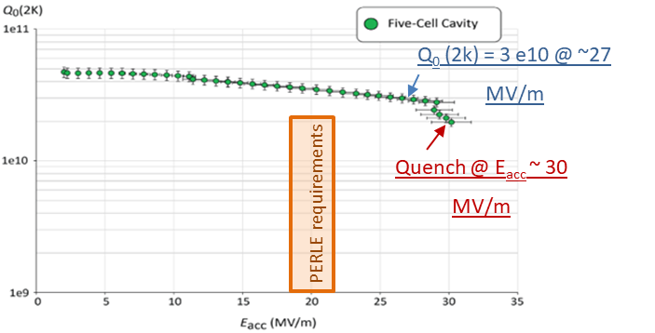
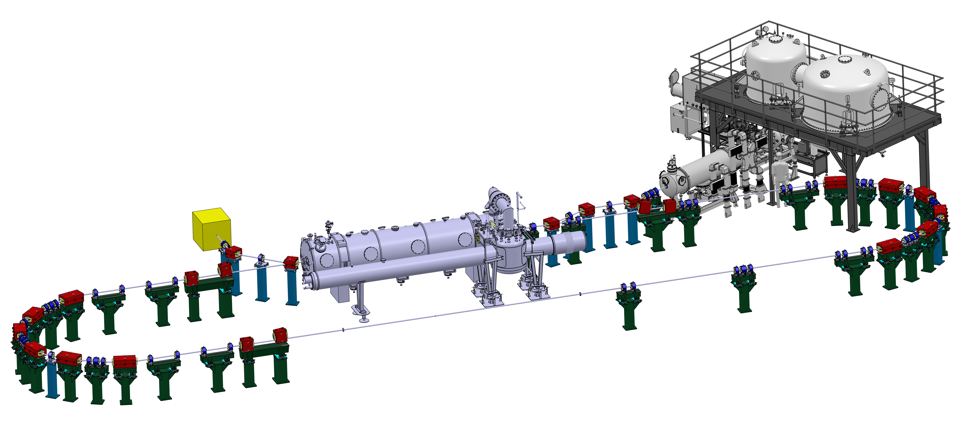
PERLE-LHeC 802 MHz SRF Cavity Development
Challenges:
High dynamic losses → High Q₀.
High HOM excitation → Extraction.
Microphonics detuning and mechanical stability → Fast tuning → FE-FRT.
TODAY:
TRL3
Proof of
Concept
Strong synergy with FCC developments
First Nb 800 MHz 5-Cell cavity
fabricated @ JLAB
Powerful ERL for Experiments (PERLE) at IJCLab
Principal SRF technology demonstrator for LHeC
Peter McIntosh
F Marhauser (JLab), IPAC18, THPAL146
Electron
DC-Photo
Gun
Booster
Cryomodule
ERL
Cryomodule
Dump

Slide 42





SC RF cavities: R&D
Accel gradient and Q₀ continue to improve, for both bulk-Nb,
and thin films: cheaper, higher-T op (less He + cryo power)
Recent surface processing advances (surface coating, electro-polishing, N-doping/infusion …) potentially enable much higher project specifications to be realised
European SRF Thin Film Roadmap
S. Posen (FNAL), Supercond. Sci. Technol. 30 033004, 2017
24/06/2025
Physics Preparatory Group - Accelerator Science and Technology WG
42

Slide 43



Power sources – FCCee example
Injector:
2 / 3 GHz, 80 MW, 3 / 5 µs, 100 Hz
Similar to widespread 3 GHz tubes. High power tubes exist but 40 MW is most common
Design, prototype-to-series remains to be carried out
Main ring:
Total of 100 MW required: 264 klystron/cavity units (Z → ZH) 400 MHz CW
Efficiency is a key parameter: 398 kW, η = 70% prototype exists (HL-LHC)
Two-stage klystron design with η = 86% (similar to CLIC drive-beam / ILC)
Concept for ‘Tristron’ under development η= 93%
Two-stage klystron
(design)
Tristron
(concept)
HL-LHC
(relevant prototype)
Walter Wuensch
24/06/2025
Physics Preparatory Group - Accelerator Science and Technology WG
43

Slide 44
Power sources – comments
Power sources are a key technology for ALL proposed future projects
European laboratories depend on industrial supplier base of 3 companies (only 1 European)
Large numbers of units required for all projects, well beyond current capacity of suppliers.
High-power vacuum tubes have very limited range of applications → very irregular market
Limited accelerator laboratory capability to design and fabricate (SLAC) even prototype devices
→ Critical situation; would require investment
Walter Wuensch
24/06/2025
Physics Preparatory Group - Accelerator Science and Technology WG
44

Slide 45

High-gradient RF structures/systems
LDG Mid-term Review
24/06/2025
Physics Preparatory Group - Accelerator Science and Technology WG
45

Slide 46
Plasma wakefield acceleration
Concepts for colliders: HALHF, ALiVE, 10 TeV pCM, ALEGRO
24/06/2025
Physics Preparatory Group - Accelerator Science and Technology WG
46

Slide 47
Plasma wakefield acceleration
Concepts for colliders: HALHF, ALiVE, 10 TeV pCM, ALEGRO
NB: AWAKE (high-energy beam for PP in 2030s)
FLASHForward, LUX, Kaldera, SPARC_Lab / EuPRAXIA, CLF/EPAC …
BELLA (LBNL), FACET2 (SLAC), ATF (BNL)
24/06/2025
Physics Preparatory Group - Accelerator Science and Technology WG
47

Slide 48
Plasma wakefield acceleration
Significant technical progress:
  Single-stage-energy gain (laser-driven)
  Beam quality (energy / energy-spread control)
  Scalable high rep-rate plasma sources
  Simulation tools
→ approaching performance levels for first applications
24/06/2025
Physics Preparatory Group - Accelerator Science and Technology WG
48

Slide 49



Plasma wakefield acceleration
Significant technical progress:
  Single-stage-energy gain (laser-driven)
  Beam quality (energy / energy-spread control)
  Scalable high rep-rate plasma sources
  Simulation tools
→ approaching performance levels for first applications FELs, 6 GeV injector for PETRA-IV
24/06/2025
Physics Preparatory Group - Accelerator Science and Technology WG
49

Slide 50
Plasma wakefield acceleration
Significant technical progress:
  Single-stage-energy gain (laser-driven)
  Beam quality (energy / energy-spread control)
  Scalable high rep-rate plasma sources
  Simulation tools
→ approaching performance levels for first applications FELs, 6 GeV injector for PETRA-IV
But outstanding challenges for colliders:
  Positron acceleration
  Multi-staging to reach high energies, with collider-grade beams
  High repetition rate → luminosity (control of plasma heating)
  Wall → beam power efficiency
LDG Roadmap re-oriented around developing HALHF: feasibility study + pre-CDR
  HALHF submission proposes a 3-stage 15-yr R&D plan: 213 MChF materials + 341 FTE-yr for proof-of-principle demo / prototyping
24/06/2025
Physics Preparatory Group - Accelerator Science and Technology WG
50

Slide 51
Plasma wakefield acceleration
LDG Mid-term Review
24/06/2025
Physics Preparatory Group - Accelerator Science and Technology WG
51

Slide 52
Plasma wakefield acceleration
Recommendation:
Develop a plan to construct a demonstrator for multi-stage plasma acceleration capable of producing collider-grade beams
LDG Mid-term Review
24/06/2025
Physics Preparatory Group - Accelerator Science and Technology WG
52

Slide 53
Muon beams / collider
Alternative to electrons → multi-TeV lepton collisions
For a given beam energy + ring radius: synchrotron power ~ 200⁴ less for muons
Muons decay with rest-frame lifetime ~ 2us
LDG Roadmap focussed on conceptual design of a 3 → 10 TeV collider
Synergies with HFM + high-gradient RF R&D pillars
CERN-based Muon Collider study + EU design study ‘MuCol’ + International MC Collaboration (strong interest/effort from USA, Asia)
R&D plan 2026-36: 300 MChF materials + 2000 staff years (‘absolute minimum’)
→ see also next talk
24/06/2025
Physics Preparatory Group - Accelerator Science and Technology WG
53

Slide 54
Energy Recovery Linacs (ERLs)
LDG Roadmap focused in context of electron-hadron collisions (eg. LHeC), but also (at lower priority) ideas for future e+e- colliders
LHeC: aim is a ~50-GeV linac @ 100MW wall power → high-luminosity e-h collisions
Two ERL test facilities coming online: PERLE (IJCLab), bERLinPro/SEALab (HZB) + EU project: iSAS
  → Important demonstrator for an ERL-based collider
R&D plan → 2032: 46MEuro + 328 FTEy (minimum) needed; 28MEuro + 96 FTEy to be found
Proponents aim for a decision on LHeC by ~ 2034 at the latest
TDR for LHeC would need to be developed compatible with the decision date
24/06/2025
Physics Preparatory Group - Accelerator Science and Technology WG
54

Slide 55
Sustainability
For society, environmental sustainability of any future project will be an important factor, along with science, cost, economic benefit …
Recognise this in planning for our future accelerator technology R&D programmes
Continue to promote (+ celebrate) technology R&D that reduces environmental footprint of future accelerators:
higher-T operation of RF cavities and magnets (eg. 4K) → reduce cryo power
more efficient power sources → higher wall-plug → beam efficiency
use of HTS + permanent magnets → reduced power
energy-recovery techniques, fast reactive tuners → reduced power
facility ‘life cycle assessment’ at an early stage to inform + optimise design
24/06/2025
Physics Preparatory Group - Accelerator Science and Technology WG
55

Slide 56
Summary
  Excellent progress has been made on accelerator R&D since ESPPU 2020:
    Via large projects – well defined technical/performance needs
    Across a broader front of technical issues with wide impact (synergies beyond PP)
  Coordination on R&D within Europe has been strengthened via LDG Roadmap
  Strong collaboration with international partners (N. America, Asia …)
  Looking to the future …
24/06/2025
Physics Preparatory Group - Accelerator Science and Technology WG
56

Slide 57
The LDG R&D Roadmap Redux
  High Field Magnet (HFM) development for a future hadron collider
  Radio Frequency (RF) systems (superconducting + normal-conducting)
  Plasma wakefield acceleration (laser- and beam-driven)
  Muon beams/colliders
  Energy-recovery linacs (ERLs)
  Sustainability
  → Will need to be reviewed in light of EPPSU 2026 recommendations (workshop early 2026)
  → Whatever the highest-priority recommendation(s), some of the above R&D areas should likely be pursued to support both the broader and longer-term future of the field
24/06/2025
Physics Preparatory Group - Accelerator Science and Technology WG
57

Slide 58
Technology-related submissions
56 PERLE
57 HALHF
65 INFN R&D
97 C³
98 10 TeV Wakefield Collider
104 HTS potential
105 MuCol Magnet R&D
152 US MuCol
154 LDG Review
159 ALEGRO
162 Sustainability
172 AWAKE
210 ALiVE
219 RF developments
243 High Field Magnets
256 Superconductivity Alliance
24/06/2025
Physics Preparatory Group - Accelerator Science and Technology WG
58

Slide 59
Acknowledgements
Members of PPG Accelerator WG:
Deepa Angal-Kalinin (ASTEC, UK) Gianluigi Arduini (CERN)
Bernhard Auchmann (PSI, CH) Angeles Faus-Golfe (IJCLab, FR)
Massimo Ferrario (INFN-LNF, IT) Jacqueline Keintzel (CERN)
Roberto Losito (CERN) Anke-Susanne Mueller (KIT, DE)
Tor Raubenheimer (SLAC, USA) Marlene Turner (CERN)
Pierre Vedrine (CEA Saclay, FR) Hans Weise (DESY, DE)
Walter Wuensch (CERN) Chenghui Yu (IHEP, China)
+ Peter McIntosh, Yukiyoshi Ohnishi, Maksym Titov (parallel session speakers)
+ Karl Jakobs, Mike Seidel, Paris Sphicas, Ezio Todesco
24/06/2025
Physics Preparatory Group - Accelerator Science and Technology WG
59

Slide 60
Backup slides
24/06/2025
Physics Preparatory Group - Accelerator Science and Technology WG
60

Slide 61
LDG Review status overview
LDG Mid-term Review
24/06/2025
Physics Preparatory Group - Accelerator Science and Technology WG
61

Slide 62

LDG Review Status criteria
24/06/2025
Physics Preparatory Group - Accelerator Science and Technology WG
62

Slide 63
LDG review recommendations: HFM
Down-select designs for a 12-14T Nb3Sn dipole ASAP
Accelerate the demonstration of full-length magnets
Set up a task force to accelerate R&D on ReBCO aiming at demonstrating:
  10-20kA magnet conductor
  Quench protection of long HTS coils
  → Required for an early decision on prioritising ReBCO over NB3Sn
24/06/2025
Physics Preparatory Group - Accelerator Science and Technology WG
63

Slide 64
High Gradient RF structures/systems:
LDG Review comments
Good progress in important areas across projects:
  SCRF: Higher Q0, Nb3Sn thin-film technology
  High-efficiency klystrons
  New accelerating structure designs
  Power + HOM couplers
Progress is slower than originally planned (budgets, effort availability, supply chains … )
24/06/2025
Physics Preparatory Group - Accelerator Science and Technology WG
64

Slide 65
LDG review recommendations: RF
Focus on key aspects with high impact / cross-cutting PP applications
Define processes for down-selecting among multiple options, on timescales appropriate for the respective projects (eg. SCRF cavities high Q0, thin films)
For next roadmap phase: limit goals to align with resources; avoid aspirational goals that are unlikely to be supported
24/06/2025
Physics Preparatory Group - Accelerator Science and Technology WG
65

Slide 66
LDG review recommendations: PWFA
Ensure timely completion of HALHF pre-CDR
Hold an independent review
Plan to construct a demonstrator for multi-stage plasma acceleration capable of producing collider-grade beams
24/06/2025
Physics Preparatory Group - Accelerator Science and Technology WG
66

Slide 67
LDG review comments/findings:
muon collider
Key challenges:
Start-to-end simulation needed → global system/performance optimisation
2 MW graphite target feasibility
Conceptual solutions developed for several critical challenges:
Design of cooling cell, RF cavities, power converter for RCS …
Next steps require development of prototypes + testing: cooling demonstrator crucial
10 TeV machine requires 40T final cooling solenoid + 14T dipoles with 140mm aperture (HTS approach for both) – not currently high priority for HFM programme
Detailed evaluation of power requirements + energy consumption
Neutrino flux evaluation/mitigation (for specific sites)
24/06/2025
Physics Preparatory Group - Accelerator Science and Technology WG
67

Slide 68
LDG review recommendations:
muon collider
Conduct an independent review of scope, schedule and costs:
  Scope, timeline, budget for R&D programme in the period 2026-36
Develop a start-to-end performance simulator:
  key parameter robustness, luminosity, cost, energy consumption
  Performance optimisation, sensitivity analysis, risk mitigation …
Define and fund a high-field HTS and RF development strategy:
  Establish a clear roadmap for HTS magnet and RF systems, with well defined specification/performance targets
  Adequate funding essential for advancement
24/06/2025
Physics Preparatory Group - Accelerator Science and Technology WG
68

Slide 69
Muon beams / collider
LDG Mid-term Review
24/06/2025
Physics Preparatory Group - Accelerator Science and Technology WG
69

Slide 70
Energy Recovery Linacs
LDG Mid-term Review
24/06/2025
Physics Preparatory Group - Accelerator Science and Technology WG
70

Slide 71






HTS Practical Impact Examples
Fusion for Energy (ITER EU Domestic Agency)
  Contribution to the design of the HTS target solenoid, relevant to the central solenoid of DTT
EUROFusion (next step European fusion reactor)
  Contribution to the design of the HTS target solenoid, relevant to the magnets of a Volumetric Neutron Source proposed as next step in the European fusion strategy
Gauss Fusion (one of the leading EU fusion start-ups)
  CERN contribution to the design of the LTS/HTS GIGA stellarator magnets, based on advances in the HTS target solenoid
ENI (oil and gas energy giant)
  Collaboration on the conceptual design and project proposal for the CERN construction of a large bore HTS solenoid (20@20 model coil) relevant to the muon collider and fusion
IFAST-2 proposal to INFRA-2025-TECH-01-02 (CERN, INFINEON, PSI)
  Proposal of fast pulsed power cell + magnet system sent to IFAST-2 coordination for ranking at TIARA
  Industrial interest in rapidly pulsed and large energy/power supplies

