Slide 1

PLENARY / ACCELERATOR SCIENCE & TECHNOLOGY
Challenges towards high luminosity for proposed colliders
Gianluigi Arduini - CERN
Acknowledgements: PPG Accelerator Science and Technology WG members, N. Mounet, Y. Ohnishi, Y. Papaphilippou,
D. Schulte, R. Tomas, F. Zimmermann
24th June 2025

Slide 2
Outline
e⁺/e⁻ colliders (circular and linear)
High Energy Hadron colliders
Muon colliders
Summary

Slide 3
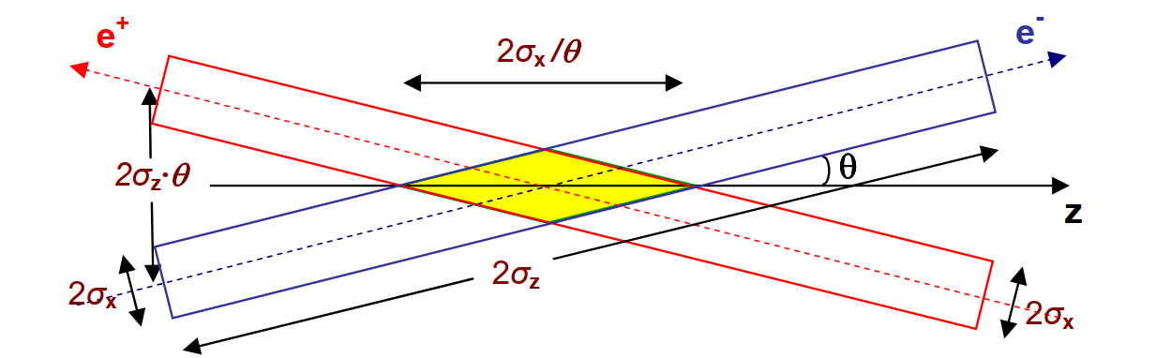
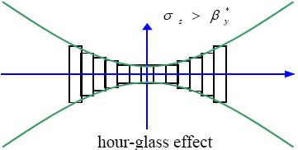

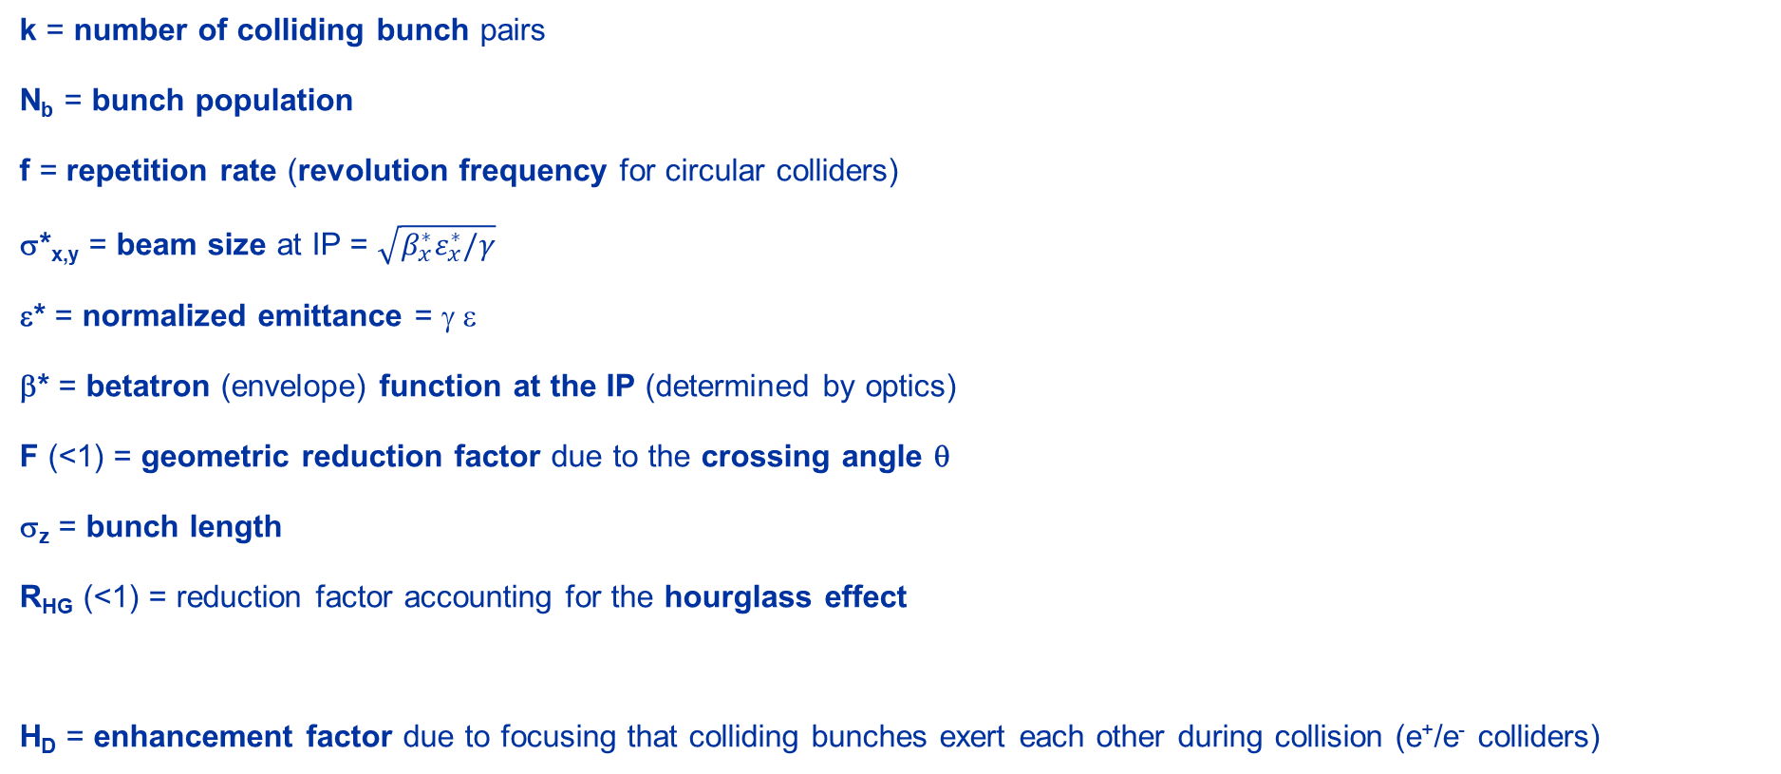
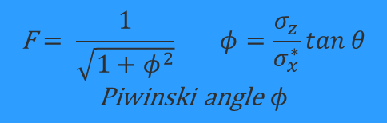
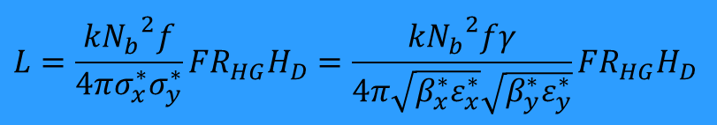
Luminosity
$$L=\frac{k{N_{b}}^{2}f}{4πσ_{x}^{∗}σ_{y}^{∗}}FR_{HG}H_{D}=\frac{k{N_{b}}^{2}fγ}{4π\sqrt{β_{x}^{∗}ε_{x}^{∗}}\sqrt{β_{y}^{∗}ε_{y}^{∗}}}FR_{HG}H_{D}$$
Horizontal crossing
k = number of colliding bunch pairs
N_{b} = bunch population
f = repetition rate (revolution frequency for circular colliders)
σ*_{x,y} = beam size at IP = $\sqrt{β_{x}^{∗}ε_{x}^{∗}/γ}$
ε* = normalized emittance = γ ε
β* = betatron (envelope) function at the IP (determined by optics)
F (<1) = geometric reduction factor due to the crossing angle θ
σ_{z} = bunch length
R_{HG} (<1) = reduction factor accounting for the hourglass effect
H_{D} = enhancement factor due to focusing that colliding bunches exert each other during collision (e⁺/e⁻ colliders)
$$\text{F}= \frac{1}{\sqrt{1+φ^{2}}} φ=\frac{σ_{z}}{σ_{x}^{∗}}\tan{θ}$$
Piwinski angle $φ$
$$β(s)=β^{∗}+\frac{s^{2}}{β^{∗}}$$
Hourglass effect
Notes:
Need to keep beta*>= sigma_z to keep R_HG~1 or at least beta*>= overlap region

Slide 4
e⁺ e⁻ Circular and Linear Colliders

Slide 5
Differences
Circular colliders
Linear colliders
f ~ O(kHz - MHz) ☺
Synchrotron radiation losses ➔ limit in power ➔ limit in current (or larger radius) ☹
Can serve more experiments in parallel ☺
Only particle losses need to be compensated ☺
Multi-turn effects (e.g. beam-beam limitations) ☹
f ~ O (10 – 100 Hz) ☹
No synchrotron radiation losses (only at the IP - beamstrahlung) ☺
Can only share luminosity among experiments ☹
Beam is dumped after collision ➔ Limit in current/power ➔ strain on the injectors ☹
Single passage. You have always “fresh” beams ☺
Notes:
For the low-energy circular colliders (e.g DAFNE)

Slide 6
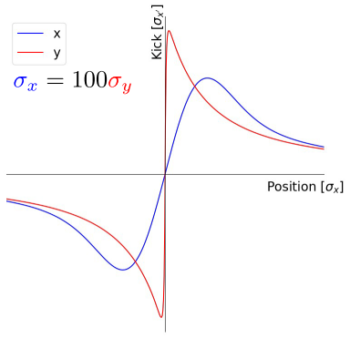
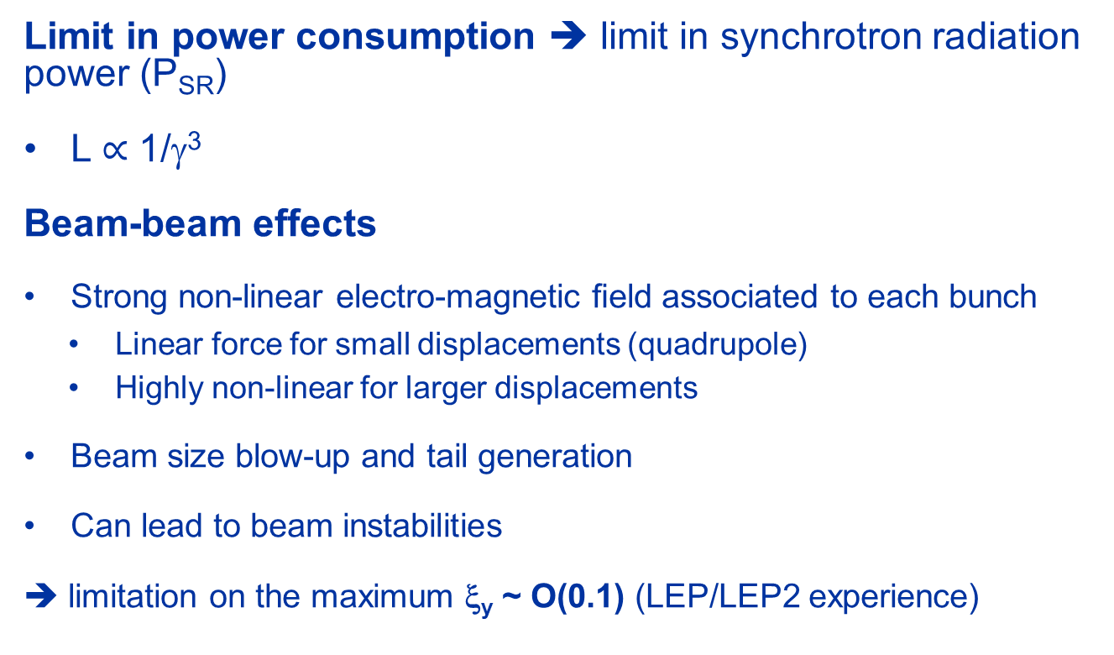
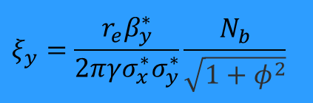
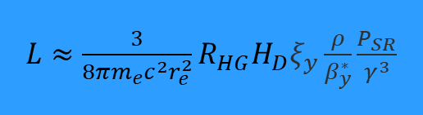
Luminosity (circular colliders)
Flat beams
Limit in power consumption ➔ limit in synchrotron radiation power (P_{SR})
L $∝$ 1/γ³
Beam-beam effects
Strong non-linear electro-magnetic ﬁeld associated to each bunch
  Linear force for small displacements (quadrupole)
  Highly non-linear for larger displacements
Beam size blow-up and tail generation
Can lead to beam instabilities
➔ limitation on the maximum ξ_{y} ~ O(0.1) (LEP/LEP2 experience)
$L≈$ $\frac{3}{{8πm_{e}c^{2}r}_{e}^{2}}R_{HG}H_{D}ξ_{y}\frac{ρ}{β_{y}^{∗}}\frac{P_{SR}}{γ^{3}}$
$$ξ_{y}=\frac{r_{e}β_{y}^{∗}}{2πγσ_{x}^{∗}σ_{y}^{∗}}\frac{N_{b}}{\sqrt{1+φ^{2}}}$$

Slide 7
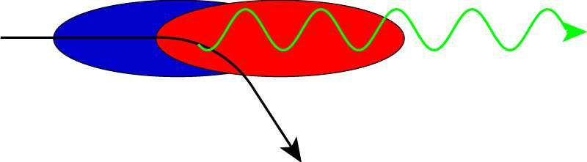
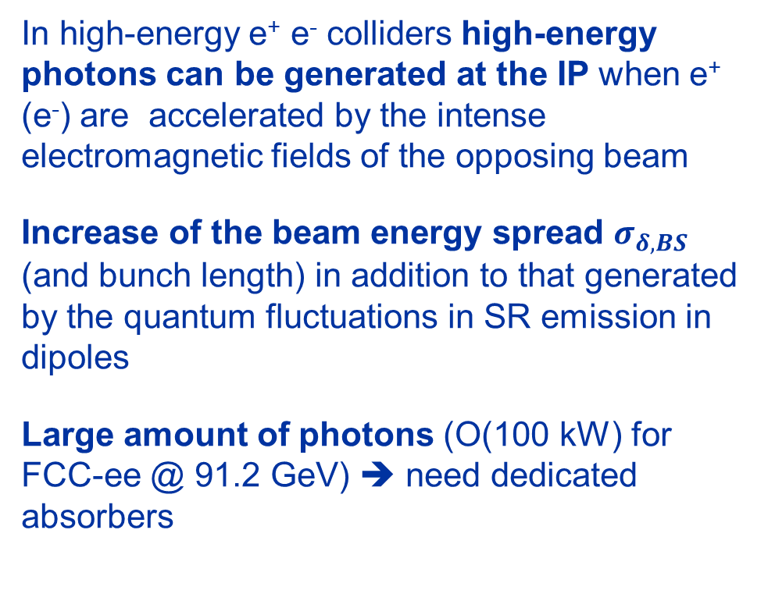
Beamstrahlung (circular colliders)
In high-energy e⁺ e⁻ colliders high-energy photons can be generated at the IP when e⁺ (e⁻) are accelerated by the intense electromagnetic fields of the opposing beam
Increase of the beam energy spread $σ_{δ,BS}$ (and bunch length) in addition to that generated by the quantum fluctuations in SR emission in dipoles
Large amount of photons (O(100 kW) for FCC-ee @ 91.2 GeV) ➔ need dedicated absorbers
Minimized in circular colliders design to avoid too large energy spread, lower lifetime, background ➔ limit on minimum β∗_{x}

Slide 8
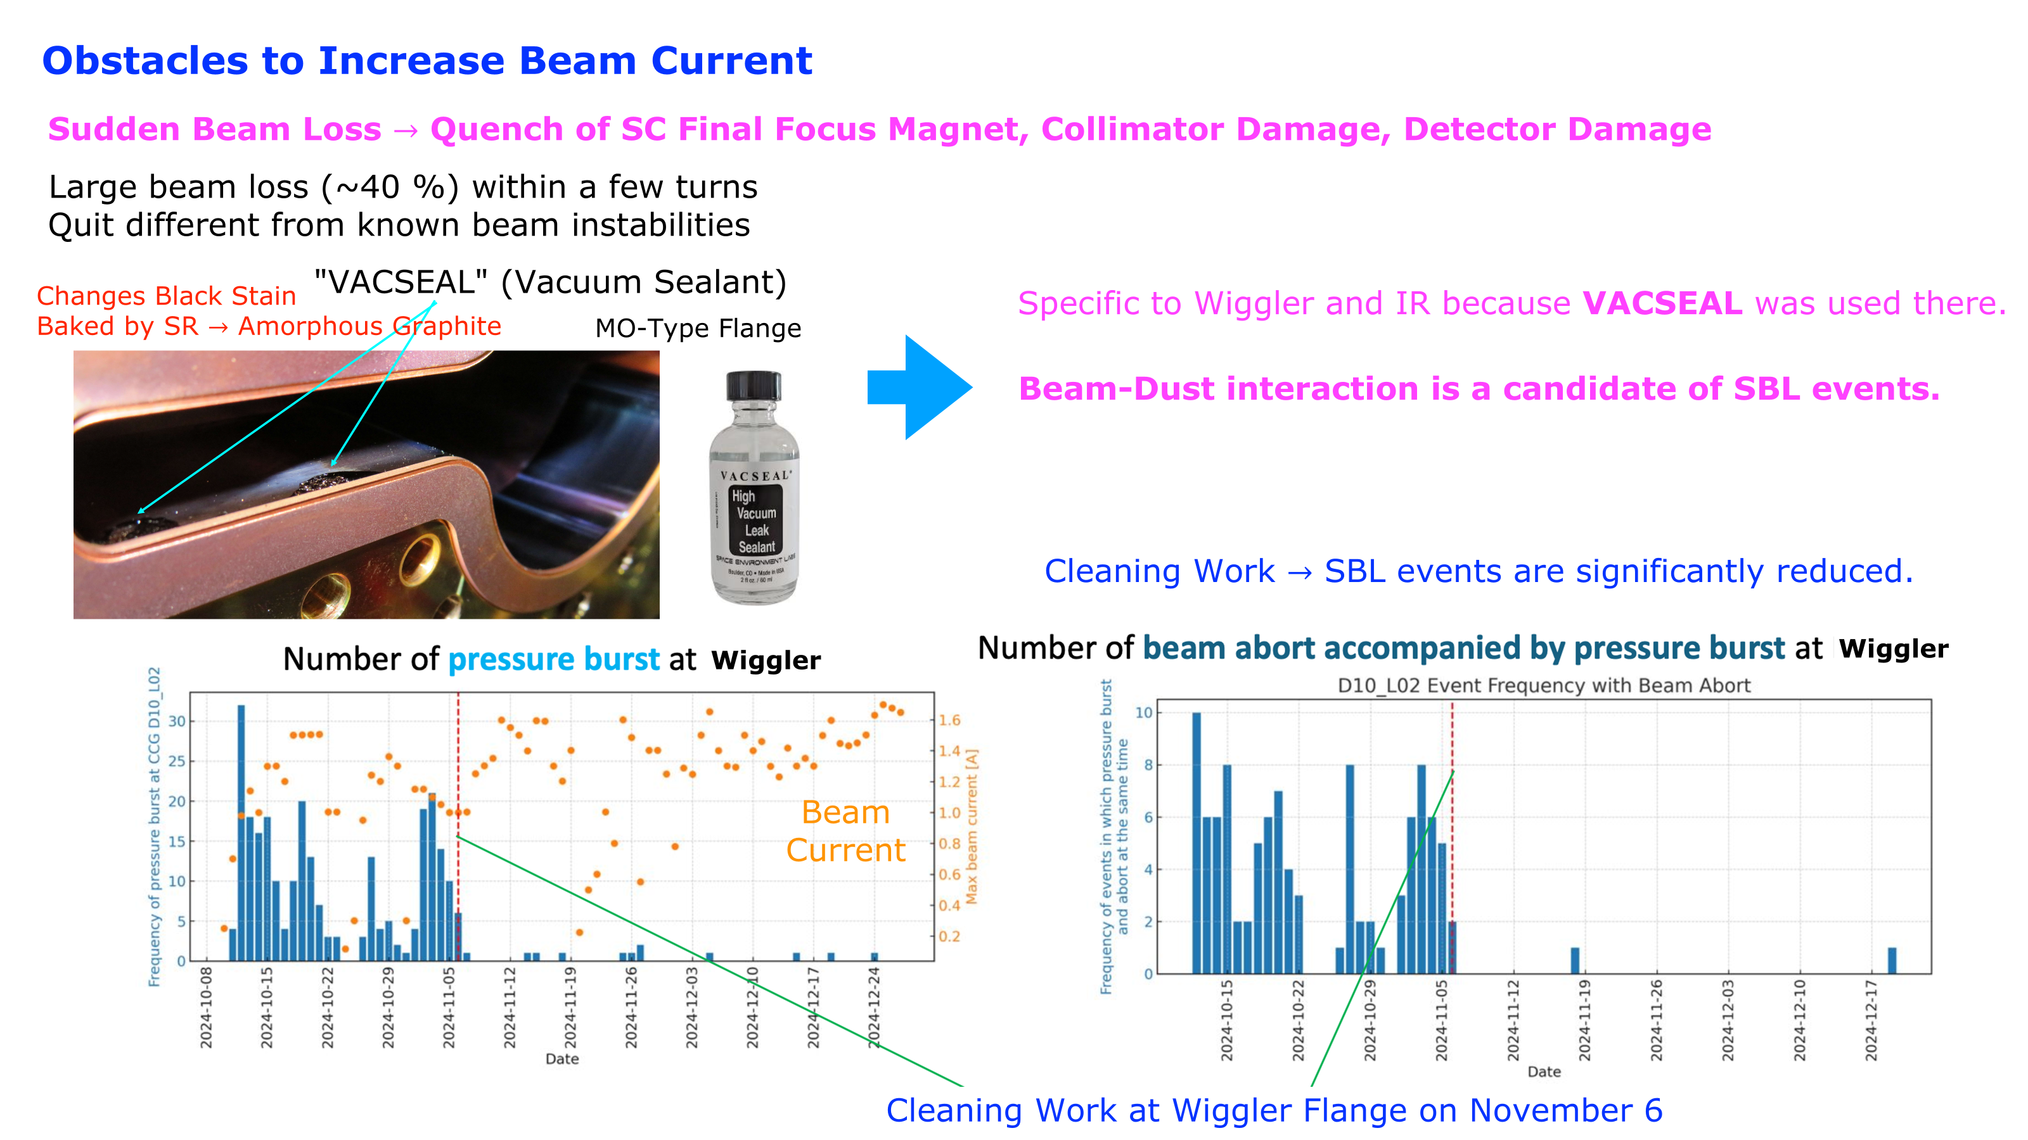
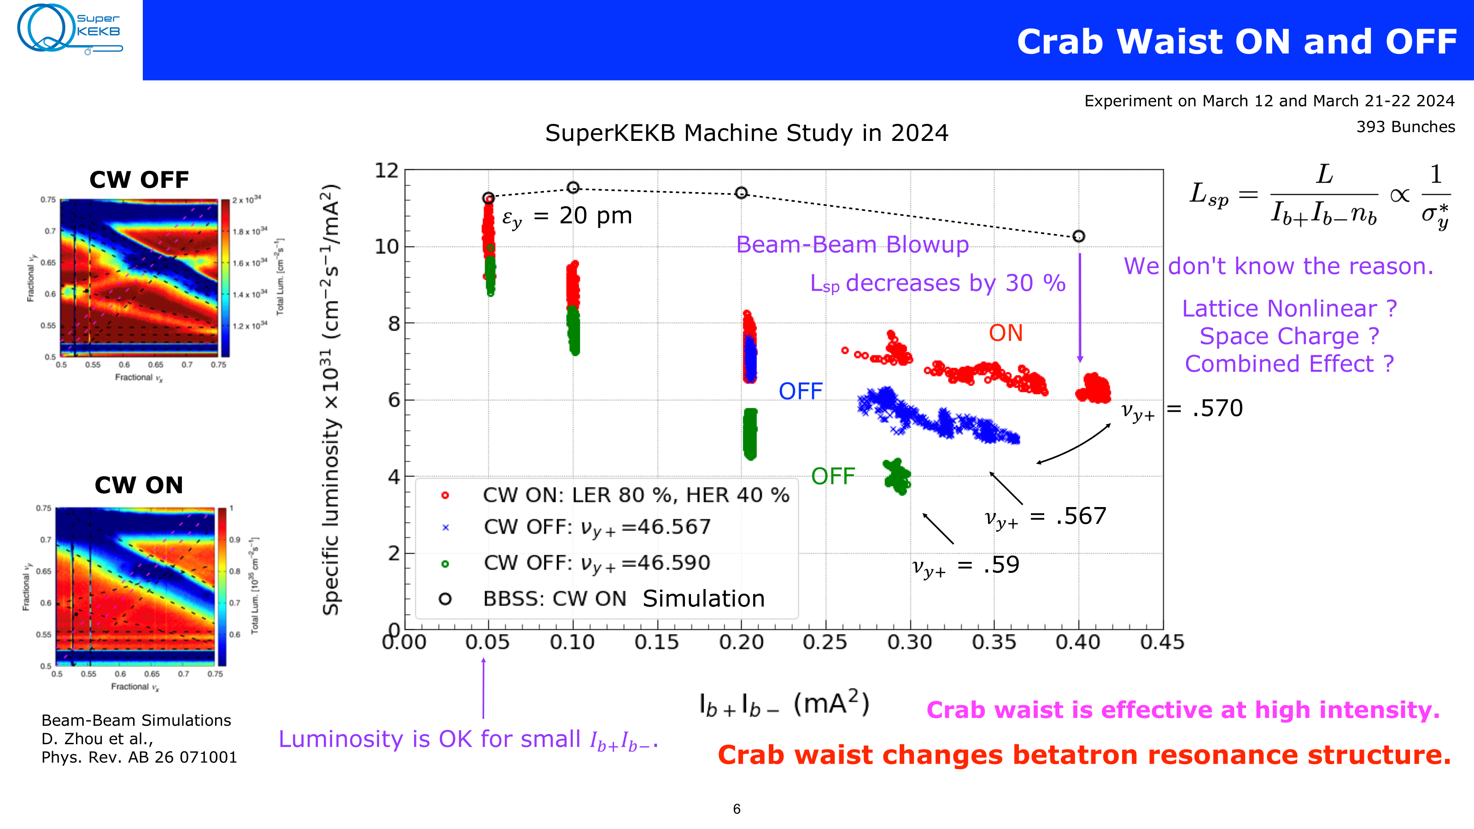
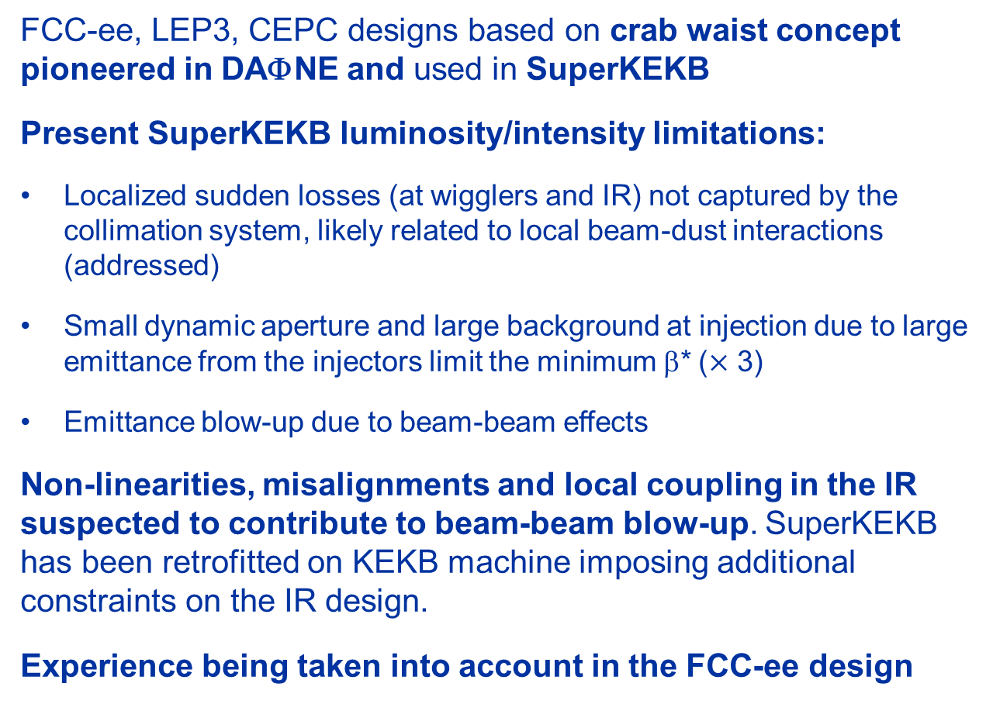
Experience (DAΦNE, SuperKEKB)
FCC-ee, LEP3, CEPC designs based on crab waist concept pioneered in DAΦNE and used in SuperKEKB
Present SuperKEKB luminosity/intensity limitations:
Localized sudden losses (at wigglers and IR) not captured by the collimation system, likely related to local beam-dust interactions (addressed)
Small dynamic aperture and large background at injection due to large emittance from the injectors limit the minimum β* ($×$ 3)
Emittance blow-up due to beam-beam effects
Non-linearities, misalignments and local coupling in the IR suspected to contribute to beam-beam blow-up. SuperKEKB has been retrofitted on KEKB machine imposing additional constraints on the IR design.
Experience being taken into account in the FCC-ee design
Y. Ohnishi

Slide 9
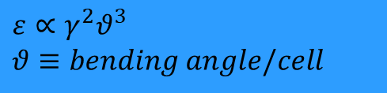
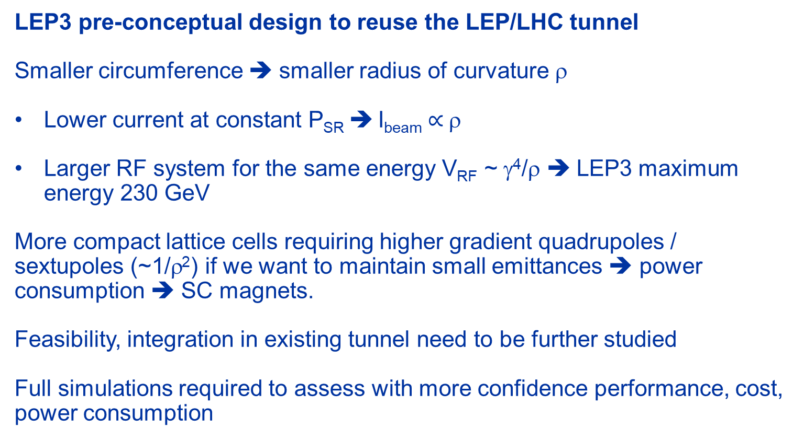

Luminosity vs. circumference
LEP3 pre-conceptual design to reuse the LEP/LHC tunnel
Smaller circumference ➔ smaller radius of curvature ρ
Lower current at constant P_{SR} ➔ I_{beam}$∝$ρ
Larger RF system for the same energy V_{RF} ~ γ⁴/ρ ⎝ LEP3 maximum energy 230 GeV
More compact lattice cells requiring higher gradient quadrupoles / sextupoles (~1/ρ²) if we want to maintain small emittances ➔ power consumption ➔ SC magnets.
Feasibility, integration in existing tunnel need to be further studied
Full simulations required to assess with more confidence performance, cost, power consumption
$U_{0}∝\frac{γ^{4}}{ρ}$
$$ε∝γ^{2}θ^{3}$$
$$θ≡bending angle/cell$$

Slide 10
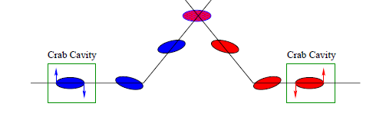
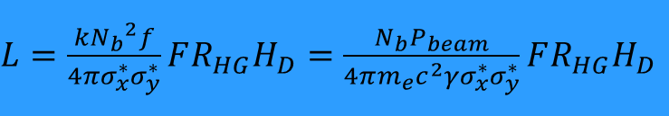
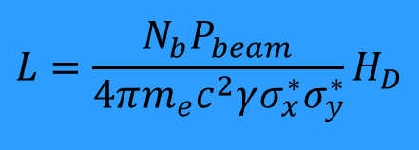
Linear colliders
Limited by beam current/power P_{beam} (➔ power consumption) as the beam is continuously generated (and dumped)
“Do not care” about multi-turn effects in the collider. No beam-beam limit.
Need very small beam size at IP to compensate for low f
Crab cavities are used to maximize overlap of the beam at the IP ➔ F=1
β*_{y}~σ_{z} to minimize hourglass effect ➔ R_{HG}~1
$L=\frac{k{N_{b}}^{2}f}{4πσ_{x}^{∗}σ_{y}^{∗}}FR_{HG}H_{D}=$ $\frac{N_{b}P_{beam}}{4πm_{e}c^{2}γσ_{x}^{∗}σ_{y}^{∗}}FR_{HG}H_{D}$
$$L=\frac{N_{b}P_{beam}}{4πm_{e}c^{2}γσ_{x}^{∗}σ_{y}^{∗}}H_{D}$$

Slide 11
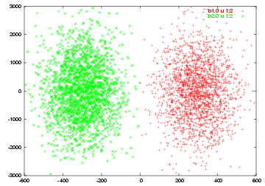
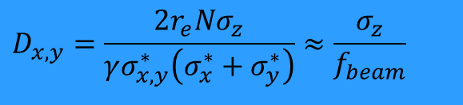
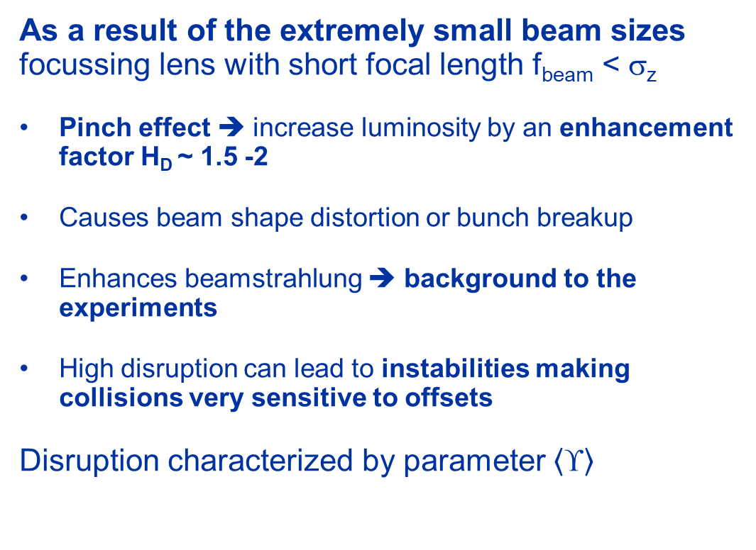
Disruption
As a result of the extremely small beam sizes focussing lens with short focal length f_{beam} < σ_{z}
Pinch effect ➔ increase luminosity by an enhancement factor H_{D} ~ 1.5 -2
Causes beam shape distortion or bunch breakup
Enhances beamstrahlung ➔ background to the experiments
High disruption can lead to instabilities making collisions very sensitive to offsets
Disruption characterized by parameter $\left\langle \text{¡}\right\rangle$
$$D_{x,y}=\frac{2r_{e}Nσ_{z}}{γσ_{x,y}^{∗}\left(σ_{x}^{∗}+σ_{y}^{∗}\right)}≈\frac{σ_{z}}{f_{beam}}$$
y
e⁺ ➔
⬅ e⁻
z
D. Schulte

Slide 12
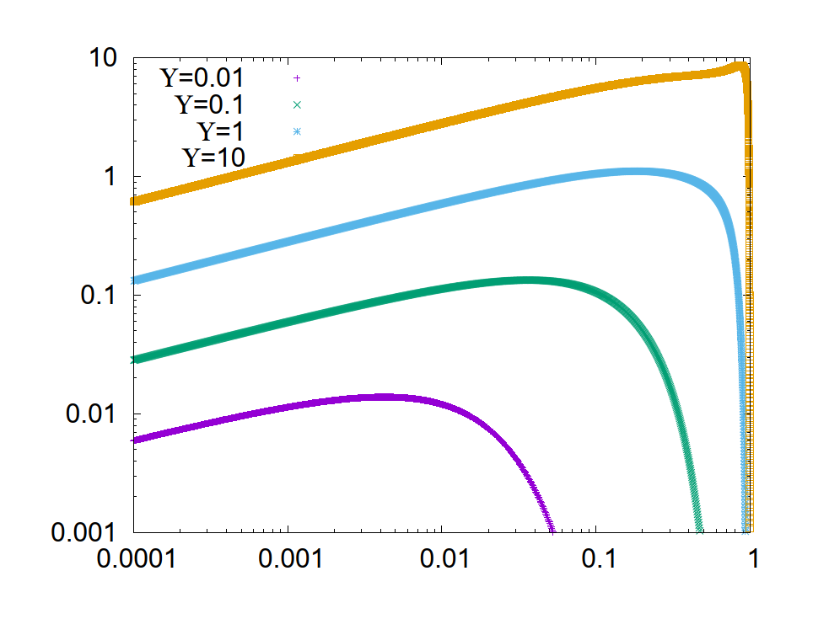
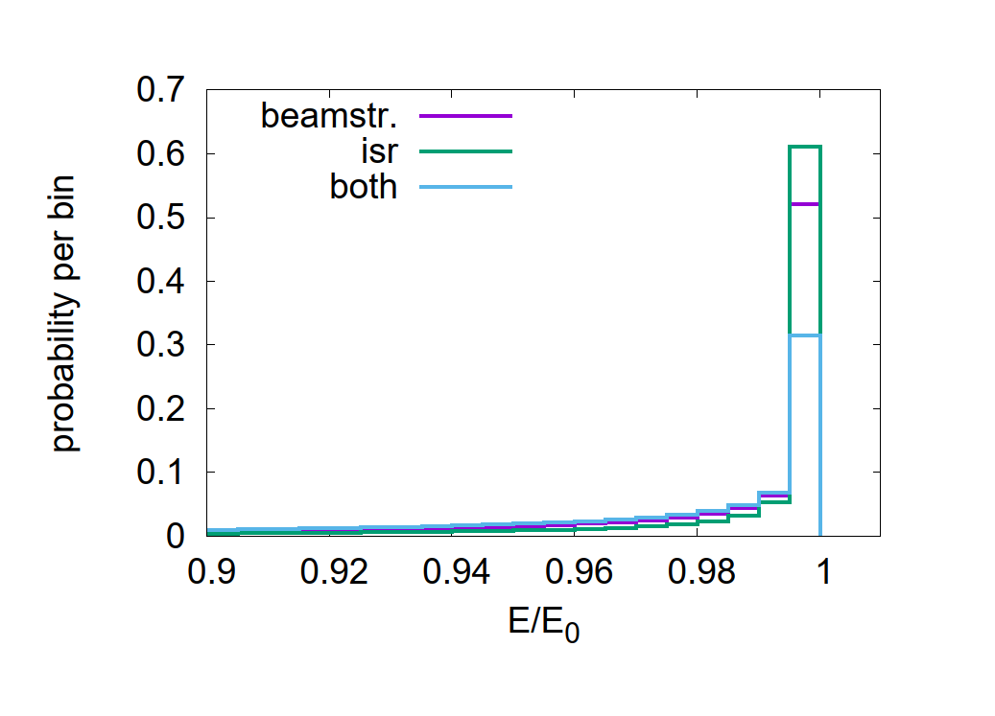
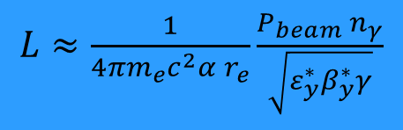
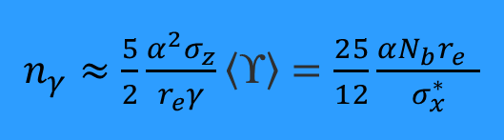
Beamstrahlung
D. Schulte
For LCs large number of photons n_{γ} emitted: O(1) per beam particle
The emitting particle will contribute to the luminosity at a lower than nominal c.o.m. energy ➔ Luminosity spectrum
Minimum σ*_{x}: trade-off L_{0.01,BS} vs. L_{tot} normally chosen L_{0.01,BS} ~ L_{0.01,ISR} (ISR=Initial State Radiation)
$n_{γ}≈\frac{5}{2}\frac{α^{2}σ_{z}}{r_{e}γ}\left\langle \text{¡}\right\rangle =$ $\frac{25}{12}\frac{αN_{b}r_{e}^{}}{σ_{x}^{∗}}$
dP/d(E_{γ}/E_{beam}) [a.u.]
CLIC 380 GeV ϒ ∼0.17 n_{γ}~1.4
LCF 250 GeV ϒ ~0.02 n_{γ}~1.6
E_{γ}/E_{beam}
$L≈$ $\frac{1}{4πm_{e}c^{2}α r_{e}}\frac{P_{beam} n_{γ}}{\sqrt{ε_{y}^{∗}β_{y}^{∗}γ}}$
CLIC 380 GeV
Notes:
$Conditions for the lumi formula{ σ}_{x}^{∗} ≫σ_{y}^{∗}$, $\left\langle \text{upsilon}\right\rangle ≪1$ $n_{γ}≈1−2$
If particles collide, they can emit a photon just before the collision as a part of the
physics process; this is called initial state radiation.

Slide 13
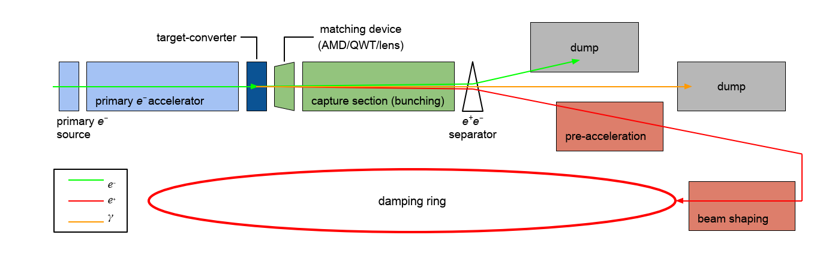
Positron production
Colliders need large currents of electrons and positrons from the injectors, LCs are particular demanding (could be a limit for luminosity, if not achieved).
FCC-ee ~ 10¹³ e⁺/s (Z operation) but only needed when filling from scratch, in top-up mode lower current required
CLIC: ~ 2 × 10¹⁴ e⁺/s
LCF: ~ 4-8 × 10¹⁴ e⁺/s (×2 - 4 ILC requirement!)
SLC: ~ 6 × 10¹² e⁺/s
SuperKEKb: ~ 2.5 × 10¹² e⁺/s world’s highest intensity positron source currently in operation.
LC baselines include polarized e⁻ beams (and for LCF also e⁺).

Slide 14
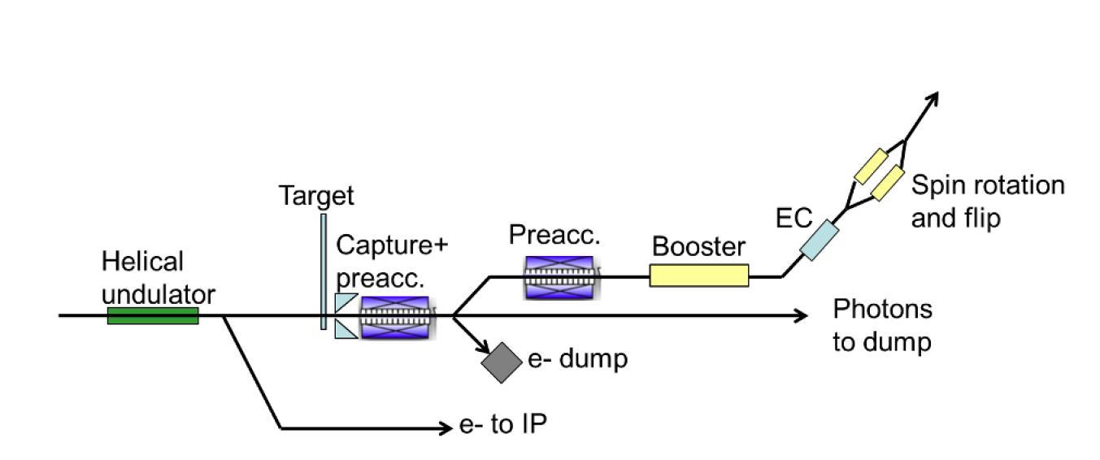
Positron production
‘Thick’ target: CLIC and FCC-ee baseline ➔ PSI Positron Project - P3 - will demonstrate FCC-ee requirements
Undulator source: high energy e⁻ produce γ in 230 m long undulator magnet + thin conversion target (ILC/LCF baseline)
  much less energy deposition in the target but still very high peak energy deposition density (very small γ opening angle)
  could produce polarised e⁺ by helical undulator (~30%)
  need very high initial electron energy ~ 128 GeV !
    Complex scheme of e⁺ production for operation at c.o.m. energies <250 GeV (reduced rep rate)

Slide 15
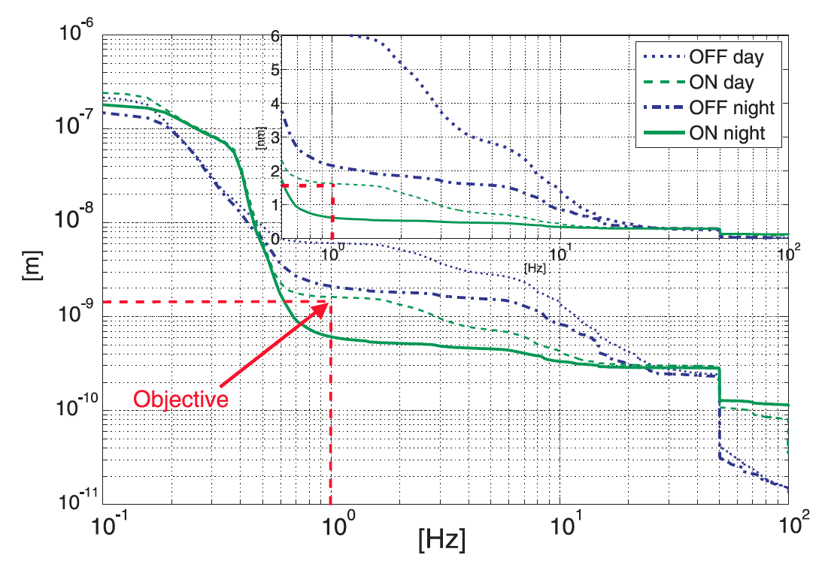
Low Emittance
Generation of low emittances is challenging (close or beyond what SR light sources can do today)
Preserving the emittance from the damping rings to the IP is equally critical for LCs
misalignments of the accelerator components primary sources of emittance growth ➔ dispersion and wakefields in the accelerator structures (particularly critical for CLIC).
Ad-hoc design to minimize transmission of vibration to main linac components, rigorous pre-alignment and active stabilization of accelerator components against ground motion
Series of complex feedforward systems operating in parallel (dispersion free steering, wakefield free steering etc..) ➔ pioneering work at SLC and further tests at ATF, FACET, FERMI@ELETTRA
nm or sub-nm stability!
Test bench reached required stability of CLIC MB quadrupole
Notes:
By adapting the civil engineering of the tunnel and cavern by, for instance, placing machinery on a separate floor structure or the use of adapted technical concrete, the length of the vibration path and hence the attenuation of the vibrations will be improved. Vibration dampers can be used under the machinery. The design of all components and supports in the CLIC tunnel shall have natural frequencies as high as possible by careful design. Also a verification with seismometers during the construction phase will help to remove unwanted vibration sources. The most significant consequence is the beam height from the floor that shall be as small as possible. Where possible, the mass of the components shall be reduced and also the position of support points can increase the stiffness of components.

Slide 16
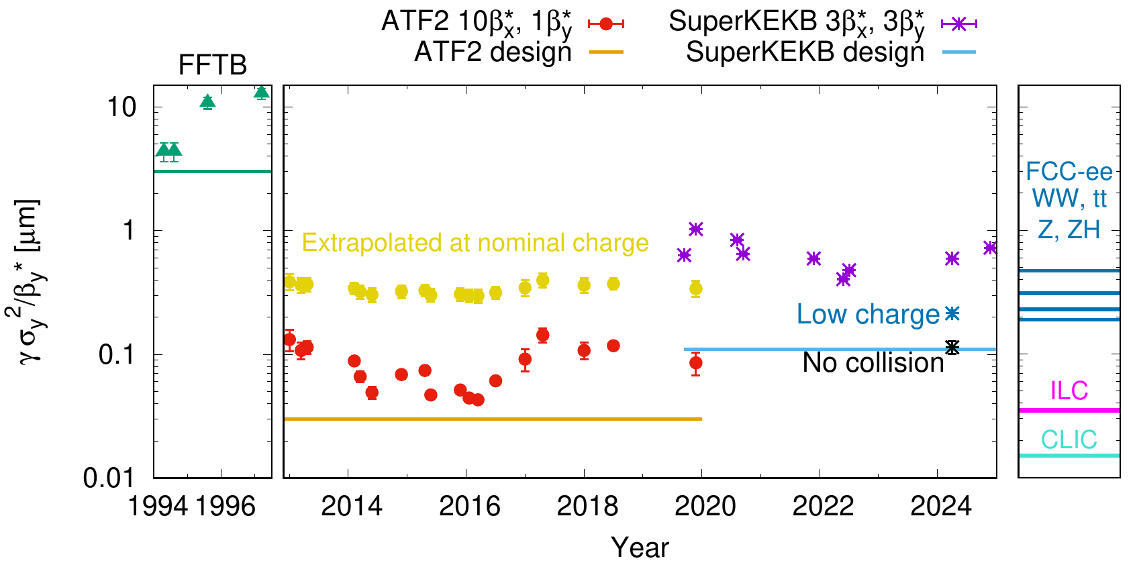
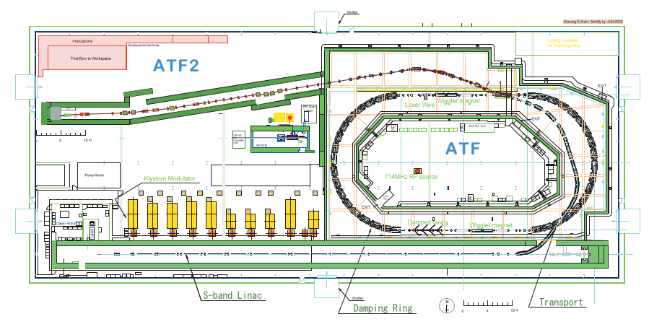
Beam size control at the IP
Extremely small σ_{IP} requires strong focusing ➔ chromatic aberrations, other non-linear effects.
Achieving stable and repeatable operation at these low beam sizes is challenging.
Design targets approached at ATF2 at lower than nominal intensity and with ×10 β_{x}∗
R. Tomas, Y. Ohnishi, F. Zimmermann
ATF2:
Single beam facility
IP beam size measurement rely on complex instrumentation
Scalability to LCs for wakefield effects non-trivial
Notes:
ATF2 1.3 GeV

Slide 17
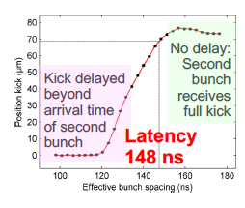
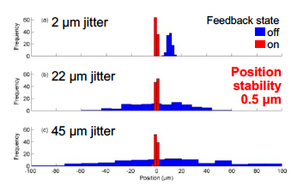
Beam position control at the IP
Control of the beam–beam offset is required at the level of a fraction of a nanometre
Control of the beam–beam offset is required at the level of a fraction of a nanometre
  ILC: correction from one bunch to the next (bunch spacing: 336-554 ns)
  CLIC: Bunch-to-bunch (0.5 ns) correction not possible.
R. Apsimon et al.
Notes:
Can easily detect an offset as resulting deﬂection of the beams is in the order of tens of µrad (detectable a few m downstream with a BPM)

Slide 18
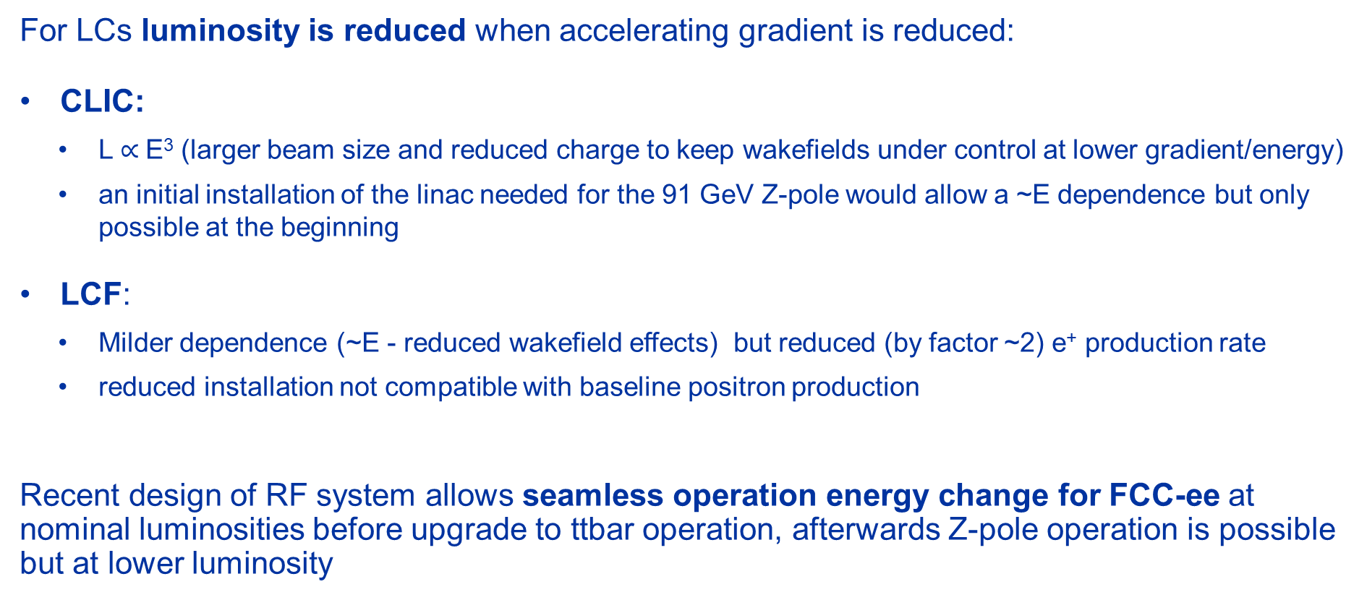
Operation at energies below nominal
For LCs luminosity is reduced when accelerating gradient is reduced:
CLIC:
  L $∝$E³ (larger beam size and reduced charge to keep wakefields under control at lower gradient/energy)
  an initial installation of the linac needed for the 91 GeV Z-pole would allow a ~E dependence but only possible at the beginning
LCF:
  Milder dependence (~E - reduced wakefield effects) but reduced (by factor ~2) e⁺ production rate
  reduced installation not compatible with baseline positron production
Recent design of RF system allows seamless operation energy change for FCC-ee at nominal luminosities before upgrade to ttbar operation, afterwards Z-pole operation is possible but at lower luminosity
Notes:
Seamless operation energy change not possible at nominal luminosity once we move from Z to WW or ZH
Ramp-up not considered for LEP3

Slide 19
High Energy Hadron Colliders

Slide 20
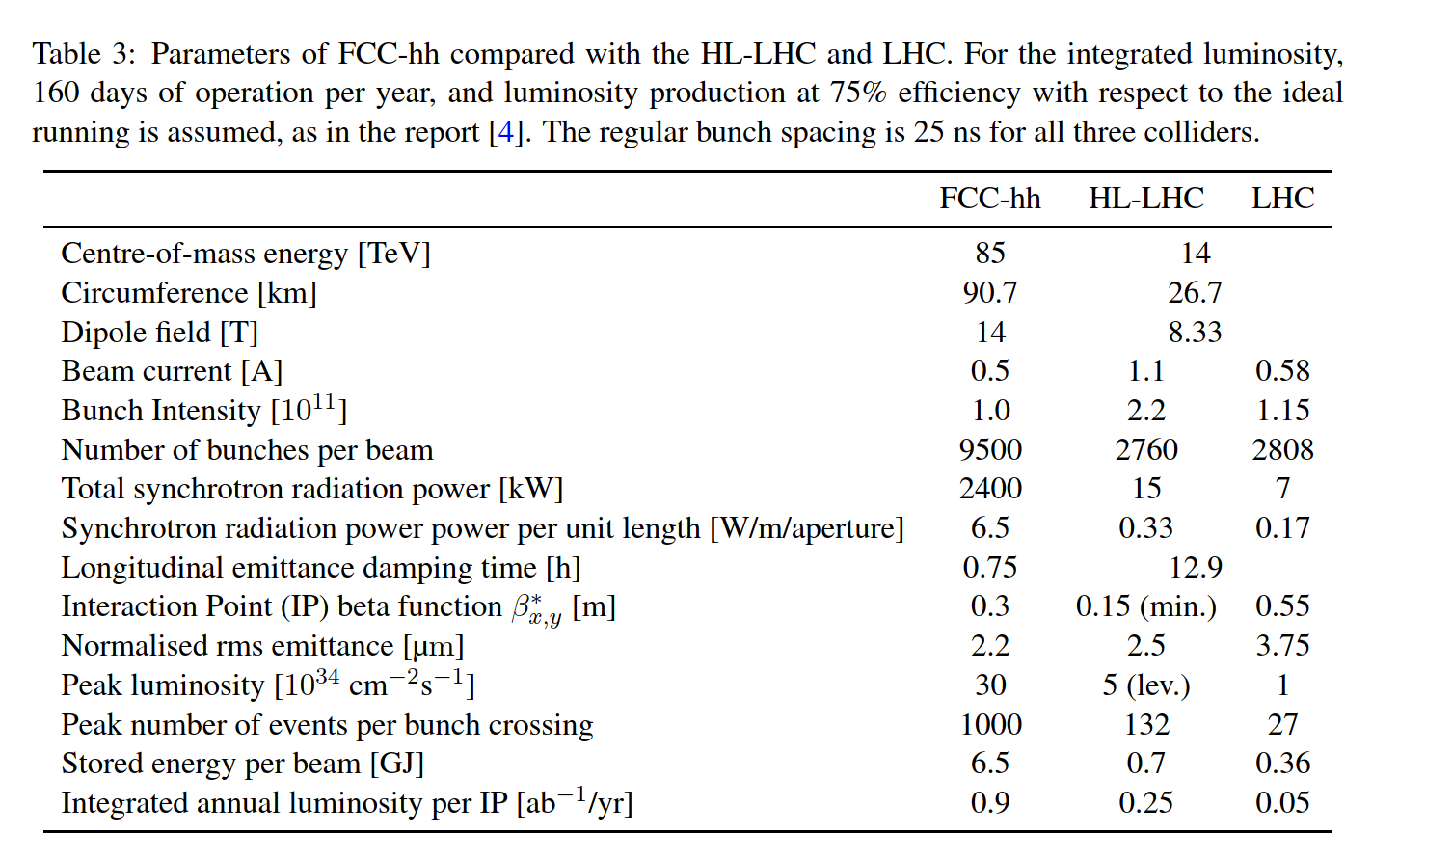
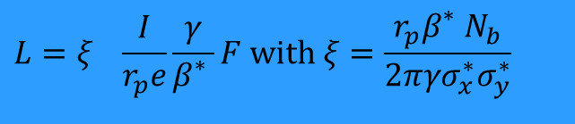
High Energy Hadron Colliders
Extensive experience gained with the LHC
Going to higher energy beam-beam effects are less pronounced
Critical (based on LHC experience):
Field quality
Low power converters’ noise
Reproducibility (magnet-to-magnet and cycle-to-cycle)
Levelled operation at pile-up limit (or synch radiation power limit) might be required
$${L=ξ}_{}\frac{I}{r_{p}e}\frac{γ}{β_{}^{∗}}F with ξ=\frac{r_{p}β_{}^{∗}N_{b}}{2πγσ_{x}^{∗}σ_{y}^{∗}}$$

Slide 21
High Energy Hadron Colliders
Electron cloud is one of LHC main limitations ➔ mitigation measures (beam screen coating) are available and will be implemented (at least partly) for HL-LHC
Impedance sources are generally understood and under control
Synchrotron Radiation effects will be visible:
Radiation damping ➔ emittance reduction during the fill. Initially dominating over burn-off ➔ initial luminosity increase (compatibly with maximum acceptable pile-up)
Significant heat load on the beam screens (> 50 K): ~2.4 MW for FCC-hh ➔ scales with γ⁴/ρ! Reduction by a factor ~2 going from 16 to 14 T magnets (i.e. from 100 to 85 TeV).
Mainly technological challenges: high field magnets, cryogenics, vacuum, beam stored energy (see Ph. Burrows)
Notes:
Damping time ~1.5-2 hours.

Slide 22
Muon Colliders

Slide 23
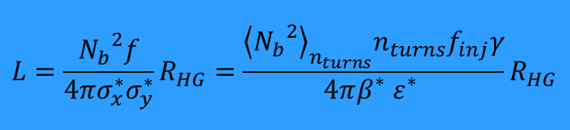
Muon colliders
m_{μ}~200 m_{e}:
lower P_{SR} wrt e⁺e⁻ colliders P_{SR}~ E⁴/m⁴
Beamstrahlung/disruption negligible
One intense bunch per beam with no crossing angle to maximize luminosity at limited total current (μ are difficult to produce!) ➔ k=1, F=1, H_{D}=1
muons decay (104 ms lifetime at 5 TeV ~3000 turns in a 10 km machine)
…need to be replaced rapidly: limited number of turns n_{turns} between injections ➔ high repetition rate f_{inj} (5 Hz)
n_{turns} must be maximized ➔ small circumference ➔ High Field Magnets ➔ see Ph. Burrows’ talk
$$L=\frac{{N_{b}}^{2}f}{4πσ_{x}^{∗}σ_{y}^{∗}}R_{HG}=\frac{{\left\langle {N_{b}}^{2}\right\rangle }_{n_{turns}}n_{turns}f_{inj}γ}{4πβ_{}^{∗}ε_{}^{∗}}R_{HG}$$
Small ε* and β* at the IP to compensate for the small number of bunches
Small σ_{z} to minimize hourglass effect ➔ R_{HG} ~1

Slide 24
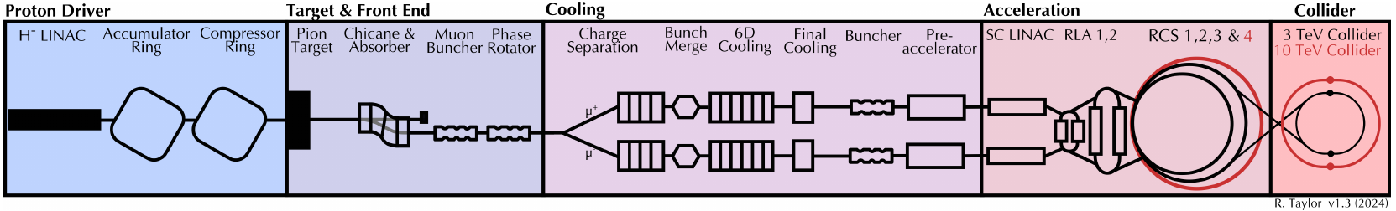
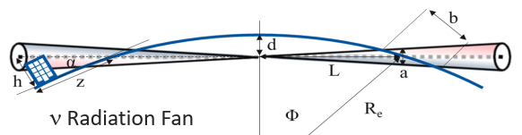
Challenges
High brightness muon beams are difficult to produce:
Tertiary production from a O(MW) proton beam on a target
Beams must be bunched and cooled to produce luminosity in a collider
Muons decay:
All beam manipulations required for small longitudinal and transverse emittance must be rapidly carried out
Significant energy deposit from μ decays in the accelerator components and detector
Neutrinos from the muon decays can produce ionizing radiation far from the accelerator complex

Slide 25
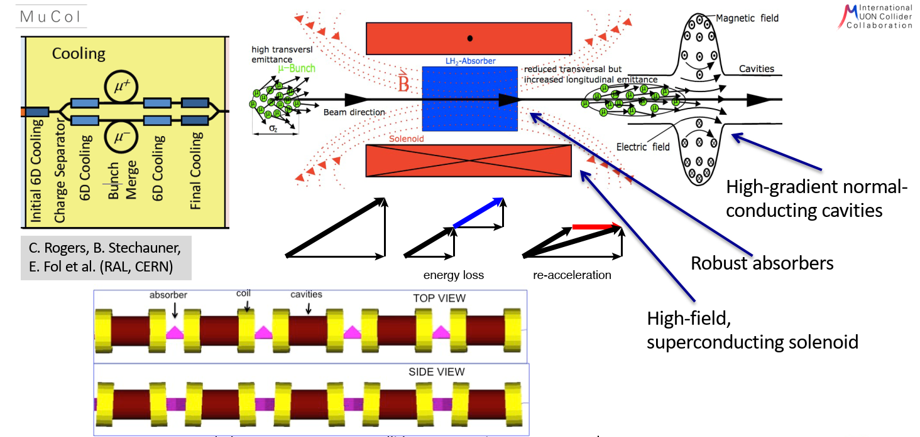
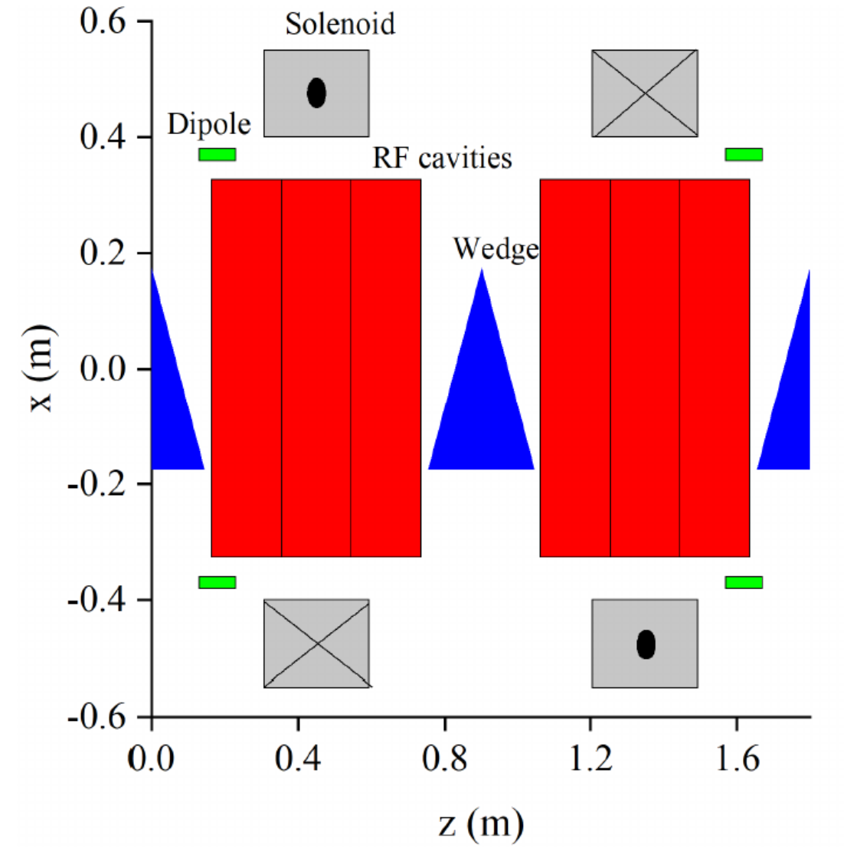
Muon Cooling
Ionization cooling provided by Liquid Hydrogen wedge absorbers
Solenoid magnet to focus the beam at the absorber location
Warm RF cavities (20-30 MV/m) in strong magnetic field - O(10 T) - to restore the beam longitudinal momentum
O(km) length cooling channel
Quite a number of technological challenges (see Ph. Burrows)
6D cooling performance is vital for achieving luminosity and not demonstrated ➔ “Cooling demonstrator" is a crucial milestone
Notes:
From Interim report: https://arxiv.org/abs/2407.12450
Chris Rogers prensetation?

Slide 26
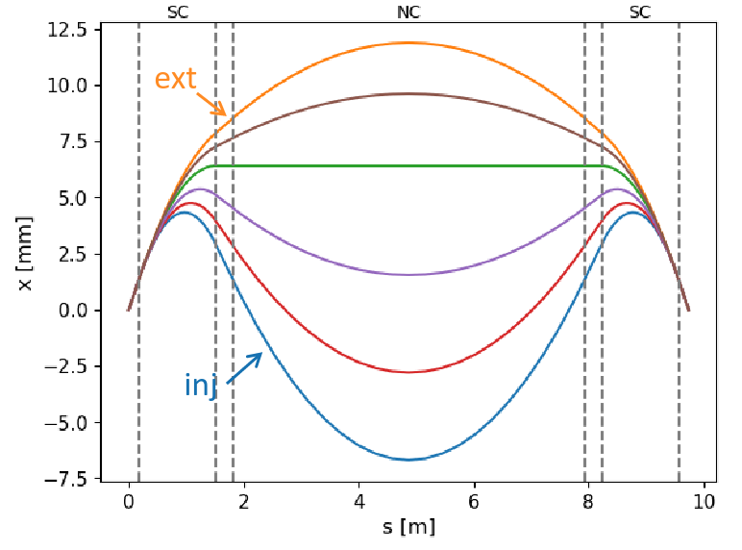
Rapid Cycling Synchrotrons (RCS)
Large RF voltage required to accelerate the beams: many RF cavities in each machine. Up to 90 GV and 3000 cavities
Fast NC ramping magnets are needed (4200 T/s) in RCS 1
Hybrid synchrotrons for higher energy: alternate fixed-field 10 T SC dipoles and pulsed 1.8T NC dipoles to increase the energy swing
  This creates large orbit excursion in the dipole magnets
  No detailed lattice design available yet for CERN implementation
  New beam dynamics regimes
L. Soubirou
Notes:
Lisa Soubirou annual meeting: https://indico.cern.ch/event/1325963/contributions/5806746/attachments/2817648/4921129/Status_RCS_geometry_LSoubirou.pdf

Slide 27
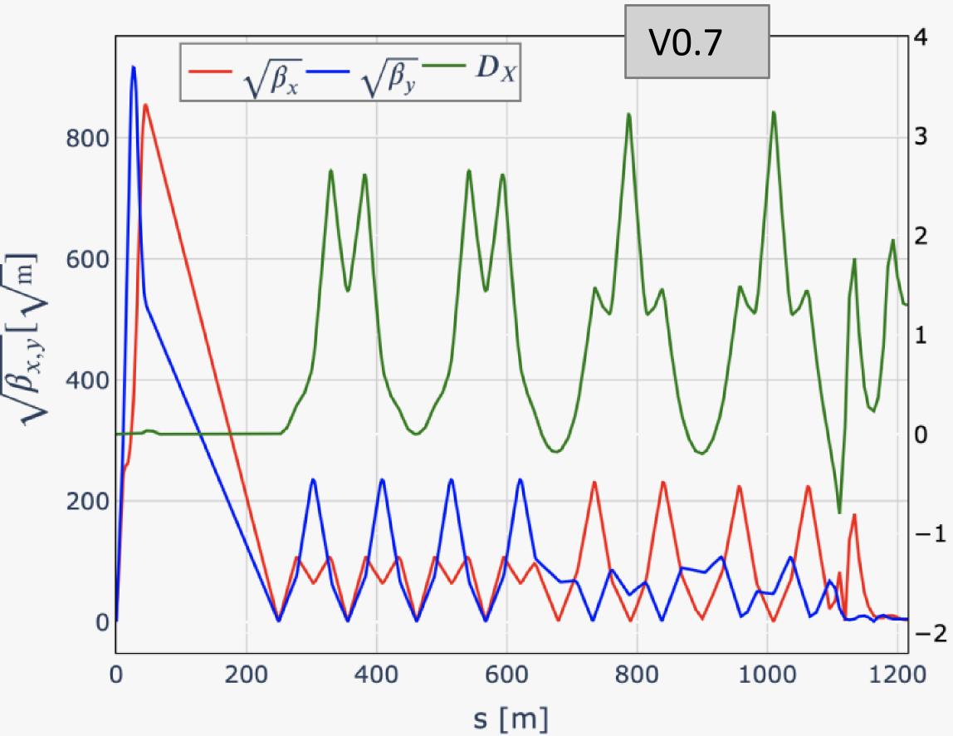
Collider
Achieve high luminosity
  Small β* (1.5 mm), high bunch population (1.8·10¹²)
Challenging lattice design with strong final focus magnets creating large chromatic aberrations and in general sensitivity to errors
Collective and impedance effects are critical
A comprehensive simulation and optimization tool capable of modelling the entire Muon Collider complex is not yet available. Essential to validate performance predictions.
K. Skoufaris, M. Vanwelde
Notes:
Marion presentation: https://indico.cern.ch/event/1325963/contributions/5806746/attachments/2817648/4921129/Status_RCS_geometry_LSoubirou.pdf
Kyriacos:

Slide 28
Summary

Slide 29
Summary
FCC-ee, CLIC, LCF propose designs for e⁺/e⁻ colliders with similar level of complexity, challenges, readiness. LEP3 at pre-conceptual design level. All the proposals have challenging targets.
Circular colliders offer the possibility to serve more experiments and more flexibility for the operation at different energies at high luminosity. Beam-beam and intensity (e.g. electron cloud) effects are challenging but there is extensive experience.
SuperKEKB, and potentially DAΦNE, provide vital experience for FCC-ee/LEP3 in further understanding and addressing potential limitations and devising solutions.

Slide 30
Summary
Linear colliders can operate at higher energies, still limited at the ~TeV energy. Rely on sophisticate feedbacks/feedforwards as demonstrated by SLC experience. Positron production is challenging (particularly for LCF). They deliver polarized beams (at least e⁻)
ATF is a test bed for addressing challenges related to nanobeams (IP size and IP position stabilization, reproducibility) for single beam, scaling to LC for impedance effects non-trivial.

Slide 31
Summary
Next generation high energy hadron colliders challenges are mostly technological and related to HFM, cryogenics, vacuum.
Muon colliders could be an option for achieving high energy lepton collisions but are not at the level of maturity of the other proposals at present.
Particularly critical is the demonstration of the 6D cooling. A variety of technological challenges are associated with the various acceleration steps. Start-to-end simulation tools need to be further developed to validate the overall performance of MCs. Neutrino flux mitigation remains a critical issue, particularly with regard to its impact on potential host sites and public acceptance.

Slide 32
Related submissions
ID | Title | Contact
40 | The Linear Collider Facility (LCF) at CERN | Jenny List
78 | The Compact Linear e+e- Collider (CLIC) | Erik Adli
140 | A Linear Collider Vision for the Future of Particle Physics | Jenny List
153 | The Circular Electron Positron Collider (CEPC) | Miao He
154 | Midterm Review of the European Accelerator R&D Roadmap | Mike Seidel
188 | LEP3: A High-Luminosity e+e− Higgs & Electroweak Factory in the LHC Tunnel | Tiziano Camporesi
207 | The Muon Collider | Federico Meloni
233 | FCC Integrated Programme Stage 1: The FCC-ee | Panagiotis Charitos
247 | FCC Integrated Programme Stage 2: The FCC-hh | Panagiotis Charitos
275 | Status of the International Linear Collider | Tatsuya Nakada

Slide 34
Differences
Circular colliders
Linear colliders
f ~ O(kHz) ☺
Can serve more experiments in parallel ☺
Only particle losses need to be compensated ☺
Synchrotron radiation losses ➔ limit in power ➔ limit in current ☹
Multi-turn effects (e.g. beam-beam limitations) ☹
No synchrotron radiation losses (only at the IP - beamstrahlung) ☺
Single passage. You have always fresh beams ☺
f ~ O (10 – 100 Hz) ☹
Can only share luminosity among experiments ☹
Beam is dumped after collision ➔ Limit in current/power ➔ strain on the injectors ☹

Slide 35
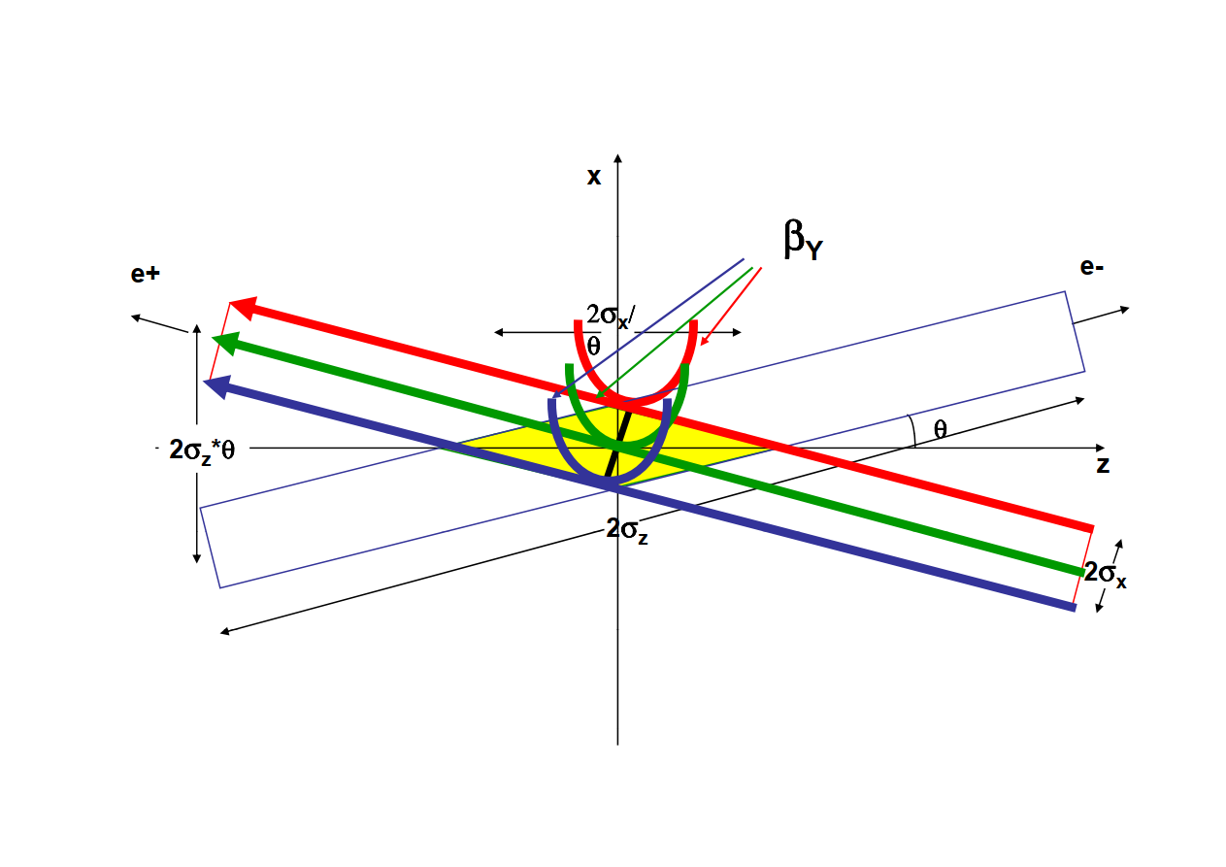
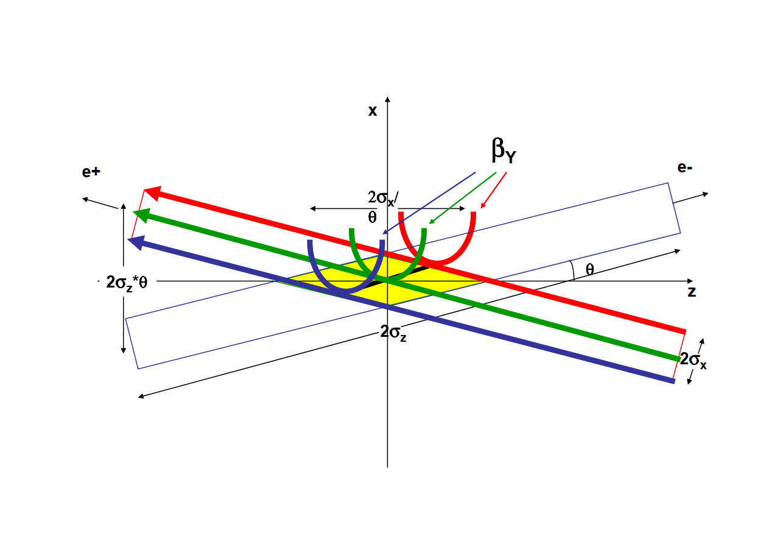
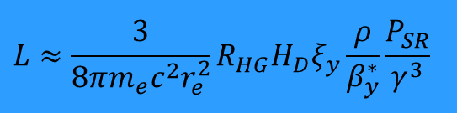
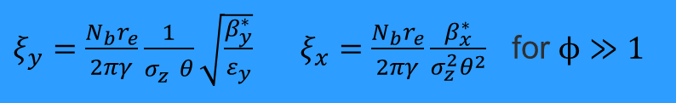
Luminosity (circular colliders)
Innovative approach to mitigate beam-beam limitations while enhancing luminosity
Crab waist scheme (DAΦNE, SuperKEKb) ➔ CEPC, FCC-ee:
Large Piwinski angle φ by increasing θ and/or reducing β∗_{x} to control ξ_{x}, ξ_{y} while maximizing bunch population (compatibly with SR power)
Small β∗_{y}, comparable with overlap area β∗_{y}~σ∗_{x}/θ << σ_{z} , (to keep R_{HG}~1) ➔ L increases, ξ_{y} decreases, suppression of vertical synchro-betatron resonances
Crab waist to avoid X-Y betatron and synchro-betatron resonances
$$L≈\frac{3}{{8πm_{e}c^{2}r}_{e}^{2}}R_{HG}H_{D}ξ_{y}\frac{ρ}{β_{y}^{∗}}\frac{P_{SR}}{γ^{3}}$$
$ξ_{y}=\frac{N_{b}r_{e}}{2πγ}\frac{1}{σ_{z}^{}θ}\sqrt{\frac{β_{y}^{∗}}{ε_{y}}} ξ_{x}=\frac{N_{b}r_{e}}{2πγ}\frac{β_{x}^{∗}}{σ_{z}^{2}θ^{2}}$ for $ϕ≫1$
Crab Sextupoles OFF
Crab Sextupoles ON
P. Raimondi, D. Shatilov, M. Zobov

Slide 36
Beam position control at the IP
Control of the beam–beam offset is required at the level of a fraction of a nanometre
Active stabilization of beam-guiding magnets with movers (CLIC)
Feedback based on beam–beam offset:
  ILC: can correct from one bunch to the next within the pulse (bunch spacing: 554 ns (LP) ➔ 336 ns (FP)) ➔ tested successfully at ATF2
  CLIC: tighter bunch spacing (0.5 ns). Bunch-to-bunch correction not possible, but the latency of the feedforward is short enough to allow several iterations during the 176 ns bunch train.
R. Apsimon et al.
Notes:
Can easily detect an offset as resulting deﬂection of the beams is in the order of tens of µrad (detectable a few m downstream with a BPM)

Slide 37
Beam size control at the IP
Extremely small σ_{IP} requires strong focusing ➔ chromatic aberrations, other non-linear effects. Thorough studies at ATF relevant for e+/e- colliders and in particular for LC.
Achieving stable and repeatable operation at these low beam sizes is challenging.
Design targets approached at lower than nominal intensity and with × 10 β_{x}∗
R. Tomas, Y. Ohnishi, F. Zimmermann
ATF2 experience vital
IP beam size measurement rely on complex instrumentation
Scalability to LCs for wakefield effects not trivial
Notes:
ATF2 1.3 GeV

Slide 38
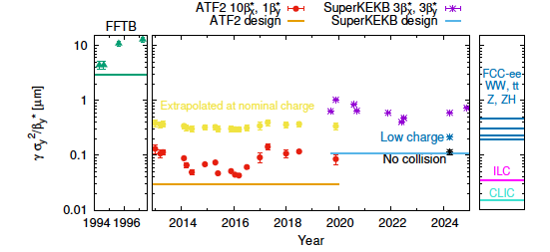
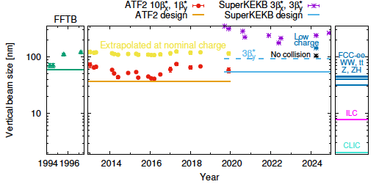

Smallest vertical beam sizes in
HEP colliders
Emittance plot is energy normalized for some phenomena scaling with $\sqrt{γ}$.
So, the emittance plot shows one aspect of the challenge and the beam size plot shows other aspects of the challenge that indeed relate more to vibration tolerances.
A. Faus-Golfe, R. Tomas
Notes:
1) It is not totally clear to me whether the "normalized emittance" is the right parameter to compare ATF with CLIC/ILC.
This would mean essentially that all the important phenomena scale with 1/sqrt{gamma}?
2) I can imagine that the resolution of the monitors for the feedbacks at some point saturate when going to high energies. This means that from the point of view of beam stabilization, stabilizing two beams having the same normalized emittance but different energies at the same fraction of a sigma is equivalent in terms of difficulty. I guess that when you go to high-energy, therefore you have a smaller beam size and smaller tolerances (in absolute value, say in nanometers) then at some point the resolution of the monitor that you use to measure the beam position will become critical.
In general, higher energy needs tighter tolerances in nm. This you show e.g. when quoting the QD0 0.15nm CLIC tolerance (which actually is for 3 TeV, at 380 GeV this should be larger, not sure number has been computed / distributed). ATF2 FD quads have a jitter about 5nm. Also, CLIC BPMs should have a better resolution than ATF2 ones. For the particular case of ILC BDS BPM at least sub-micron ( ~ 100 nm) level is needed (TDR Volume 3 p148, section 8.7.1). In ATF2 we get 25nm (by Stewart Boogert) without any attenuation of signal. Most of CBPM in ATF2 uses attenuator to make wider dynamic range let’s say mm order. Then resolution will be a few 100nm.
For sure the trick here is relying on the IP feedback thanks to the long trains. So, the emittance plot shows one aspect of the challenge and the beam size plot shows other aspects of the challenge that indeed relate more to vibration tolerances, BPM resolutions and feedback systems. Then, how the beam size challenge materializes at higher energy depends on the characteristics of the project. In any case thorough simulations are needed for all projects to demonstrate that the different challenges are under control. E.g. one limitation to the IP feedback mitigation could be wakefields that introduce intra-train motion. Hence, all wakefield sources should be simulated (Pierre Korysko's thesis had such simulations for ILC including some of the wakefield sources but not all).

Slide 39
Experience (ATF)
R. Apsimon et al.
Control of the beam–beam offset is required at the level of a fraction of a nanometre
  ILC: correction from one bunch to the next (bunch spacing: 336-554 ns)
  CLIC: Bunch-to-bunch (0.5 ns) correction not possible, but some iterations during the bunch train.
Extremely small σ_{IP} strong focusing ➔ chromatic aberrations, other non-linear effects
Achieving stable and repeatable operation at these low beam sizes is challenging
LC targets approached at < nominal intensity and with ×10 β_{x}
R. Tomas, Y. Ohnishi, F. Zimmermann
Notes:
Can easily detect an offset as resulting deﬂection of the beams is in the order of tens of µrad (detectable a few m downstream with a BPM)

Slide 40



Commonalities
Crossing angle at the IP (O(10 mrad)):
LC: to avoid parasitic collisions, measure the energy and dump the beam after collision
CC: to avoid parasitic collisions
Flat beams:
Consequence of synchrotron radiation emission (ε_{x} >> ε_{y}) either in the collider (CC) or in the injectors (LC)
σ_{x}~O(100) σ_{y}

Slide 41
Challenges towards high luminosity for proposed colliders
Gianluigi Arduini - CERN
Acknowledgements: PPG Accelerator Science and Technology WG members, N. Mounet, Y. Ohnishi, Y. Papaphilippou, D. Schulte, R. Tomas, F. Zimmermann
24th June 2025

