Slide 1
HEP Computing Needs and Ideas for the Next Generation Initiatives
Borut Paul Kersevan
Jozef Stefan Institute and University of Ljubljana Open Symposium on the European Strategy for Particle Physics
Venice, June 26th, 2025

Slide 2
Future projects and Computing
We aimed to compile information based on the proposals for ‘big’ future collider and experiments at CERN (called projects in this presentation), emphasizing common findings and points we believe are important to stress.
FCC-ee, LHeC, LC, Muon Collider, LEP3 and FCC-hh.
In addition, we organized a structured discussion with the respective communities.
Many thanks to all for a prompt feedback and valuable input!
‘Problem’ definition: The HEP computing challenge is to ensure successful and timely delivery of the best possible physics results for the future HEP experiments.

Slide 3
Main summary
Let us state the main important conclusion immediately:
We can conclude that for all of the projects, meeting the computing requirements is feasible.
In other words, the needs can be accommodated by ‘evolution’ without the needs for technological breakthroughs.
There is, of course, a significant potential from breakthroughs (e.g. AI, new tech).
However, in order to achieve this, one needs to assume a continuous R&D and sustained activity throughout the years!
The needs are somewhat different, as are the timelines, and it is important to take them jointly into account.

Slide 4
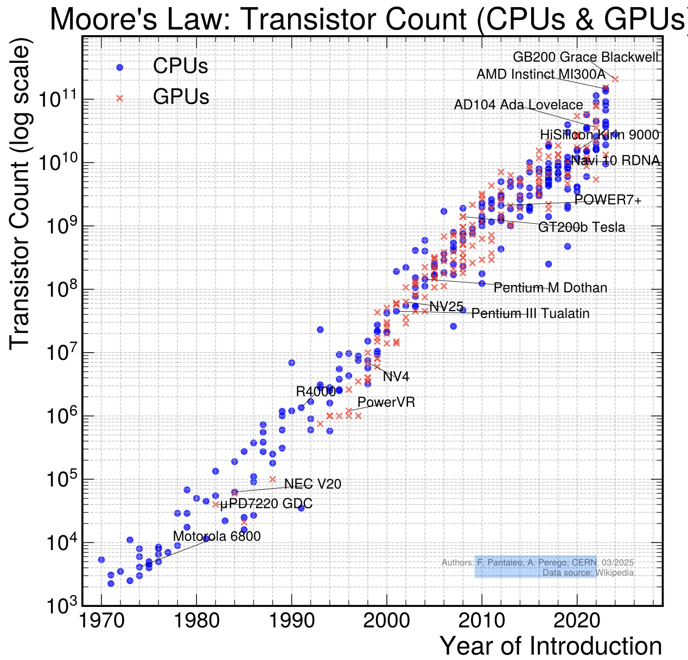
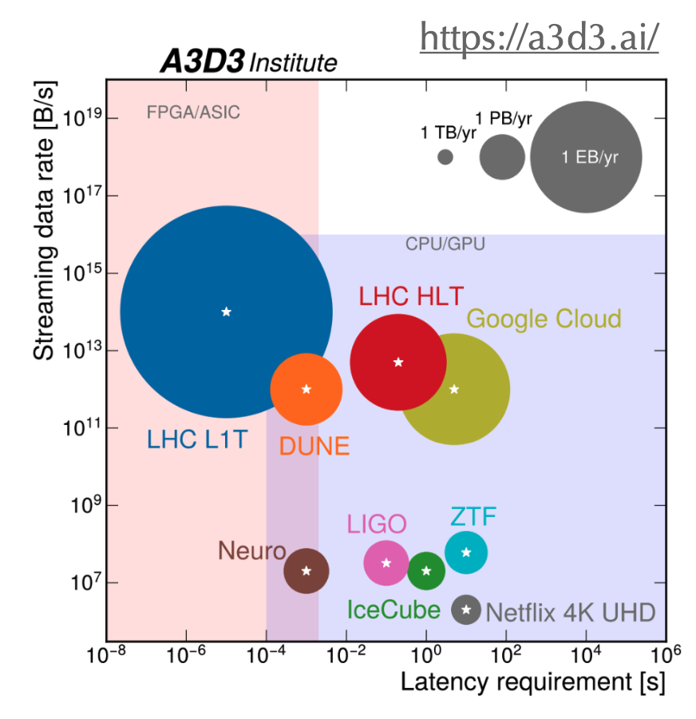
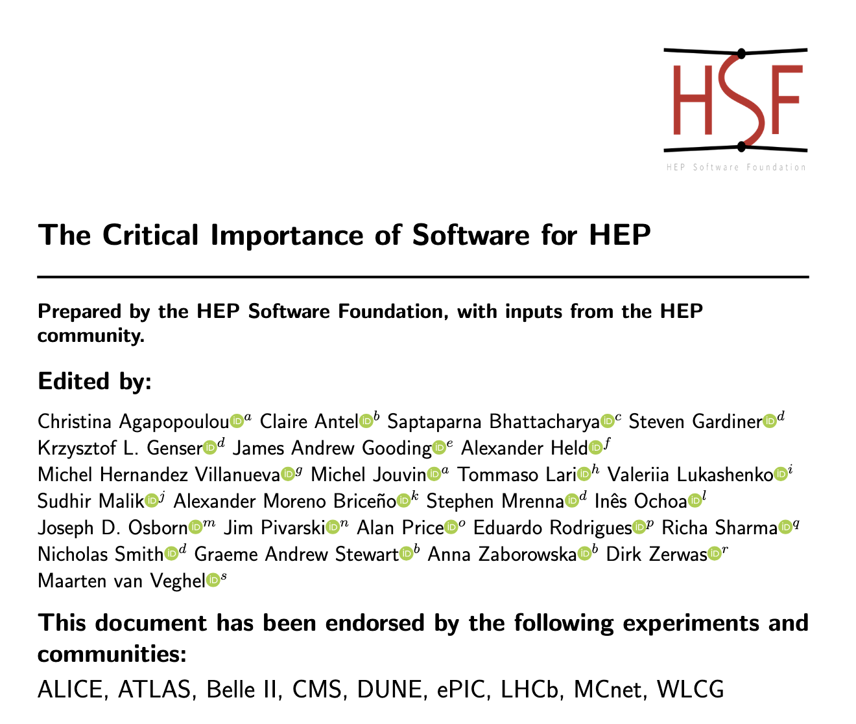
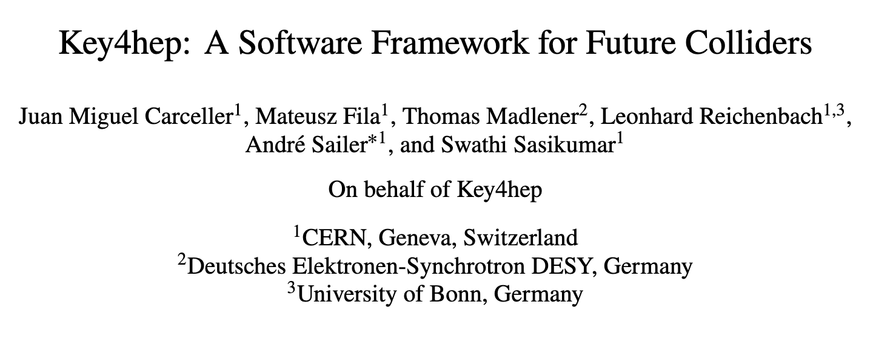
Common findings
All the projects are conservative in their modeling, trying to connect their computing models and resource projections to the existing HL-LHC scenarios.
In other words, the proposals aim to show it can be done without a need for revolution/technological breakthroughs.
Always an interesting point how far some modeling like Moore’s law will stretch.
An important lesson, that cannot be stressed enough, is that the future projects all aim to build on common foundations in terms of software (various aspects), services (WLCG, data management...) and operations.
A lesson learned from the LHC era.

Slide 5
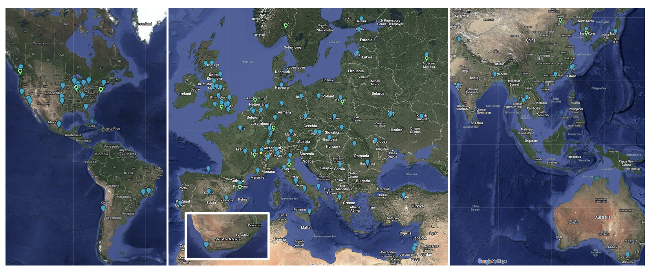
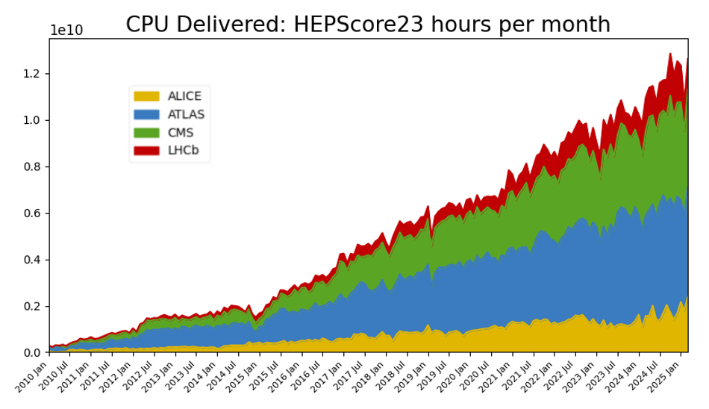
Worldwide LHC Computing Grid
All the projects assume the WLCG will continue providing the existing functionality for distributed computing even after the end of the LHC program!
There is no big paradigm shift in terms of doing it all on a single (quantum) computer!
An effort must be made to preserve and evolve the WLCG services, both in terms of operation as well as underlying software, lower-level services and networking!
A period of a concurrent need for the computing infrastructure in which LHC experiments ramp down (after 2041) and future projects ramp up is also expected.

Slide 6
Use of Computing Facilities
Parallel talk by M. Girone, G. Iadarola, G. Merino, S. Ryan
All the projects envisage the use of available resources, with adaptability.
Use of HPCs with heterogeneous architectures is commonly foreseen.
Clouds are also a possible solution but at present not economically viable.
There is a common understanding that the availability of resources will vary in the ‘gap’ years leading to future projects at CERN.
A feasible approach needs to be found.
In addition, the future projects already now (and onwards) urgently need modest computing resources (at percent level w.r.t. the LHC needs!), which should be accommodated as much as possible.

Slide 7
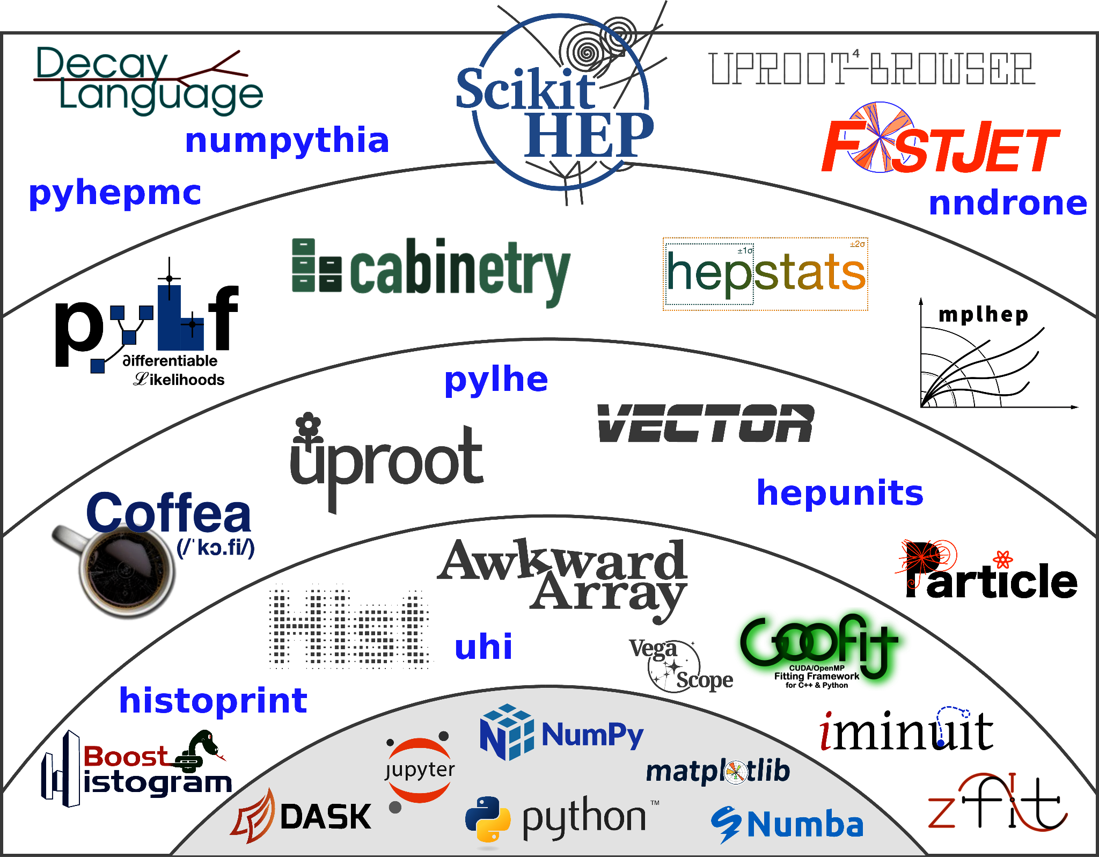
Software
As already mentioned, the future projects plan to build on common foundations (for multiple experiments), based on existing common projects and communities:
The LHC experiments started from different positions on too many aspects, duplicating activities and this needs to be avoided in the future.
Examples used in the new studies and future models are e.g.
the HSF supported tools, Key4HEP software stack (all projects!)
Packages like Root, Geant4, Gaudi …
The use of multi-threading/parallelization, offloading to GPU (especially ML), smart scheduling of CPU/GPU resources etc ... will become paramount.
Also important is the investment in the Monte Carlo generators both in terms of precision and resource consumption!
There is a common concern that these activities/communities need to remain continuous (and funded!) throughout the time towards the future projects.

Slide 8
Software
As already mentioned, the future projects plan to build on common foundations (for multiple experiments), based on existing common projects and communities:
Examples used in the studies and future models are e.g.
the HSF supported tools, Key4HEP software stack (all projects!)
Packages like Root, Geant4, Gaudi …
The use of multi-threading/parallelization, offloading to GPU (especially ML), smart scheduling of CPU/GPU resources etc ... will become paramount.
The LHC experiments diverged on too many aspects, duplicating activities.
Also important is the investment in the Monte Carlo generators both in terms of precision and resource consumption!
There is a common concern that these activities/communities need to remain continuous (and funded!) throughout the time towards the future projects.

Slide 9
Software
Parallel talk by N. Skidmore and F. Gaede

Slide 10
Machine Learning and Artificial Intelligence
Observed two levels of AI/ML in consideration:
Machine Learning (ML) tools, facilitating methods like efficient event selection, flavor tagging etc..., i.e. simpler tools with direct applications.
Artificial Intelligence (AI) tools, today matched to LLM (ChatGPT-like tools).
The future projects are (surprisingly) conservative: everyone will definitely use ML and find it essential to meet the physics goals, none of them will rely on AI.
We put this as an explicit question at the projects’ interviews.
The importance of communities fostering new ideas and bridging the gap to computer science and industry is acknowledged.
HEP (LHC, WLCG, EuCAIF...) Collaborations can be a good a role model on how to collaborate in a distributed grid of diverse research institutions with CERN as an important node.
How to span these across many decades efficiently is a challenge.

Slide 11
The use of ML and AI
The projects aim to have a conservative development basis: Nobody is defining the baseline for detector development and software environment to be (only) AI-based,
as a backup at least, there is always a non-AI-based approach.
They all acknowledge the crucial role of ML in various stages:
Notably also using them on custom hardware (e.g. ML-enabled FPGAs for triggers), new approaches like focused/targeted data acquisition etc...
Often mentioned is also the use of Generative ML methods for fast simulation solutions.
If the execution time is fast enough, on-demand simulation is possible, without the need for storage (which is the most challenging resource).
A strong ‘nudge’: It would be really short-sighted not to explore new approaches in a timely manner!
It would be bad to miss the ML/AI developments that would give the HEP program a strong boost!
Parallel talk by G.Kasieczka, S. Giagu

Slide 12
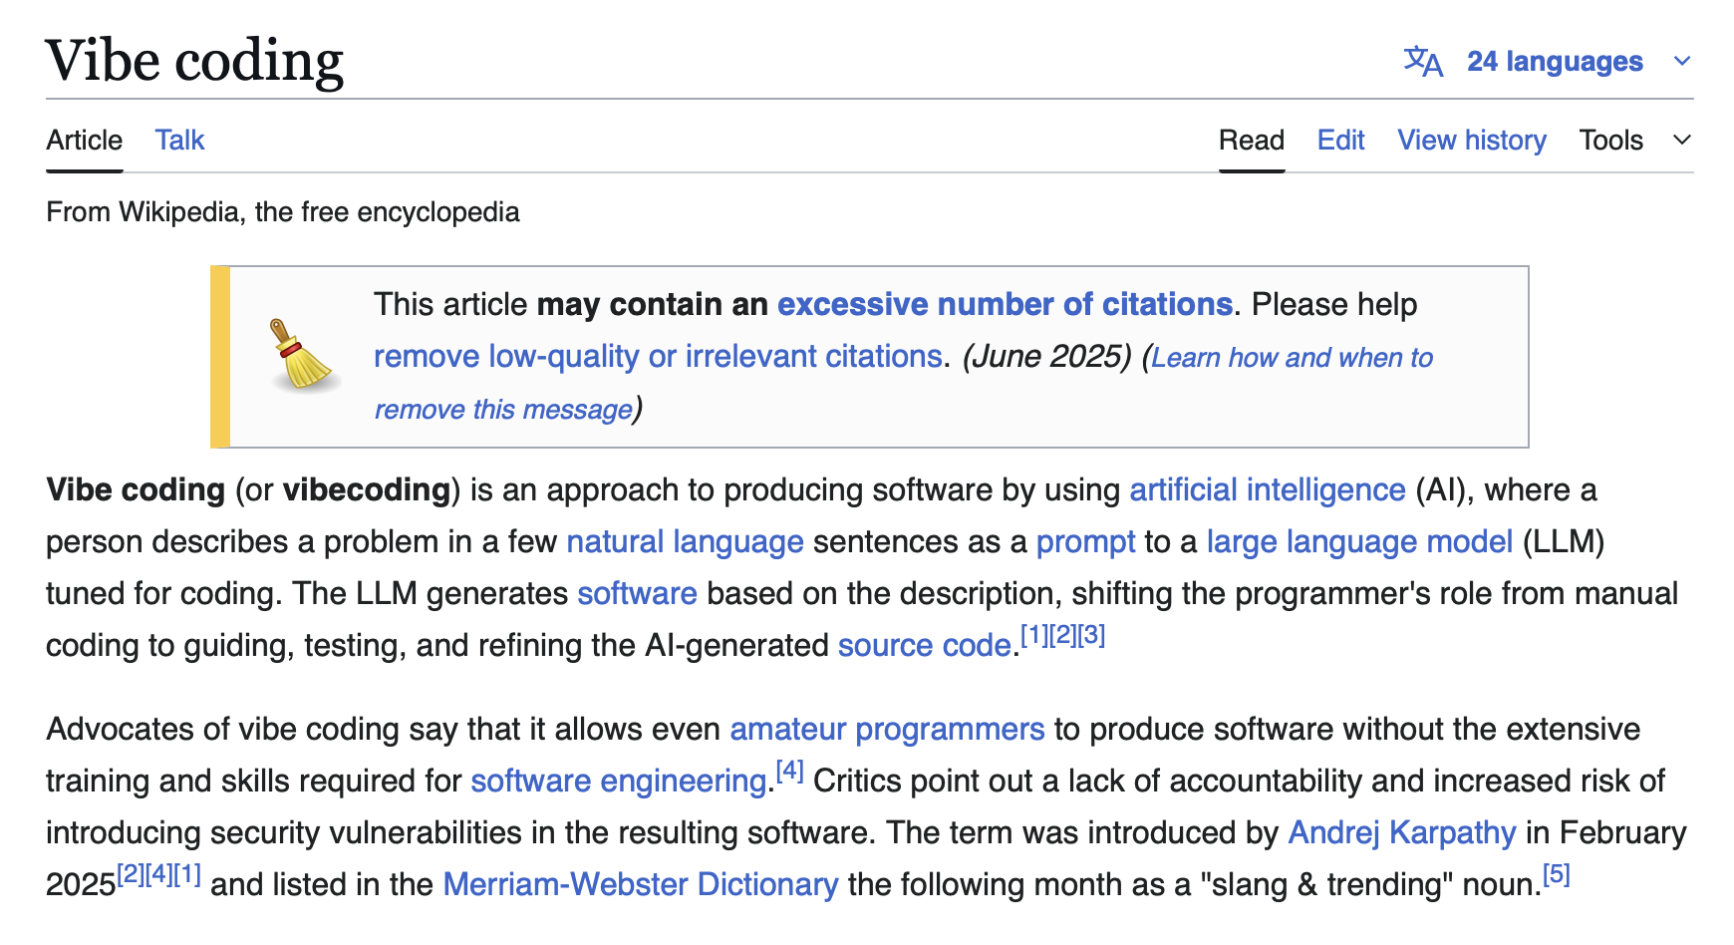
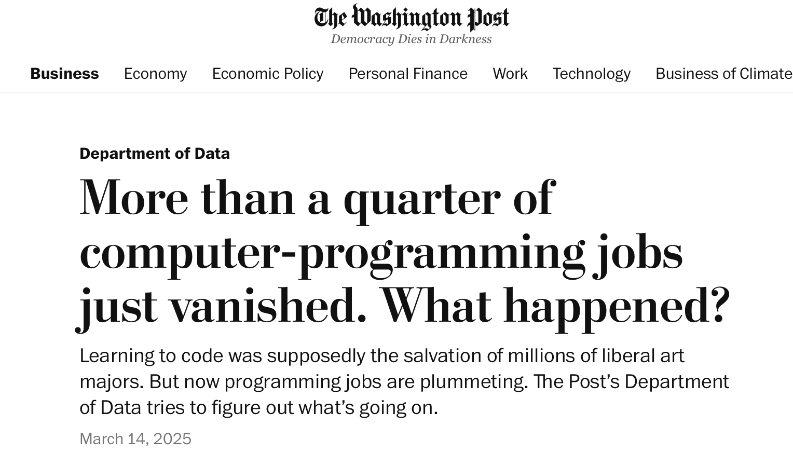
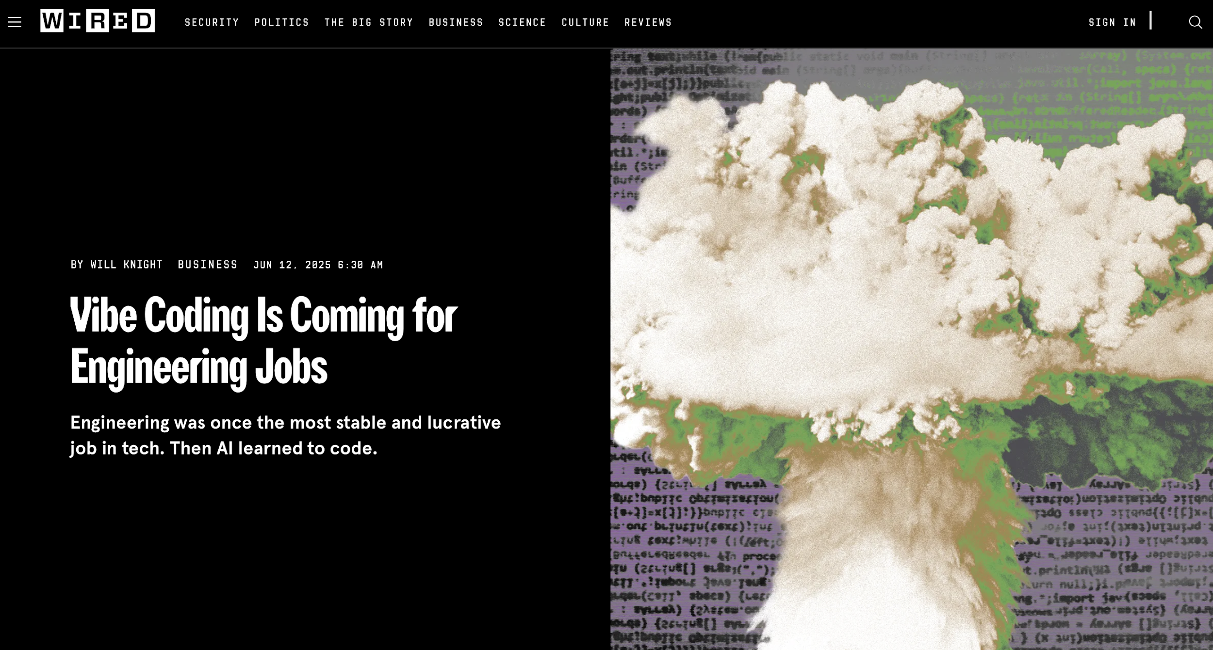
The use of ML and AI
It is hard to guess how transformative AI will be in the future years:
Good example is the impact of the vibe coding in the industry in the last 6 months:

Slide 13
Resource Requirements
We tried to summarize the modeling of resource requirements and computing models for the main future projects: We asked them for additional feedback and/or pointers to documentation to be as quantitative as possible (and reasonable). Very good feedback!
 | HL-LHC (GPE) | LCF4CERN | FCC-ee | LEP3 | LHeC | Muon Coll | FCC-hh
Potential start | ~2030 | ~2042 | ~2045 | ~2045 | ~2042 | ~2050 | ~2055 or 2070
Physics program (Energy: Lumi [ab⁻¹] , Events) | 14: 3, 1e12 | Z: 0.1, 3e9 250: 3, 550: 8, | Z: 205, 6e12 W: 19, 2.4e8 ZH: 11, 2.2e6 top: 3, 2.5e6 | Z: 48, 2e12 W: 5.6, 4e7 ZH: 2.4, 4e5 | 1.2: 1, 70B | 10: 10, 1e10 | 85: 40, 2e13
Length [Yrs] | 12 | 25 | 15 | 20 | 6 | 5 | 25
Total CPU [MHS23-y] | 500 | 0.5 | ~110 | ~30 | 4 | 200 | ~100000
Avg. annual CPU [MHS23] | 40 | 0.02 | 7 (33/yr for Z) | 1.5 (0.5/yr for Z) | 1.5 | 40 | 4000
Est total cum. Storage [EB] (including SIM hit tier) | 20 | 1 | ~8 (40) | ~10 | 0.12 | 0.7 (29) | ~4000 (in yr~2100)
Parallel talk by D. Lange, S. Jezequel and J. D. Chapman

Slide 14
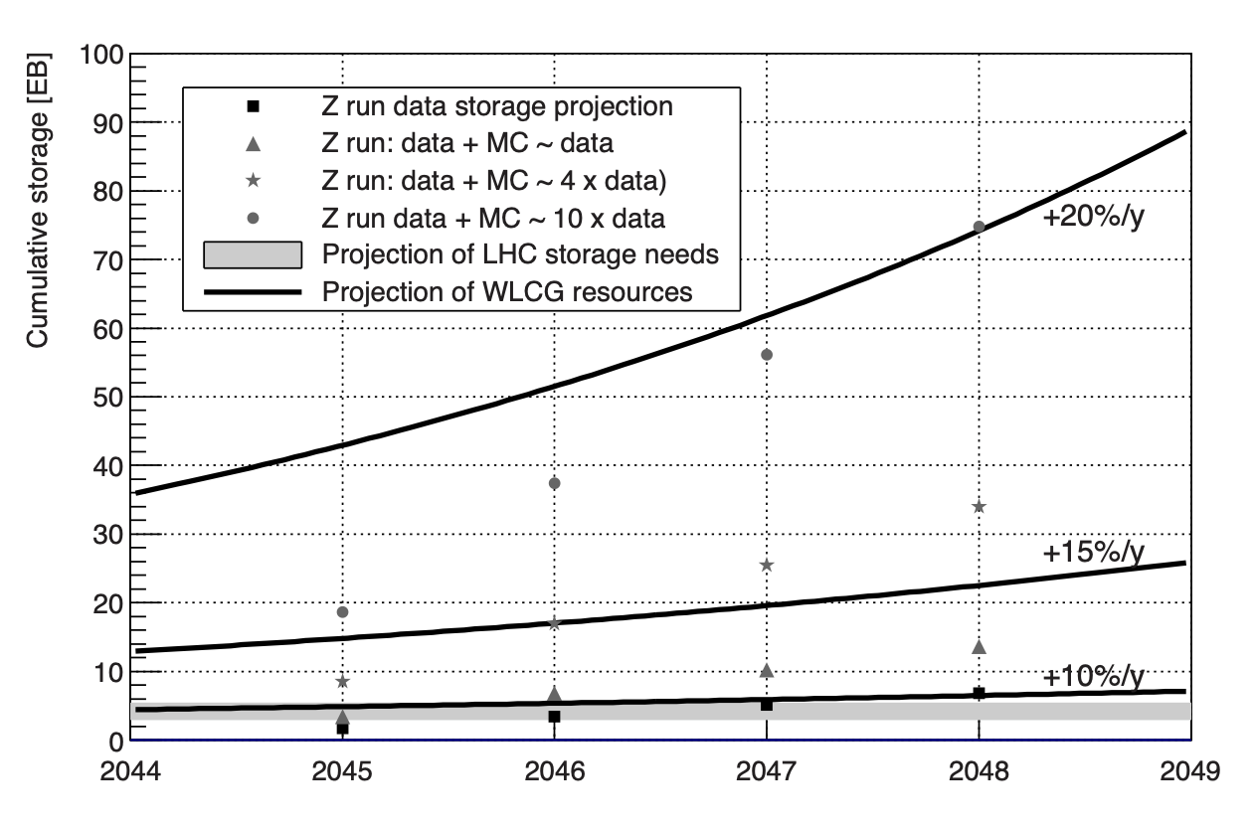
Major challenges for Future Computing
Parallel talk by D. Lange, S. Jezequel and J. D. Chapman
FCC-ee: The biggest bottleneck is the processing and storing the 10¹² Z⁰ bosons in the Z-peak operation ...
Muon Collider: full data processing with the beam backgrounds deserves an honorable mention ...
FCC-hh: the most challenging in absolute scale of computing load - by 2 orders of magnitude w.r.t. HL-LHC – but also furtest away (LHC pileup equivalent of 1700 – intensity and energy, 100 kHz trigger rate)
All projects will spend considerable resources producing and storing enough high-quality simulation.
Considerable uncertainties - is 10x the data enough for all precision measurements?
Importance of MC Generator evolution (N^{k}LO and speed)
Here on-demand new tools like generative ML can help a lot.
FCC-ee
MuonC
Simulation (FCC-ee)

Slide 15
New Technologies
Many inputs acknowledge the future potential of new technologies, such as e.g. quantum computing and neuromorphic processors.
On the other hand, the future projects do not explicitly include such potential developments in their computing models.
We believe this is not because we would not use them - in HEP we have an excellent track record to use whatever is available - but:
Aiming to be conservative, proving they do not need revolution to succeed.
Also, in part due to person power – non-essential contributions are currently hard to populate.
One needs to consider, that from our experience it takes (at least) 10 years to adopt a new technology to our needs (e.g. HPC...), so we should really do a continuous R&D on new technologies with advance preparation whenever possible!

Slide 16
Quantum Computing Potential
Parallel talk by S. Vallecorsa and H. Gray
CERN has its own Quantum Technology Initiative (https://quantum.cern)

Slide 17
Look into the future
It is quite hard to have an informed look into the crystal ball on what the future computing will look like:
“Making projections on several of the questions you ask , for experiments running 40 years from now, is like having discussed in 1970 which sort of technology the 2010 LHC experiments would have used for punching their cards ...”
Nonetheless, to repeat the main statement with confidence: Whatever the future project chosen, the required software and computing is feasible for optimal and timely physics results, provided adequate person power and funding are available for continuous activities and R&D in this domain.

Slide 18
Notes on the table (backup)
MuonColl: Doc, Tables 22.1.1 and 22.2.1 storing RAW and AOD/analysis
FCC-ee: Doc, Tables 21,22 and Figure 133 are for detector simulation. Then we assume 4x MC/data and that the reconstruction time is 30% of the sim time based on the doc. Raw and simulated raw are stored (data raw size from this doc)
FCC-hh: Doc and Doc. Effective pileup and event rate suggests scaling of 100x HL-LHC and 2x longer program
LHC: CMS Doc and ATLAS Doc together with extrapolation to end of planned running. Storage includes RAW
LEP3: Estimated as 1/4 to 1/3 of FCC-ee (Doc)
LHeC: Doc
LC: https://arxiv.org/pdf/2503.24049 https://zenodo.org/records/4659567 https://zenodo.org/records/4659571 Z run extrapolated from FCC-ee

