Slide 1
PLENARY / COMPUTING
Computing in HEP: how we got here and needs for the next decade [and some more]
Tommaso Boccali (INFN Pisa)
for the Computing PPG

Slide 2
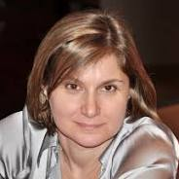
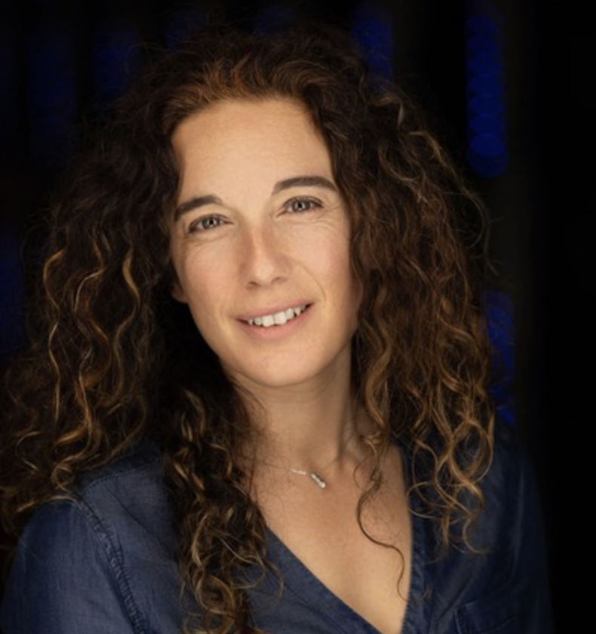
The computing PPG team
Computing PPG
Facilities
SW
AI
Modelling
New Tech

Slide 3
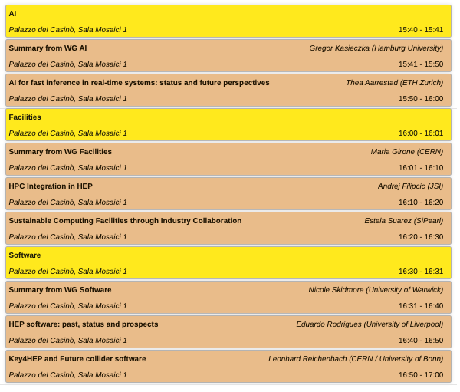
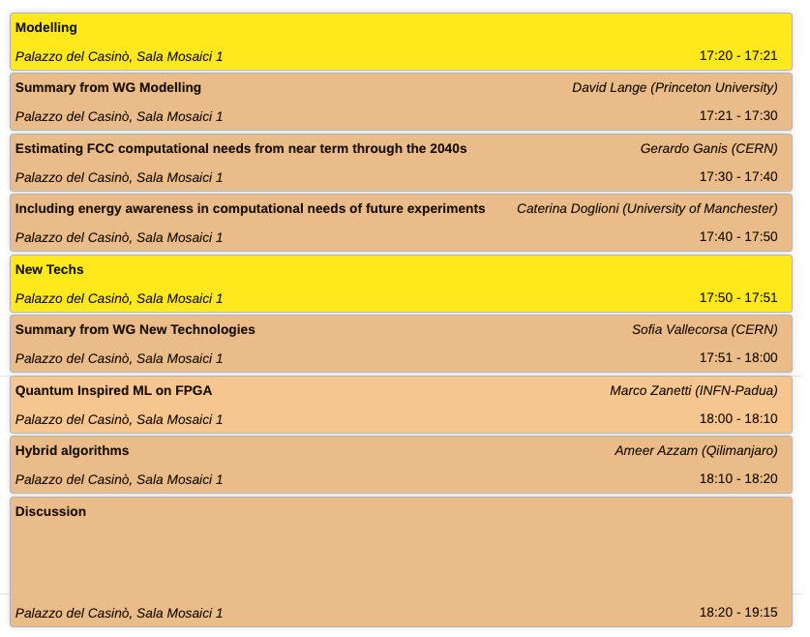
Long and interesting Parallel Session on Monday – with open discussion at the end

Slide 4
The two talks – and the input material
Computing in HEP: how we got here and needs for the next decade
Tommaso Boccali (this talk)
HEP Computing needs and ideas for the next generation initiatives
Borut Kersevan
All major running and planning projects submitted computing related inputs to the ESPP
Or sections inside wider inputs
We had interviews with the projects (thanks!)
LHCC reviews for ATLAS and CMS
LHCC meetings and C-RSG resource evaluation
WLCG documents from workshops, meetings, …

Slide 5
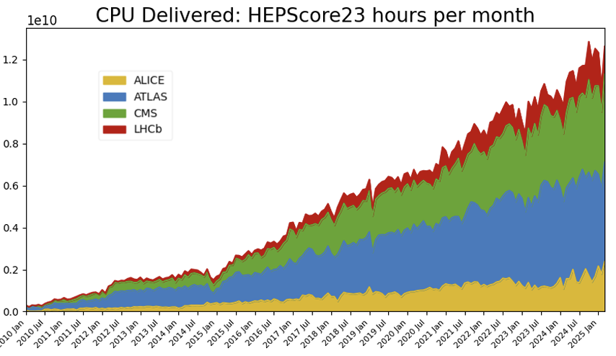
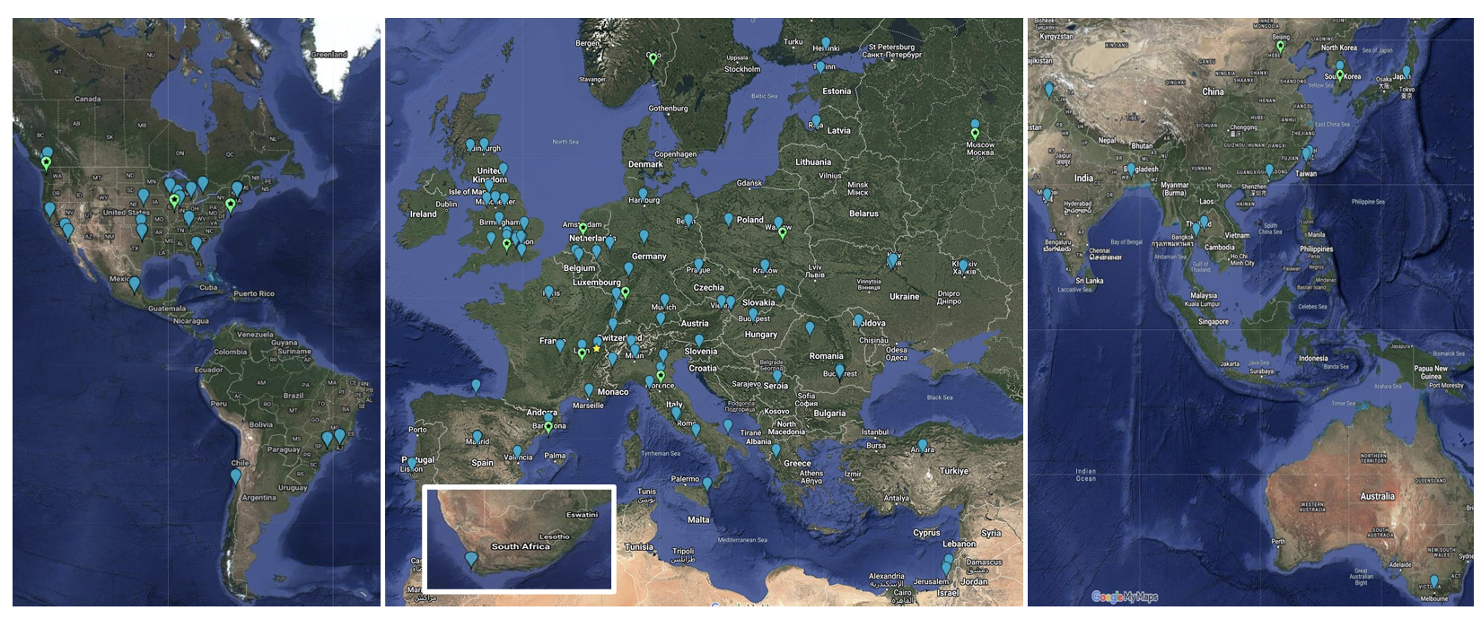
HEP Computing @ CERN – circa 2025
The 4 LHC experiments are in uninterrupted computing operations since the start of Run1(and before with data challenges and simulation…)
[Offline] Computing managed via the WLCG Collaboration
WLCG evolved from a ”system of uniform centers” to a “system of heterogeneous systems” [Grid, Cloud, GPU, Supercomputers, Filter farms, …]

Slide 6
Evolution with time - (ATLAS is very similar)
Increase relative to 2009 (log)
Increase relative to 2013 (log)
16 years resource increase fits +20% -- +30% / y
12 years resource increase fits +15% -- +25% / y
“The amount of money spent per year in computing resources shall at most be stable” [the famous “flat budget”]
In the 2009-2025, <PU> x Trigger rate has increased by 60 x 100

Slide 7
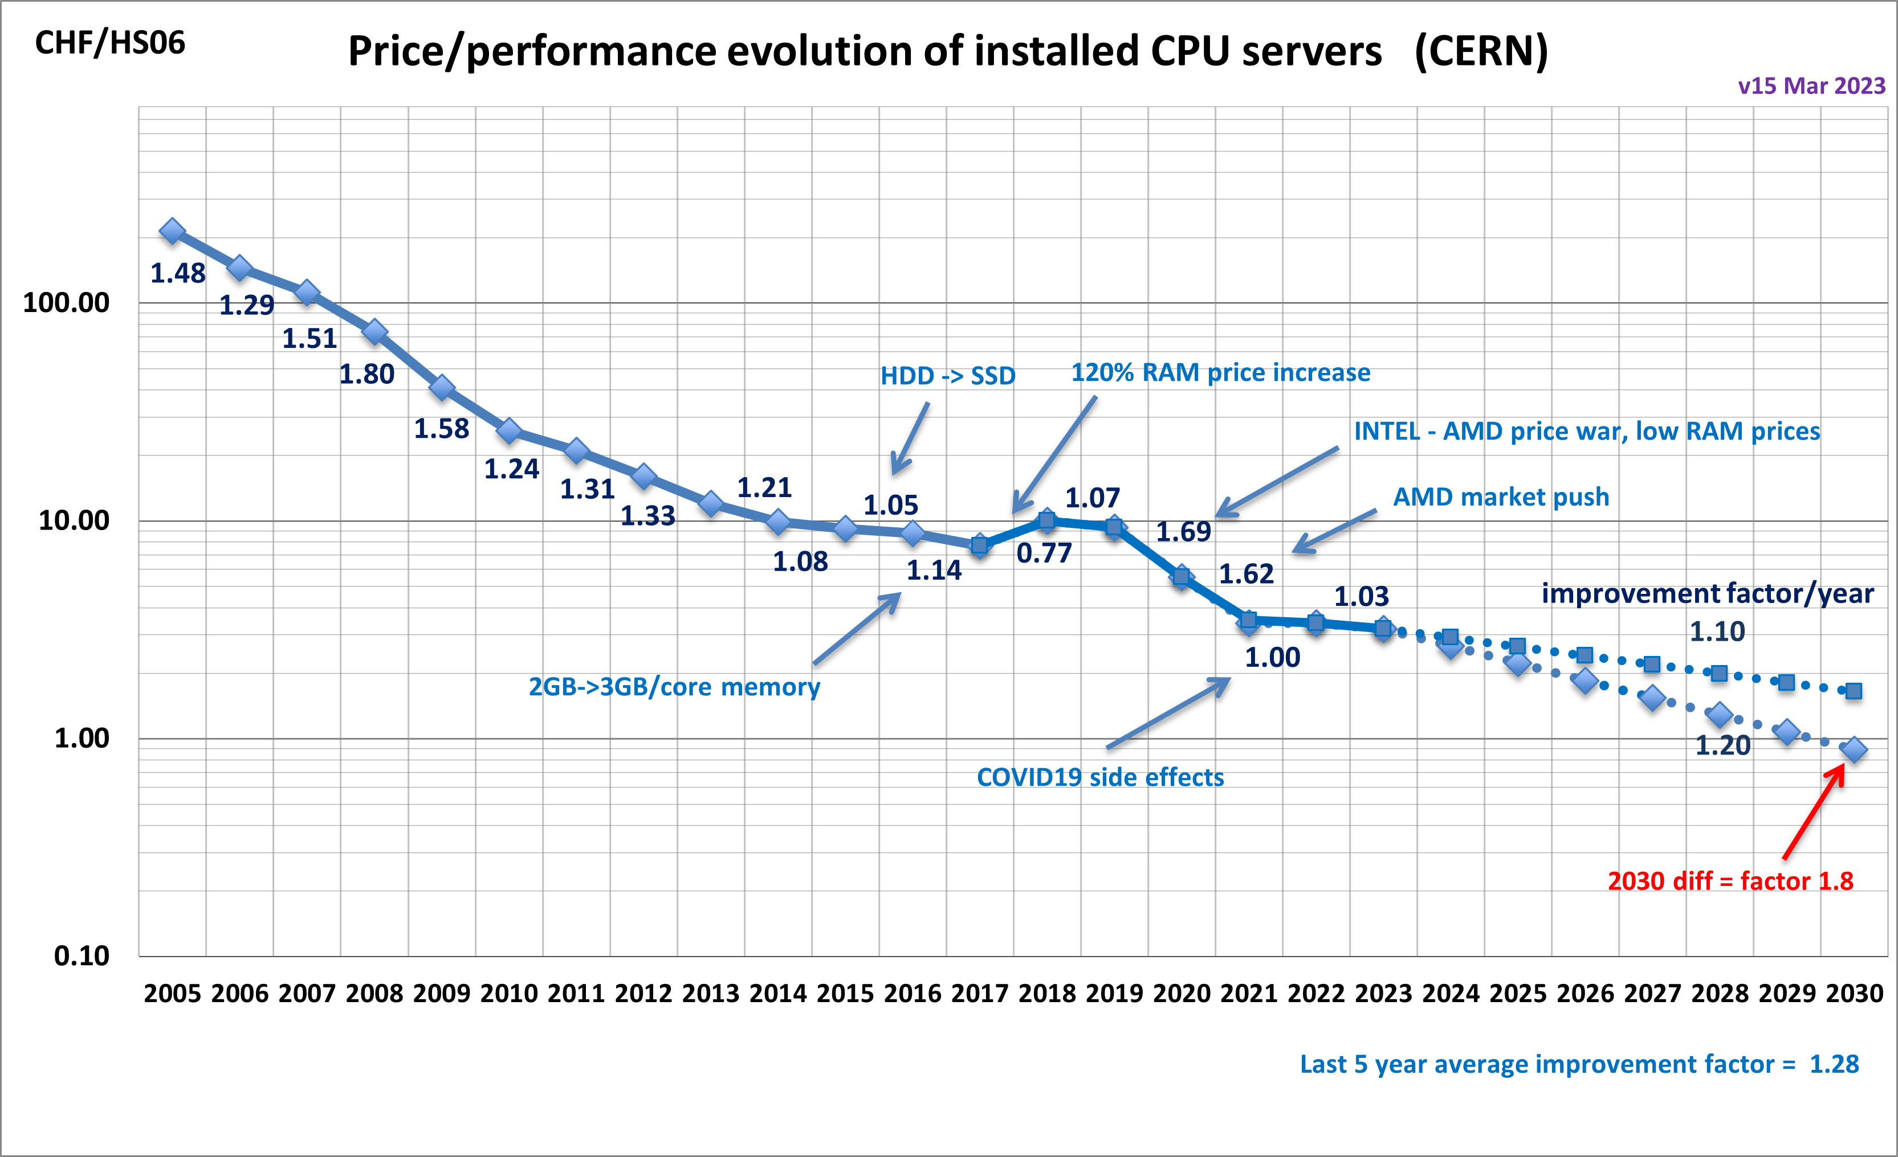
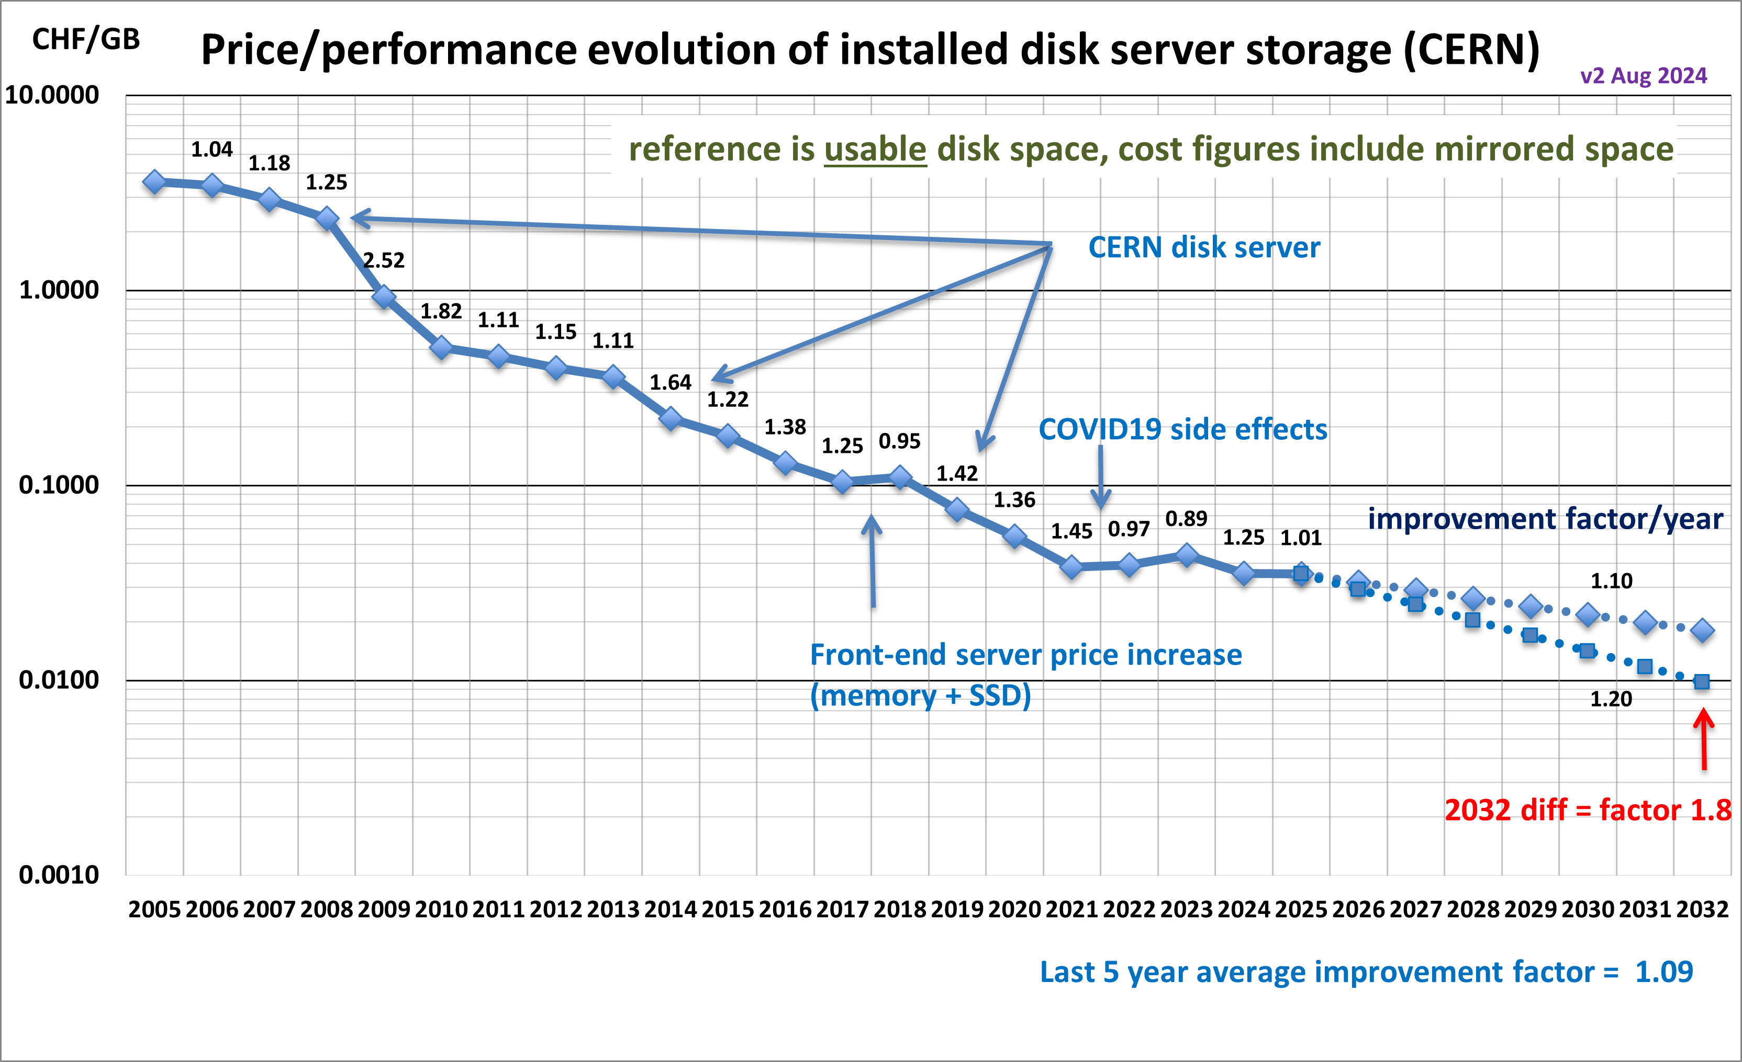
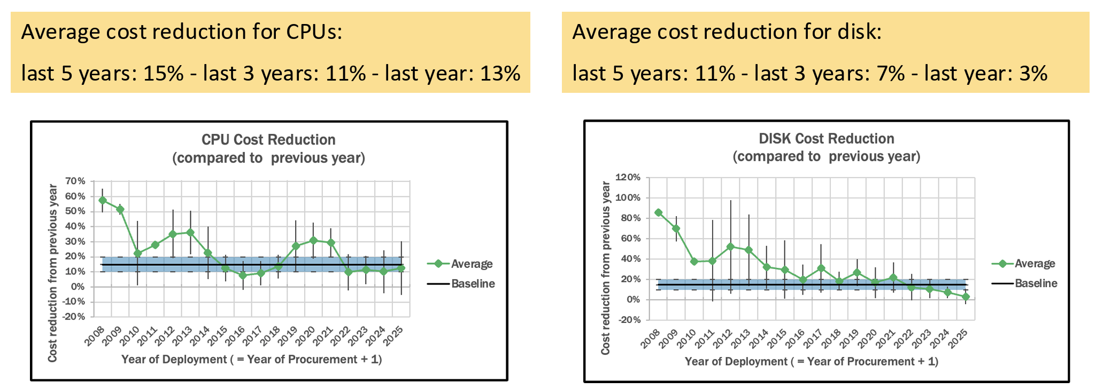
In the meantime, technology …
The famous Panzer/Sciaba’ plots
1 TB disk ~ 5 TB tape ~ 10 HS23 [1/2 CPU core]
tape
Old “Flat Budget == +20%/y” not more realistic today, at least for disk
Notes:
Industrial competition

Slide 8
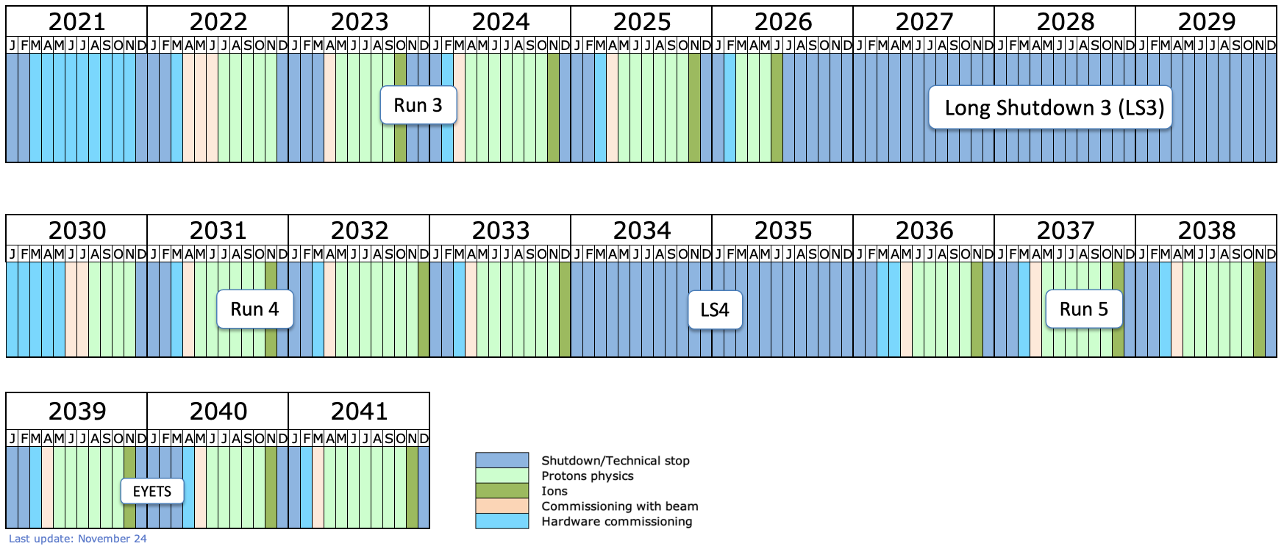
The expected future within ~a decade
CMS and ATLAS undergoing the largest upgrades with Run4: 3000/fb total lumi
Computing planning and modelling well advanced AND there is a LHCC mechanism in place for their cmp scrutiny
ALICE and LHCb have successfully upgraded for Run3 – gearing up to have upgrades approved for Run5
Computing under (early) studies
ATLAS and CMS PhaseI
ALICE-2, LHCb Upgrade-I
ATLAS and CMS PhaseII
ALICE-2, LHCb Upgrade-I
ALICE-3, LHCb Upgrade-2
ATLAS and CMS PhaseII
ALICE-3, LHCb Upgrade-2
ATLAS and CMS: nominal inst lumi from 2e34 to up to 7.5e34; trigger rates in the O(10) kHz ballpark
LHCb: from 2e33 up to 1.5e34
ALICE: 3x Pb-Pb rates, 90x pp

Slide 9
ATLAS and CMS [latest public projections]
+20%/y
+10%/y
Multiple projections (lines): depend on (successful) R&D
Notes:
Controllare gli R&D denrtro
: it is assumed that the fraction of full simulation used by the collaboration will be reduced from 33% to 10%; the event generation and reconstruction times will be reduced by 20% each; a smaller fraction of the AODs will be 6ATLAS Software and Computing HL-LHC Roadmap, version 2.1 held on disk; and the number of replicas and versions of datasets will be significantly reduced.

Slide 10
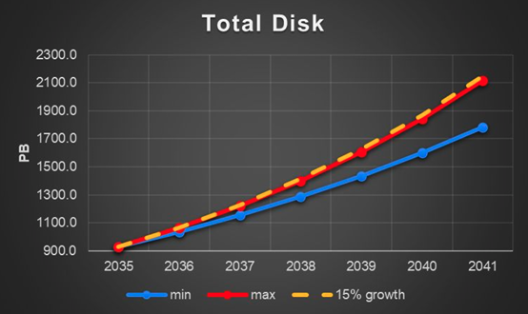
ALICE -- Run3+Run4+Run5+
ALICE-2 (Run3, 4) as the major scheduled upgrade
Major change in Computing Mode: triggerless operations, 50 kHz data taking, …
Managed without major deviations from flat budget
ALICE-3 under study / in the approval process
3x Pb-Pb wrt Run4, 90x pp
Min and Max depend on the Ion type, but at most +15%/y
CPU not yet modelled
LS2-Run3
LS3-Run4-LS4
2018
Run 5+
2041
Notes:
35/nb IonIon, 18/fb pp

Slide 11
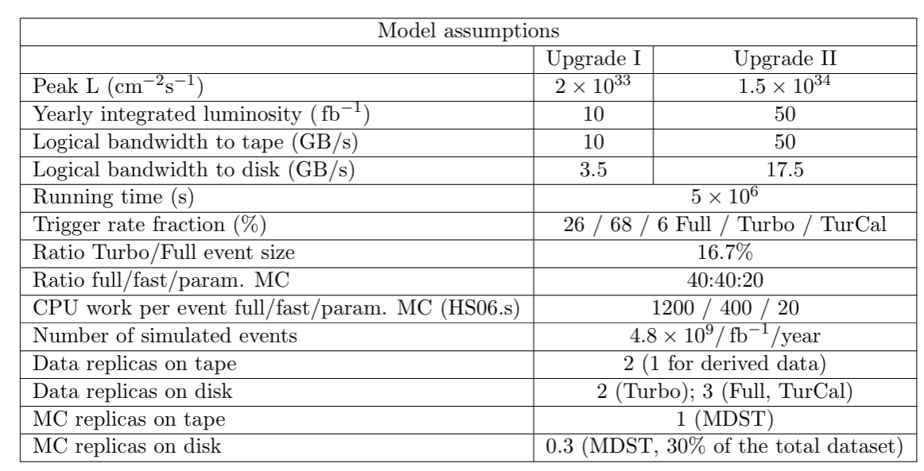
LHCb -- Run3+4+5+
TDR vs Real
Run3 represents a major increase in computing resources
Gone triggerless, higher inst lumi
Smoothed, in reality, due to delays AND changes in the model – manageable
Run4 not different from Run3
Run5 is ~ 5x in bandwidth or <PU>; LHCb deploying R&D (e.g, HLT2 on GPU, fast simulation, optimization of data formats, …)

Slide 12
Which are the main recurrent themes and directions of R&D?
AI
Heterogeneous computing
Evolution in SW
Evolution in HW
Evolution in the distributed computing infrastructure
Evolution in the position of HEP among other scientific endeavors
New Techs
Careers
LTDP
…
Common Frameworks
Low power archs
GPUs
Sustainability
Tiered Model
Analysis facilities
HPCs
Clouds
Quantum
FPGA
ESCAPE
LTDP
JENA
SPECTRUM
Careers

Slide 13
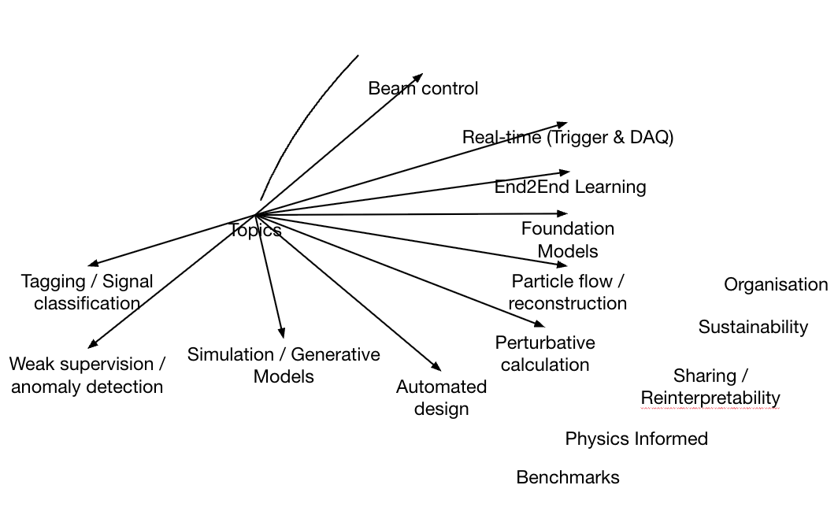
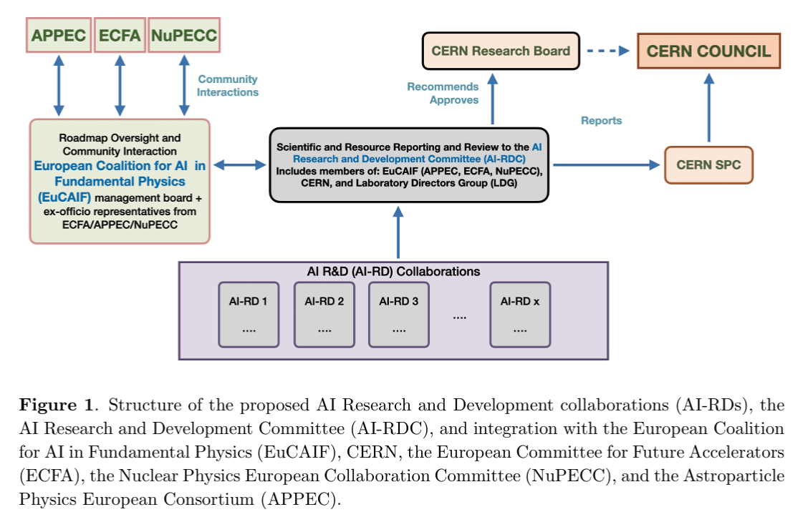
Artificial Intelligence
How to better coordinate AI efforts in the HEP domain [and beyond]? Options on the table:
Experiments drive it – today’s model
AI is seen at the level of other R&Ds (as the DRDs): an AI-RDs [input 167]
The EuCAIF model, with an umbrella coalition for AI in Fundamental Research
A process difficult to drive (personal opinion):
Many actors [Maths, CS, Eng, …]
Impact of industries
Larger interests at stake [EU AI strategy, ”CERN for AI”]
How to benefit from EU-level push for scientific AI?
All current experiments explicitly mention AI as a cornerstone towards better|cheaper physics
In some cases on the critical path, like (much) faster simulations or trigger capabilities
AI needs (if we want it to be incisive):
Access to specific computing resources
Access to domain experts, training, young researchers
Funding opportunities

Slide 14
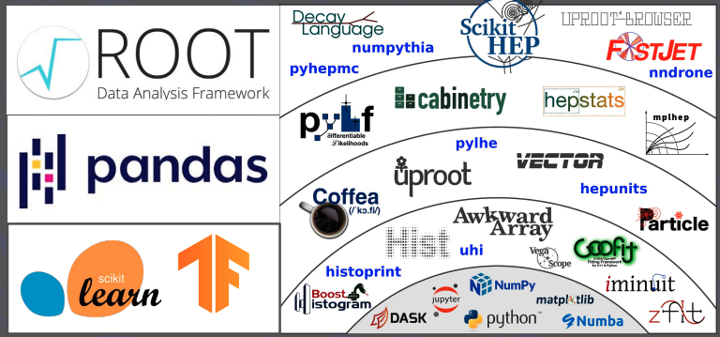
Software – what will it look like?
Huge range of tools available makes interoperability across software ecosystems crucial
“Many analyses have integrated a variety of ML tools, often including industry-standard software libraries” #187
New languages are also on the horizon
“... recent addition to the community is a small but growing group of analysts employing Julia. ...significant performance benefits against Python and usability benefits against C++ make Julia appealing” #67
Collaboration with external software projects is key
“work is ongoing to integrate both the AdePT prototype and the Celeritas code within the Gaussino framework... a fruitful synergy between external and LHCb R&D projects” #127
“ATLAS looking to use EM calorimeter GPU sim to run full sim as GPU+CPU hybrid by Run 4, via work with Celeritas / AdePT” #187
“CMS relies on (Geant4) … GPU acceleration for electromagnetic showers and neutron modeling” #107
The HEP Software Foundation (HSF) has done a good job in fostering exchange of ideas, training, career opportunities, covering an important fraction of the sw activities
[event generators, detector simulation, reconstruction and software triggers, data analysis, …]

Slide 15
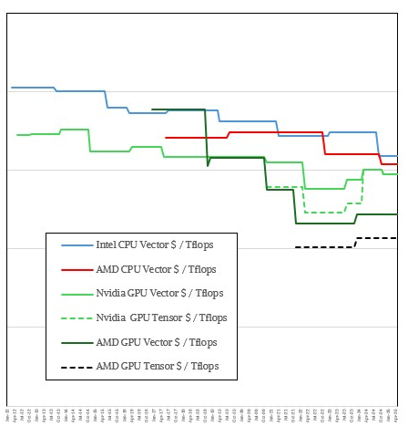
Heterogeneous computing
The problem(s)
Experiments have by now large codebases (5-10 M lines of code per experiment) – they come from ~20 years of development
If you write code for CUDA/Nvidia, it will not (not easily) work elsewhere: we need a long term solution
There are exp-specific solutions used with success (ALICE, for example)
There are promising “High Level Frameworks” which promise some level of (current/future) compatibility. No domain-wide solution(s) identified. Should we?
HEP computing has in the past 20y lived in the sweet spot of the technology curve – Linux Intel boxes
This is no longer the case
Most CPUs fabricated are for “mobile”
The ability to use new architectures such as ARM (now) and Risc-V (future) gives the opportunity to adopt lower power alternatives
GPUs offer a much better theoretical “bang for the buck”
For specific applications, FPGAs even more
$100,000
$10,000
$1,000
$100
$10
$1
$/Teraflops
~ 10x
[link]
Notes:
competition

Slide 16
HPCs (a.k.a. Supercomputers)
HPCs, worldwide, are a huge opportunity for HEP
Much larger deployment of resources wrt WLCG
In some countries, the FA is the same behind HEP → push for optimization
HEP/TH (Lattice QCD in particular) already a major user / driver
But …
Much stricter access policies
Systems are NOT standard: need NxM handshakings (experiments x centers)
Limited connectivity
No (or feeble) data management
Emphasis on GPUs
Short granting opportunities
…
Why would we like to use them?
Depending on national policies:
A way to reduce (overall national) computing costs
A way to give additional computing to HEP (more computing → more and / or better physics)
For specific workflow, for example training of large AI models
Directions
Follow / (influence) closely standardization efforts in HPCs (EuroHPC EFP and DOE IRI)
HEP is not a reference user for HPCs today. Work in this direction needed
There are initiatives in this direction: JENA/HPC, the SPECTRUM_EU project, the HEP/HPC integration White Paper

Slide 17
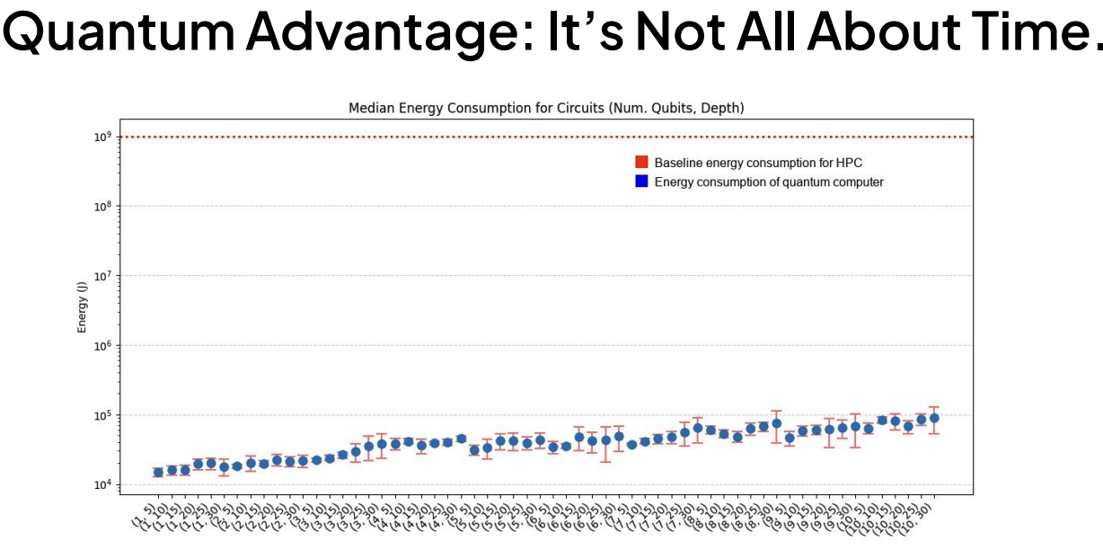
New Techs: Quantum
Joule
QC: 4 orders of magnitude better than HPC in power consumption
Is “next era” compatible with “HL-LHC”?
The inputs received are mostly from National Programs, not experiments. Why? Hypotheses:
Quantum research is a national priority
Quantum research is complex and expensive and cannot be pursued by an experiment in isolation, without an ecosystem
The near future of HEP does not need it
Still: getting ready for a technology like this (in HEP) takes time (as in: decades)
Notes:
BinaryQuadraticModel

Slide 18
External collaborations
When LHC Computing went into operations, there was no (close) comparable initiative in size and complexity, in science
Now:
Other HEP exps (Belle-2, …)
Neutrinos (DuNE, …)
Astroparticle (SKA, CTA, GW, …)
Nuclear (GSI, …)
[a lot more in science: fusion, chemistry, genomics, …]
As of today, WLCG has as “partners” (used to be called “observers”) Belle-2, DUNE, JUNO and Virgo
They directly participate in activities, like common data challenges
The partners contribute to the WLCG governance and to evolve the infrastructure in a common direction
In general, there seem to be a good alignment between ECFA, NuPECC and APPEC [via JENA], and via Projects like ESCAPE before and SPECTRUM now
”Going beyond the L in WLCG”

Slide 19
Evolution of the WLCG
Next talk:
WLCG is seen by all the large projects as a foundational starting point
“The WLCG needs to remain functional beyond the end of LHC”
The WLCG provided an input with actions for [2024-2028], including 33 actions, which cover most of the items discussed here:
[OPS], [TECH], [FIN], [INFRA], [REL], [SOFT], [GOV], [ENV], [RISK]
[link]

Slide 20
Careers – Open Data – LT(D)P
HL-LHC data will be the reference pp data for quite some time
How to guarantee its exploitability?
Not only Bit Preservation (“easy”)
(cmp)Environment preservation, knowledge preservation, analysis preservation, reinterpretation, …
“… This will require concerted attention and resources throughout the end-to-end life cycle of data generation, processing, analysis, preservation, and distribution, and should be considered already in the design and commissioning phase of experiments… ” [#150]
Again, where to budget it?
All the inputs mention the career problem in ”computing”
If anything, “our” people are becoming “more attractive” in the AI/Big Data Analysis world
Perceived improvement small (if any) since Granada
Many inputs mention the needs for FAIR Data and Software Management [which can mean “open” but not only]
It has a cost! Where to budget it?
At least, during operations

Slide 21
Conclusions
The landscape “till the end of LHC” is sketched and is not unfeasible, provided an intense and continuous R&D in computing. In its absence, the required computing will exceed the available capacities by several factors
Common projects [and their financial / personpower sustainability] are key to a viable HEP computing:
Common software stacks (Geant4, ROOT, generators, analysis stacks, …)
Common infrastructures (the WLCG and its evolution)
Common solutions with other initiatives and sciences (other HEP, GW, Astro…)
Common with other [national|continental|global] level initiatives. For example in QT, AI, HPC, …
What is not covered here:
Clouds: not an economically appealing solution at the moment; vendor lock-in, …
Energy/CO₂ Sustainability: see the ESG talk on Friday
(many other things)

Slide 22
BACKUP

Slide 23
Analysis and Analysis facilities
Extremely successful evolution of analysis models since the start of LHC
Analysis data formats went down ~ 1000x from Full Reconstruction to “NANO”; a major factor in the reduction of resources
Next step:
Imagine/define HOW to do analysis in the next 10 years
Possible ingredients
Users love to work interactively and then scale-out
Columnar analyses scale well on many-core machines and eventually GPUs
Combination of small data formats and powerful CPUs allow “prototyping from a plane”
“process centrally” vs “users get resources”
Are standard “WLCG/Grid resources” optimal?
Probably not, or at least the access method (“batch”) is not; could need more memory / fast disks / GPUs on board
Data access can easily become the limiting factor; files vs DB
How to provision resources for analysis?
Local clusters? In WLCG via “special means”? Specific facilities [AliHyperloop]?
R&D, R&D, R&D needed!

Slide 24
Outline
The HEP Computing as of now (with a focus on CERN/LHC)
The journey from early 2000 to today
Expected experiments needs for the next decade (and some…)
How to satisfy them?
“Things happening” and “things which should happen”

Slide 25
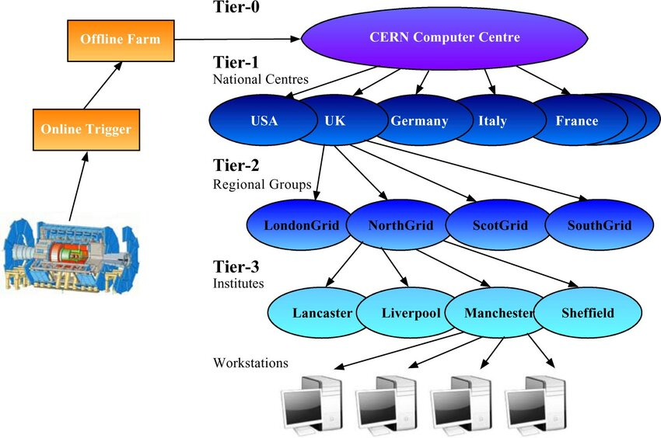
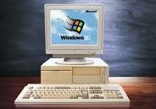
How did we get here? [study the past, prepare for the future]
[link]
Decision to “distribute” the LHC Computing dates back to Monarc (end of the 90’s):
Financial reasons, Practical reasons, Political reasons
Looking back 30 years after, a very brave decision: PC 1 MegaByte → the Exabyte
The model was able to support experiments in a number of “era changes” via (mostly) adiabatic changes
Always in production: no time for a “Big Bang deployment”
50x larger than in 2010
But today’s system is largely different from the initial one!
WLCG evolved from a ”system of uniform centers” to a “system of heterogeneous systems”
[link]
GRID centers (the baseline)
GPU equipped partitions
Online farms
Supercomputers (HPCs)
Public/Private Clouds
…

Slide 26
LHC computing 2025 vs 2009
WLCG evolved from a ”system of uniform centers” to a “system of heterogeneous systems”
Experiments compute already today on heterogeneous resources :
GRID centers (the baseline)
GPU equipped partitions
Online farms
Supercomputers (HPCs)
Public/Private Clouds
…
Some notable transitions:
From 32 to 64 bit codes
From Intel/AMD x86 architecture to ARM, Power8/9, evenrually RISC-V
From CPUs to GPUs
From single core processes to many core (as in 10+) processes
From local only data to remote streaming and storage federations
From ScientificLinux to … anything via virtualization
From MB/event analysis data, to kB/event

Slide 27
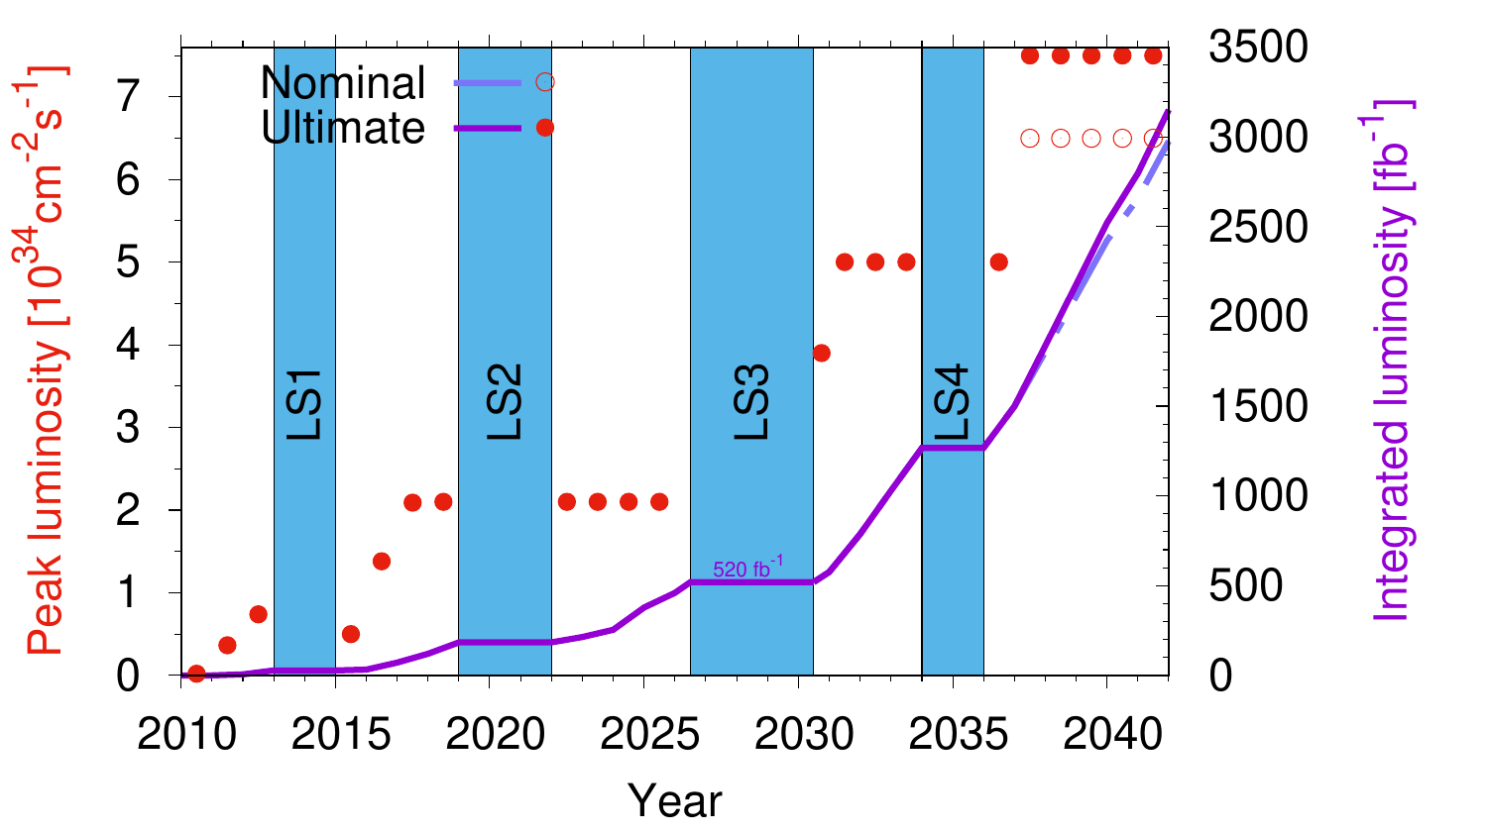
The planning from the machine

Slide 28
CMS is following a similar path
Scenarios: with no / conservative / aggressive R&D

Slide 29
Heterogenous computing – examples and plans
AI at online uses compressed models running on FPGAs
CMS, LHCb and ALICE have trigger level workflows executed on GPUs; ATLAS is considering the GPU option for Run4
GPU in offline workflows less advanced. In some cases “a byproduct” [same code as online]
Geant4 R&D on AdePT [em transport] and CELERITAS [calorimeter simulation]
Madgraph and Sherpa accelerated on GPUs
AI needs (lots of) GPUs
Today for training; soon also for inference
If WLCG will need to provision GPUs, we need not only enabled experiment software, but also services
A proper benchmark
A pledging mechanism
An accounting system
A provisioning mechanism
…

Slide 30
Cloud - sustainability
Are cloud systems a resource for HEP Computing?
Technically: yes, “easier than HPC”
Economically:
Public clouds (universities, …) – YES
Commercial Clouds – apparently NO
The lock-in factor:
Do we really want to send (the only copy of) our data to a commercial provider?
Commercial clouds are … commercial:
Can we exclude sharp price increases / acquisitions / ?

