Slide 1
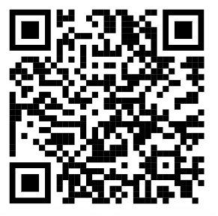
CH4rLiE
Associate Professor. Dr. Daniele Dondi
Director in Laboratory of Radiation Chemistry and EPR Spectroscopy
Department of Chemistry, University of Pavia, 27100, Italy.
Monday, FEB 17th, 2025

Slide 2
Experiments
Experiment-1
Preparation of UCSB-9 zeolite
Experiment-2
Preparation of Z5-g C₃N₄ (40%)
Experiment-3
Preparation of Z5-C (20%)- Prepared around 8g of material in addition with 10g previous

Slide 3
Synthesis of UCSB-9 Zeolite
Modified synthesis of UCSB-9 zeolite failed to yield the zeolite, So the reported procedure was followed which is heating the mixture of GeO₂, 40% methylamine, Ga(NO₃)₃, and ethylene glycol at 180 °C for eight days in a Teflon-coated steel autoclave.
After which the reaction mixture is removed from the autoclave.
Reaction mixture is centrifuged and the precipitate obtained is washed with water 2 or more times.
The sample is submitted for powder X ray diffraction and Scanning Electron Microscope studies.

Slide 4
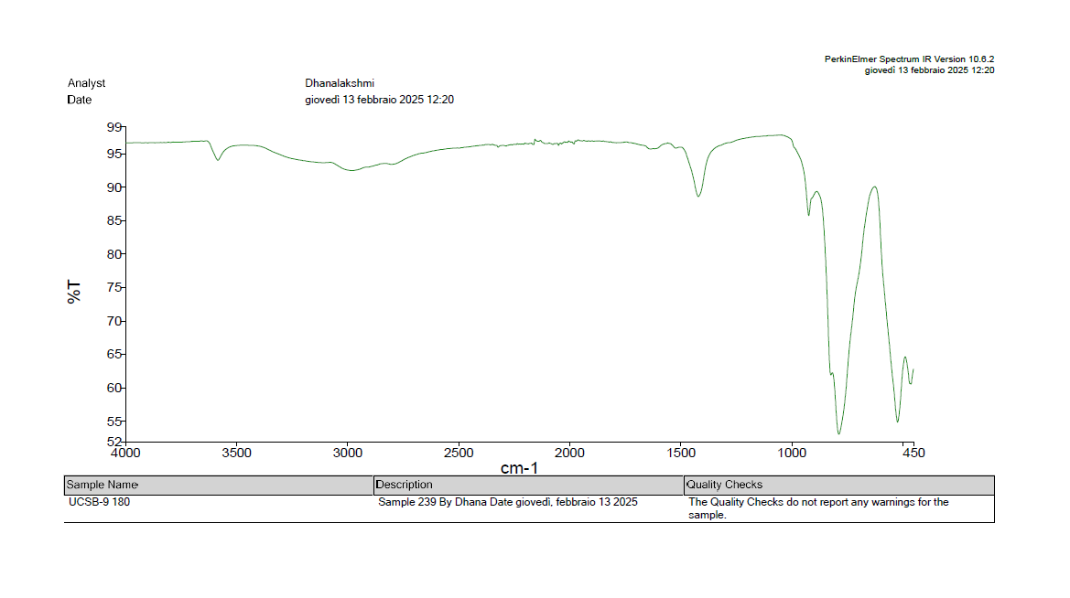
FT-IR UCSB-9
Ga(NO₃)₃
GeO₂

Slide 5
Preparation of Z5-g C₃N₄ (40%)
Based on the literature review the zeolite material nature can be improved incorporating activated carbon on the pores of zeolite for enhancing methane capture activity.
Earlier experiments did not yield required carbon material with melamine
ZSM 5 zeolite and Melamine 40% is prepared by physically grinding the mixture
The mixture is added to hydrothermal reactor and added 40 ml of water.
The mixture is heated in the hot air oven at 160 ֯C for 12 hours.
The reaction mixture is obtained and dried in the oven at 110 ֯C overnight.
The obtained material is heated in muffle furnace at 550 ֯C for 4 hours. The sample is also submitted for PXRD and SEM imagining.

Slide 6
Future experiments
PLA etching and catalyst loading
Granulation experiments
Synthesis of TUT-100 zeolite

Slide 7
Acknowledgement
Thank you

