Slide 1

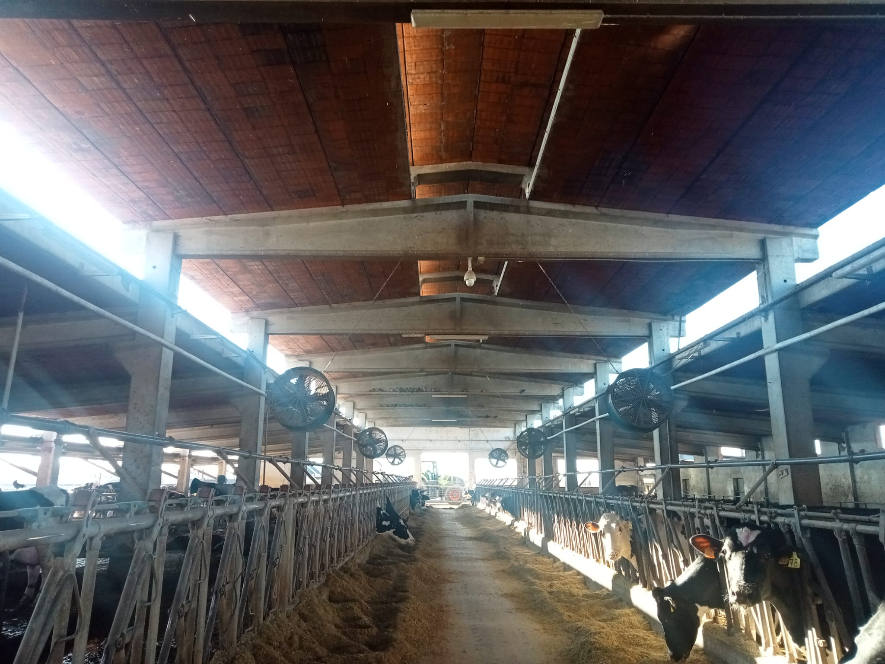

CH4rLiE
Annual Meeting
Pavia, 28 Gennaio 2025
Updates on barn measurements
Biagini D.^{1,2}, Dinuccio E.^{1,2}
¹ DISAFA, Università di Torino
² INFN Sezione di Torino
CH4rLiE (PRIN PNRR 2022 -P2022FTF7L)

Slide 2
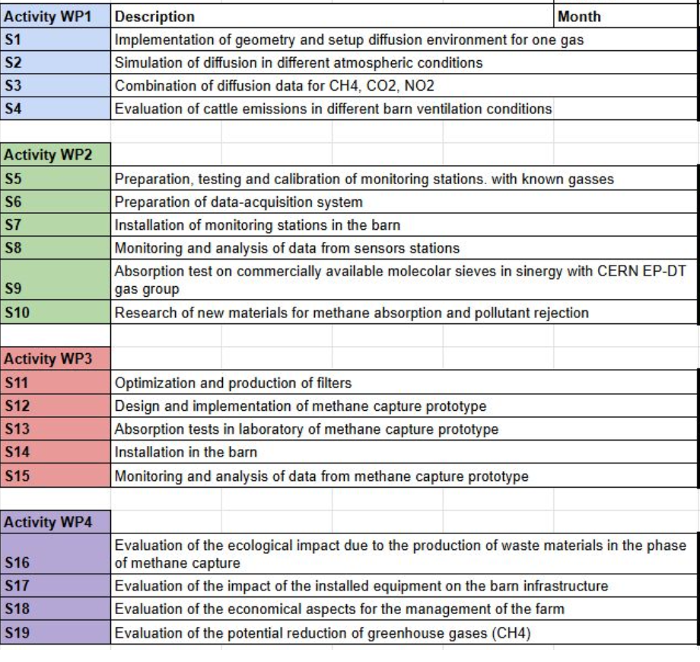

UNITO Unit
Role in the Project
Concluded
CH4rLiE (PRIN PNRR 2022 -P2022FTF7L)

Slide 3
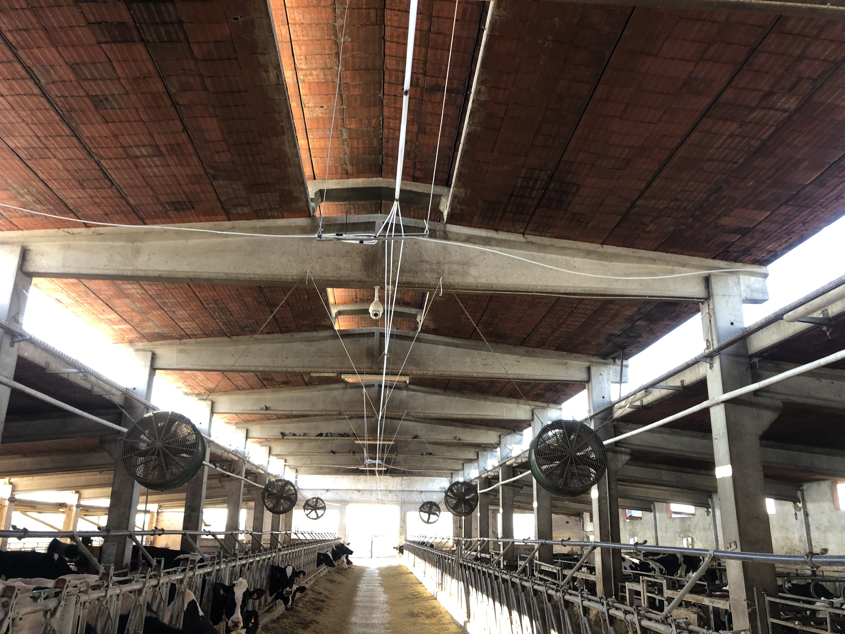
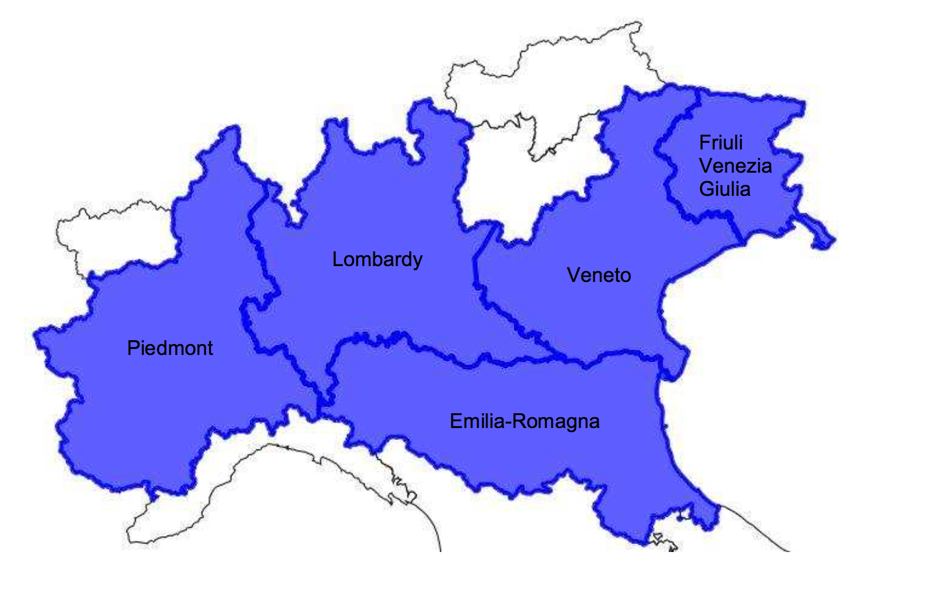
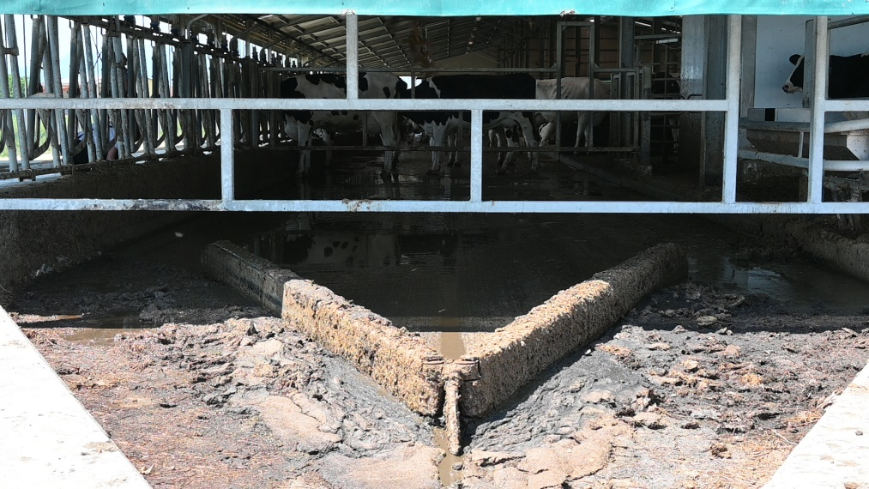
EVALUATION OF CATTLE EMISSIONS IN DIFFERENT BARN CONDITIONS
DONALISIO - FARM (Volvera, TO)
Naturally-ventilated dairy barn
Reared cows: 310 heads
Slurry removal frequencies: 4 times/day
4 measuring compaigns over the course of a year, covering season variability
automatic delta scrapers
4 measuring compaigns over the course of a year, covering season variability

Slide 4

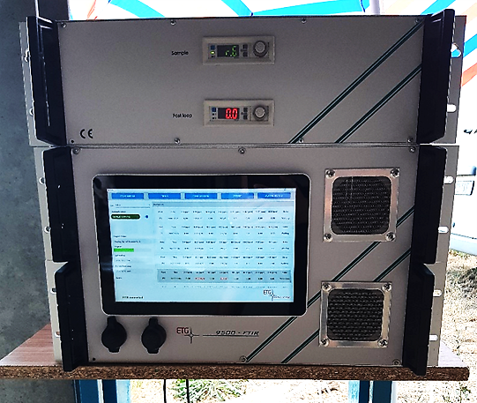
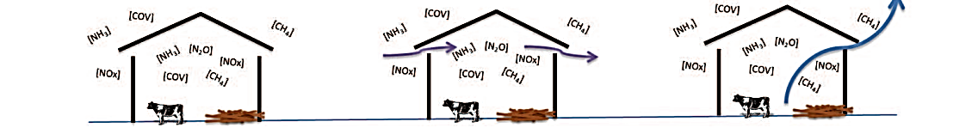
METHODOLOGY
Measurement of GHG and NH₃ emission rates
EMISSION MEASUREMENTS ANIMAL’S BUILDING
CO₂ mass balance method
VR
CIGR, 2002
Gas concentration (ppm)
Ventilation rate
(mᶟ h⁻¹)
Gas emission
(g h⁻¹)
QEPAS + Multipoint sampler
CH4rLiE (PRIN PNRR 2022 -P2022FTF7L)

Slide 5
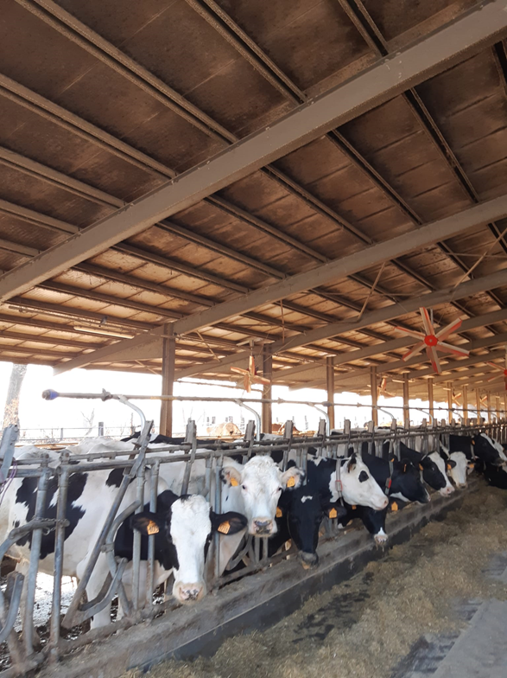
METHODOLOGY
Measurement of GHG and NH₃ emission rates
EMISSION MEASUREMENTS ANIMAL’S BUILDING
VR (m³ h⁻¹ animal⁻¹)= Cprod /(CO₂ inside – CO₂ outside)*10⁻⁶
Cprod = 0.185 * ϕtot /1000
0.185 is the amount of CO₂ produced by one dairy cow for 1000 W of produced heat
Φtot is the total heat production for one dairy cow, function of:
Daily milk production
Days of pregnancy
Live weight
Average temperature

Slide 6
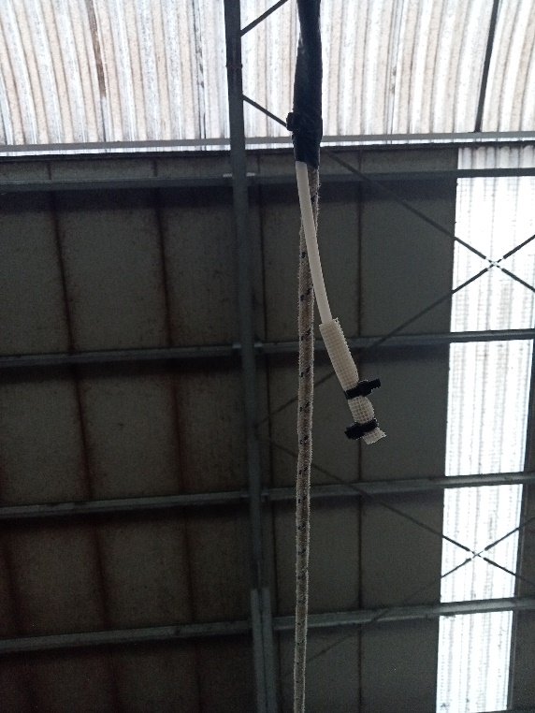
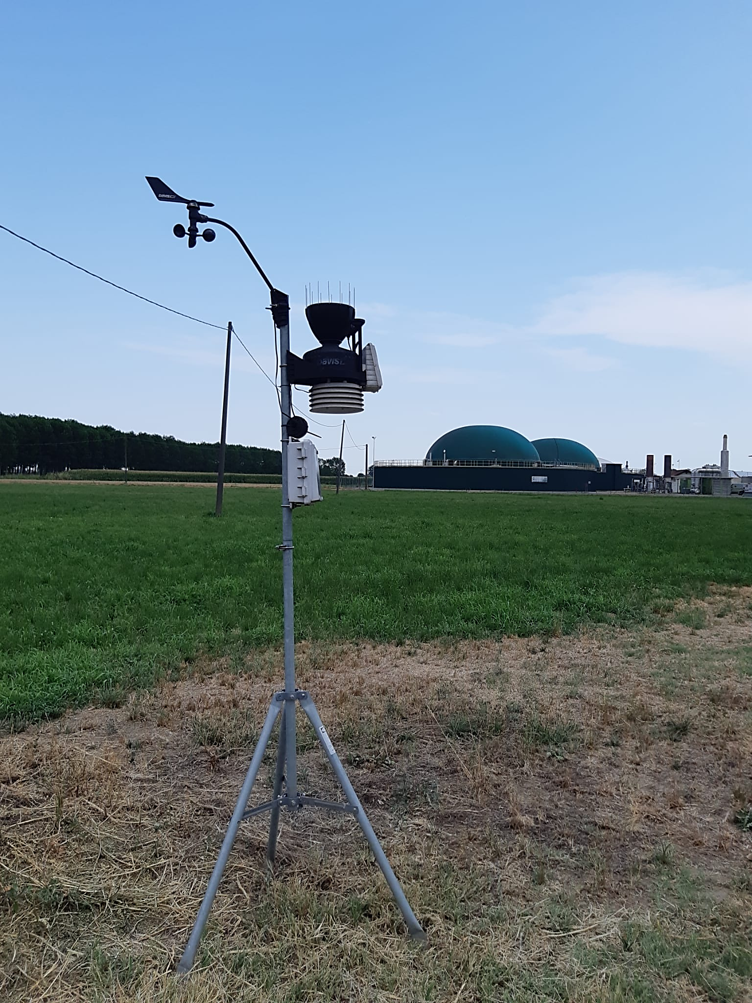
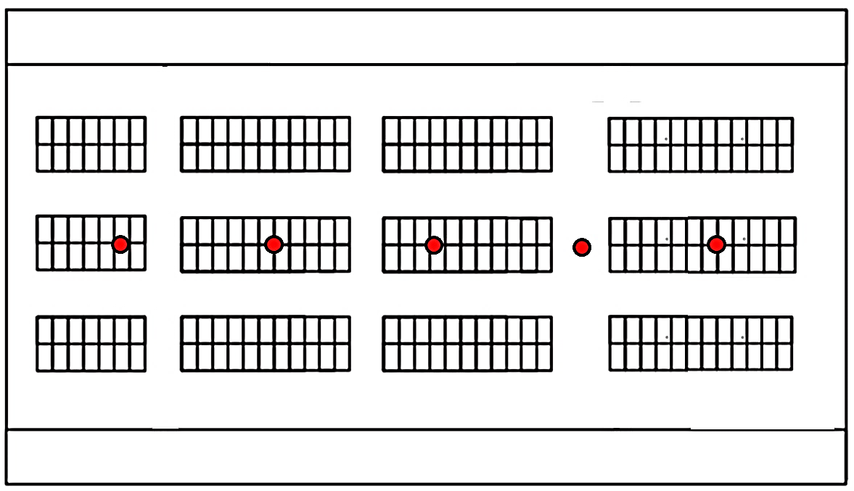
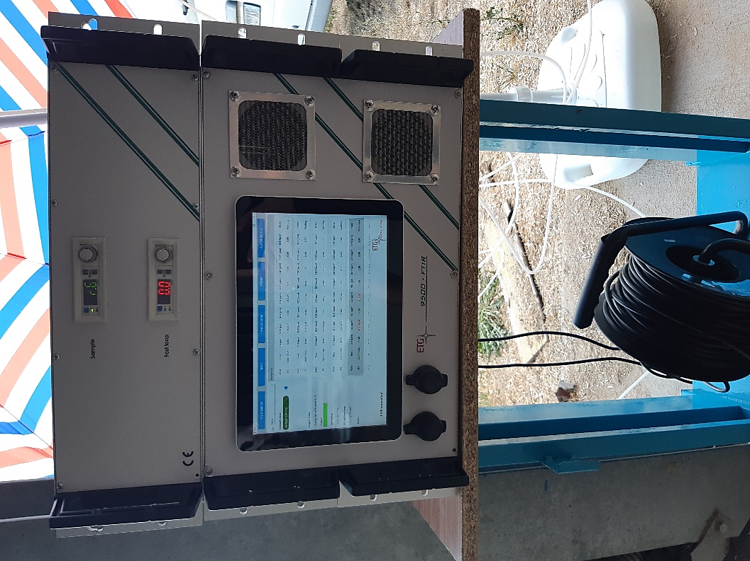
METHODOLOGY
EMISSION MEASUREMENTS ANIMAL’S BUILDING
Equipment
GHG | NH3
CO₂ mass balance + QEPAS
Animal building
5 internal sampler point every 10 m equipped with dust filter
2D anemometer to detect the approching wind direction
B
Quarts-enhanced photoacoustic spectroscopy (QePAS) analyser (A) coupled with a multipoint sampler (B)
Temperature and humidity sensors (Hobo)
1 external sampling point (according to the prevailing WD)
A
6 mm Ø PTFE tubes

Slide 7
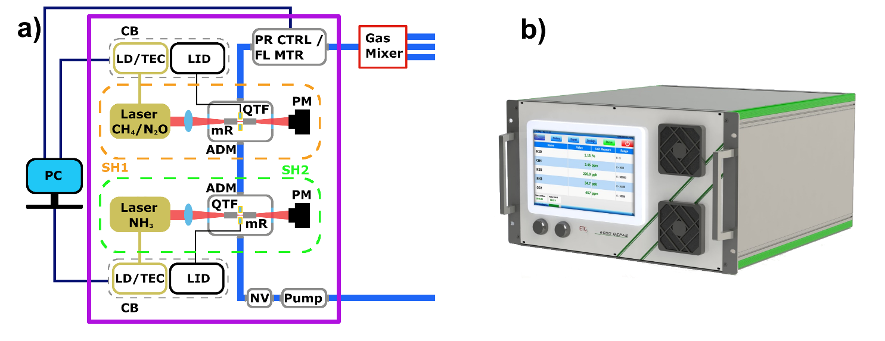
Quarts-enhanced photoacoustic spectroscopy (QePAS) analyser
measure the vibrational relaxation rate of gas species, employing quartz tuning forks (QTFs) as sound detectors

Slide 8
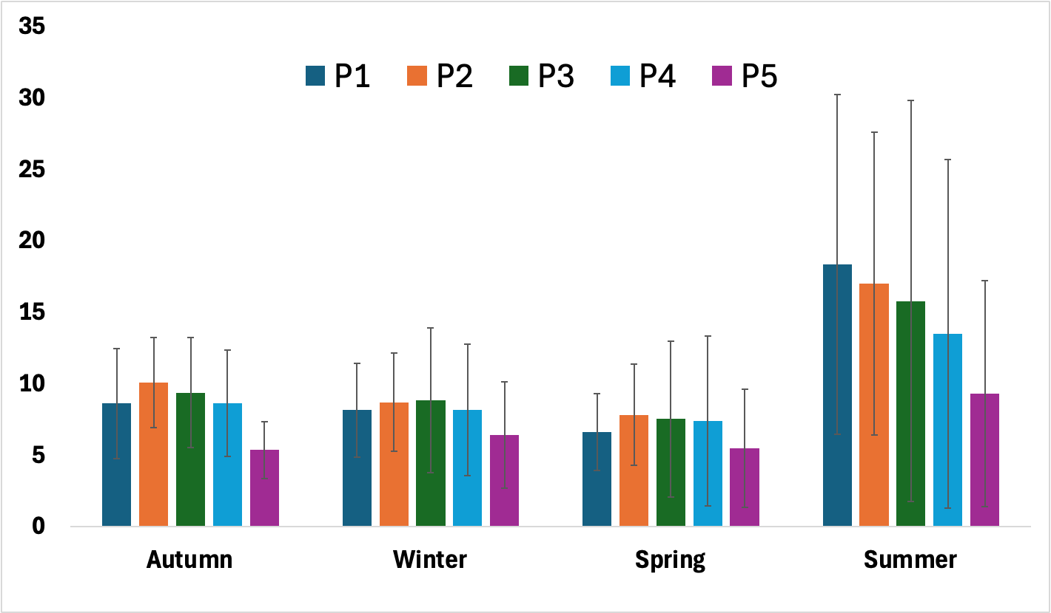
Results: temporal and spatial variations in methane concentrations within the barn
Av. 14.5 ppm
CH₄ concentration (ppm)
Av. 8.40 ppm
Av. 8.04 ppm
Av. 6.94 ppm

Slide 9
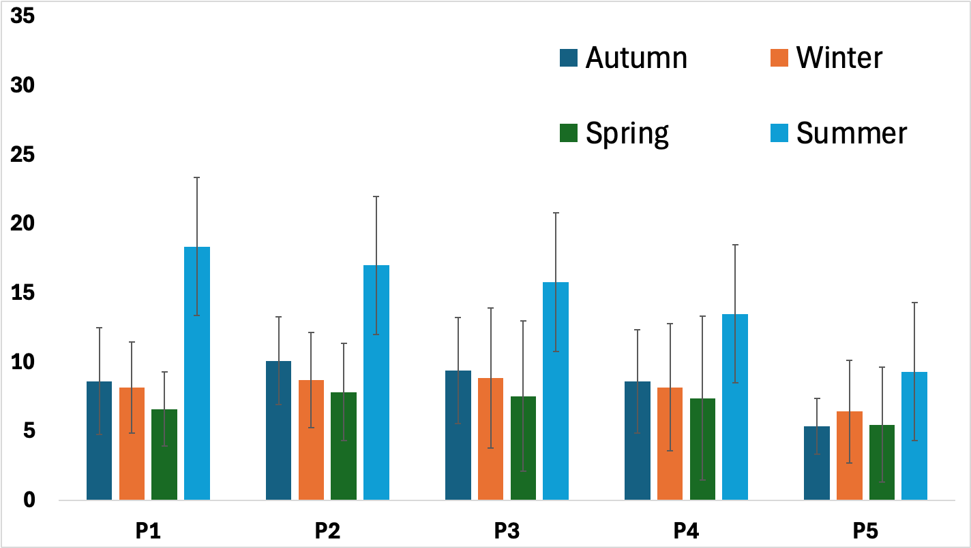
Results: season variability in average methane concentrations
CH₄ concentration (ppm)

Slide 10
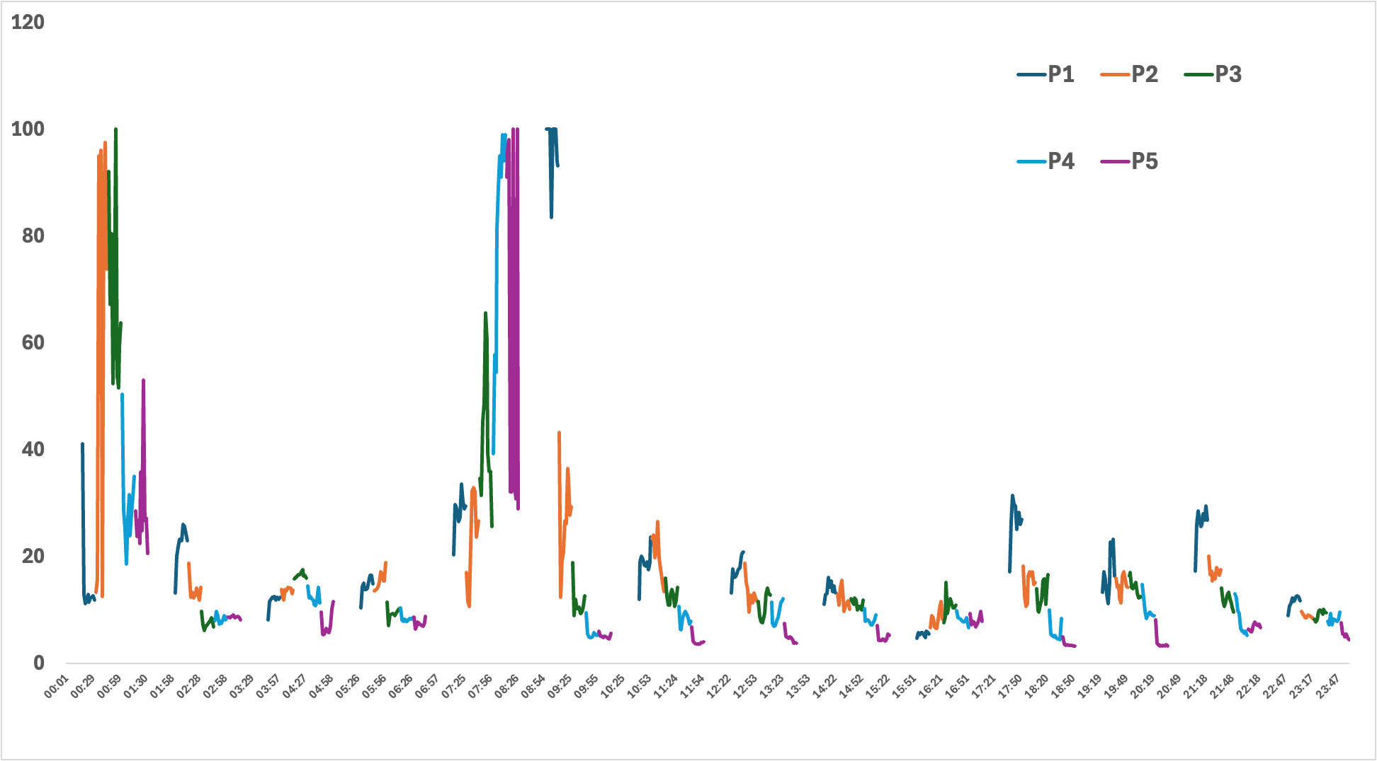
Results: Daily trend in methane concentrations
16/07/2024 (Summer conditions)
CH₄ concentration (ppm)

Slide 11
Some Considerationions
Seasonal Variability:
CH₄ concentrations show significant seasonal differences, with the highest levels observed during summer, likely due to increased microbial activity, ration variations, and higher temperatures
Daily Fluctuations:
Diurnal trends influenced by animal activity, with peaks typically occurring after feeding times

