Slide 1
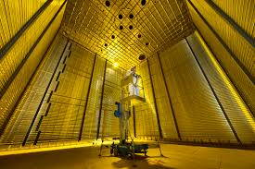
Deep Underground Neutrino Experiment
Francesco Di Capua
Riunione Gruppp1-Napoli
16/01/2025

Slide 2
Long-baseline Neutrino Oscillation: what we know
The 3 know flavor states $ν$_{e}, $νμ$, $ντ$are linear combination of 3 mass eigenstates $ν$₁, $ν$₂, $ν$₃ through the Pontecorvo-Maki-Nakagawa-Sakata (PMNS) unitary matrix U_{PMNS}
Previous oscillation experiments determined the two mass-squared differences and the three mixing angles

Slide 3
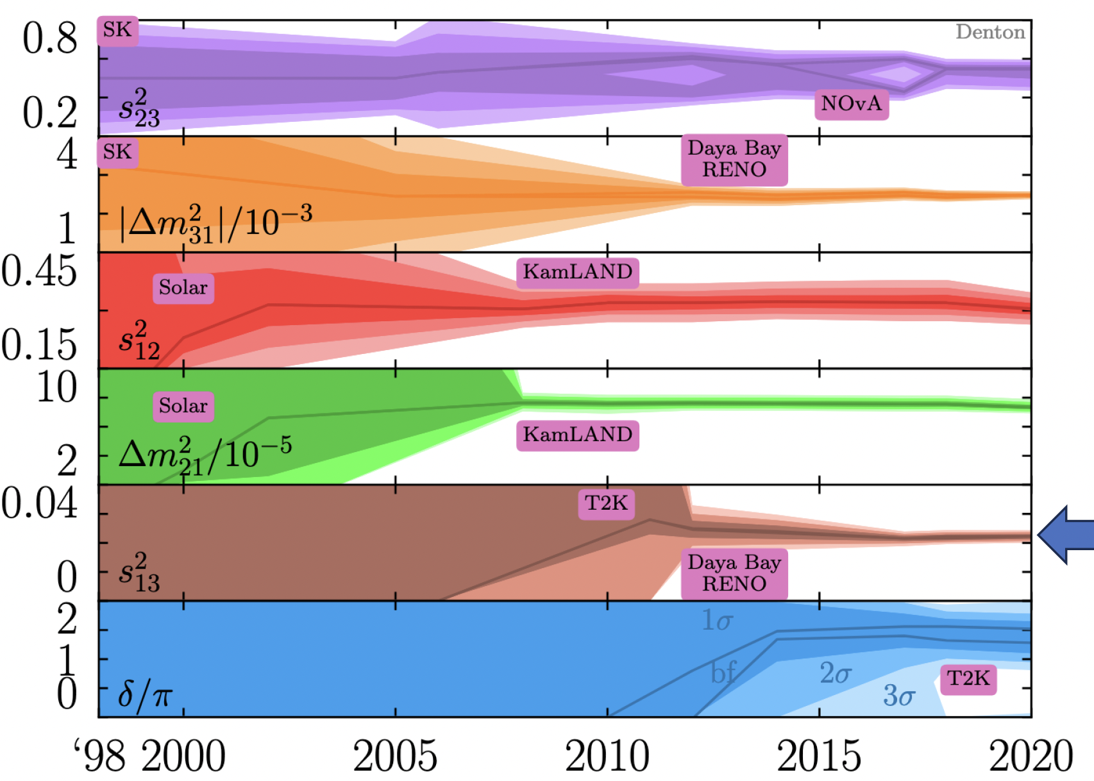
The era of precision for neutrino physics
Remarkable progresses in last 20 years in determining neutrino properties

Slide 4
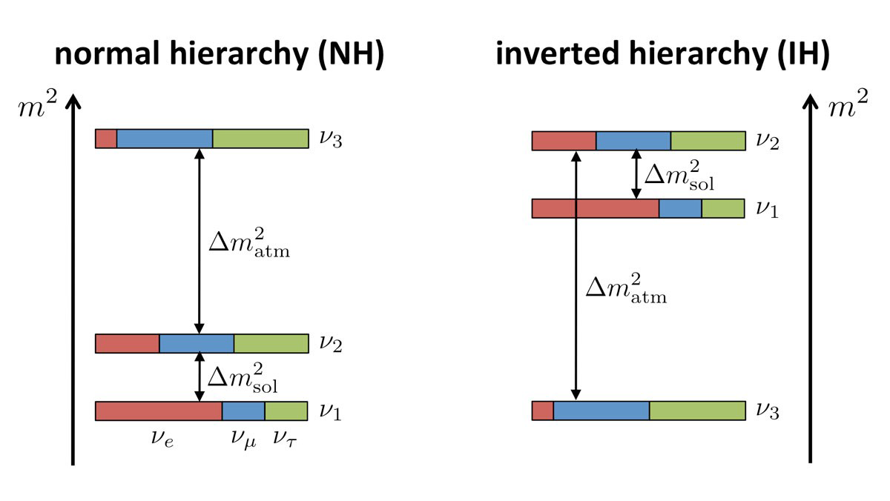
Long-baseline Neutrino Oscillation: what is still missing?
Goal for next generation experiments:
Measure CP and determine if $δ$_{CP} is violated
Determine the neutrino mass ordering (sign of $∆m$²₃₁)
Determine the octant of $θ23$
Understand if the three-flavor picture of the oscillation is complete
Finally the absolute neutrino mass or if neutrino is its own anti-particle are still unknown (not accessible with osc. exp.)

Slide 5
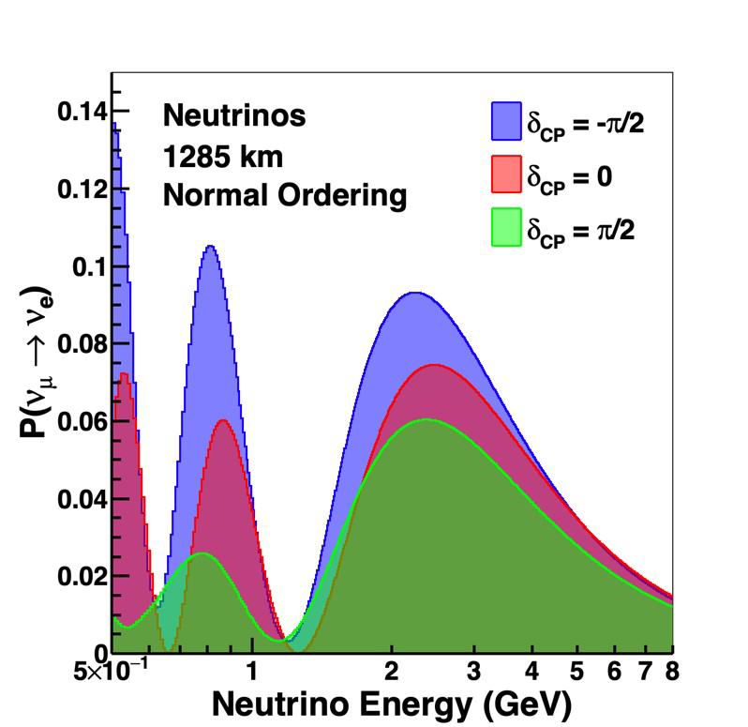
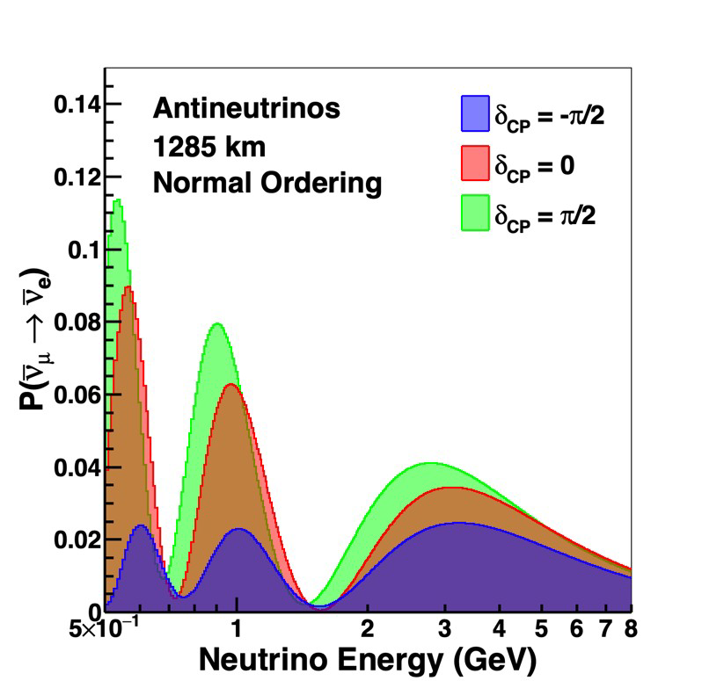
Neutrino Oscillation in the 3-flavor model
Measure neutrino and antineutrino oscillation as a function of L/E
Very long baseline $→$ large matter effect
CPV and mass ordering are totally non-degenerate
Broadband neutrino energy $→$ high statistics over full oscillation period. Spectral information resolves degeneracies between $θ23$, $θ13$ and $δ$_{CP}

Slide 6
The Deep Underground Neutrino Experiment (DUNE)
The most powerful neutrino beam in the world (1.2 MW upgradable to 2.4 MW) will be sent from Fermilab (Chicago) to SURF (South Dakota) along 1300 km distance to be detected by four liquid argon far detector modules (70 kton LAr) at 1.6 km deep underground and a near detector complex at 560 m from the neutrino source
Wide-band neutrino energy spectrum enables detailed fitting of the oscillation parameters
Long-baseline allows to unambiguous measurement of the neutrino mass ordering
LAr TPC technology allows for precise reconstruction of the neutrino interactions
Near Detector complex allows for a careful control of systematics
Underground location of the Far Detector modules enables a wide astroparticle measurement program

Slide 7
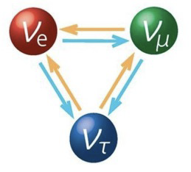
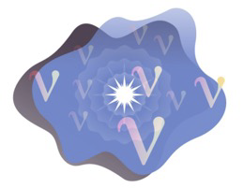
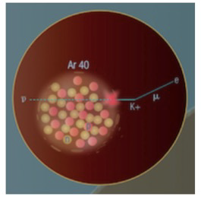
DUNE: a broader physics program
Long-baseline wide-band neutrino beam
Measurement of CP violation phase and determination of neutrino mass ordering in a single experiment with spectral information
Underground location (1600 m) $→$Access to astrophysical neutrinos
Supernova neutrino burst detection $→$ sensitive to $ν$_{e} component
Atmospheric neutrino $→$ capability of $ντ$ identification
Solar neutrinos $→$ potential detection of hep flux
Massive detector with excellent tracking and calorimetric information
Search for nucleon decay like the baryon number violating channel p $→$ $ν$ k⁺
Intense beam and capable Near Detector Complex
Precise neutrino physics
BSM search

Slide 8
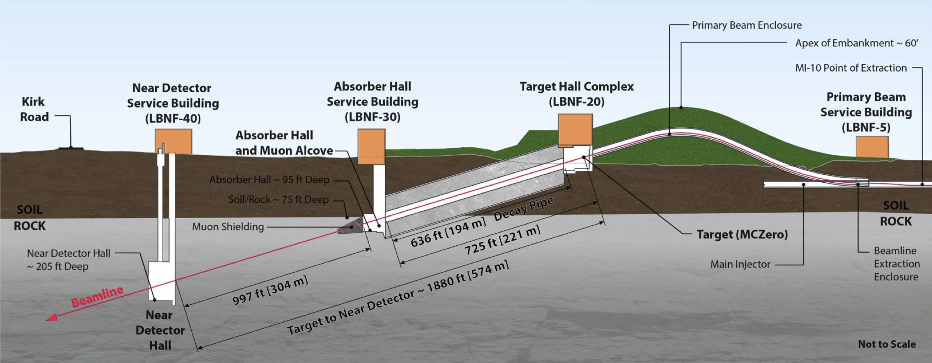
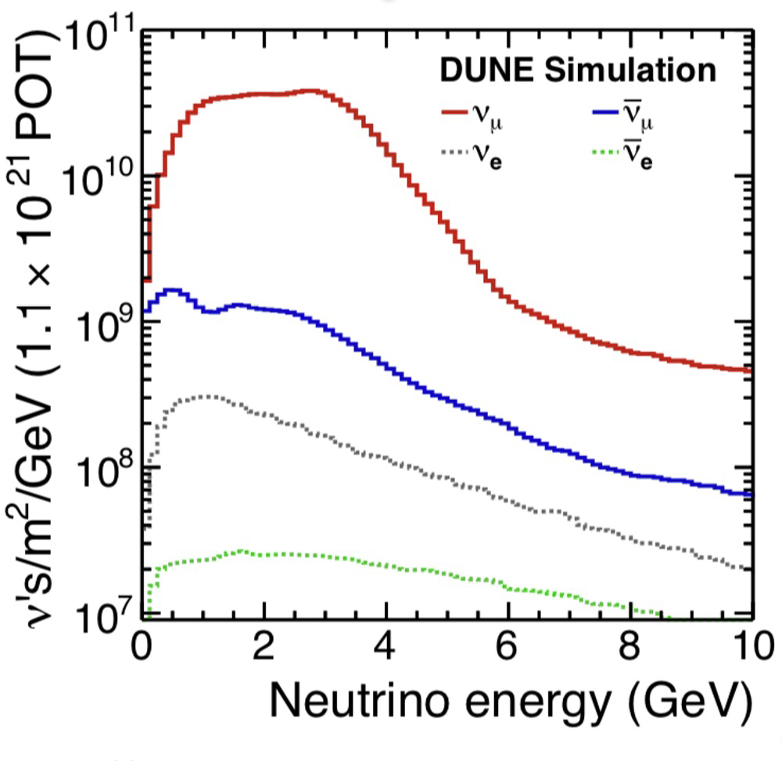
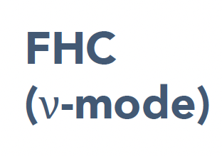
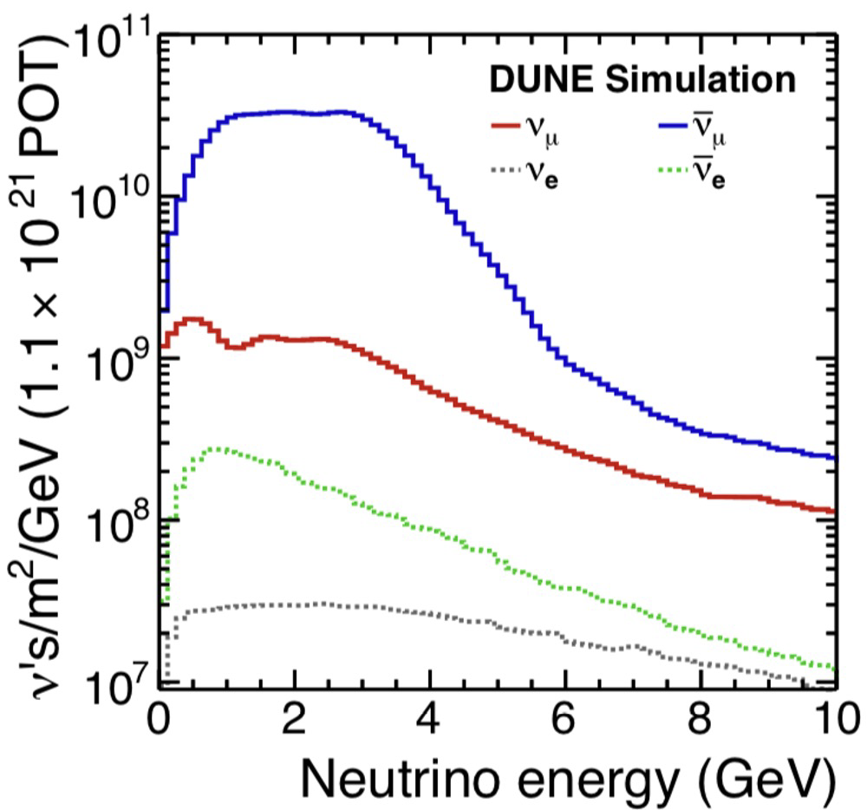
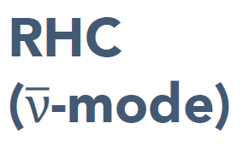
The Long Baseline Neutrino Facility
High intensity primary proton beam (60-120 GeV) on a graphite target (1.1-1.9)x10²¹ pot/yr
Neutrino beamline at a slope of 5.8°
Expected neutrino fluxes
Forward Horn Current (FHC) neutrino-enhanced
Reverse Horn Current (RHC) antineutrino-enhanced
Wide band beam
8

Slide 9
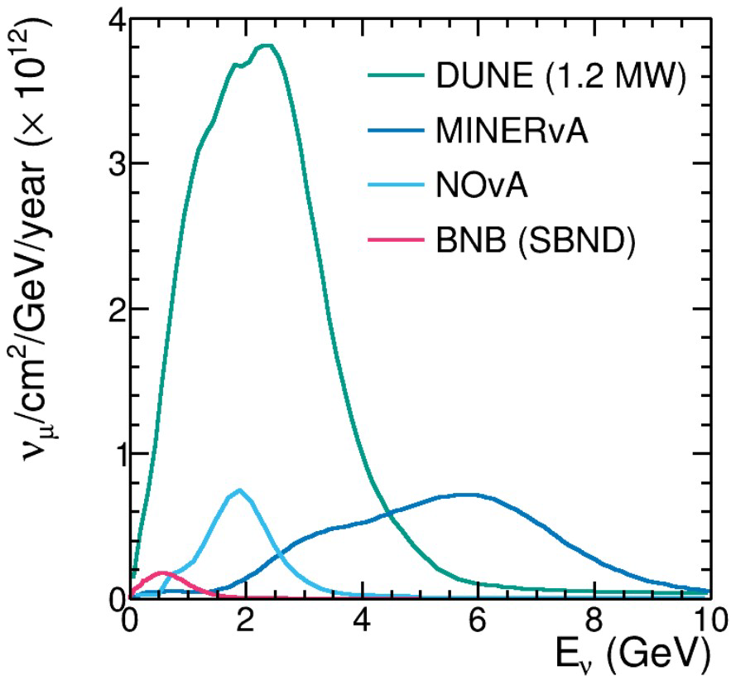
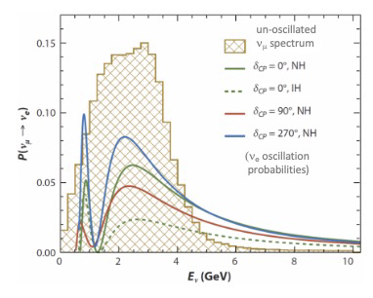
The Long Baseline Neutrino Facility
DUNE neutrino beam is far higher intensity than present-day experiments
Very high flux covering the full neutrino oscillation curve between the oscillation minimum (1.27 GeV) and the oscillation maximum (2.54 GeV) with coverage of second maximum (0.8 GeV)
Recent development: Beam upgrade (ACE-MIRT) could increase beam intensity > 2 MW by decreasing the time between spills from 1.2 s to 0.6 s, can be achieved before DUNE operations begin
9

Slide 10
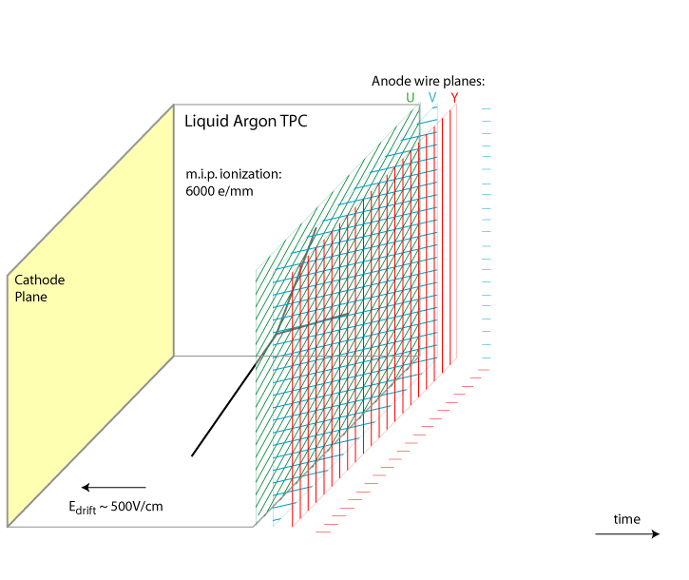
LAr TPC: working principle
Detection principle first conceived by C. Rubbia (1977)
Charged particle from neutrino interaction in LAr produces free ionization electrons and scintillation light (128 nm)
Light is quickly detected by photon detection system
Electrons slowly drift to anode instrumented with readout wires/strip
Each wire/strip plane provide a 2D (s, t) view of the ionization event. Multiple 2D views results in a 3D image of the event
10

Slide 11
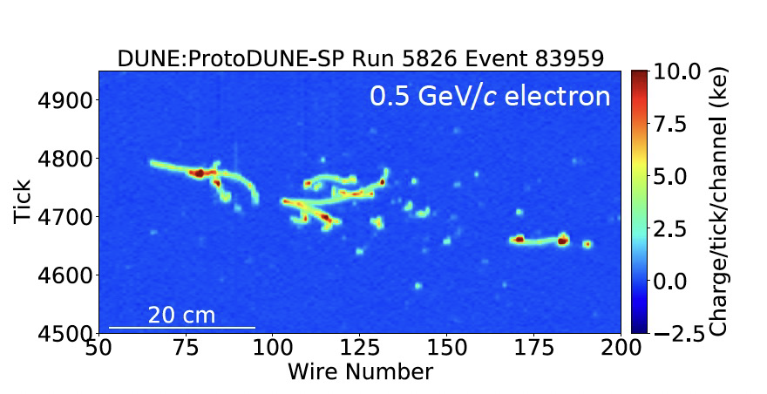
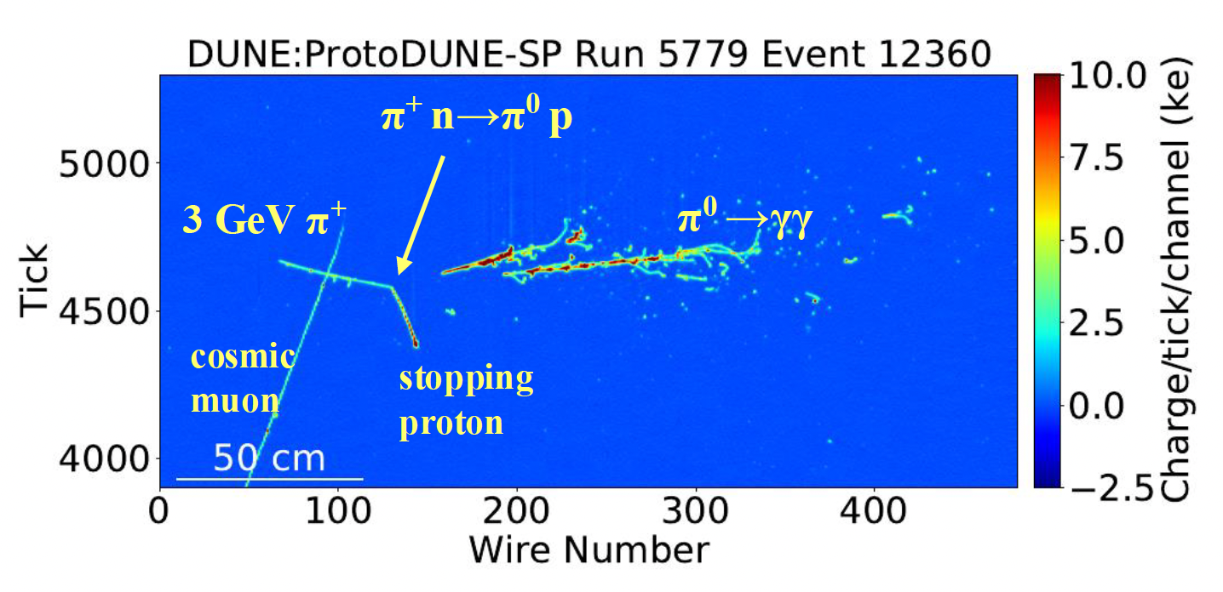
LAr TPC: particle imaging at kTon scale, flavor identification & energy reconstruction
ProtoDUNE data
3 GeV $νμ$ interaction
2.5 GeV $νe$ interaction
Simulated neutrino events
Good capability of pion reconstruction (in final state for 60% of DUNE interactions)
Excellent electron/muon separation
11

Slide 12
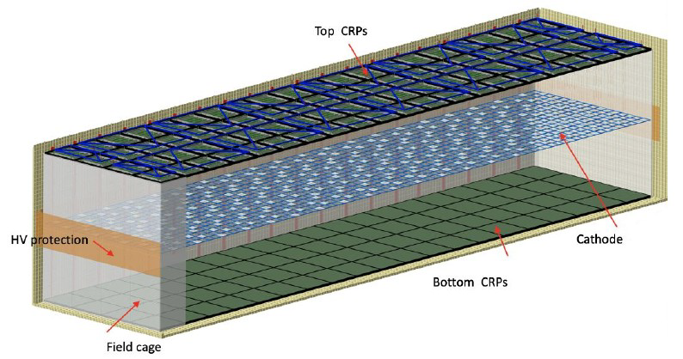
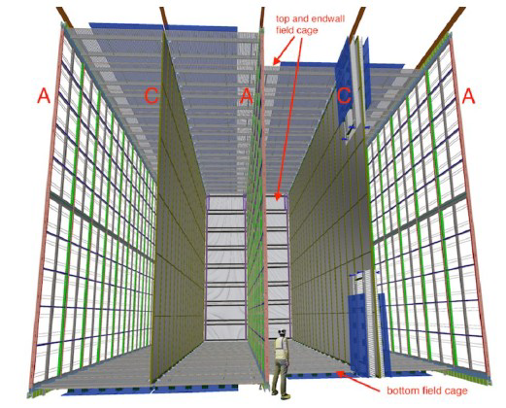
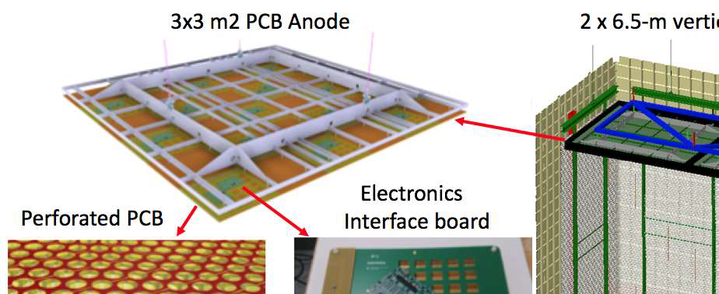
Far detector: two different readout technologies
FD1
FD2
APA
Charge Readout Planes (CRP)
FD1 module will use Horizontal Drift technology: four 3.5 m drift regions (3.5 m x 12 m x 58 m), charge readout with 348,000 wires in 150 Anode Planes Assembly (APA). Similar to ICARUS, MicrobooNE, SBND. Photon detection: X-Arapuca module (SiPM based light trap), about 300,000 SiPM
FD2 module will use Vertical Drift technology (two volumes 13.5 m x 6.5 m drift x 60 m), charge readout with strips (perforated PCB). Photon detection on the field cage walls and on the cathode @300 kV; decoupling from HV achieved with optical fibers for power and signal transmission. Larger active volume, cheaper than FD1 and similar performances
12

Slide 13
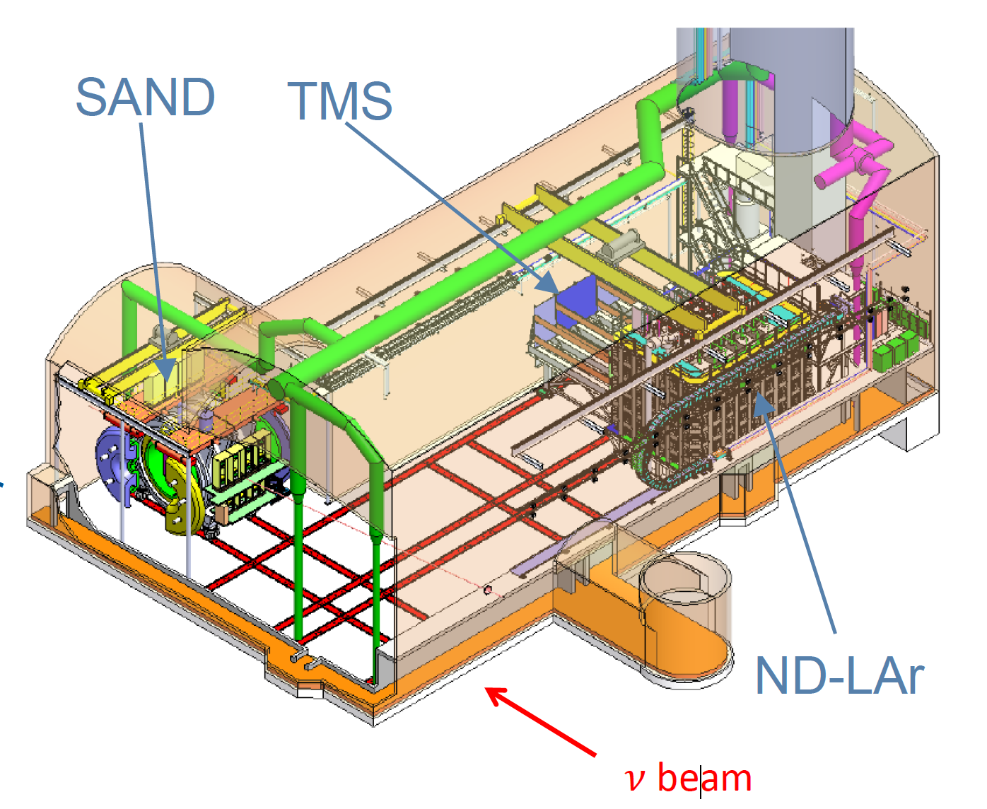
Near Detector Complex
Main purpose
measure the rate and spectrum of v’s before oscillations
constraint systematic uncertainties (flux, cross-sections, detector response) for oscillation measurement
ND is a (movable) LArTPC (ND-LAr) + muon spectrometer (TMS) and a fixed magnetized tracker+calorimeter (SAND)
Off-axis data constrains energy dependence of neutrino cross sections
Same target and same technology to predict reconstructed Ev in Far Detector
On-axis magnetized detector (SAND) for beam monitoring and neutrino energy measurement: repurposes solenoid magnet and ECAL from KLOE,
SAND allows fine-grained, particle-by-particle reconstruction with very low rescattering, excellent for highly exclusive neutrino-nucleus measurements
13

Slide 14
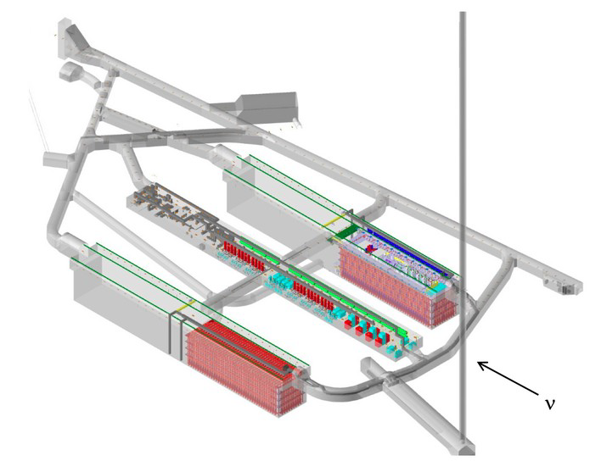
DUNE Construction: Phase I
Detector installation starting in 2026
Full near + far site facility and infrastructure
Two 17 kt LArTPC modules
1.2 MW upgradeable neutrino beamline
Movable LArTPC ND+muon spectrometer, SAND
On-axis near detector
14

Slide 15
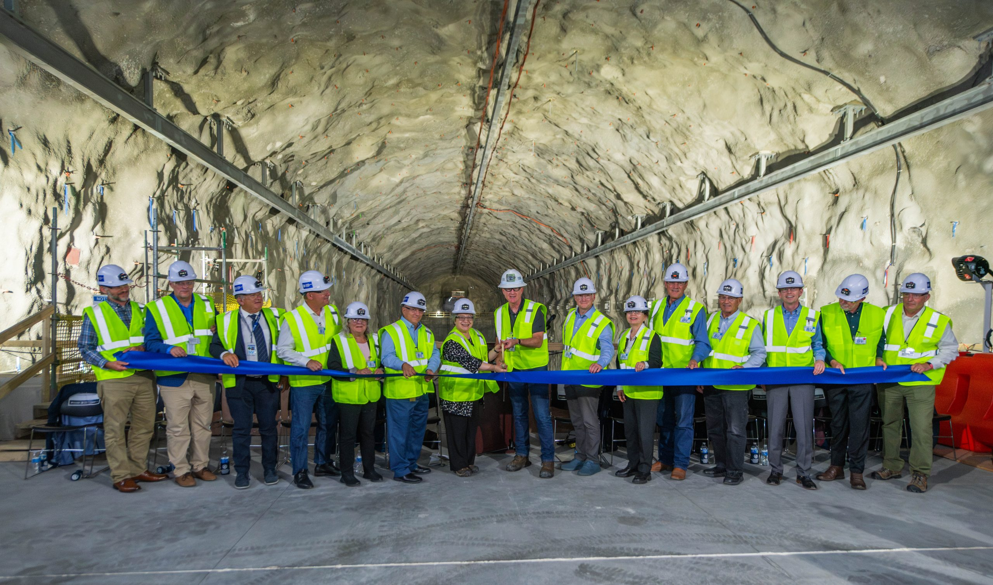
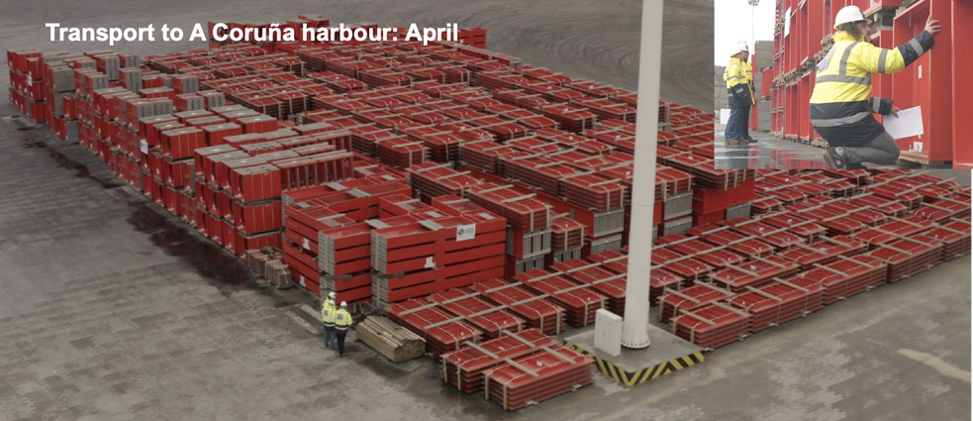
Building DUNE: construction schedule
Far site excavation is complete
Next: Building and Site infrastructure work until mid-2025
Cryostat warm structure has been shipped from CERN to US, to be installed in 2025-26
Detector installation in 2026-27
Purge and fill with liquid argon in 2028
Physics in early 2029
Beam physics with Near Detector 2031
15

Slide 16
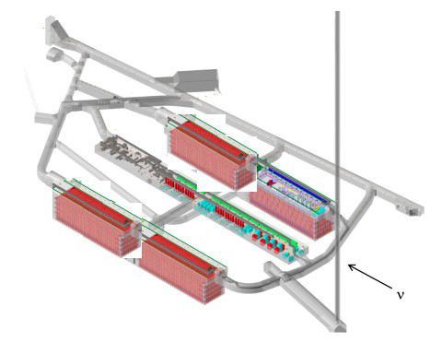
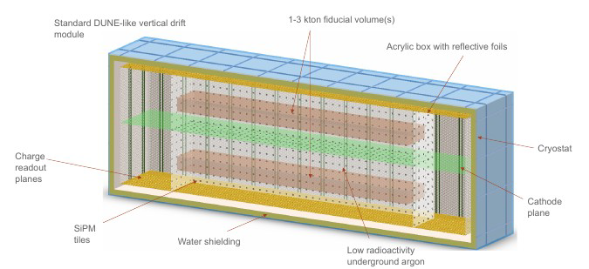
DUNE Construction: Phase II
Two additional Far Detector modules (on overall fiducial $≥$40 kt)
Beamline upgrade to >2 MW (ACE-MIRT)
More capable Near Detector (ND-GAr)
Vertical Drift module is the baseline design for Phase II FD modules
Several proposal to improve light collection (FD3): Aluminum Profiles with Embedded S-Arapuca (APEX) and PoWER (POlymer Wavelenght shifter ed Enhanched Reflection)
The phased construction program allows the development of the technology to expand the DUNE physics scope ($0νββ)$, dark matter…)
FD4 is the «Module of Opportunity», more ambitious design are being considered, including pixel readout, integrated charge-light readout, low-background modules and non-LAr technologies
16

Slide 17
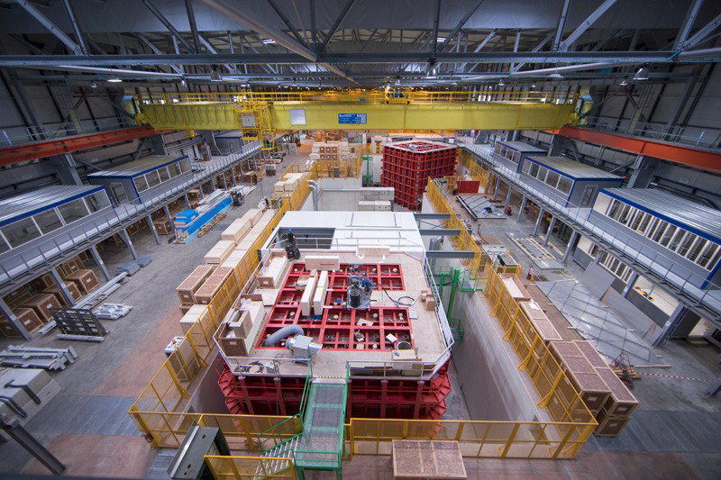
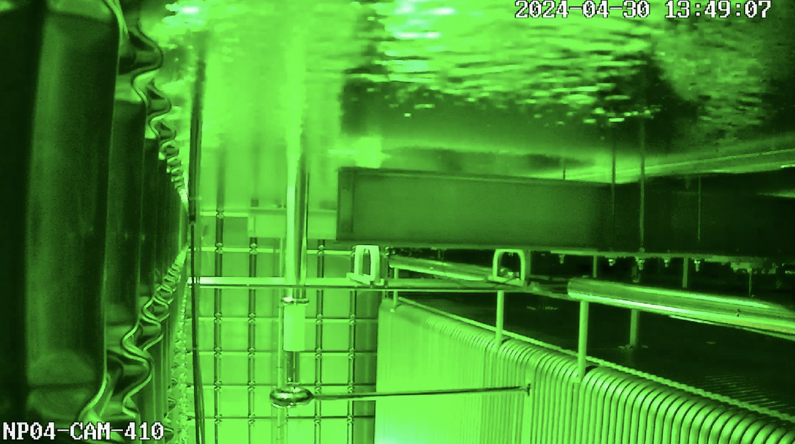
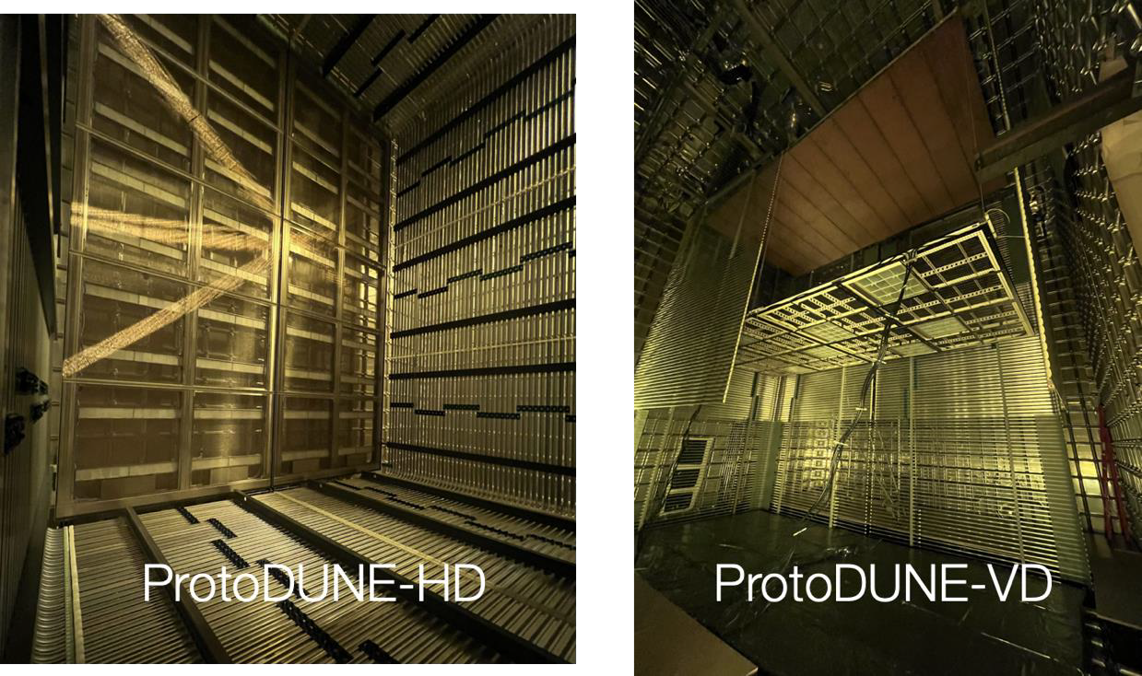
ProtoDUNEs at CERN
First Phase of ProtoDUNEs
Construction and operation of ProtoDUNEs at CERN (2018-2020)
Succesfull demonstration of the DUNE LArTPC
Several ongoing analysis (hadron-Ar cross section)
Second Phase of ProtoDUNEs (2020-2023 construction + operations 2024-2025)
ProtoDUNE Horizontal Drift
Final technical solution for all FD-HD subdetectors
Detector filled and currently taking data with charged-particle beams and cosmic muons
ProtoDUNE-Vertical Drift
Realization of a Module-0 detector in 2022-2023
LAr will be transferred to ProtoDUNE-VD in October with operations starting in early 2025
17

Slide 18
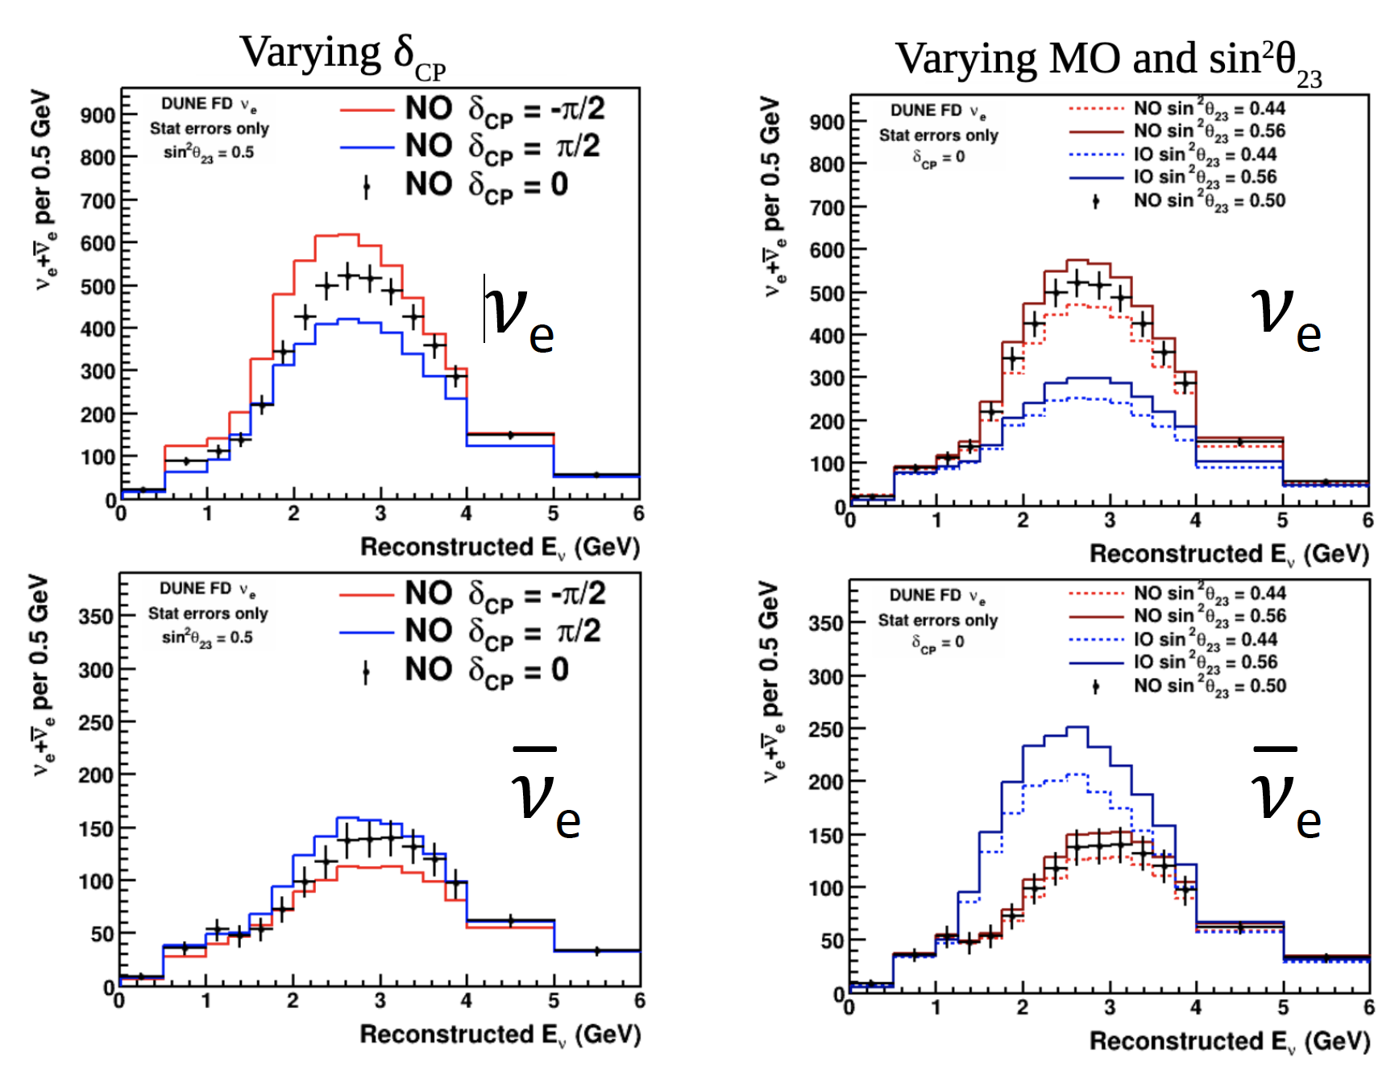
Neutrino energy spectra at Far Detector
Sensitivity to $δCP$
If $δCP \sim \text{−}π/2$is DUNE will measure an enhancement in electron neutrino appearance, and a reduction in electron antineutrino appearance
Sensitivity to mass ordering (MO)
If MO is normal, DUNE will measure a much larger enhancement in electron neutrino appearance, and a reduction in electron antineutrino appearance, with respect to inverted order
MO, $δCP$ and $θ23$ all affect spectra with different shape, additional handle on resolving degeneracies
18

Slide 19
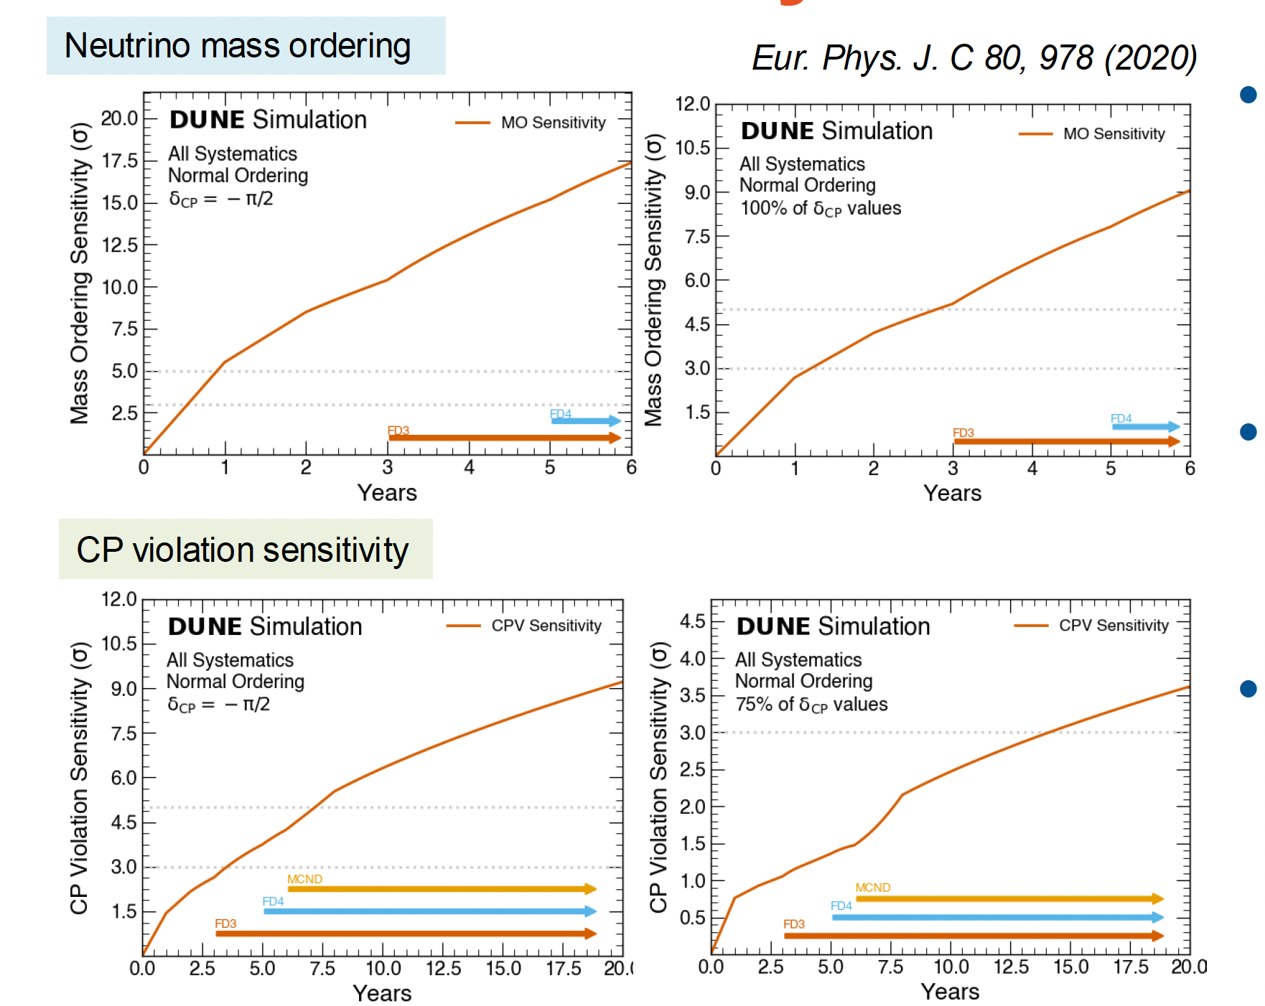
Mass order and CPV DUNE Sensitivity
For best-case oscillation scenario DUNE will reach
>5$σ$Mass Ordering sensitivity in 1 year
>3$σ$ CPV sensitivity in 3.5 years
For worst-case oscillation scenario
>5$σ$ Mass Ordering sensitivity in 3 year (no matter the value of $δCP$ or any other parameter)
In long term DUNE can establish CP violation at > 3$σ$ for 75% possible values of $δCP$
19

Slide 20
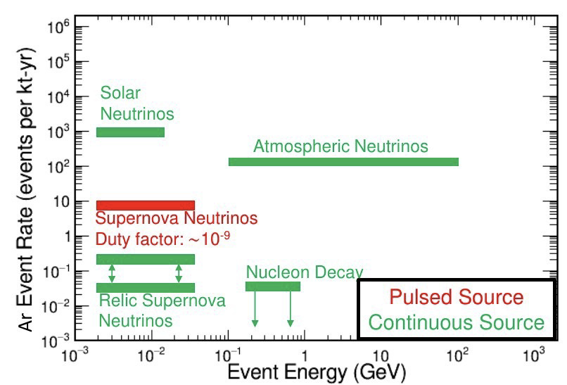
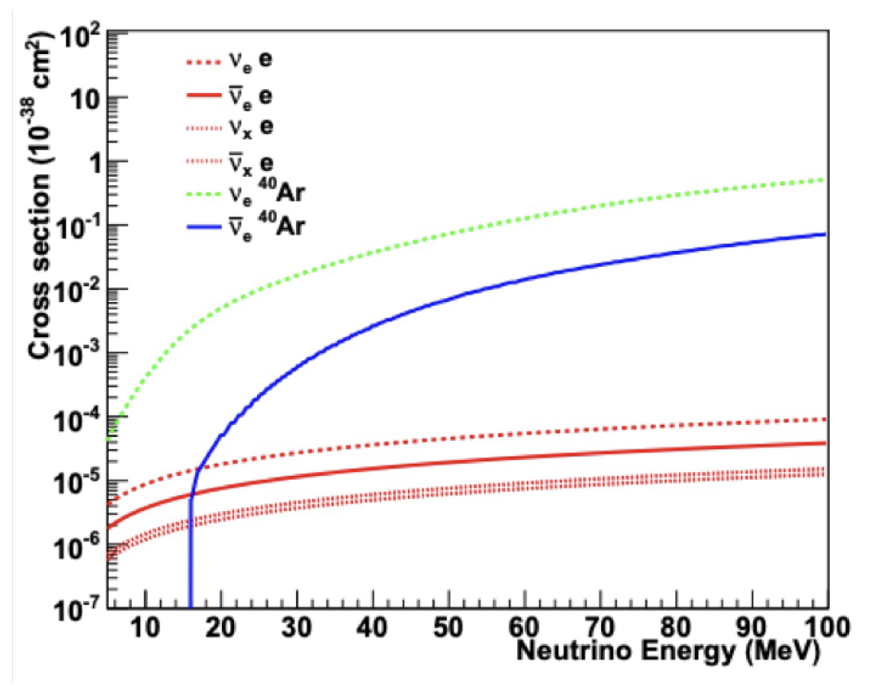
Astrophysical neutrinos in DUNE
Neutrinos from atmospheric, solar and core collapse supernovae
Argon target gives unique sensitivity to MeV-scale electron neutrinos
Charged Current (CC) interaction on Ar
$νe+40Ar→e^{−}+40K∗(Eν$>1.5 MeV)
$\overline{ν}e+40Ar→e^{+}+40Cl∗(Eν$>7.5 MeV)
ES on electrons
$νx+e^{−}→νx+e^{−} (pointing)$
Neutral Current (NC) interaction on Ar
$$νx +40Ar→νx +40Ar∗$$
20

Slide 21
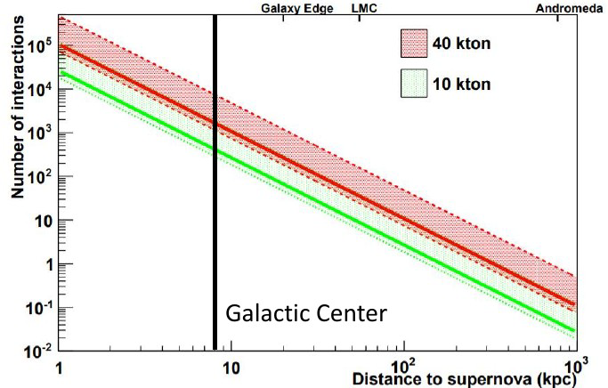
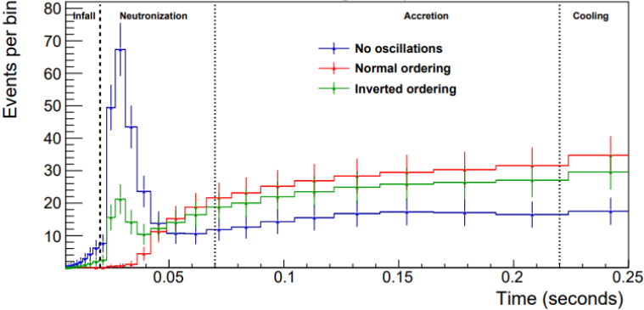
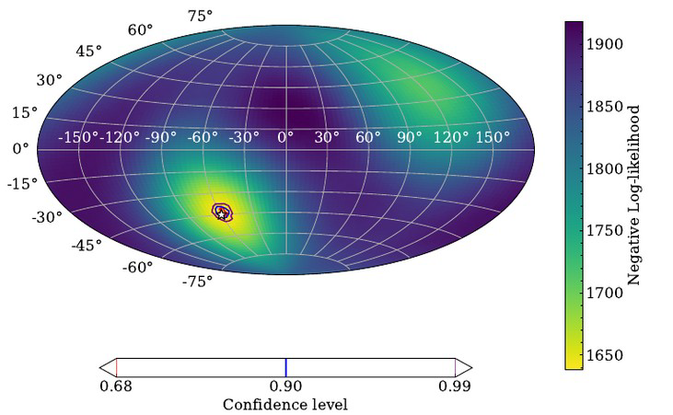
Supernova burst neutrinos
DUNE will observe thousand of neutrino interactions from a galactic supernova burst
Time and energy spectra are sensitive to core collapse mechanism and stellar evolution
Neutronization through electron capture (depending from oscillation and MO)
Matter falling into core during accretion
Emission cools as neutrinos diffuse
Pointing capabilities: ES channel, about 5° resolution
21

Slide 22
DUNE activities in Naples
Main involvment in the Photon Detection System
Characterization of the PDS module (Megacell)
PDE of SiPMs at cryogenic temperatures
European site for evaporation of the wavelength shifter
Active participation to ProtoDUNE (analysis and simulation)
Proposal for a new design for Far Detector 3
Simulation and perfomance study
In situ R&D small prototypes

Slide 23
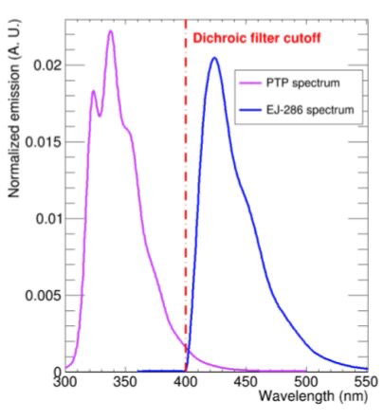
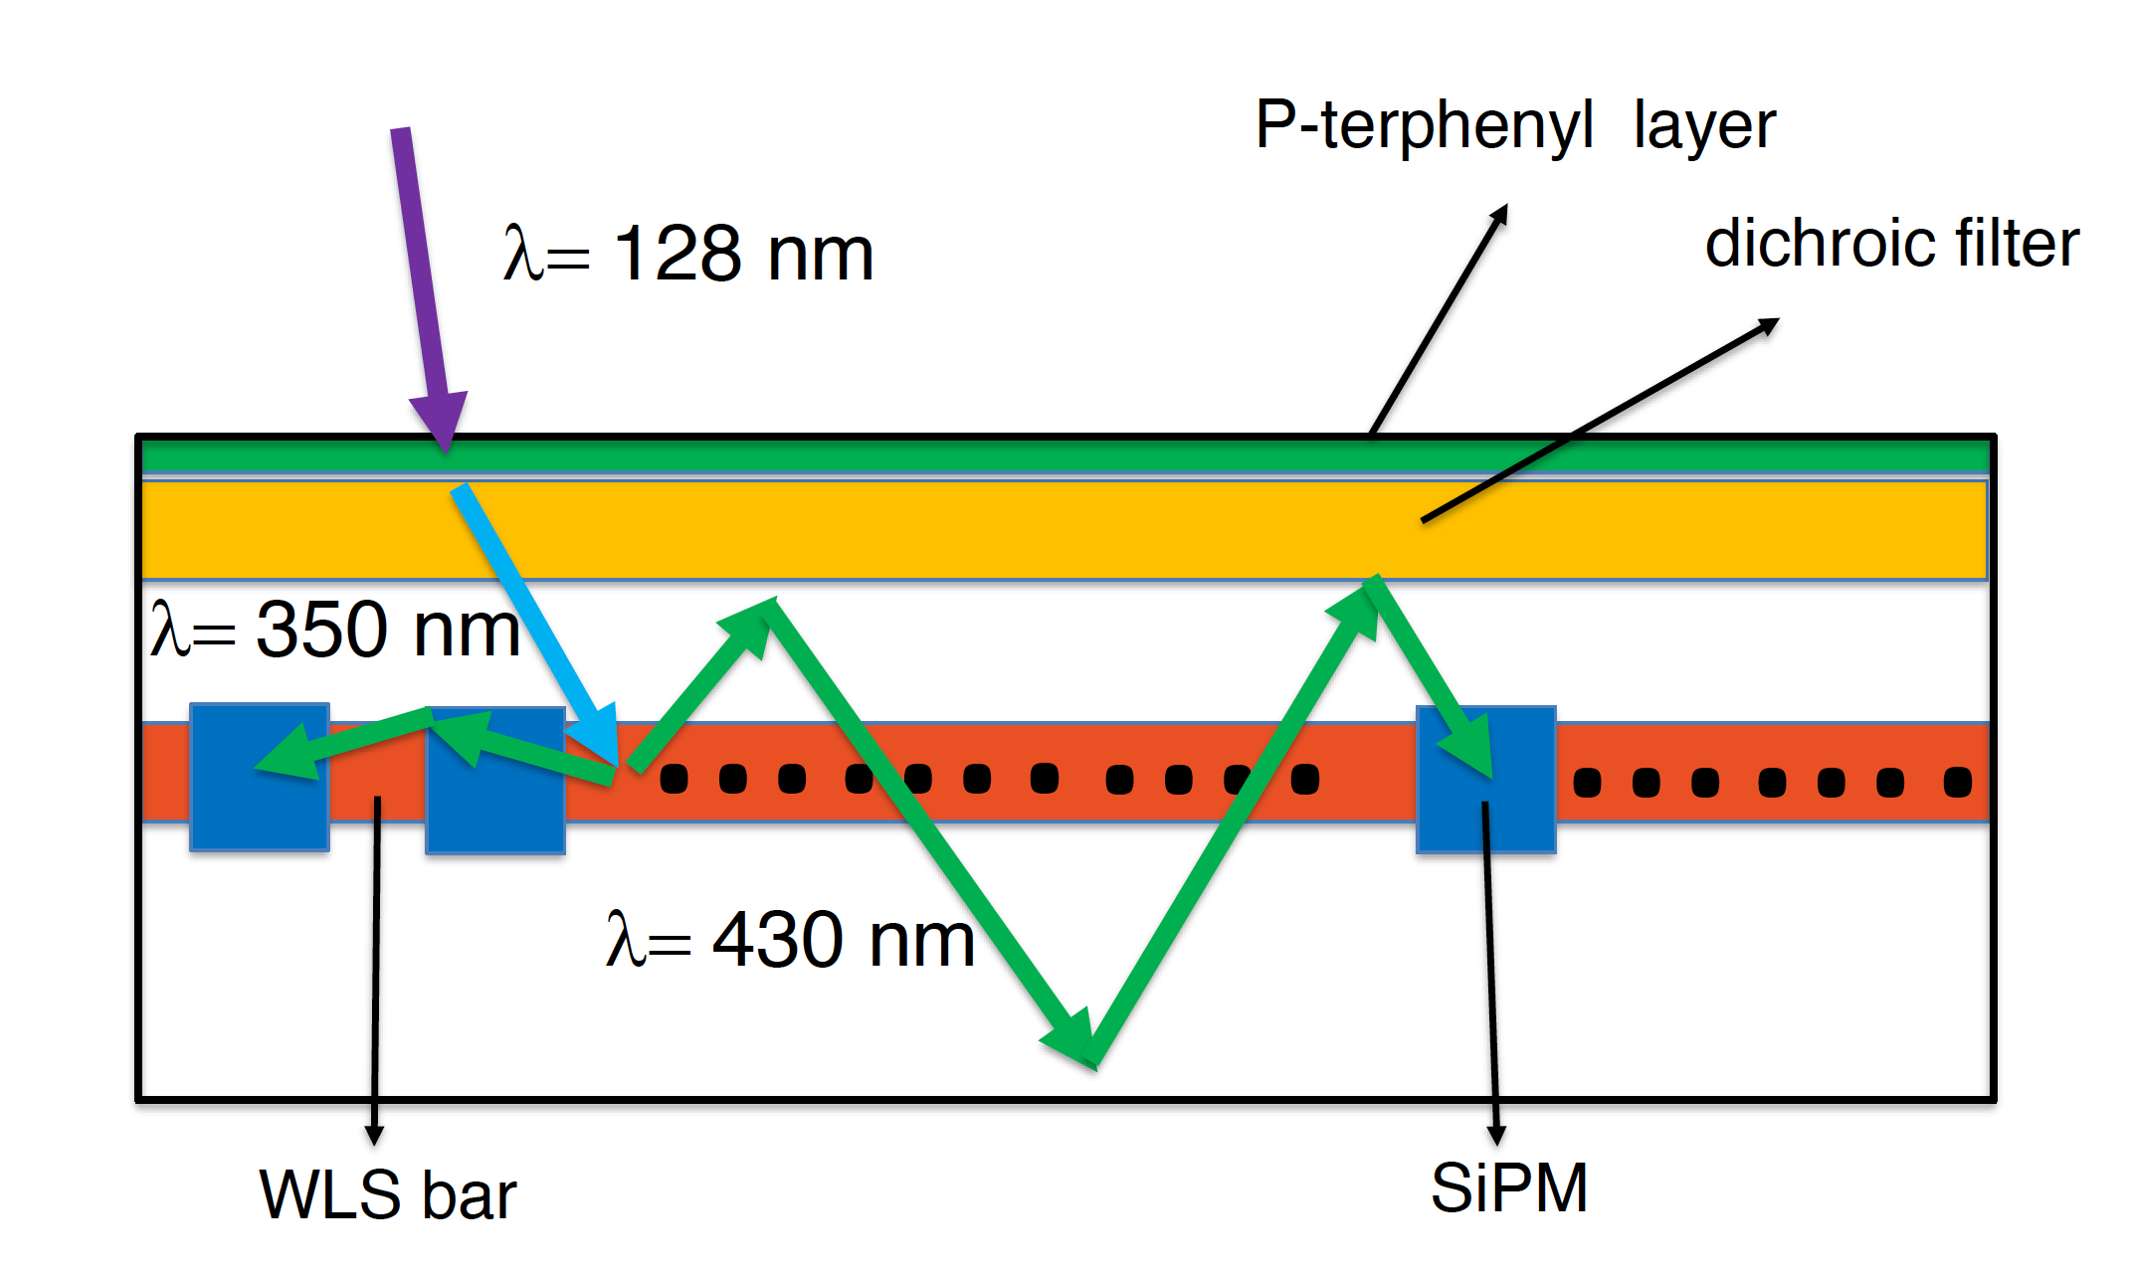
Photon Detection System (FD)
VUV scintillation light produced in LAr
PTP shifter deposited on the dichroic external side converts VUV light to a wavelenght < dichroic cutoff (light transmitted)
The internal WLS bar converts the primary shifted photons to a wavelenght > dichroic cutoff (light is trapped)
After reflections the photons can be detected by SiPM positioned laterally with respect to the WLS plane

Slide 24
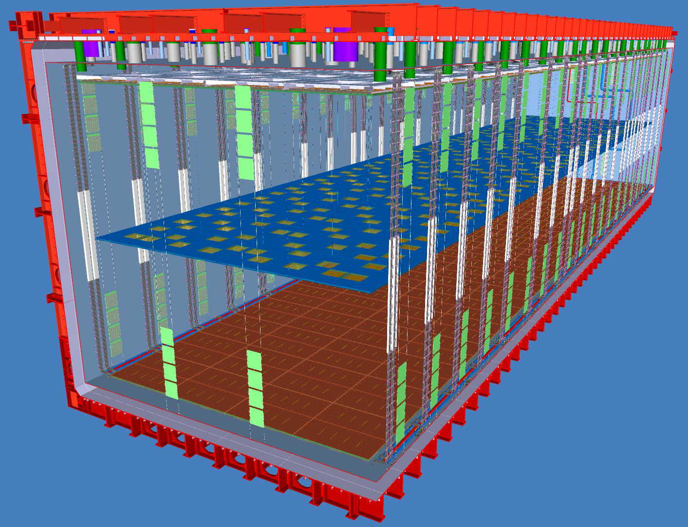
Photon Detection System in VD detector
PD modules mounted on the cathode (at 300 kV) and on the cryostat walls (membrane) behind the transparent (70%) field cage
Square geometry: dimension 65 cm x 65 cm
A single large WLS light guide plane
160 lateral SiPMs
SiPMs mounted on flexible strips
320 double side (cathode) + 352 single sided (membrane)
12

Slide 25
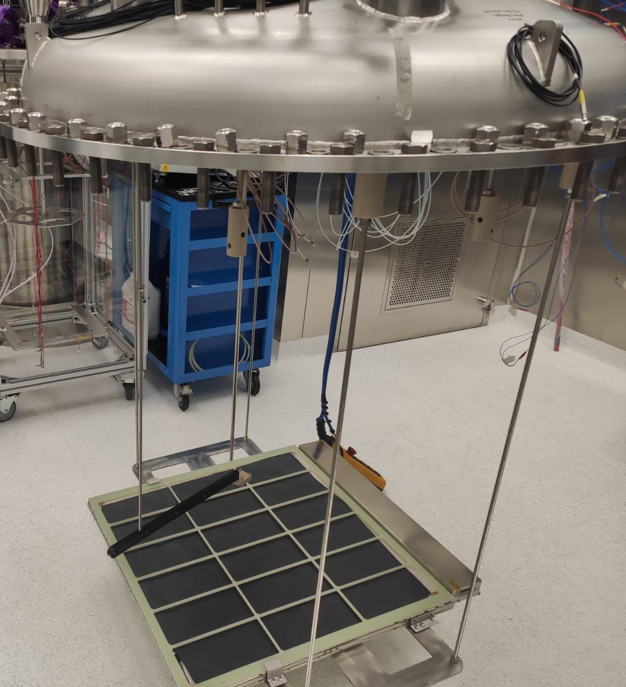
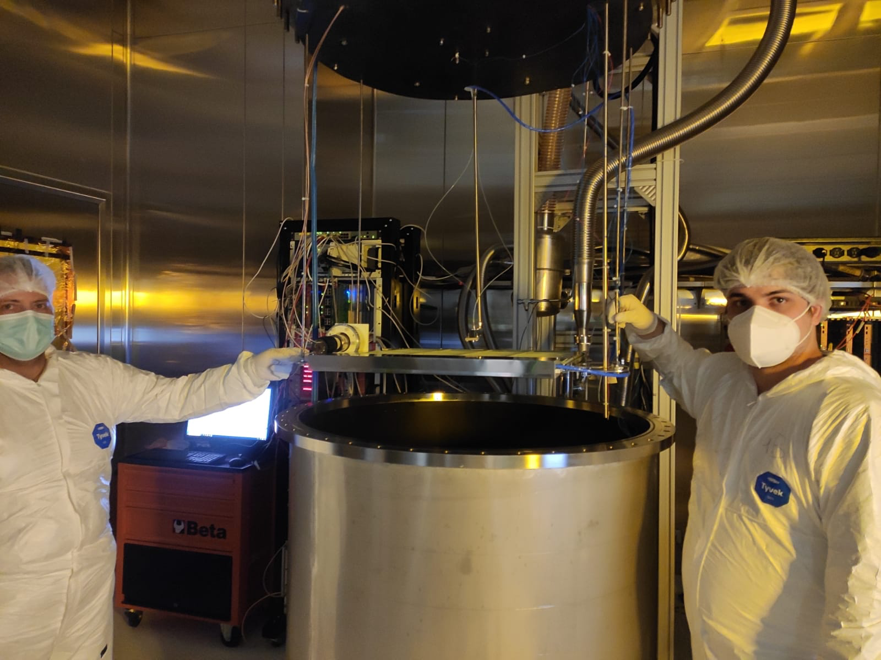
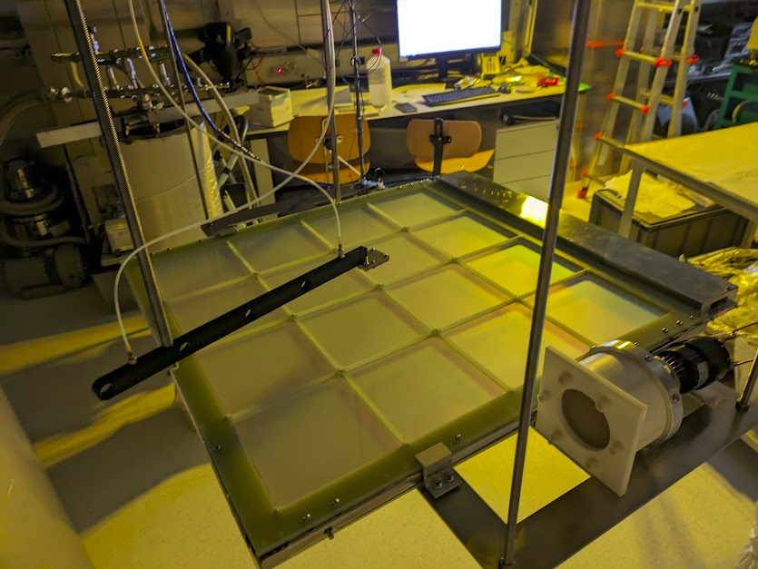
PDS-VD module tested in Naples
²⁴¹Am source (250 Bq)
A PDS module of the DUNE Far Detector 2 with SiPM readout assembled in Napoli and performances in LAr first time tested in the Collaboration

Slide 26
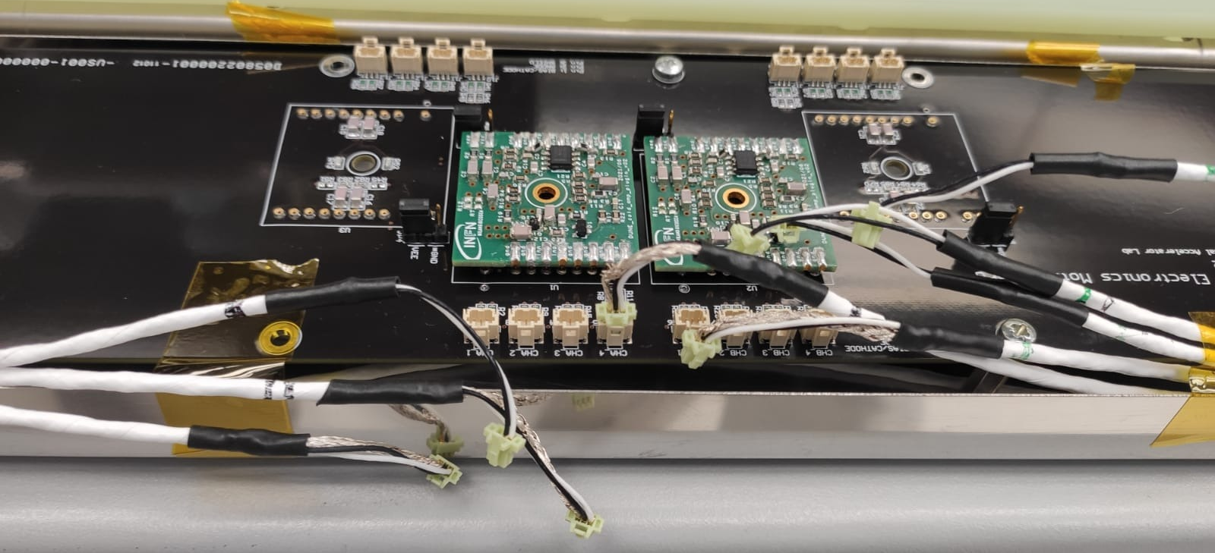
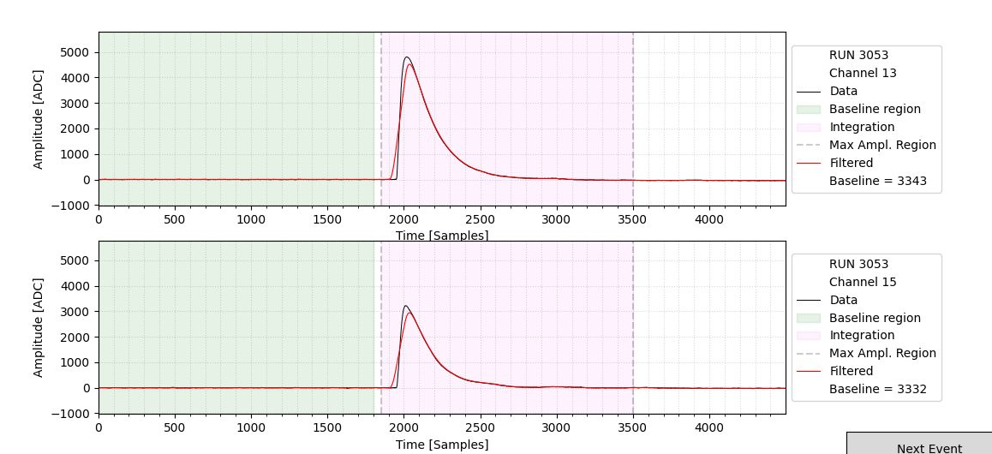
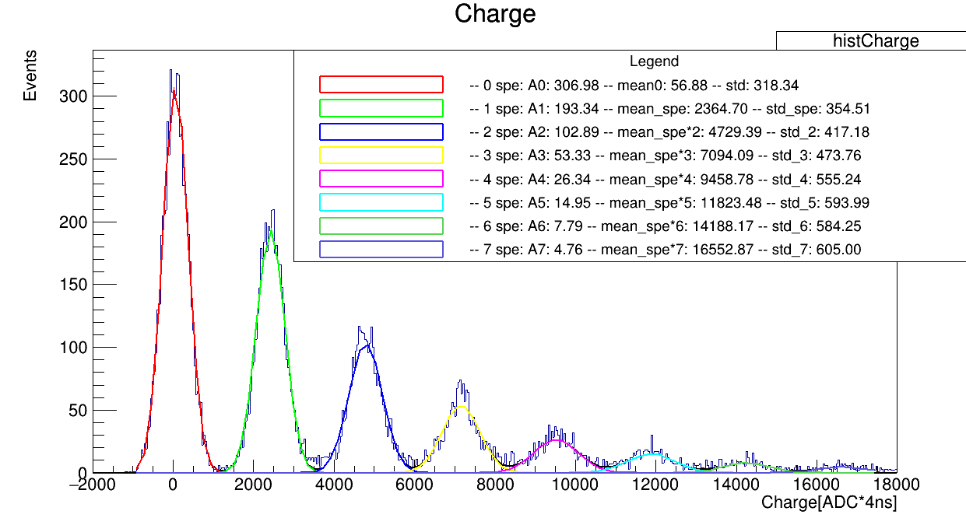
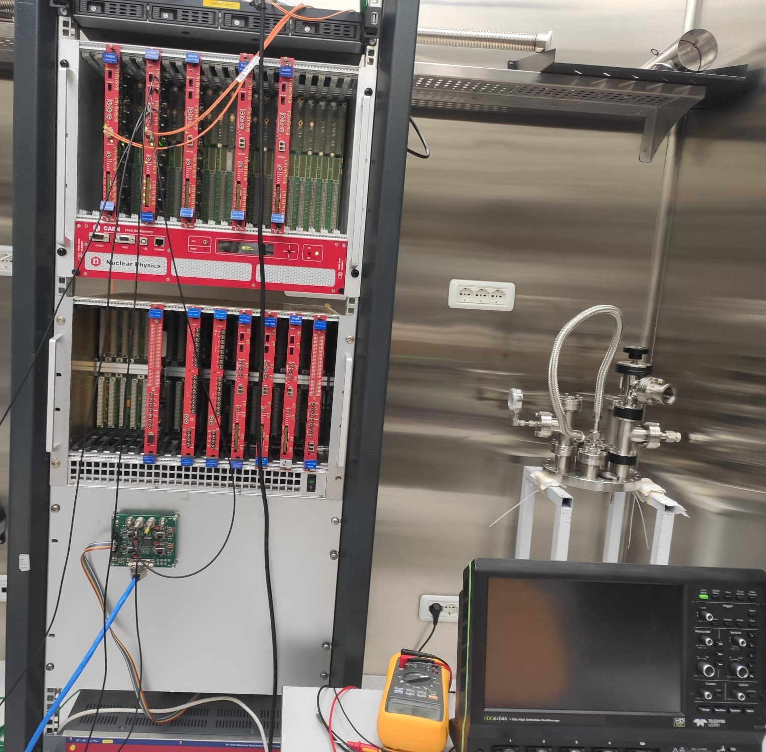
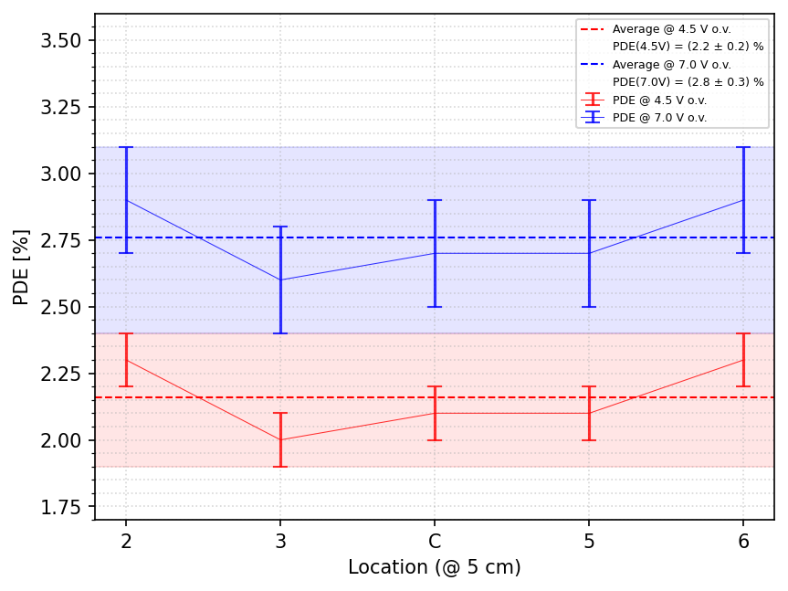
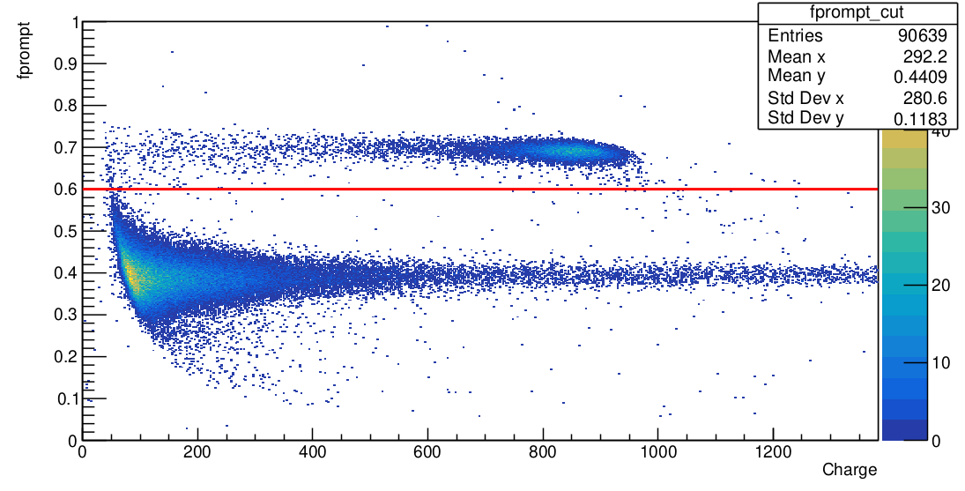
Electronics
Signal processing and analysis
Cold amplifier
Warm second stage amplifier

Slide 27
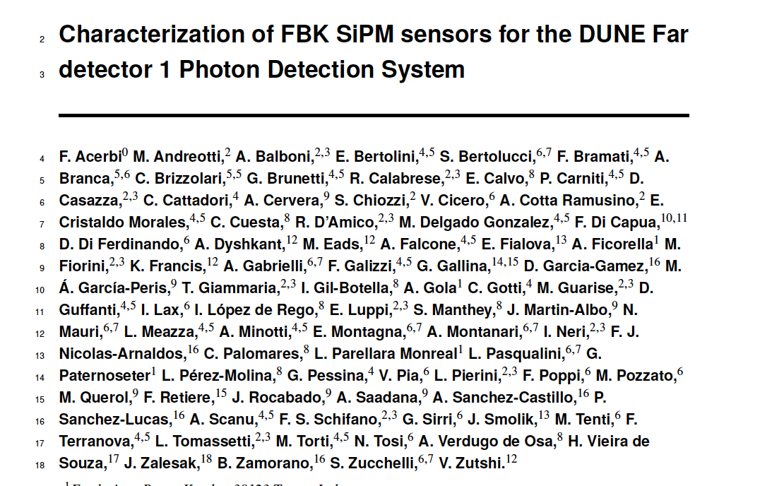
SiPM PDE measurement at cryogenic temperature

Slide 28
PTP coating for Far Detector 2
Evaporation of the cathod (320 double sided) and membrane (320+32 single sided) XA-VD modules
Evaporator design inherited from the Campinas evaporation chamber with
Relevant improvements:
larger chamber with 120 cm diameter providing +100% evaporation throughput wrt Campinas evaporator
multiple crucibles to assure more uniformity in the coatings and speed up the process
Pumping system sized to ensure 2 full coating processes/day
Evaporation system hosted in a ISO-6 Clean Room
Quality characterization in a dedicated experimental area at the Naples Physics Department

Slide 29
Chamber Design
Stainless Stell cylindrical vacuum chamber developped by custom design:
- 120 cm diameter
- 70 cm height
- removable dome flange
Multi-port flanges for crucibles (optimization of the position will be done in commissioning phase) and other tools
Motor with rotating feedthrough and disk holder connected to the top dome
Pumping station with a 40 m³/h (primary pump) and 2300 l/s turbopump
Three evaporation sources
Thickness measurement unit based on quartz sensor and oscillator

Slide 30
Status of vessel construction
Chamber produced
Motorized disk movement to be implemented by end of month
Helium leak test performed with leak rate <10⁻¹⁰ mbar/l/s
Inner part electropolished
Vessel ready be delivered to Naples by end of 2024

Slide 31
The crucibles
pneumatic opening
Custom design:
Volume of the cell $\sim$30 cm³
Copper crucible directly mounted in flange DN 100 ISO-K
Designed to host fused silica crucibles
1000 W heater
Electro-pneumatic opening and cooling system
Working temperature at 250-300 °C, maximum temperature 500°C
Production and test:
3 crucibles produced and tested
PID controlled temperature, with a very good set point stability
Control system hosting 3 power units and safety control
water cooling system
250°C

Slide 32
Development of tools for evaporation operations
Dedicated tools for handling and manipulation already designed
Parts in production
Substrate to be coated: dimension of 14,4×14,4 cm²
Disk holder for filters with 112 cm diameter
Up to 24 substrates for evaporation process can be accommodated

Slide 33
Vacuum evaporation operations
Phases of operations
Preparation
Mounting of the filters on a proper holder
Weighting of the reference samples
Mounting of the holder on the dome flange
Coating
Vacuum phase till ~5$×$10⁻⁶ mbar
Starting and monitoring of the evaporation
End of coating, breaking of the vacuum and back filling with gaseous nitrogen
Opening of the flange and removal of the coated filters
Quality Control
Visual inspection of the coatings
Placement of the filters in appropriate shipping boxes
Quality check of the reference samples

Slide 34
Quality tests
Protocol for quality process defined in agrement with UniCampinas Group
Visual check of the overall deposition process
Check of 10% of coated samples for each evaporation process
Measurement of mass densities with precision scale (O(10⁻⁵ g))
Conversion yield test: measurements with a spectrofluorimeter and comparison wrt a reference
Adhesion test: controlled immersion in liquid nitrogen (system under development)
Collaboration with UniNa Chemical Department and CNR-SPIN to set up an overall quality check procedure

Slide 35
FD2 evaporation site: programming of the operations
Main tasks of Naples Group:
Construction and completion of the evaporation facility
Set-up and validation of the evaporation process
Coordination and partecipation to the activities
Management of the facility and shipment of the filters in the assembly sites
System design to have a duration of whole evaporation process estimated in approximately 4-5 hours
Possibility to perform 2 cycles per day
 | Number of modules | Number of filters per module | Total number of filters
Membrane modules | 352 | 16 | 5632
Cathode modules (double side) | 320 | 32 | 10240
Spares | ?? | 10% ?? | 750
Total |  |  | 16622
2 shift for day: 8-10 hours
48 filters/day
Required 346 days (about 70 weeks)
2 years of operation involving 2 INFN technicians

Slide 36
Evaporation facility
Vacuum
Evaporation
System for
VESUVIO for DUNE experiment
Ultra
VIolet
Optics

Slide 37
Design of the Far Detector 3

Slide 38
Detection principle

Slide 39
Active Veto capabilities

Slide 40
Summary
DUNE is a next generation long-baseline oscillation experiments and astrophysics neutrino observatory
Very reach program in the next decade (about 20 years lifetime)
Neutrino and anti-neutrino Oscillations with CPV investigation
Studies of MeV-scale neutrinos
BSM searches
LNBF and DUNE making rapid progress on facility construction, with excavation complete and components under construction
DUNE Naples group very active in this process
DUNE science begins in this decade

Slide 41
Backup slides

Slide 42
DUNE precision measurements
Ultimate precision 6°-16° in $δCP$
World-leading precision (for long baseline experiments) in $θ13$
42

Slide 43
DUNE sensitivity to solar neutrinos
Neutrinos from the Sun
DUNE has excellent sensitivity to ⁸B solar neutrinos above ~10 MeV, and discovery sensitivity to the hep solar flux
DUNE can improve upon existing solar oscillation measurement via day-night asimmetry induced by matter effect (bottom plot shows hypothetical DUNE result at old best fit point)
43

Slide 44
Beyond three-flavor $ν$ Oscillation

Slide 45
BSM searches with the Far detector
DUNE due to large mass and long exposure time is sensitive to rare processes (proton decay, n-nbar oscillation) and new physics of cosmogenic origin
Boosted Dark Matter produce low energy soft e/p and spatially proximate e+e- pair

