Slide 1


Misure di sezioni d’urto @SPES
Mou Liliana
liliana.mou@lnl.infn.it

Slide 2

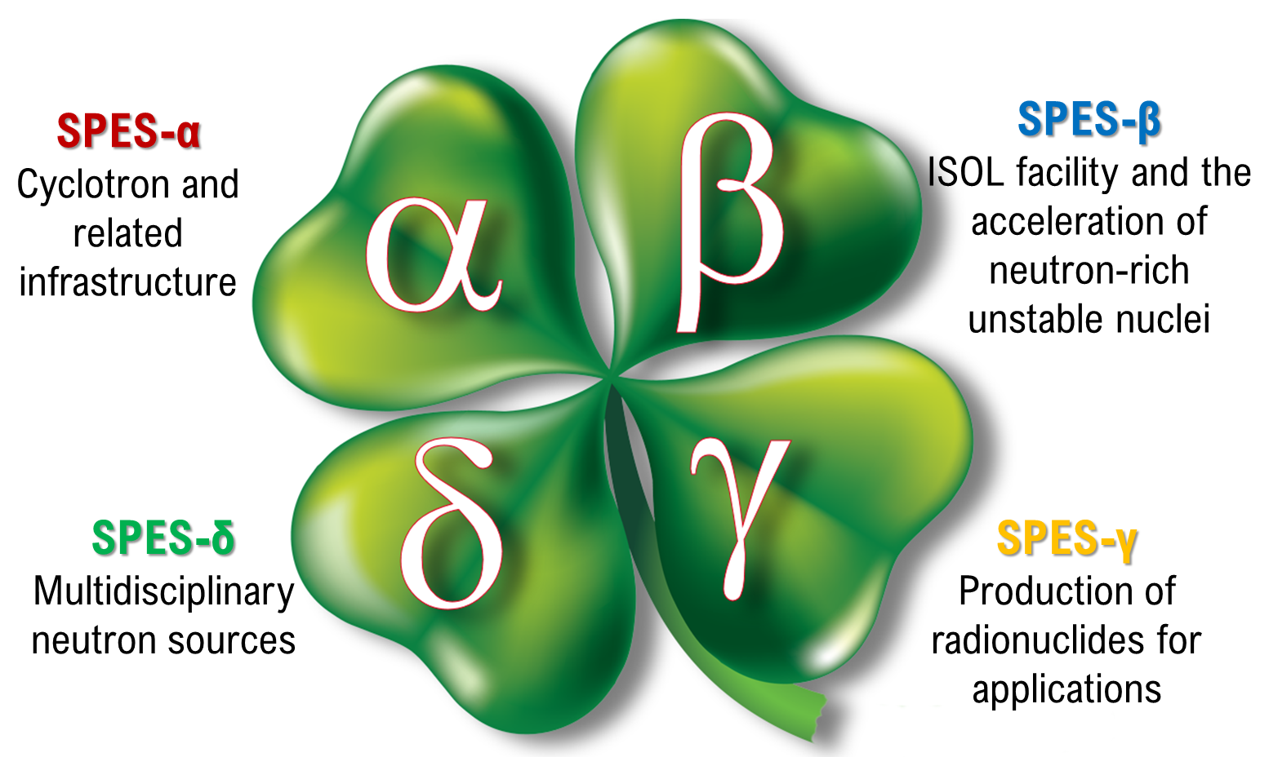
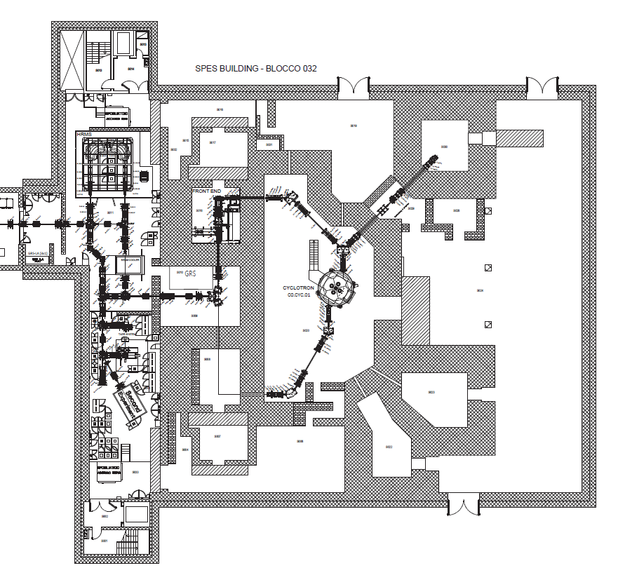
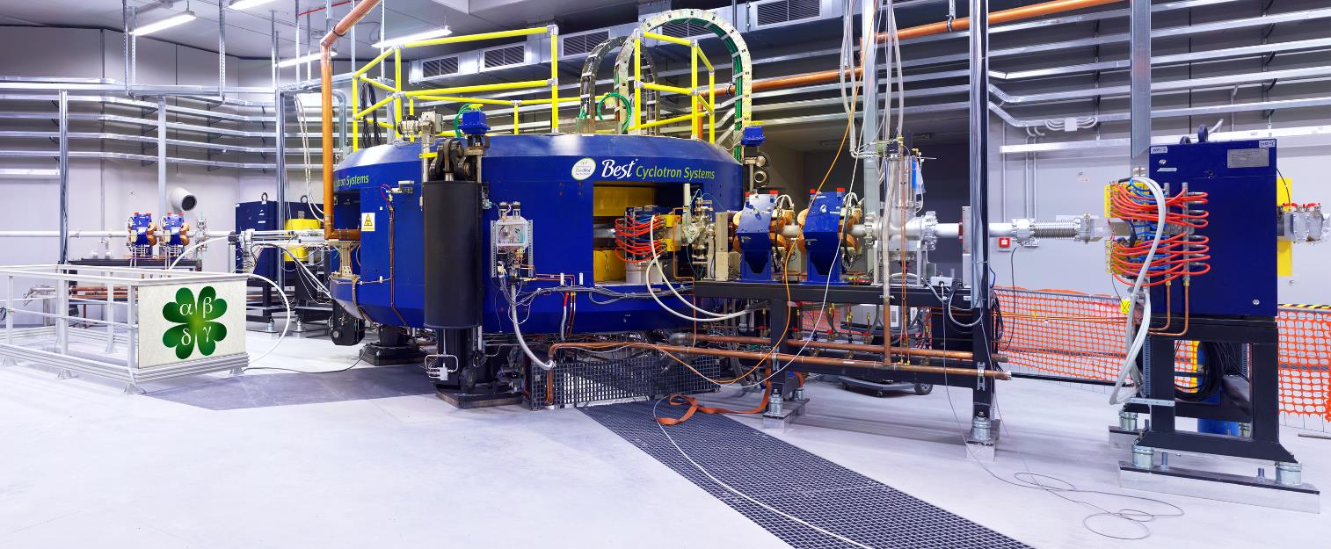

The SPES project
Selective Production of Exotic Species
RILAB
DIRECT activation
technology
LAboratory of Radiouclides for MEDicine
https://web.infn.it/LARAMED/
Dual beam proton Cyclotron
E_{p,max}=70 MeV I=700 µA
ISOL technology
Possible collaboration with industry for production
RIFAC
https://isolpharm.pd.infn.it/web//
liliana.mou@lnl.infn.it

Slide 3


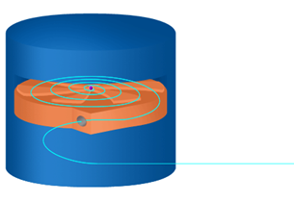
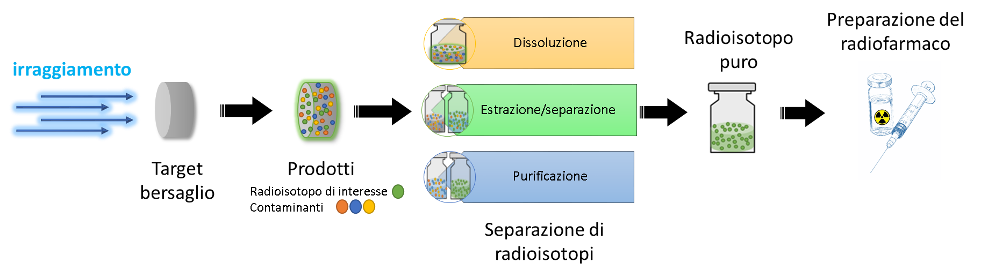
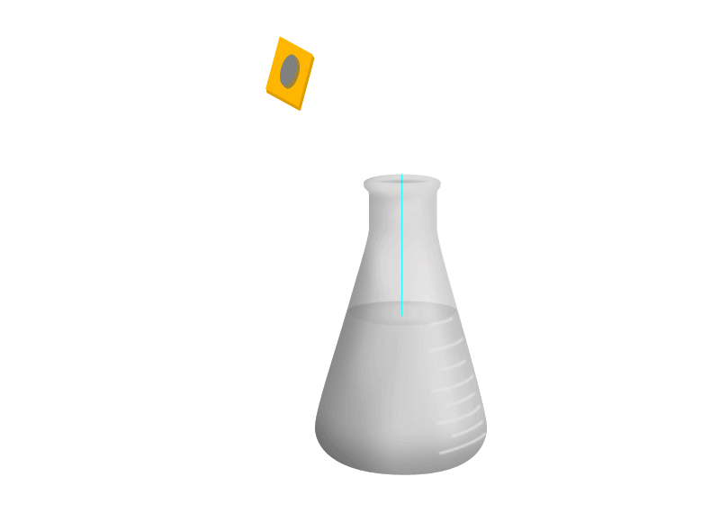

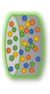
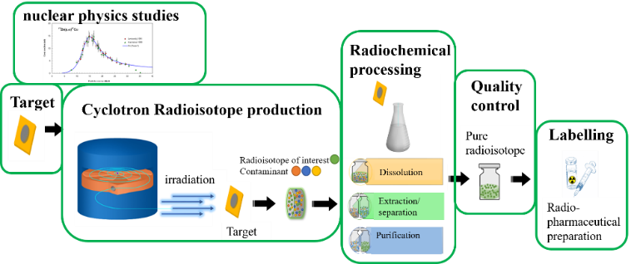


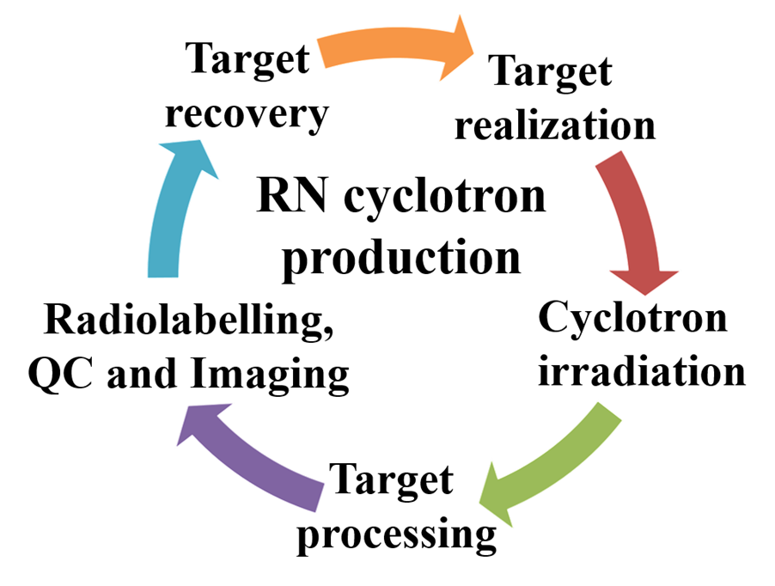
Cyclotron radiopharmaceutical production
Cyclotron Radioisotope production
Radiochemistry process
Quality Control
Radioisotope
of interest
Contaminants
Target preparation
Radiopharmaceutical preparation
Irradiation
Dissolution
Extraction/
separation
Target
Purification
Pure radioisotope
Nuclear physics studies
Target recovery
liliana.mou@lnl.infn.it

Slide 4
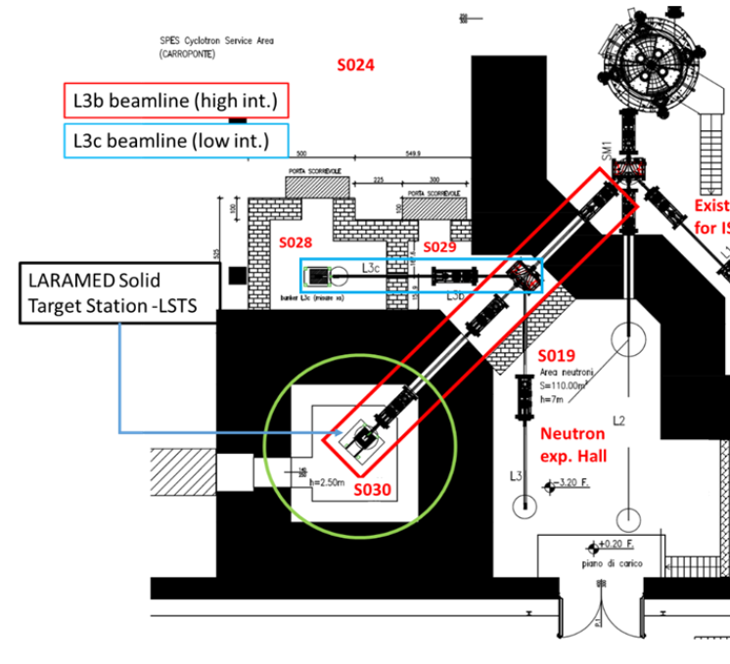
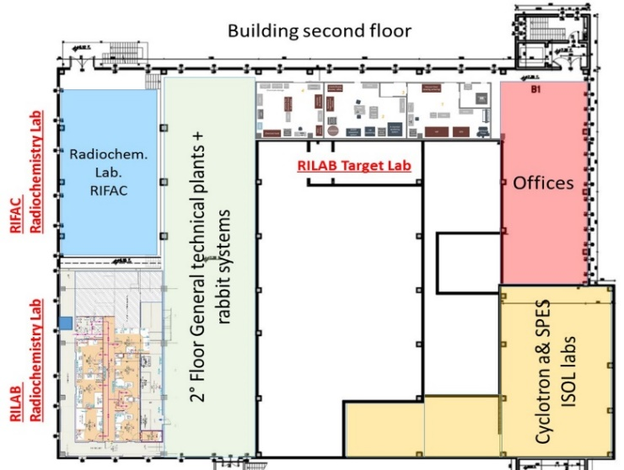
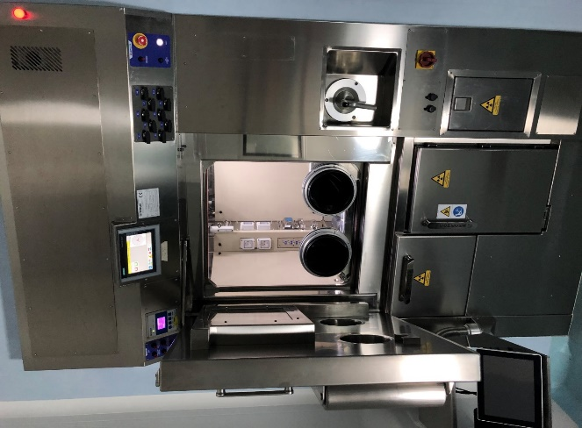
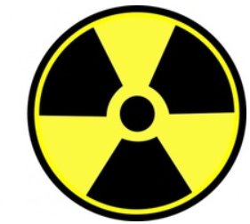
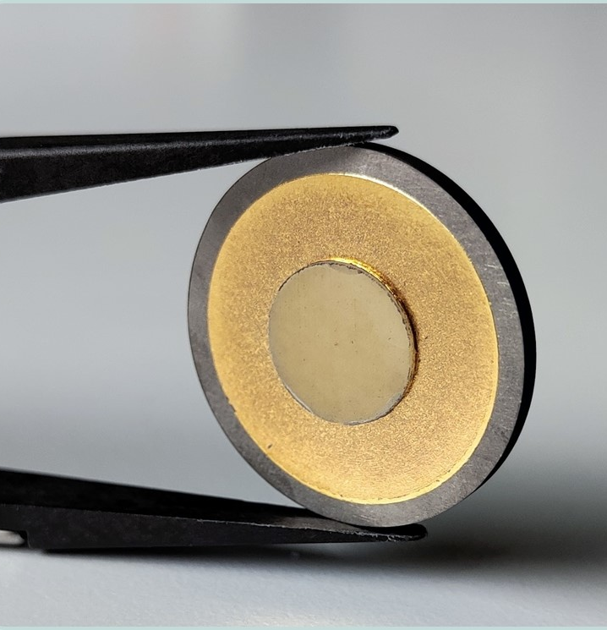
LARAMED facility
LAboratory of RAdionuclides for MEDicine
Level -1: Bunkers
Level +2 : Laboratories
RILAB – x sections
p⁺ beam
E: 35-70 MeV
I_{max}: 100 nA
RILAB – High power
p⁺ beam
E: 35-70 MeV
I_{max}: 500 µA
«Rabbit»
RILAB
RILAB radiochemistry lab.
Target process
Radionuclide purification
Spectrometry
Target recovery
Target manufacturing lab.
Cold chemistry
ISO 7 clean room
Target preparation
Pass box
Central corridor
Hot Cell
liliana.mou@lnl.infn.it

Slide 5
First commissioning test @LNL
RILAB
DIRECT technology
LAboratory of Radiouclides for MEDicine
https://web.infn.it/LARAMED/
ISOL technology
Possible collaboration with industry for production
https://isolpharm.pd.infn.it/web//
RIFAC
ISOL-2 temporarily dedicated to nuclear cross section measurements
liliana.mou@lnl.infn.it

Slide 6
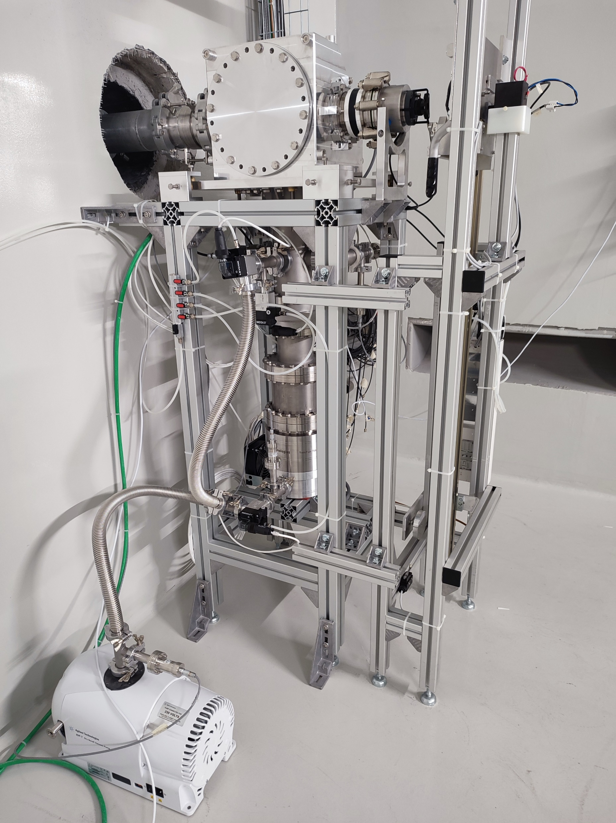
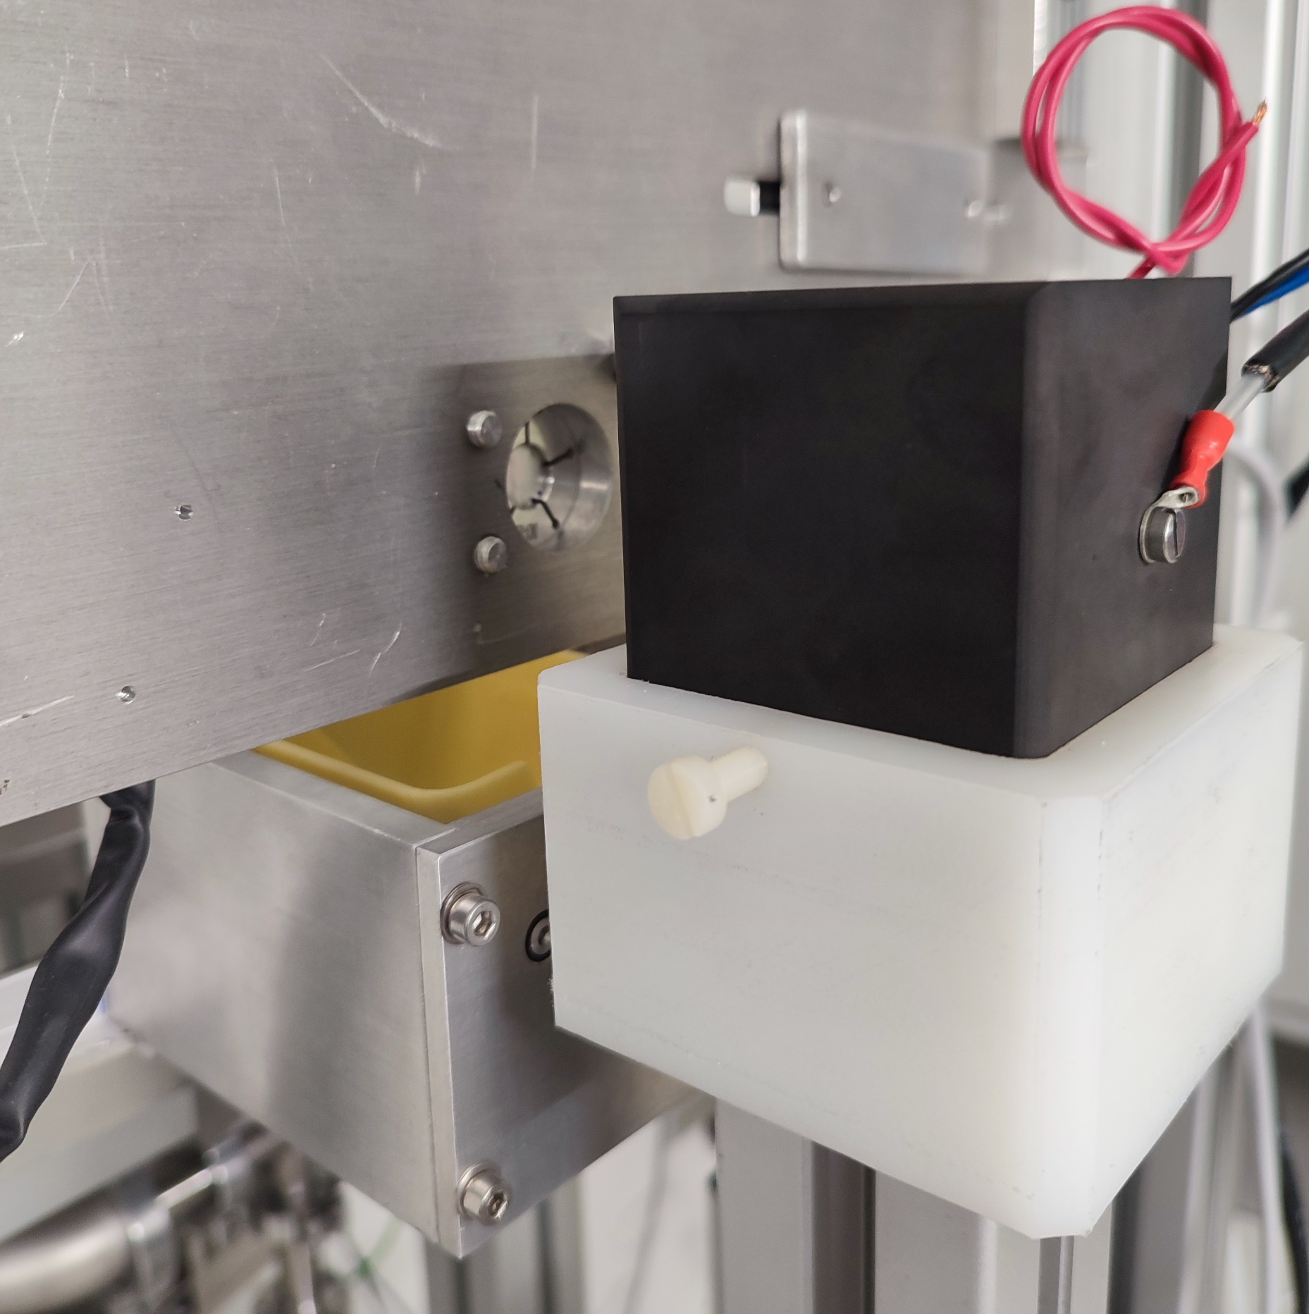
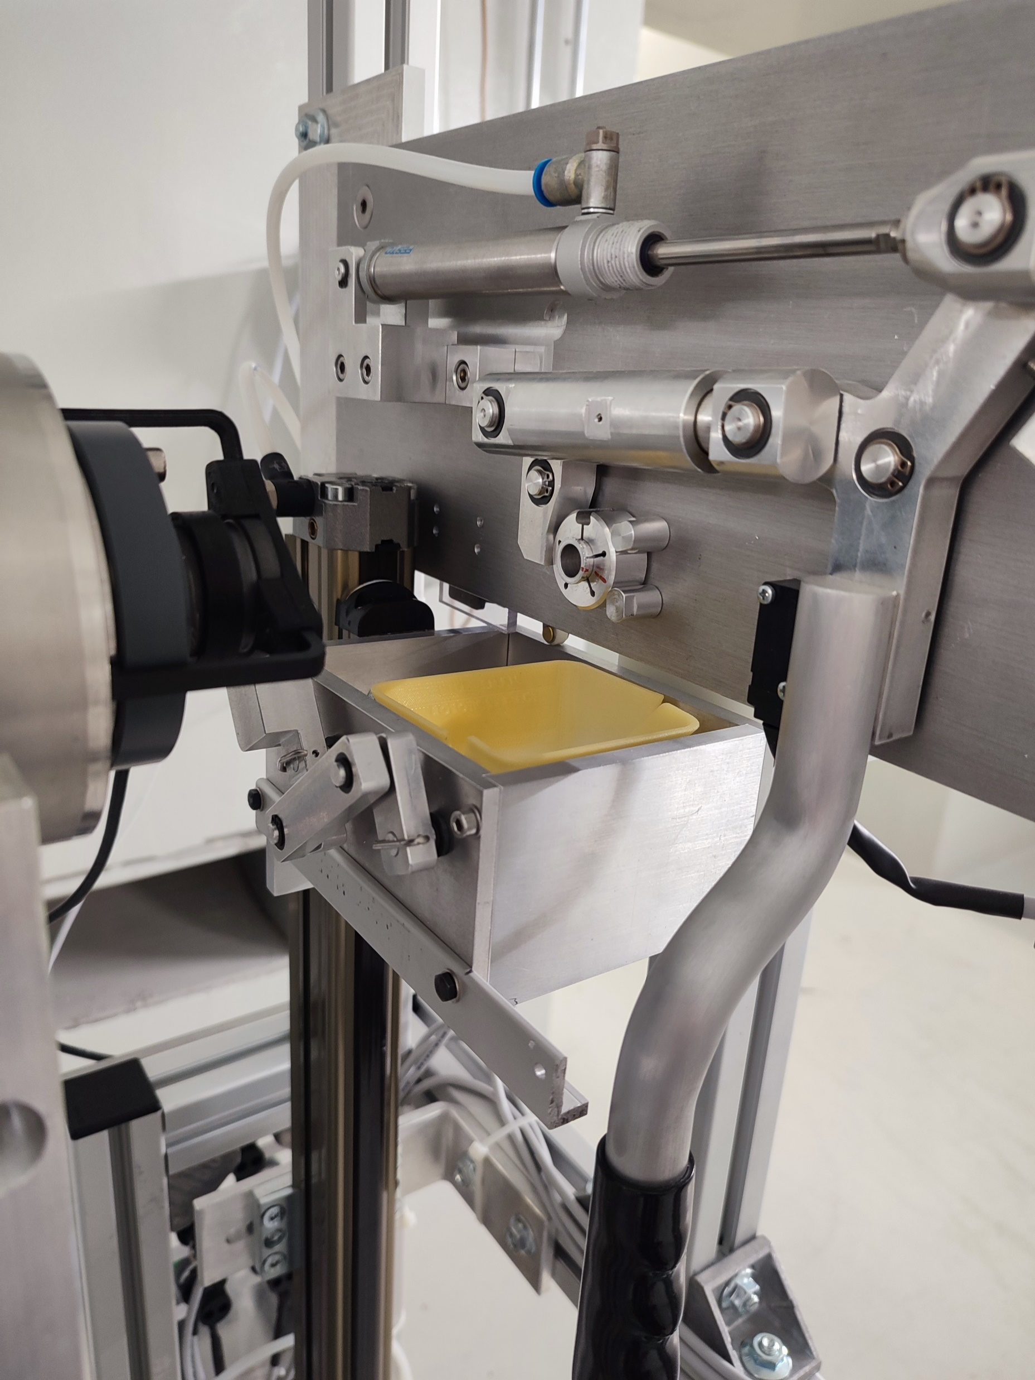
Cross section measurements in ISOL-2
Target Station (TS)
Beam
stopper
Cyclotron
Target
Holder
liliana.mou@lnl.infn.it

Slide 7
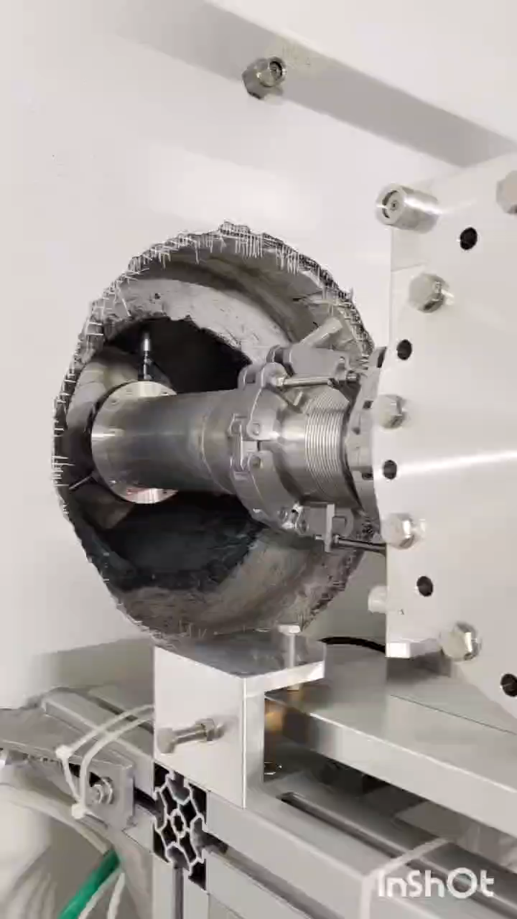
Cross section measurements in ISOL-2
Target Station (TS)
Cyclotron
liliana.mou@lnl.infn.it

Slide 8
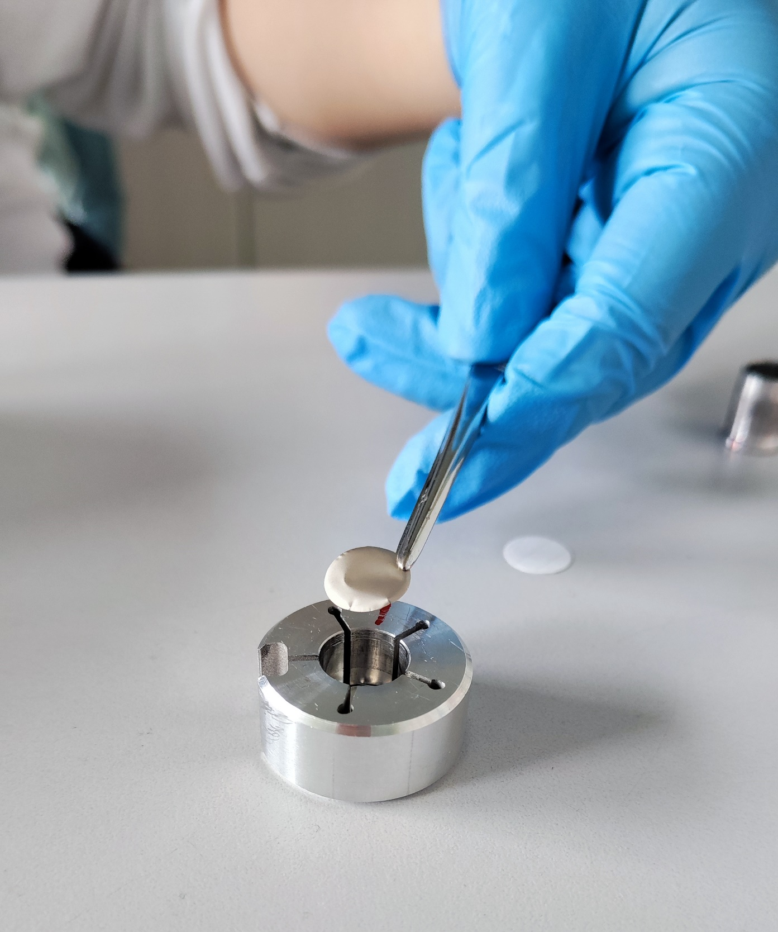
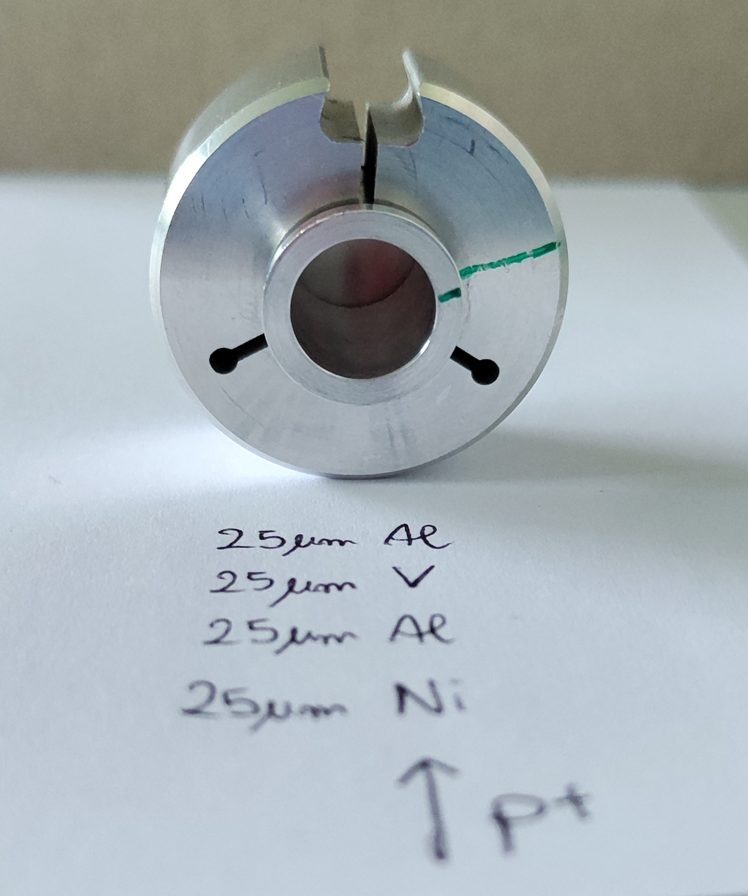
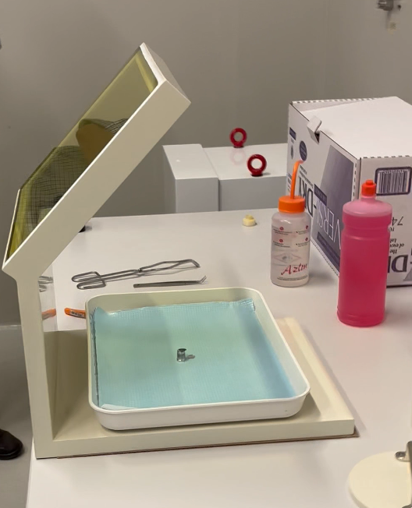
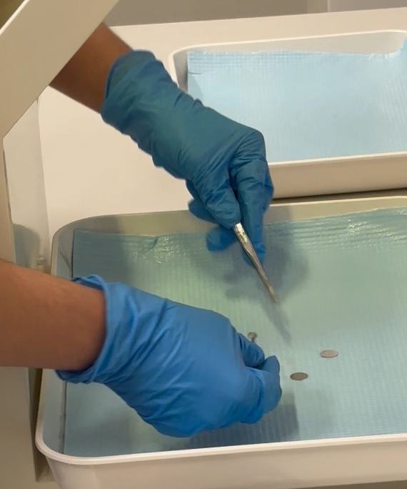
Cross section measurements in ISOL-2
Experimental area to prepare/recover the irradiated samples
Stacked-foil target preparation and positioning in the target-holder
Cyclotron
Stacked-foil target disassembly and separation of the irradiated foils
liliana.mou@lnl.infn.it

Slide 9
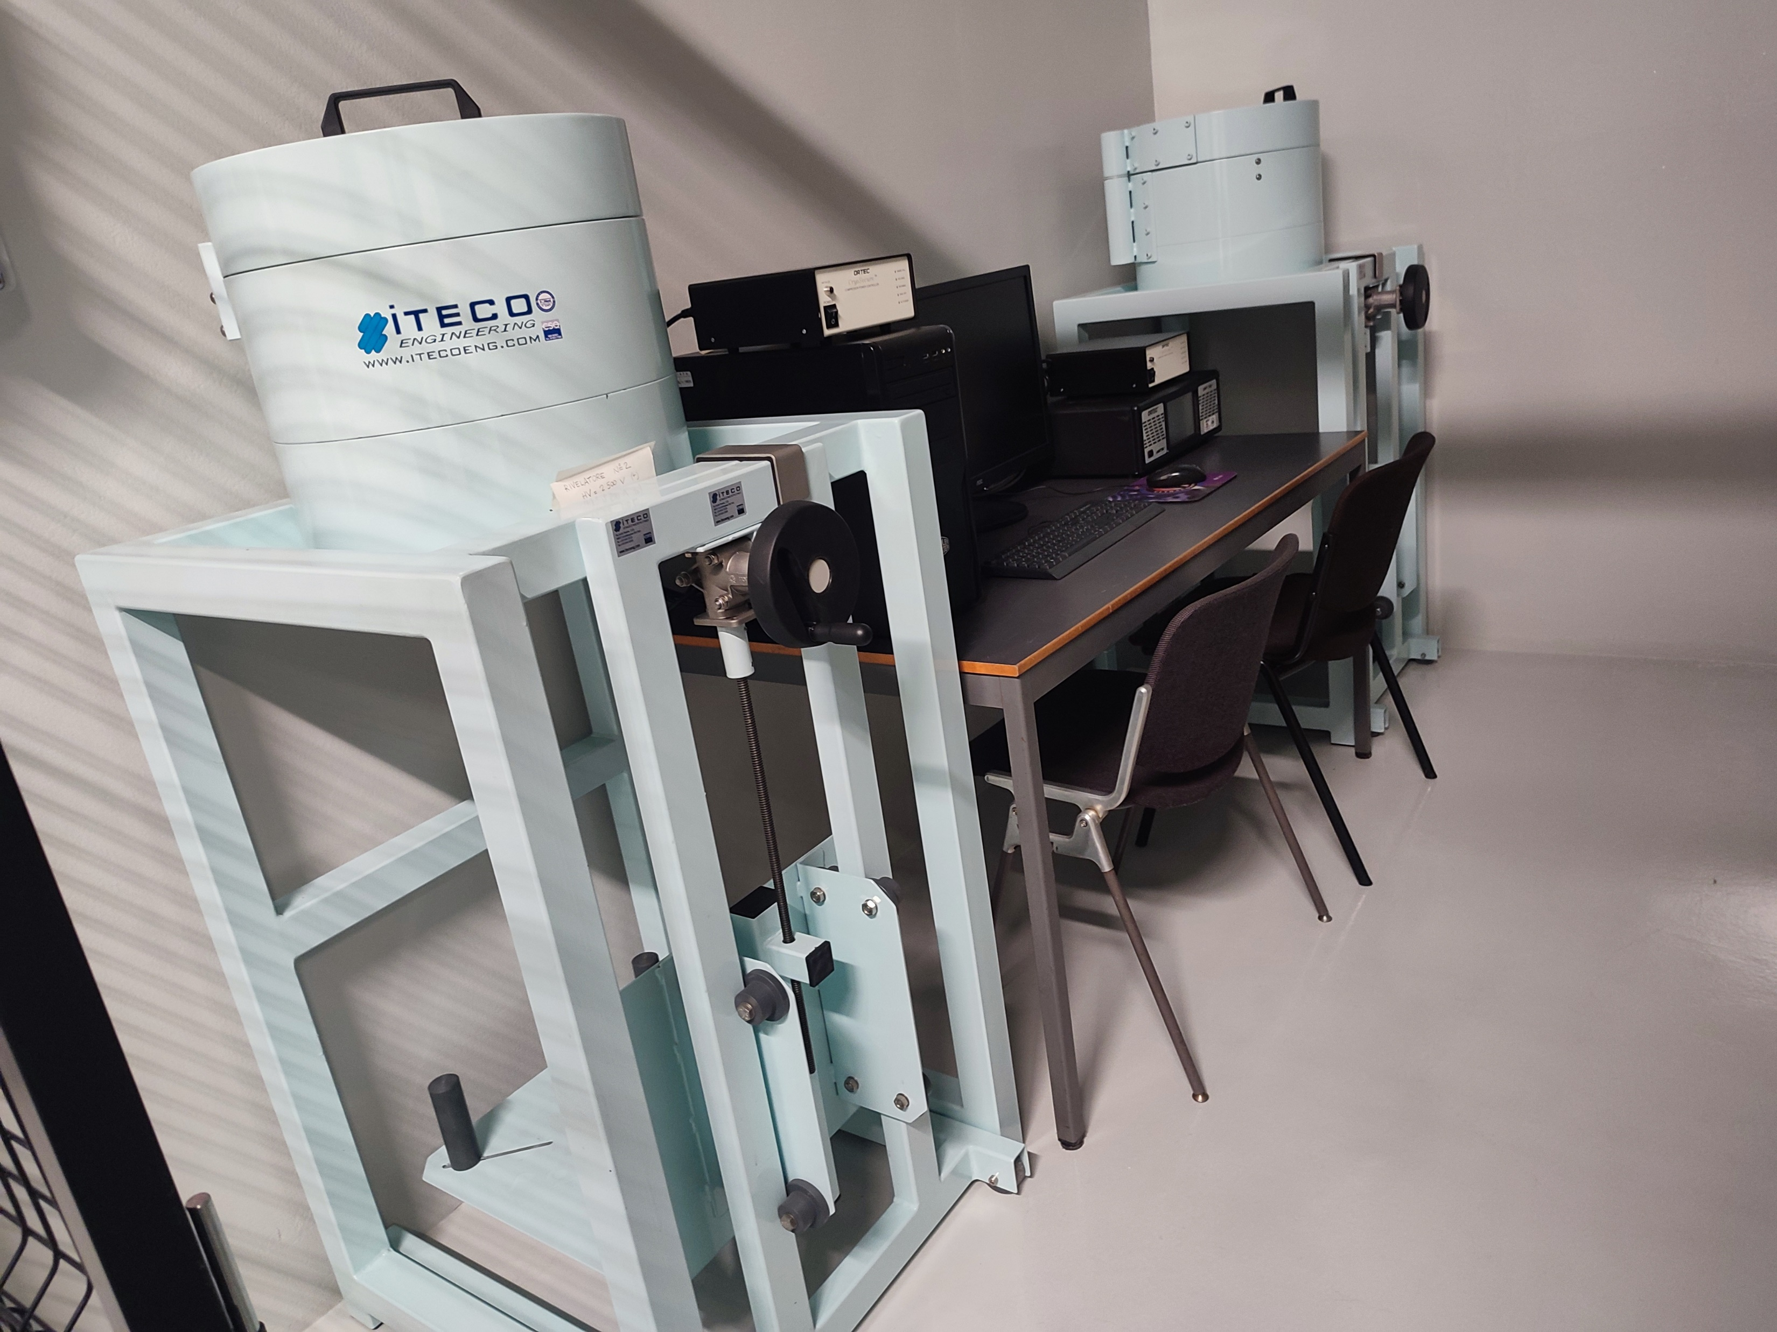
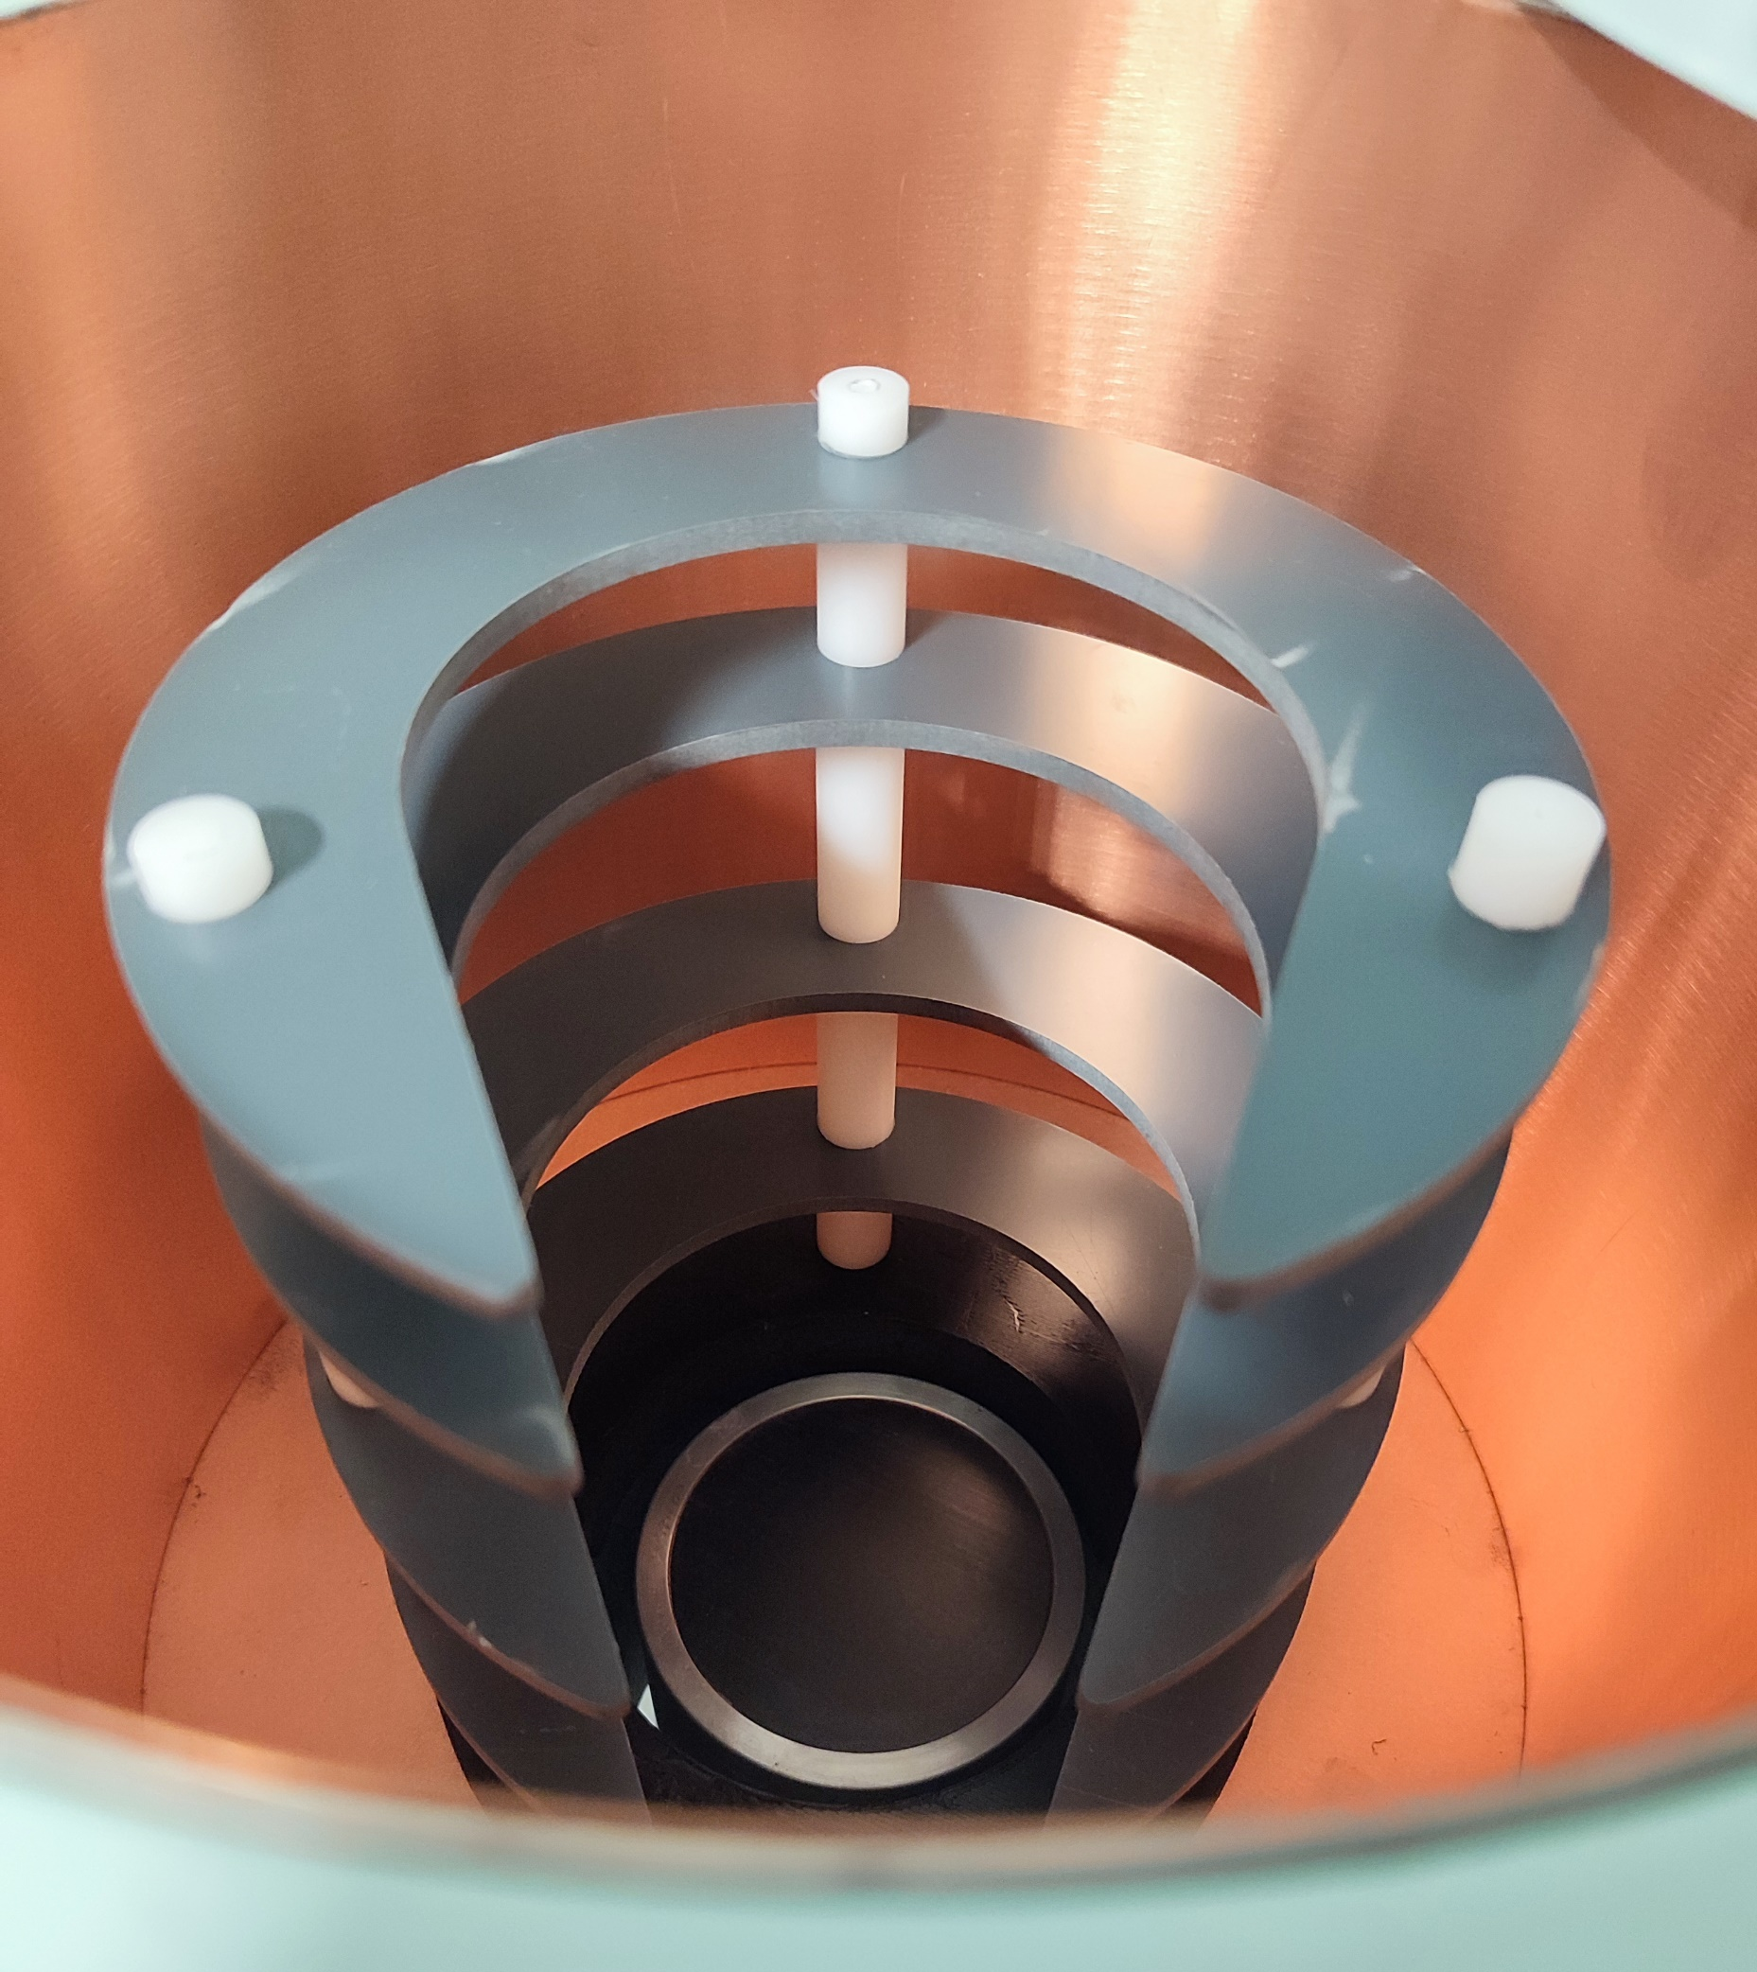
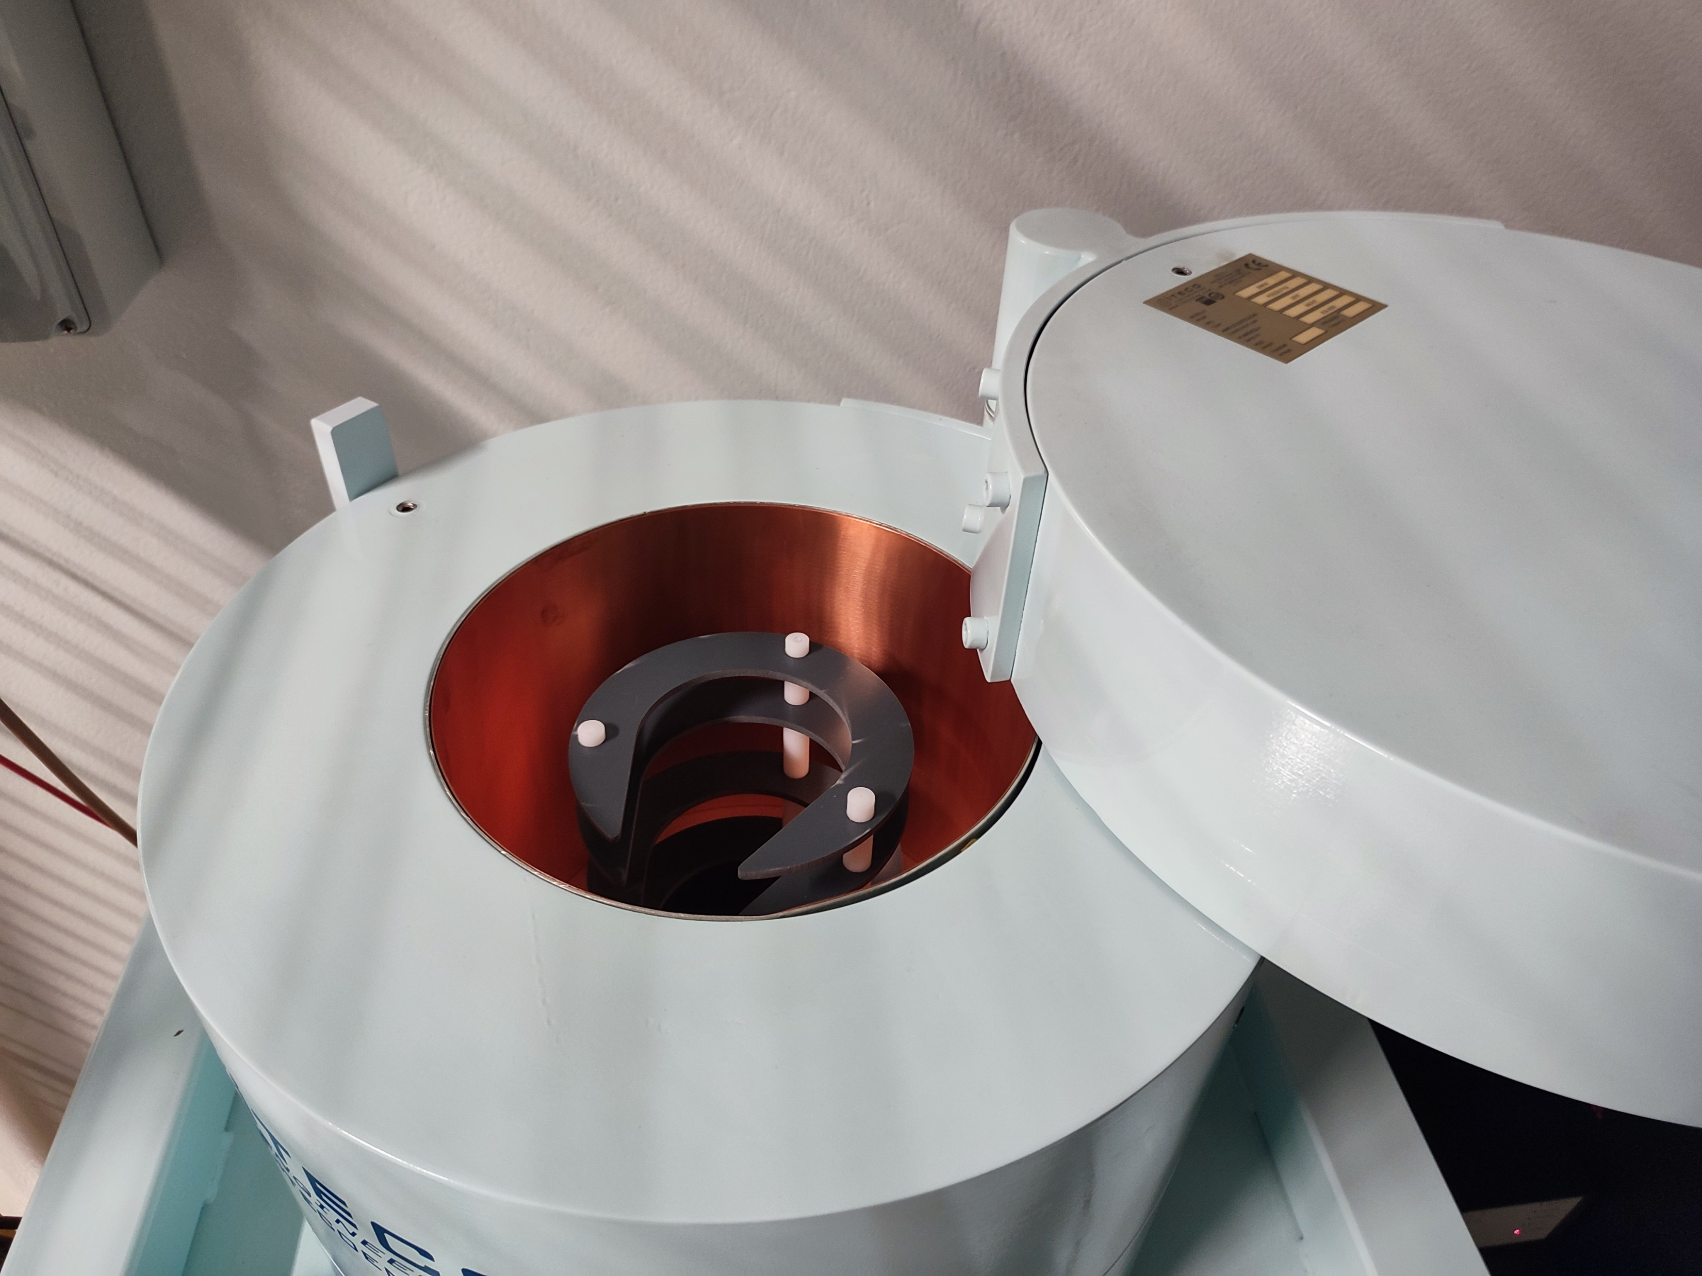
Cross section measurements in ISOL-2
Experimental area for γ-spectrometry
plastic support that allows the positioning of the irradiated target at different distances from the HPGe
Cyclotron
liliana.mou@lnl.infn.it

Slide 10
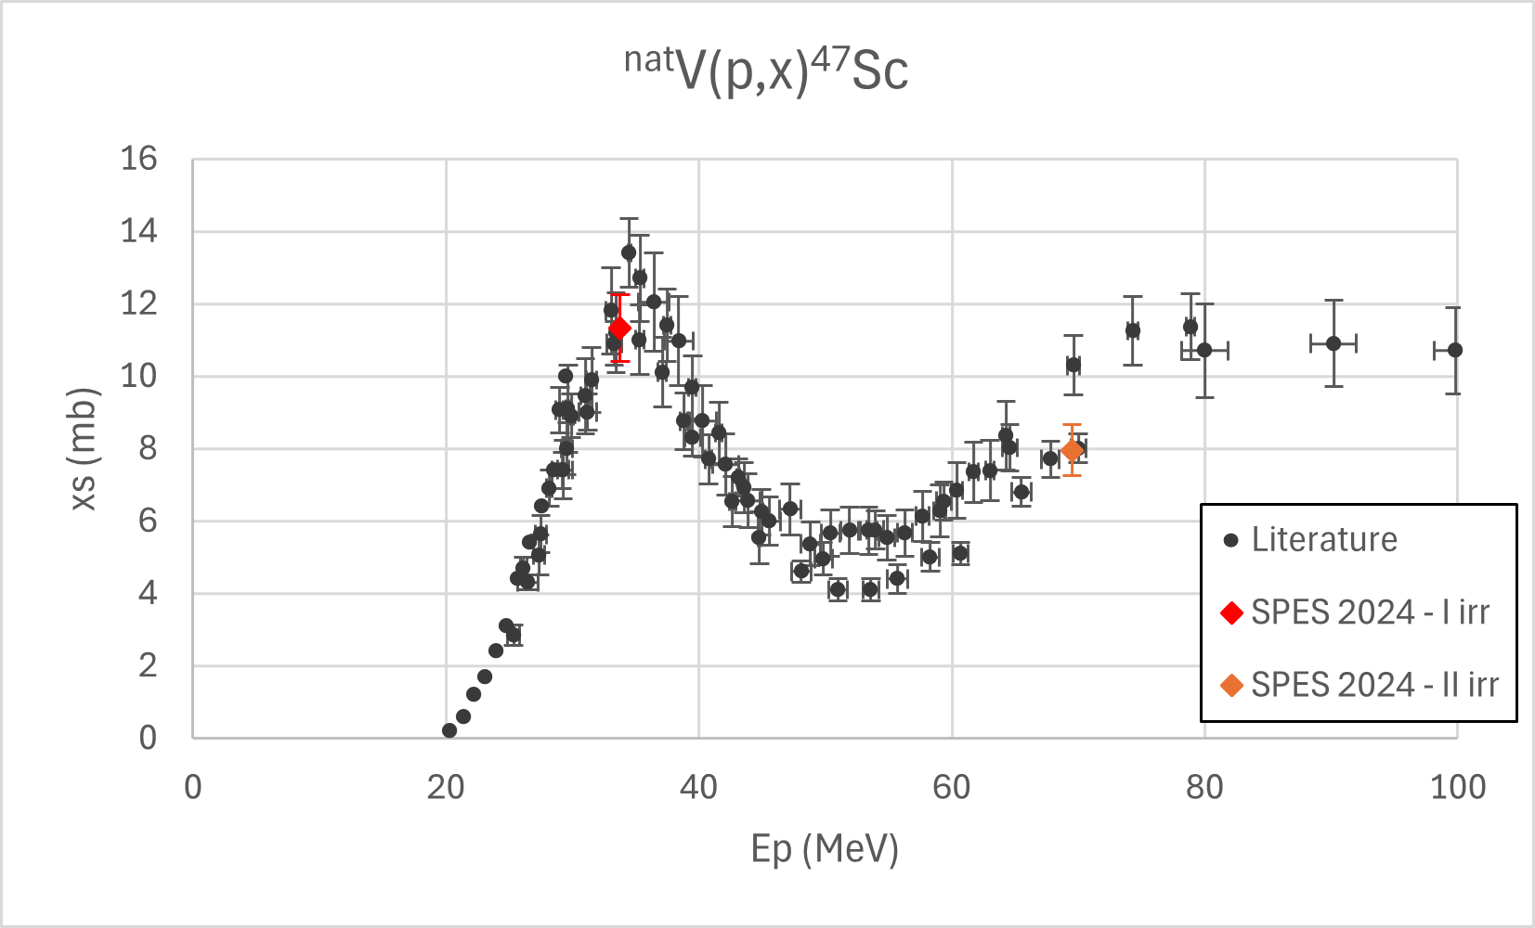

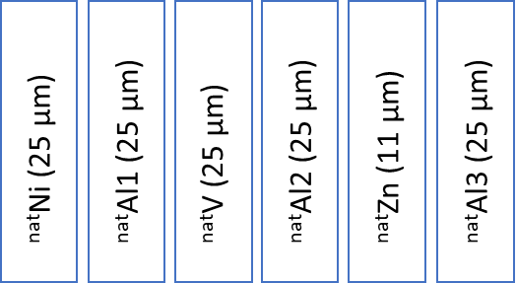
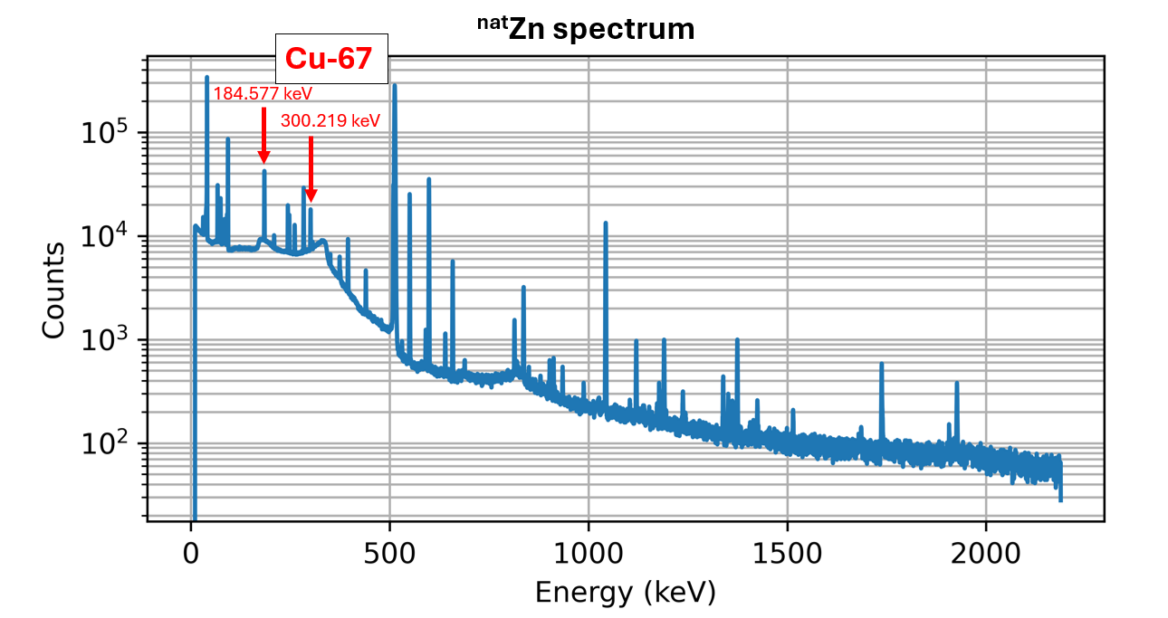
Commissioning experiments @ SPES
May-June 2024: First commissioning experiments @SPES!
3 irradiation runs to extract info on the beam current at
35, 50, and 70 MeV proton beam energies
1° and 2° Irradiation stacked-foils target composition
3° irradiation stacked-foils target composition:
^{nat}Zn foil added to detect ⁶⁷Cu

Slide 11



















LARAMED projects and future works @LNL
Research lines | Project name (years)
Accelerator-Tc-99m alternative (direct) production route through hospital cyclotrons | APOTEMA (2012-2014) TECHNOSP (2015-2017)
CRP on“Alternative, non HEU-based, Tc-99m /Mo-99 supply” | IAEA CRP (2011-2015)
Alternative Cu-64/Cu-67 production for theranostic application | COME (2016)
Alternative Sc-47 production for theranostic application | PASTA (2017-2018)
CRP on “Radiopharmaceuticals Labelled with New Emerging Radionuclides” Cu-67, Re-186, Sc-47” | IAEA CRP (2016-2019)
High Power Target concepts R&D (^{64/67}Cu) | TERABIO (2016-2019)
High intensity vibrational powder plating | E_PLATE (2018-2019)
Multimodal pET/mRi Imaging with Cyclotron-produced Mn-52/51 and stable paramagnetic Mn iSotopes | METRICS (2018-2020)
Research on emerging Medical radIonuclides (Sc-47 and Tb-xx) from the X-sections | REMIX (2021-2023)
magnetron sputtering ctclOtron TargEt Manufactoring | TOTEM (2021-2022)
Solid Target Dissolution System | STarDiS (2023)
^{67/64/61}CU PRoductionand Use in Medicine –Target Technology Development | CUPRUM-TTD (2023-2025)
Accelerator-based Production of tHeranostic radionuclides Investigations on Terbium-155 | APHRODITE-155 PRIN PNRR (2024-2025)
Cross section investigation of medical radionuclides (⁴⁷Sc, ^{67/64}Cu, ^{1xx}Tb) | SPES_MED (2025-2027)
National collaborations
Padua University
INFN Padova
CNR Milan
Ferrara University
INFN Ferrara
LENA lab. Pavia
Milan University
INFN Milan
INFN Pavia
IOV
Pavia University
Sant’Orsola Hospital (BO)
Sacro Cuore Don Calabria Hospital (VR)
International collaborations
IAEA
Univ. Of Winsconsin, Madison (USA)
Progetti in corso
ARRONAX, Nantes (France)
liliana.mou@lnl.infn.it

Slide 12

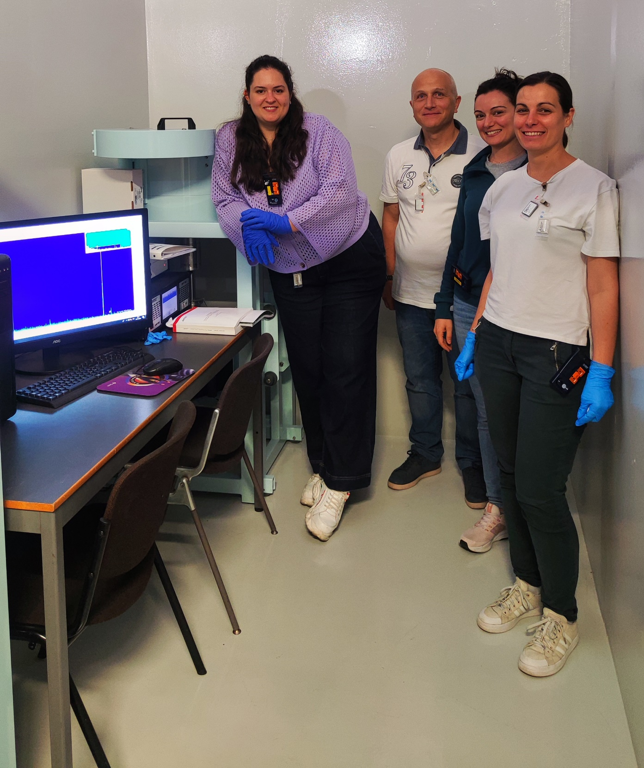

Grazie a tutto il personale del laboratorio per il lavoro di squadra che ci ha permesso di ottenere questo primo risultato!
…ed è solo l’inizio!

