Slide 1
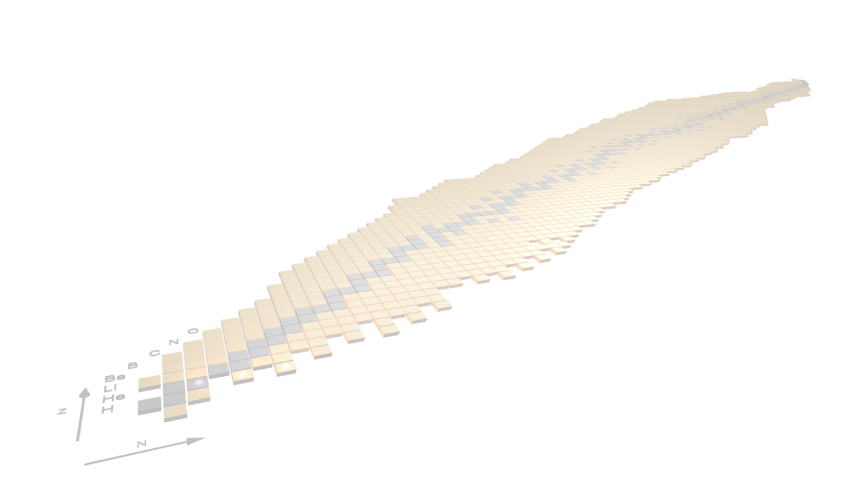

Recent results from the AGATA campaign at LNL

Slide 2

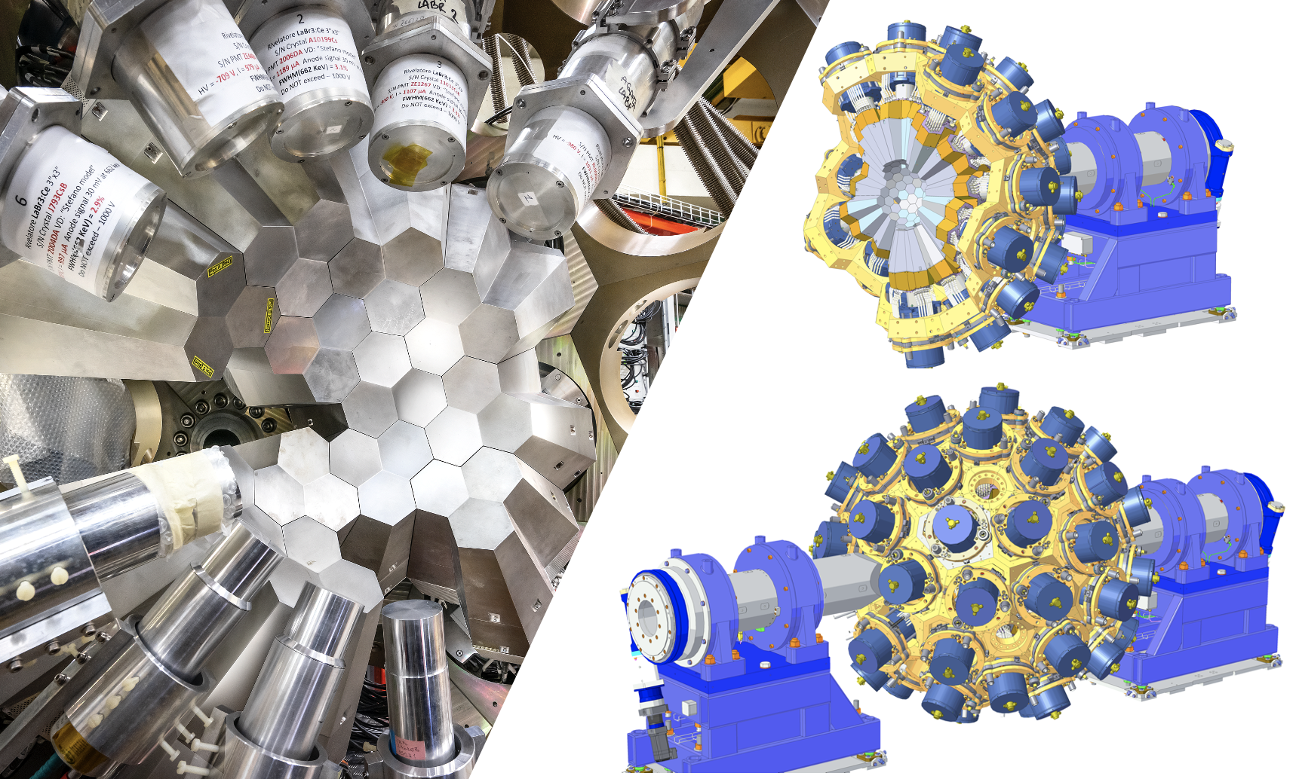
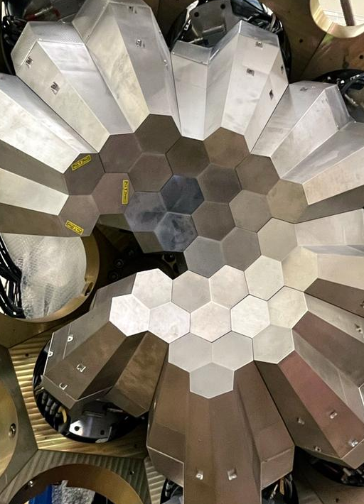
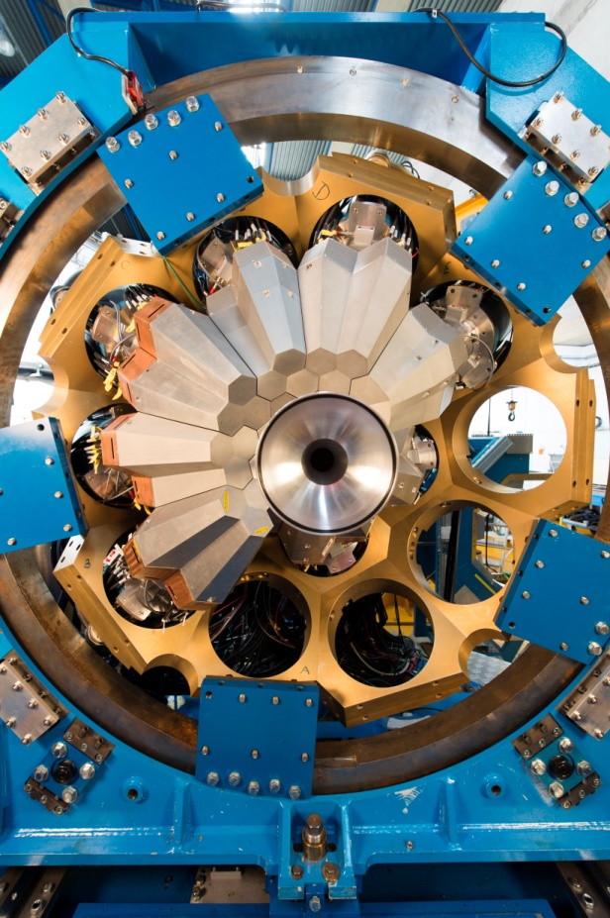
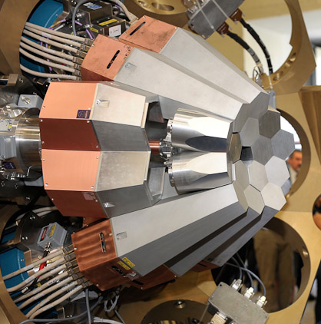
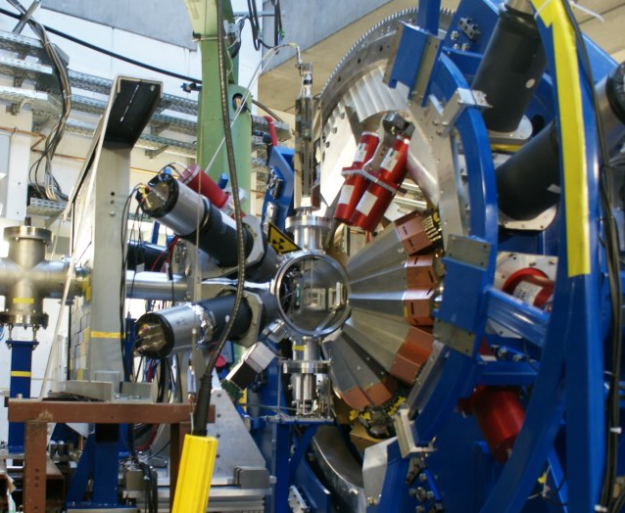
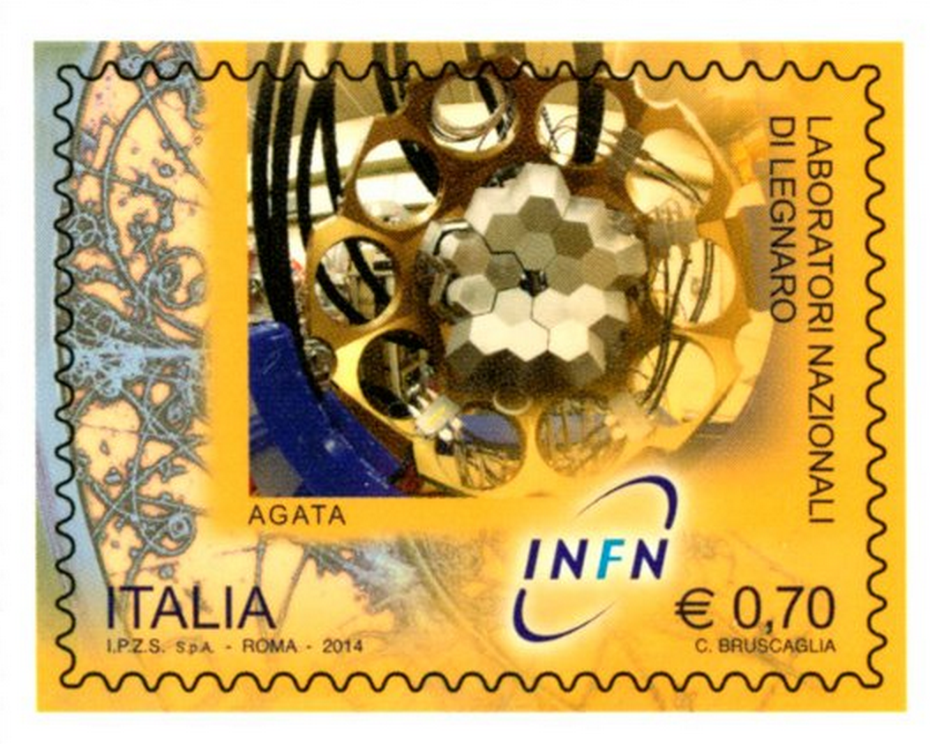
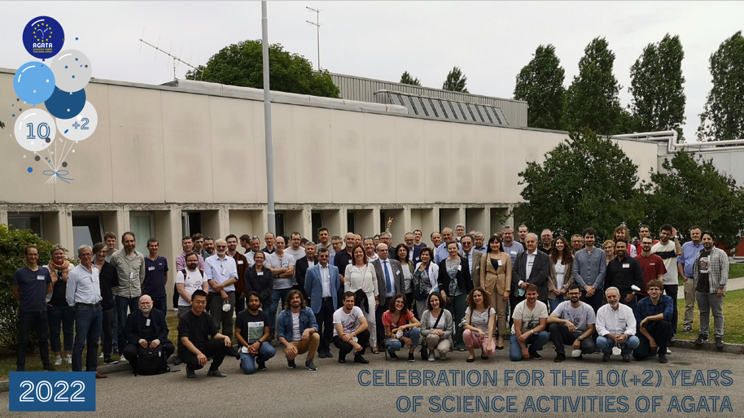
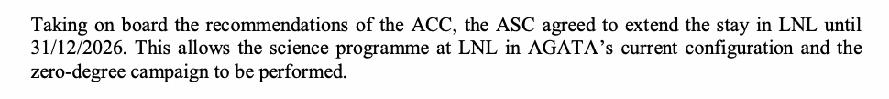
The AGATA 𝛾-ray tracking array
European collaboration towards a 4𝜋 array
Travelling detector array
AGATA@LNL
AGATA@LNL
AGATA@GSI
AGATA@GANIL
Celebration 10(+2) years
M. Zielinska physics coordinator
2009
2011
2014
2021-2026
Phase 1
Phase 2

Slide 3
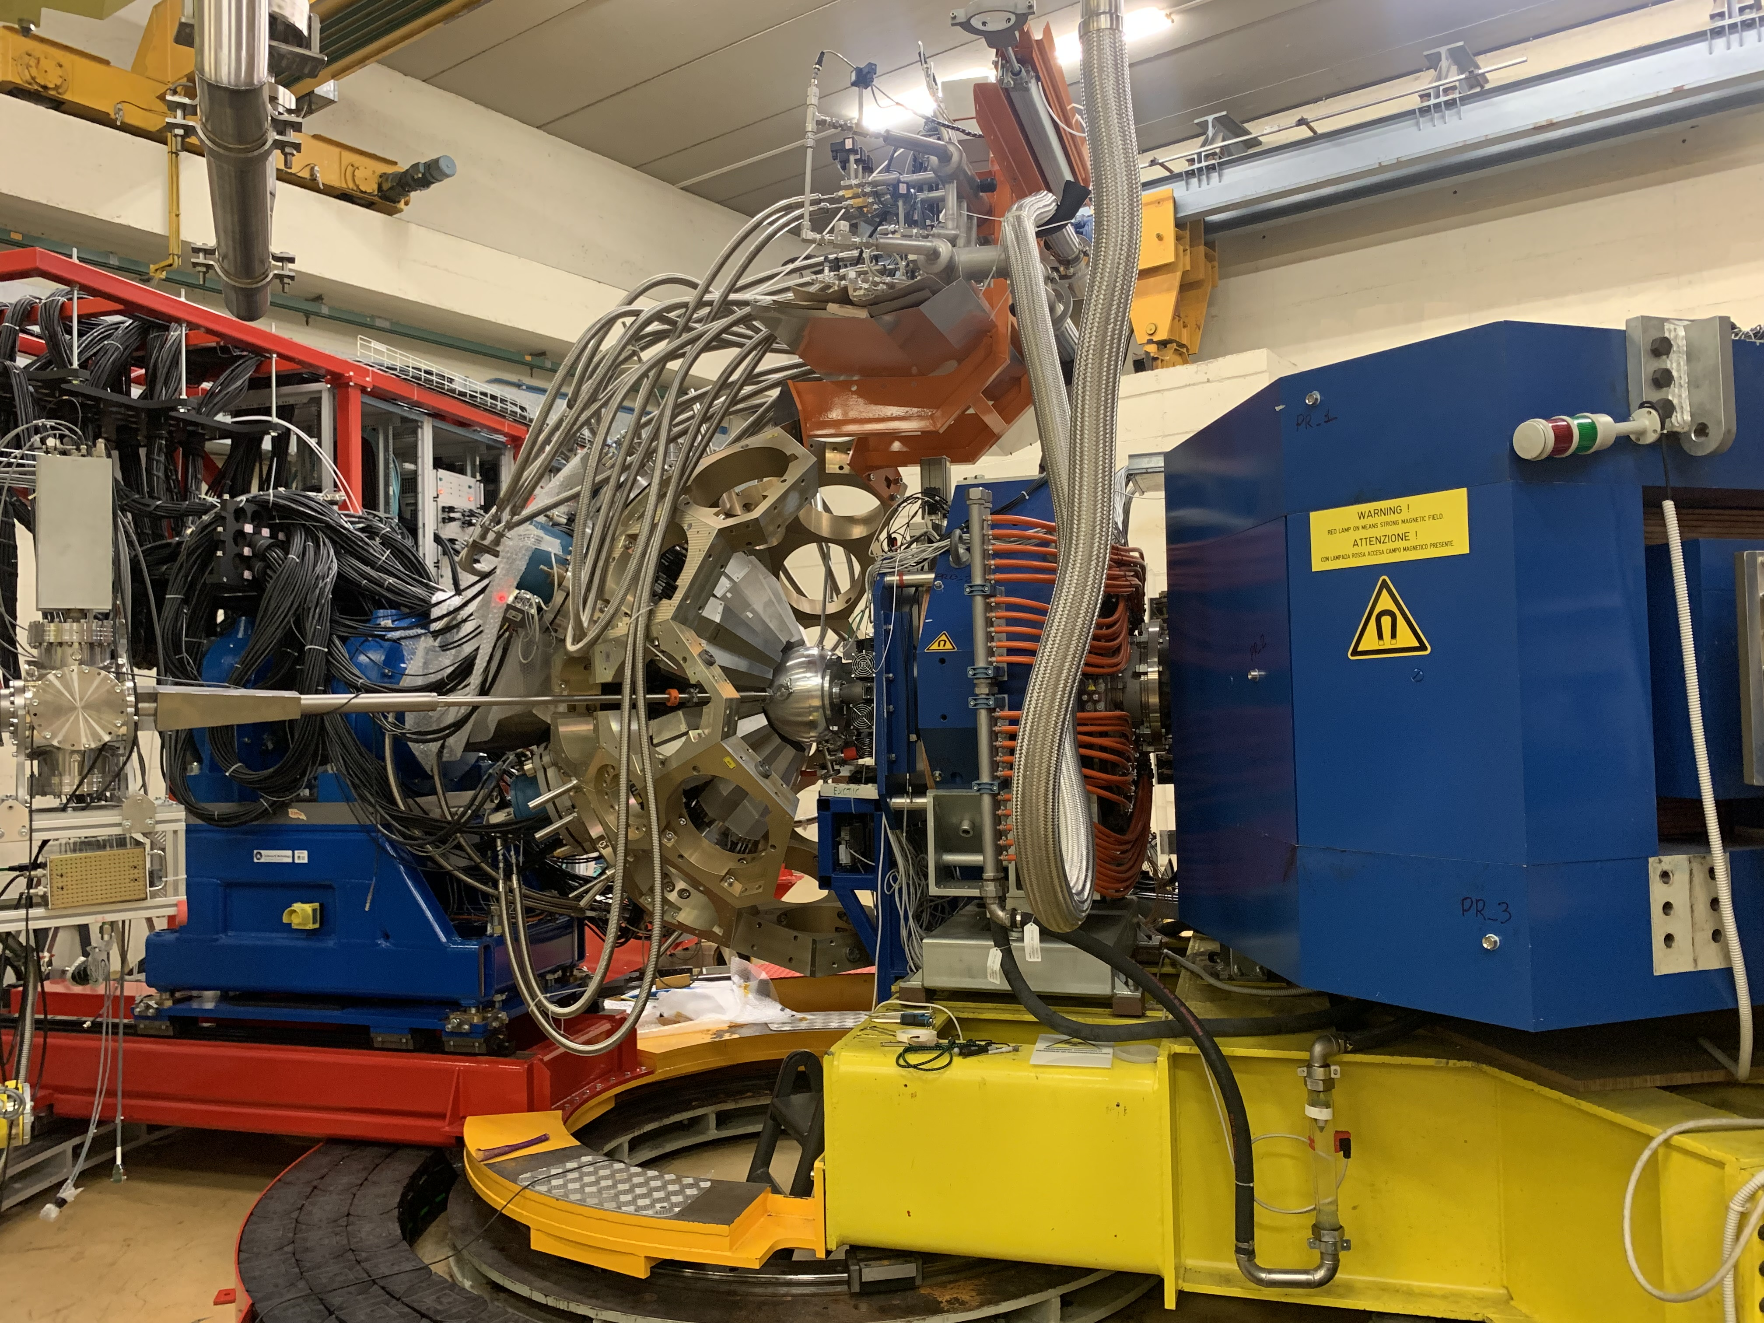
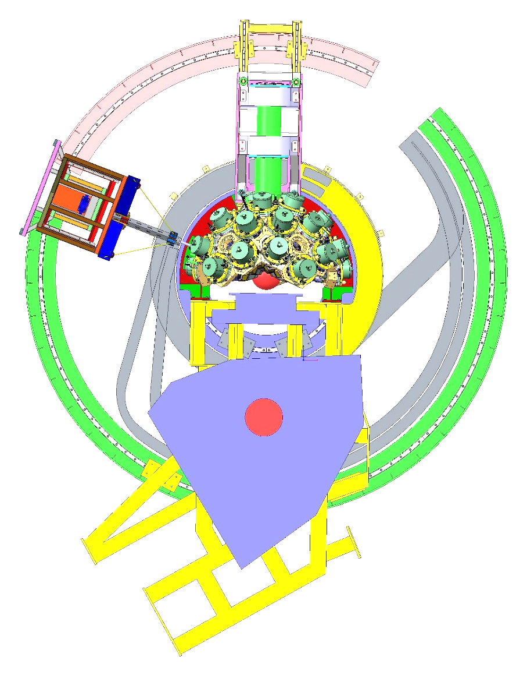
Installation at LNL
AGATA coupled with PRISMA
PRISMA
Current configuration

Slide 4
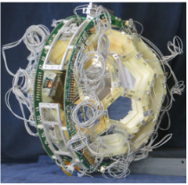
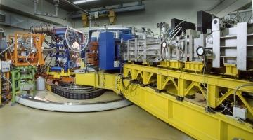
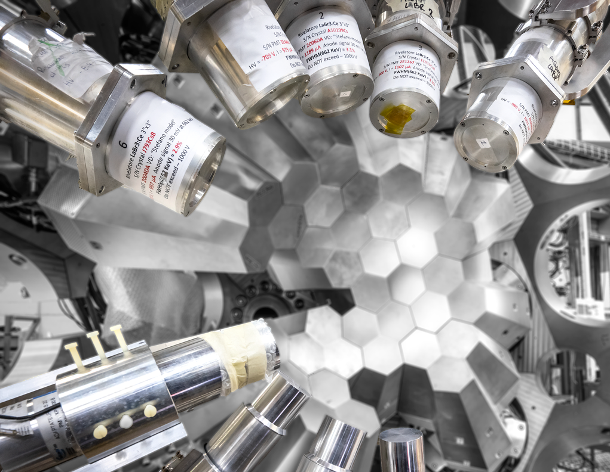
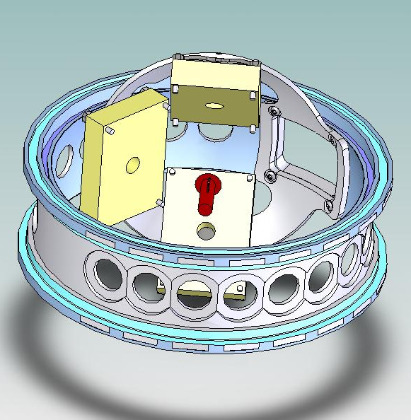
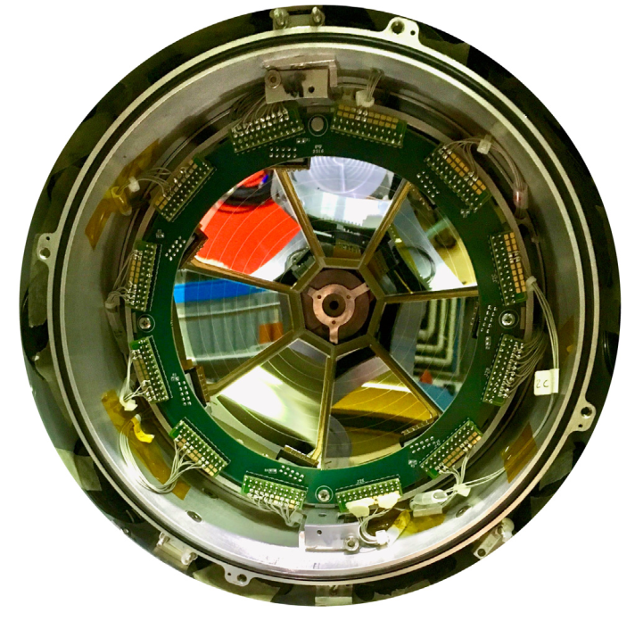
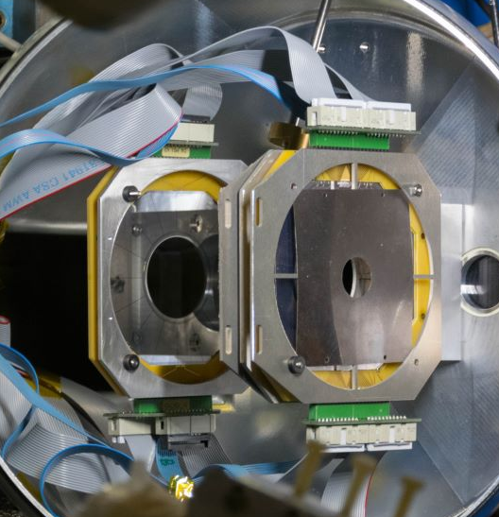
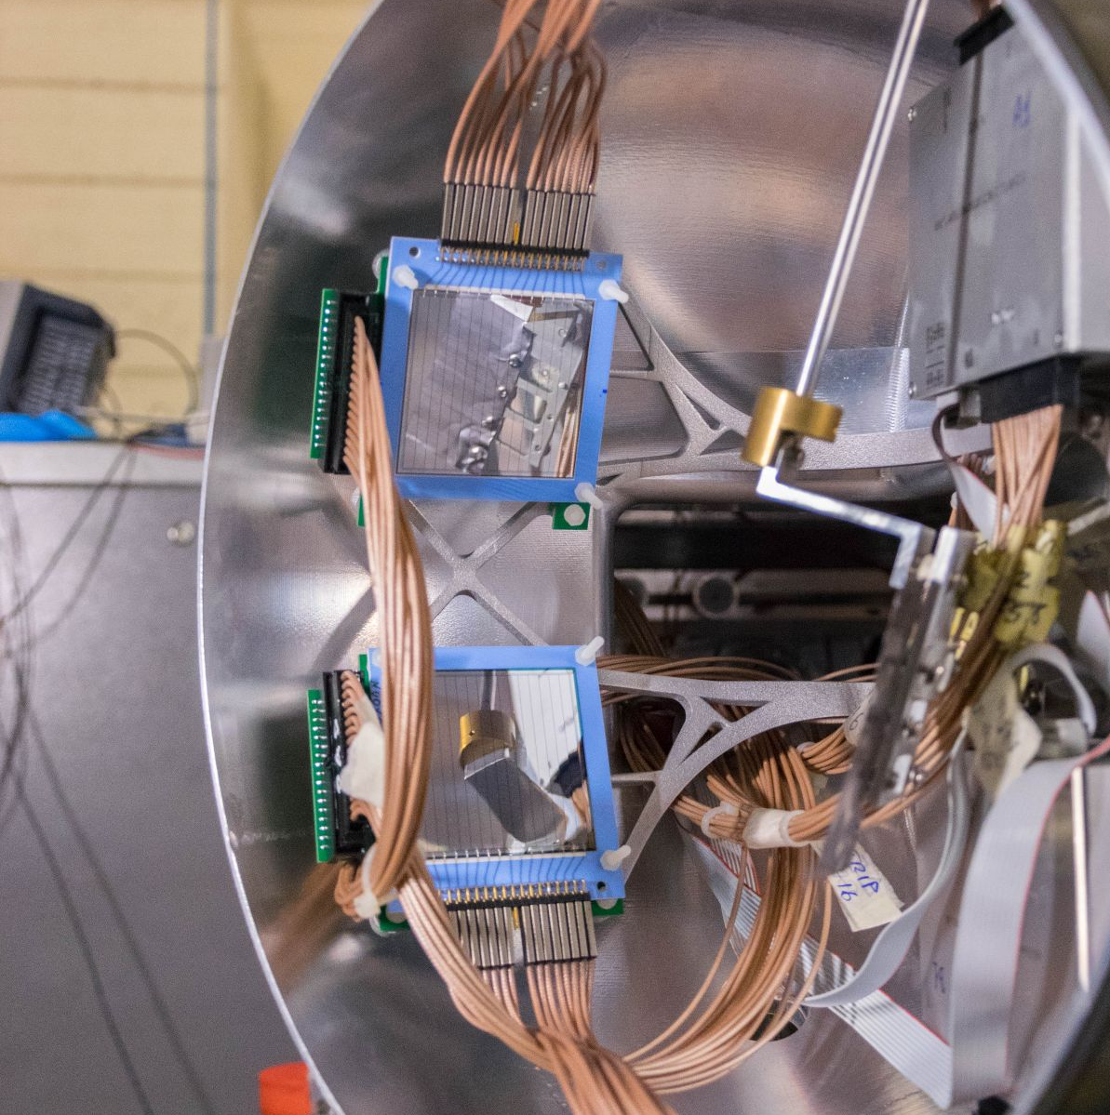
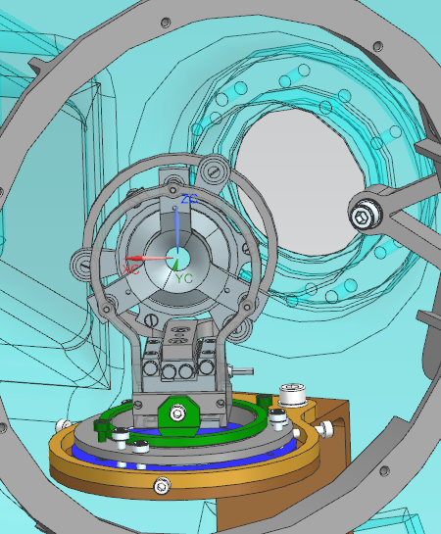
Complementary detectors for AGATA in coupling with PRISMA configuration
PRISMA
heavy ions
LaBr
γ-rays, fast timing
EUCLIDES
light charged particles
DANTE
heavy ions
OSCAR
light charged particles
PLUNGER
Lifetime measurements
SPIDER
light and heavy ions
SAURON
light charged particles

Slide 5
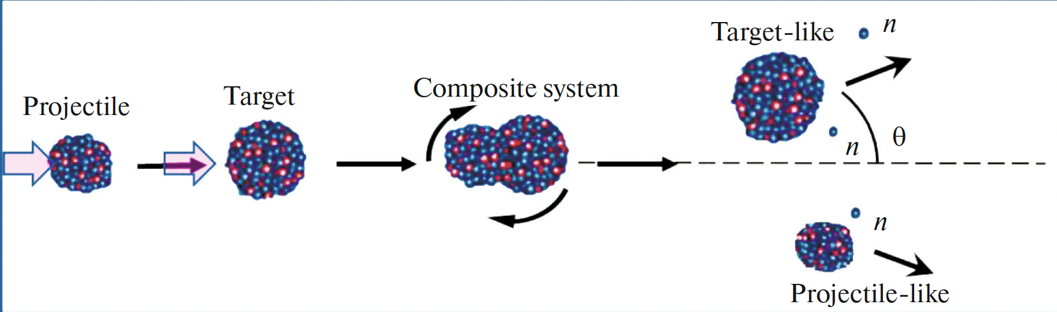
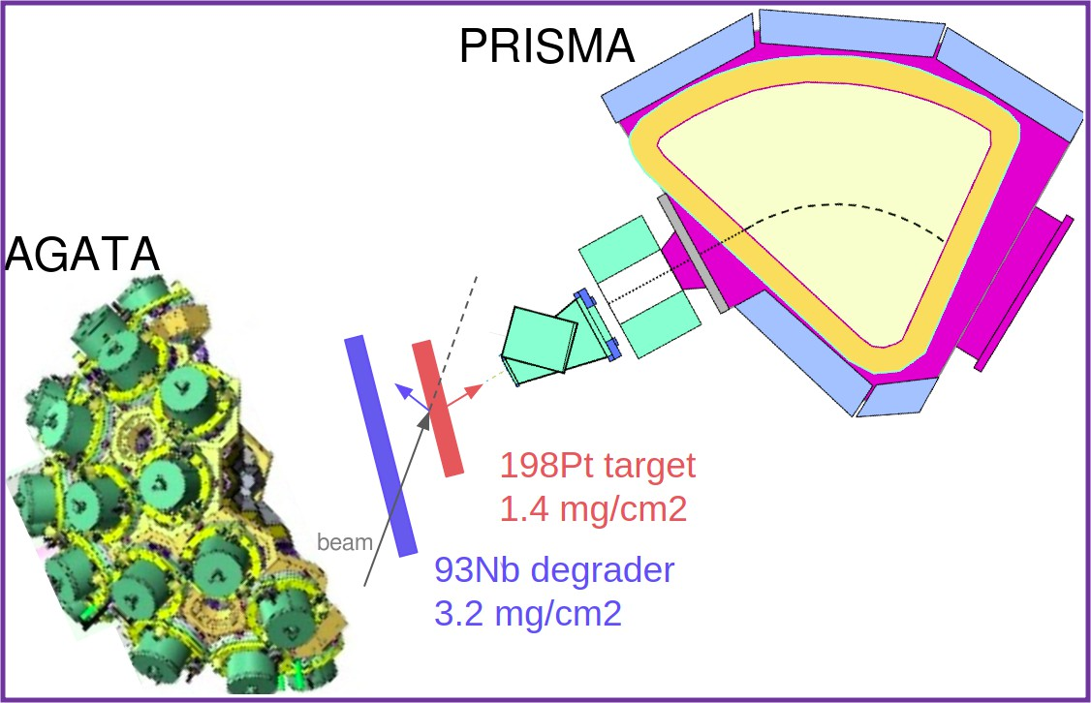
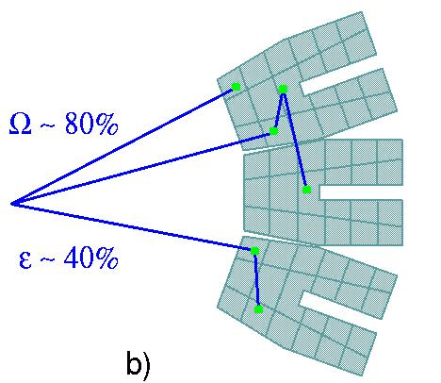
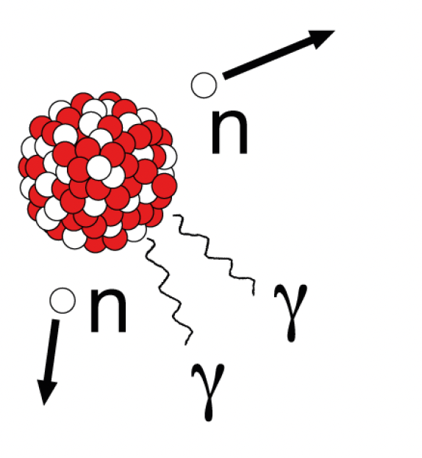
Typical 2024 experiments with AGATA
In a typical AGATA-PRISMA experiment we make a nuclear reaction of a beam on a target
^{234,236}U
⁴⁸Ca
²³⁸U
^{50,52}Ca
Neutron/proton exchange
Gamma rays emitted by the reaction products are detected by AGATA
AGATA
Reaction products are detected in PRISMA and identified event-by-event

Slide 6
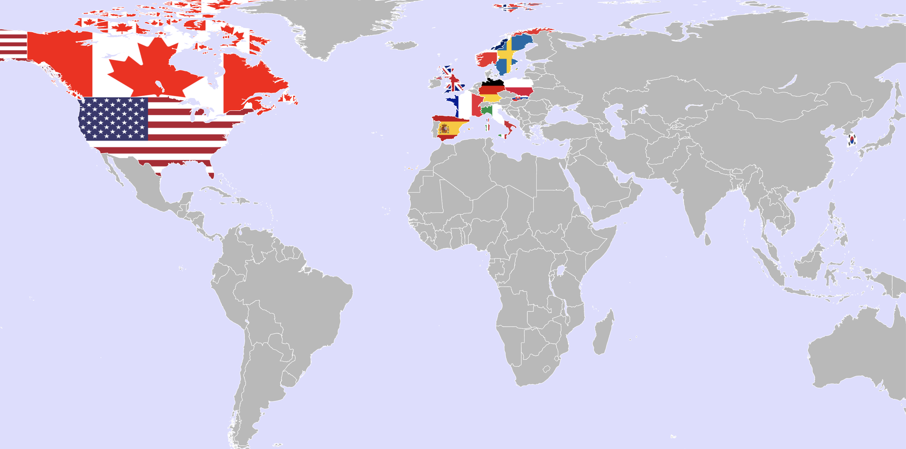
AGATA Users’ institutions in 2024

Slide 7
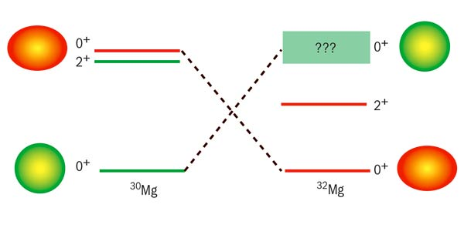
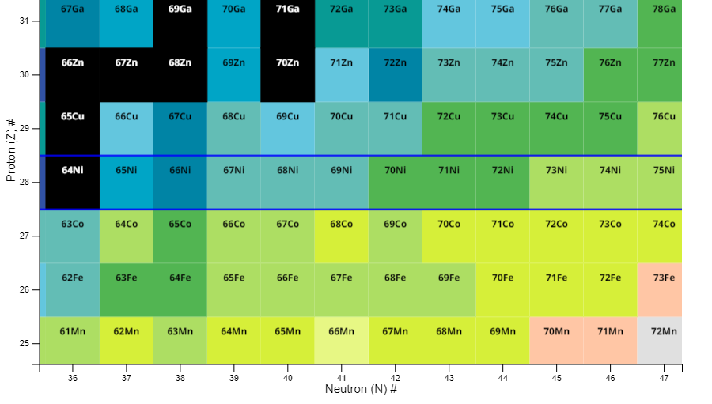
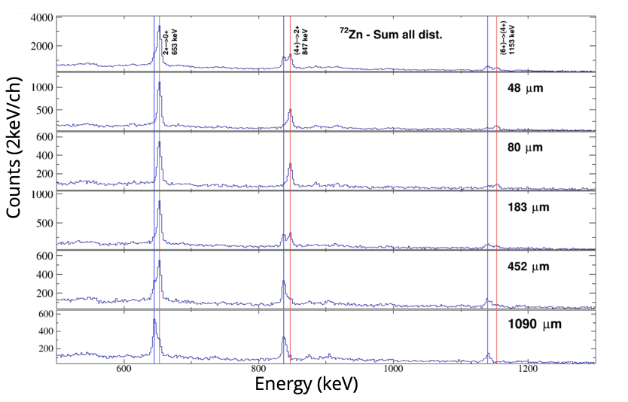
1. Exploring the structure inversion near ⁷⁰Zn
⁷⁰Zn @ 470 MeV onto ²³⁸U, AGATA- PRISMA, RDDS
In certain nuclei, the normal structure is inverted compared to the standard one
Gamma rays from AGATA will clarify the changing of nuclear structure
Spokepersons: R.M.Pérez Vidal, S.Bottoni, E.Sahin, A.Illana, J. Benito, J. Ljungvall, M. Doncel, A.Gadea, L.M. Fraile

Slide 8
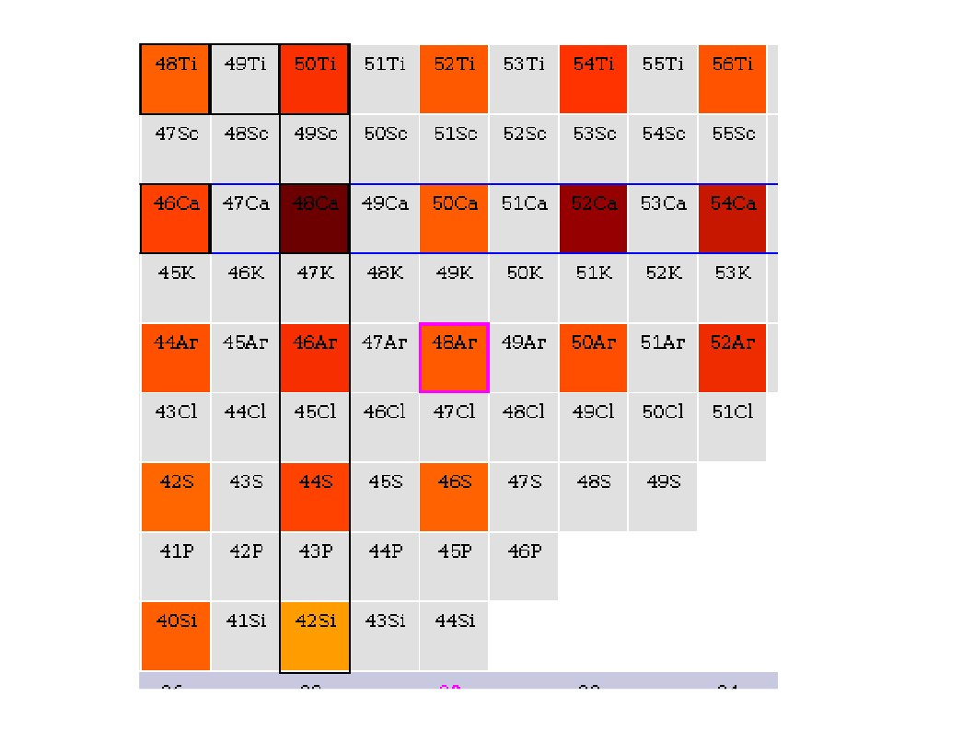
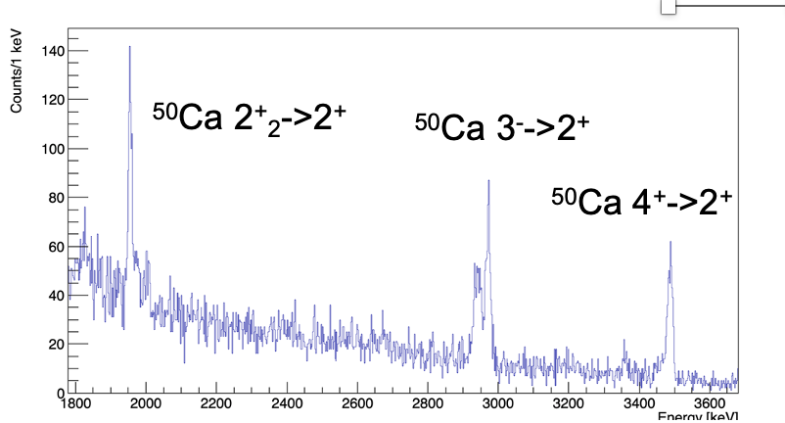
2. Exploring nuclear forces around ⁴⁸Ca
⁴⁸Ca @ 305 MeV onto ²³⁸U
AGATA-PRISMA
Gamma rays from ^{50,52}Ca will allow to measure lifetimes of nuclear states for the first time
Intense and stable ⁴⁸Ca beam delivered by PIAVE-ALPI
Optimal performance of the AGATA-PRISMA setup
50Ca
52Ca
Z=28
𝛾 rays from AGATA
46Ar
48Ar
Spokepersons: C. Fransen, A. Gottardo, D. Mengoni,
N=28
E(2⁺) = 700 – 800 keV
E(2⁺) = 1000 – 1500 keV
E(2⁺) > 2500 keV

Slide 9
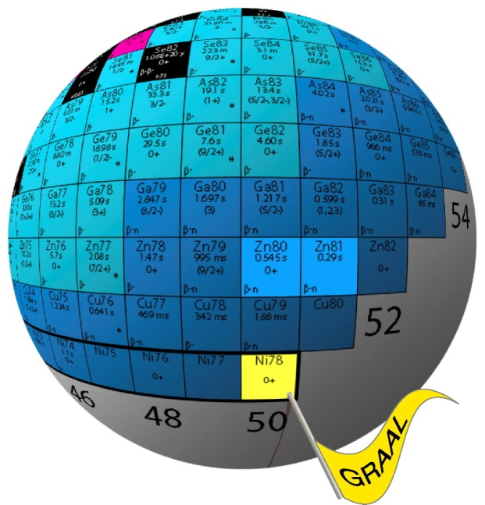
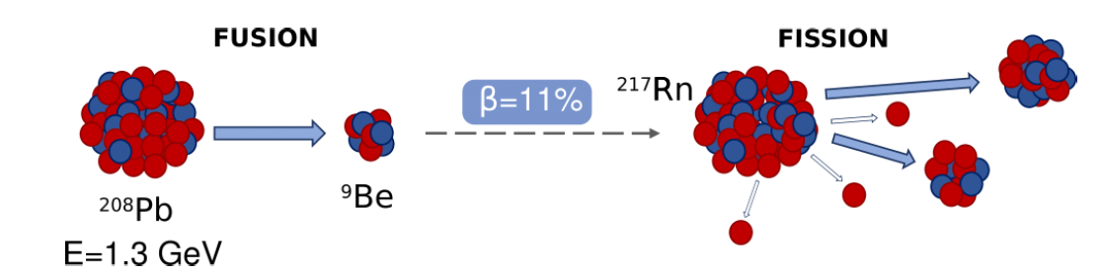

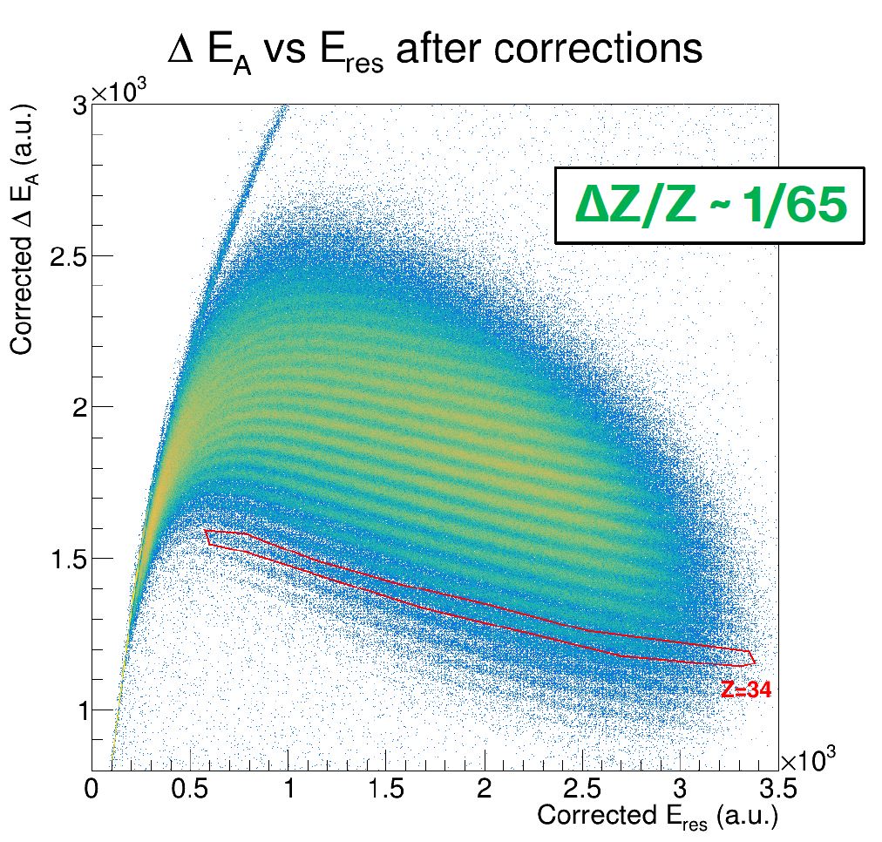
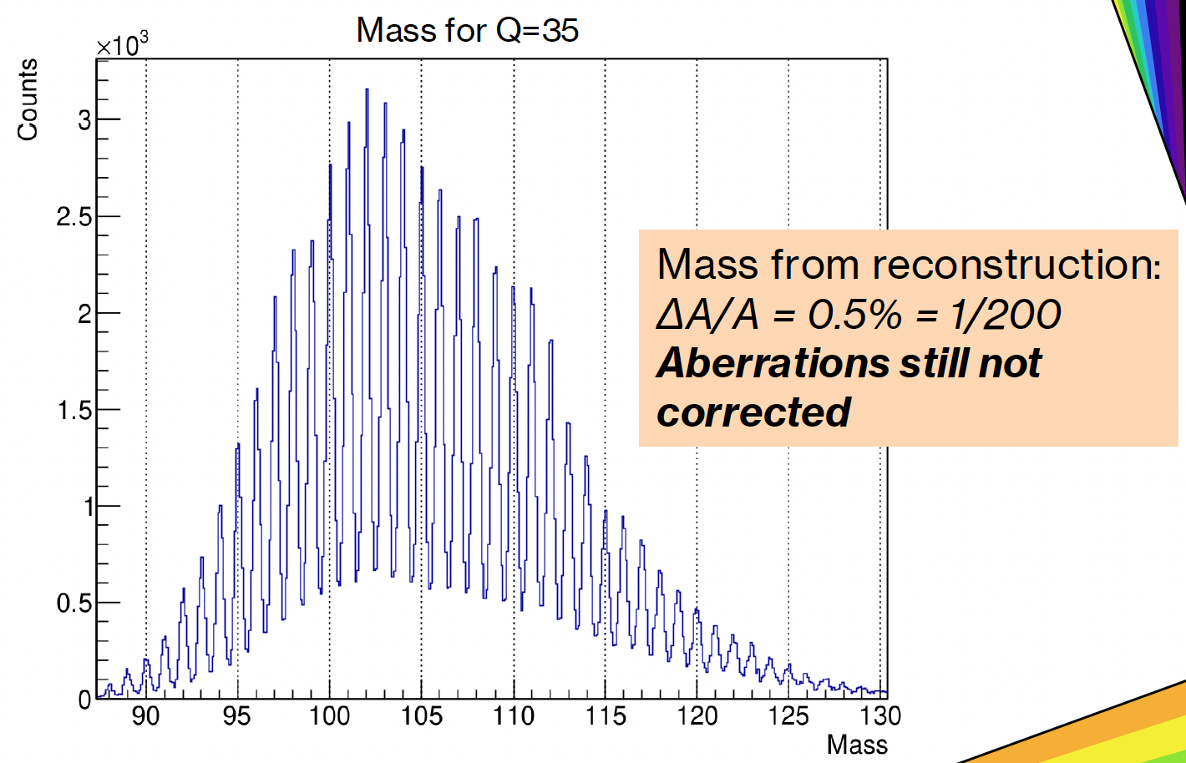
Plans for 2025-2026
²³⁸U beams at 7 MeV/u from PIAVE-ALPI for fusion-fission and MNT reactions
- spectroscopy of medium spin states
- lifetimes of excited states
First experiment with ²⁰⁸Pb at 6 MeV/u onto a Be target
- spectroscopy towards ⁷⁸Ni for medium spin states
D. Verney
Spokepersons:
M. Caamano,
A. Gottardo,
J.J. Valiente-Dobon
Courtesy of D. Verney
F. Angelini PhD thesis

Slide 10
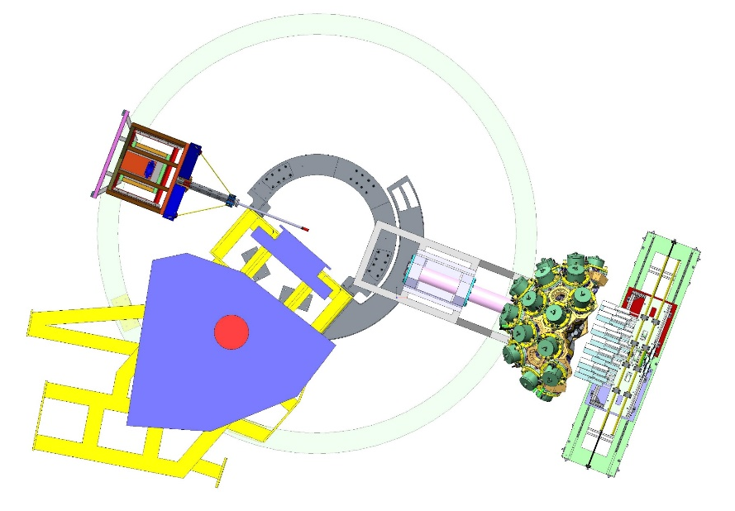
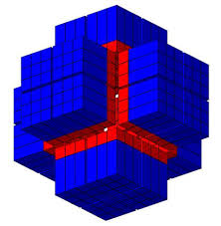
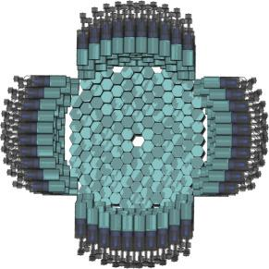
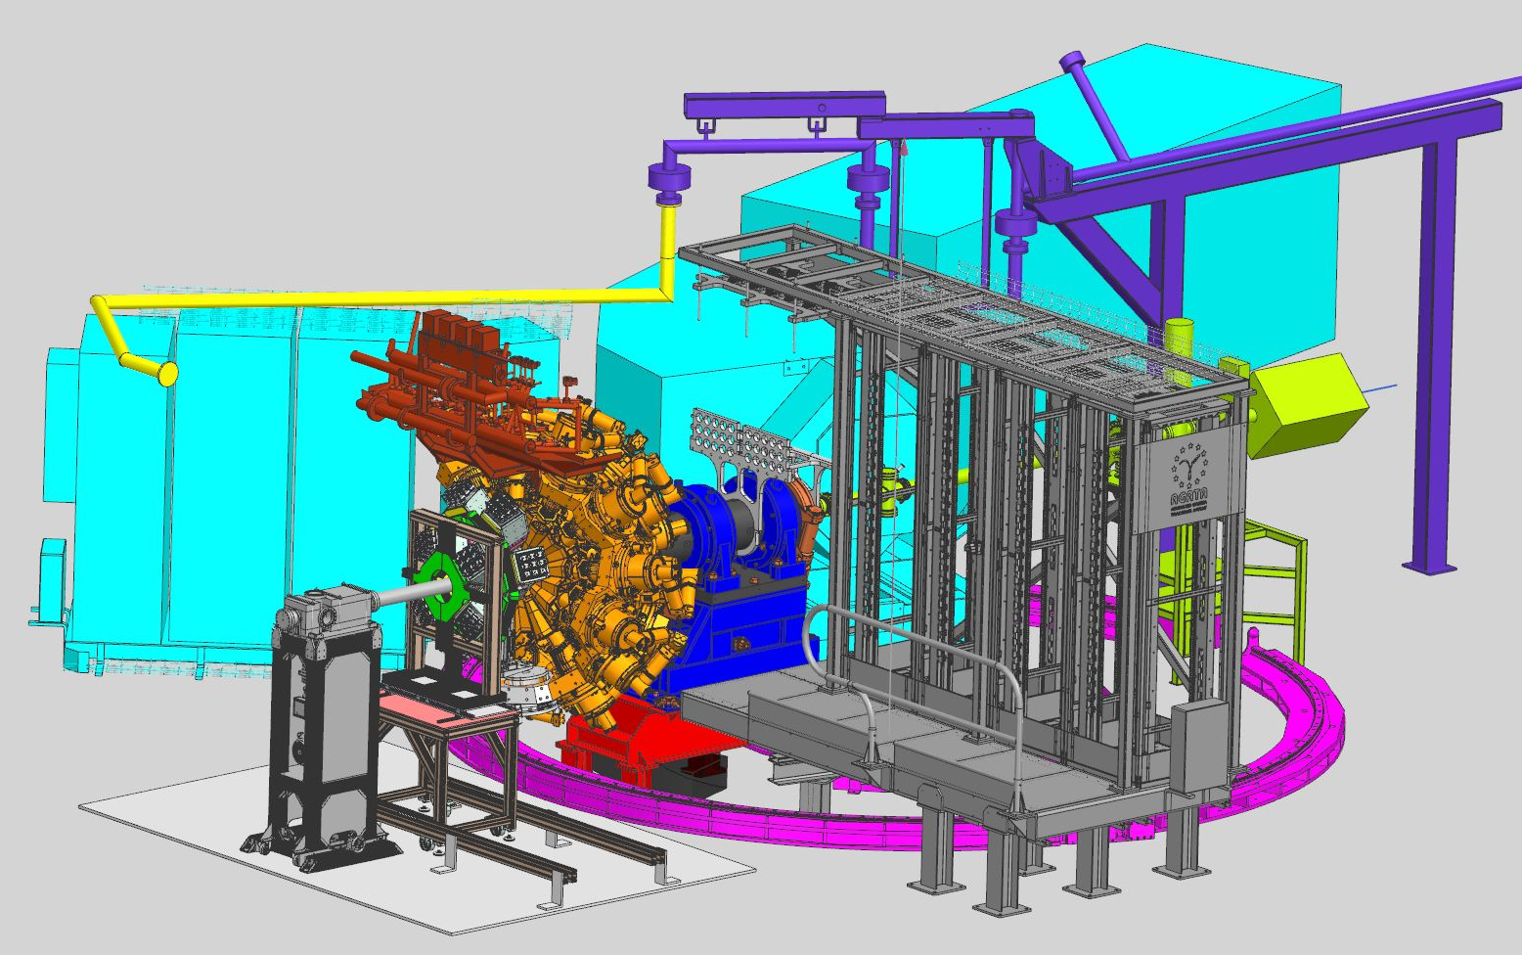
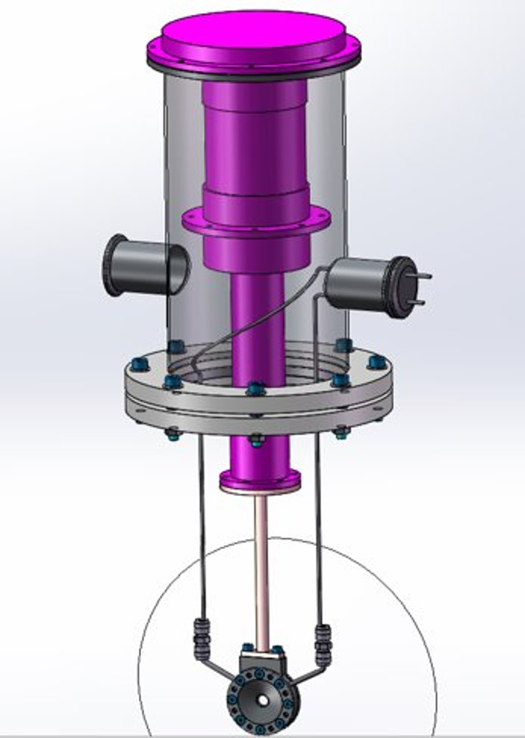
Agata @ zero degree (~ mid ’26-mid ‘28)
To be performed around 2026 after the Uranium campaign
PARIS
γ-rays
NEDA
neutrons
NEDA
neutrons
CTADIR
cryogenic target

Slide 11






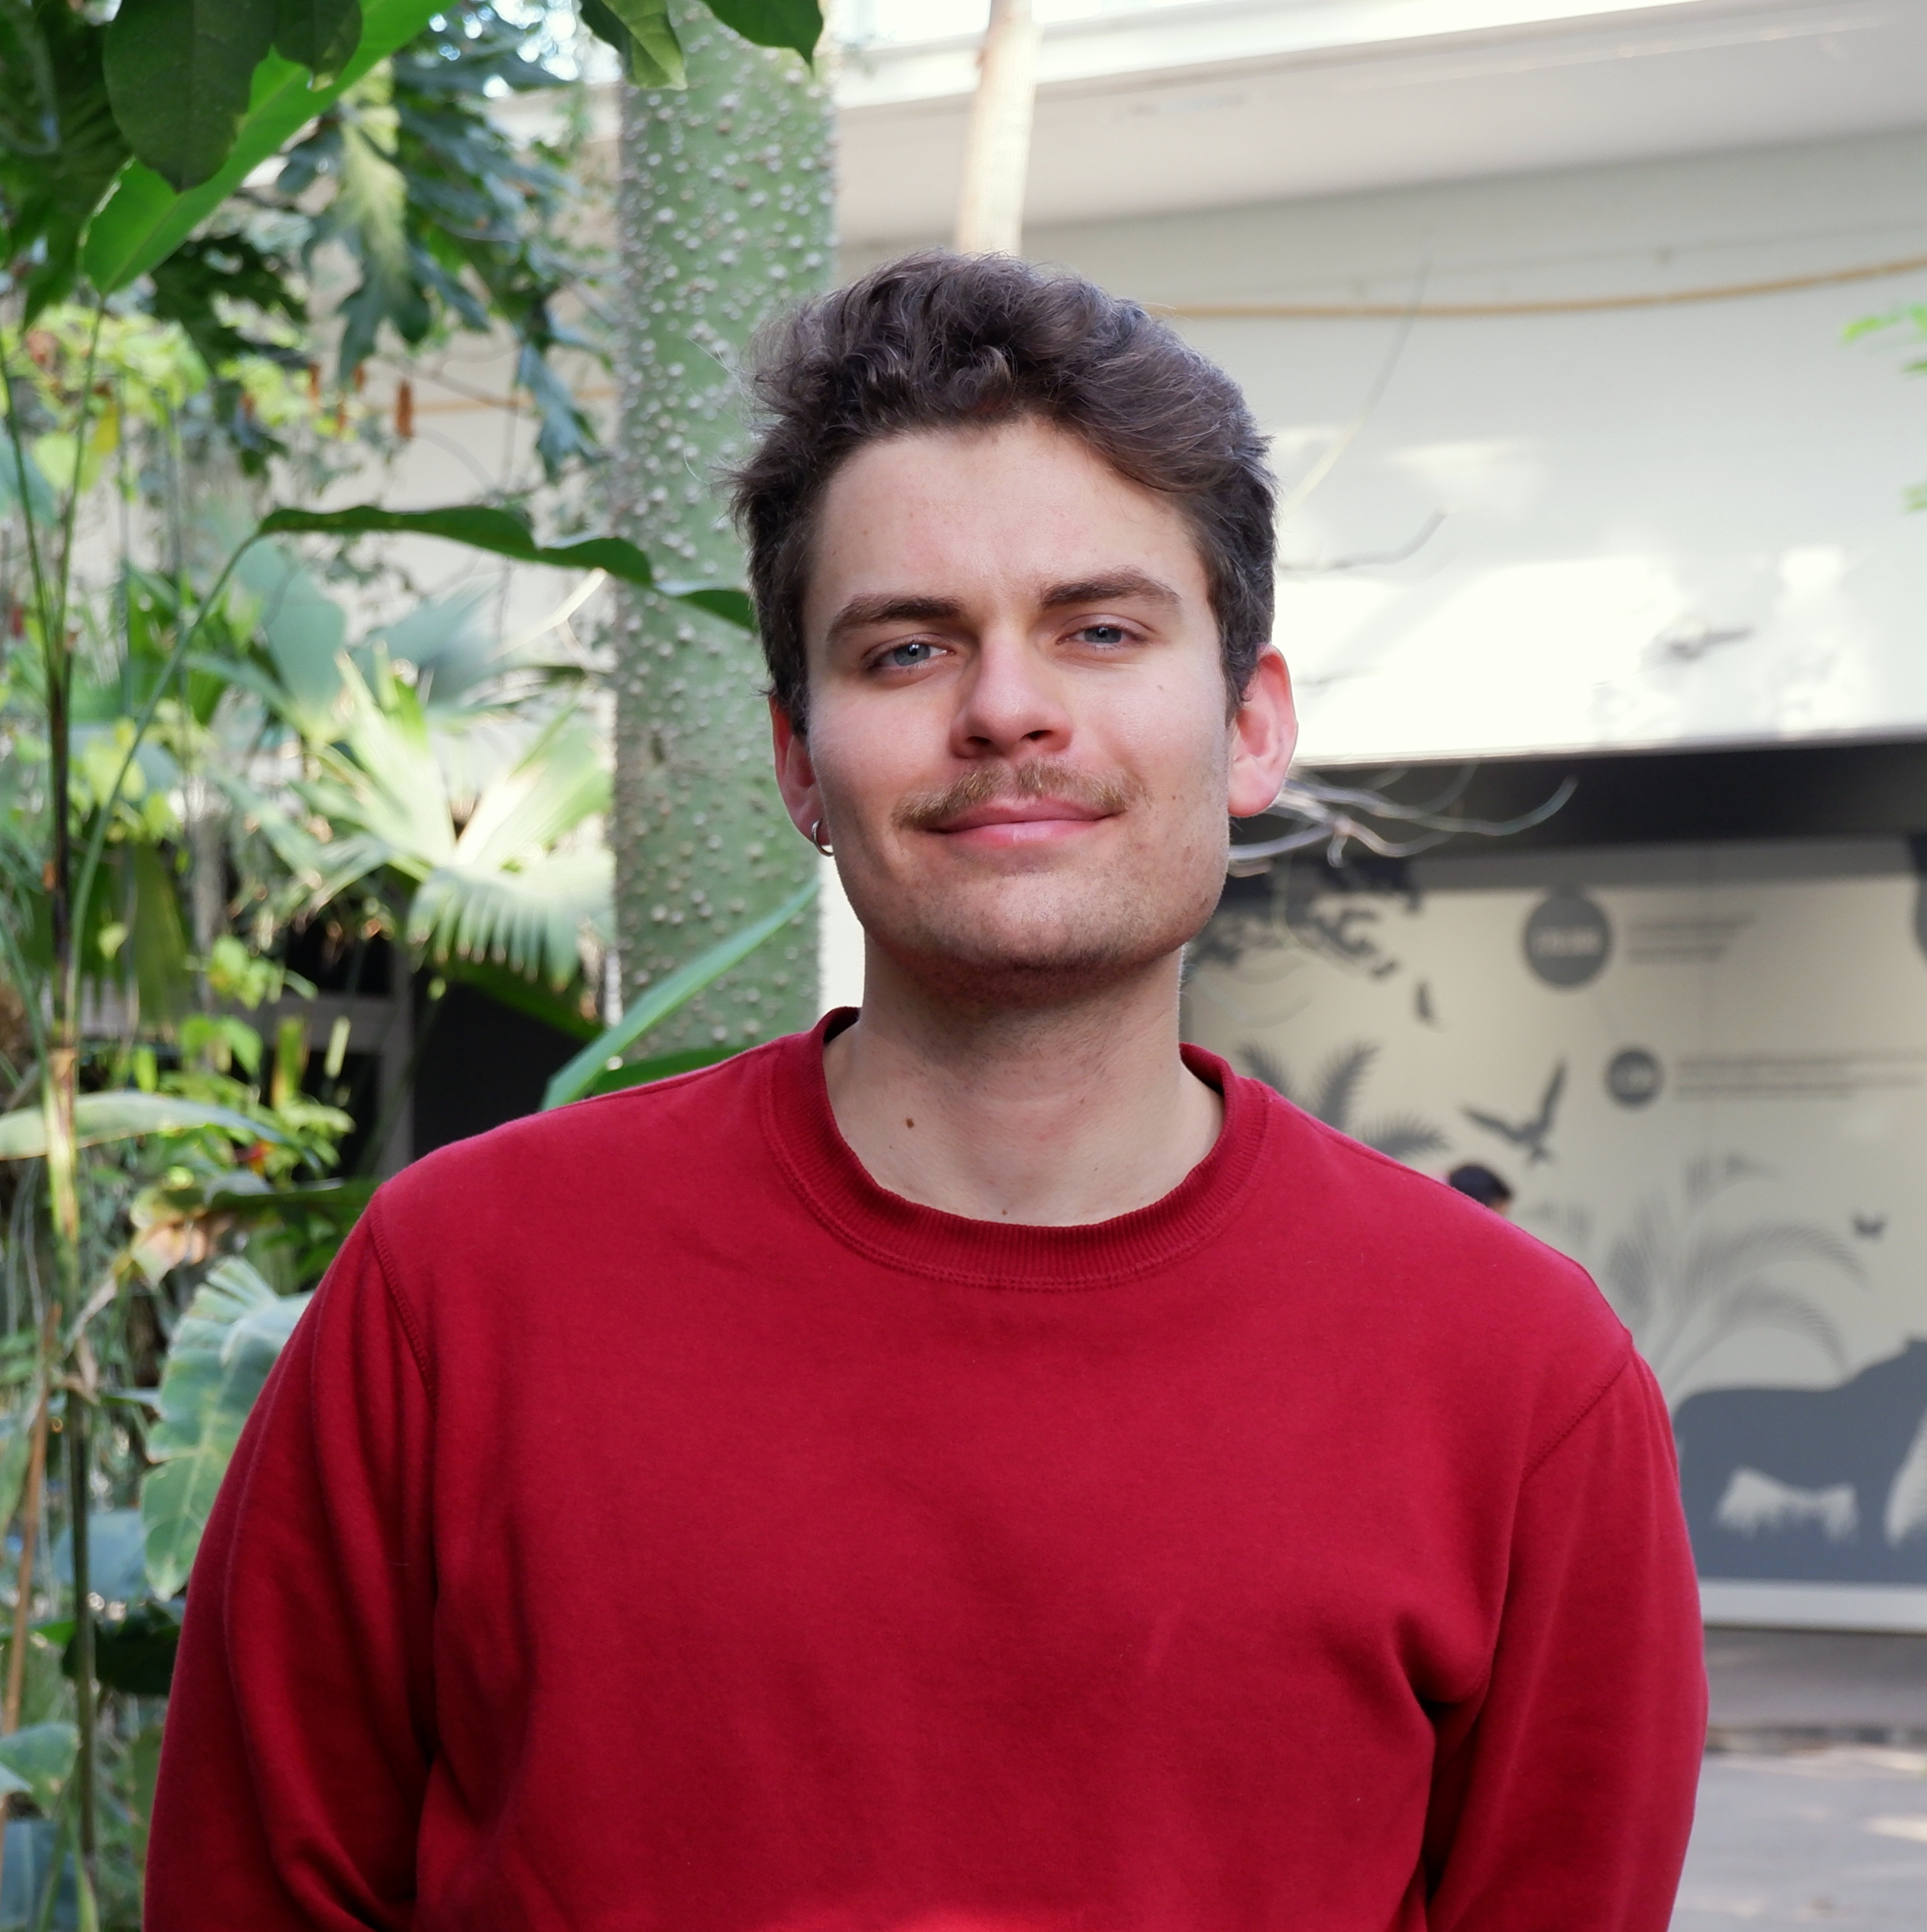
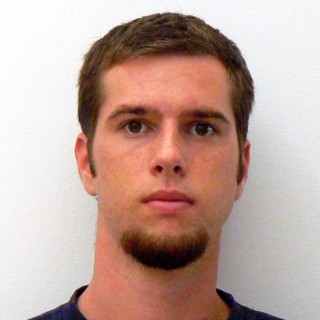





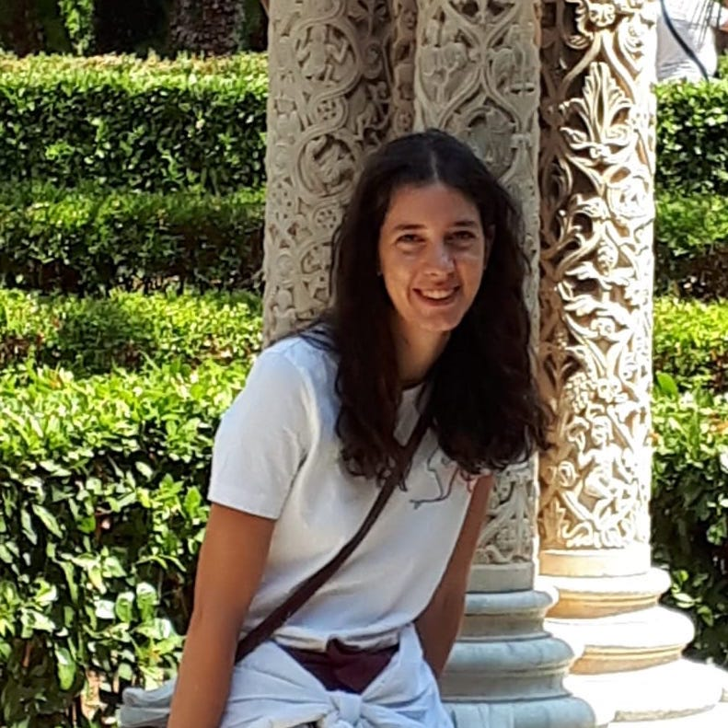
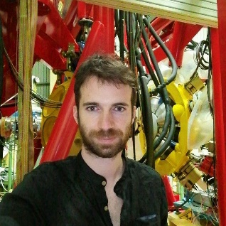
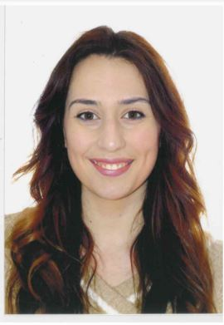




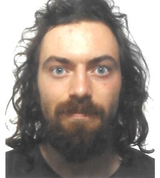








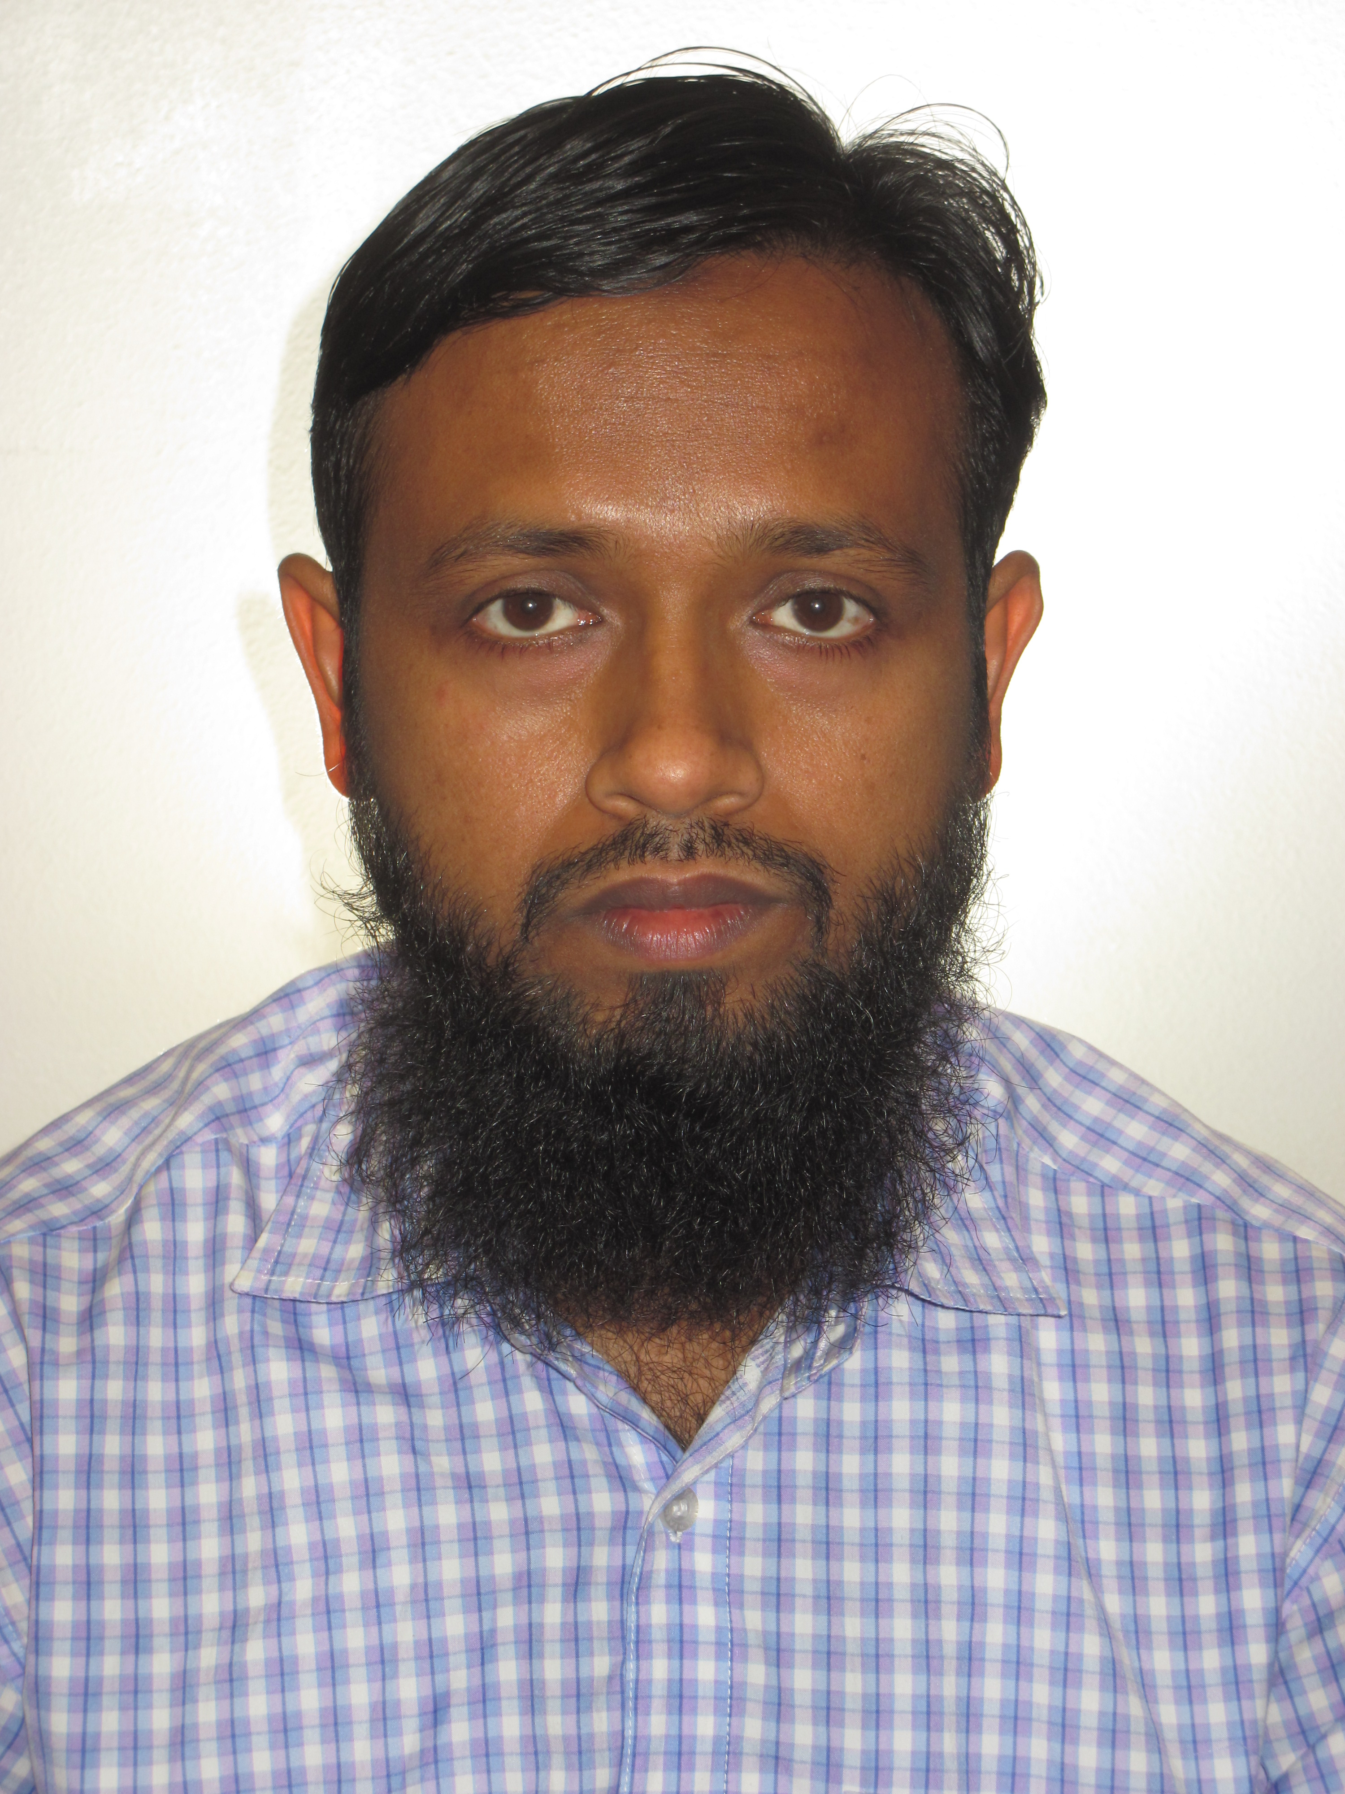

The young strength of AGATA@LNL: PhD, Postdocs
9 nationalities !

Slide 12

Laboratory for Underground Nuclear Astrophysics (LUNA)
Experiment located deep underground at Gran Sasso National Laboratories (LNGS)
The mission is to study charged-particle-induced nuclear reactions of astrophysical interest

Slide 13
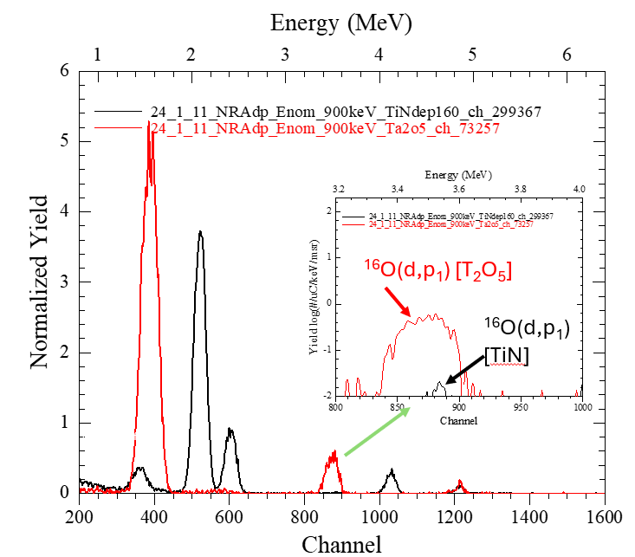
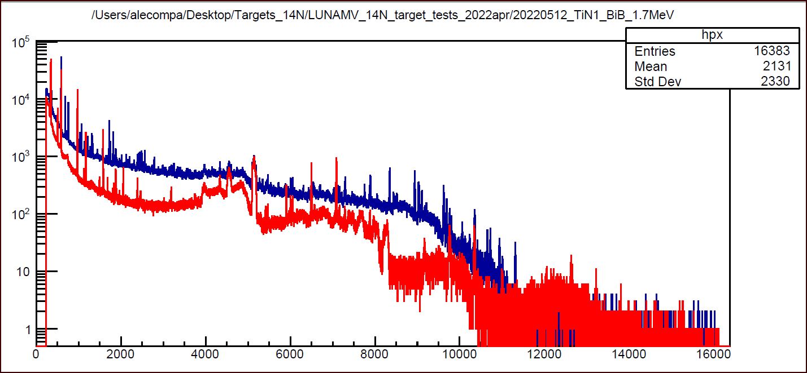
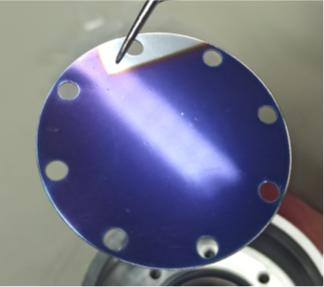
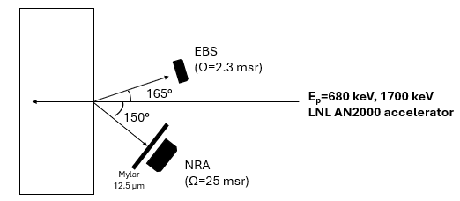
LUNA: highlights 2024
Intense activity at LNL at the AN2000 and CN accelerators (IBA characterization: p-EBS, α-RBS and (d,p) (p,α) NRA) and in the Laboratory of Materials (target deposition and backings preparation) for the campaigns at the Bellotti Facility and LUNA400 @LNGS:
¹⁴N(p,ϒ)¹⁵O: isotopically enriched targets Ti⁽¹⁴⁾N and Ta⁽¹⁴⁾N with extreme low gamma background entirely developed and optimized at LNL, highest endurance under intense proton beam.
(d,p)@CN
(p,a)@AN2000
²³Na(p,α)²⁰Ne: target NaNbO₃ perowskite with reduced interference low level contaminants:
  Boron at ppm level
  Lithium to reach 50 ppm.
  High endurance under intense proton beam.
M. Campostrini, V. Rigato

Slide 14
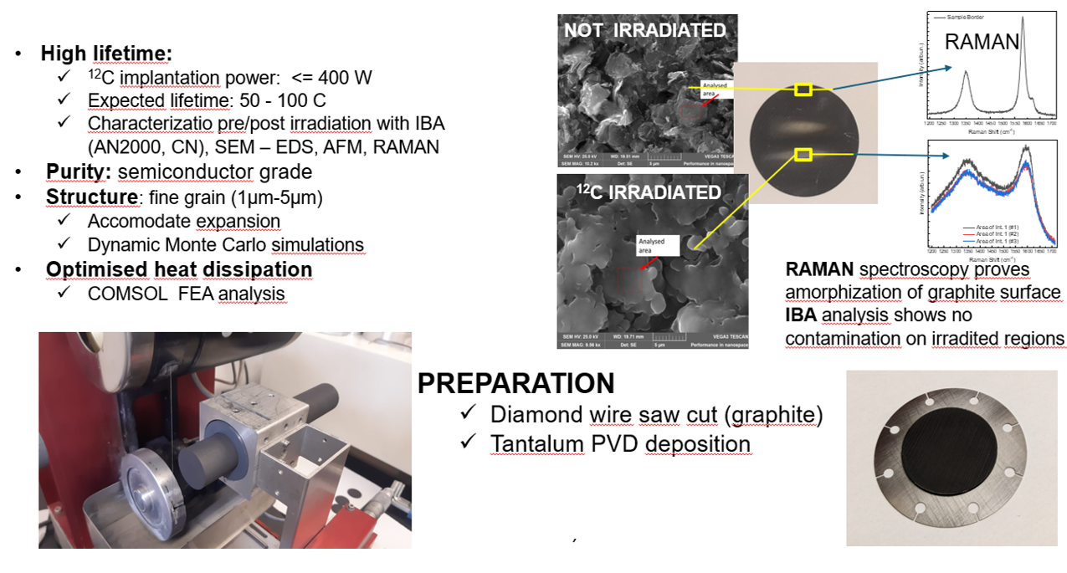




LUNA: highlights 2024
¹²C+¹²C: 2024 experiments at HZDR Felsenkeller (Dresden) and at the Bellotti facility (LNGS) with high intensity carbon beams have been performed to select the carbon targets for endurance and purity.
The targets proposed and developed at LNL have been chosen for the full 2025 campaign at IBF due to the excellent endurance and ¹H, ²H purity.
IBF December 2024 data
M. Campostrini, V. Rigato

Slide 15
Thanks for the attention !

Slide 16

The 2nd LNL AGATA campaign until now
Search for octupole structures in the light U Th and Pa isotopes via Multinucleon transfer reactions
(A. Goasduff G. De Angelis)
Octupole correlations in the neutron deficient plutonium isotopes (J.F.Smith,D.Mengoni )
Accessing neutron-rich nuclei close to ²⁰⁸Pb via multi-nucleon transfer reactions (F. Galtarossa, T. Mijatovic)
33 experiments performed
~ 260 days of beam on target (+ preparation)
Wide users community:
EU, UK, USA, Canada,
South Korea, China
Decay-out of the oblate, triaxial and highly-deformed bands in ^{136,137}Nd (C. Petrache/O. Stezowski )
Understanding the nature of 0⁺ states in ¹¹⁰Sn and ¹¹²Sn and ¹⁰⁸Cd
( N. Marginean, M.Ciemala, F.Crespi)
Lifetimes in the ¹⁹⁶Os region populated with multinucleon transfer reactions
(D. Brugnara, M. Sedlak, J. Pellumaj)
Probing Multiple Shape Coexistence in ¹¹⁰Cd with Coulomb Excitation (M.Zielinska, K.Wrzosek Lipska, A.Nannini, P.Garrett)
Pathway to nuclear structure in heavy neutron rich nuclei in the vicinity of N=126 and nuclei northwest of ¹³²Sn via multinucleon transfer reactions (P.Reiter)
Search for a Josephson like effect in the ¹¹⁶Sn+⁶⁰Ni system
(L. Corradi, S. Szilner)
Probing nucleon nucleon correlations in the ⁴⁸Ca+²⁰⁸Pb system below the Coulomb barrier
(T. Mijatovic L. Corradi)
Combined lifetime and transition-probability measurements in ⁹⁶Zr via unsafe Coulomb excitation (M. Zielinska, F. Ercolano, N. Marchini, J.J. Valiente Dobon)
Two-Phonon Octupole excitation in ⁹⁶Zr
(D. Stramaccioni, J.J. Valiente-Dobon, A. Gadea)
Shape Coexistence Coulex of ⁷⁴Se
(W.Korten, K.Wrzosek Lipska, E.Clement)
Coexisting Shapes in ⁹⁶Zr
(D. Doherty, N. Marchini, M. Zielinska)
The emergence of enhanced collectivity near magic nuclei: Coulomb excitation of ⁶⁰Ni (K. HadinskaKleck, N. Marchini, M. Rocchini,)
Fusion fission for gamma ray spectroscopy of neutron rich nuclei around N=50 (A. Gottardo, M. Caamano, D. Ramos, JJVD)
Nuclear structure in the vicinity of the Z=28 neutron rich isotopes with AGATA and PRISMA
(R.M.Pérez Vidal, S.Bottoni, E.Sahin,A.Illana, J. Benito, J. Ljungvall, M. Doncel, A.Gadea, L.M. Fraile)
Study of shape coexistence in ⁶⁰Fe via lifetime measurement of excited 0⁺ states (G.Pasqualato/J.Ljungvall)
The low energy fusion in the system ¹²C + ²⁶Mg (G. Montagnoli)
Precise measurement of the B(E2; 2⁺₁ → 0⁺₁) in ⁵⁶Ni (F. Galtarossa, A. Gottardo)
Test of the CKM unitarity and the existence of Fierz interference through the measurement of superallowed beta decay of light nuclei
(J.Ha/F.Recchia )
Lifetime measurements around ⁴⁸Ca
(C. Fransen, A. Gottardo, D. Menogni)
Evolution of the mixing between single particle and intruder configurations at N=20 (F. Galtarossa, A. Gottardo)
Shell and shapes above ⁵⁶Ni: lifetime measurements in ground-state and side band of ⁶⁰Zn (E. Pilotto, G. Pasqualato)
Spectroscopy and lifetime measurements toward the Island of Inversion (K.Wimmer, S.Bottoni, G.Benzoni, F.Recchia, P.Aguilera)
Lifetime of the 6793 keV state in ¹⁵O (J.Skowronski, E. Pilotto)
Lifetime measurements intruder states towards the island of inversion along the N=20 shell closure (Z. Irene, D. Brugnara)

Slide 17

The campaign: main physics subjects
Nuclear Structure: - Excited level lifetimes measurement in key regions: N=20 (³⁶S, ²⁶Mg) , N=28
(⁴⁸Ca,⁵⁶Ni, ⁵⁸Fe), towards N=126 (¹⁹⁸Pt) using direct and MNT reactions
- Spectroscopy of N=50 nuclei towards ⁷⁸Ni with fusion-fission reactions
Safe and unsafe Coulex measurements in the ⁶⁰Ni, ⁷⁴Se, ¹¹⁰Cd, ⁹⁶Zr for quadrupole/octupole deformation
Inelastic scattering on ⁹⁶Zr and MNT on actinides for octupole structures
Nuclear Reactions: - Nuclear Josephson effect in near-barrier neutron pair transfer reactions
between heavy ions
- Increasing the cross-section sensitivity of sub-barrier reactions to the nbarn using 𝛾-ray tagging
Nuclear Astrophysics/fundamental physics

Slide 18
Backup

Slide 20






LNL beam time
60 Letters of intents for STABLE BEAMS
genesis
2019
2021
04/2022: AGATA with STABLE BEAMS
2022
 |  |  |  |  | TANDEM |  |  |  |  | TAP | TAP
1. PAC
Feb. 22
2. PAC
Dic. 22
01/2023-12/2023: AGATA with STABLE (Tandem-Piave-ALPI) BEAMS
2023
TAP | TAP | TAP | TAP | TAP | TAP |  |  | TANDEM | TANDEM | TANDEM | TANDEM
3. PAC
July 23
4. PAC
Dic./Gen. 23
01/2024 … AGATA with STABLE (Tandem-Piave-ALPI) BEAMS
2024
TAP | TAP | TAP | TAP | TAP | TAP |  |  |  | TANDEM | TANDEM | TANDEM
5. PAC July 24

Slide 21

INFN costs for Zero Degrees configuration (115 kE) – approved
Original installation costs (~570 kE)
New vacuum elements
(beamline prolonged by > 5m) 25 kE
New mechanics:
Beamline elements upstream
Beamline elements downstream
Scattering chamber
Beam dump
50 kE
New mechanics:
Support structure and movements of ancillary detectors 30 kE
Prolongation of LN2 distribution line: 10 kE

Slide 22


Complementary detectors
AGATA coupled with PRISMA
AGATA zero degrees
PRISMA
heavy ions
EUCLIDES
light charged particles
PARIS
γ-rays
CTADIR
cryogenic target
SUGAR
gas-jet target
DANTE
heavy ions
LaBr
γ-rays, fast timing
OSCAR
light charged particles
PLUNGER
Lifetime measurements
GRIT
light charged particles
SPIDER
light and heavy ions
SAURON
light charged particles
NEDA
neutrons

Slide 23

AGATA organization

Slide 24


Discovery potential of AGATA
Super Deformation- Hyper Deformation High γ multiplicity→ gain factor 300!!

Slide 25




Research focus: shell structure around N=50 (III)
Spectroscopy of N=50 shell-closure breaking ? Observable: level energy, B(E2)
- Spokesperson LNL AGATA-PRISMA
fusion-fission ²⁰⁸Pb(⁹Be,x)⁷⁰⁻⁷⁸Zn, ⁷¹⁻⁷⁷Cu
- Spokesperson LNL AGATA-PRISMA fusion fission LoI ²³⁸U(⁹Be,x)⁸²Ge, ⁸⁰Zn, ⁷⁹Cu
Filippo Angelini PhD thesis (2nd year) UNIPD

