Slide 1
Emulsion data reconstruction development
Valeri Tioukov
2025.01.07

Slide 2
Most important development steps of the last year
Understood the origin of the accuracy problem related mainly to the microscope mechanics
Found and implemented the solution of this problem in case of SND@LHC data (thanks to high tracks density)
Unbending of the volume: improve the global tracks linearity
Main result of the improvements: 2 um -> 0.2 um at tracking accuracy
Makes possible SND reconstruction when emulsion&scanning data are of a good quality
Significant upgrade of FEDRA with several applications

Slide 3
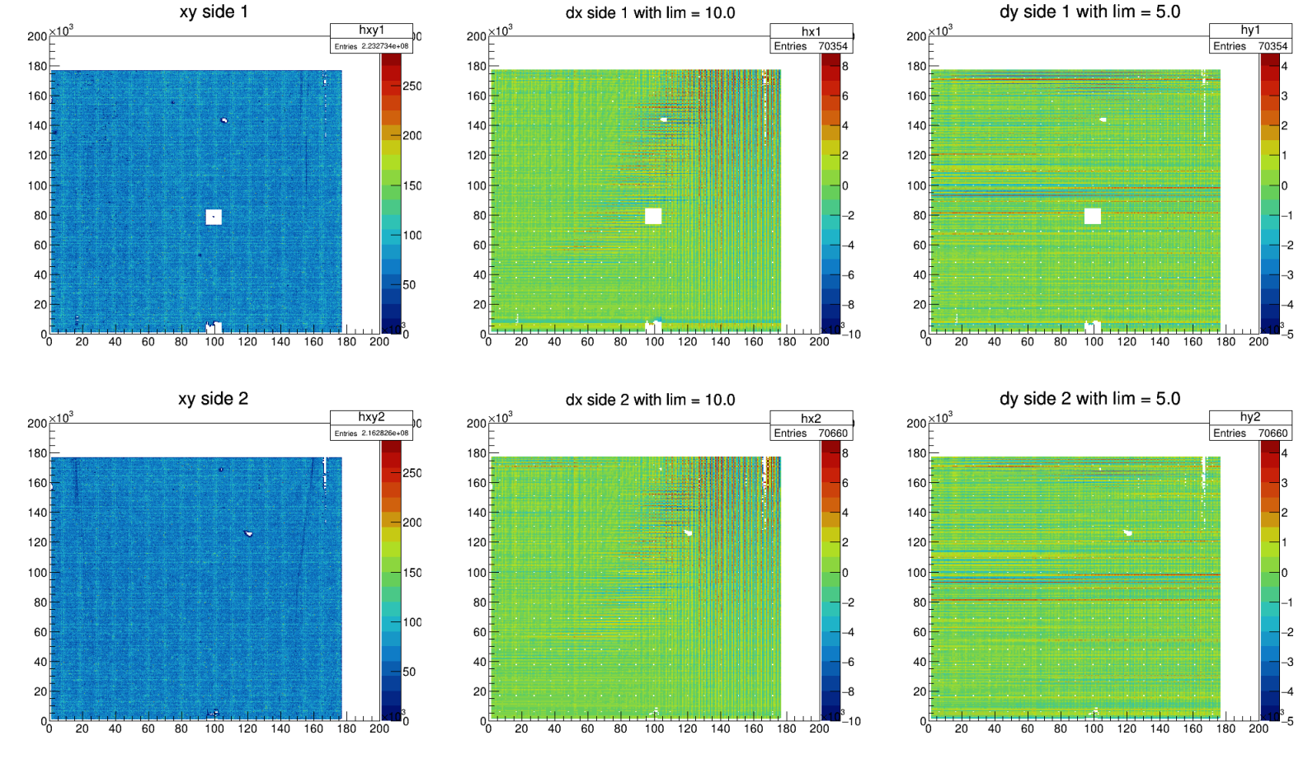
MIC3 pattern

Slide 4
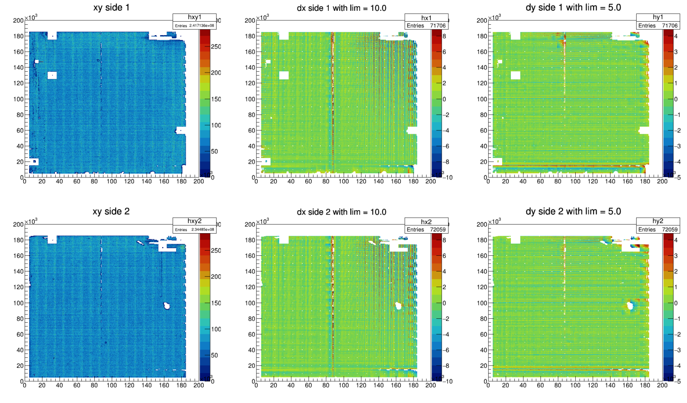
MIC3 pattern before maintenance

Slide 5
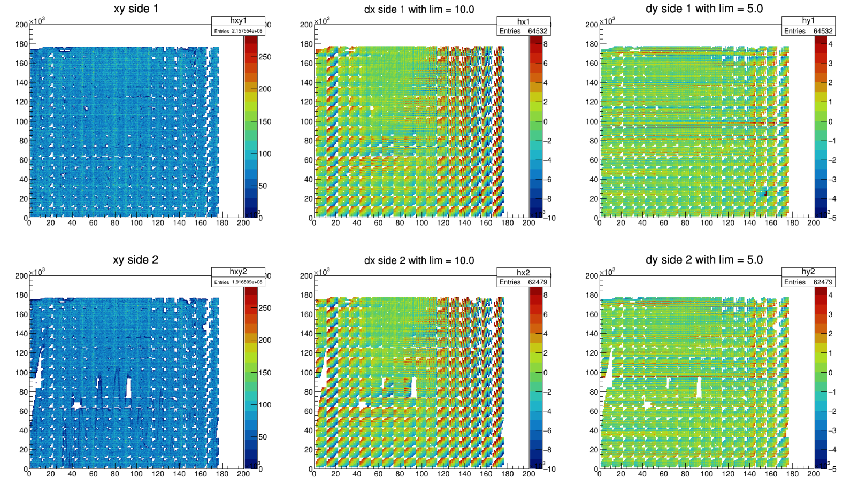
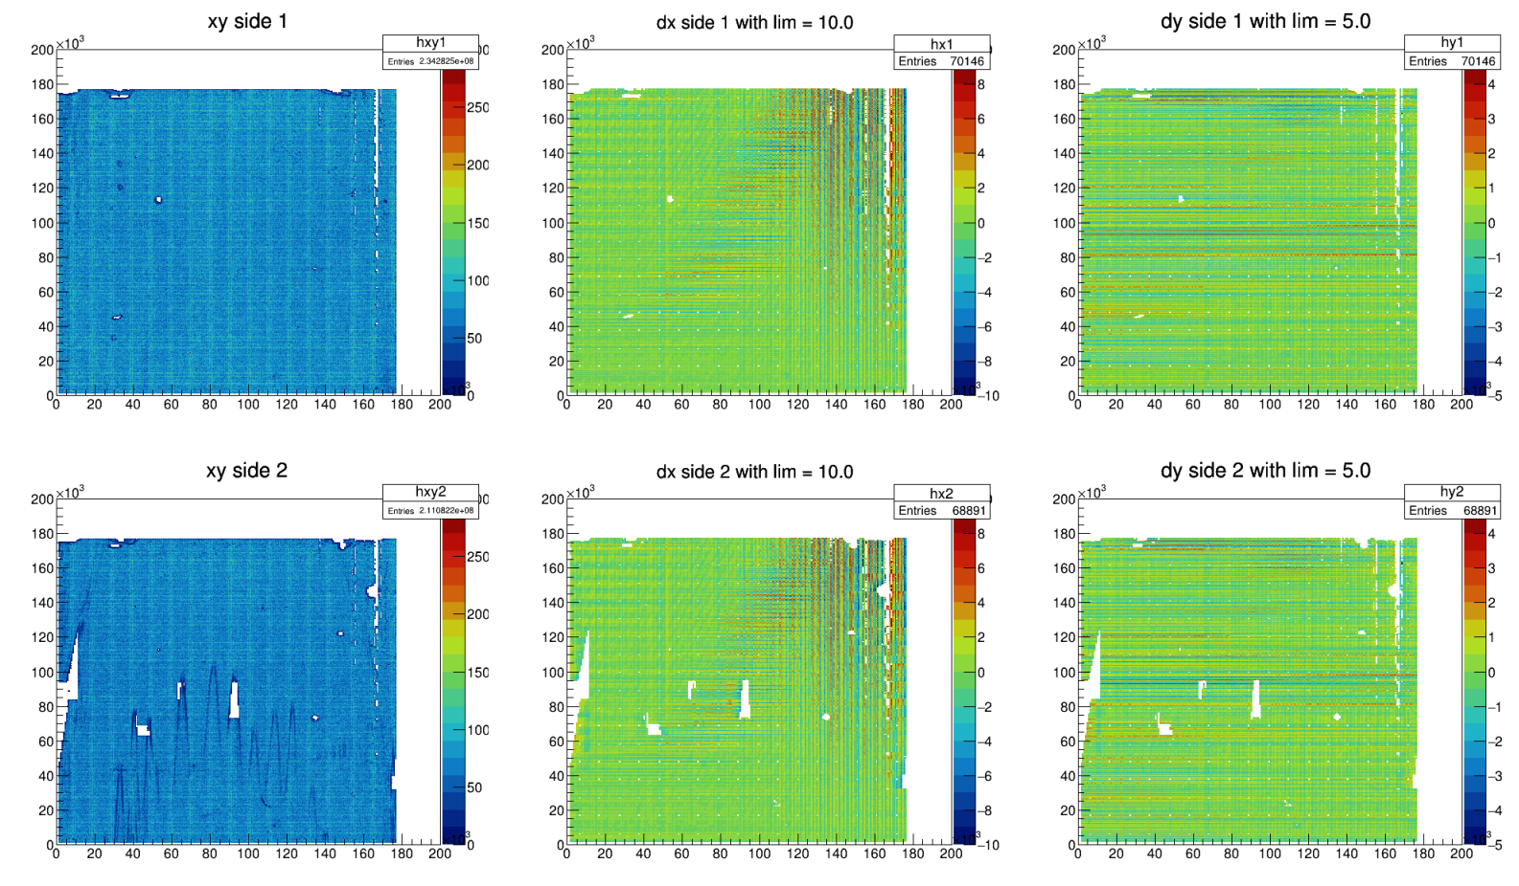
MIC3 pattern
Wrong matrix
Correct matrix

Slide 6
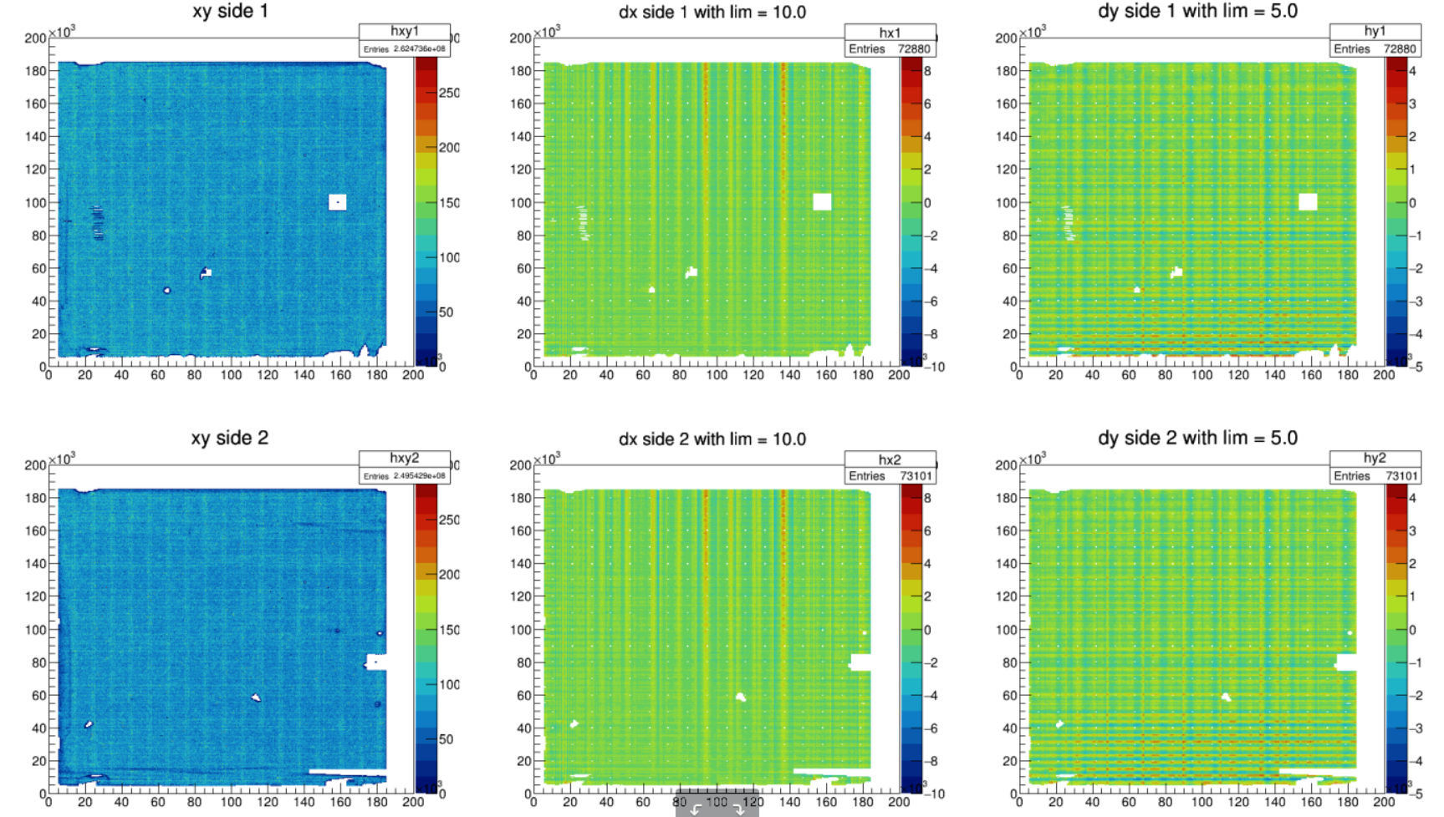
SND/mic2/RUN2_W3_B2/p005
MIC2 pattern

Slide 7
Pilot mass-production is started
Global showers tagging and global brick alignment using density peaks
Bricks divided in to volumes (cells) 1x1 cm x 57 plates
Full reconstruction in each cell from mosaic up to vertexing
Generally automatic reconstruction with two manual checkpoints
Tracking: check the tracking quality plots
Vertexing: check vertex display by eye
The final goal of this step is neutrino events triggering
Pilot production and algorithms tuning is ongoing now

Slide 8
Neutrino events signature
Neutral-like vertex (no parent track) with
Muon or
Electron (shower)
Two possible neutrino event triggers in the emulsion data:
Shower differ from the muon-generated one (see Fabio talk)
Neutral-like vertex detection (in this talk)
After the event triggering full reconstruction is required including vertex-shower merging (Nicolò)
Manual check for a more detailed study can be applied for a very special events (see Vasileios talk)

Slide 9
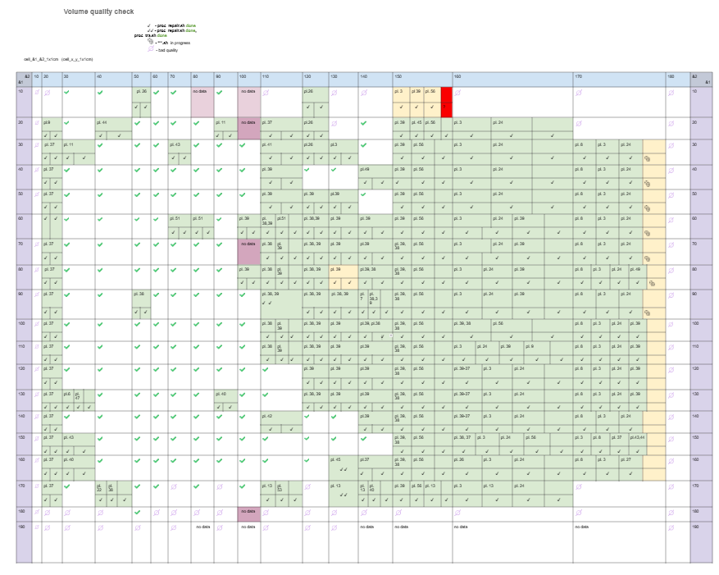
Run1 brick 21 is almost completed
Automatic processing up to the tracking phase is set up by VT at Napoli server
Tracking quality check and volumes “reparation” by skip of the bad plates and realignment
Tatiana Shchedrina
Daria Morozova
Automatic vertexing
Manual vertex check and preselection
Tatiana, Daria, VT

Slide 10
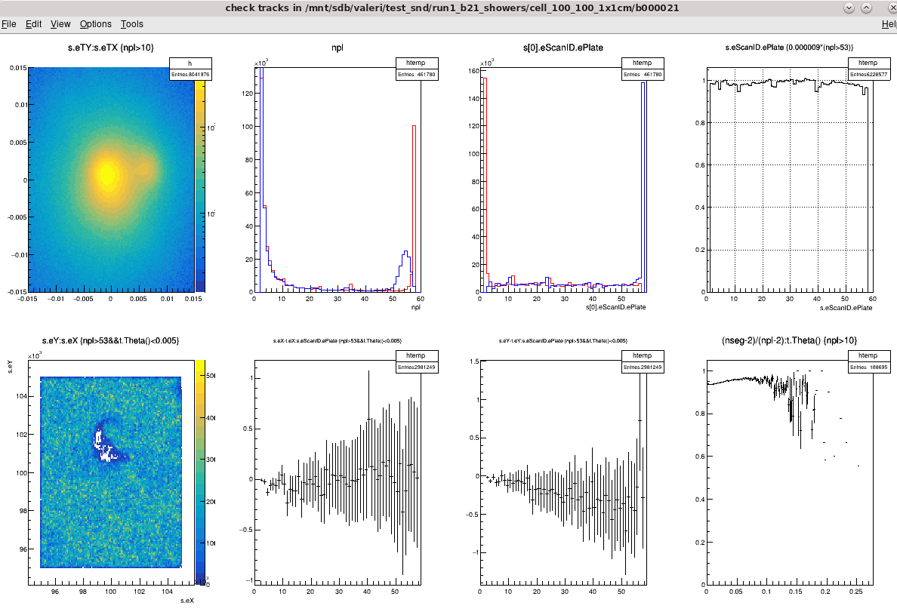
Tracking in a “typical” volume (1x1 cm² x57 plates)
Beam core structure is clearly visible.
Confirms angular resolution stability across the brick
Nplates
Nsegments
All tracks
TrackStart
TrackStop
All tracks
Plates fill factor (close to 1)
Long tracks only
Defect visible with long tracks - what is this?
Emulsion, scanning or assembling effect?
Efficiency estimation
>0.9

Slide 11
Automatic vertexing
Pair-based algorithm – developed for OPERA
end
Pairs formation with impact parameter criteria
Start-Start
End-End
End-Start
Pairs joining – multiprong vertex formation and fitting
start
end
start
start
end
emvertex –set=21.0.0.0
end
start
EdbDataProc::ReadTracksTree: select 145761 of 490920 tracks by cut nseg>4&&npl<50
145761 tracks for vertexing
…..
36194 vertices with number of tracks = 2 was found
3671 vertices with number of tracks = 3 was found
812 vertices with number of tracks = 4 was found
75 vertices with number of tracks = 5 was found
19 vertices with number of tracks = 6 was found
2 vertices with number of tracks = 7 was found
0 vertices with number of tracks = 8 was found
0 vertices with number of tracks = 9 was found
0 vertices with number of tracks = 10 was found
0 vertices with number of tracks >= 11 was found
EdbDataProc::MakeVertexTree: write vertices into ../b000021/b000021.0.0.0.vtx.root
end
start
end
start
About 15-30 min/volume

Slide 12
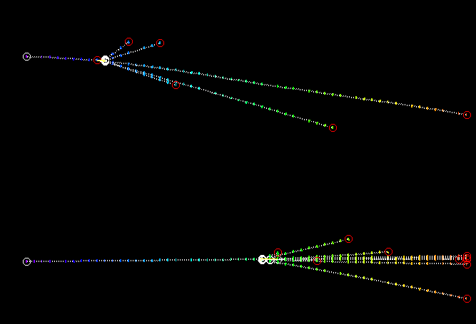
Manual vertex check and display
emvertex –set=21.0.0.0 -r -display
Parent was found at vertexing phase
Read vertex file with cuts – select multiprong only
Read all tracks and try to associate additional tracks including the pass-through ones
Display if requested
emvertex -set=21.0.0.0 -r -display -v=2
EdbDataProc::ReadVtxTree: select 2 of 31796 vertices by cut ((flag>=0&&n>4)||(flag==0&&n>3))&&probability>0.9
AddCompatibleTracks: 313417 tracks, 2 vertex
Probable parent associated as a compatible passing-through

Slide 13
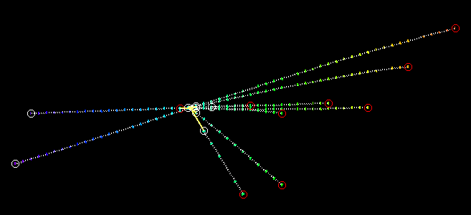
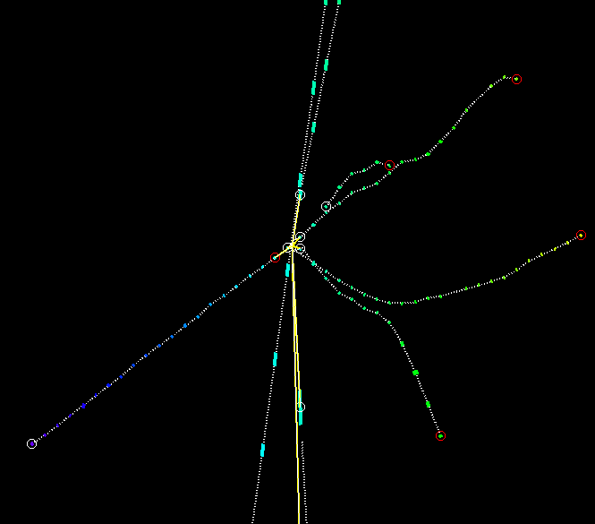
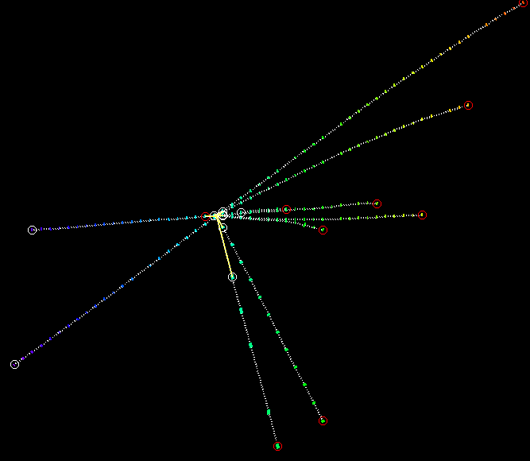
Just an example
Parent event
Close pass-through track clearly not related to this event
Drastic momentum change at the vertex point

Slide 14
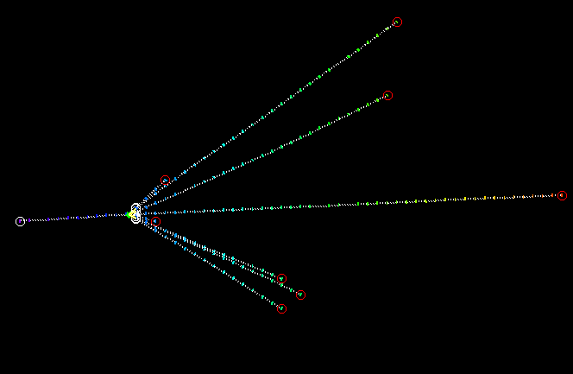
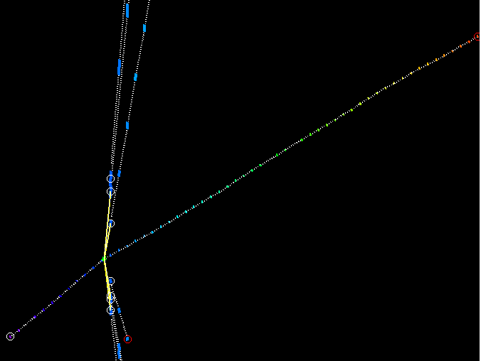
Reconstructed as a “neutral” vertex
Compatible passing-through is found
Is it a parent or casual?
It’s a parent – kink at vertex point is evident!
We have a lot of vertices like that
Sometimes the kink is not so clear, but the probability of random association with so low IP is generally small

Slide 15
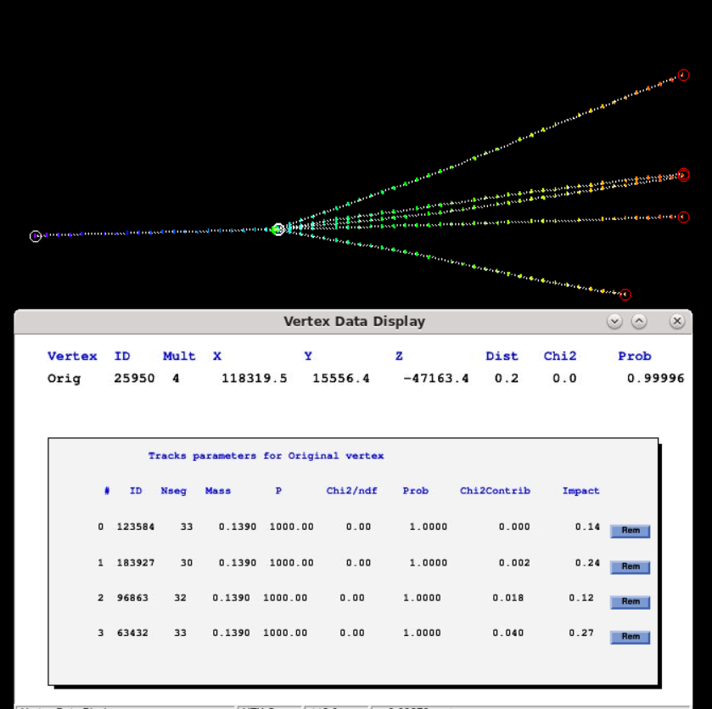
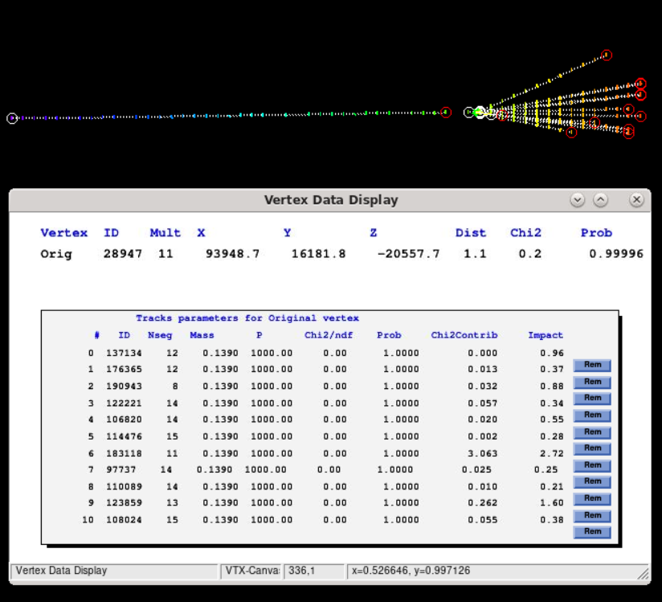
Reconstructed as 4-prongs neutral
Parent associated from passing-through
Reconstructed as 11-prongs neutral
Parent associated from stopped far before vertex

Slide 16
In most of volumes parent-like vertices has been detected
But do we have a neutral-like ones??
We expect to have some
Neutrino
Gamma
Other?

Slide 17
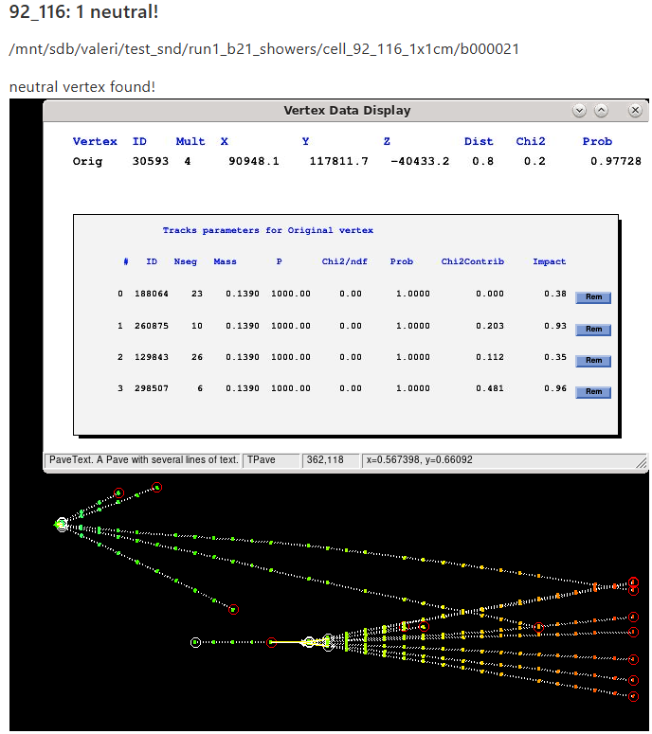
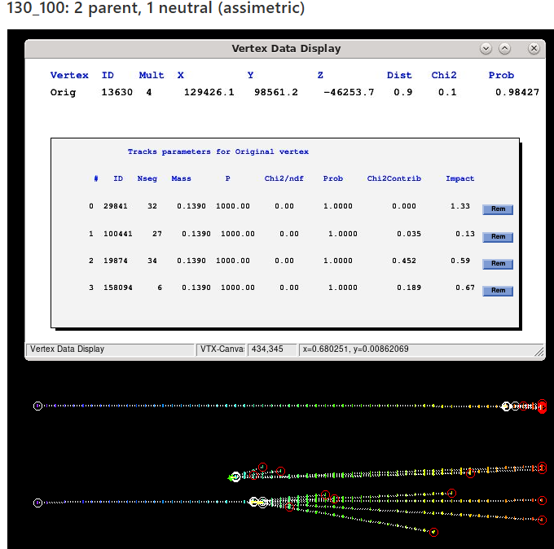

Slide 18
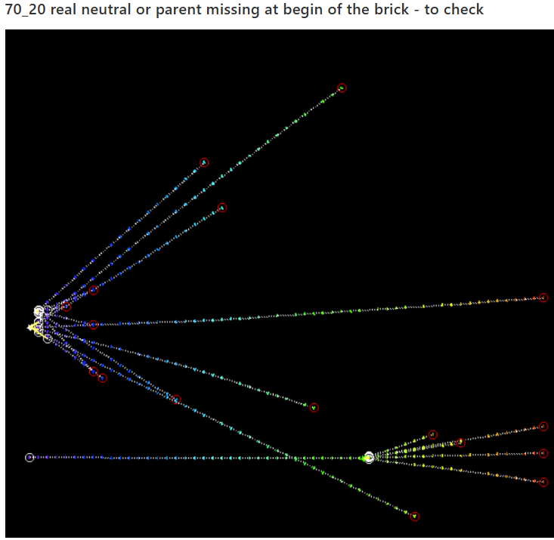
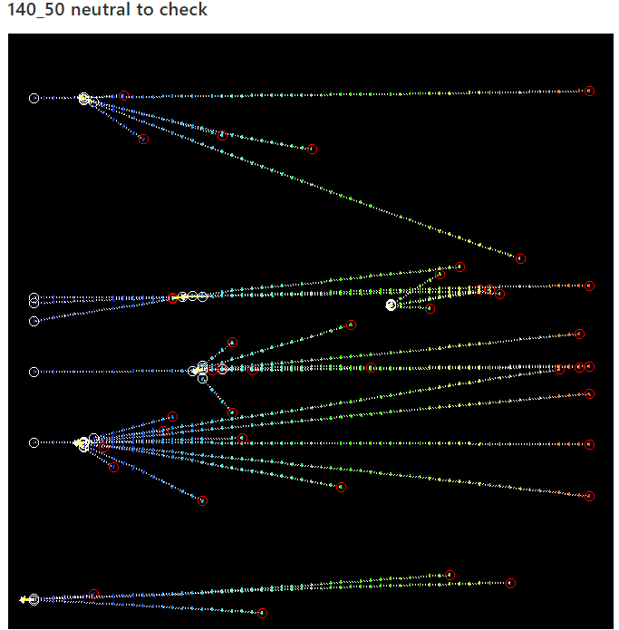

Slide 19
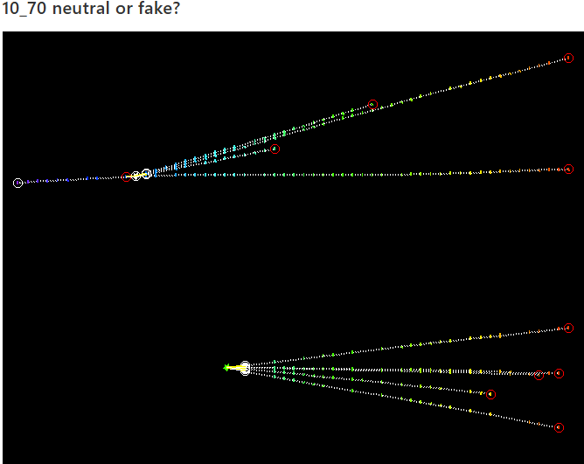
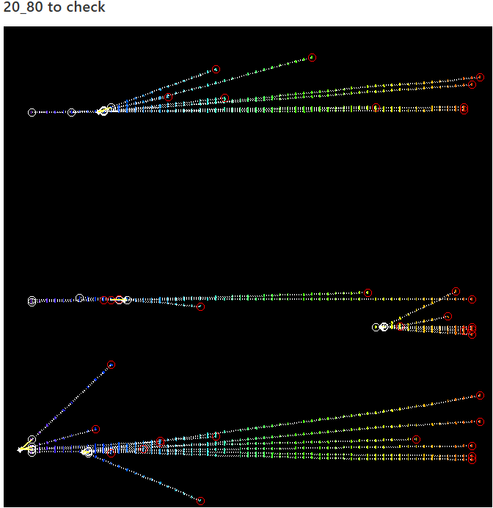

Slide 20
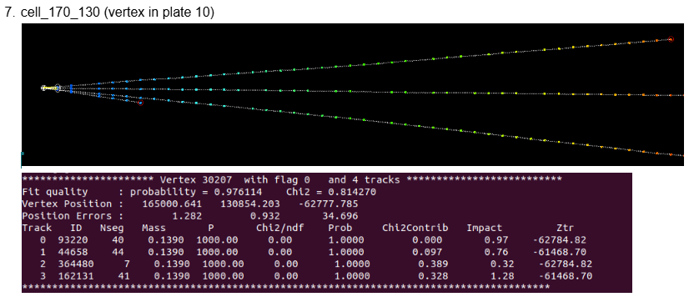
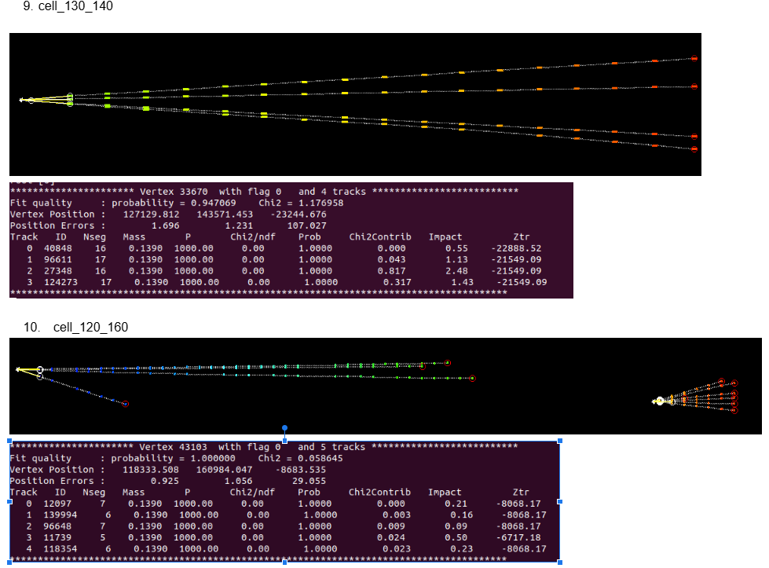
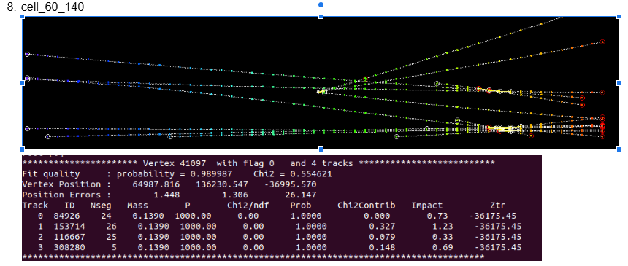
Checks are going on now for all volumes of B21
Thanks to Tatiana and Daria!

Slide 21
Summary of the current status
The procedure for mass data reconstruction is established at Napoli
Run1 Brick21 is fully processed
Volume data quality is generally good after the “reparation” procedure
Vertex checks are ongoing, we expect completion in this week
A lot of parent-like real (not fake) vertices are found
Several neutral vertices are found and to be classified
The efficiency and purity of this analysis is not well known yet
The expected processing rate using the Napoli server only is order of brick/month

Slide 22
Open tasks for mass-production optimization and algorithms tuning
Go on with currently established volume processing and vertex control procedure (TS, DM)
Add to this chain the shower triggering (FA, VT, Nicolò)
Vertexing tuning and neutrino vertex detection efficiency/purity estimation using the Monte Carlo data (VT + tbd)
Mass production chain establishing at CERN (FA, VT …)
Reduction of manual intervention steps (O(10⁵) volumes expected)
Automatic bad plates detection, exclusion, reparation
Automatic neutrino-like vertices selection (can be consciously done only after the completing of vertexing tuning using the Monte Carlo data

Slide 23
Backup slides

Slide 24
Challenges for emulsion data reconstruction in SND@LHC
OPERA conditions:
Low track density (10/mm²)
Low momentum 1-20 Gev
Scanning System:
Position resolution 2-3 µm
Angular resolution 3 mrad
Enough for OPERA!
SND@LHC:
Track density 4000/mm² so the mean distance between tracks is of 16 µm
Momentum O(100) GeV, no scattering, tracks are straight
Most of tracks are parallel (beam), so angles become useless for tracks separation
Scanning System position resolution become a problem!
Main contribution in this 2 µm: mechanical stage limits as hysteresis, Abbe errors and vibrations
Without improvement of position resolution:
Tracks mixing and splitting: instead of passing-through muons – fake prongs candidates
Huge number of fake track stopping points inside the target
Huge amount of the fake vertices, no way to reject using lower then 2 um impact parameter
Reliable vertices reconstruction is not possible

Slide 25
Summary of emulsion reconstruction development progress
Distortion correction suffers of stage hysteresis&jumping effects – solved by modification of matrix search procedure
Microtracks accuracy suffers of stage hysteresis&jumping effect – solved by mosaic alignment, developed for that purpose
3D shower search using the density peaks is developed
By-product: brick alignment using showers information – very useful as a preliminary step of reconstruction
OK, we have segment patterns per each plate with the improved accuracy, what next?
Tracking: long 3d tracks reconstruction
Vertex reconstruction
Showers association..
Event analysis…

Slide 26
Tracking modification and fine alignment
Segments angular information much less precise in respect to coordinate, so tracking was modified for propagation using coordinates instead of angles
Usually we use plate-to-plate alignment followed by calculation of cumulative transformation to get all patterns in the same Reference System
This procedure can suffer of accumulated errors and do not guarantee the necessary precision in case of SND@LHC
New “volume unbending” algorithm is developed for the fine alignment using high-momentum beam muons. This procedure acts both on the mean pattern positions and mean angles aligning them in a way to get straight mean path
1
57
1
57

Slide 27
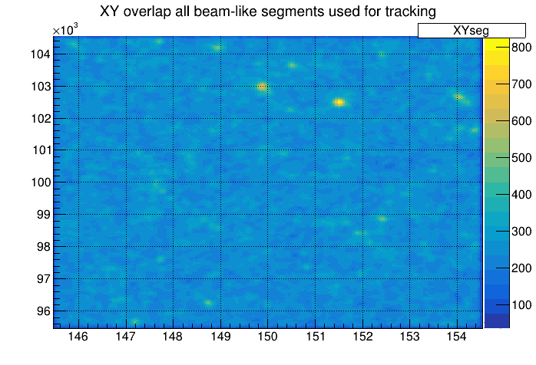
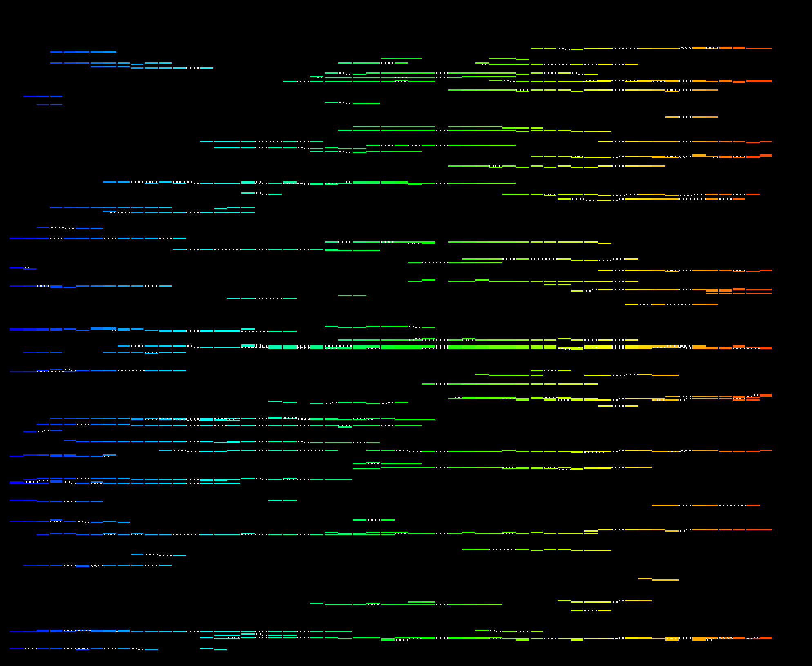
Aligned volume
Beam-angle shower patterns are evident and could be used for automatic or manual patterns matching and for 3-d shower reconstruction

Slide 28
Tracking in a “typical” volume (1x1 cm² x57 plates)
1x1cm

Slide 29
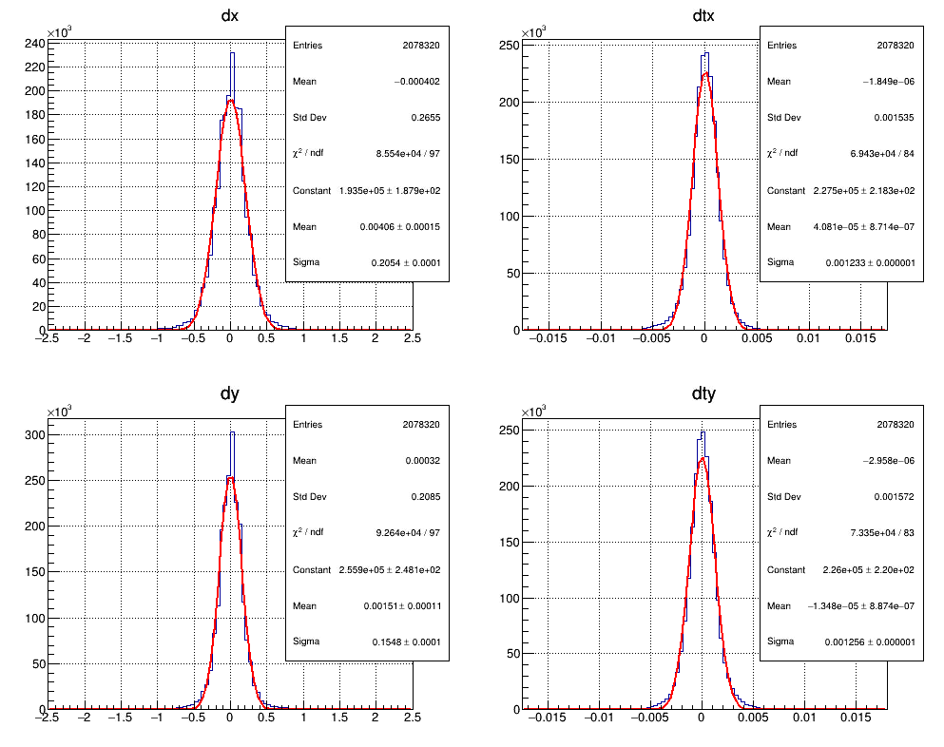
Segment-track resolution calculated as 1-out-of-5
In each track for each group of 5 consecutive segments the central one is excluded from the fit and fit4-to-segment difference is calculated
Position resolution: 0.2 µm
Angular resolution: 1.2 mrad
About 10 times improvement in respect to OPERA scanning for position resolution

Slide 30
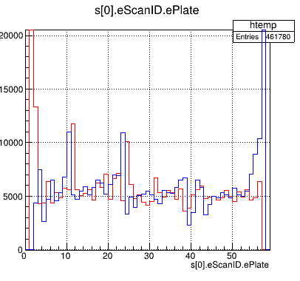
Residuals plate by plate
11
24

Slide 31
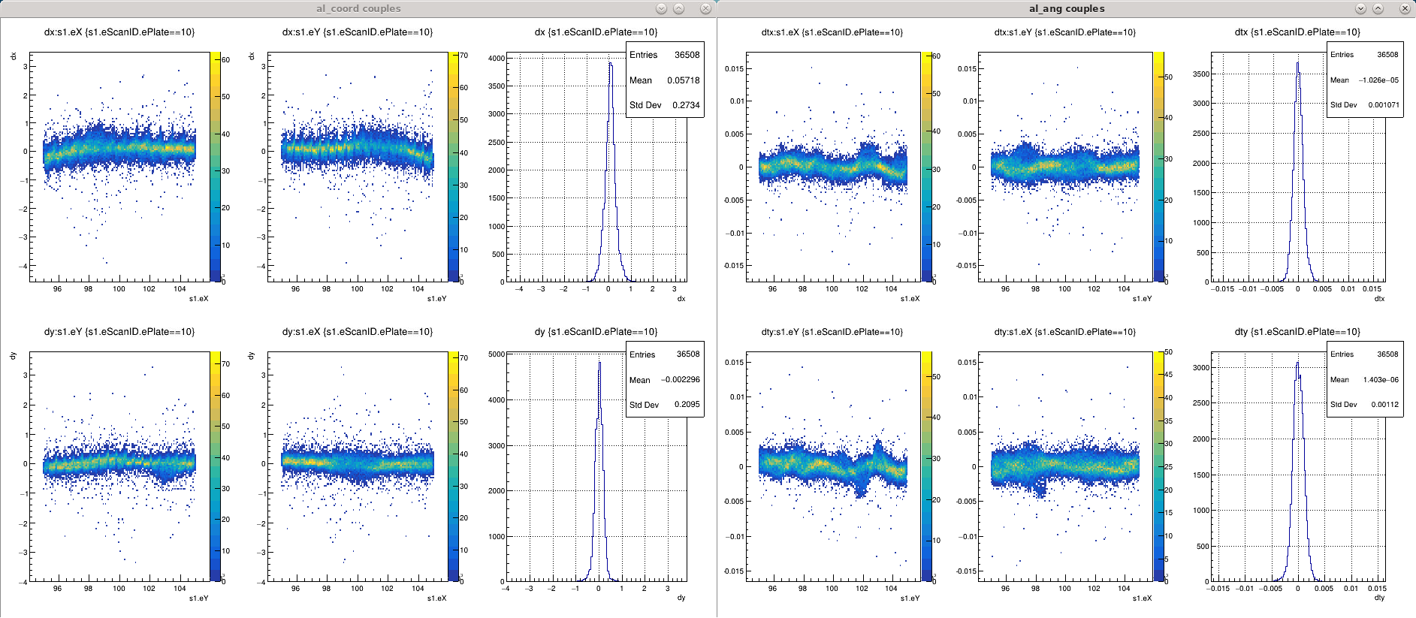
Plate 10, normal

Slide 32
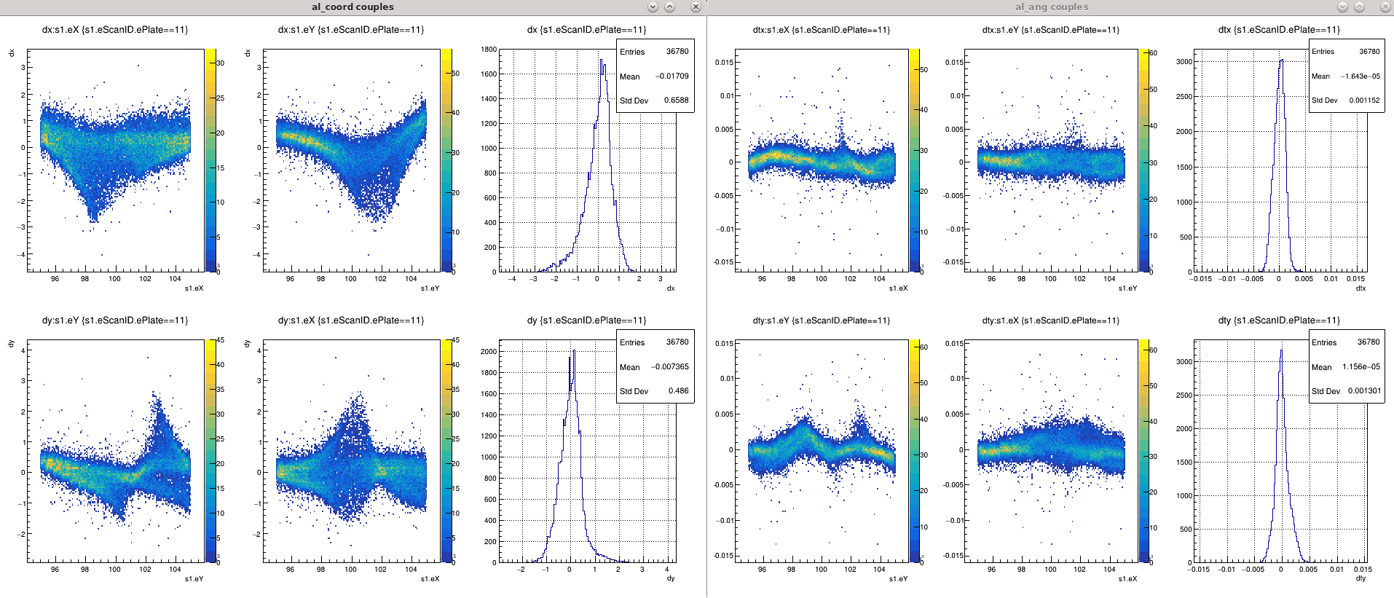
Plate 11 – anomalous, tracks lost possible

Slide 33
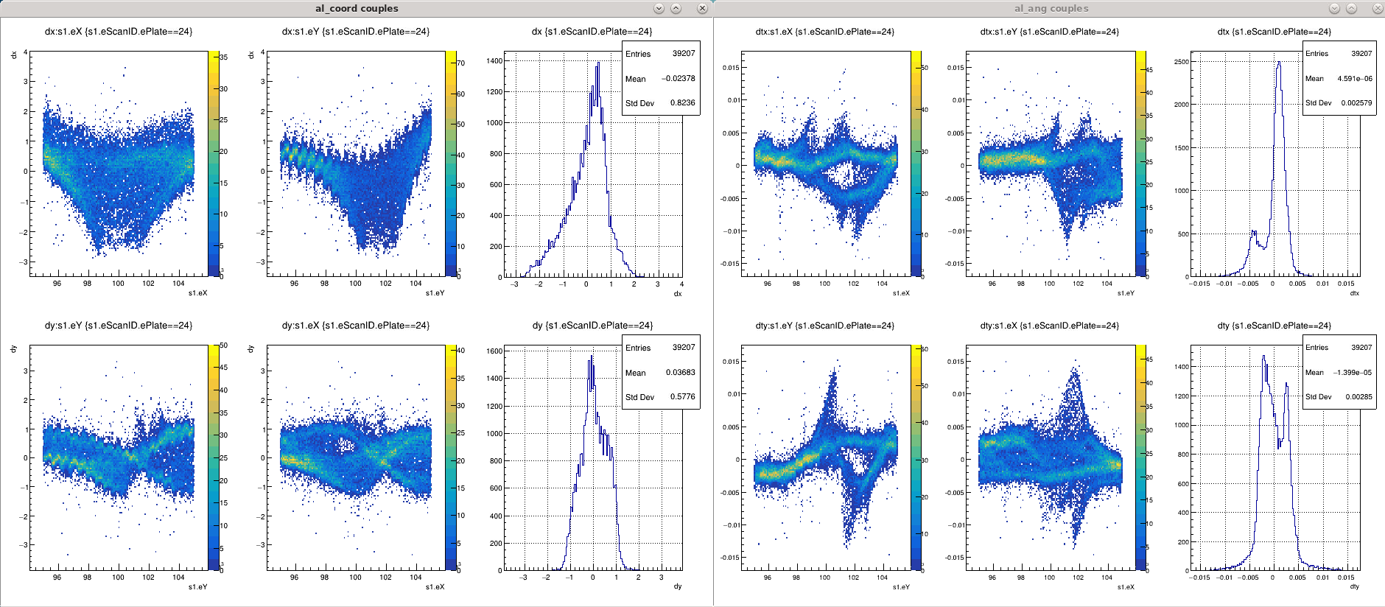
Plate 24 – anomalous, tracks lost possible

Slide 34
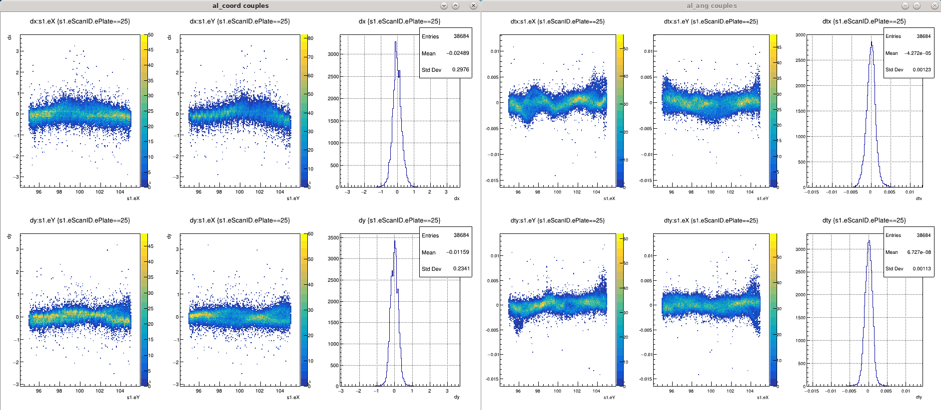
Plate 25, normal

Slide 35
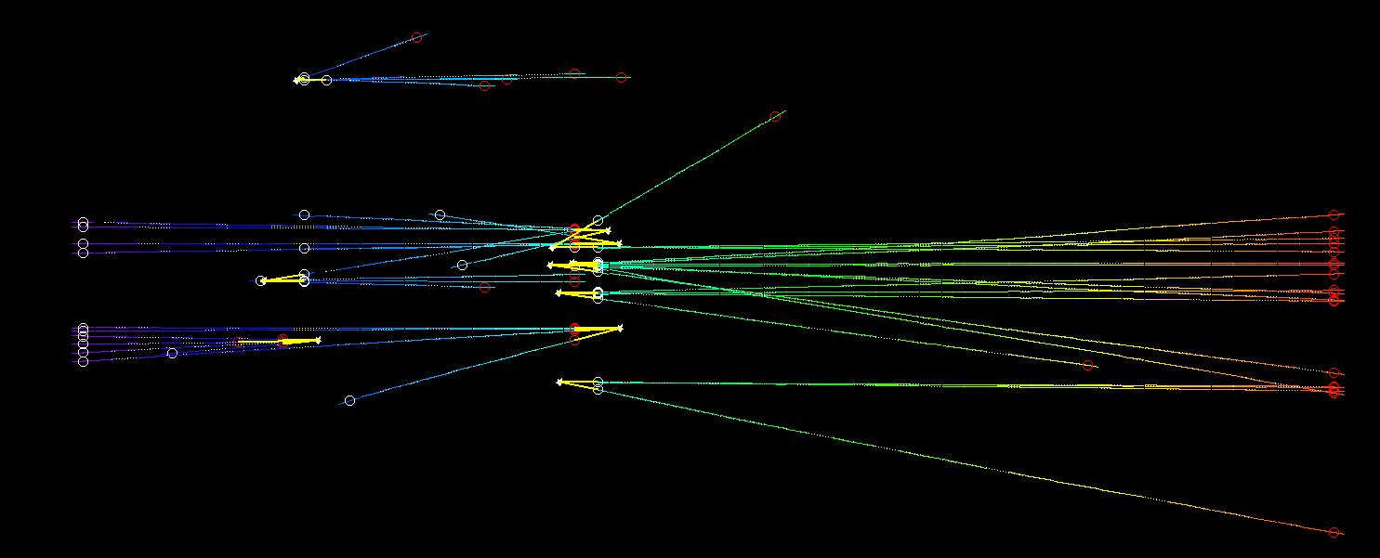
Vertexing test in this volume by taken
>= 4 prong
Neutral-like (one side tracks)
Without the direction selection
Pl 11
Pl 24
Most probably all these vertices are fake, just formed by a broken tracks near bad plates

Slide 36
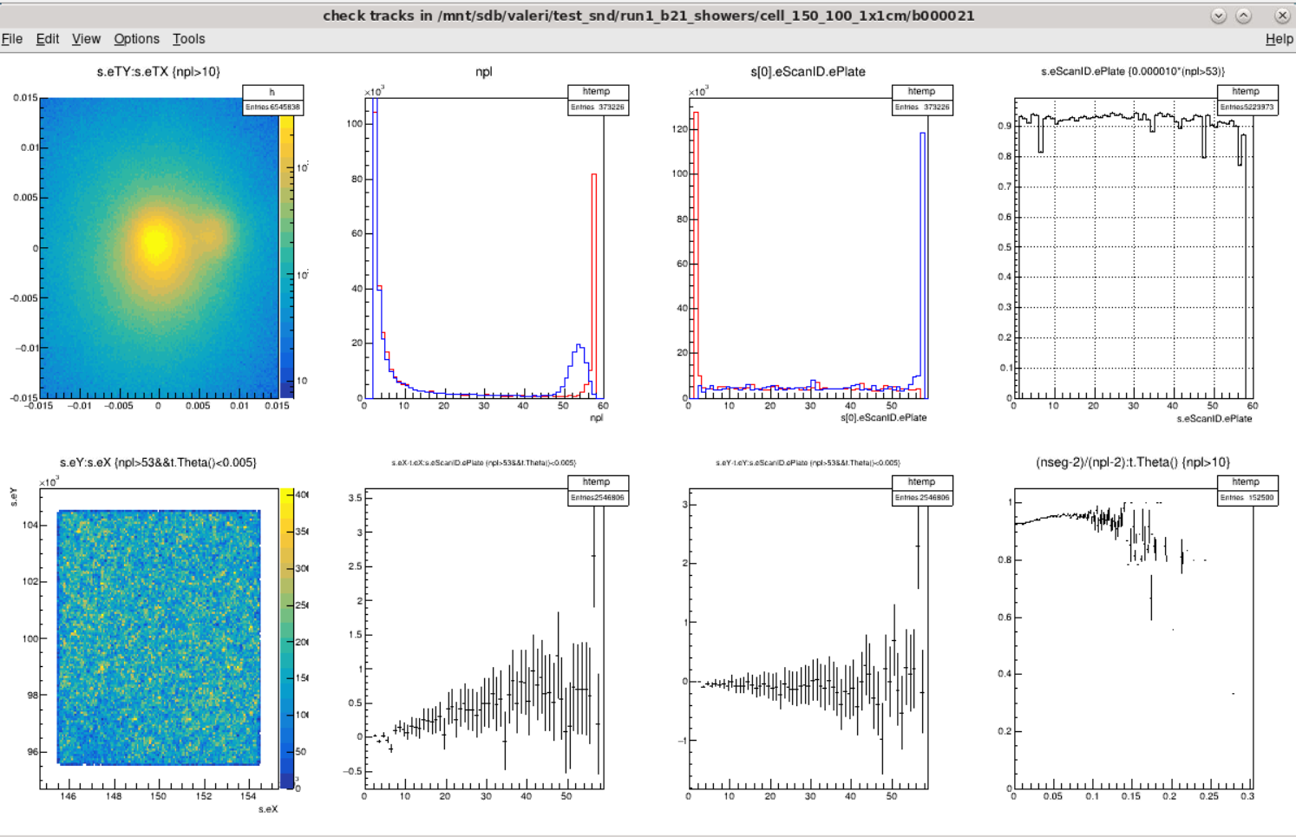

Slide 37
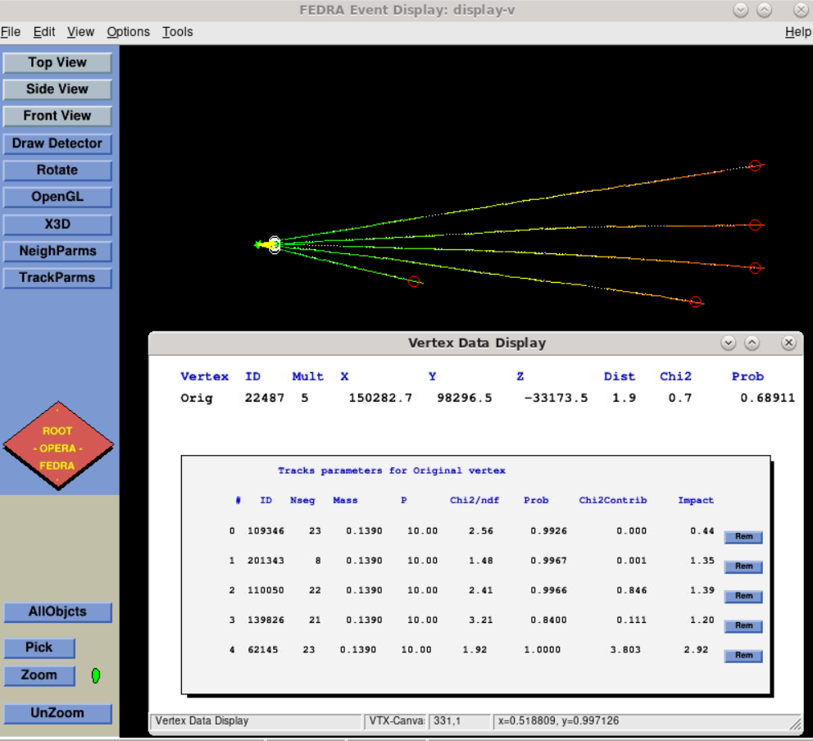
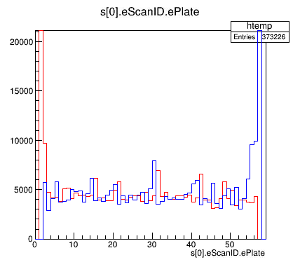
P32-33
To check the gap and large angle tracks quality

Slide 38
Volume processing automatized with using scripts
$ . ./make_volume.sh 110 100 (position in mm)
Copy b21_aligned to cell_110_100_1x1cm
Prepare parameters
$ . ./proc.sh
Do mosaic, linking, alignment in parallel for all plates
Do tracking and unbending – several iterations
Works perfectly in Napoli environment
CERN, some problems?
Possible solution: install local linux server in lab as we have in Naples
Fast volumes processing without memory or cpu time limits (r&d and special events)
Manual check tools require to run root&fedra locally, scripts are tuned for linux

Slide 39
RUN1 data 1x1 cm volumes test processing
Processing done for about 10 volumes – no errors or crash
Total processing time – 4-5 h on nusrv1 (server with 20 cores 200 Gb RAM)
Longest operation: tracking with realignment
Process | Memory [Gb] | CPU time single/all | Cores used
Viewsideal x 57 | 2 | 3m / 15m | 15
Emalignbeam x 57 | 1 | 2m / 10m | 15
moslink x 57 | 1 | 1.5m / 6 m | 15
moslink –m x 57 | 1 | 0.5m / 3 m | 15
emalign 250 x 56 | 0.5 | 0.5m / 3m | 15
emalign 50 x 56 | 1 | 1.5m / 5m | 15
emtra realign | 20 | 2h30m | 1
emtra | 20 | 30m x 3 | 1
emunbend | 3 | 8m x 3 | 1
Total |  | 5h

Slide 40
Manual check procedure and emulsion data visualization
Follow showers to find the origin and association to vertex
Characterize showers by it’s internal structure if possible
Vertex cross-checks and fakes rejection
Deep details analysis of special events
See Vasileios talk for the progress

Slide 41
Summary
After mosaic alignment application and tracking updates the tracks quality improved significantly
Most of muons now correctly reconstructed as passing-through with a good accuracy and efficiency
Technical vertexing test is successful
But in many volumes there are plates/spots with data missed or deformed in a way that some tracks got split or broken. This could provoke a great amount of fake vertices
Additional procedures should be developed for reliable vertex analysis:
Broken tracks check, merging or rejection
Missed parent check
Additional prongs search and association
etc

