Slide 1



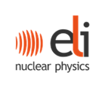
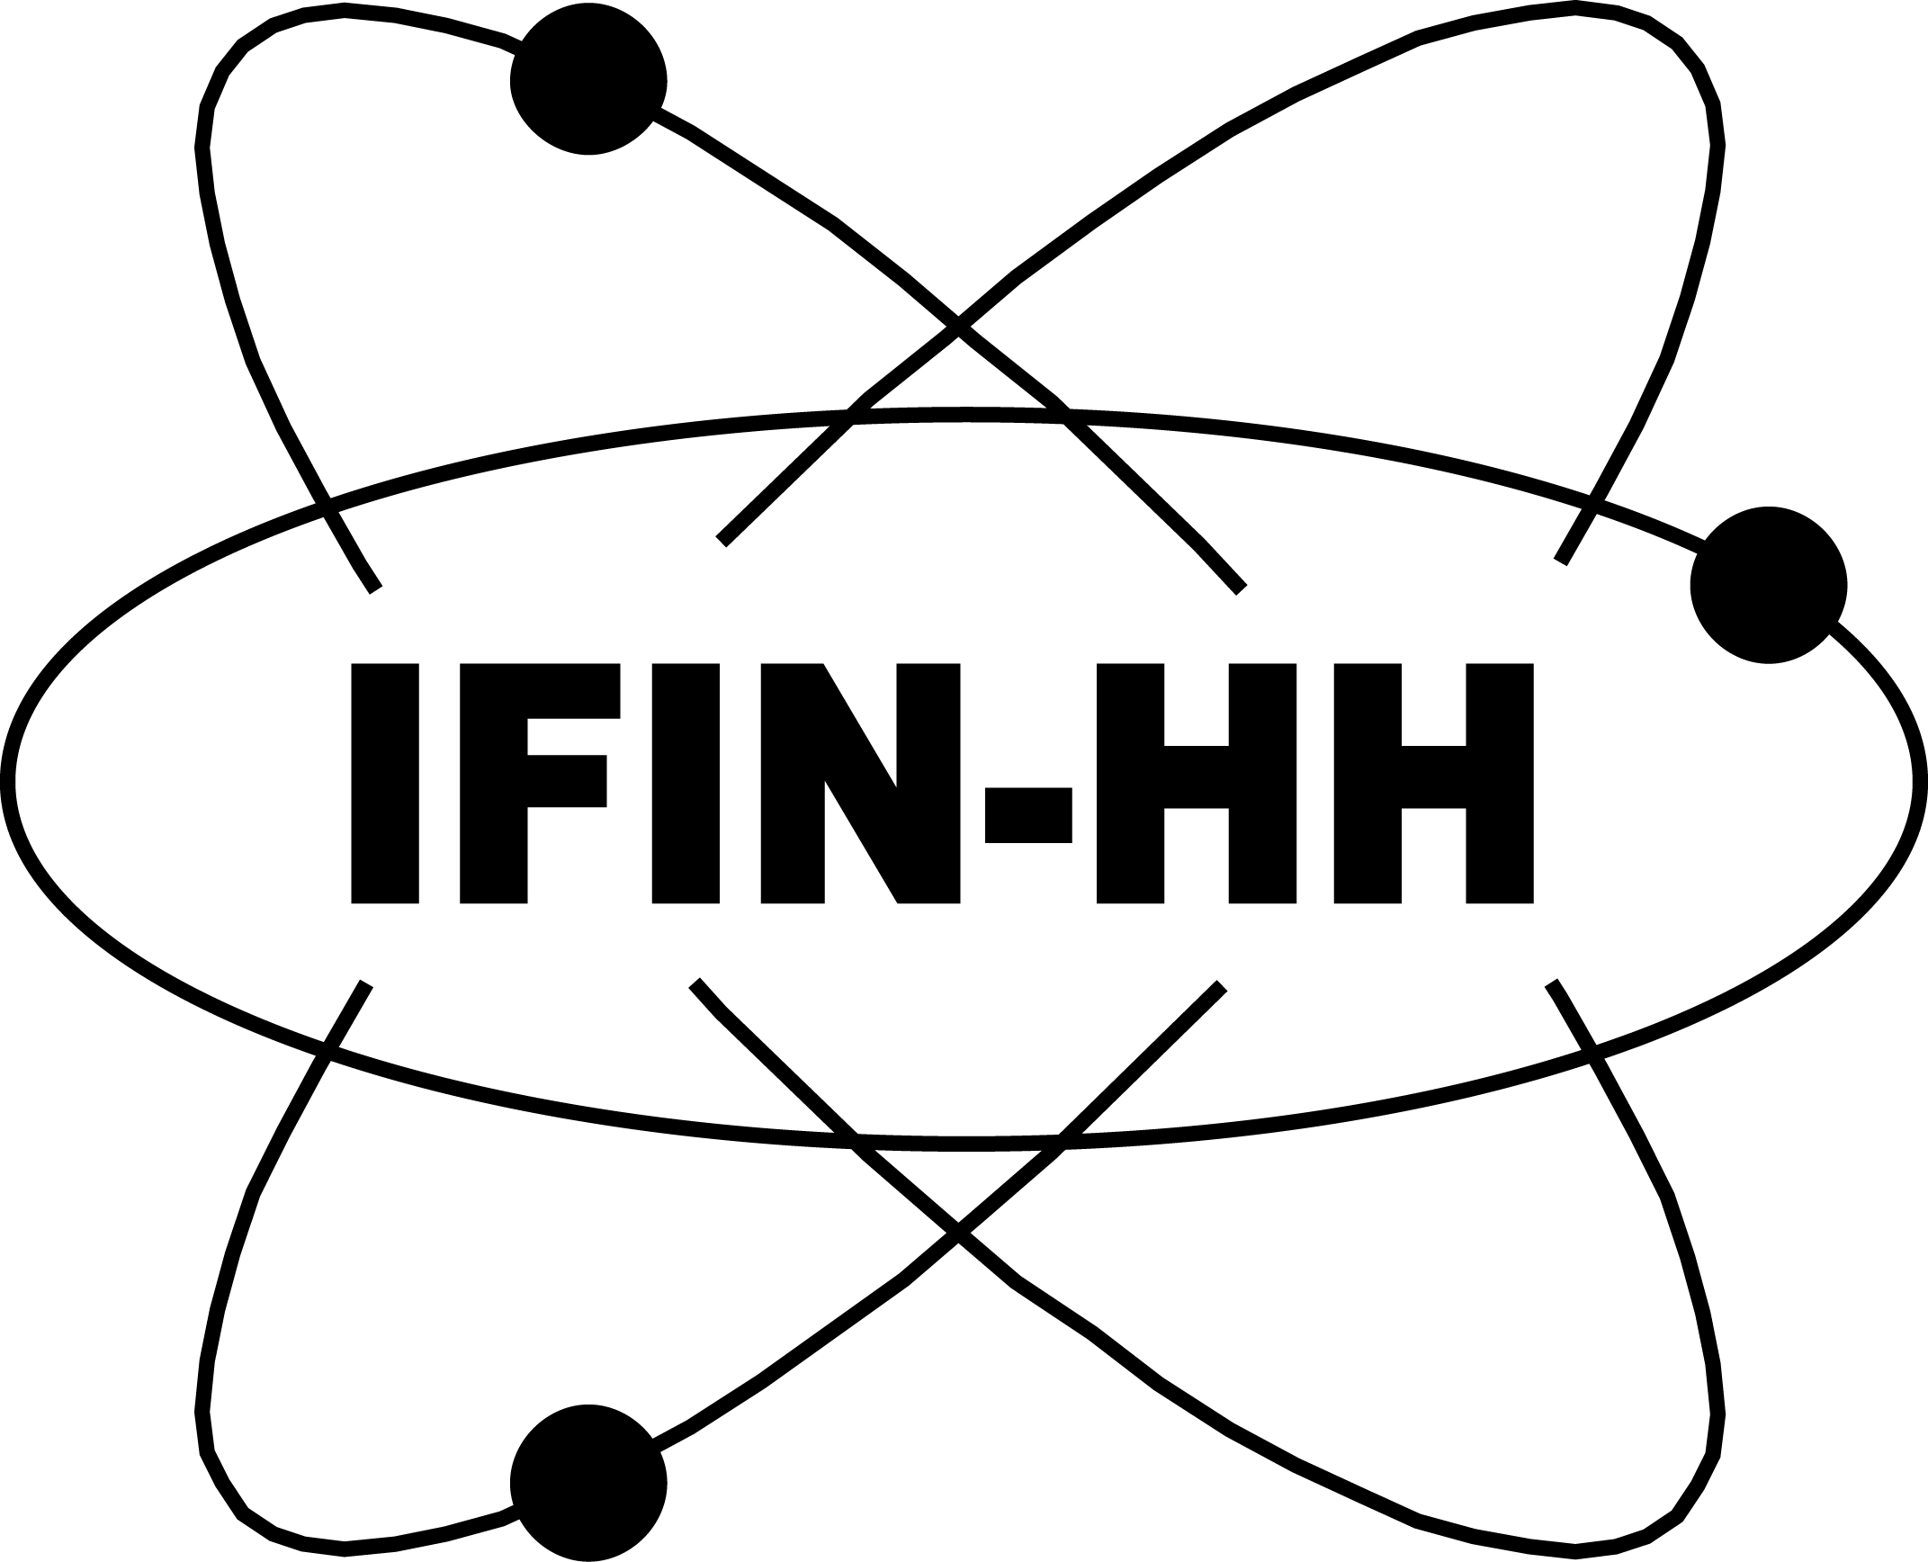


Radiobiology with laser-driven carbon ions and the medical project of ELI-NP
Domenico Doria
for the Dr. LASER team
The Extreme Light Infrastructure - Nuclear Physics (ELI-NP),
Horia Hulubei National Institute for R&D in Physics and Nuclear Engineering (IFIN-HH),
Strada Reactorului 30, 077125 Bucharest-Măgurele, Romania
https://www.eli-np.ro/projects/drlaser/
2nd INFN School and Workshop on “High Power Lasers for Fundamental Science and Applications” (HPLA2025), 17 – 19 Nov 2025, Catania, Italy

Slide 2
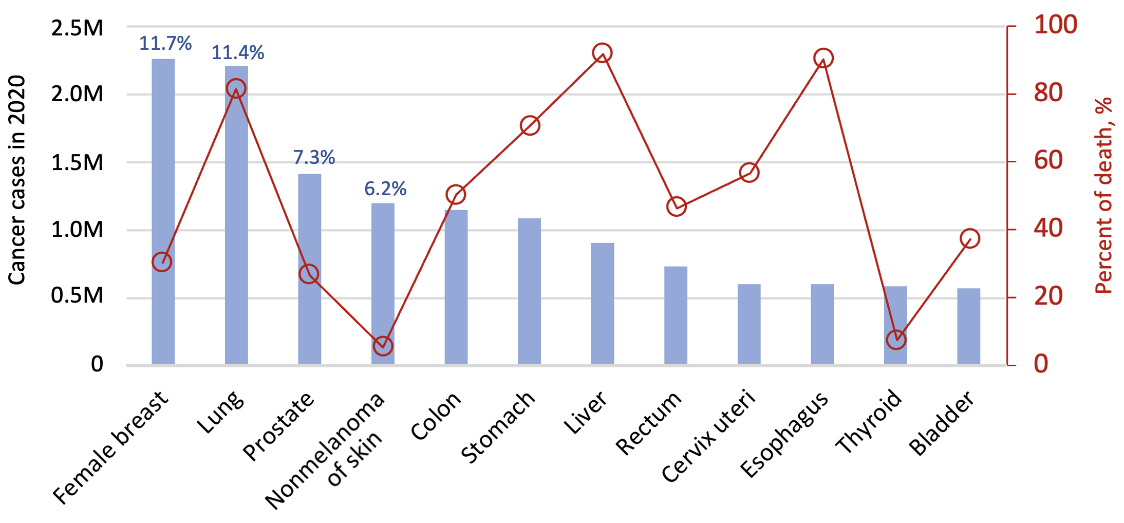
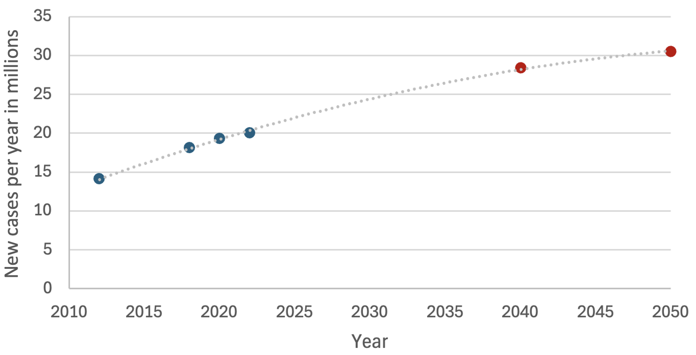


Trend of Global cancer cases in time
Some of the new cancer cases in 2020 (total 19.3M cases, 10.0M deaths)
Trend of Global Cancer Cases
Projected data
Existing data
It is estimated to grow to 28.4 million cases in 2040 (that is an increase of 47%), and to 30.5 million cases in 2050.
Graph adapted from Sung H, Ferlay J, Siegel RL, Laversanne M, Soerjomataram I, Jemal A, Bray F. Global cancer statistics 2020: GLOBOCAN estimates of incidence and mortality worldwide for 36 cancers in 185 countries. CA Cancer J Clin. 2021: 71: 209-249. https://doi.org/10.3322/caac.21660

Slide 3

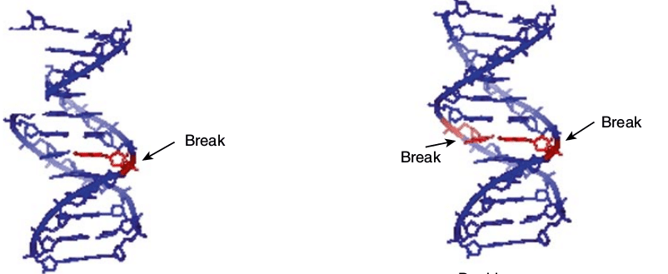
Cell damage
A cell can undergo direct or indirect DNA damage, i.e., chemically via water ionization, or physically via direct DNA helix breaking.
For instance, X-rays, as the primary mechanism, cause ionization in the cell's water and DNA, leading to many chemical damages.
X-rays cause single-strand breaks (SSBs) more frequently than double-strand breaks (DSBs).
In Normoxic conditions, for a given dose, a typical mammalian cell can experience thousands of SSB, while it will have only around 40 DSB. That is of the order of ~ 1:100 DSB:SSB
Single Strand Break (SSB)
Tumors are generally in a Hypoxic condition, i.e., a lack of oxygen in the body's tissues.
(For instance, breast cancer often involves hypoxia)
Lack of Oxygen leads to radioresistance* as primary cell damage occurs as indirect damage due to the generation of reactive oxygen species (ROS) that cause stable DNA lesions.
Resistance to radiotherapy: Oxygen is required for many forms of radiation therapy to work effectively. Hypoxic cells are less damaged by radiation and have more efficient DNA repair, making them significantly more resistant to treatment.
Double Strand Break (DSB)

Slide 4
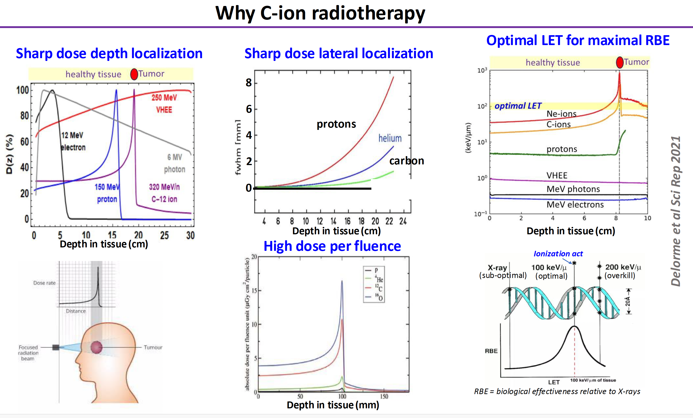
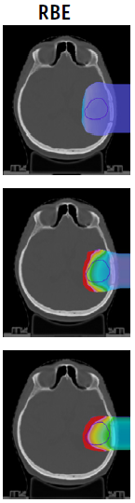
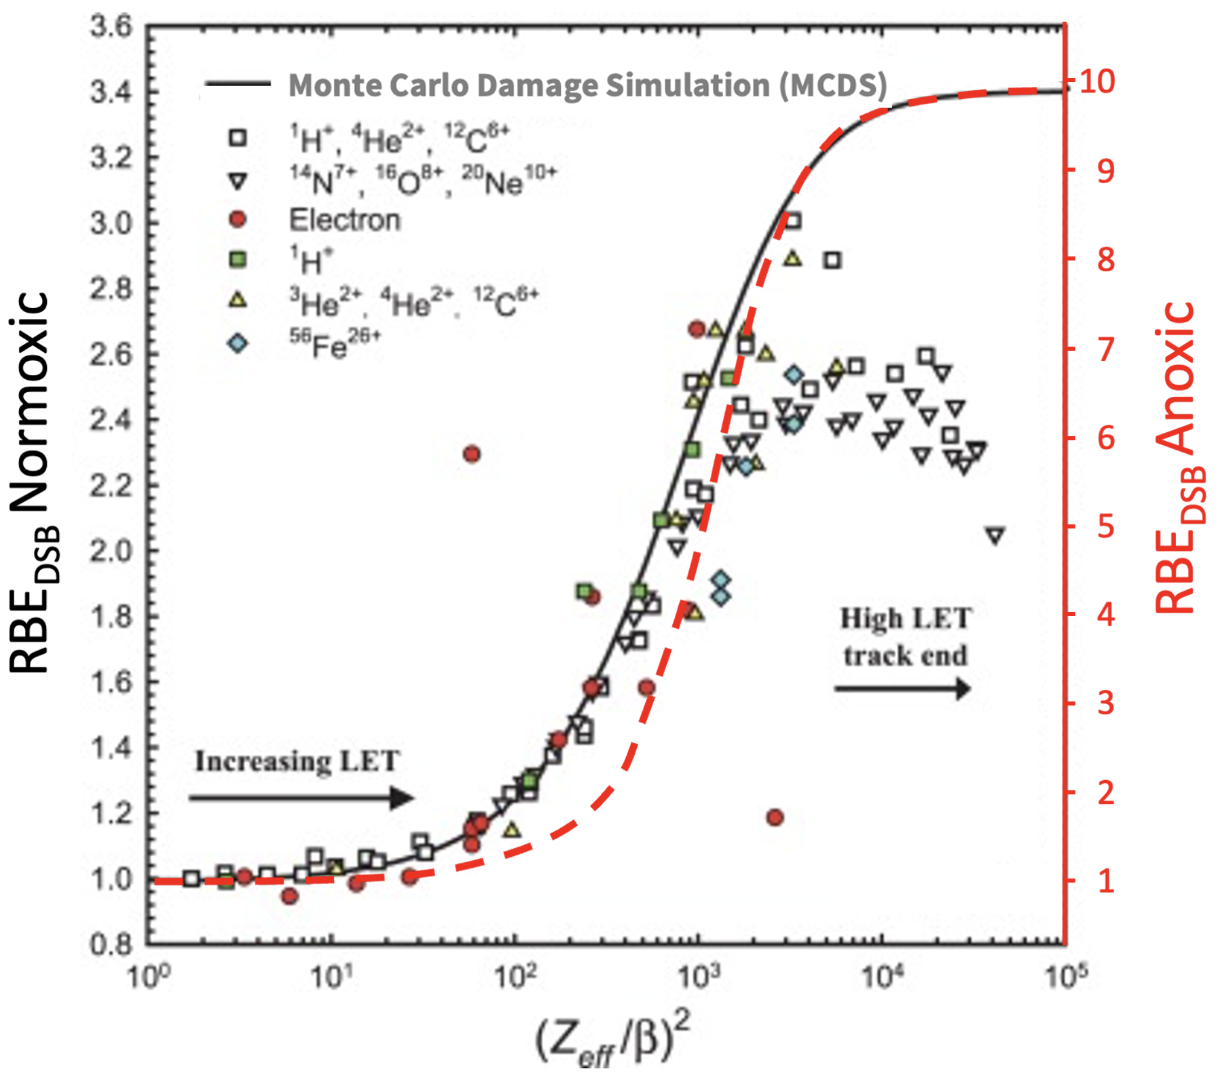
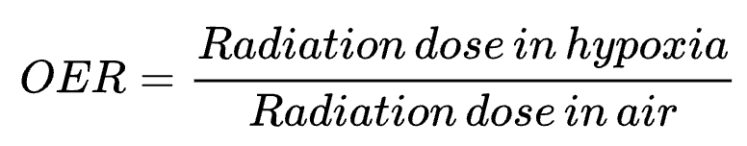
Effect of different radiation types
Relative dose deposition in the tissue
Monte Carlo estimates of the relative biological effectiveness of a double-stranded break (RBE_{DSB}) created by charged particles relative to ⁶⁰Co γ-rays.
Ebner 2022
Protons
Helium
Carbon
The Oxygen level will change the damaging power, that is the Relative Biological Effectiveness (RBE), and this depends the type of ionizing radiation.
β is the ion velocity
Z_{eff} is the effective ion charge
The oxygen enhancement ratio (OER)
Adapted from Stewart RD. Induction of DNA Damage by Light Ions Relative to ⁶⁰Co γ-rays. Int J Part Ther. 2018 Summer;5(1):25-39.

Slide 5
Radiotherapy with Heavy ions may be the “gold” modality
Carbon Ion Radiotherapy (CIRT)
Laser-driven ion therapy
C-ions offer the most precise and localized dose delivery along with high killing power
Better treatment of hard-to-reach, radioresistant, pediatric cancers
Better kill cancer stem cells, synergy with immunotherapy
High ion energy and high dose still need to be reached
FLASH effect with UHDR C-ions can be easily achieved
Acceleration of any type of ion
In the future, it might become an alternative to conventional accelerators if the size and cost are reduced.
C-ion UHDR therapy niche for multi-PW laser system
In 2023, there were only 15 carbon ion therapy centers worldwide
Globally, 3600 patients per year are treated with CIRT
For instance, the Heidelberg Ion Therapy Center (HIT) in Germany has a maximum capacity of 750 patients per year
Synchrotron C-ion facilities very expensive, reaching UHDR is difficult
Financial considerations present the most formidable obstacle: A CIRT facility costs €138.6 million, compared to €23.4 million for a photon facility.
Operational costs for CIRT is substantially high, with treatment cost per patient of 10k to 40k euros, compared to a few keuros for photons *.
*How costly is particle therapy? Cost analysis of external beam radiotherapy with carbon-ions, protons and photons. Peeters A, Grutters JP, Pijls-Johannesma M, et al. https://doi.org/10.1016/j.radonc.2009.12.002. Radiother Oncol. 2010;95:45–53. doi: 10.1016/j.radonc.2009.12.002.

Slide 6
Project Dr. LASER
Project Dr. LASER
Program: National Health Program
Priority: P5. Innovative approaches in healthcare research
Funding: co-funded by the European Regional Development Fund and the Romanian Government
Duration: 20.02.2025 – 31.12.2029
Objective: Support for the implementation of strategically important research solutions in the medical field: genomics; non-communicable diseases (e.g. development of research solutions for treating cancers); vaccines, serums and other biological medicines

Slide 7






Project Dr. LASER - Partneship
Institutul Național de Cercetare-Dezvoltare pentru Fizică și Inginerie Nucleară "Horia Hulubei” – IFIN-HH | Leader
Universitatea de Medicină și Farmacie „Carol Davila" din București – UMFCD | Partner
Institutul Regional de Oncologie Iași – IRO | Partner
Institutul Oncologic „Prof. Dr. Ion Chiricuță" Cluj-Napoca – IOCN | Partner
Universitatea Națională de Știință și Tehnologie Politehnica București – POLITEHNICA București | Partner
ACCENT PRO 2000 SRL – AP2K | Partner
iP Automatic Design SRL – IPAD | Partner

Slide 8
Basic research on laser medical applications at ELI-NP
Proof of principle experimental setups and first experiments towards:
I) Radiotherapy with laser-accelerated C-ions
II) Phase contrast imaging with laser-produced X-rays
III) Isotope production with laser-accelerated protons and deuterons
Medical focus: breast cancer (easier experimentally, increasing incidence in Romania)
5-year goals: I) C-ions - ready for design of small-animal research platform
II) X-ray imaging - ready for design of patient prototype
III) Isotopes - ready for design of small-animal research platform
A dedicated medical research facility is possible at a later stage

Slide 9
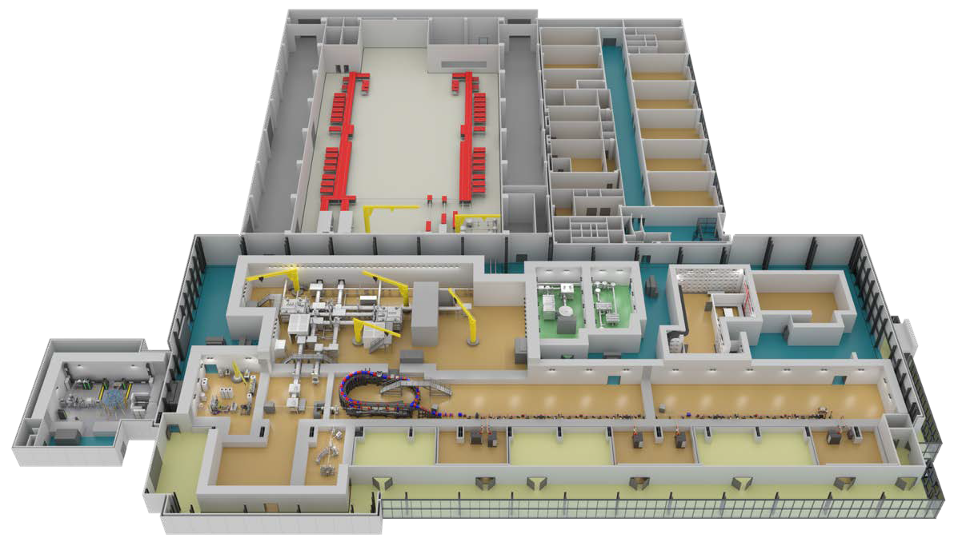
The experimental building of ELI-NP
Isotope production
100 TW/10 Hz
New 200 TW/5 Hz
X-ray imaging + isotope production
C-ion irradiation 10 PW/min
X-ray imaging
1 PW/1 Hz

Slide 10
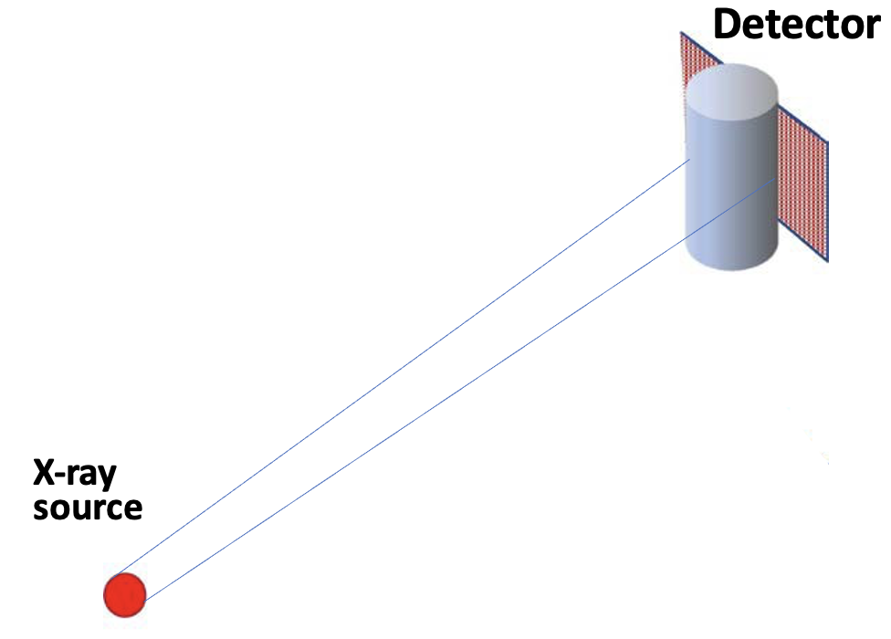
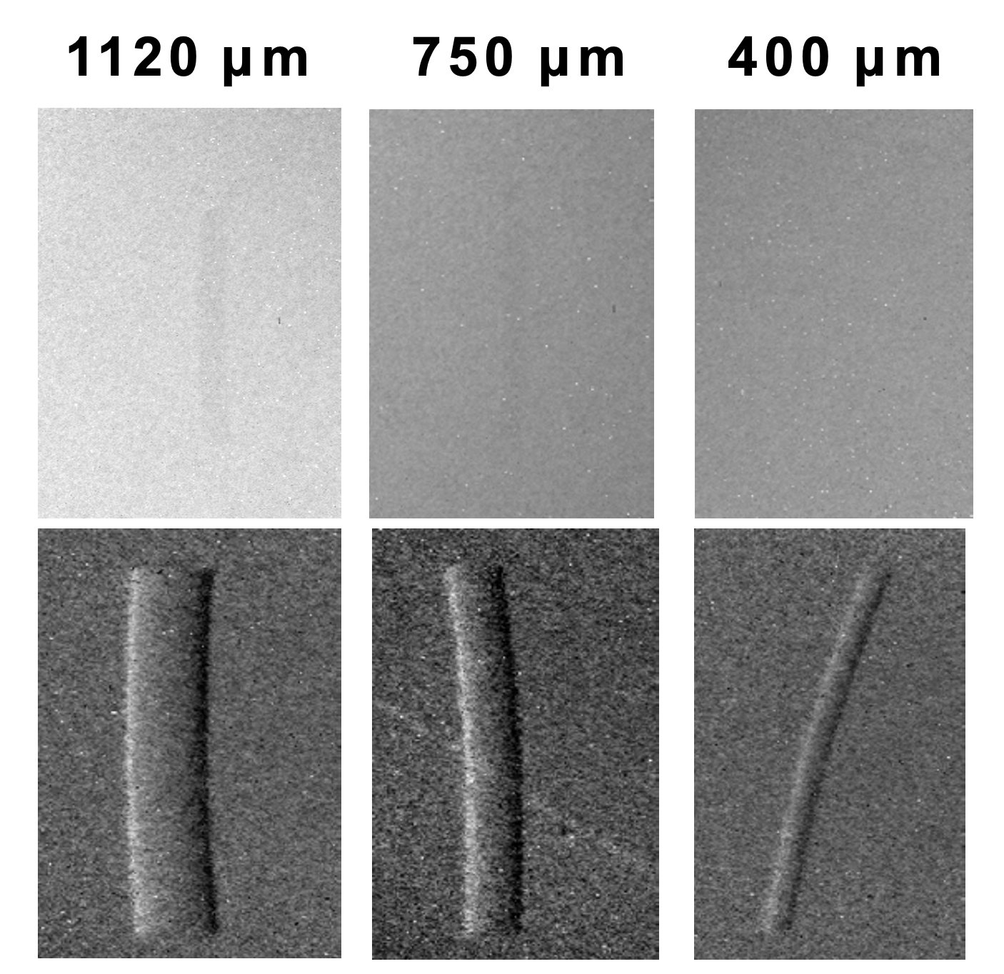
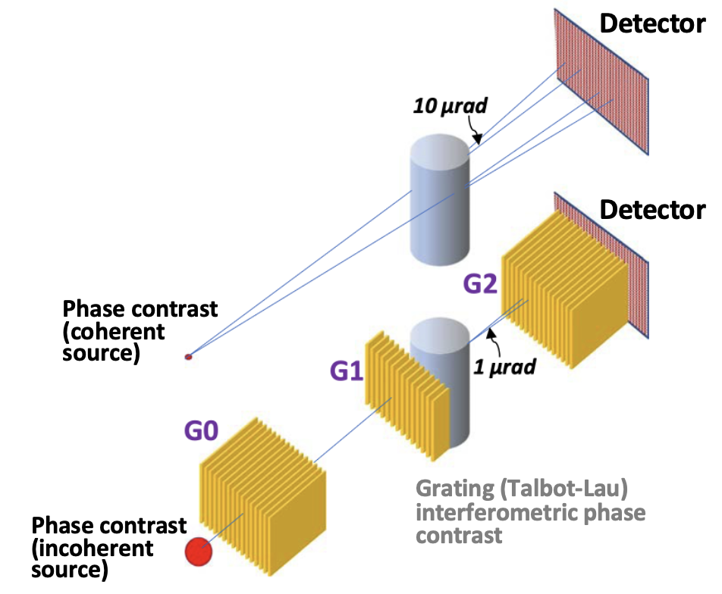
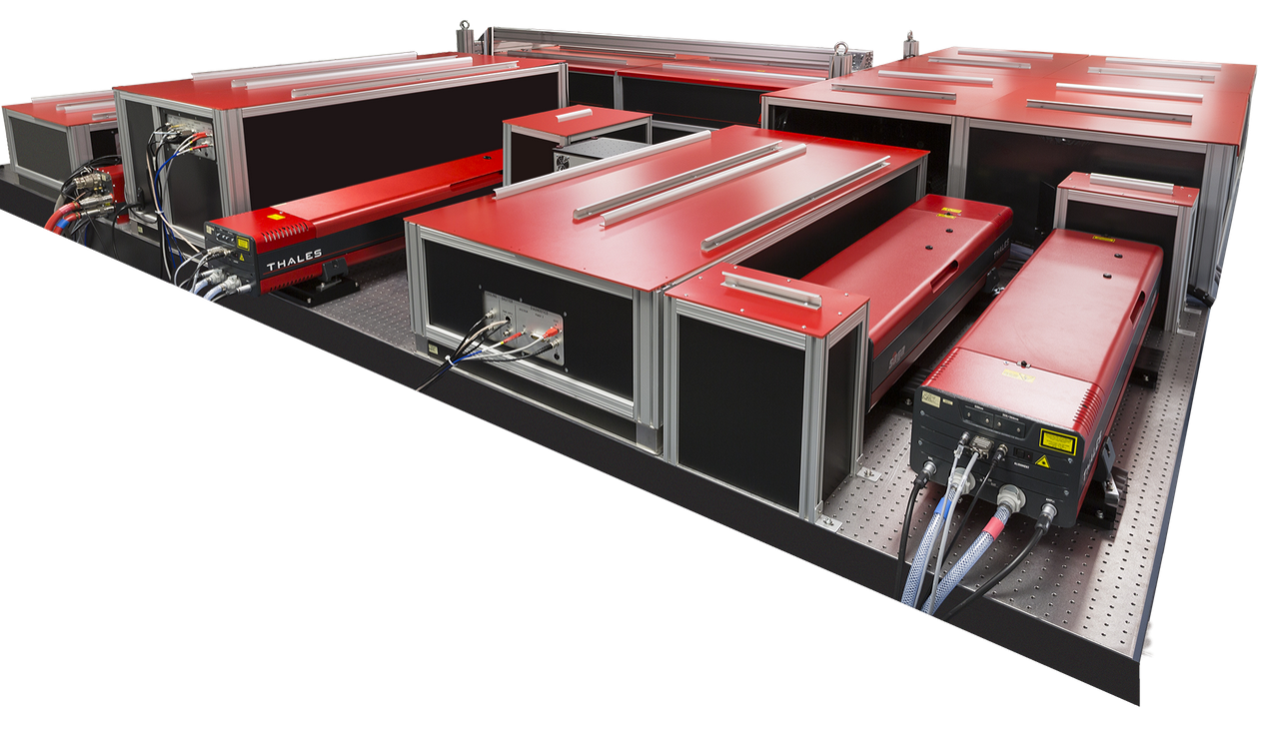
Phase contrast imaging with laser-produced X-rays
Strongly increased visibility of objects simulating breast cancer along with potential for order of magnitude dose reduction
X-ray imaging
Absorption contrast
Fibrils in mammography accreditation phantom
New 200 TW/5 Hz laser and experimental area for X-ray imaging research at ELI-NP
Conventional mammograph 2.4 mGy
Phase contrast imaging
Interferometric mammography
2.4 mGy
N Safca et al Phys Med Bio 2022
200 TW laser
X-ray of 20 - 30keV will be generated via electron betatron via LWFA at high rep. rate (5 Hz).
Conventional X-ray tubes for clinical mammography with multi-meter long interferometers will take ~ 10 min exposure, with the laser it will take seconds
Pfeiffer et al., Nature 2006

Slide 11
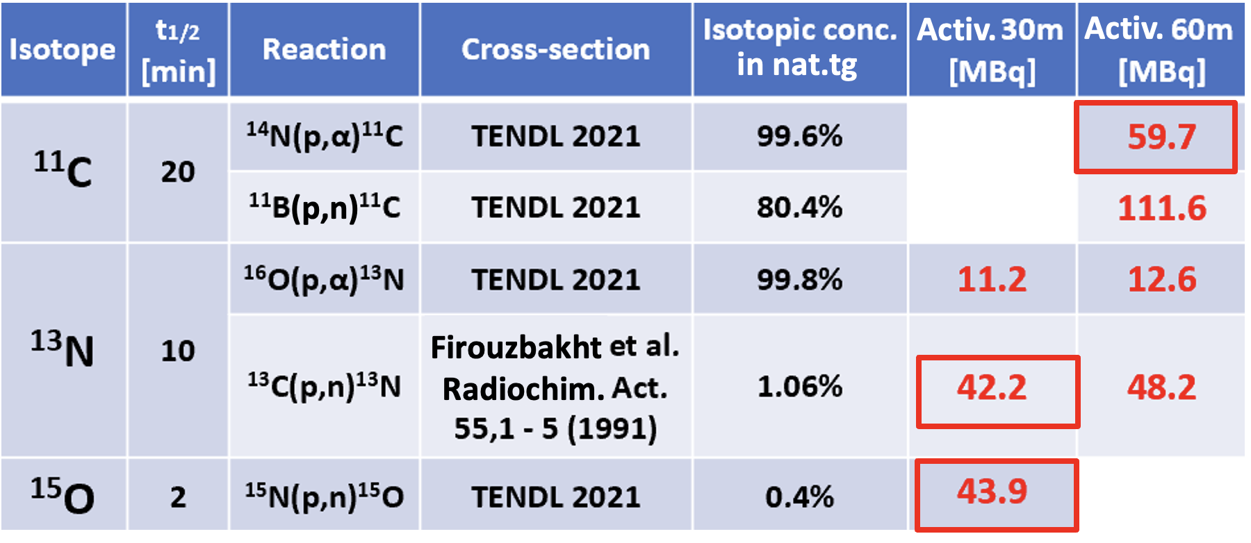
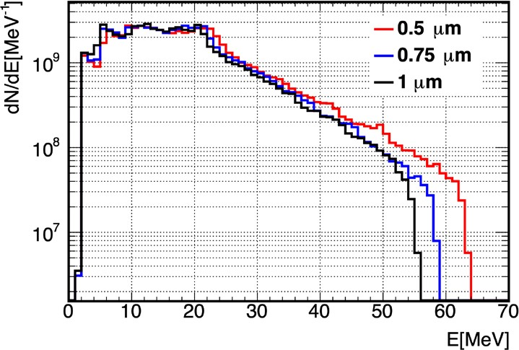
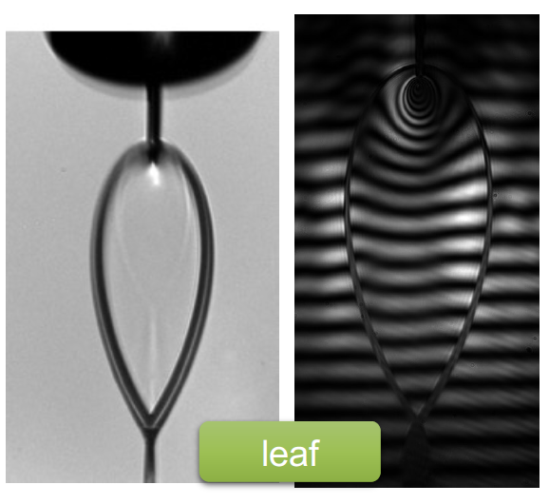
Isotope production with laser-accelerated protons and deuterons
Lasers may enable affordable on-site production of short-lived diagnostic isotopes
Short-lived PET diagnostic isotopes (¹¹C, ¹⁵O, ¹³N, ⁶²Cu) expensive to produce in hospitals and clinics
Low-cost production of small doses also important for preclinical (cell, small-animal) research
Potential for new PET applications (e.g., intra-operative tumor margin assessment with radioisotopes)
Predicted isotope production (A Cucoanes ELI-NP)
Preclinical doses of short-lived PET isotopes predicted with protons accelerated by 300 TW/1 Hz laser on water leaf target
Predicted proton spectra (P Tomassini ELI-NP)
Water leaf target
(D Ursescu ELI-NP)
Water leaf target for high rep rate, debris-free operation over long times
Proton beam focusing for high specific activity and for spectral filtering
Experiments to start with 100 TW/10 Hz, D₂O

Slide 12
Isotope production with laser-accelerated protons and deuterons
Lasers may enable affordable on-site production of short-lived diagnostic isotopes
Short-lived PET diagnostic isotopes (¹¹C, ¹⁵O, ¹³N, ⁶²Cu) expensive to produce in hospitals and clinics
Low-cost production of small doses also important for preclinical (cell, small-animal) research
Potential for new PET applications (e.g., intra-operative tumor margin assessment with radioisotopes)
Predicted isotope production (A Cucoanes ELI-NP)
Preclinical doses of short-lived PET isotopes predicted with protons accelerated by 300 TW/1 Hz laser on water leaf target
See Vincent Lelasseux’s talk on Wednesday morning
Predicted proton spectra (P Tomassini ELI-NP)
Water leaf target
(D Ursescu ELI-NP)
Water leaf target for high rep rate, debris-free operation over long times
Proton beam focusing for high specific activity and for spectral filtering
Experiments to start with 100 TW/10 Hz, D₂O

Slide 13
Radiobiology with laser-driven ions
(Towards Radiotherapy with laser-accelerated C-ions)

Slide 14
Problematics in the Laser-Driven ion acceleration
Ion acceleration (energy and flux)
Accelerating a proton to a high energy and obtaining a high flux (i.e., high dose) is not so difficult (e.g., TNSA);
Heavy ions, as Carbon, need schemes that use volumetric acceleration (i.e., bulk acceleration e.g., RPA);
Stability of the ion flux at a given energy is not yet achieved.
The minimum ion energy needed for therapy is just about achieved, but the flux is still low.
Multi-species beam and ion selection
Hydrocarbons and water as surface contaminants prevent an optimal bulk acceleration
Even if the target is cleaned of the surface contamination, the bulk can contain impurities of other elements.
For instance, a Carbon foil can contain a high level of hydrogen and oxygen, depending on the fabrication process.
A liquid or cryo-target can be used to obtain a single-species beam
Proton can be selected by filtering out other ions with a physical filter, e.g., a thin metal plate
The acceleration mechanisms can help select the ion species.
E.g., Carbon and proton with the same cut-off energy per nucleon will deflect differently in a given magnetic field and get spatially separated (see Fig.).
The beam transport can be designed with more complexity for this task.
Beam collimation and post acceleration
Laser-driven beams are generally diverging. This characteristic affects the extraction and the transport of the ions, reducing the efficiency of the beamline
Proton
Carbon
Iso-energy lines
B-field
Zero-point
E-field
Example of Thomson Parabola signal.
In a ideal RPA case all ions have the same max energy/nucleon

Slide 15
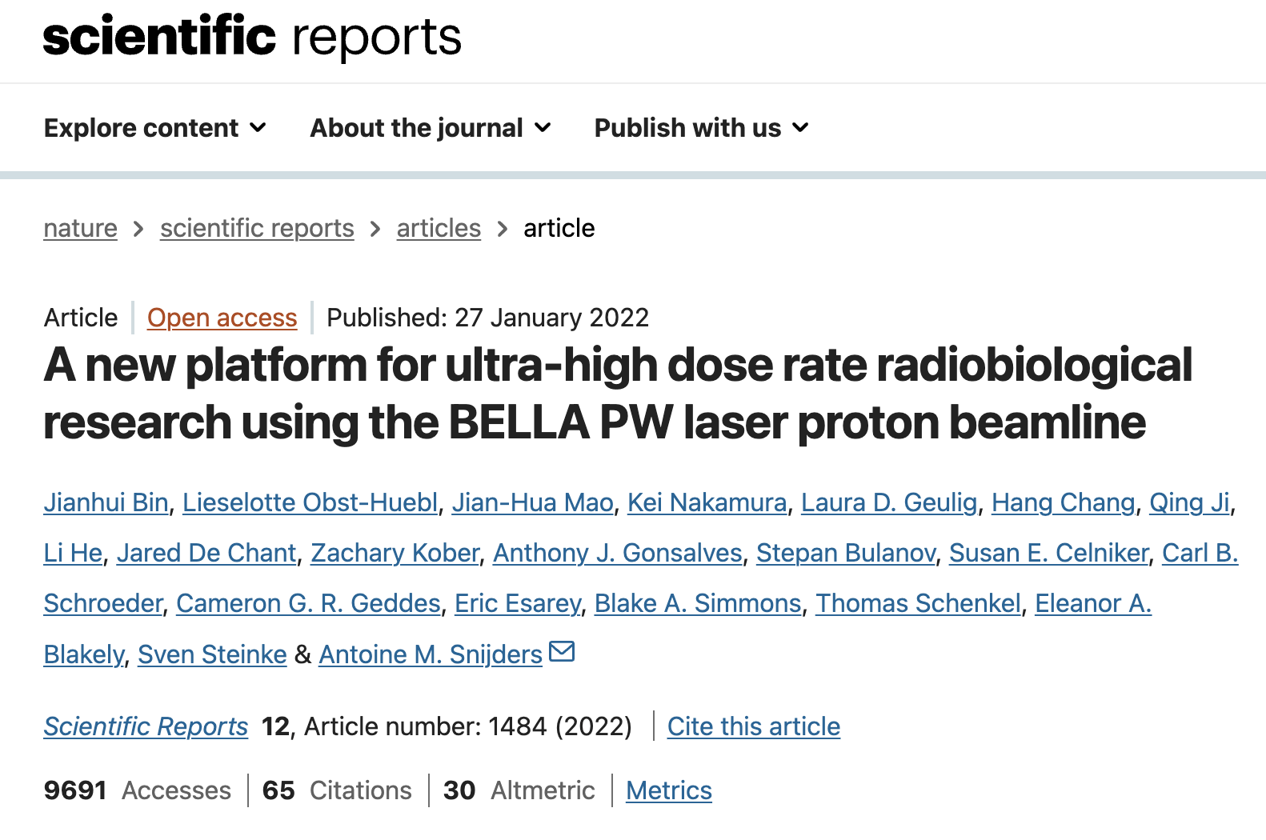
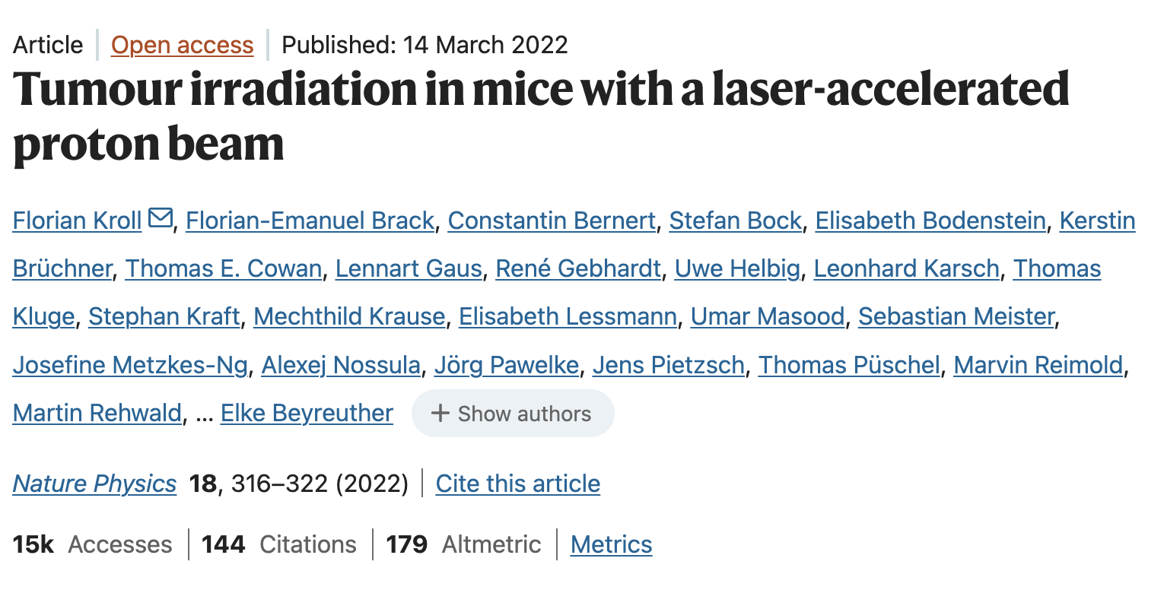
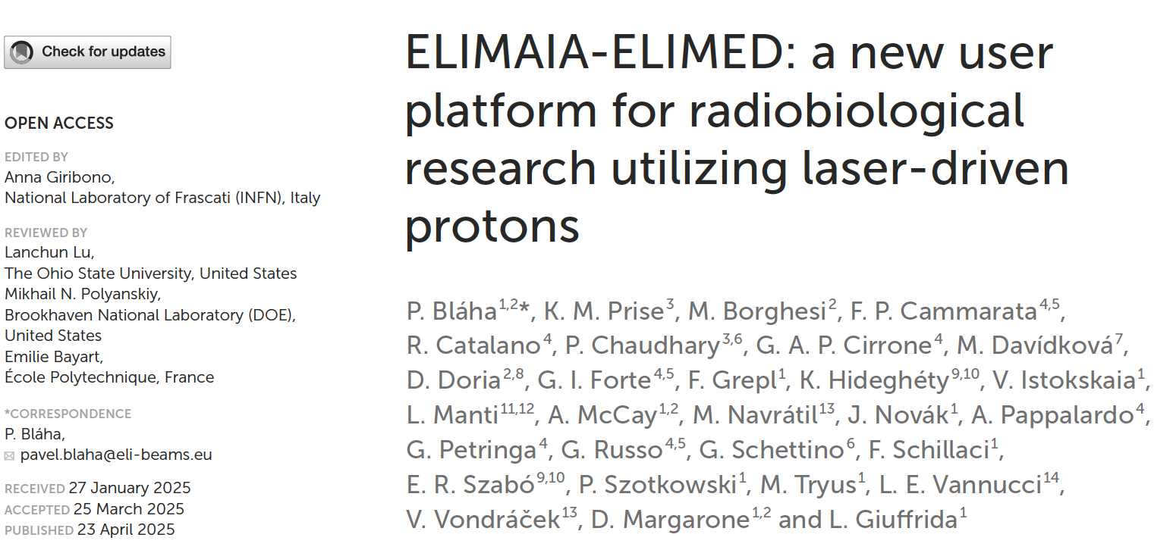
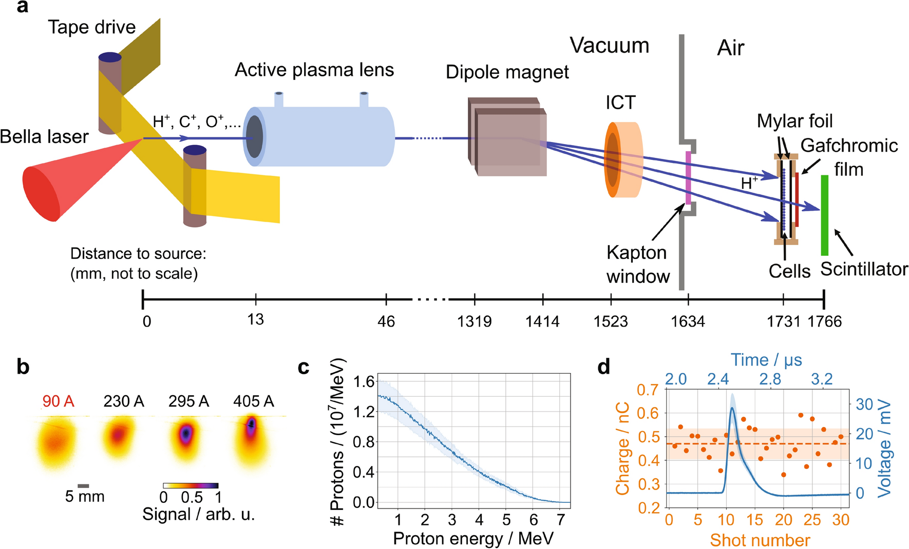
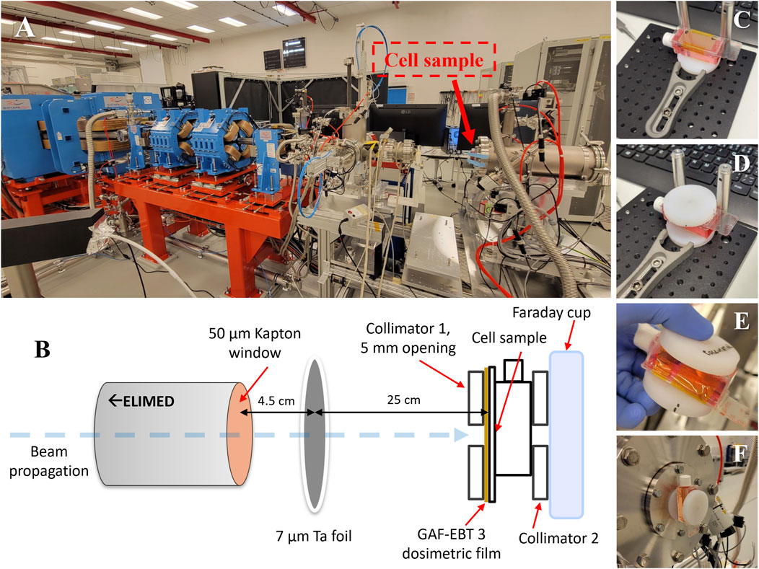
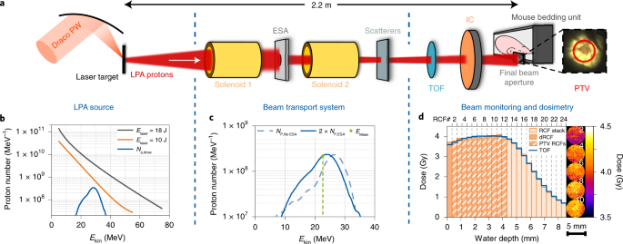
State-of-the art in Laser-Driven Radiobiology
Overview of the system for radiobiology at BELLE PW
Overview of the ELIMAIA system at ELI-BL
Overview of the system for radiobiology at Draco PW
BELLA PW laser system at LBNL, Berkeley (40 J, 40 fs). Pilot experiments applying clinically relevant doses ranging from 7 to 35 Gy via irradiation an area of 10 mm in diameter with proton bunches of ~30 ns with an average dose of 1.0 Gy per shot at 1 Hz, with a dose rate of 3 × 10⁷ Gy/s.
Beam transport via Plasma lens and dipole.
Draco PW laser at Helmholtz-Zentrum Dresden-Rossendorf (18 J in 30 fs on the target). Protons with energy ranging from 15 to 40 MeV, up to 20 Gy delivered in a single shot at 1 × 10⁹ Gy/s.
Beam transport via Solenoids and dipoles.
The ELIMAIA-ELIMED beamline, powered by the L3 HAPLS petawatt at ELI-BL. It has demonstrated protons with a mean energy of ∼24 MeV and a doses up to ∼14 mGy per shot at 0.2 Hz, with ∼4 ns proton bunch duration and a dose rate of ~3 × 10⁶ Gy/s.
Beam transport via quadrupoles and dipoles.
delivering 10 J on target (approximately one-third of its nominal full power, which will become available after a forthcoming upgrade) with a 30 fs pulse length. The maximum laser intensity is well above 10²¹ W/cm², with a repetition rate of up to 0.5 Hz,

Slide 16
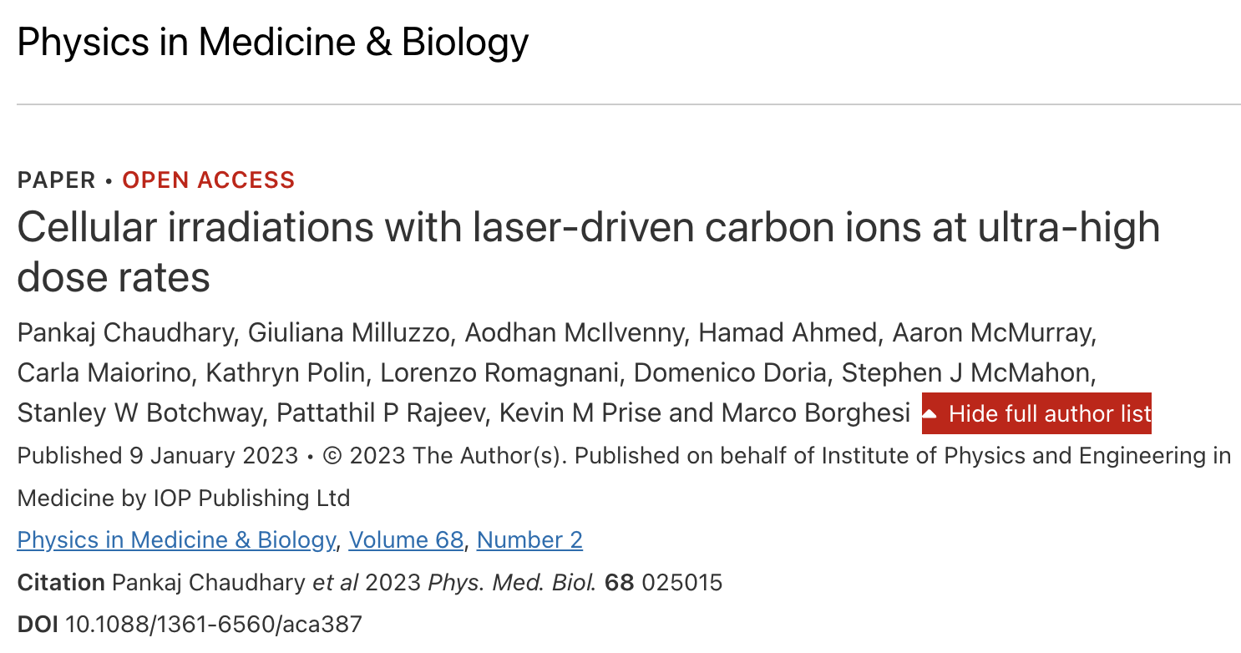
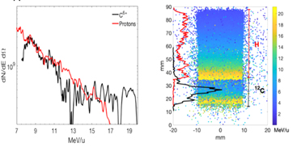
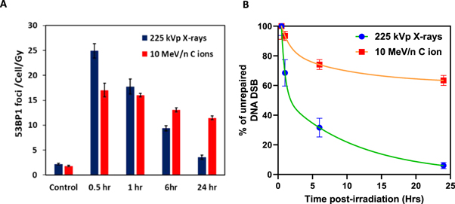
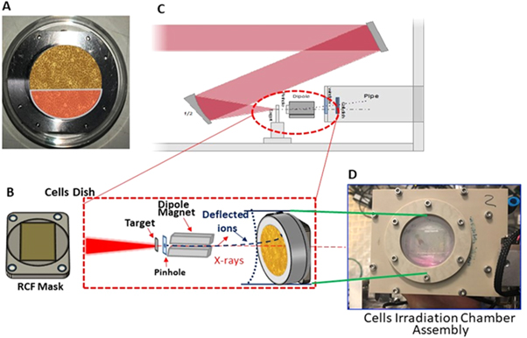
Laser-Driven Carbon ions Radiobiology
Proton and carbon (C6+) energy spectra for 15 nm carbon foil
Proton and carbon (C6+) dose distribution at cell location
GSCs were exposed to 1 Gy of 9.5 ± 0.5 MeV/n carbon ions delivered in a single ultra-short (∼400-picosecond) pulse, at a dose rate of 2 × 10⁹ Gy/s
GEMINI laser at Central Laser Facility, Rutherford Appleton Laboratory, ∼12 J, 40 fs onto 15 nm carbon foil targets, at intensities ∼6 × 10²⁰ W cm⁻², by an f/2 parabola.
Laser-accelerated carbon ions induced complex DNA DSB damage, as seen through persistent 53BP1 foci (11.5 ± 0.4 foci/cell/Gy) at 24 h and significantly larger foci (1.69 ± 0.07 μm²) than x-rays induced ones (0.63 ± 0.02 μm²)
For low LET x-ray induced DNA DSB damage, at 24 h only about 6% unrepaired DNA DSB damages were observed; while for the carbon ion the unrepaired DNA DSB damages was more then 60%.
Beam transport via a single magnet dipole

Slide 17
Ion acceleration

Slide 18
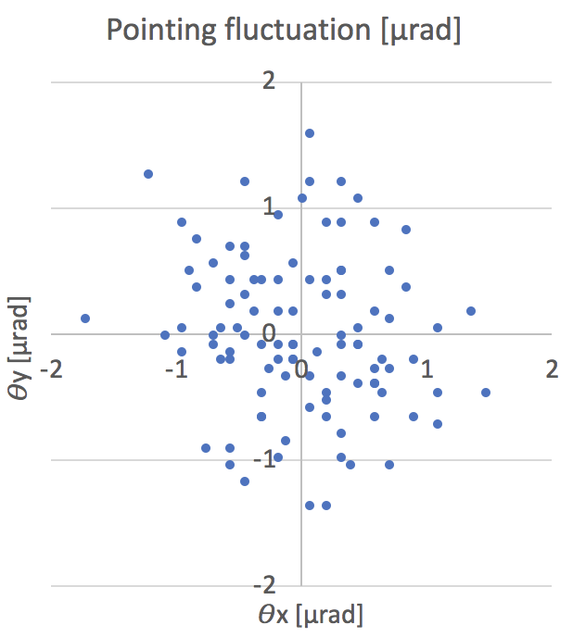
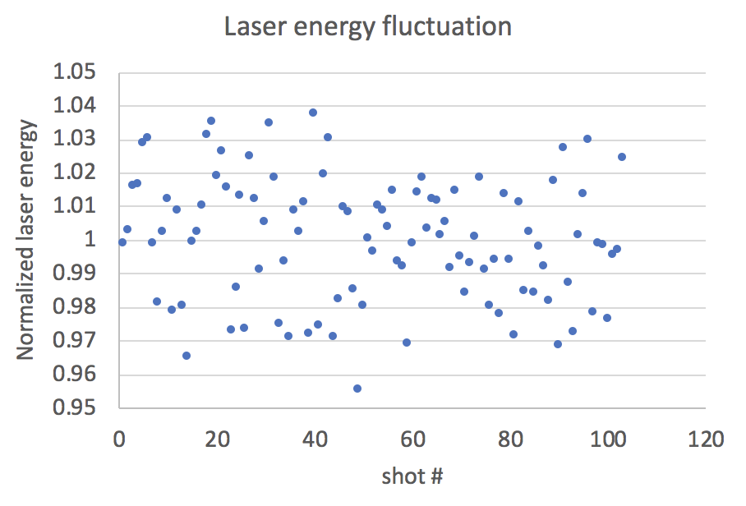
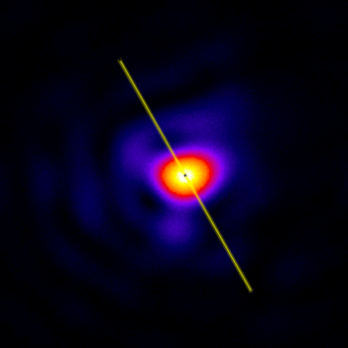
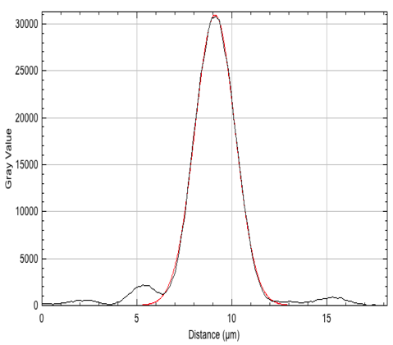
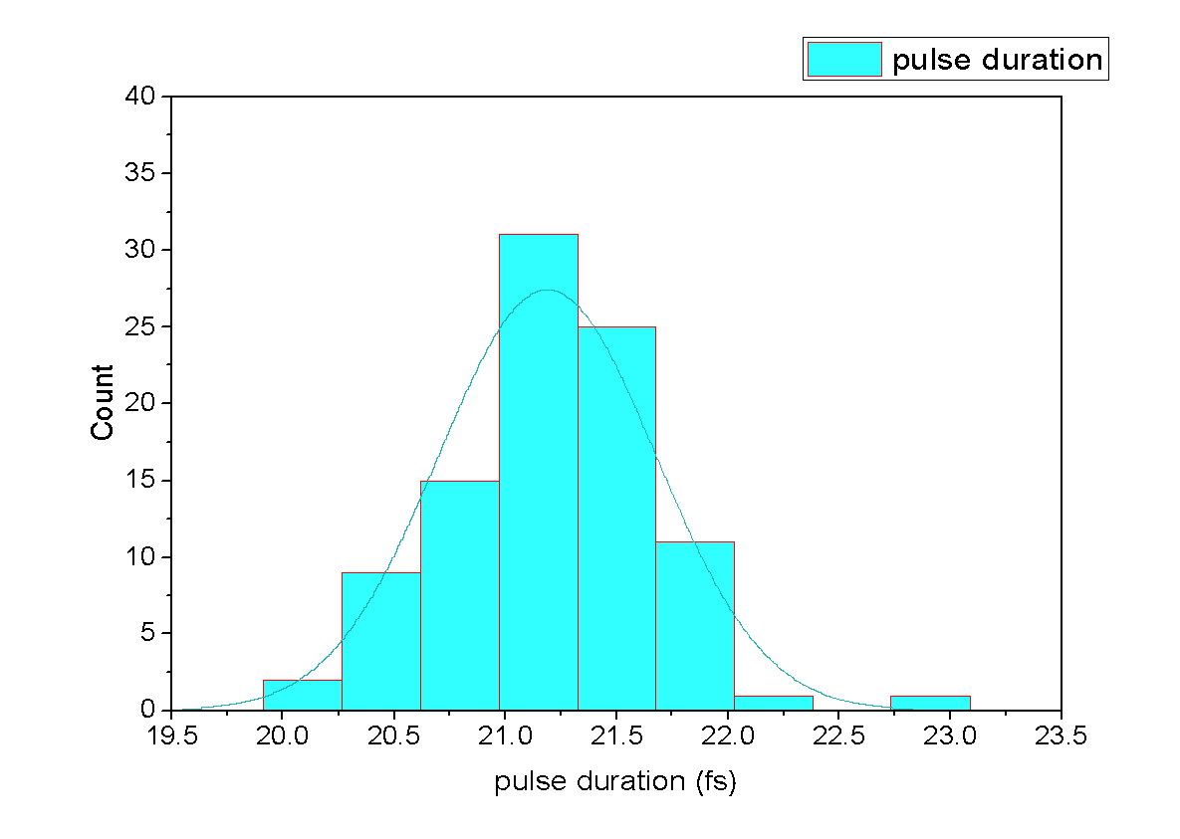
The 10 PW laser of ELI-NP (short focal)
Laser characteristics with the shot focal mirror
Parabolic mirror: 1.5 mt focal length (F# ~3)
Spot size diameter: ~ ﻿3.0 ± 0.2 µm at FWHM
Laser max. energy: <240 J on target
Encircled energy: ~ 50% @ 1/e² (ideal Gaussian beam is 86%)
Pulse duration : 23±2 fs on target
Laser energy stability at full power: ±2%
Laser pointing stability on target: < 2 µrad
~2%
Best focal spot
Far-field
Video
Statistics on best pulse duration ever at full power shots
Average pulse duration=21.2 fs
STD=0.48
Laser peak intensity
40 µJ, 25 fs
Gaussian fit
10 PW with 2.8 µm FWHM focal spot -> ~1.0 x 10²³ Wcm⁻²
with an encircled energy @ 1/e² of ~ 55% -> ~5.5 x 10²² Wcm⁻²
FWHM ~ 2.8 µm
with SPM ~ 75% reflectivity -> ~4.1 x 10²² Wcm⁻²

Slide 19
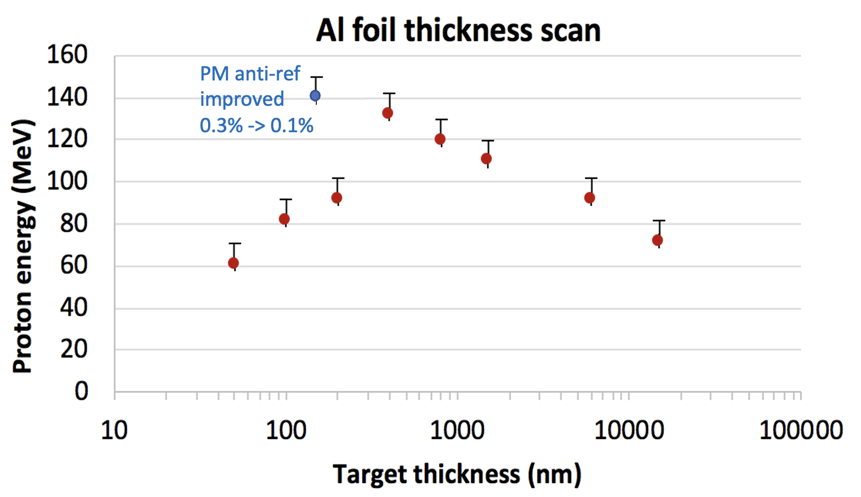
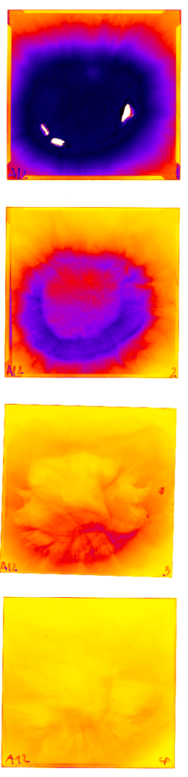
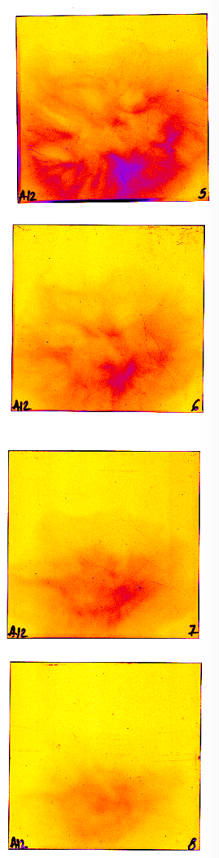
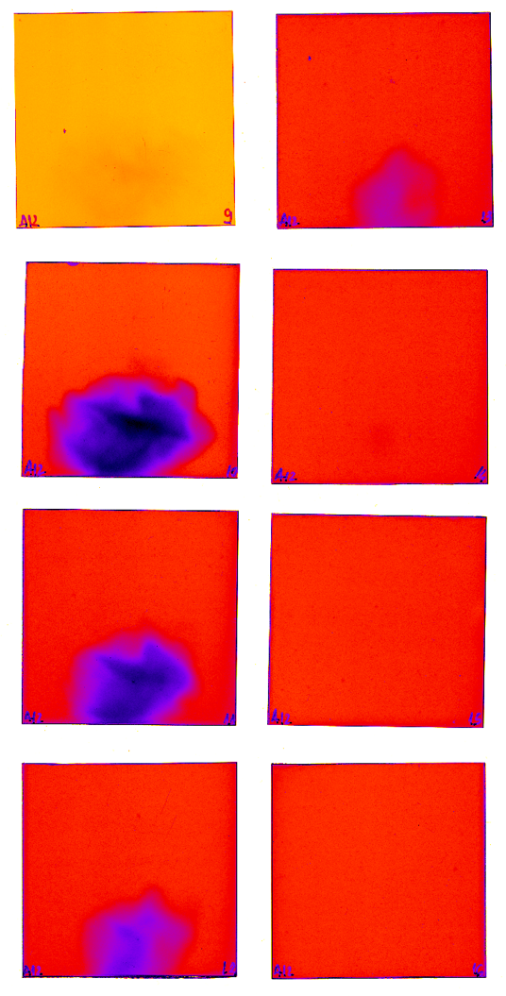
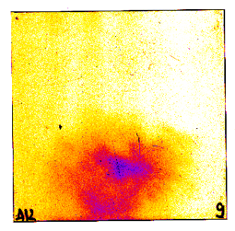
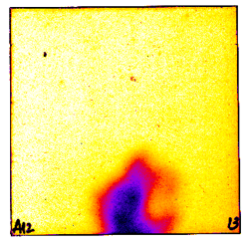
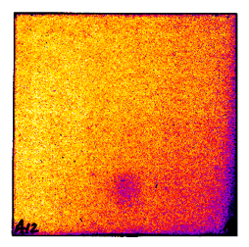
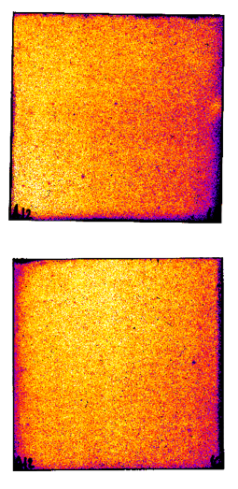
Laser-Driven proton acceleration
150 MeV proton energy with the 10 PW of ELI-NP
Al target thickness scan at full power (~3.6 x 10²² Wcm⁻²)
Radiochromic and CR39 stack detector
1 MeV
9.5 MeV
20 MeV
31 MeV
Some references that achieved milestone proton energy
58 MeV - R. A. Snavely et al., PhysRevLett 85, 2945 (2000)
85 MeV - Wagner, F. et al., Phys Rev Lett 116, 205002 (2016)
94 MeV - A. Higginson et al., Nat. Commun., 9(1):724 (2018)
~90 MeV - Hornung, J., et al., High Power Laser Science and Engineering, 8, E24 (2020)
121 MeV
132 MeV
~150 MeV - Ziegler, T., Göthel, I., Assenbaum, S. et al. Nat. Phys. (2024)

Slide 20
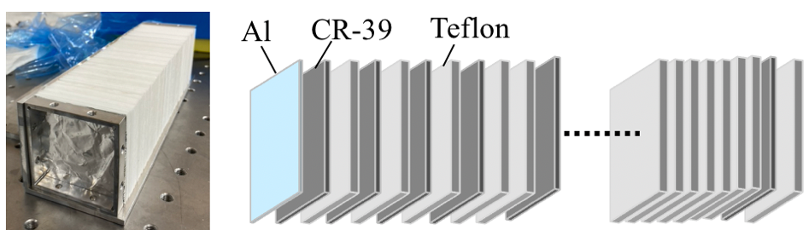
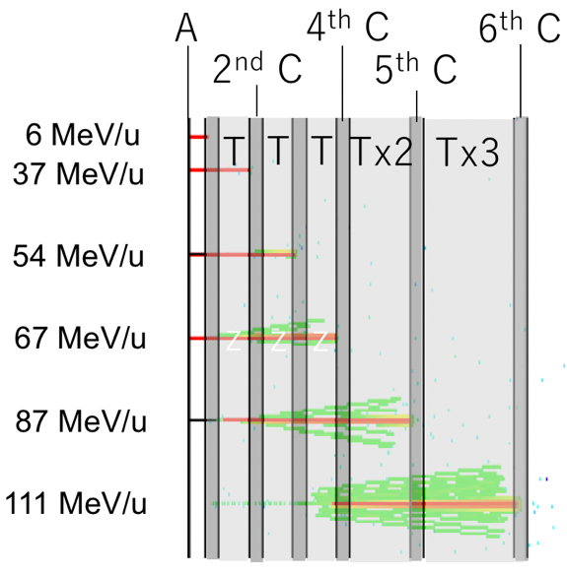
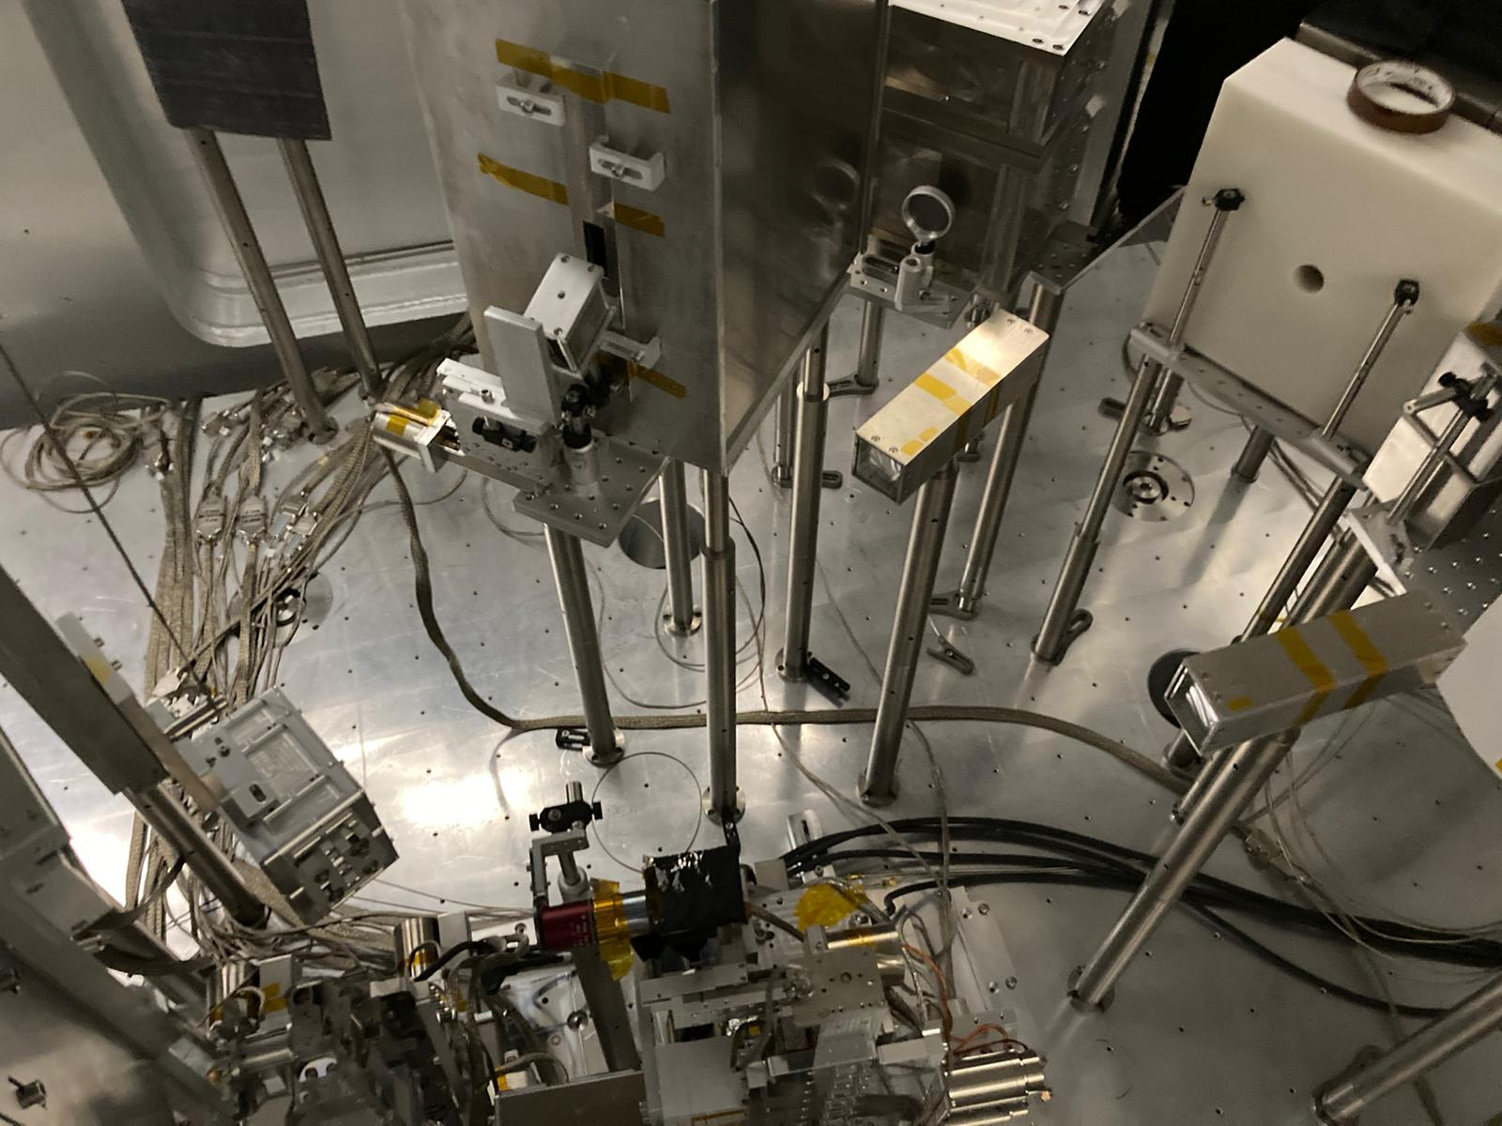
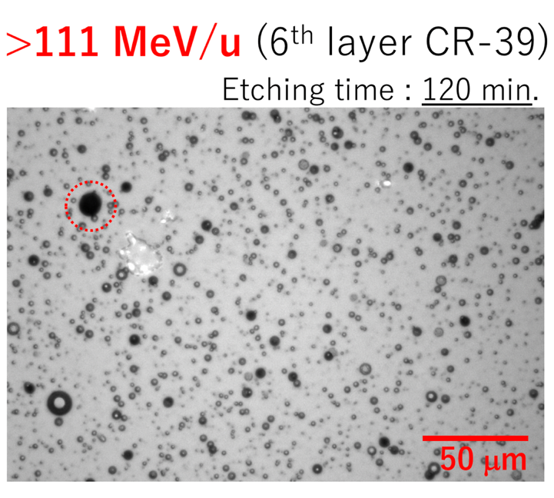
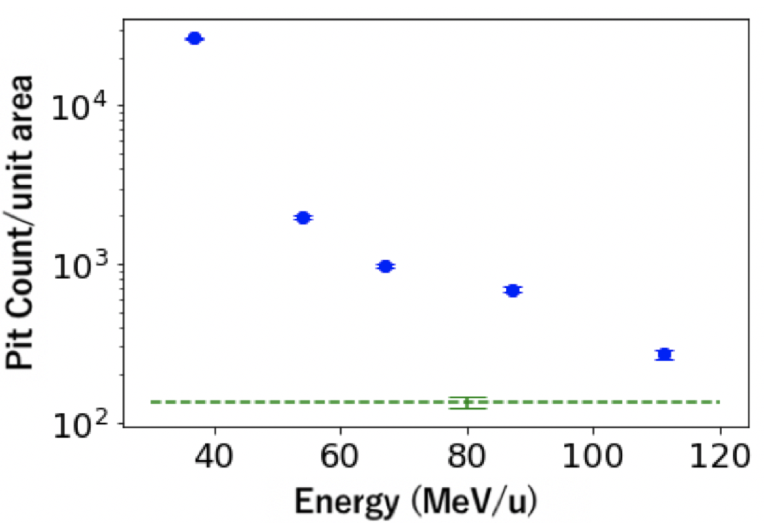
Laser-Driven Carbon ion acceleration
Above 100 MeV/u carbon Ion energy
Monte Carlo simulation for Carbon ions (PHITS²)
Schematic of the CR-39 Stack¹
M. J. Ma et al., Phys. Rev. Lett. 122, 014803 (2019) have accelerated carbon ions up to 48 MeV per nucleon
Experiemnt with the 10 PW laser of ELI-NP:
240 J, 24 fs, ~ 4 x 10²² W/cm² on target.
Accumulation of a few shots onto Gold foil ~150-200 nm
Pic of the experimental setup
1. M. Kanasaki et al., in preparation.
2. T. Sato et al., J. Nucl. Sci. Technol. 55, 68 (2018).
TP
Microscope Image of Etched Pits
A: Aluminum (13 um)
C: CR-39 (0.9 mm)
T: Teflon (1.8 mm)
CR39①
Carbon ion spectrum
TNSA
~ 4 x 10⁸ C/Sr
Laser axis
Under analysis
~ 3 x 10⁷ C/Sr
RCF
CR39②
~ 4 x 10⁶ C/Sr
Analysis by Ozaki, Kanasaki (Kobe), Fukuda (KPSI)
Notes:
M. J. Ma et al., Phys. Rev. Lett. 122, 014803 (2019), carbon acceleration up to 48 MeV per nucleon

Slide 21
Laser-Driven Carbon ion acceleration
Above 100 MeV/u carbon Ion energy
Monte Carlo simulation for Carbon ions (PHITS²)
Schematic of the CR-39 Stack¹
M. J. Ma et al., Phys. Rev. Lett. 122, 014803 (2019) have accelerated carbon ions up to 48 MeV per nucleon
Experiemnt with the 10 PW laser of ELI-NP:
240 J, 24 fs, ~ 4 x 10²² W/cm² on target.
Accumulation of a few shots onto Gold foil ~150-200 nm
Pic of the experimental setup
1. M. Kanasaki et al., in preparation.
2. T. Sato et al., J. Nucl. Sci. Technol. 55, 68 (2018).
TP
Microscope Image of Etched Pits
A: Aluminum (13 um)
C: CR-39 (0.9 mm)
T: Teflon (1.8 mm)
CR39①
Carbon ion spectrum
TNSA
~ 4 x 10⁸ C/Sr
Laser axis
Under analysis
~ 3 x 10⁷ C/Sr
RCF
CR39②
~ 4 x 10⁶ C/Sr
Analysis by Ozaki, Kanasaki (Kobe), Fukuda (KPSI)
Notes:
M. J. Ma et al., Phys. Rev. Lett. 122, 014803 (2019), carbon acceleration up to 48 MeV per nucleon

Slide 22
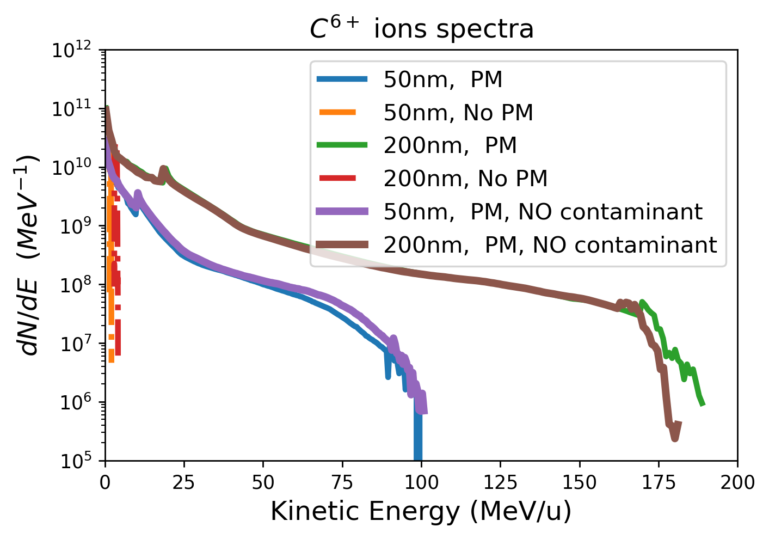
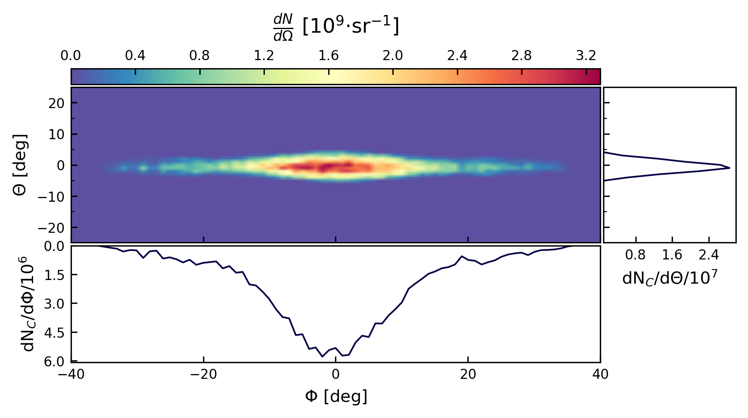
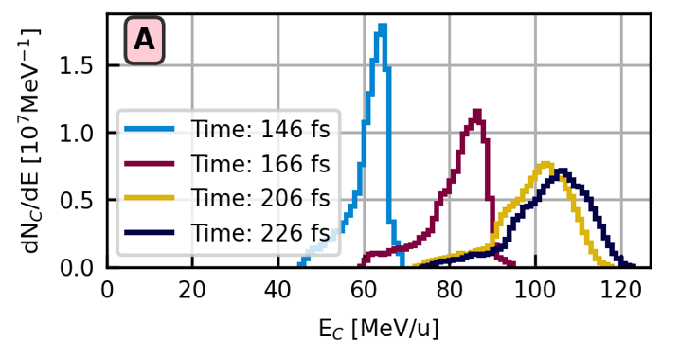
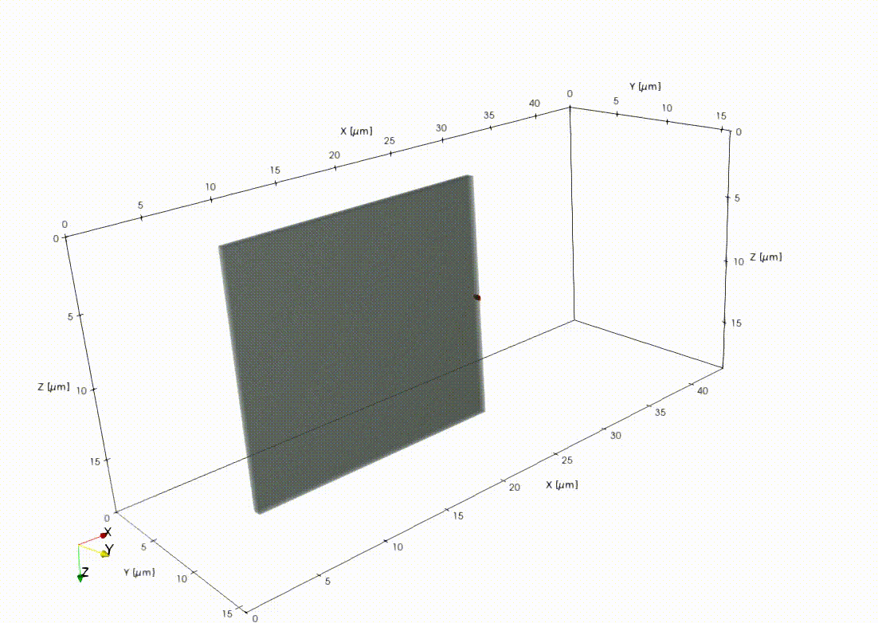
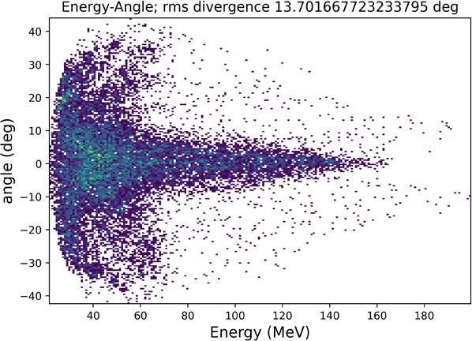
Laser-Driven Carbon ion acceleration with 10 PW
RPA Quasi-3D PIC simulations 10 PW on C foils with single plasma mirror (P Tomassini, V Horny ELI-NP)
PEELER C6+ with 10PW ELI-NP. 3D PIC simulations with Al thickness of 500nm [B. Corobean, SMILEI].
Mass-limited C source placed on the rear surface.
C⁶⁺ angular distribution
C⁶⁺ spectrum evolution
~5 deg
~15 deg
PIC simulation with 10 PW on C targets
PEELER mechanisms
Beam divergence (deg) for 200 nm C-target
~14 deg @ 100 MeV/u
B. Corobean et al., Laser–plasma acceleration of quasi-monoenergetic carbon ion beams with the “peeler” scheme, Matter Radiat. Extremes 10, 057204 (2025)

Slide 23
Multi-species beam and ion selection

Slide 24










Target cleaning investigation
Study of target cleaning in the 1 PW area of ELI-NP
Laser energy 16 J
Pulse duration 24fs
Target 70nm Al
Laser Cleaning: the CW VERDI laser was used for cleaning
TP RAW images (Enhanced contrast)
I
II
III
H⁺
H⁺
H⁺
Cleaning setup
An 8 W laser beam @ 532 nm (green)
And the optical system
Light absorber and heat-conductive tape
C⁶⁺
C⁶⁺
C⁶⁺
Front
VERDI
Back
Target
Tape
Uncleaned
Cleaned
Cleaned
Target
holder
Plastic
support
Zero-points
Unclean
After cleaning for 20 sec the proton number decreased about 6.5 times, and the carbon 6+ of about 14 times
Targets were fabricated at ELI-NP
20s cleaning with VERDI laser at 0.52 W
40s cleaning with VERDI laser at 0.52 W
The III trace shows a even less number of particle after 40 sec of laser cleaning.

Slide 25









Target fabrication at ELI-NP
Structured targets: Al lamella in Al foils for PEELER schema
SEM image of the lamella tilt
C layer
Type 1
Al lamella
Type 2
Thermo Fisher SEM-FIB system used for target fabrication (ELI-NP Target Laboratory)
FIB (Focus Ion Beam), with a Xe ions beam, was used to fabricate the lamellas from Al foil. Each target, consisting of the Al lamella, of about 600 nm thick and 25 μm width, was etched in a 2x2 mm² foil, of 25 μm thickness. Several types of targets were fabricated: type 1: 600 nm thick Al lamella without C coating; type 2: Al lamella with central C coating of about 500 x 500 x 700 nm³; type 3: Al lamella coated with a 700 nm thick C layer on its entire width and lenght.
Type 3
Structure of the Al lamella targets
SEM image of the final target

Slide 26






Target fabrication at ELI-NP
Free-standing C-based targets 100 – 300 nm thick, were fabricated at ELI-NP
Other targets
Liquid targets (e.g., He, N₂)
Optical profilometry image of a-C film indicating a surface roughness of less than 3 nm
Cross-section SEM image of a C film
Deposition system from ELI-NP Target Laboratory used for C films fabrication
Amorphous DLC free-standing targets were fabricated by RF sputtering. The XPS analysis indicated a high concentration of sp3, up to 93 %, dependent on the deposition conditions (Ar pressure and RF power applied to the sputtering target).
RAMAN confirmed the DLC characteristics of the films.
D. Ursescu (ELI-NP)
Cryo targets (e.g., He, N₂)
Free-standing 200 nm thick DLC target
XPS analysis

Slide 27
Beam collimation and post acceleration

Slide 28







Ion beam divergence control
Au Helical PM
Far-field (focus): 25 µJ, 25 fs
Generation of Helical Beams with a fs Laser
l=1
l=0
Laguerre-Gaussian beams
Setup sketch
Helical mirror element
l=2
l=3
NF screen
Gaussian
Successful generation and demonstration of the vortex beams with high orders in low-field
1 PW experimental results
10²⁰ ⁻10²¹ W/cm², 100 nm Al, best contrast ELI-NP
Near-field high power shot ~22 J, 25 fs ,~900 TW
Wavefront measurement
PV (µm) ~2.1 µm
l=3 helical WF
10 PW experiemnts with this technique are coming soon

Slide 29



Ion beam divergence control
Guided post-acceleration of laser-driven ions by a coil structure
Laser-generated electromagnetic pulse
Coil target characteristics
Proton collimation and energy enhancement
The focusing beam containing more than 75% of the total flux
Energy increase of ~ 2 GeV/m
(energy increase up to 30%)
S.Kar et al, Nature Comm., 7, 10792 (2016)
H.Ahmed et al, Sci. Rep., 11, 699 (2021)

Slide 30
Radiobiology with carbon ions at ELI-NP

Slide 31


Ion beam transport
Two stages of implementation of carbon ion irradiation systems
A simple system with a re-entrance tube and a single dipole will be used for radiobiology research with carbon ions
One of the milestones is the design, installation, and testing of an ion beam transport system for radiobiology irradiation. That is a beamline for future animal irradiation with carbon ions.
Conceptual design of the composition of the transport system by Eng. M Parrascoiu of ELI-NP.
Conceptual design by D. Doria

Slide 32
Ion beam transport
Two stages of implementation of carbon ion irradiation systems
A simple system with a re-entrance tube and a single dipole will be used for radiobiology research with carbon ions
One of the milestones is the design, installation, and testing of an ion beam transport system for radiobiology irradiation. That is a beamline for future animal irradiation with carbon ions.
See C. Marin’s Poster on today
See D. Dorobantu’s Poster on today
Conceptual design of the composition of the transport system by Eng. M Parrascoiu of ELI-NP.
Conceptual design by D. Doria

Slide 33
“Medical applications of high-power lasers - Dr. Laser”
www.eli-np.ro/projects/drlaser/
SMIS Code: 326475
Project co-financed by the European Union and the Romanian Government within the Romanian Health Program
“This material does not represent the viewpoint of the European Union or the Romanian Government, neither of them being liable for the way the information contained in this presentation might be used.“

