Slide 1






Perspectives for the physics of nuclear decays in laser-generated vs ECR plasmas
David Mascali, Domenico Santonocito
on behalf of INFN-LNS Plasma Team and the PANDORA collaboration

Slide 2



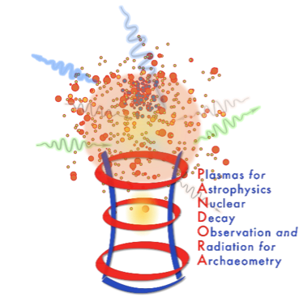
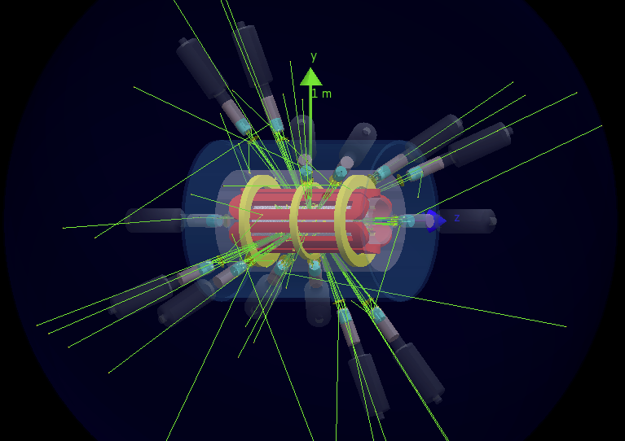
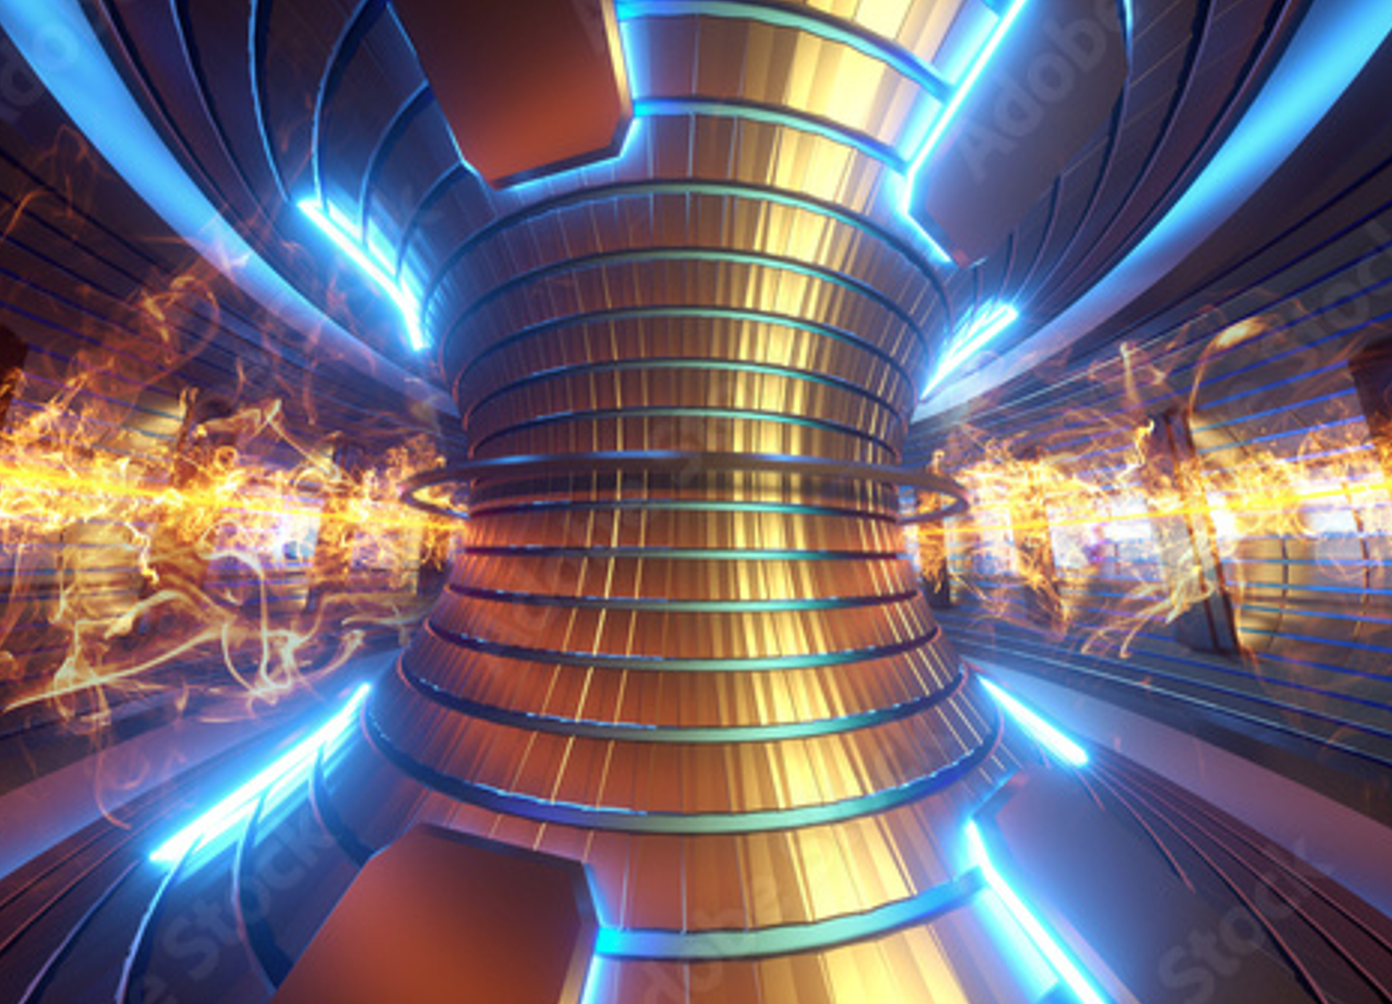



The PANDORA Collaboration
PANDORA project is founded by INFN (National Institute of Nuclear Physics)
The collaboration includes 34 departments/laboratories in Italy and Europe
SAMOTHRACE (SiciliAn MicronanOTecH Research And innovation CEnter) Ecosystem funded by the EU Next Gen Program
Production of new isotopes (from metals) for Quantum Technology manufacturing and optimization
Innovative R&D for Plasma Diagnostics:
Detectors and technologies for Fusion Power (Energy)

Slide 3
β-decay investigation in matter: from early experiments to Storage Rings
Long standing question: How constant really are nuclear decay constant ?
One of the paradigms of nuclear science since the very early days has been the general understanding that the decay constant is independent of extranuclear considerations
What happens to β-radioisotopes under extreme conditions of Temperature (2500 K), Pressure (2000 atm) or Magnetic fields (80000 G) ? → almost nothing… < 0.05 % decay constant variation
In 1947 Segrè and Daudel pointed out that the possibility to alter the decay rate (e.g. of ⁷Be) by changing the electron density, at least for low Z nuclei, an effect due to different chemical environment
How does the surrounding chemical environment (lattice structure and electron affinity) affect the host atoms decay? (e.g. ⁷Be →⁷Li) → A variation of E.C. lifetime of around 3.5%
G. T. Emery, Perturbation of Nuclear Decay Rates, Annual Review of Nuclear Science 22, 1972
H. Mazaki et al., Effect of Pressure on the Decay Constant of ^{99m}Tc, Phyc. Rev. C 5, 1972
E. Segrè , Possibility of altering the decay rate of a radioactive substance Phys. Rev. 71, (274) 1947
G. T. Emery, Perturbation of Nuclear Decay Rates, Annual Review of Nuclear Science 22, 1972
What happens when atoms are highly ionized? → Storage Rings (data already available) + PANDORA @GSI !!! (coming soon…)

Slide 4
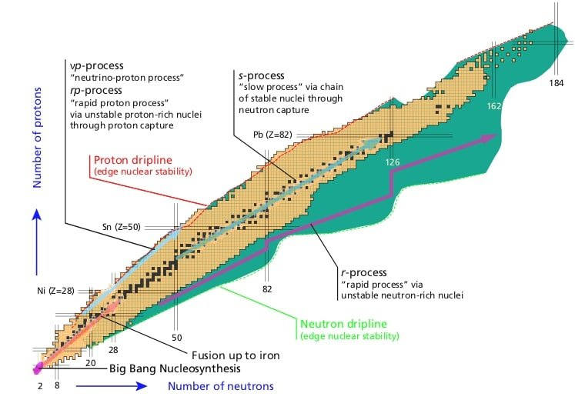
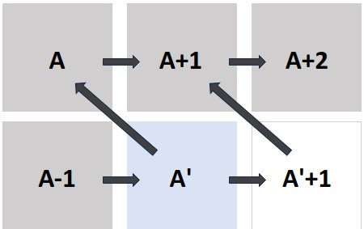
Neutron Capture Processes
Slow Neutron Capture (s-process)
Takes place inside AGB stars (main branch) and massive stars (weak branch)
Neutron density around 10⁵⁻⁶ cm⁻³ from either ¹³C(α,n)¹⁶O or ²²Ne(α,n)²⁵Mg reactions
τ_{n} ~ [d to yrs] competes with τ_{β} [d to yrs] to synthesise 60<A<208 elements in equilibrium
COSMO-CHRONOMETER
reproduction of ¹³⁴Ba, ¹³⁶Ba s-only isotope yields
Chart of nuclei and nucleosynthesis pathways. R-process takes place far from the valley of stability and proceeds through waiting point nuclei.
T.R. Rodriguez, J. Phys. Conf. Ser. 503 (2014)
Solving the puzzle about the contribution of s-processing to ⁹⁴Mo: β-decay or binary stars

Slide 5
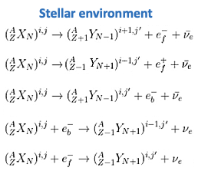
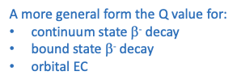
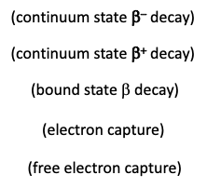
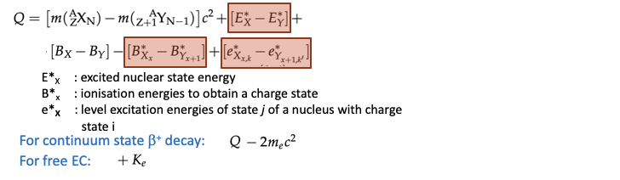
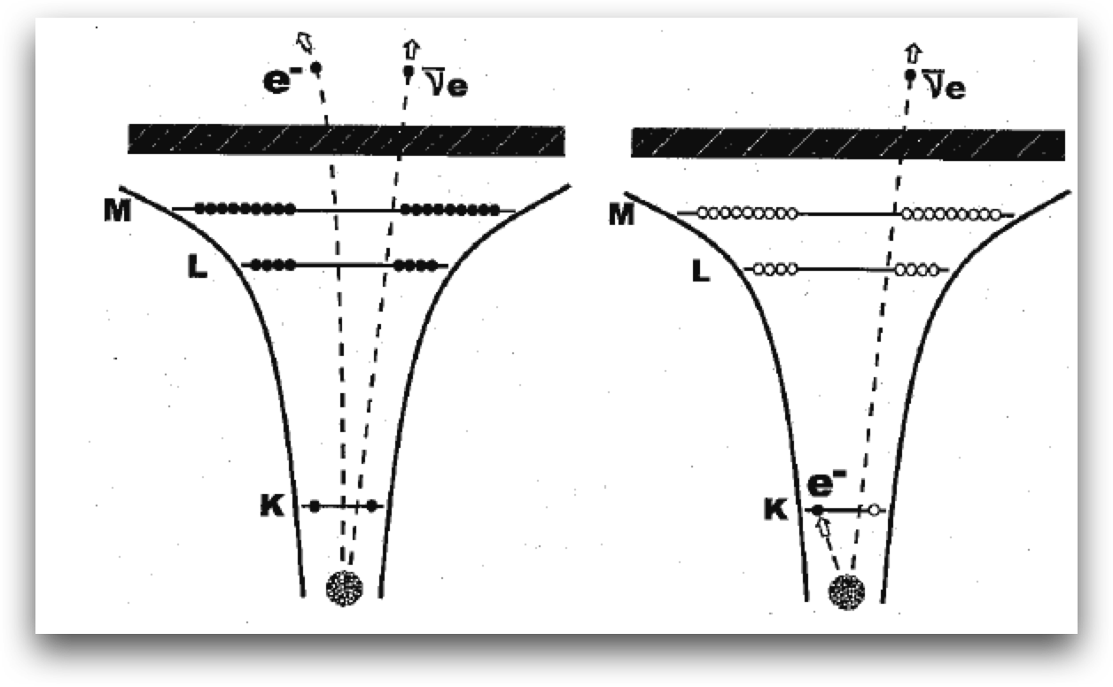
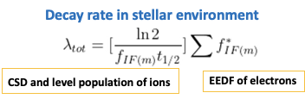




Fundamentals of Beta decay theory

Slide 6
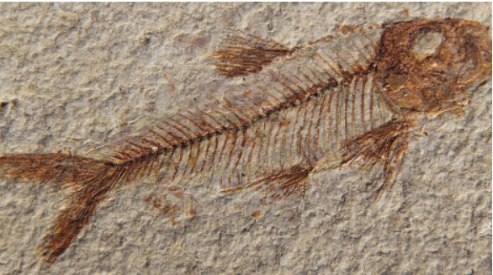
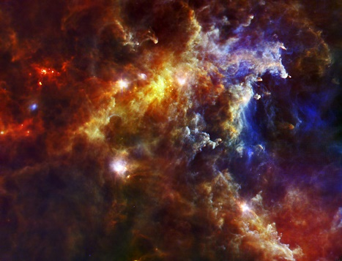


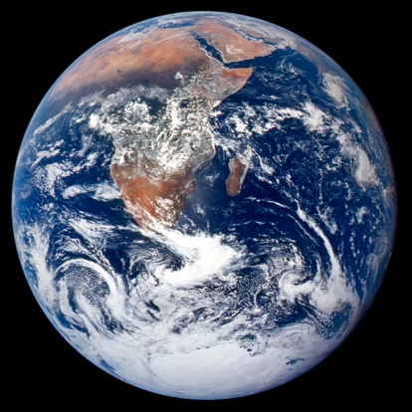
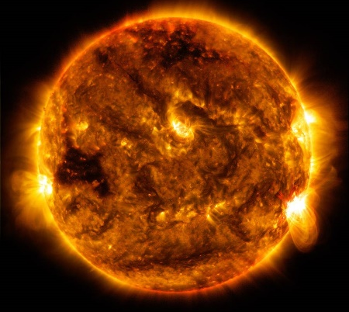
Other Astrophysical implications of β-decays in plasmas
β-decay occur with hugely different lifetimes in a plasma: this has a huge impact in stellar nucleosynthesis chains
COSMOCHRONOMETERS: ¹⁸⁷Renium, ¹⁷⁶Luthetium, etc
The cases of ¹⁸⁷ Re or ¹⁷⁶Lu are quite impressive:
Neutral atoms have lifetime of >30 billions of years,
In can be reduced to 30-40 years only if in plasma-highly ionized state!
A BILLION OF TIMES SHORTER!!!
NUCLEOSINTHESIS
¹⁸⁷Re: dating astrophysical or cosmological objects
T_{1/2} = 42 billios of years!
¹⁴C: for dating of fossils
τ = 8267 years
On our planet
in astophysical Plasma
https://www.nasa.gov/multimedia/imagegallery/iotd.html

Slide 7

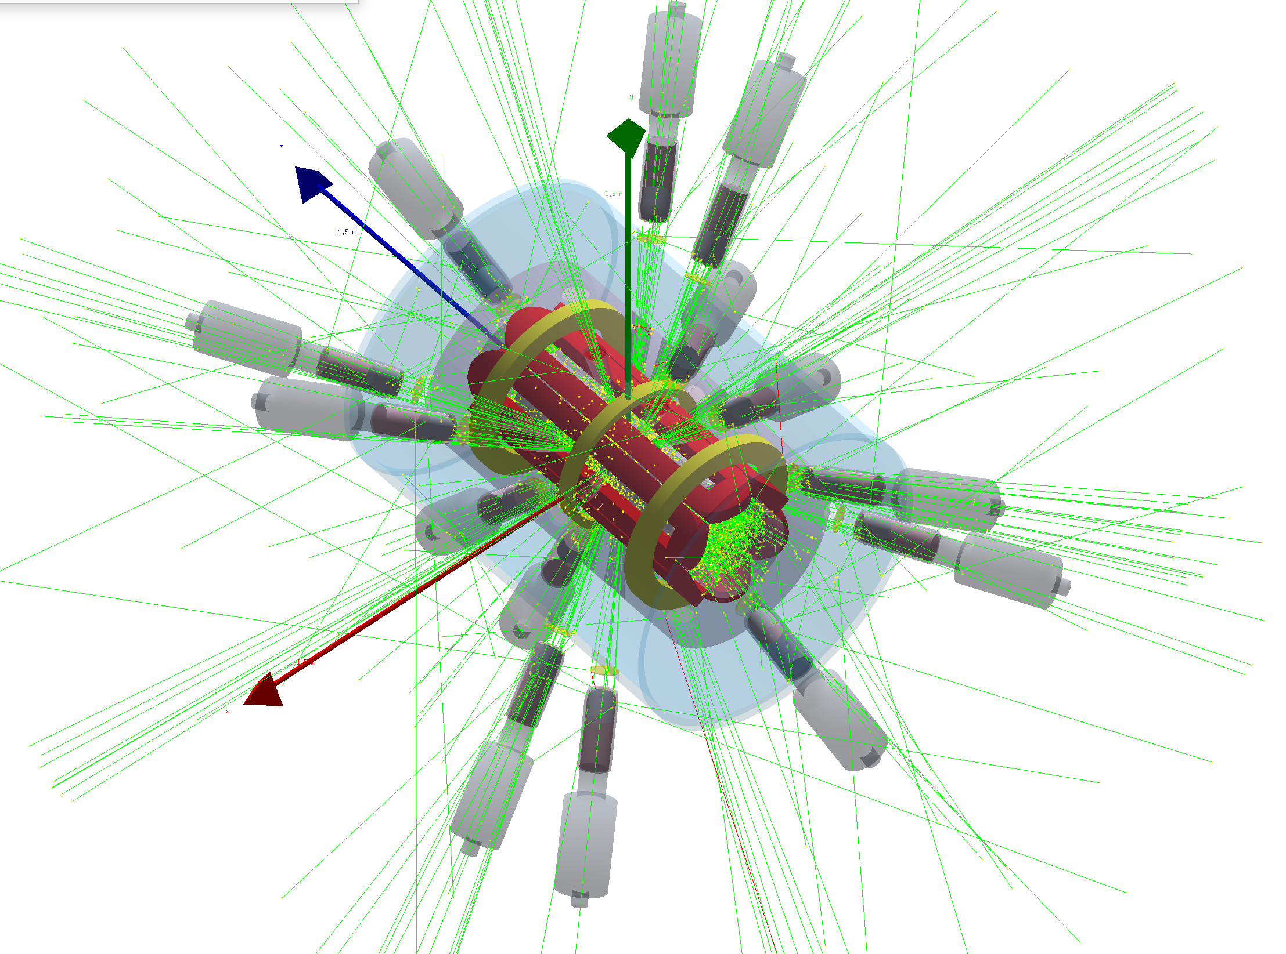


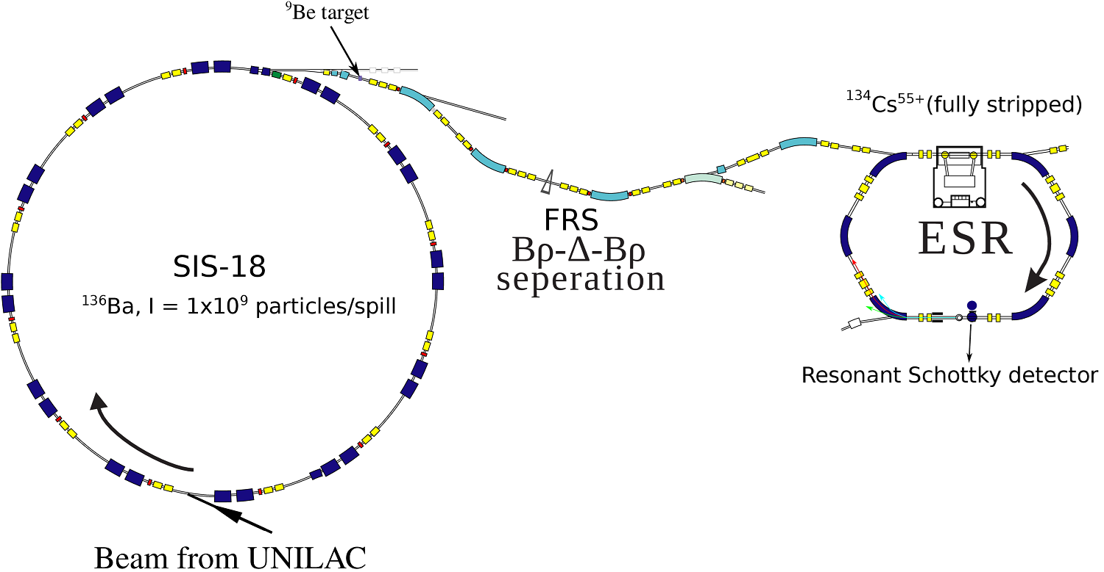
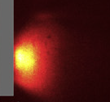
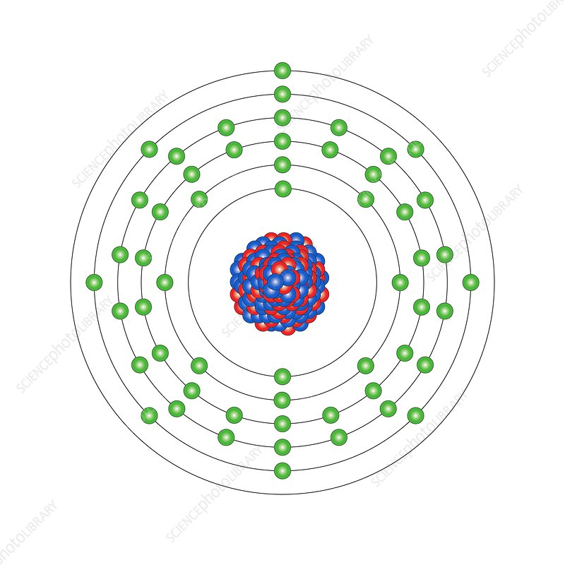
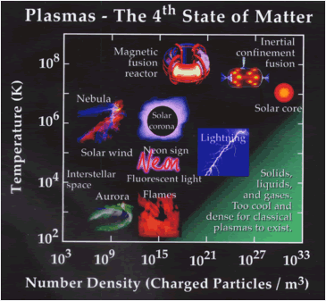



Plasma Properties
Towards the fully understanding of β-decays in matter
Leptonic (atom/ion) + plasma + hadronic contribution (ground vs. excited/isomeric states)
Leptonic (atom) contribution
BSBD
Leptonic (atom → ion) + plasma contribution
K-shell
β
Fully-stripped/H/He-like Ions

Slide 8
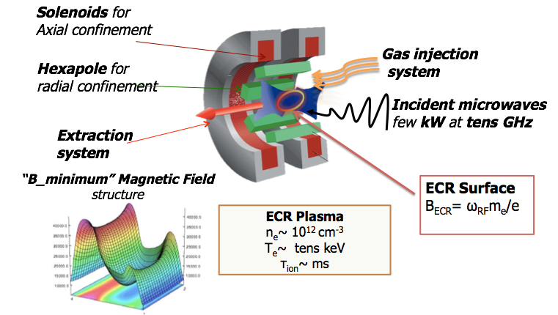
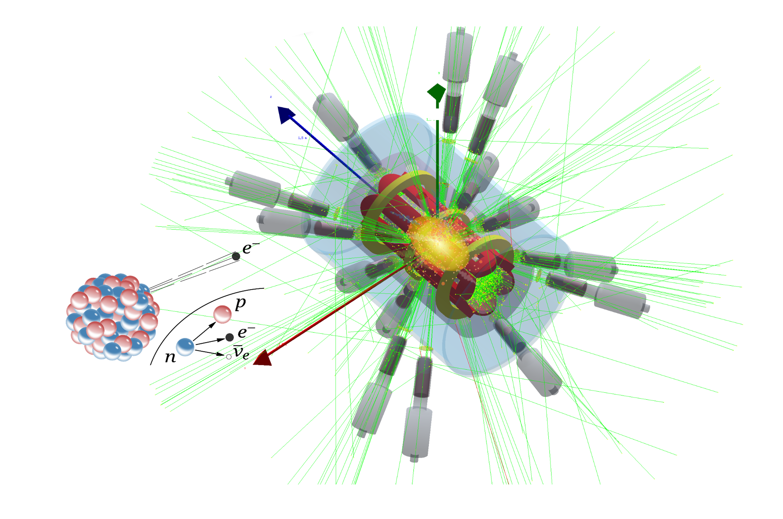
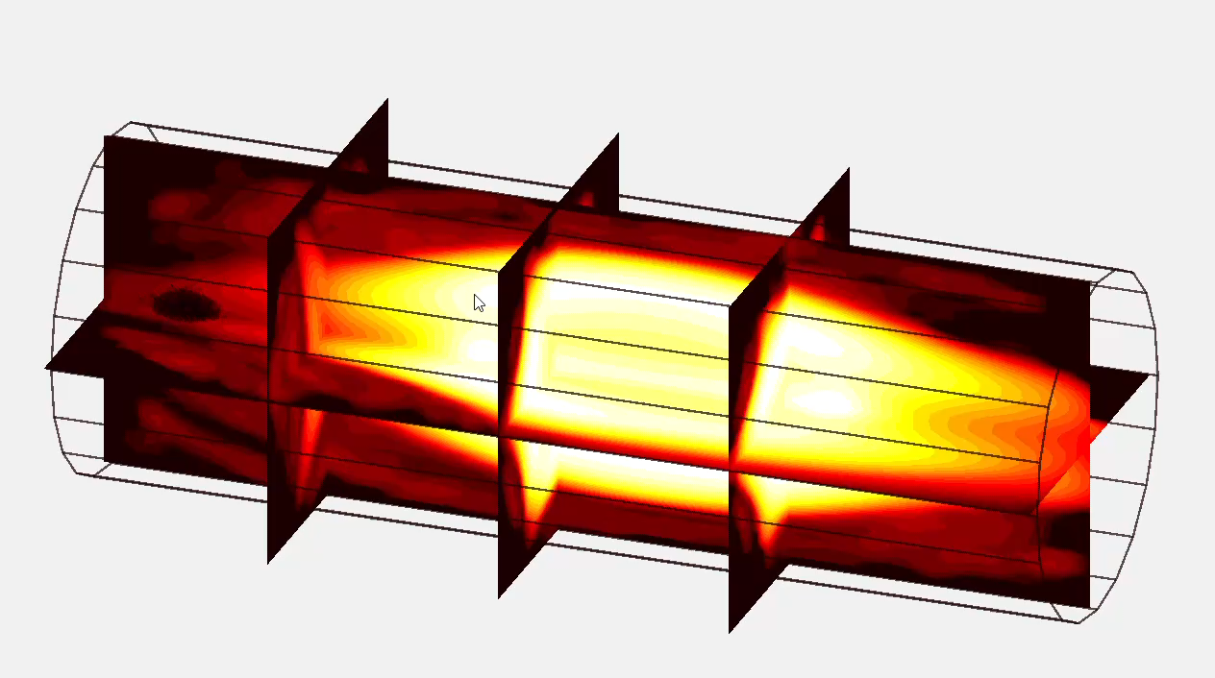
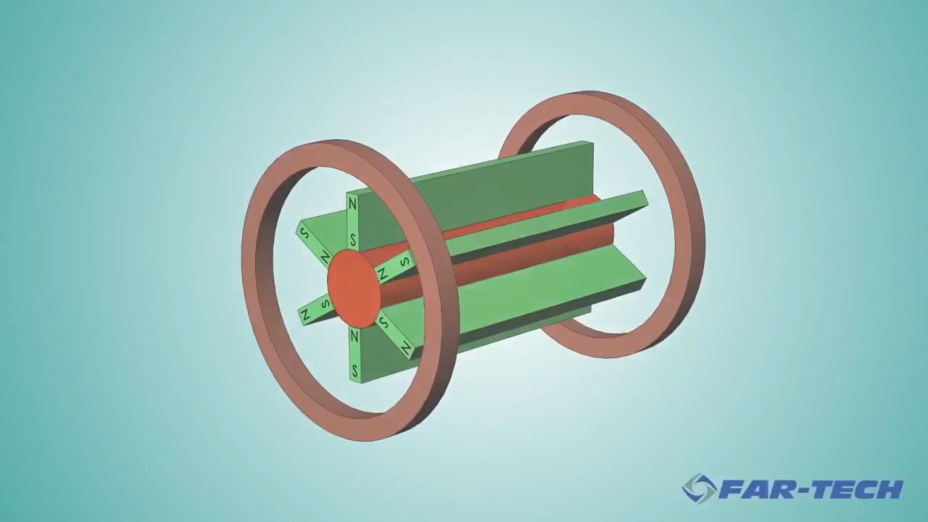
PANDORA in a nut-shell
HpGe detectors
γ-rays
Simplified representation of electrons motion in a B-minimum trap
Mascali, D. et al., EPJ-A, 2017
Mascali, D. et al. Universe 2022, 8, 80

Slide 9
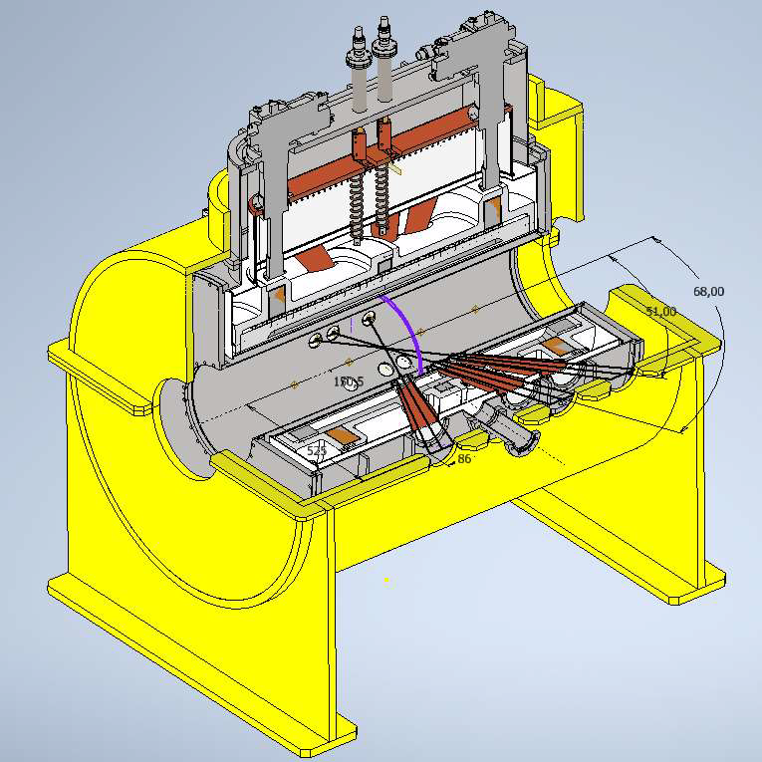
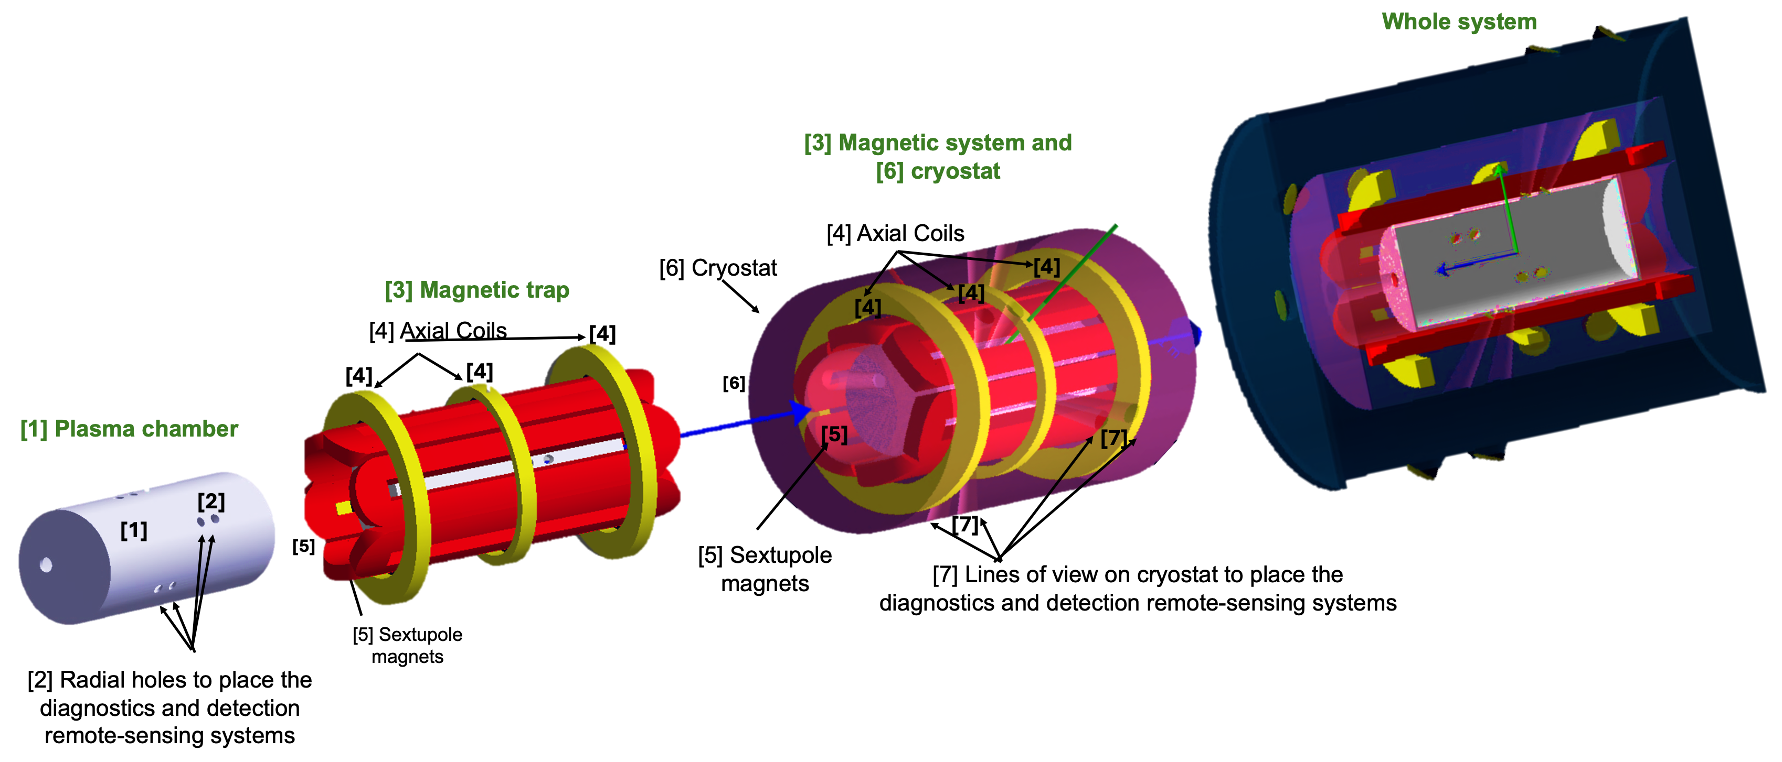
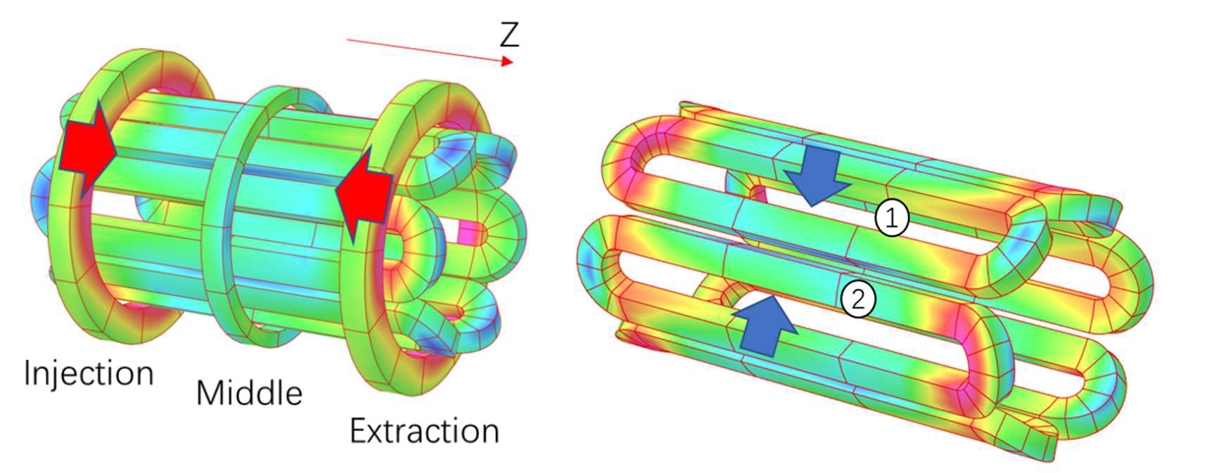
MAIN SUBSYSTEMS UPDATES: Trap procurement
Competitor #1-Executive Design
TENDER IS NOW COMPLETE AND THE COMPANY IS STARTΙΝG MANUFACTURING!!

Slide 10
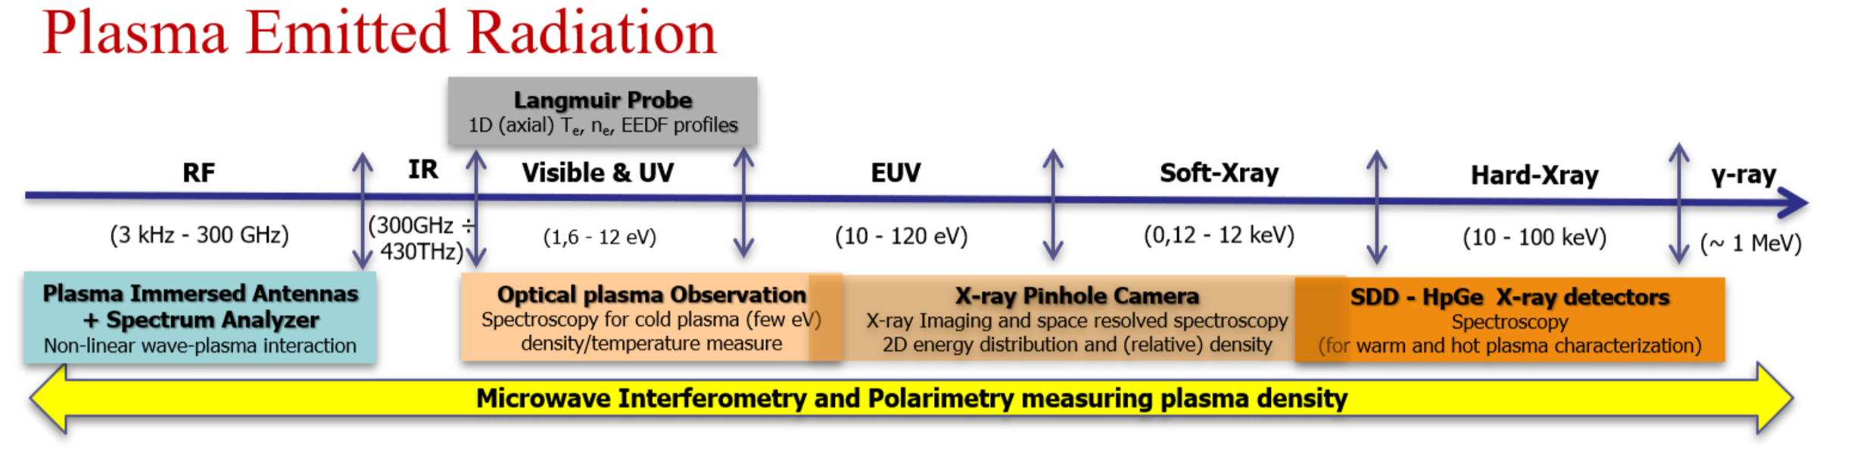
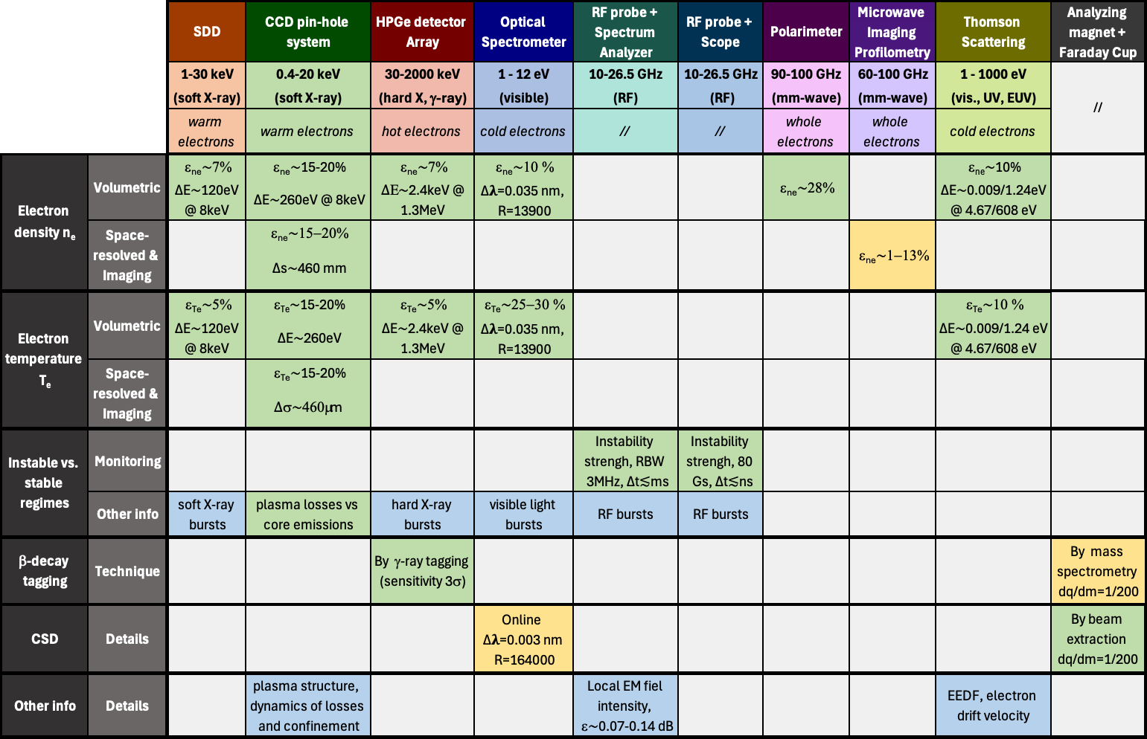
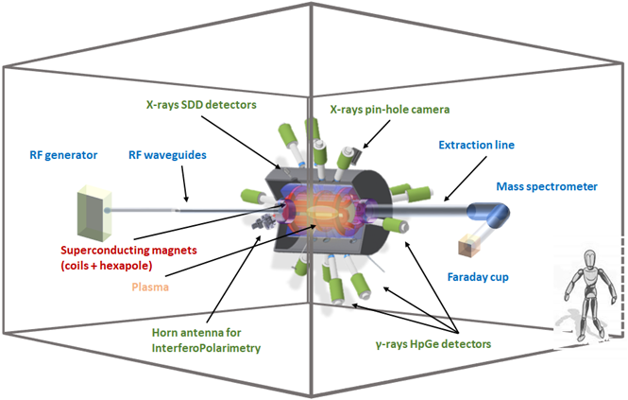
plasma diagnostics

Slide 11
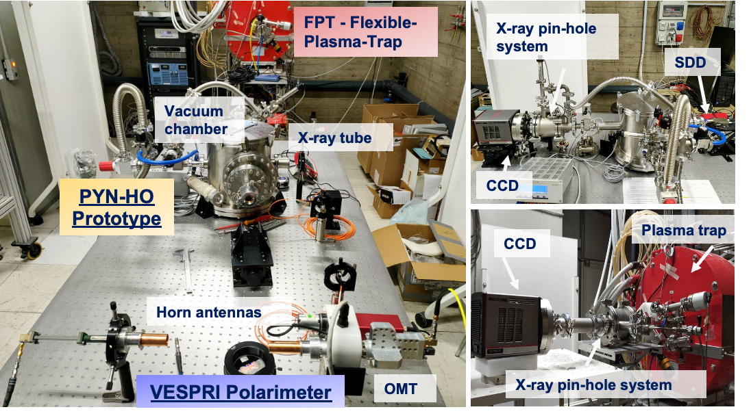
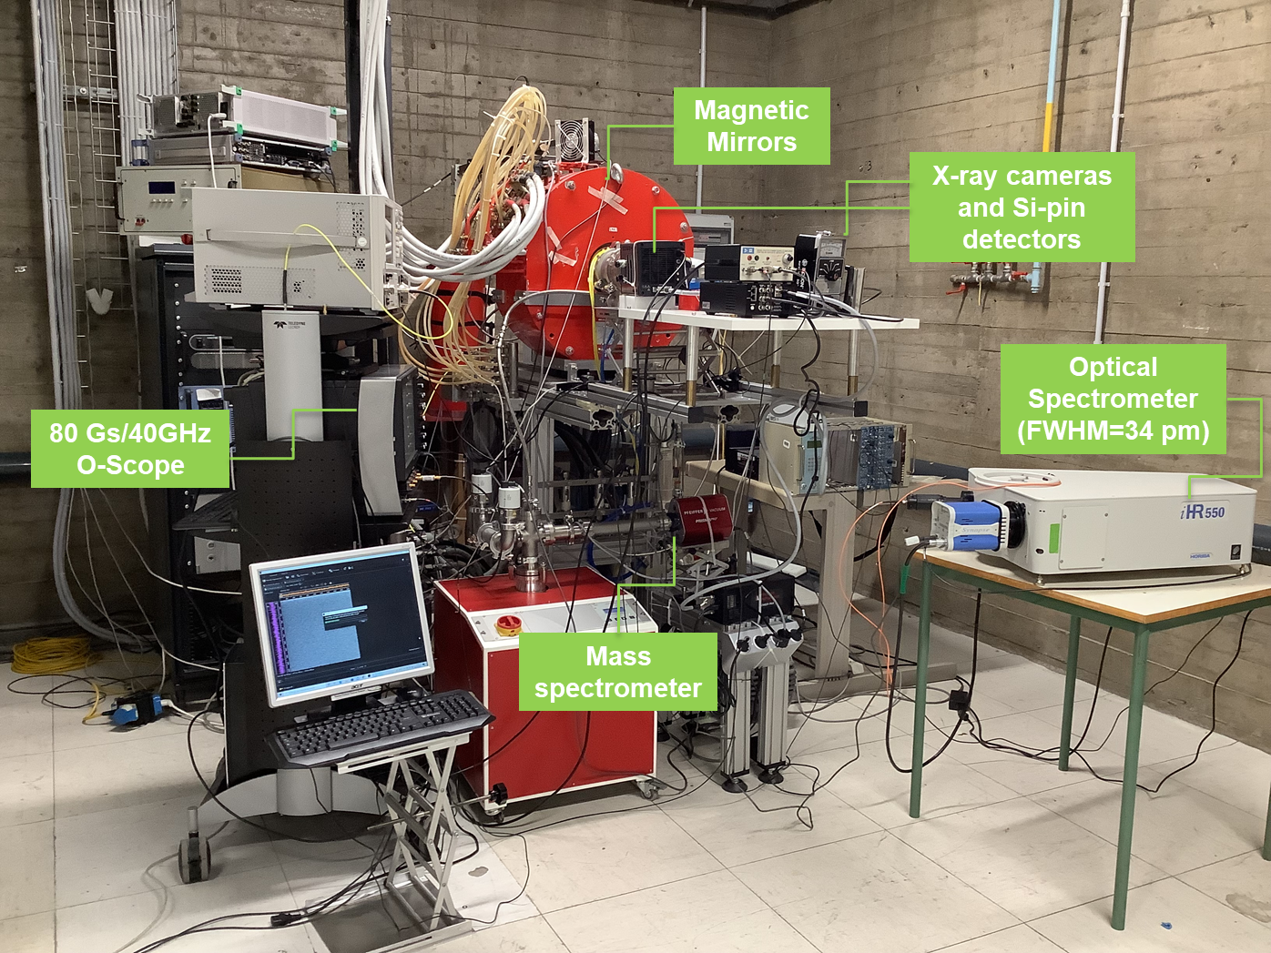
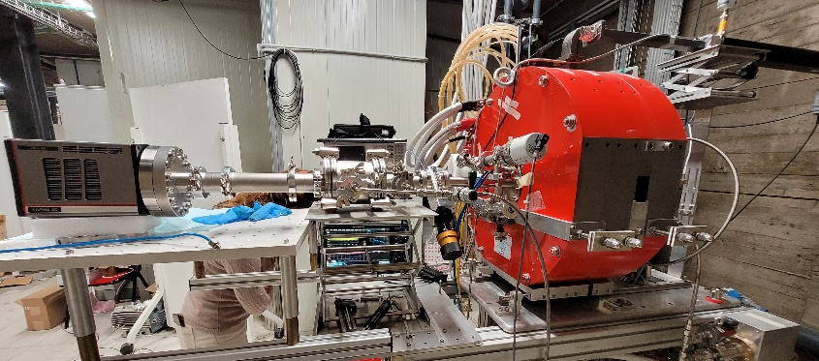

PANDORA test-benches @ ATOMKI and LNS
Flexible Plasma Trap @ LNS
It can be considered as a test-bench for the development of diagnostics, heating systems, etc.
X-ray tube

Slide 12
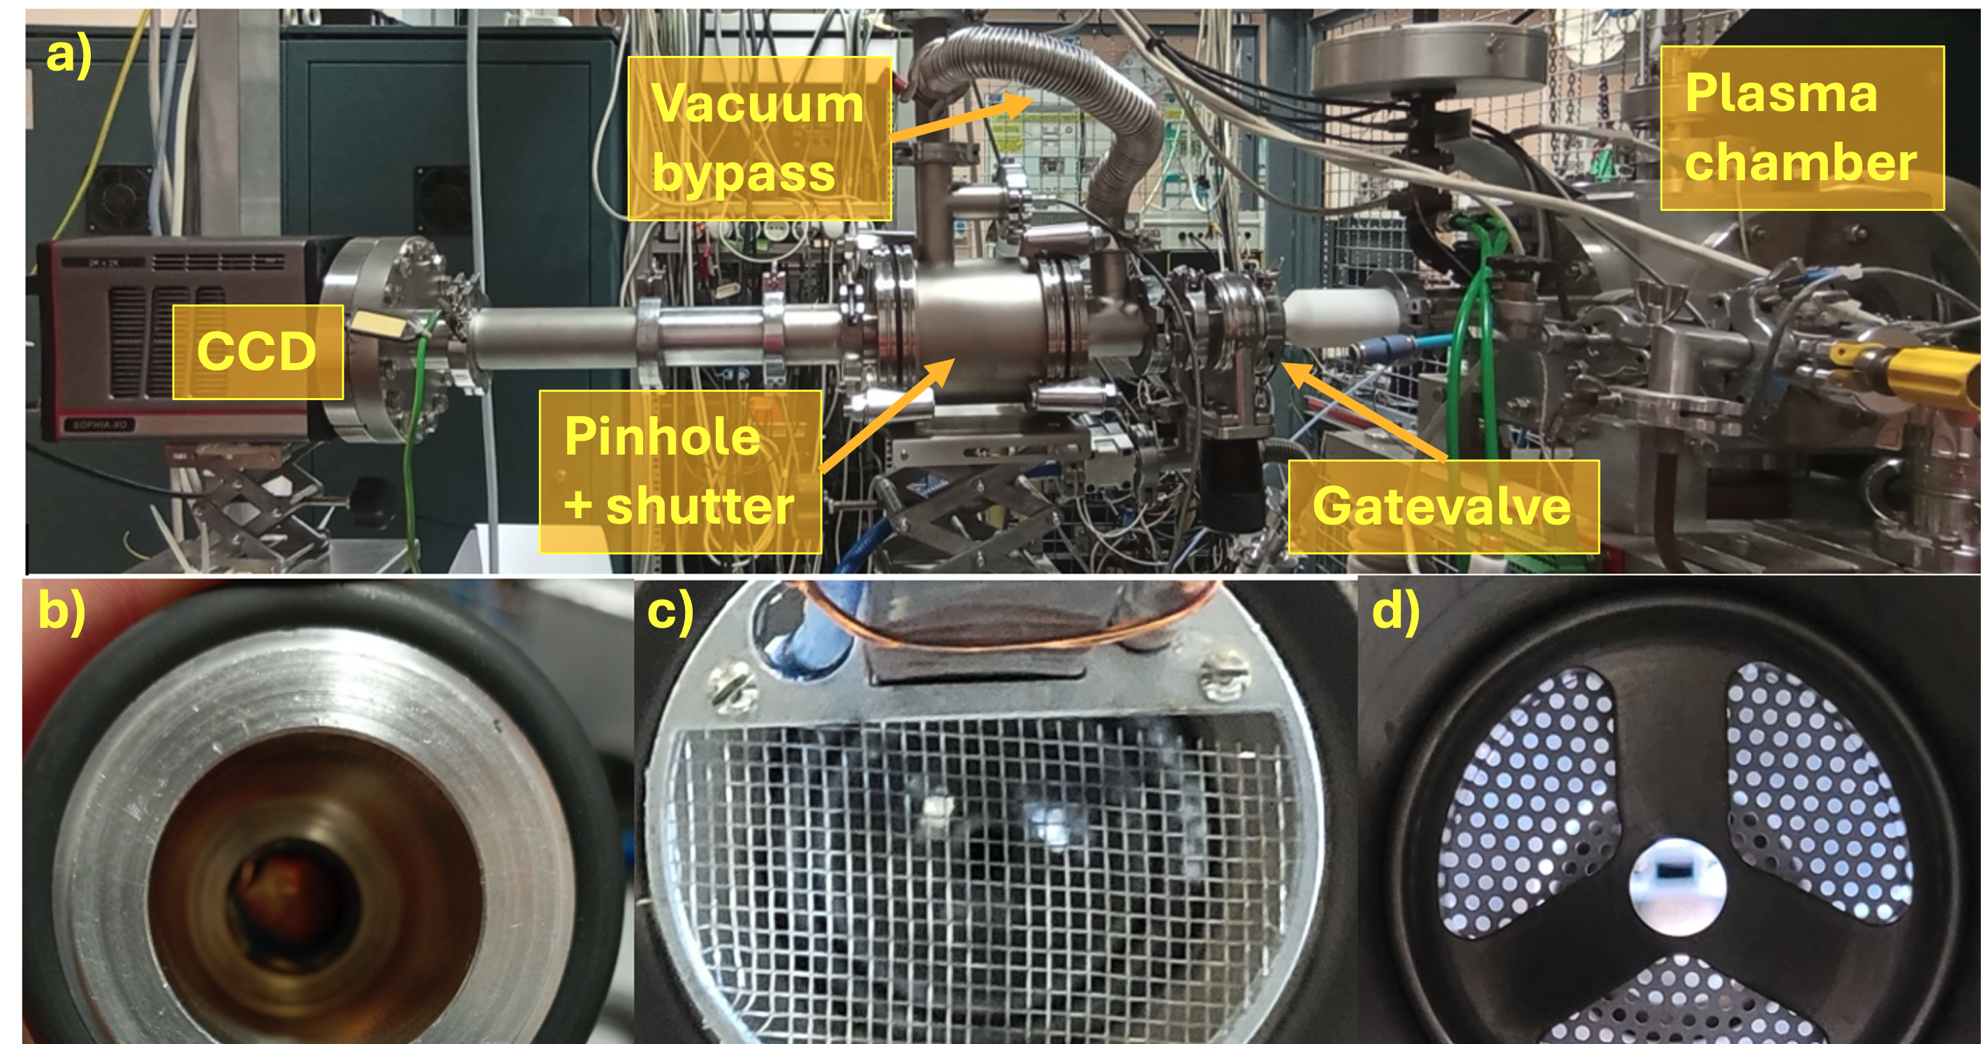
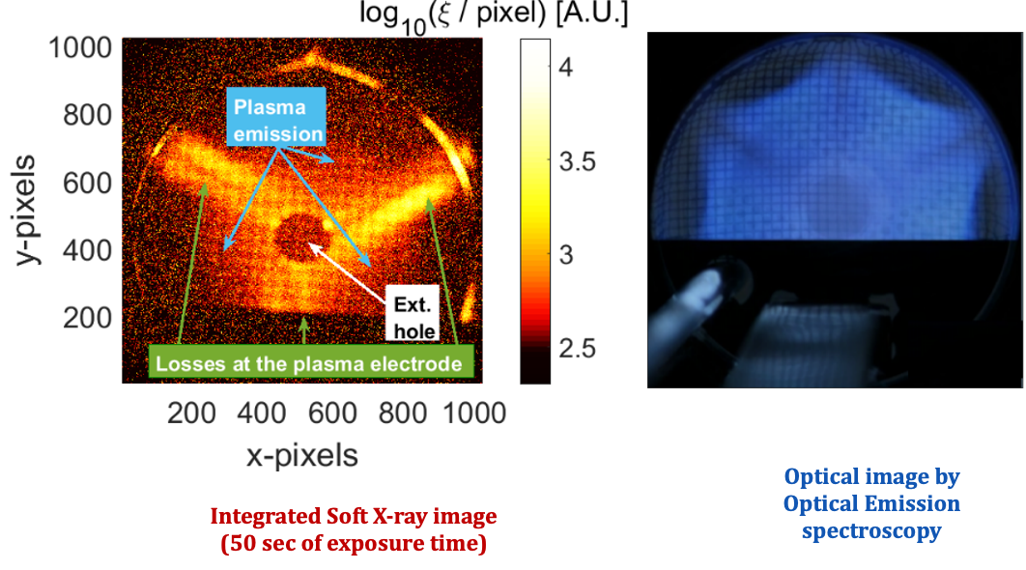
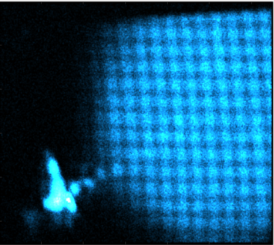
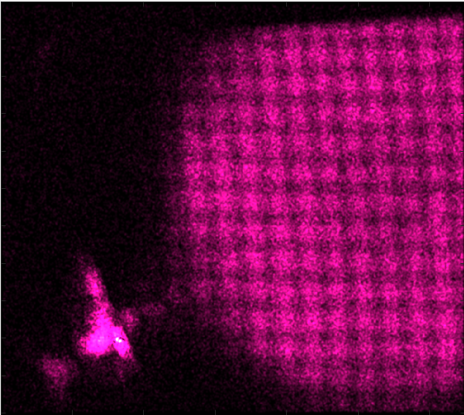
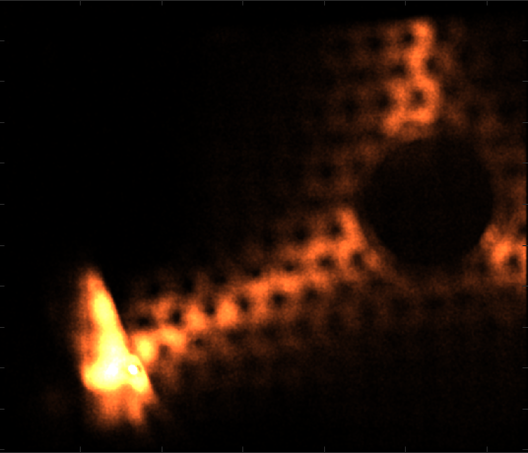
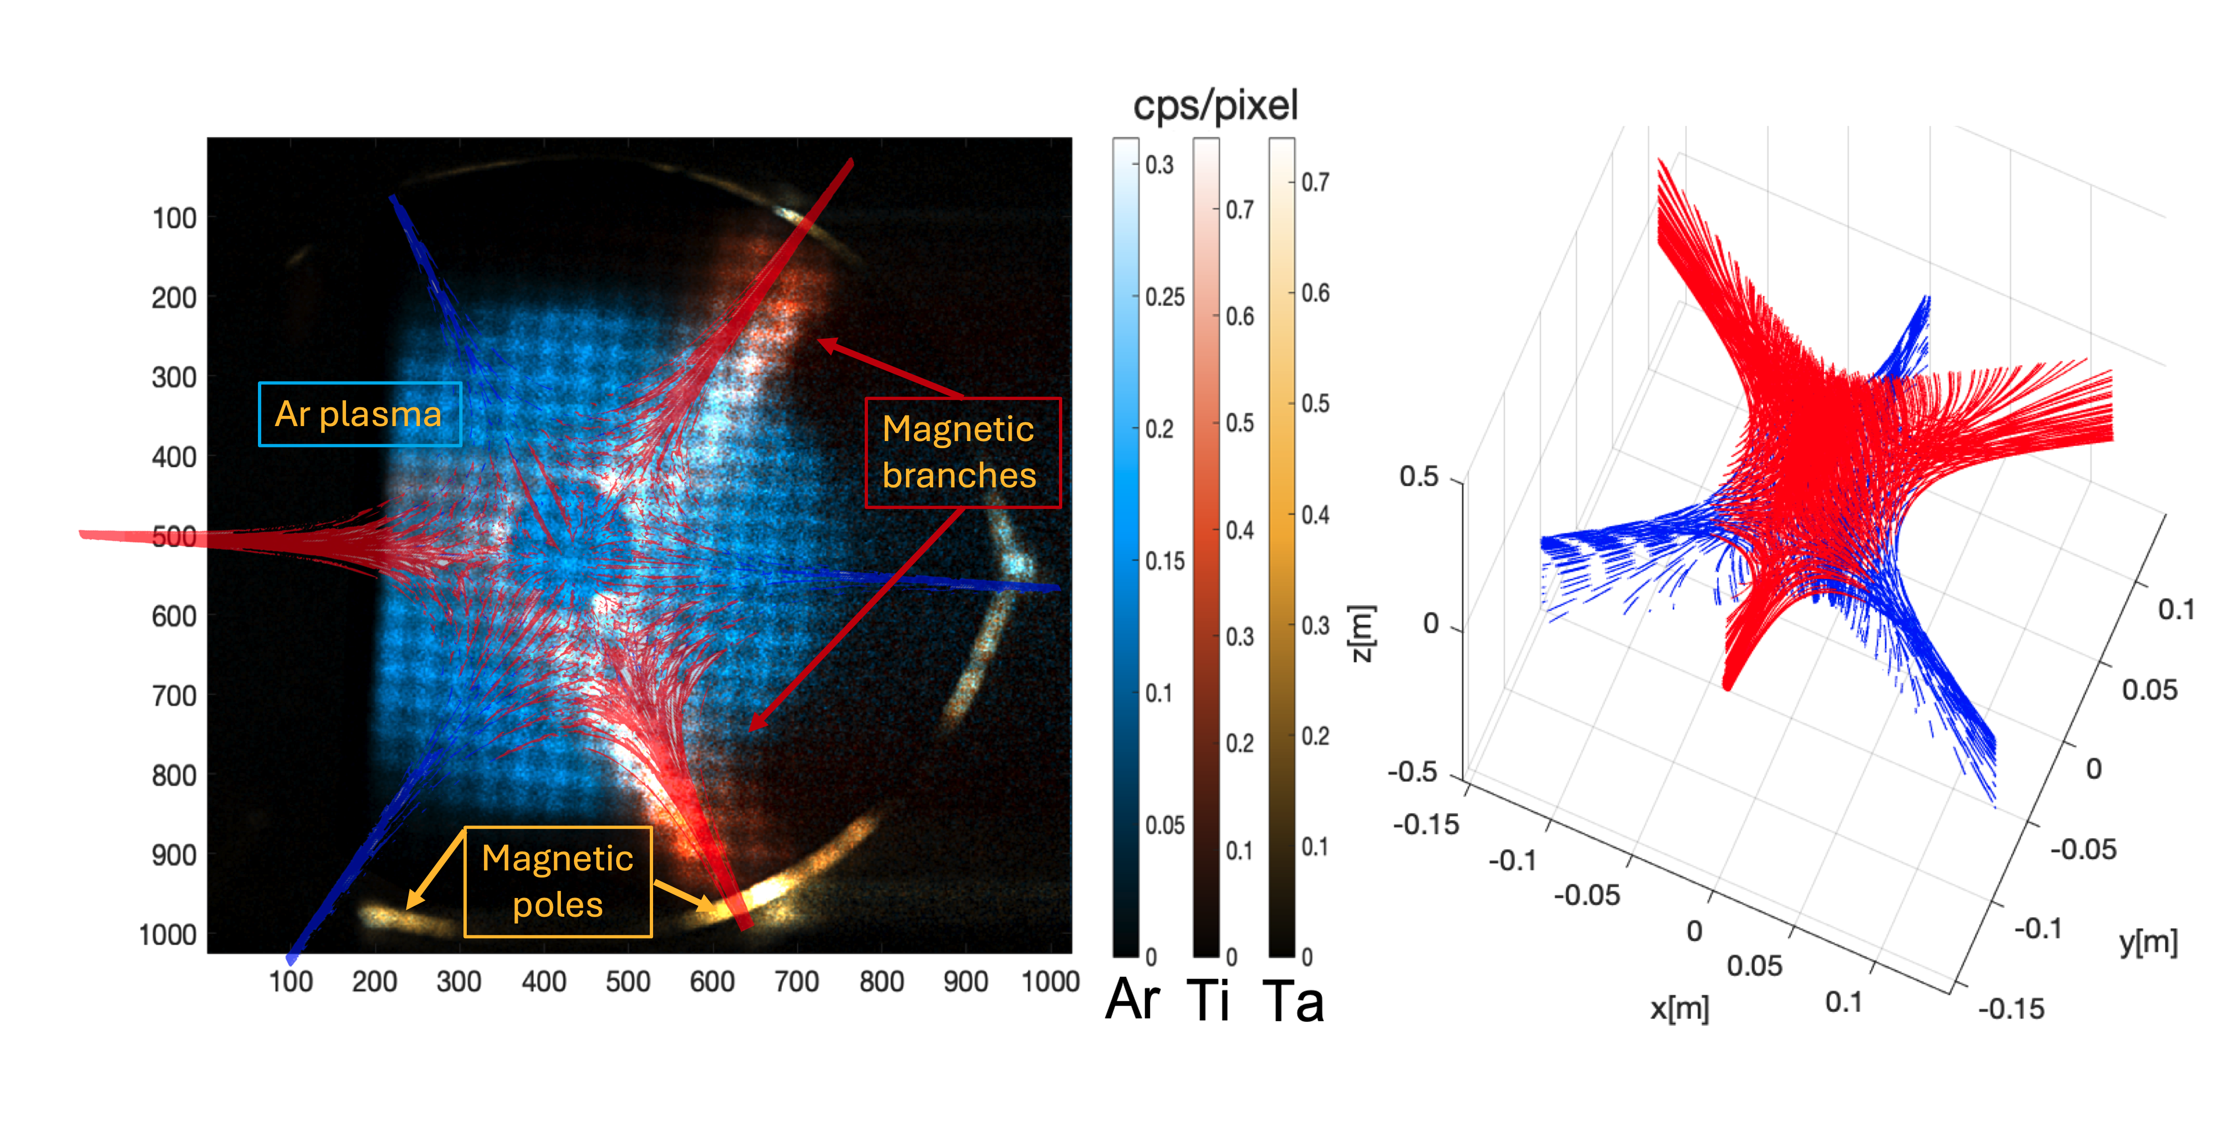
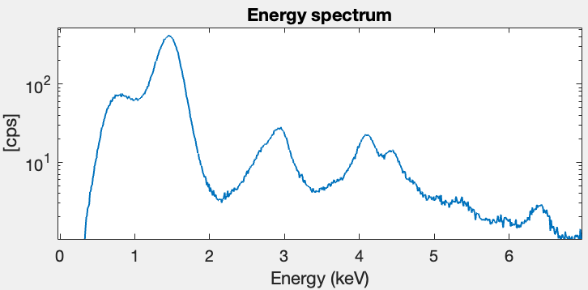
Energy-resolved imaging by X-ray CCD detectors
Ar K-line
Xe L-line
Al K-line
Al
Ar
Xe
1.49 keV 2.96 keV 4.11 keV
See Bianca Peri Poster on AI – tools implementation with perspectives for HPLA

Slide 13
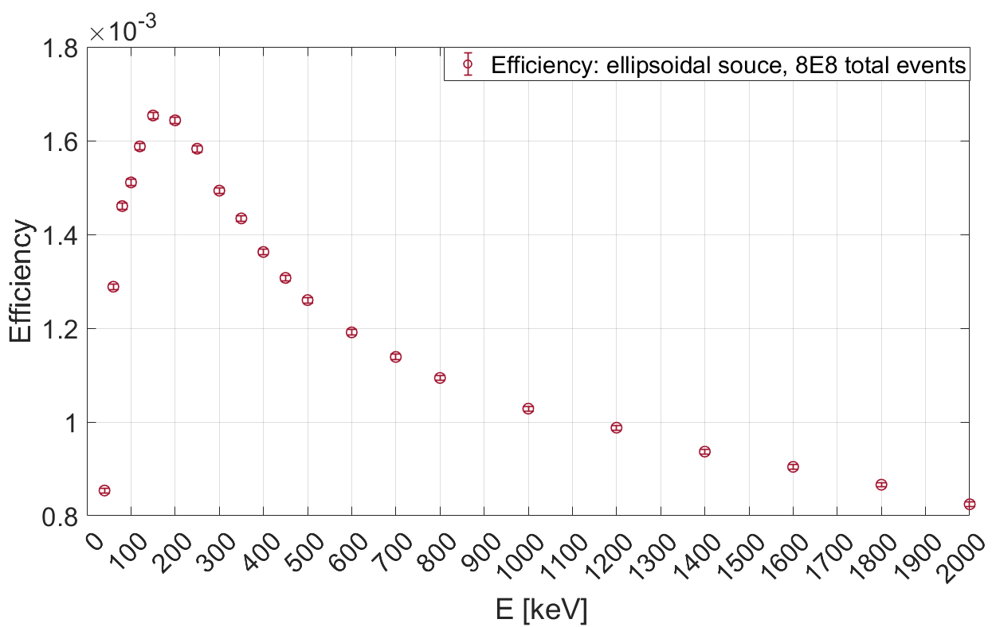
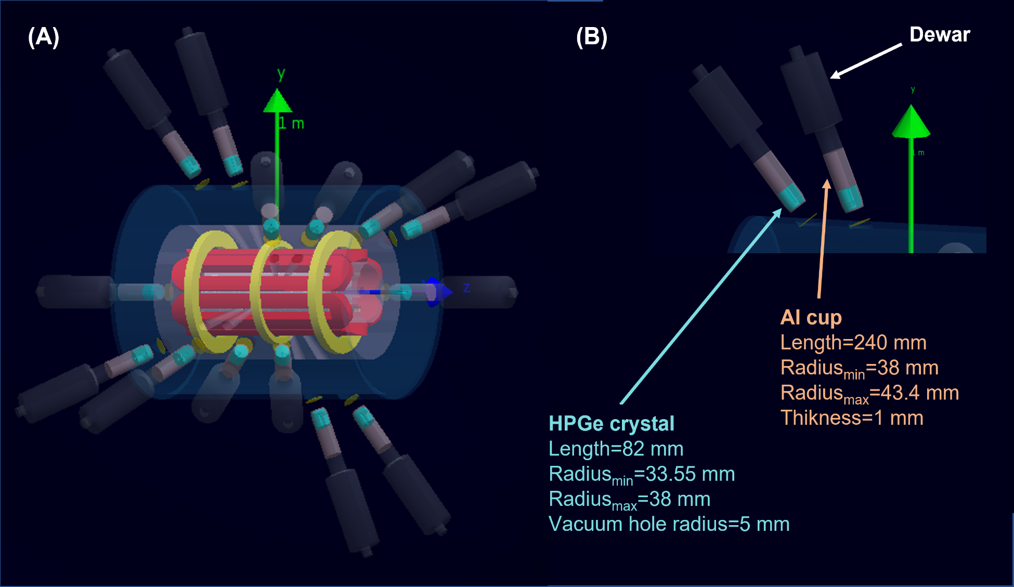
PANDORA Facility: HPGe γ-detectors Array
2
HPGe γ-detectors Array
β-decay detection by γ-rays tagging;
E. Naselli et al., Front Phys (2022) 10:935728
A. Goasduff et al., Front. Phys. 10:936081
14 HPGe detector array surrounding the PANDORA trap
Evaluation of the array efficiency by GEANT4 Simulation
GEANT4 Simulations to design the HPGe array
  Array efficiency vs. the incident γ-ray energy assuming 14 HPGe detectors
  Simulations were performed considering an isotropic ellipsoidal source placed in the center of the plasma chamber, having semi-axis lengths of 79x79x56 mm³ (plasma volume in the PANDORA plasma trap).
14 γ-ray detectors array. Each detector was placed collinearly at each collimator
  The γ-ray energy range extends from 40 keV to 2 MeV. For the evaluation of the background due to plasma self-emission, we considered a density of n = 10¹³ cm⁻³, and a volume of 1500 cm³.
HPGe detectors were chosen for their energy resolution (0.2% @ 1 MeV), since the harsh environment (the intense background by the plasma self-emission) strongly affects the signal-to-background ratio
Tag γ-rays (typical energies ~ 200 keV - 1800 keV) emitted from the post-β «radio-products»

Slide 14

Plasma Properties
Towards the fully understanding of β-decays in matter
Leptonic (atom/ion) + plasma + hadronic contribution (ground vs. excited/isomeric states)
Leptonic (atom) contribution
BSBD
Leptonic (atom → ion) + plasma contribution
K-shell
β
Fully-stripped ¹³⁴Cs

Slide 15




Plasma Properties
Plasma properties: ECR vs. Laser plasma
Thermodynamic Equilibrium (TE)
Electrons follow Maxwell distribution function
Ionisation stages obey Saha equation
Excited levels within an ionisation stage obey Boltzmann equation
Radiation field obeys Planck distribution
All 4 distributions defined by same temperature T (= T_{e} = T_{i} = T_{r})

Slide 16
Plasma properties: ECR vs. Laser plasma
Local Thermodynamic Equilibrium (LTE)
Electrons follow Maxwell distribution function
Ionisation stages obey Saha equation
Excited levels within an ionisation stage obey Boltzmann equation
Radiation field doesn’t follow Planck distribution - radiation transport code needed
All distributions except radiation field defined by same temperature T (= T_{e} = T_{i})

Slide 17
Plasma Properties
Plasma Properties
Plasma properties: ECR vs. Laser plasma
Non - Local Thermodynamic Equilibrium (n-LTE)
Electrons are (generally) non-Maxwellian
Ionisation stages are not modelled according to Saha equations
Excited states do not obey Boltzmann equation
Radiation modelling requires transport code. No concept of unique temperature because no distributions exist
A comprehensive rate equations matrix is constructed based on collisional and radiative processes - CR Model – and iteratively solved till steady-state is reached
ECR plasmas are n-LTE, but modelling has been developed to extrapolate datas to fully LTE plasmas in astrophysical sites
Laser gen. Plasmas are LTE, with a bath of photons potentially capable of exciting nuclear states

Slide 18
Pro and Cons between magnetic confinement vs laser produced plasma
ECR vs. Laser plasma: pro and cons
Magnetic confinement
PRO:
Long-living plasma (order of weeks)
steady state dynamical equilibrium for density and temperature,
  →hence, over days/weeks constant values for charge state distribution of in-plasma ions
Online monitoring of plasma density, temperature, volume, eventual kinetic turbulence, at any energy domain in nLTE conditions
CONS:
Low density/high temperature plasma: nLTE conditions
Difficult “plasmization” of solid/metallic isotopes
No access to nuclear excited state studies (too low T)
Scenario can be different using plasma produced by HP lasers
PRO:
High density plasma, reaching LTE
Online production of RIBs is in principle possible
Full or LTE thermodynamical equilibrium allows, in principle, nuclear excitation
CONS:
Difficult to implement diagnostics following on-line the fast time-variation of plasma parameters
Short living plasma, with duration much shorter than typical lifetimes of isotopes involved in stellar nucleosynthesis

Slide 19
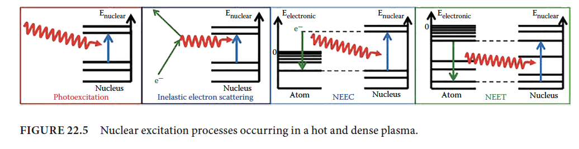
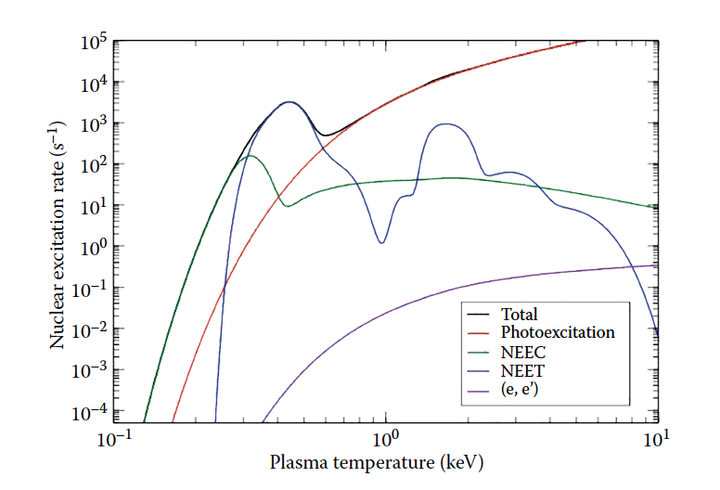
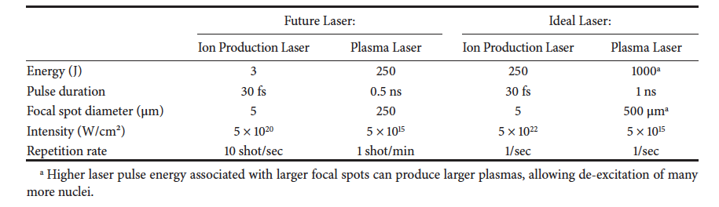
Laboratory Plasmas
Plasma Properties
Plasma properties: ECR vs. Laser plasma
Nuclear excitation in a dense plasma
D. Denis-Petit, K. W.D. Ledingham, P. McKenna, D. Mascali, S. Tudisco, K. M. Spohr, M.Tarisien.
Nuclear Reactions in a Laser-Driven Plasma Environment, in Applications of Laser-Driven Particle Acceleration
Edited by Paul R. Bolton, Katia Parodi, Jörg Schreiber, Taylor & Francis (2018)
Pulse «stretching» is needed to provide a dense and long lasting (>>1ps) photon-bath

Slide 20
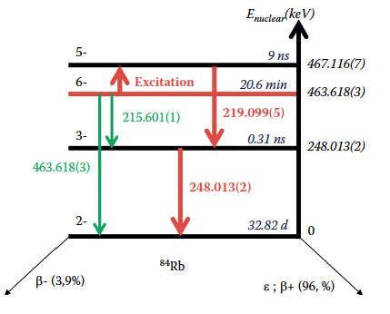
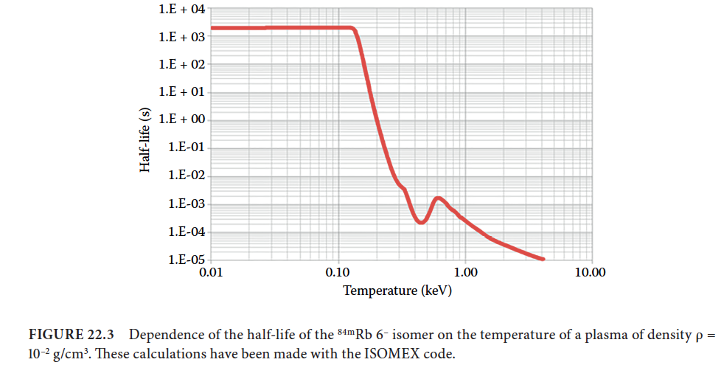
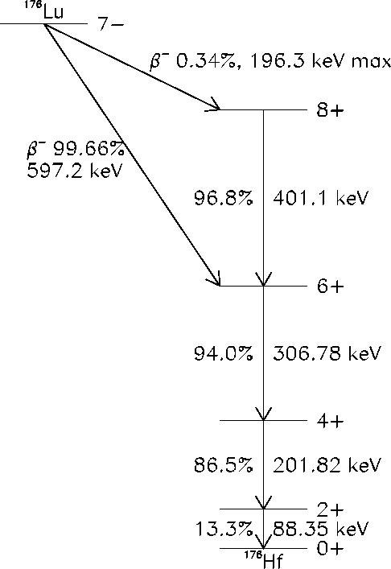


Isomeric or excited states decay rates (e.g. ^{176m}Lu, ^{84m}Rb) in stellar-like high density and energetic plasma.
Pro and Cons between magnetic confinement vs laser produced plasma
The intermixing between nuclear levels has been an open topic in nuclear astrophysics for years because it has a direct impact on nucleosynthesis, cosmochronometers, etc.
The contribution of the isomer level will drastically modify the half-life (from billion years to a couple of hours, or from minutes to μsec for Rb)
122.9 keV
${}_{}^{176 }{Lu}m$
$$1^{−}$$
To populate 1⁻ level it is needed to populate a
level at about 800 keV !

Slide 21
Isomeric or excited states decay rates (e.g. ^{176m}Lu, ^{84m}Rb) in stellar-like high density and energetic plasma.
Pro and Cons between magnetic confinement vs laser produced plasma
Veeery preliminary calculations about NEEC probability and yeld calucations (^{93m}Mo or ^{84m}Rb as test case)
Let’s assume to operate with 300 TW laser, 1 ps pulse, focused at 10¹⁶ W/cm^{2,} then the NEEC rate can be estimated as:
R_{NEEC} ~ 10⁶ – 10⁸ sec⁻¹
Considering τ=1 ps and 10⁹-10¹¹ isomers in the plasma volume, this translates into:
~10³ – 10⁵ excited nuclei per pulse.
NEEC not efficient for ¹⁷⁶Lu: let’s estimate probability and yields by direct γ-ray excitation using the suitable 800keV «hidden» state of 176Lu
Bremsstrahlung yield in a 300 TW class laser, 30 fs pulse duration, in 0.1-10 MeV range: 10¹⁰-10¹² ph/shot
Fraction in a 10% bandwidth around 800 keV (suitable for the Lu hidden level excitation): 1%
Assuming geometrical efficiency and typical photoexcitation cross sections σ_{eff} ~ 10⁻²⁷ cm²
For 1 g of enriched ¹⁷⁶Lu we may have: 3-30 excited nuclei per shot
Using 10 Hz and irradiating for 1 h: up to 50 Bq of activity from the isomer ^{176m}Lu

Slide 22

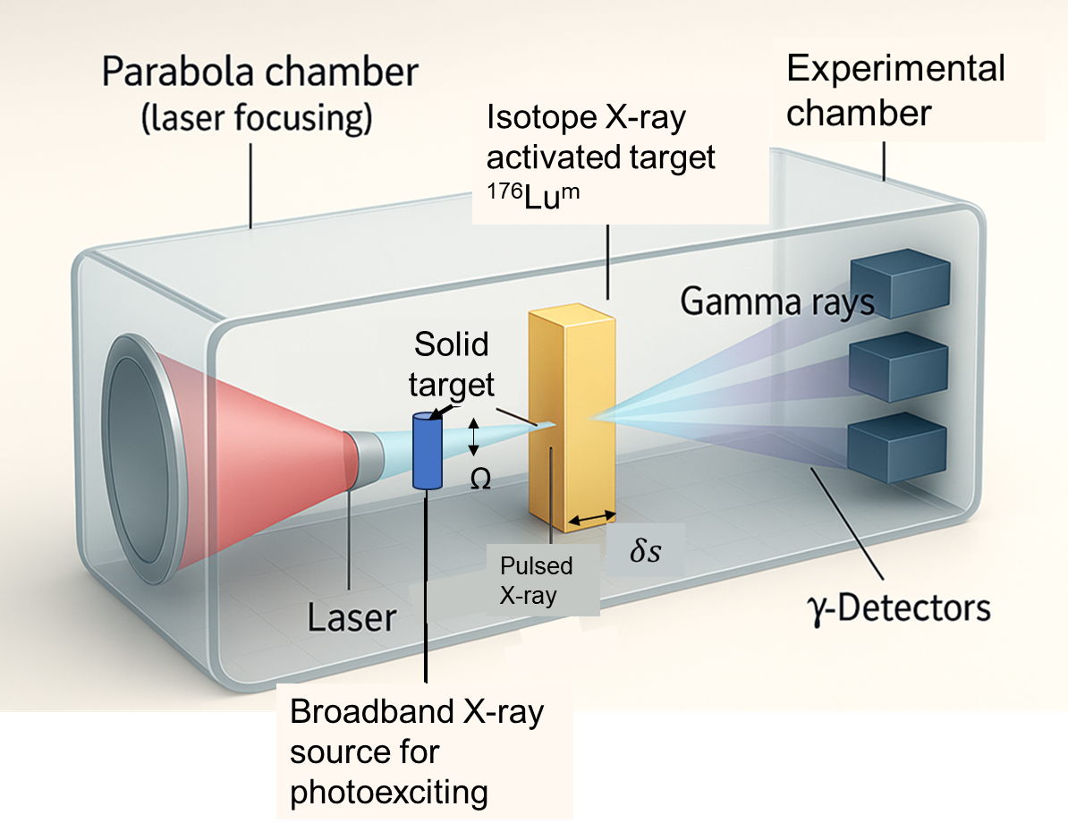
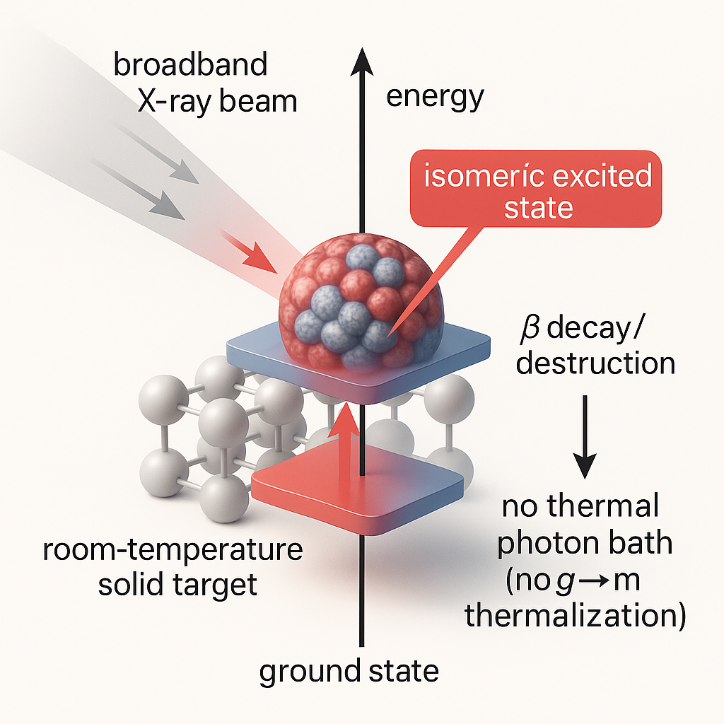



Isomer nuclei in-plasma reaction rates measurements – feasibility study
Isomer in cold-target do not thermalize: ready for in-plasma decay experiments
Lab laser-beam possible experiment
Laser plasma: LTE regime, high density and temperature; possible g↔m thermalization competing with β decay. CONS: less control on plasma; complex diagnostics architecture
Driving nuclei isomer level population with an engineered laser-generated beam
$$N_{m}^{res}\left(>2 h\right)∼0.68 N_{m},t_{1/2}∼4 h$$
Studying in-plasma β-decay via γ-tagging of ¹⁷⁶Hf cascade
See A. Pidatella poster with much more details!

Slide 23


In-Plasma Decay Model: From Lab to Stars
General model of in-plasma decay
High density and temperature
n ~ 10²⁴⁻²⁶ cm⁻³, kT ~ 100 eV - 1 keV
LTE
CSD – Saha equation, LPD – Boltzmann equation, electrons – Maxwellian
Perfect confinement
Low density, high temperature
n_{e} ~ 10¹¹⁻¹³ cm⁻³, kT_{e} ~ 100 eV - 1 keV
NLTE
CSD and LPD described by collision-radiative model
Finite ion confinement
Ions are subject to transport, reactions are non-local
Model can be tested with measurements from PANDORA and applied to stellar core
Generates more observables – can be tested in other facilities (ESR-FAIR@GSI, ERNA)
Useful for assessing feasibility of studying an isotope in PANDORA (how much material, how long to measure)

Slide 24
“Virtual Experiments” are now possible in several scenarios

Slide 25




A special test-case: Orbital Electron Capture Decay in ⁷Be
The CSD and LPD of ions can be calculated according to the thermodynamic conditions (n_{e} and T_{e}) of the plasma, and according to its nature (LTE vs NLTE)
t_{1/2} in ⁷Be⁰⁺ at ground state = 53.44 days with BR = 10.45%
ENSDF t_{1/2} = 53.22 ± 0.06 days and BR = 10.44%
EXCELLENT MATCH!
B. Mishra et al, under review, Phys Rev C
<Z> of ⁷Be ions in a uniform plasma with n_{e} = 10¹² and n_{e} = 10²⁵cm⁻³, under LTE and NLTE conditions.
λ* of ⁷Be ions in a uniform plasma with n_{e} = 10¹² cm⁻³, under LTE and NLTE conditions.

Slide 26





A special test-case: Orbital Electron Capture Decay in ⁷Be
The in-plasma decay model can be combined with Particle-in-Cell Monte Carlo (PIC-MC) codes to predict spatial distribution of λ* in PANDORA.
B. Mishra et al, Front. Phys. 932448 (2022)
3D distribution of n_{e} in PANDORA (preliminary simulation)
⁷Be EC rate in PANDORA (pure collision)
Lines of sight of HPGe detectors
λ*/ λ ~ 10⁻²

Slide 27





From PANDORA to the DECAYTOR
Italian Patent deposited in 2025, after CNTT approval in April 2024
Interdisciplinary impact: study decay acceleration in long lived fission products, e.g., ¹³⁷Cs, having a striking role in nuclear waste management.

Slide 28

Many thanks for your attention!
Many thanks to the #LNSplasmateam members and to the colleagues of the PANDORA collaboration
https://www.lns.infn.it/it/apparati/pandora.html

Slide 29

Thank you for your attention

Slide 30

The Problem
Slow Neutron Capture (s-process)
Abundance of isotopes, particularly at branching points, depends on
Maxwell Averaged Cross Sections (MACS) of neutron capture and
β-decay rates
S. Palmerini et al, ApJ 921, 7 (2021)
Stars and neutron star merger ejecta as plasmas:
How sure are we about these quantities in a plasma environment?

