Slide 1


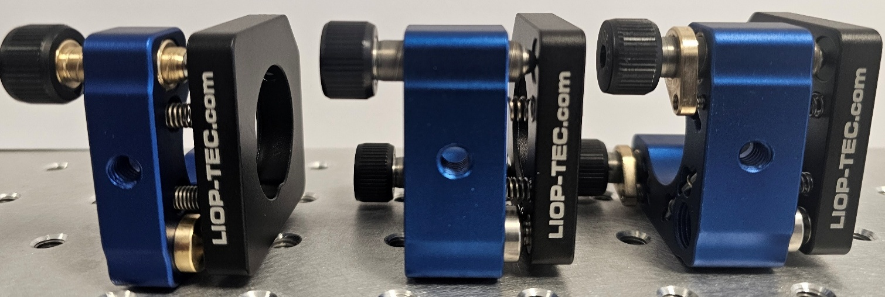
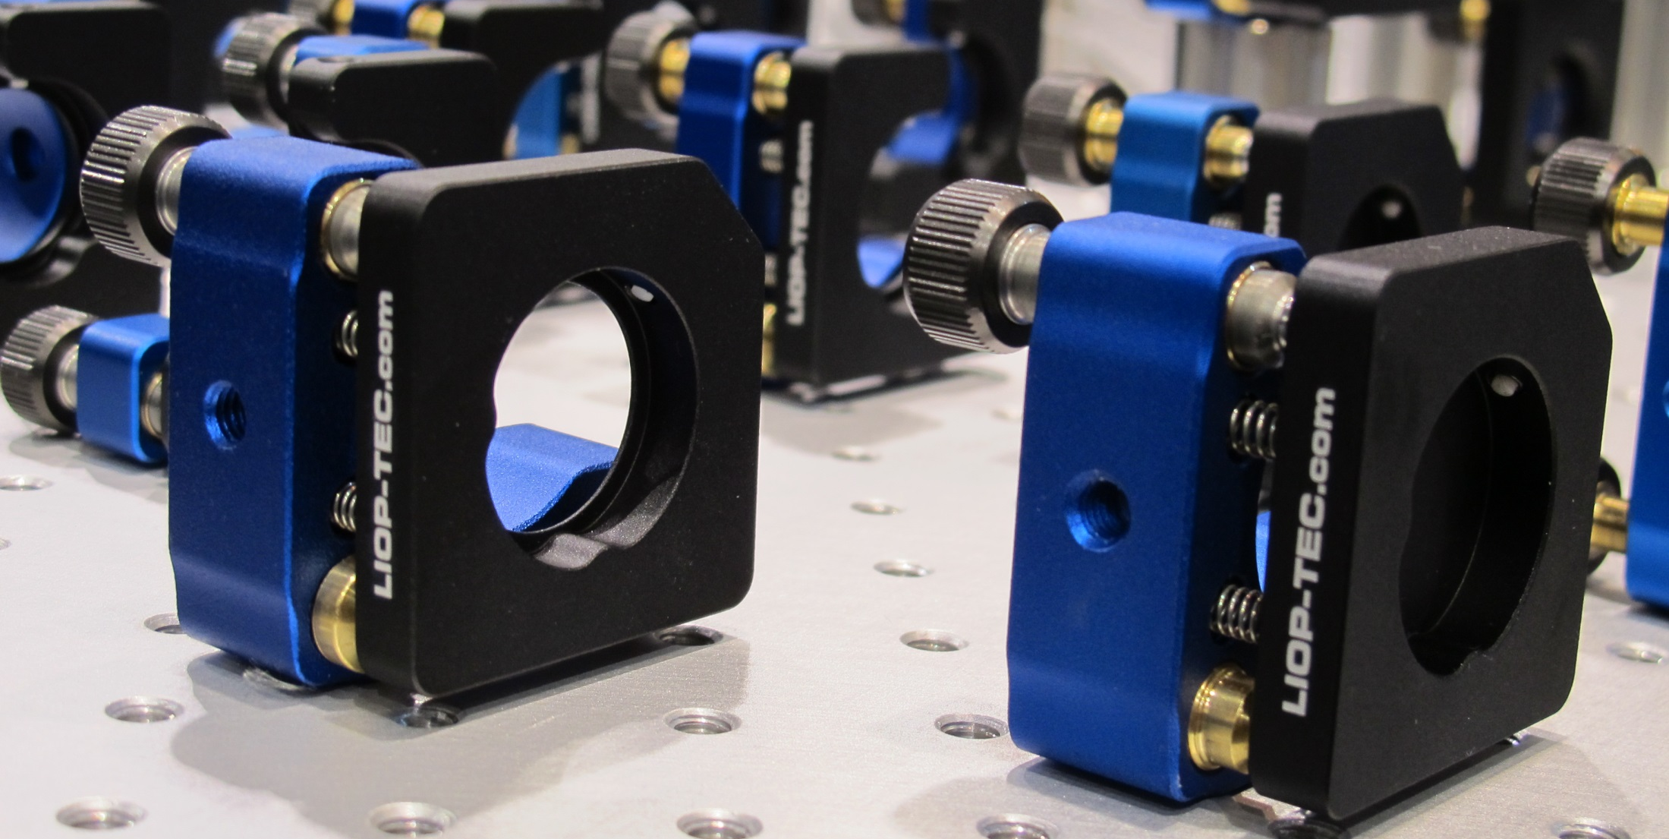

HPLA25
Patrick Incorvaia

Slide 2
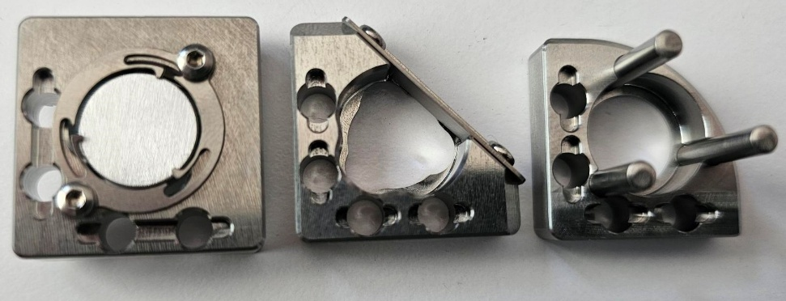
Based in Radevormwald, near Cologne
Pulsed ns dye laser
Standard pitch of 0,15mm (170 TPI)
mounts standard from ½“, 1“, 1.5“, 2“…etc
Custom made items till 1m optics

Slide 3
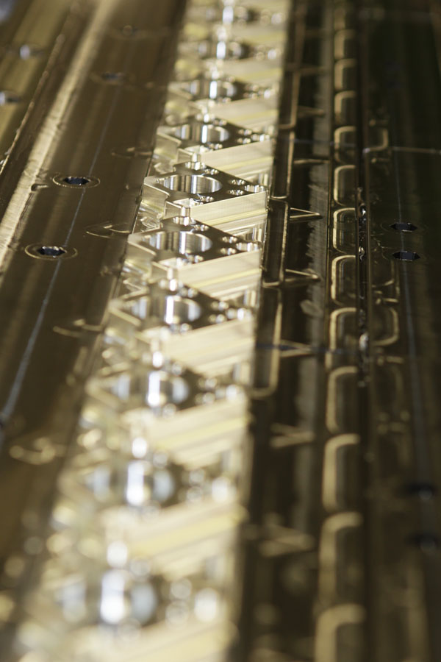
0,15mm (170 TPI) standard pitch
Standard mounts
Custom made
Vacuum compatible
Ultra high vacuum
Custom made fine thread screws
Colour concept

Slide 4
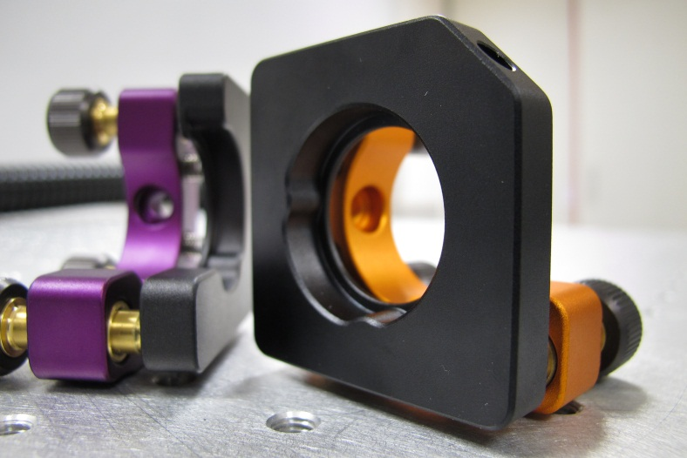
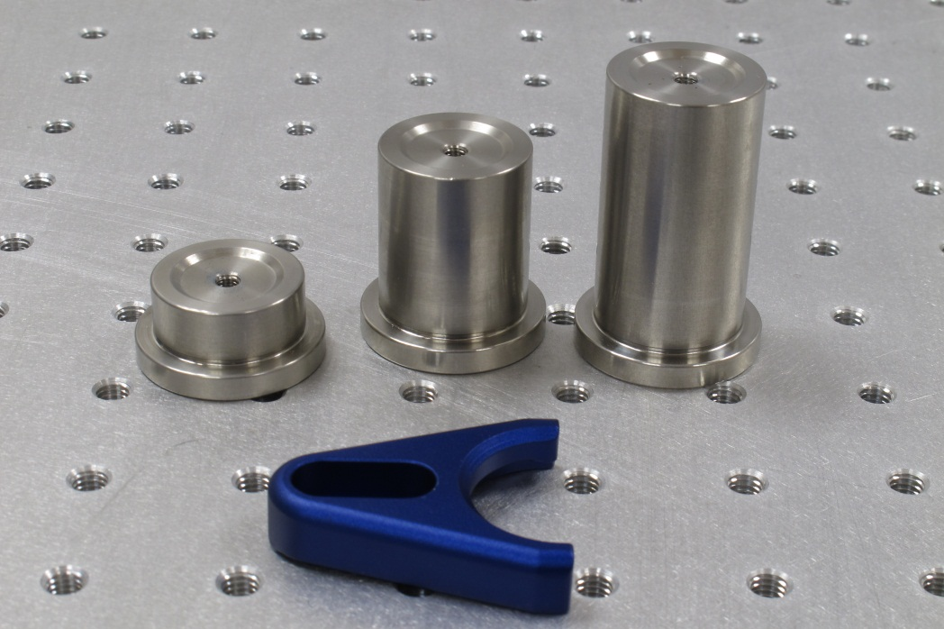
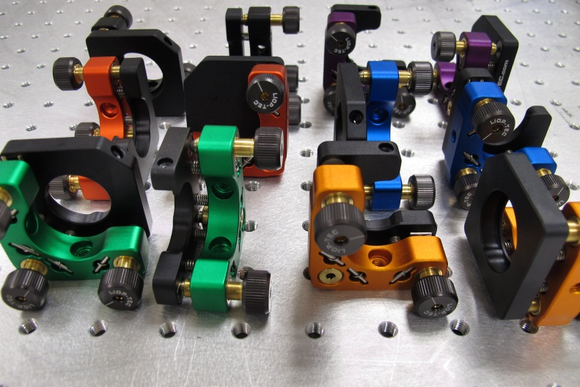
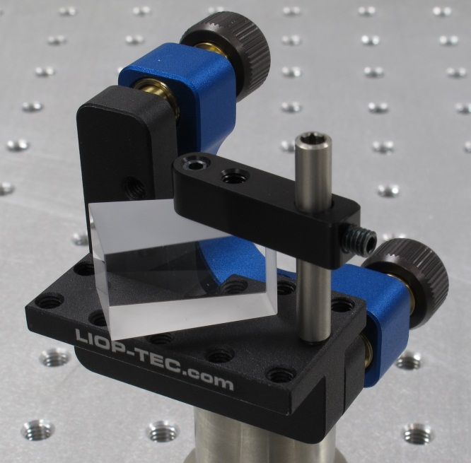
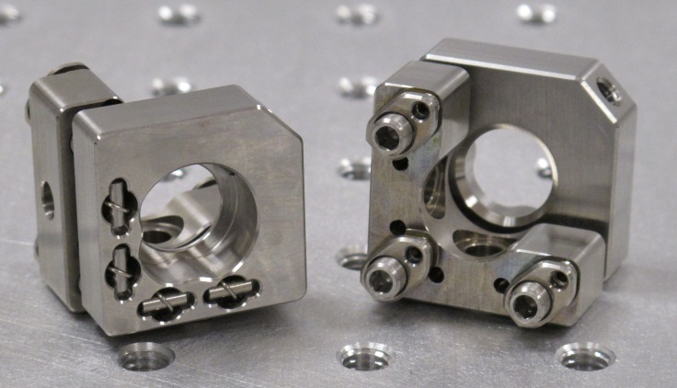
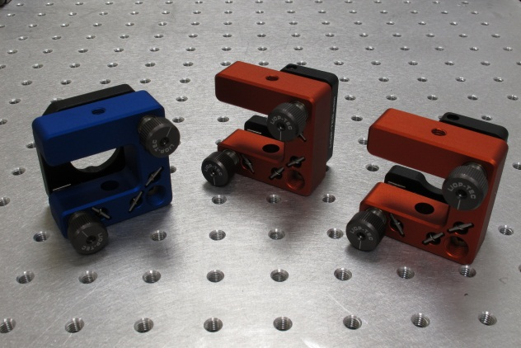

Slide 5

Pulsed ns dye lasers

Slide 6
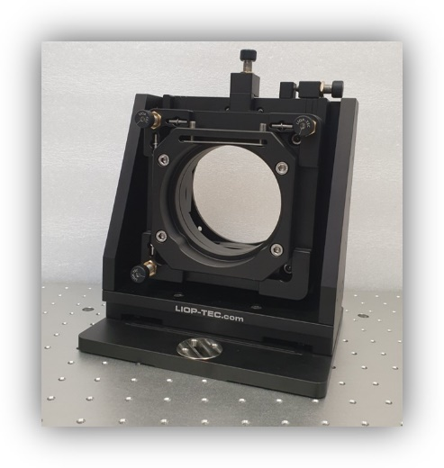
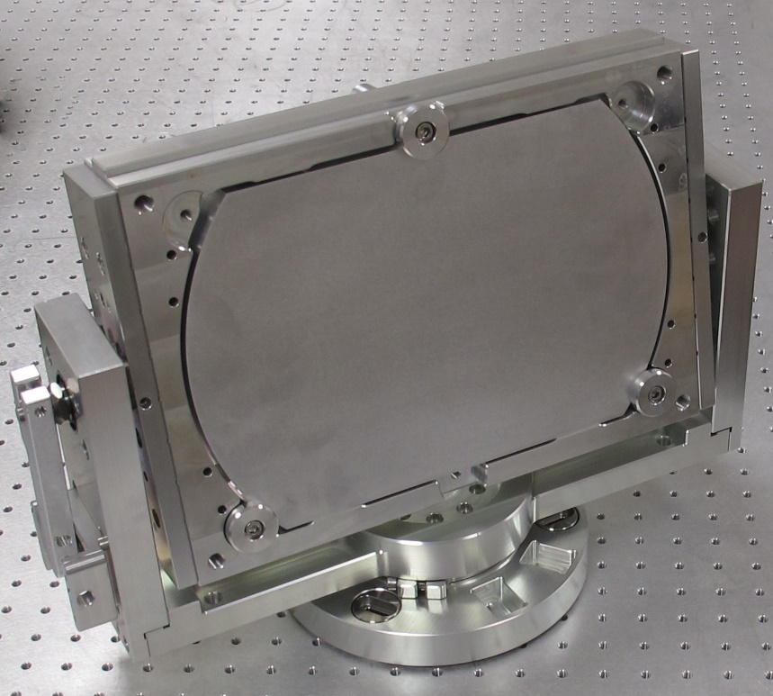
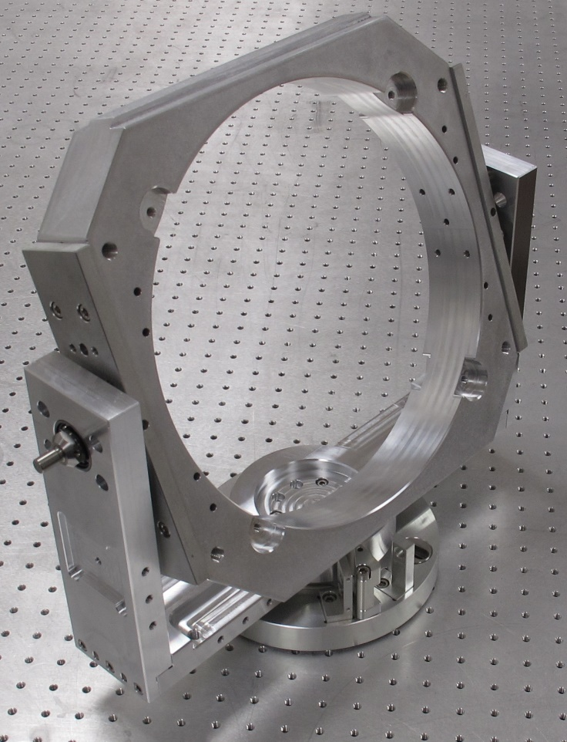
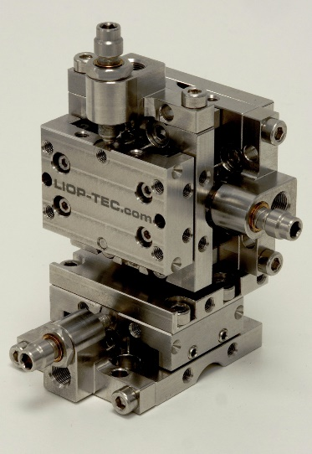
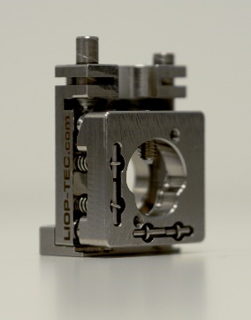
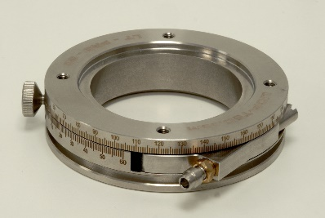

Slide 7
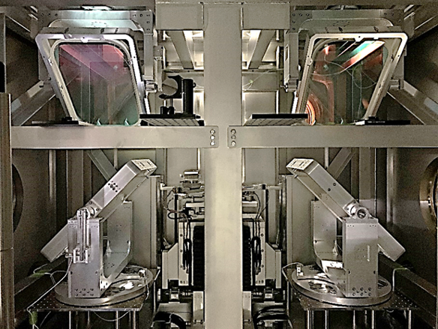
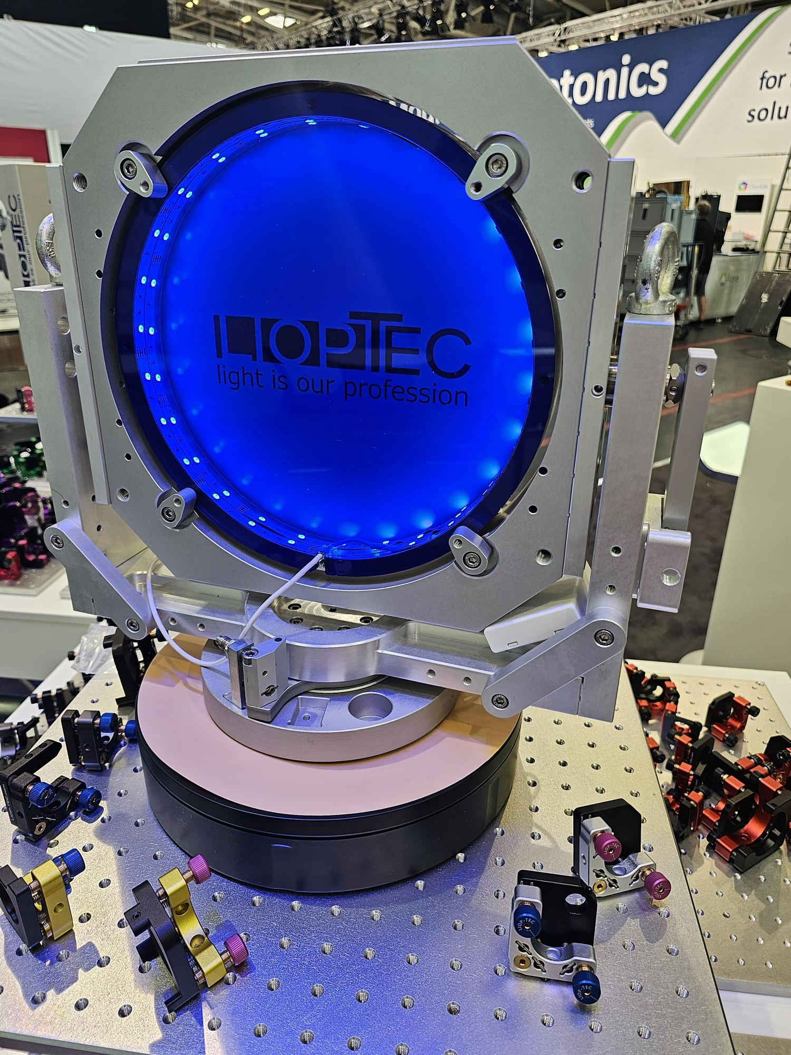
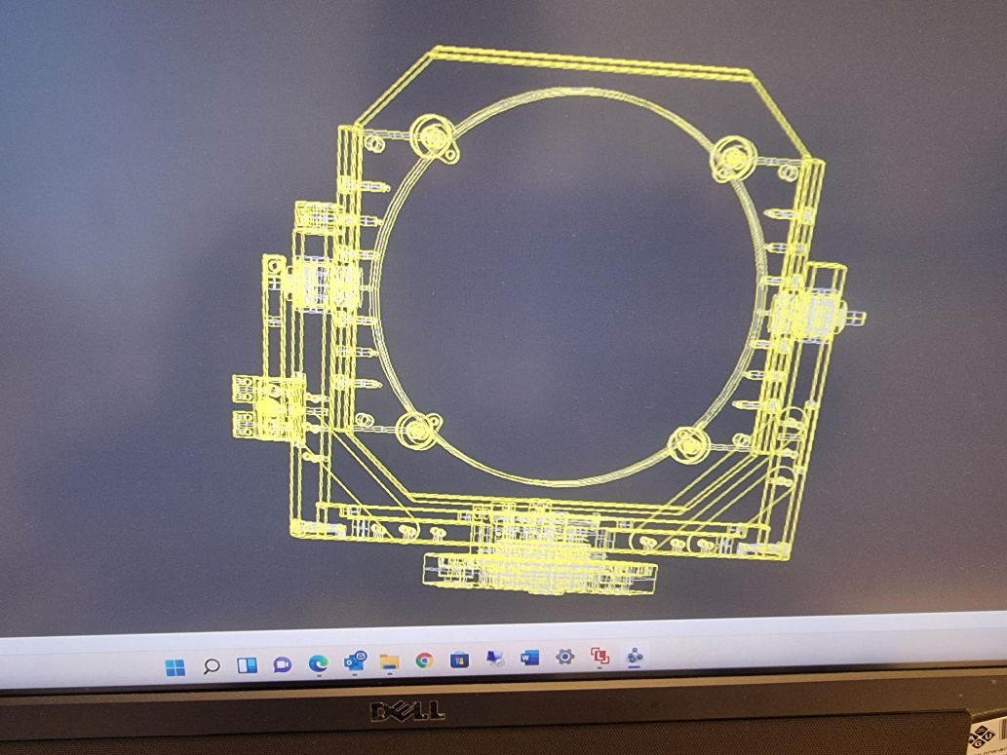

Slide 8
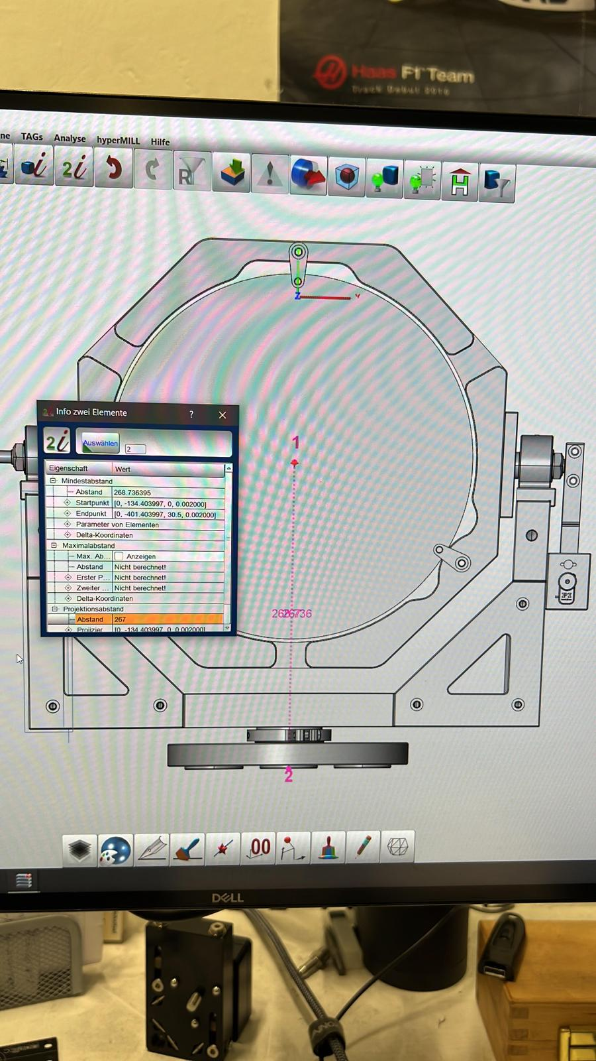
Grazie!!
2nd INFN School and Workshop on
“High Power Lasers for Fundamental Science and Applications” (HPLA)
Catania
LIOP-TEC GmbH
Patrick Incorvaia
p.incorvaia@liop-tec.com

