Slide 1
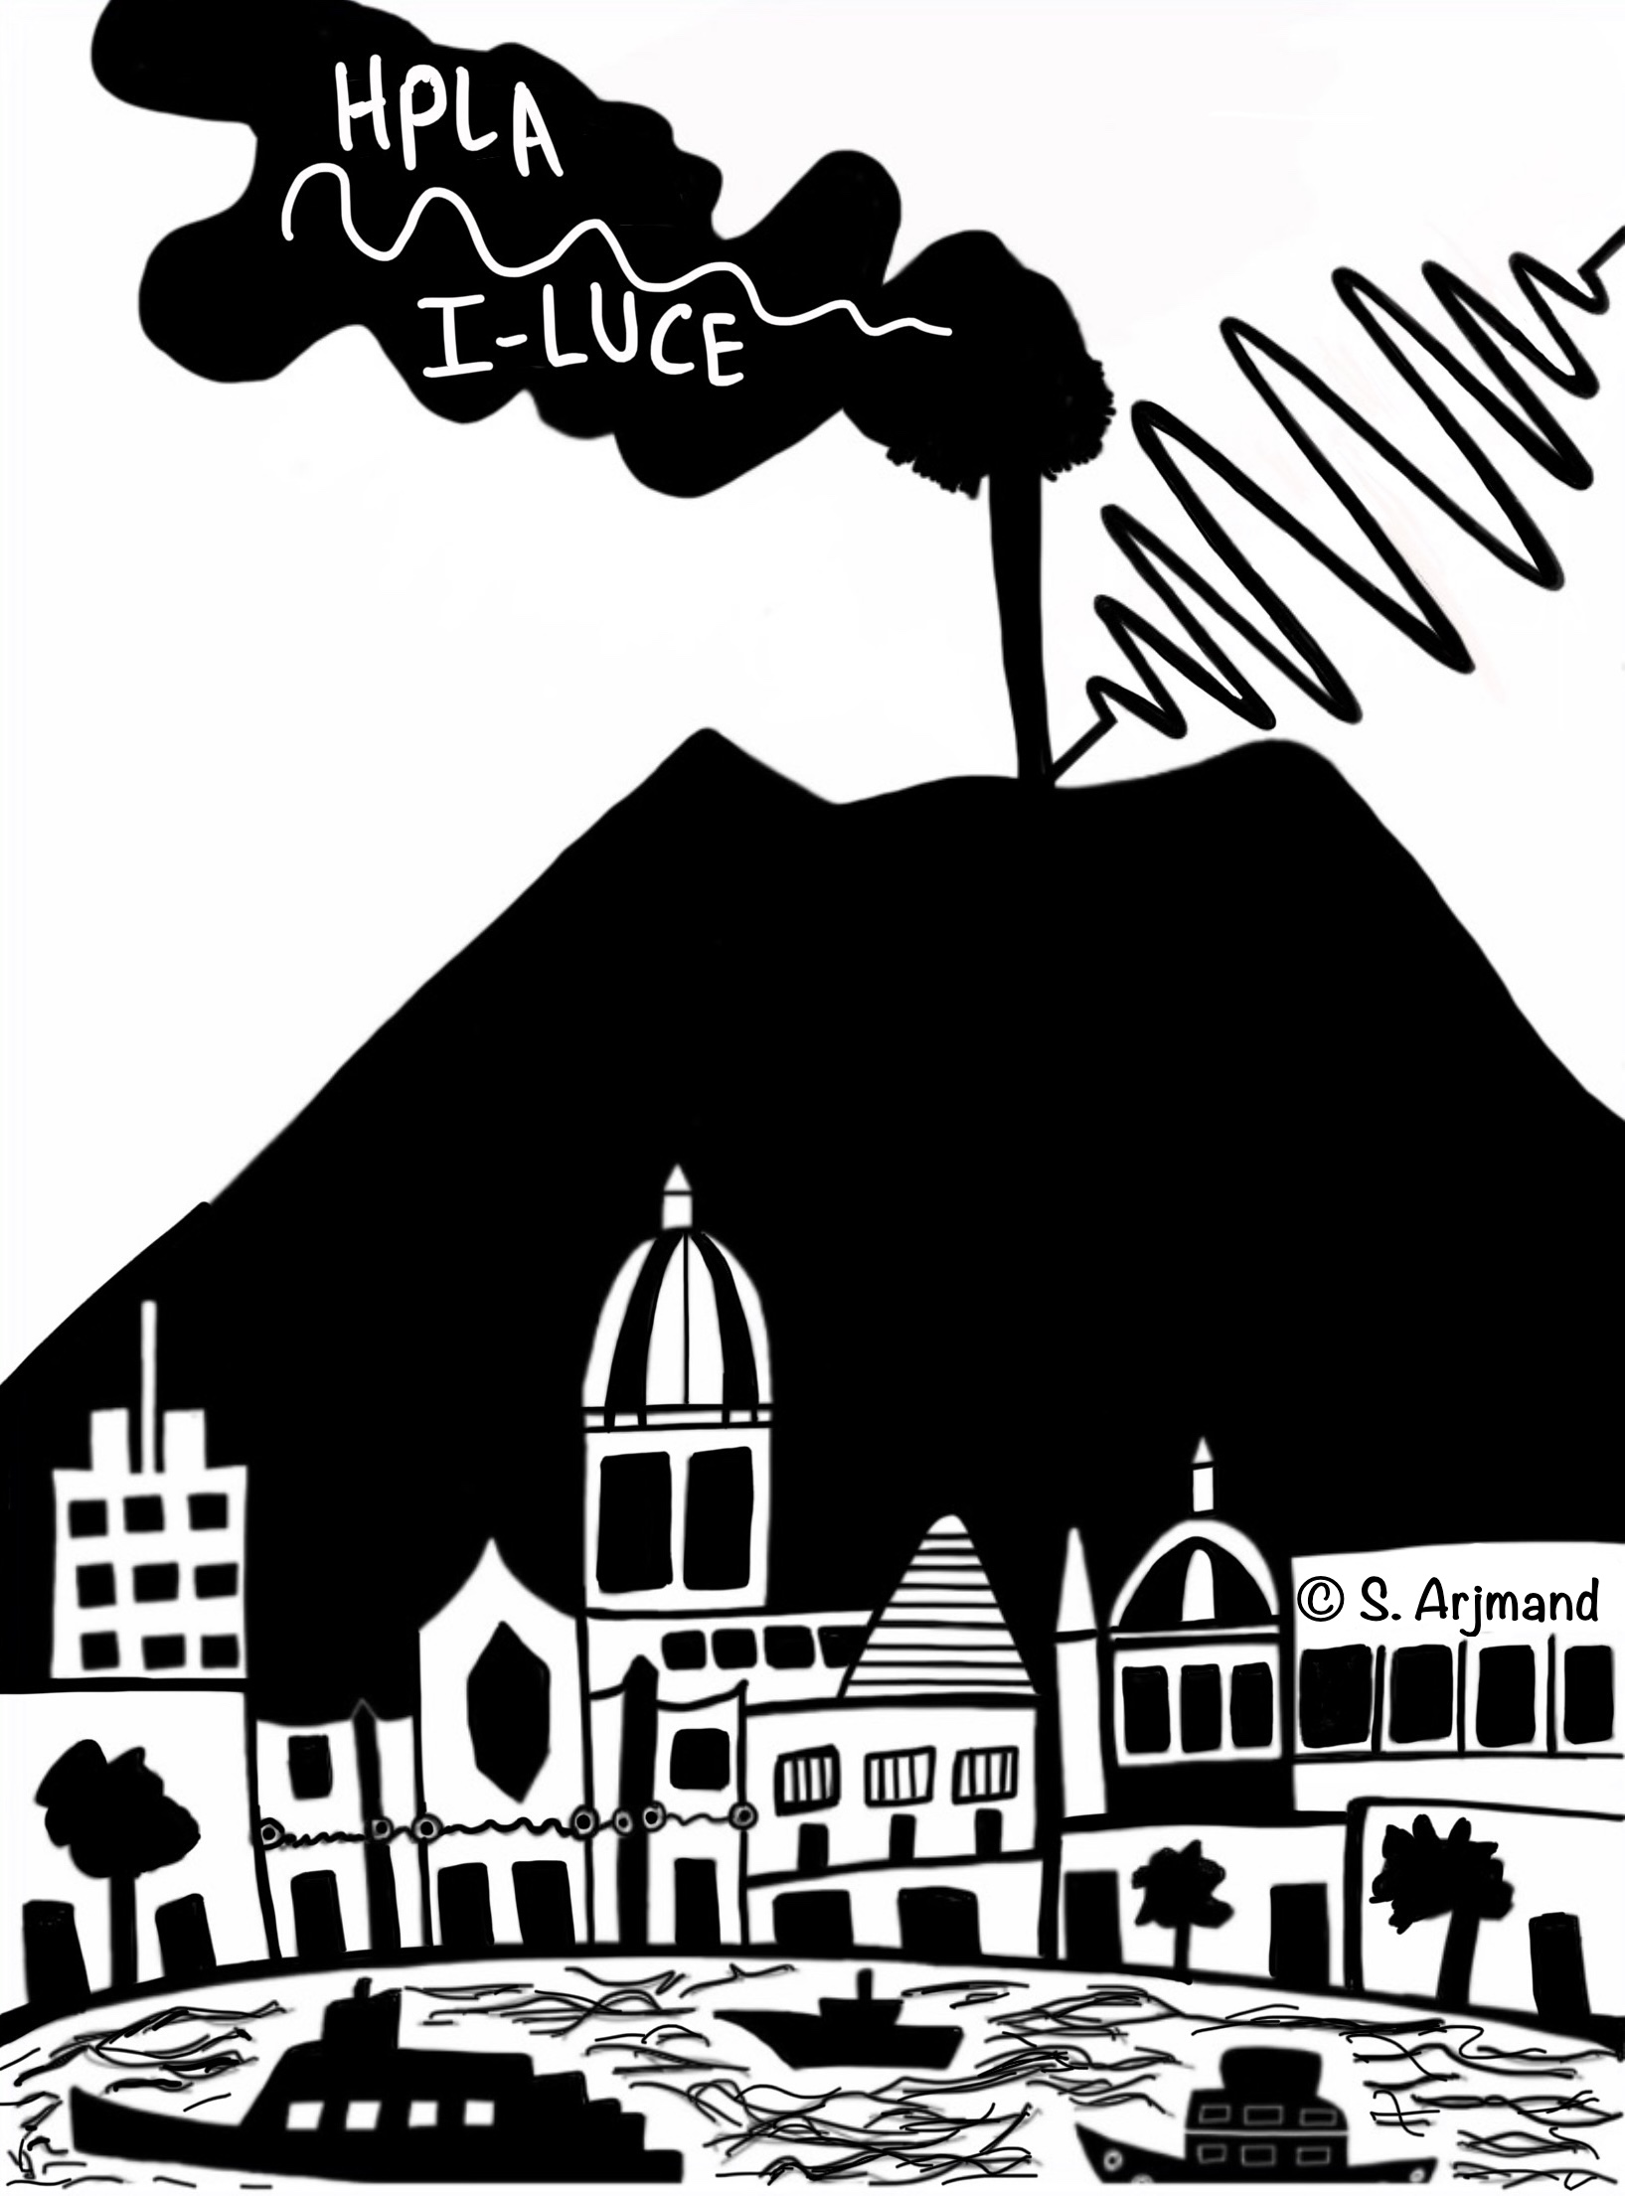


Nuclear AstroPhysics via Coulomb Explosion Mechanism
G.L. Guardo
on behalf of the AsFiN group

Slide 2
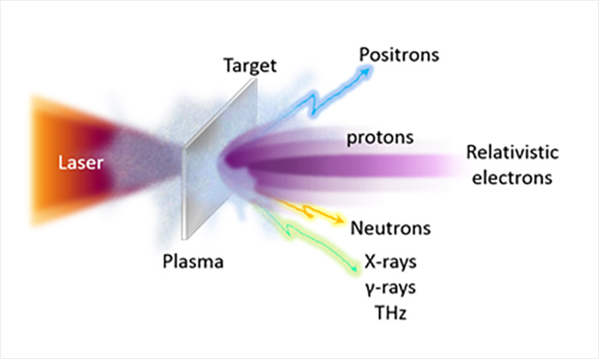
Laser induced reaction for nuclear astrophysics
An effective approach to improve our knowledge on fusion reactions in stars can be to mimic the stellar conditions by generating a controlled laboratory plasma with thermodynamical status not too different from the stellar conditions.
The advent of novel techniques in laser amplification on one hand opened the way to the the implementation of high-power high-intensity lasers in many facilities around the world and on the other it forced a steep development on the diagnostics side, de facto unlocking the feasibility of new paradigms of research.

Slide 3
Nuclear Astrophysics with laser beams
The most common scenario on laser-ion acceleration relies on focusing a high intensity laser pulse into a target made of the species of interest. Depending on the intensity and on the surface density of the target, different acceleration mechanisms are involved. The most studied scenario today relies on the Target Normal Sheath Acceleration mechanism originated by high-intensity laser pulses focused on thin targets.
These methods will open the way for a new approach to study Nuclear Astrophysics Reaction such as:
deuterium- deuterium
deuterium-³He
proton-lithium
proton-boron
¹²C-¹²C
¹⁶O-¹⁶O
and much more….

Slide 4
Coulomb Explosion paradigma
The interaction of ultra-short laser pulses with an expanding gas mixture at controlled temperature and pressure inside a vacuum chamber causes the formation of plasmas with multi-keV temperature. These energies overlap with the typical temperatures of stellar environments where thermonuclear reactions occur, thus making this paradigm a perfect scenario for nuclear astrophysics research.

Slide 5
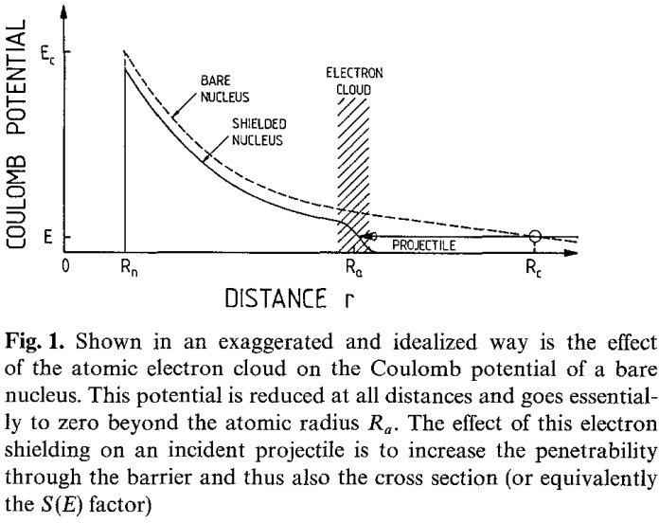
Electron Screening
Relatively small enhancements due to electron screening at energies E/U = 100 could cause significant errors in the extrapolation to lower energies, if the cross section curve is forced to follow the trend of the enhanced cross sections without correcting for screening
The whole effect of screening in this case (U₀<<E_{max}) is then that the reaction rate with screening
⟨ ^{σ v} ⟩accelerator ≠ ⟨ ^{σ v} ⟩ plasma ≈ ⟨ ^{σ v} ⟩stars ≠ ⟨^{σ v} ⟩bare

Slide 6
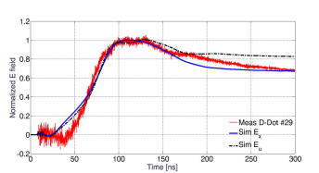
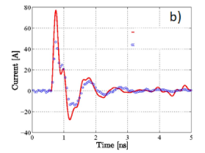
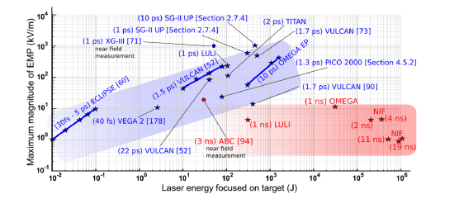
Electro-magnetic Pulse
The charge separation and target polarization under the action of a laser pulse produce an electromagnetic pulse.

Slide 7
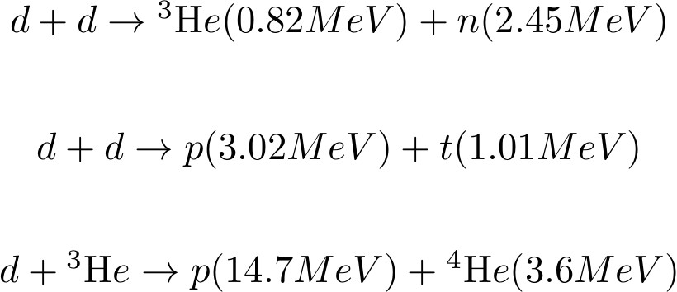
Deuterium-deuterium fusion

Slide 8
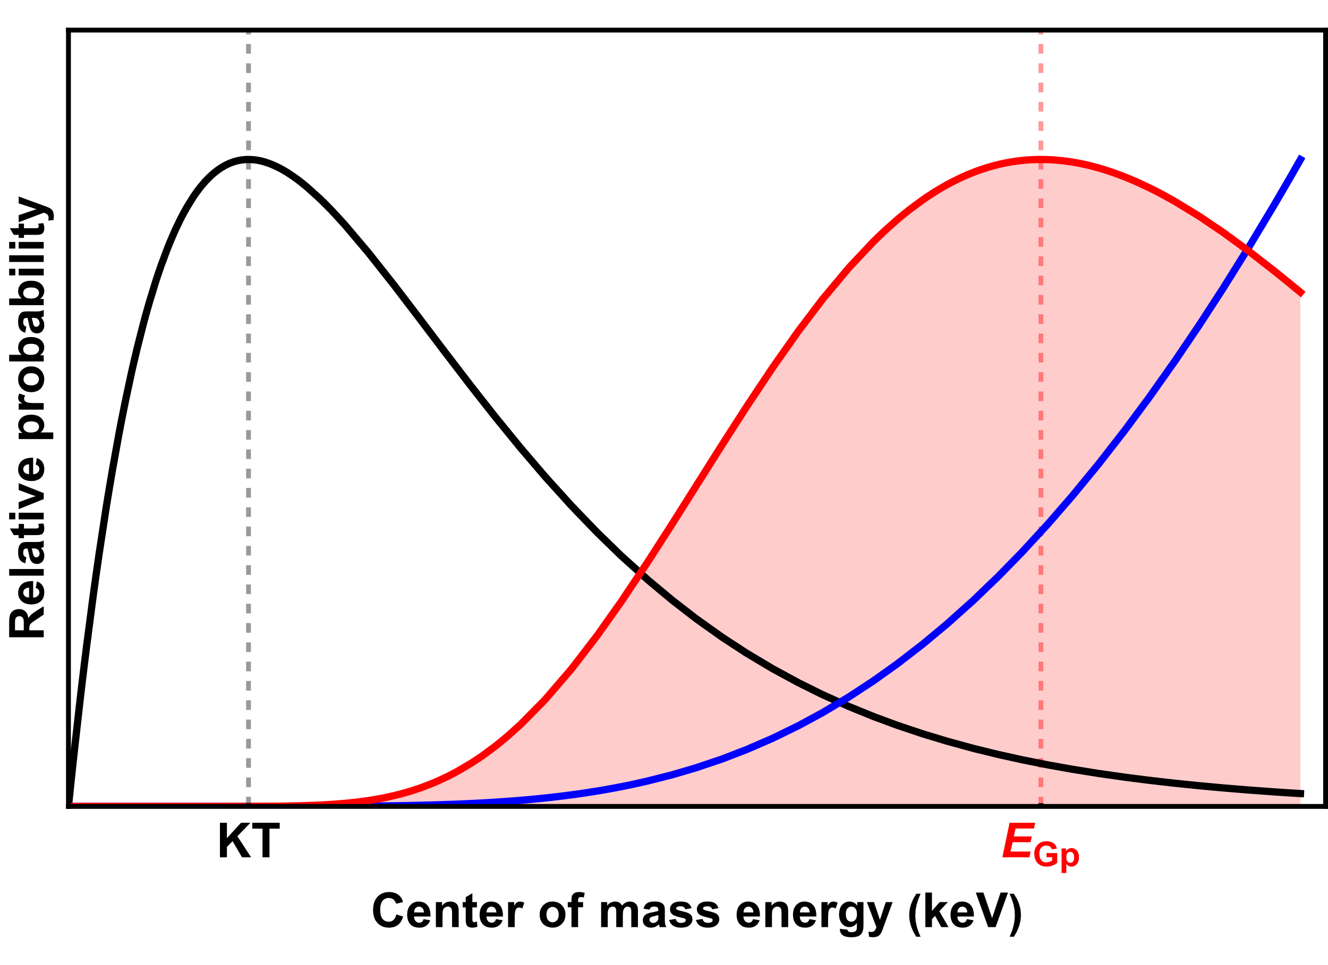
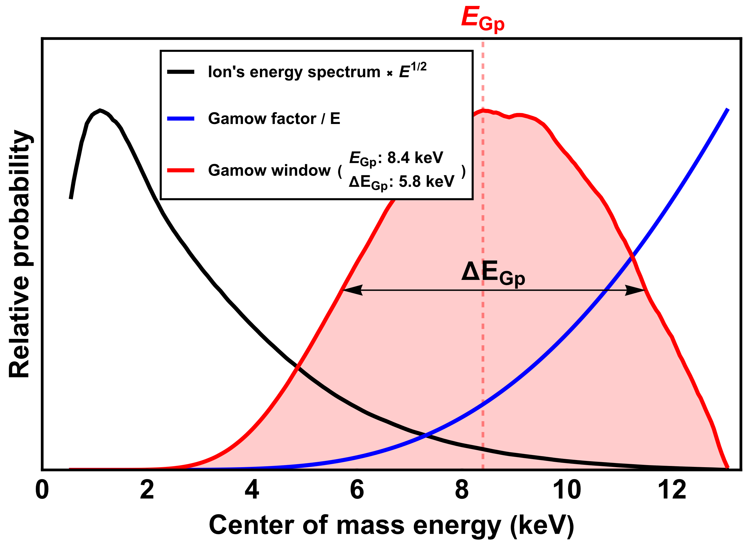
Energy definition in Coulomb Explosion
Ideal Maxwellian distribution
Energy spectrum from the MCP
kT ~ 1.9 keV

Slide 9
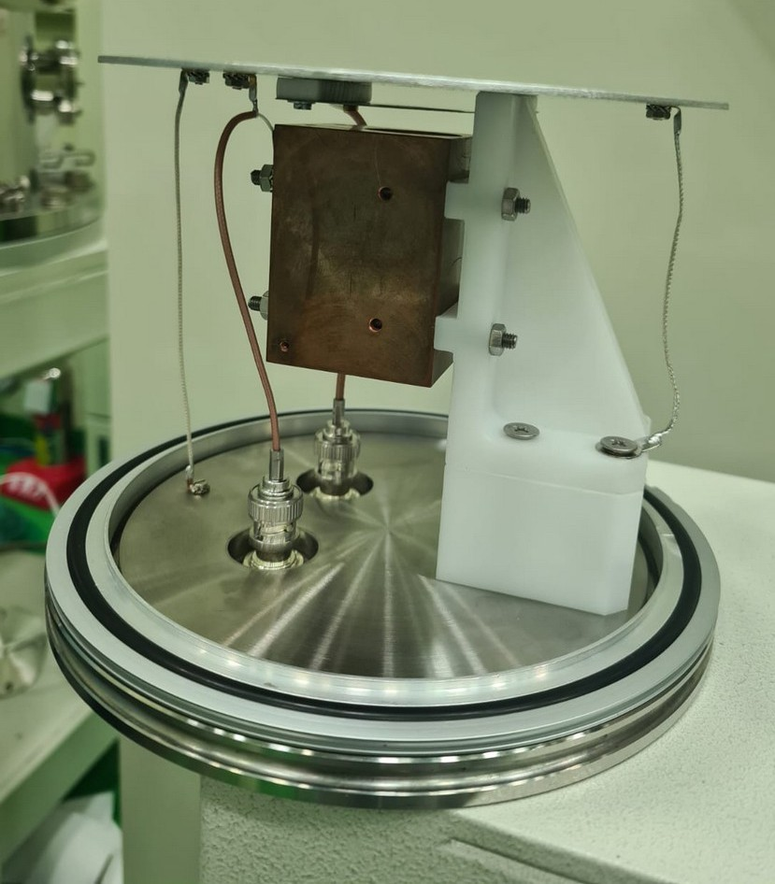
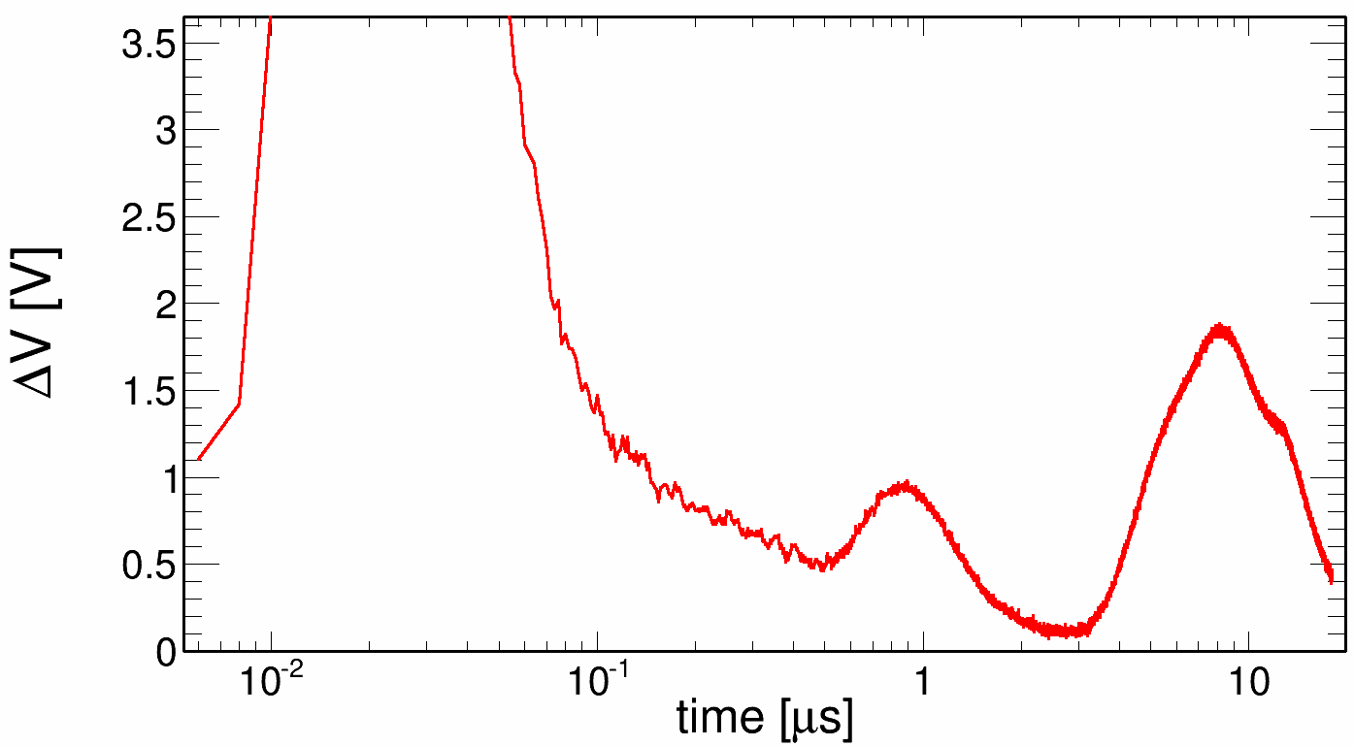
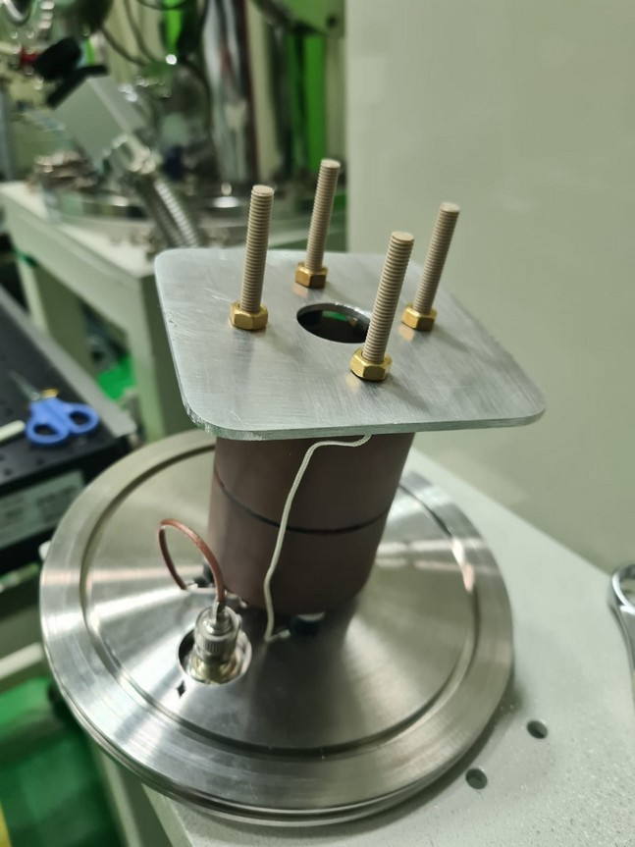
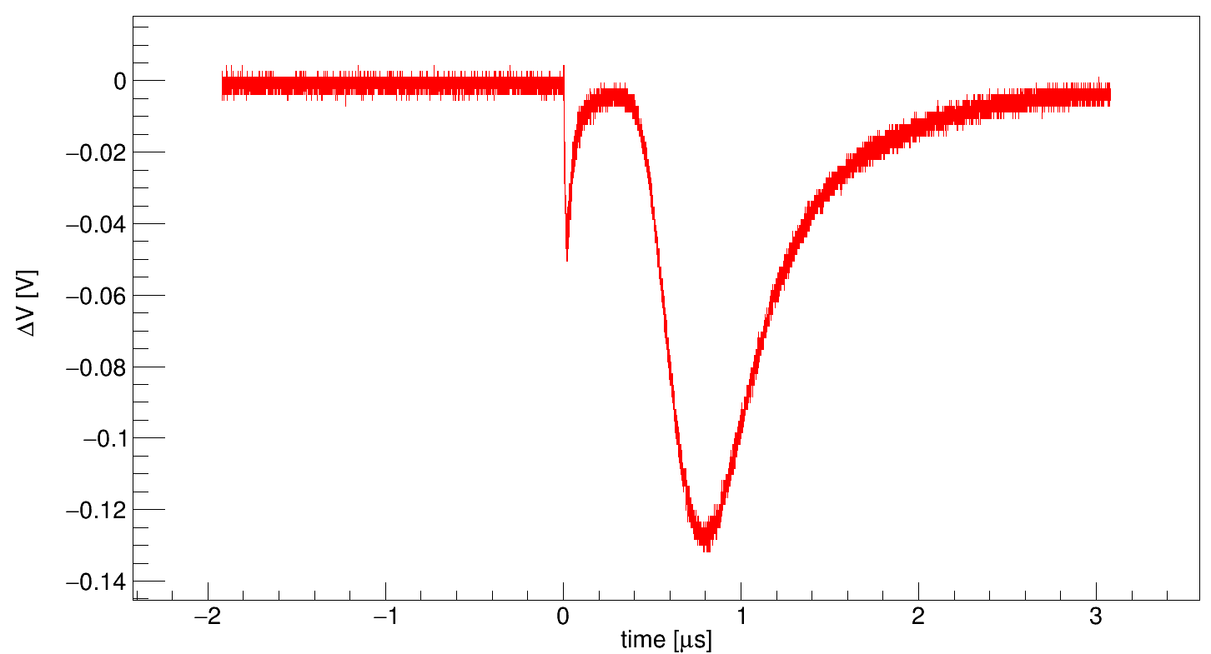
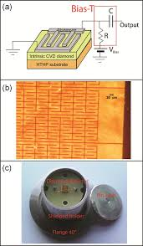
Energy definition in Coulomb Explosion
slow ions
x-rays
keV ions
photopeak

Slide 10
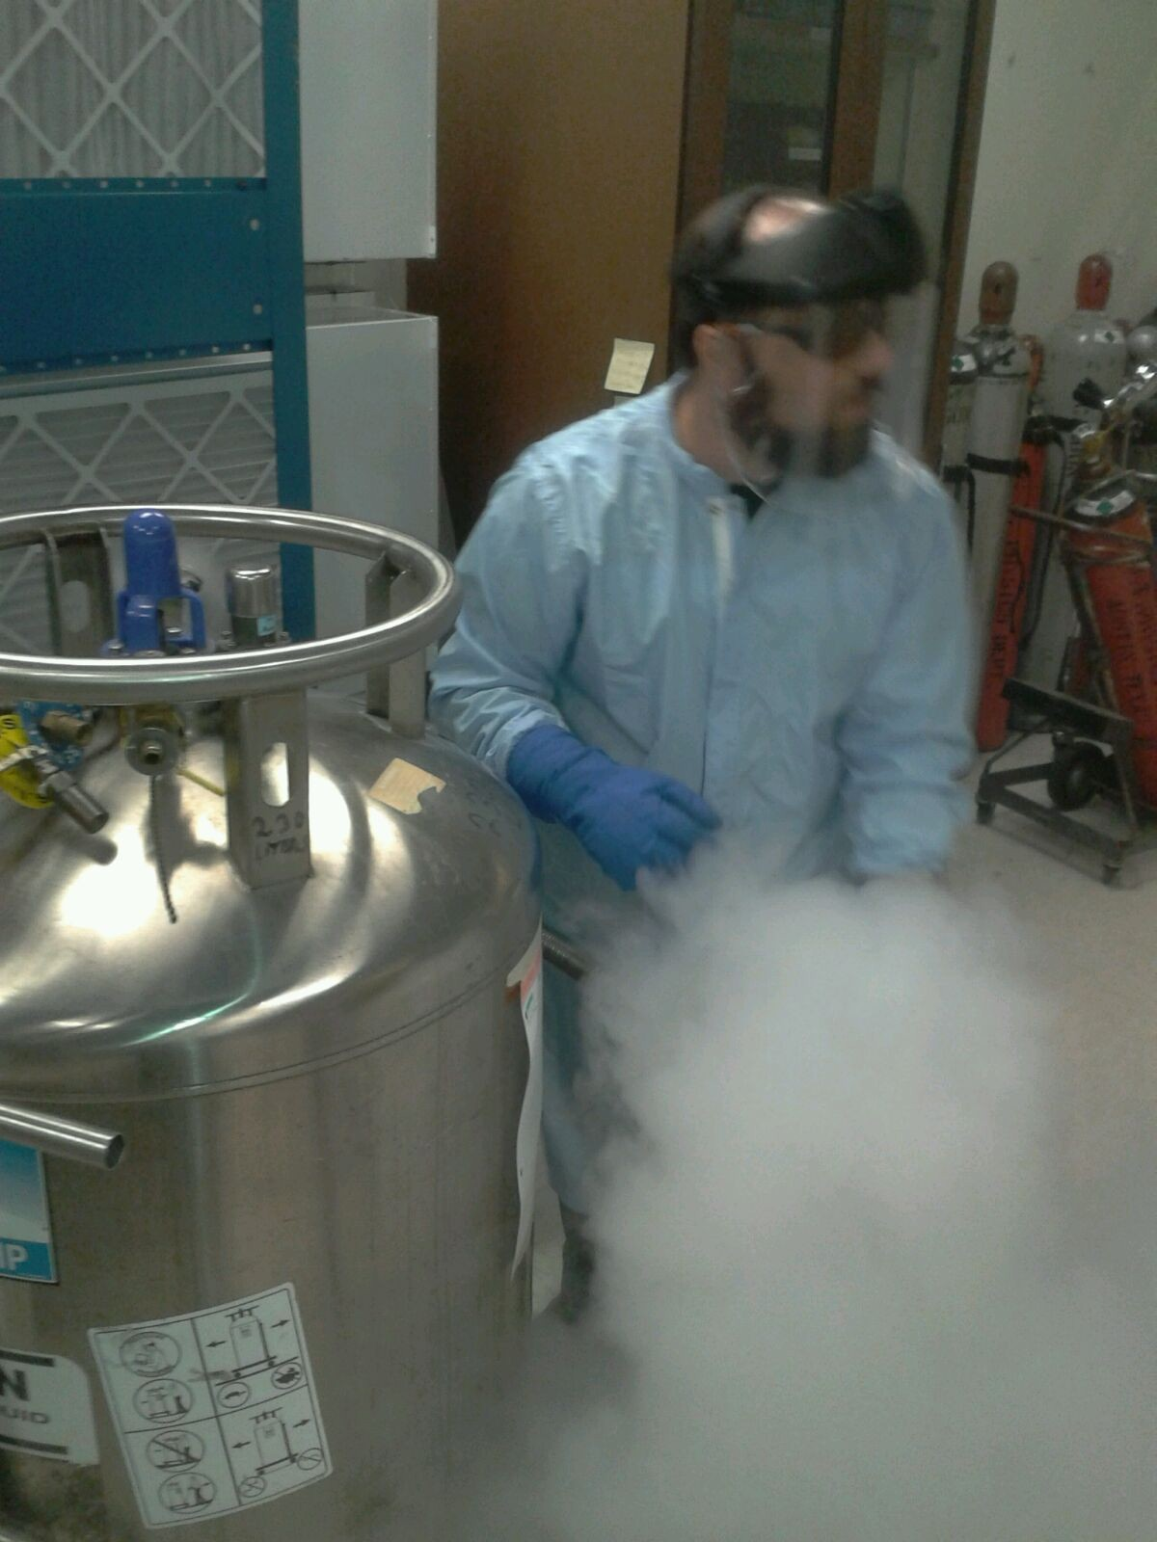
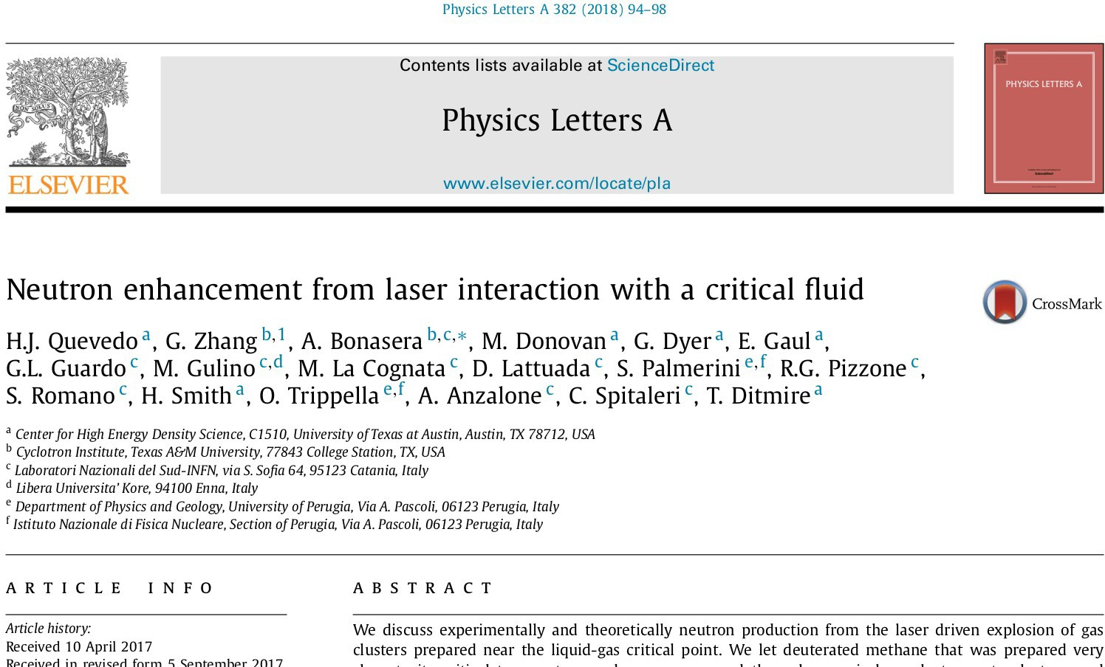
Experimental preparation
the number of fusion displays the power law dependence from the critical temperature with the critical exponent close to χ thus dominated by the surface term
the number of fusion reaches the maximum for T~T_{c}

Slide 11
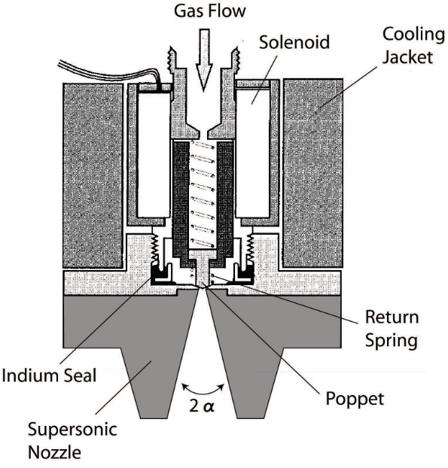
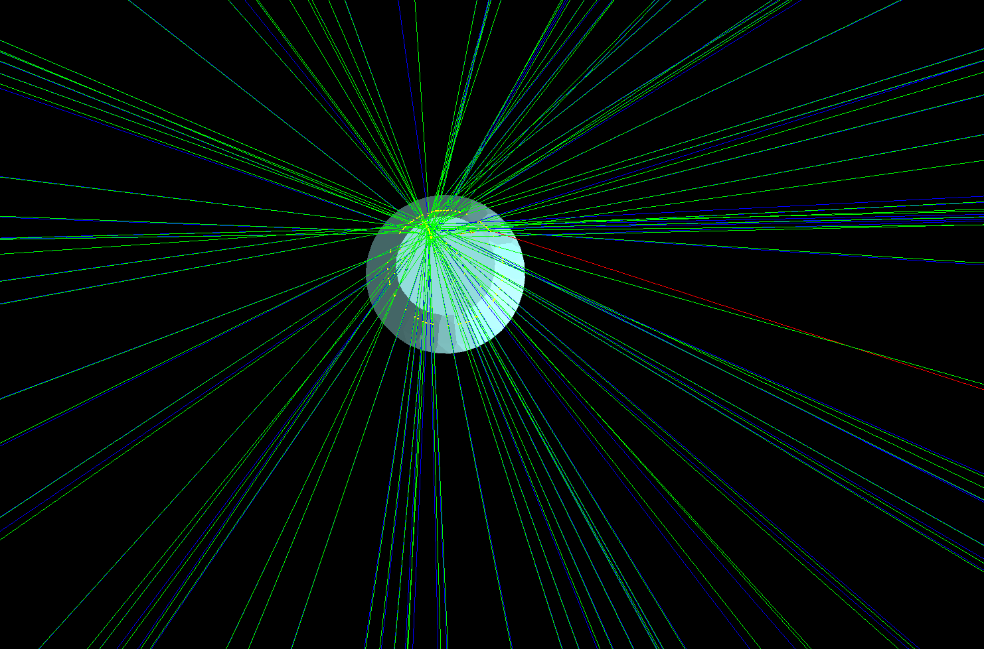
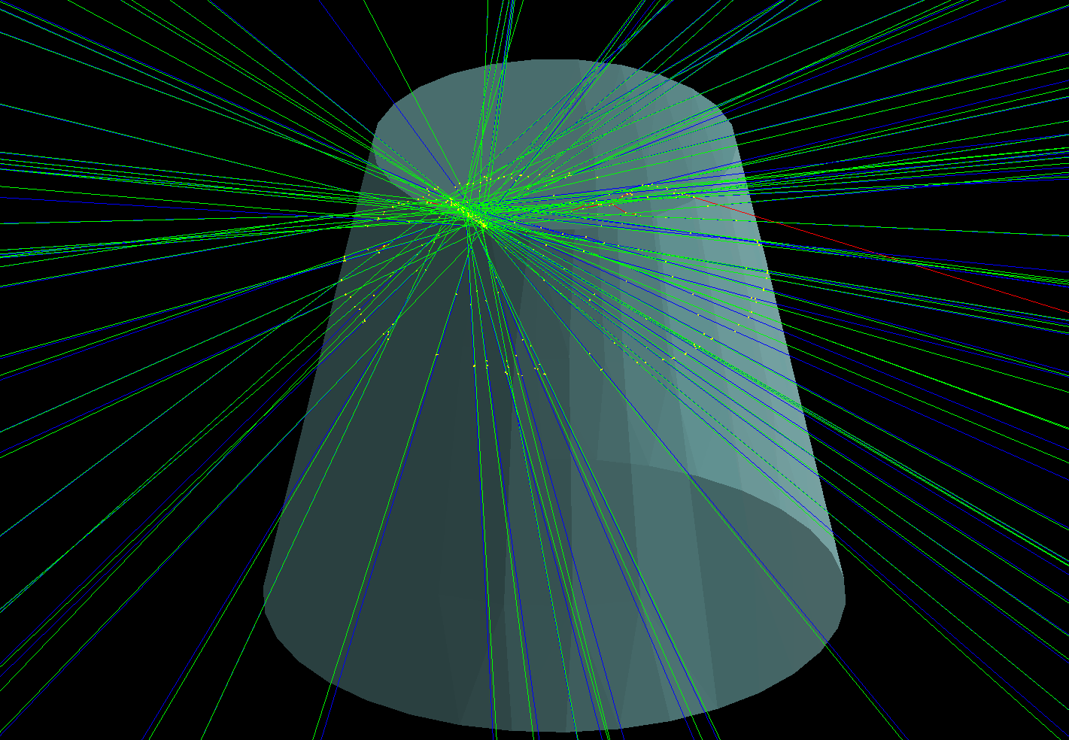
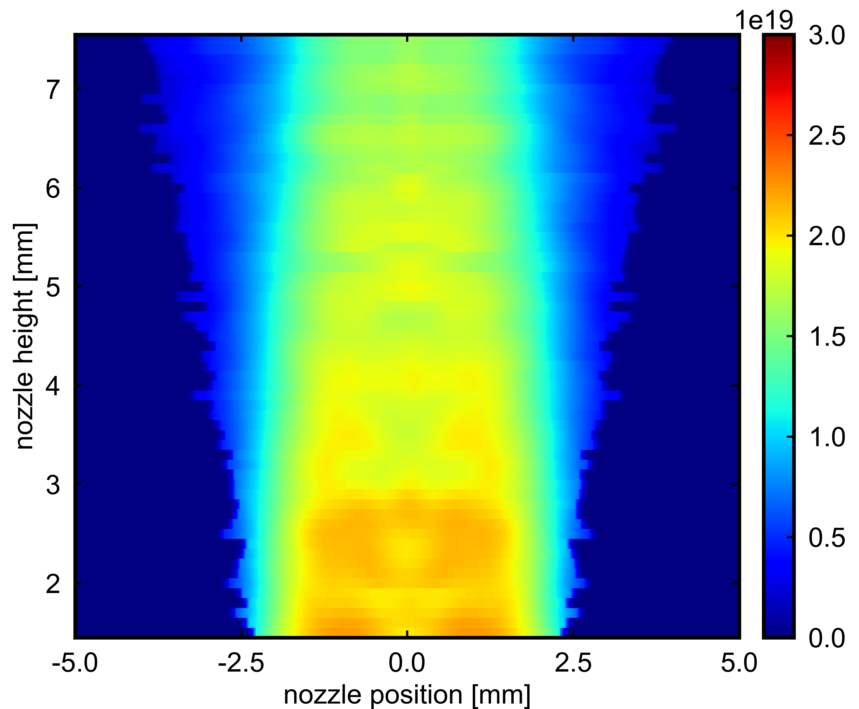
Target Characterization
GROOT 10.1051/epjconf/201716501034

Slide 12
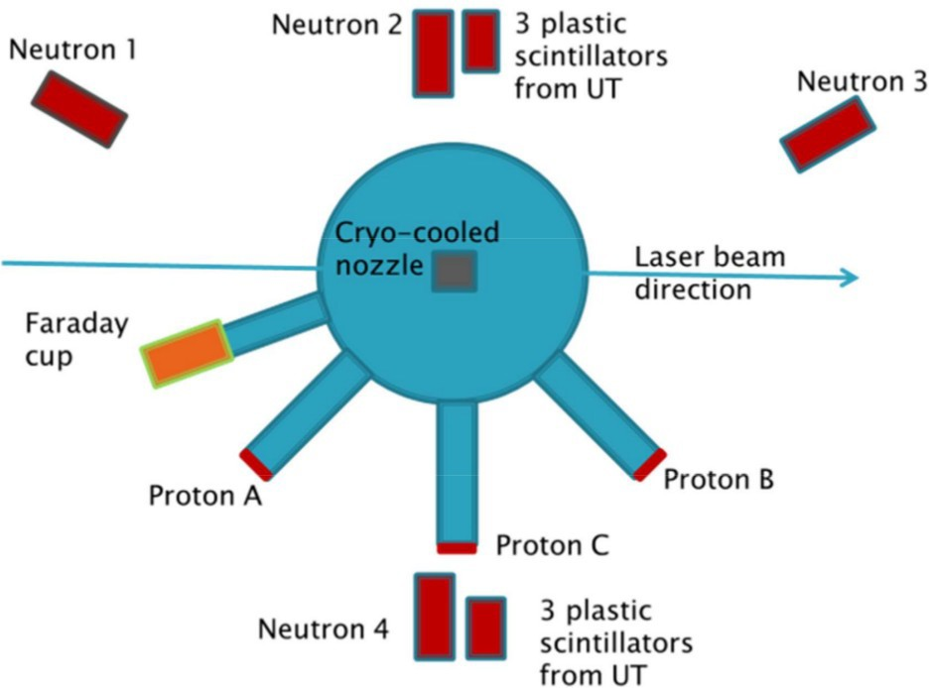
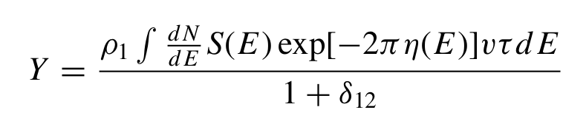
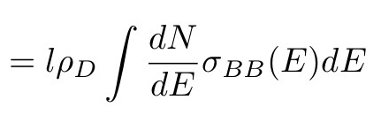
Experimental setup
n
d
p
n & p → scintillators, diamond, CR39
Deuteron spectrum → MCP, FC, diamond, CR39
Gas and plasma diagnostics → interferometry, CCD, previous Rayleigh scattering measurements

Slide 13
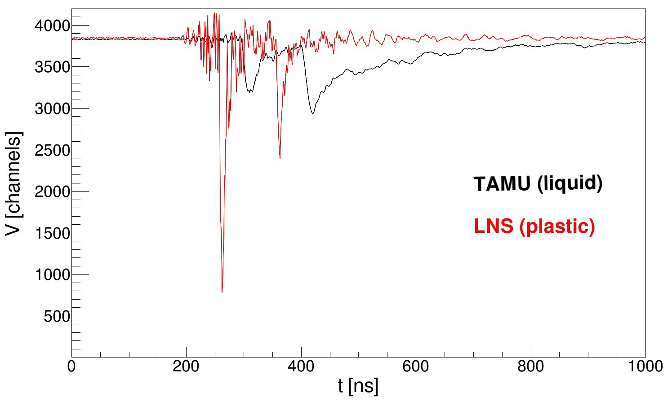
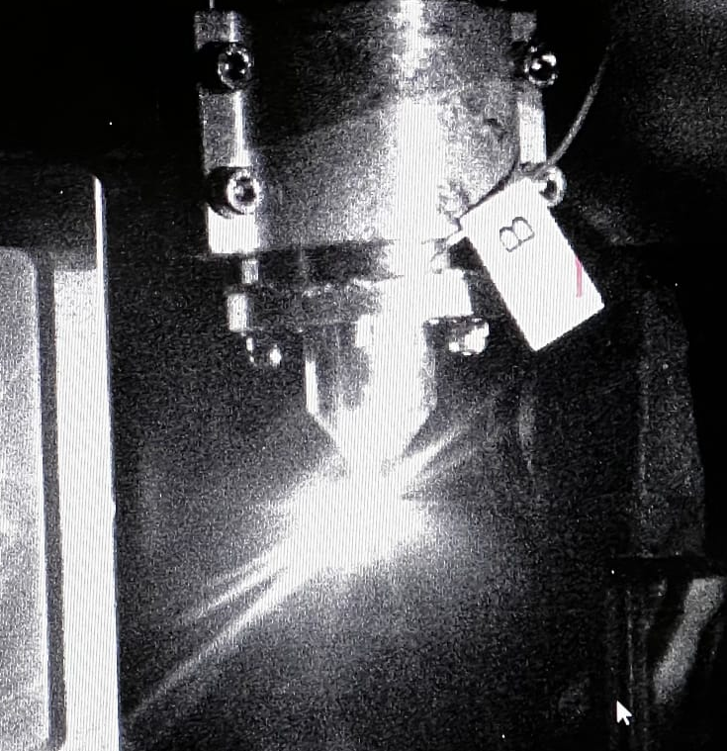
Experimental setup
neutron
n
d
p
photopeak
A star in the lab!!

Slide 14
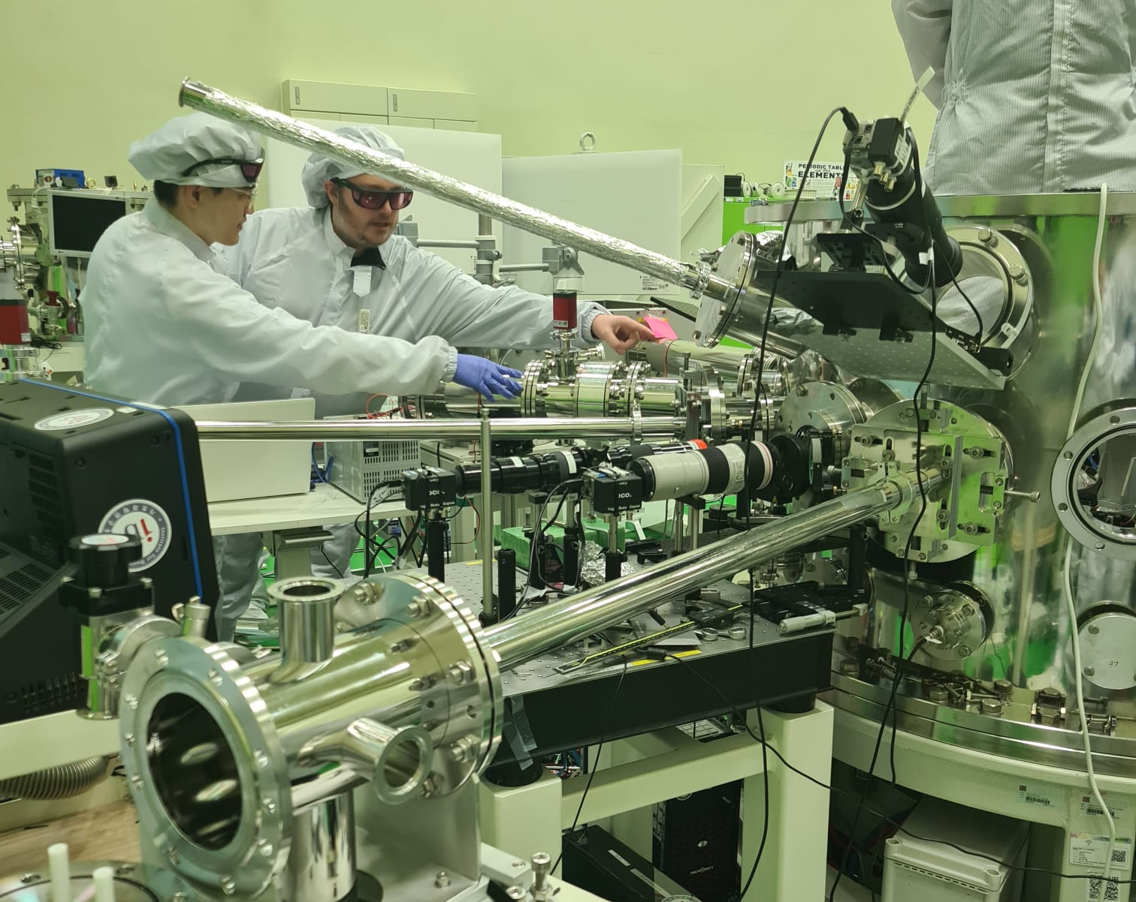
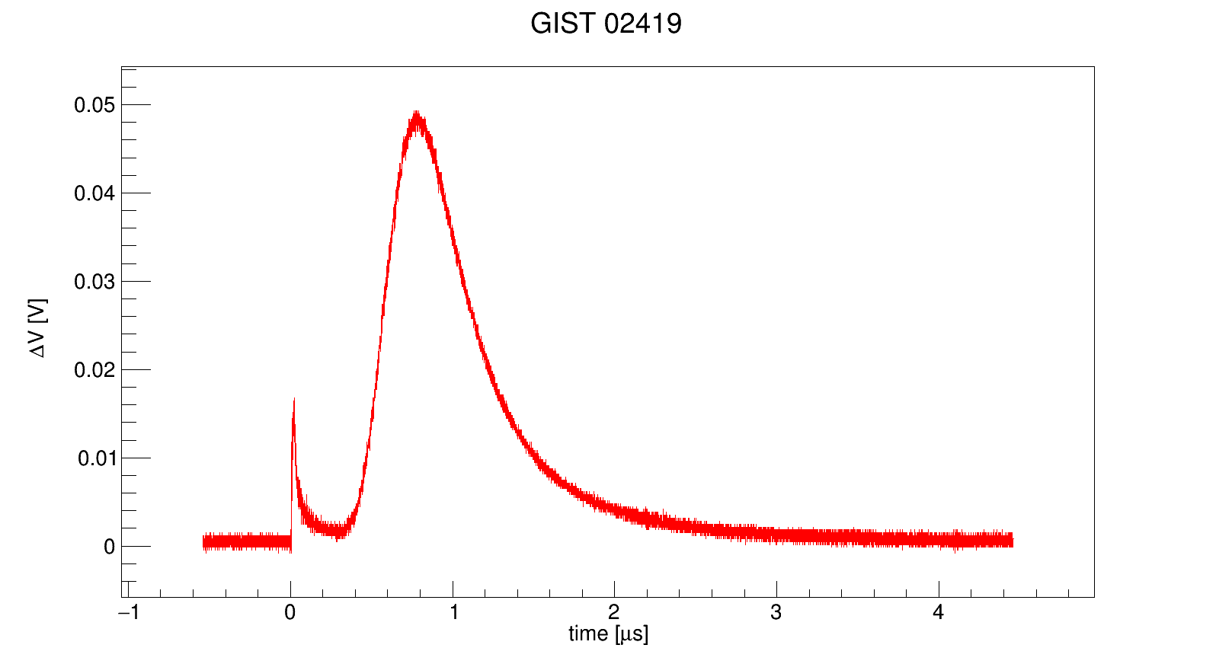
Data taking
Over 3000 shots, with T control between kT~1 keV and kT~40 keV

Slide 15
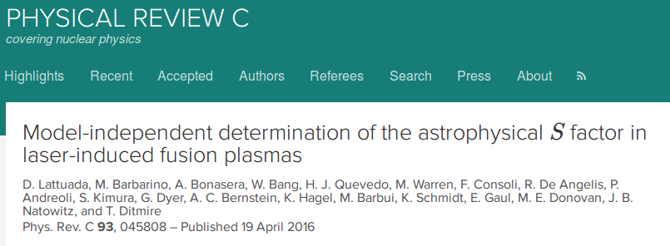
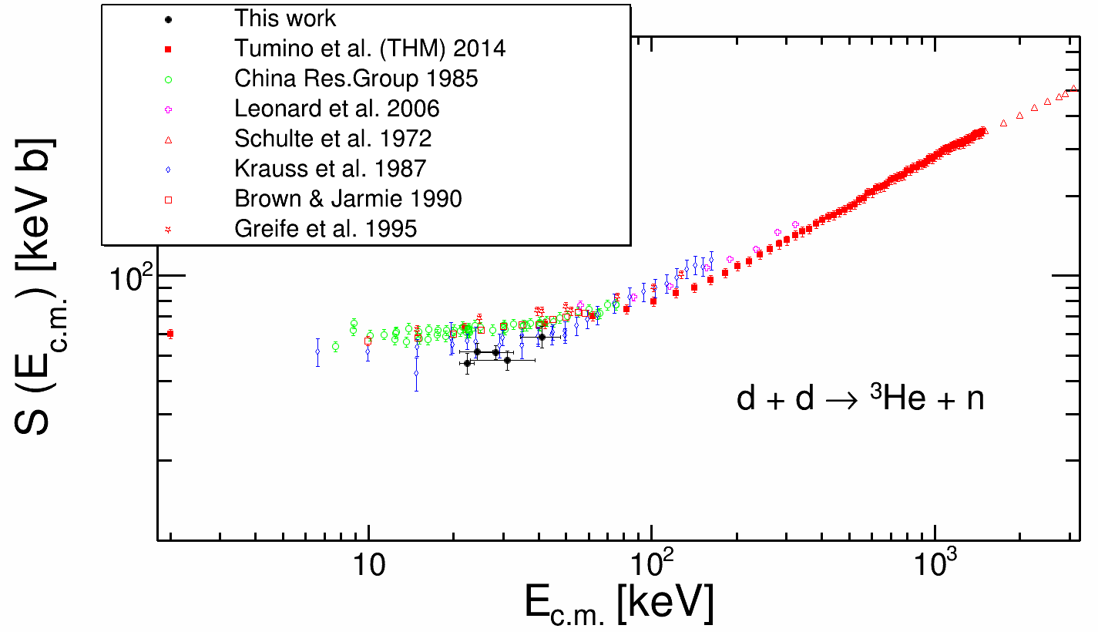
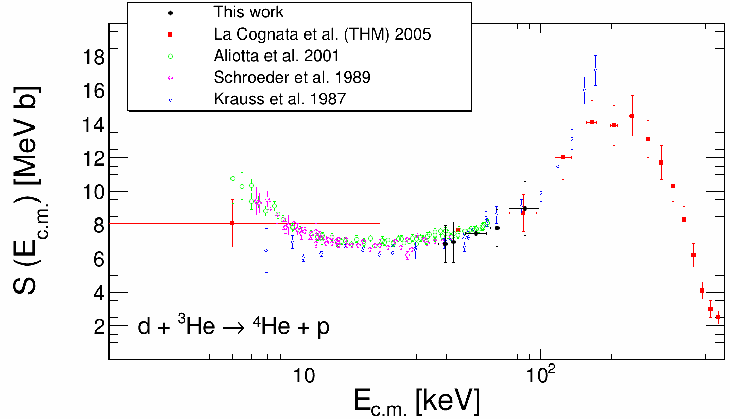
Results

Slide 16
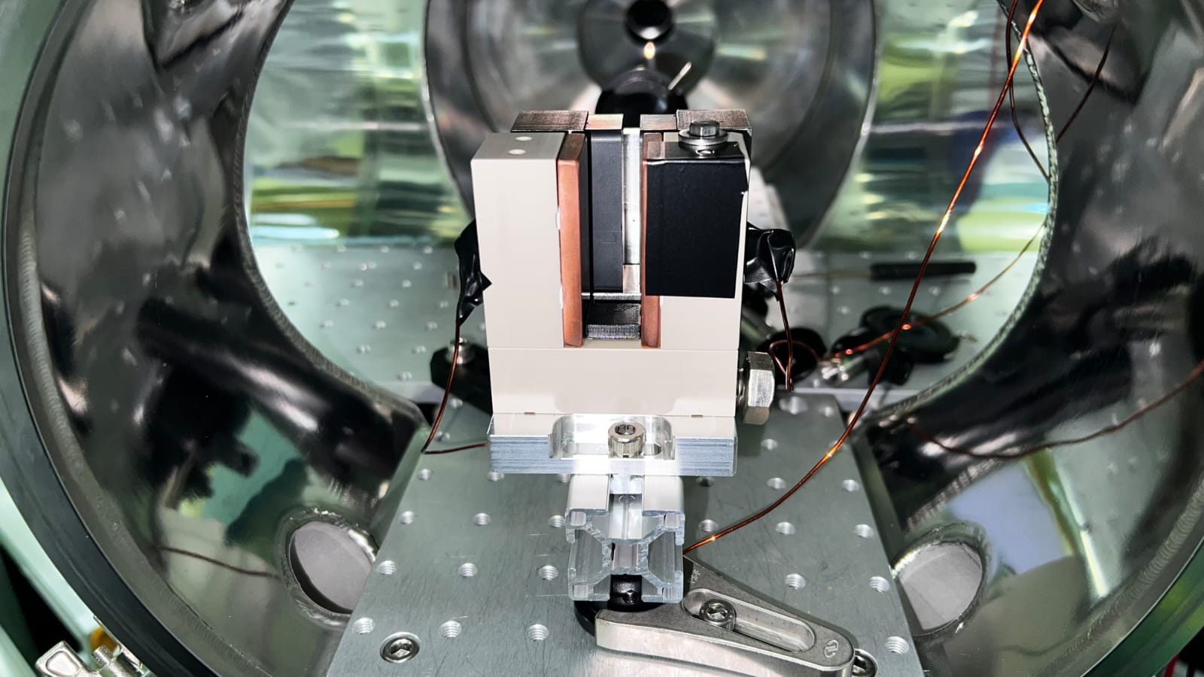
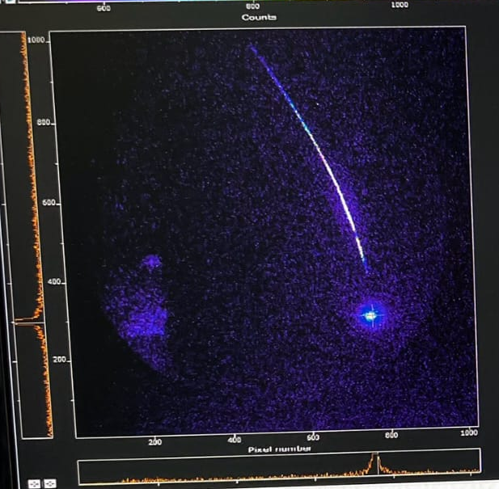
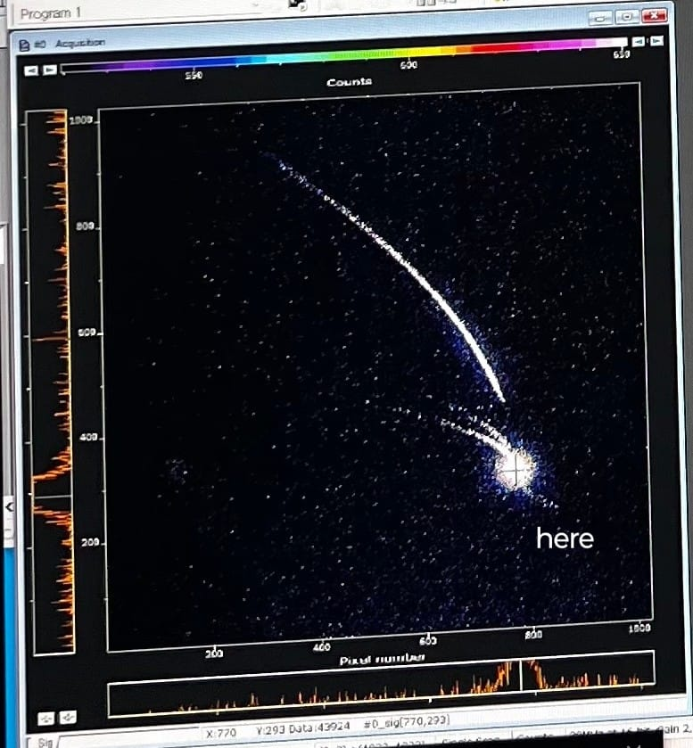
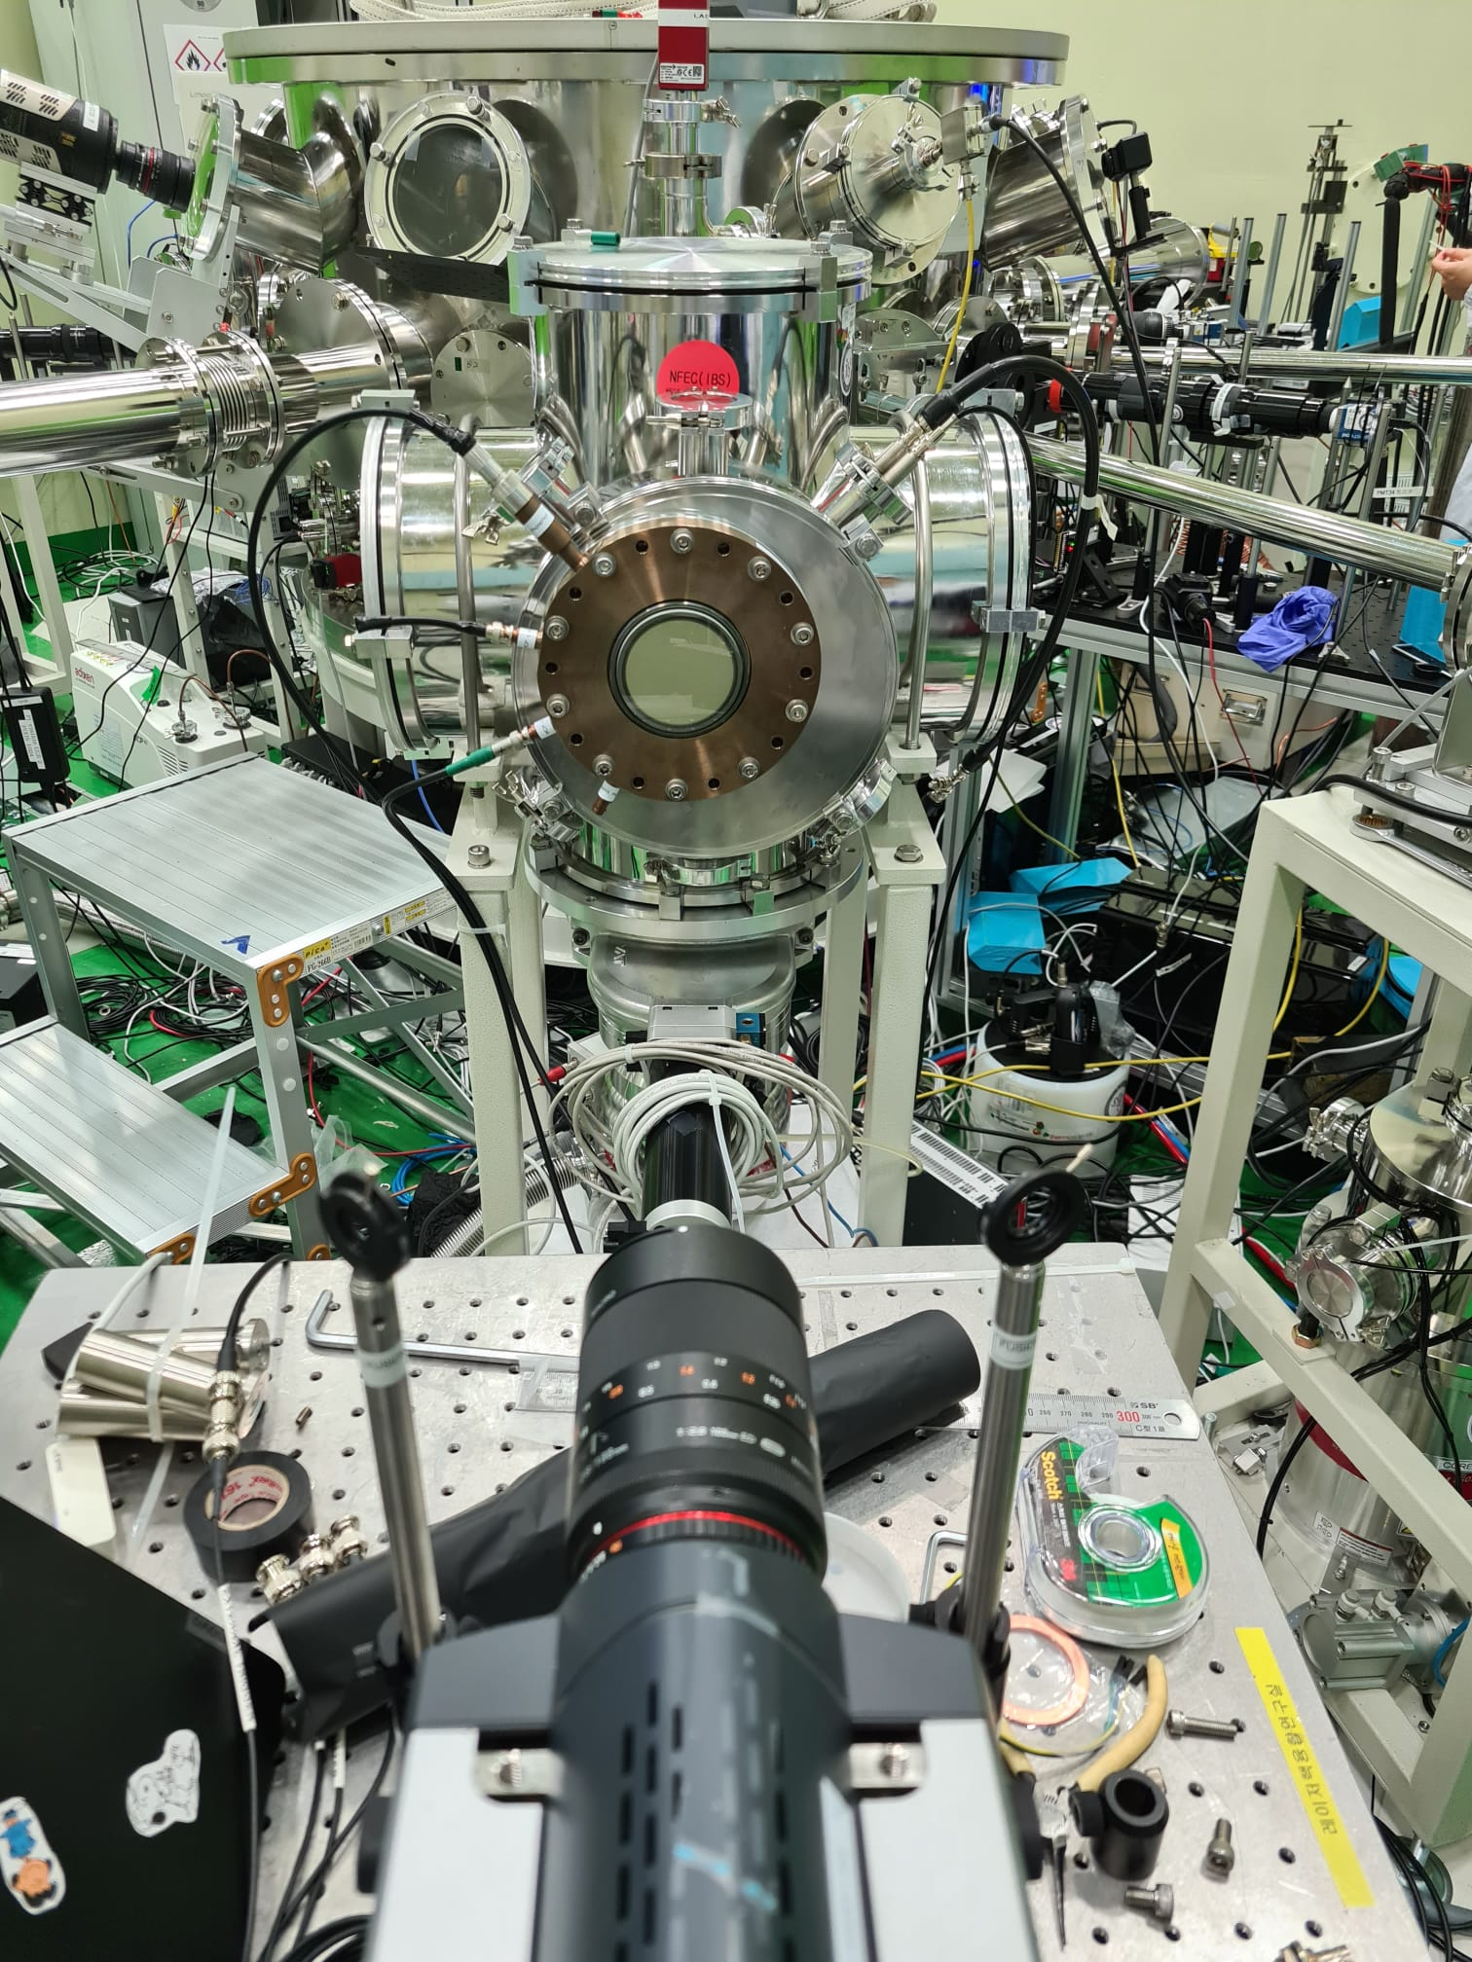
Towards C-C Fusion reaction
Online Thomson Parabola Spectrometer with MCP-readout developed in collaboration with ELI-NP (D. Doria et al.) and GIST, for CH₄ test.
D⁺
H⁺
C^{+?}

Slide 17
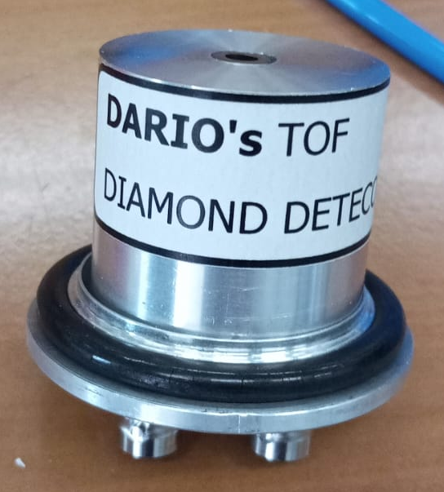
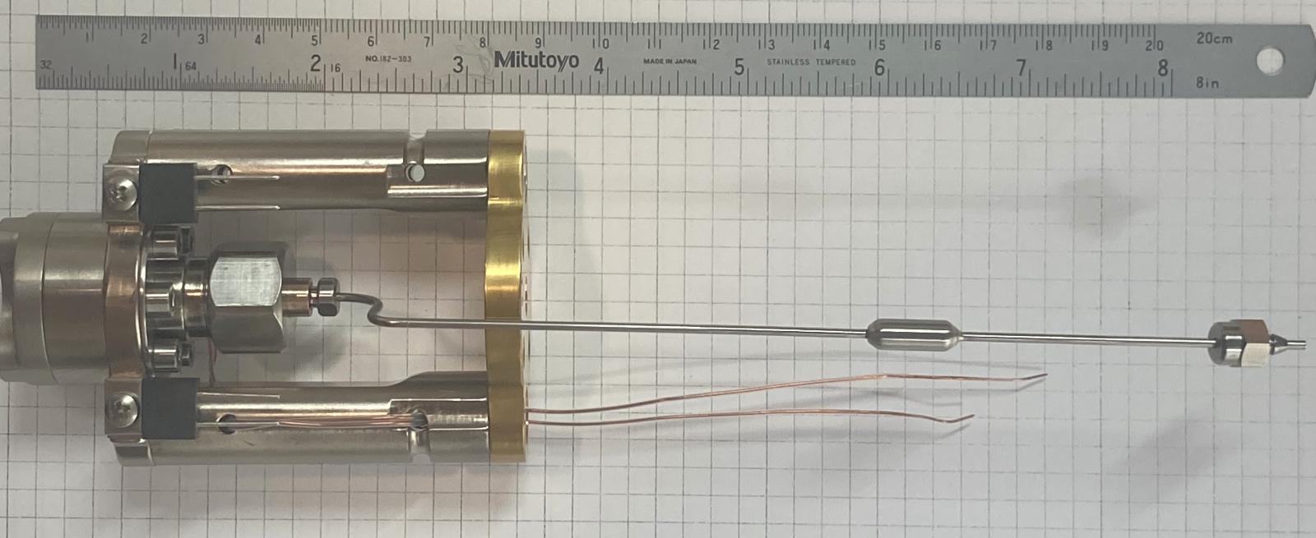
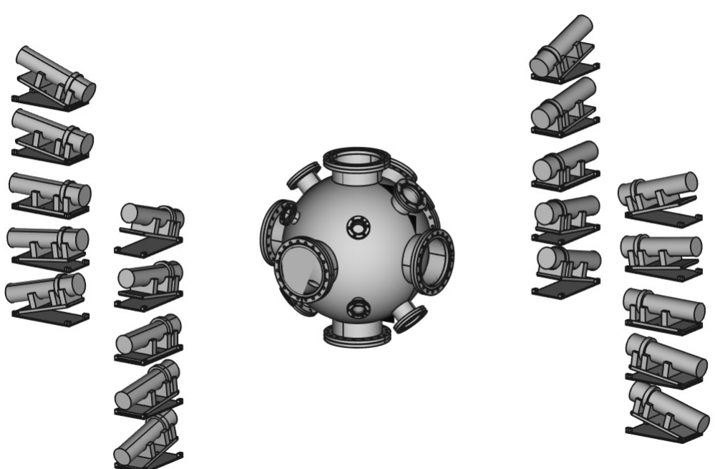
Versatile Array for Laser-induced Astrophysics Research
Science-driven, portable, cost-efficient
cryo-cooled supersonic nozzle
compact interaction chamber
neutron ToF detectors (plastic/liquid scintillators)
charged particle ToF detectors (SiC/CVD diamond detectors + FCs)
2 TPS
(CR39 for checks/normalization)

Slide 18
Summary
The advent of high-power and high-repetition rate lasers open the way for systematic studies of nuclear astrophysics reaction in plasma with stellar conditions
To catch these new experimental opportunities, the Asfin group is developing new arrays with peculiar characteristics: high-resolution, low-threshould, high-efficiency, compactness…
Preliminary results on methods and arrays make us confident for the new perspectives and open the way for new experimental campaigns
WAITING FOR i-LUCE!!!!!!

Slide 19

Thank you for your attention

Slide 20
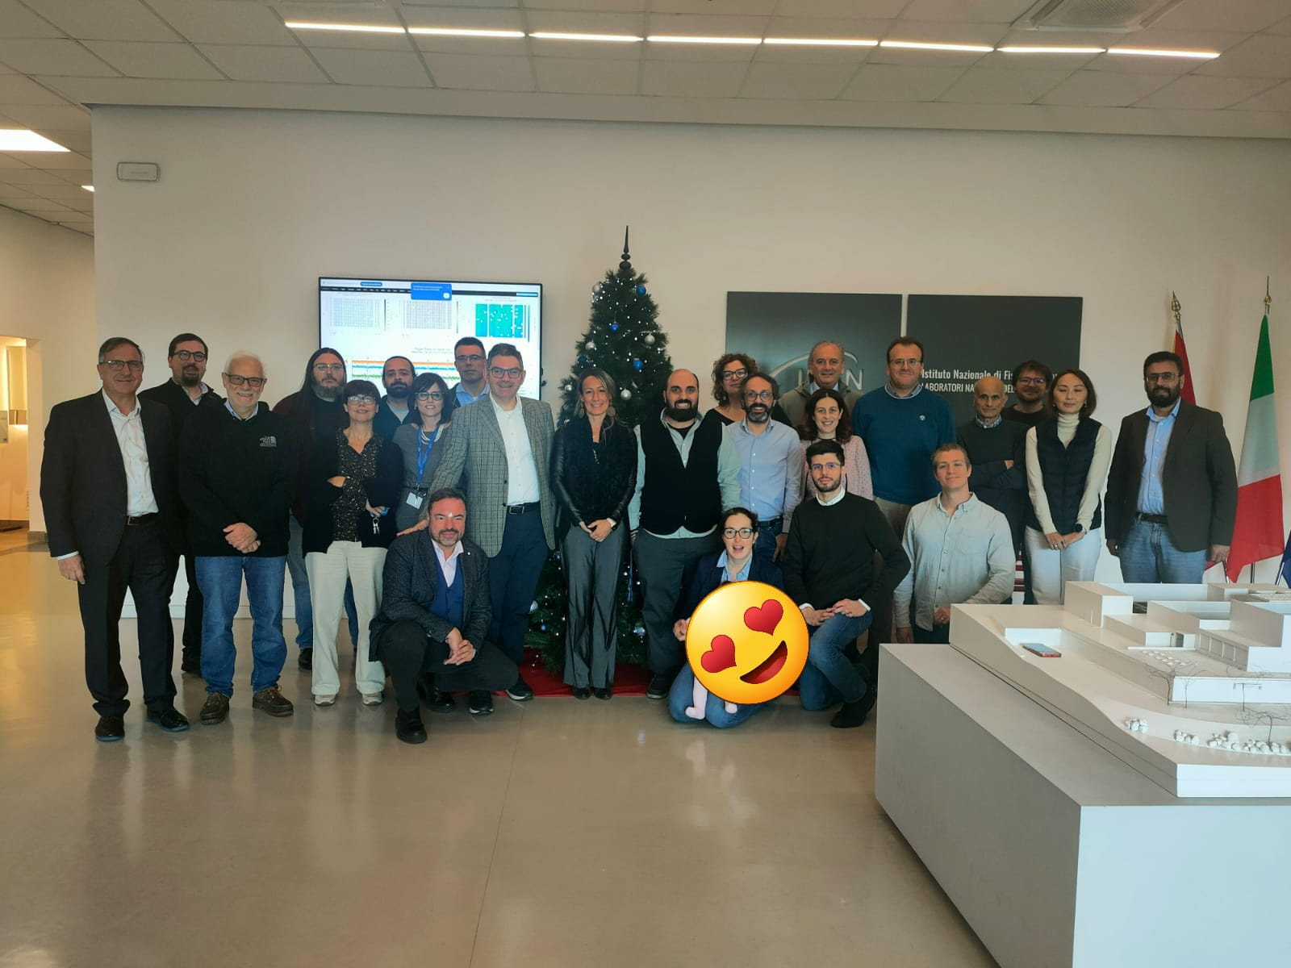

Collaborations
Cyclotron Institute,Texas A&M,US: R. Tribble, V. Goldber Texas A&M Commerce US: C. Bertulani
Florida State University US: I. Wiedenhofer
Notre Dame University US: M. Wiescher, M. Couder
C.N.S. Riken, Wako, Japan: S. Kubono, H. Yamaguchi, S. Hayaka University of Taskent: B. Irgaziev, R. Yarmukhanmedov
CIAE, Beijing, China: S. Zhou, C. Li, Q. Wen
Nuclear Physics Institute, ASCR, Rez, Czech Rep.: V. Kroha, V. Burjan, J. Mrazek
Nipne IFIN Bucharest: L. Trache
ELI-NP Bucharest: C. Matei, D. Balabanski Atomki, Debrecen, Hungary: G. Kiss
CSNSM, Orsay, France : A. Coc , F. Hammache, N. De Sereville
University of Catalunya: J. Jose
Rudjer Boskovic Institute Zagreb Croatia: N. Soic, M. Milin
GIST, Gwangju, South Korea: W. Bang
@Catania: A. Bonasera, S. Cherubini, G. D’Agata, A. Di Pietro, P. Figuera, S. Gammino, G.L. Guardo, M. Gulino, M. La Cognata, L. Lamia, D. Lattuada, A.A. Oliva, R.G. Pizzone, G.G. Rapisarda, S. Romano, D. Santonocito, M.L. Sergi, R. Spartà, C. Spitaleri, A. Tumino
@Napoli M. La Commara @Padova M. Mazzocco, S. Pigliapoco, A. Togni
@Perugia S. Palmerini, M. Limongi, A. Chieffi, M.C. Nucci

Slide 21
