Slide 1
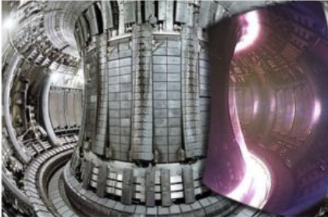
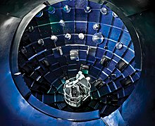
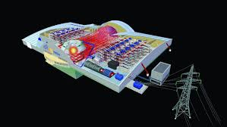


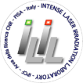
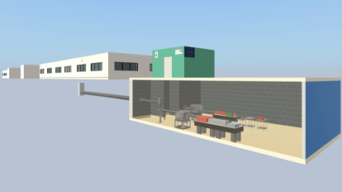

Fusion energy research with high power lasers in Europe: from ELI to HiPER+
2nd INFN School and Workshop on “High Power Lasers for Fundamental Science and Applications” (HPLA2025)
Leonida Antonio GIZZI
ILIL, INO, Consiglio Nazionale delle Ricerche, Pisa, Italy
also @ ELI-ERIC

Slide 2
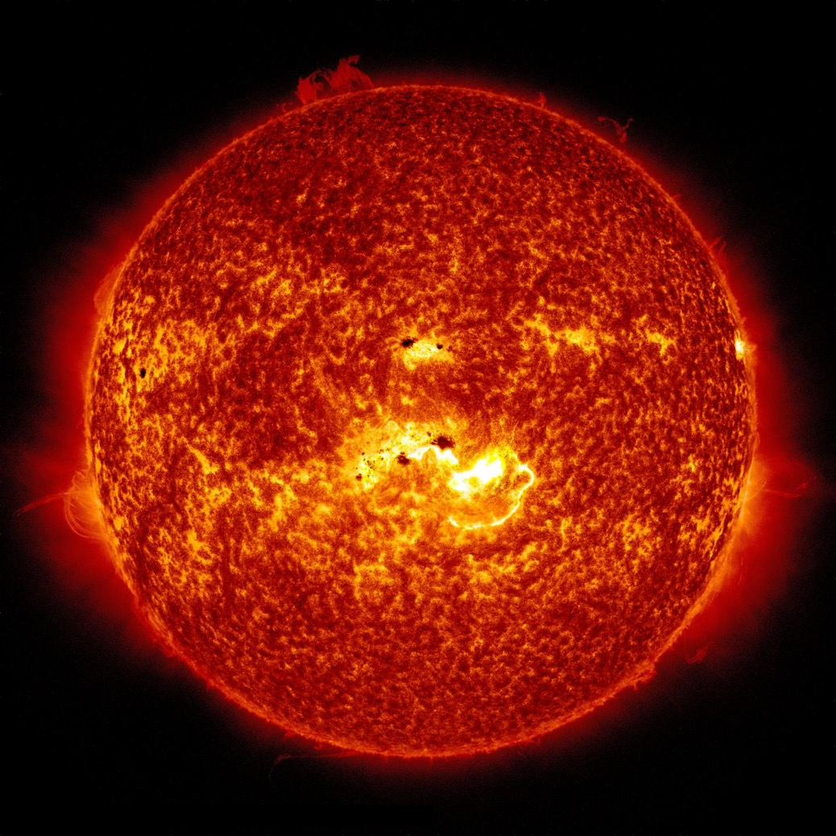
Inertial fusion energy: where we stand
Nuclear fusion is the “challenge of challenges” in the energy field.
Laser Fusion is a very promising approach:
  use powerful laser pulses to compress and heat a small fuel capsule until fusion reactions are ignited.
In recent years, we have witnessed extraordinary progress
  the first experiment in the world to achieve net energy gain at the National Ignition Facility (NIF).
This is the beginning of a complex journey.
Foto NASA

Slide 3
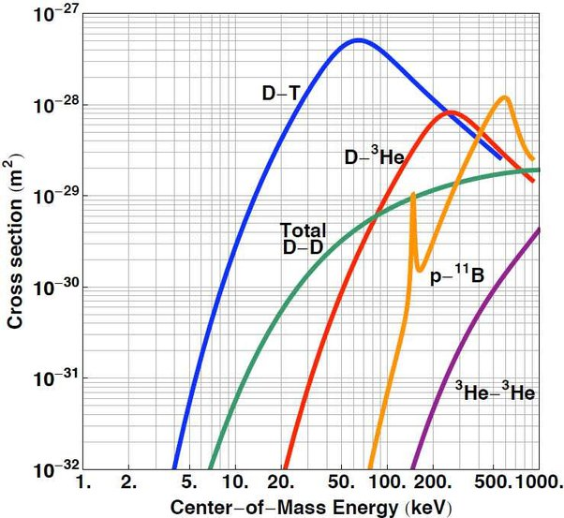
Founding principle: fusion reactions
  Among the many possible fusion reactions, only some have practical uses based on their efficiency and the abundance of the "reactants" in nature.
Prop Probabilità
(Temperatura (11600 x °K/keV)

Slide 4
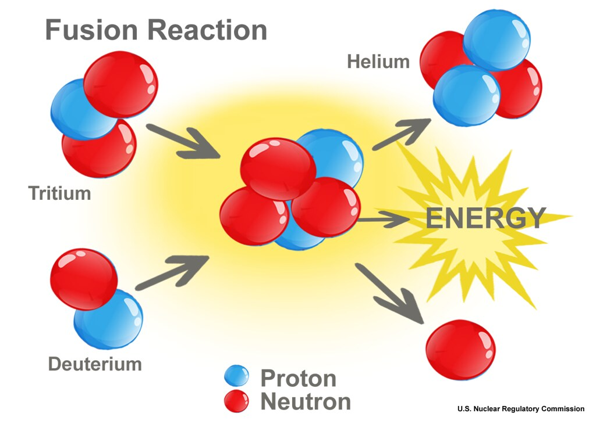
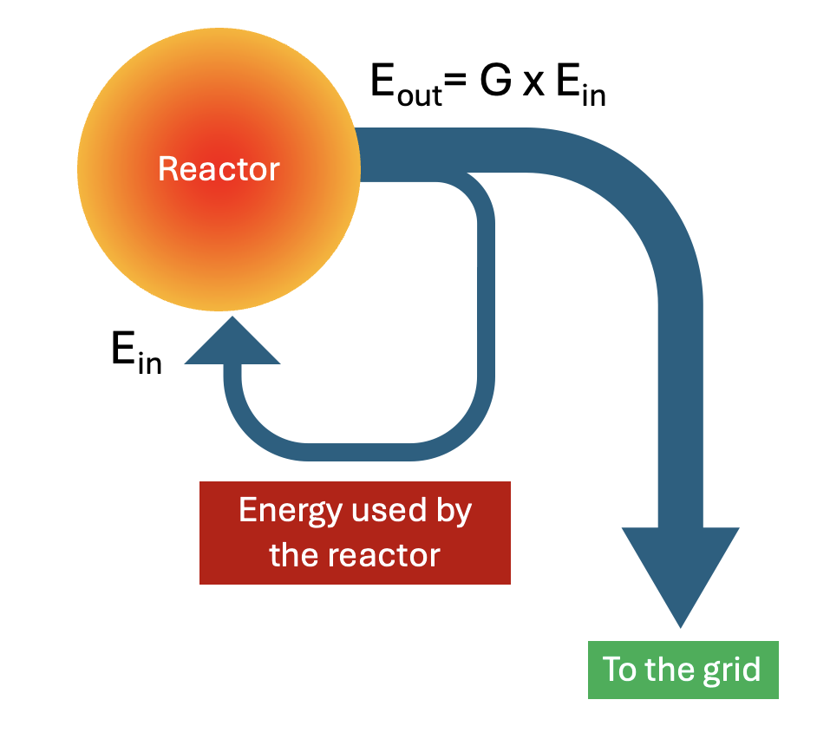
From fusion reactions to electricity
A fusion reactor converts into electricity the kinetic energy of particles from fusion reactions
D + T → n (14.07 MeV) + 4He (3.52 MeV)

Slide 5
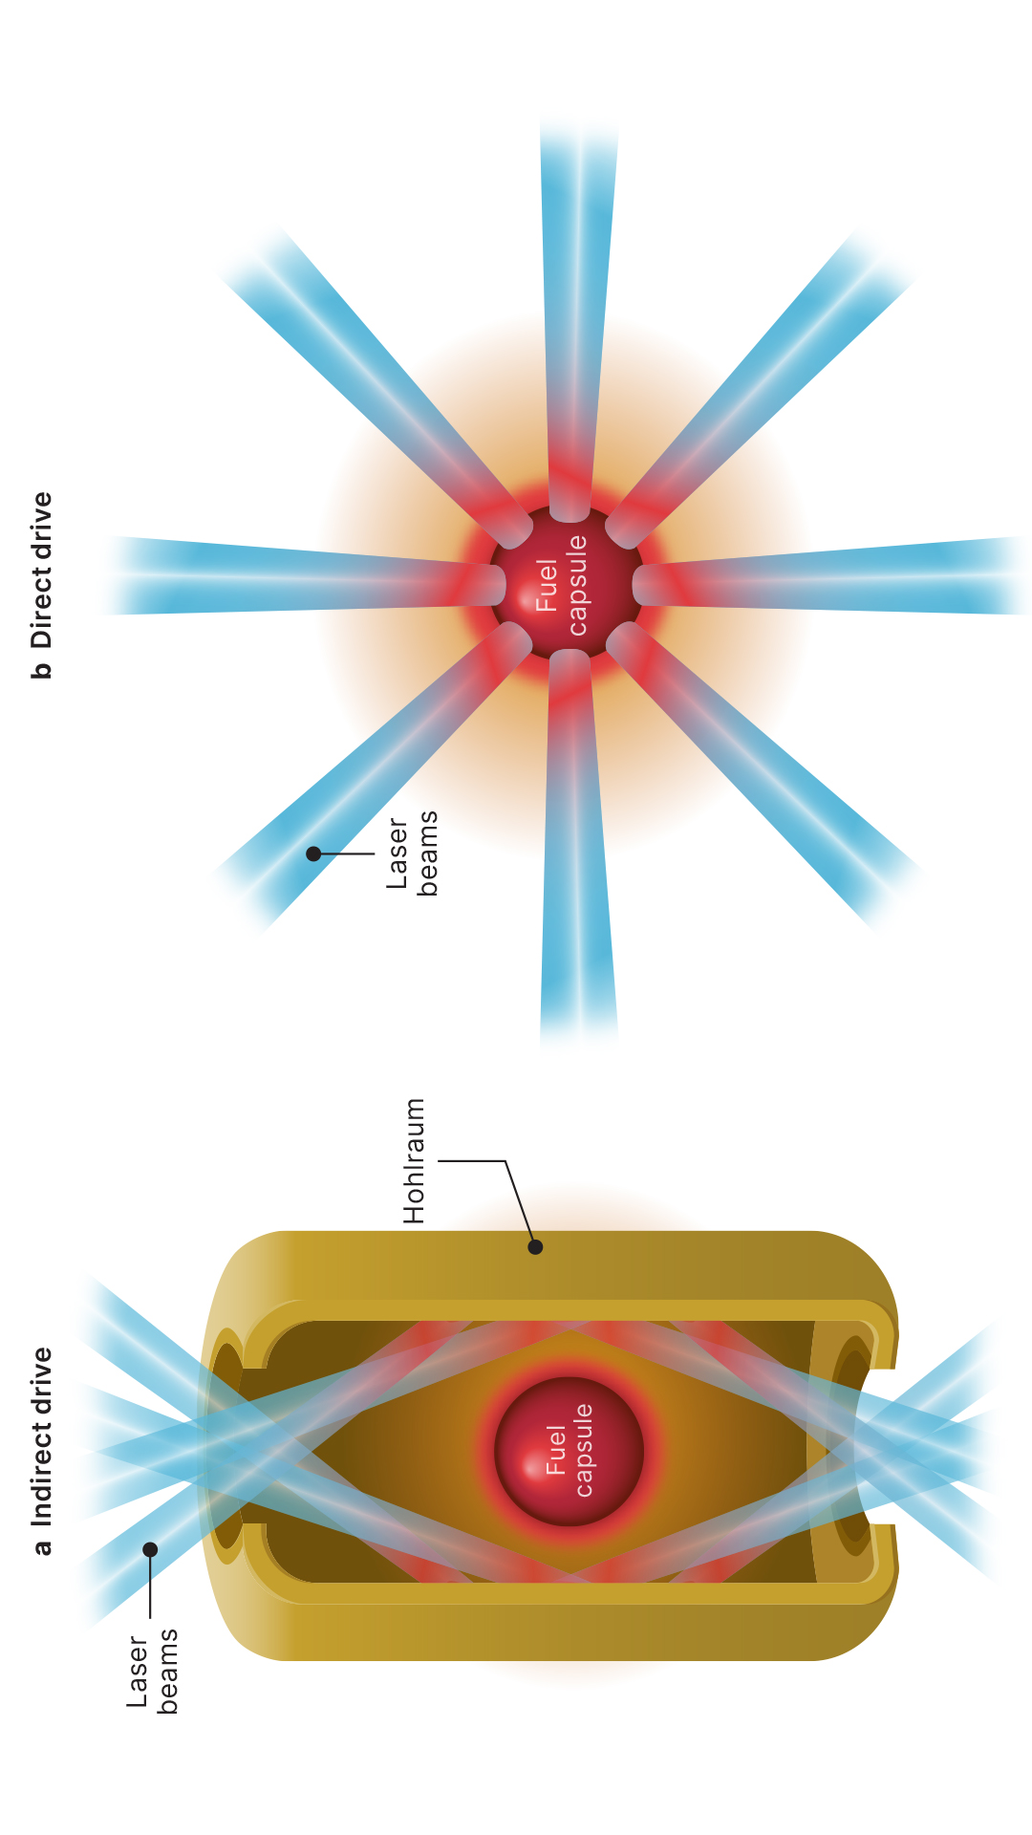
How laser fusion works
In direct drive (DD) Laser Fusion many laser beams are focused onto a millimeter-scale capsule containing deuterium and tritium.
The laser rapidly heats the outer surface → the material explodes outward.
By reaction, fuel is compressed to extreme densities and temperatures and ignites;
This entire process occurs within billionths of a second (inertial confinement).
Indirect drive (ID) uses a cavity to convert laser light into X-rays to ease the compression phase

Slide 6
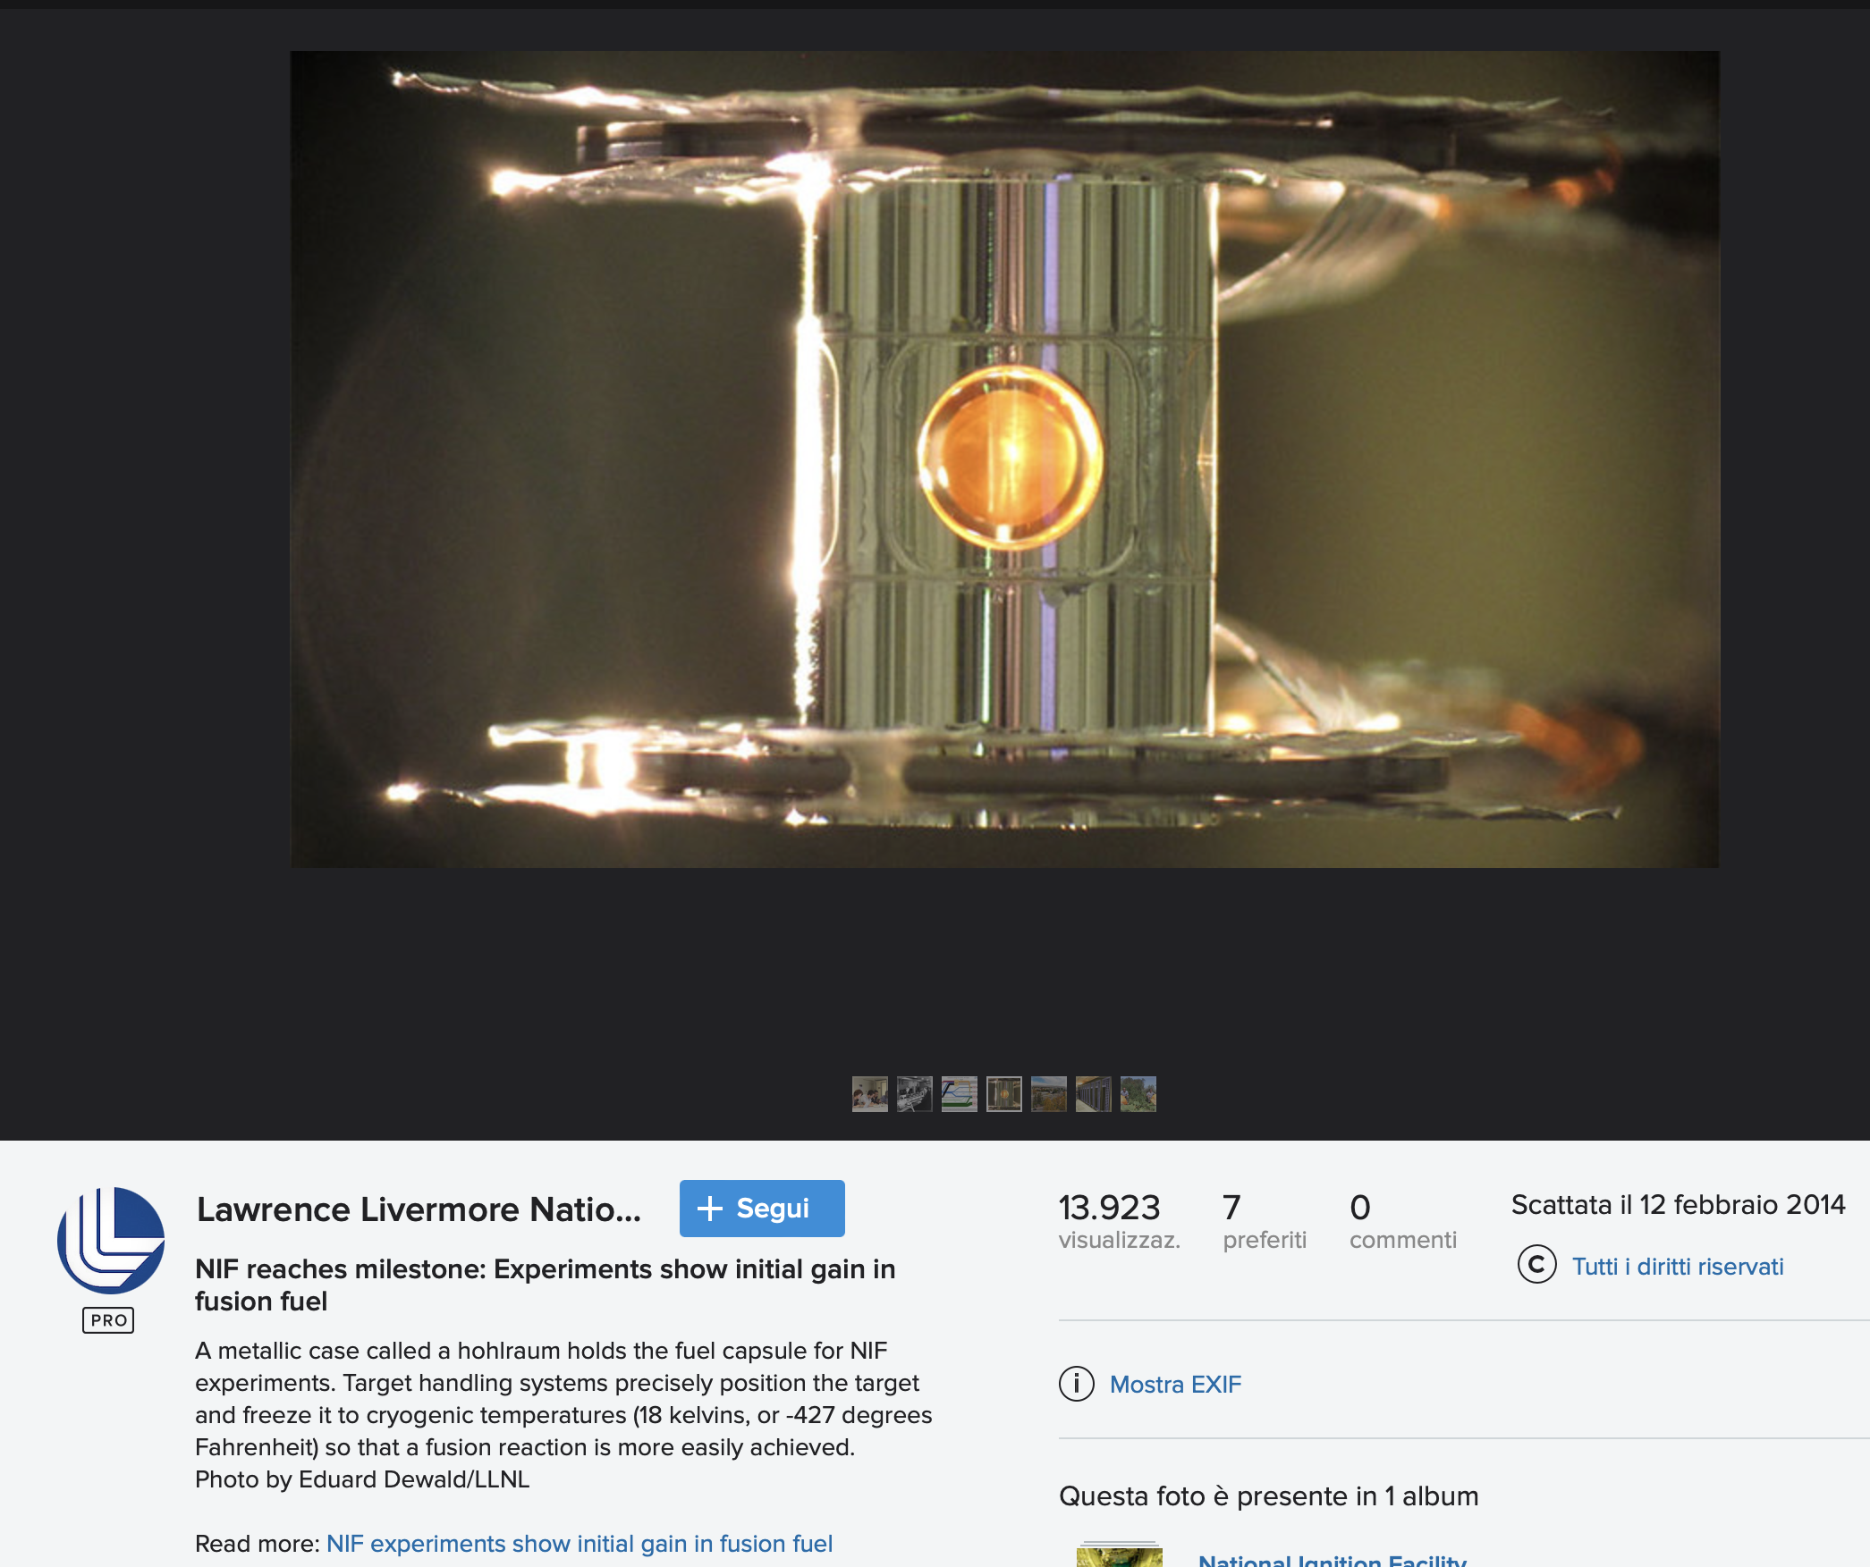
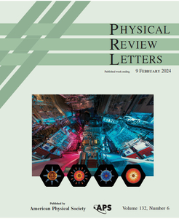
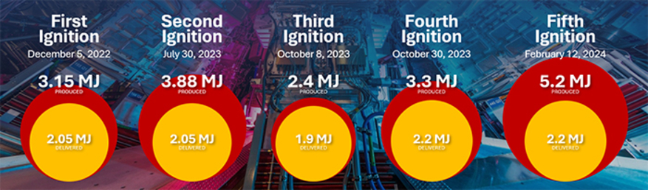
Indirect drive: breakthrough
In December 2022, experiments performed at the National Ignition Facility (NIF) in the U.S. have demonstrated a “net energy gain” from an inertial confinement fusion (ICF) experiment with ID
Gain = 3.15MJ (fusion yield) / 2.05 MJ (laser input energy) = 1.54
Ignition shots
Most recent result: 8.6 MJ

Slide 7

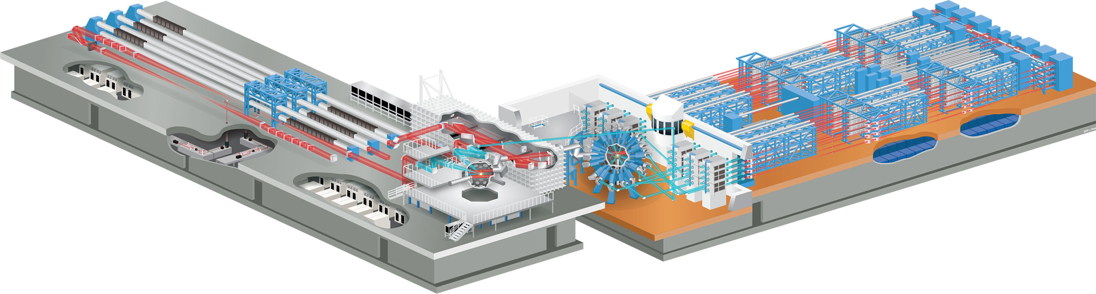
Experimental evidence of direct drive
Experiments at OMEGA (LLE, Rochester University, US) show a steady progress in the DIRECT DRIVE experiments: recenty, increase of neutron yield by 10 times and energy coupling to the hot spot by 6 times (recent experiments used a deep learning approach to optimize implosions).
Laser direct drive experiments couple 3-6 times more energy to the hot spot compared to the NIF indirect drive experiments
Direct drive experiments at omega: 30 kJ
Direct Drive is more subject than DD to the growth and the impact of hydro instabilities which distort the target during implosion, making ignition hard to achieve
V. Gopalaswamy et al. Nature 2019
V. Goncharov EUROfusion seminar, 2022
Omega Laser
Laboratory for Laser Energetics
University of Rochester

Slide 8
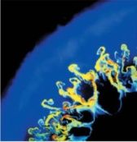
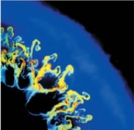
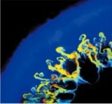
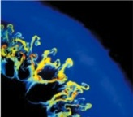
Challenge: spherical compression
Compression symmetry and uniformity is a major challenge
Compression symmetry - The capsule must be compressed in a perfectly uniform way. Even a small asymmetry can prevent ignition.
Hydrodynamic instabilities - Phenomena such as Rayleigh–Taylor instability amplify microscopic imperfections, reducing compression efficiency.
Materials and extreme physics - During the process, matter reaches high-density plasma conditions that are difficult to model and to measure. New theoretical models and advanced diagnostics (e.g. X-ray FEL) are required.
Understanding ignition and burn - Predicting when the plasma “turns on” and how the burn front propagates remains one of the greatest uncertainties in the field.

Slide 9
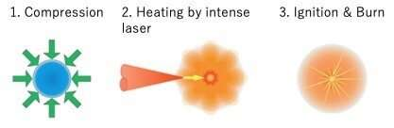
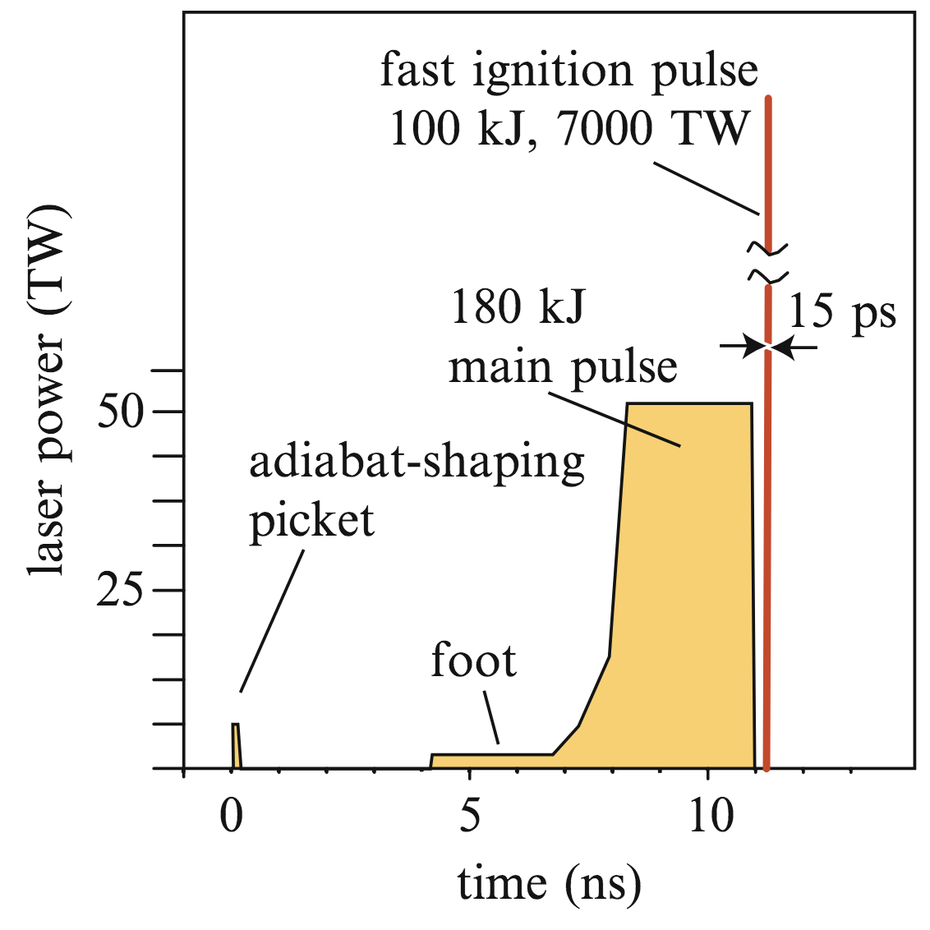
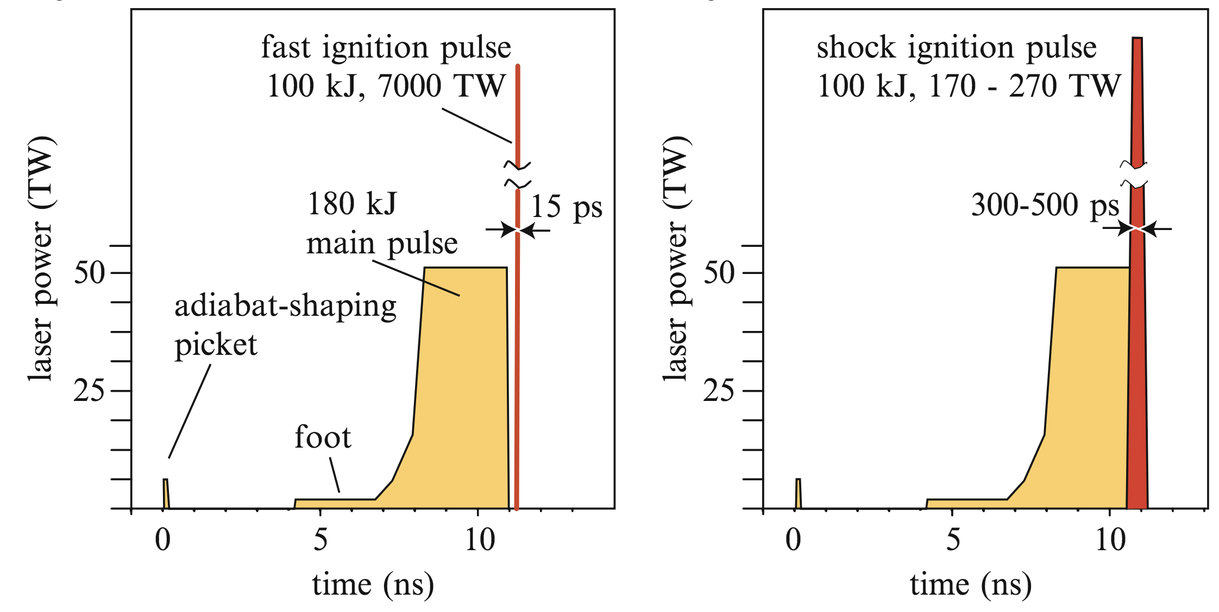
Mitigation strategies
How to mitigate the impact of hydro instabilities in Direct Drive?
Separation of the compression phase and the ignition phase.
Options:
Fast Ignition exotic and non-scalable physics
requires $≥100 kJ 10 ps$ laser
Shock Ignition compatible with present-day laser technology ☺

Slide 10
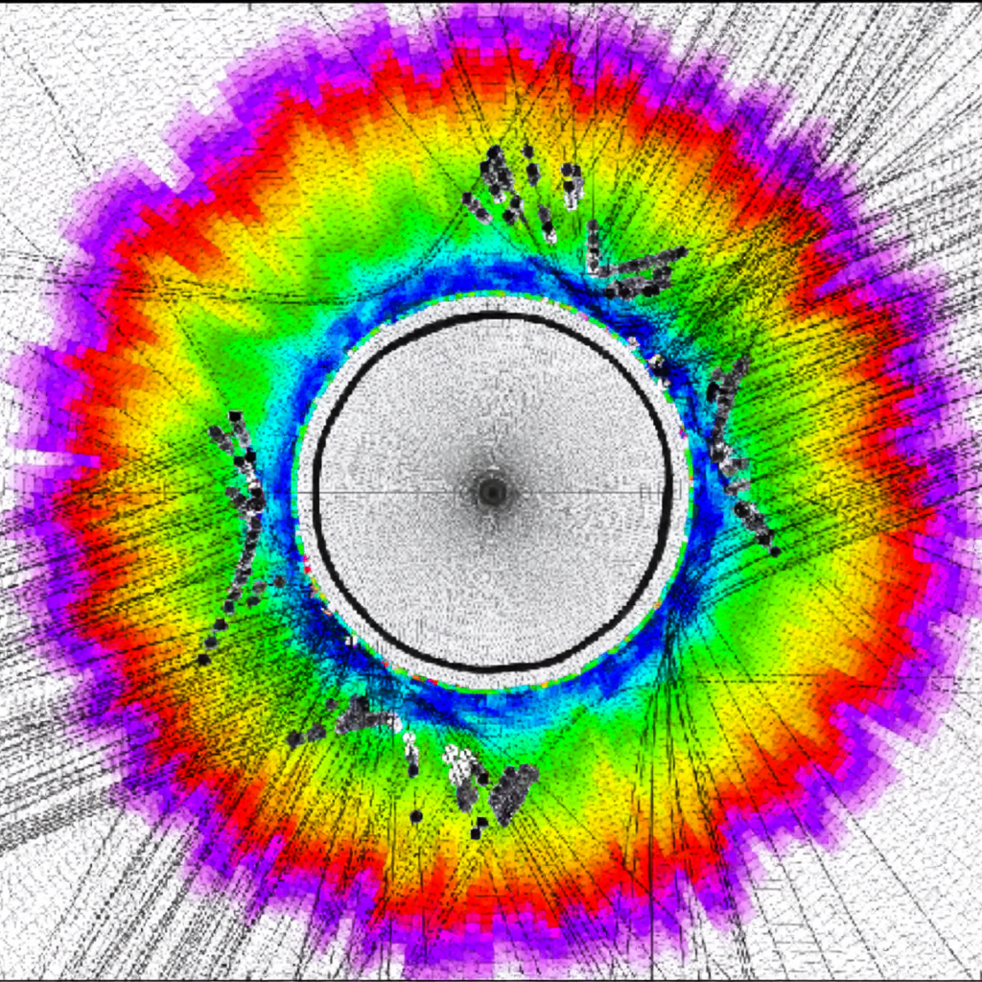
Challenge: laser-plasma interaction
Many physical processes occur in the interaction between laser light and the plasma surrounding the pellet
Stimulated scattering instabilities can siphon energy away from the main process and degrade the quality of the implosion;
To mitigate them, an emerging strategy is the use of broadband laser systems
The reduced coherence inhibits these instabilities , improving both symmetry and stability of the compression.
DOI 10.1088/1741-4326/aab21a

Slide 11
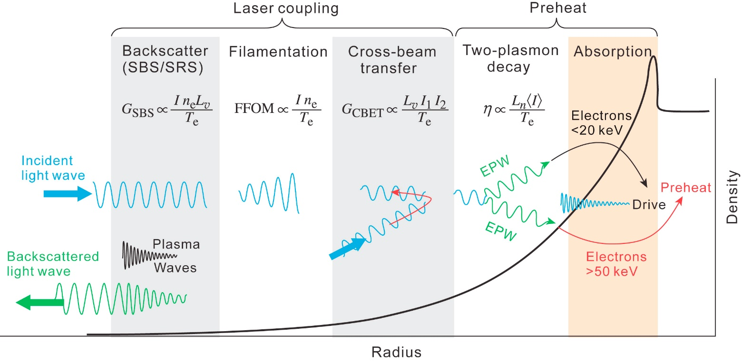
Parametric instabilities
Laser-Plasma Interaction of ignition pulse (10¹⁵-10¹⁶ W/cm²) is dominated by parametric instabilities including Stimulated Brillouin Scattering (SBS), Stimulated Raman Scattering (SRS) and Two Plasmon Decay (TPD) – and filamentation.
Froula et al., Plasma Phys. Control. Fusion 54 (2012) 124016
energy is backscattered by SRS/TPD and SBS (up to ~40-50%) - can increase laser energy requirements
SRS and TPD generate fast electrons, that can preheat the fuel and/or affect the shock pressure
Is it possible to turn off or limit the growth of LPI ?
(Laser coherence manipulation, Broadband laser, comb diode lasers…)

Slide 12
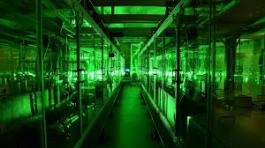
Challenge: laser
IFE relies on a new generation of high power lasers
IFE requires laser sources with extremely high power, but also high repetition rates (10–15 shots per second), far beyond today’s experimental capabilities.
Broadband laser for suppression of instabilities
Electrical-to-optical wall-plug efficiency above 10%
Diode pumped solid-state lasers or gas lasers under development.

Slide 13
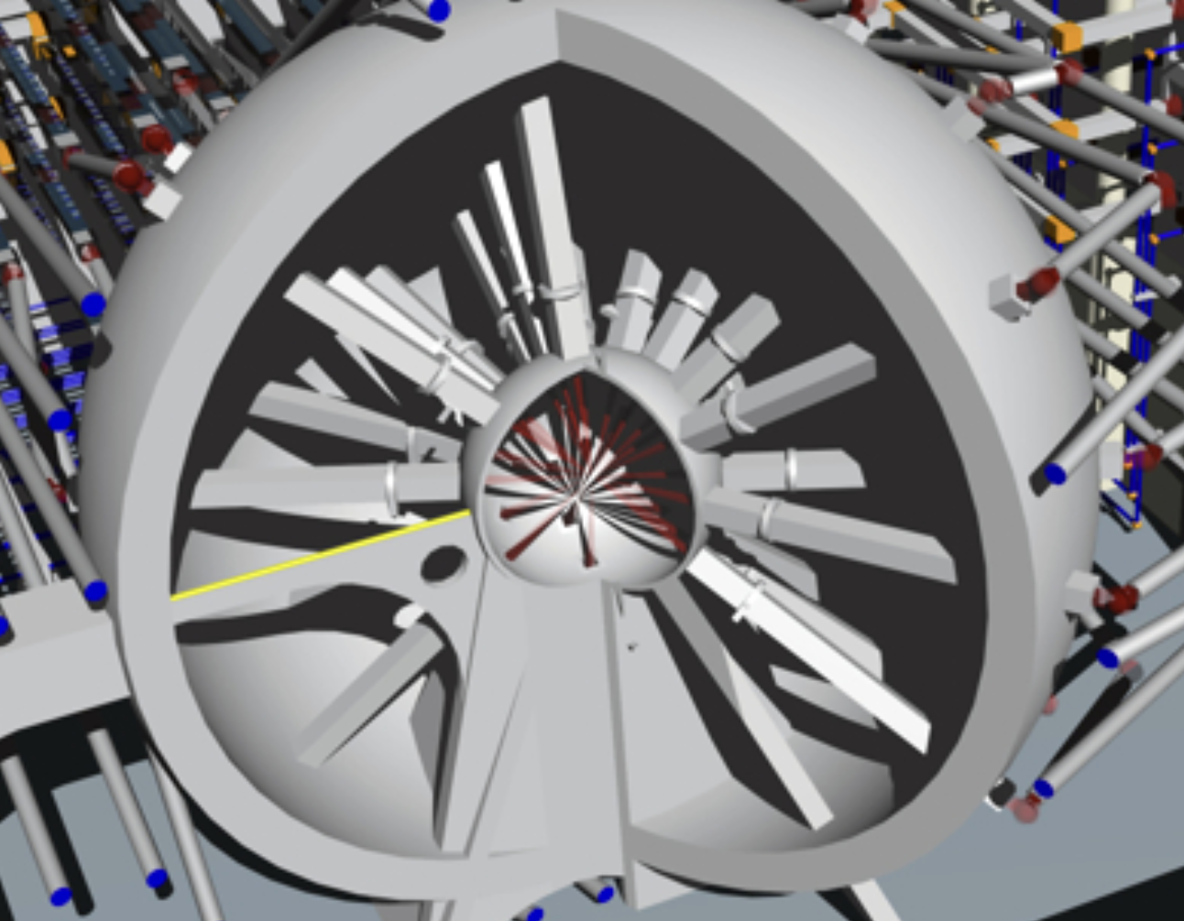
Challenge: reactor
IFE reactor concept needs new materials and components
Low-cost fuel capsules - Fuel capsules must be manufactured by the millions per year, with perfect quality - a challenge reminiscent of semiconductor industry scaling.
Reaction chambers and resistant materials - Each shot generates neutrons, X-rays, and debris; materials must withstand extreme conditions for years.
Measurement and control - Systems must operate at the picosecond and micrometer level, to control each experiment in real time.

Slide 14

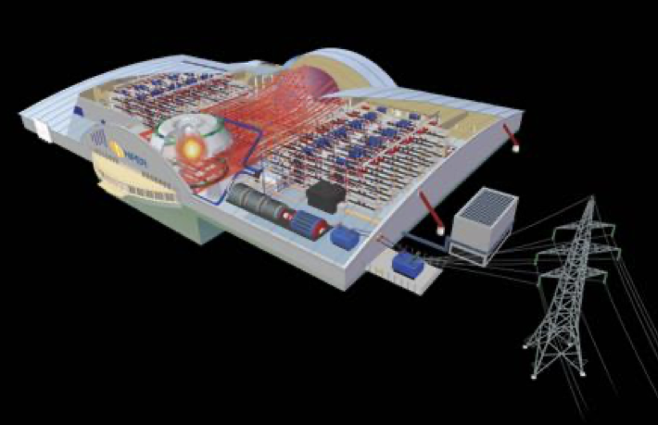

Europe-wide initiatives
2005-2014 European Project “HIPER” (High Power Laser Energy Research Facility)
HiPER, conceived as a large-scale laser system designed to demonstrate significant energy production form ICF, was listed on the ESFRI large scale facility roadmap and awarded preparatory phase funding ($\sim$2 M€) by the EU with additional funding from STFC, UK, and the Ministry of Education, Czech Republic, and work in-kind from many other partners
The project was based on the assumption that NIF would ignite during the National ignition Campaign (2009-2012)
www.hiper-laser.org

Slide 15


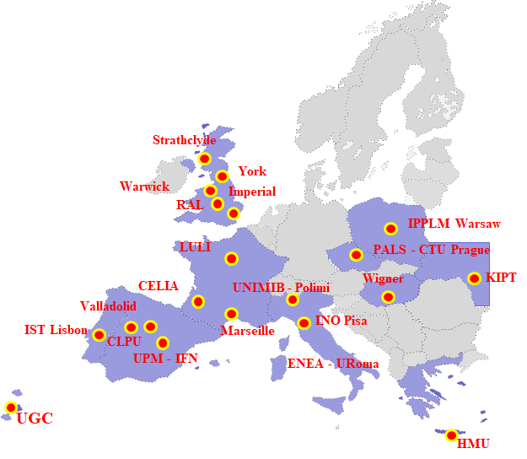

The EU IFE community
COST Action MP1208 «Developing the Physics and the Scientific Community for Inertial Fusion at the time of NIF ignition» 2013-2017
Laserlab Europe AISBL supports 3 ICF-related groups:
Expert group in ICF/IFE
Expert group in micro-structured materials
Expert group in laser-generated EMP
EUROFusion within Enabling Research projects EUROFusion supports projects related to direct-drive and shock ignition at the level of $\sim 300 k€$ /year (2017-2024)
24 groups and more than 100 researchers involved throughout Europe

Slide 16
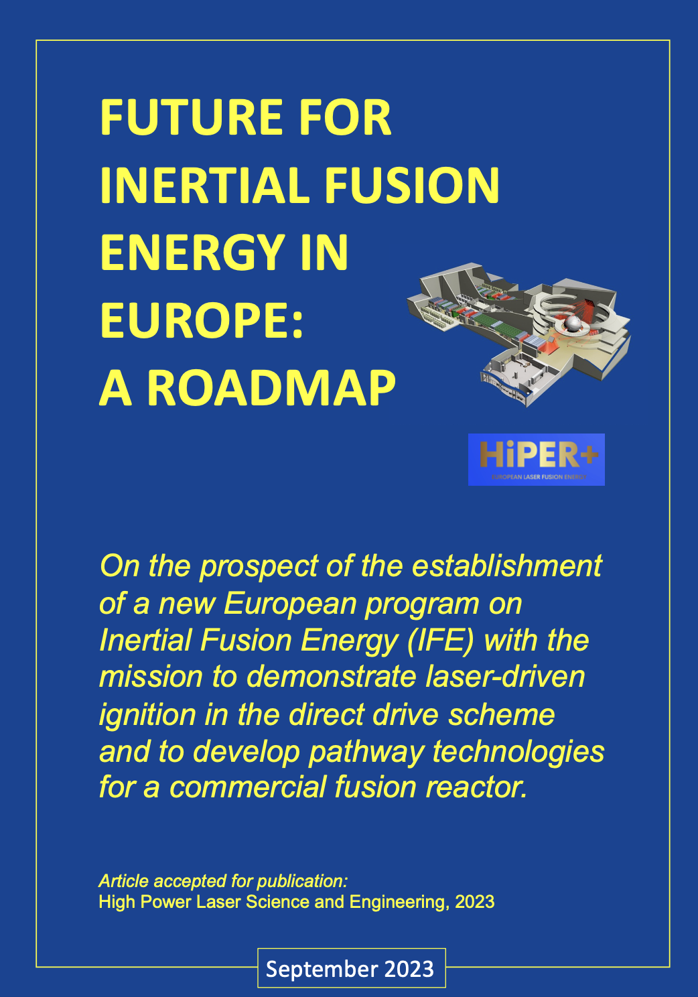


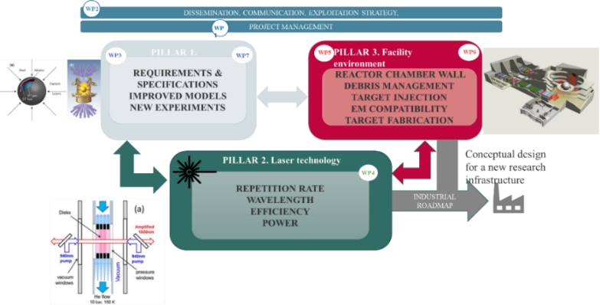
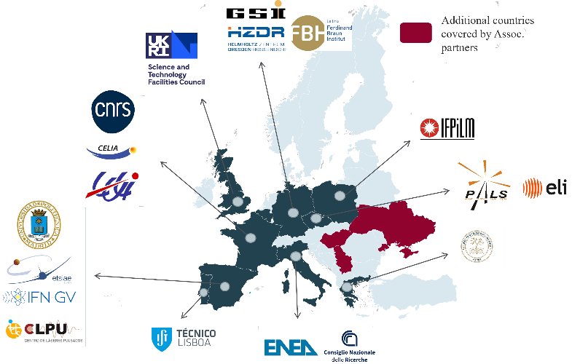
HiPER+ Research Infrastructure
A large scale infrastructure to demonstrate ignition (DD)
Conceptual Design
HiPER+ Consortium
To address scientific and technological challenges including: modelling, laser, LPI, facility engeneering etc …

Slide 17
EXPERIMENTAL ROADMAP TOWARDS SHOCK IGNITION IFE
How to approach the final goal of “Performing shock ignition demonstration experiments” ?
Geometry
Spherical
Cylindrical
Planar
Laser Energy
NIF
SG-III
HiPER+RF
LMJ/PETAL
Omega
SG-II
Orion
Gekko
LULI,
PALS Phelix
ELI

Slide 18


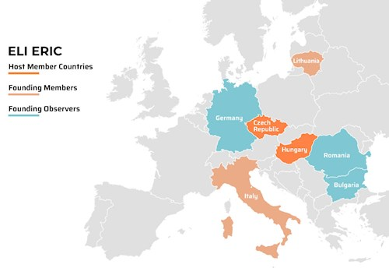
EXTREME LIGHT INFRASTRUCTURE
A joint effort of the whole laser and plasma community
ELI-Beamlines facility, Prague, Czech Republic
ELI Attosecond Light Pulse Source (ELI-ALPS) in Szeged, Hungary
ELI Nuclear Physics (ELI-NP), Magurele, Romania
(Approx 1 Bln € investment)

Slide 19
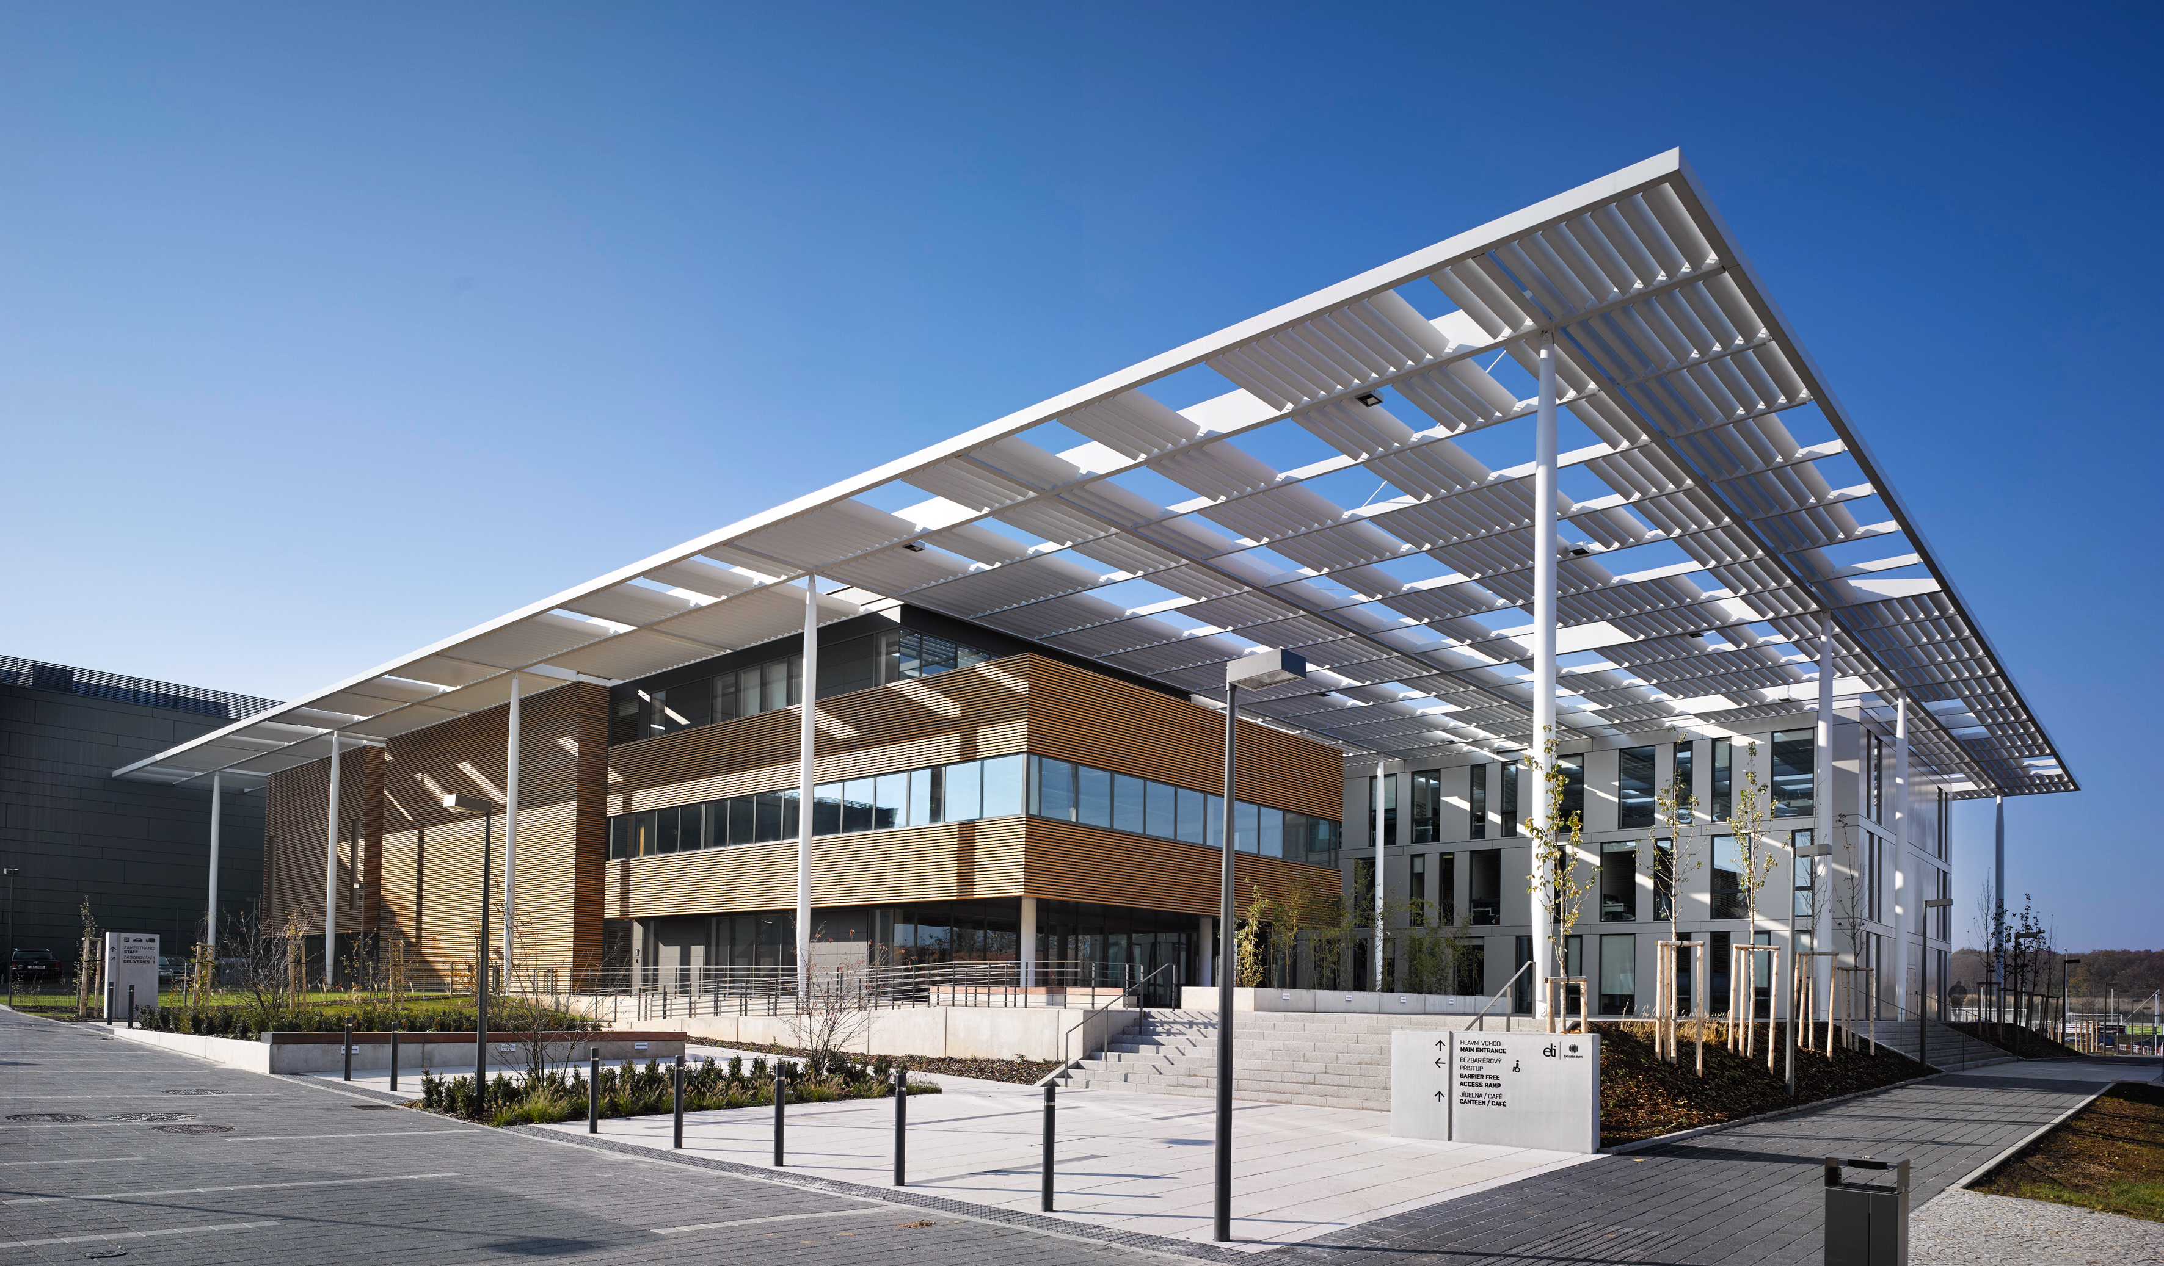
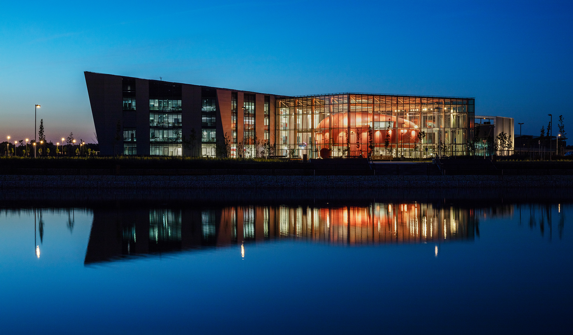
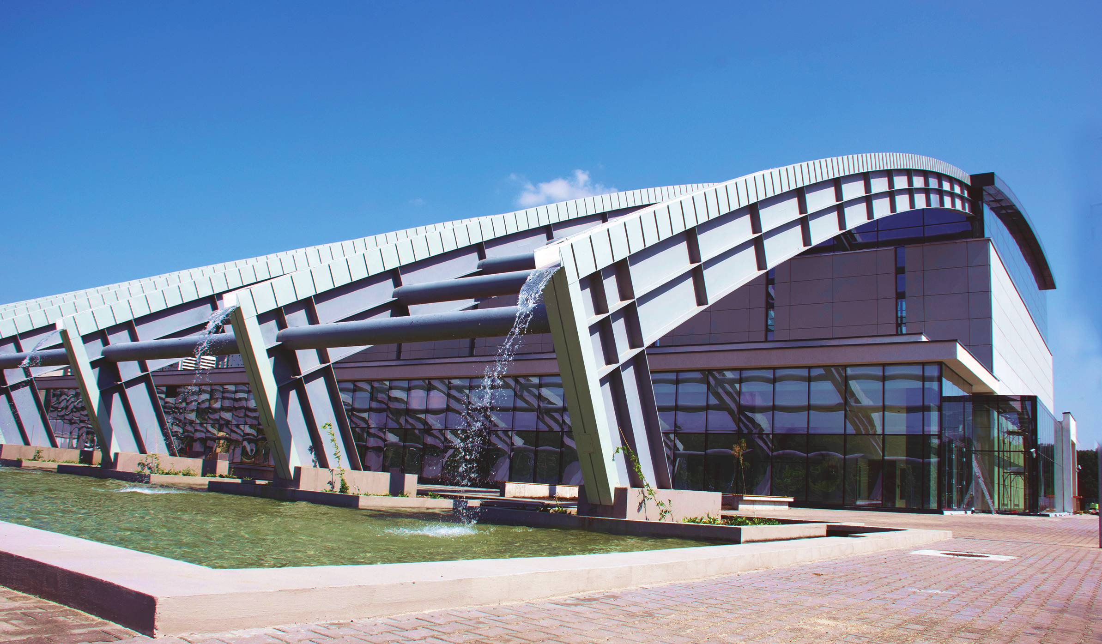
ELI Facilities
Excellence across three facilities.
ELI Beamlines
High-Energy Beam facility, develops and applies ultra-short pulses of ultra-intense radiation to explore extreme conditions or produce high-energy particles and radiation.
ELI Attosecond Light Pulse Source (ALPS)
Attosecond Light Pulse Source, offers unique time-resolved investigation possibilities for both nonrelativistic and relativistic interaction of light with all the four states of matter.
ELI Nuclear Physics (NP)
Nuclear Physics facility with ultra-intense lasers and brilliant gamma beams (up to 19 MeV) to produce and explore new nuclear states or generate neutron beams.
Dolní Břežany, Czech Republic
Szeged, hungary
Măgurele, romania
19

Slide 20
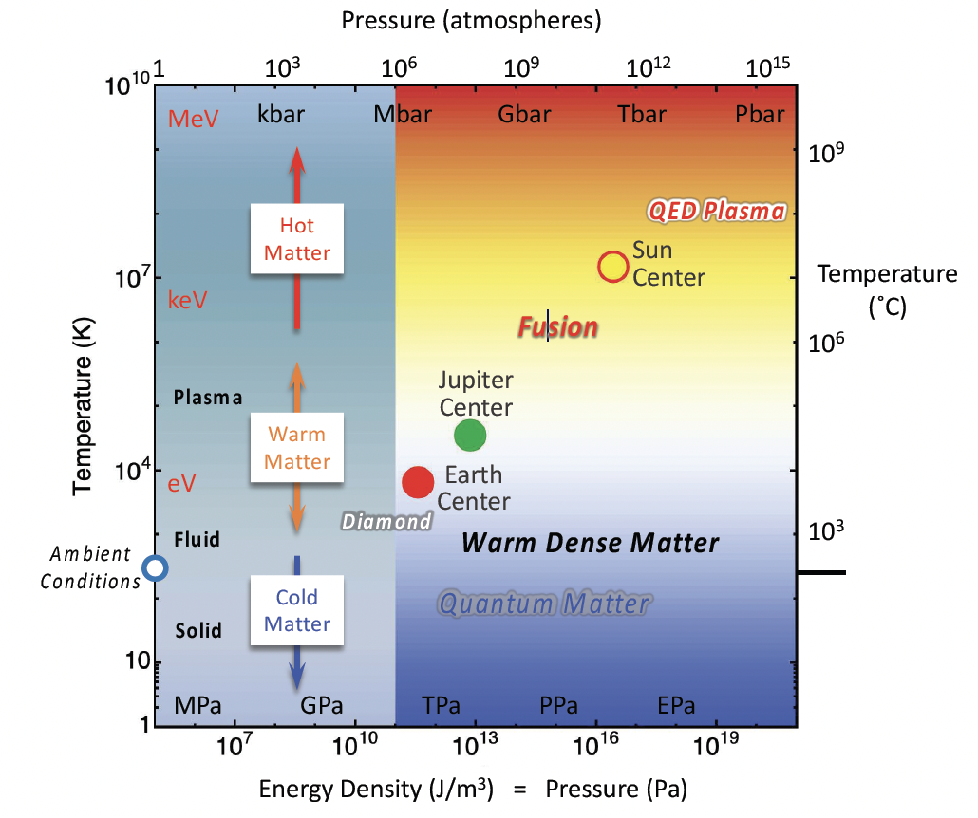
ELI as a medium-scale facility: why it is important for IFE
Fundamental physics studies of IFE:
  EoS, opacities
  Instabilities
  Laser absorption
  Shocks
Training of young scientist
Testbed for diagnostics, targetry, emp, debris etc.
What is HEDP: > 1Mbar or > 10¹¹ J/m³ = 100 J/mm³
Extreme state of matters are of extreme relevancee
for ICF/IFE, astrophysics, geophysics etc.

Slide 21
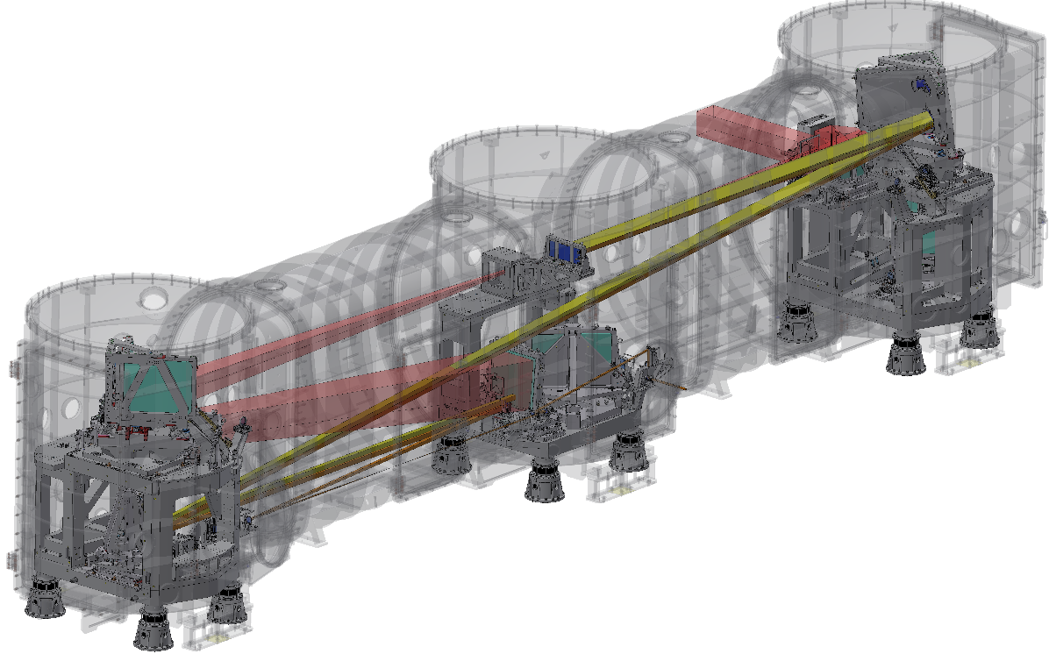
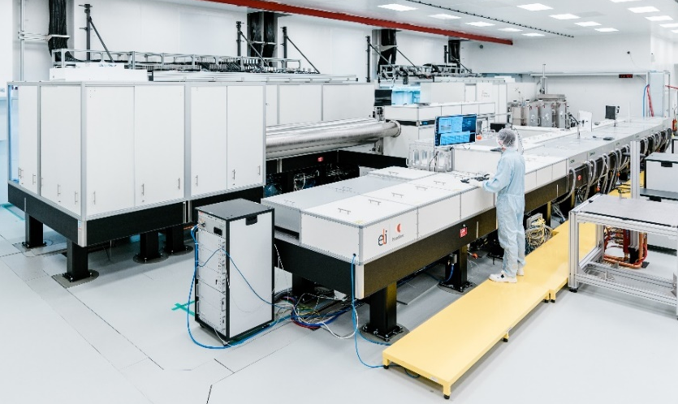
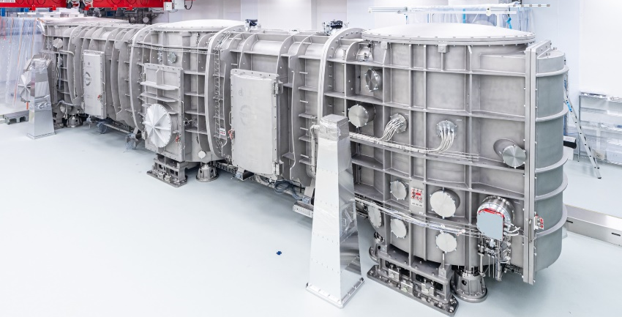
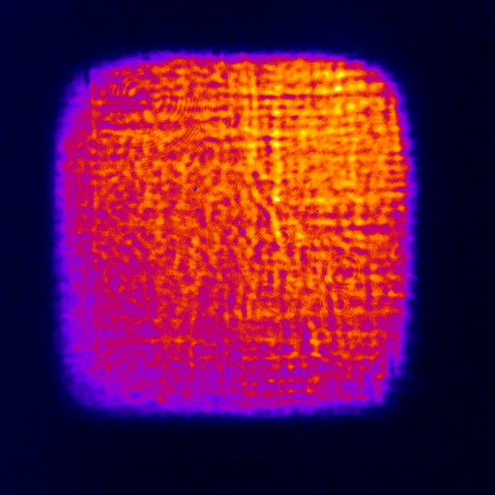
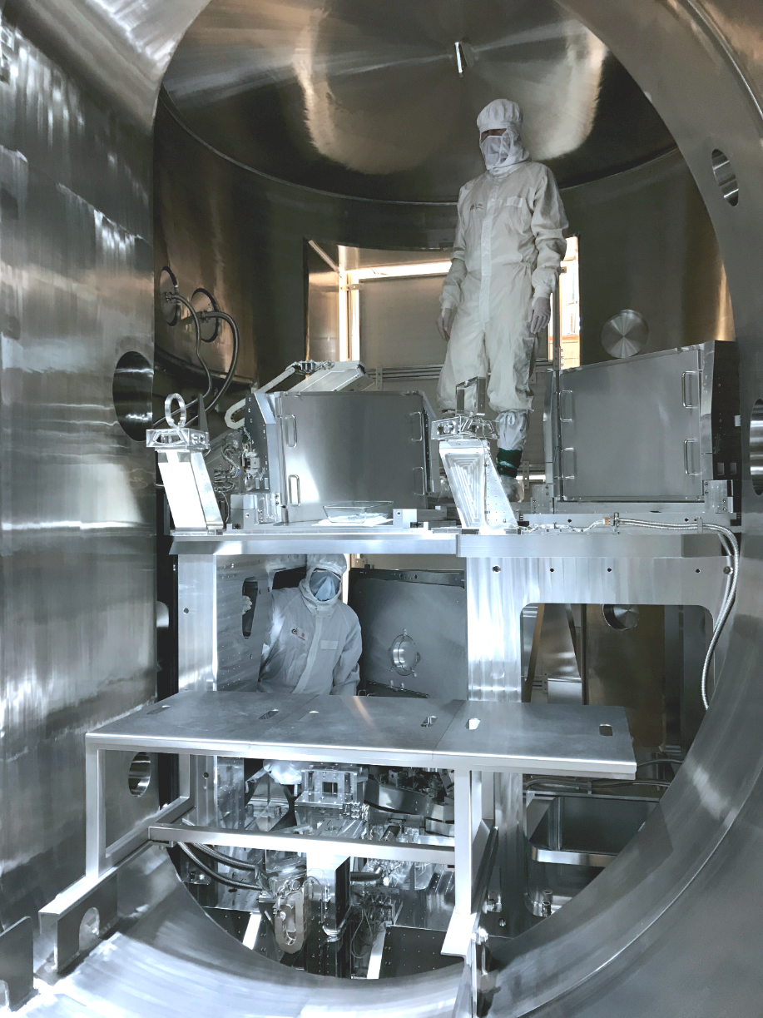
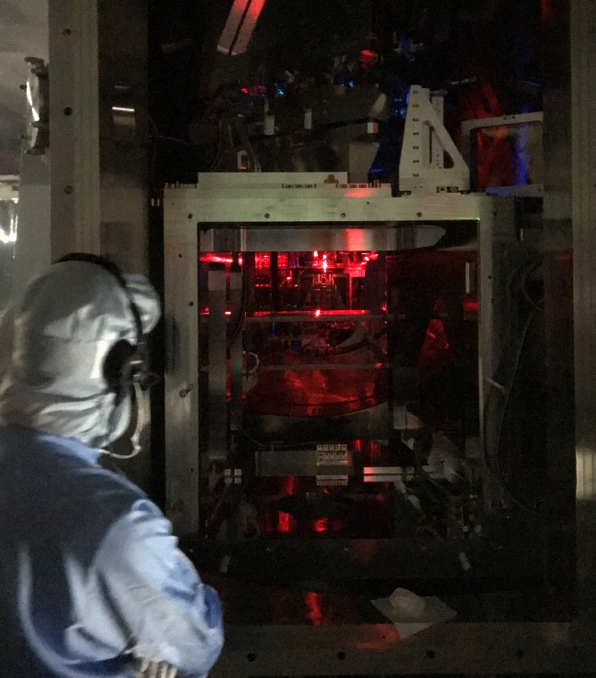
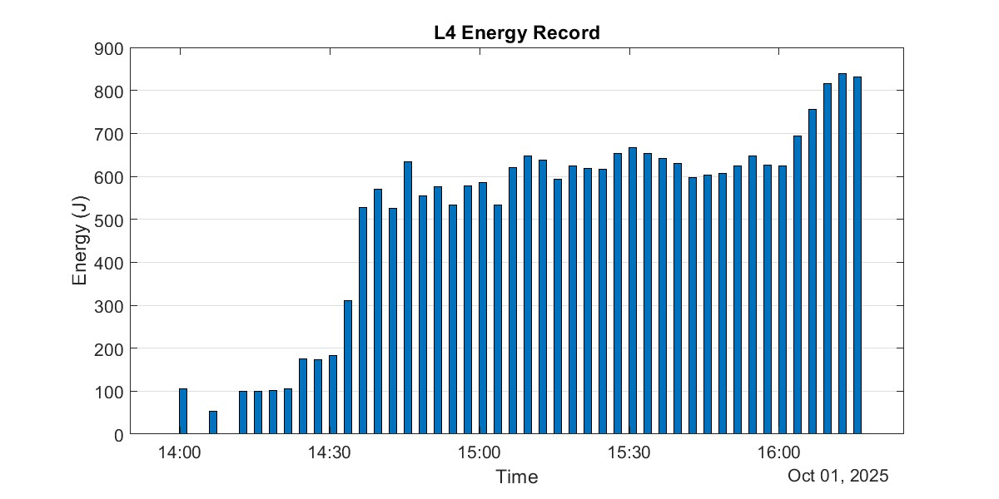
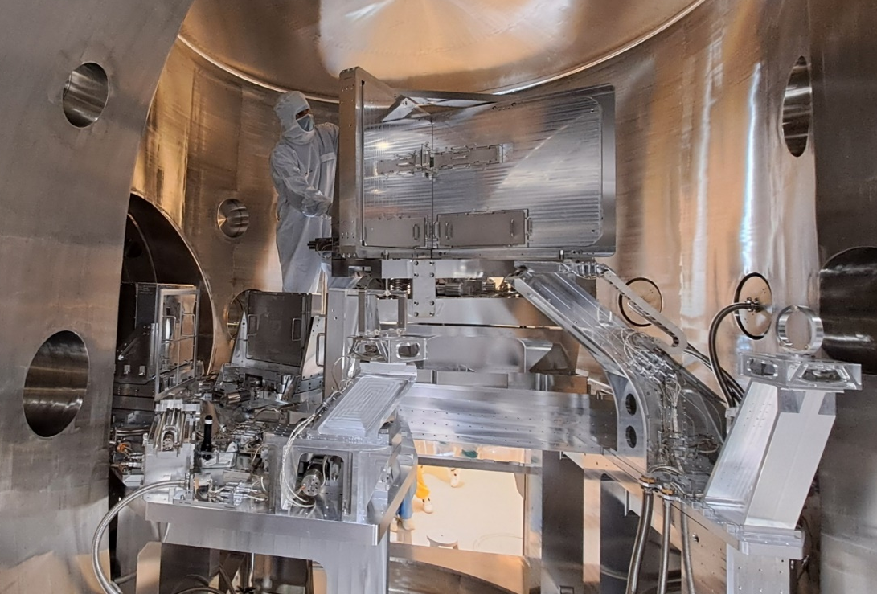
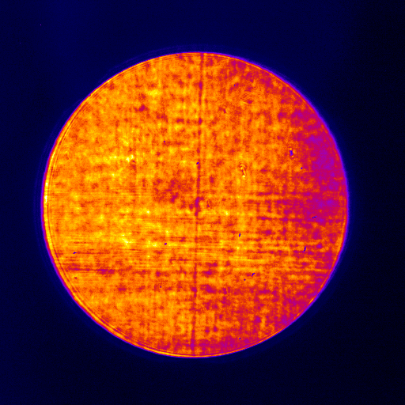
L4 ATON laser system at ELI Beamlines
high-energy (1.5 kJ), high-peak power (10 PW)
L4-ATON: 1.5kJ/150fs (10PW) @1shot/min target performance (demonstrated – 786J/154fs → 5.1 PW)
G2
MLD gratings 1136 l/mm, off plane-of-incidence (3.25°) Littrow geometry
North tower
G4
G3
South tower
Beam size 620 x 620 mm, fluence 0.4 J/cm²
Gratings 850 x 700 mm made by LLNL
Mirrors phased to gratings G2 and G3
Pulse compressor
G1
Mixed Nd:glass (>15nm spectral bandwidth @1w)
Compressor chamber: 18 m length, 4.2 m height
Demonstration of 5 PW (Oct 2025): multi-PW laser with the highest energy worldwide!
L4 Compressor Optics
North Tower
Energy at the compressor input on Oct 1, 2025
Compressor input 30x30 cm
Compressor output
South Tower
Gratings Alignment
Full beam size 60x60 cm

Slide 22
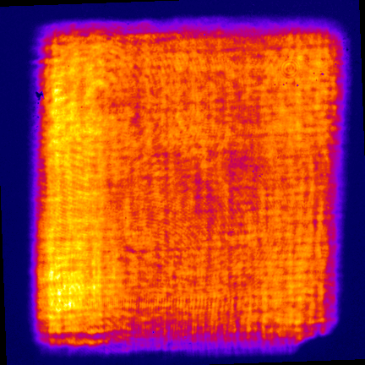
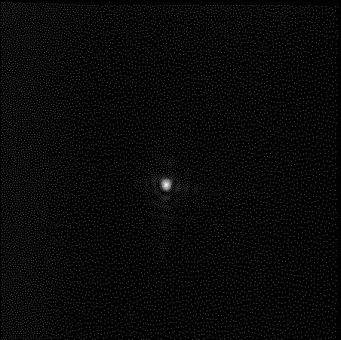
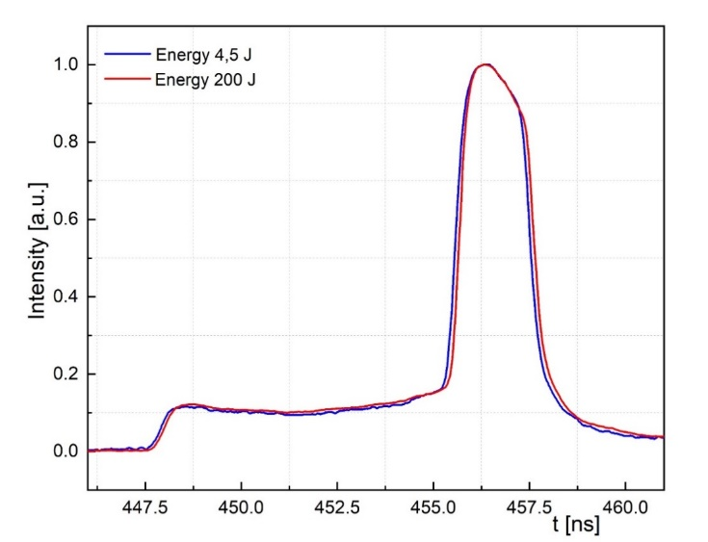
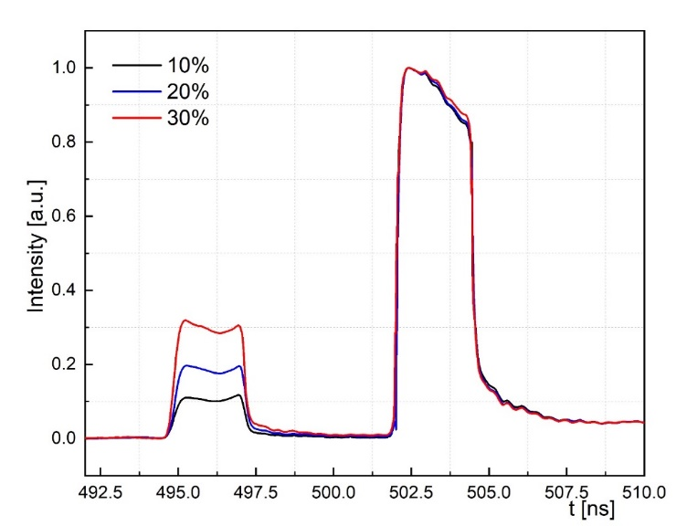
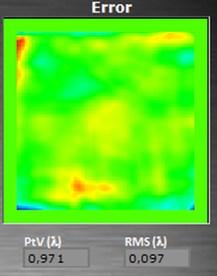
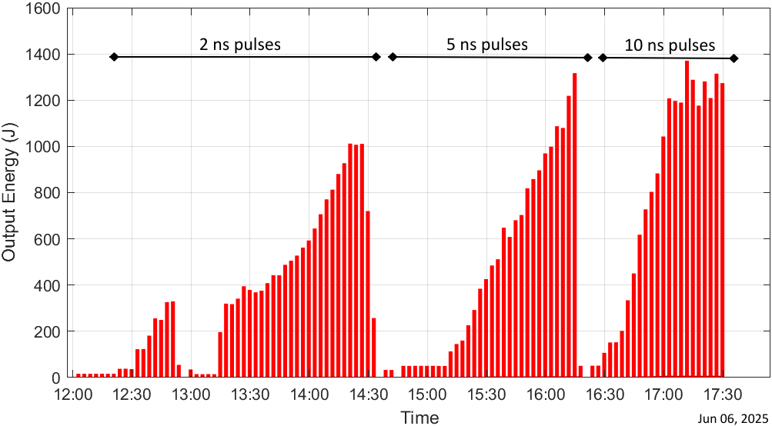
L4n (ns pulse) ATON laser system @ ELI Beamlines
high-energy (1.5 kJ), high-rep,-rate (1shot/min), nanosecond pulses
L4 long pulse in operation – 1.5kJ (0.6kJ @2w)/2-10ns/1shot/2min)
Examples of pulse temporal profiles requested by users
2 ns pulse with pedestal at two different energies
Double 2.5 ns pulse with various contrast ratio
Strehl ratio ≈ 0.7
89%
84%
77%
of pulse
energy
FWHM =2.4 ns
21%
15%
9%
of pulse
energy
FWHM ≈ 2.3 ns
FWHM = 2.4 ns
Grid structure is a diagnostic artefact
Pedestal length ≈ 7.3 ns
5 ns gap
Close to diffraction limit
FWHM ~35 µm, diffr. limit 32 µm
29% of pulse energy
71%
of pulse energy
Beam profile (31x31 cm)
Example of a sequence of pulses of different energies and lengths requested by users
“Hot state” beam (1shot/min) wavefront error <λ/10 rms

Slide 23

P3 Plasma Physics Platform (E3) @ ELI Beamlines
1-10PW (L3+L4) & kJ-ns class lasers
L4n-P3: exp platform for HEDP, including ICF/IFE and shock physics
High rep. rate capability at kJ level (up to 1shot/min)
L4n pulse width tuneability (2-10 ns), temporal shaping (~100ps res), and narrow-band vs broadband (~7nm @527nm) options
time-resolved diagnostics for LPI (Raman, Brillouin, TPD), shock physics (VISAR/SOP), and X-ray and particle diagnostics
Targetry: solid, gas, multi-layer, foam, cryogenics, etc.
L4 + L3 as PW backligther in LFL/SFL setup (e.g. Betatron source)
P3 interaction chamber

Slide 24





Major diagnostic systems for IFE-relevant research @ ELI Beamlines
Betatron radiation at 90º for shock propagation
& imaging of deuterated targets using X-rays, THz, electrons
In front of target: time-resolved
Backscattered radiation (SRS, SBS, TPD)
Behind the target: VISAR/SOP
for EoS studies
Around the target: time-resolved
Side-scatter radiation

Slide 25
ELI IFE Mission-based Call Proposals: Distribution by Research Topics and Requested ELI Systems
Target and Plasma Interaction Studies
• ELI ALPS: HF PW laser + UFO station
• ELI Beamlines: L4n + L3 lasers + P3 platform
• ELI Beamlines: L4n laser + E3 exp. area, optionally L3 laser
• ELI Beamlines: L4n laser + E3 exp. Area
• ELI-NP: HPLS 1PW+E5, 1PW + E6
Diagnostics & Platform Development
• ELI Beamlines: L3 (L4p) laser + Gammatron beamline + P3 platform
• ELI-NP: HPLS 10PW laser + E6 exp. area
Laser-Driven Fusion Concepts
• ELI ALPS: Sylos3 laser + LEIA-n beamline; HF PW laser + UFO station
• ELI Beamlines: Lasers L4, L3 + Betatron source; Lasers L3 and L4 Sync + P3 platform
Ion and Particle Transport
• ELI ALPS: Sylos3 laser + LEIA-n beamline; HF PW laser + UFO station
• ELI Beamlines: L3 laser + ELIMAIA beamline
• ELI ALPS: Sylos3 laser + LEIA-n beamline
Outcome of the selection expected soon

Slide 26

Summary
Inertial Fusion Energy is an endeavor at the very edge of contemporary technology.
Recent historical progress shows that it is achievable.
Transforming it into a reliable energy source will require a convergence of physics, engineering, advanced materials, and new laser technologies.
It is a challenge—but also an extraordinary opportunity for a EU-wide collaboration for a staged approach from DD ignition demonstration to the reactor.

