Slide 1

HPLA 2025: STMicroelectronics
November 18th, 2025
Fabrizio La Rosa – SRA/System Lab
STMicroelectronics – Catania

Slide 2
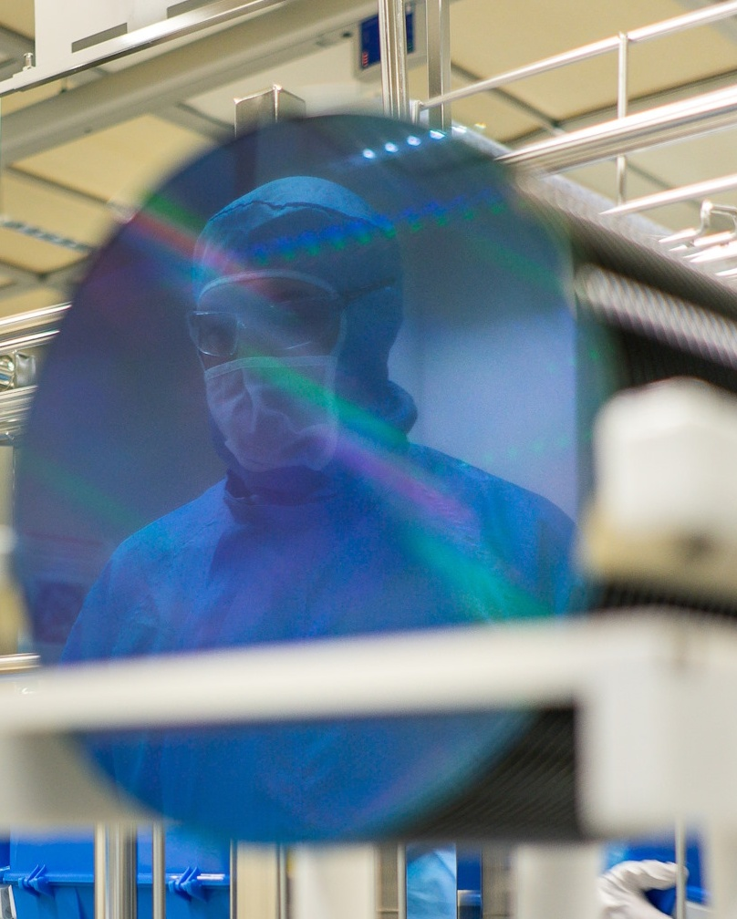
STMicroelectronics: Company overview

Slide 3
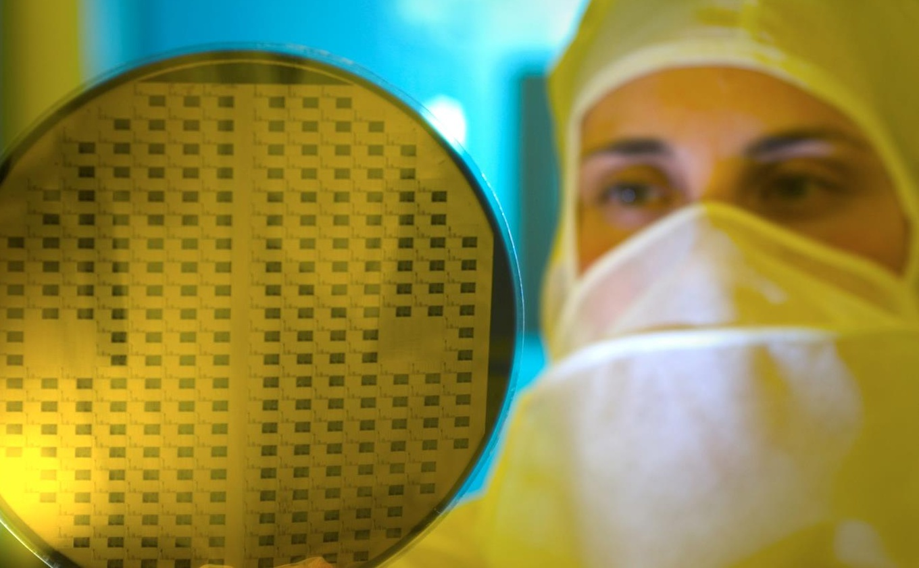







We are creators and makers of technology
One of the world’s largest semiconductor companies
50,000 employees of which 9,000+ in R&D
$13.3 billion revenues in 2024
Over 80 sales & marketing offices serving over 200,000 customers across the globe
14 main manufacturing sites
Signatory of the United Nations Global Compact (UNGC) Member of the Responsible Business Alliance (RBA)
As of December 31, 2024

Slide 4

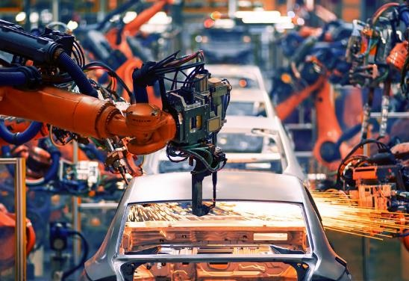


Where you find us
Making driving safer, greener, and more connected
Enabling the evolution of industry towards smarter, safer, and more efficient factories & workplaces
Making homes & cities smarter, for better living, higher security, and to get more from available resources
Making everyday things smarter, connected, and more aware of their surroundings
4
Notes:
Inside our cars, making mobility smarter
Inside the Industry, enforcing process efficiency
Inside our homes and in the cities, improving resources utilization and security
Inside our lives, connecting the things that matter

Slide 5
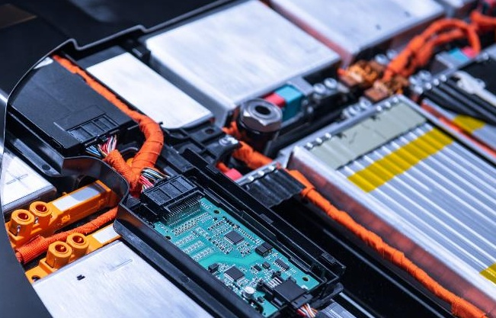

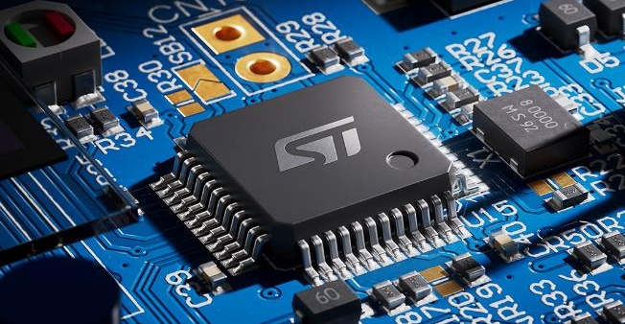

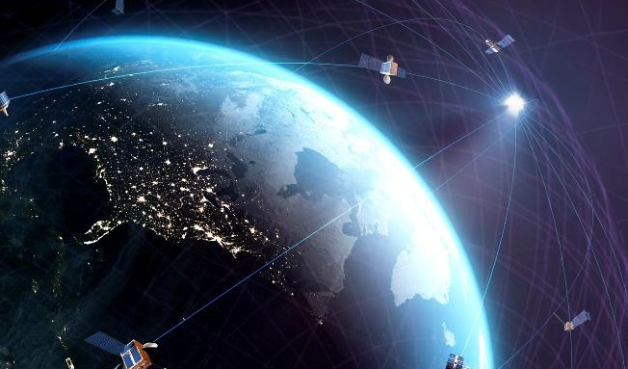
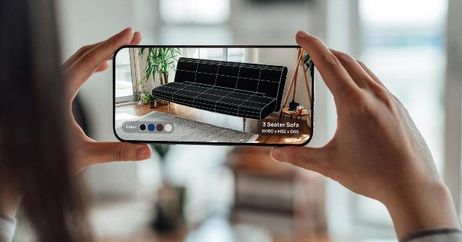
Our products and solutions enable customer innovation
Dedicated
automotive ICs
Analog, industrial & power conversion ICs
GP MCU & MPU, Wireless solutions, secure MCU, EEPROM
Discrete & power transistors
MEMS & optical sensing solutions
ASICs based on ST proprietary technologies

Slide 6
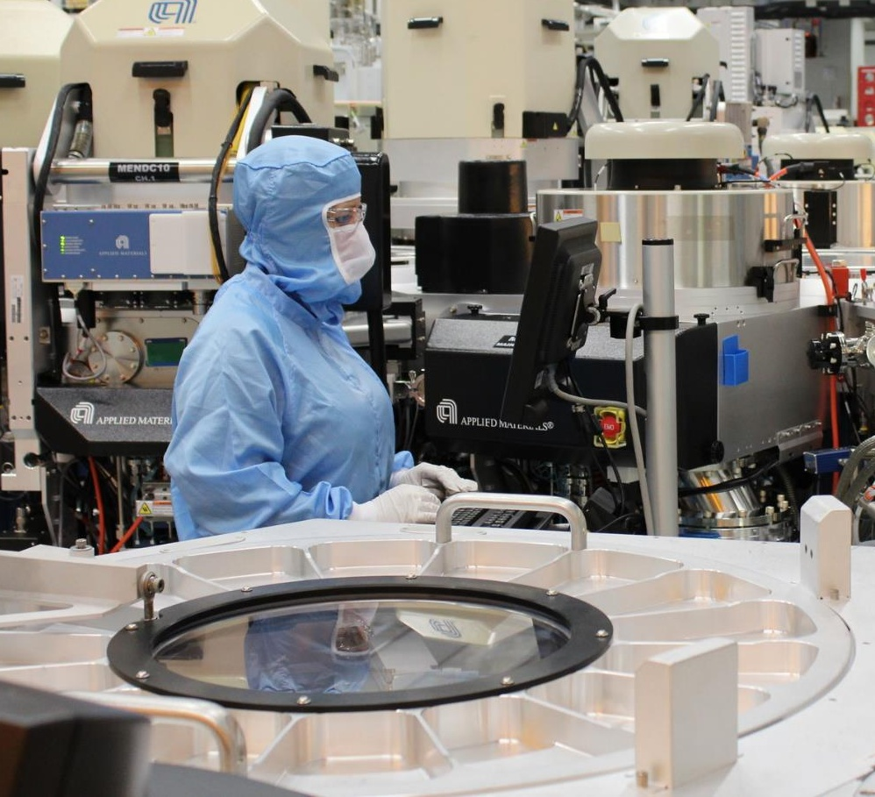
Differentiated technologies are our foundation
MEMS
for sensors & micro-actuators
Smart Power: BCD (Bipolar - CMOS - Power DMOS)
FD-SOI CMOS
FinFET through Foundry
Discrete, Power MOSFET, IGBT
Silicon Carbide, Gallium Nitride
Analog, RF CMOS & BiCMOS,
Silicon photonics
Vertical Intelligent Power
eNVM CMOS
Optical sensing solutions
Packaging technologies
Leadframe – Laminate – Sensor module – wafer level

Slide 7
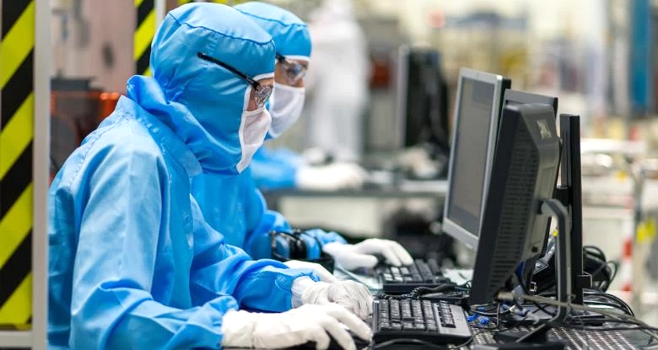
We are drivers of your innovation
Advanced R&D centers around the world for close collaboration with operations, customers, and partners
~9,300 people working in R&D and product design
~21,000 active and pending patents worldwide
~16% of revenues invested in R&D in 2024
~200 active R&D partnerships
13 fab labs to drive open innovation
~80 startups engaged in our programs
Notes:
ST invests heavily in R&D, with 15% of revenue allocated, 9,500+ R&D employees, and a global network of 12 fab labs and 900+ technical experts.
ST encompasses many experts from Tech Fellows to PhD students.
All the skills of our value chain are integrated, to create a product, to create an innovative IP
ST englobes fabs, chips, boards, systems: various experts from these fields of expertise become an added value for Startups

Slide 8
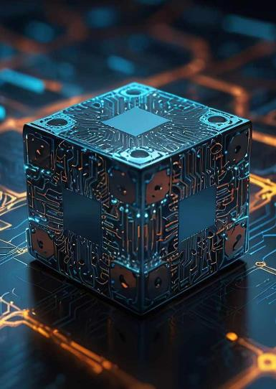

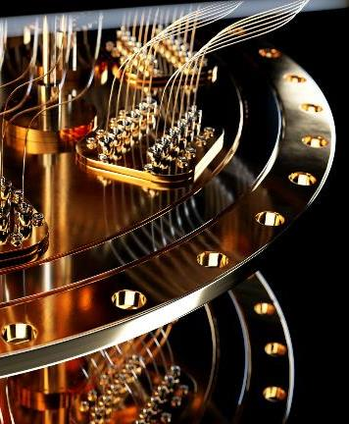
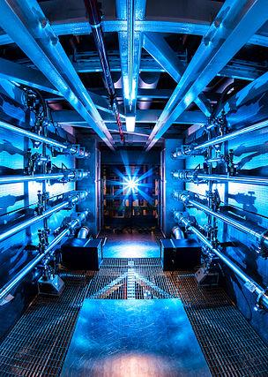
New challenges for engineering in innovation scenarios
Heterogeneous Integration
Photonics
Quantum Technologies
Nuclear Energies

Slide 9
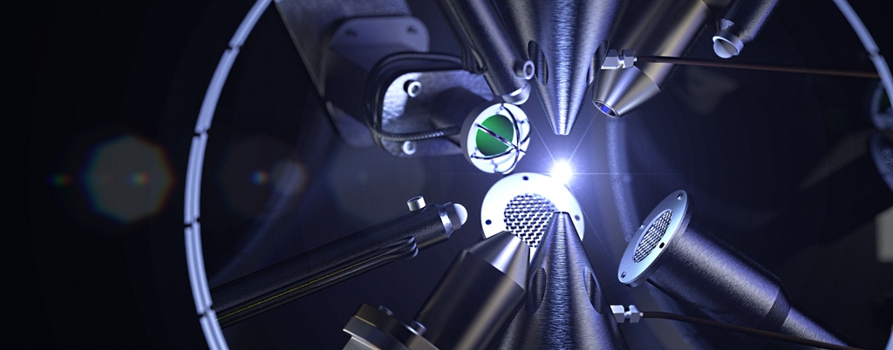
Why are we interested in Nuclear Fusion?

Slide 10
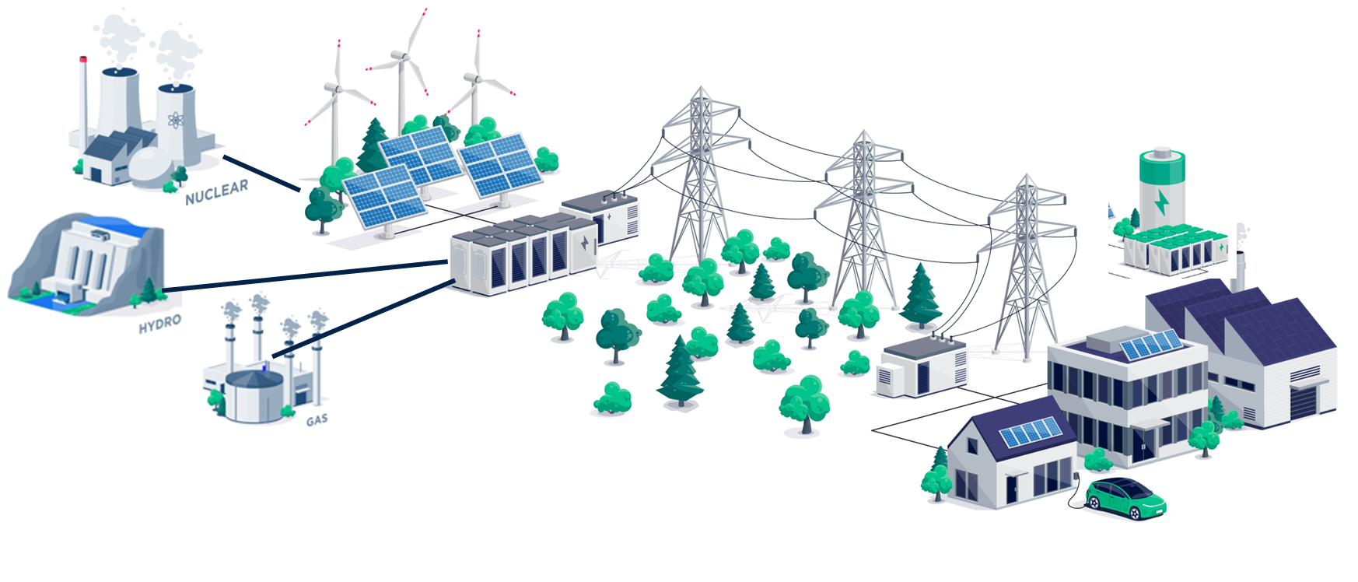
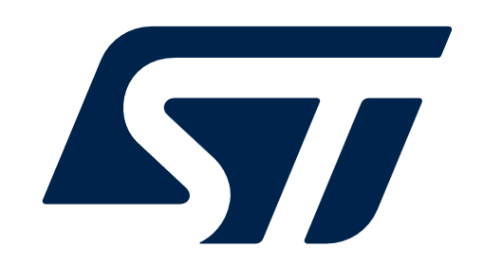
The End-to-End “Energy” Chain
Energy
Generation
Energy
Transmission
Energy Storage and
Utilization
Medium Voltage (1kV – 30kV) – High Voltage Systems (30kV ~ 150kV )
Low Voltage Systems ~1000 Vdc

Slide 11


A new Energy Deal
By end of 2100, demand for energy is expected to tripled due to:
population growth & increased urbanization;
expanding access to electricity in developing countries;
electrification of vehicles (including cars, planes and drones)
Significant increase (3x) in energy cost, due to geopolitical tensions, requiring world leaders to propose alternative solutions
Public opinion on nuclear energy improved
new mini-reactors with compact design making them very safe.
Renewable energy sources are not yet fully scalable due to their intermittent nature
The renewal, modernization, and proliferation of nuclear technologies are underway:
fusions, SMR, AMR, Gen3/4 , plant lifetime >60Y, new local usages

Slide 12
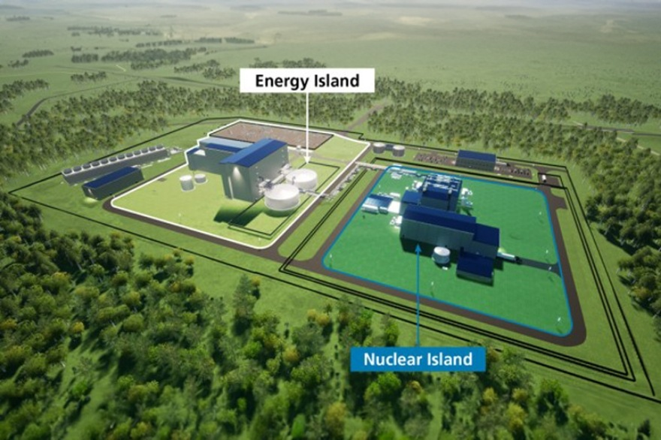
An insight into a nuclear power plant
Key functions to perform in Nuclear environments
Measure, Actuate, Control & Monitor, Diagnose
Communicate (Data and Video)
Identify and localize (total asset visibility)
Protect, track and guide
From ultrahard-to-softer radiation perimeters
Nuclear island (extreme radiation, temp., lifetime)
Turbine island
Industrial Plant (including cooling tower)
Front end (low radiation level) & recycling (severe radiation level )
Mixed Nuclear Constraints
Radiation (gamma, neutrons …): medium <1Mrad to extreme >10Mrad
Humidity, Vibration, Temperature
RAMS : Reliability - Availability - Maintainability - Safety - Security
Lifecycle (obsolescence) & Qualification (authority acceptance)

Slide 13
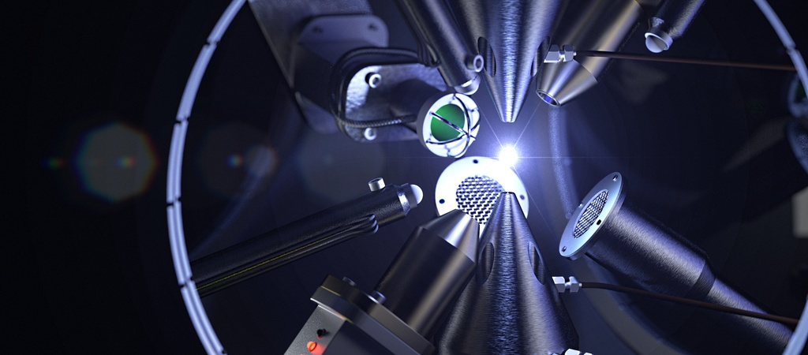
Main technologies convergence
Power Electronics
Control and Data Acquisition
Sensors and Detectors
MEMS
MOSFETs, IGBTs and Thyristors power devices for converters and inverters.
Silicon Carbide (SiC) Devices (as WBG Emerging Technology)
Motor Drives and Control ICs for pumps, compressors, robotic actuators
Power Converters for Voltage/current conditioning
Microcontrollers (MCUs) and Microprocessors (MPU) for signal processing
Analog and Digital ICs for real-time diagnostics and control systems
High-Speed Data Acquisition Systems to capture and digitize large volumes of sensor data for analysis
Photodiodes and Photodetectors for light emission, laser signals and scintillation
X-ray Detectors for hi-Res. Spectroscopy,
Neutron Detectors for monitoring fusion reaction
CCDs and CMOS Image sensors for light emission, visible and ultraviolet spectroscopy
MEMS Sensors for monitoring temperature, pressure, and magnetic field inside diagnostic ports or reactor components

Slide 14

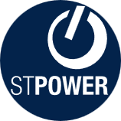
Discrete & power transistors​
Key power technologies & packages for:
Car electrification, power management, motor control
High-voltage and low-voltage silicon power MOSFETs (STripFET*, Planar & MDmesh*)
IGBTs. Power bipolar transistors
Silicon carbide MOSFETs
Gallium nitride (GaN) on silicon power and RF transistors
LDMOS & DMOS RF power transistors
ACEPACK* power modules. SLLIMM* intelligent power modules
Diodes, rectifiers, thyristors (SCR), AC switches
Transient voltage suppressors (TVS)
EMI filtering & protection ICs
Silicon carbide (SiC) & high-voltage and low-voltage silicon diodes
Ultra-fast & bridge rectifiers
Power Schottky diodes & field-effect rectifiers
Thyristors (SCR) & triacs
ACS* AC switches
ESD protection
EOS & lightning surge protection
Current limiters
IPAD* integrated EMI and ESD protection devices
Integrated passive devices
* registered and/or unregistered trademarks of STMicroelectronics International NV or its affiliates in the EU and/or elsewhere

Slide 15
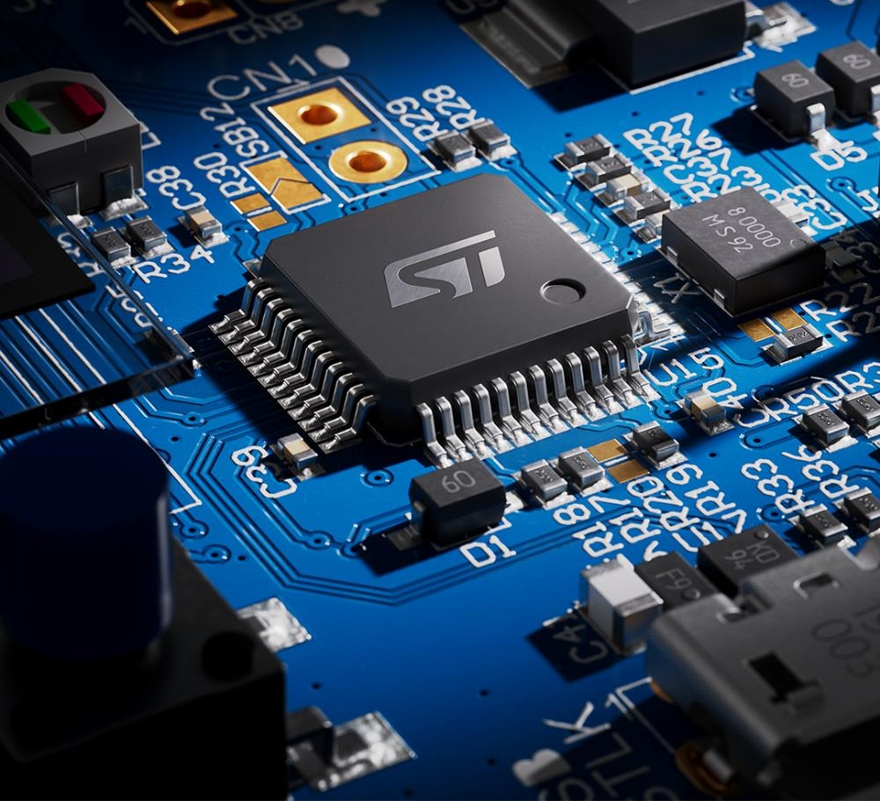
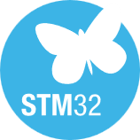

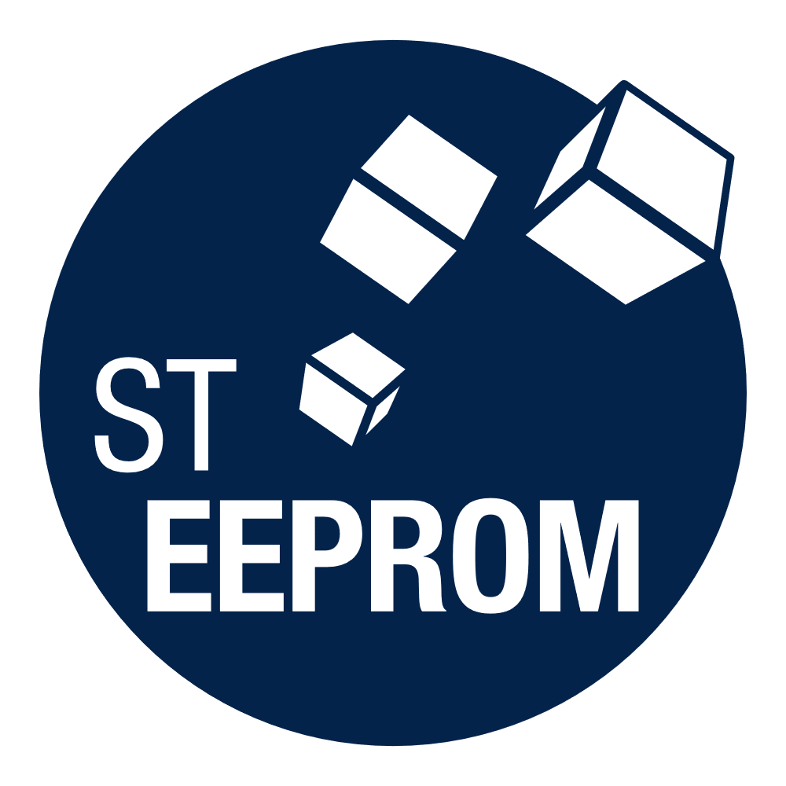
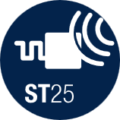
General-purpose MCU & MPU, secure solutions & NFC
General-purpose 32-bit MCU & MPU
Wireless 32-bit MCU
STM32* 32-bit general-purpose MCUs and 32/64-bit MPUs
Arm® Cortex® cores
High performance, mainstream, ultralow power MCU offer Graphics & AI accelerators
Extensive ecosystem with edge AI
Bluetooth® Low Energy ICs
Zigbee, Thread, Matter
Wi-Fi modules
Sub-1 GHz & Sigfox-compatible devices
LoRaWAN® technology
STM32 DNA, extended ecosystem for RF
Secure solutions
NFC & Memory
Mobile consumer transactions
Authentication and brand protection
Payment systems
Connected services in cars
NFC / RFID Tags
Dynamic NFC tags
NFC / RFID Readers
High-performance & high-endurance EEPROMs
* registered and/or unregistered trademarks of STMicroelectronics International NV or its affiliates in the EU and/or elsewhere

Slide 16

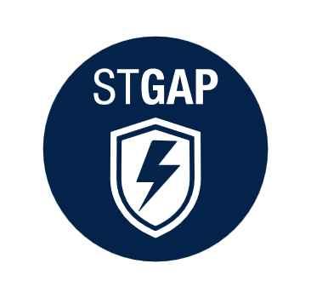





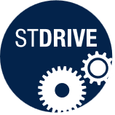
Analog, industrial & power conversion ICs
Power management
Analog products
AC/DC & DC/DC
MOSFET, IGBT, SiC, GaN gate drivers
Analog / digital controllers
Linear voltage regulators
Intelligent power switches
Galvanic isolation
Digital power
Smart power GaN
Battery management | eFuses
Operational amplifiers, comparators, LDOs
Current sensing amplifiers
Filtering & conditioning
Interfaces & transceivers
Reset & supervisors
Powerline communication
IO-Link
Rad-hard
Motion control
Application specific ICs
Brushed DC motor drivers
Brushless DC motor drivers
Stepper motor drivers
PMIC, pre-amps for data storage & servers
Wireless charging, touch controller, display PMIC for personal devices
Medical ICs

Slide 17


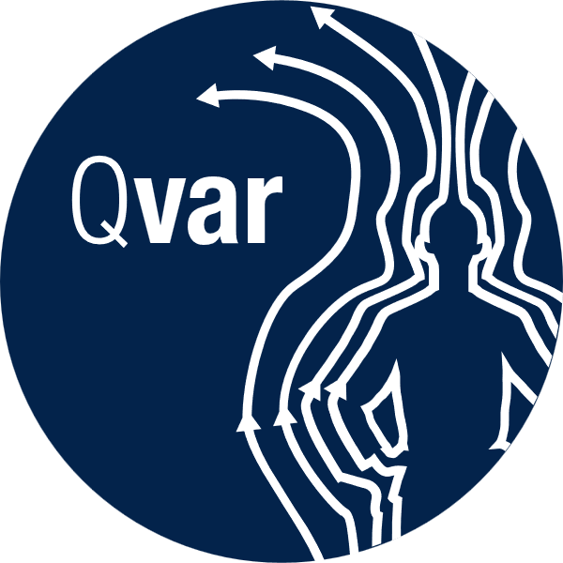


MEMS & optical sensing solutions
Motion sensors
Environmental & biosensors
Accelerometers & gyroscopes
Inertial modules & smart sensors
Vibrometers, inclinometers
Magnetometers
T-Plus: Motion MEMS with embedded temperature sensor
Biosensors (motion + bio-signals)
Barometers, pressure sensors
Temperature sensors
Electrostatic sensors
MEMS microphones
Micro actuators
Optical sensing solutions
Actuators for printheads
Piezoelectric actuators
Electrostatic actuators
Electromagnetic actuators
Thermal actuators
FlightSense* ToF proximity & multi-zone ranging modules
3D FlightSense ToF sensors
BrightSense* global shutter CMOS sensors
Ambient light sensors
Micro-optics
Custom optical solutions
* registered and/or unregistered trademarks of STMicroelectronics International NV or its affiliates in the EU and/or elsewhere

Slide 18
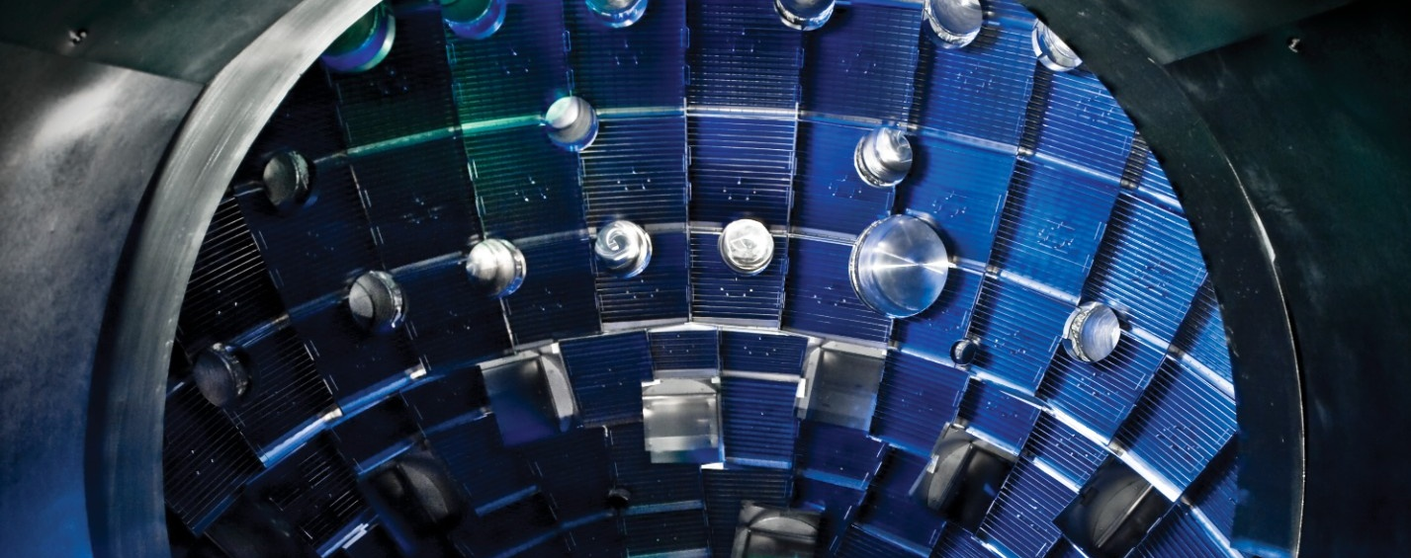
Take aways

Slide 19
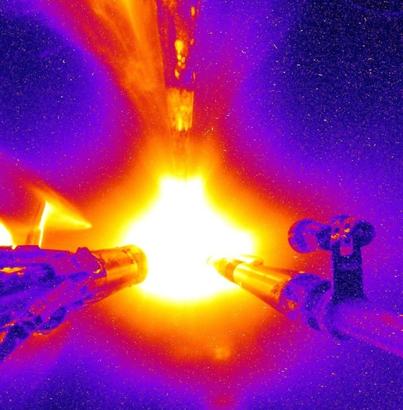
Take aways
As nuclear fusion technology advances toward practical energy generation, it presents significant opportunities for semiconductor companies as:
Growth in clean energy sector: strategic positioning in the energy transition.
Technological innovation: developing materials and packaging resistant to extreme conditions.
Demand for advanced components: supplying sensors, microcontrollers and power devices.
Research collaborations: strengthening know-how and visibility in the high-tech sector.

Slide 20

Find out more at www.st.com

